Slide 1
Stephen Marshak
ESSENTIALS OF
Geology
FIFTH EDITION
Chapter 2
The Way the Earth Works:
Plate Tectonics
©2016 W. W. Norton & Company, Inc.

Slide 2
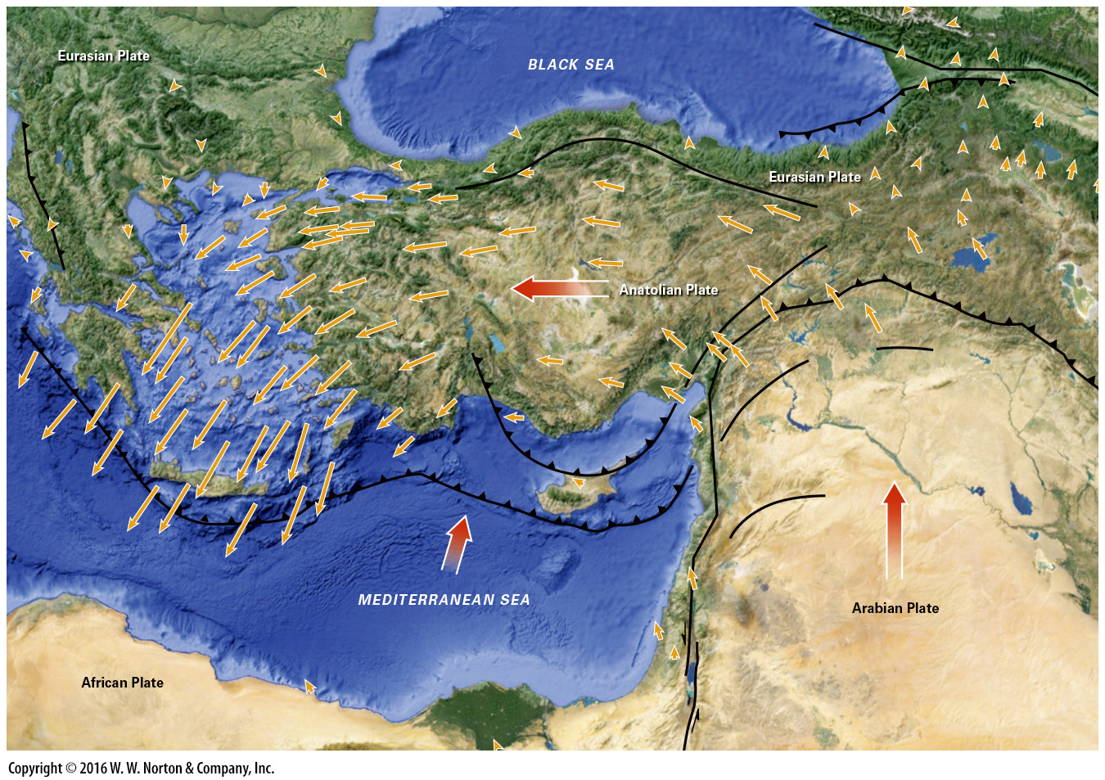
Notes:
Measurements with GPS indicate that Turkey is moving west relative to Asia. Such measurements allow us to “see” plate movements. Each yellow arrow indicates the velocity of the point at the end of the arrow. Red arrows give overall plate-movement direction.

Slide 3
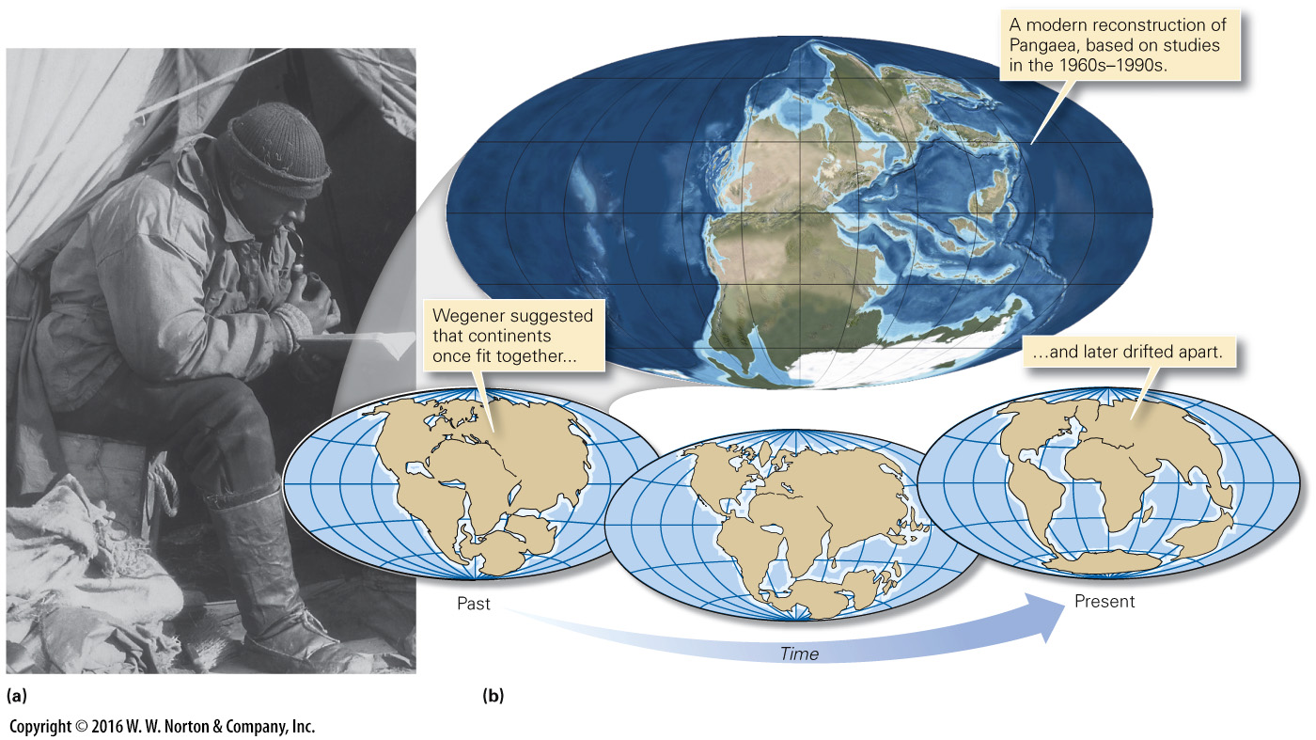
Notes:
FIGURE 2.1 Alfred Wegener and his model of continental drift.
(a) Wegener in Greenland. (b) Wegener’s maps illustrating continental drift.

Slide 4
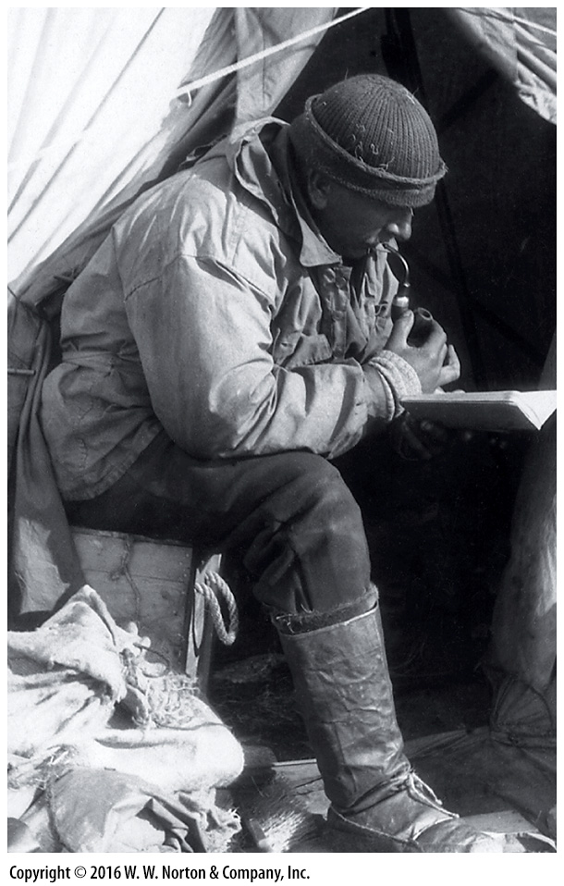
Notes:
FIGURE 2.1a Alfred Wegener and his model of continental drift.
(a) Wegener in Greenland.

Slide 5
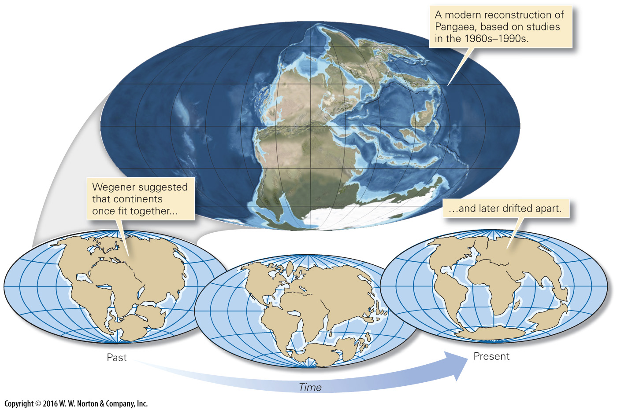
Notes:
FIGURE 2.1b Alfred Wegener and his model of continental drift.
(b) Wegener’s maps illustrating continental drift.

Slide 6
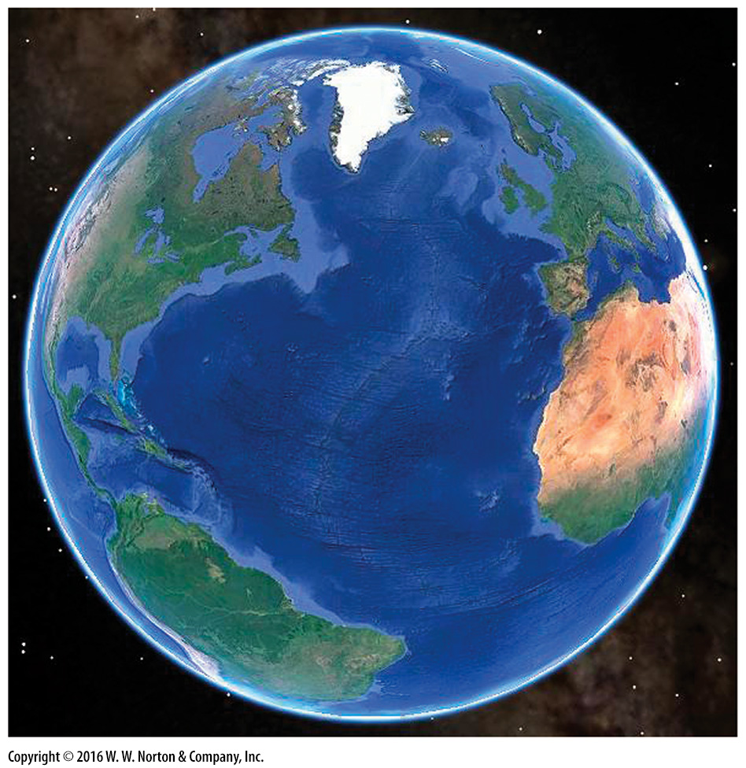
Notes:
SEE FOR YOURSELF…
THE FIT OF CONTINENTS

Slide 7
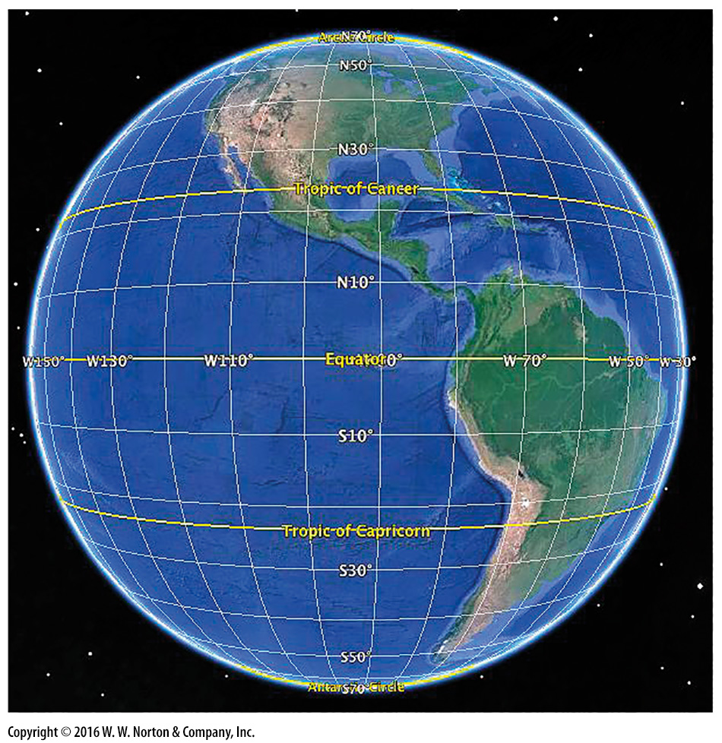
Notes:
SEE FOR YOURSELF…
CLIMATE BELTS

Slide 8
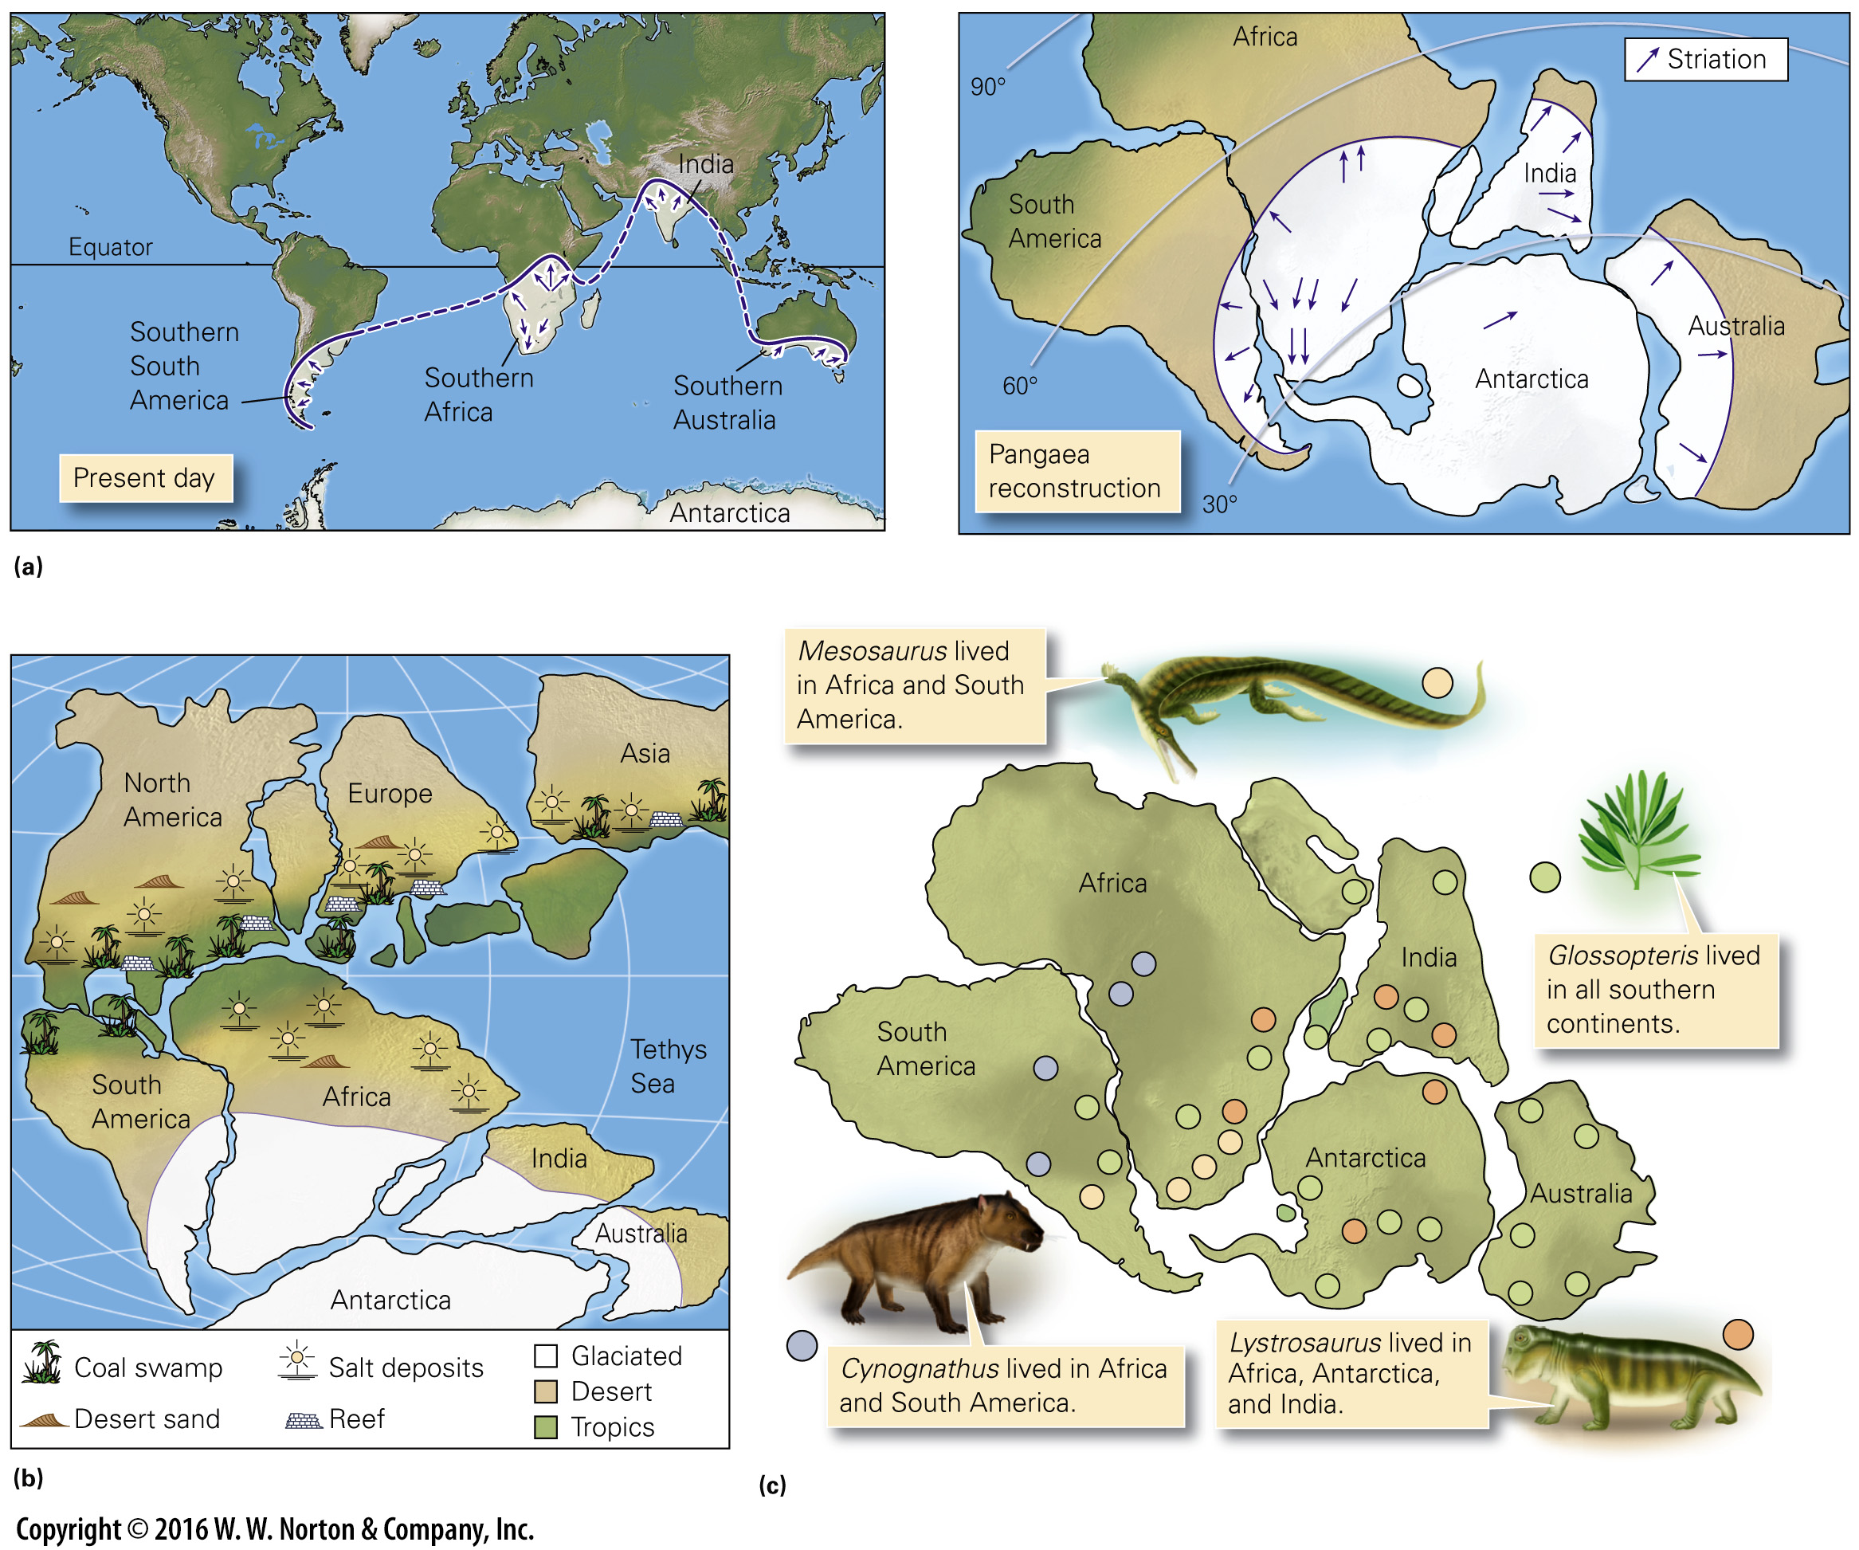
Notes:
FIGURE 2.2 Wegener‘s evidence for continental drift came from analyzing the geologic record.
(a) The distribution of late Paleozoic glacial deposits and striations on present-day Earth (left) are hard to explain. But on Pangaea (right), areas with glacial deposits fit together within a southern polar cap. (b) The distribution of late Paleozoic rock types plots sensibly in Pangaea’s climate belts. (c) A plot of fossil localities shows that Mesozoic land-dwelling organisms occured on multiple continents. This would be hard to explain if continents were separated.

Slide 9
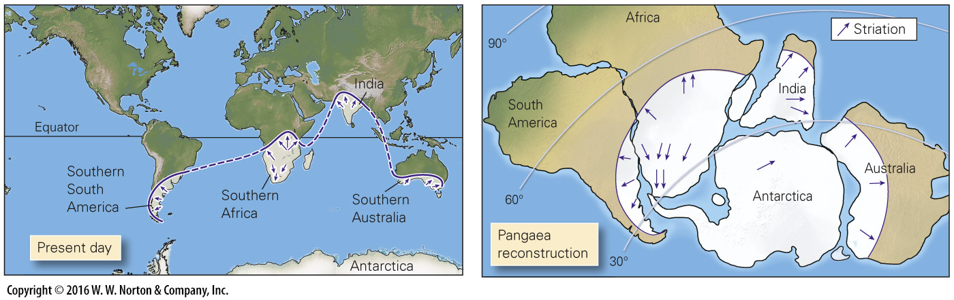
Notes:
FIGURE 2.2a Wegener‘s evidence for continental drift came from analyzing the geologic record.
(a) The distribution of late Paleozoic glacial deposits and striations on present-day Earth (left) are hard to explain. But on Pangaea (right), areas with glacial deposits fit together within a southern polar cap.

Slide 10
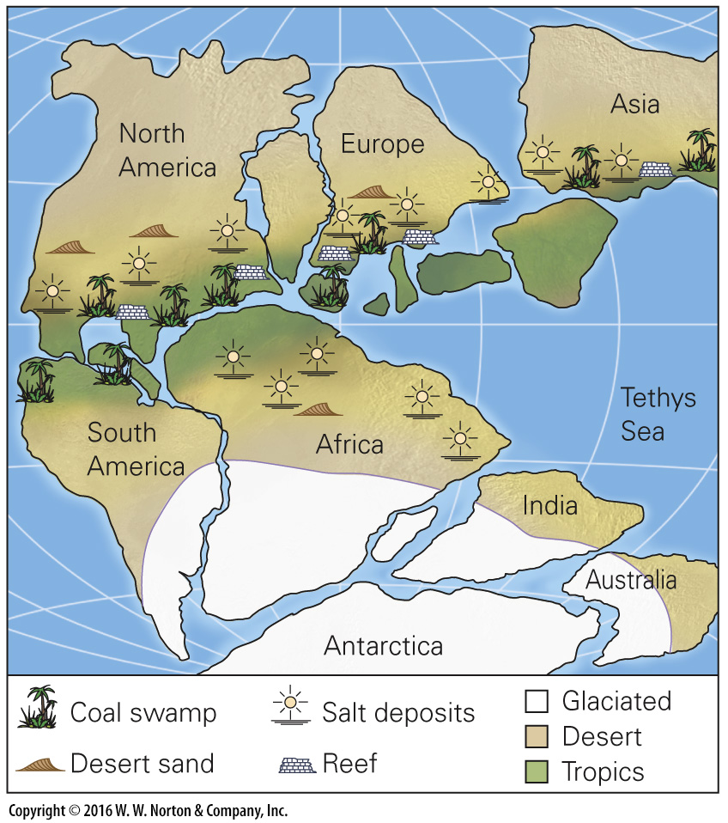
Notes:
FIGURE 2.2b Wegener‘s evidence for continental drift came from analyzing the geologic record.
(b) The distribution of late Paleozoic rock types plots sensibly in Pangaea’s climate belts.

Slide 11
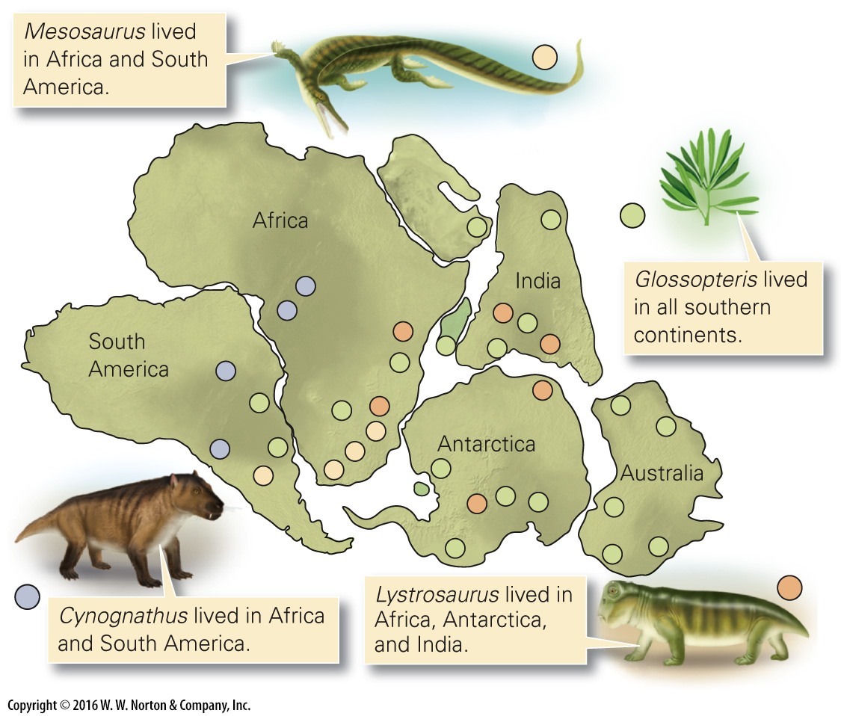
Notes:
FIGURE 2.2c Wegener‘s evidence for continental drift came from analyzing the geologic record.
(c) A plot of fossil localities shows that Mesozoic land-dwelling organisms occured on multiple continents. This would be hard to explain if continents were separated.

Slide 12
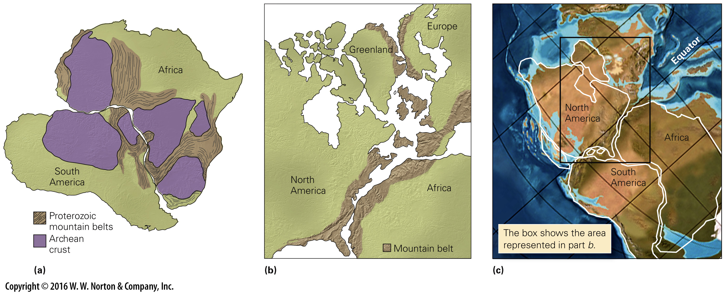
Notes:
FIGURE 2.3 Further evidence of continental drift: rocks on different sides of the ocean match.
(a) Without the Atlantic, distinctive belts of rock in South America would align with similar ones in Africa. (b) If the Atlantic didn’t exist, Paleozoic mountain belts on both coasts would be adjacent. (c) A modern reconstruction showing the positions of mountain belts in Pangaea. Modern continents are outlined in white.

Slide 13
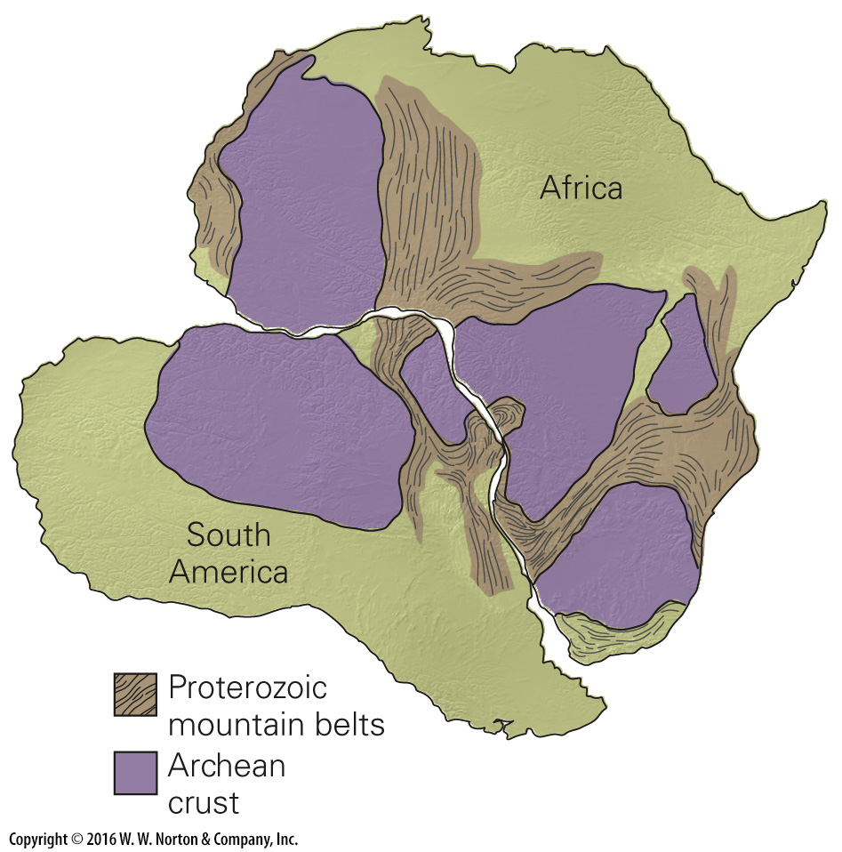
Notes:
FIGURE 2.3a Further evidence of continental drift: rocks on different sides of the ocean match.
(a) Without the Atlantic, distinctive belts of rock in South America would align with similar ones in Africa.

Slide 14
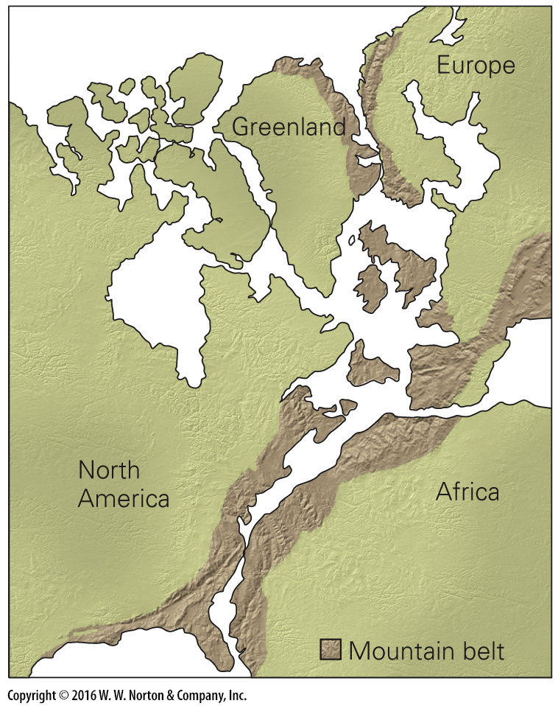
Notes:
FIGURE 2.3b Further evidence of continental drift: rocks on different sides of the ocean match.
(b) If the Atlantic didn’t exist, Paleozoic mountain belts on both coasts would be adjacent.

Slide 15
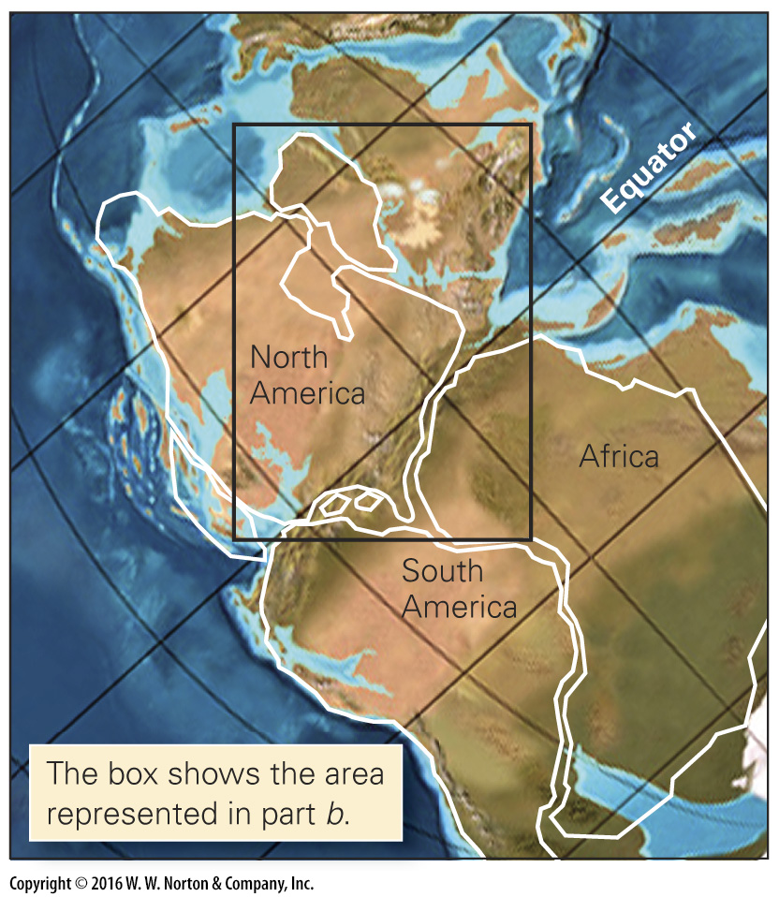
Notes:
FIGURE 2.3c Further evidence of continental drift: rocks on different sides of the ocean match.
(c) A modern reconstruction showing the positions of mountain belts in Pangaea. Modern continents are outlined in white.

Slide 16
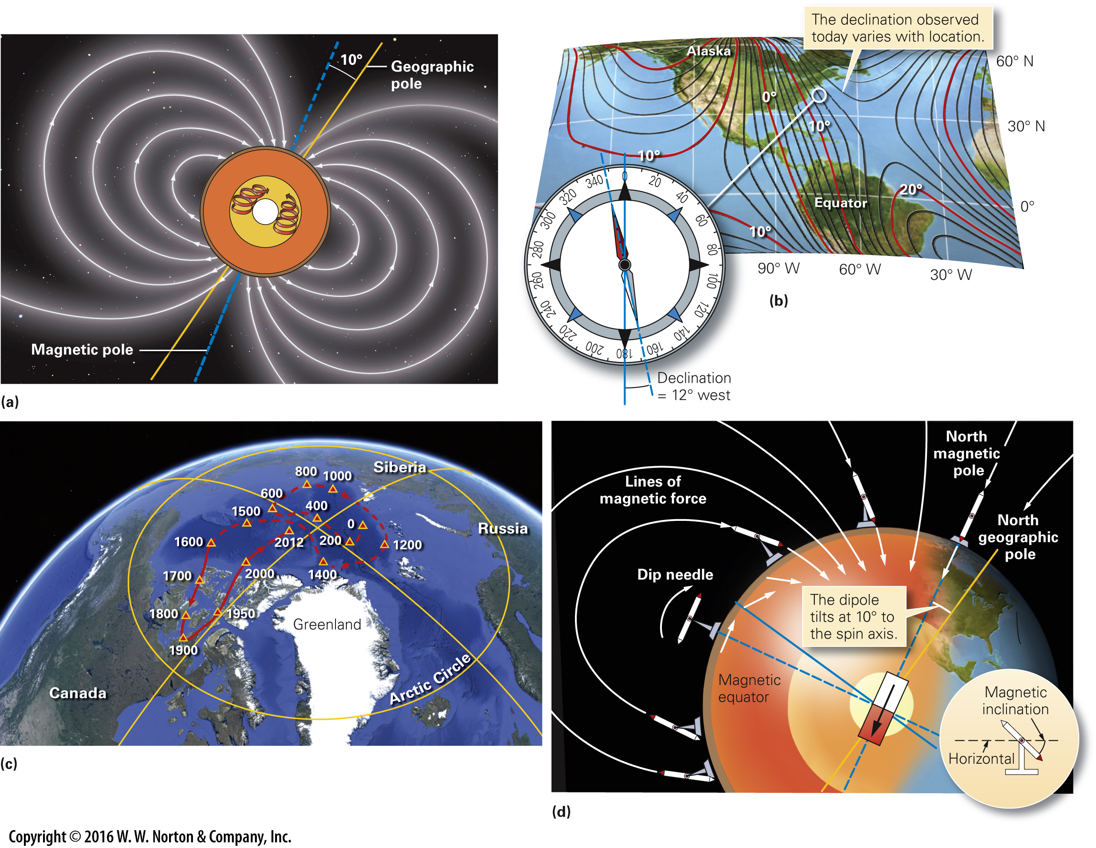
Notes:
FIGURE 2.4 Features of Earth’s magnetic field.
(a) The magnetic axis is not parallel to the spin axis. The field is due to flow in the outer core. (b) The magnetic pole and the geographic pole do not coincide, so in most locations a compass does not point exactly to geographic north. The difference is declination. In this example the declination is 12° west. (c) A simplified map showing the changing position of the north magnetic pole over the past 2,000 years. Before about 1600 C.E., the position was not as well constrained, so the path is dashed. (d) Earth’s field lines curve, so the tilt of a magnetic needle changes with latitude. This tilt is the magnetic inclination.

Slide 17
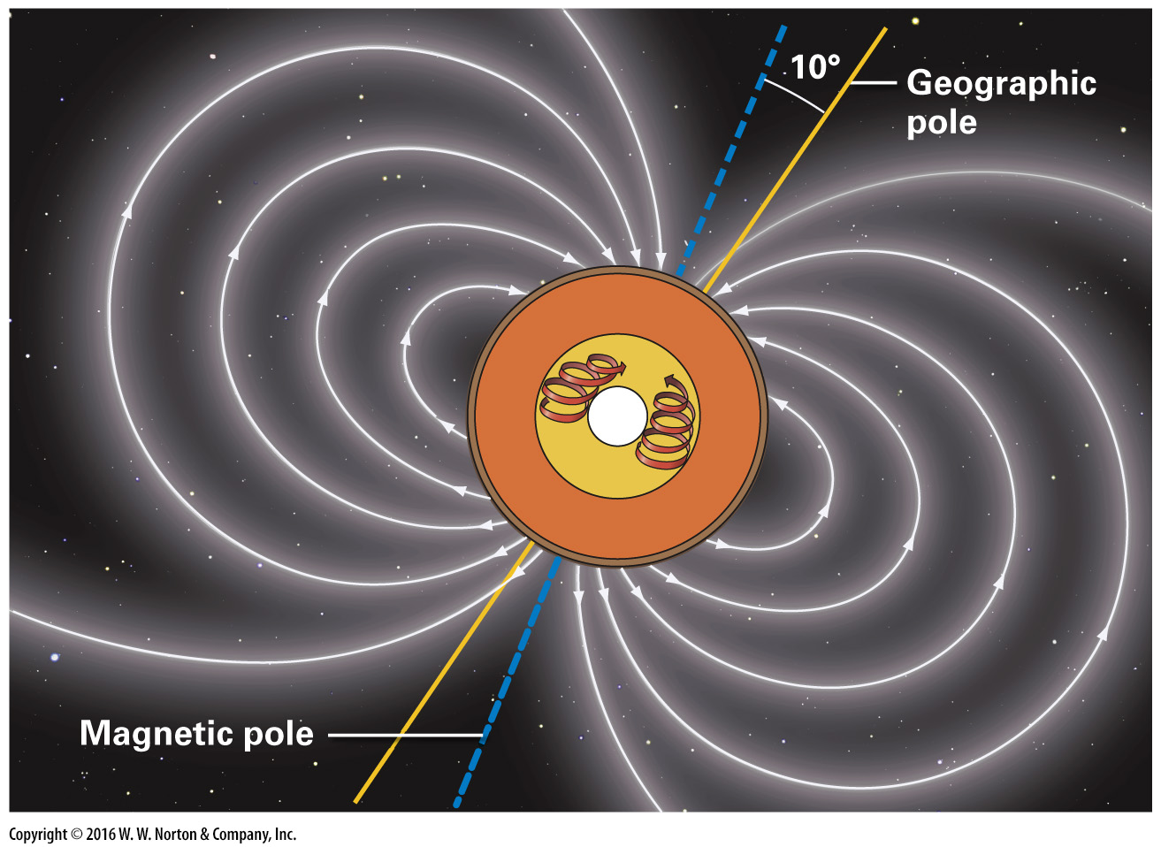
Notes:
FIGURE 2.4a Features of Earth’s magnetic field.
(a) The magnetic axis is not parallel to the spin axis. The field is due to flow in the outer core.

Slide 18
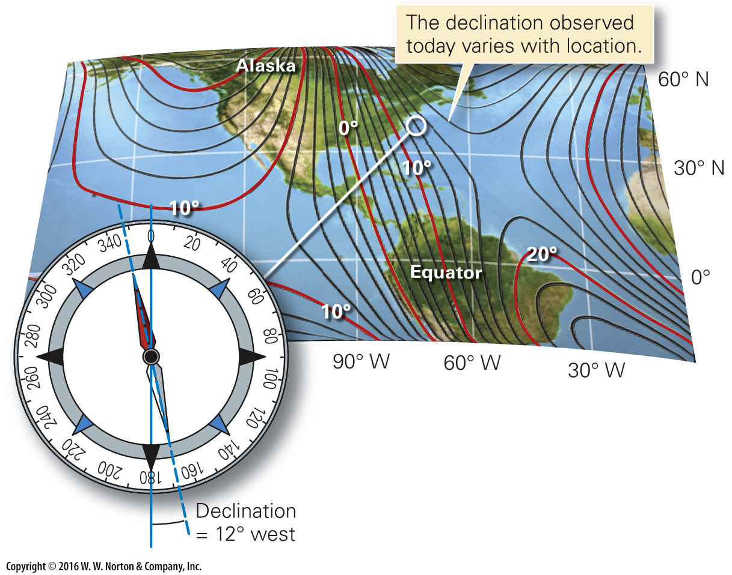
Notes:
FIGURE 2.4b Features of Earth’s magnetic field.
(b) The magnetic pole and the geographic pole do not coincide, so in most locations a compass does not point exactly to geographic north. The difference is declination. In this example the declination is 12° west.

Slide 19
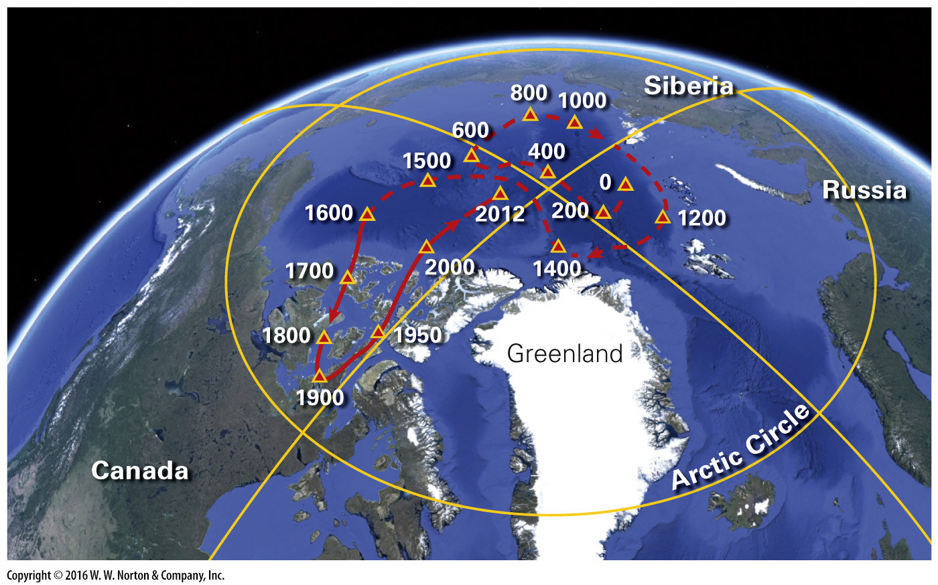
Notes:
FIGURE 2.4c Features of Earth’s magnetic field.
(c) A simplified map showing the changing position of the north magnetic pole over the past 2,000 years. Before about 1600 C.E., the position was not as well constrained, so the path is dashed.

Slide 20
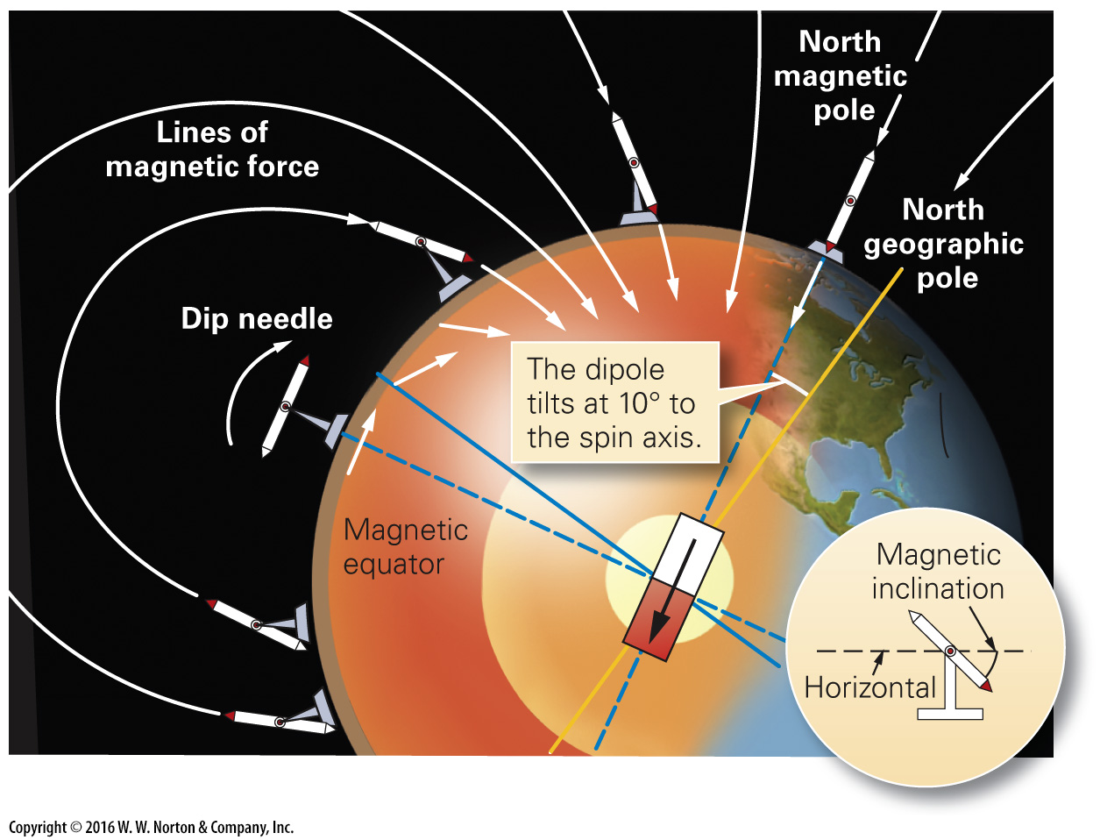
Notes:
FIGURE 2.4d Features of Earth’s magnetic field.
(d) Earth’s field lines curve, so the tilt of a magnetic needle changes with latitude. This tilt is the magnetic inclination.

Slide 21
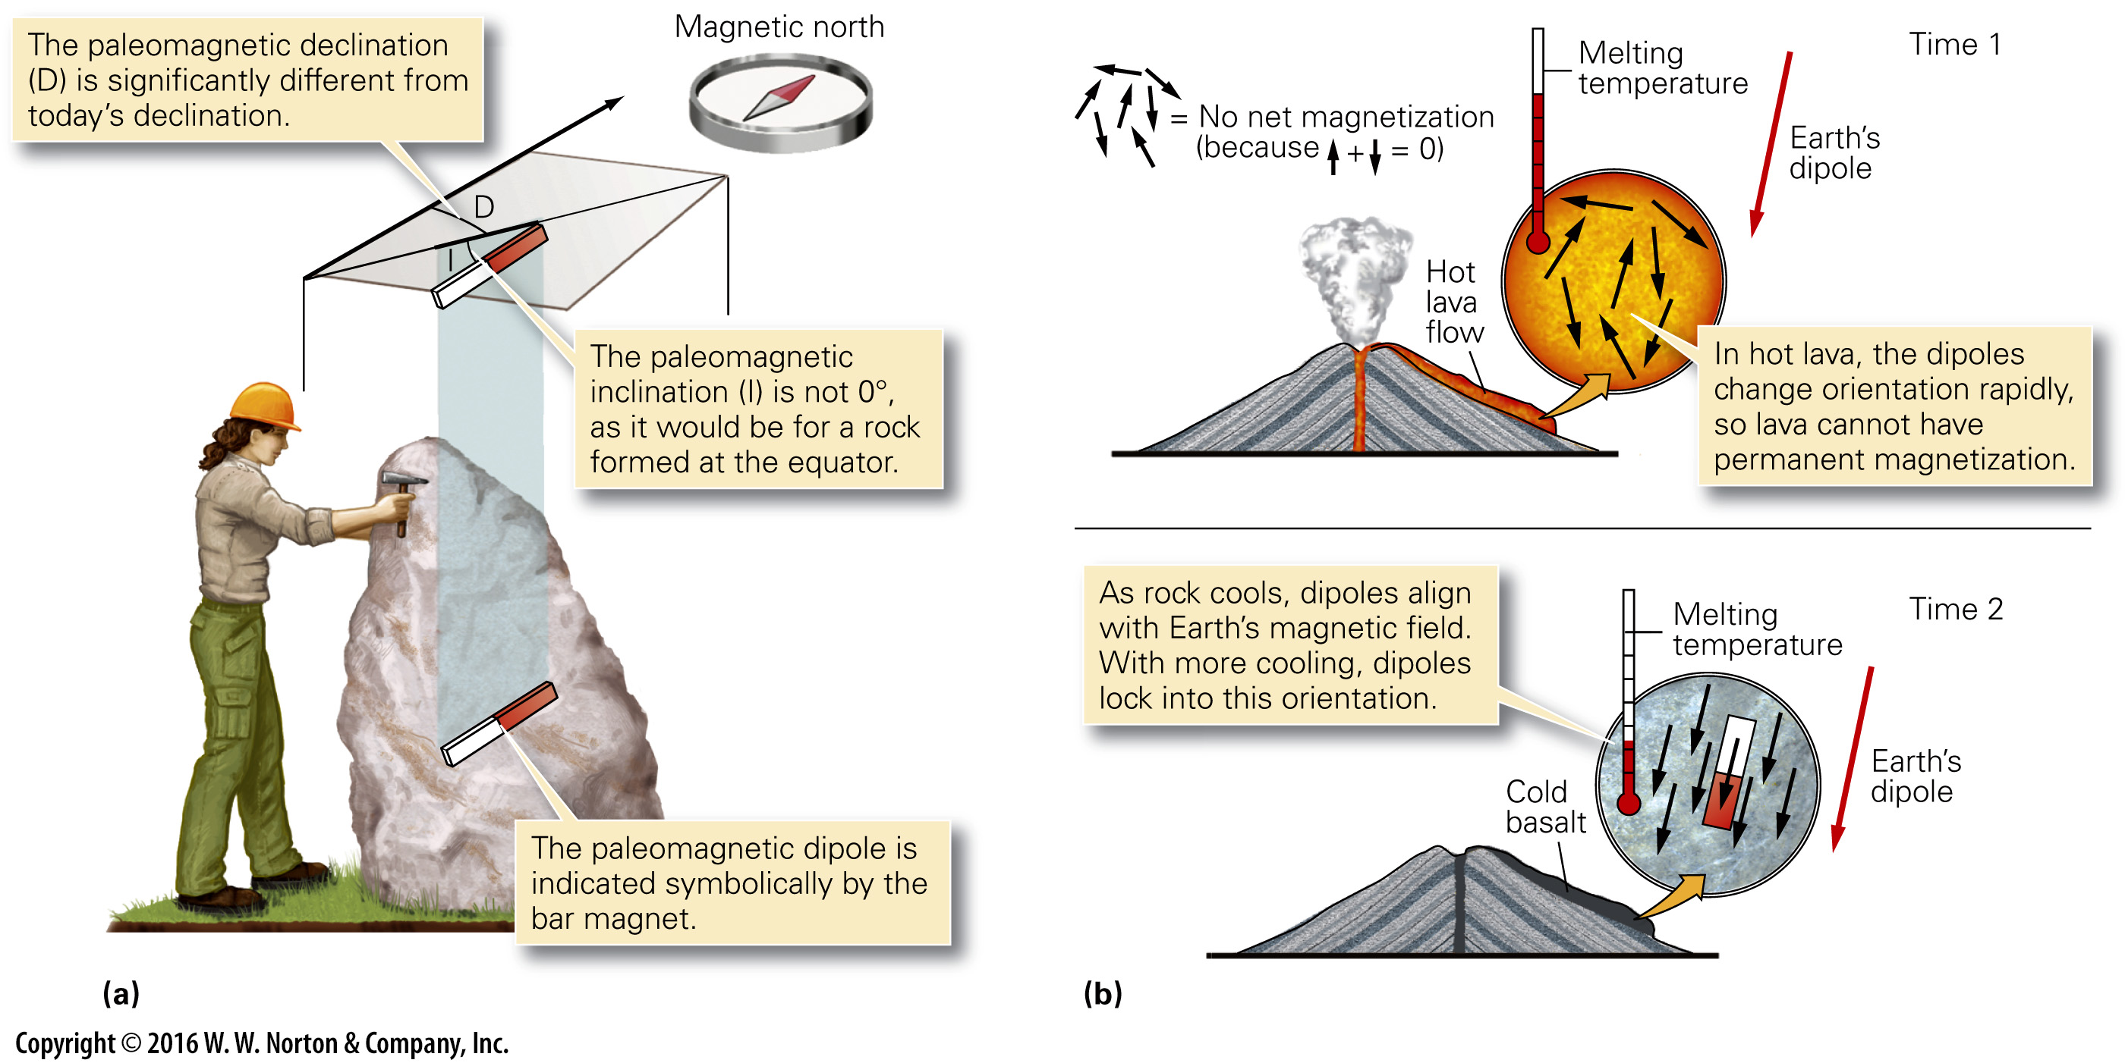
Notes:
FIGURE 2.5 Paleomagnetism and how it can form during the solidification and cooling of lava.
(a) A geologist finds an ancient rock sample at a location on the equator, where declination today is 0°. The orientation of the rock’s paleomagnetism is different from that of today’s field. (b) Paleomagnetism can form when lava cools and becomes solid rock.

Slide 22
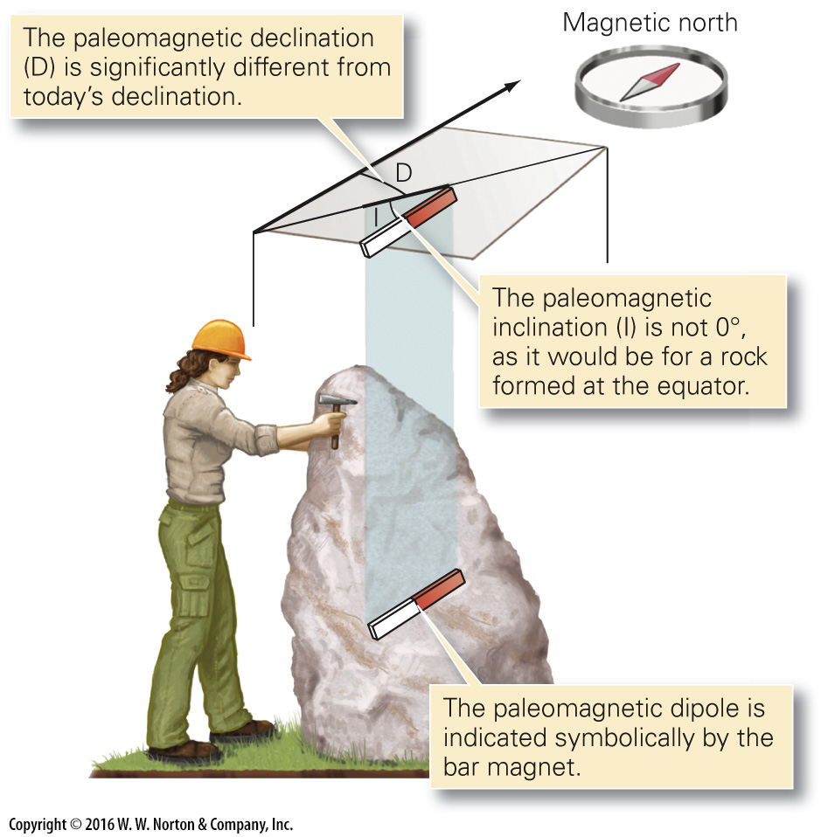
Notes:
FIGURE 2.5a Paleomagnetism and how it can form during the solidification and cooling of lava.
(a) A geologist finds an ancient rock sample at a location on the equator, where declination today is 0°. The orientation of the rock’s paleomagnetism is different from that of today’s field.

Slide 23
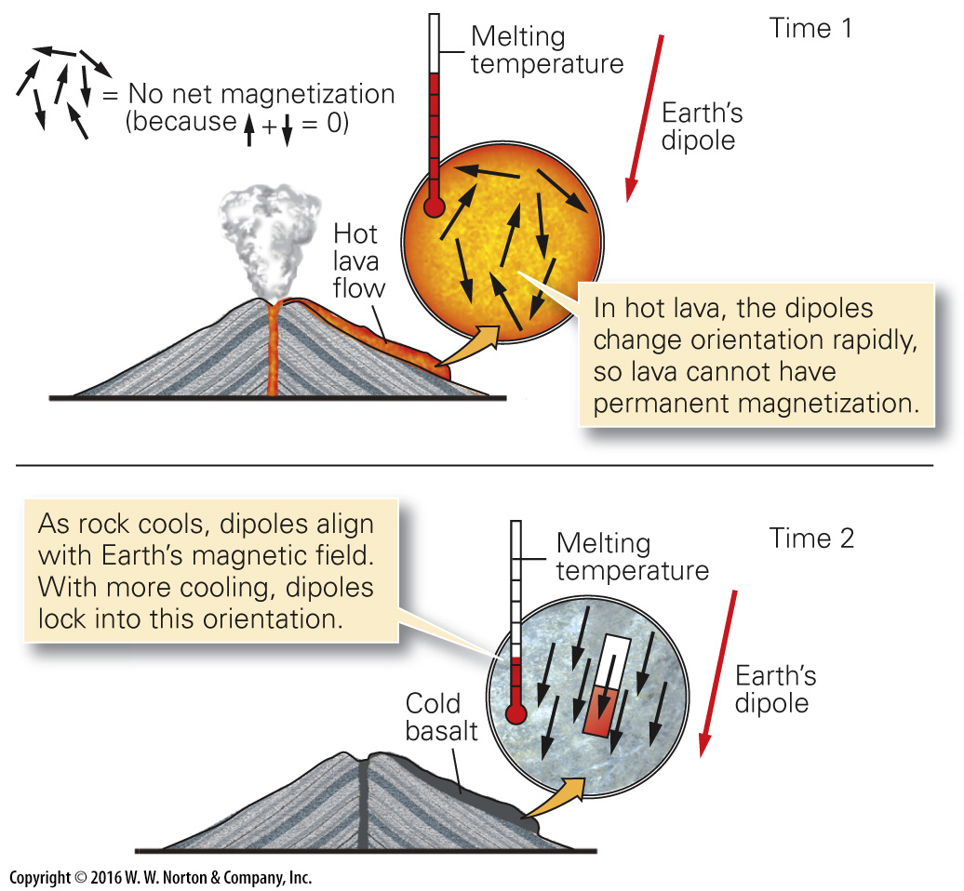
Notes:
FIGURE 2.5b Paleomagnetism and how it can form during the solidification and cooling of lava.
(b) Paleomagnetism can form when lava cools and becomes solid rock.

Slide 24
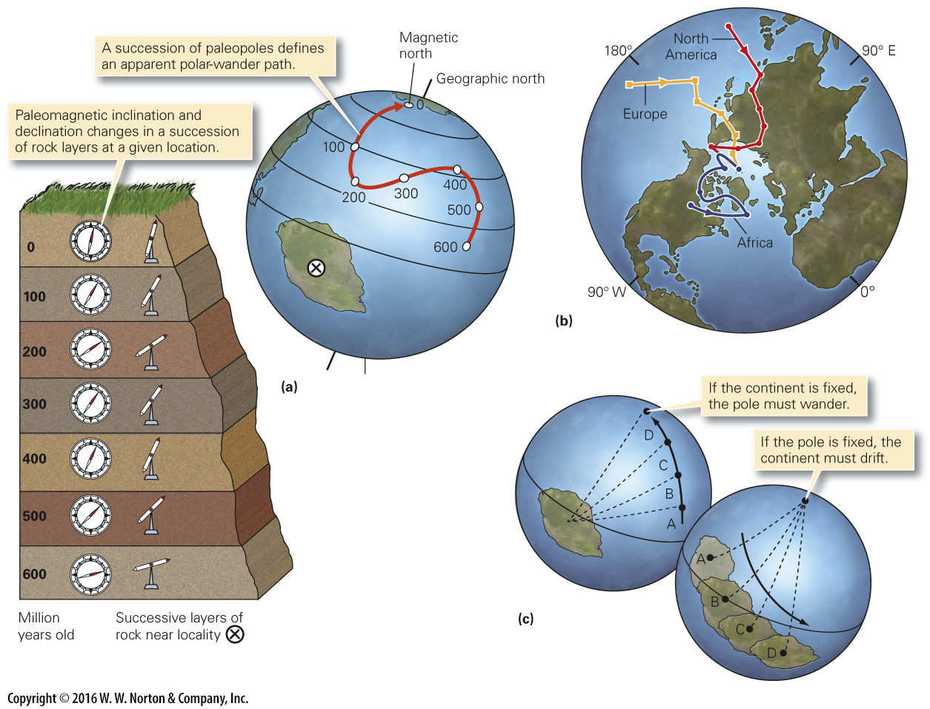
Notes:
FIGURE 2.6 Apparent polar-wander paths and their interpretation.
(a) Measurements of paleomagnetism in a succession of rock layers on a continent (x) define an apparent polar-wander path relative to the continent. (b) The apparent polar-wander path of North America is not the same as that of Europe or Africa. (c) If continents are fixed, then the pole moves relative to the continent. If the pole is fixed, then the continent must drift relative to the pole.

Slide 25
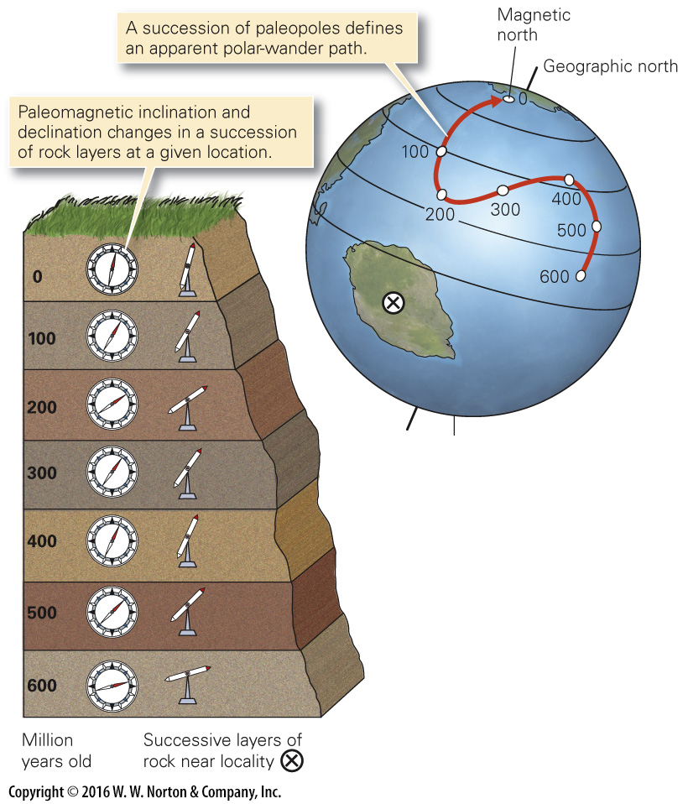
Notes:
FIGURE 2.6a Apparent polar-wander paths and their interpretation.
(a) Measurements of paleomagnetism in a succession of rock layers on a continent (x) define an apparent polar-wander path relative to the continent.

Slide 26
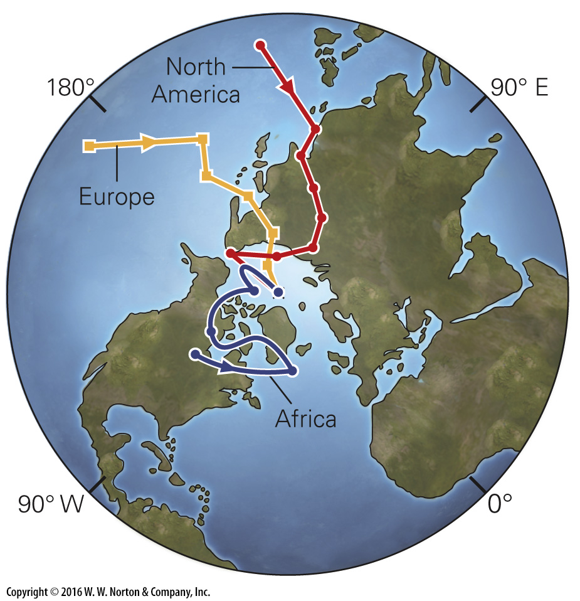
Notes:
FIGURE 2.6b Apparent polar-wander paths and their interpretation.
(b) The apparent polar-wander path of North America is not the same as that of Europe or Africa.

Slide 27
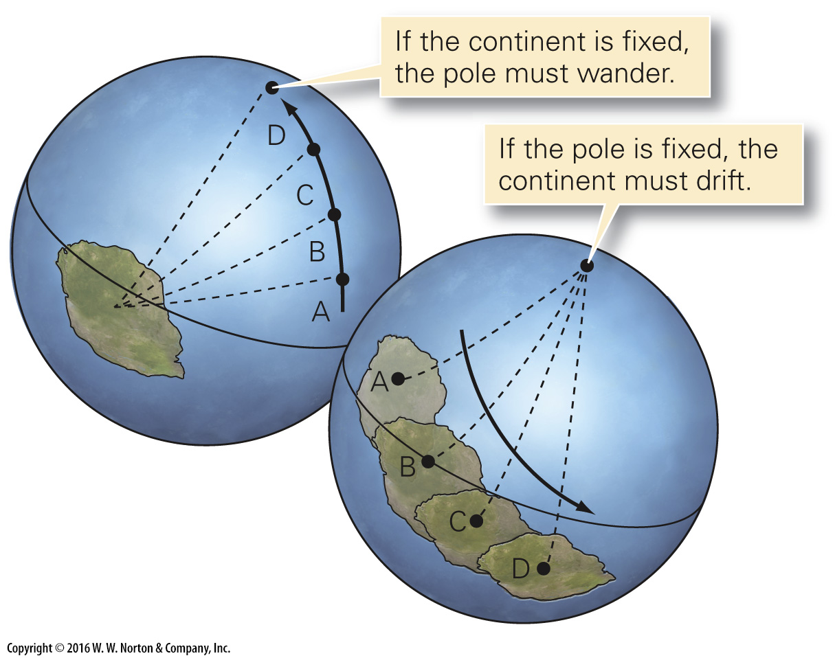
Notes:
FIGURE 2.6c Apparent polar-wander paths and their interpretation.
(c) If continents are fixed, then the pole moves relative to the continent. If the pole is fixed, then the continent must drift relative to the pole.

Slide 28
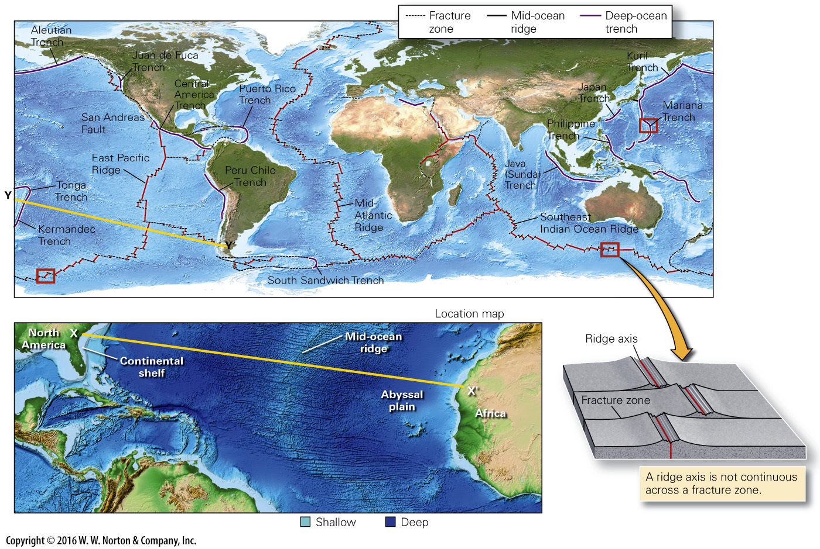
Notes:
FIGURE 2.7a Bathymetric features of the ocean floor.
(a) Bathymetric map of the ocean floor, highlighting key bathymetric features. The boxes show the location of the maps in b and c.

Slide 29
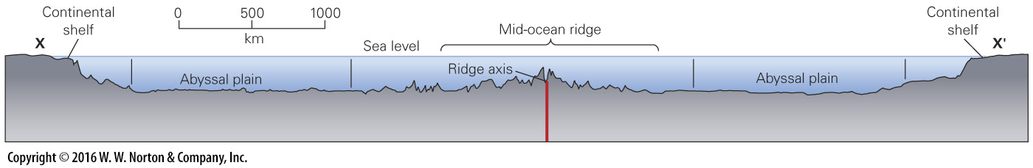
Notes:
FIGURE 2.7b Bathymetric features of the ocean floor.
(b) A bathymetric profile along line XX'. The location map shows the position of XX', and the inset shows a fracture zone intersecting a ridge axis, in 3-D.

Slide 30
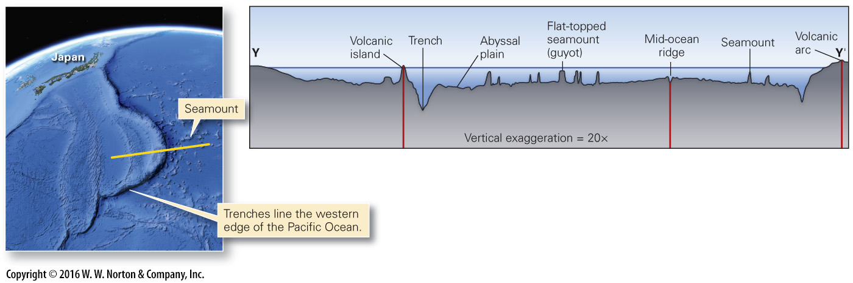
Notes:
FIGURE 2.7c Bathymetric features of the ocean floor.
(c) A bathymetric profile of a trench, and nearby seamounts. The yellow line on the map shows the location of the profile.

Slide 31
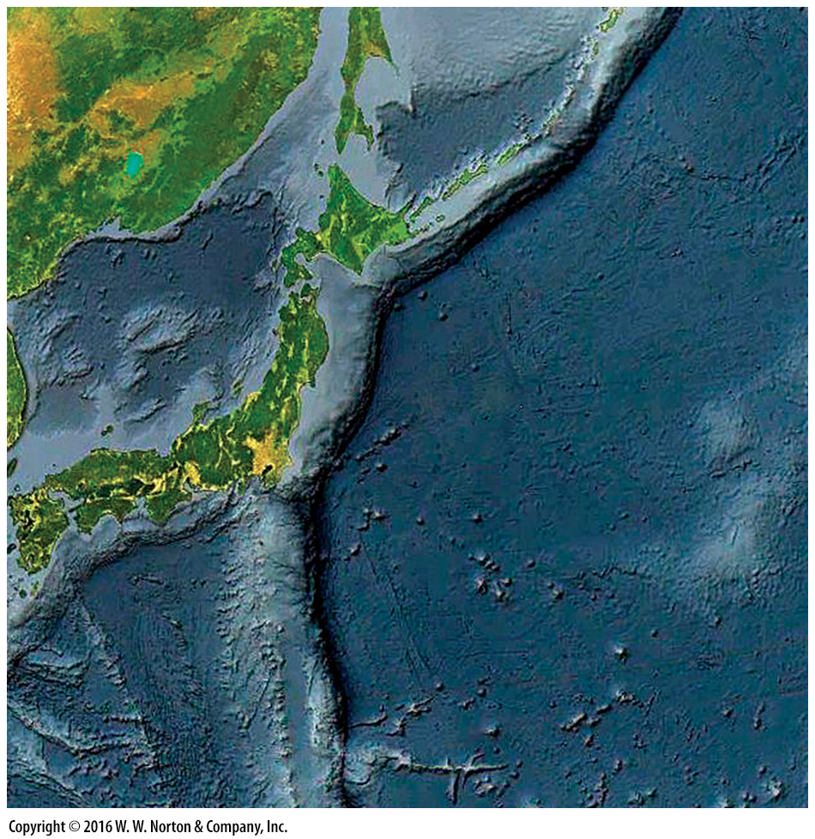
Notes:
SEE FOR YOURSELF…
TRENCHES

Slide 32
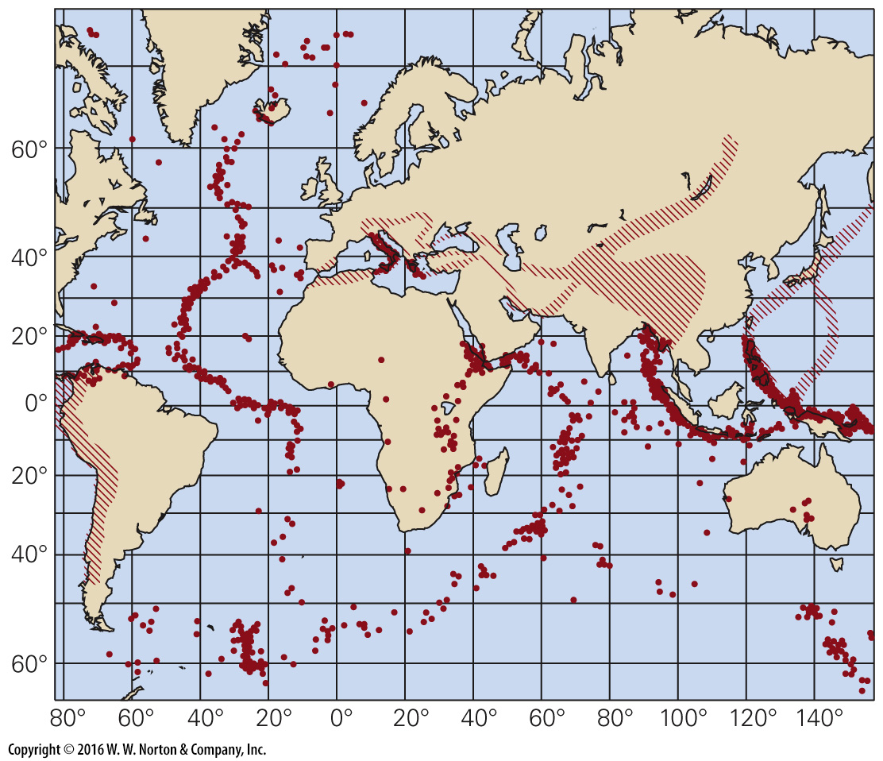
Notes:
FIGURE 2.8 A 1953 map showing the distribution of earthquake locations in the ocean basins. Note that earthquakes occur in belts.

Slide 33
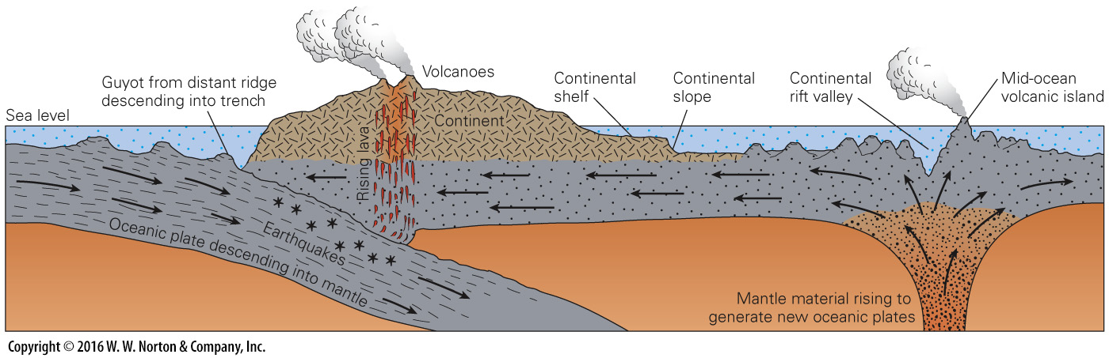
Notes:
FIGURE 2.9 Harry Hess’s basic concept of seafloor spreading (1962). Hess implied, incorrectly, that only the crust moved. We will see that this sketch is an oversimplification and contains errors, but it was an important step in the development of plate tectonics.

Slide 34
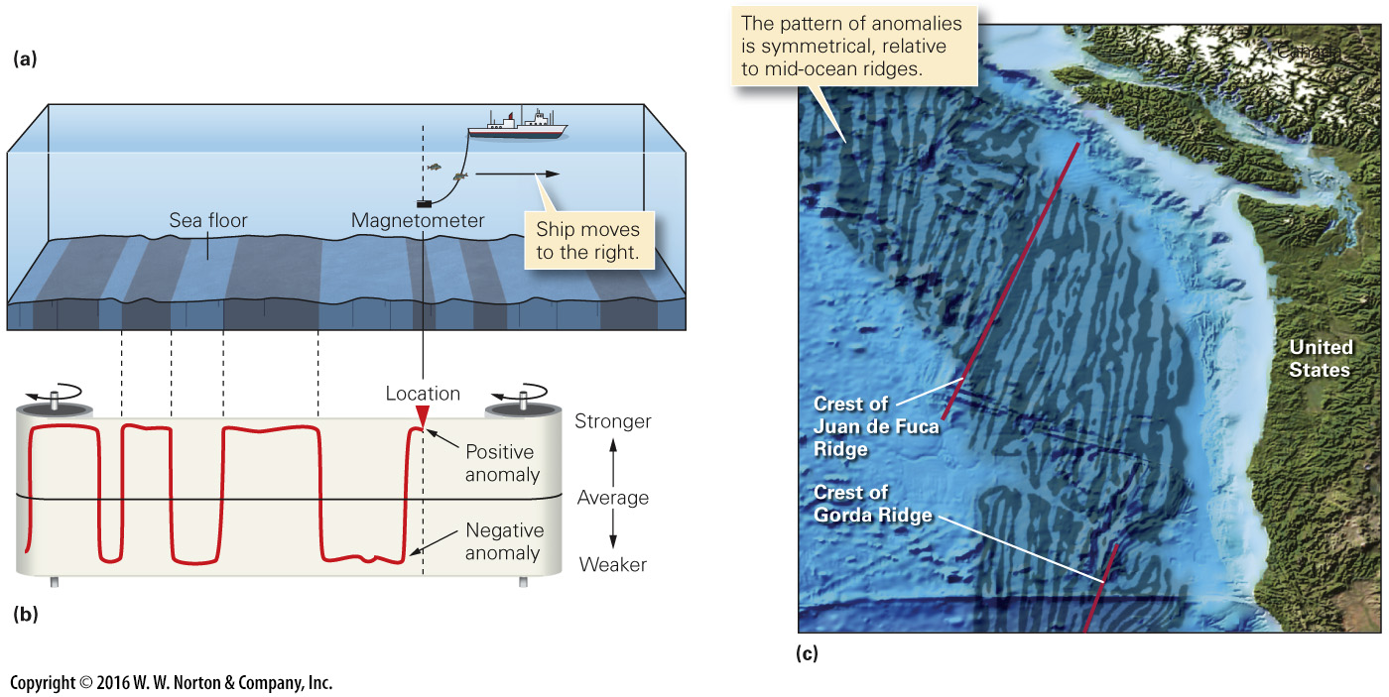
Notes:
FIGURE 2.10 The discovery of marine magnetic anomalies.
(a) A ship towing a magnetometer detects changes in the strength of the magnetic field. (b) On a paper record, intervals of stronger magnetism (positive anomalies) alternate with intervals of weaker magnetism (negative anomalies). (c) A map showing areas of positive anomalies (dark) and negative anomalies (light) off the west coast of North America. The pattern of anomalies resembles candy-cane stripes.

Slide 35
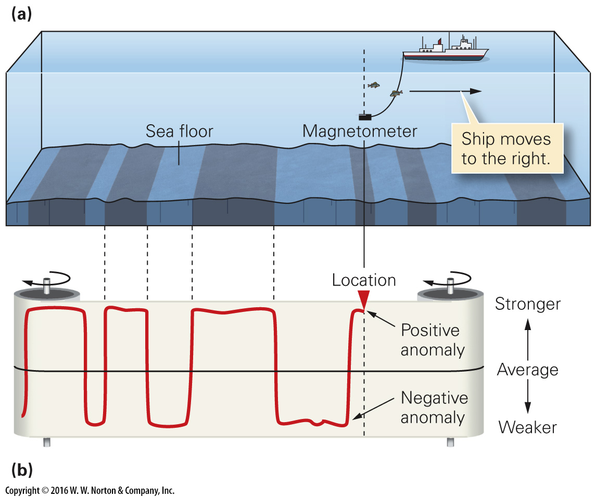
Notes:
FIGURE 2.10ab The discovery of marine magnetic anomalies.
(a) A ship towing a magnetometer detects changes in the strength of the magnetic field. (b) On a paper record, intervals of stronger magnetism (positive anomalies) alternate with intervals of weaker magnetism (negative anomalies).

Slide 36
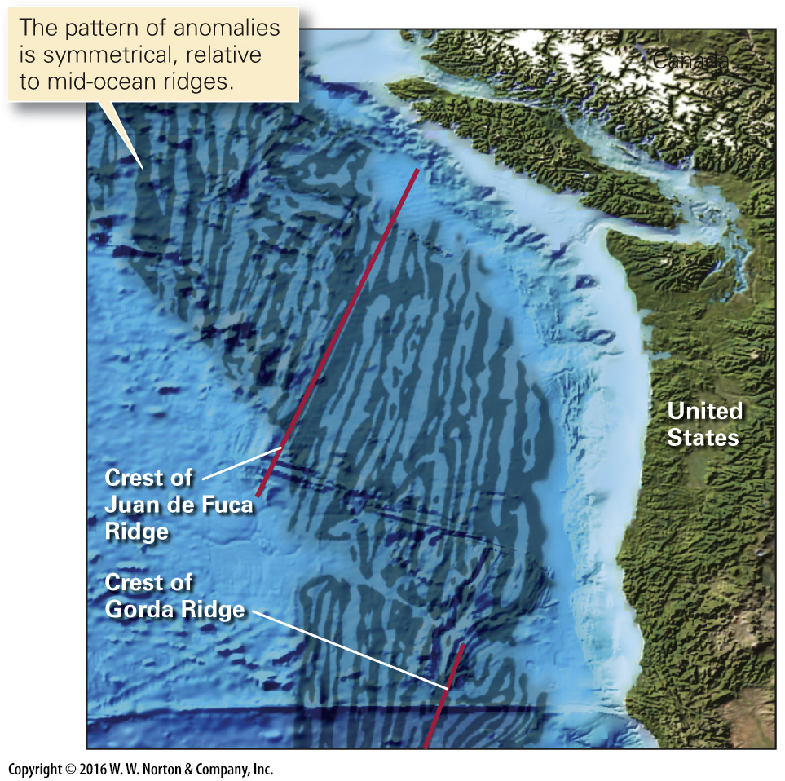
Notes:
FIGURE 2.10c The discovery of marine magnetic anomalies.
(c) A map showing areas of positive anomalies (dark) and negative anomalies (light) off the west coast of North America. The pattern of anomalies resembles candy-cane stripes.

Slide 37
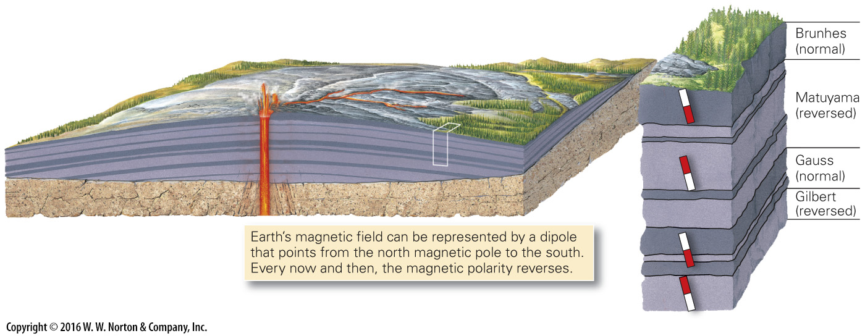
Notes:
FIGURE 2.11a Magnetic polarity reversals and the chronology of reversals.
(a) Successive layers of lava build at a volcano over time. Some layers have normal polarity, whereas others have reversed polarity.

Slide 38
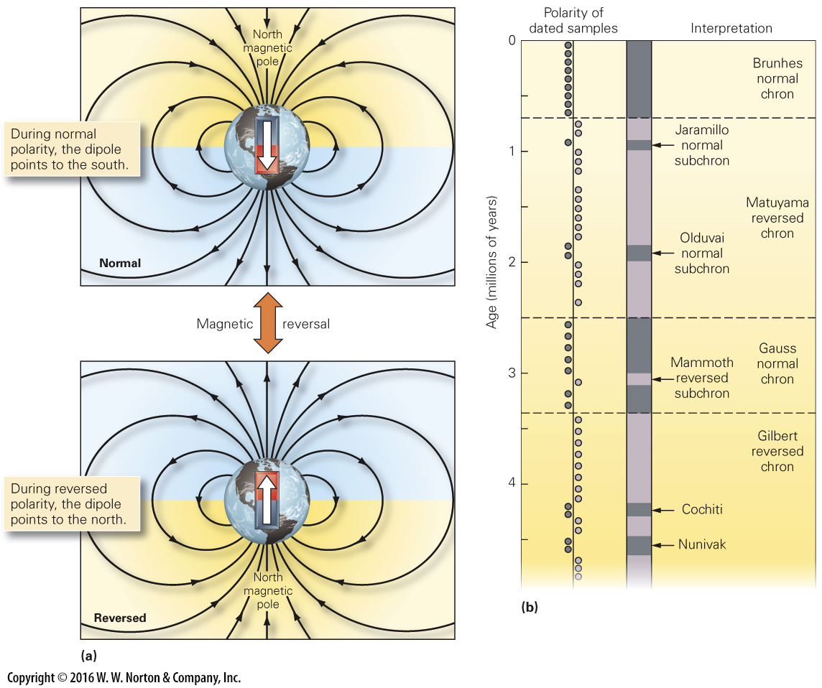
Notes:
FIGURE 2.11bc Magnetic polarity reversals and the chronology of reversals.
(b) The polarity of the Earth’s magnetic field reverses every now and then. (c) Observations led to the production of a reversal chronology, with named polarity intervals, or chrons.

Slide 39
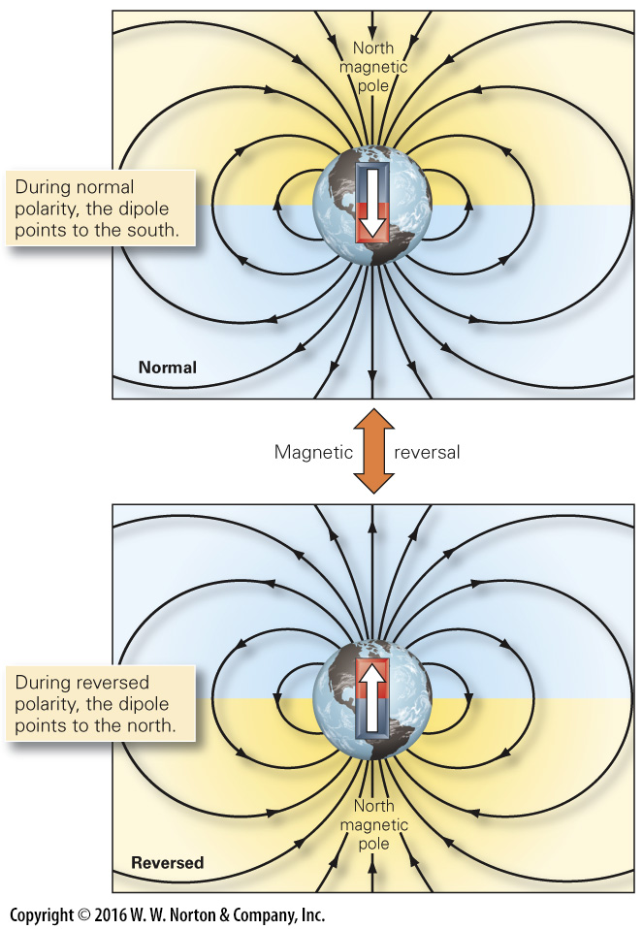
Notes:
FIGURE 2.11b Magnetic polarity reversals and the chronology of reversals.
(b) The polarity of the Earth’s magnetic field reverses every now and then.

Slide 40
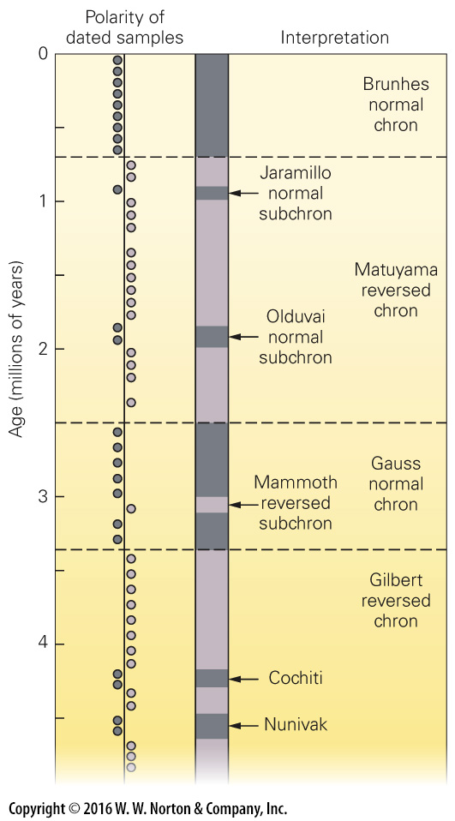
Notes:
FIGURE 2.11c Magnetic polarity reversals and the chronology of reversals.
(c) Observations led to the production of a reversal chronology, with named polarity intervals, or chrons.

Slide 41
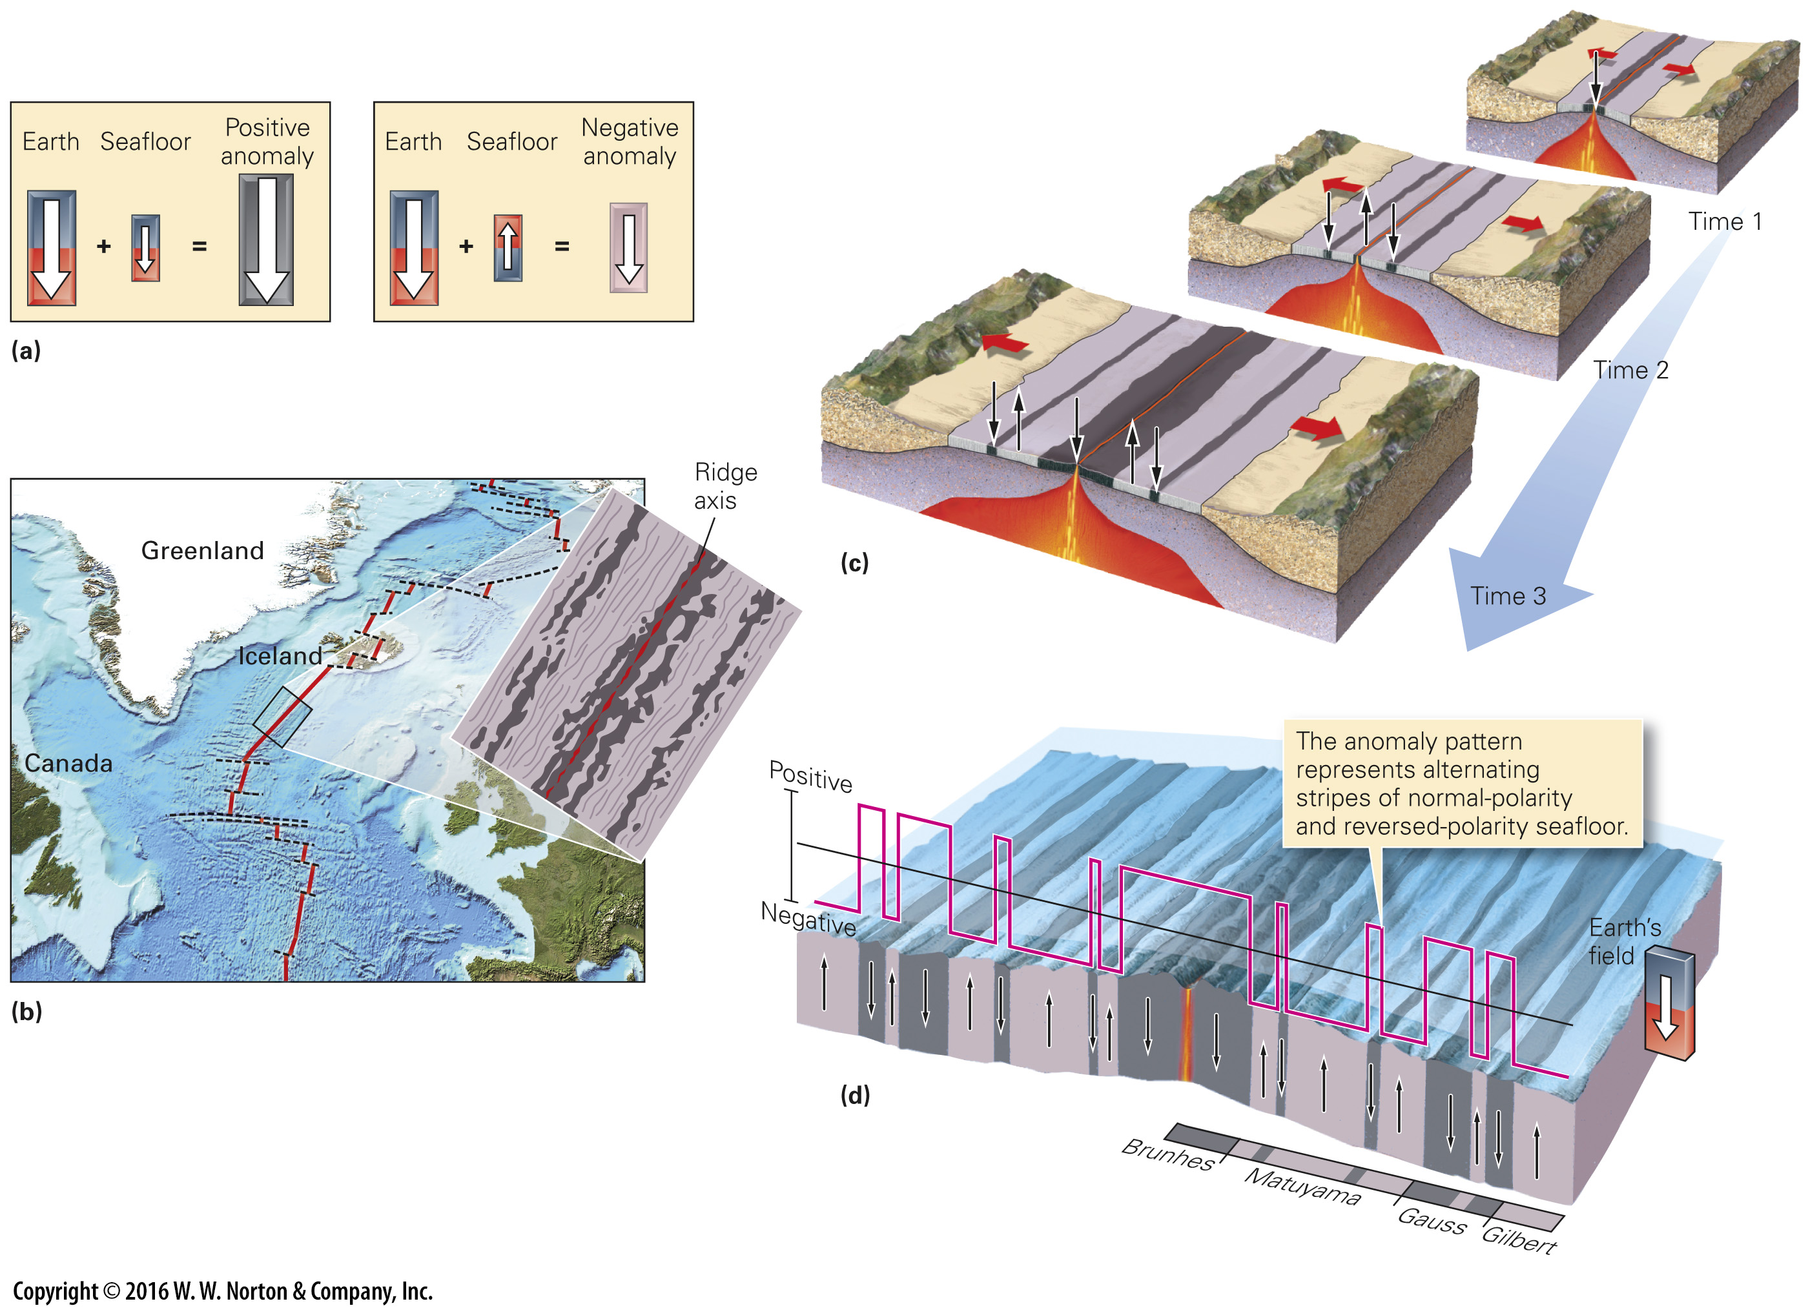
Notes:
FIGURE 2.12 The progressive development of magnetic anomalies and the long-term reversal chronology.
(a) Positive anomalies form when seafloor rock has the same polarity as the present magnetic field. Negative anomalies form when seafloor rock has polarity that is opposite to the present field. (b) The seafloor-spreading model predicts that magnetic anomalies are symmetrical relative to the mid-ocean ridge. (c) Seafloor spreading explains the stripes. The field flips back and forth while the ocean basin grows wider. (d) The width of magnetic stripes on the seafloor is proportional to the duration of chrons.

Slide 42
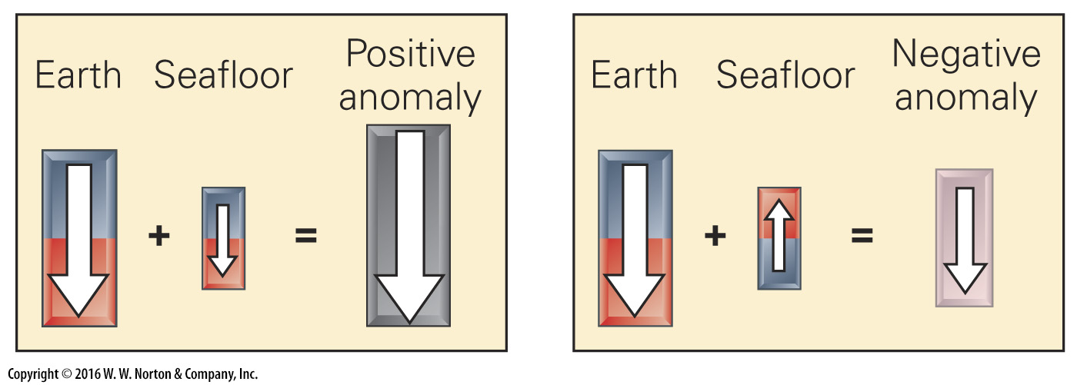
Notes:
FIGURE 2.12a The progressive development of magnetic anomalies and the long-term reversal chronology.
(a) Positive anomalies form when seafloor rock has the same polarity as the present magnetic field. Negative anomalies form when seafloor rock has polarity that is opposite to the present field.

Slide 43
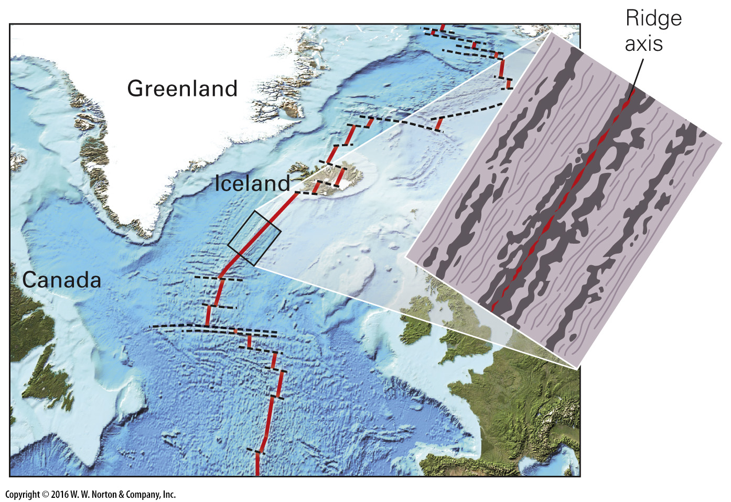
Notes:
FIGURE 2.12b The progressive development of magnetic anomalies and the long-term reversal chronology.
(b) The seafloor-spreading model predicts that magnetic anomalies are symmetrical relative to the mid-ocean ridge.

Slide 44
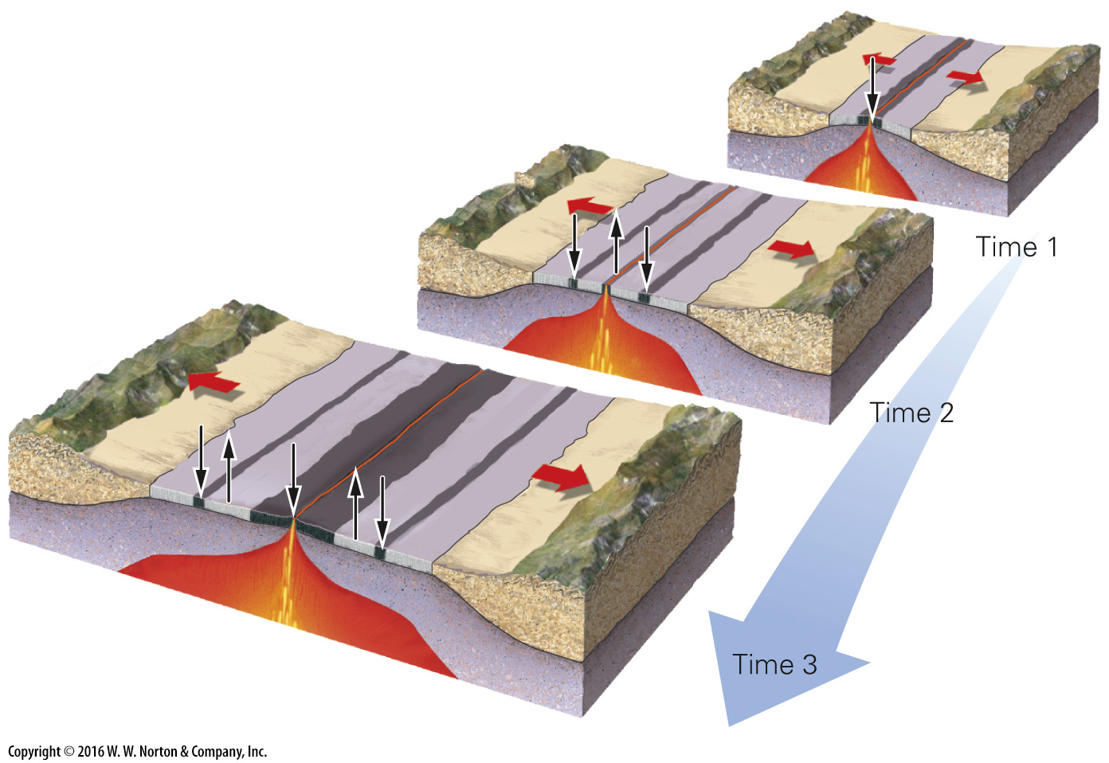
Notes:
FIGURE 2.12c The progressive development of magnetic anomalies and the long-term reversal chronology.
(c) Seafloor spreading explains the stripes. The field flips back and forth while the ocean basin grows wider.

Slide 45
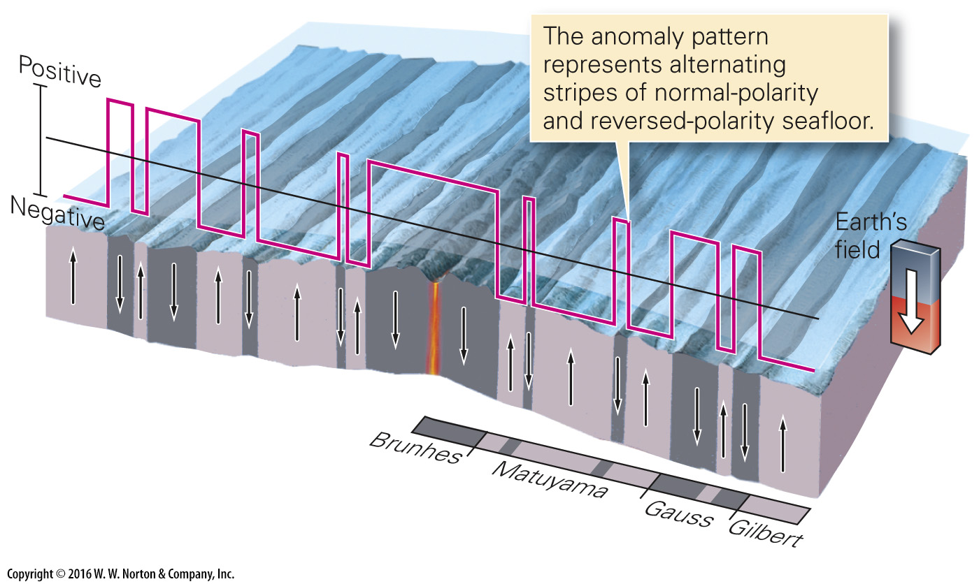
Notes:
FIGURE 2.12d The progressive development of magnetic anomalies and the long-term reversal chronology.
(d) The width of magnetic stripes on the seafloor is proportional to the duration of chrons.

Slide 46
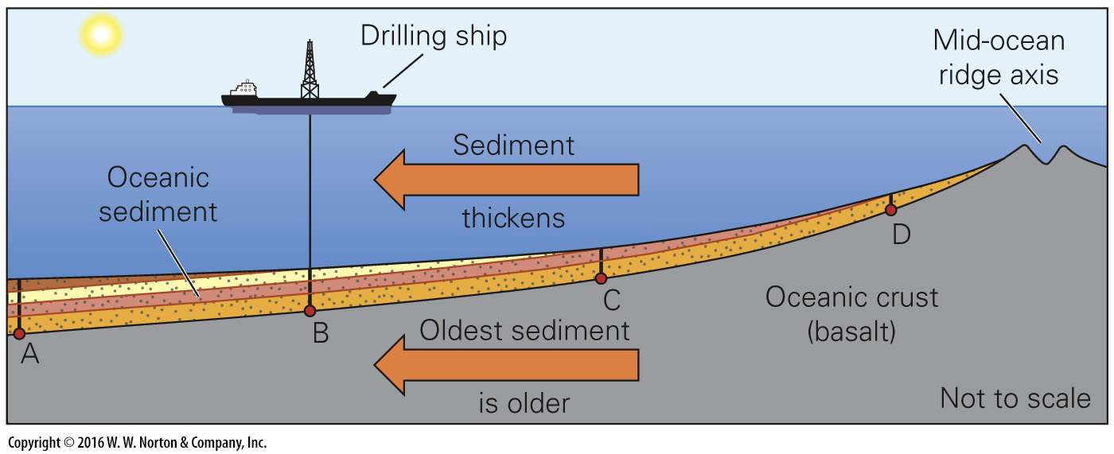
Notes:
FIGURE 2.13 Drilling into the sediment layer of the ocean floor confirmed that the age of the oldest sediment in contact with ocean-crust basalt gets older the farther away it is from the ridge. For example, Point A is older than Point B.

Slide 47
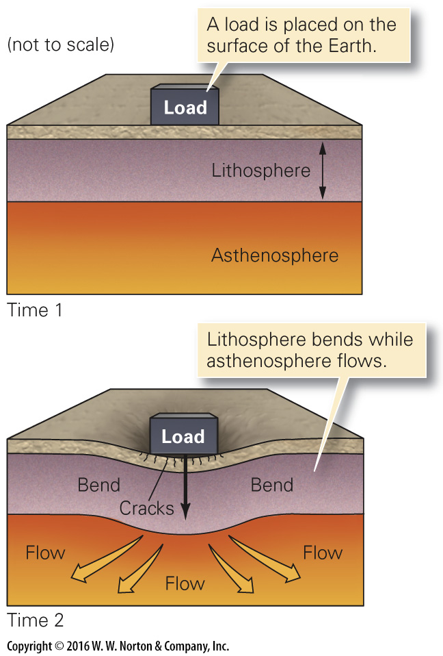
Notes:
FIGURE 2.14a The nature and behavior of the lithosphere.
(a) The lithosphere is fairly rigid, but when a heavy load builds on its surface, the surface bends down. This can happen because the “plastic” asthenosphere can flow out of the way.

Slide 48
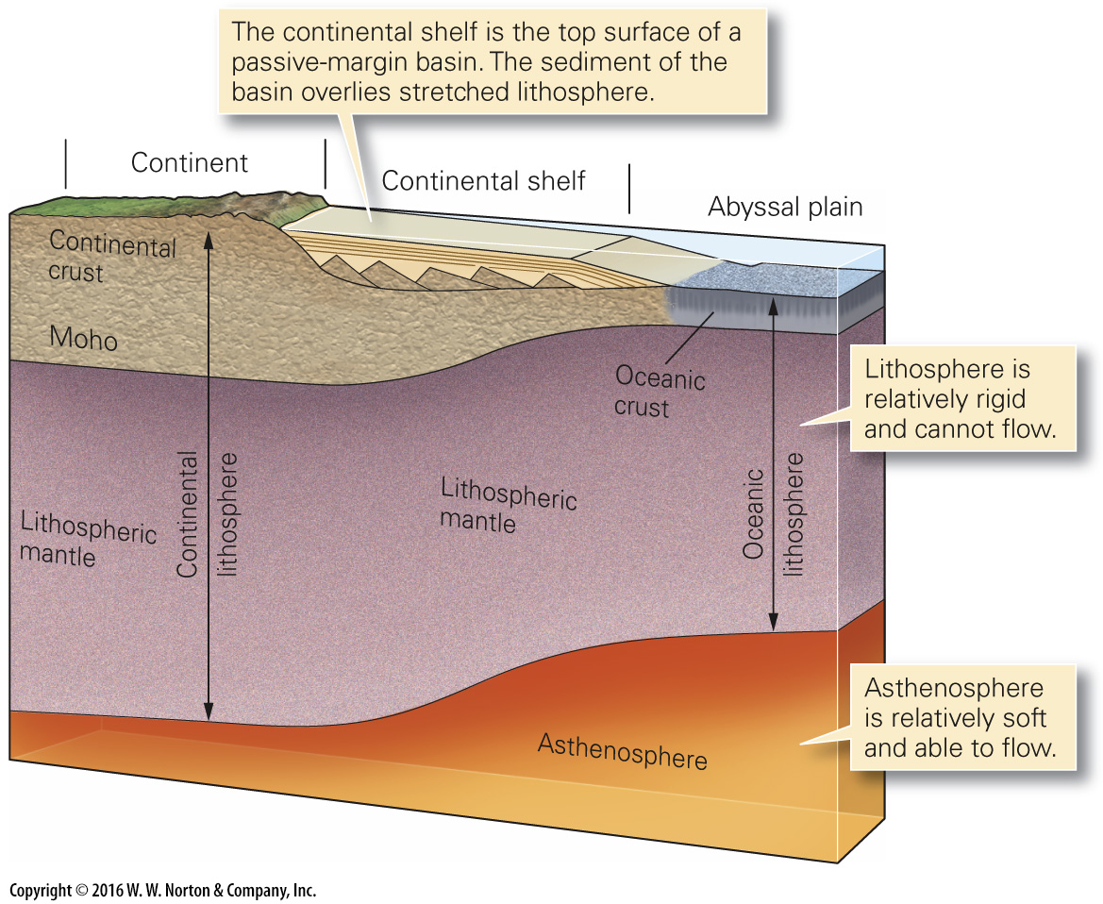
Notes:
FIGURE 2.14b The nature and behavior of the lithosphere.
(b) The lithosphere consists of the crust plus the uppermost mantle. It is thicker beneath continents than beneath oceans.

Slide 49
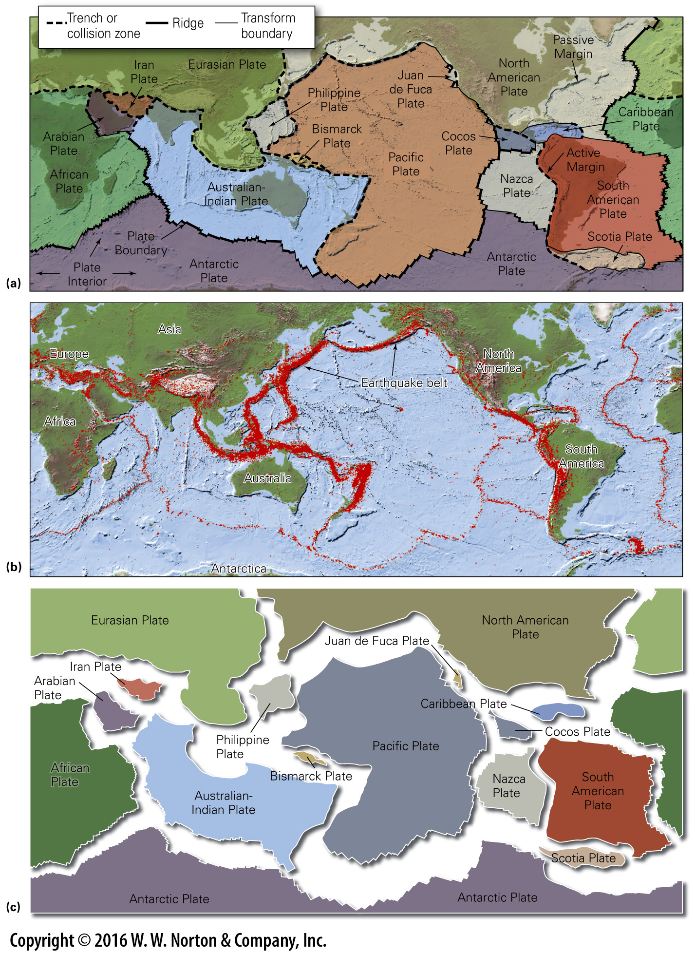
Notes:
FIGURE 2.15 The locations of plate boundaries and the distribution of earthquakes.
(a) A map of major plates shows that some consist entirely of oceanic lithosphere, whereas others consist of both continental and oceanic lithosphere. Active continental margins lie along plate boundaries; passive margins do not. (b) The locations of earthquakes (red dots) mostly fall in distinct bands that correspond to plate boundaries. Relatively few earthquakes occur in the more stable plate interiors. (c) An exploded view of the plates emphasizes the variation in shape and size of the plates.

Slide 50
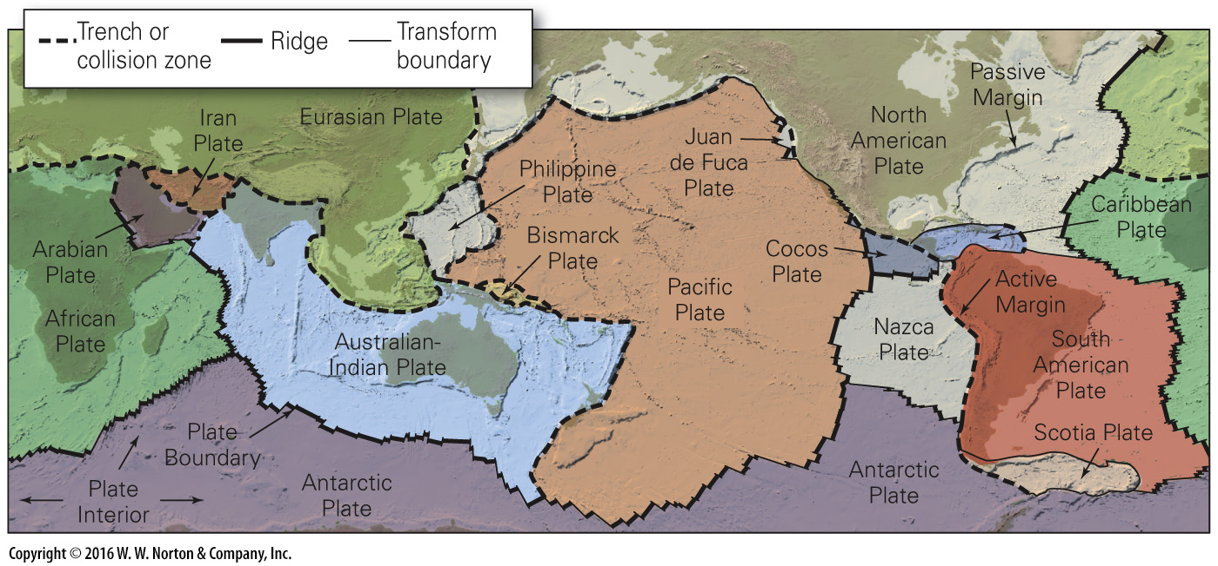
Notes:
FIGURE 2.15a The locations of plate boundaries and the distribution of earthquakes.
(a) A map of major plates shows that some consist entirely of oceanic lithosphere, whereas others consist of both continental and oceanic lithosphere. Active continental margins lie along plate boundaries; passive margins do not.

Slide 51
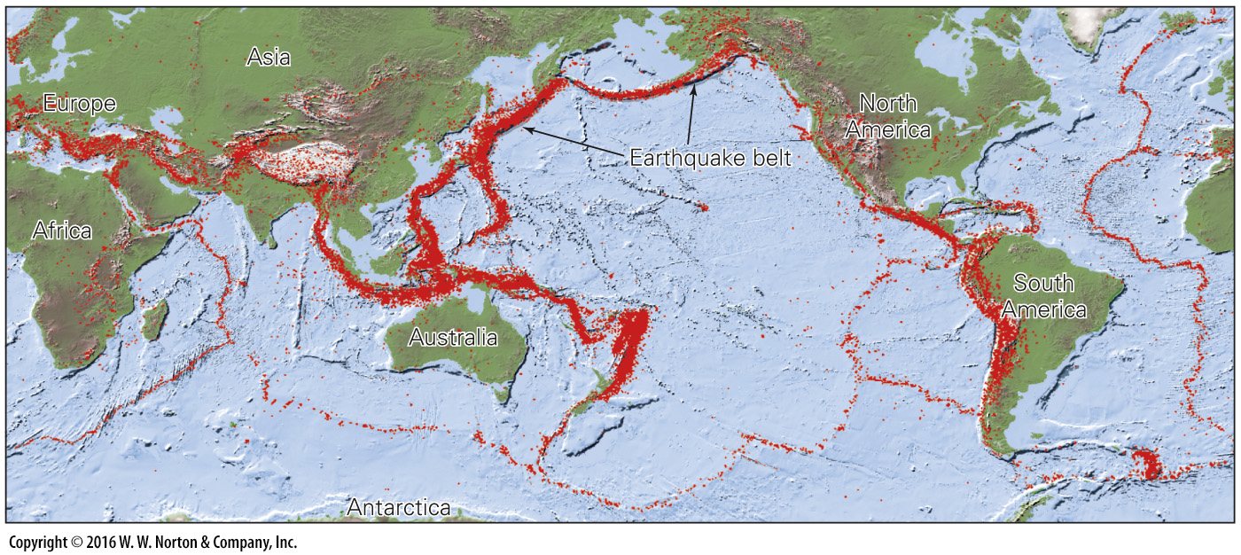
Notes:
FIGURE 2.15b The locations of plate boundaries and the distribution of earthquakes.
(b) The locations of earthquakes (red dots) mostly fall in distinct bands that correspond to plate boundaries. Relatively few earthquakes occur in the more stable plate interiors.

Slide 52

Notes:
FIGURE 2.15c The locations of plate boundaries and the distribution of earthquakes.
(c) An exploded view of the plates emphasizes the variation in shape and size of the plates.

Slide 53

Notes:
FIGURE 2.16 The three types of plate boundaries differ based on the nature of relative movement.
(a) At a divergent boundary, two plates move away from the axis of a mid-ocean ridge. New oceanic lithosphere forms. (b) At a convergent boundary, two plates move toward each other; the downgoing plate sinks beneath the overriding plate. toward each other; the downgoing plate sinks beneath the overriding plate. (c) At a transform boundary, two plates slide past each other on a vertical fault surface.

Slide 54

Notes:
FIGURE 2.16a The three types of plate boundaries differ based on the nature of relative movement.
(a) At a divergent boundary, two plates move away from the axis of a mid-ocean ridge. New oceanic lithosphere forms.

Slide 55

Notes:
FIGURE 2.16b The three types of plate boundaries differ based on the nature of relative movement.
(b) At a convergent boundary, two plates move toward each other; the downgoing plate sinks beneath the overriding plate. toward each other; the downgoing plate sinks beneath the overriding plate.

Slide 56

Notes:
FIGURE 2.16c The three types of plate boundaries differ based on the nature of relative movement.
(c) At a transform boundary, two plates slide past each other on a vertical fault surface.

Slide 57

Notes:
FIGURE 2.17 Divergent-plate boundaries are delineated by mid-ocean ridges, where seafloor spreading occurs.
(a) During seafloor spreading, the ocean floor gets wider, and continents on either side move apart. New oceanic crust forms at the ridge axis. Rising asthenosphere melts beneath the axis. (b) The Mid-Atlantic Ridge in the South Atlantic Ocean. The lighter shades of blue are shallower water depths.

Slide 58

Notes:
FIGURE 2.17a Divergent-plate boundaries are delineated by mid-ocean ridges, where seafloor spreading occurs.
(a) During seafloor spreading, the ocean floor gets wider, and continents on either side move apart. New oceanic crust forms at the ridge axis. Rising asthenosphere melts beneath the axis.

Slide 59

Notes:
FIGURE 2.17b Divergent-plate boundaries are delineated by mid-ocean ridges, where seafloor spreading occurs.
(b) The Mid-Atlantic Ridge in the South Atlantic Ocean. The lighter shades of blue are shallower water depths.

Slide 60

Notes:
FIGURE 2.18a Geologic activity at a mid-ocean ridge.
(a) Beneath a mid-ocean ridge, there is a magma chamber. Gabbro forms on the side of the magma chamber. Basalt dikes protrude upward.

Slide 61

Notes:
FIGURE 2.18b Geologic activity at a mid-ocean ridge.
(b) Fine mineral grains precipitate as a cloud from a column of superhot water gushing from a black smoker. Bacteria, shrimp, and worms live around the vent.

Slide 62

Notes:
SEE FOR YOURSELF…
THE MID-ATLANTIC RIDGE

Slide 63

Notes:
FIGURE 2.19 This map of the world shows the age of the seafloor. Note how the seafloor grows older with increasing distance from the ridge axis. (Ma = million years ago.)

Slide 64

Notes:
FIGURE 2.20 Changes accompanying the aging of lithosphere.
(a) As seafloor ages, the dense lithospheric mantle thickens and the seafloor surface gets deeper. (b) Like the ballast of a ship, older (thicker) lithosphere sinks deeper into the mantle.

Slide 65

Notes:
FIGURE 2.21 During the process of subduction, oceanic lithosphere sinks back into the deeper mantle.
(a) A trench delineates the place where the Pacific Plate is being subducted. (b) Sinking of the downgoing plate resembles sinking of an anchor attached to a line. (c) A belt of earthquakes (dots) defines the position of the downgoing plate in the region above a depth of about 660 km. Sometimes plates “pile up” at a depth of 660 km.

Slide 66

Notes:
FIGURE 2.21a During the process of subduction, oceanic lithosphere sinks back into the deeper mantle.
(a) A trench delineates the place where the Pacific Plate is being subducted.

Slide 67

Notes:
FIGURE 2.21b During the process of subduction, oceanic lithosphere sinks back into the deeper mantle.
(b) Sinking of the downgoing plate resembles sinking of an anchor attached to a line.

Slide 68

Notes:
FIGURE 2.21c During the process of subduction, oceanic lithosphere sinks back into the deeper mantle.
(c) A belt of earthquakes (dots) defines the position of the downgoing plate in the region above a depth of about 660 km. Sometimes plates “pile up” at a depth of 660 km.

Slide 69

Notes:
FIGURE 2.22 The nature of a convergent-plate margin varies with location.
(a) A subduction zone along the edge of a continent. Here compression caused faulting behind the arc. (b) The Peru-Chile Trench, as seen from space. (c) The overriding plate acts like a bulldozer, scraping up sediment off the downgoing plate to build an accretionary prism. (d) Subduction beneath oceanic lithosphere produces an island arc. (e) Marginal seas form by seafloor spreading behind some volcanic arcs.

Slide 70

Notes:
FIGURE 2.22a The nature of a convergent-plate margin varies with location.
(a) A subduction zone along the edge of a continent. Here compression caused faulting behind the arc.

Slide 71

Notes:
FIGURE 2.22b The nature of a convergent-plate margin varies with location.
(b) The Peru-Chile Trench, as seen from space.

Slide 72

Notes:
FIGURE 2.22c The nature of a convergent-plate margin varies with location.
(c) The overriding plate acts like a bulldozer, scraping up sediment off the downgoing plate to build an accretionary prism. (d) Subduction beneath oceanic lithosphere produces an island arc. (e) Marginal seas form by seafloor spreading behind some volcanic arcs.

Slide 73

Notes:
FIGURE 2.22d The nature of a convergent-plate margin varies with location.
(d) Subduction beneath oceanic lithosphere produces an island arc.

Slide 74

Notes:
FIGURE 2.22e The nature of a convergent-plate margin varies with location.
(e) Marginal seas form by seafloor spreading behind some volcanic arcs.

Slide 75

Notes:
FIGURE 2.23 The concept of transform faulting.
(a) Numerous transform faults segment the Mid-Atlantic Ridge. (b) A comparison of the old model of transform faults with the new model required by the seafloor-spreading hypothesis. (c) Note that only the segment of the fracture zone between the two ridge segments is active.

Slide 76

Notes:
FIGURE 2.23a The concept of transform faulting.
(a) Numerous transform faults segment the Mid-Atlantic Ridge.

Slide 77

Notes:
FIGURE 2.23b The concept of transform faulting.
(b) A comparison of the old model of transform faults with the new model required by the seafloor-spreading hypothesis.

Slide 78

Notes:
FIGURE 2.23c The concept of transform faulting.
(c) Note that only the segment of the fracture zone between the two ridge segments is active.

Slide 79

Notes:
FIGURE 2.24 The San Andreas fault—A continental transform boundary.
(a) The San Andreas fault is a transform plate boundary between the North American and Pacific Plates. The Pacific is moving northwest, relative to North America. (b) In southern California, the San Andreas fault cuts a dry landscape. The fault trace is in the narrow valley. The land has been pushed up slightly along the fault.

Slide 80

Notes:
FIGURE 2.24a The San Andreas fault—A continental transform boundary.
(a) The San Andreas fault is a transform plate boundary between the North American and Pacific Plates. The Pacific is moving northwest, relative to North America.

Slide 81

Notes:
FIGURE 2.24b The San Andreas fault—A continental transform boundary.
(b) In southern California, the San Andreas fault cuts a dry landscape. The fault trace is in the narrow valley. The land has been pushed up slightly along the fault.

Slide 82

Notes:
FIGURE 2.25 Examples of triple junctions. The triple junctions are marked by dots.
(a) A ridge-ridge-ridge triple junction occurs in the Indian Ocean. (b) A trench-transform-transform triple junction occurs at the north end of the San Andreas fault.

Slide 83

Notes:
FIGURE 2.26 Locations of selected hot-spot volcanoes and hot-spot tracks. The most recent volcano (dot) is at one end of the track (red lines). Some of these volcanoes are extinct. Some hot spots are fairly recent and do not have tracks. Dashed tracks were broken by seafloor spreading.

Slide 84

Notes:
FIGURE 2.27 The deep mantle plume hypothesis for the formation of hot-spot tracks.
(a) A bathymetric map showing the hot-spot tracks of the Pacific Ocean. (b) Progressive stages in the development of a hot-spot track, according to the plume model. (c) According to the plume model, the Hawaiian island chain is a hot-spot track that formed as the Pacific Plate moved northwest relative to a plume. (d) As a volcano moves off the hot spot, it gradually sinks below sea level due to sinking of the plate, erosion, and submarine landslides.

Slide 85

Notes:
FIGURE 2.27a The deep mantle plume hypothesis for the formation of hot-spot tracks.
(a) A bathymetric map showing the hot-spot tracks of the Pacific Ocean.

Slide 86

Notes:
FIGURE 2.27b The deep mantle plume hypothesis for the formation of hot-spot tracks.
(b) Progressive stages in the development of a hot-spot track, according to the plume model.

Slide 87

Notes:
FIGURE 2.27c The deep mantle plume hypothesis for the formation of hot-spot tracks.
(c) According to the plume model, the Hawaiian island chain is a hot-spot track that formed as the Pacific Plate moved northwest relative to a plume.

Slide 88

Notes:
FIGURE 2.27d The deep mantle plume hypothesis for the formation of hot-spot tracks.
(d) As a volcano moves off the hot spot, it gradually sinks below sea level due to sinking of the plate, erosion, and submarine landslides.

Slide 89

Notes:
FIGURE 2.28 During rifting, continental lithosphere stretches and thins. If rifting succeeds, a new mid-ocean ridge forms.

Slide 90

Notes:
FIGURE 2.29 Examples of present-day crustal rifting.
(a) The East African Rift is growing today. The Red Sea started as a rift. The inset shows the map location relative to the rest of Africa. (b) An air photo of the northern end of the East African Rift, showing faults and volcanoes. (c) The Basin and Range Province is a rift. Faulting bounds the narrow north-south-trending mountains, separated by basins. The arrows indicate the direction of stretching.

Slide 91

Notes:
FIGURE 2.29a Examples of present-day crustal rifting.
(a) The East African Rift is growing today. The Red Sea started as a rift. The inset shows the map location relative to the rest of Africa.

Slide 92

Notes:
FIGURE 2.29b Examples of present-day crustal rifting.
(b) An air photo of the northern end of the East African Rift, showing faults and volcanoes.

Slide 93

Notes:
FIGURE 2.29c Examples of present-day crustal rifting.
(c) The Basin and Range Province is a rift. Faulting bounds the narrow north-south-trending mountains, separated by basins. The arrows indicate the direction of stretching.

Slide 94

Notes:
FIGURE 2.30 Continental collision (not to scale).
(a) Subduction consumes an oceanic plate until two continents collide. (b) After the collision, the oceanic plate detaches and sinks into the mantle. Rock caught in the collision zone gets broken, bent, and squashed and forms a mountain range.

Slide 95

Notes:
SEE FOR YOURSELF…
HIMALAYAN COLLISION

Slide 96

Notes:
FIGURE 2.31 Forces driving plate motions.
(a) The old, incorrect, image of simple convection cells. In this image, the plates were viewed as passive rafts carried along by convecting mantle. (b) Modern studies show that convective flow in the mantle is complicated. Warm (redder) areas rise, and blue (cooler) areas sink. (c) Ridge push develops because the region of a rift is elevated. Like a wedge of honey with a sloping surface, the mass of the ridge pushes sideways. (d) Slab pull develops because lithosphere is denser than the underlying asthenosphere and sinks like a stone in water (though much more slowly).

Slide 97

Notes:
FIGURE 2.31a Forces driving plate motions.
(a) The old, incorrect, image of simple convection cells. In this image, the plates were viewed as passive rafts carried along by convecting mantle.

Slide 98

Notes:
FIGURE 2.31b Forces driving plate motions.
(b) Modern studies show that convective flow in the mantle is complicated. Warm (redder) areas rise, and blue (cooler) areas sink.

Slide 99

Notes:
FIGURE 2.31c Forces driving plate motions.
(c) Ridge push develops because the region of a rift is elevated. Like a wedge of honey with a sloping surface, the mass of the ridge pushes sideways.

Slide 100

Notes:
FIGURE 2.31d Forces driving plate motions.
(d) Slab pull develops because lithosphere is denser than the underlying asthenosphere and sinks like a stone in water (though much more slowly).

Slide 101

Notes:
FIGURE 2.32 The black arrows show relative plate velocities. Outward-pointing arrows indicate spreading (divergent boundaries), inward-pointing arrows indicate subduction (convergent boundaries), and parallel arrows show transform motion. The length of an arrow represents the velocity. The red arrows show the absolute velocity of the plates with respect to a fixed point in the mantle.

Slide 102

Notes:
FIGURE 2.33 Due to plate tectonics, the map of Earth‘s surface slowly changes. Here we see the assembly, and later the breakup, of Pangaea during the past 400 million years.

Slide 103

Notes:
GEOLOGY AT A GLANCE
The Theory of Plate Tectonics

