Slide 1
Stephen Marshak
ESSENTIALS OF
Geology
FIFTH EDITION
Interlude F
An Introduction to Landscapes and the Hydrological Cycle
©2016 W. W. Norton & Company, Inc.

Slide 2
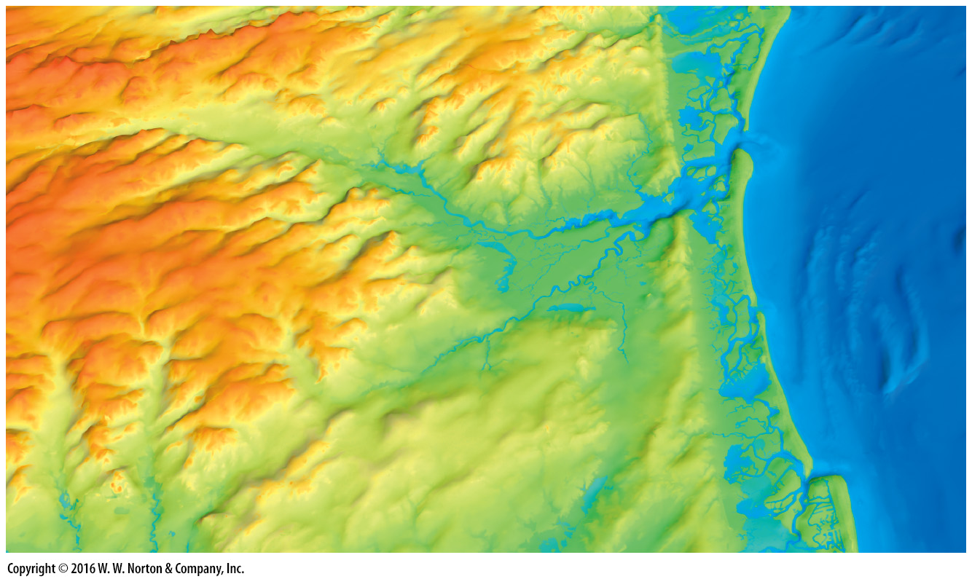
Notes:
This digital elevation model of the Atlantic City, New Jersey, region reveals the details of a landscape modified by the ocean surf on the east and stream erosion inland. Water cycles among the ocean, air, land surface, and subsurface in this region.

Slide 3
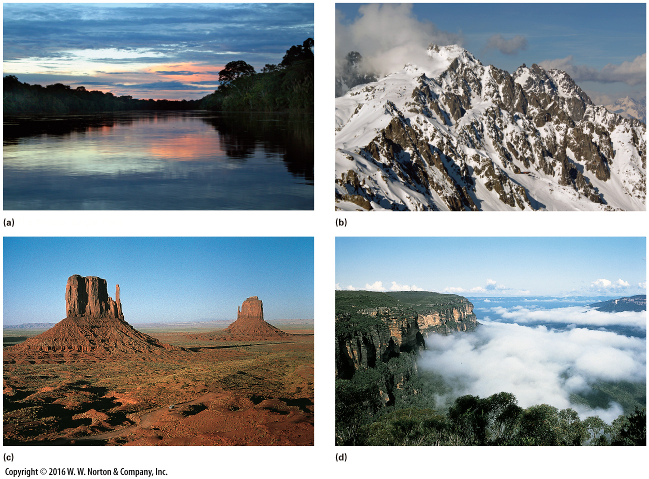
Notes:
FIGURE F.1 Examples of the great variety of landscapes on Earth.
(a) The Amazon jungle, Peru. (b) Glaciated peaks of the Alps, France. (c) Buttes of sandstone, Monument Valley, Arizona. (d) Cliffs rise from the forest in the Blue Mountains, Australia.

Slide 4
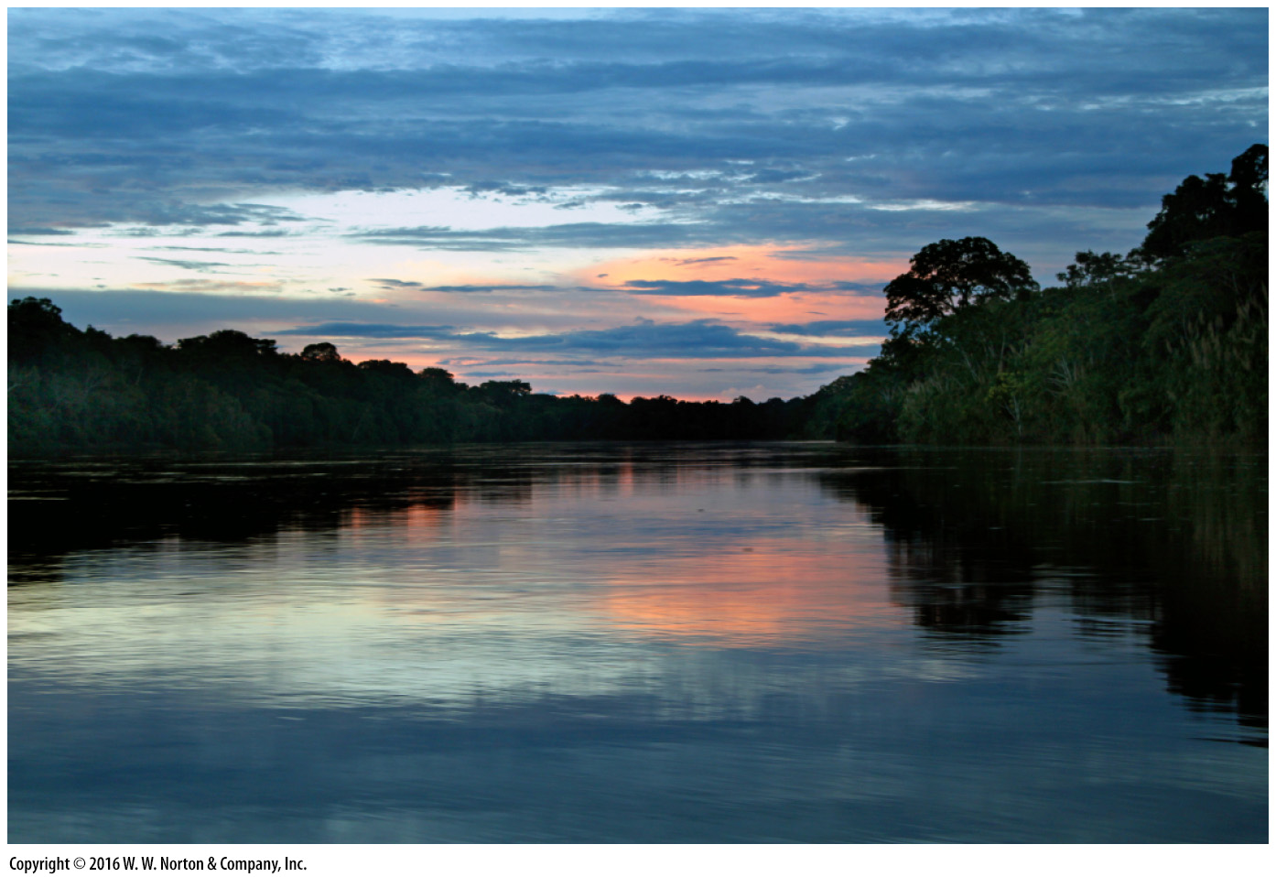
Notes:
FIGURE F.1a Examples of the great variety of landscapes on Earth.
(a) The Amazon jungle, Peru.

Slide 5
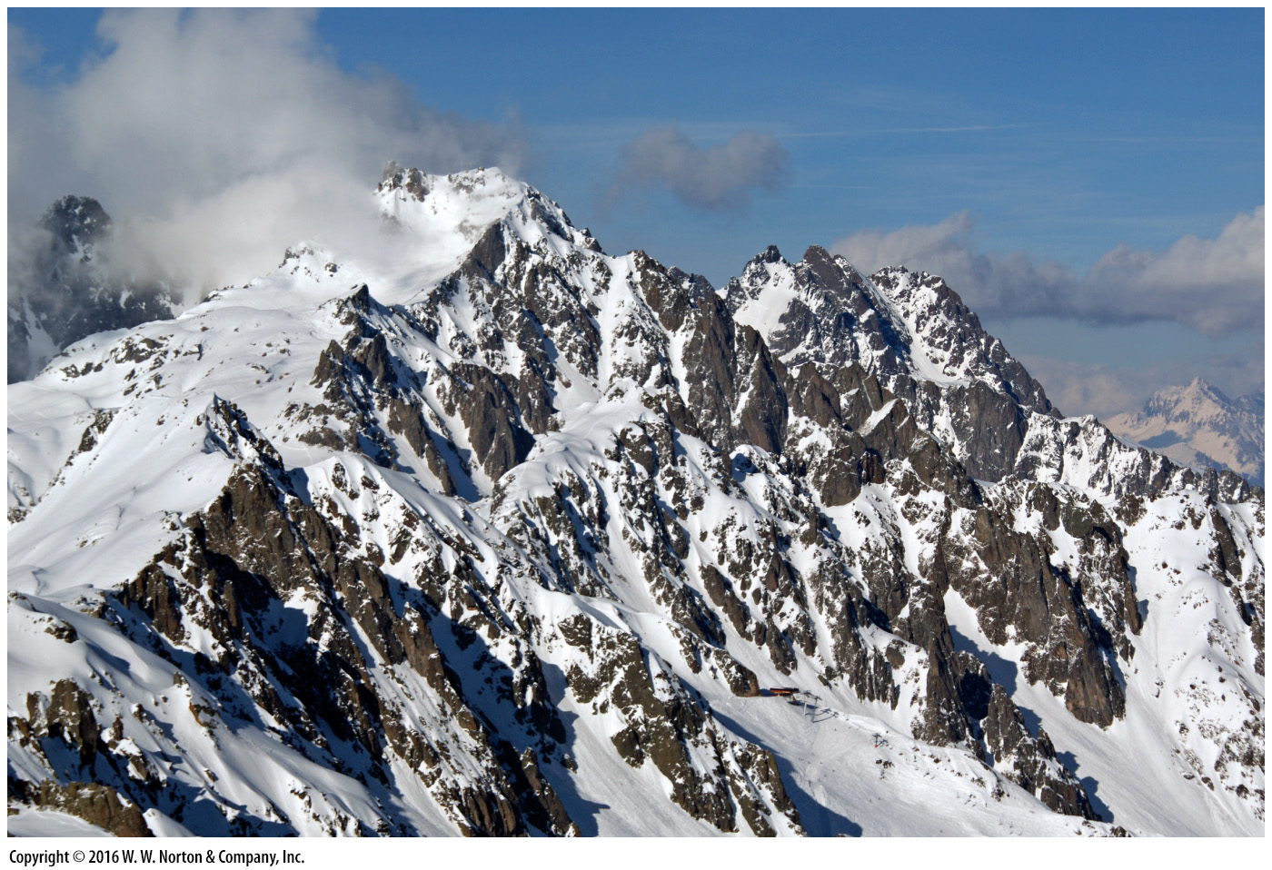
Notes:
FIGURE F.1b Examples of the great variety of landscapes on Earth.
(b) Glaciated peaks of the Alps, France.

Slide 6
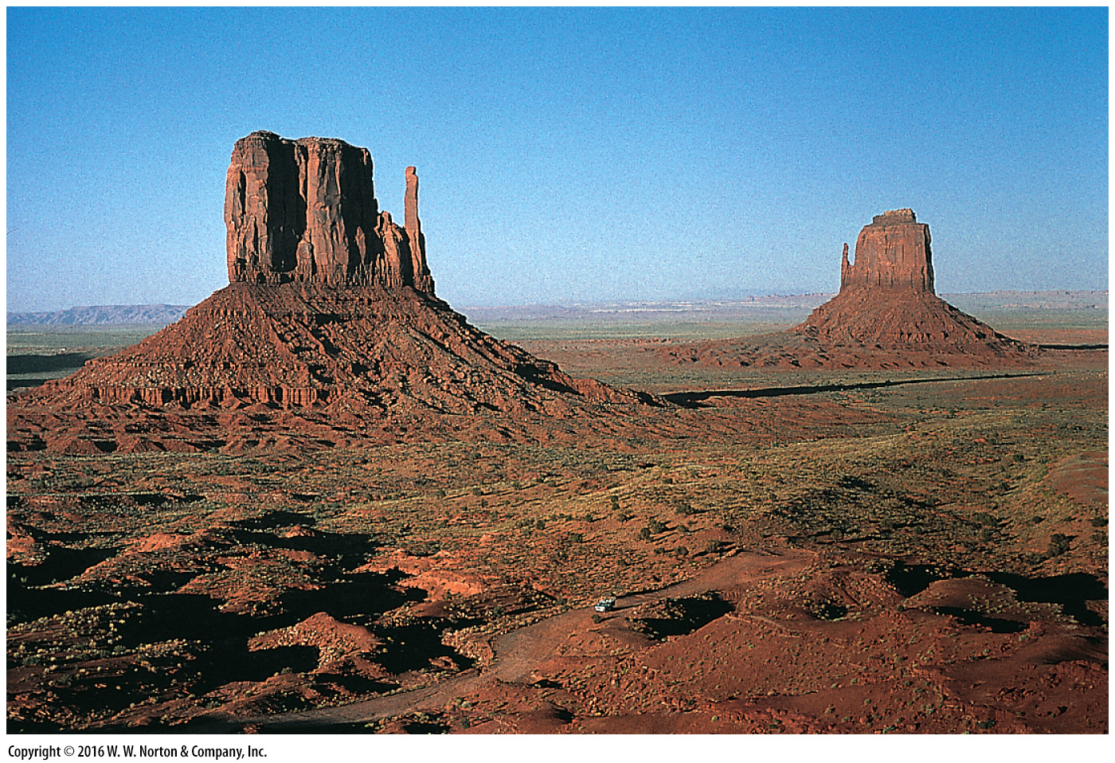
Notes:
FIGURE F.1c Examples of the great variety of landscapes on Earth.
(c) Buttes of sandstone, Monument Valley, Arizona.

Slide 7
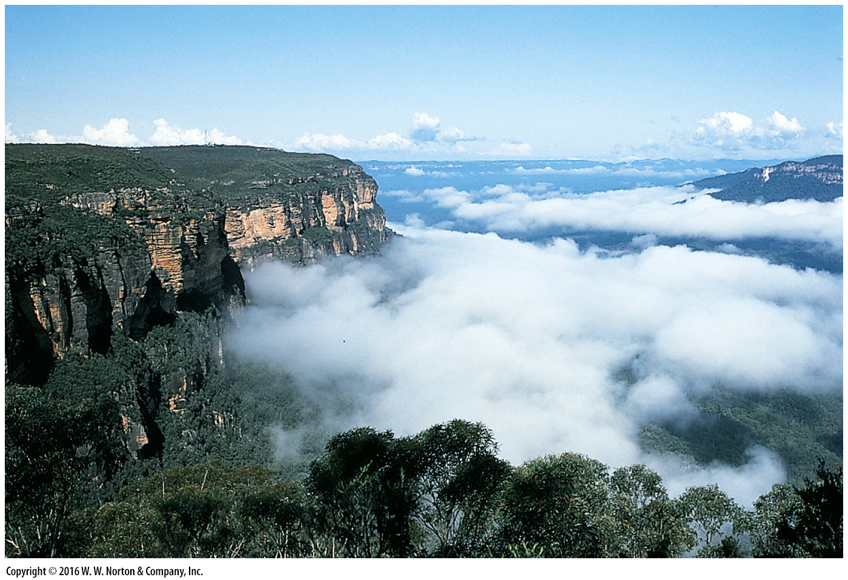
Notes:
FIGURE F.1d Examples of the great variety of landscapes on Earth.
(d) Cliffs rise from the forest in the Blue Mountains, Australia.

Slide 8
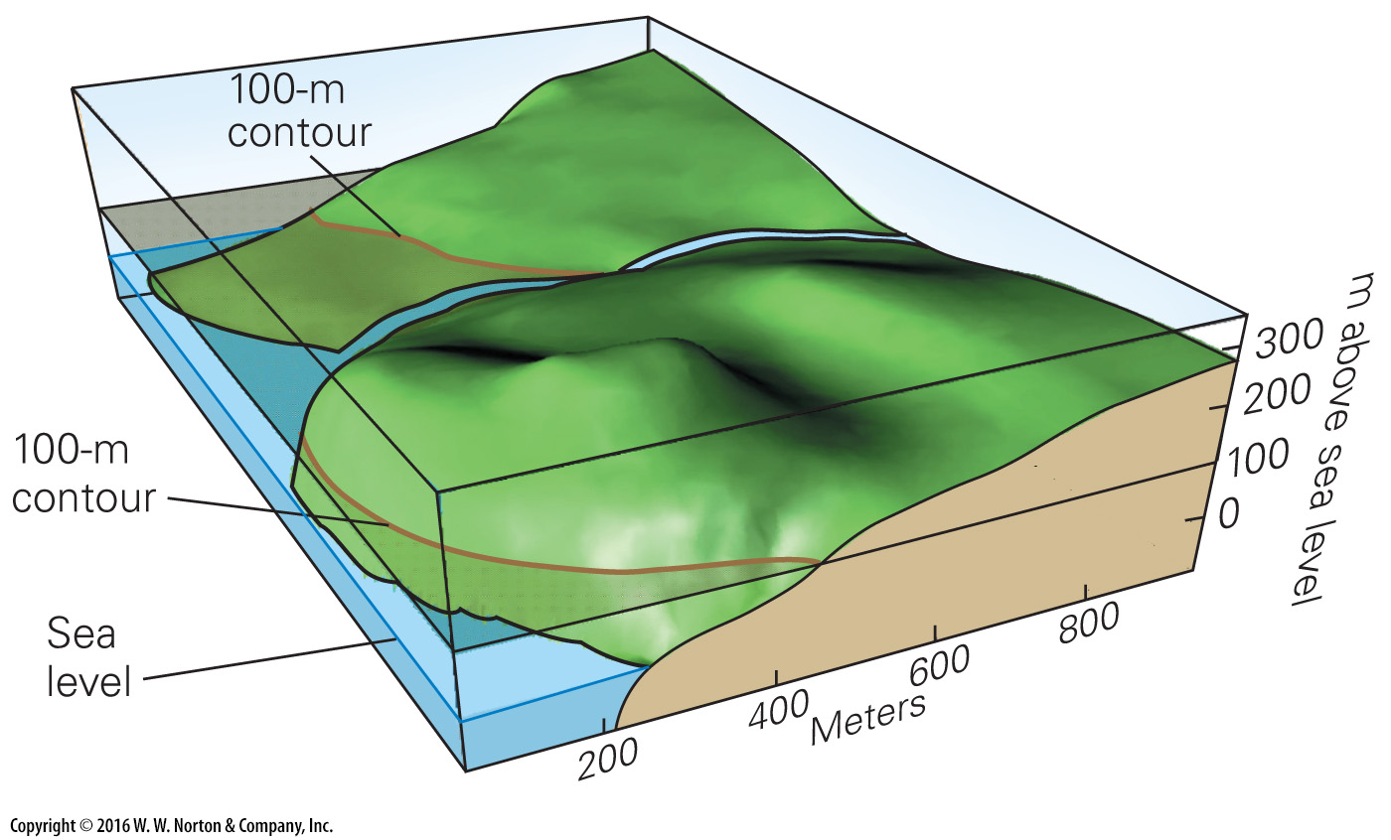
Notes:
FIGURE BxF.1a Topographic maps and profiles.
(a) A contour line is the intersection of a horizontal plane with the land surface. This block diagram shows the map area.

Slide 9
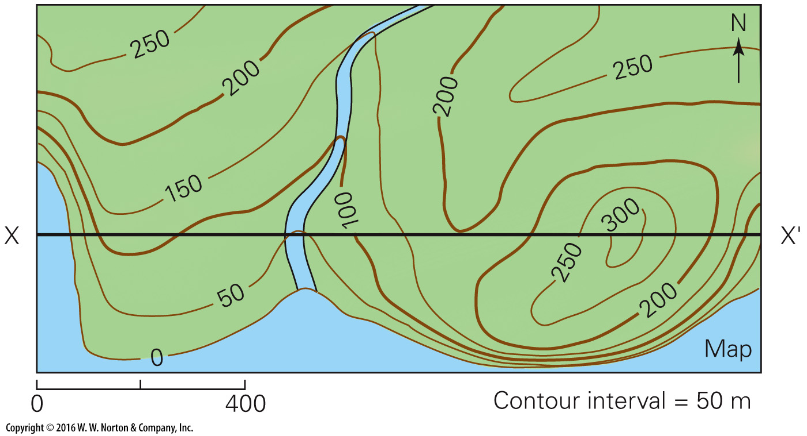
Notes:
FIGURE BxF.1b Topographic maps and profiles.
(b) A topographic map depicts the shape of the land surface through the use of contour lines. The difference in elevation between two adjacent lines is the contour interval.

Slide 10
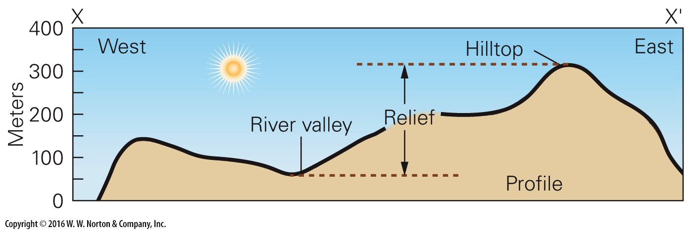
Notes:
FIGURE BxF.1c Topographic maps and profiles.
(c) A topographic profile (along section line XX') shows the shape of the land surface as seen in a vertical slice.

Slide 11
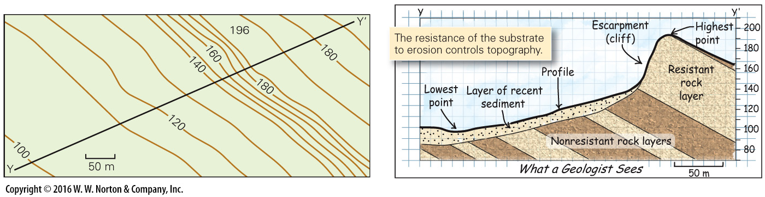
Notes:
FIGURE BxF.1d Topographic maps and profiles.
(d) This topographic map shows a distinct cliff. A cross section (right) depicts a geologist’s interpretation of the subsurface along YY'. The cliff is the edge of a resistant rock layer.

Slide 12
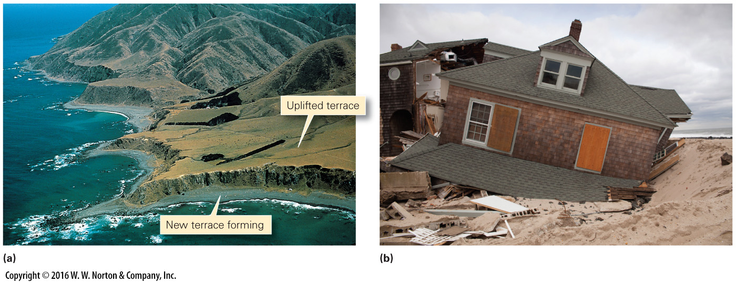
Notes:
FIGURE F.2 The processes of uplift, subsidence, erosion, and deposition can be slow or rapid.
(a) Uplifted beach terraces form where the coast is rising relative to sea level. Present-day wave erosion is forming a new terrace and cutting a cliff on the edge of the old one. (b) So much erosion can take place during a single hurricane that houses built along the beach become undermined. This example happened as a result of “Superstorm Sandy” in 2012.

Slide 13
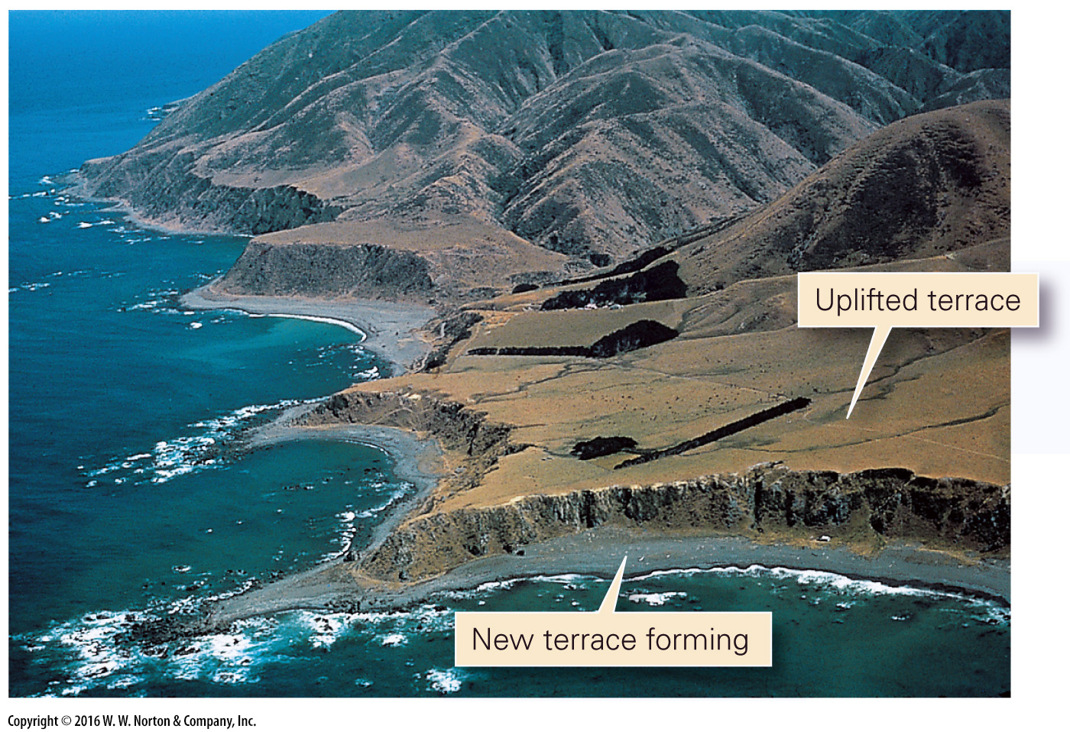
Notes:
FIGURE F.2a The processes of uplift, subsidence, erosion, and deposition can be slow or rapid.
(a) Uplifted beach terraces form where the coast is rising relative to sea level. Present-day wave erosion is forming a new terrace and cutting a cliff on the edge of the old one.

Slide 14
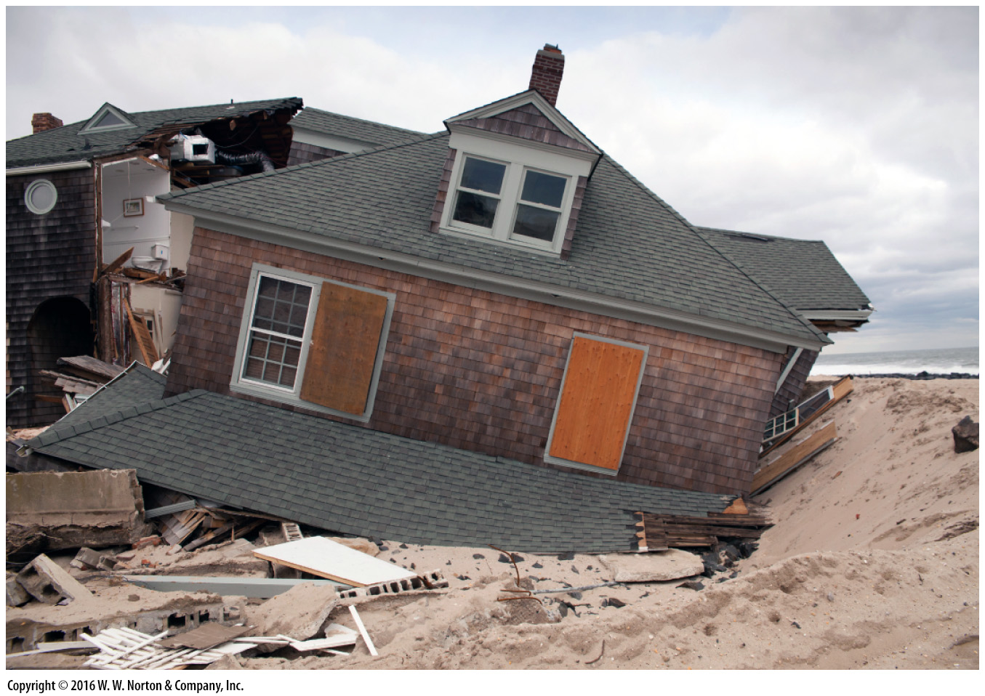
Notes:
FIGURE F.2b The processes of uplift, subsidence, erosion, and deposition can be slow or rapid.
(b) So much erosion can take place during a single hurricane that houses built along the beach become undermined. This example happened as a result of “Superstorm Sandy” in 2012.

Slide 15
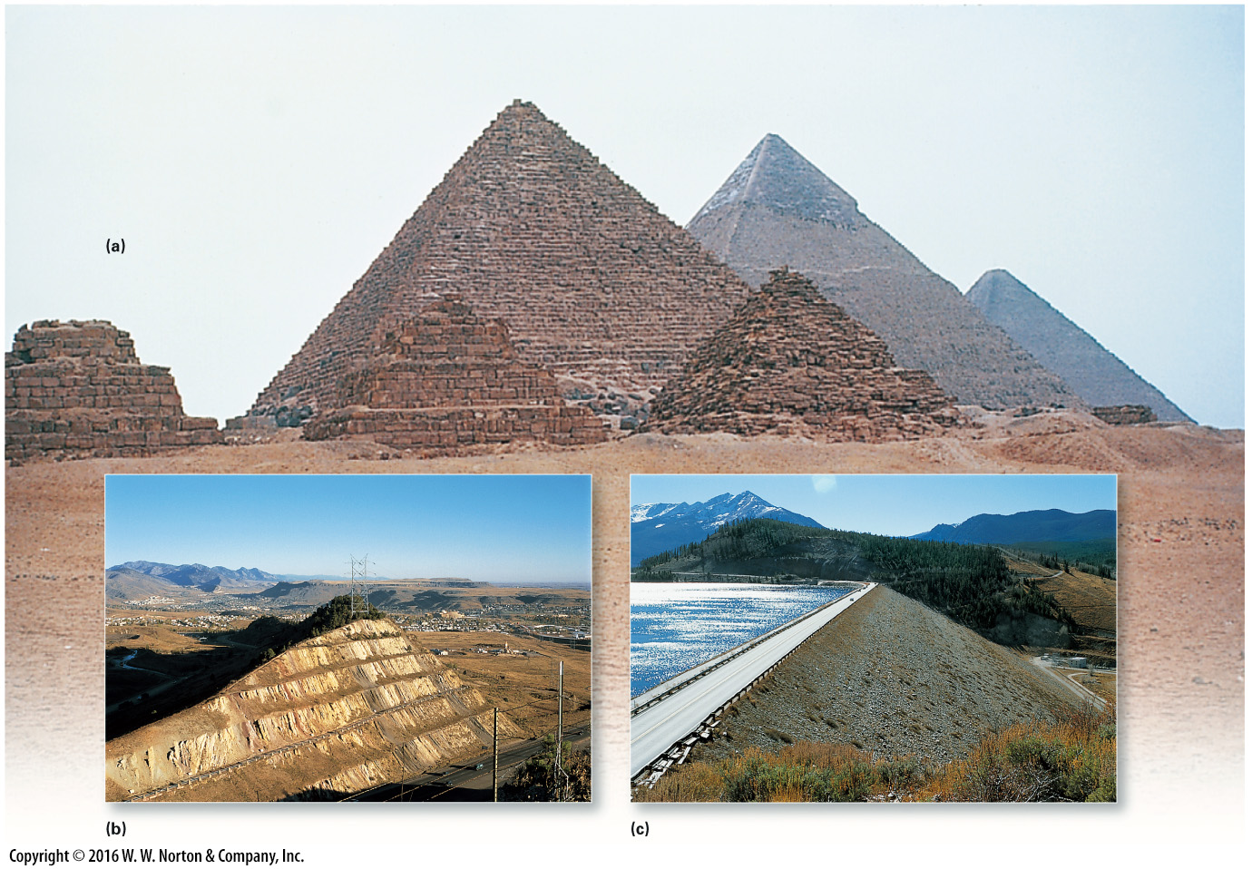
Notes:
FIGURE F.3 Human influence on a geologic scale.
(a) The pyramids of Egypt are human-made hills that rise above the desert sands. They have lasted for thousands of years. (b) In the process of making highway cuts, deep valleys are cut through high ridges. This example borders a highway near Denver. (c) This stone dam holds back a reservoir in Colorado. Think about how long it would take a glacier to pile up so much sediment.

Slide 16
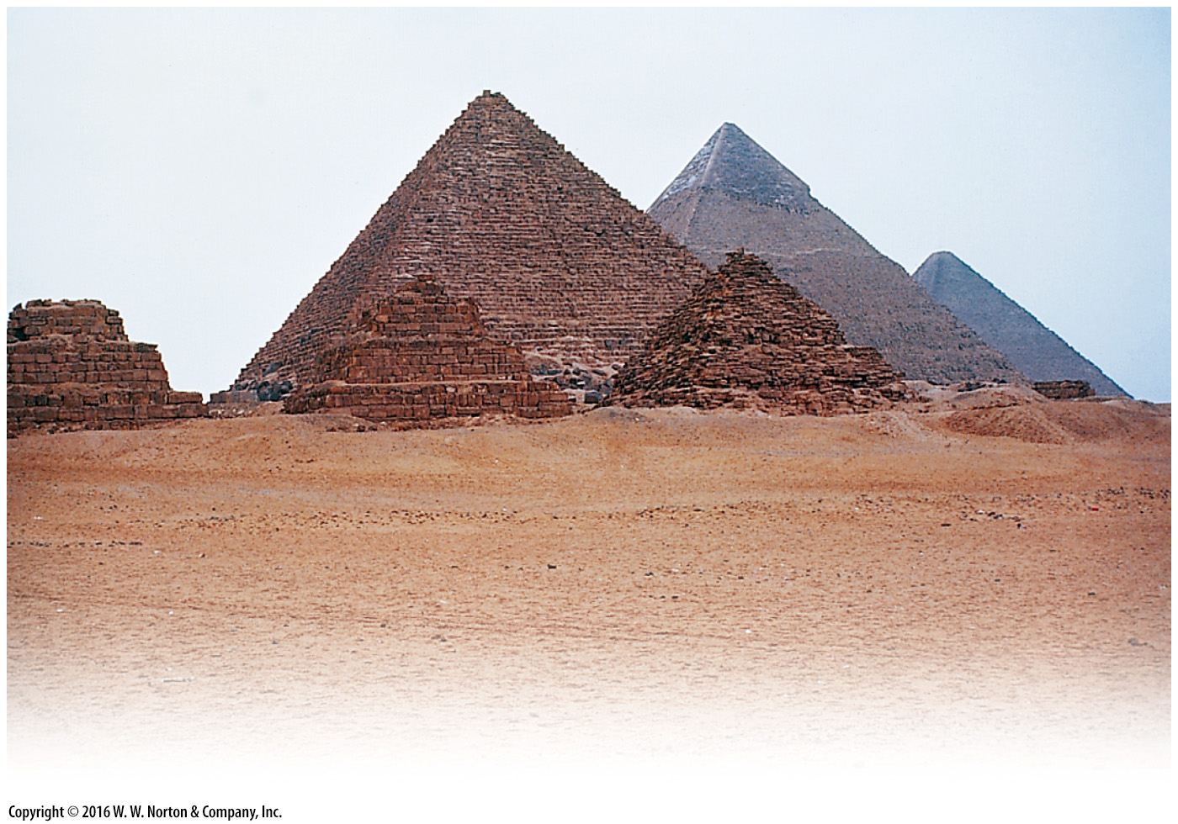
Notes:
FIGURE F.3a Human influence on a geologic scale.
(a) The pyramids of Egypt are human-made hills that rise above the desert sands. They have lasted for thousands of years.

Slide 17
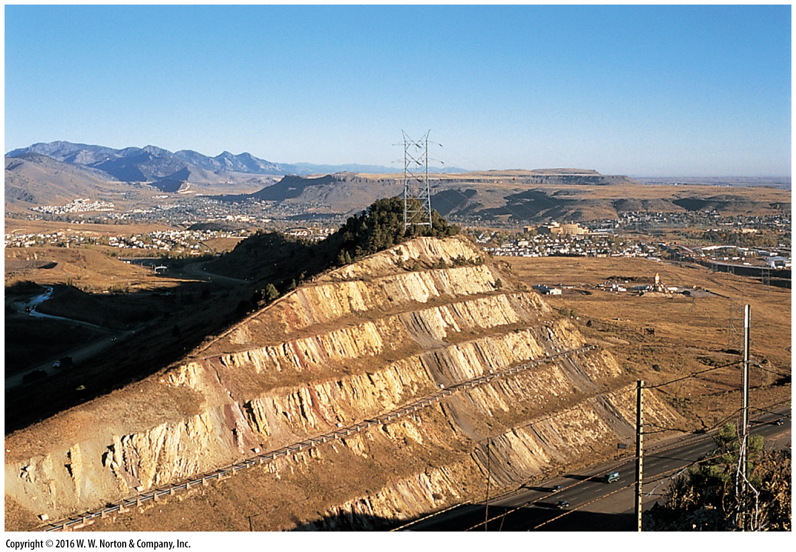
Notes:
FIGURE F.3b Human influence on a geologic scale.
(b) In the process of making highway cuts, deep valleys are cut through high ridges. This example borders a highway near Denver.

Slide 18
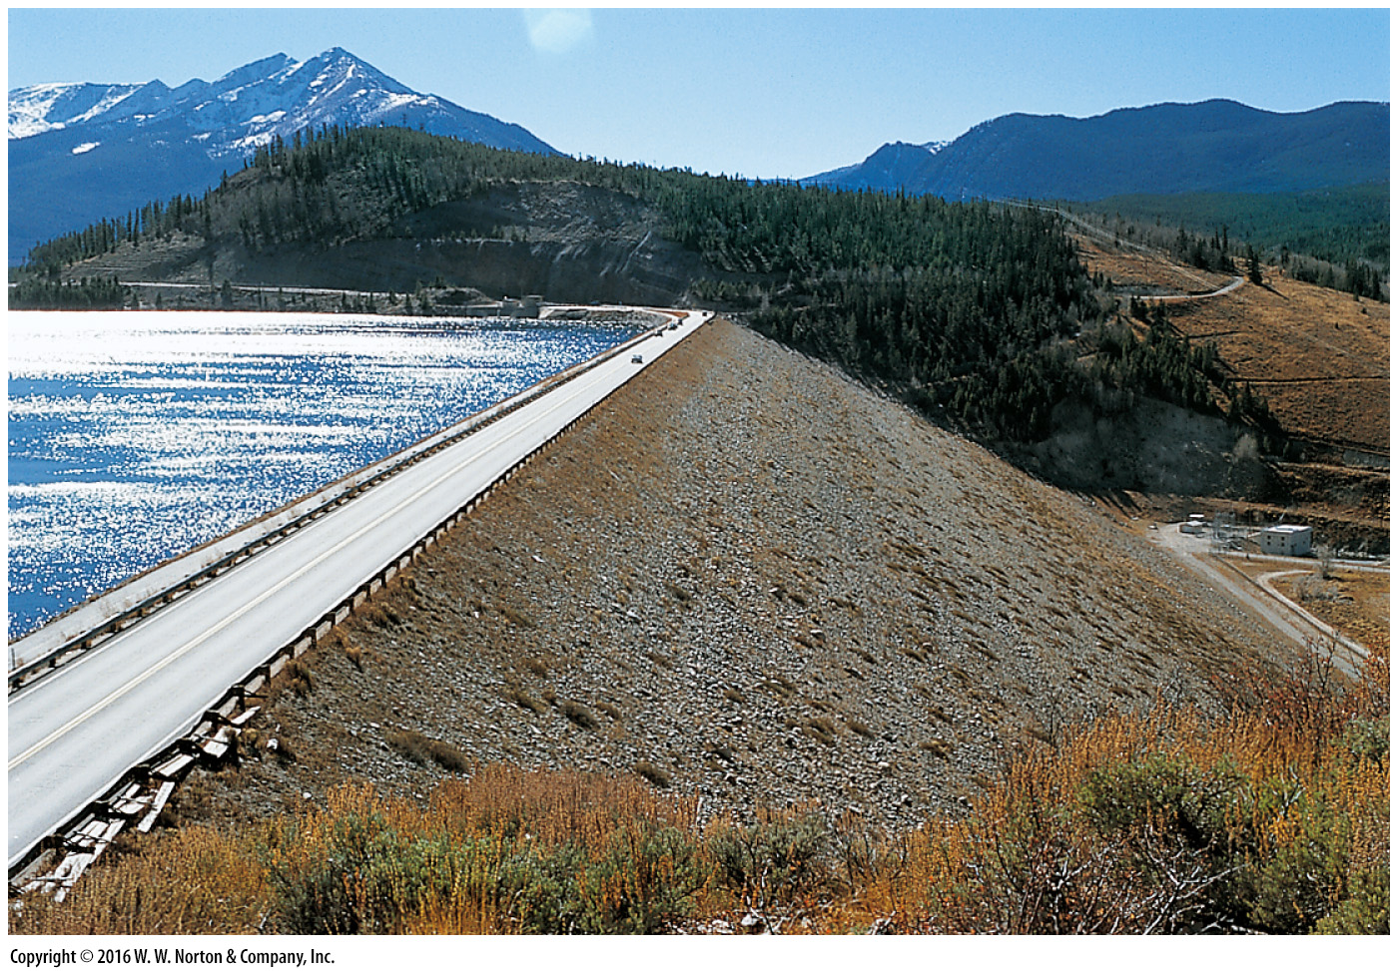
Notes:
FIGURE F.3c Human influence on a geologic scale.
(c) This stone dam holds back a reservoir in Colorado. Think about how long it would take a glacier to pile up so much sediment.

Slide 19
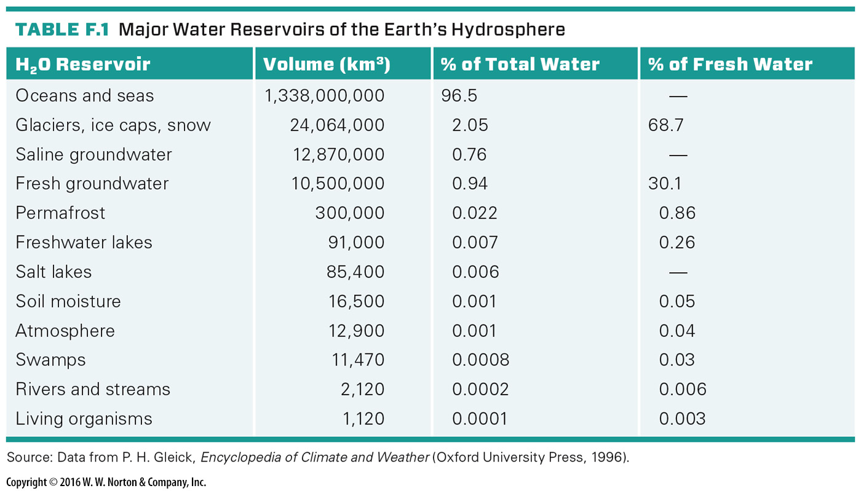
Notes:
TABLE F.1 Major Water Reservoirs of the Earth’s Hydrosphere

Slide 20
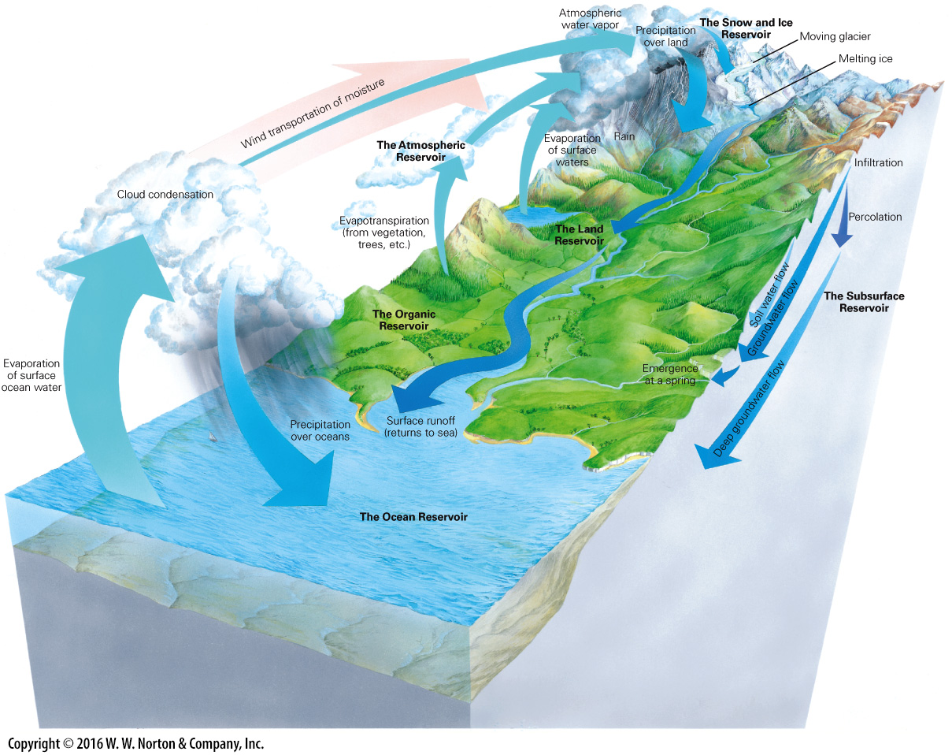
Notes:
GEOLOGY AT A GLANCE
The Hydrologic Cycle

Slide 21
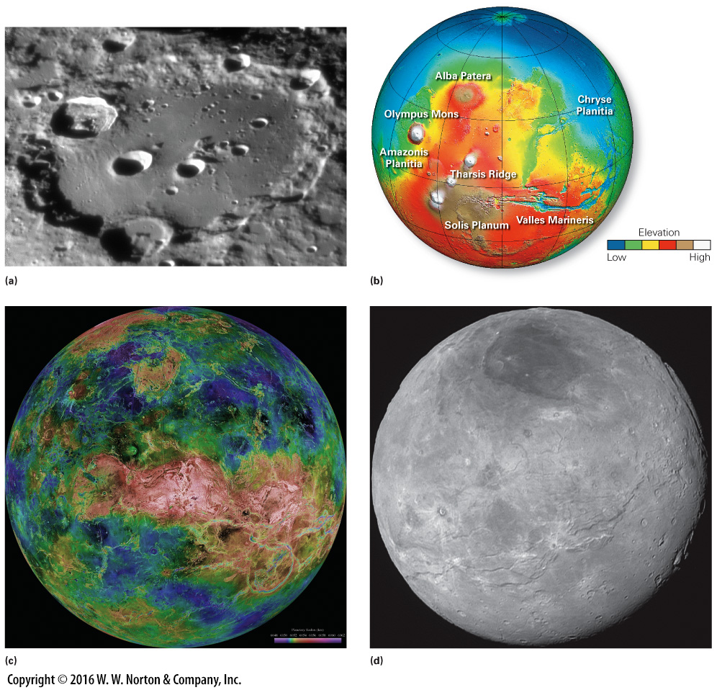
Notes:
FIGURE F.4 Landscapes of other planets.
(a) Astronomers estimate the crater Clavius, on the Moon, is about 3.8 to 3.9 billion years old, even though its outline remains very clear. It’s been around long enough for other craters to have impacted within it. (b) A DEM depicting the surface of Mars. Note the huge bulge of the Tharsis Ridge, the giant Olympus Mons volcano, and the deep Valles Marineris canyon. (c) A radar image of Venus. A thick blanket of clouds obscures the planet’s surface, so it can’t be seen through a telescope. Red areas are higher, blue areas lower. (d) In 2015, NASA captured the first high-resolution image of Pluto’s surface. Pluto is a dwarf planet.

Slide 22
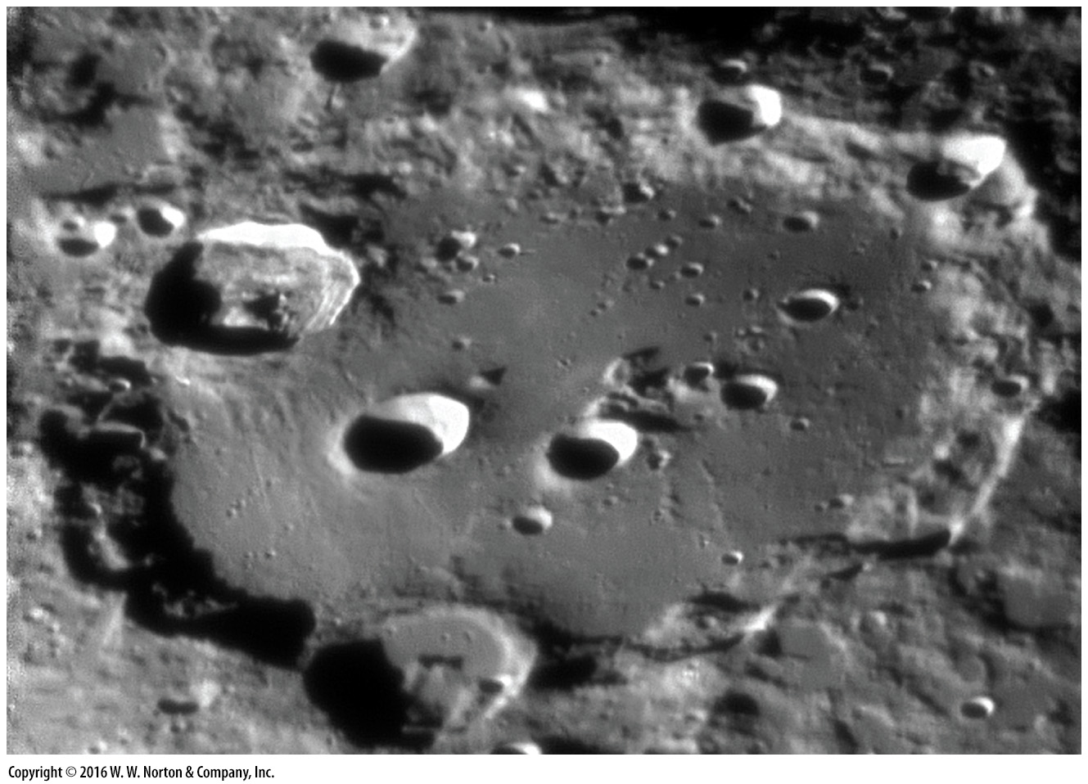
Notes:
FIGURE F.4a Landscapes of other planets.
(a) Astronomers estimate the crater Clavius, on the Moon, is about 3.8 to 3.9 billion years old, even though its outline remains very clear. It’s been around long enough for other craters to have impacted within it.

Slide 23
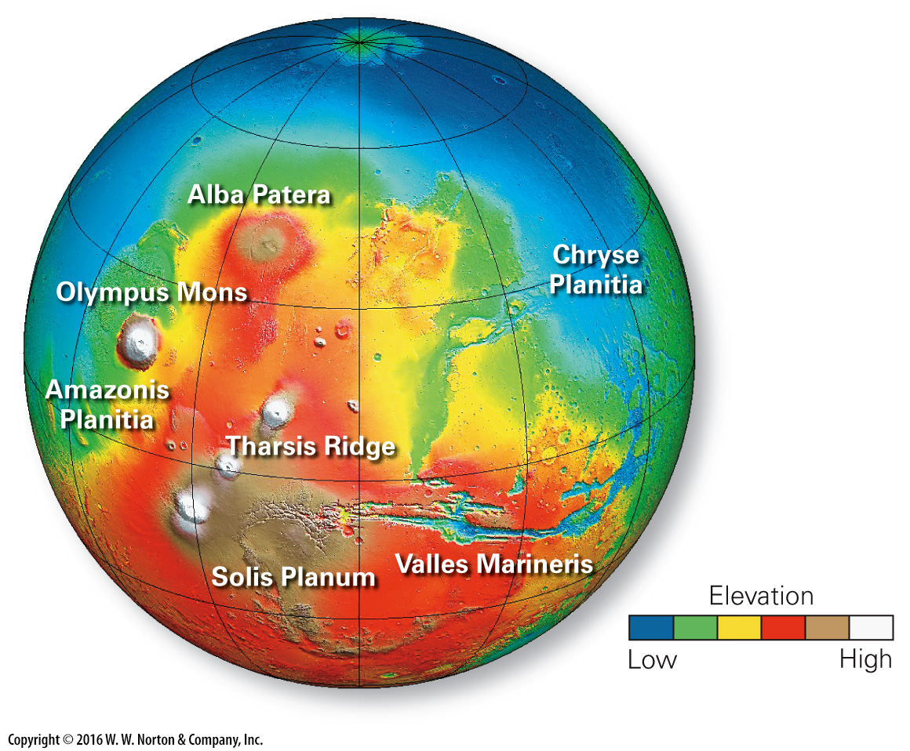
Notes:
FIGURE F.4b Landscapes of other planets.
(b) A DEM depicting the surface of Mars. Note the huge bulge of the Tharsis Ridge, the giant Olympus Mons volcano, and the deep Valles Marineris canyon.

Slide 24
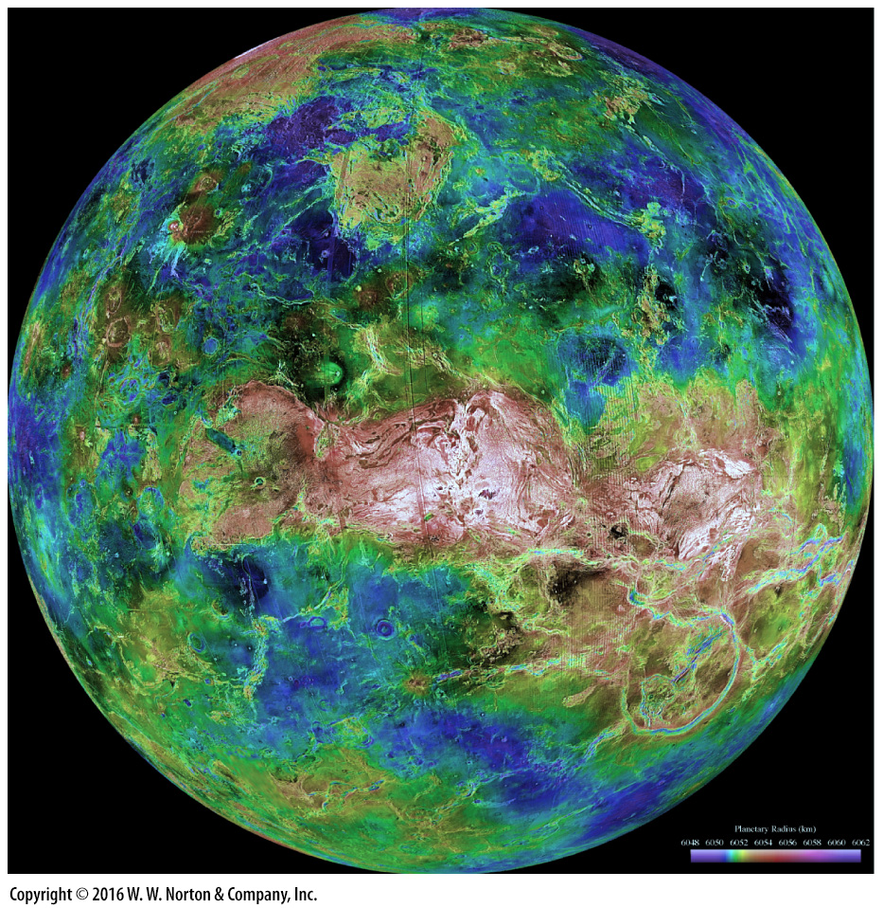
Notes:
FIGURE F.4c Landscapes of other planets.
(c) A radar image of Venus. A thick blanket of clouds obscures the planet’s surface, so it can’t be seen through a telescope. Red areas are higher, blue areas lower.

Slide 25
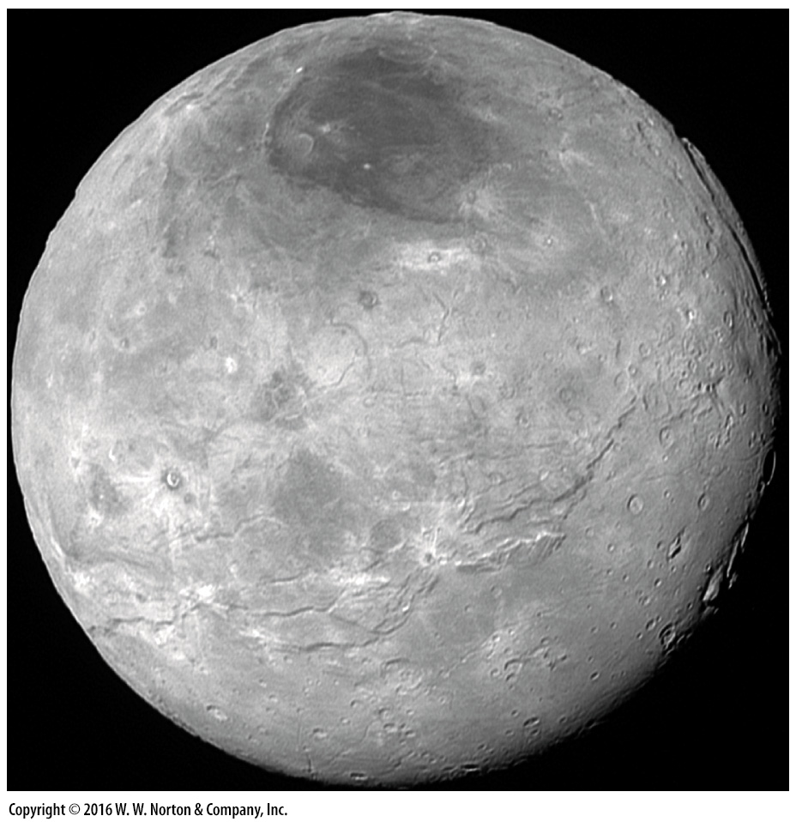
Notes:
FIGURE F.4d Landscapes of other planets.
(d) In 2015, NASA captured the first high-resolution image of Pluto’s surface. Pluto is a dwarf planet.

Slide 26
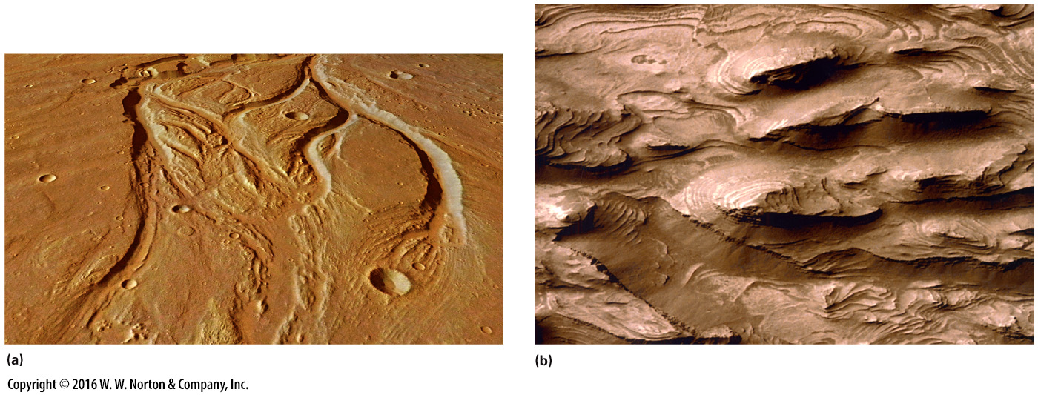
Notes:
FIGURE BxF.2 Water-carved landscapes on Mars, as photographed by satellites orbiting the planet.
(a) An oblique view showing stream channels on Mars resembling channels cut by rivers on Earth. (b) Layers of strata, interpreted to be water deposited, in Chasma Canyon, Mars. Note the elongate islands in the channel, resembling islands that have been shaped by rivers on Earth.

Slide 27
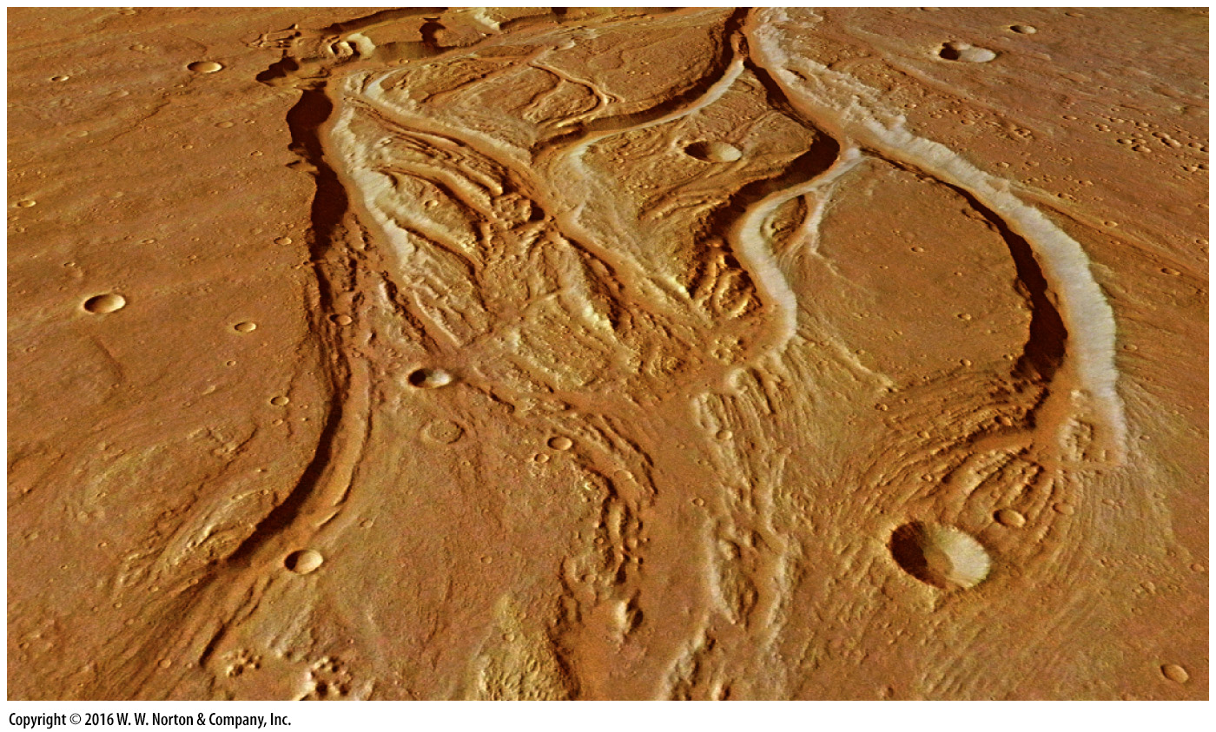
Notes:
FIGURE BxF.2a Water-carved landscapes on Mars, as photographed by satellites orbiting the planet.
(a) An oblique view showing stream channels on Mars resembling channels cut by rivers on Earth.

Slide 28
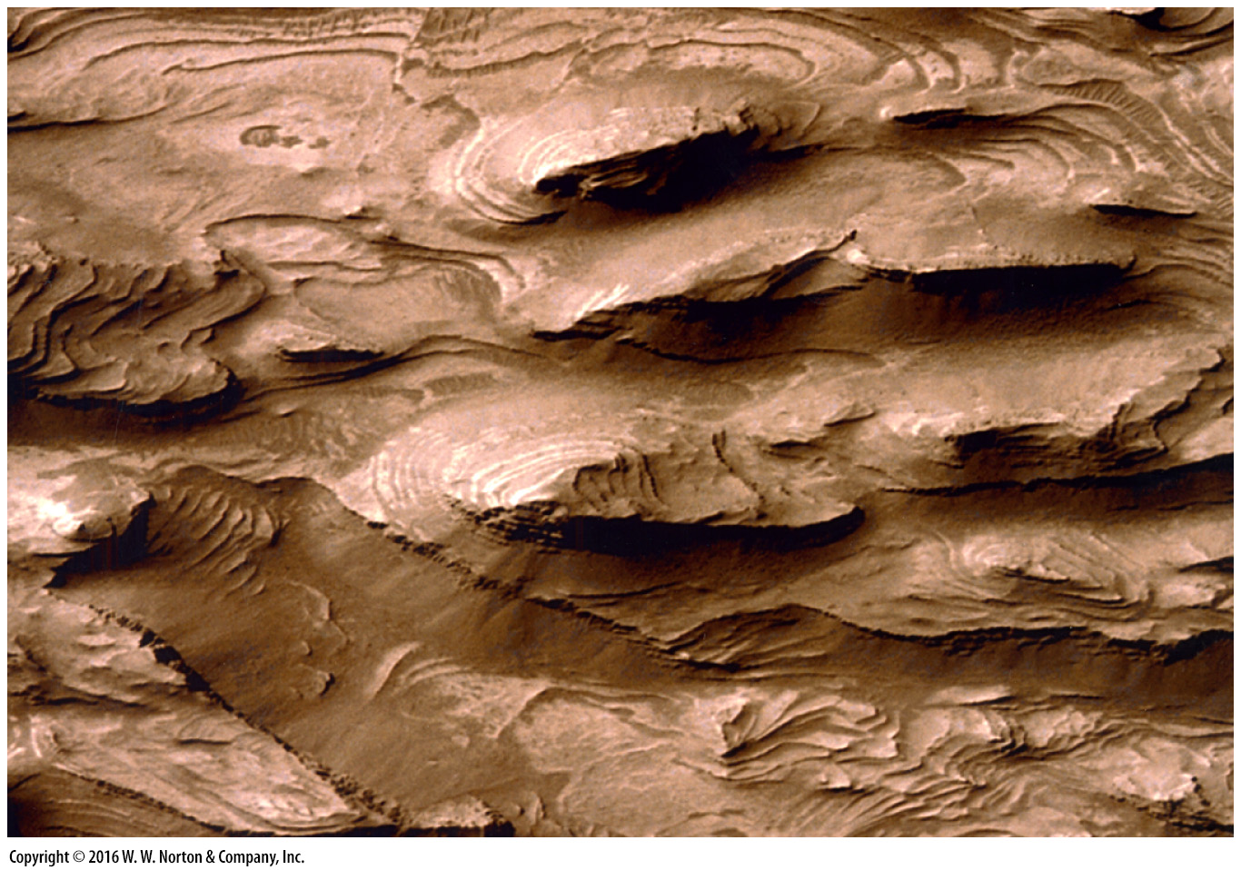
Notes:
FIGURE BxF.2b Water-carved landscapes on Mars, as photographed by satellites orbiting the planet.
(b) Layers of strata, interpreted to be water deposited, in Chasma Canyon, Mars. Note the elongate islands in the channel, resembling islands that have been shaped by rivers on Earth.

