Slide 1
Histology

Slide 2
AP Revealed Module: 3. Tissues
Select topic: Epithelial, Connective, Muscle and Nervous
After completion of this lab, students should be able to identify the following tissues:
Epithelium:
Simple squamous
Simple cuboidal
Simple columnar
Stratified
Connective tissue (CT)
Areolar (loose) CT
Dense CT (regular and irregular)
Adipose tissue
Blood
Cartilage Specialized CT
Bone:
Compact (hard), osteon, spongy bone (cancellous)
Lamellae, lacunae, canaliculi, osteocyte, osteoblast,
Muscle tissue
Skeletal muscle
Cardiac muscle
Smooth muscle
Nerve tissue
Nerve
Glial cells

Slide 3
Epithelium

Slide 4
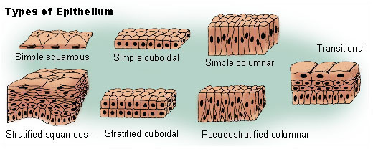
Epithelium

Slide 5
Epithelium

Slide 6
Simple Squamous Epithelium

Slide 7
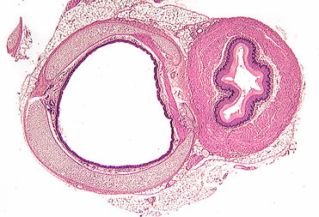

Slide 8
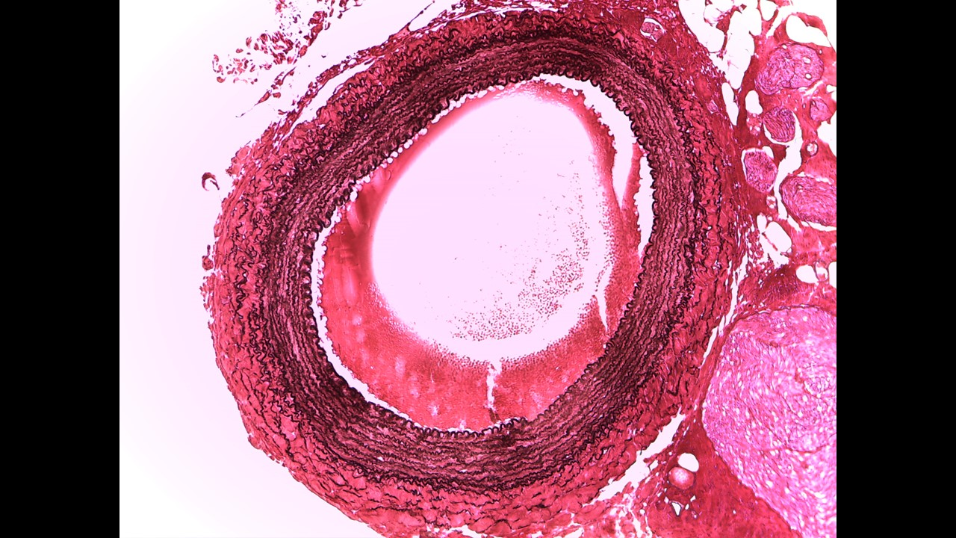

Slide 9
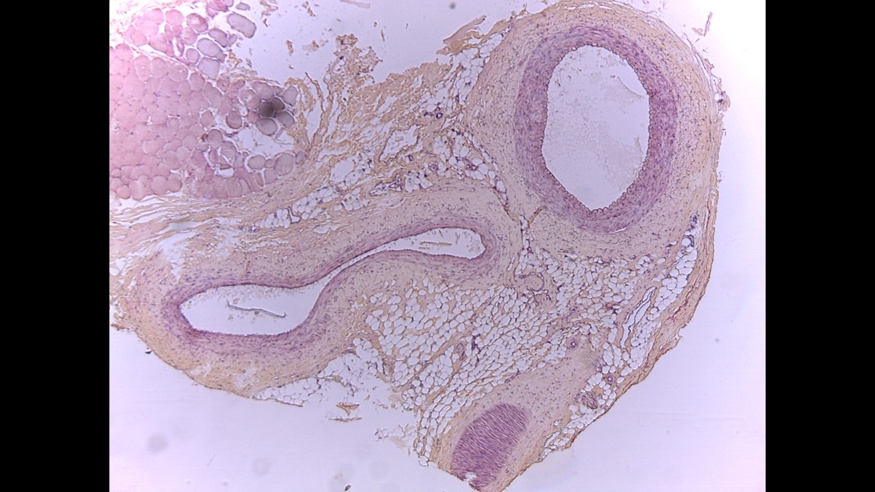

Slide 10
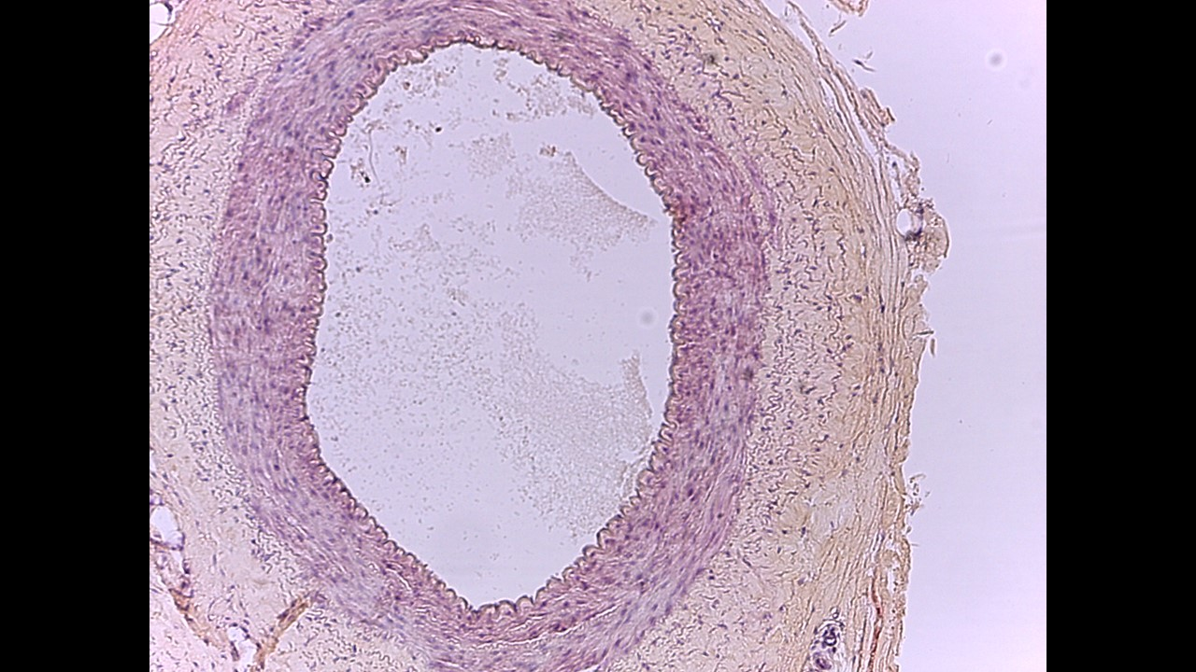

Slide 11
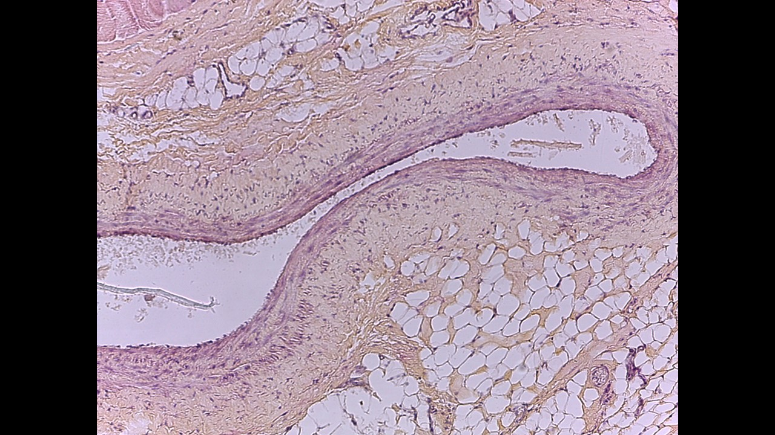

Slide 12
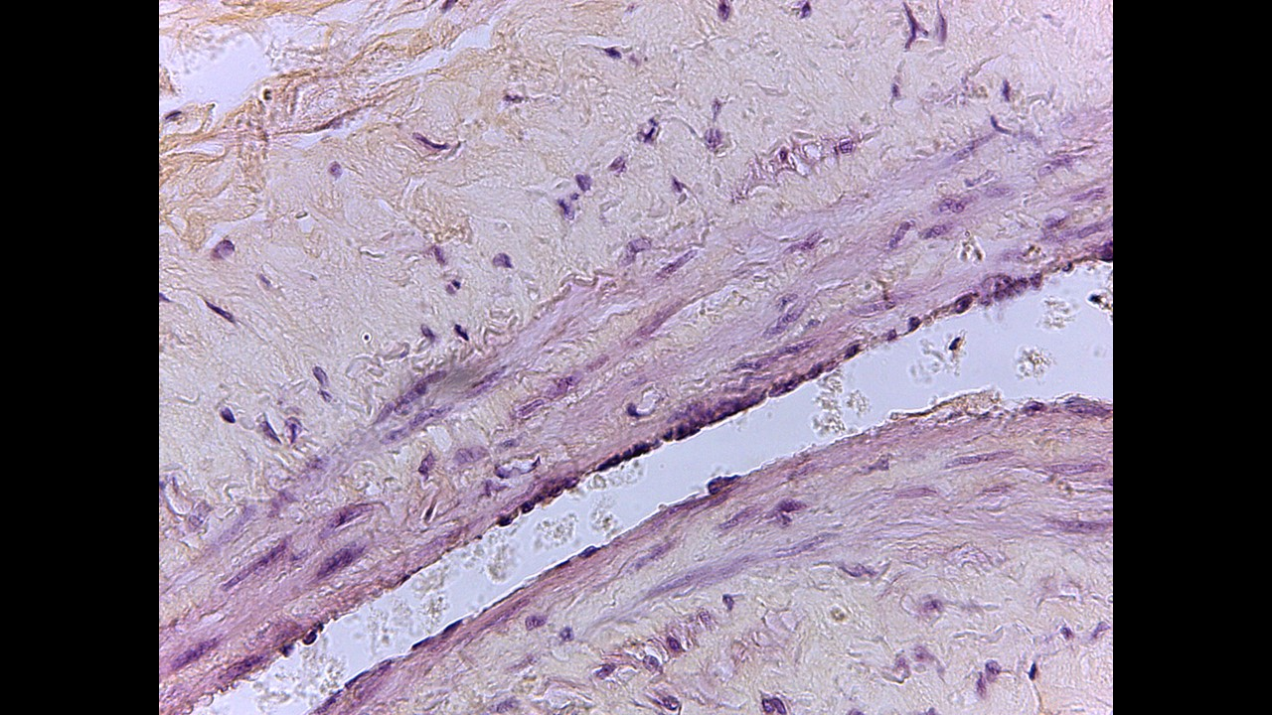

Slide 13
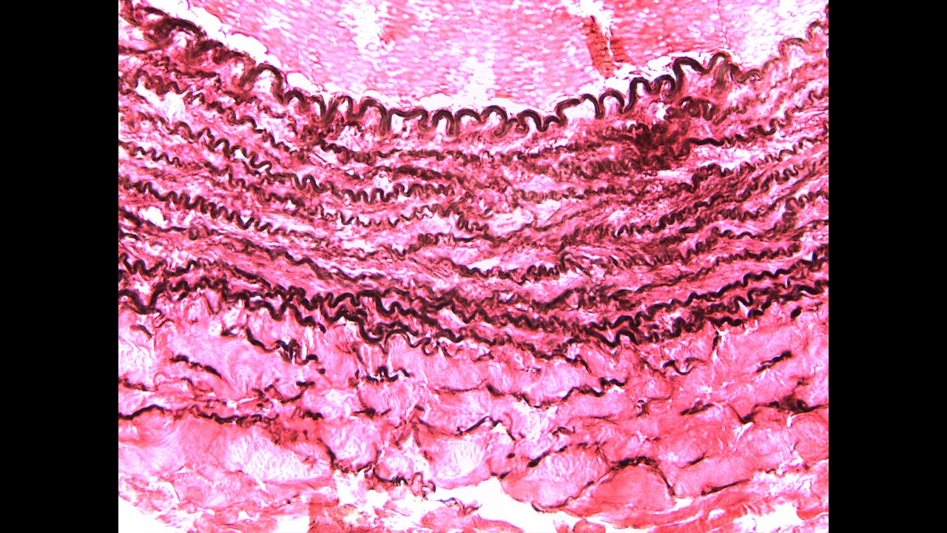

Slide 14
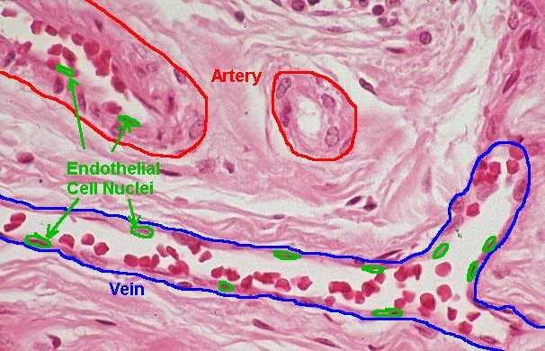

Slide 15
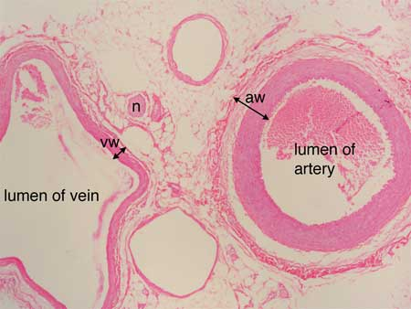

Slide 16
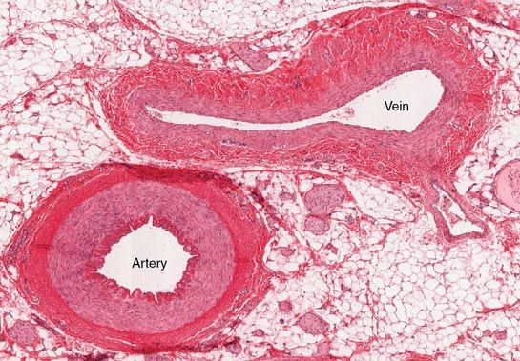

Slide 17
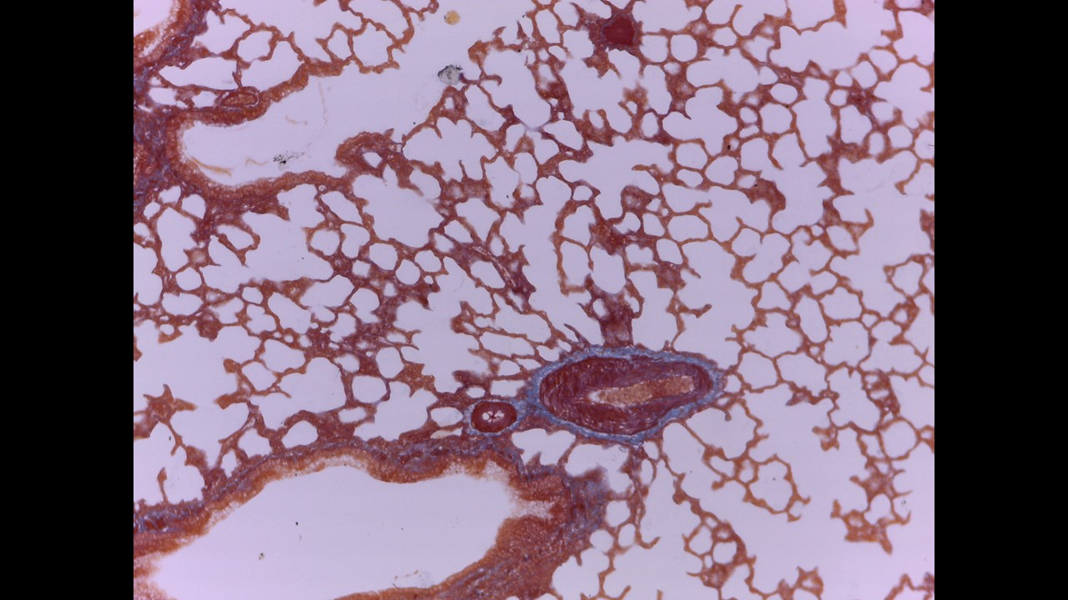

Slide 18
Simple Cuboidal Epithelium

Slide 19
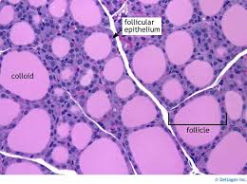

Slide 20
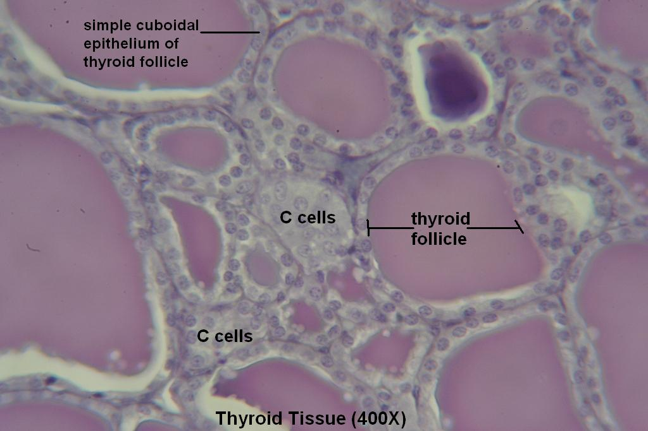

Slide 21
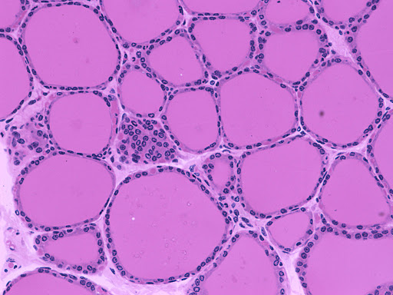

Slide 22
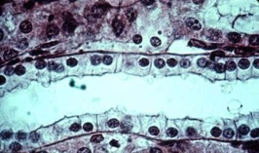

Slide 23
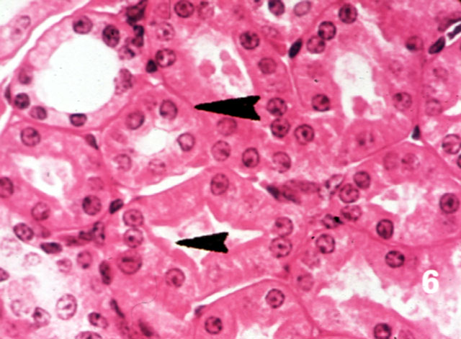

Slide 24
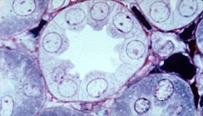

Slide 25
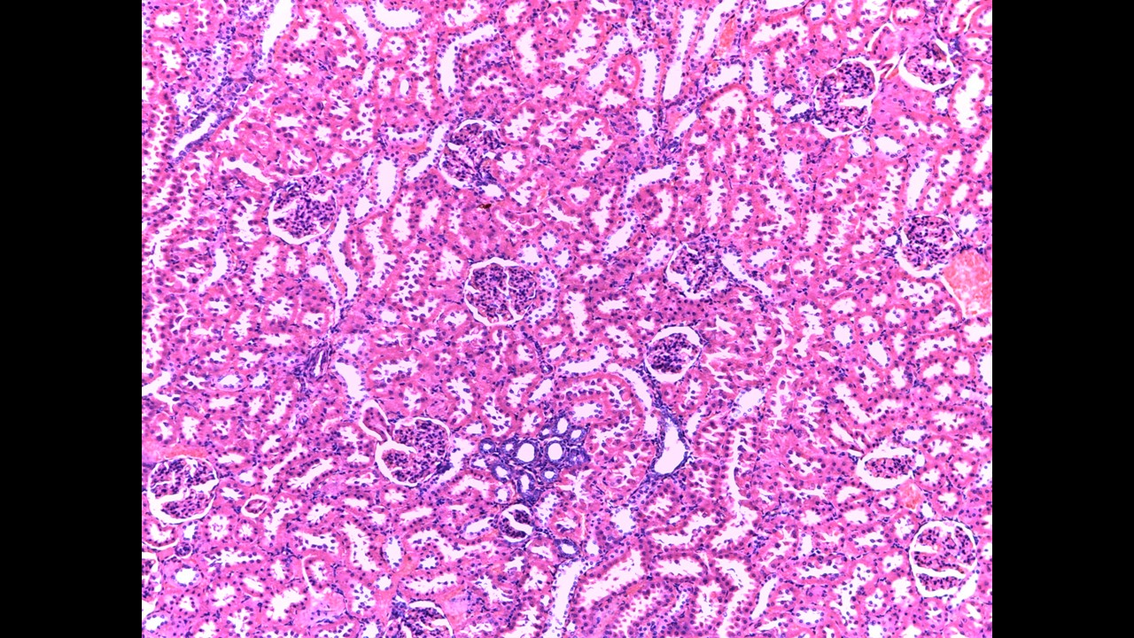
Kidney

Slide 26
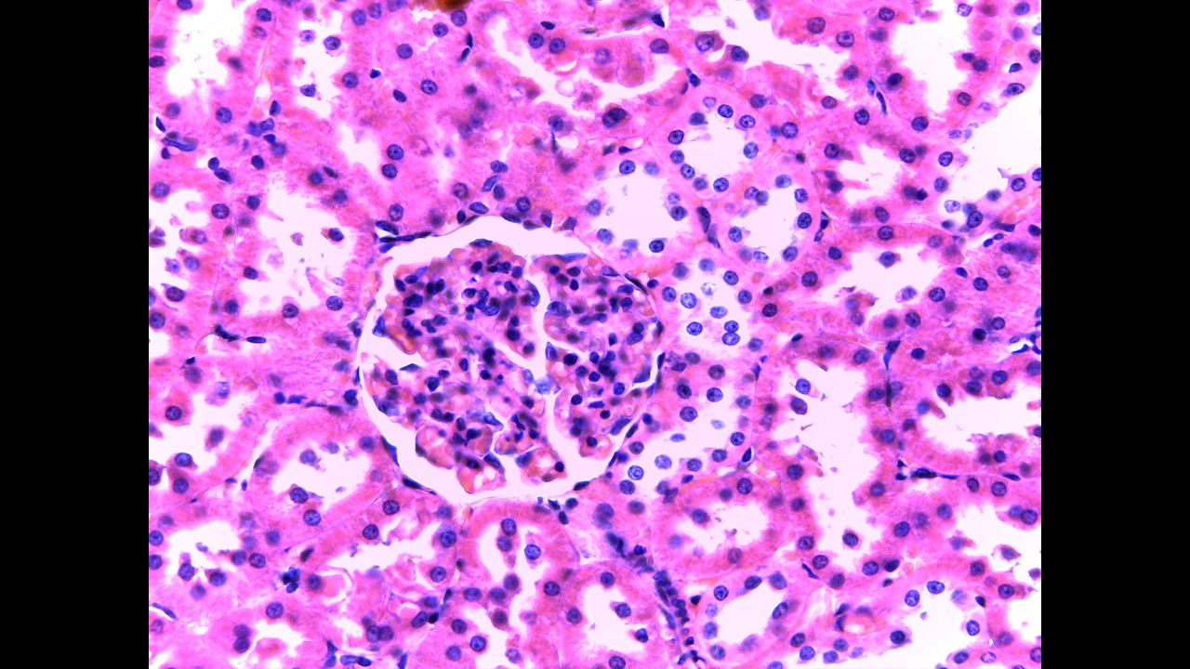

Slide 27
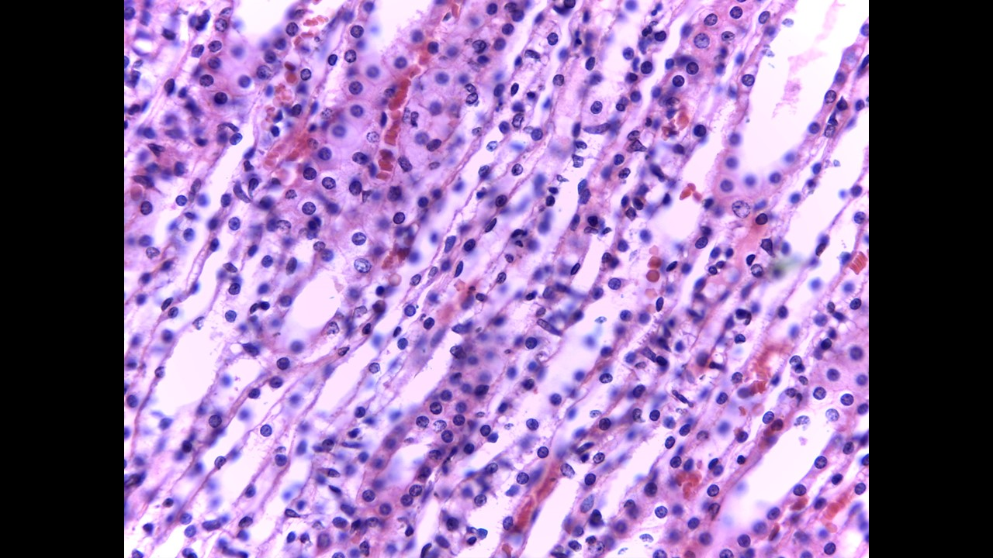

Slide 28
Simple Columnar Epithelium

Slide 29
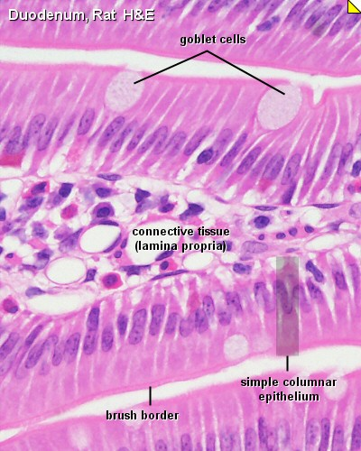

Slide 30
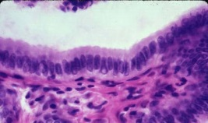

Slide 31
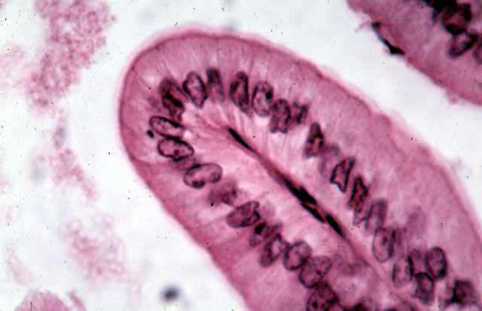

Slide 32
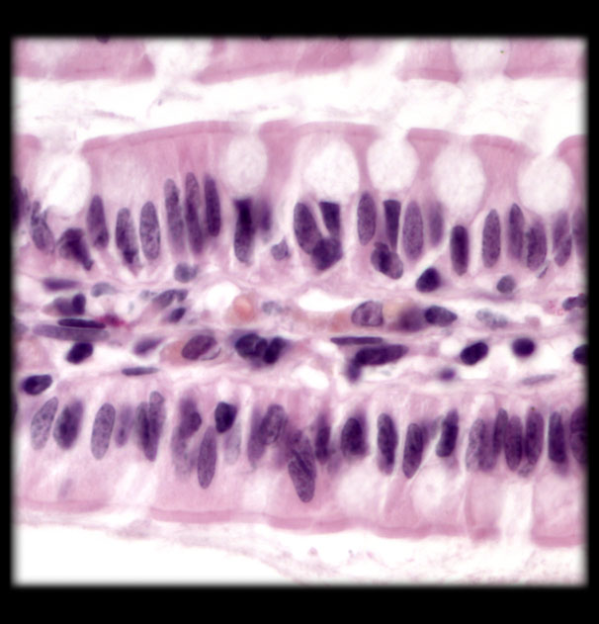

Slide 33
Stratified Epithelium

Slide 34
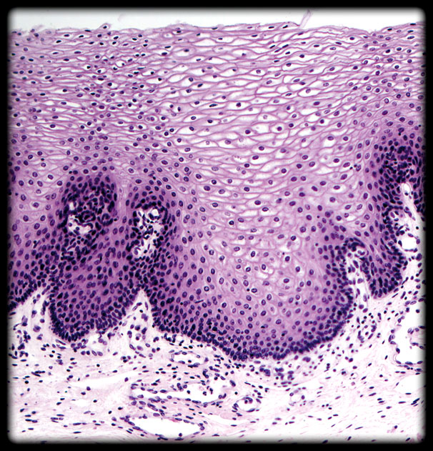

Slide 35
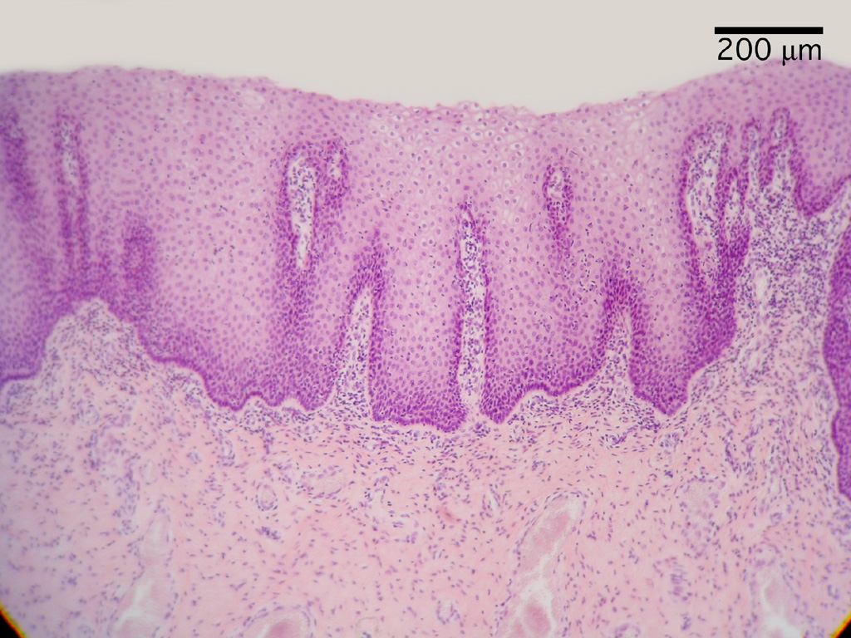

Slide 37
The Skin

Slide 38
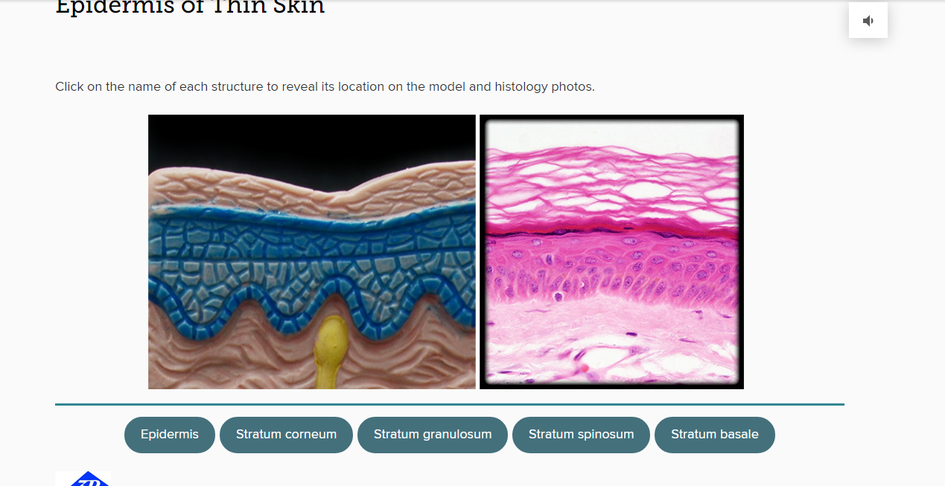

Slide 40
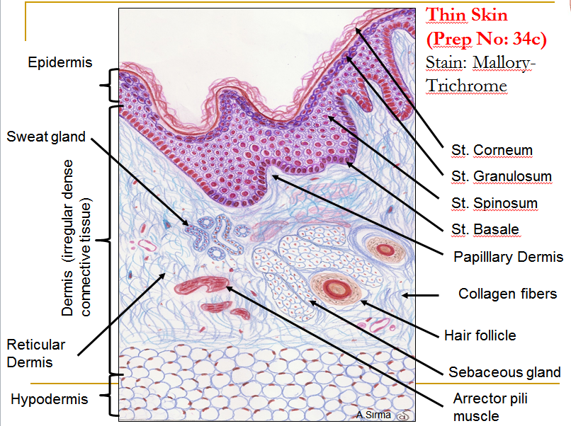

Slide 41
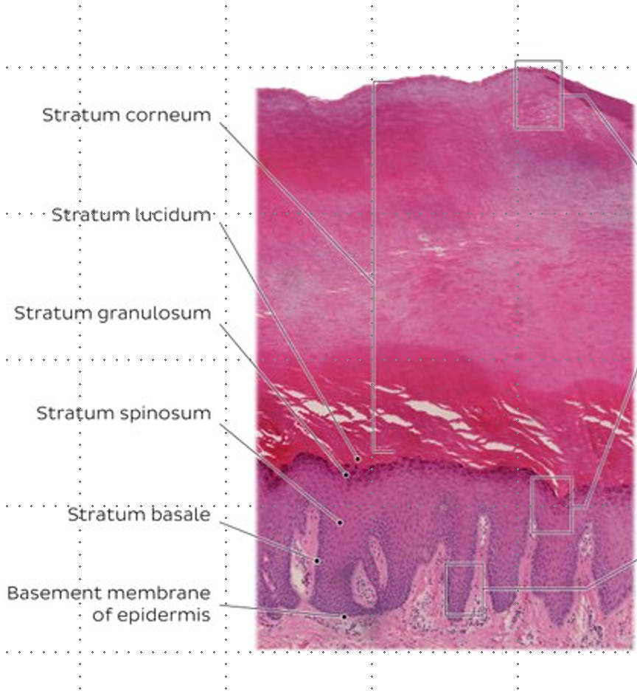

Slide 42
Pseudostratified Epithelium

Slide 43
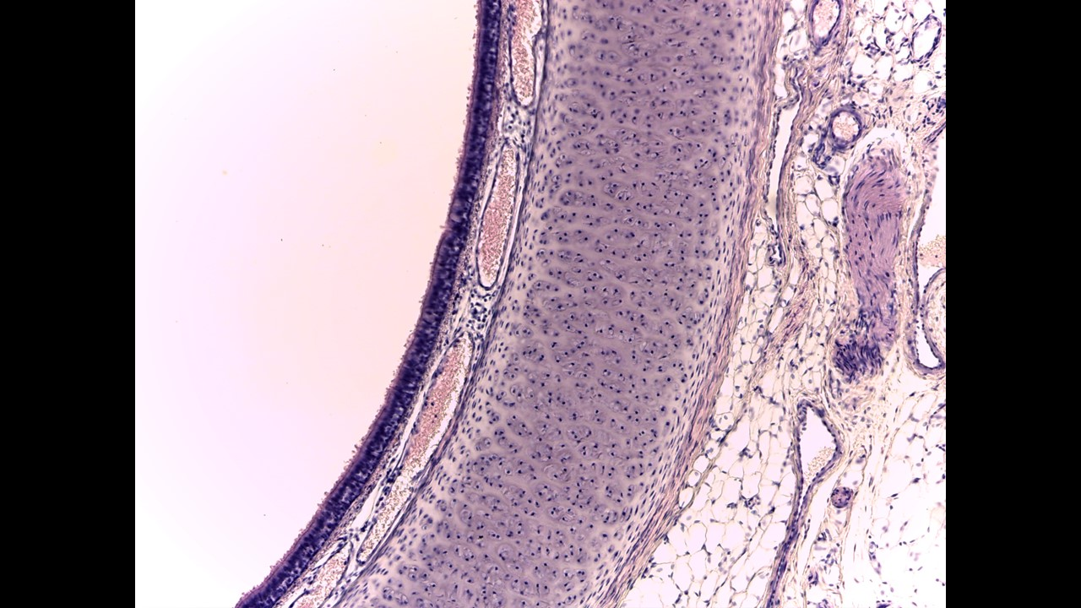

Slide 44
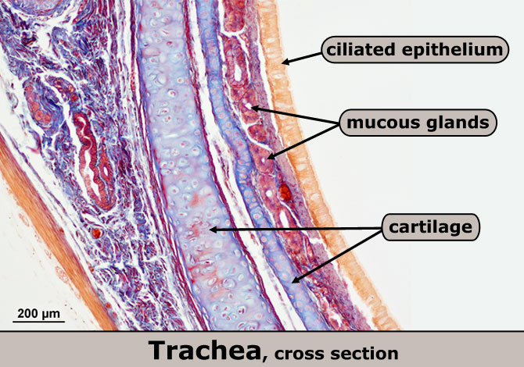

Slide 45
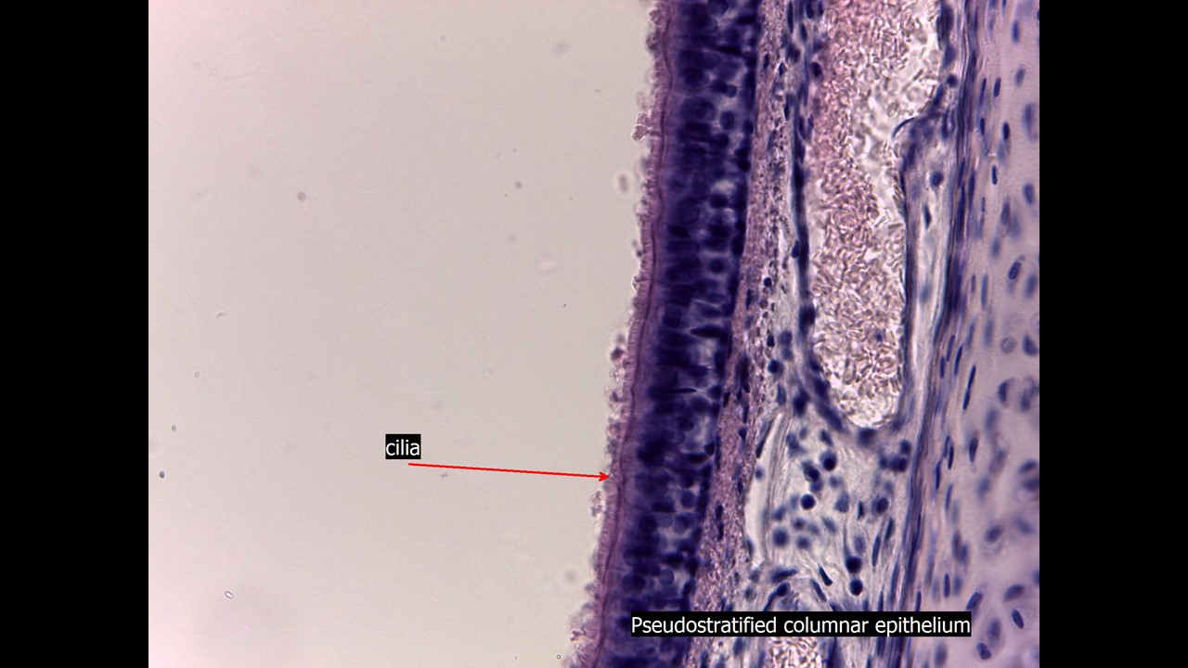

Slide 46
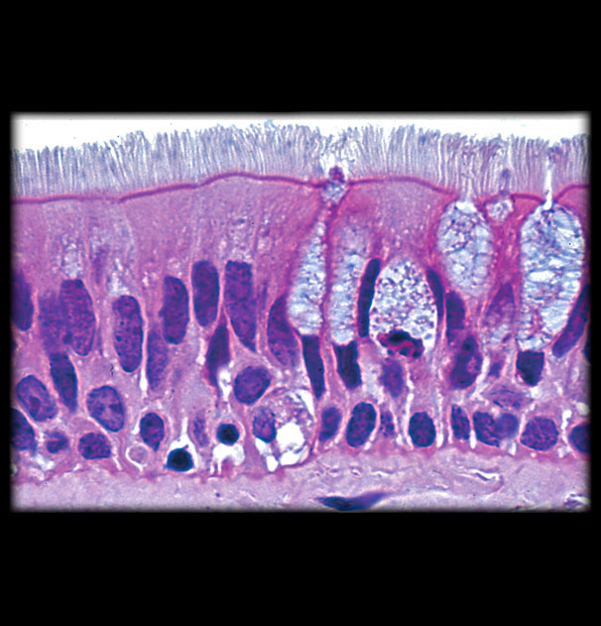

Slide 47
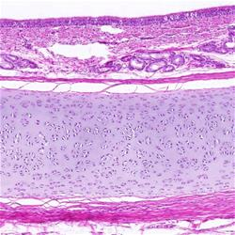

Slide 48
Connective tissue (CT)

Slide 49
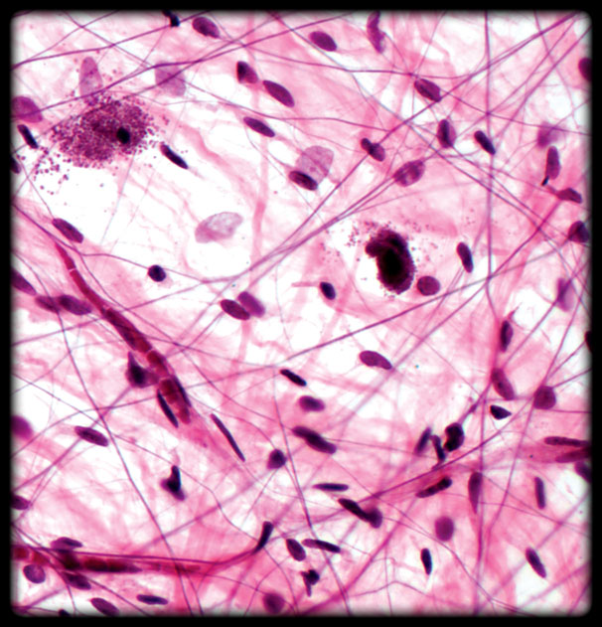
Loose Areolar Connective Tissue

Slide 50
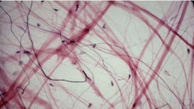
Loose Areolar Connective Tissue

Slide 51
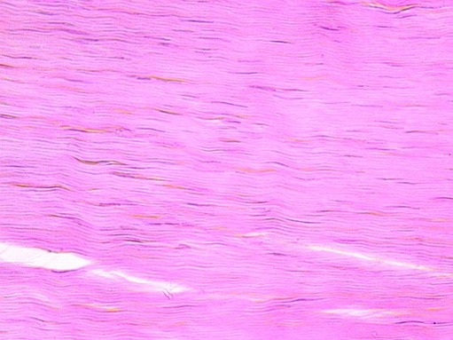
Dense regular CT (tendon)

Slide 52
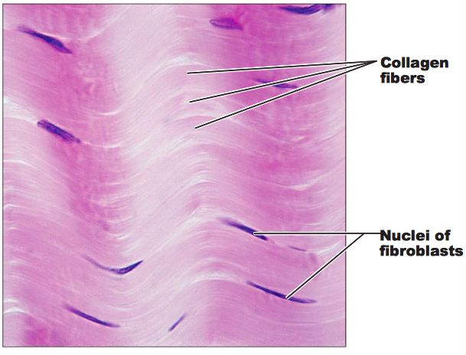
Dense regular CT (tendon)

Slide 53
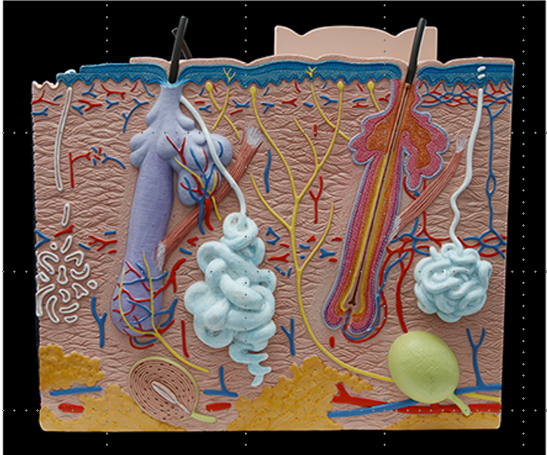
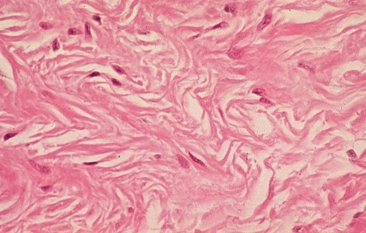
Dense irregular CT (dermis of the skin)

Slide 54
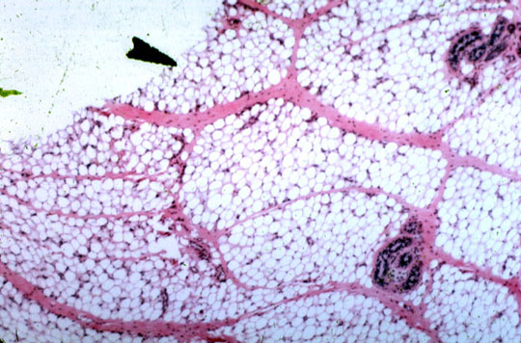
Adipose tissue

Slide 55
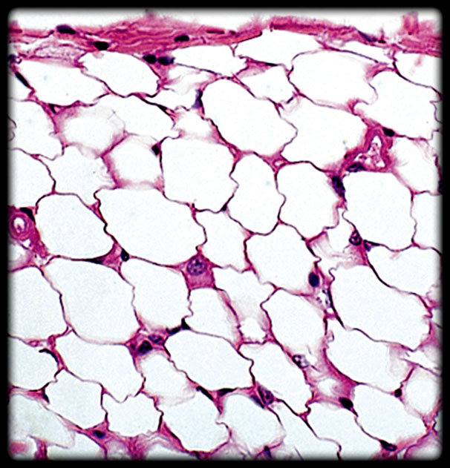
Adipose tissue

Slide 56
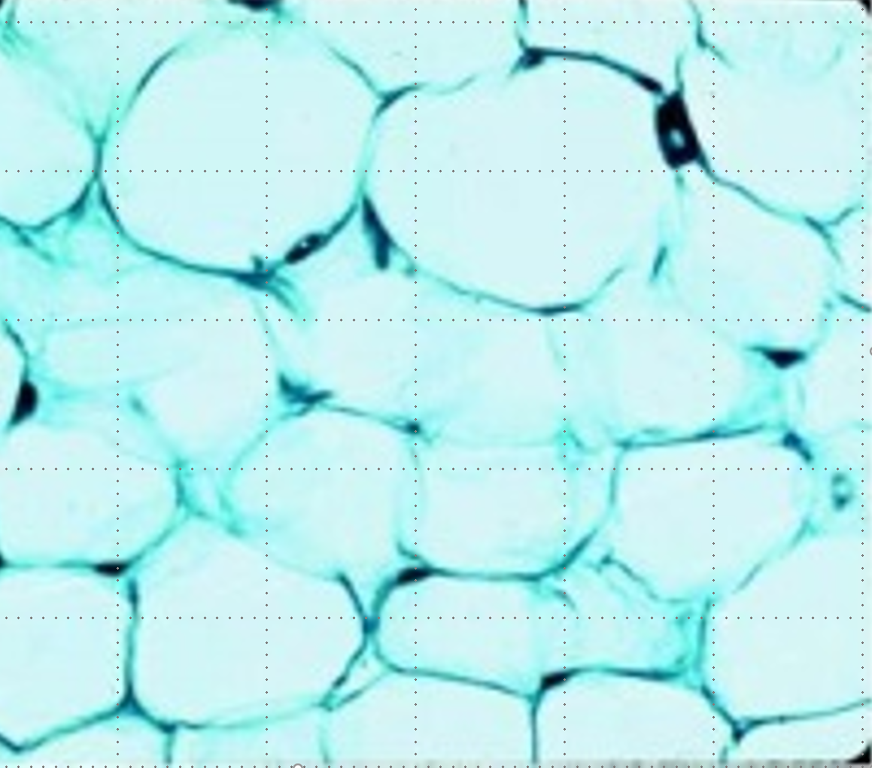

Slide 57
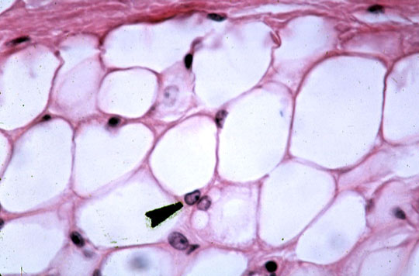

Slide 58
Specialize CT – bone

Slide 59
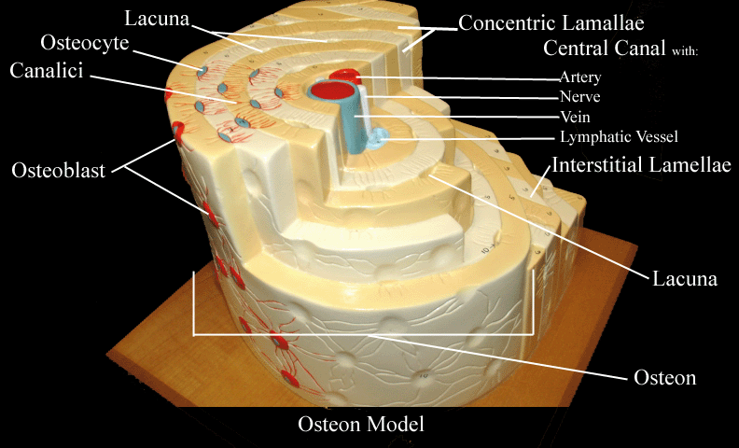

Slide 60
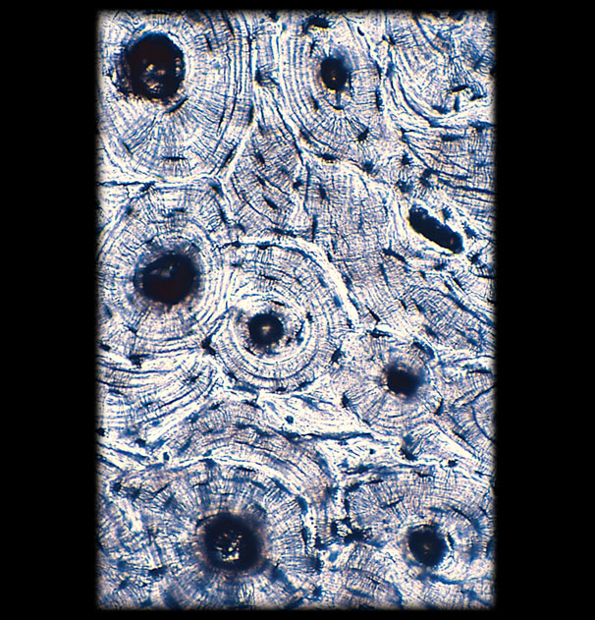
Specialized CT - bone

Slide 61
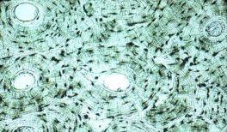

Slide 62
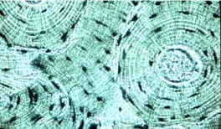

Slide 63
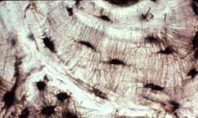

Slide 65
Specialize CT – blood

Slide 66
Blood

Slide 70
Specialize CT – cartilage

Slide 80
Muscle tissue

Slide 81
Skeletal Muscle tissue

Slide 84
Cardiac Muscle tissue

Slide 85
Intercalated disc

Slide 90
Smooth Muscle tissue

Slide 91
VS

Slide 92
Smooth muscle tissue
Hard to differentiate
From dense regular CT
Look at the periphery
Dense regular CT

Slide 94
Nerve tissue

Slide 96
How many neurons?

Slide 97
Axon vs dendrite

Slide 98
Axon vs dendrite

Slide 99
Soma

Slide 101
Nerve
A bundle of axons

