Slide 1
Stephen Marshak
ESSENTIALS OF
Geology
FIFTH EDITION
Chapter 1
The Earth in Context
©2016 W. W. Norton & Company, Inc.

Slide 2
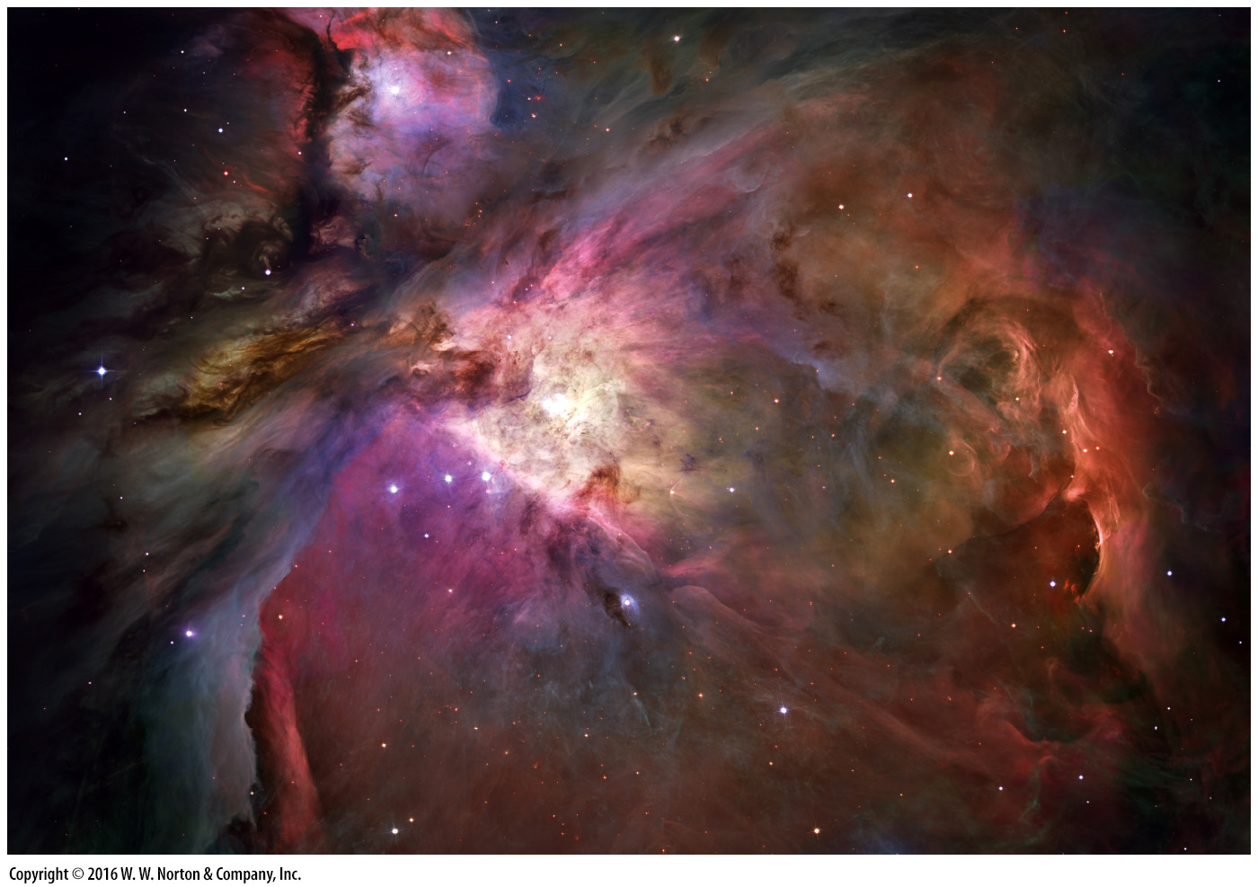
Notes:
The Hubble Space Telescope captured this image of the Orion Nebula, a cloud of gas and dust 24 light years across, in which new stars are forming.

Slide 3
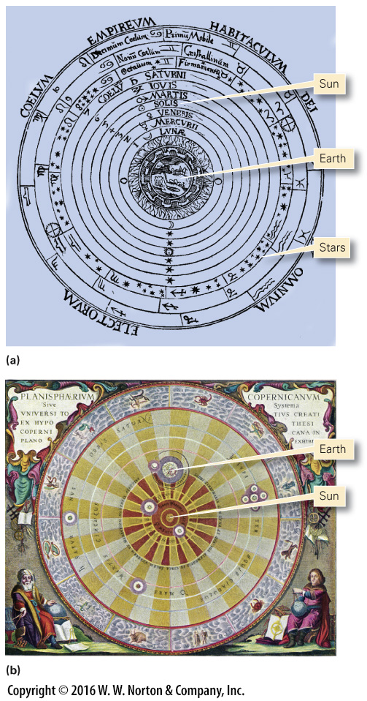
Notes:
FIGURE 1.1 Contrasting views of the Universe, as drawn by artists hundreds of years ago.

Slide 4
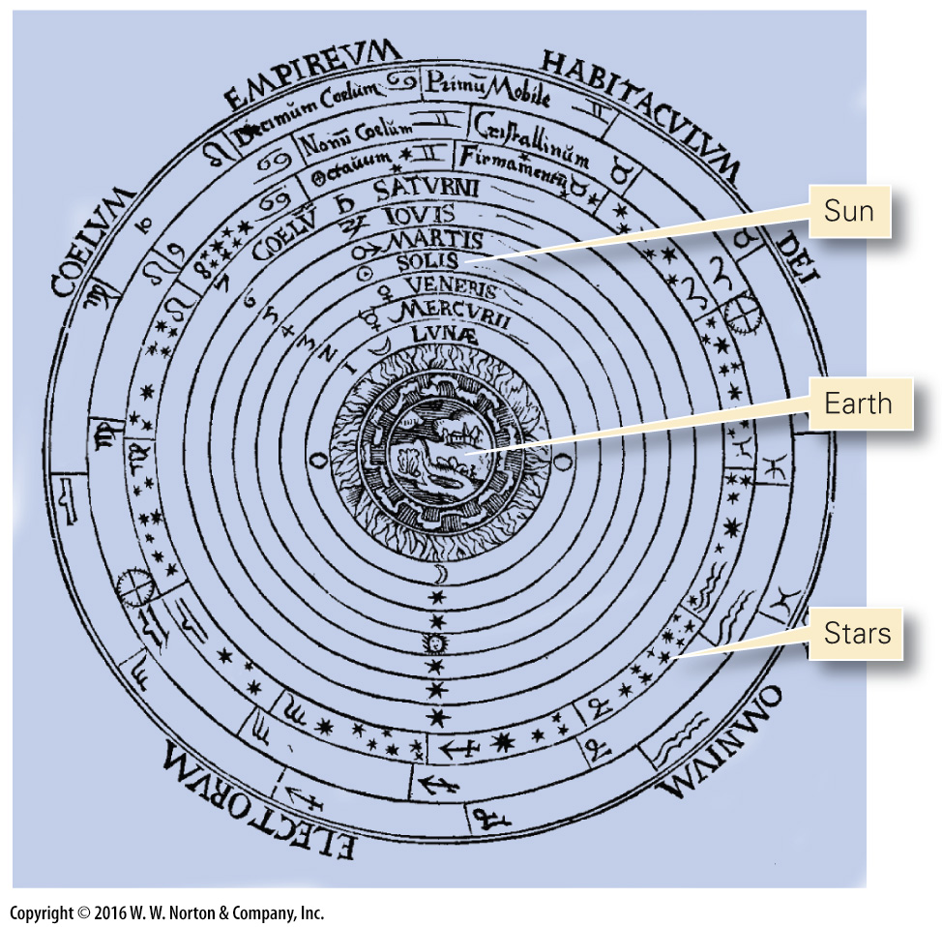
Notes:
FIGURE 1.1a Contrasting views of the Universe, as drawn by artists hundreds of years ago.

Slide 5
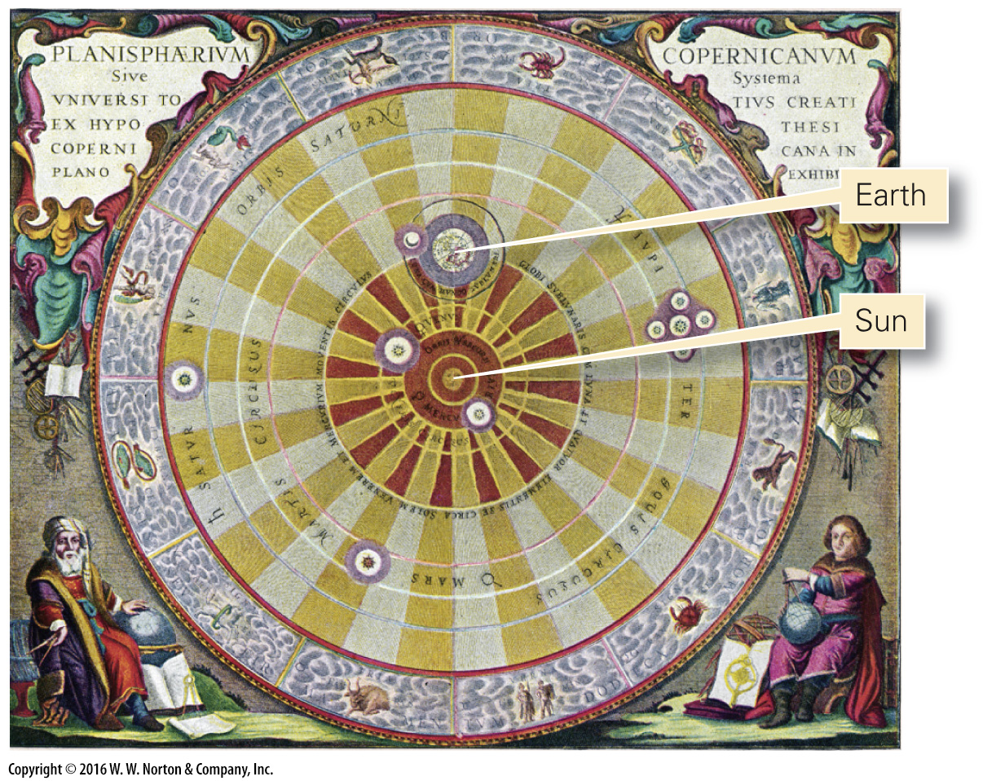
Notes:
FIGURE 1.1b Contrasting views of the Universe, as drawn by artists hundreds of years ago.

Slide 6
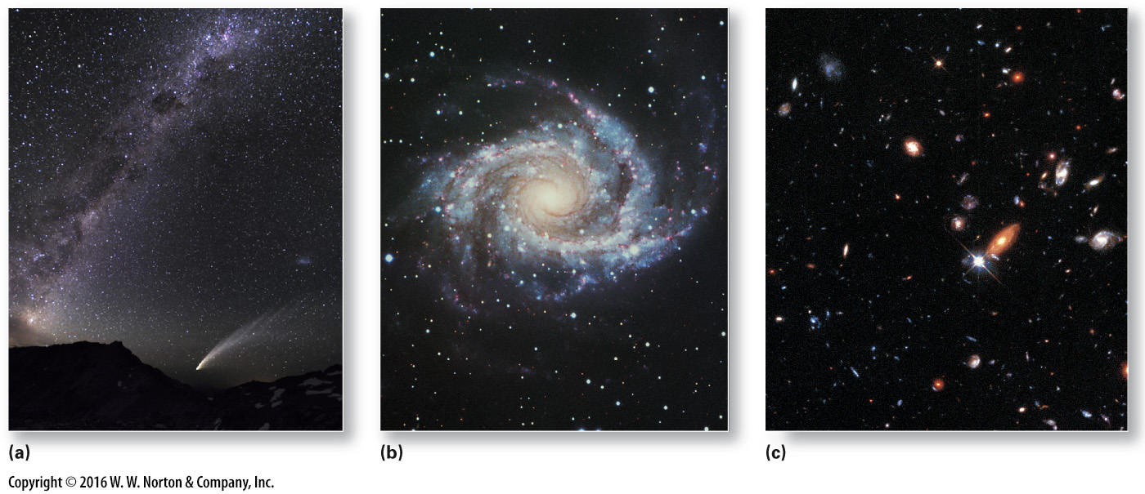
Notes:
FIGURE 1.2 A galaxy may contain about 300 billion stars.
(a) The Milky Way on a clear night. The “haze” actually consists of millions of faraway stars. (b) A spiral galaxy that looks like the Milky Way, as viewed from the top. (c) A Hubble Space Telescope view of deep space showing some of the billions of galaxies in the Universe.

Slide 7
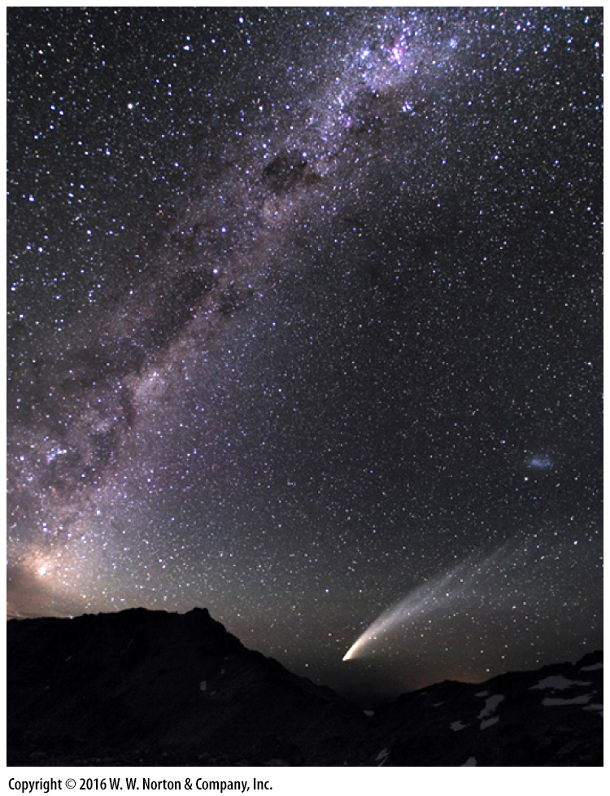
Notes:
FIGURE 1.2a A galaxy may contain about 300 billion stars.
(a) The Milky Way on a clear night. The “haze” actually consists of millions of faraway stars.

Slide 8
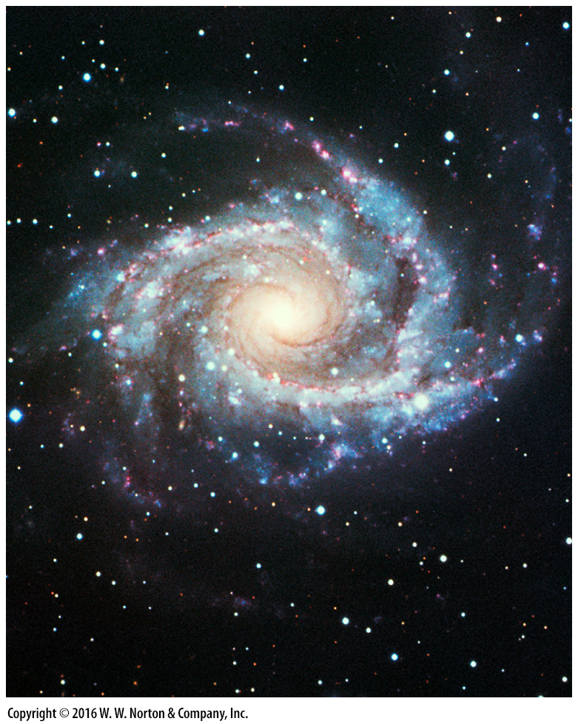
Notes:
FIGURE 1.2b A galaxy may contain about 300 billion stars.
(b) A spiral galaxy that looks like the Milky Way, as viewed from the top.

Slide 9
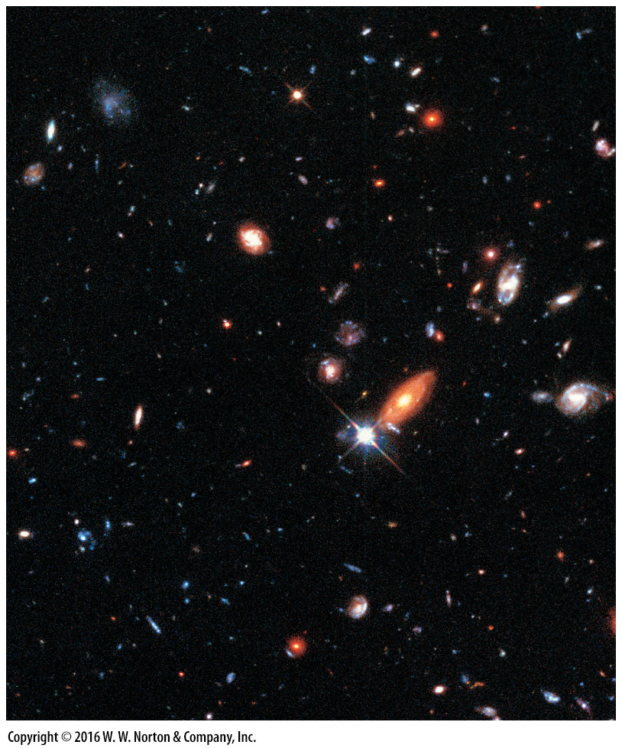
Notes:
FIGURE 1.2c A galaxy may contain about 300 billion stars.
(c) A Hubble Space Telescope view of deep space showing some of the billions of galaxies in the Universe.

Slide 10
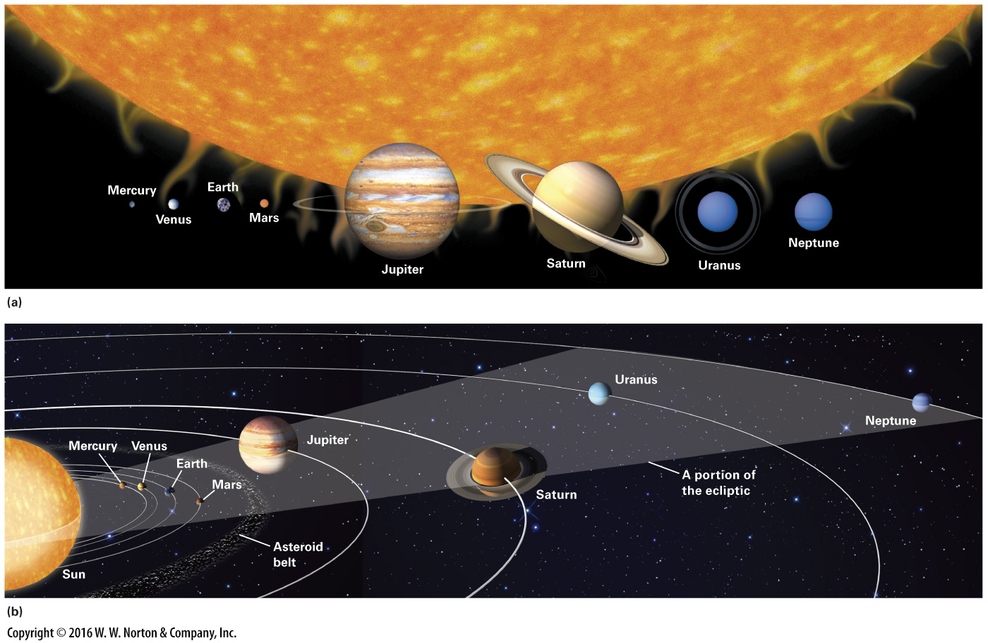
Notes:
FIGURE 1.3 The relative sizes and positions of planets in the Solar System.
(a) Relative sizes of the planets. All are much smaller than the Sun, but the gas-giant planets are much larger than the terrestrial planets. Jupiter’s diameter is about 11.2 times greater than that of Earth. (b) Relative positions of the planets. This figure is not to scale. If the Sun in this figure were the size of a large orange, the Earth would be the size of a sesame seed 15 meters (49 feet) away. Note that all planetary orbits lie roughly in the same plane, called the ecliptic.

Slide 11
Notes:
FIGURE 1.3a The relative sizes and positions of planets in the Solar System.
(a) Relative sizes of the planets. All are much smaller than the Sun, but the gas-giant planets are much larger than the terrestrial planets. Jupiter’s diameter is about 11.2 times greater than that of Earth.

Slide 12
Notes:
FIGURE 1.3b The relative sizes and positions of planets in the Solar System.
(b) Relative positions of the planets. This figure is not to scale. If the Sun in this figure were the size of a large orange, the Earth would be the size of a sesame seed 15 meters (49 feet) away. Note that all planetary orbits lie roughly in the same plane, called the ecliptic.

Slide 13
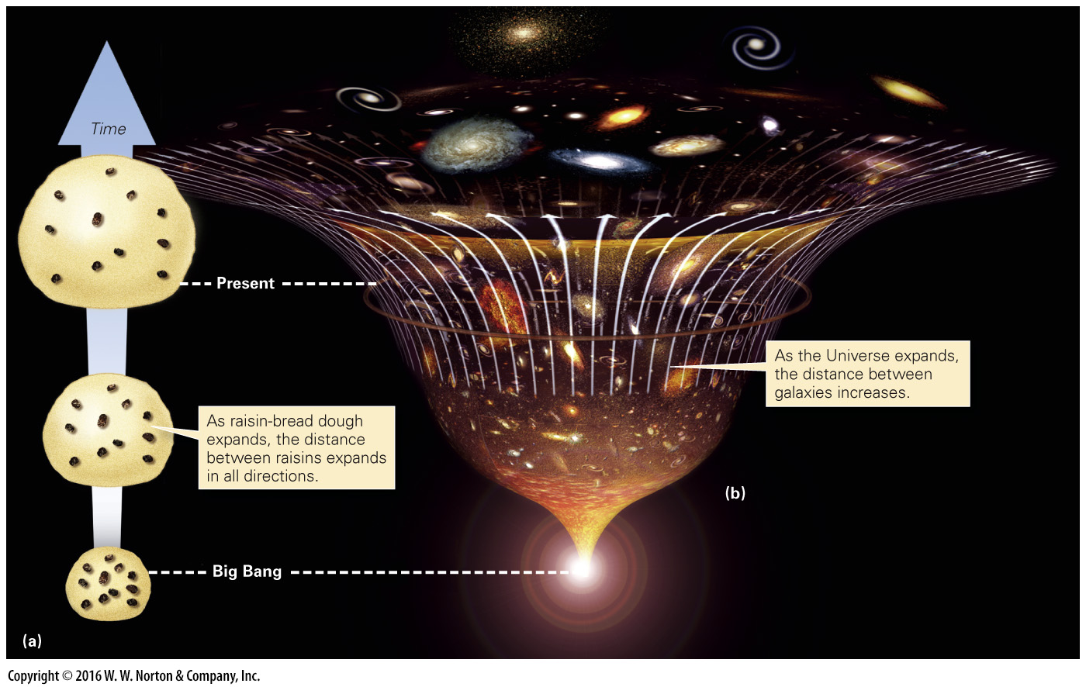
Notes:
FIGURE 1.4 The concept of the expanding Universe and the Big Bang.

Slide 14
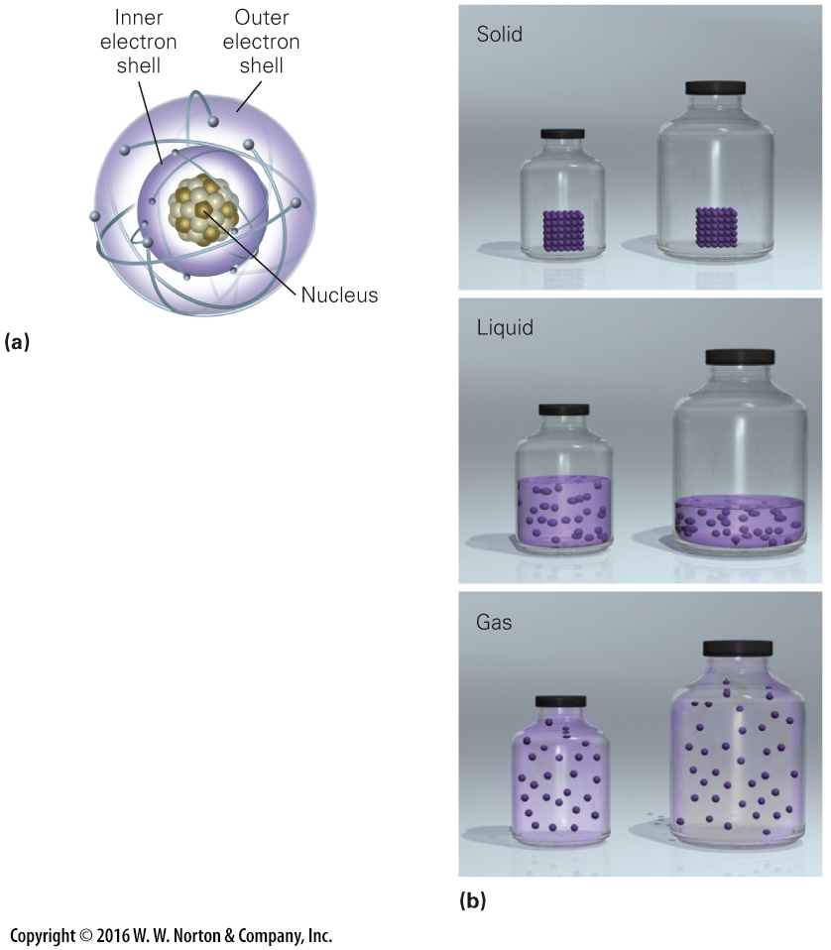
Notes:
FIGURE Bx1.1 The nature of atoms and matter.
(a) An image of an atom with a nucleus orbited by electrons. (b) The three common states of matter. Solids keep their shape, liquids conform to the shape of their container without changing density, and gases expand to fill their container.

Slide 15
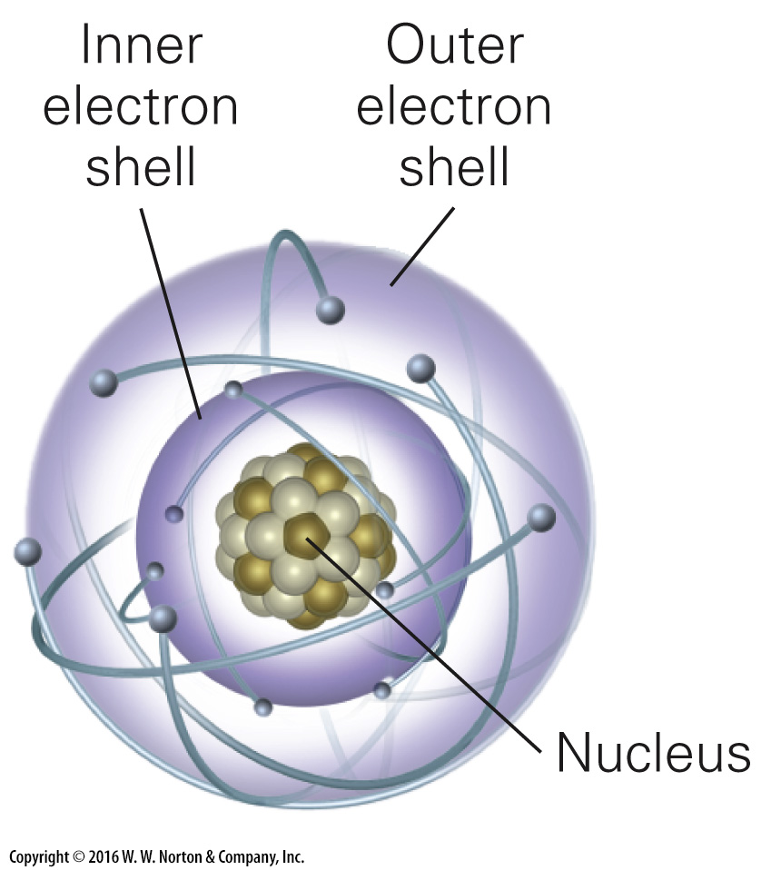
Notes:
FIGURE Bx1.1a The nature of atoms and matter.
(a) An image of an atom with a nucleus orbited by electrons.

Slide 16
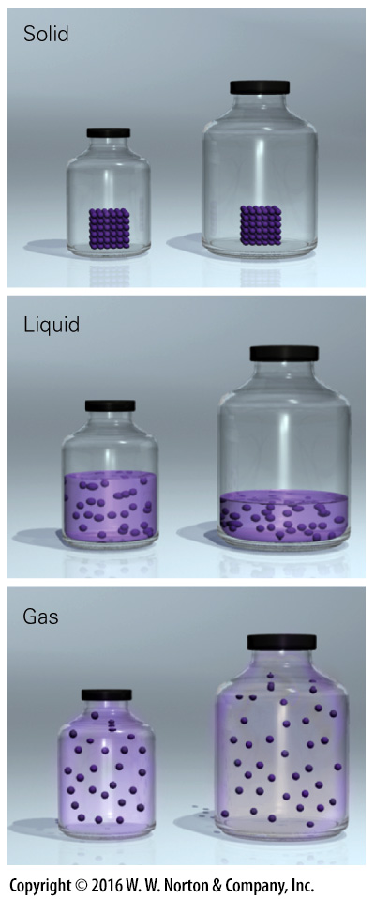
Notes:
FIGURE Bx1.1b The nature of atoms and matter.
(b) The three common states of matter. Solids keep their shape, liquids conform to the shape of their container without changing density, and gases expand to fill their container.

Slide 17
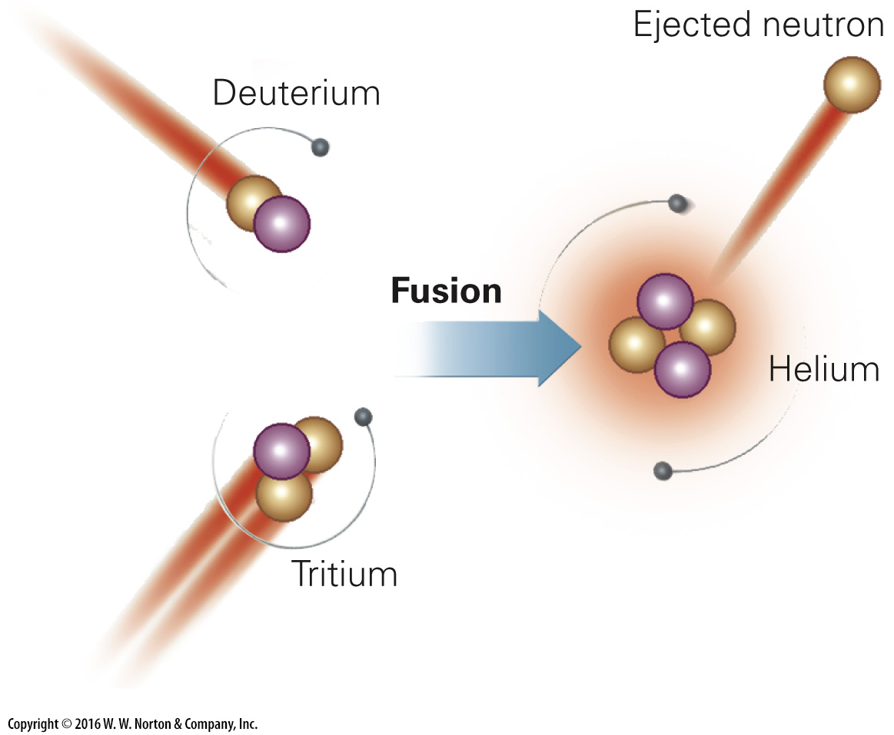
Notes:
FIGURE 1.5 Fusion happens when colliding particles fuse to form a new, larger nucleus. Deuterium and tritium are versions of hydrogen in which a proton fused to one or two neutrons, respectively. These nuclei, in turn, can collide to form a helium nucleus.

Slide 18
Notes:
FIGURE 1.6 Nebular theory for planet formation.

Slide 19
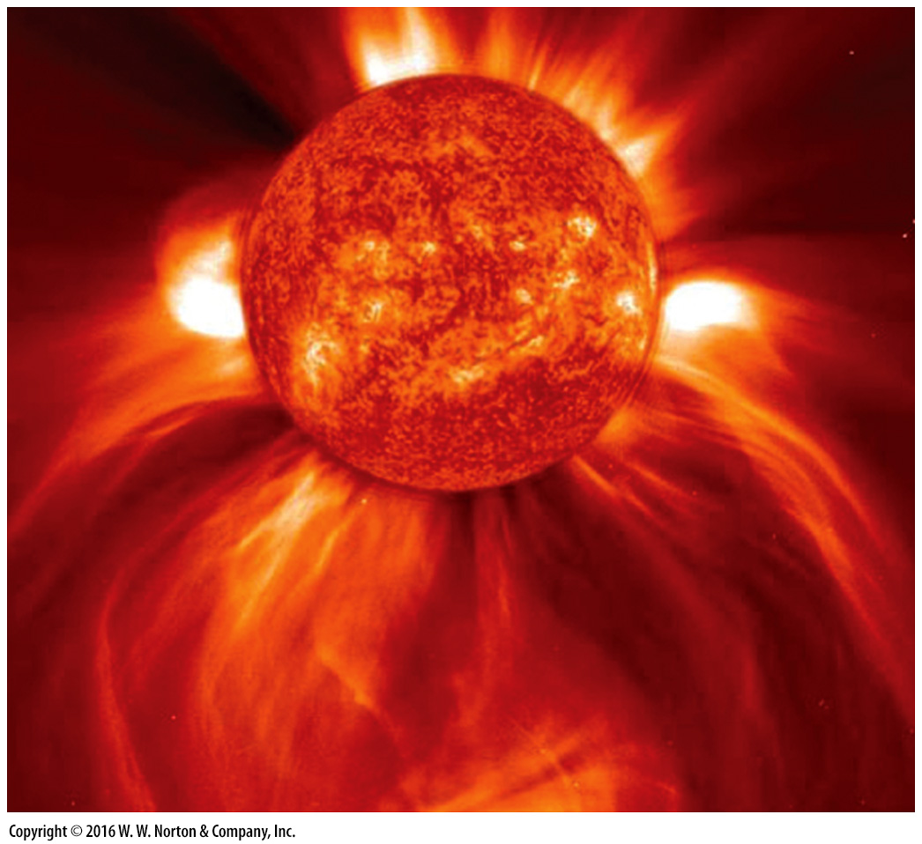
Notes:
FIGURE 1.7a Element factories in space.
(a) A photo of solar (stellar) wind streaming into space.

Slide 20
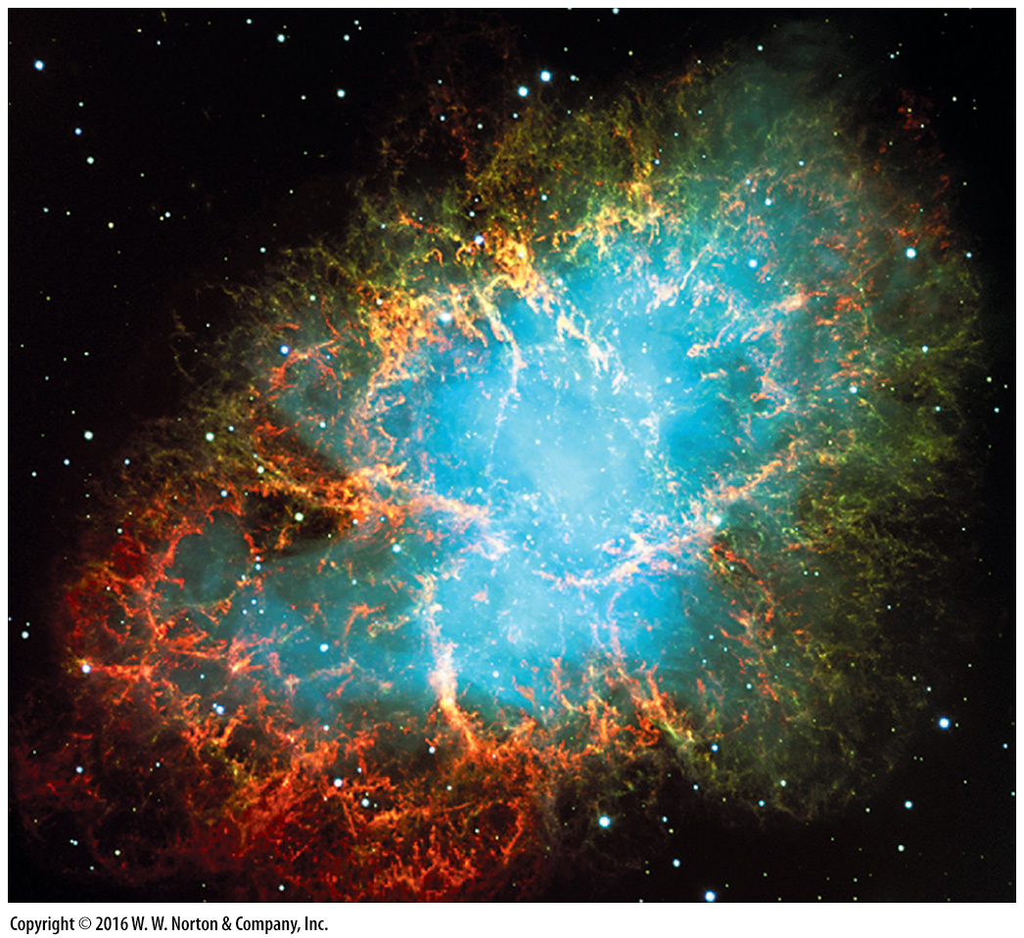
Notes:
FIGURE 1.7b Element factories in space.
(b) This expanding cloud of gas, ejected into space from a supernova explosion whose light reached the Earth in 1054 C.E., is called the Crab Nebula.

Slide 21
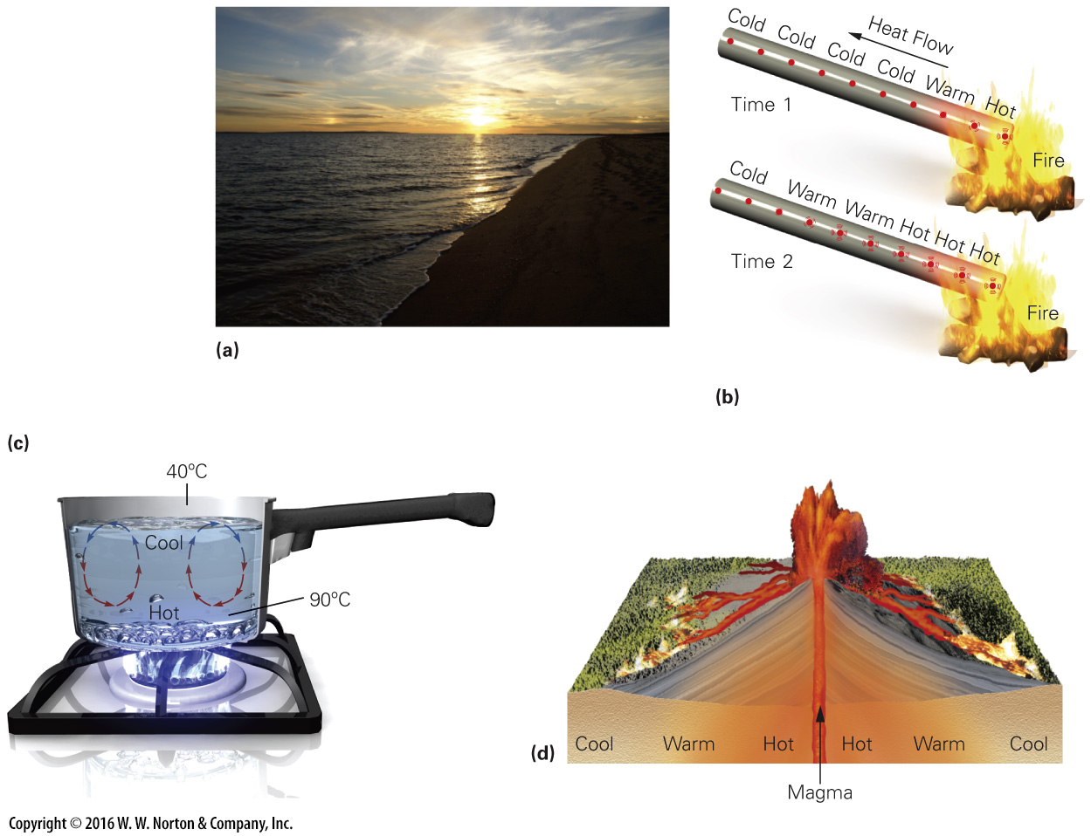
Notes:
FIGURE Bx1.2 The four processes of heat transfer.
(a) Radiation from sunlight warms the Earth. (b) Conduction occurs when you heat the end of an iron bar in a flame. Heat flows from the hot region toward the cold region as vibrating atoms cause their neighbors to vibrate. (c) Convection takes place when moving fluid carries heat with it. Hot fluid rises while cool fluid sinks, setting up a convection cell. (d) During advection, a hot liquid (such as molten rock) rises into cooler material, and heat then conducts from the hot liquid into the cooler material.

Slide 22
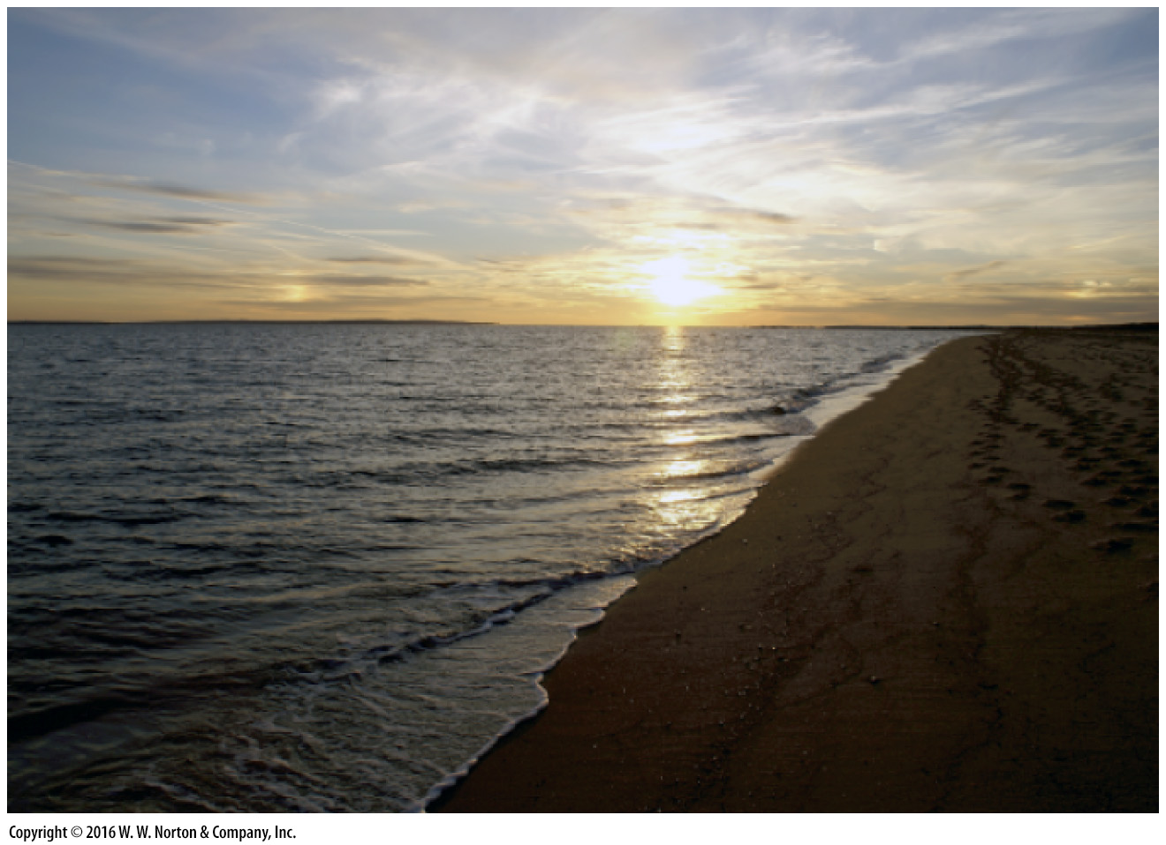
Notes:
FIGURE Bx1.2a The four processes of heat transfer.
(a) Radiation from sunlight warms the Earth.

Slide 23
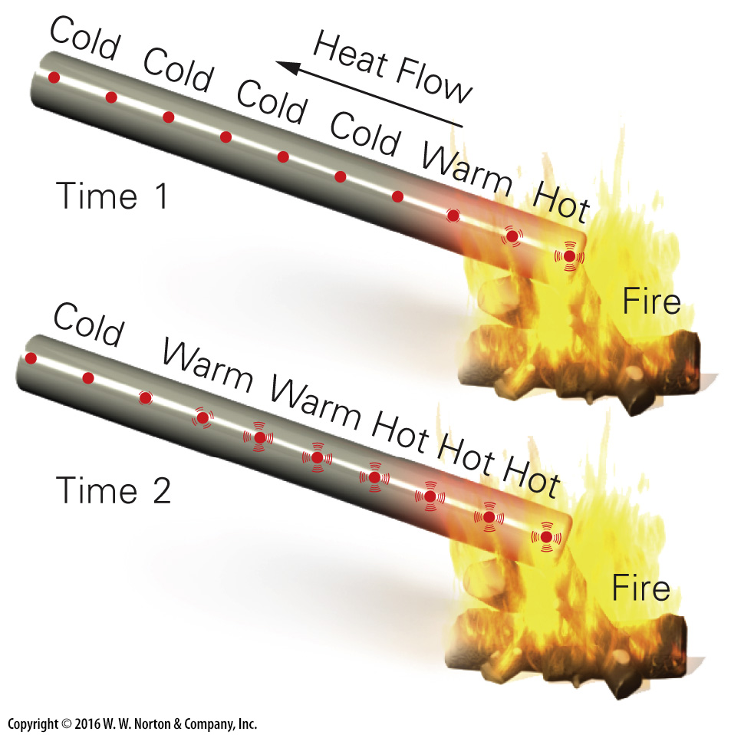
Notes:
FIGURE Bx1.2b The four processes of heat transfer.
(b) Conduction occurs when you heat the end of an iron bar in a flame. Heat flows from the hot region toward the cold region as vibrating atoms cause their neighbors to vibrate.

Slide 24
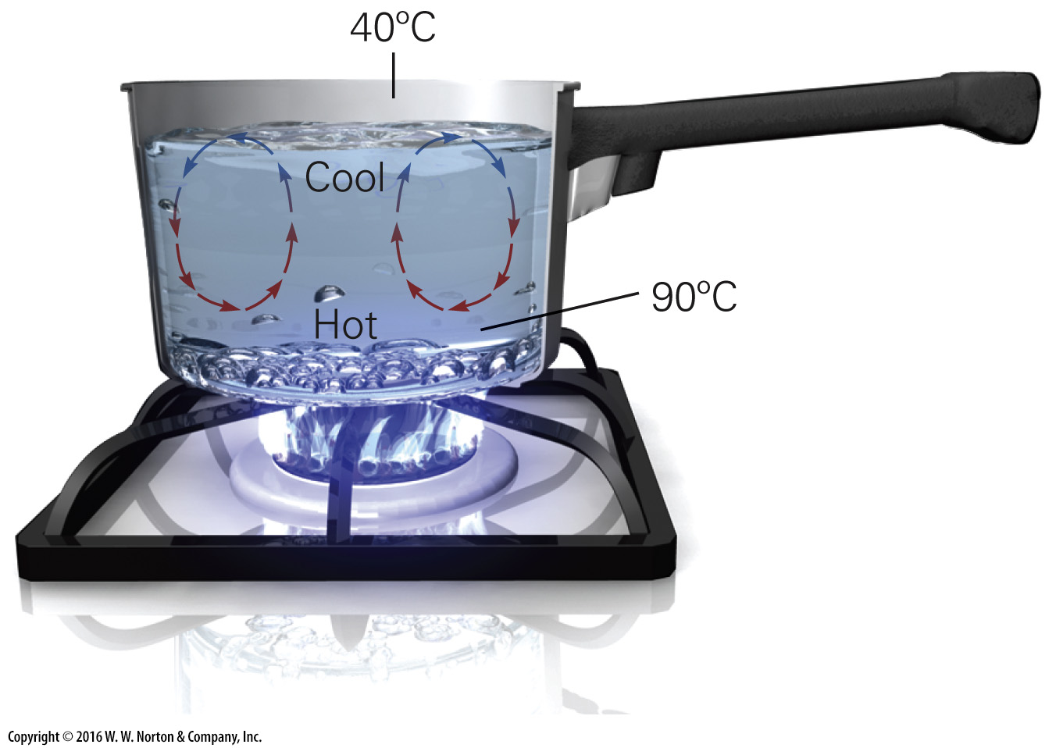
Notes:
FIGURE Bx1.2c The four processes of heat transfer.
(c) Convection takes place when moving fluid carries heat with it. Hot fluid rises while cool fluid sinks, setting up a convection cell.

Slide 25
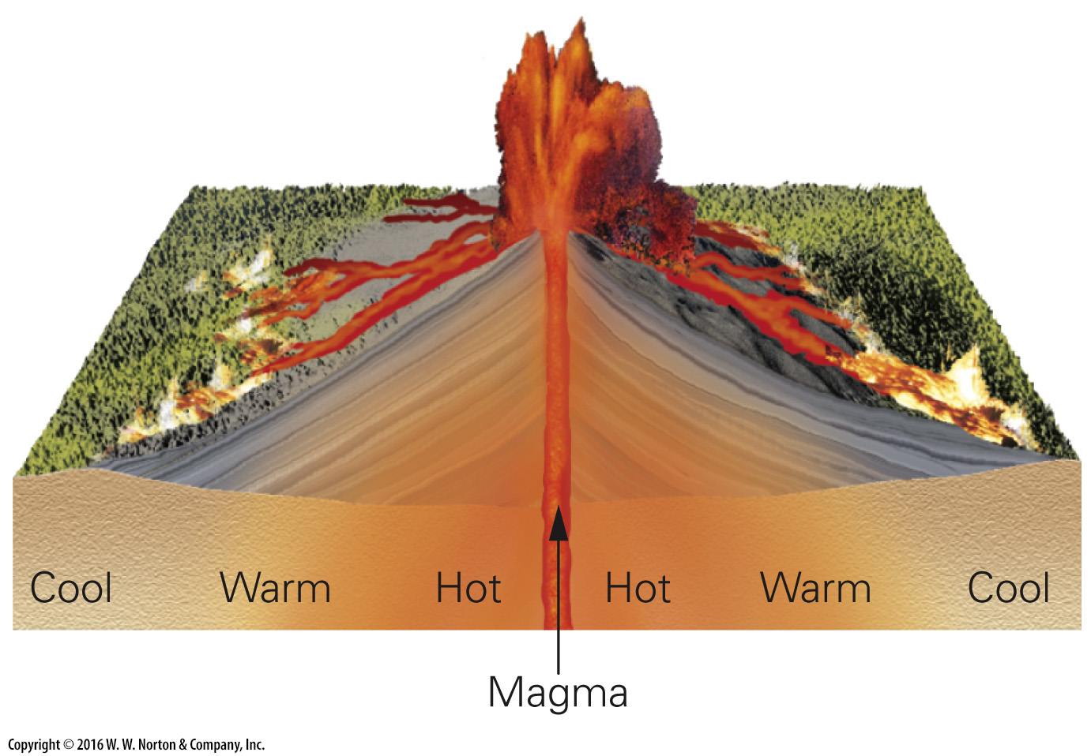
Notes:
FIGURE Bx1.2d The four processes of heat transfer.
(d) During advection, a hot liquid (such as molten rock) rises into cooler material, and heat then conducts from the hot liquid into the cooler material.

Slide 26
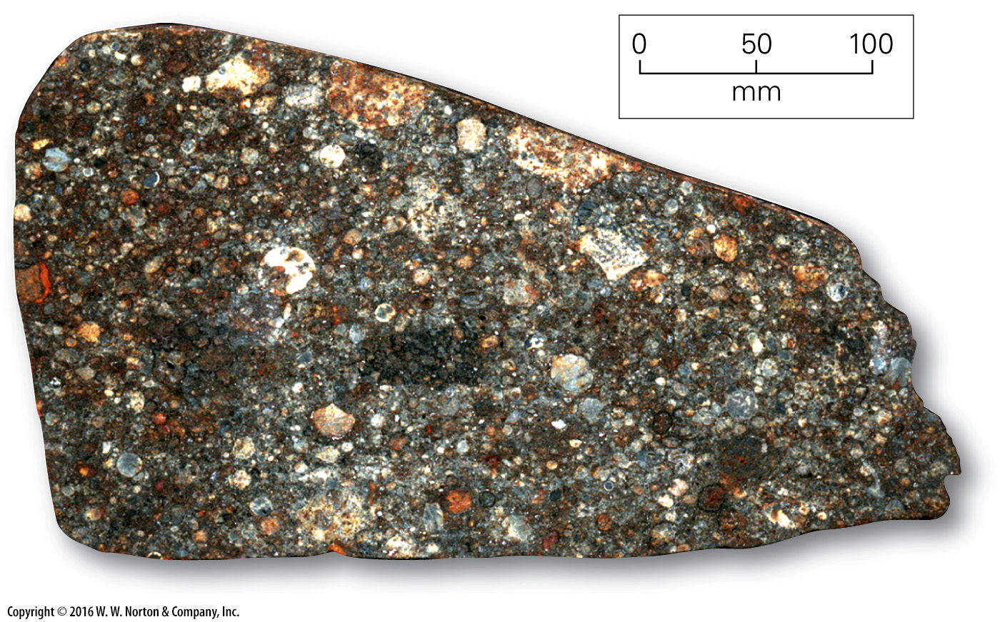
Notes:
FIGURE 1.8 The grainy texture of this meteorite fragment may resemble the texture of a small planetesimal.

Slide 27
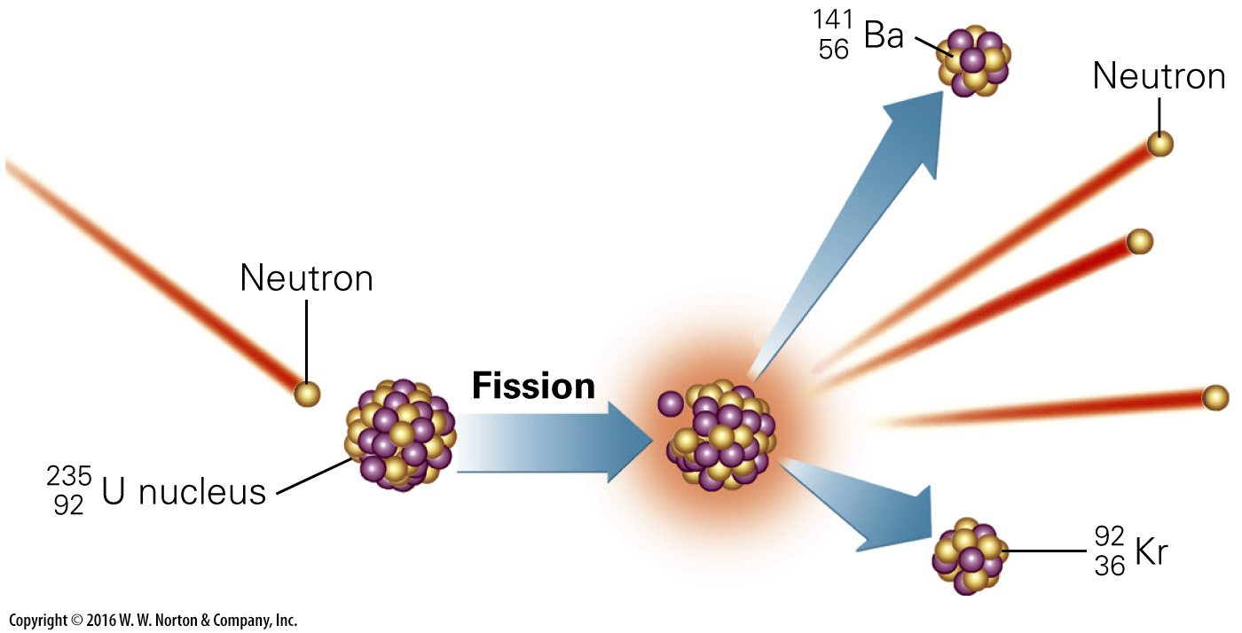
Notes:
FIGURE 1.9 During nuclear fission, a uranium atom splits to form two smaller atoms. The process releases neutrons.

Slide 28
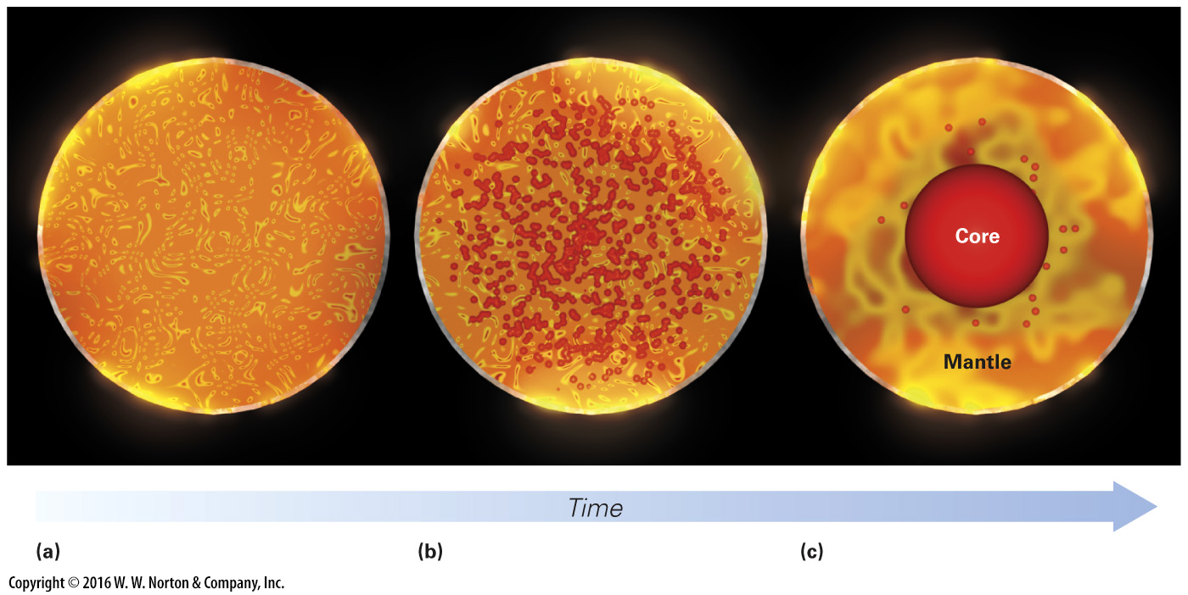
Notes:
FIGURE 1.10 Differentiation of the Earth’s interior.
(a) Early on, the Earth was fairly homogeneous inside. (b) When the temperature got hot enough, iron began to melt. (c) The iron accumulated at the center of the planet to form a metallic core.

Slide 29
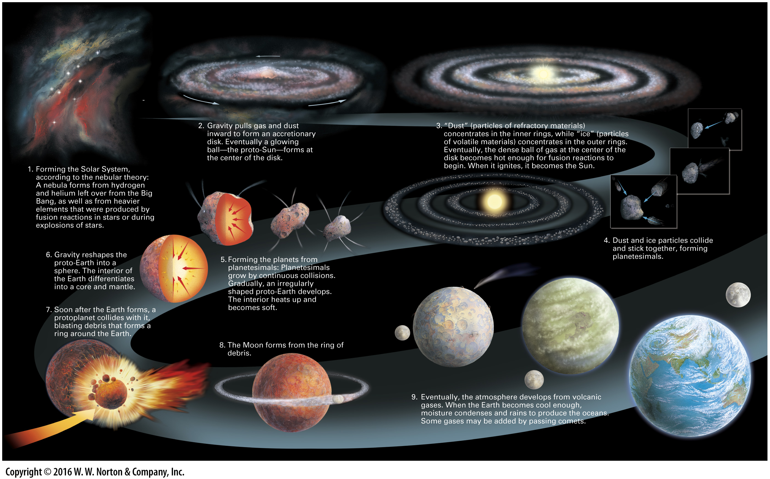
Notes:
GEOLOGY AT A GLANCE: Forming the Planets and the Earth-Moon System

Slide 30
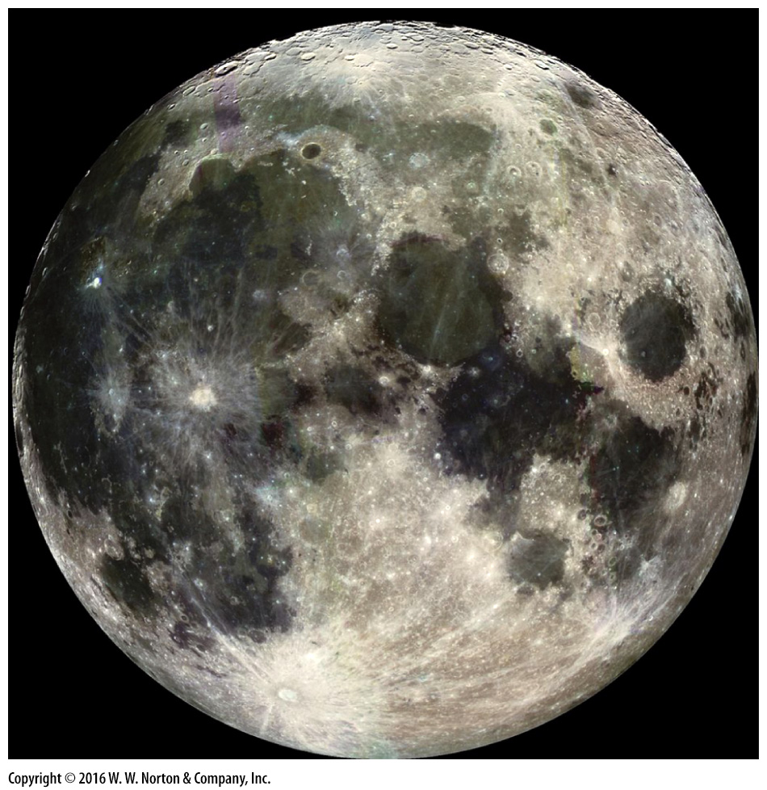
Notes:
FIGURE 1.11 The Earth‘s moon has distinct maria (dark areas), and lighter-colored, intensively cratered highlands.

Slide 31
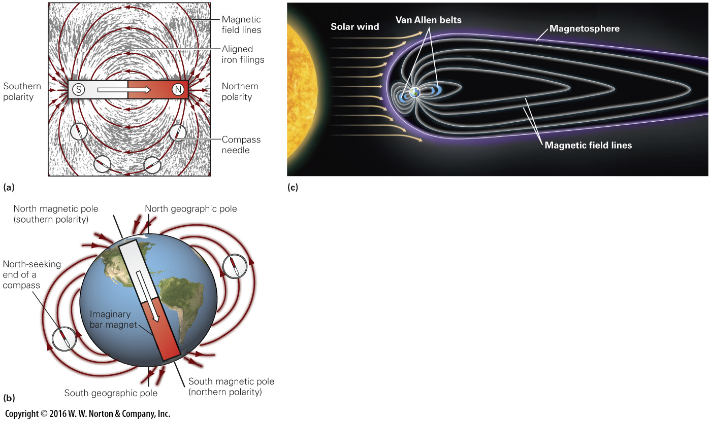
Notes:
FIGURE 1.12 A magnetic field permeates the space around the Earth. It can be symbolized by a bar magnet.
(a) Magnetic field lines produced by a bar magnet point into the magnet’s south pole and out from its north pole. (b) We can represent the Earth‘s magnetic field by an imaginary bar magnet inside. (c) Earth behaves like a magnetic dipole, but the field lines are distorted by the solar wind. The Van Allen radiation belts trap charged particles.

Slide 32
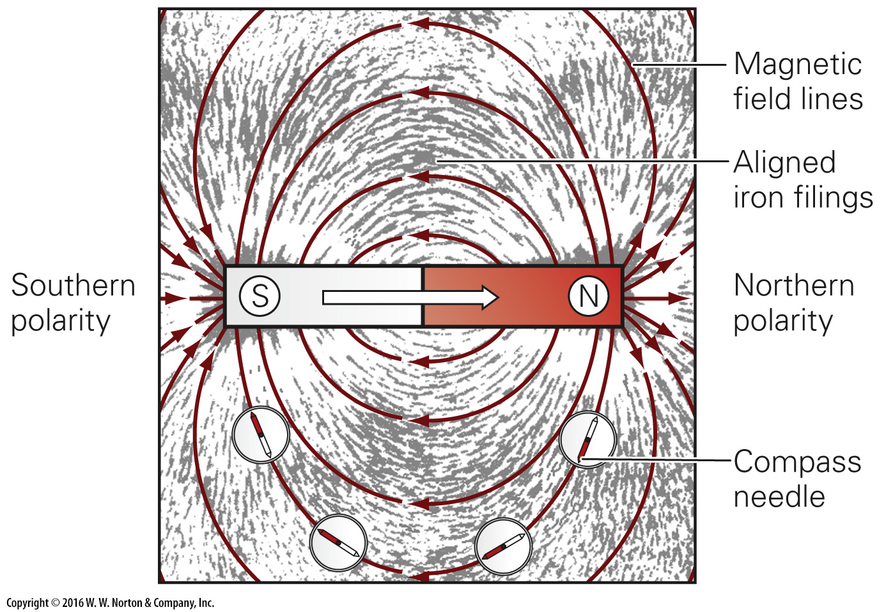
Notes:
FIGURE 1.12a A magnetic field permeates the space around the Earth. It can be symbolized by a bar magnet.
(a) Magnetic field lines produced by a bar magnet point into the magnet’s south pole and out from its north pole.

Slide 33
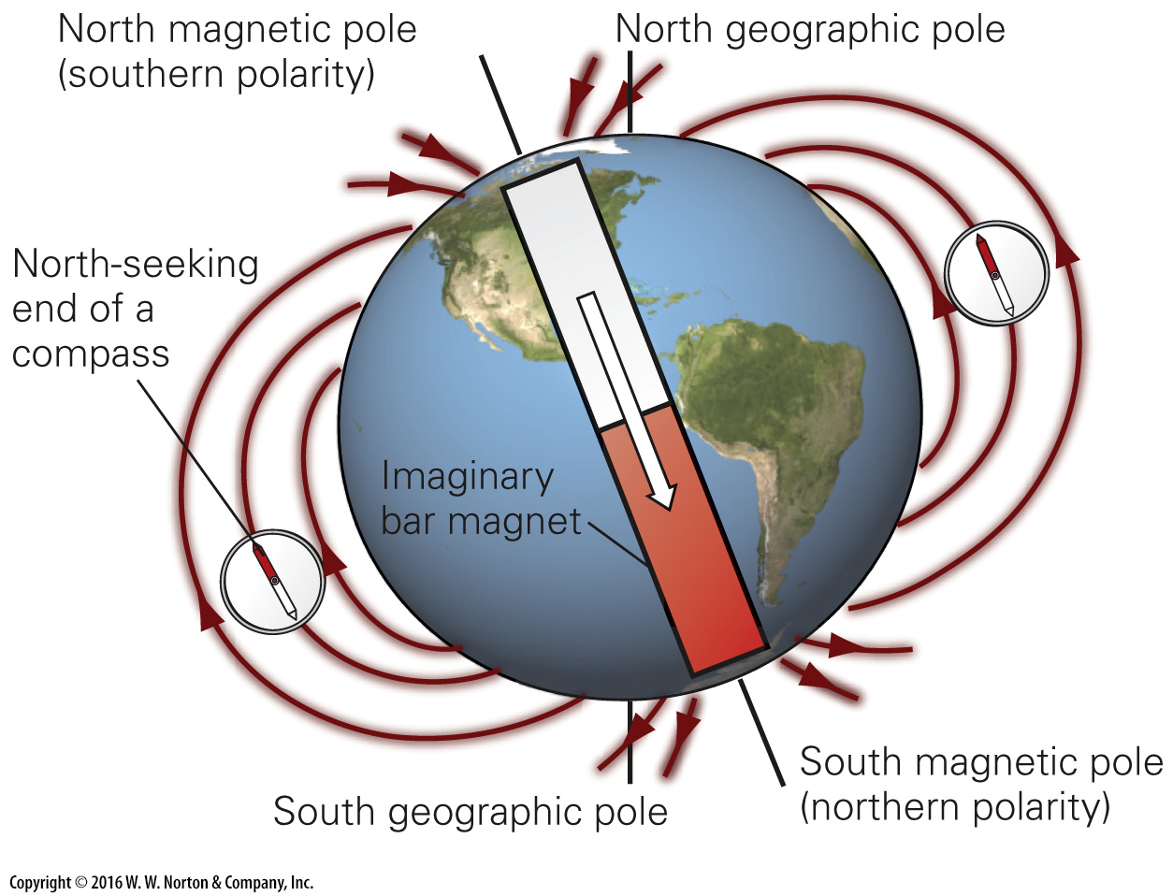
Notes:
FIGURE 1.12b A magnetic field permeates the space around the Earth. It can be symbolized by a bar magnet.
(b) We can represent the Earth‘s magnetic field by an imaginary bar magnet inside.

Slide 34
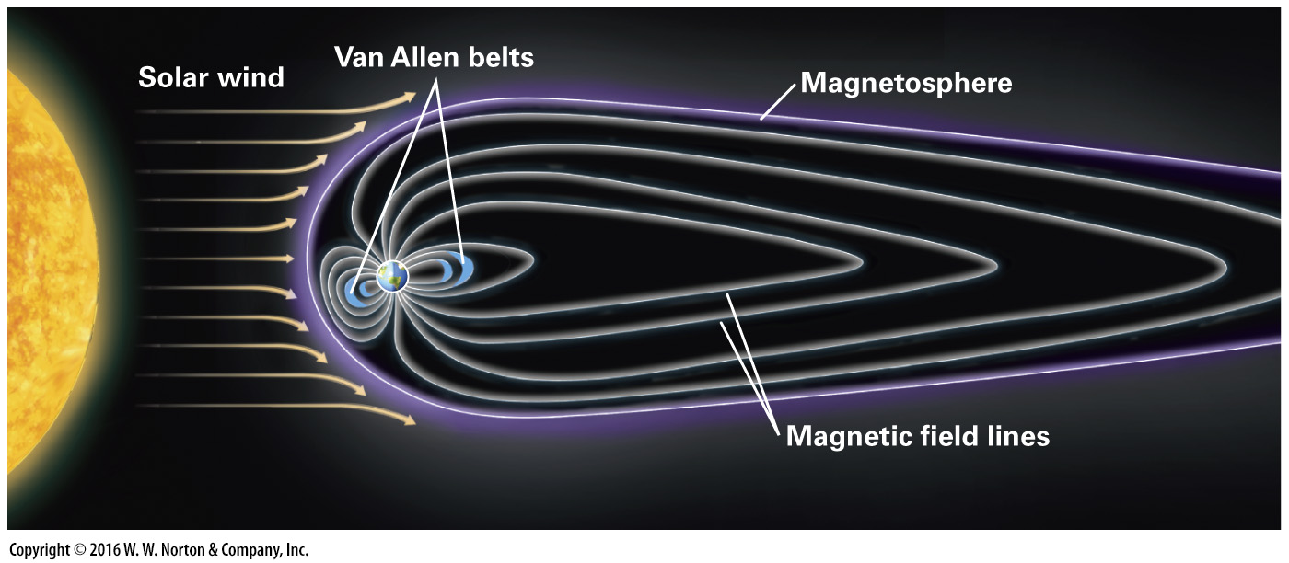
Notes:
FIGURE 1.12c A magnetic field permeates the space around the Earth. It can be symbolized by a bar magnet.
(c) Earth behaves like a magnetic dipole, but the field lines are distorted by the solar wind. The Van Allen radiation belts trap charged particles.

Slide 35
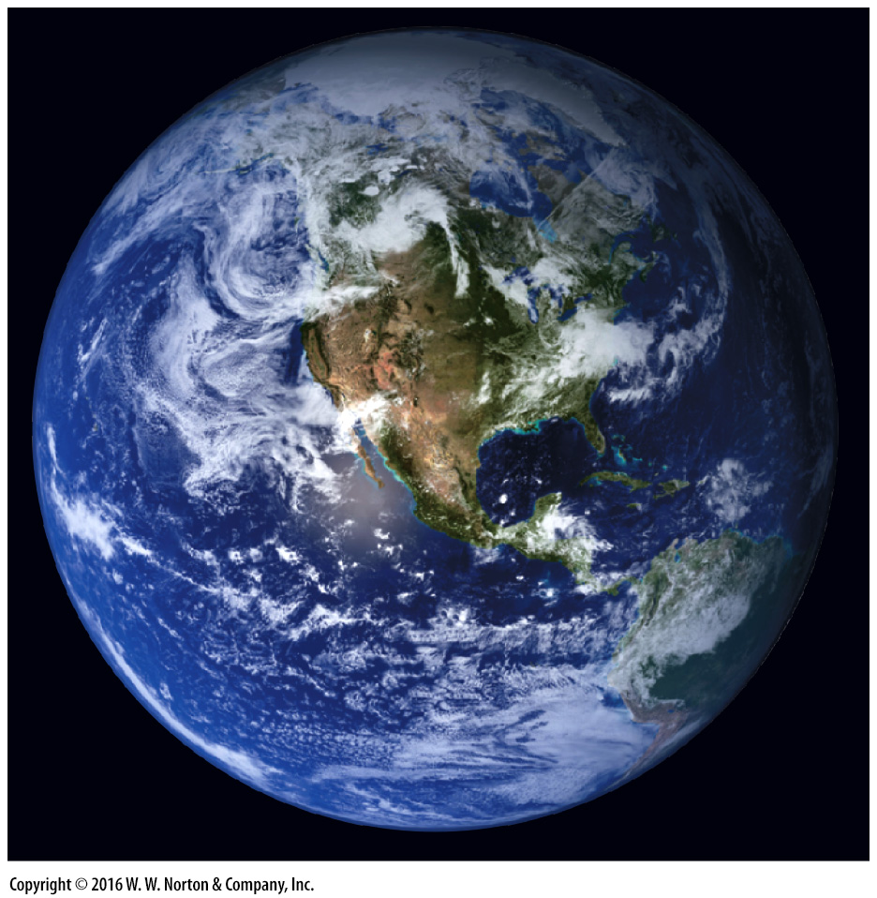
Notes:
FIGURE 1.13 The Earth, as seen from space, has an overall bluish glow. You can distinguish land, sea, clouds, ice, and vegetation.

Slide 36
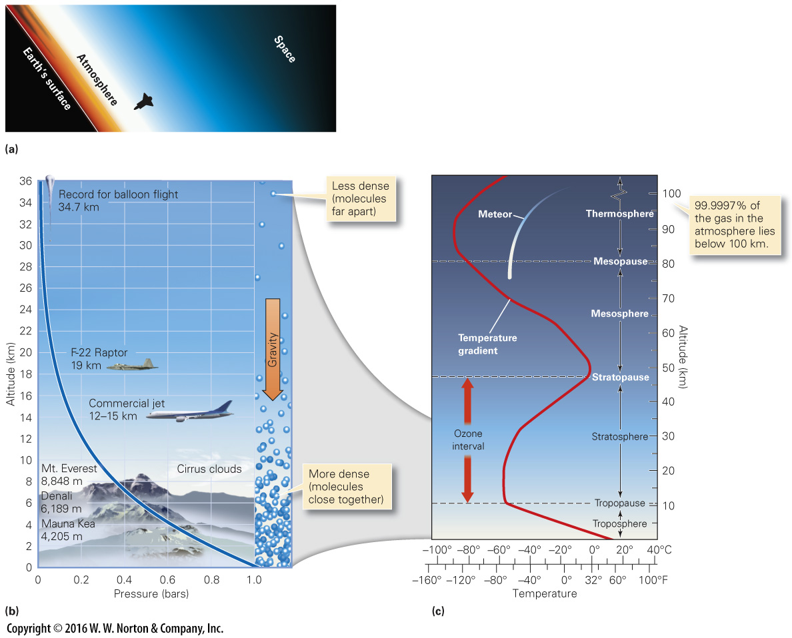
Notes:
FIGURE 1.14 Characteristics of the atmosphere that envelops the Earth.
(a) An orbiting astronaut's photograph shows the haze of the atmosphere fading up into the blackness of space. (b) Molecules pack together more tightly at the base of the atmosphere, so atmospheric pressure changes with elevation. (c) The atmosphere can be divided into several distinct layers. We live in the troposphere.

Slide 37
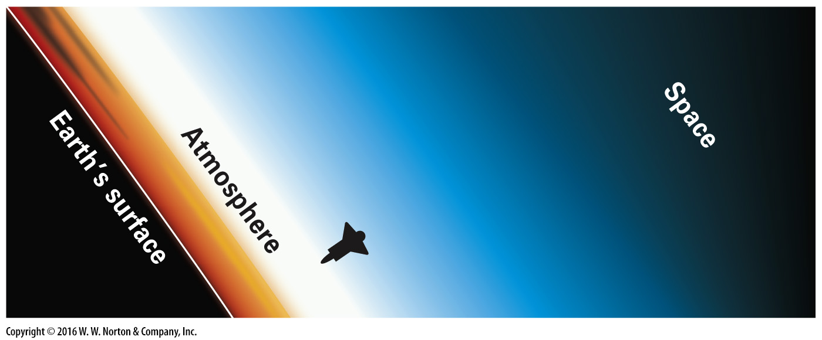
Notes:
FIGURE 1.14a Characteristics of the atmosphere that envelops the Earth.
(a) An orbiting astronaut's photograph shows the haze of the atmosphere fading up into the blackness of space.

Slide 38
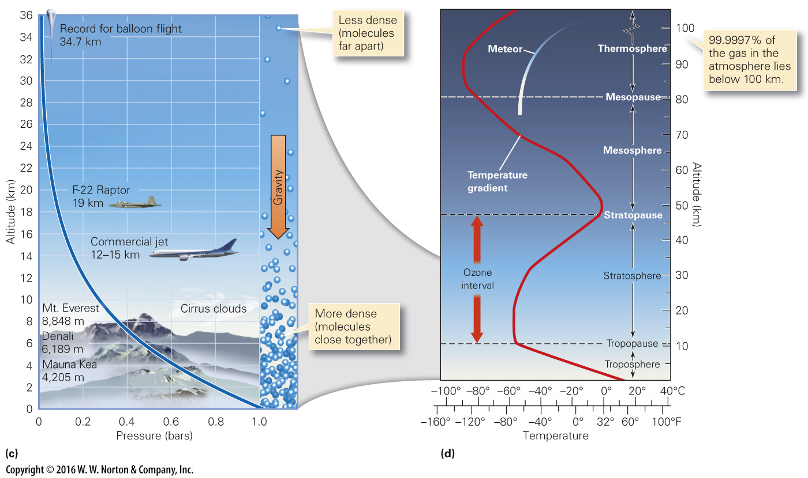
Notes:
FIGURE 1.14bc Characteristics of the atmosphere that envelops the Earth.
(b) Molecules pack together more tightly at the base of the atmosphere, so atmospheric pressure changes with elevation. (c) The atmosphere can be divided into several distinct layers. We live in the troposphere.

Slide 39
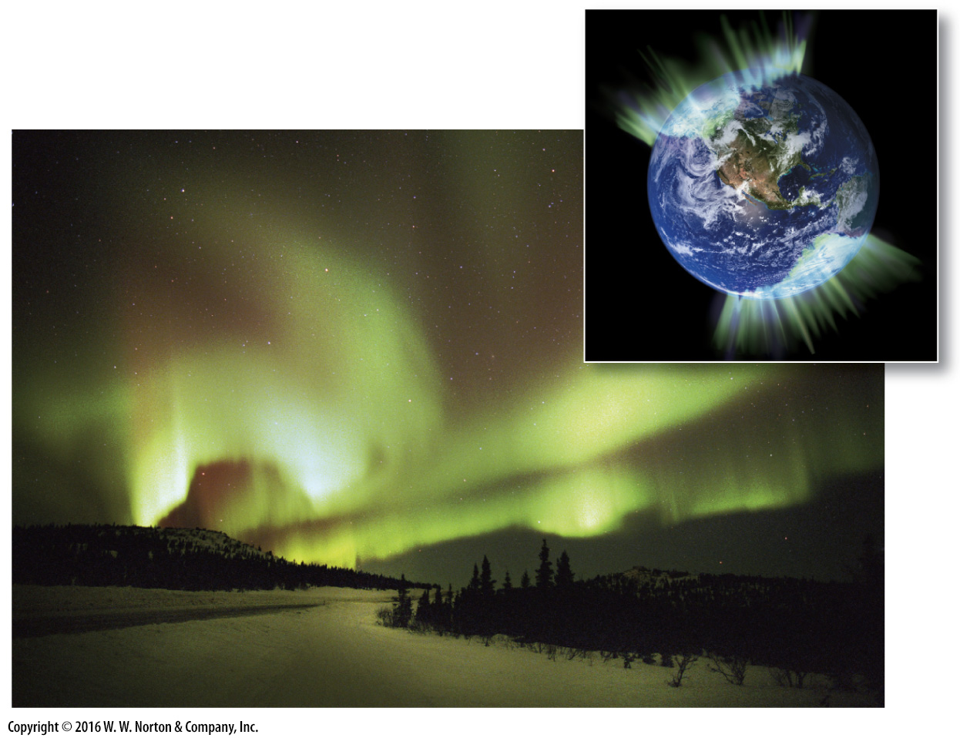
Notes:
FIGURE 1.15 The aurorae are an atmospheric phenomenon.
(a) Charged particles flow toward Earth‘s magnetic poles. (b) Particles cause gases in the atmosphere to glow, forming colorful aurorae in polar skies.

Slide 40
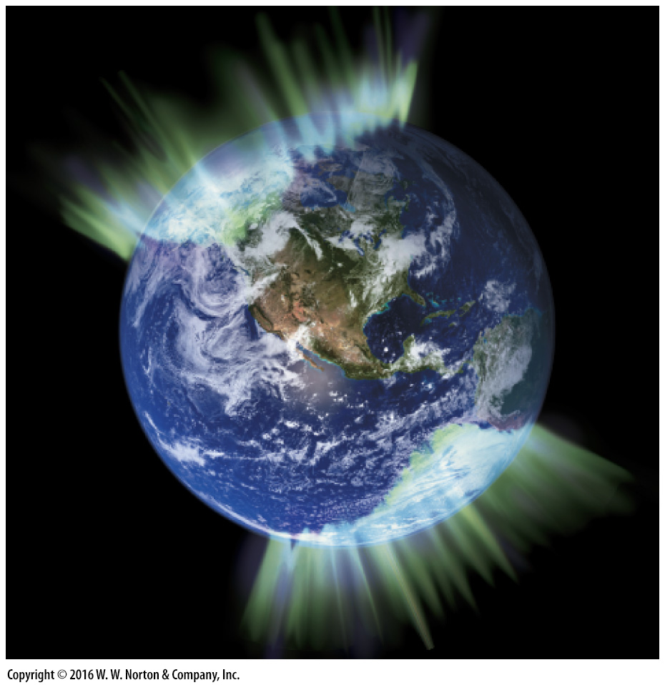
Notes:
FIGURE 1.15a The aurorae are an atmospheric phenomenon.
(a) Charged particles flow toward Earth‘s magnetic poles.

Slide 41
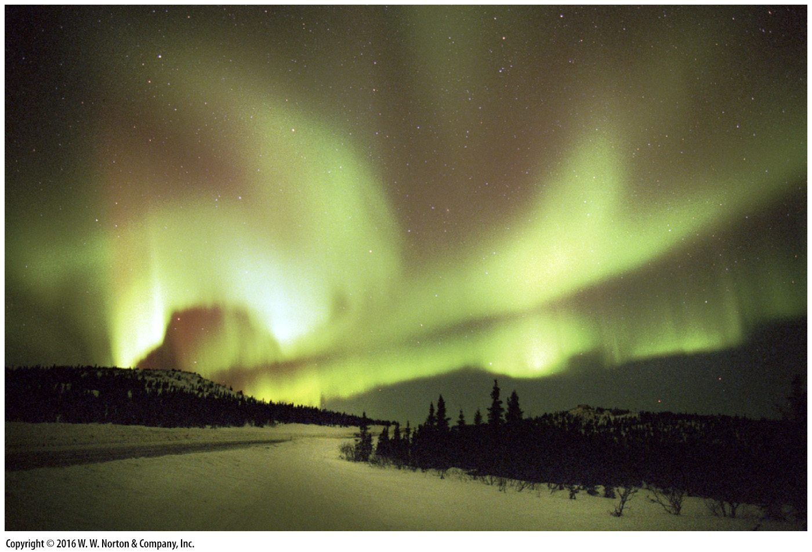
Notes:
FIGURE 1.15b The aurorae are an atmospheric phenomenon.
(b) Particles cause gases in the atmosphere to glow, forming colorful aurorae in polar skies.

Slide 42
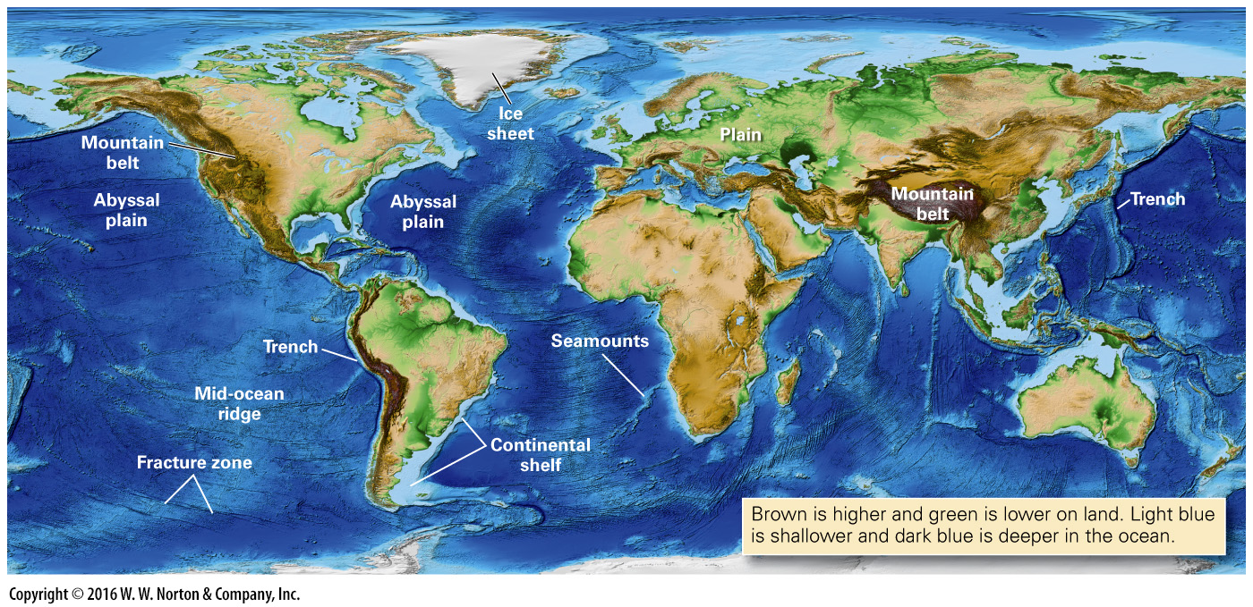
Notes:
FIGURE 1.16 This map shows the Earth‘s topography (variations in land elevation) and bathymetry (variations of ocean-floor depth), and shows where glaciers cover the land (white areas).

Slide 43
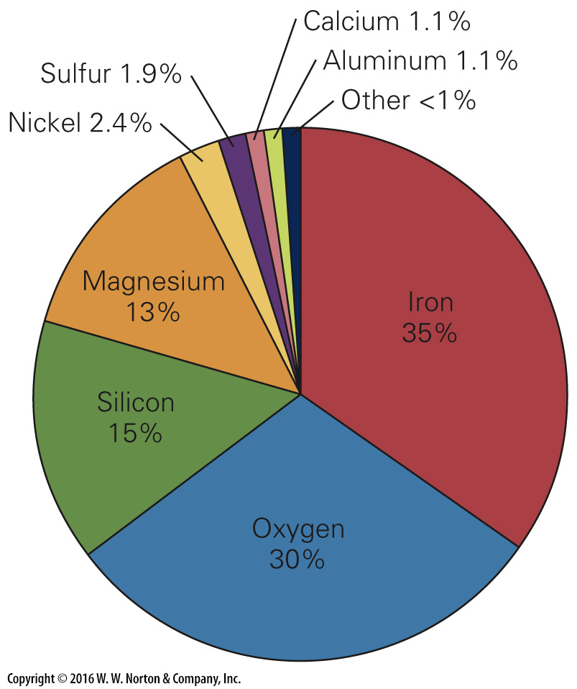
Notes:
FIGURE 1.17 The proportions of major elements making up the mass of the whole Earth. Note that iron and oxygen account for most of the mass.

Slide 44
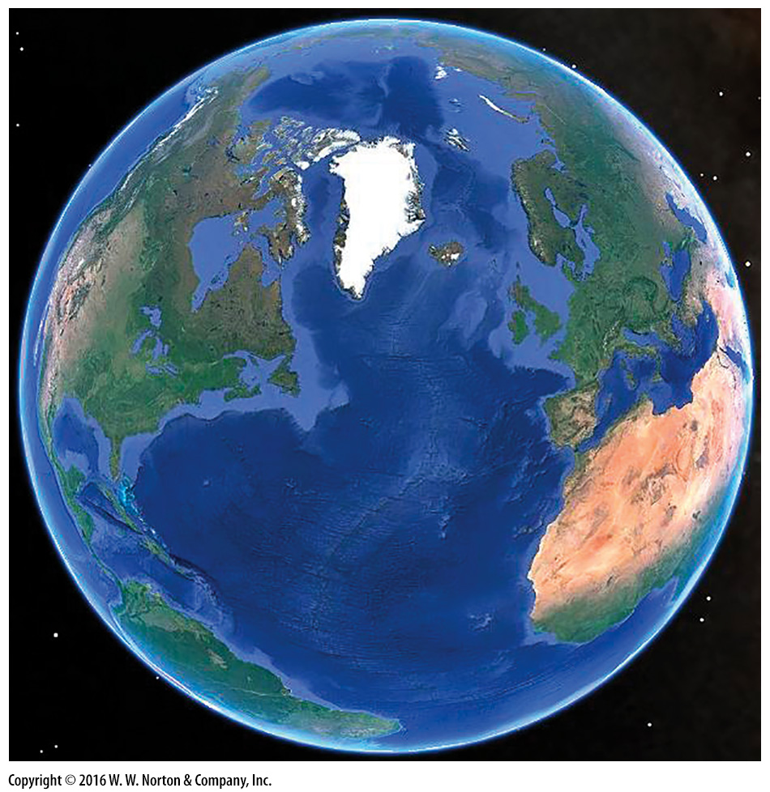
Notes:
SEE FOR YOURSELF…
THE WHOLE EARTH

Slide 45
Notes:
FIGURE 1.18 These are examples of materials that compose the Earth. The left four are types of silicate rocks—granite has the most silica, peridotite the least. The image on the right is a metal alloy.

Slide 46
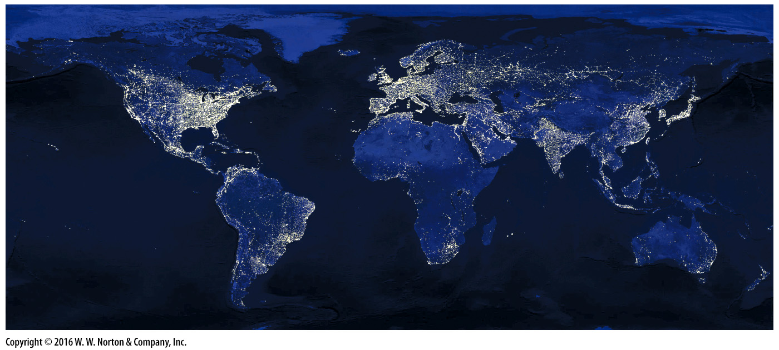
Notes:
FIGURE 1.19 The lights of the Earth as seen at night from space. This image gives a sense of the distribution of human society, and of variations and industrialization.

Slide 47
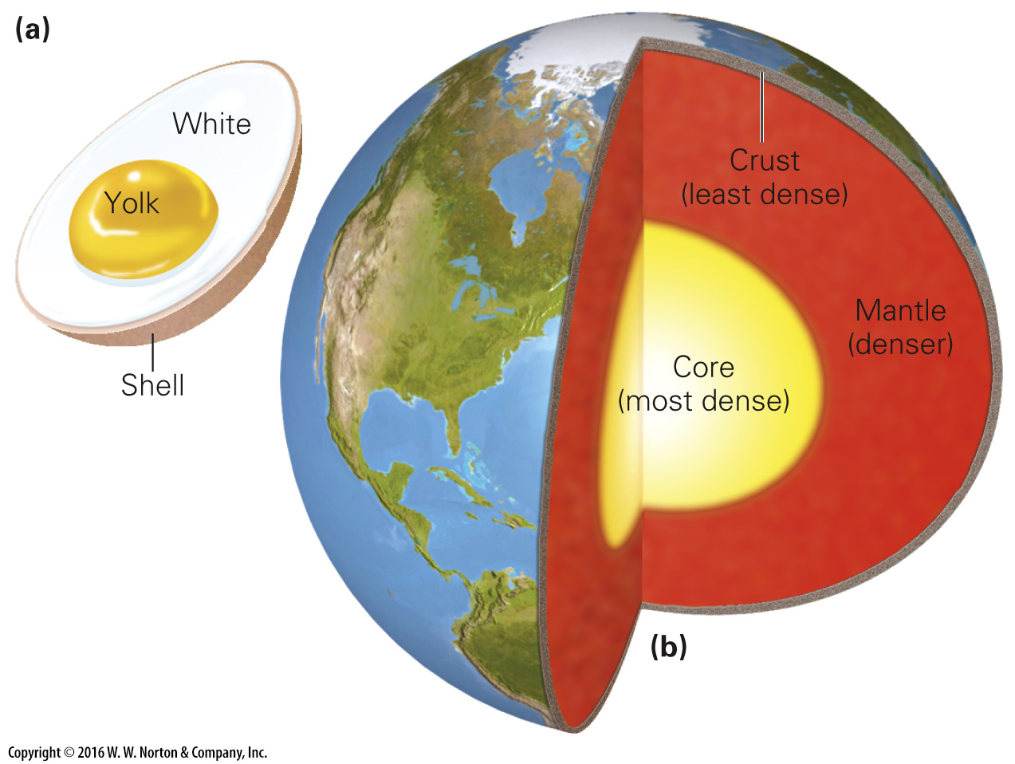
Notes:
FIGURE 1.20 An early image of Earth’s internal layers.
(a) The hard-boiled egg analogy for the Earth’s interior. (b) Earth’s interior is denser than the surrounding regions.

Slide 48
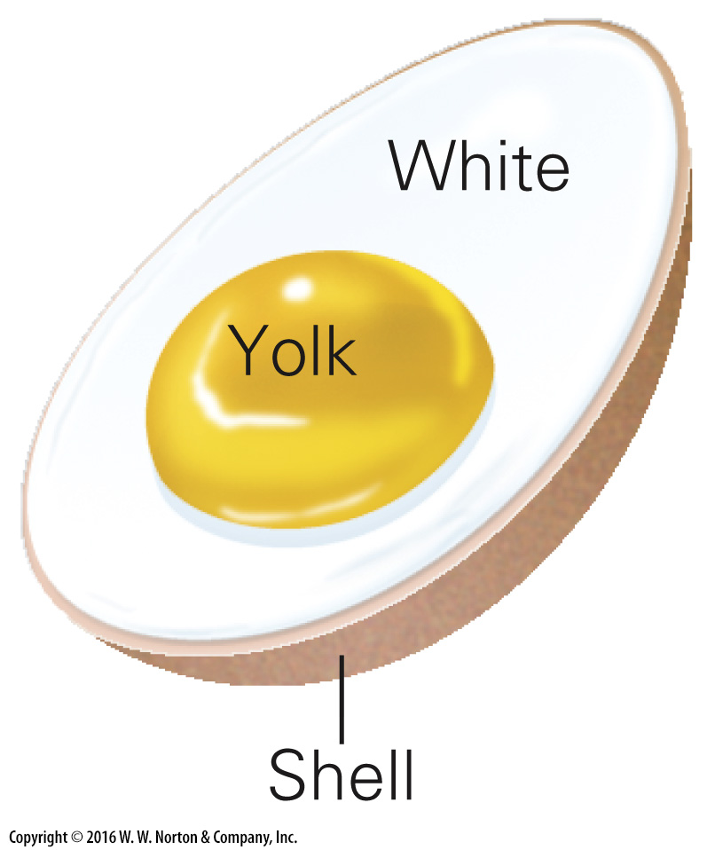
Notes:
FIGURE 1.20a An early image of Earth’s internal layers.
(a) The hard-boiled egg analogy for the Earth’s interior.

Slide 49
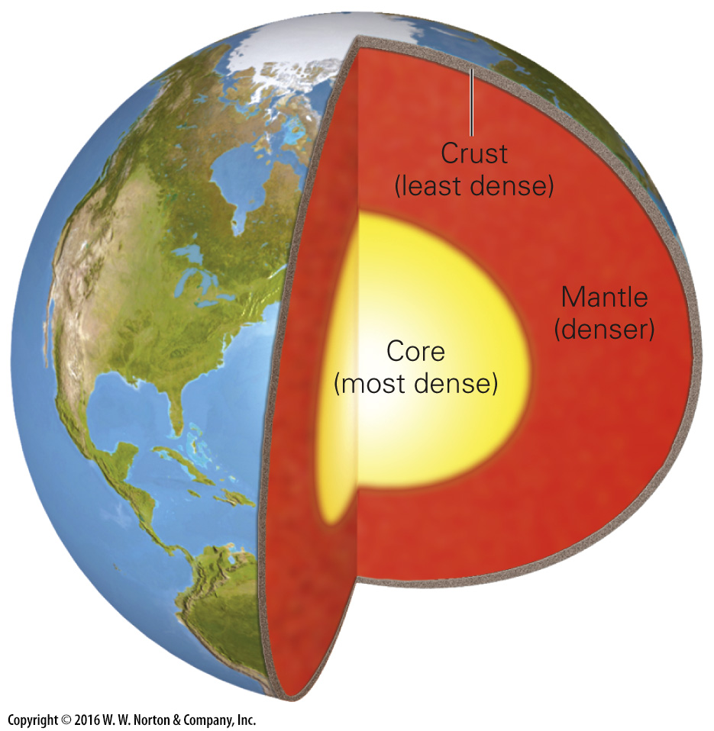
Notes:
FIGURE 1.20b An early image of Earth’s internal layers.
(b) Earth’s interior is denser than the surrounding regions.

Slide 50
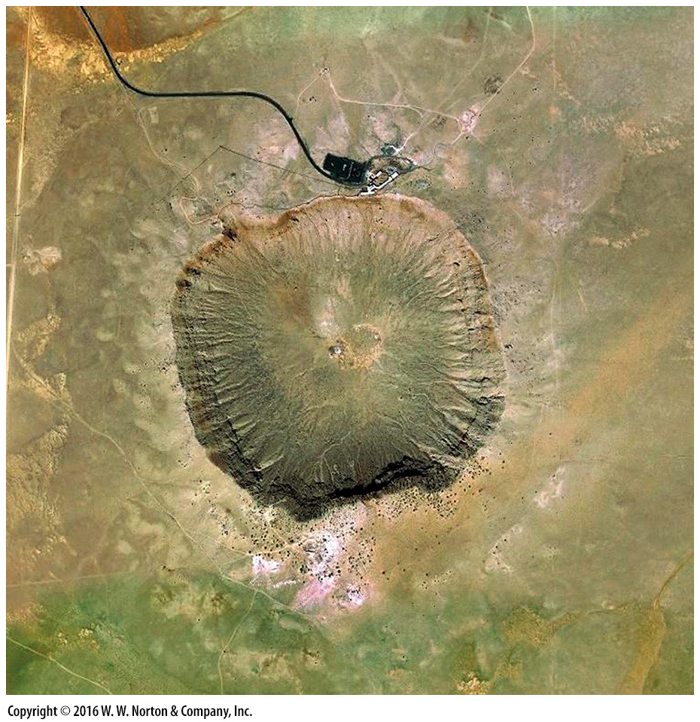
Notes:
SEE FOR YOURSELF…
METEOR CRATER

Slide 51
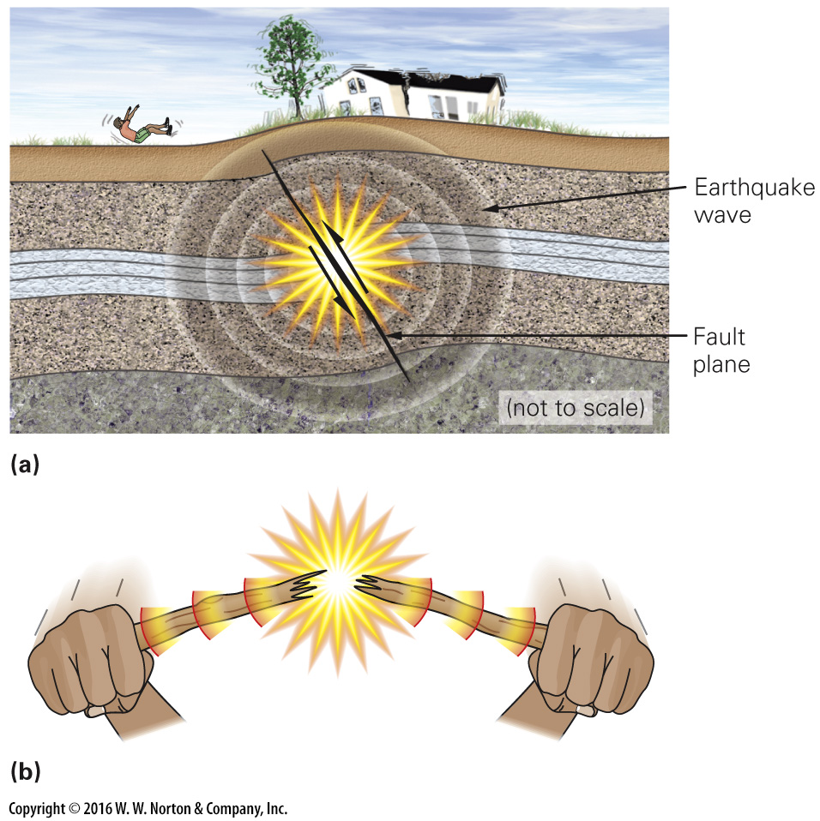
Notes:
FIGURE 1.21 Faulting and the generation of seismic waves.
(a) When the rock inside the Earth suddenly breaks and slips on a a fault, it generates seismic waves that pass through the Earth. When they reach the surface, we feel an earthquake. (b) You are feeling seismic waves, in effect, when you snap a stick. The vibrations pass through the stick to your hands.

Slide 52
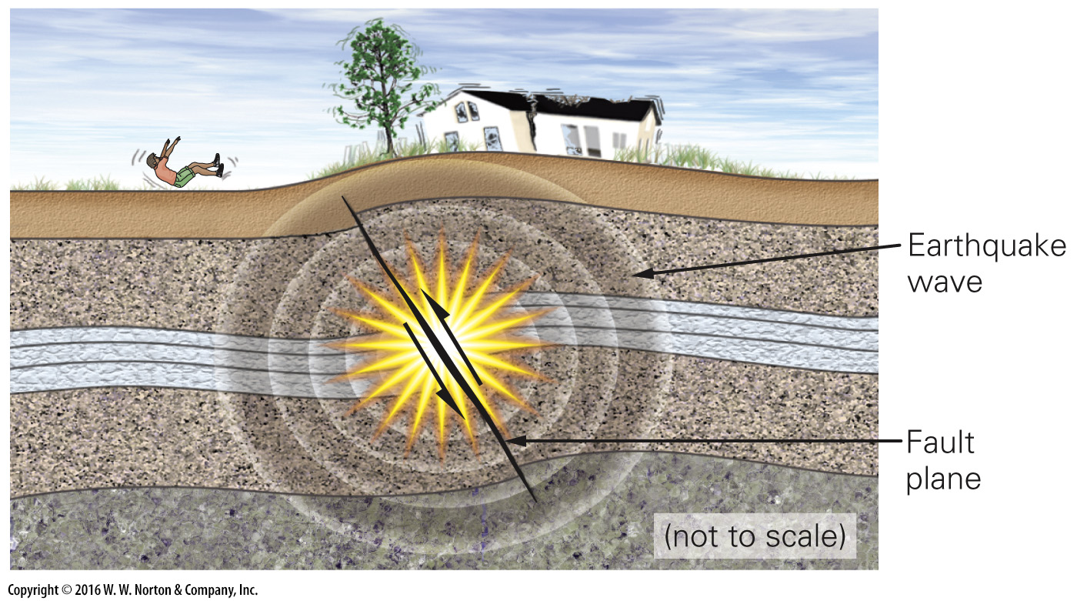
Notes:
FIGURE 1.21a Faulting and the generation of seismic waves.
(a) When the rock inside the Earth suddenly breaks and slips on a a fault, it generates seismic waves that pass through the Earth. When they reach the surface, we feel an earthquake.

Slide 53
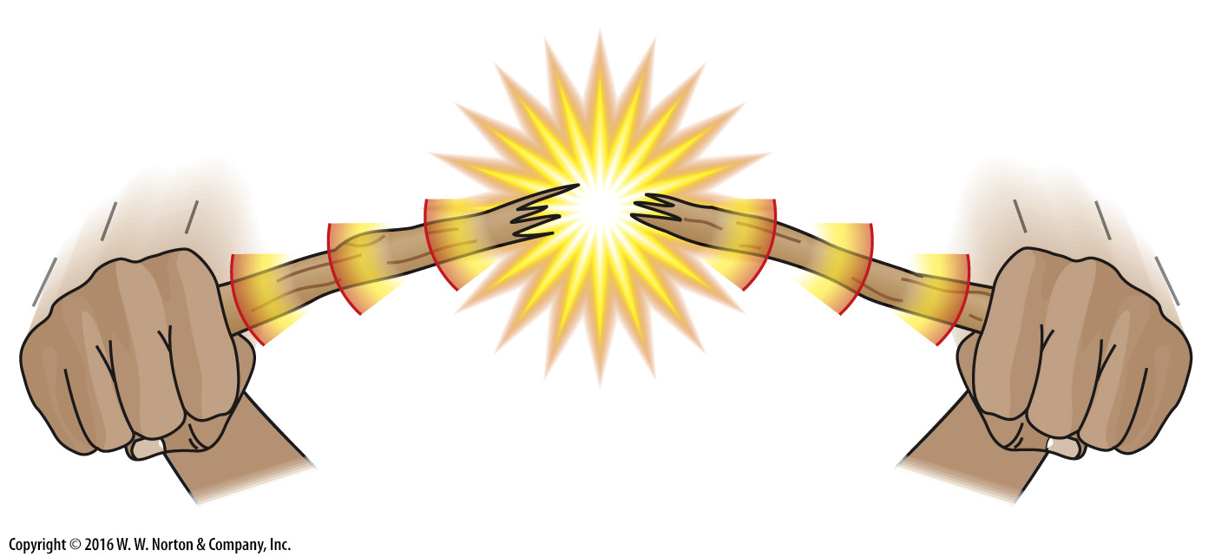
Notes:
FIGURE 1.21b Faulting and the generation of seismic waves.
(b) You are feeling seismic waves, in effect, when you snap a stick. The vibrations pass through the stick to your hands.

Slide 54
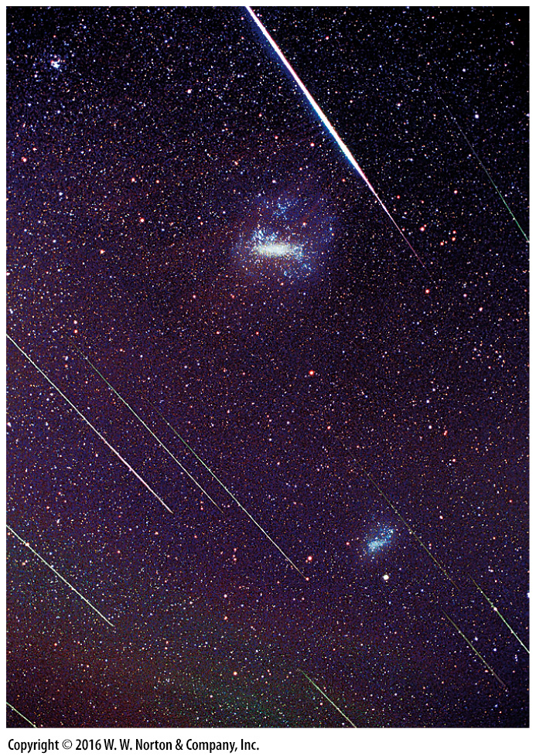
Notes:
FIGURE Bx1.4a Meteors and meteorites.
(a) A shower of meteors over Hong Kong in 2001.

Slide 55
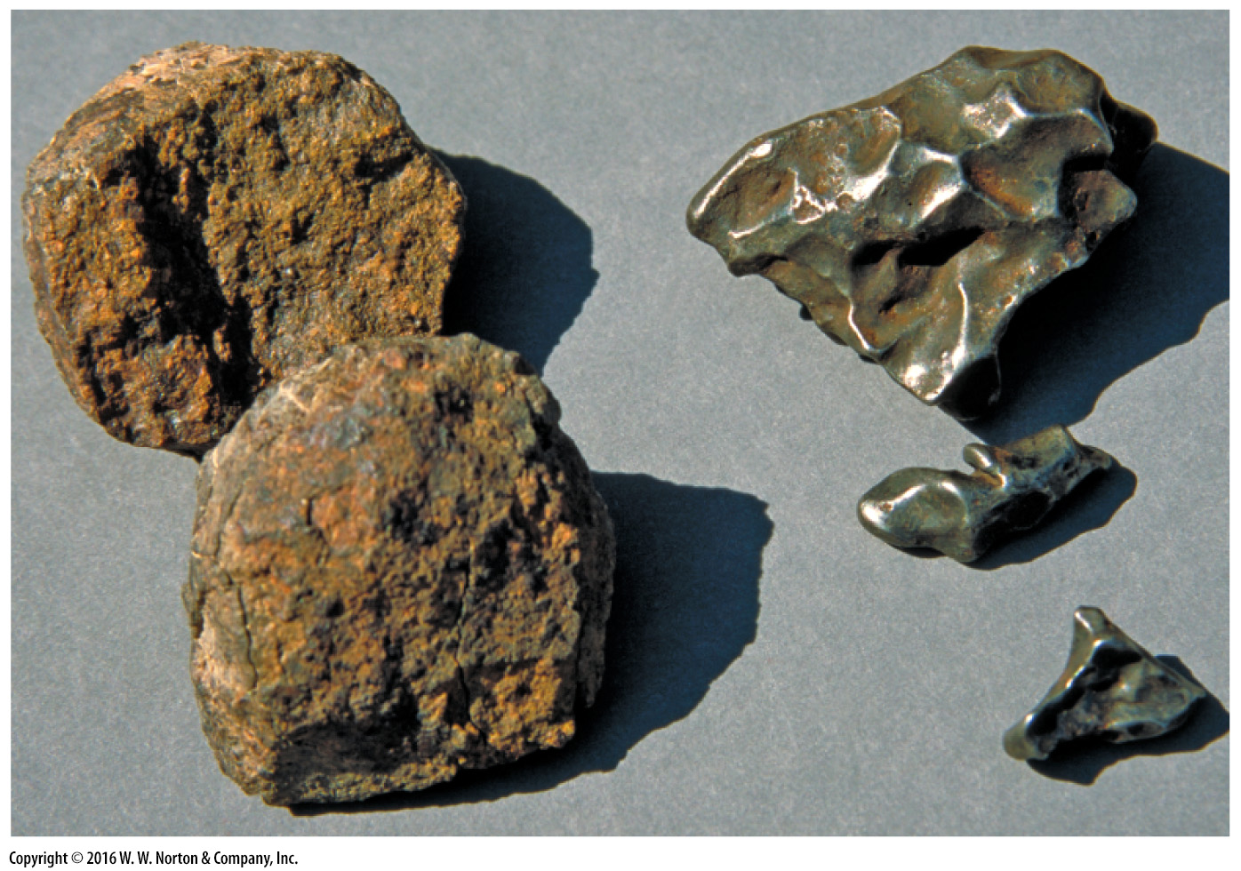
Notes:
FIGURE Bx1.4c Meteors and meteorites.
(c) Examples of stony meteorites (left) and iron meteorites (right).

Slide 56
Notes:
FIGURE Bx1.4b Meteors and meteorites.
(b) The Barringer meteor crater in Arizona. It formed about 50,000 years ago and is 1.1 km in diameter.

Slide 57
Notes:
FIGURE 1.22 A modern view of Earth‘s interior layers.
(a) There are two types of crust. Oceanic crust is thinner, and consists of basalt and gabbro. Continental crust varies in thickness and includes many rock types. (b) By studying earthquake waves, geologists produced a refined image of Earth‘s interior, in which the mantle and core are subdivided.

Slide 58
Notes:
FIGURE 1.22a A modern view of Earth‘s interior layers.
(a) There are two types of crust. Oceanic crust is thinner, and consists of basalt and gabbro. Continental crust varies in thickness and includes many rock types.

Slide 59
Notes:
FIGURE 1.22b A modern view of Earth‘s interior layers.
(b) By studying earthquake waves, geologists produced a refined image of Earth‘s interior, in which the mantle and core are subdivided.

Slide 60
Notes:
TABLE 1.1 Average Relative Abundances of Elements in the Earth’s Crust

Slide 61
Notes:
FIGURE 1.23 A block diagram of the lithosphere emphasizing the difference between continental and oceanic lithosphere.

Slide 62
Notes:
Another View Astronomers are discovering many planetary systems around other nearby stars in our galaxy. This is an artist’s conception of what the nearest planetary system, Epsilon Eridani, might look like. This example has an asteroid belt and comets. Their tails follow the currents of the stellar wind.

