Slide 1
Stephen Marshak
ESSENTIALS OF
Geology
FIFTH EDITION
Chapter 3
Patterns in Nature
©2016 W. W. Norton & Company, Inc.

Slide 2
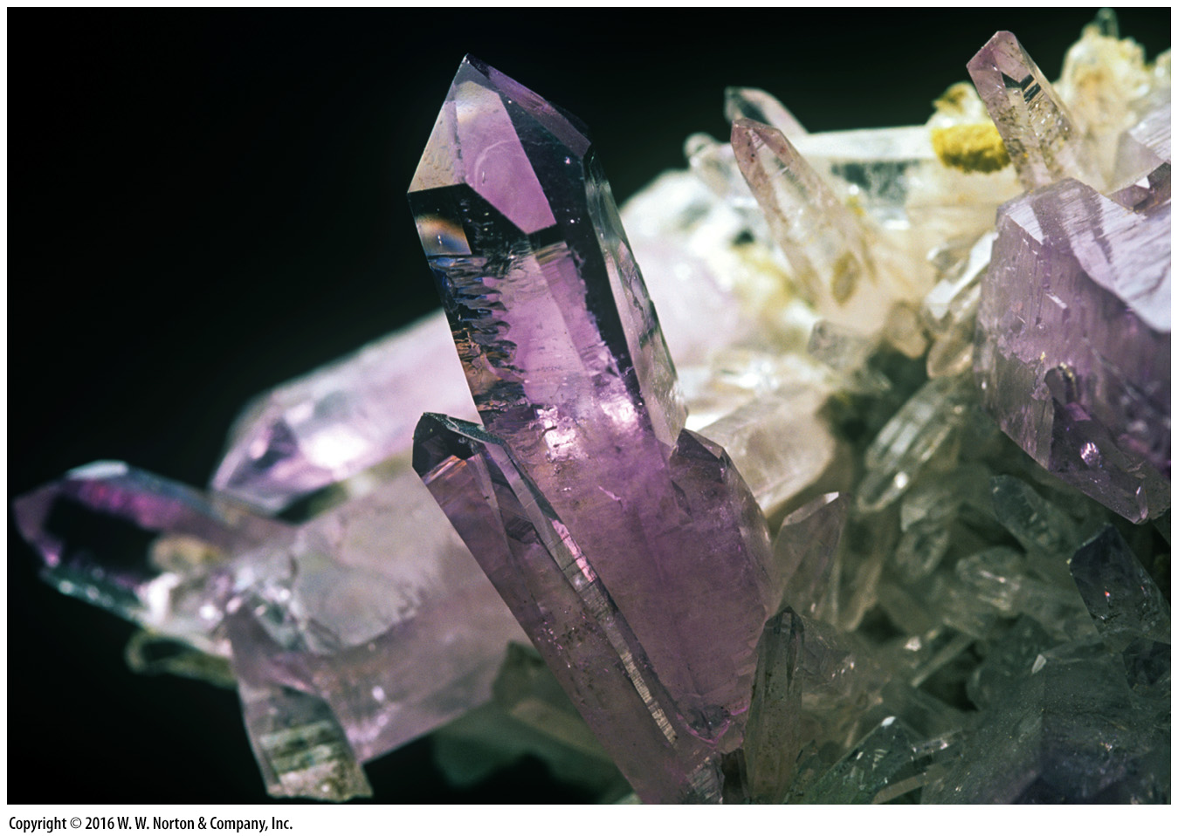
Notes:
A cluster of amethyst crystals . . . nature’s abstract art. Amethyst is one of about 4,000 known minerals, the building blocks of the Earth.

Slide 3
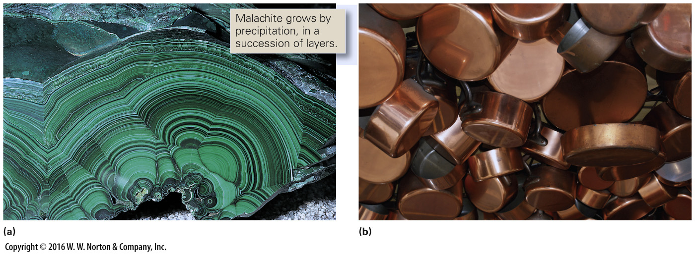
Notes:
FIGURE 3.1 Copper ore is a useful mineral that serves as a source of copper metal.
(a) Malachite is a type of copper ore (Cu₂[CO₃][OH]₂); it contains copper plus other chemicals. (b) The copper for pots is produced by processing ore minerals.

Slide 4
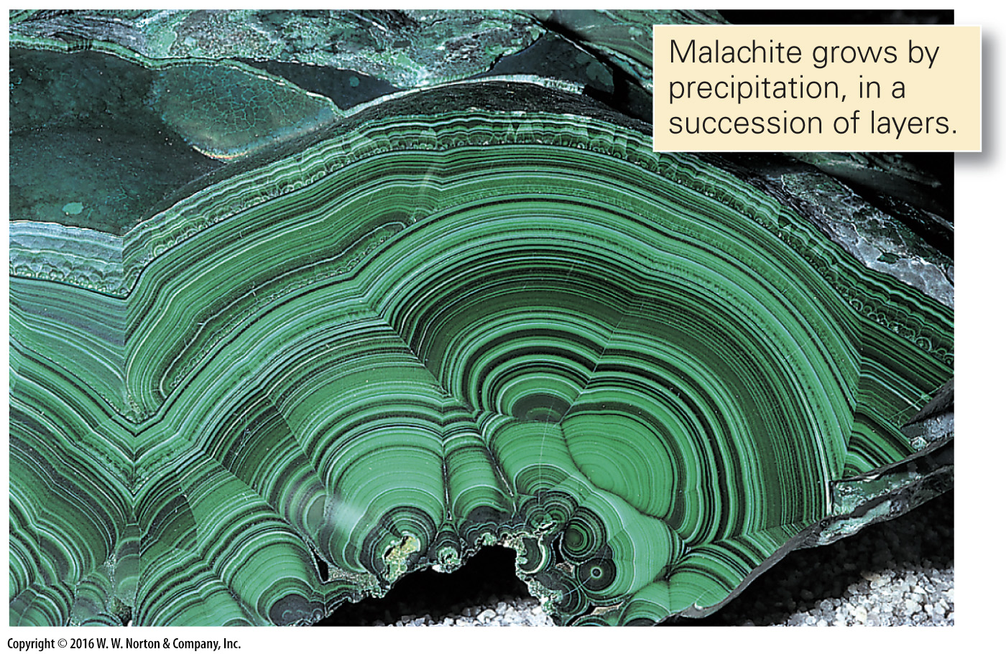
Notes:
FIGURE 3.1a Copper ore is a useful mineral that serves as a source of copper metal.
(a) Malachite is a type of copper ore (Cu₂[CO₃][OH]₂); it contains copper plus other chemicals.

Slide 5
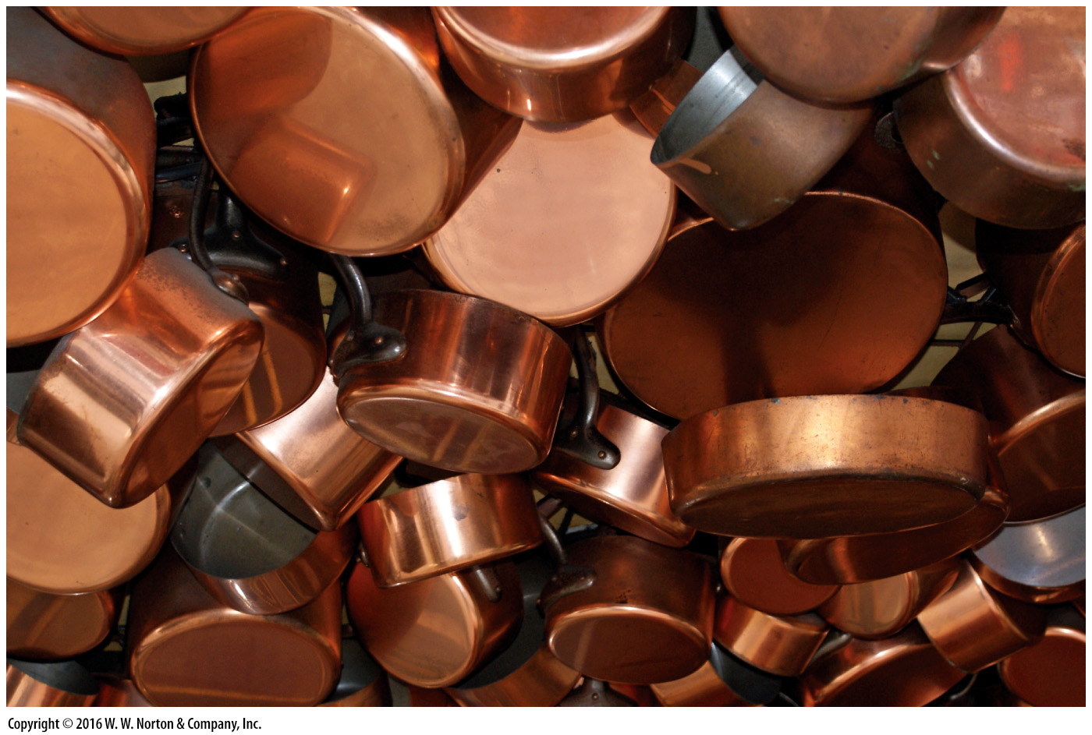
Notes:
FIGURE 3.1b Copper ore is a useful mineral that serves as a source of copper metal.
(b) The copper for pots is produced by processing ore minerals.

Slide 6
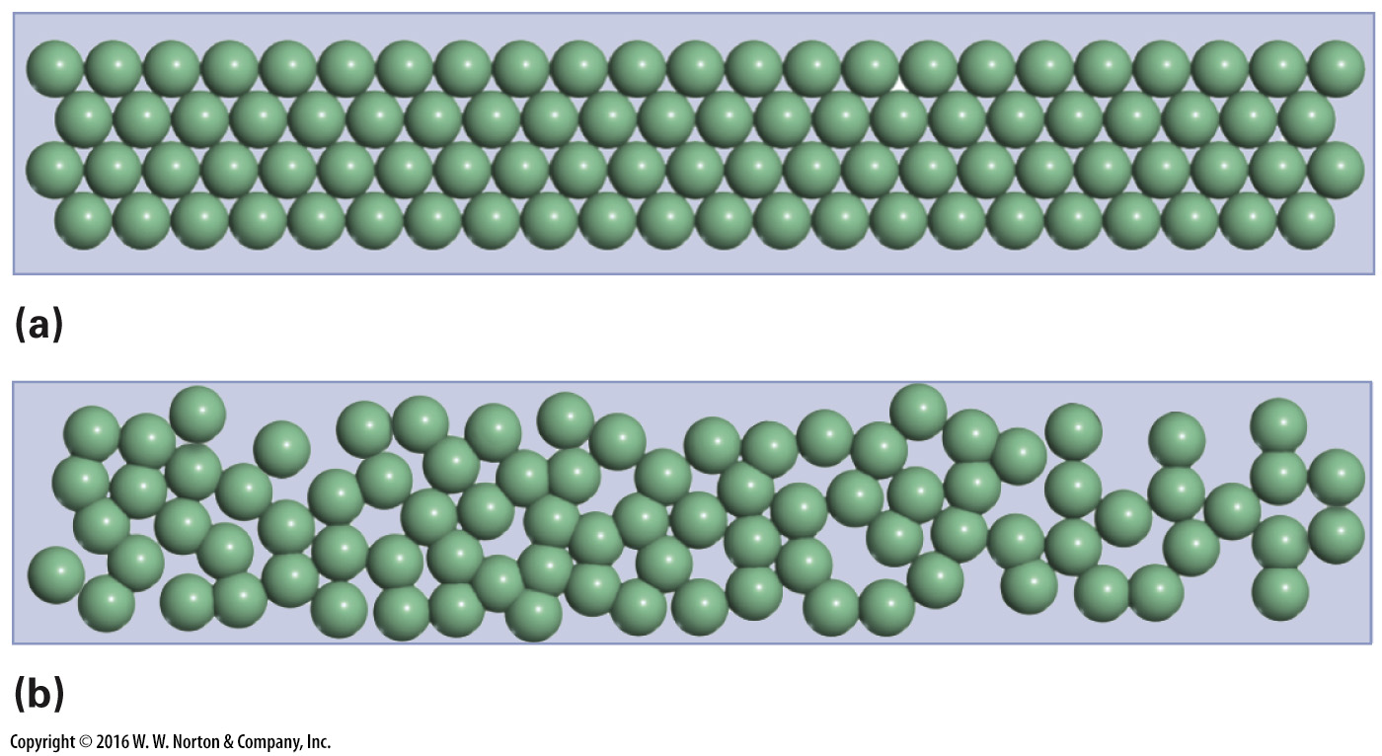
Notes:
FIGURE 3.2 The contrast between crystalline and noncrystalline solids.
(a) A crystal contains an orderly arrangement of atoms. (b) Atoms in noncrystalline solids, such as glass, are not orderly.

Slide 7
Notes:
FIGURE 3.2a The contrast between crystalline and noncrystalline solids.
(a) A crystal contains an orderly arrangement of atoms.

Slide 8
Notes:
FIGURE 3.2b The contrast between crystalline and noncrystalline solids.
(b) Atoms in noncrystalline solids, such as glass, are not orderly.

Slide 9
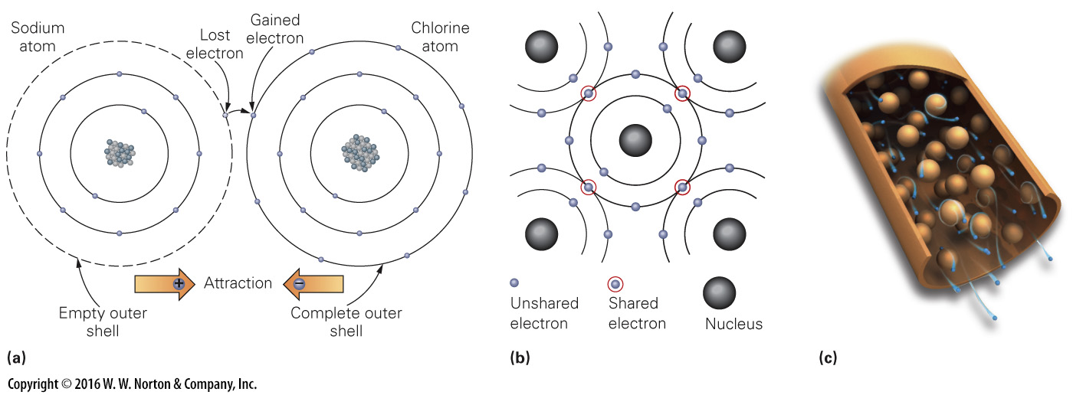
Notes:
FIGURE Bx3.1 Types of chemical bonds.
(a) An ionic bond forms between a positive ion of sodium (Na⁺) and chloride (Cl–), a negative ion of chlorine. When sodium gives up one electron to chlorine, so that both have filled shells, halite (NaCl) is produced. (b) Covalent bonds form when carbon atoms share electrons so that all have filled electron shells. (c) In metallically bonded material, nuclei and their inner shells of electrons float in a sea of free electrons. The electrons stream through the metal if there is an electrical current.

Slide 10
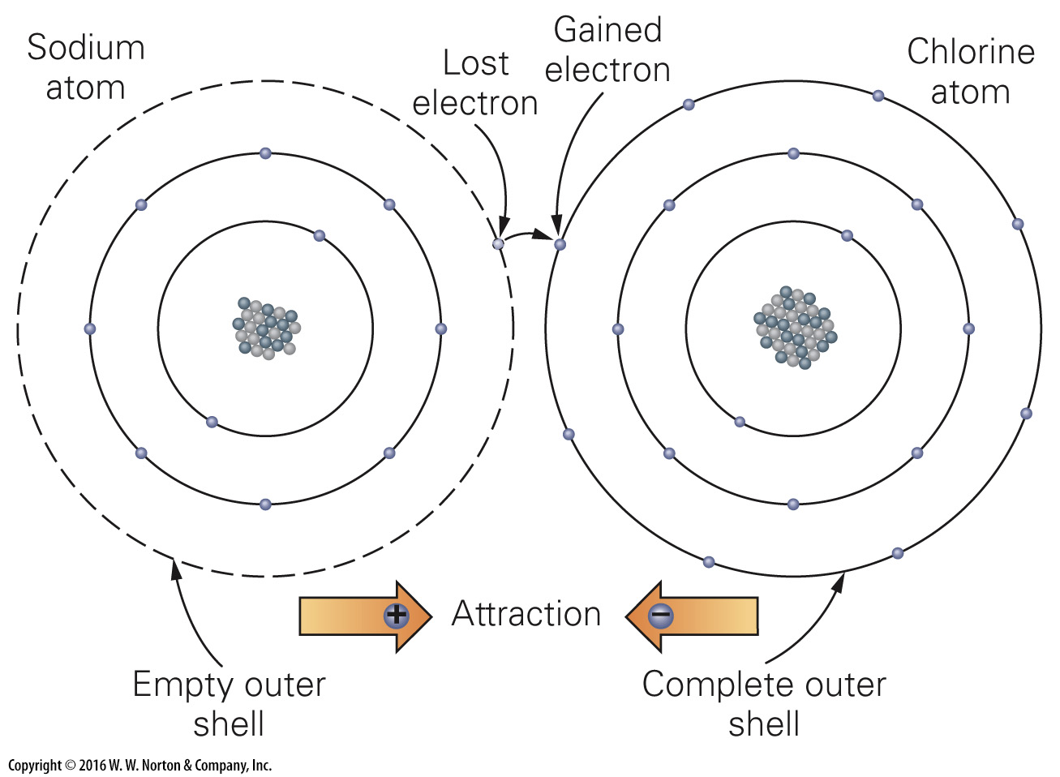
Notes:
FIGURE Bx3.1a Types of chemical bonds.
(a) An ionic bond forms between a positive ion of sodium (Na⁺) and chloride (Cl–), a negative ion of chlorine. When sodium gives up one electron to chlorine, so that both have filled shells, halite (NaCl) is produced.

Slide 11
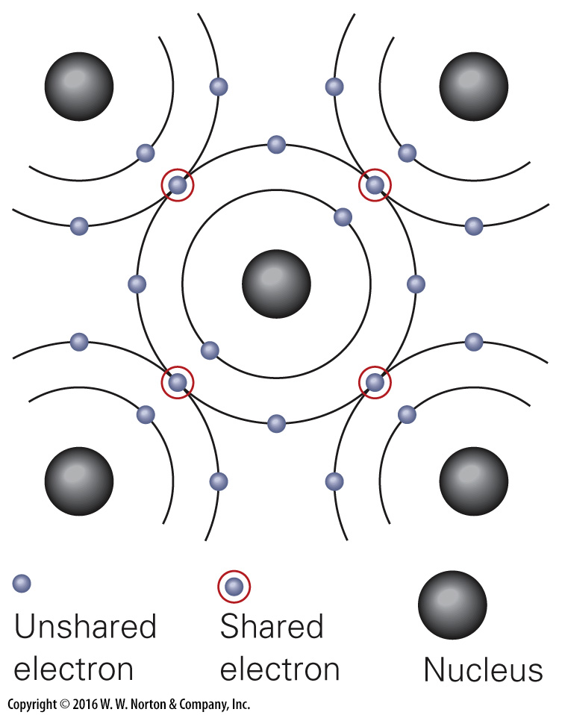
Notes:
FIGURE Bx3.1b Types of chemical bonds.
(b) Covalent bonds form when carbon atoms share electrons so that all have filled electron shells.

Slide 12
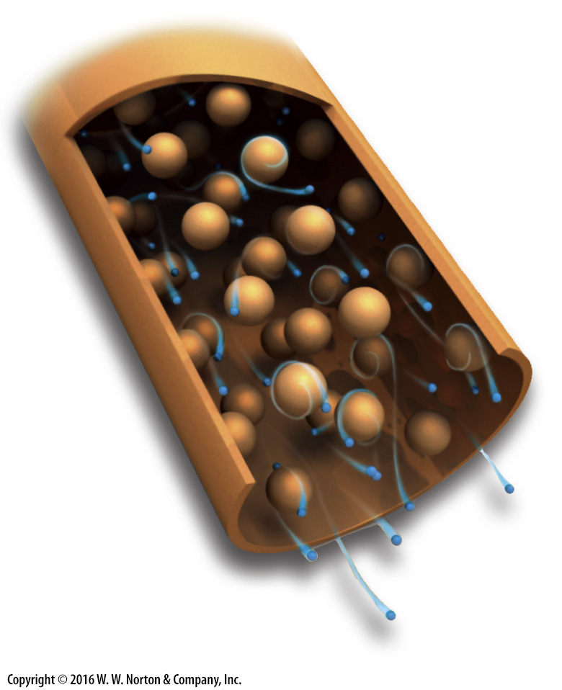
Notes:
FIGURE Bx3.1c Types of chemical bonds.
(c) In metallically bonded material, nuclei and their inner shells of electrons float in a sea of free electrons. The electrons stream through the metal if there is an electrical current.

Slide 13
Notes:
FIGURE 3.3 Some characteristics of crystals.
(a) A quartz crystal can resemble an obelisk. Inside, atoms are arranged in a specific geometric pattern, like the joint points in scaffolding. (b) Regardless of specimen size, the angle between two adjacent crystal faces is consistent in a particular mineral. (c) Crystals come in a variety of shapes, including cubes, prisms, blades, and pyramids. Some terminate at a point and some terminate with flat surfaces.

Slide 14
Notes:
FIGURE 3.3a Some characteristics of crystals.
(a) A quartz crystal can resemble an obelisk. Inside, atoms are arranged in a specific geometric pattern, like the joint points in scaffolding.

Slide 15
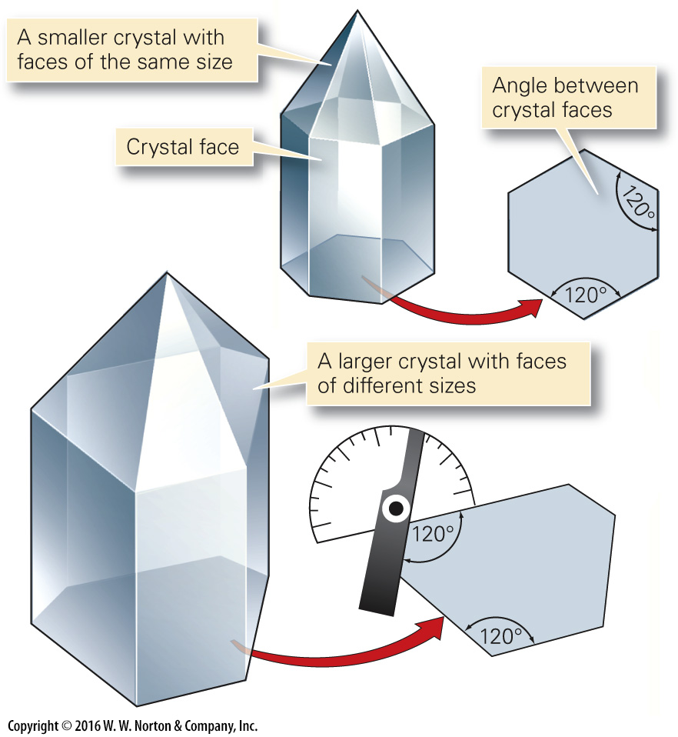
Notes:
FIGURE 3.3b Some characteristics of crystals.
(b) Regardless of specimen size, the angle between two adjacent crystal faces is consistent in a particular mineral.

Slide 16
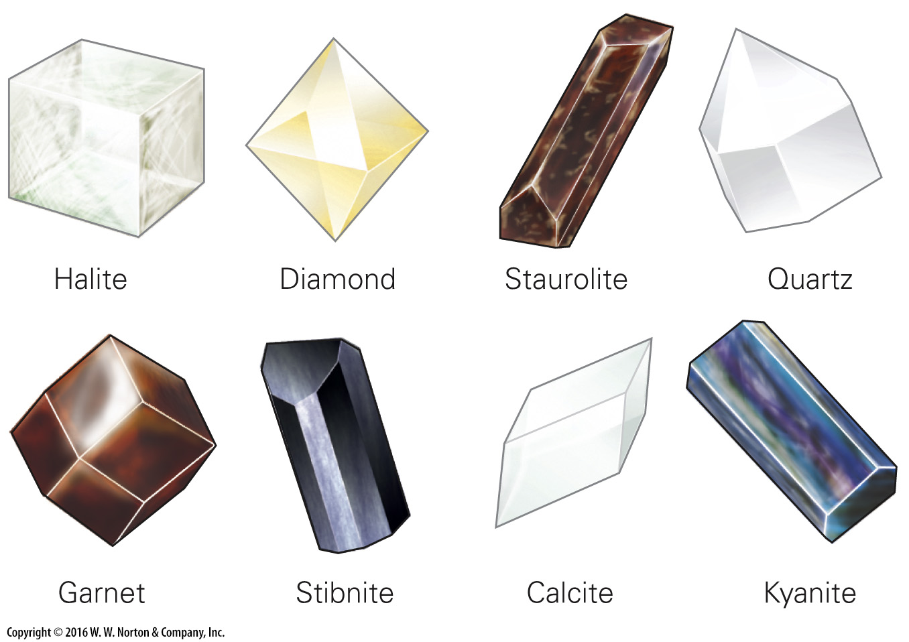
Notes:
FIGURE 3.3c Some characteristics of crystals.
(c) Crystals come in a variety of shapes, including cubes, prisms, blades, and pyramids. Some terminate at a point and some terminate with flat surfaces.

Slide 17
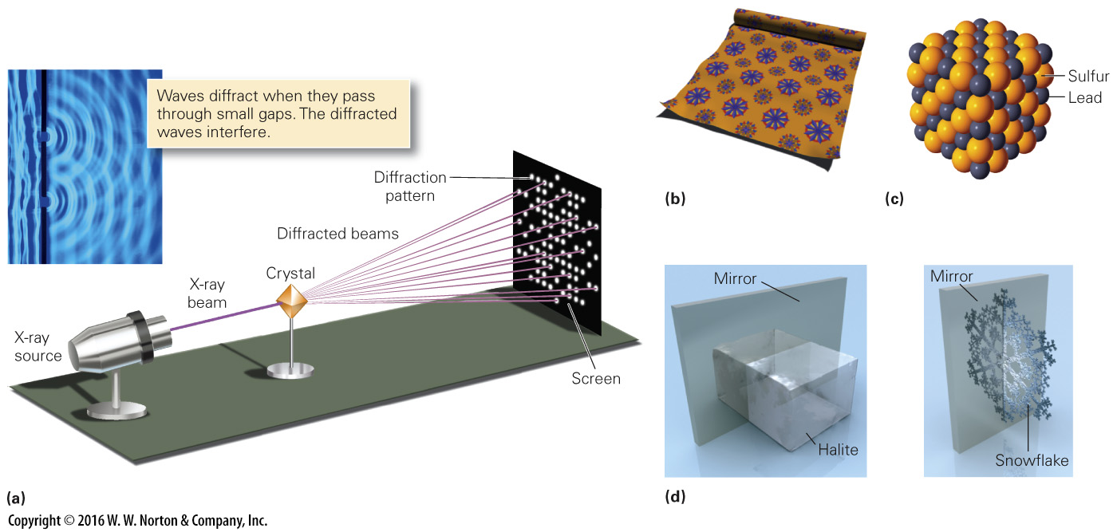
Notes:
FIGURE 3.4 Patterns and symmetry in minerals.
(a) Diffraction of an X-ray beam passing through a crystal produces a pattern of bright spots on a screen. The spots are due to interference of overlapping light waves. (b) The repetition of a flower motif on wallpaper. (c) The repetition of alternating sulfur and lead atoms in the mineral galena (PbS). (d) Minerals display symmetry. One half of a crystal is a mirror image of the other.

Slide 18
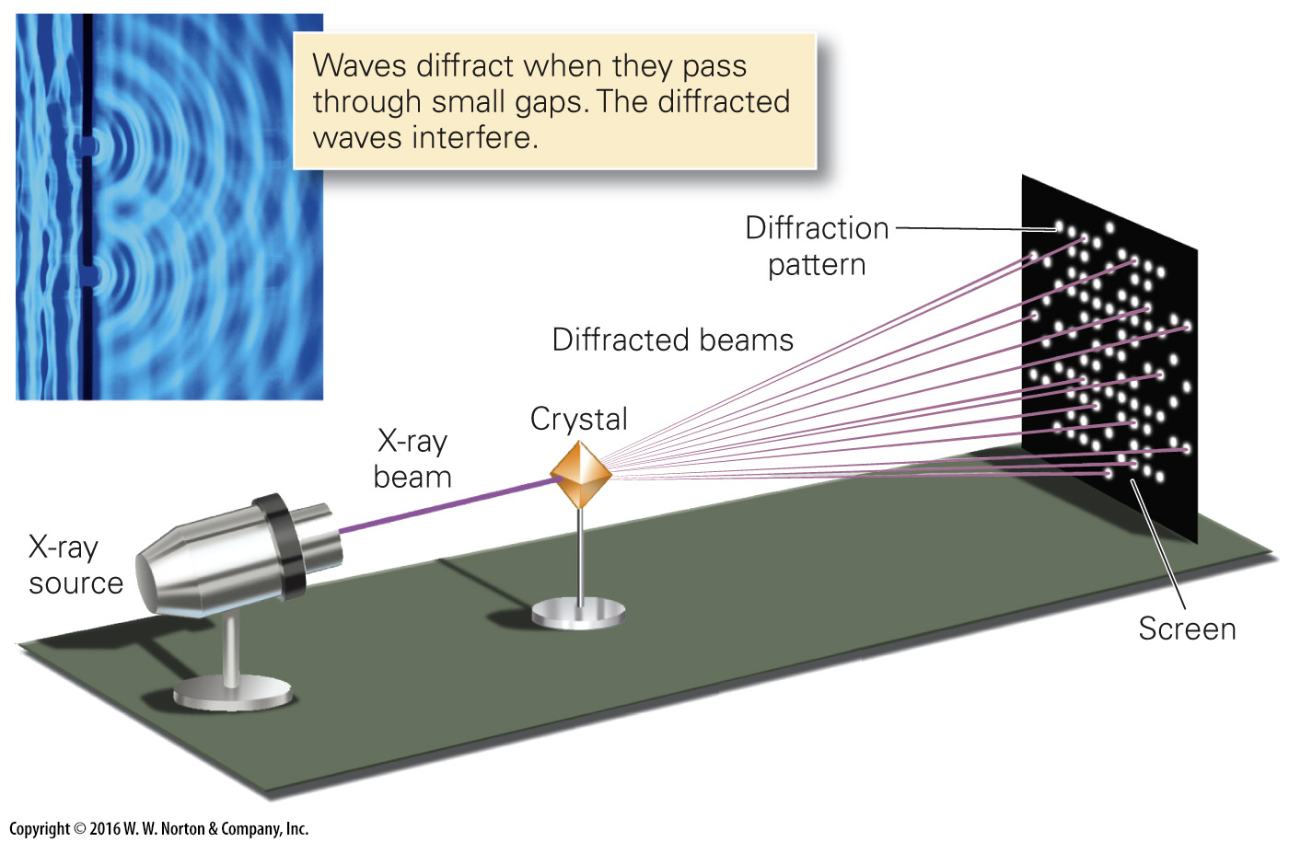
Notes:
FIGURE 3.4a Patterns and symmetry in minerals.
(a) Diffraction of an X-ray beam passing through a crystal produces a pattern of bright spots on a screen. The spots are due to interference of overlapping light waves.

Slide 19
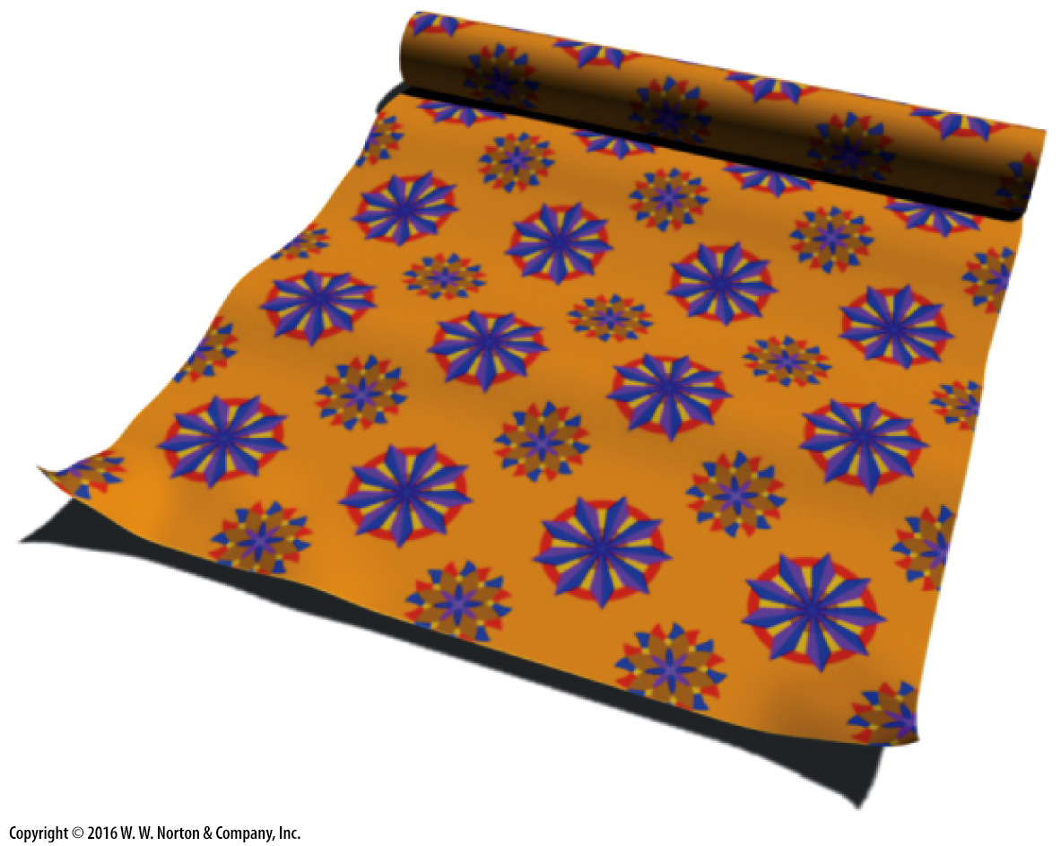
Notes:
FIGURE 3.4b Patterns and symmetry in minerals.
(b) The repetition of a flower motif on wallpaper.

Slide 20
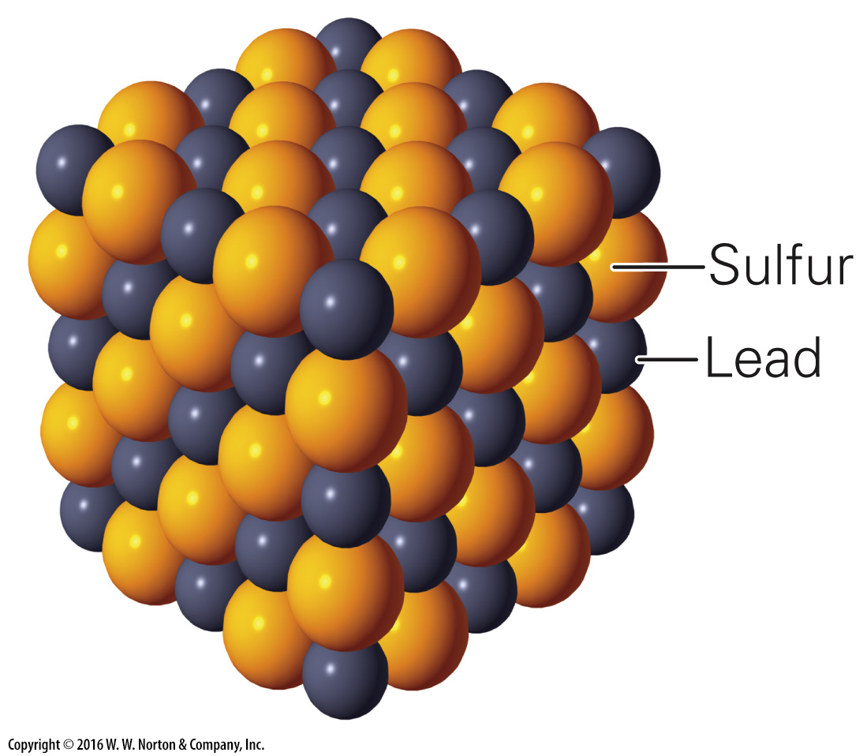
Notes:
FIGURE 3.4c Patterns and symmetry in minerals.
(c) The repetition of alternating sulfur and lead atoms in the mineral galena (PbS).

Slide 21
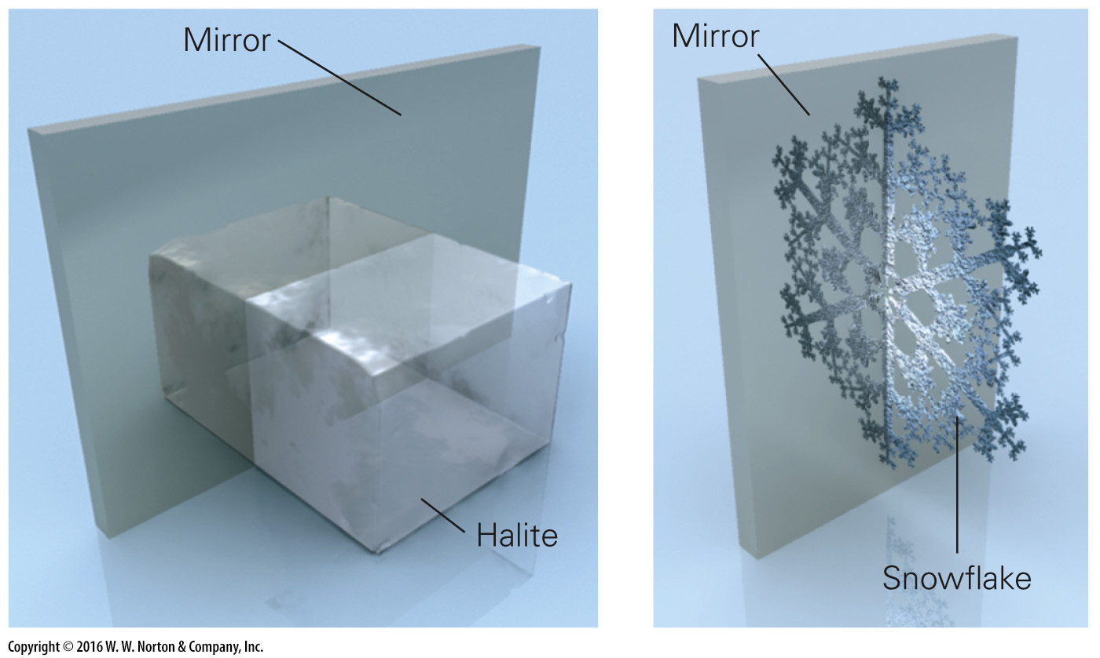
Notes:
FIGURE 3.4d Patterns and symmetry in minerals.
(d) Minerals display symmetry. One half of a crystal is a mirror image of the other.

Slide 22
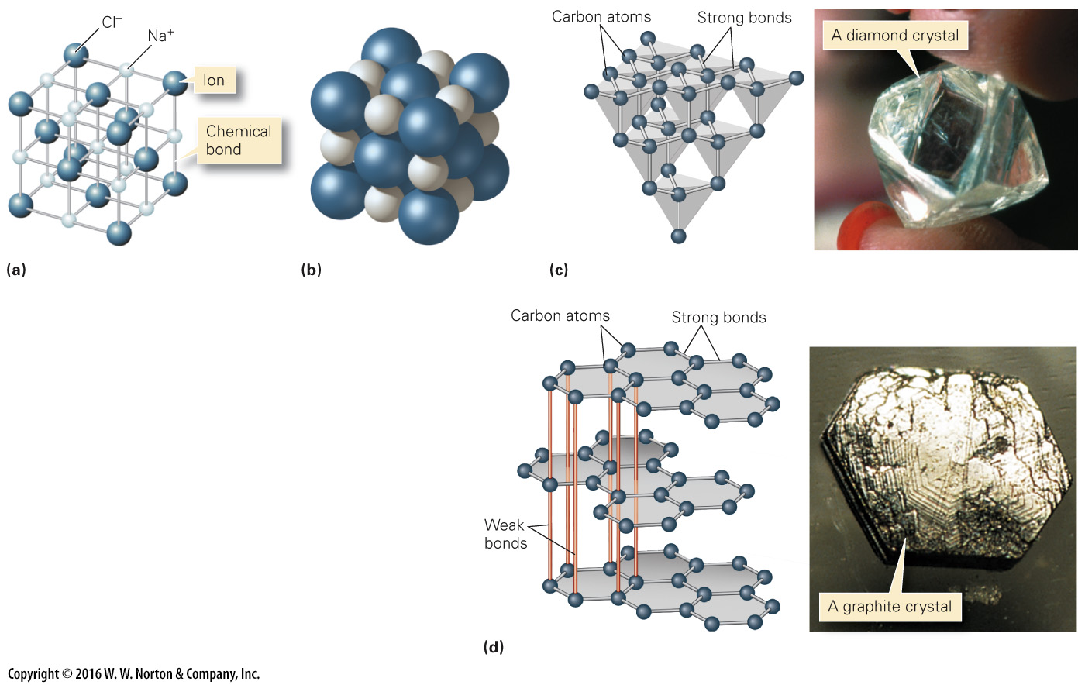
Notes:
FIGURE 3.5 The nature of crystalline structure in minerals.
(a) A ball-and-stick model of halite portrays ions as balls, and chemical bonds as sticks. (b) This packed-ball model gives a sense of how ions fit together in a crystal. (c) In a diamond, carbon atoms are arranged in tetrahedra. All of the bonds are strong. (d) Graphite consists of carbon atoms arranged in hexagonal sheets. The sheets are connected by weak bonds.

Slide 23
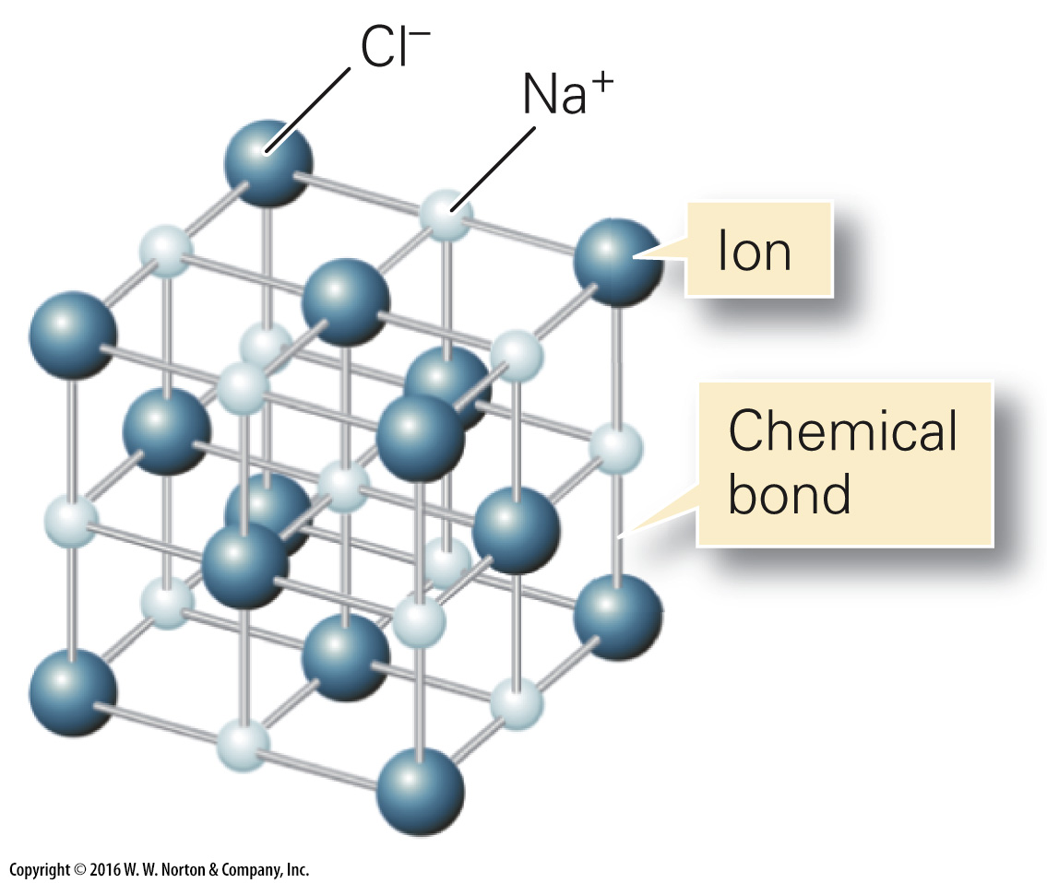
Notes:
FIGURE 3.5a The nature of crystalline structure in minerals.
(a) A ball-and-stick model of halite portrays ions as balls, and chemical bonds as sticks.

Slide 24
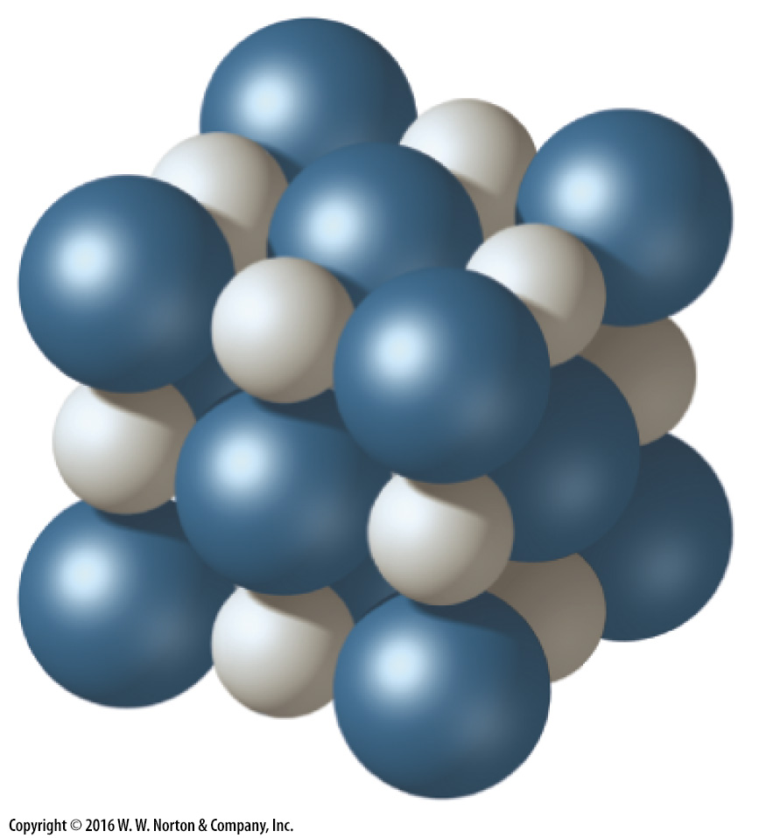
Notes:
FIGURE 3.5b The nature of crystalline structure in minerals.
(b) This packed-ball model gives a sense of how ions fit together in a crystal.

Slide 25
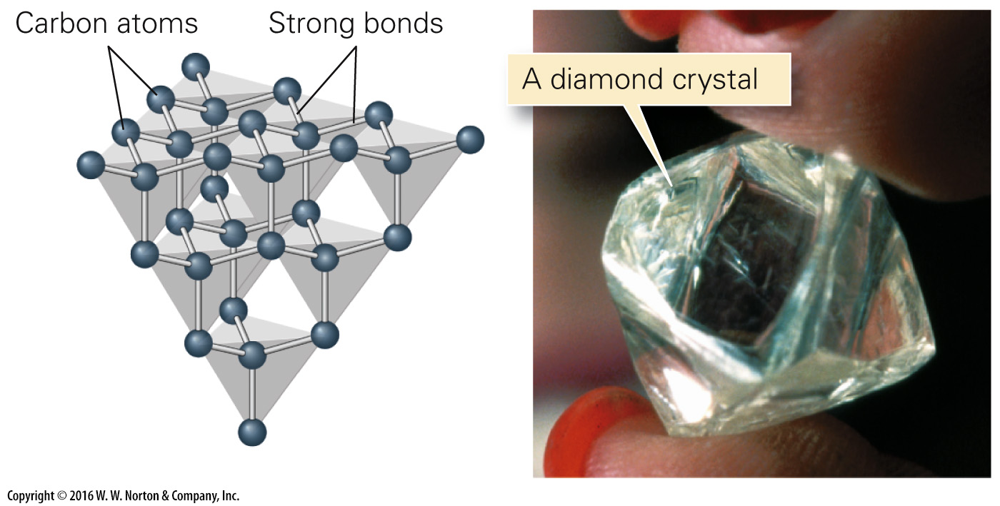
Notes:
FIGURE 3.5c The nature of crystalline structure in minerals.
(c) In a diamond, carbon atoms are arranged in tetrahedra. All of the bonds are strong.

Slide 26
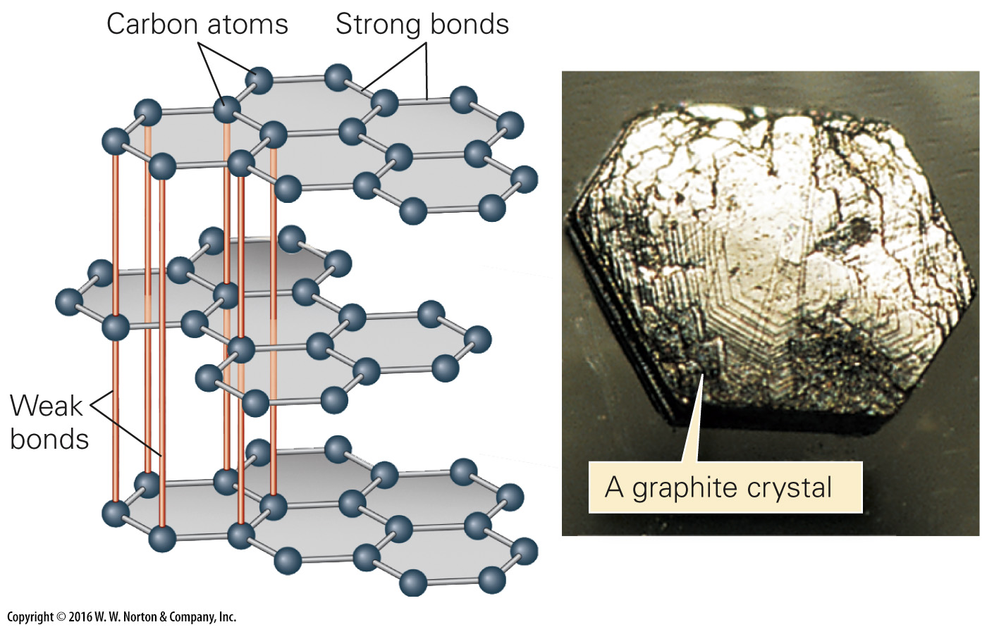
Notes:
FIGURE 3.5d The nature of crystalline structure in minerals.
(d) Graphite consists of carbon atoms arranged in hexagonal sheets. The sheets are connected by weak bonds.

Slide 27
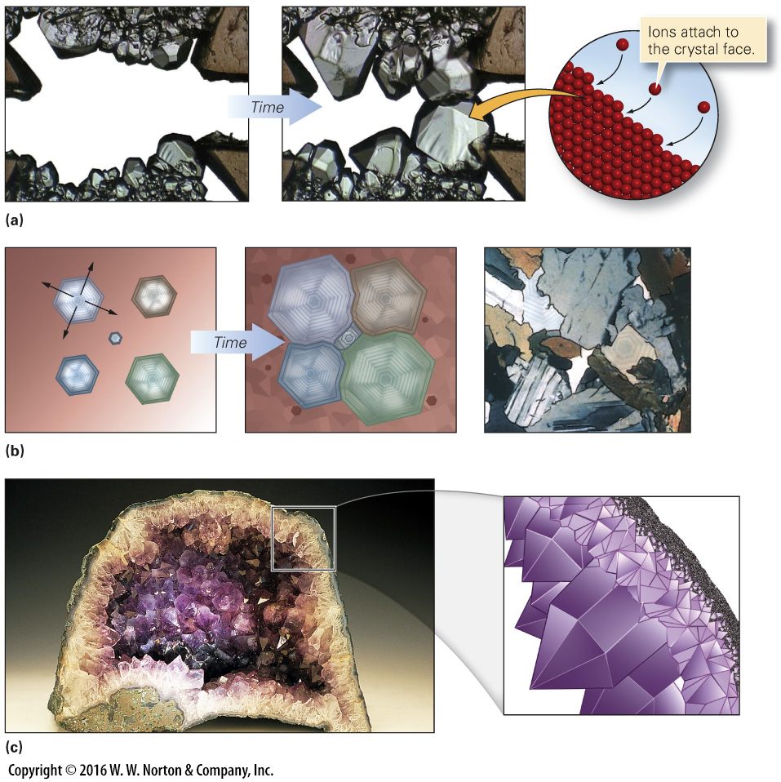
Notes:
FIGURE 3.6 The growth of crystals.
(a) New crystals nucleate and begin to precipitate out of a water solution. As time progresses, they grow into the open space. (b) New crystals grow outward from the central seed. As time passes, they maintain their shape until they interfere with each other. (c) A crystal growing in a confined space will be anhedral. (d) A geode from Brazil consists of purple quartz crystals (amethyst) that grew from the wall into the center. The enlargement sketch indicates that the crystals are euhedral.

Slide 28
Notes:
FIGURE 3.6a The growth of crystals.
(a) New crystals nucleate and begin to precipitate out of a water solution. As time progresses, they grow into the open space.

Slide 29
Notes:
FIGURE 3.6b The growth of crystals.
(b) New crystals grow outward from the central seed. As time passes, they maintain their shape until they interfere with each other.

Slide 30
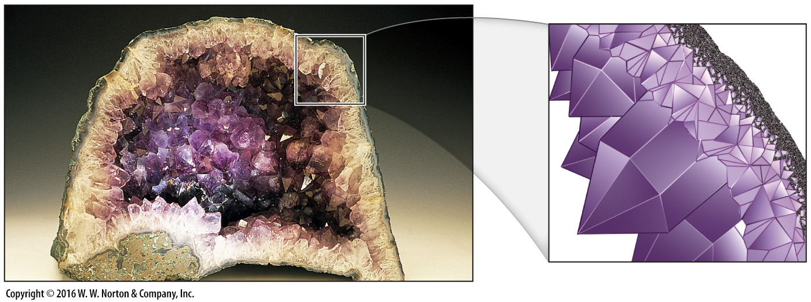
Notes:
FIGURE 3.6c The growth of crystals.
(c) A crystal growing in a confined space will be anhedral.

Slide 31
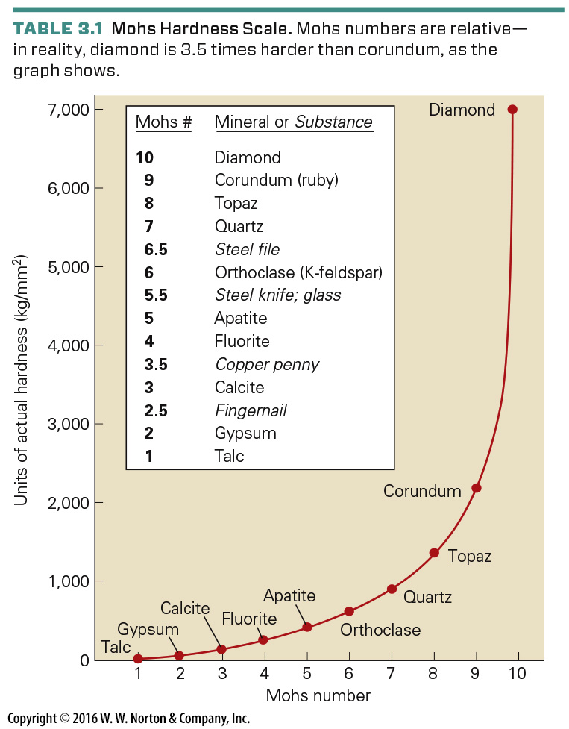
Notes:
TABLE 3.1 Mohs Hardness Scale. Mohs numbers are relative—in reality, diamond is 3.5 times harder than corundum, as the graph shows.

Slide 32
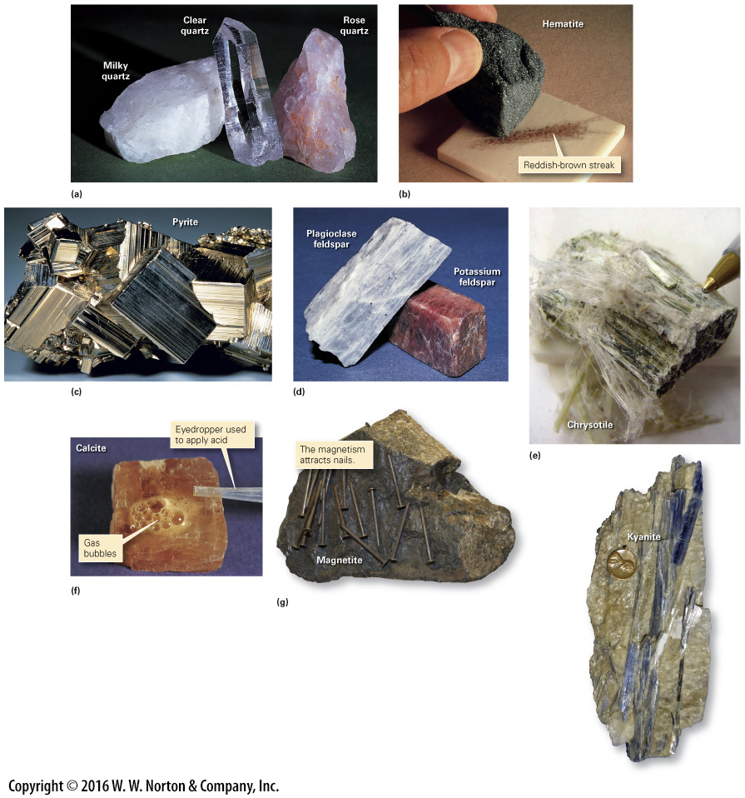
Notes:
FIGURE 3.7 Physical characteristics of minerals.
(a) Color is diagnostic of some minerals, but not all. For example, quartz can come in many colors. (b) To obtain the streak of a mineral, rub it against a porcelain plate. The streak consists of mineral powder. (c) Pyrite has a metallic luster because it gleams like metal. (d) Feldspar has a nonmetallic luster. (e) Crystal habit refers to the shape or character of the crystal. The blue kyanite crystals on the right are bladed, and the chrysotile above is fibrous. (f) Calcite reacts with hydrochloric acid to produce carbon dioxide gas. (g) Magnetite is magnetic.

Slide 33
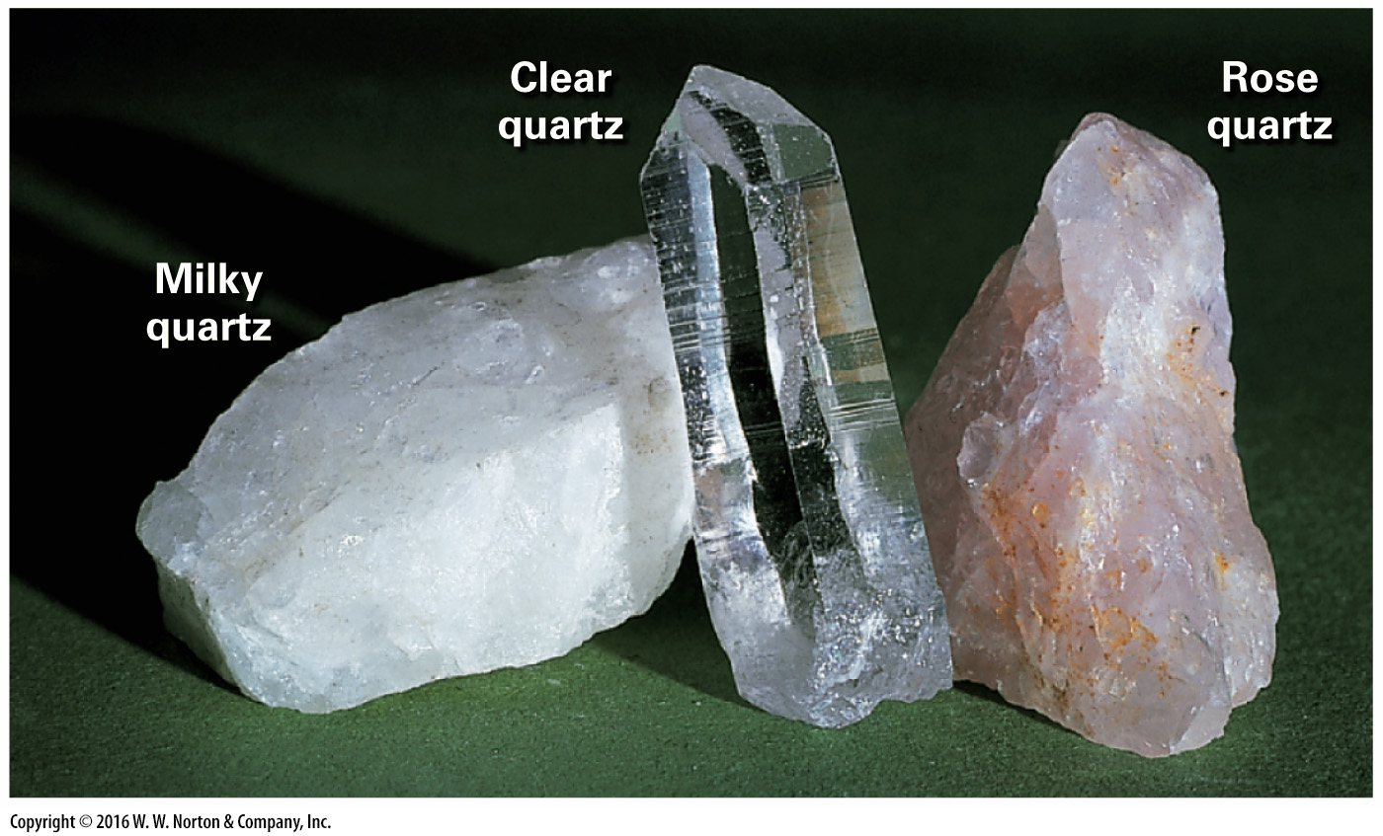
Notes:
FIGURE 3.7a Physical characteristics of minerals.
(a) Color is diagnostic of some minerals, but not all. For example, quartz can come in many colors.

Slide 34
Notes:
FIGURE 3.7b Physical characteristics of minerals.
(b) To obtain the streak of a mineral, rub it against a porcelain plate. The streak consists of mineral powder.

Slide 35
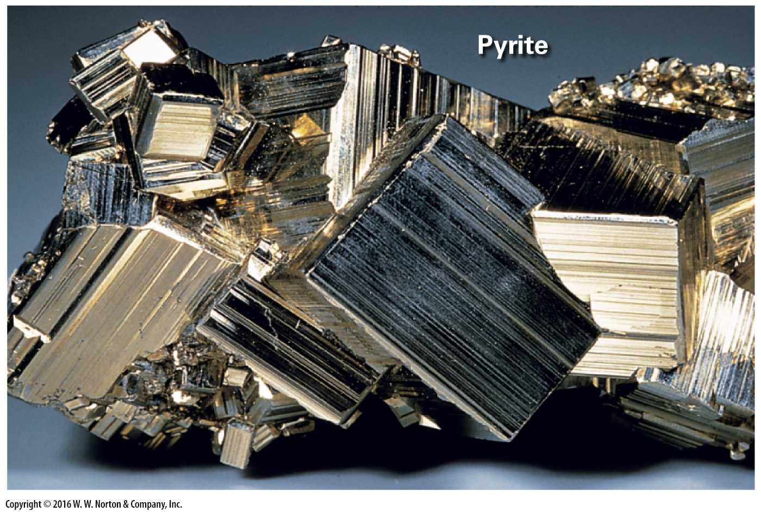
Notes:
FIGURE 3.7c Physical characteristics of minerals.
(c) Pyrite has a metallic luster because it gleams like metal.

Slide 36
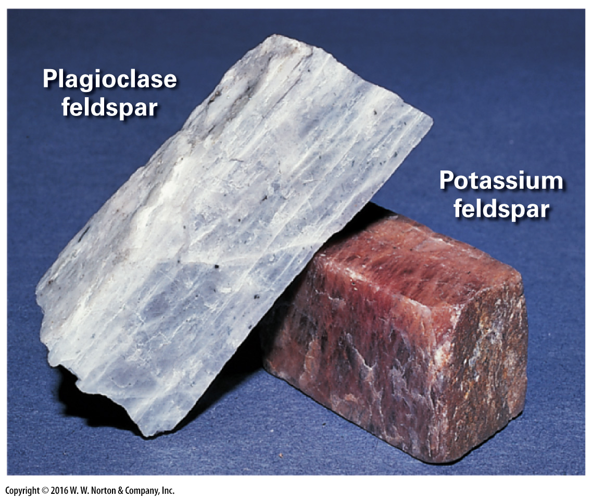
Notes:
FIGURE 3.7d Physical characteristics of minerals.
(d) Feldspar has a nonmetallic luster.

Slide 37
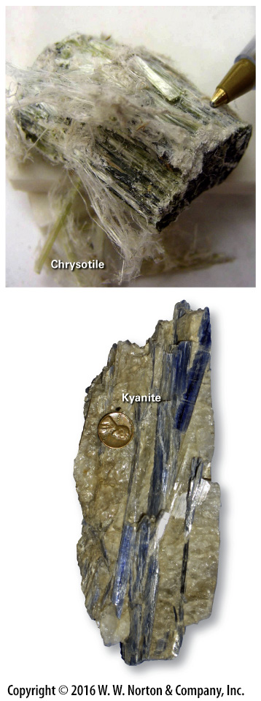
Notes:
FIGURE 3.7e Physical characteristics of minerals.
(e) Crystal habit refers to the shape or character of the crystal. The blue kyanite crystals on the right are bladed, and the chrysotile above is fibrous.

Slide 38
Notes:
FIGURE 3.7f Physical characteristics of minerals.
(f) Calcite reacts with hydrochloric acid to produce carbon dioxide gas.

Slide 39
Notes:
FIGURE 3.7g Physical characteristics of minerals.
(g) Magnetite is magnetic.

Slide 40
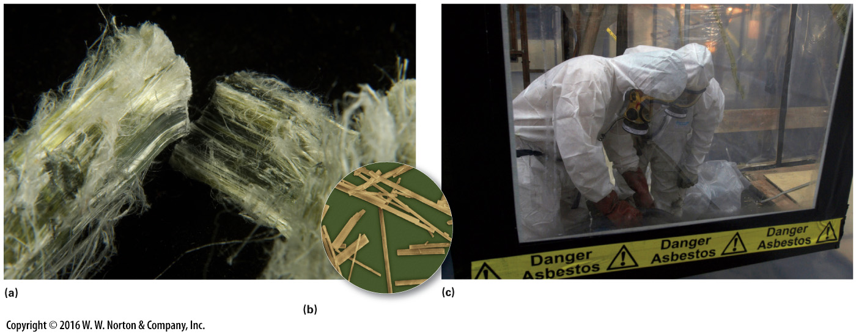
Notes:
FIGURE Bx3.2 Asbestos has characteristics that can make it both useful and hazardous.
(a) Asbestos is a fibrous mineral. (b) At high magnification, asbestos fibers look like tiny needles. (c) To remove asbestos requires protective gear and for the area to be sealed off.

Slide 41
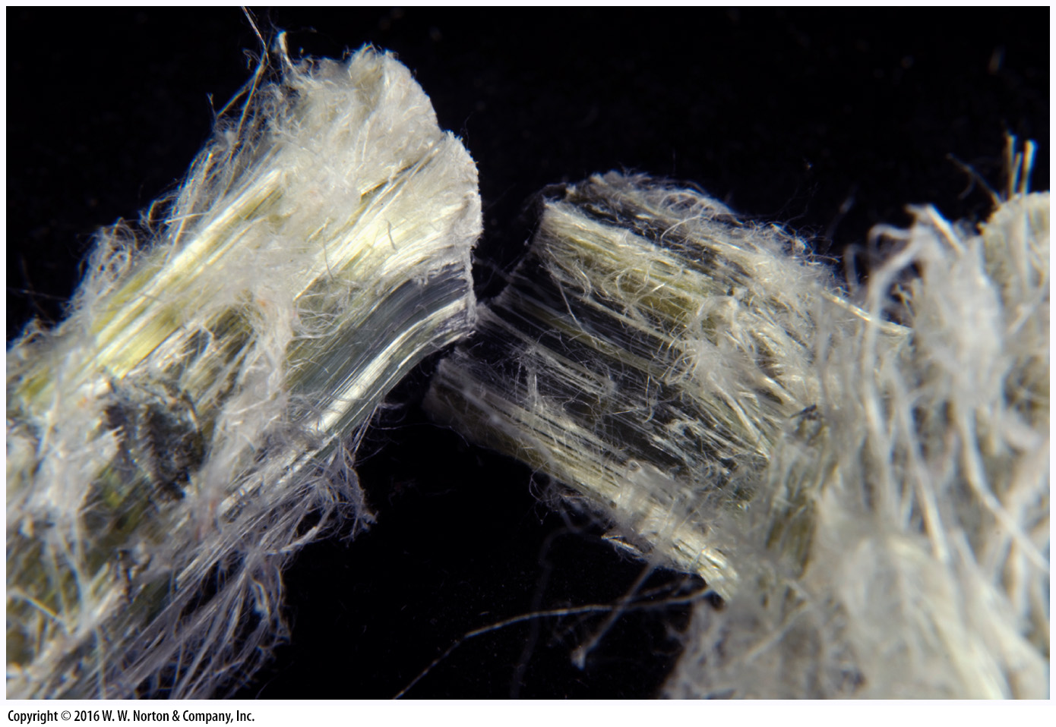
Notes:
FIGURE Bx3.2a Asbestos has characteristics that can make it both useful and hazardous.
(a) Asbestos is a fibrous mineral.

Slide 42
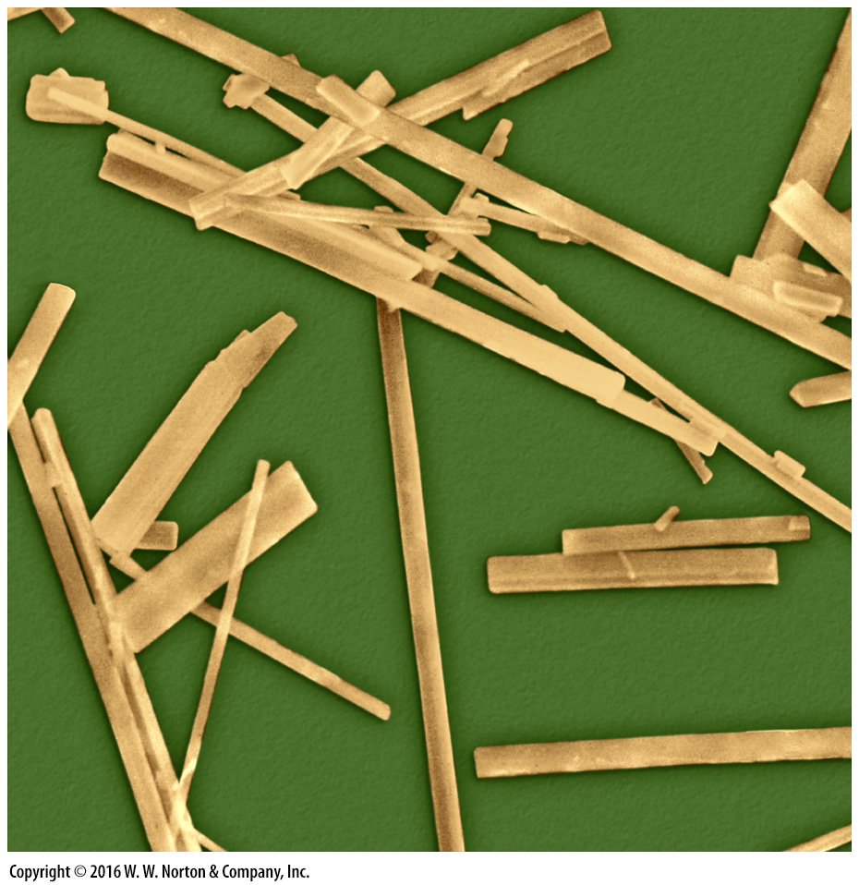
Notes:
FIGURE Bx3.2b Asbestos has characteristics that can make it both useful and hazardous.
(b) At high magnification, asbestos fibers look like tiny needles.

Slide 43
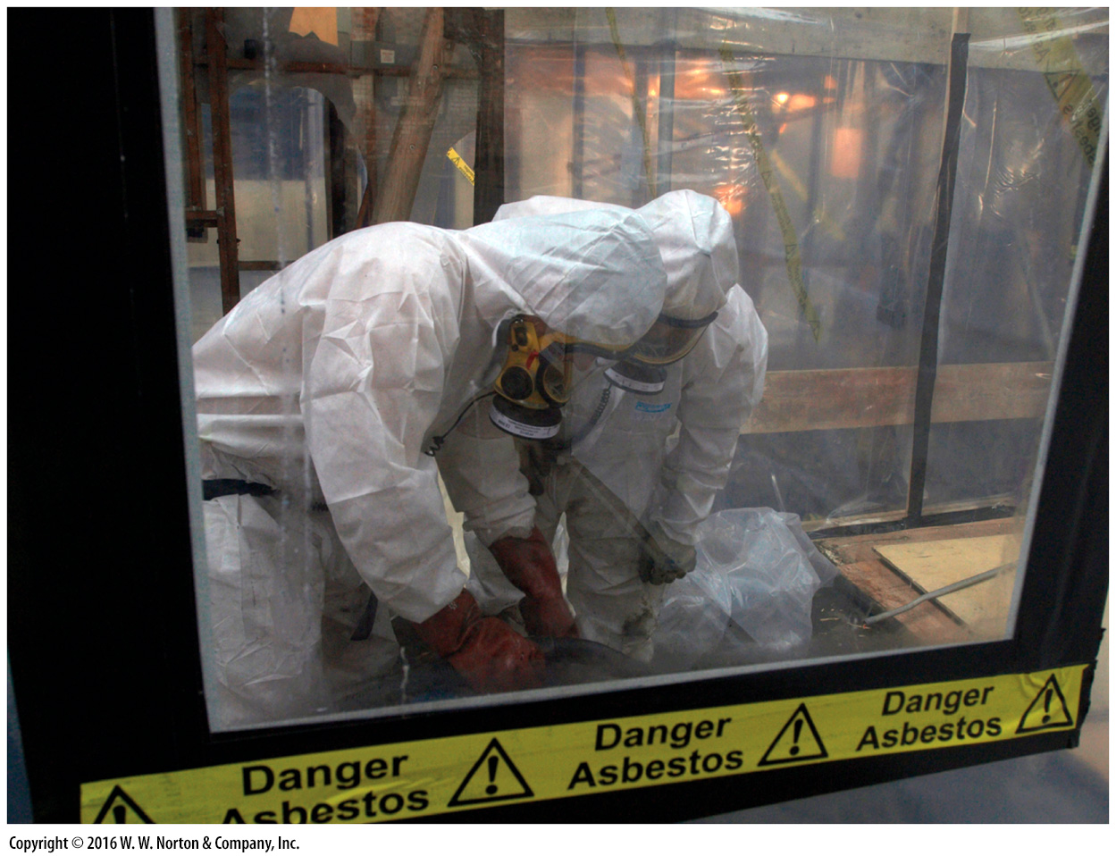
Notes:
FIGURE Bx3.2c Asbestos has characteristics that can make it both useful and hazardous.
(c) To remove asbestos requires protective gear and for the area to be sealed off.

Slide 44
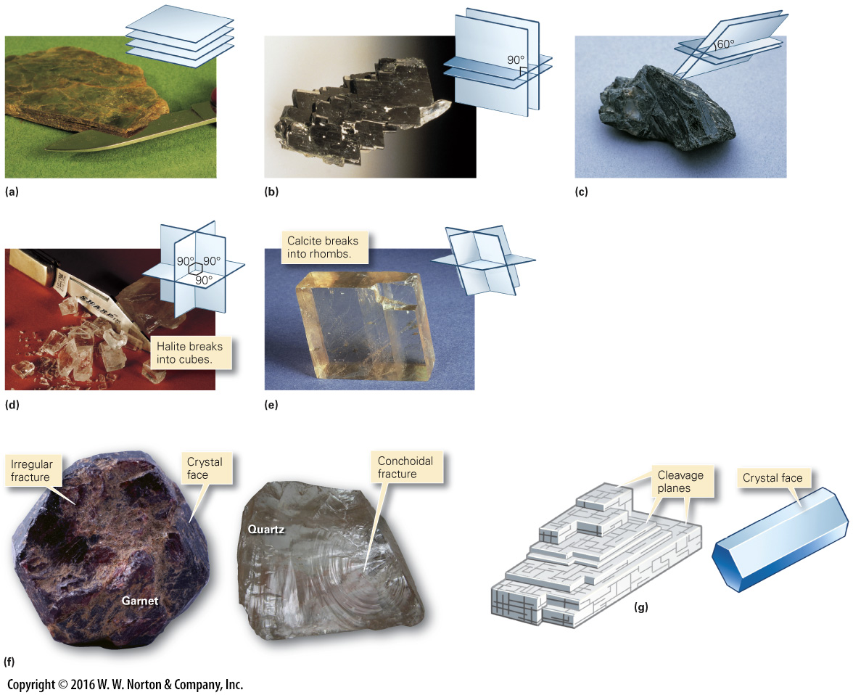
Notes:
FIGURE 3.8 The nature of mineral cleavage and fracture.
(a) Mica has one strong plane of cleavage and splits into sheets. (b) Pyroxene has two planes of cleavage that intersect at 90º. (c) Amphibole has two planes of cleavage that intersect at 60º. (d) Halite has three mutually perpendicular planes of cleavage. (e) Calcite has three planes of cleavage, one of which is inclined. (f) Minerals without cleavage can develop irregular or conchoidal fractures. (g) How do you distinguish between cleavage planes and crystal faces? Cleavage planes can be repeated, whereas a crystal face is a single surface.

Slide 45
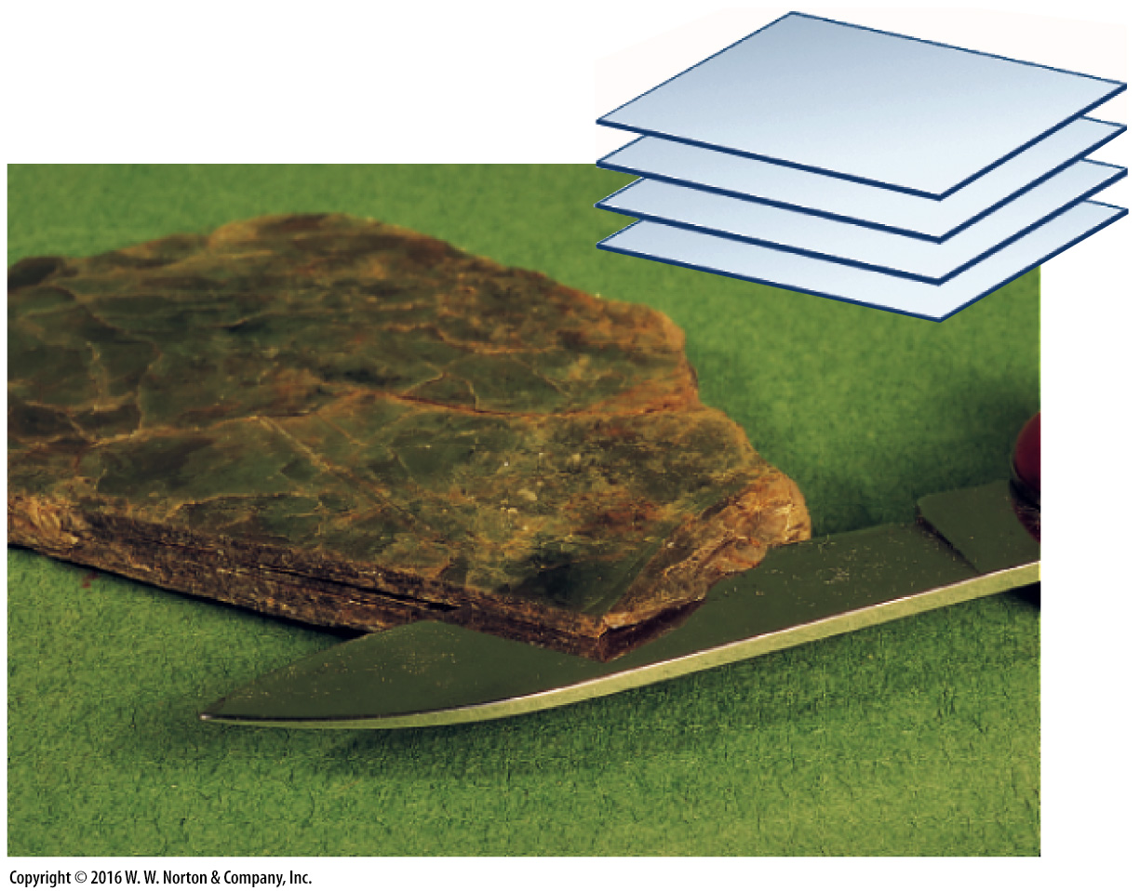
Notes:
FIGURE 3.8a The nature of mineral cleavage and fracture.
(a) Mica has one strong plane of cleavage and splits into sheets.

Slide 46
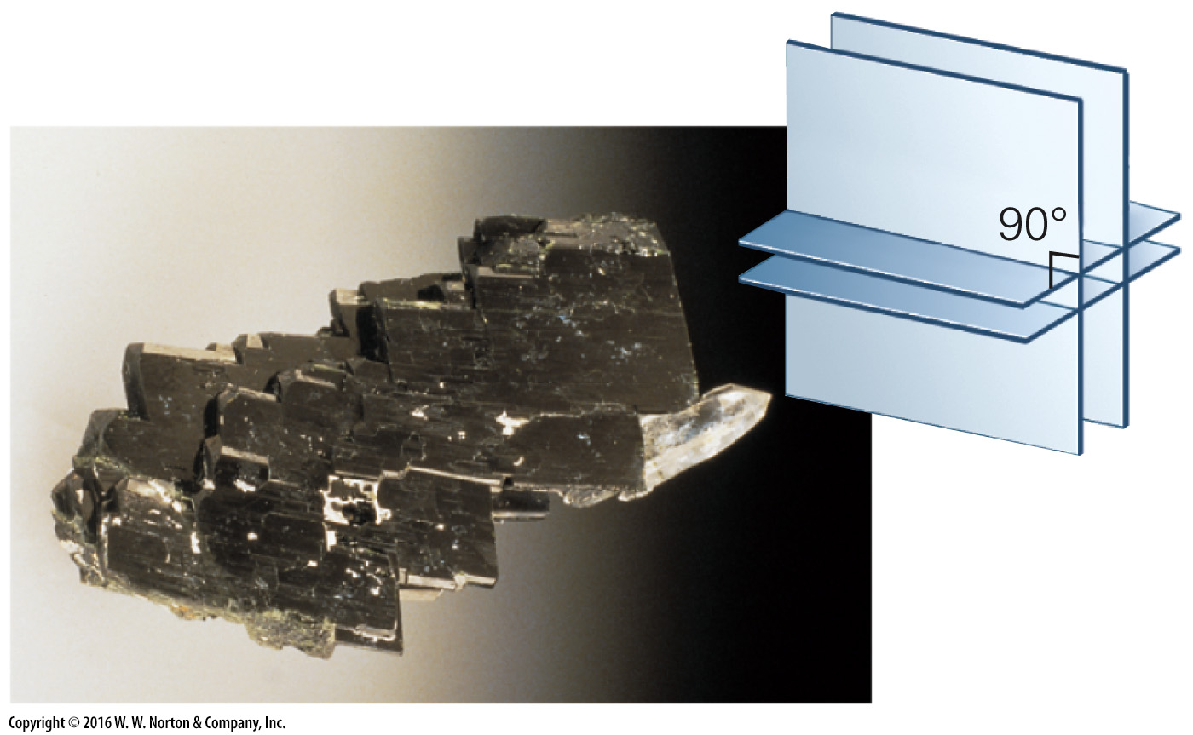
Notes:
FIGURE 3.8b The nature of mineral cleavage and fracture.
(b) Pyroxene has two planes of cleavage that intersect at 90º.

Slide 47
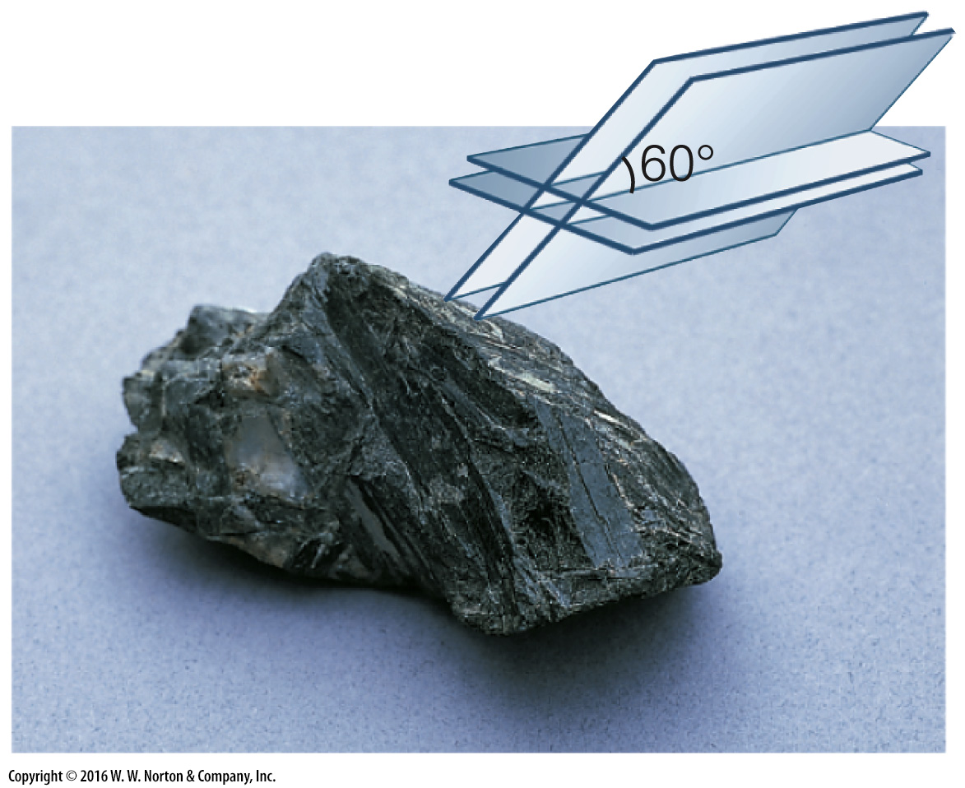
Notes:
FIGURE 3.8c The nature of mineral cleavage and fracture.
(c) Amphibole has two planes of cleavage that intersect at 60º.

Slide 48
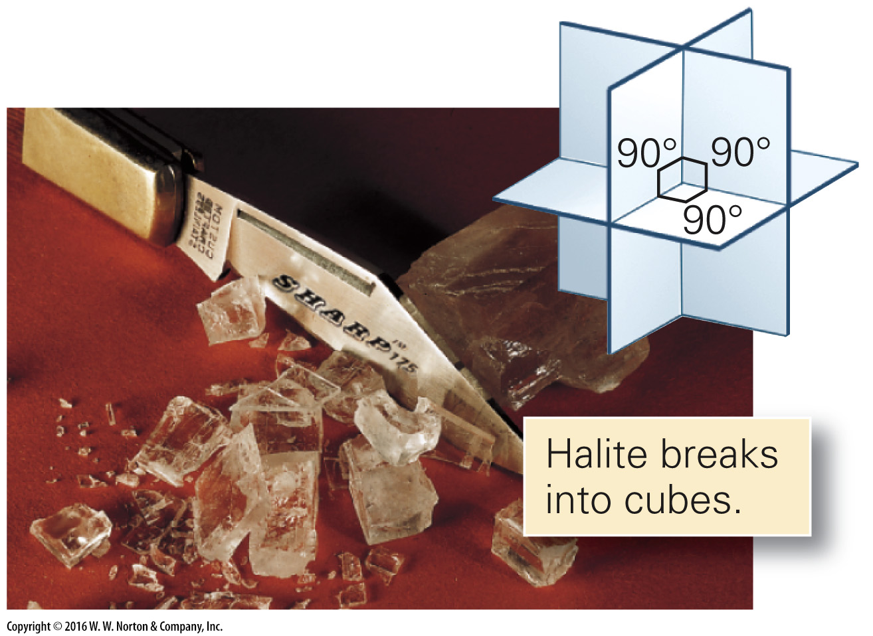
Notes:
FIGURE 3.8d The nature of mineral cleavage and fracture.
(d) Halite has three mutually perpendicular planes of cleavage.

Slide 49
Notes:
FIGURE 3.8e The nature of mineral cleavage and fracture.
(e) Calcite has three planes of cleavage, one of which is inclined.

Slide 50
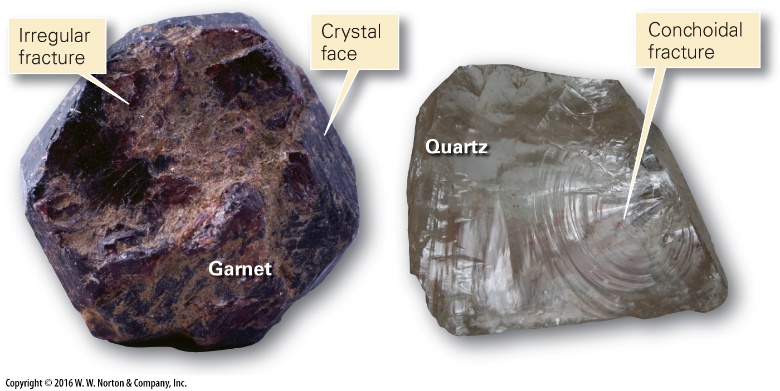
Notes:
FIGURE 3.8f The nature of mineral cleavage and fracture.
(f) Minerals without cleavage can develop irregular or conchoidal fractures.

Slide 51
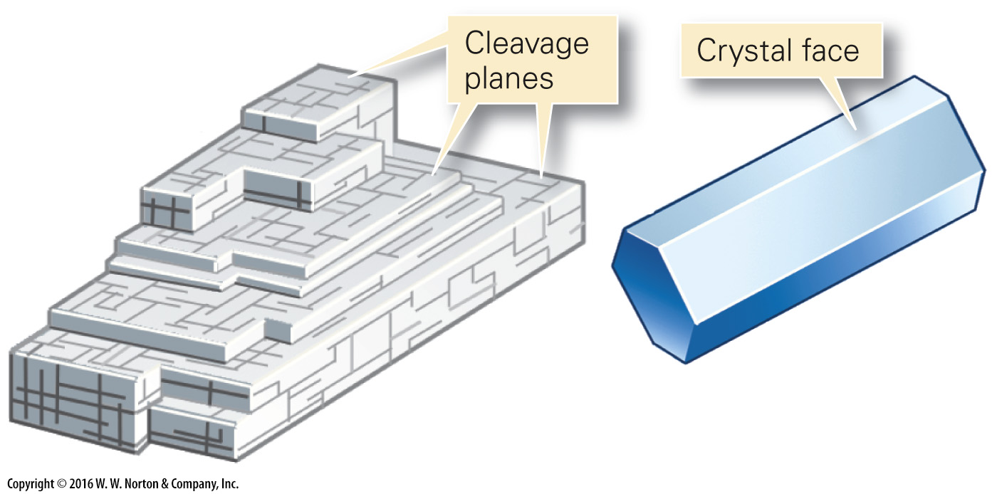
Notes:
FIGURE 3.8g The nature of mineral cleavage and fracture.
(g) How do you distinguish between cleavage planes and crystal faces? Cleavage planes can be repeated, whereas a crystal face is a single surface.

Slide 52
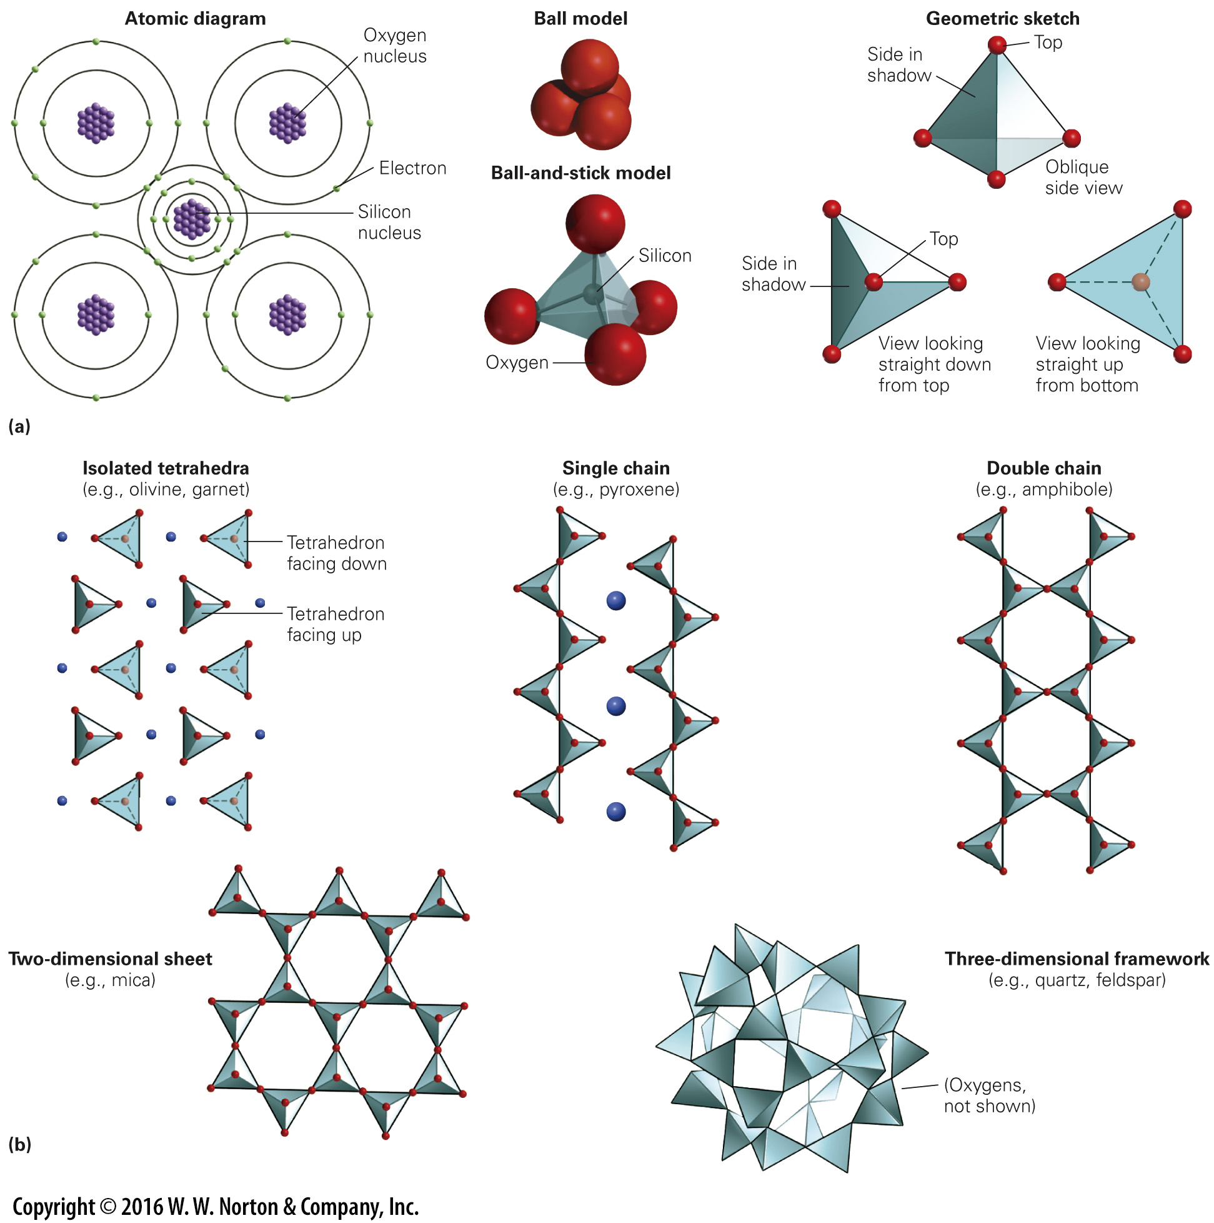
Notes:
FIGURE 3.9 The structure of silicate minerals.
(a) The fundamental building block of a silicate mineral is the silicon-oxygen tetrahedron. In this SiO₄^{4–} group, oxygens occupy the corners of the tetrahedron, and silicon lies at the center. Geologists portray the tetrahedron in a number of different ways. (b) The classes of silicate minerals differ from one another by the way in which the silicon-oxygen tetrahedra are linked. Where the tetrahedra link, they share an oxygen atom. Oxygen atoms are shown in red. Positive ions (not shown) occupy spaces between tetrahedra.

Slide 53
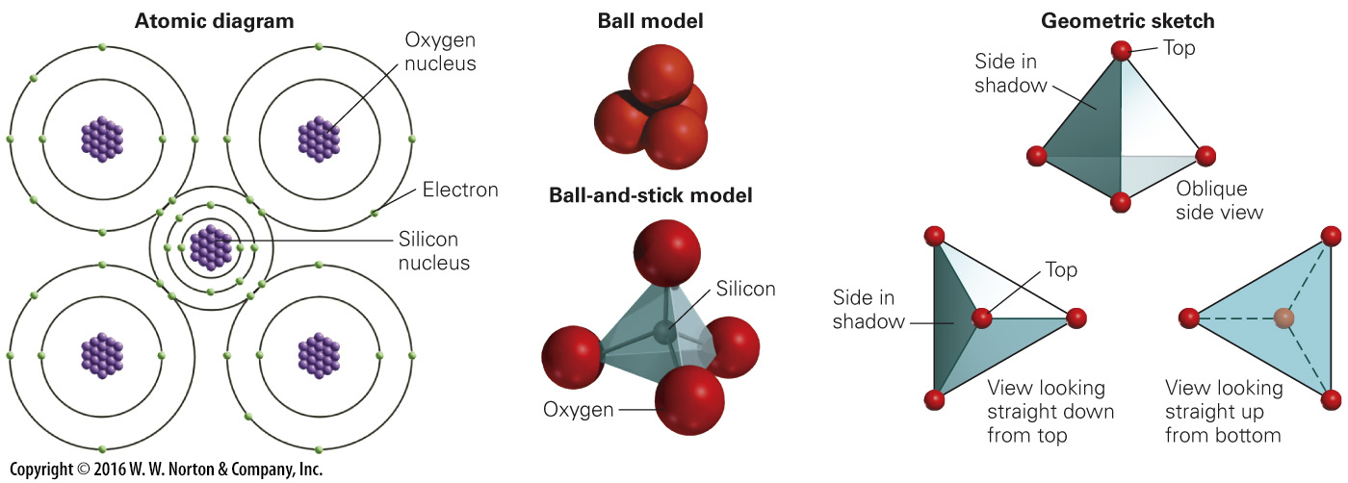
Notes:
FIGURE 3.9a The structure of silicate minerals.
(a) The fundamental building block of a silicate mineral is the silicon-oxygen tetrahedron. In this SiO₄^{4–} group, oxygens occupy the corners of the tetrahedron, and silicon lies at the center. Geologists portray the tetrahedron in a number of different ways.

Slide 54
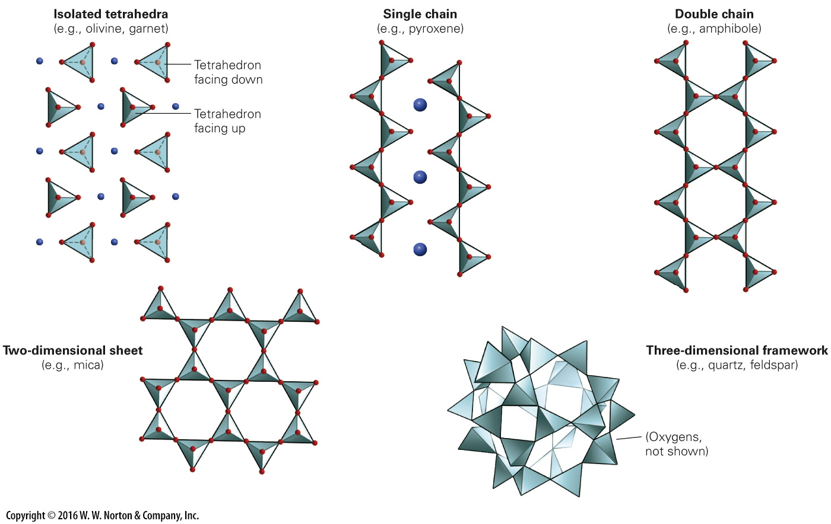
Notes:
FIGURE 3.9b The structure of silicate minerals.
(b) The classes of silicate minerals differ from one another by the way in which the silicon-oxygen tetrahedra are linked. Where the tetrahedra link, they share an oxygen atom. Oxygen atoms are shown in red. Positive ions (not shown) occupy spaces between tetrahedra.

Slide 55
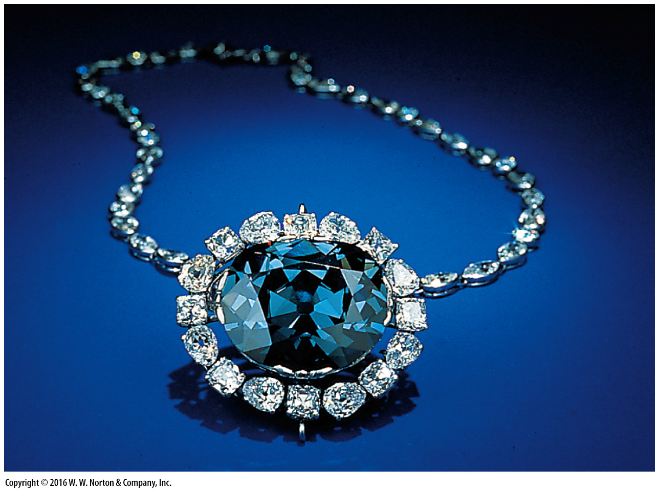
Notes:
FIGURE 3.10 The Hope Diamond, now on display at the Smithsonian Institution in Washington, DC.

Slide 56
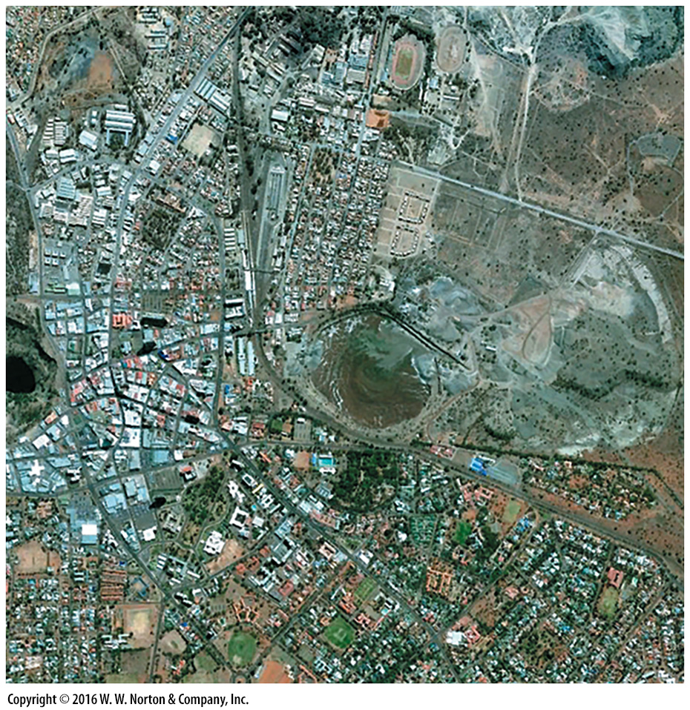
Notes:
SEE FOR YOURSELF…
KIMBERLEY DIAMOND MINE

Slide 57
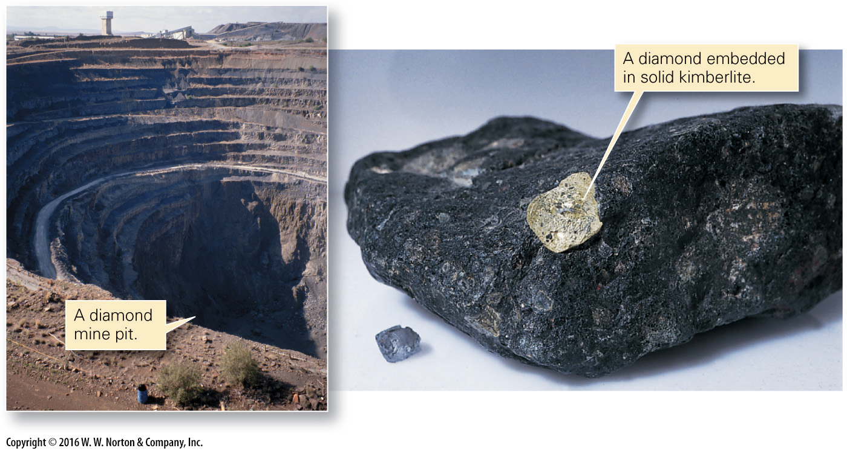
Notes:
FIGURE Bx3.3 Diamond occurrences.

Slide 58
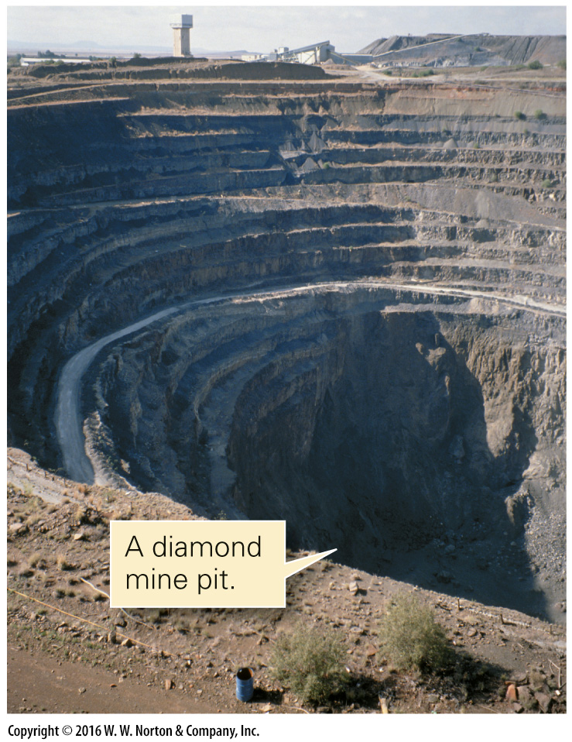
Notes:
FIGURE Bx3.3 (part 1) Diamond occurrences.

Slide 59
Notes:
FIGURE Bx3.3 (part 2) Diamond occurrences.

Slide 60
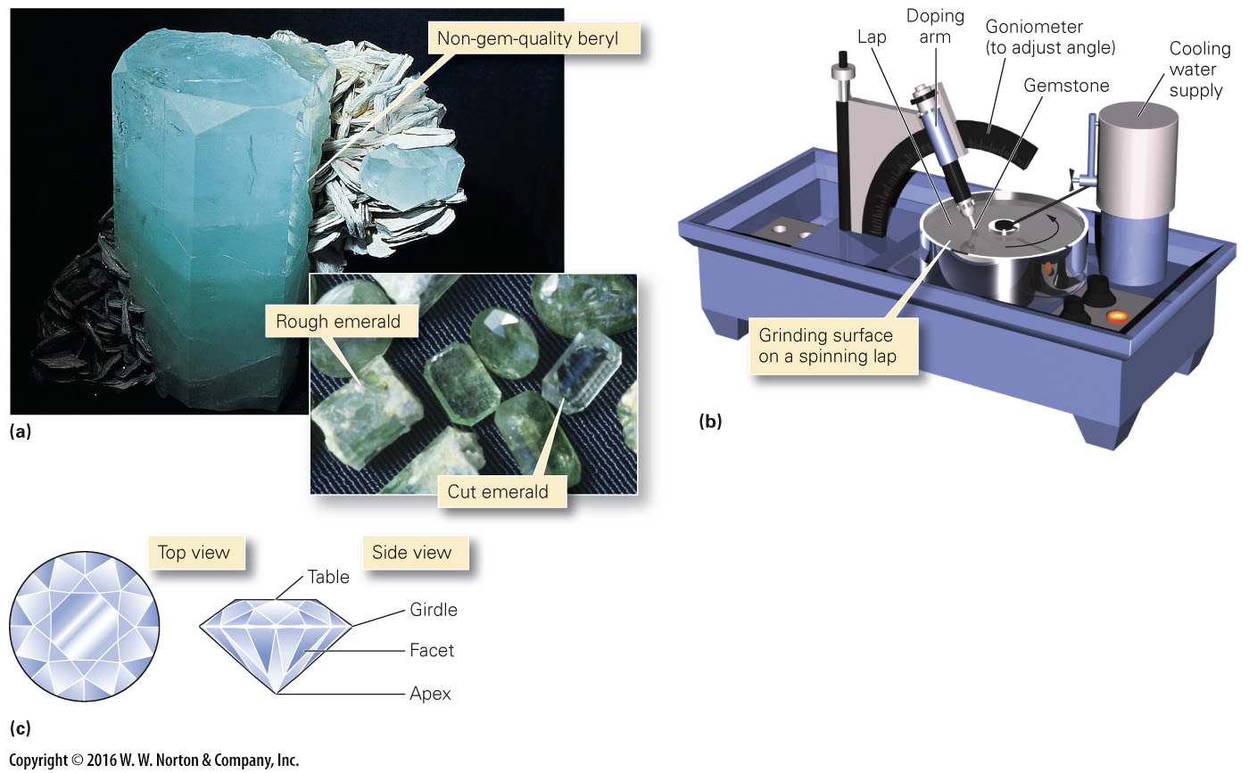
Notes:
FIGURE 3.11 Cutting gemstones.
(a) Emerald is a green, transparent variety of the mineral beryl. (b) The shiny faces of a gem are made by grinding the stone on a lap. (c) There are many different “cuts” for a gem. Here we see the top and side views of a brilliant-cut diamond.

Slide 61
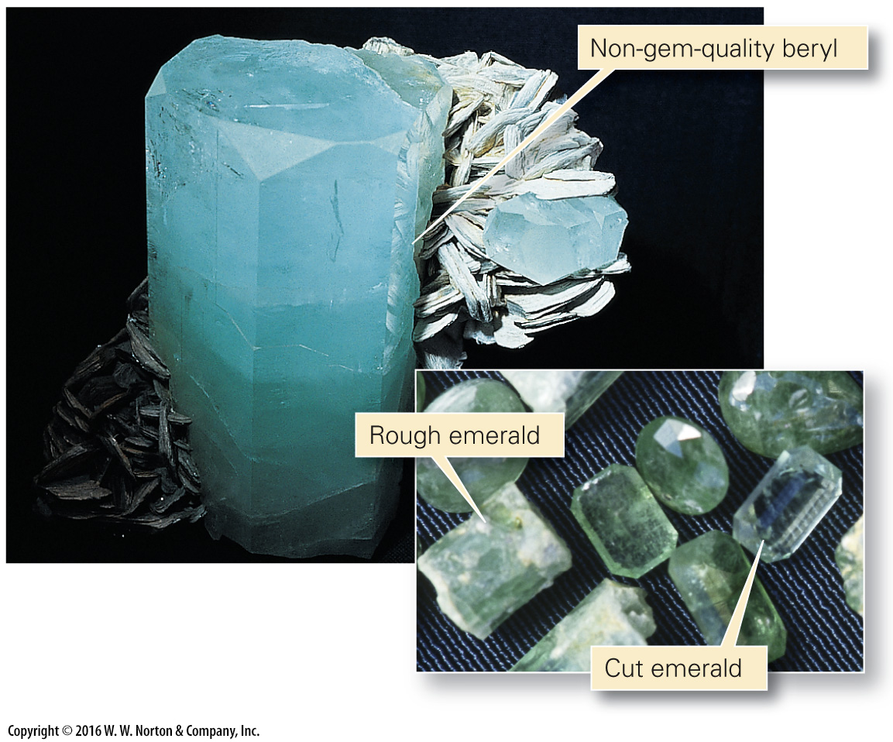
Notes:
FIGURE 3.11a Cutting gemstones.
(a) Emerald is a green, transparent variety of the mineral beryl.

Slide 62
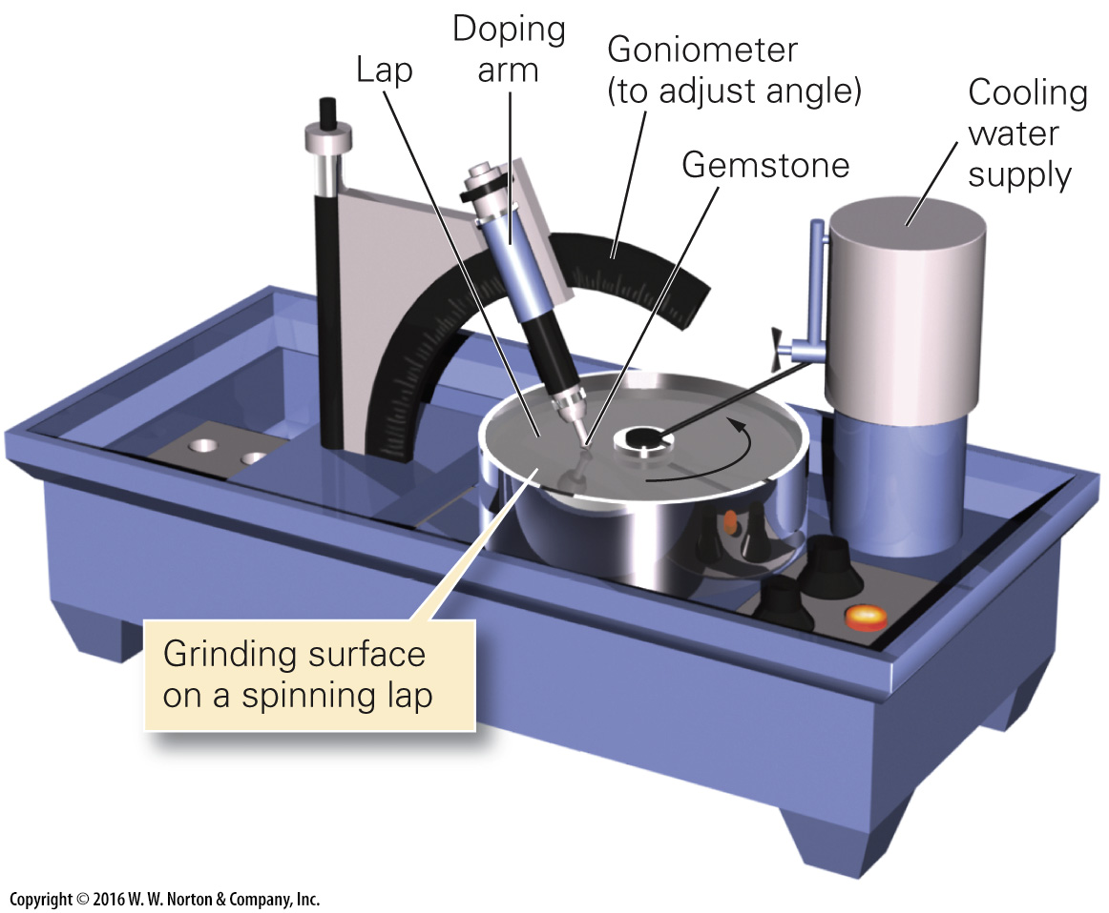
Notes:
FIGURE 3.11b Cutting gemstones.
(b) The shiny faces of a gem are made by grinding the stone on a lap.

Slide 63
Notes:
FIGURE 3.11c Cutting gemstones.
(c) There are many different “cuts” for a gem. Here we see the top and side views of a brilliant-cut diamond.

Slide 64
Notes:
SEE FOR YOURSELF…
EKATI DIAMOND MINE, CANADA

Slide 65
Notes:
Another View A museum specimen of wulfenite, a mineral containing lead and molybdenum. It precipitates in cracks to form clusters of small tabular crystals.

