Slide 1
Stephen Marshak
ESSENTIALS OF
Geology
FIFTH EDITION
Chapter 4
Up from the Inferno:
Magma and Igneous Rocks
©2016 W. W. Norton & Company, Inc.

Slide 2
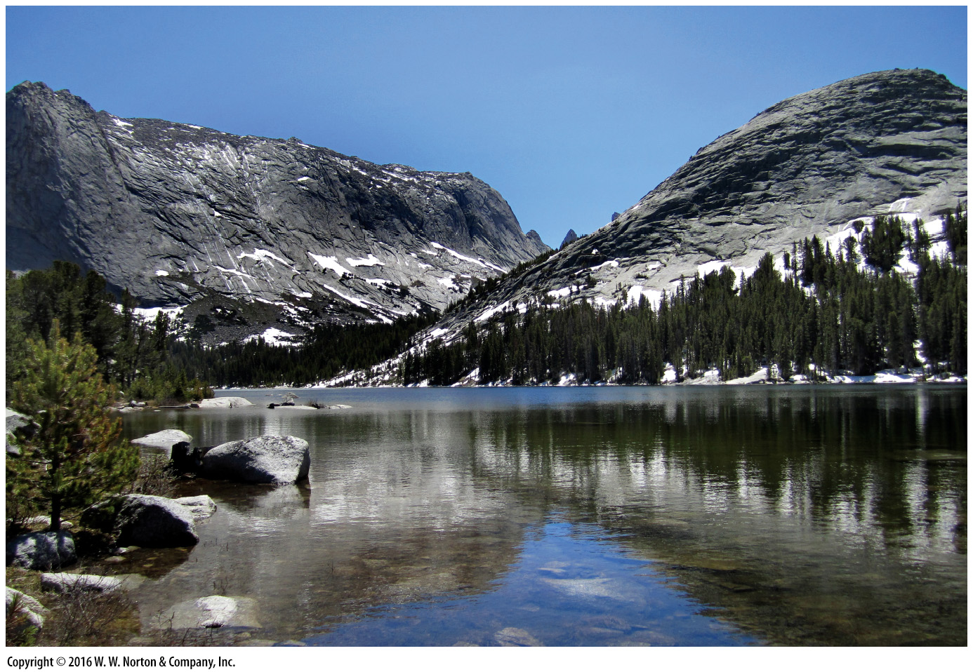
Notes:
These peaks in the Wind River Mountains of Wyoming consist of granite, formed by the cooling of molten rock over a long period of time, at depth in the crust. The granite, which formed over 2.5 billion years ago, did not reach the surface of the Earth until kilometers of overlying rock had been eroded away.

Slide 3
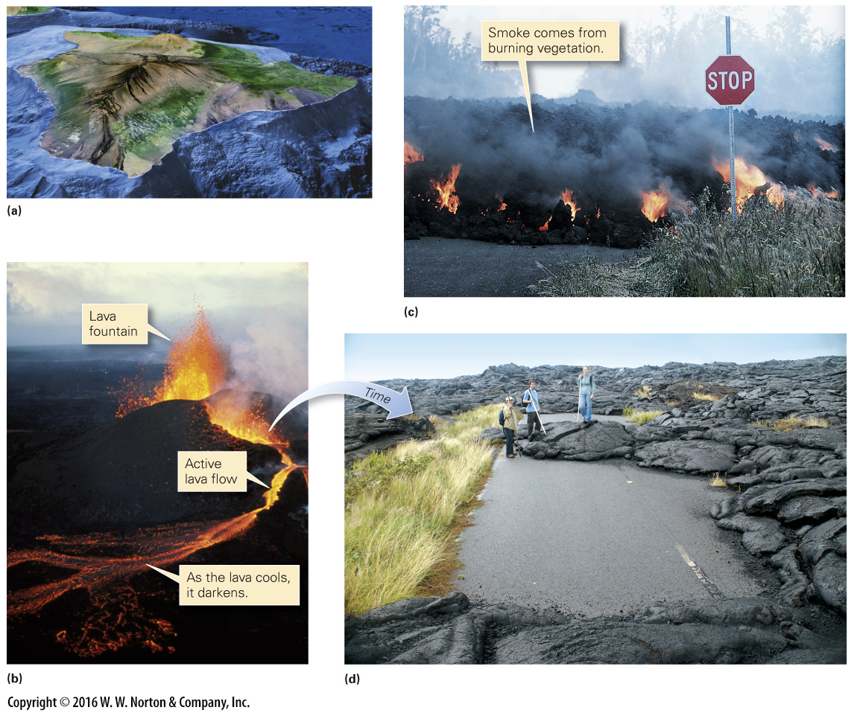
Notes:
FIGURE 4.1 Formation and evolution of lava flows.
(a) A view of Hawaii, looking north. Kilauea and Mauna Loa have erupted in the past few decades, and since their recent lava flows are darker than other areas. Mauna Kea last erupted over 4,600 years ago. (b) Lava erupts as a fountain from a volcanic vent on Hawaii. A fast-moving river of lava then flows downslope. (c) At a distance from the vent, the lava has completely crusted over with new rock, but the interior of the flow remains molten. (d) Eventually, the flow cools completely and becomes a layer of new rock. This flow engulfed a road on Hawaii.

Slide 4
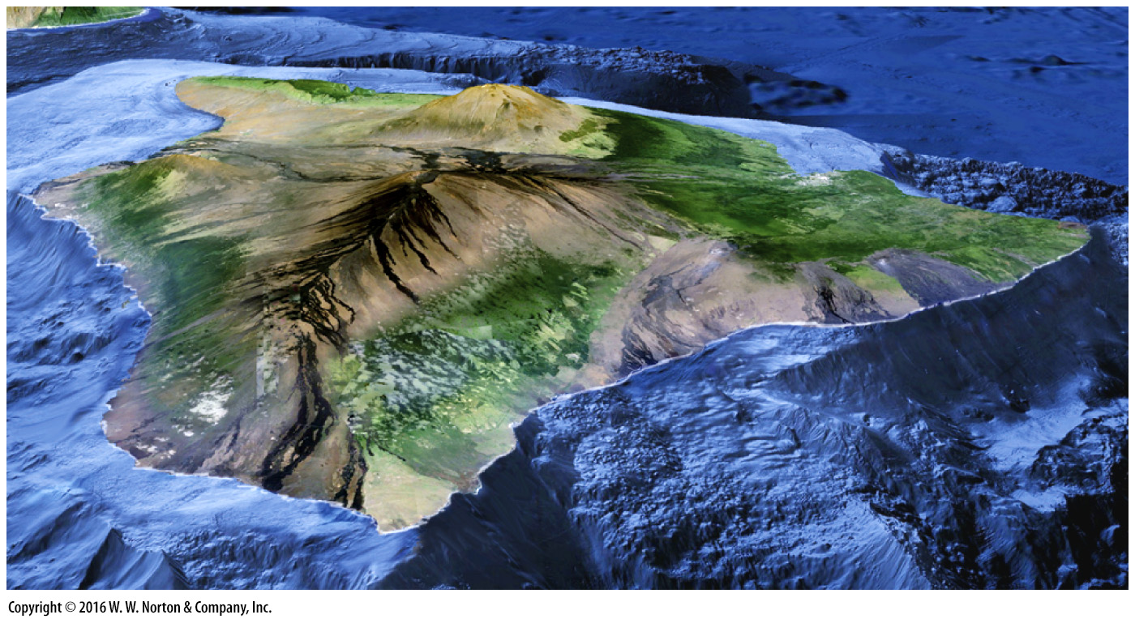
Notes:
FIGURE 4.1a Formation and evolution of lava flows.
(a) A view of Hawaii, looking north. Kilauea and Mauna Loa have erupted in the past few decades, and since their recent lava flows are darker than other areas. Mauna Kea last erupted over 4,600 years ago.

Slide 5
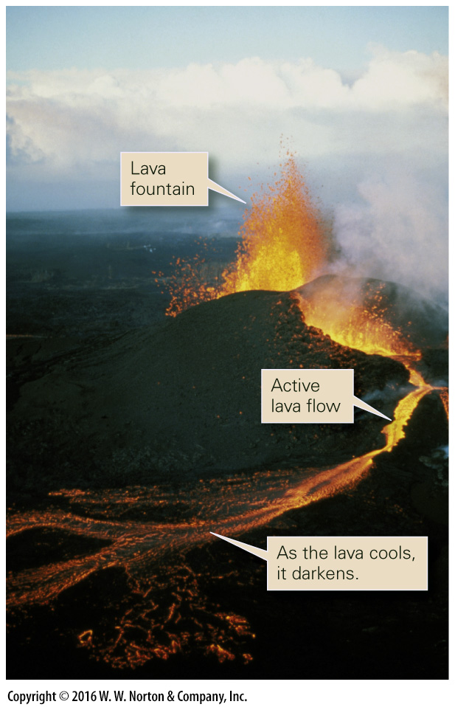
Notes:
FIGURE 4.1b Formation and evolution of lava flows.
(b) Lava erupts as a fountain from a volcanic vent on Hawaii. A fast-moving river of lava then flows downslope.

Slide 6
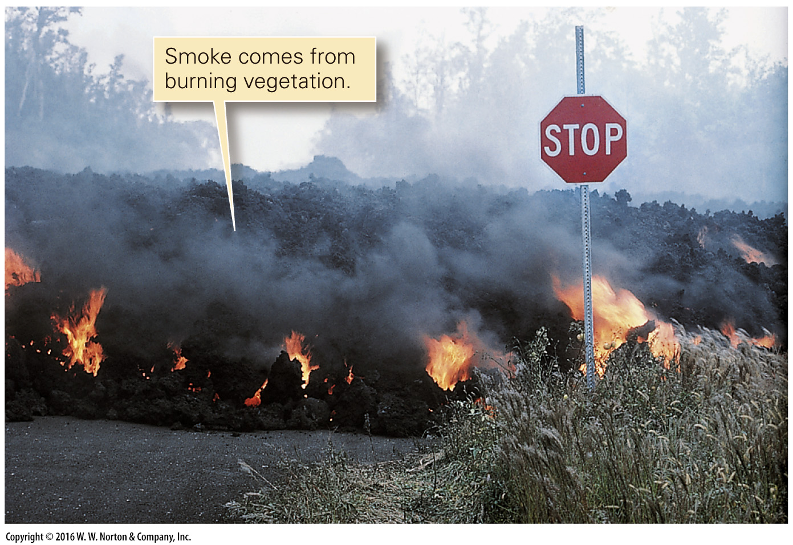
Notes:
FIGURE 4.1c Formation and evolution of lava flows.
(c) At a distance from the vent, the lava has completely crusted over with new rock, but the interior of the flow remains molten.

Slide 7
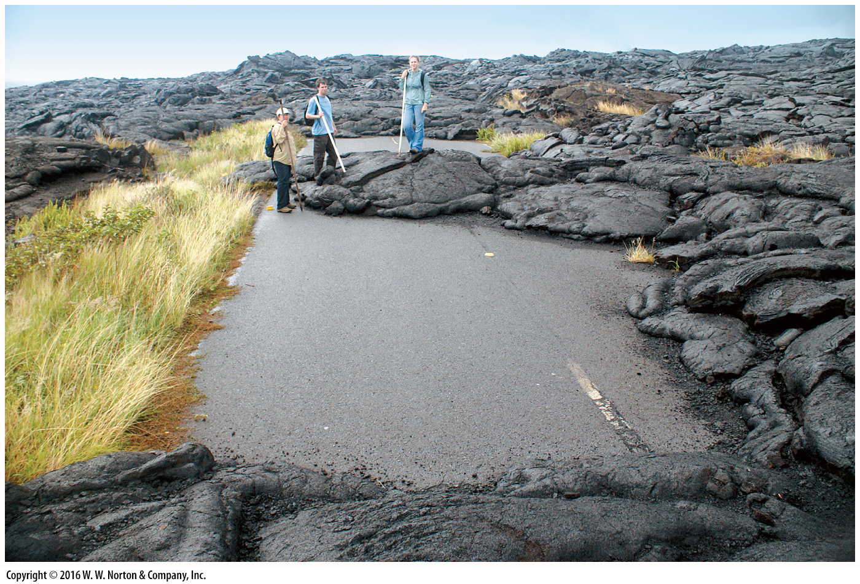
Notes:
FIGURE 4.1d Formation and evolution of lava flows.
(d) Eventually, the flow cools completely and becomes a layer of new rock. This flow engulfed a road on Hawaii.

Slide 8
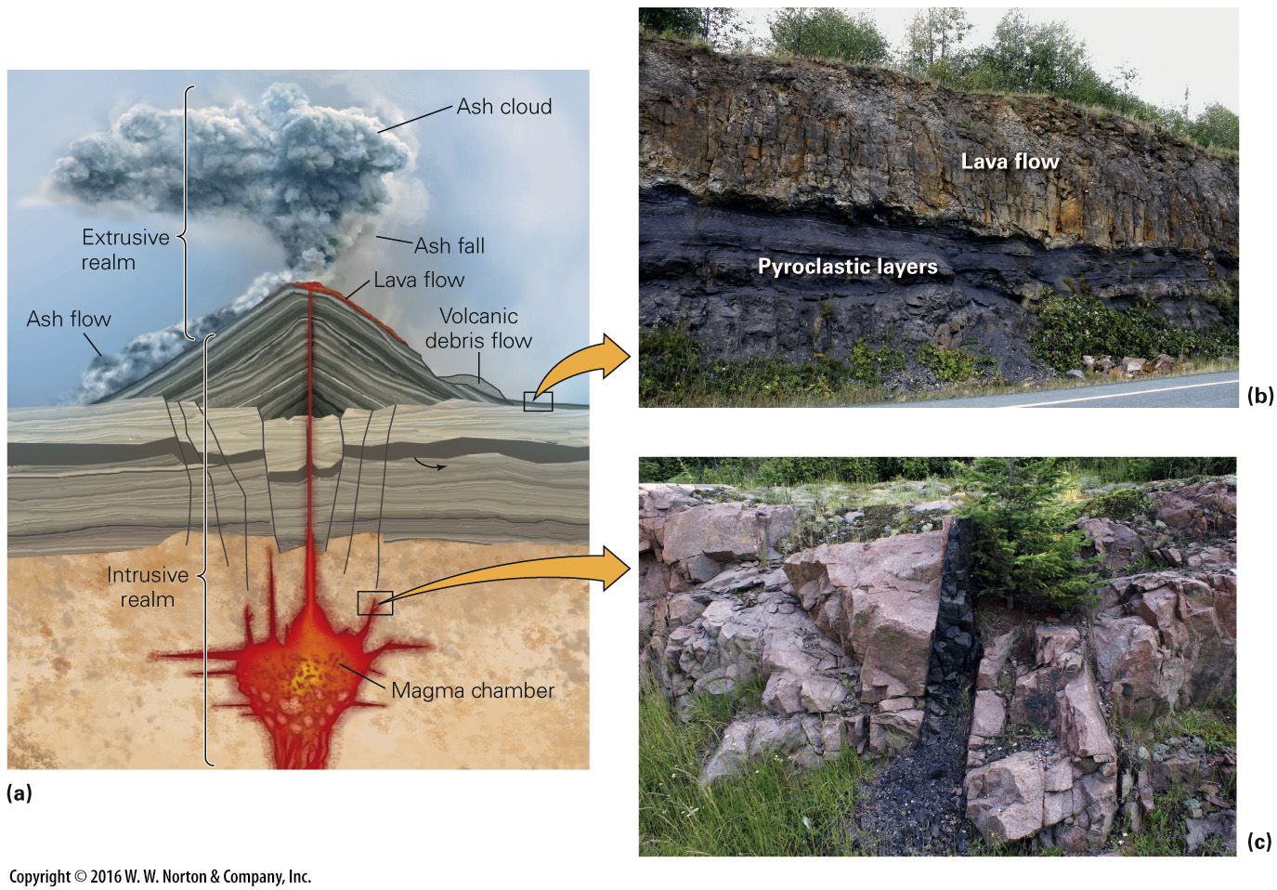
Notes:
FIGURE 4.2 The intrusive and extrusive realms.
(a) The intrusive realm lies underground and the extrusive realm lies aboveground. Lava flows, as well as various types of ash eruptions, all produce extrusive rocks. (b) Extrusive rocks include lava flows and pyroclastic layers. (c) An intrusion of basalt (dark rock) cuts across a mass of granite (light rock).

Slide 9
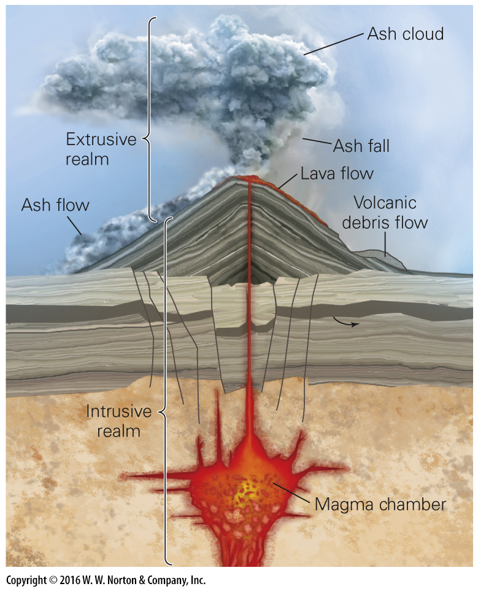
Notes:
FIGURE 4.2a The intrusive and extrusive realms.
(a) The intrusive realm lies underground and the extrusive realm lies aboveground. Lava flows, as well as various types of ash eruptions, all produce extrusive rocks.

Slide 10
Notes:
FIGURE 4.2b The intrusive and extrusive realms.
(b) Extrusive rocks include lava flows and pyroclastic layers.

Slide 11
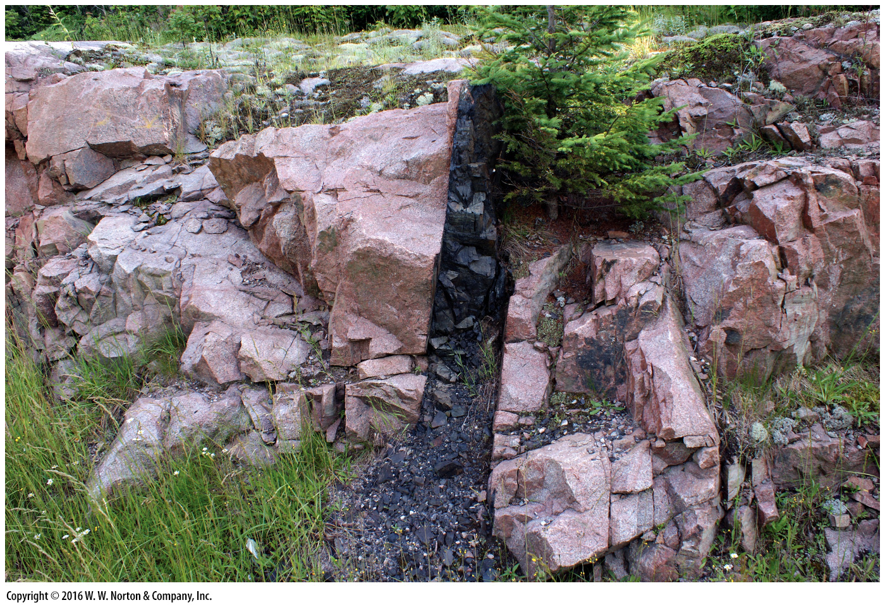
Notes:
FIGURE 4.2c The intrusive and extrusive realms.
(c) An intrusion of basalt (dark rock) cuts across a mass of granite (light rock).

Slide 12
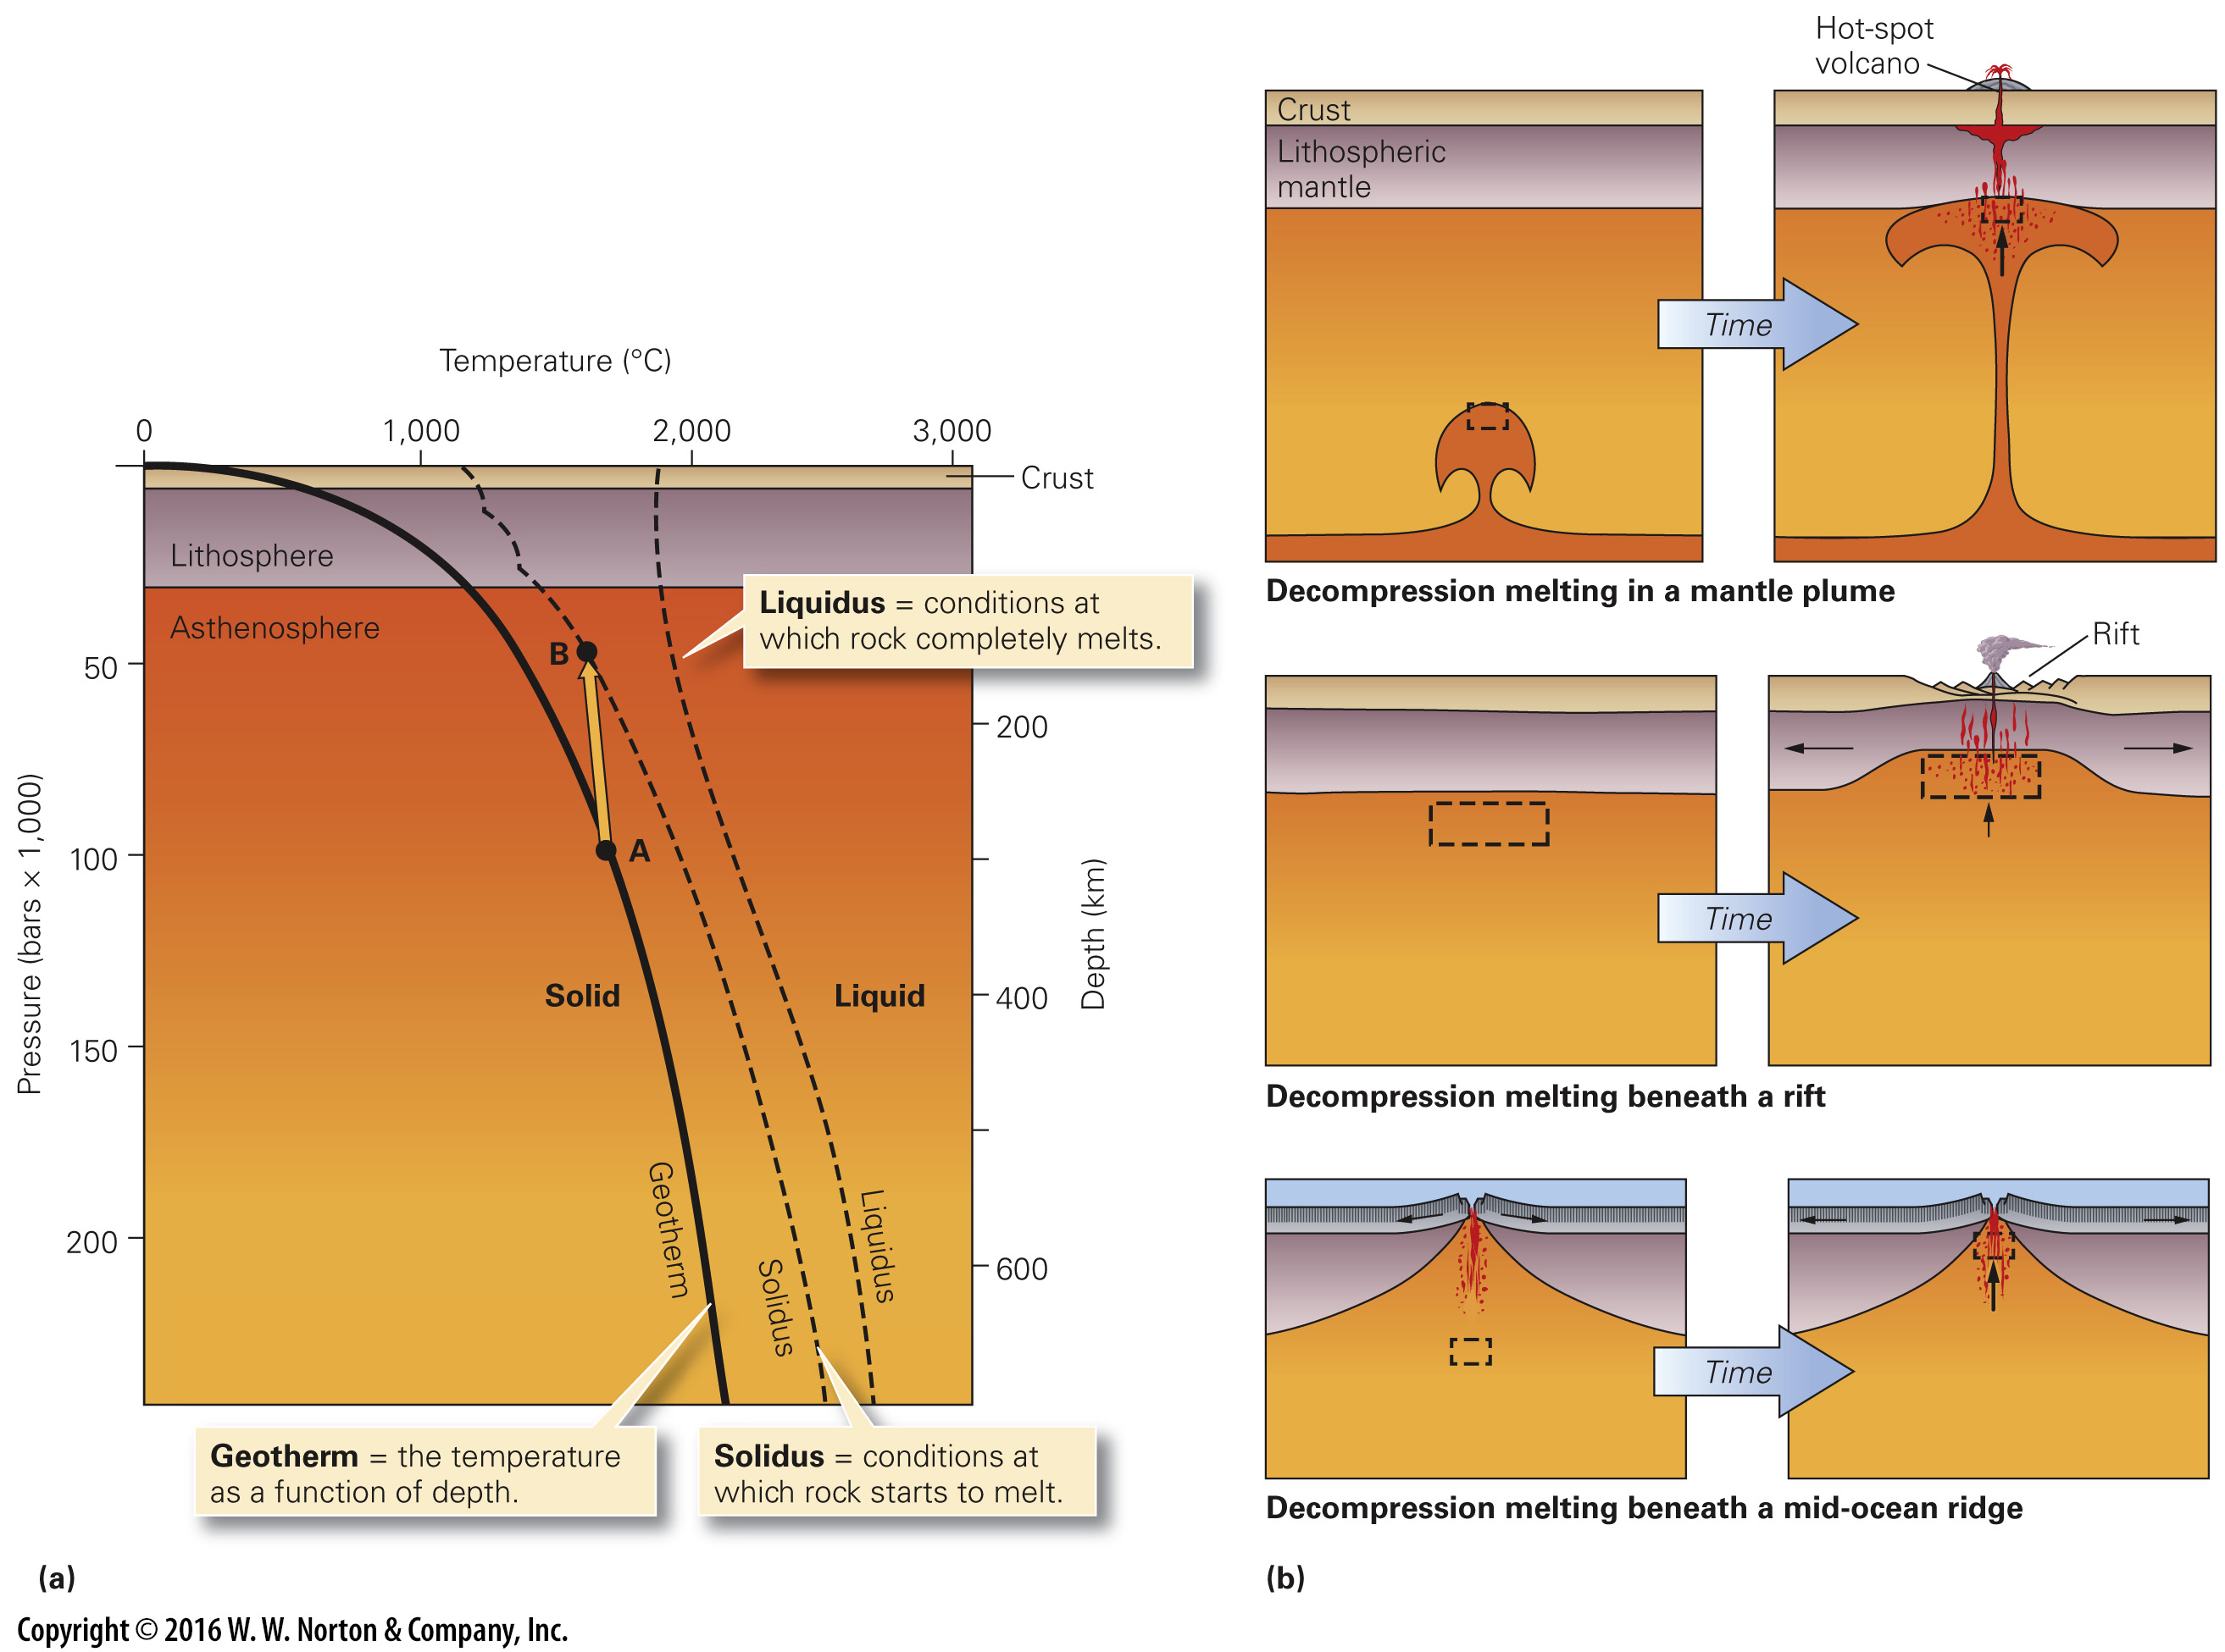
Notes:
FIGURE 4.3 Decompression melting.
(a) Decompression takes place when the pressure acting on hot rock decreases. As this graph of pressure and temperature conditions in the Earth shows, when rock rises from point A to point B, the pressure decreases a lot, but the rock cools only a little, so the rock begins to melt. (b) The conditions leading to decompression melting occur in several different geologic environments. In each case, a volume of hot asthenosphere (outlined by dashed lines) rises to a shallower depth, and magma (red dots) forms.

Slide 13
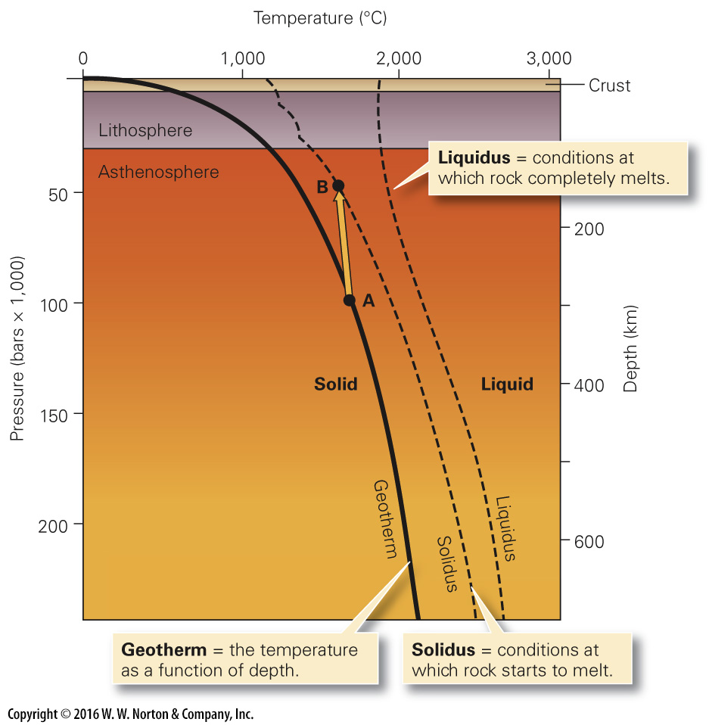
Notes:
FIGURE 4.3a Decompression melting.
(a) Decompression takes place when the pressure acting on hot rock decreases. As this graph of pressure and temperature conditions in the Earth shows, when rock rises from point A to point B, the pressure decreases a lot, but the rock cools only a little, so the rock begins to melt.

Slide 14
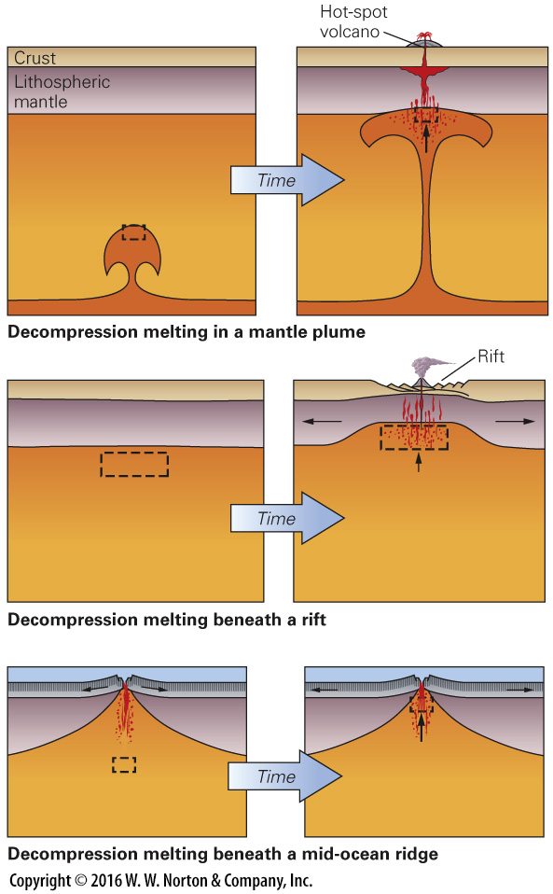
Notes:
FIGURE 4.3b Decompression melting.
(b) The conditions leading to decompression melting occur in several different geologic environments. In each case, a volume of hot asthenosphere (outlined by dashed lines) rises to a shallower depth, and magma (red dots) forms.

Slide 15
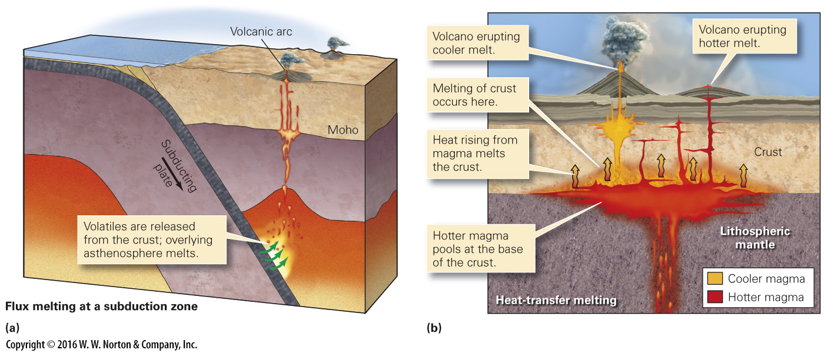
Notes:
FIGURE 4.4 Flux melting and heat-transfer melting.
(a) Flux melting occurs where volatiles enter hot mantle; this happens at subduction zones. (b) Heat-transfer melting occurs when rising magma brings heat up with it and melts overlying or surrounding rock. (We’ll see that the cooler magma is felsic, and the hotter magma is mafic.) (Not to scale.)

Slide 16
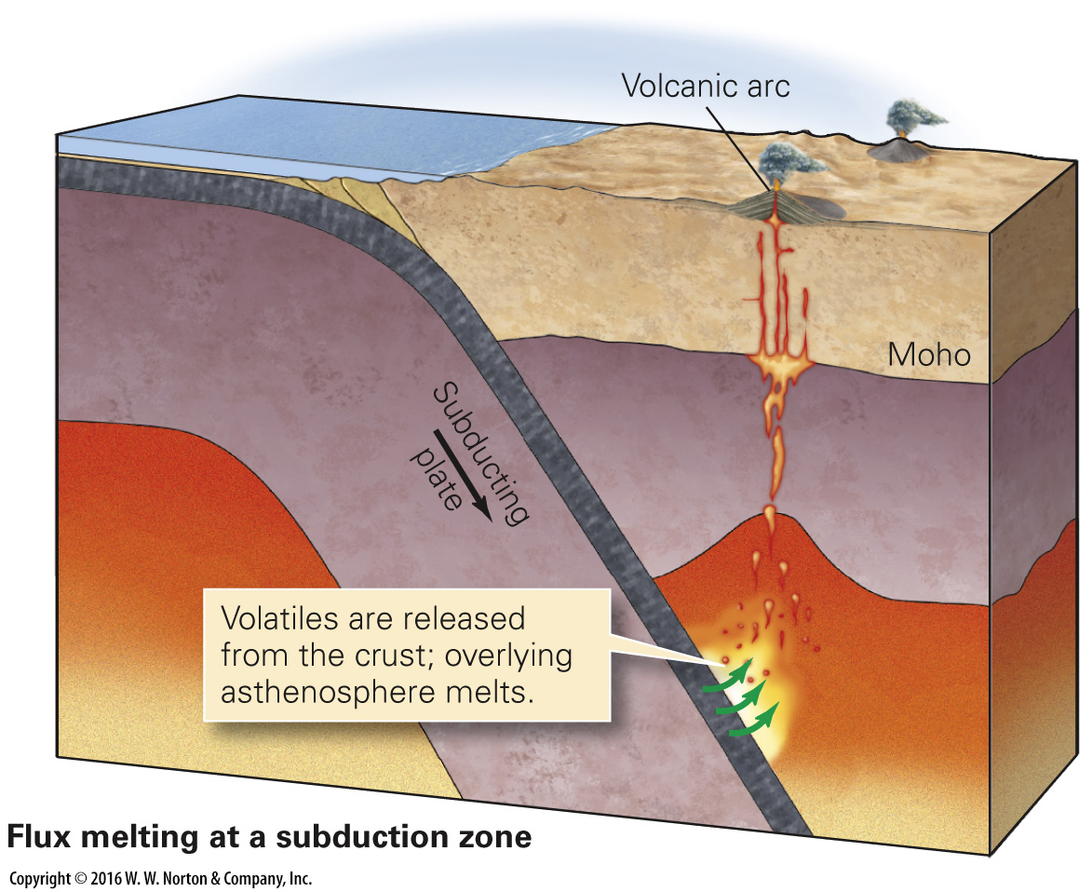
Notes:
FIGURE 4.4a Flux melting and heat-transfer melting.
(a) Flux melting occurs where volatiles enter hot mantle; this happens at subduction zones.

Slide 17
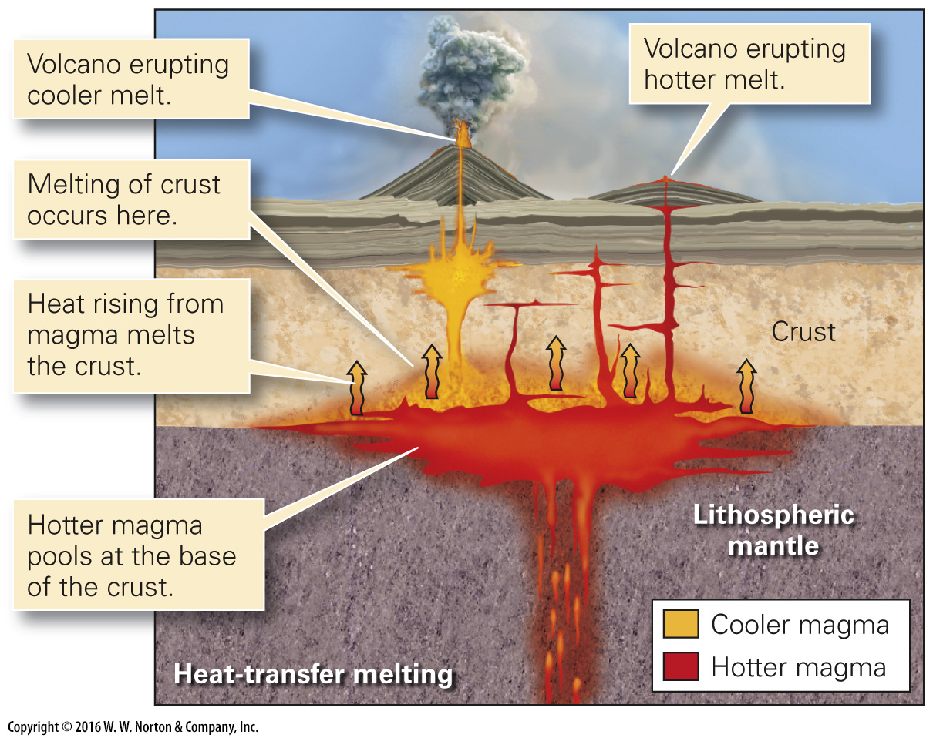
Notes:
FIGURE 4.4b Flux melting and heat-transfer melting.
(b) Heat-transfer melting occurs when rising magma brings heat up with it and melts overlying or surrounding rock. (We’ll see that the cooler magma is felsic, and the hotter magma is mafic.) (Not to scale.)

Slide 18
Notes:
TABLE 4.1 Compositional Categories of Magma

Slide 19
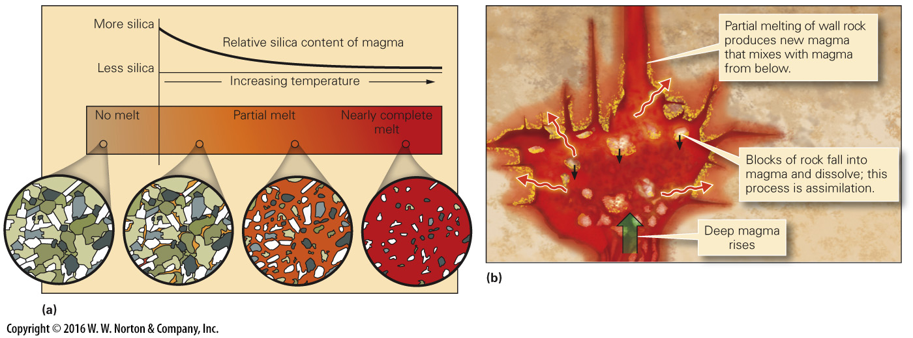
Notes:
FIGURE 4.5 Phenomena that can affect the composition of magma.
(a) Partial melting: The first-formed melt will be richer in silica than the original rock. As melting continues, magma becomes increasingly mafic. (b) Mixing and assimilation: Heat provided by deep magma partially melts wall rock; the new magma may then mix with deep magma. Also, blocks of wall rock can dissolve (assimilate) in the deep magma, and the wall rock may chemically react with the magma.

Slide 20
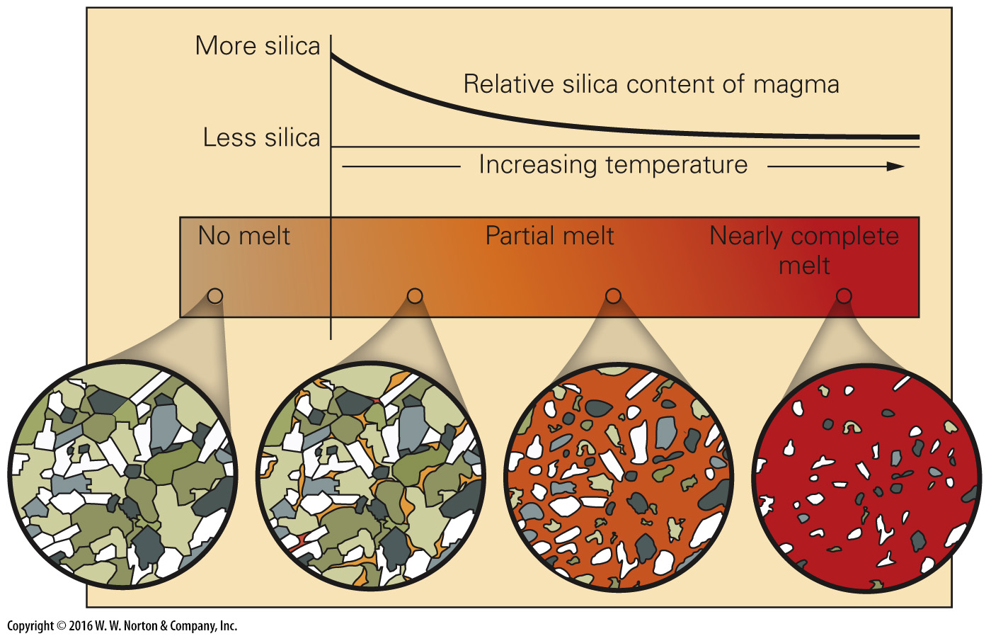
Notes:
FIGURE 4.5a Phenomena that can affect the composition of magma.
(a) Partial melting: The first-formed melt will be richer in silica than the original rock. As melting continues, magma becomes increasingly mafic.

Slide 21
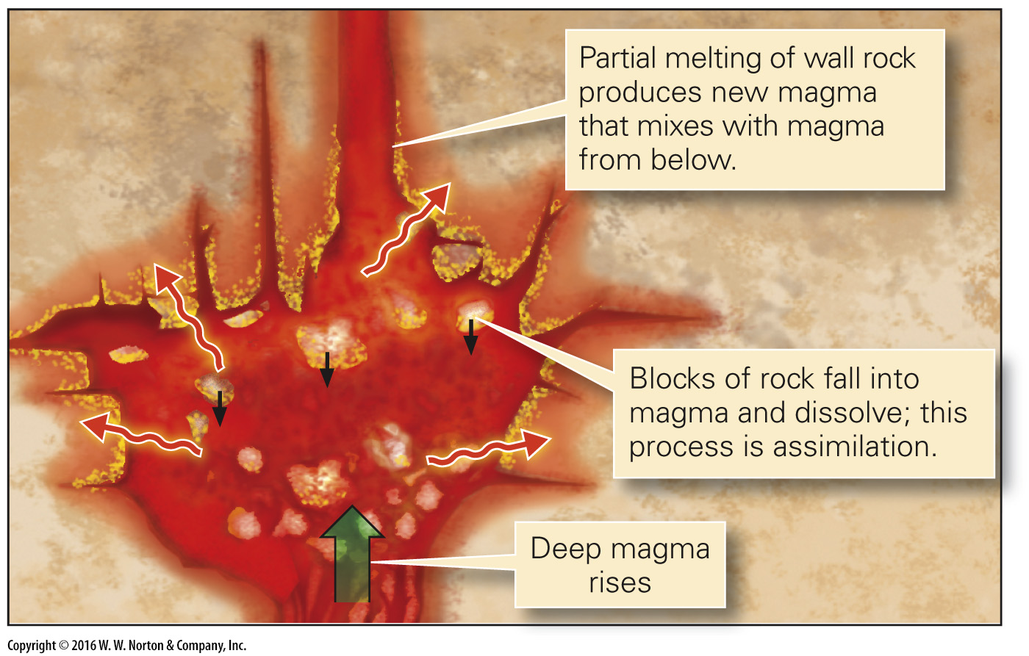
Notes:
FIGURE 4.5b Phenomena that can affect the composition of magma.
(b) Mixing and assimilation: Heat provided by deep magma partially melts wall rock; the new magma may then mix with deep magma. Also, blocks of wall rock can dissolve (assimilate) in the deep magma, and the wall rock may chemically react with the magma.

Slide 22
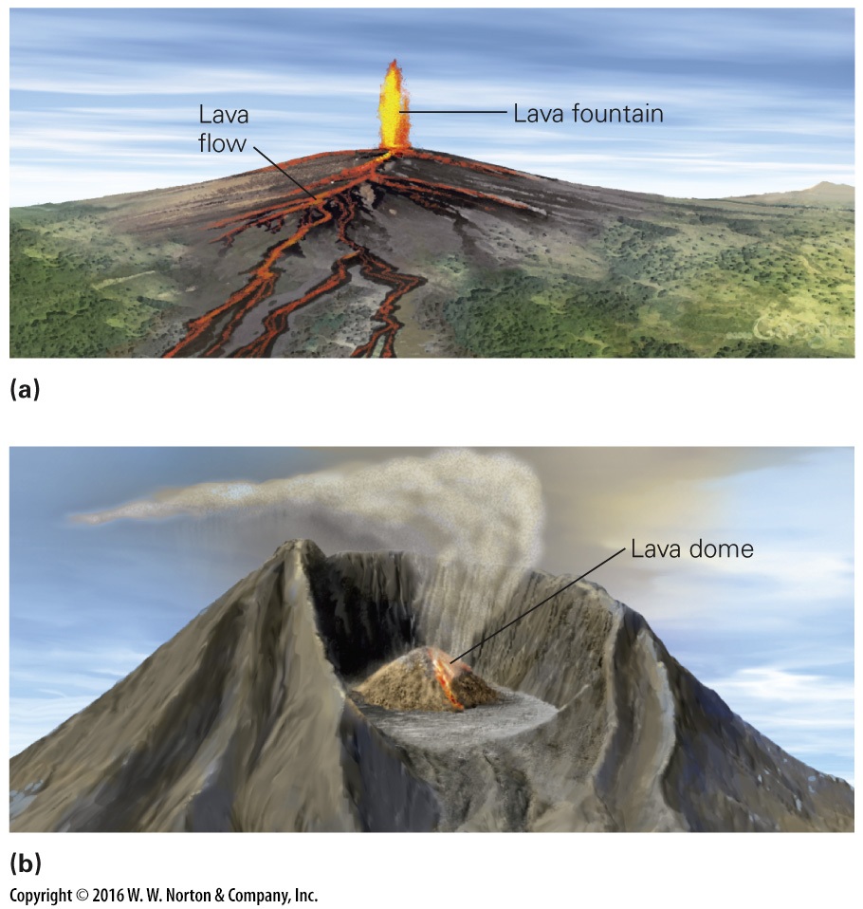
Notes:
FIGURE 4.6 Viscosity affects lava behavior.
(a) Mafic lava has relatively low viscosity. It can erupt in fountains, move long distances, and form thin lava flows. (b) Felsic to intermediate lava is very viscous. When it erupts, it may form a mound-like lava dome around the volcano’s vent.

Slide 23
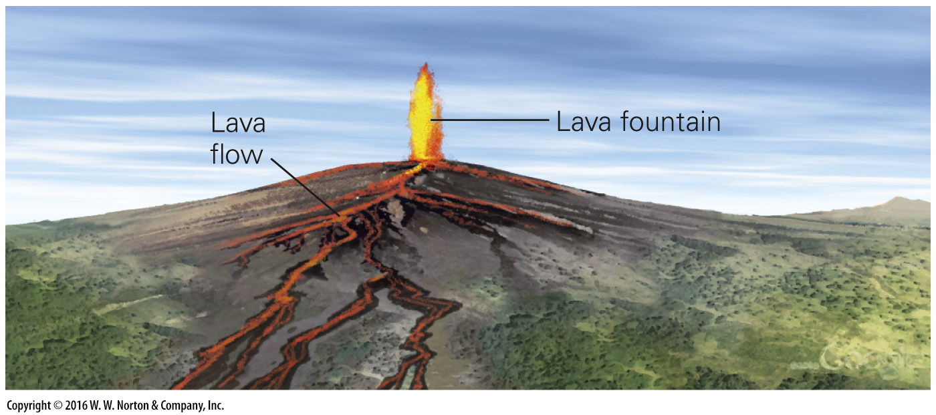
Notes:
FIGURE 4.6a Viscosity affects lava behavior.
(a) Mafic lava has relatively low viscosity. It can erupt in fountains, move long distances, and form thin lava flows.

Slide 24
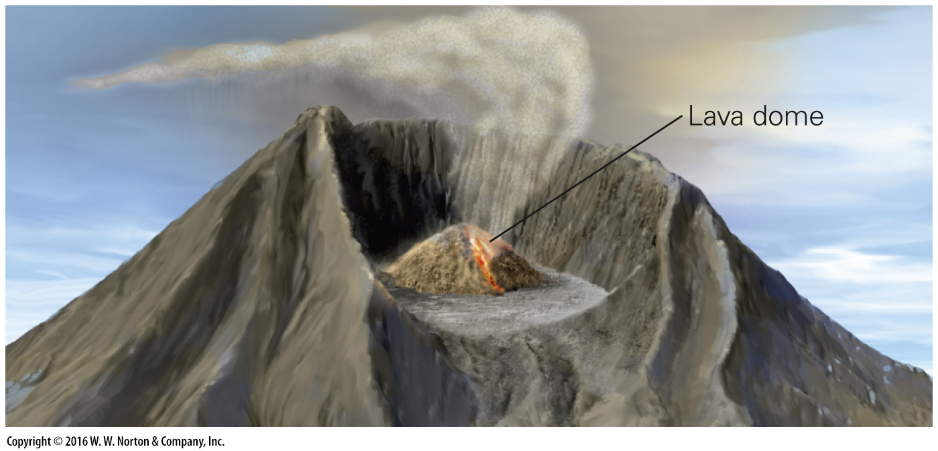
Notes:
FIGURE 4.6b Viscosity affects lava behavior.
(b) Felsic to intermediate lava is very viscous. When it erupts, it may form a mound-like lava dome around the volcano’s vent.

Slide 25
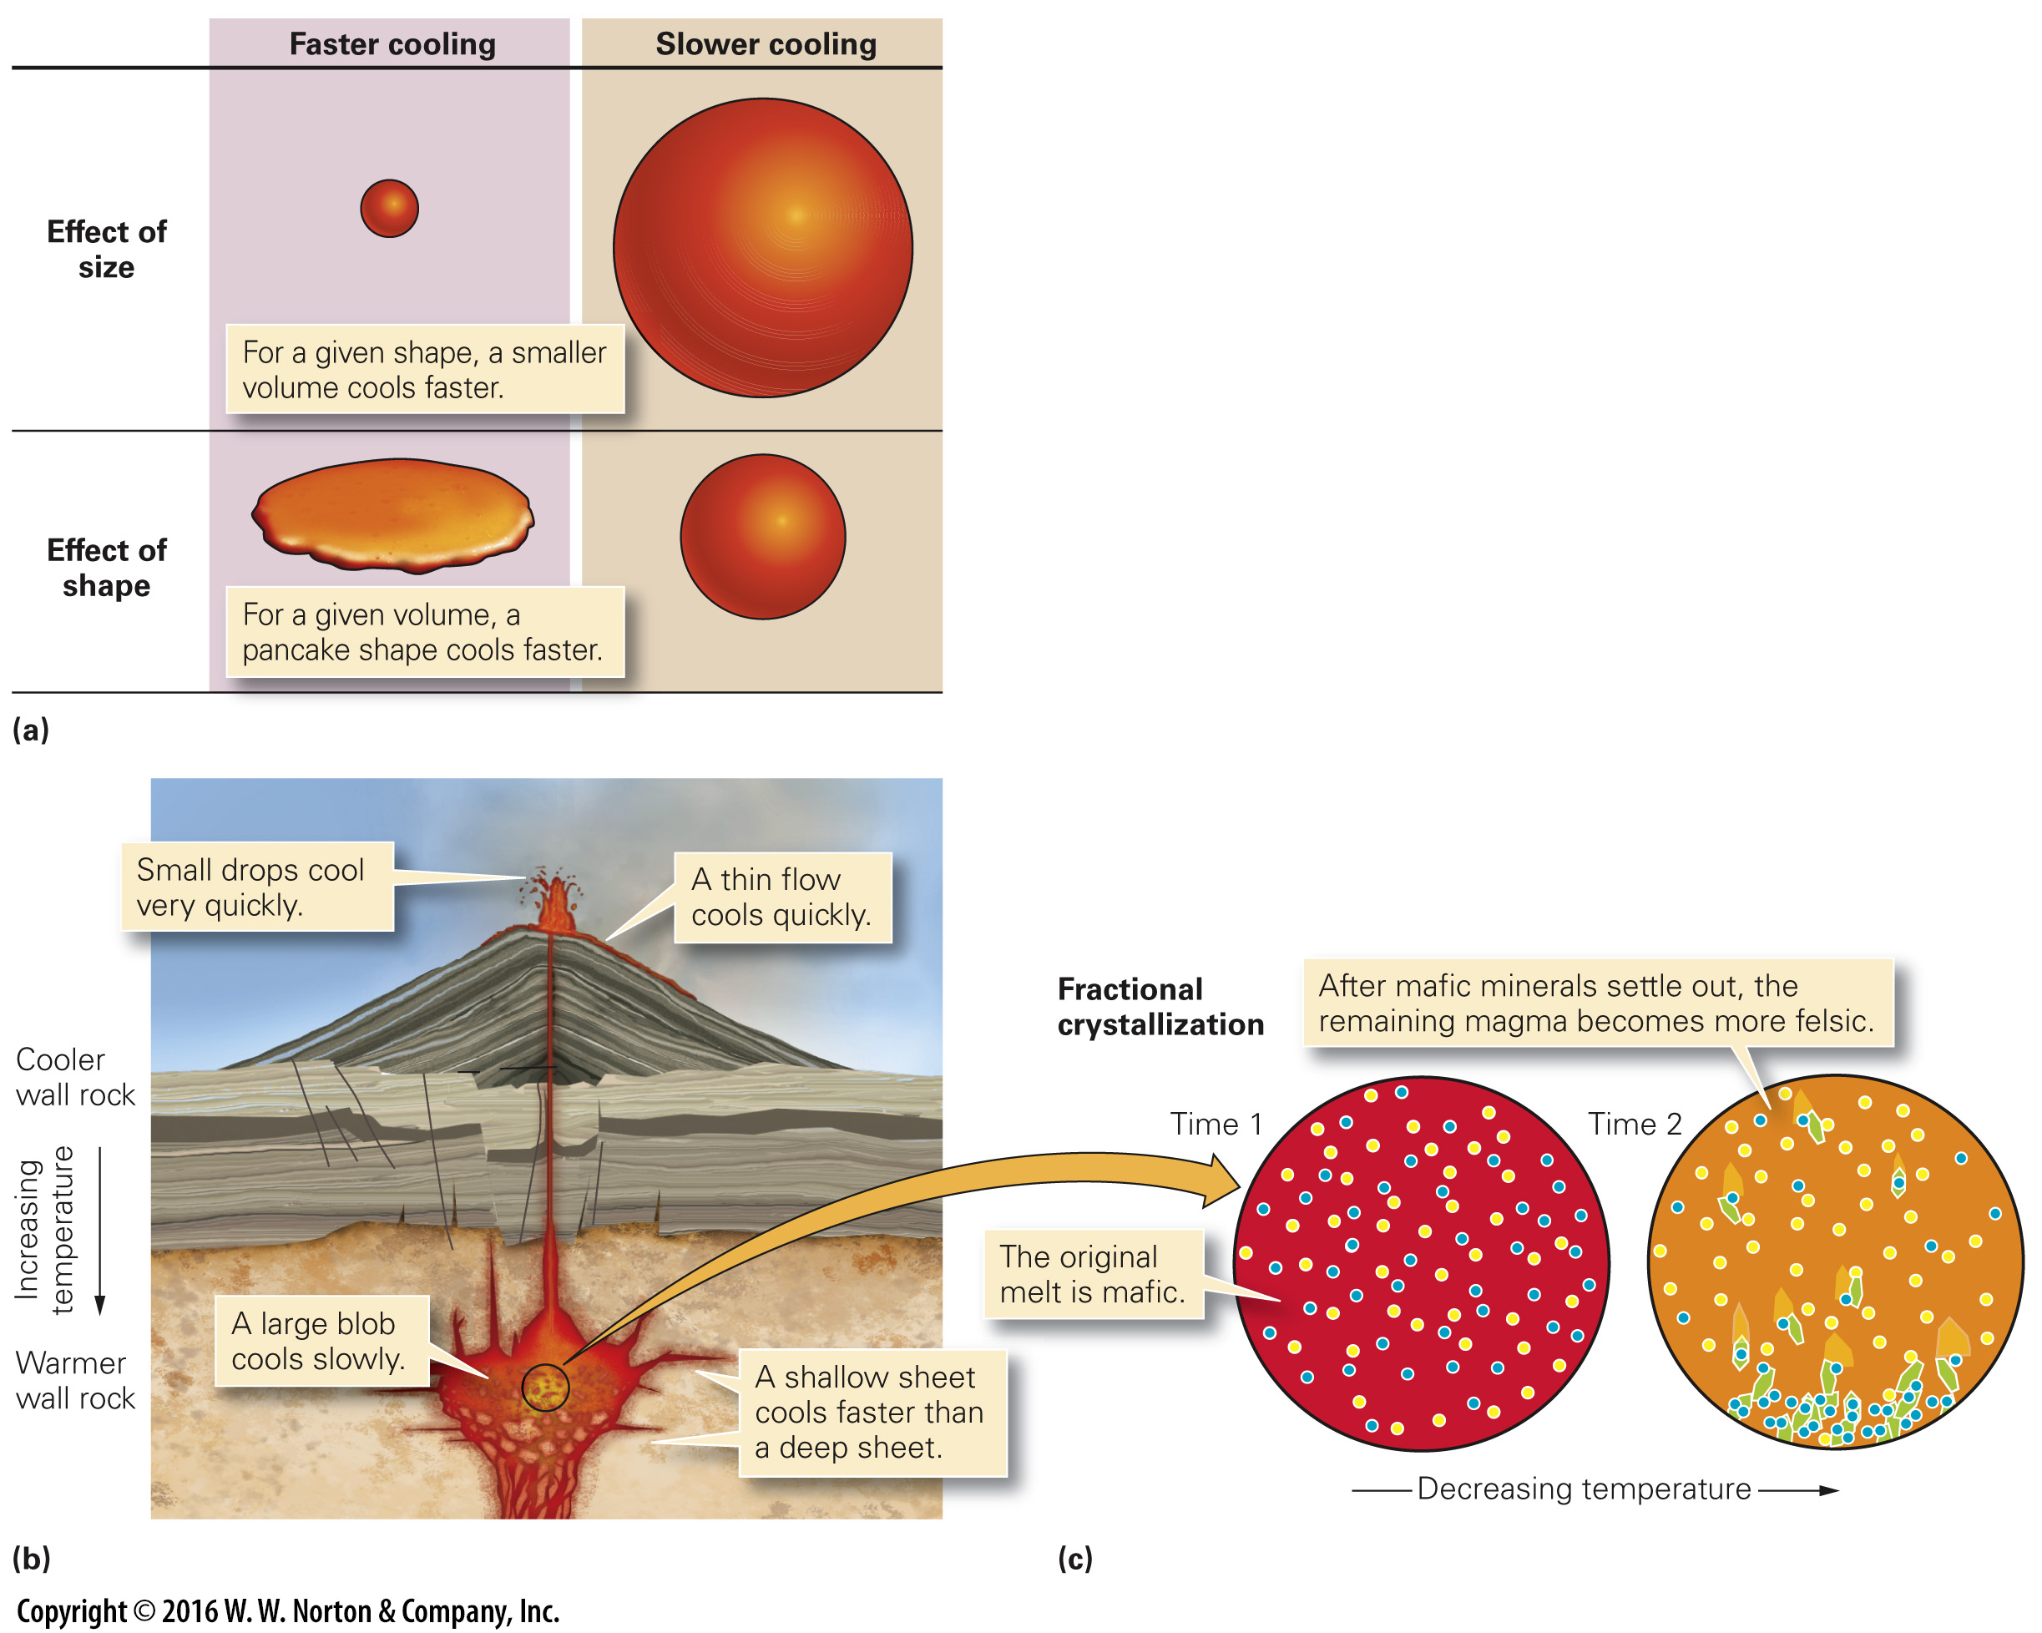
Notes:
FIGURE 4.7 Factors that affect the freezing of molten rock.
(a) The larger the ratio of its surface area to volume, the faster an intrusion cools. This ratio depends on both size and shape. (b) The cooling rate of molten rock depends on the size and shape of the magma or lava body, and on its depth. (c) The process of fractional crystallization results in a progressive change in magma composition during freezing. Blue dots represent mafic components, and yellow dots represent felsic components.

Slide 26
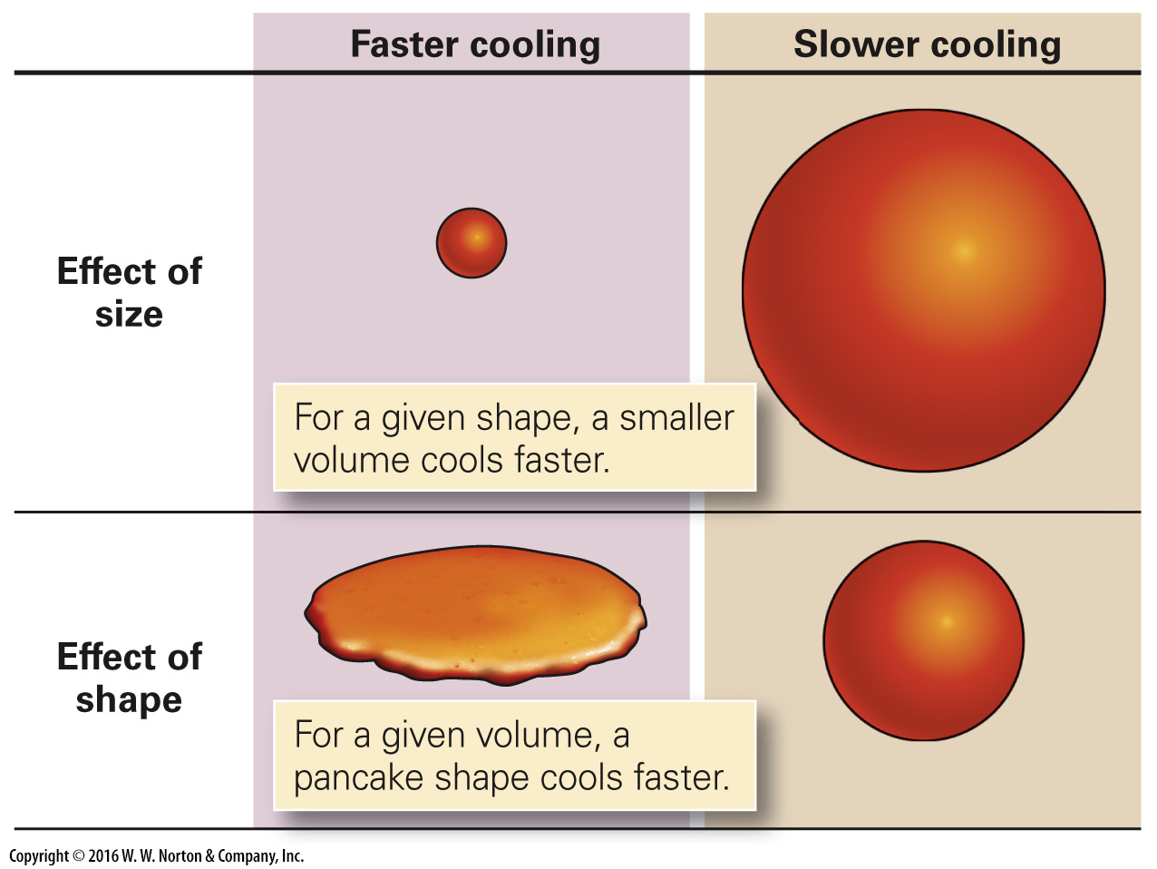
Notes:
FIGURE 4.7a Factors that affect the freezing of molten rock.
(a) The larger the ratio of its surface area to volume, the faster an intrusion cools. This ratio depends on both size and shape.

Slide 27
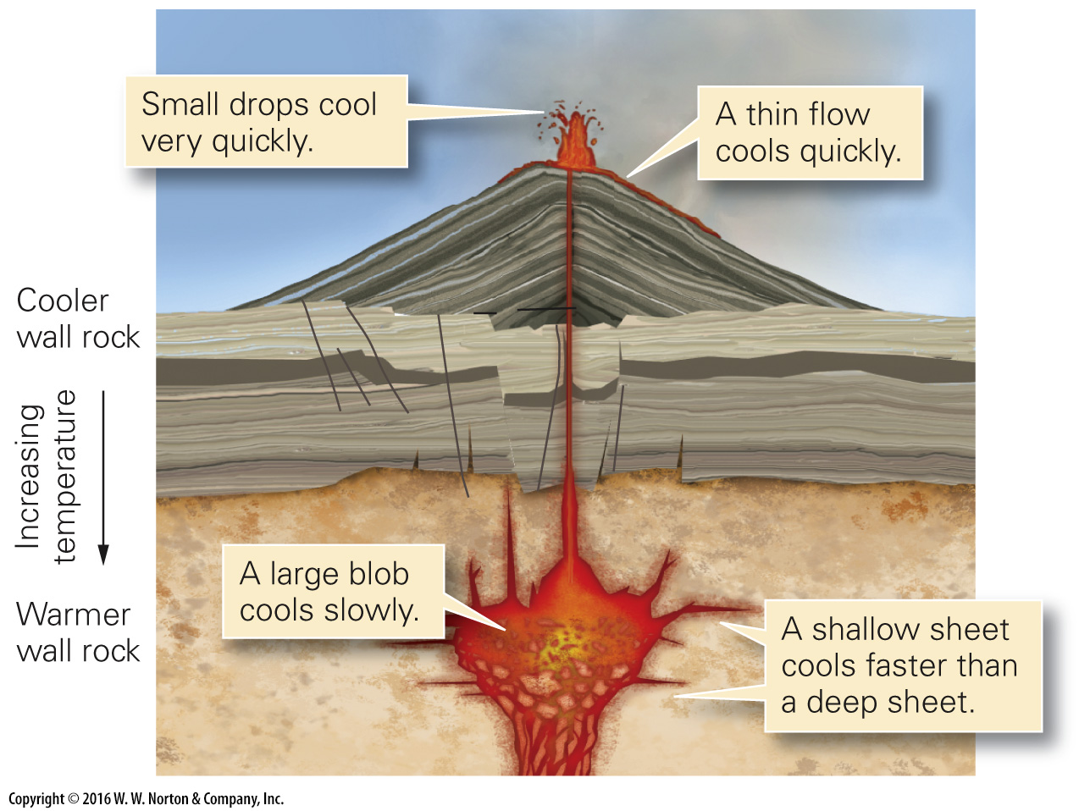
Notes:
FIGURE 4.7b Factors that affect the freezing of molten rock.
(b) The cooling rate of molten rock depends on the size and shape of the magma or lava body, and on its depth.

Slide 28
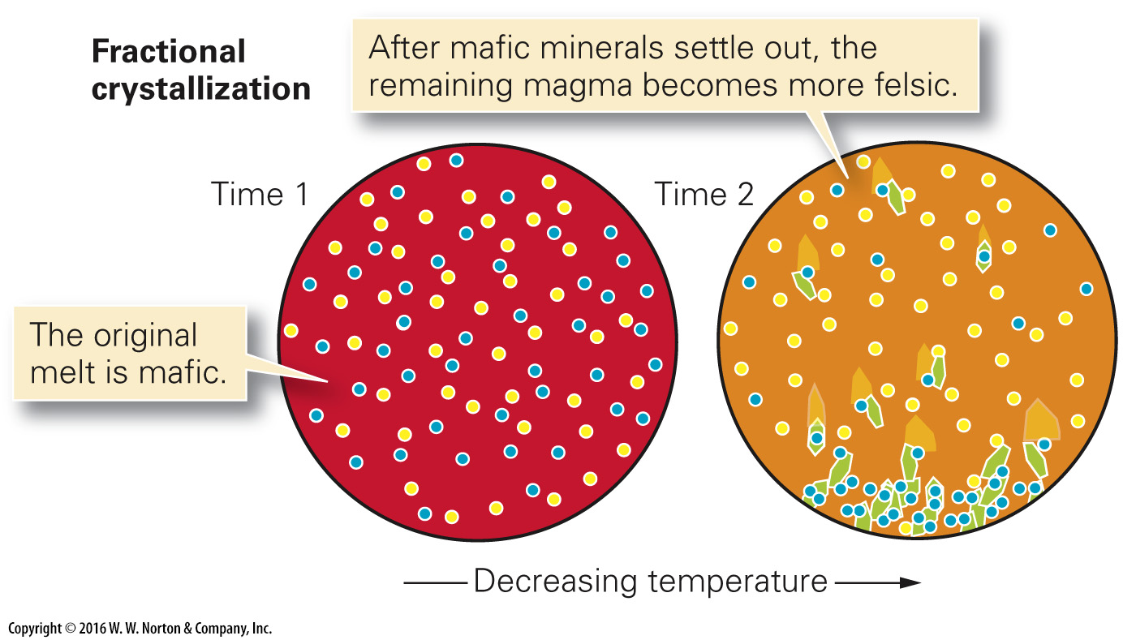
Notes:
FIGURE 4.7c Factors that affect the freezing of molten rock.
(c) The process of fractional crystallization results in a progressive change in magma composition during freezing. Blue dots represent mafic components, and yellow dots represent felsic components.

Slide 29
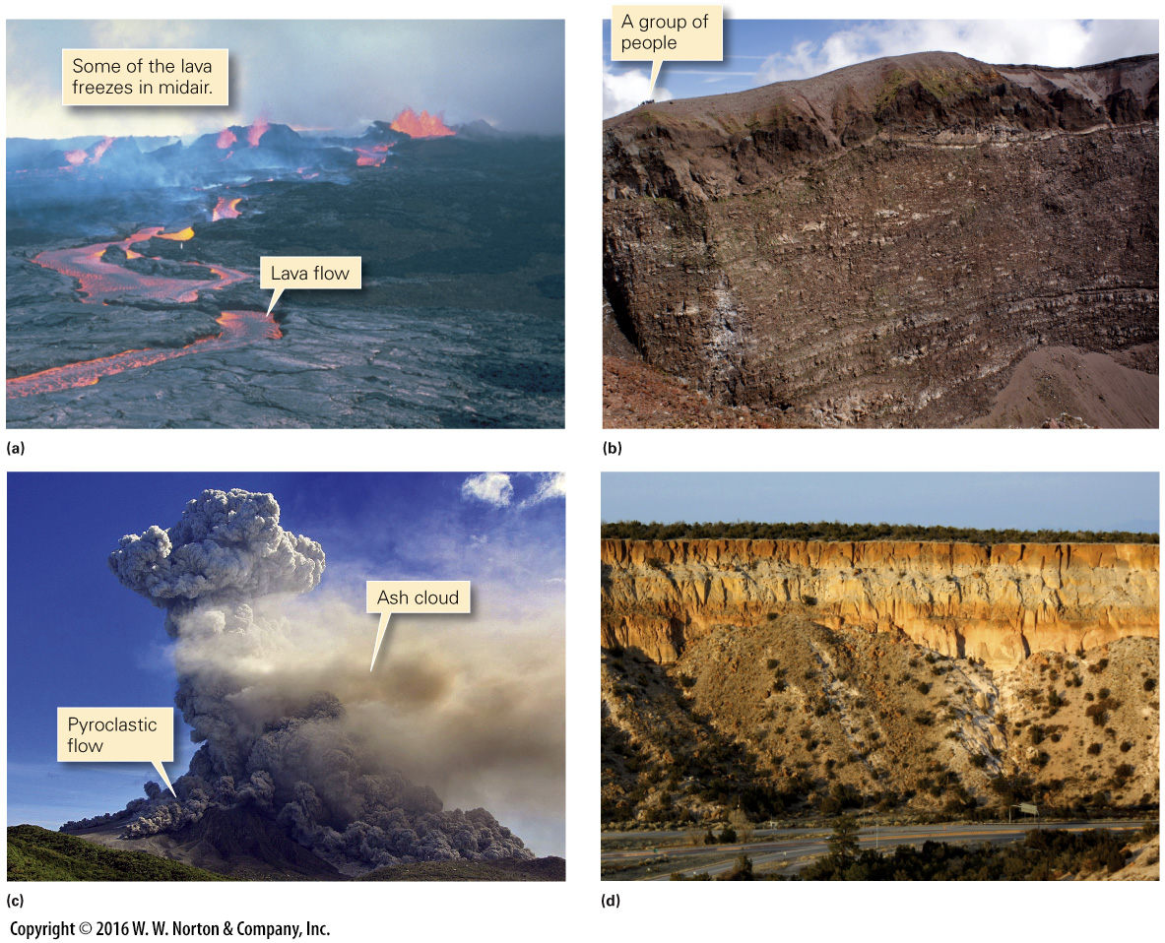
Notes:
FIGURE 4.8 Examples of eruptions and extrusive volcanic materials.
(a) This volcano is producing lava flows and fountains. (b) A stack of over 50 thin lava flows, capped by debris, visible from inside Mt. Vesuvius, Italy. (c) This volcanic explosion produced two styles of ash eruption. (d) Thick layers of ash deposited by explosive eruptions in New Mexico, about 1.14 Ma. Note the highway, for scale.

Slide 30
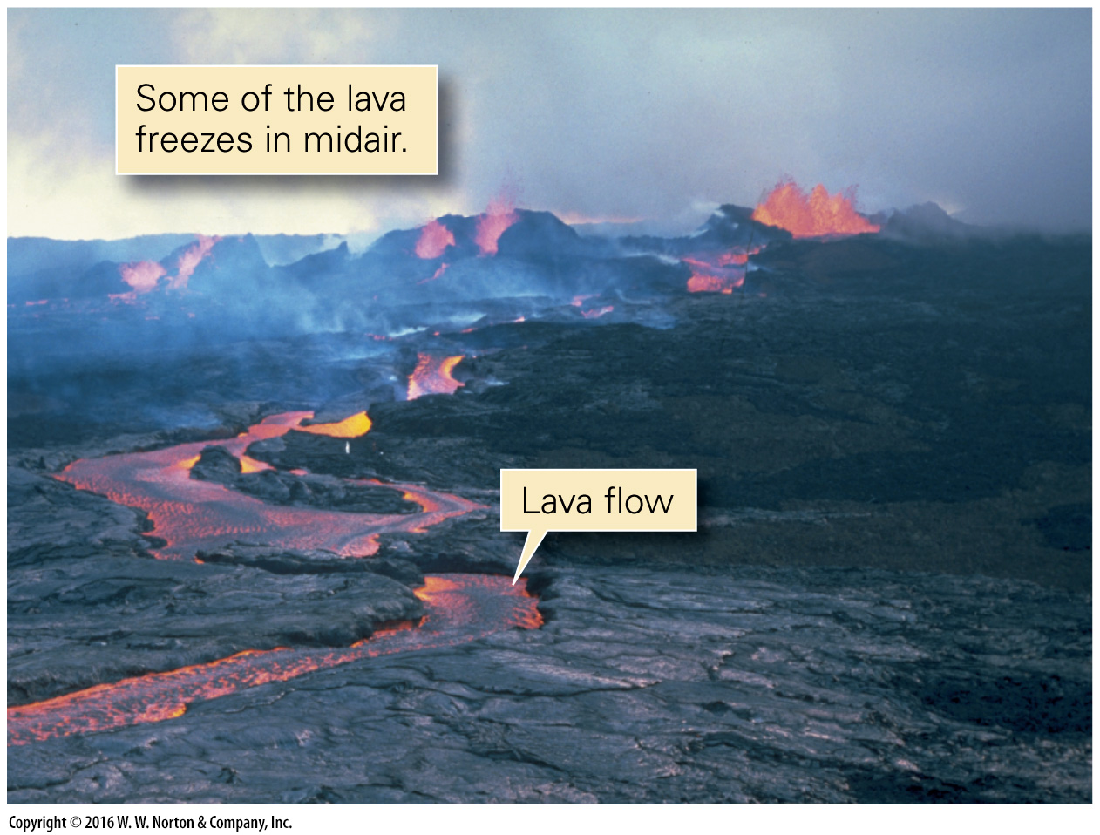
Notes:
FIGURE 4.8a Examples of eruptions and extrusive volcanic materials.
(a) This volcano is producing lava flows and fountains.

Slide 31
Notes:
FIGURE 4.8b Examples of eruptions and extrusive volcanic materials.
(b) A stack of over 50 thin lava flows, capped by debris, visible from inside Mt. Vesuvius, Italy.

Slide 32
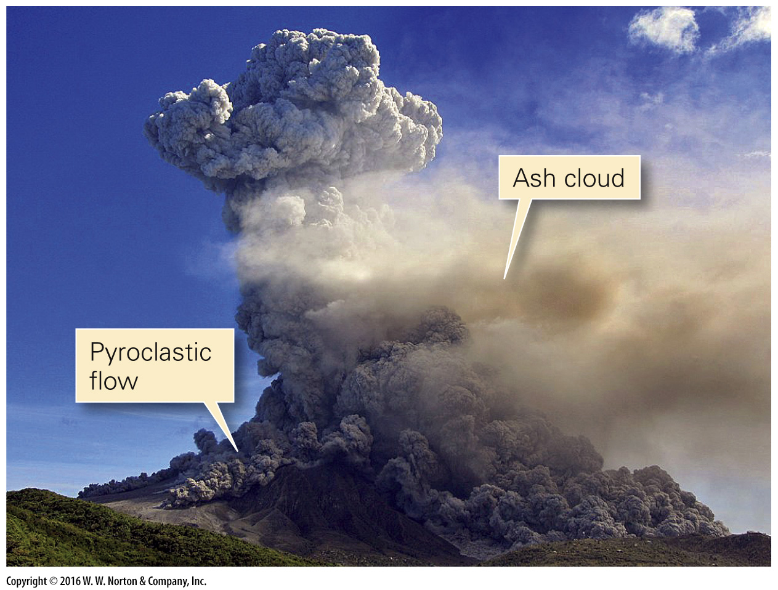
Notes:
FIGURE 4.8c Examples of eruptions and extrusive volcanic materials.
(c) This volcanic explosion produced two styles of ash eruption.

Slide 33
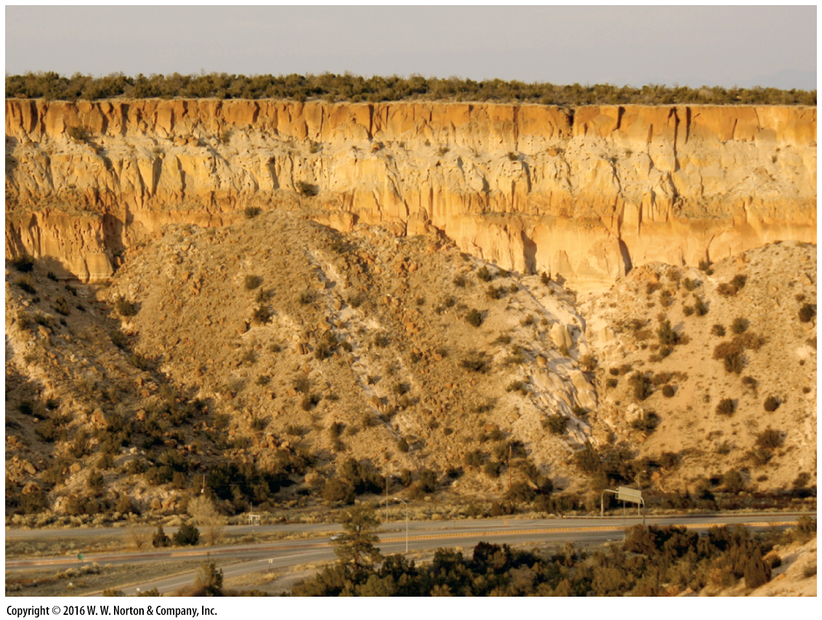
Notes:
FIGURE 4.8d Examples of eruptions and extrusive volcanic materials.
(d) Thick layers of ash deposited by explosive eruptions in New Mexico, about 1.14 Ma. Note the highway, for scale.

Slide 34
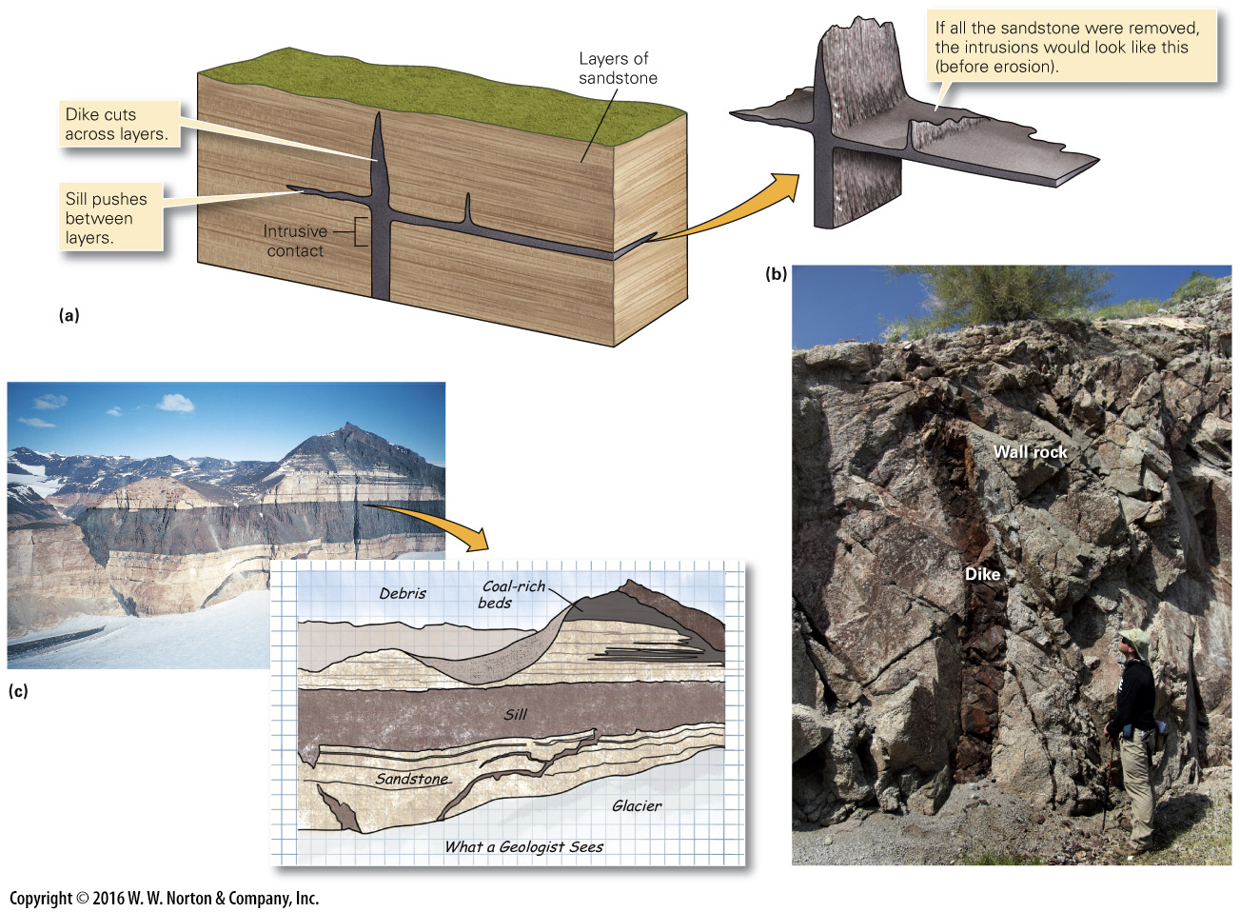
Notes:
FIGURE 4.9 Igneous sills and dikes, examples of tabular intrusions.
(a) Dikes cut across pre-existing layering. Sills are parallel to pre-existing layering. (b) A wall-like intrusion cutting into pre-existing igneous rock is also called a dike. (c) Large sills of basalt intruded sandstone beds in Antarctica, here exposed at Finger Mountain.

Slide 35
Notes:
FIGURE 4.9a Igneous sills and dikes, examples of tabular intrusions.
(a) Dikes cut across pre-existing layering. Sills are parallel to pre-existing layering.

Slide 36
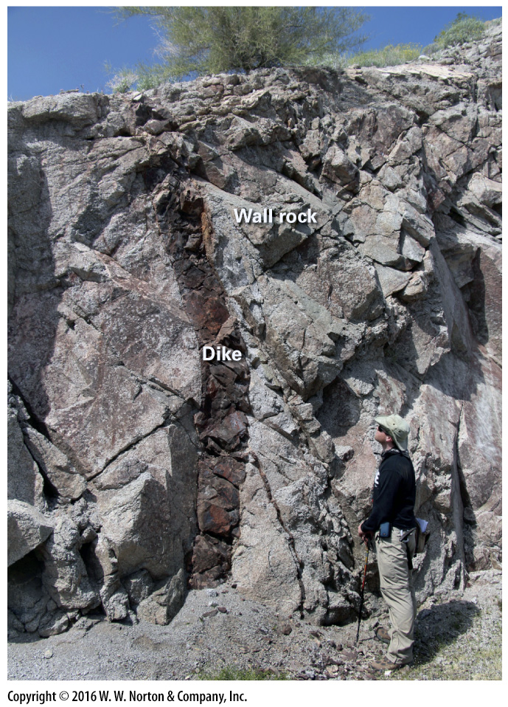
Notes:
FIGURE 4.9b Igneous sills and dikes, examples of tabular intrusions.
(b) A wall-like intrusion cutting into pre-existing igneous rock is also called a dike.

Slide 37
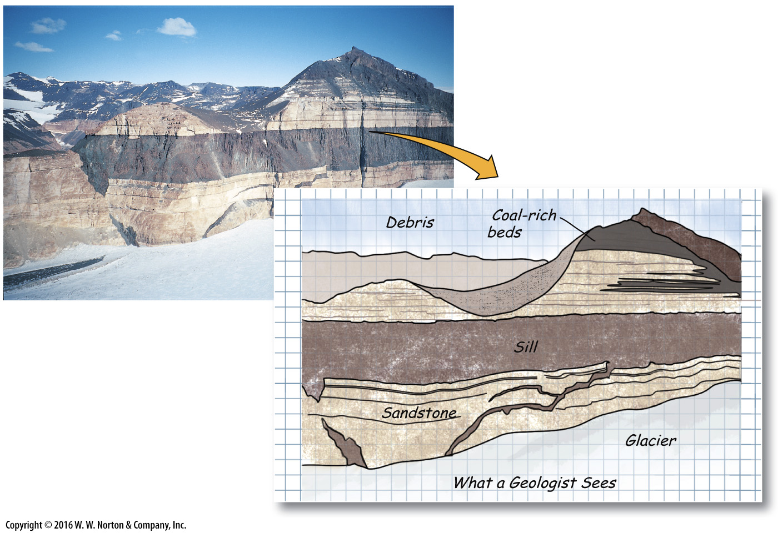
Notes:
FIGURE 4.9c Igneous sills and dikes, examples of tabular intrusions.
(c) Large sills of basalt intruded sandstone beds in Antarctica, here exposed at Finger Mountain.

Slide 38
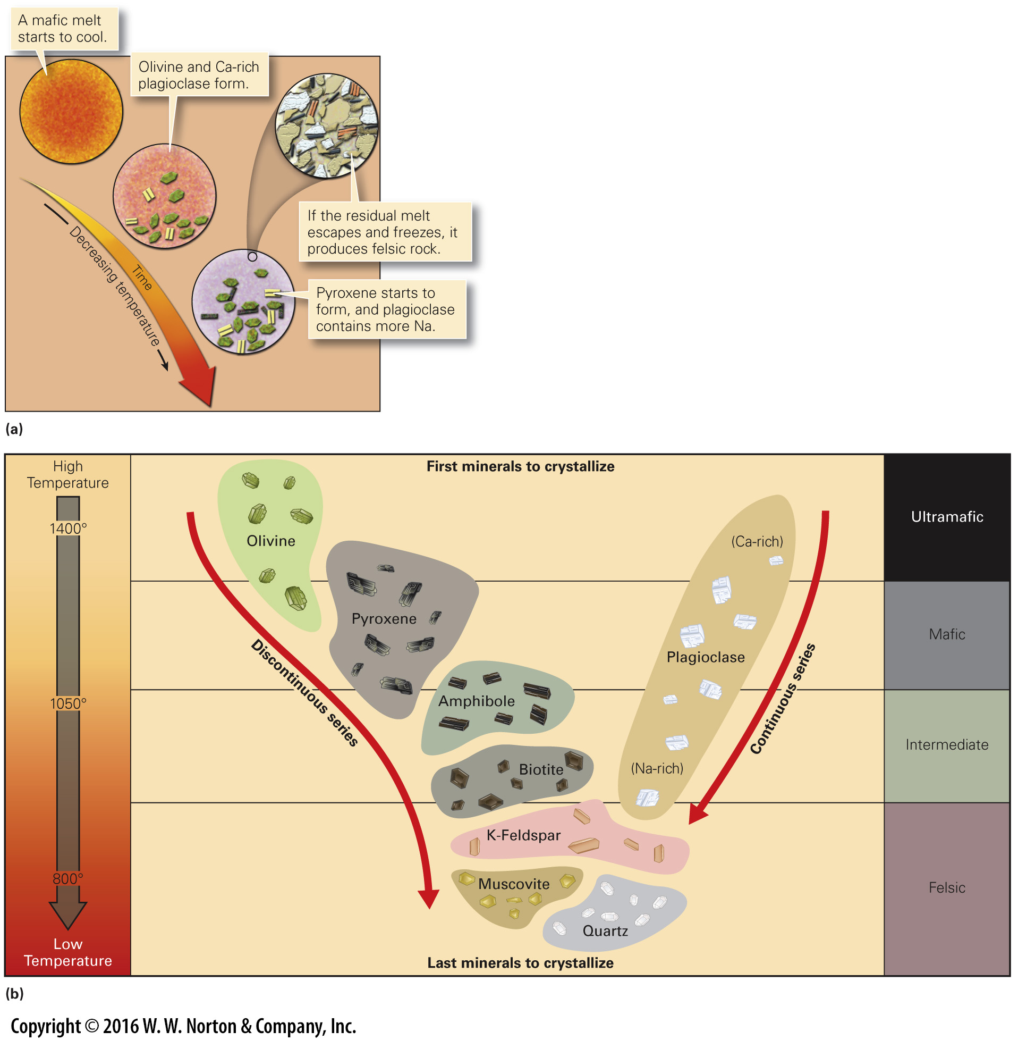
Notes:
FIGURE Bx4.1 Bowen’s reaction series indicates the succession of crystallization in cooling magma.
(a) With decreasing temperature, fractional crystallization begins and the composition of the remaining magma becomes more felsic. (b) This chart displays the discontinuous and continuous reaction series. Rocks formed from minerals at the top of the series are mafic, whereas rocks formed from the bottom of the series are felsic.

Slide 39
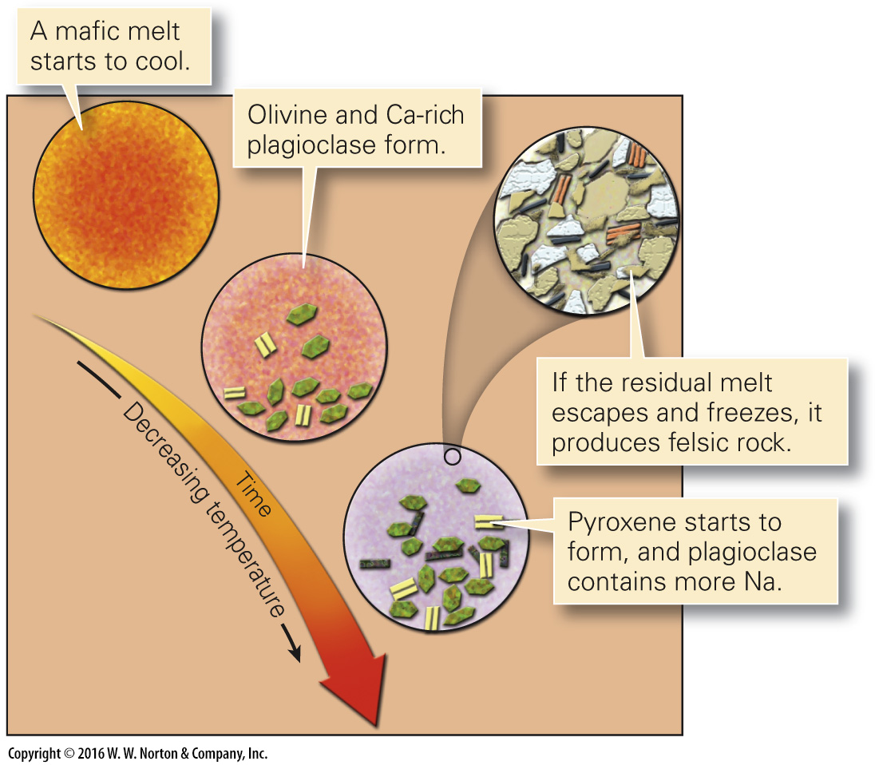
Notes:
FIGURE Bx4.1a Bowen’s reaction series indicates the succession of crystallization in cooling magma.
(a) With decreasing temperature, fractional crystallization begins and the composition of the remaining magma becomes more felsic.

Slide 40
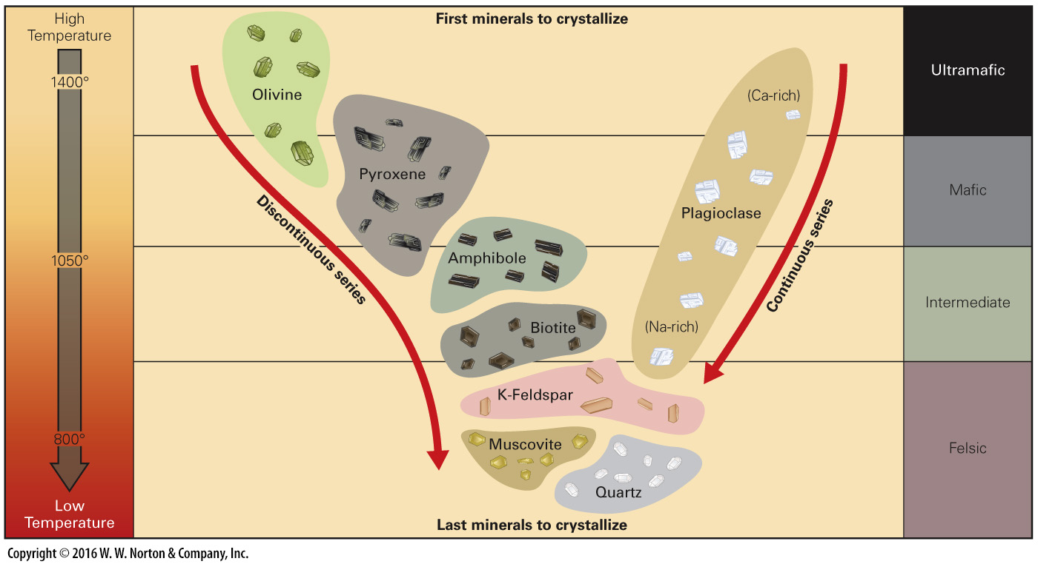
Notes:
FIGURE Bx4.1b Bowen’s reaction series indicates the succession of crystallization in cooling magma.
(b) This chart displays the discontinuous and continuous reaction series. Rocks formed from minerals at the top of the series are mafic, whereas rocks formed from the bottom of the series are felsic.

Slide 41
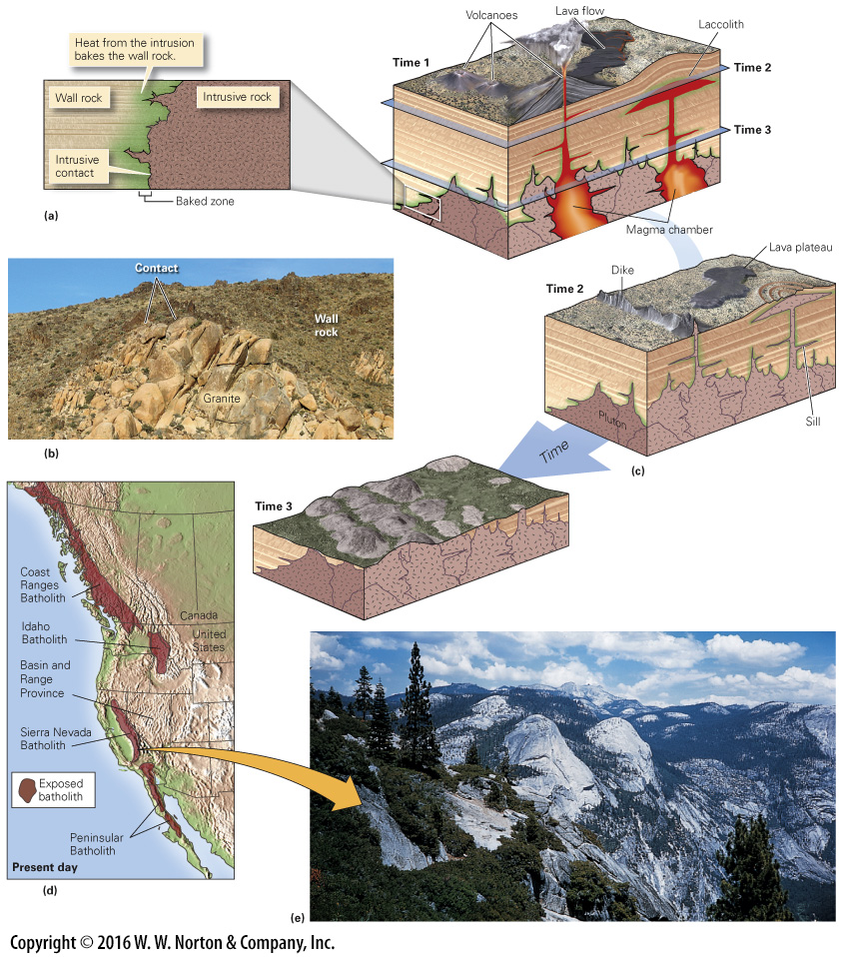
Notes:
FIGURE 4.10 Igneous plutons, blob-shaped intrusions.
(a) Plutons form when volcanoes of magma cool slowly at depth. Molten rock that reaches the surface erupts as lava. (b) Erosion exposes plutons. This example, from the Mojave Desert, shows the top of a pluton. (c) A composite of many plutons is a batholith. As erosion progresses, dikes, sills, and laccoliths are exposed. (d) During the Mesozoic, subduction produced a huge volcanic arc. In the crust, beneath the arc, large granite batholiths formed. They are now exposed by erosion. (e) The Sierra Nevada of California provide exposures of one of these Mesozoic batholiths. The huge granite cliffs, popular with climbers, are part of the batholith.

Slide 42
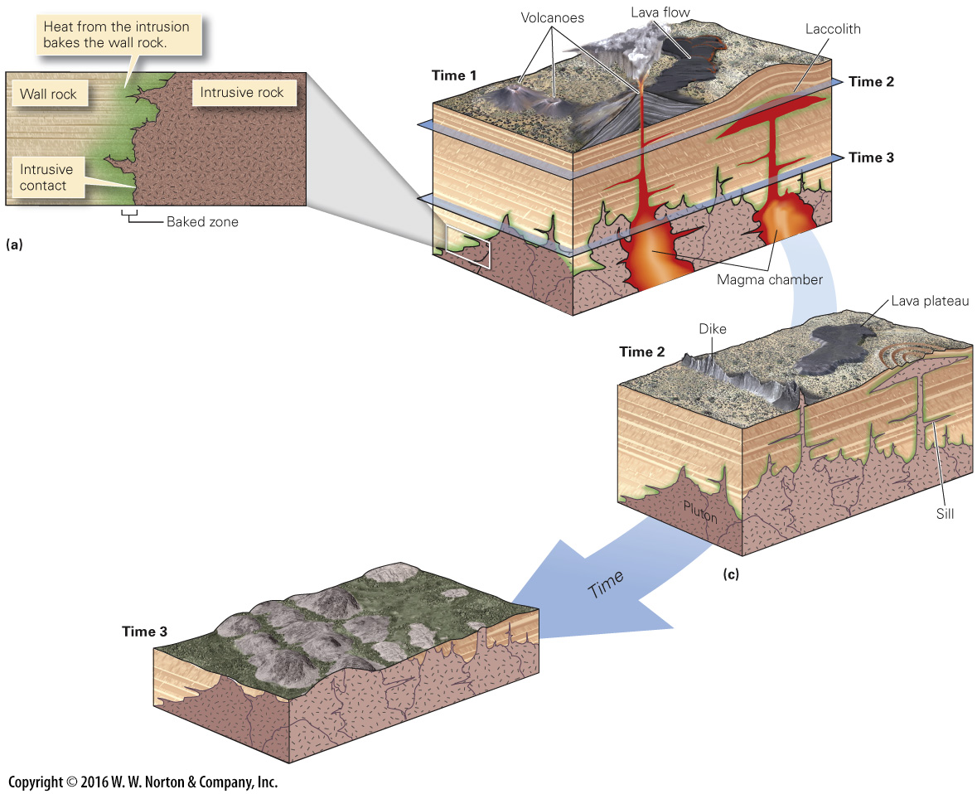
Notes:
FIGURE 4.10a,c Igneous plutons, blob-shaped intrusions.
(a) Plutons form when volcanoes of magma cool slowly at depth. Molten rock that reaches the surface erupts as lava. (c) A composite of many plutons is a batholith. As erosion progresses, dikes, sills, and laccoliths are exposed.

Slide 43
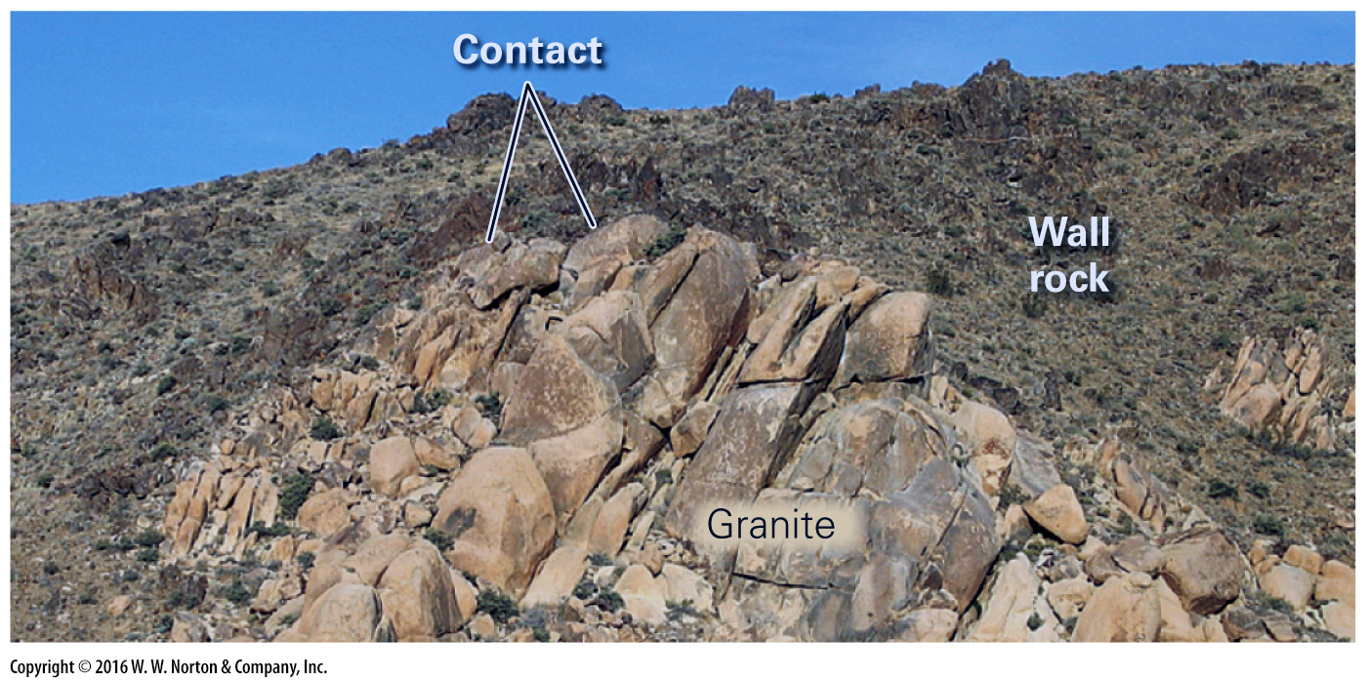
Notes:
FIGURE 4.10b Igneous plutons, blob-shaped intrusions.
(b) Erosion exposes plutons. This example, from the Mojave Desert, shows the top of a pluton.

Slide 44
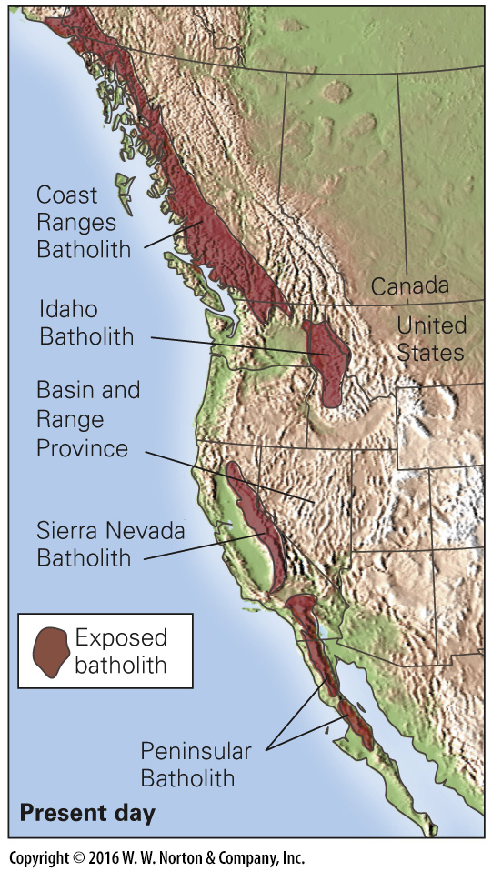
Notes:
FIGURE 4.10d Igneous plutons, blob-shaped intrusions.
(d) During the Mesozoic, subduction produced a huge volcanic arc. In the crust, beneath the arc, large granite batholiths formed. They are now exposed by erosion.

Slide 45
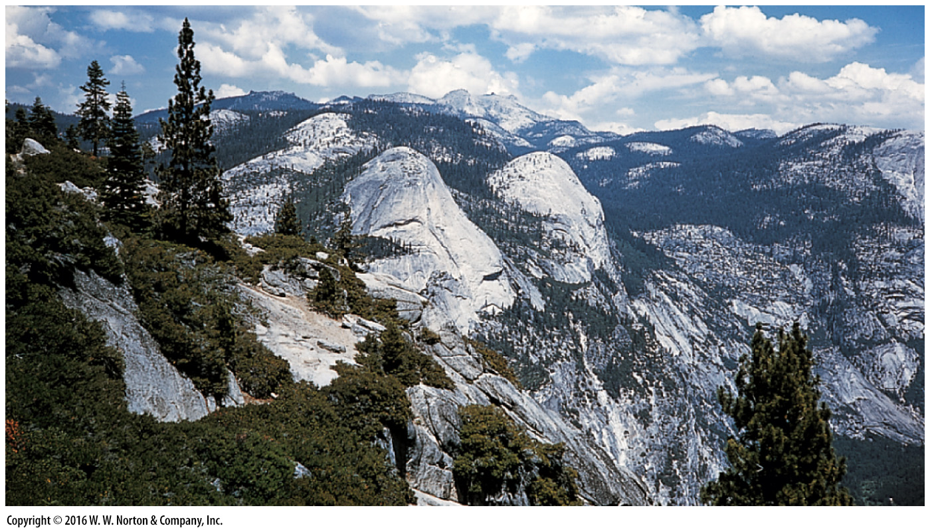
Notes:
FIGURE 4.10e Igneous plutons, blob-shaped intrusions.
(e) The Sierra Nevada of California provide exposures of one of these Mesozoic batholiths. The huge granite cliffs, popular with climbers, are part of the batholith.

Slide 46
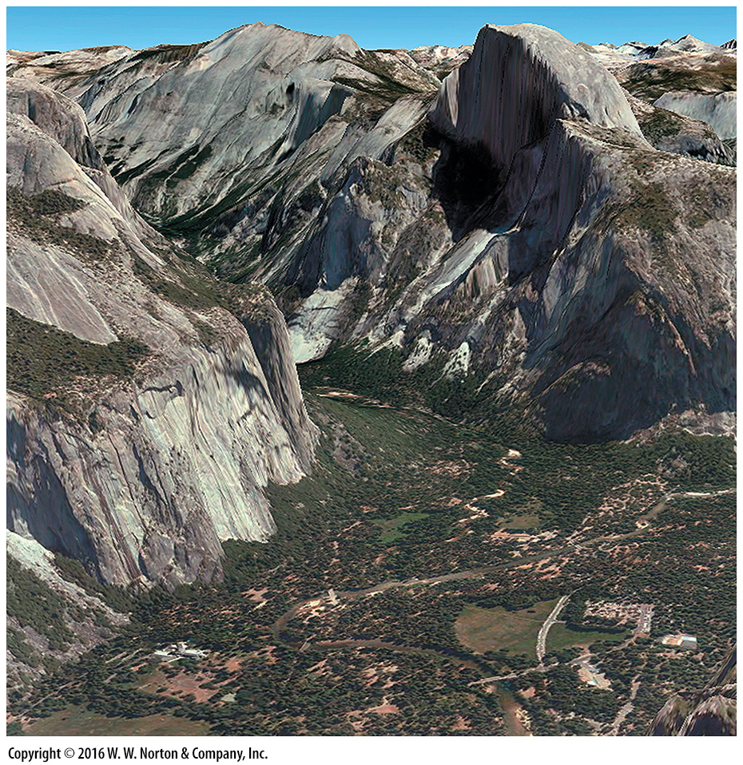
Notes:
SEE FOR YOURSELF…
GRANITE OF THE SIERRA NEVADA

Slide 47
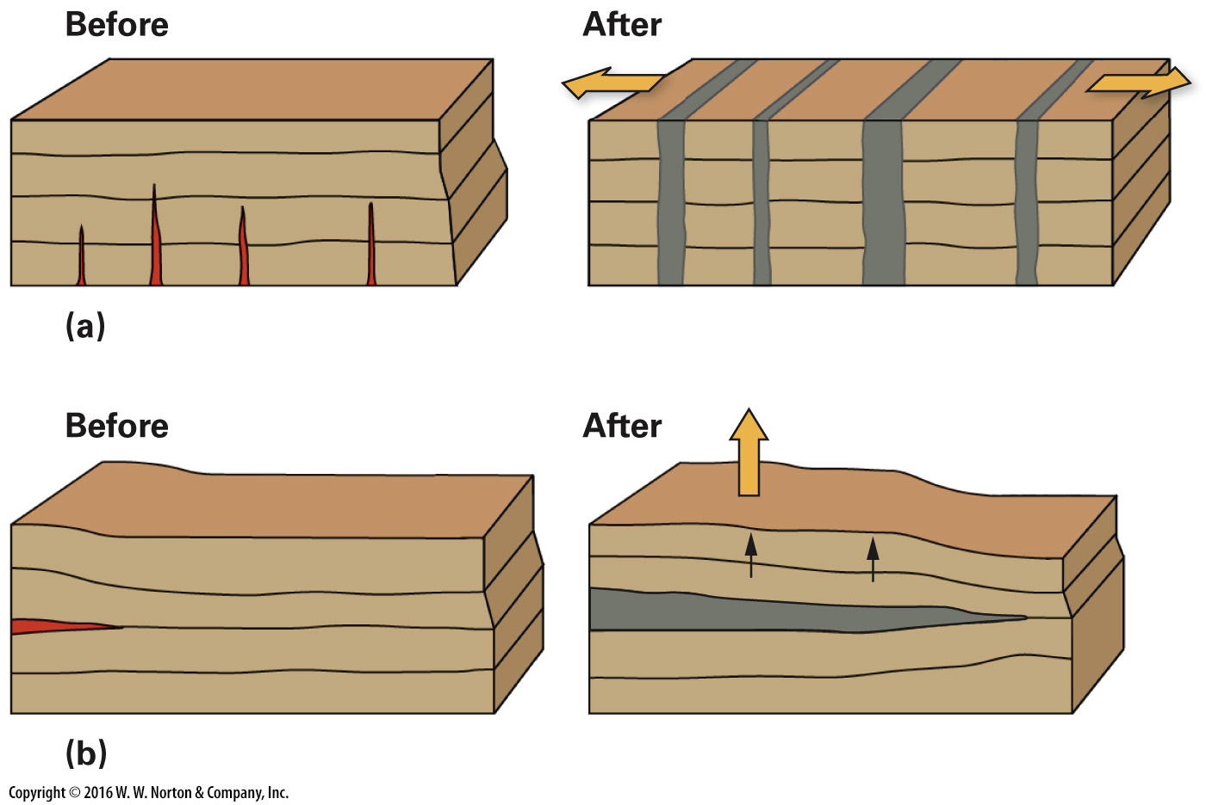
Notes:
FIGURE 4.11 Making room for igneous dikes and sills.
(a) The crust stretches sideways during the intrusion of igneous dikes. (b) The Earth’s surface rises to make room for sills.

Slide 48
Notes:
FIGURE 4.11a Making room for igneous dikes and sills.
(a) The crust stretches sideways during the intrusion of igneous dikes.

Slide 49
Notes:
FIGURE 4.11b Making room for igneous dikes and sills.
(b) The Earth’s surface rises to make room for sills.

Slide 50
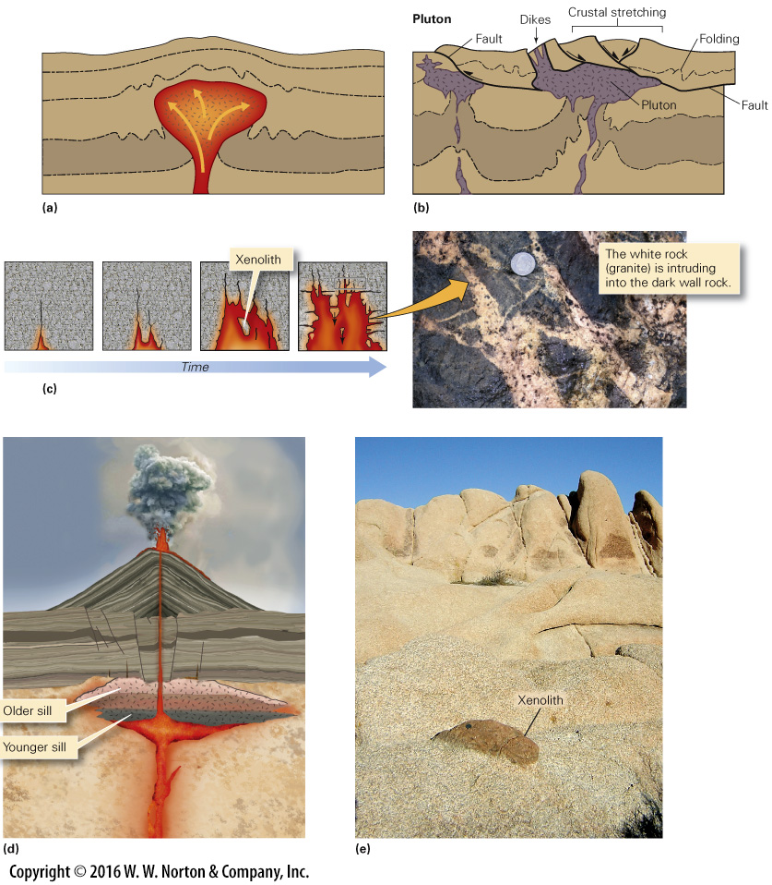
Notes:
FIGURE 4.12 Making room for igneous plutons.
(a) During diapiric rise of a mass of magma, the magma is a blob that forces its way up through wall rock, which plastically deforms to move out of the way. (b) Faulting associated with crustal stretching may accommodate the emplacement of a diapir. (c) Magma pushes up into cracks, and blocks may be incorporated in the melt by stoping. (d) Plutons may intrude as a succession of sill-like sheets. (e) A xenolith of darker rock surrounded by light-colored granite.

Slide 51
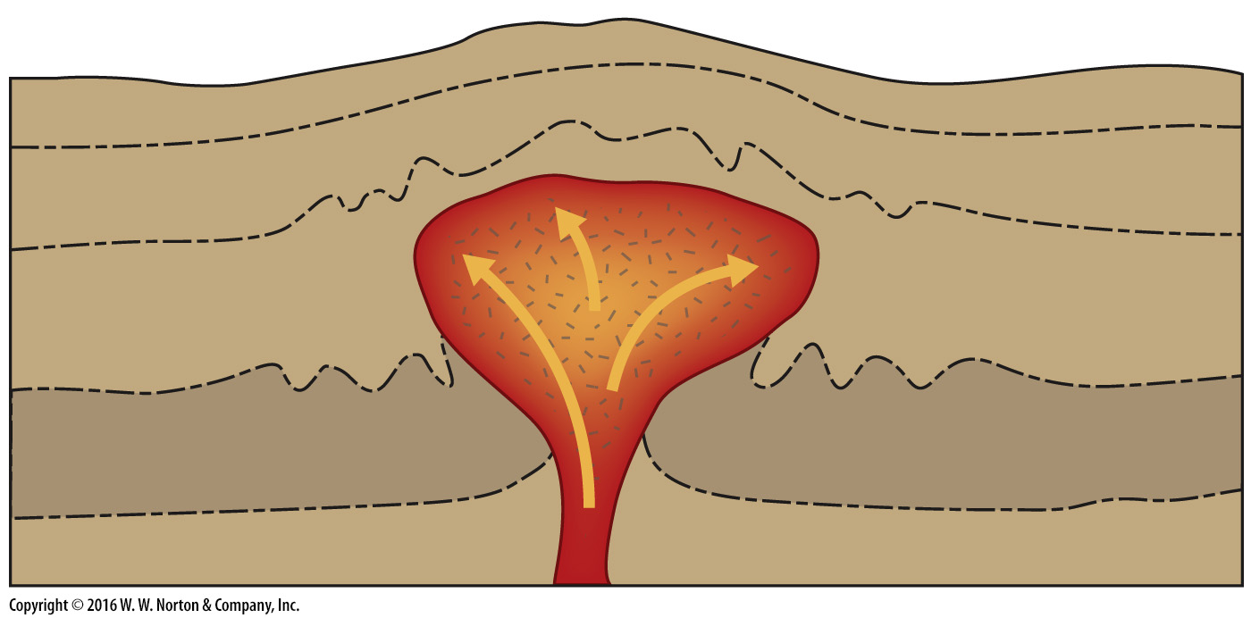
Notes:
FIGURE 4.12a Making room for igneous plutons.
(a) During diapiric rise of a mass of magma, the magma is a blob that forces its way up through wall rock, which plastically deforms to move out of the way.

Slide 52
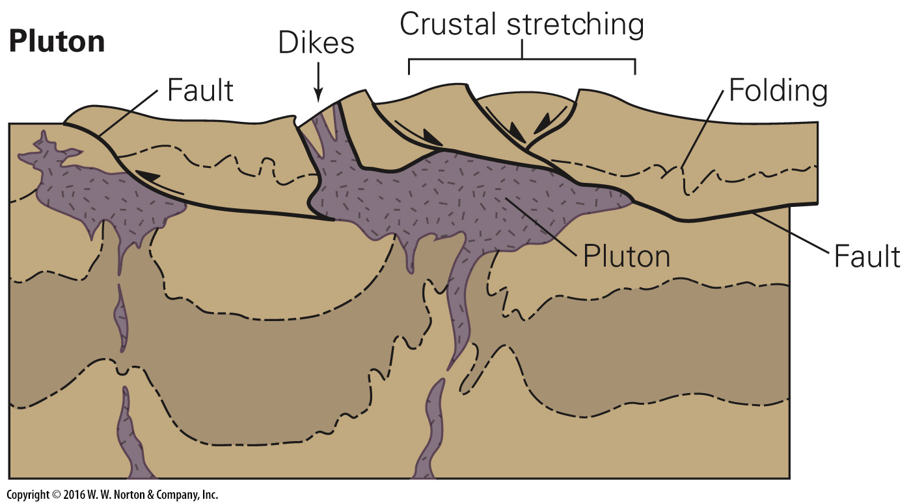
Notes:
FIGURE 4.12b Making room for igneous plutons.
(b) Faulting associated with crustal stretching may accommodate the emplacement of a diapir.

Slide 53
Notes:
FIGURE 4.12c Making room for igneous plutons.
(c) Magma pushes up into cracks, and blocks may be incorporated in the melt by stoping.

Slide 54
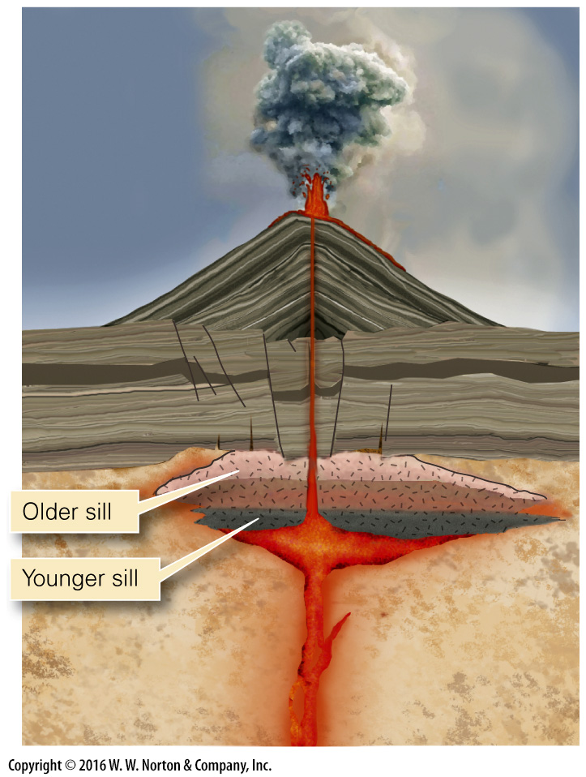
Notes:
FIGURE 4.12d Making room for igneous plutons.
(d) Plutons may intrude as a succession of sill-like sheets.

Slide 55
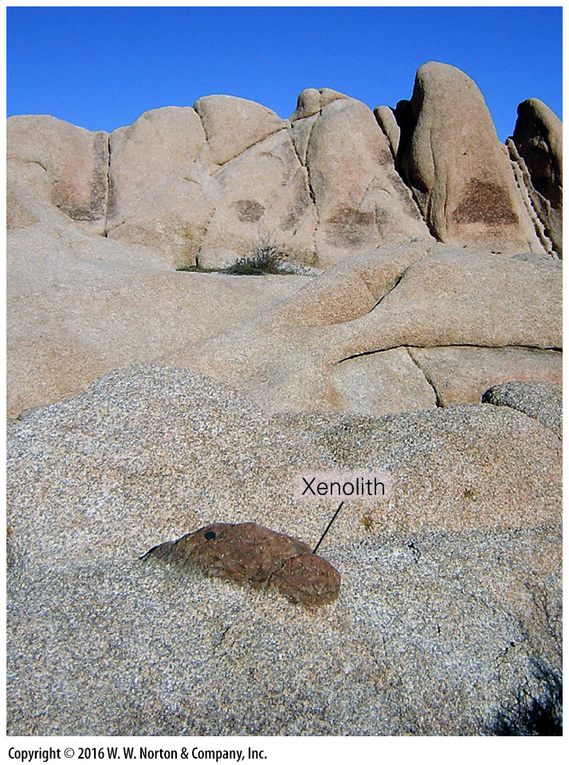
Notes:
FIGURE 4.12e Making room for igneous plutons.
(e) A xenolith of darker rock surrounded by light-colored granite.

Slide 56
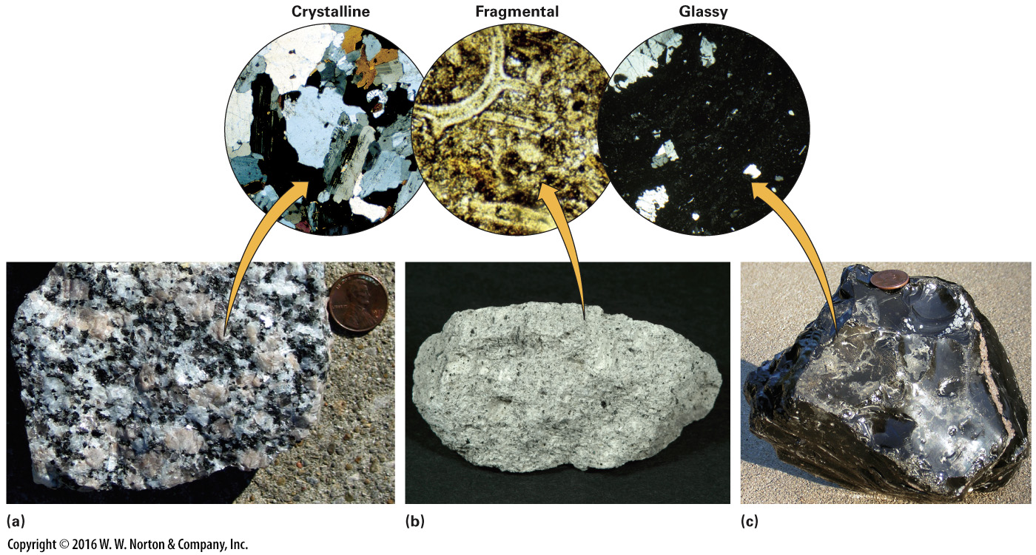
Notes:
FIGURE 4.13 Textures of igneous rocks, as viewed through a microscope. The field of view is about 3 mm. Crystalline rocks have interlocking crystals, fragmental rocks have clasts cemented or welded together, and glassy rocks contain glass (black material) as well as isolated crystals.
(a) Granite is crystalline. (b) Tuff is fragmental. (c) Obsidian is glassy.

Slide 57
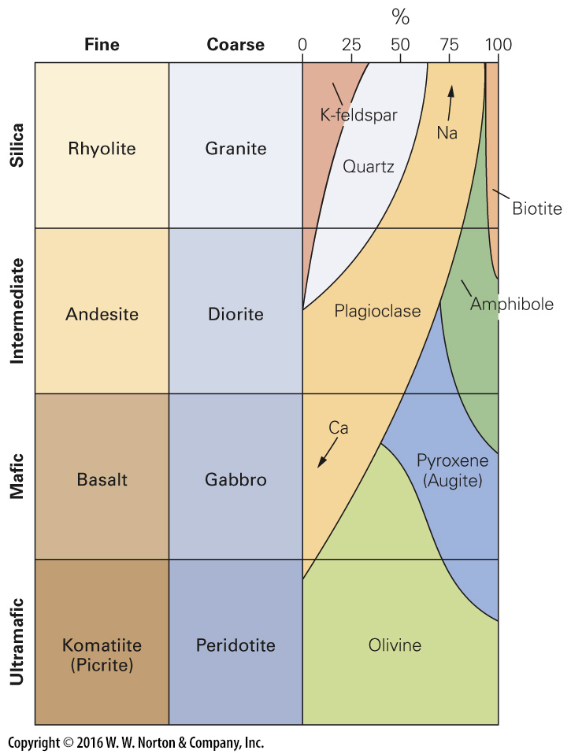
Notes:
FIGURE 4.14 Crystalline igneous rocks are classified based on composition and texture. The right side of the chart shows the percentages of different minerals in the different rock types.

Slide 58
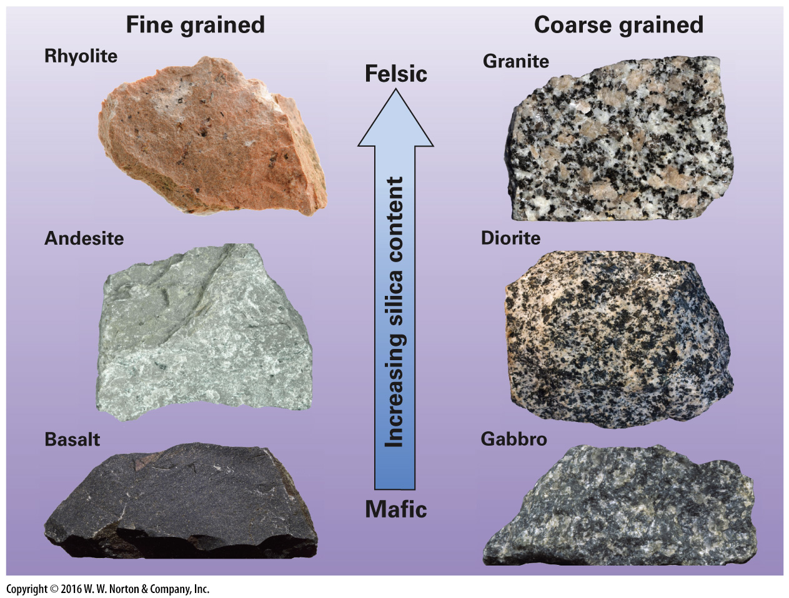
Notes:
FIGURE 4.15 Examples of igneous rocks, arranged by grain size and composition.

Slide 59
Notes:
FIGURE 4.16 Some igneous rocks contain an abundance of vesicles, gas bubbles that were frozen into the rock as it cooled.
(a) Pumice is a felsic glassy rock with tiny vesicles. (b) Scoria is a mafic glassy rock with many vesicles.

Slide 60
Notes:
FIGURE 4.16a Some igneous rocks contain an abundance of vesicles, gas bubbles that were frozen into the rock as it cooled.
(a) Pumice is a felsic glassy rock with tiny vesicles.

Slide 61
Notes:
FIGURE 4.16b Some igneous rocks contain an abundance of vesicles, gas bubbles that were frozen into the rock as it cooled.
(b) Scoria is a mafic glassy rock with many vesicles.

Slide 62
Notes:
GEOLOGY AT A GLANCE
Formation of Igneous Rocks

Slide 63
Notes:
FIGURE 4.17 The tectonic setting of igneous rocks.

Slide 64
Notes:
FIGURE 4.18 A map showing the distribution of LIPs on Earth. The red areas are or once were underlain by immense volumes of basalt; not all of this basalt is exposed.

Slide 65
Notes:
FIGURE 4.19 Flood basalts form when vast quantities of low-viscosity mafic lava “floods” over the landscape and freezes into a thin sheet. Accumulation of successive flows builds a flat-topped plateau.
(a) The plume model for forming flood basalts. (b) Flood basalts form the layers exposed in Palouse Canyon, Washington. (c) Flood basalts underlie the Columbia River Plateau in Washington and Oregon, the dark area of this map.

Slide 66
Notes:
FIGURE 4.19a Flood basalts form when vast quantities of low-viscosity mafic lava “floods” over the landscape and freezes into a thin sheet. Accumulation of successive flows builds a flat-topped plateau.
(a) The plume model for forming flood basalts.

Slide 67
Notes:
FIGURE 4.19b Flood basalts form when vast quantities of low-viscosity mafic lava “floods” over the landscape and freezes into a thin sheet. Accumulation of successive flows builds a flat-topped plateau.
(b) Flood basalts form the layers exposed in Palouse Canyon, Washington.

Slide 68
Notes:
FIGURE 4.19c Flood basalts form when vast quantities of low-viscosity mafic lava “floods” over the landscape and freezes into a thin sheet. Accumulation of successive flows builds a flat-topped plateau.
(c) Flood basalts underlie the Columbia River Plateau in Washington and Oregon, the dark area of this map.

