Slide 1
Stephen Marshak
ESSENTIALS OF
Geology
FIFTH EDITION
Chapter 5
The Wrath of Vulcan:
Volcanic Eruptions
©2016 W. W. Norton & Company, Inc.

Slide 2
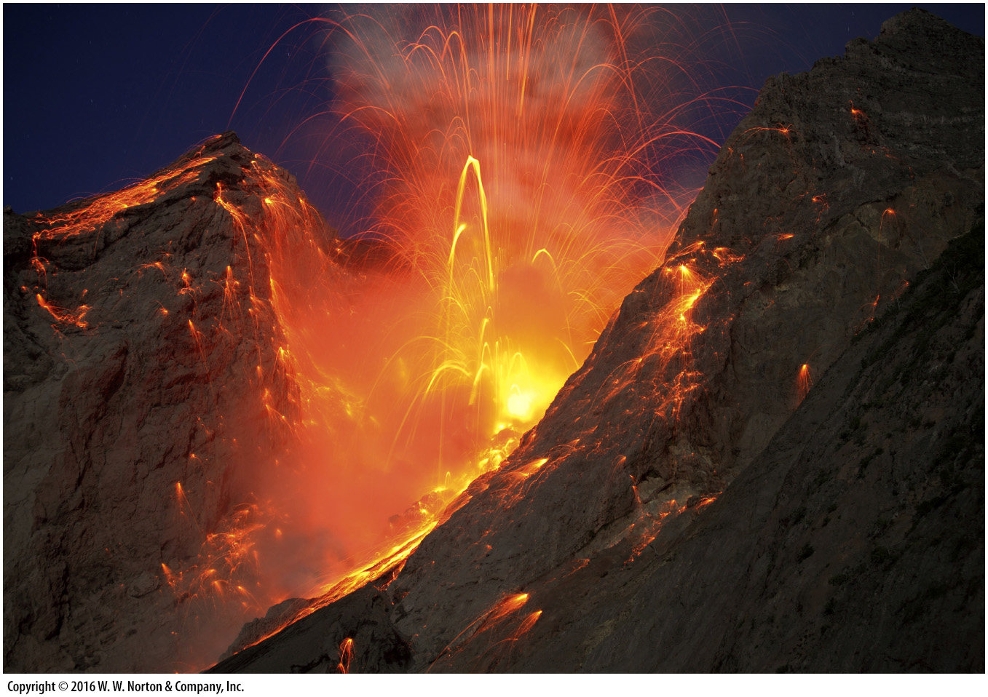
Notes:
An eruption of the Batu Tara Volcano in Indonesia spews glowing bombs of lava skyward. Volcanoes are an important component of the Earth System, serving to transfer rock and gas from our planet’s interior to its surface. But, while beautiful to watch from a distance, the force of eruptions can threaten life and property.

Slide 3
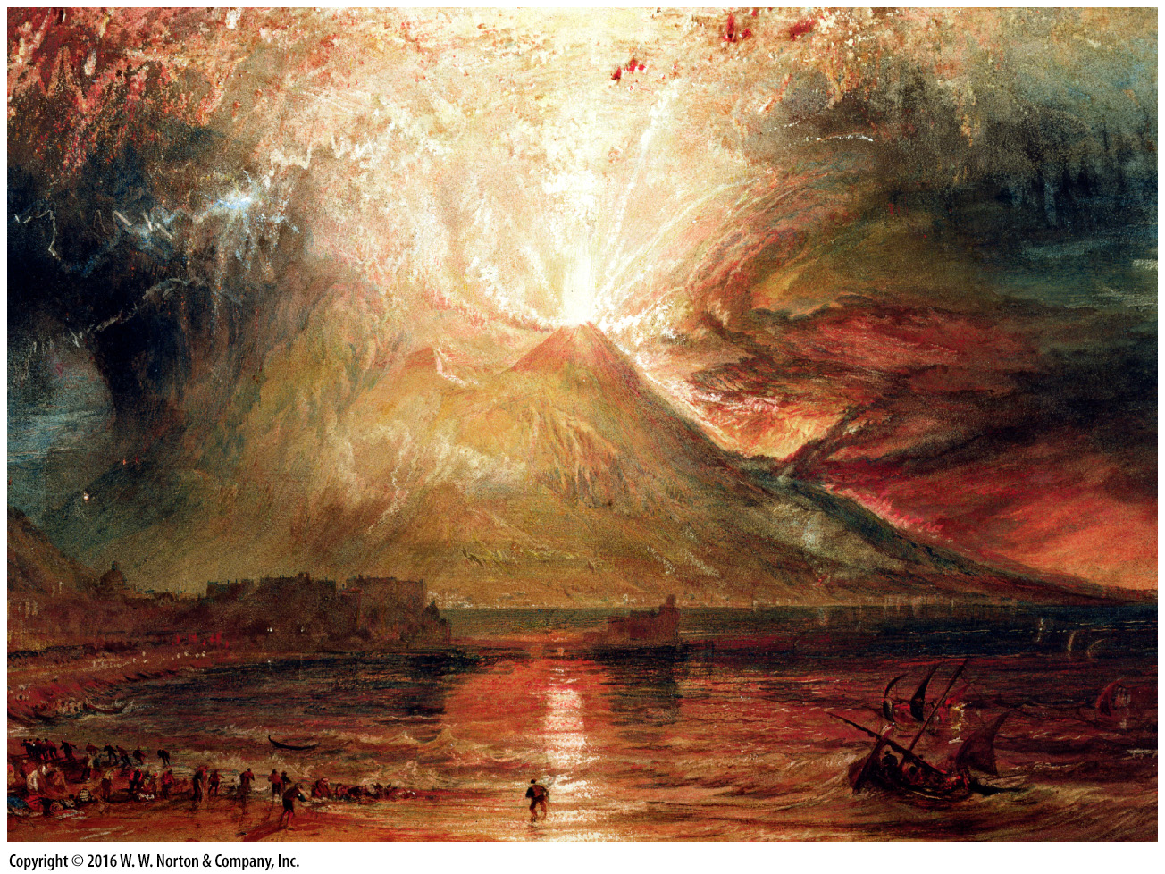
Notes:
FIGURE 5.1a The eruption of Vesuvius buried Pompeii and nearby Herculaneum in 79 C.E.
(a) In this 1817 painting, the British artist J.M.W. Turner depicted the cataclysmic explosion.

Slide 4
Notes:
FIGURE 5.1b The eruption of Vesuvius buried Pompeii and nearby Herculaneum in 79 C.E.
(b) Streets and buildings of Pompeii are well preserved.

Slide 5
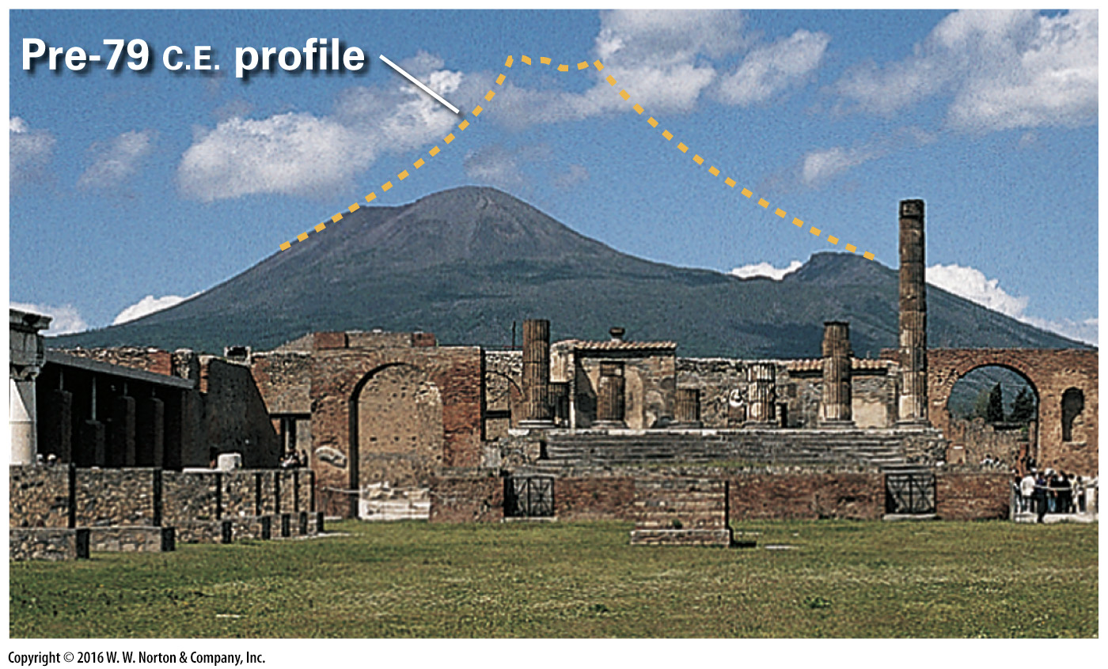
Notes:
FIGURE 5.1c The eruption of Vesuvius buried Pompeii and nearby Herculaneum in 79 C.E.
(c) Excavations exposed ruins of Pompeii with Vesuvius in the distance. The dashed line shows the volcano’s profile prior to its eruption.

Slide 6
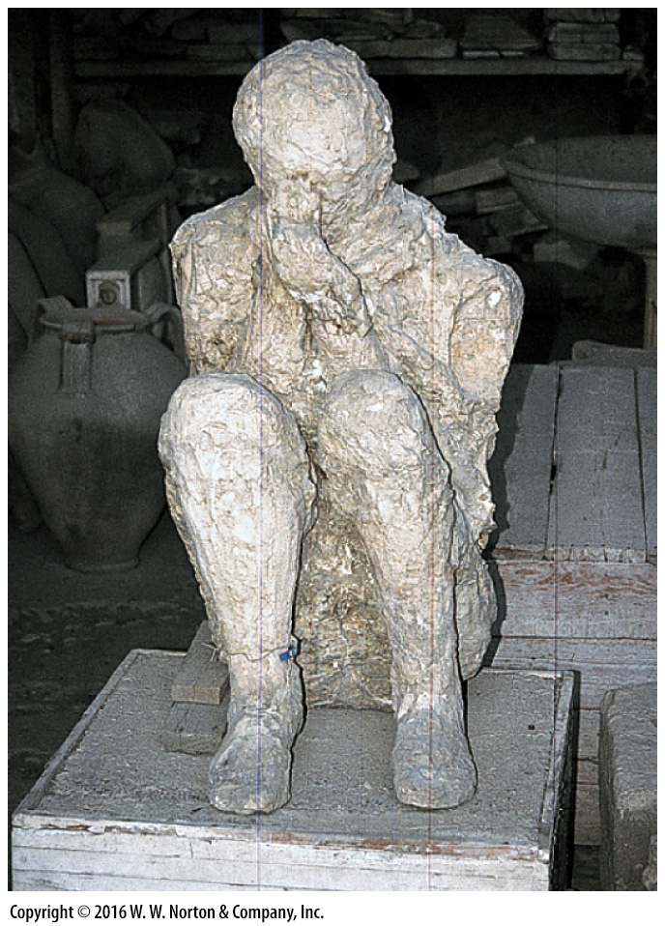
Notes:
FIGURE 5.1d The eruption of Vesuvius buried Pompeii and nearby Herculaneum in 79 C.E.
(d) A plaster cast of a Pompeii resident who was buried in ash.

Slide 7
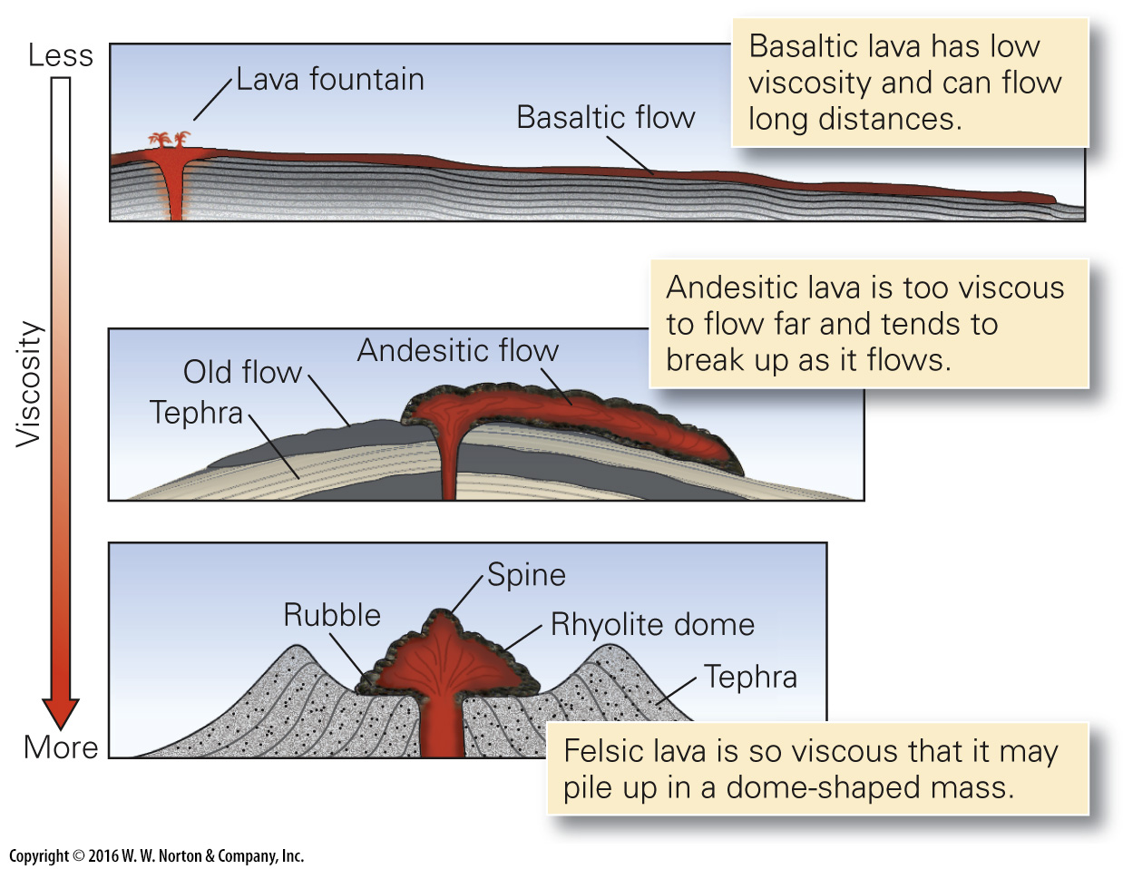
Notes:
FIGURE 5.2 The characteristics of a lava flow depends on its viscosity.

Slide 8
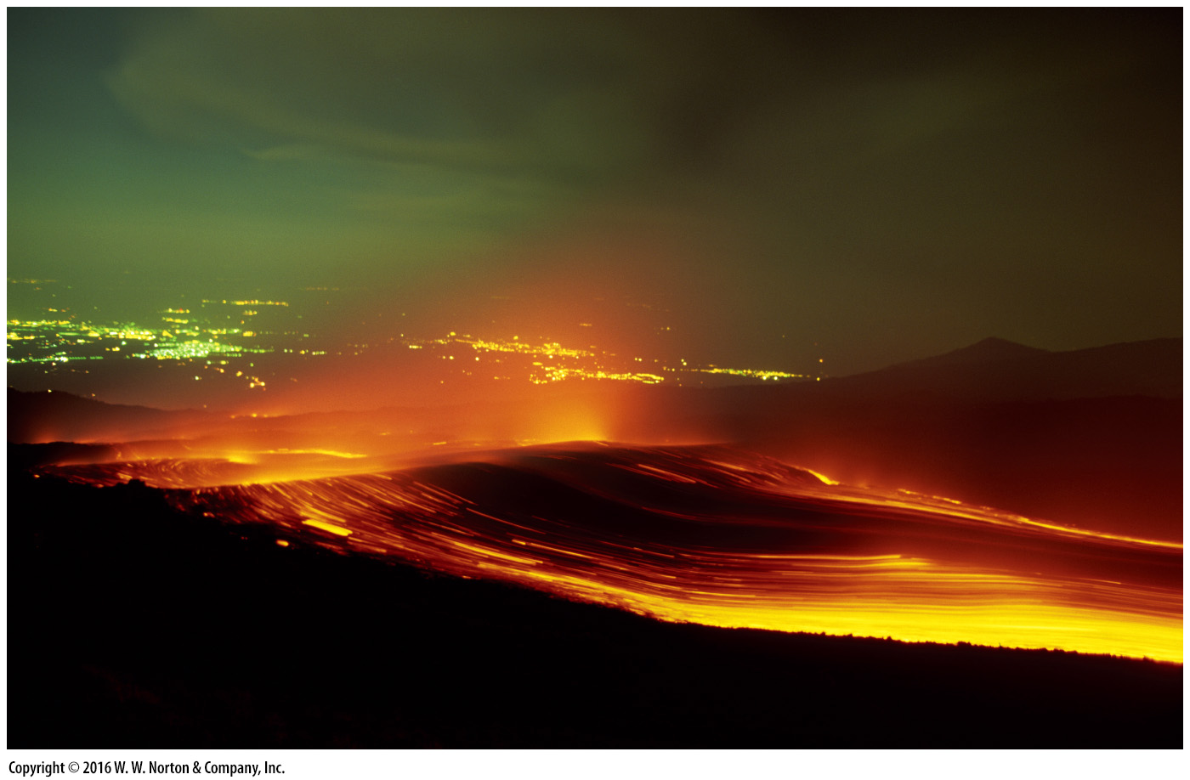
Notes:
FIGURE 5.3a Features of basaltic lava flows. They have low viscosity and thus can flow long distances. Their surface and interior can be complex.
(a) A fast-moving flow coming from Mt. Etna, Sicily.

Slide 9
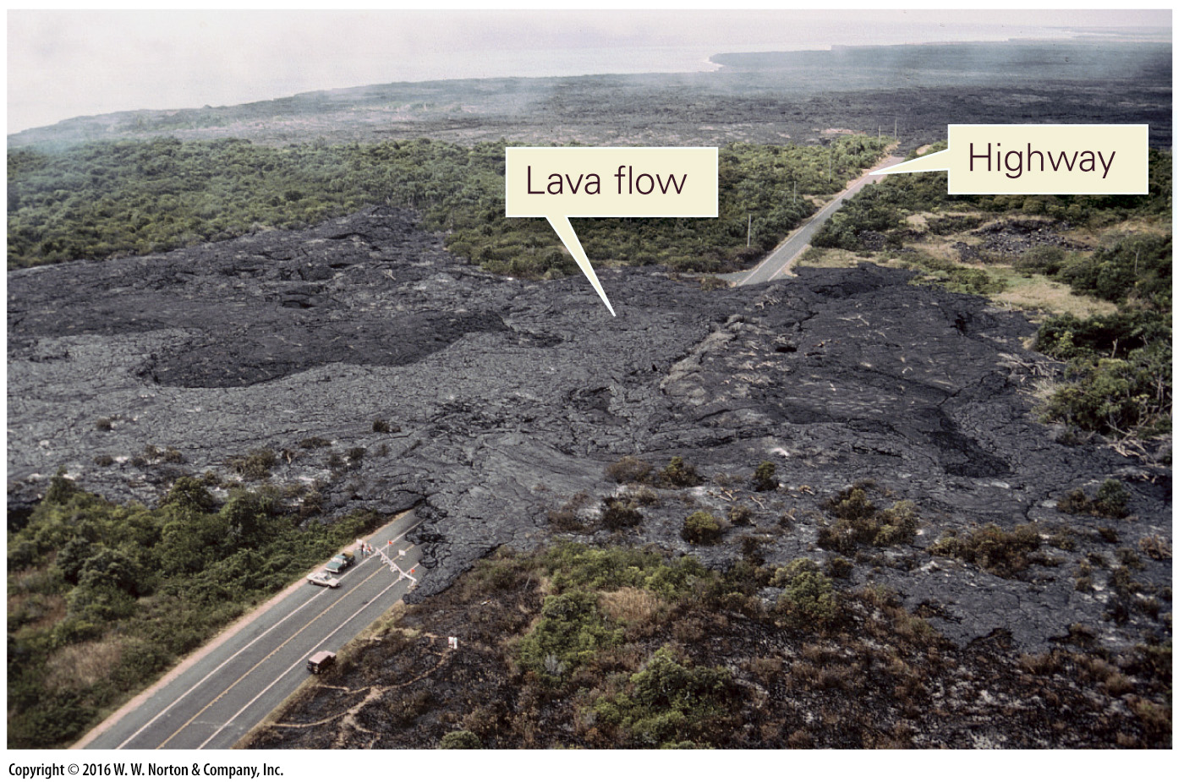
Notes:
FIGURE 5.3b Features of basaltic lava flows. They have low viscosity and thus can flow long distances. Their surface and interior can be complex.
(b) A basaltic lava flow covers a highway in Hawaii.

Slide 10
Notes:
FIGURE 5.3c Features of basaltic lava flows. They have low viscosity and thus can flow long distances. Their surface and interior can be complex.
(c) In a lava tube, still-molten lava flows beneath a crust of solid basalt.

Slide 11
Notes:
FIGURE 5.3d Features of basaltic lava flows. They have low viscosity and thus can flow long distances. Their surface and interior can be complex.
(d) A drained lava tube exposed in a road cut on Hawaii.

Slide 12
Notes:
FIGURE 5.3e Features of basaltic lava flows. They have low viscosity and thus can flow long distances. Their surface and interior can be complex.
(e) Pahoehoe from a recent lava flow in Hawaii. Note the coin for scale.

Slide 13
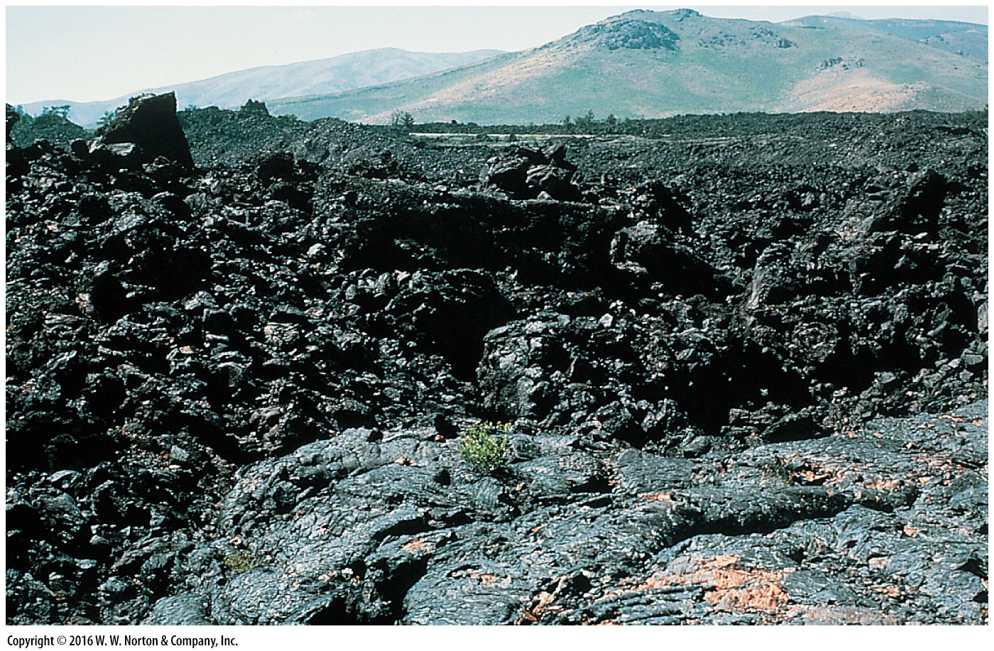
Notes:
FIGURE 5.3f Features of basaltic lava flows. They have low viscosity and thus can flow long distances. Their surface and interior can be complex.
(f) The rubbly surface of an a’a’ flow, Sunset Crater, Arizona.

Slide 14
Notes:
FIGURE 5.3g Features of basaltic lava flows. They have low viscosity and thus can flow long distances. Their surface and interior can be complex.
(g) Pillow basalt develops when lava erupts underwater. Later uplift may expose pillows above sea level, as in this Oregon outcrop.

Slide 15
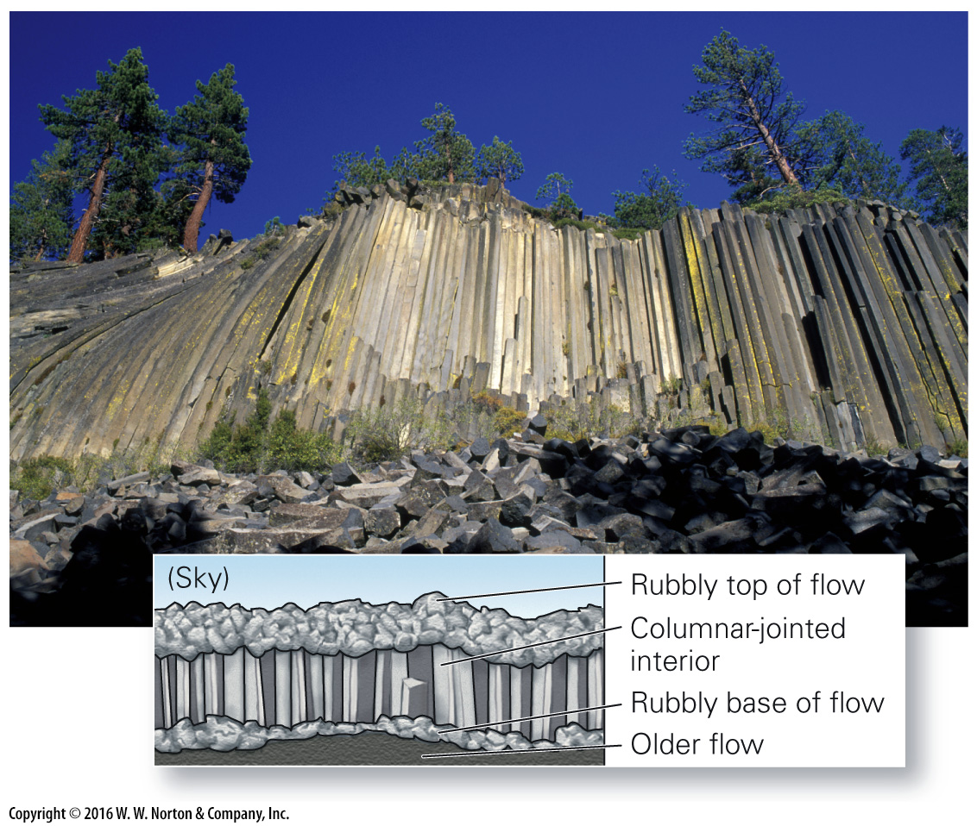
Notes:
FIGURE 5.3h Features of basaltic lava flows. They have low viscosity and thus can flow long distances. Their surface and interior can be complex.
(h) Columnar jointing develops when the interior of a flow cools and cracks. Such jointing develops in dikes and sills. This example is Devils Postpile in California.

Slide 16
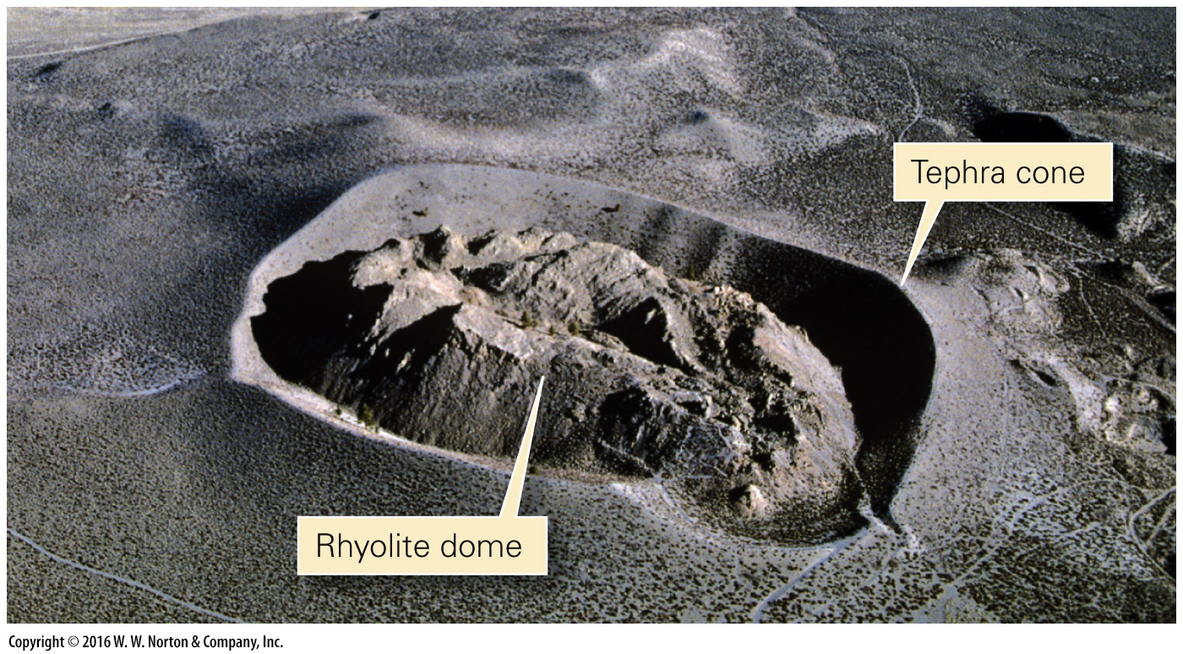
Notes:
FIGURE 5.4 This rhyolite dome formed about 650 years ago, in Panum Crater, California. Tephra (cinders) accumulated around the vent.

Slide 17
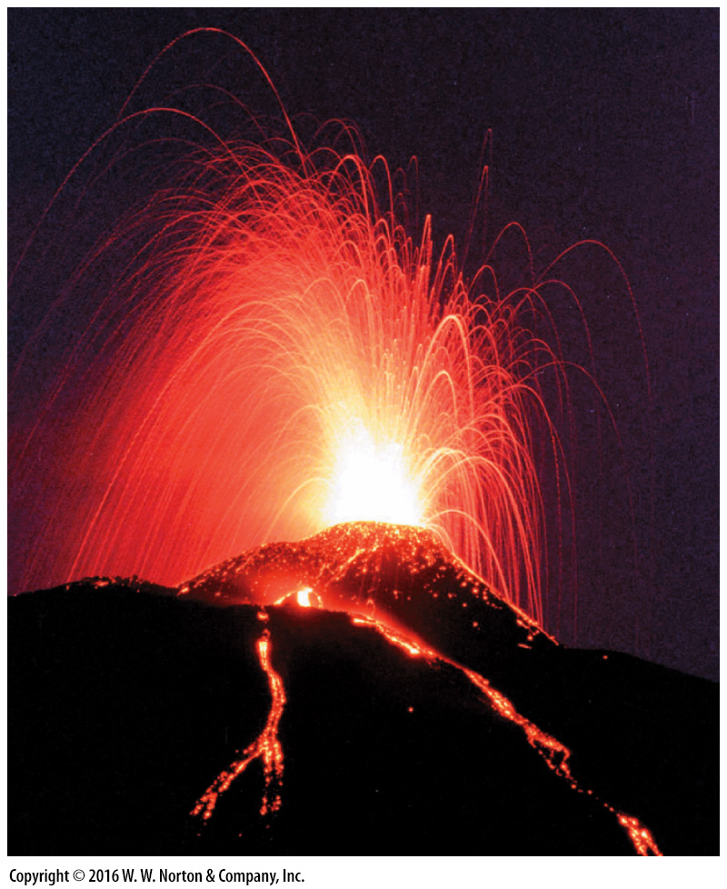
Notes:
FIGURE 5.5a Pyroclastic debris from basaltic eruptions.
(a) Fountains of lava may erupt from basaltic volcanoes.

Slide 18
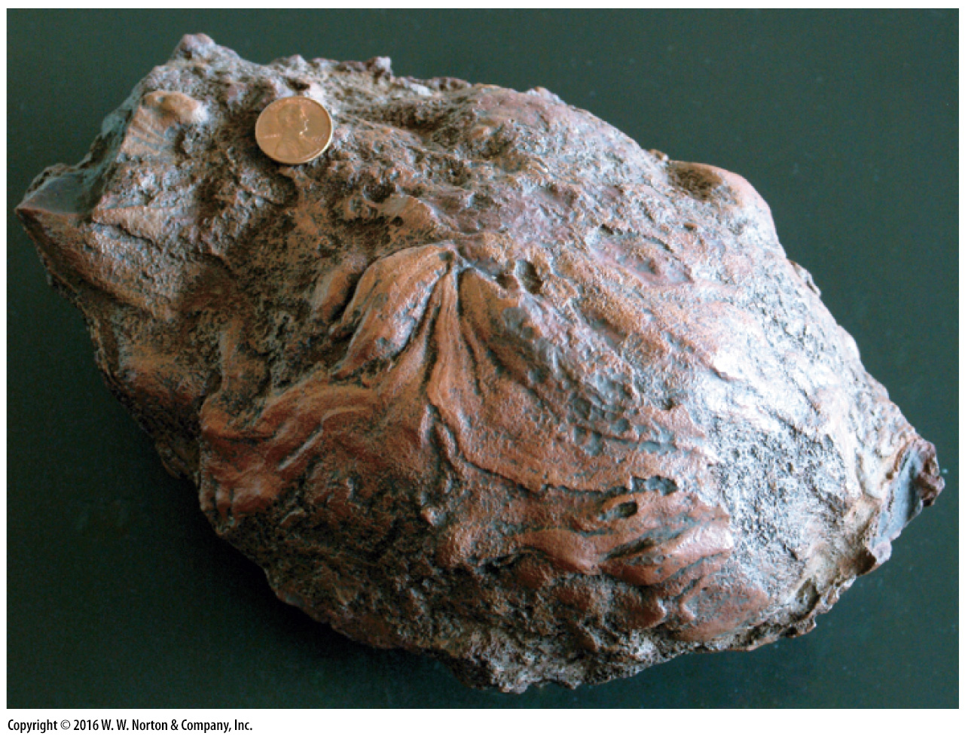
Notes:
FIGURE 5.5b Pyroclastic debris from basaltic eruptions.
(b) A bomb has a smooth, streaked surface.

Slide 19
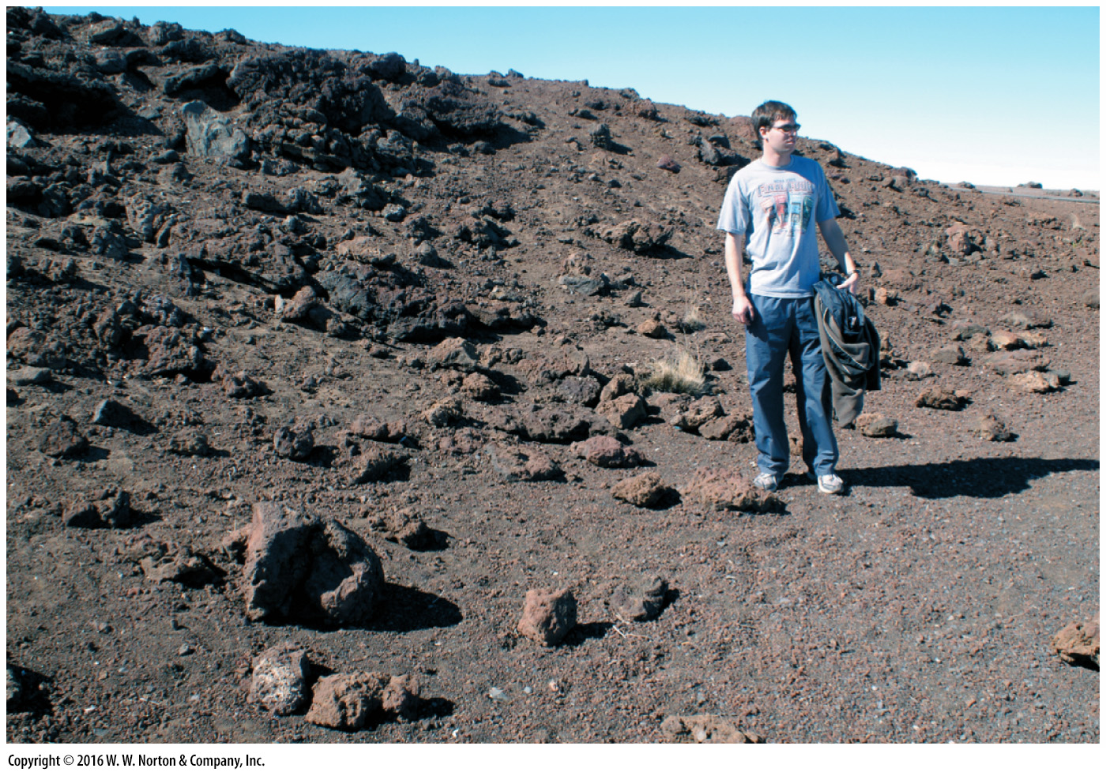
Notes:
FIGURE 5.5c Pyroclastic debris from basaltic eruptions.
(c) Blocks and lapilli on the flank of a Hawaiian volcano.

Slide 20
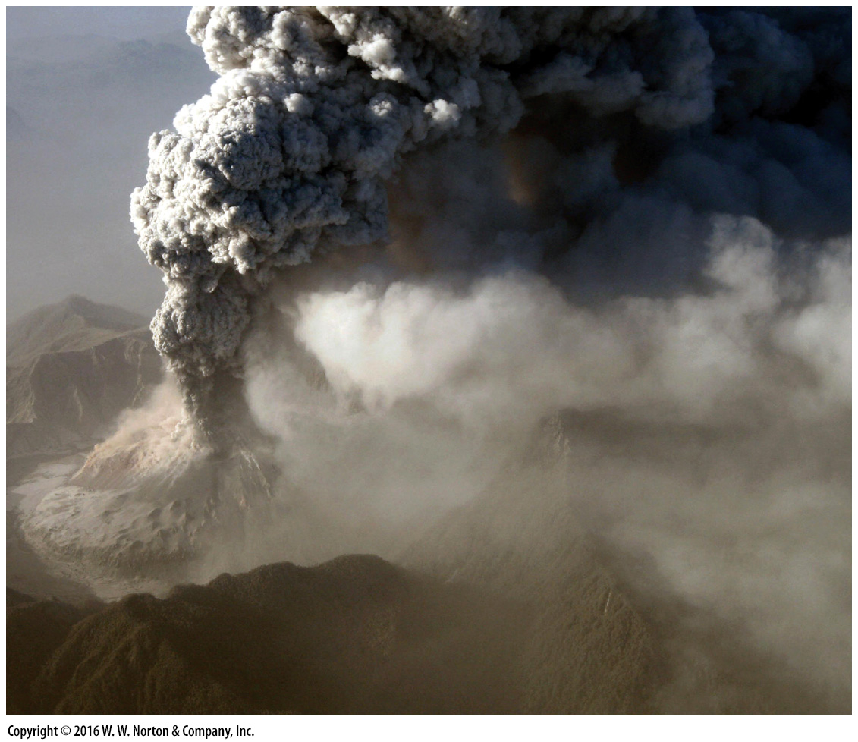
Notes:
FIGURE 5.6a Pyroclastic debris from andesitic or rhyolitic eruptions.
(a) Pyroclastic debris billowing from the 2008 eruption of Chaitén in Chile.

Slide 21
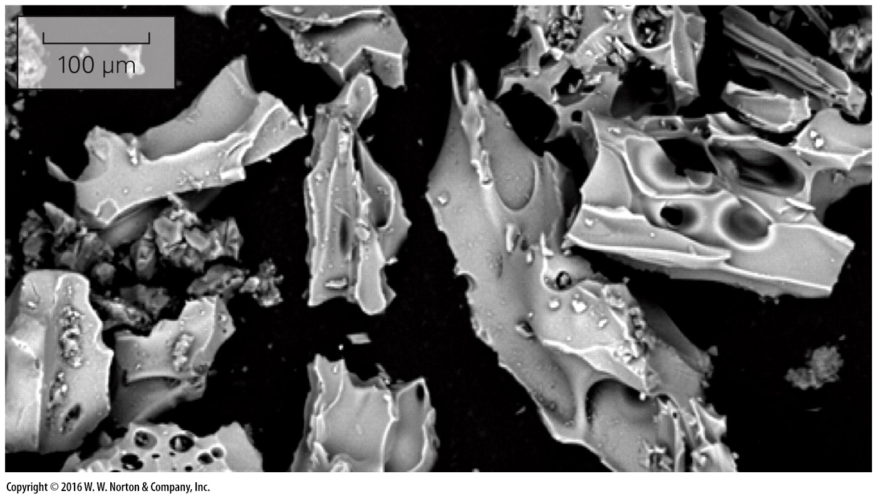
Notes:
FIGURE 5.6b Pyroclastic debris from andesitic or rhyolitic eruptions.
(b) Electron photomicrograph of ash.

Slide 22
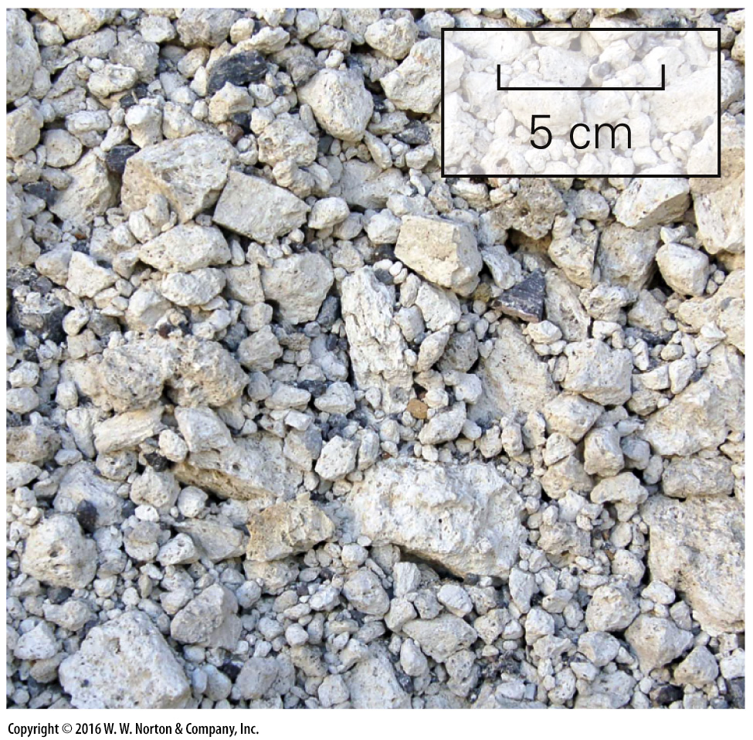
Notes:
FIGURE 5.6c Pyroclastic debris from andesitic or rhyolitic eruptions.
(c) Pumice lapilli.

Slide 23
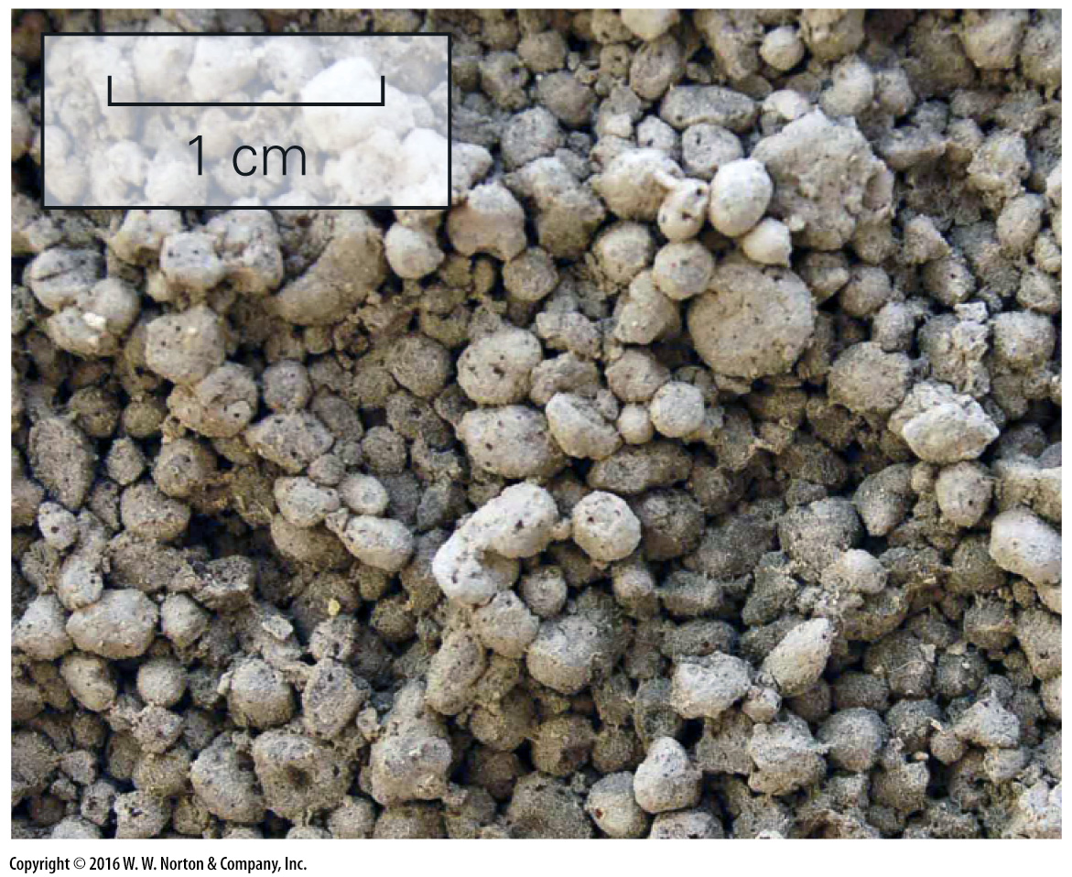
Notes:
FIGURE 5.6d Pyroclastic debris from andesitic or rhyolitic eruptions.
(d) Accretionary lapilli.

Slide 24
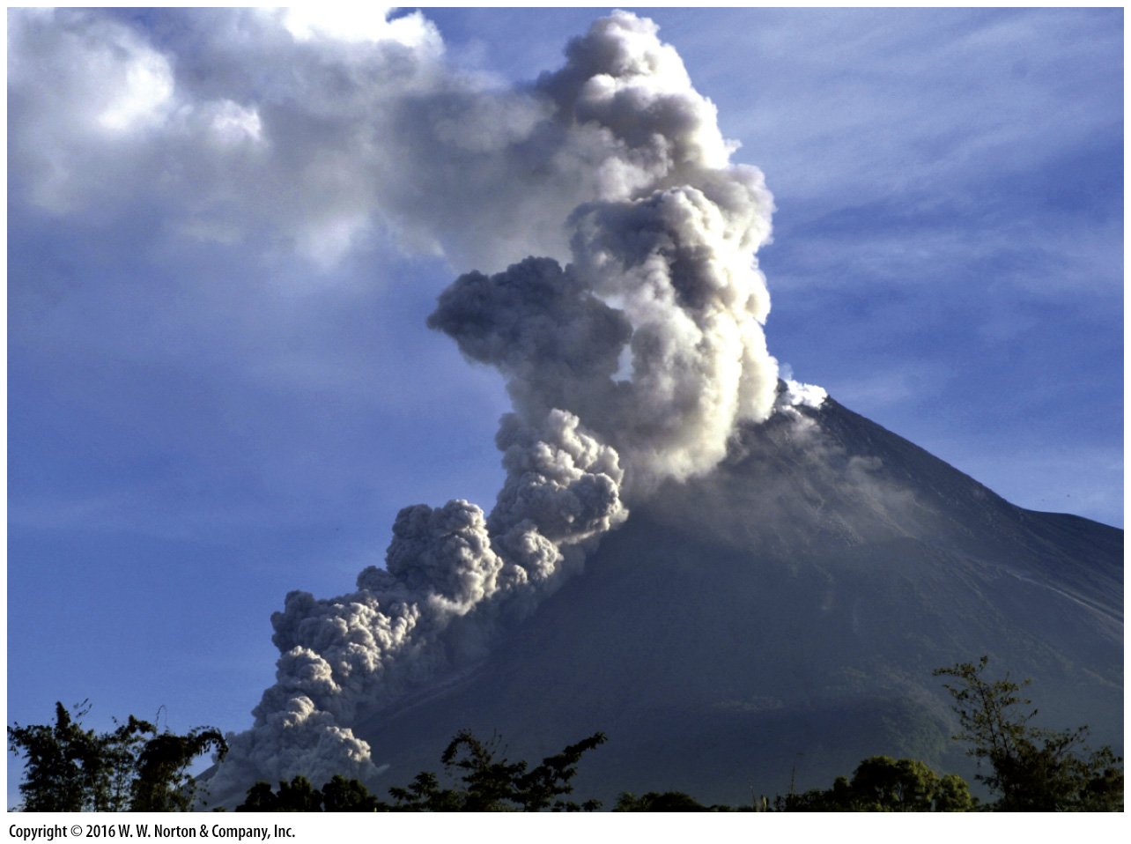
Notes:
FIGURE 5.6e Pyroclastic debris from andesitic or rhyolitic eruptions.
(e) A pyroclastic flow rushes down the flank of Mt. Merapi, Indonesia, in 2006.

Slide 25
Notes:
FIGURE 5.6f Pyroclastic debris from andesitic or rhyolitic eruptions.
(f) Water-soaked volcanic debris slid down the side of this volcano in Nicaragua.

Slide 26
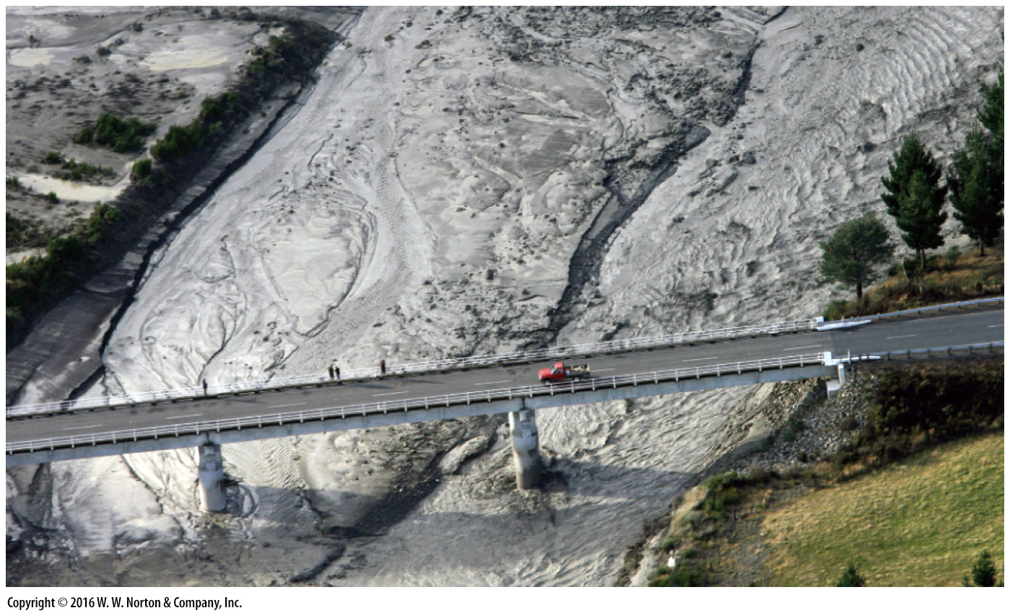
Notes:
FIGURE 5.6g Pyroclastic debris from andesitic or rhyolitic eruptions.
(g) A lahar fills a river bed in New Zealand after an eruption in 2007.

Slide 27
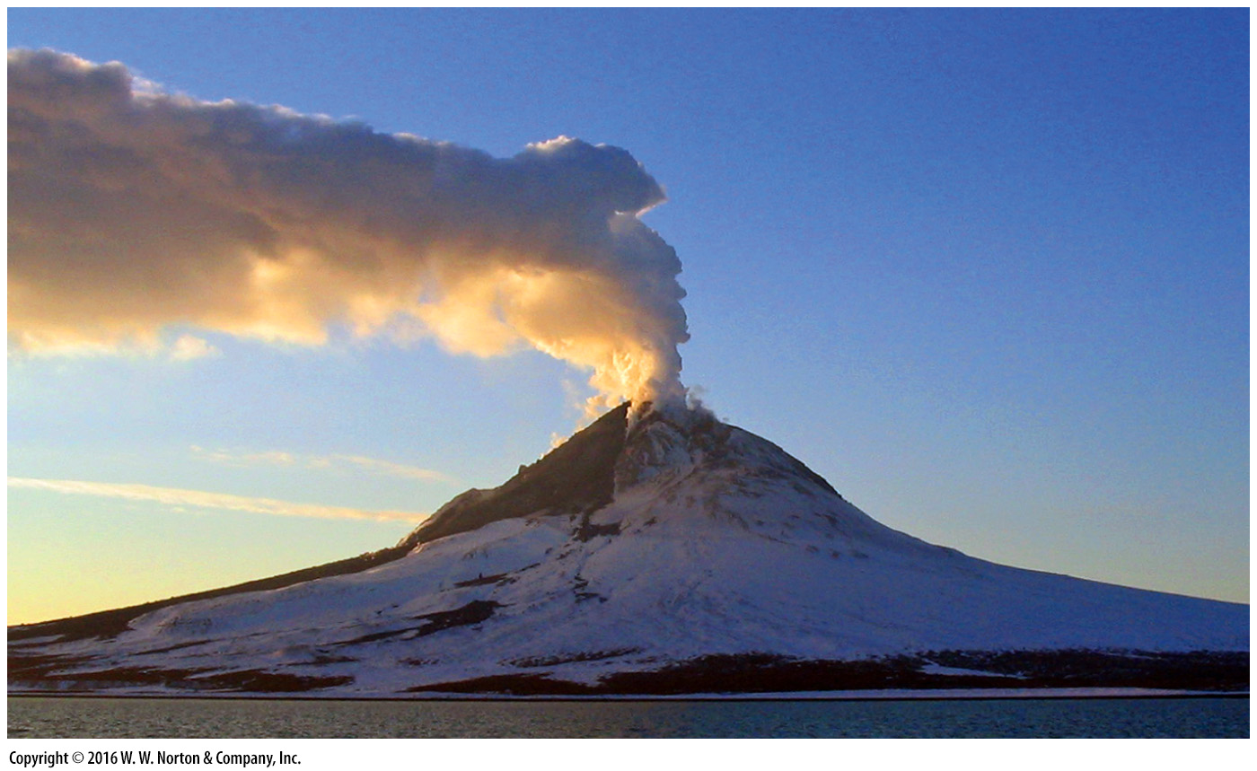
Notes:
FIGURE 5.7a The gas component of volcanic eruptions.
(a) A volcano in Alaska erupting large quantities of steam.

Slide 28
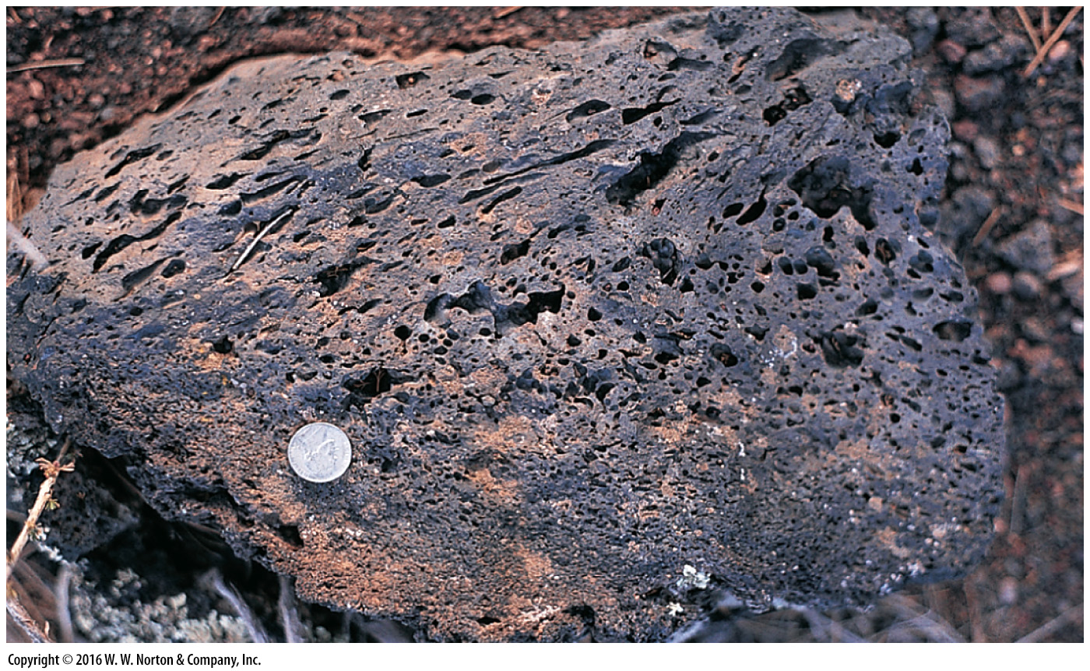
Notes:
FIGURE 5.7b The gas component of volcanic eruptions.
(b) Gas bubbles frozen in lava produce vesicles, as in this block from Sunset Crater, Arizona.

Slide 29
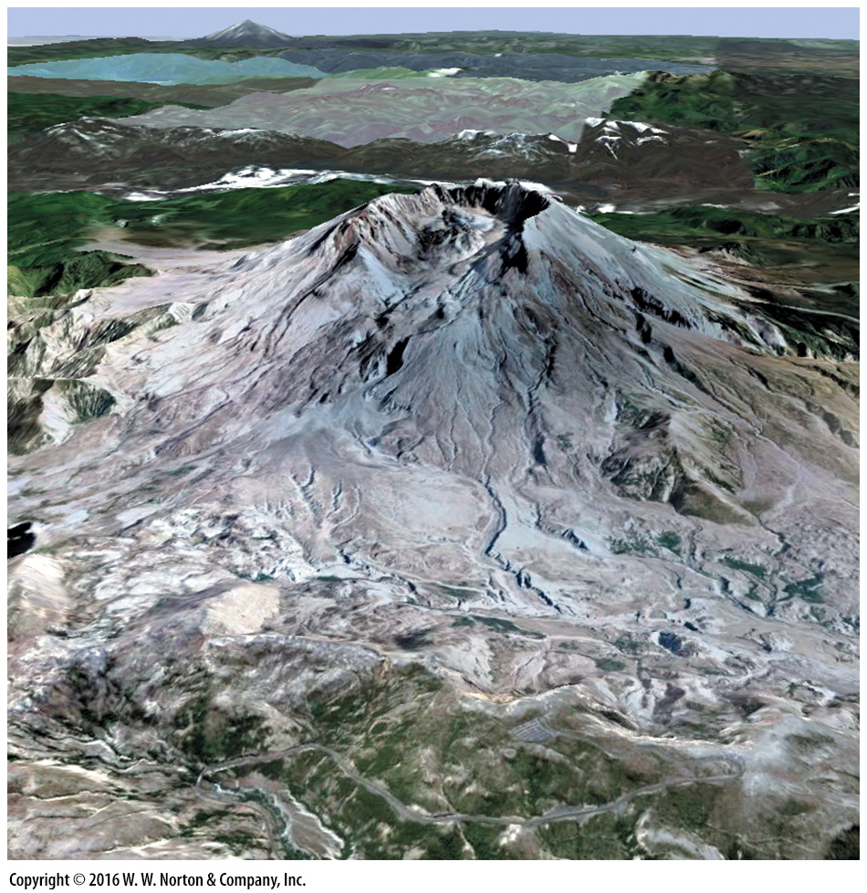
Notes:
SEE FOR YOURSELF…
MT. ST. HELENS, WASHINGTON

Slide 30
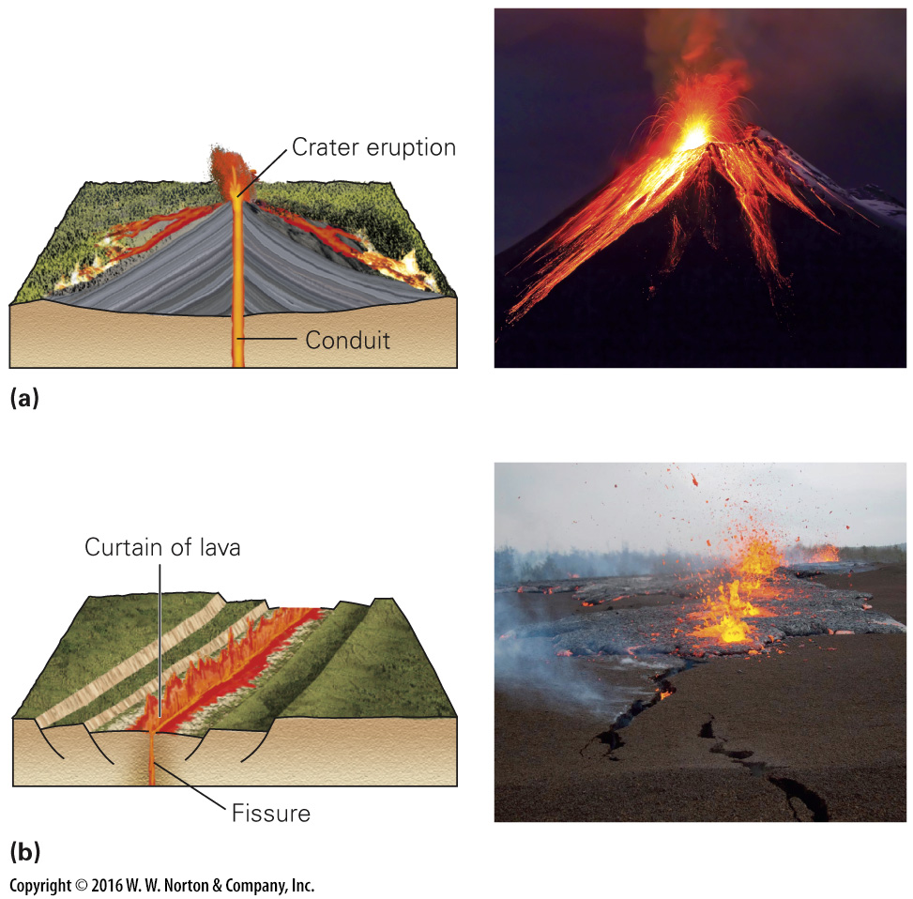
Notes:
FIGURE 5.8 Crater eruptions and fissure eruptions come from conduits of different shapes.
(a) At a crater eruption, lava spouts from a chimney-shaped conduit.
(b) At a fissure eruption, lava comes out in a curtain, along the length of a crack.

Slide 31
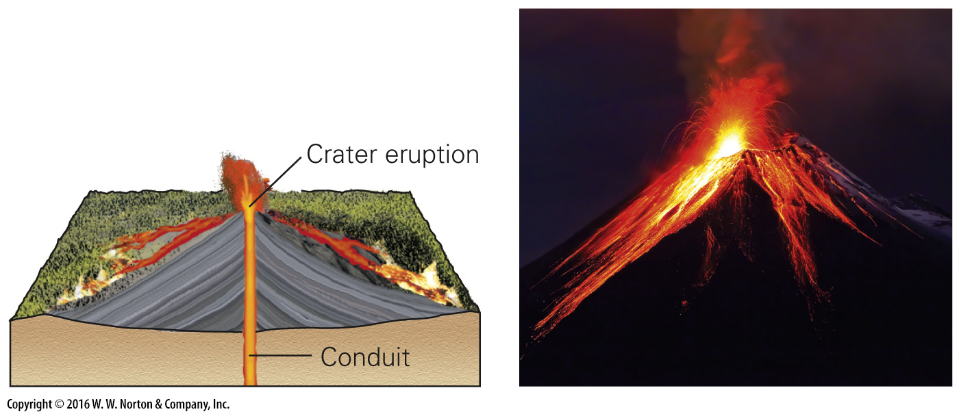
Notes:
FIGURE 5.8a Crater eruptions and fissure eruptions come from conduits of different shapes.
(a) At a crater eruption, lava spouts from a chimney-shaped conduit.

Slide 32
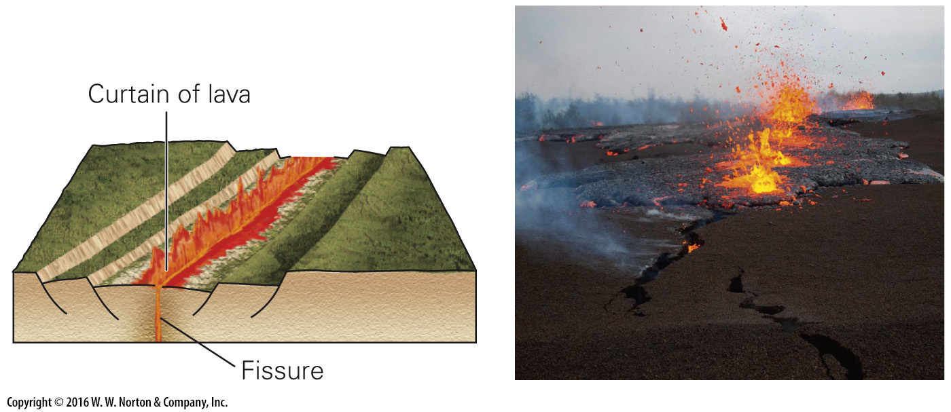
Notes:
FIGURE 5.8b Crater eruptions and fissure eruptions come from conduits of different shapes.
(b) At a fissure eruption, lava comes out in a curtain, along the length of a crack.

Slide 33
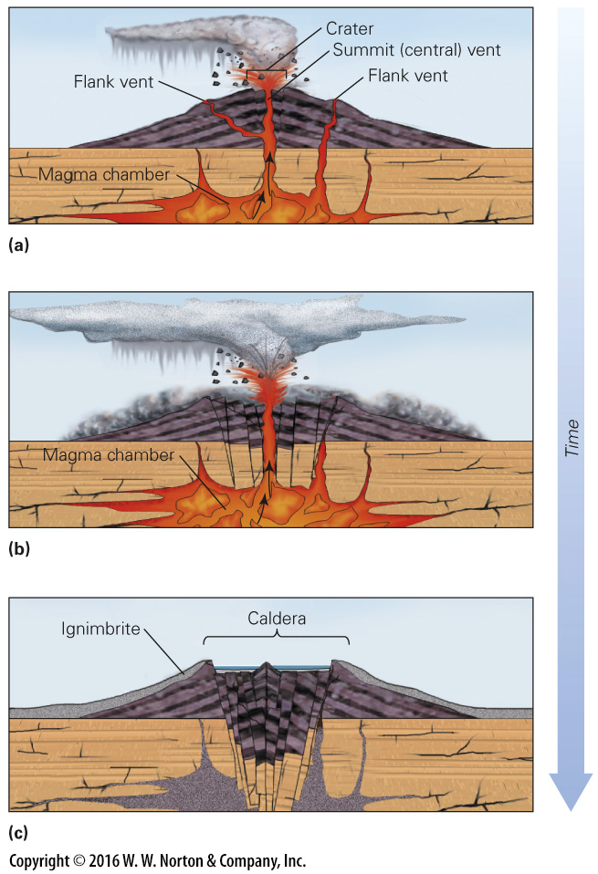
Notes:
FIGURE 5.9 The formation of volcanic calderas.
(a) As an eruption begins, the magma chamber inflates with magma. There can be a central vent and one or more flank vents.
(b) During an eruption, the magma chamber drains, and the central portion of the volcano collapses downward.
(c) The collapsed area becomes a caldera. Later, a new volcano may begin to grow within the caldera.

Slide 34
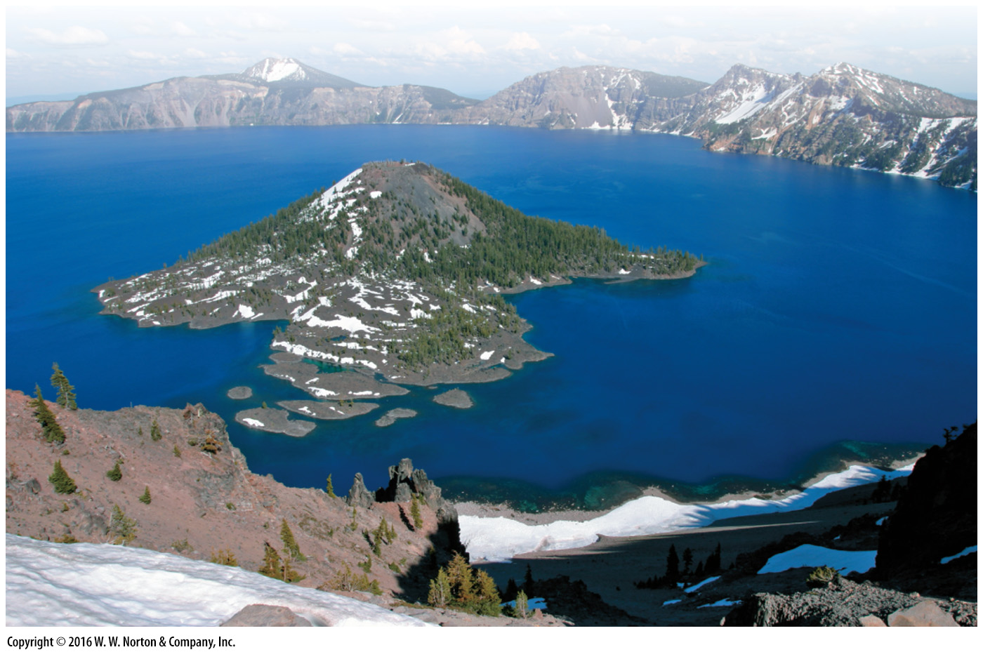
Notes:
FIGURE 5.9d The formation of volcanic calderas.
(d) This caldera in Oregon formed about 7,700 years ago. Afterward, it filled with water to become Crater Lake. Wizard Island, protruding from the lake, is a small volcano that grew on top of the caldera floor.

Slide 35
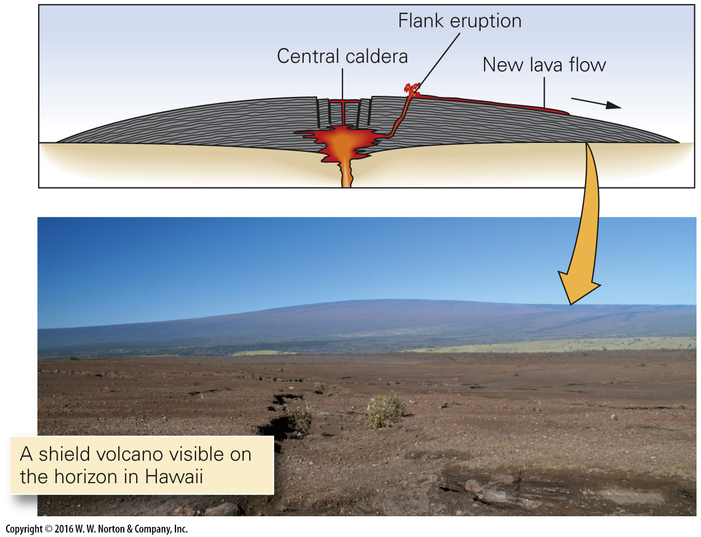
Notes:
FIGURE 5.1a Different shapes of volcanoes.
(a) A shield volcano, made from successive flows of low-viscosity basalt, has very gentle slopes.

Slide 36
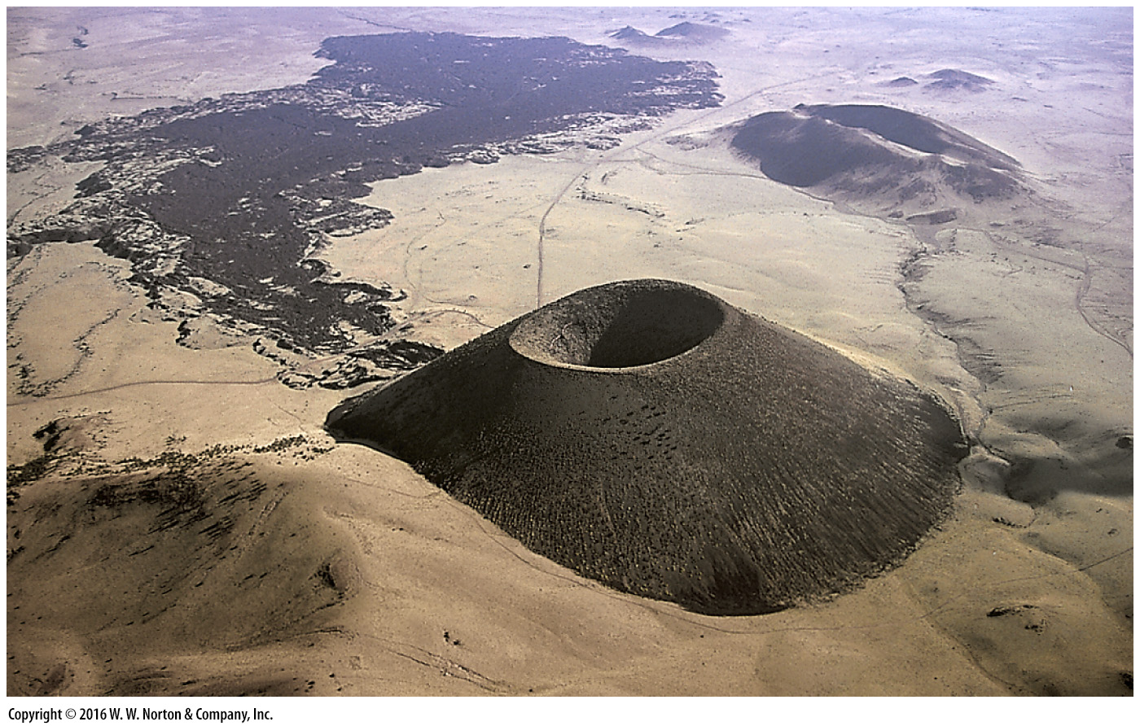
Notes:
FIGURE 5.1b Different shapes of volcanoes.
(b) A cinder cone on the flank of a larger volcano in Arizona. The pile of cinders has assumed the angle of repose. A lava flow covers the land surface in the distance.

Slide 37
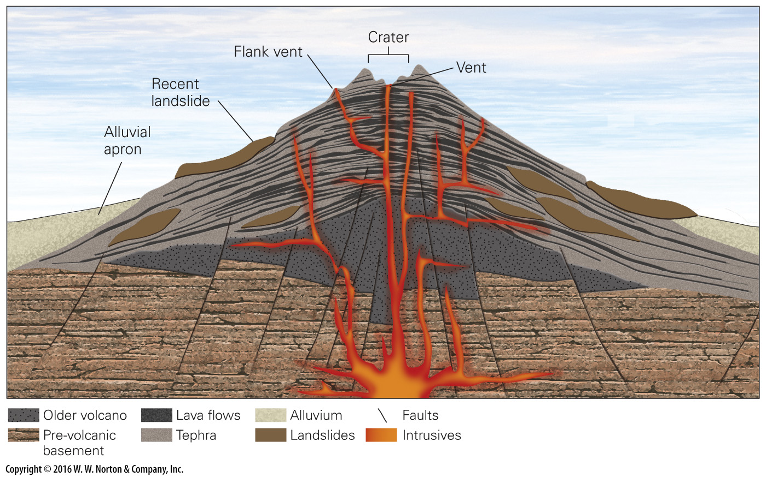
Notes:
FIGURE 5.1c (Part 1) Different shapes of volcanoes.
(c) A stratovolcano (composite volcano) consists of layers of tephra and lava. Volcanic debris flows and ash avalanches modify slopes and contribute to the development of a classic cone-like shape.

Slide 38
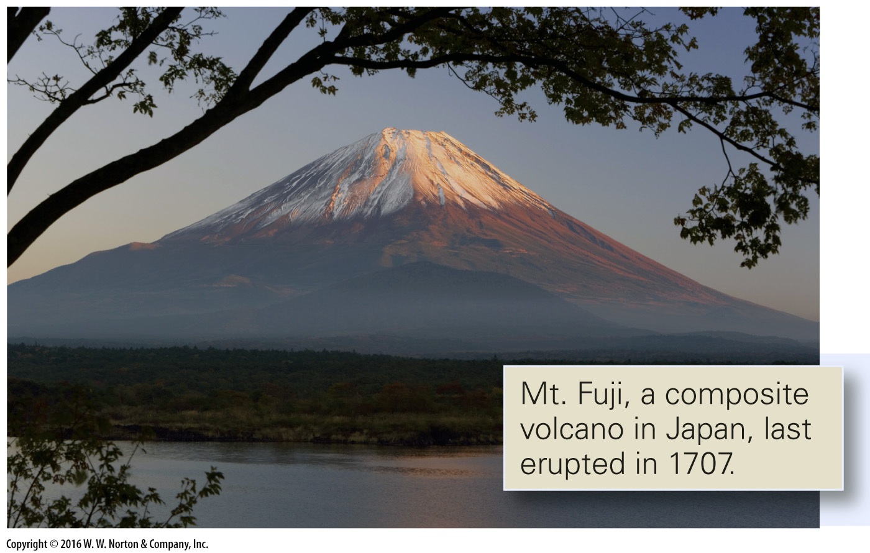
Notes:
FIGURE 5.1c (Part 2) Different shapes of volcanoes.
(c) A stratovolcano (composite volcano) consists of layers of tephra and lava. Volcanic debris flows and ash avalanches modify slopes and contribute to the development of a classic cone-like shape.

Slide 39
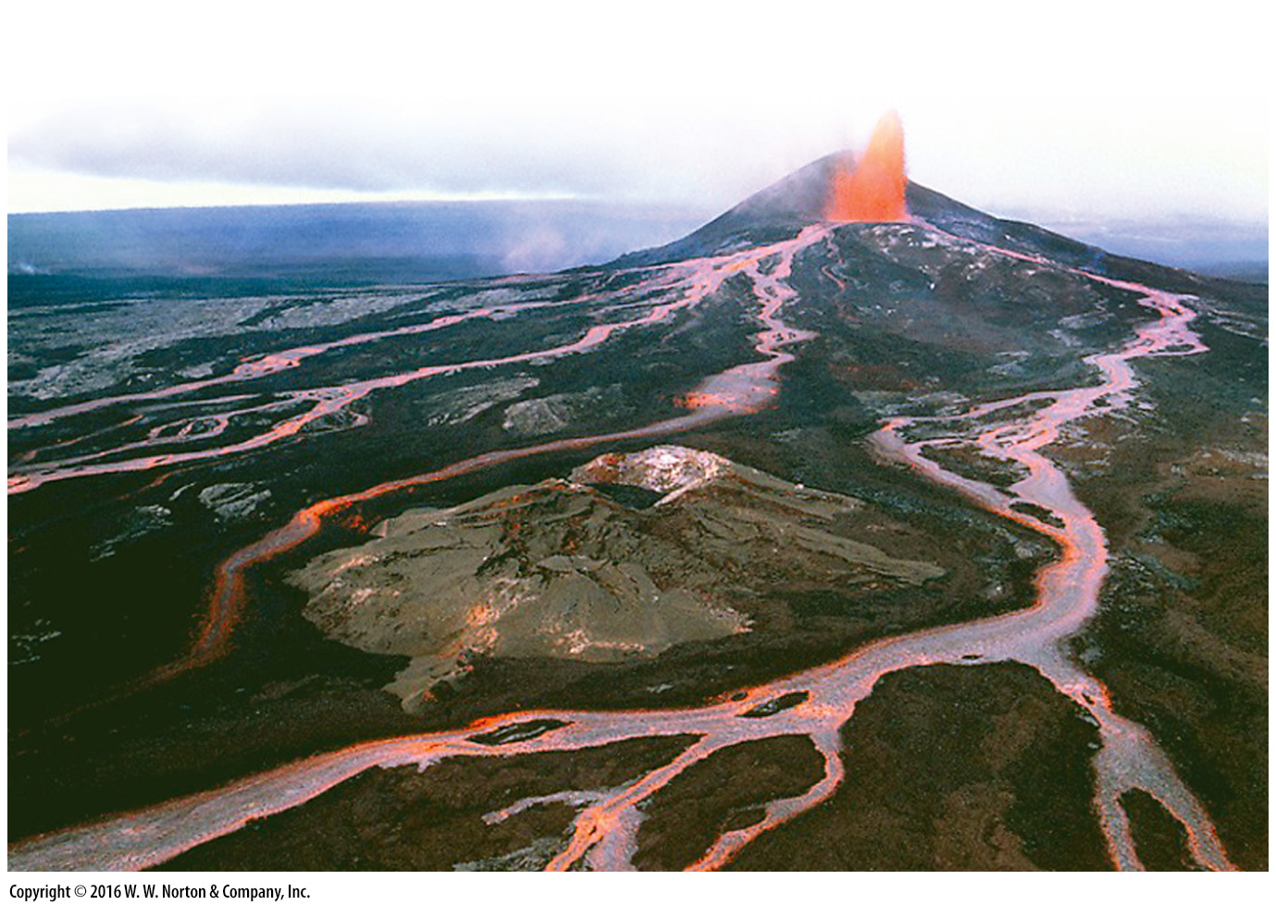
Notes:
FIGURE 5.11a Effusive eruptions compared to explosive eruptions.
(a) A 1986 effusive eruption on Hawaii.

Slide 40
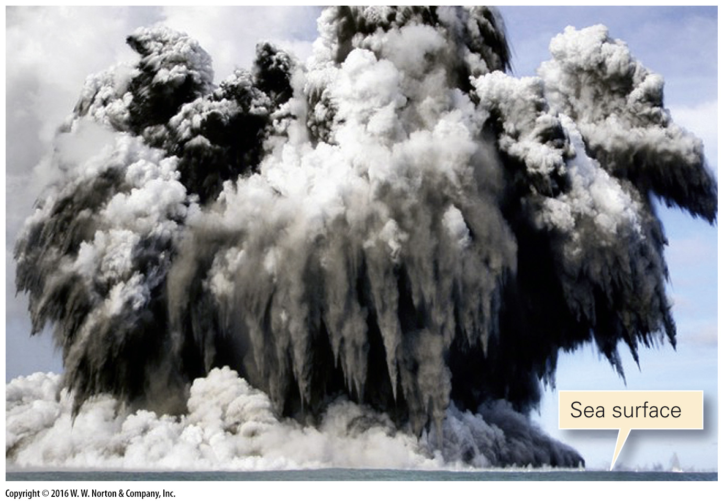
Notes:
FIGURE 5.11b Effusive eruptions compared to explosive eruptions.
(b) A volcano erupting just beneath the sea surface, near Tonga, sends a mixture of steam and ash skyward.

Slide 41
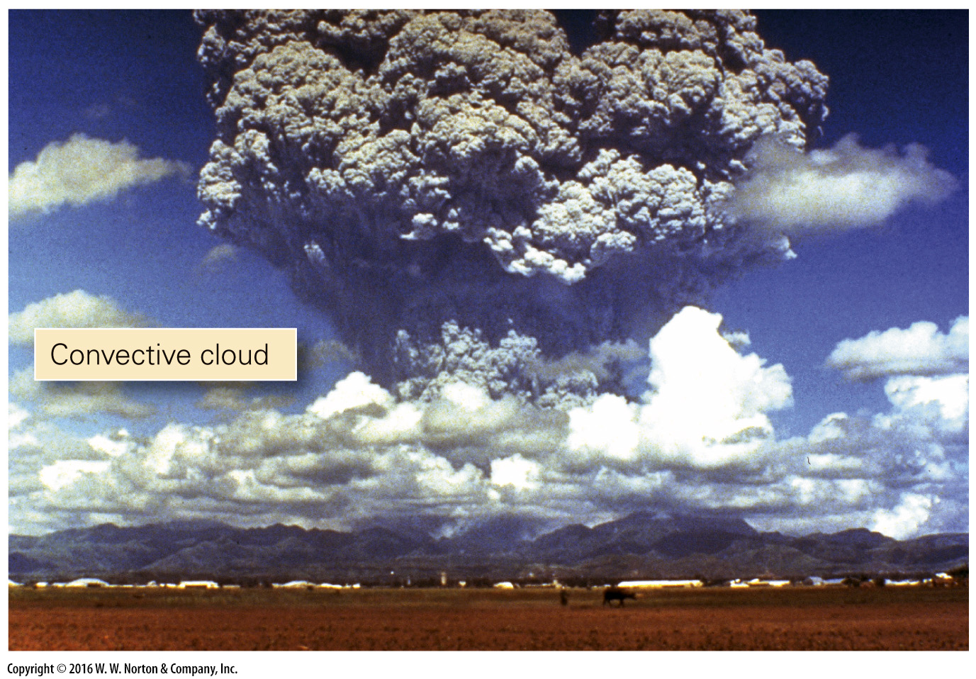
Notes:
FIGURE 5.11c Effusive eruptions compared to explosive eruptions.
(c) The eruptive cloud formed during the 1991 eruption of Mt. Pinatubo in the Philippines.

Slide 42
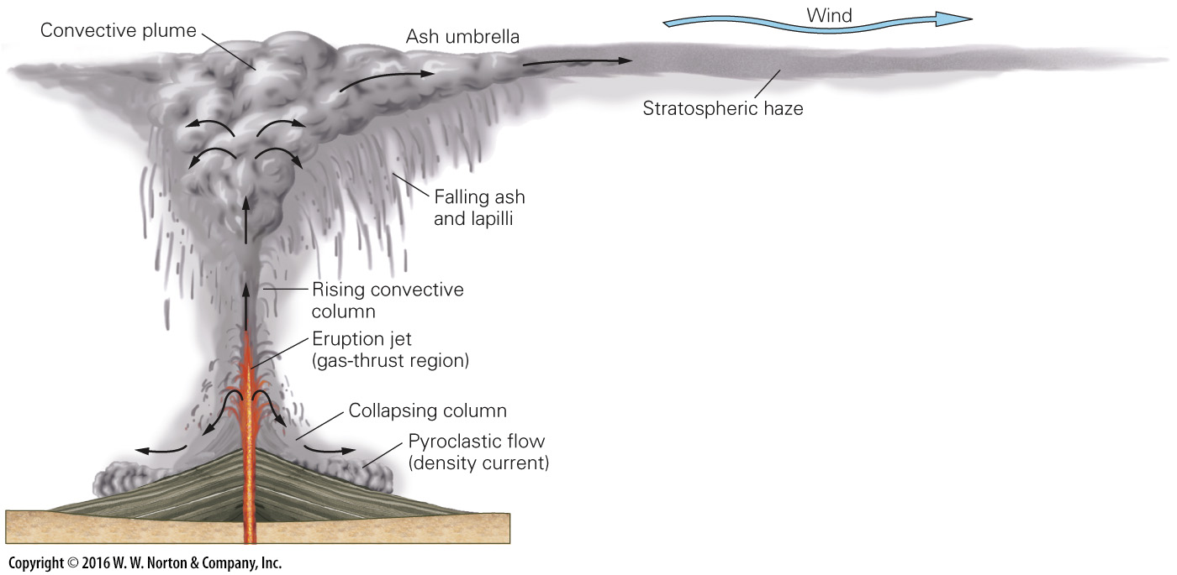
Notes:
FIGURE 5.12a The components of a large explosive volcanic eruption.
(a) A large explosive eruptive cloud (Plinean-type) contains several components.

Slide 43
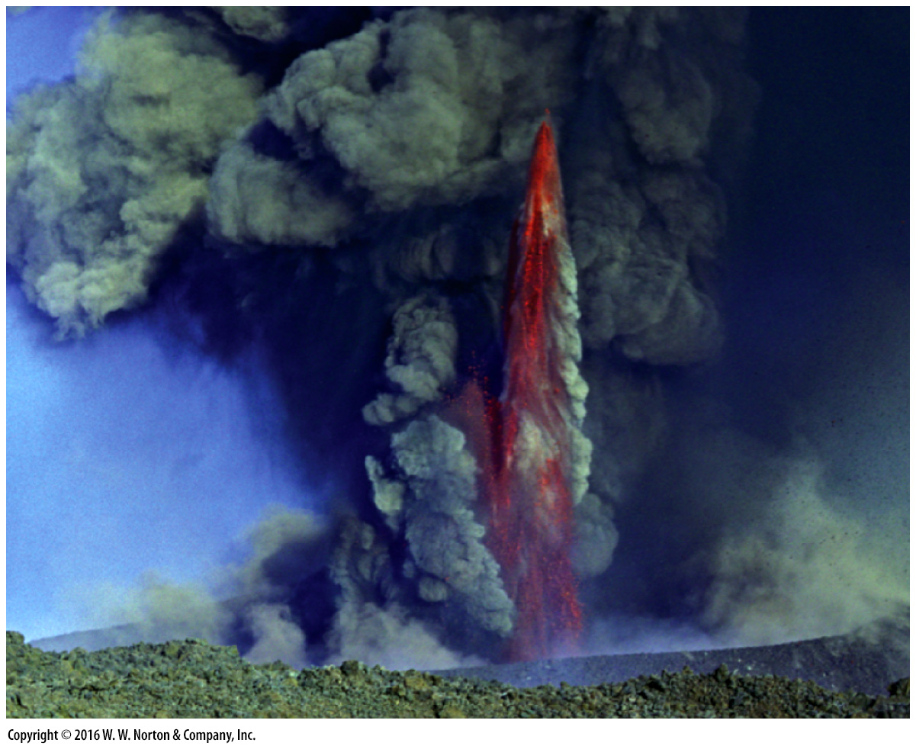
Notes:
FIGURE 5.12b The components of a large explosive volcanic eruption.
(b) The eruptive jet of an eruption on Mt. Etna, Italy.

Slide 44
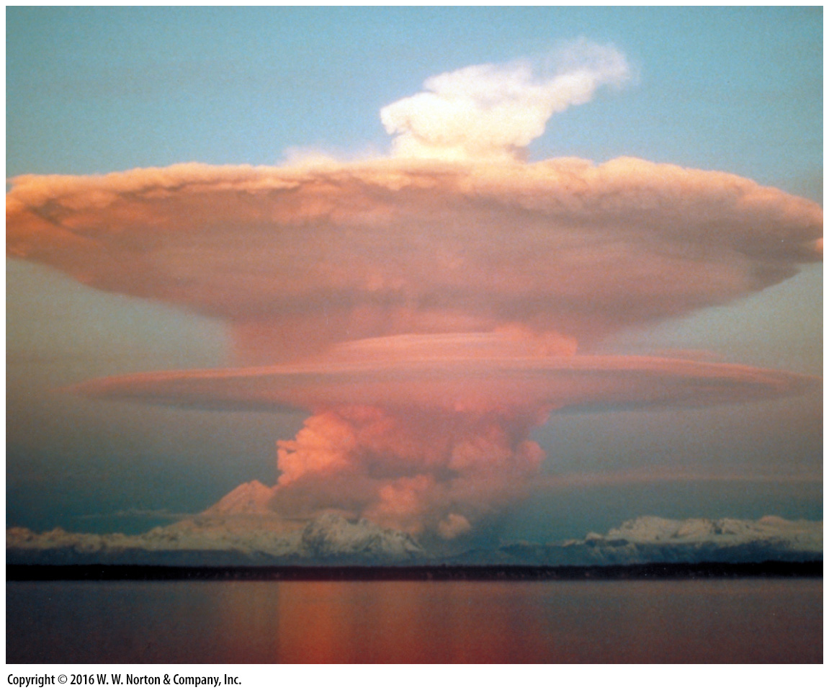
Notes:
FIGURE 5.12c The components of a large explosive volcanic eruption.
(c) The 1989 eruption of Redoubt Volcano, Alaska, produced a mushroom cloud that reached the stratosphere.

Slide 45
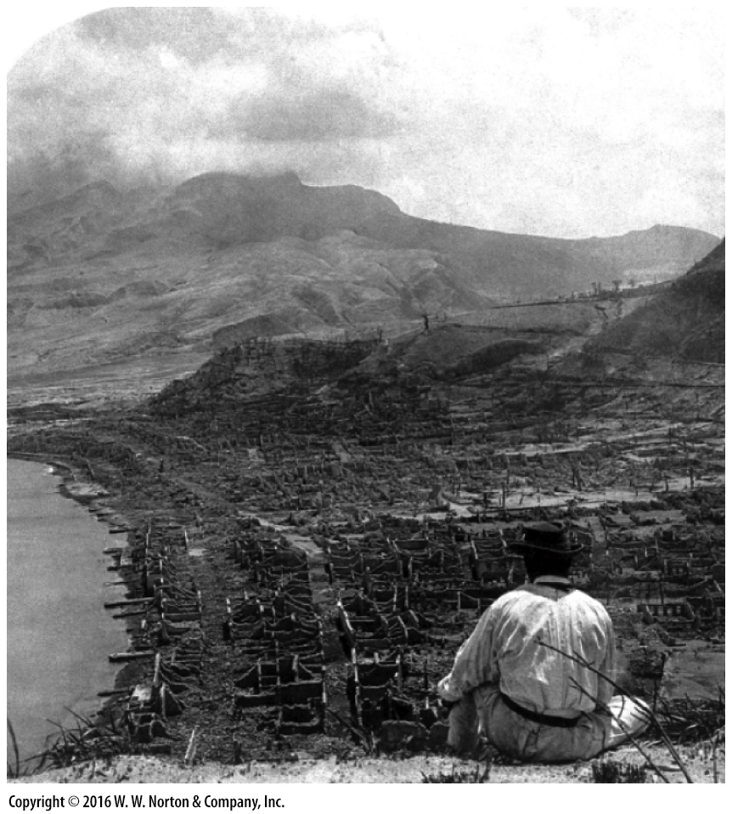
Notes:
FIGURE 5.12d The components of a large explosive volcanic eruption.
(d) The aftermath of the 1902 eruption of Mt. Pelée.

Slide 46
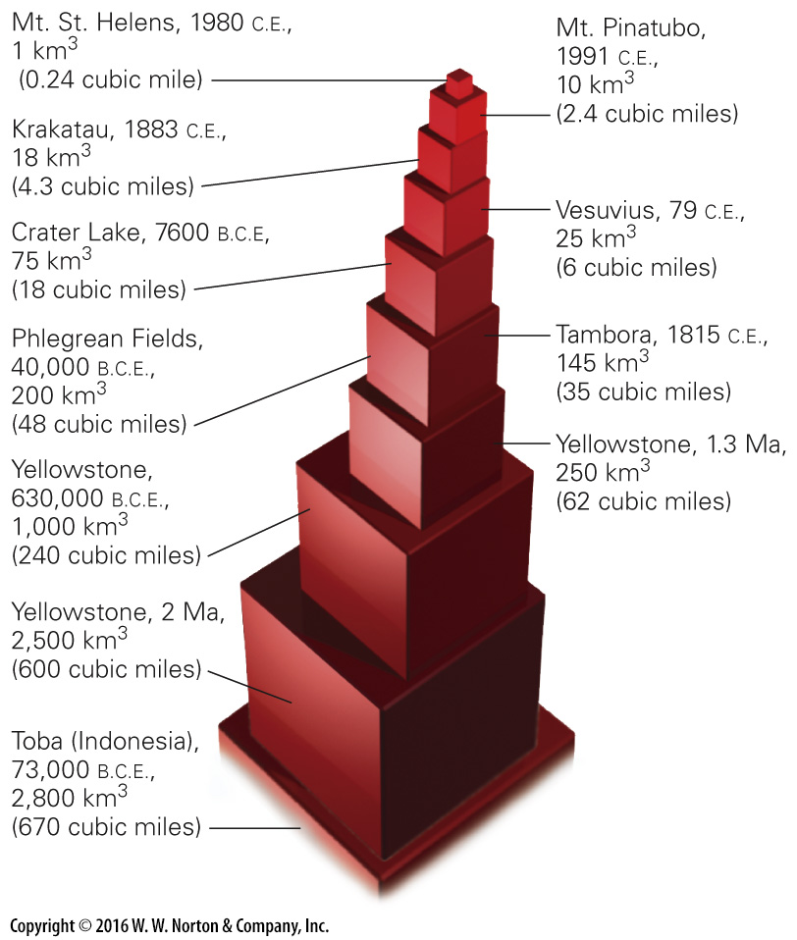
Notes:
FIGURE Bx5.1a Examples of explosive eruptions.
(a) The relative amounts of pyroclastic debris (in cubic km) ejected
during major explosive eruptions.

Slide 47
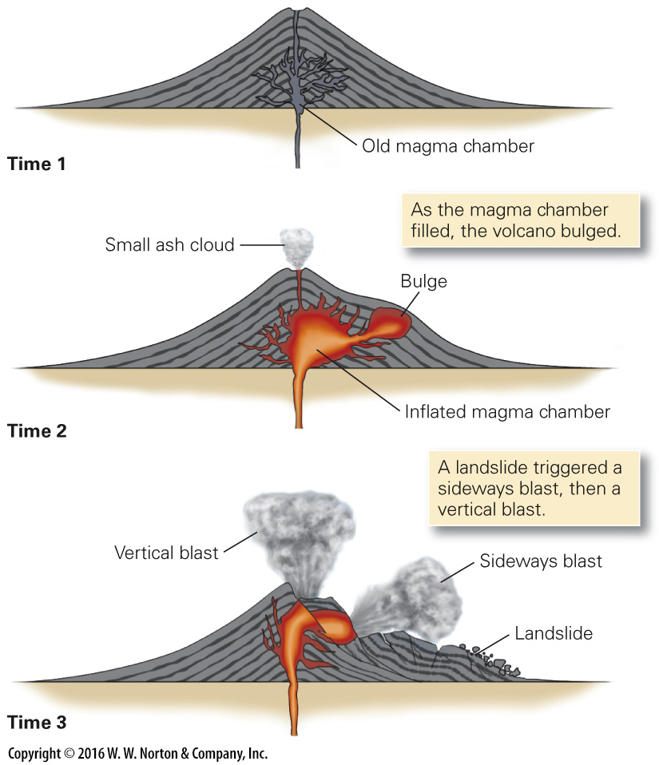
Notes:
FIGURE Bx5.1b Examples of explosive eruptions.
(b) Stages during the eruption of Mt. St. Helens, 1980.

Slide 48
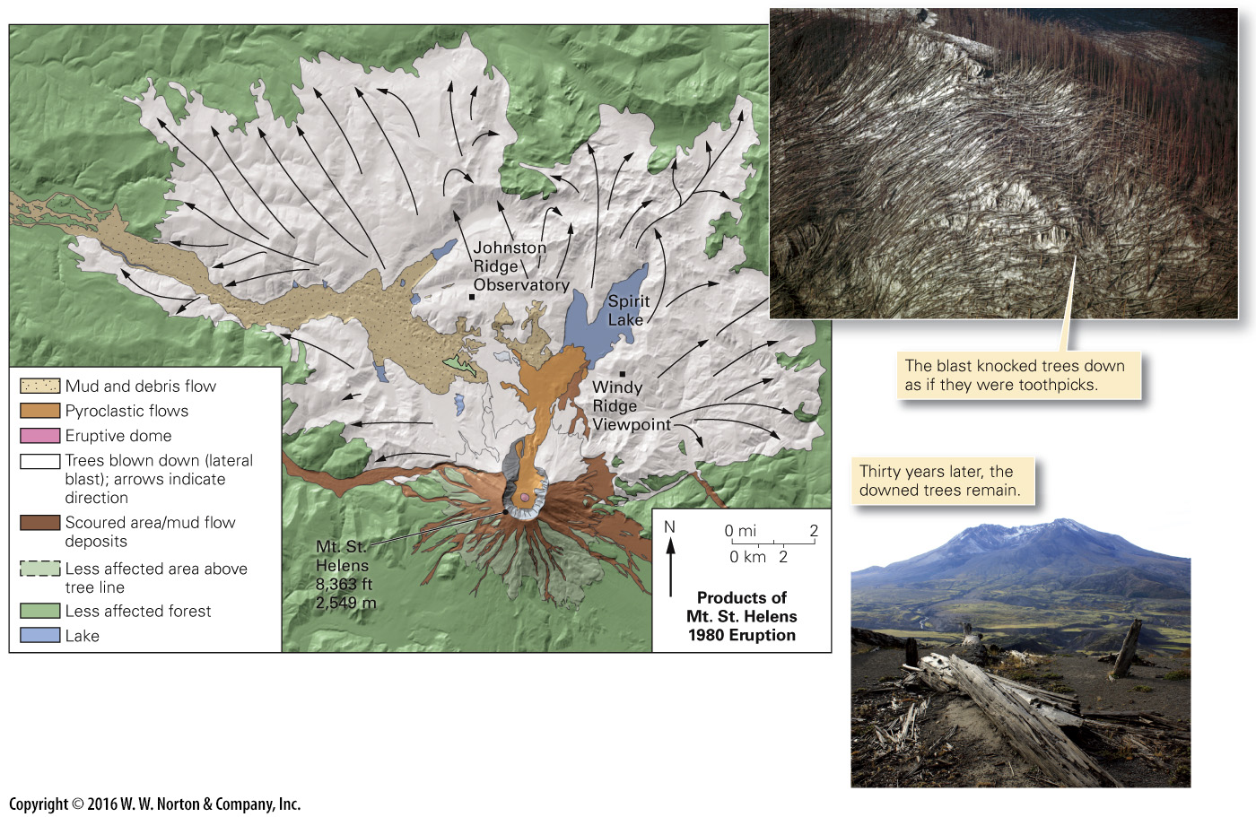
Notes:
FIGURE Bx5.1c Examples of explosive eruptions.
(c) A map shows the dimensions of the region destroyed by the eruption of Mt. St. Helens. The arrows indicate the blast direction. The neighboring forest was flattened by a blast of rock, steam, and ash.

Slide 49
Notes:
FIGURE Bx5.1d Examples of explosive eruptions.
(d) Profile of Krakatau before and after the eruption. Note that a new volcano (Anak-Krakatau) has formed.

Slide 50
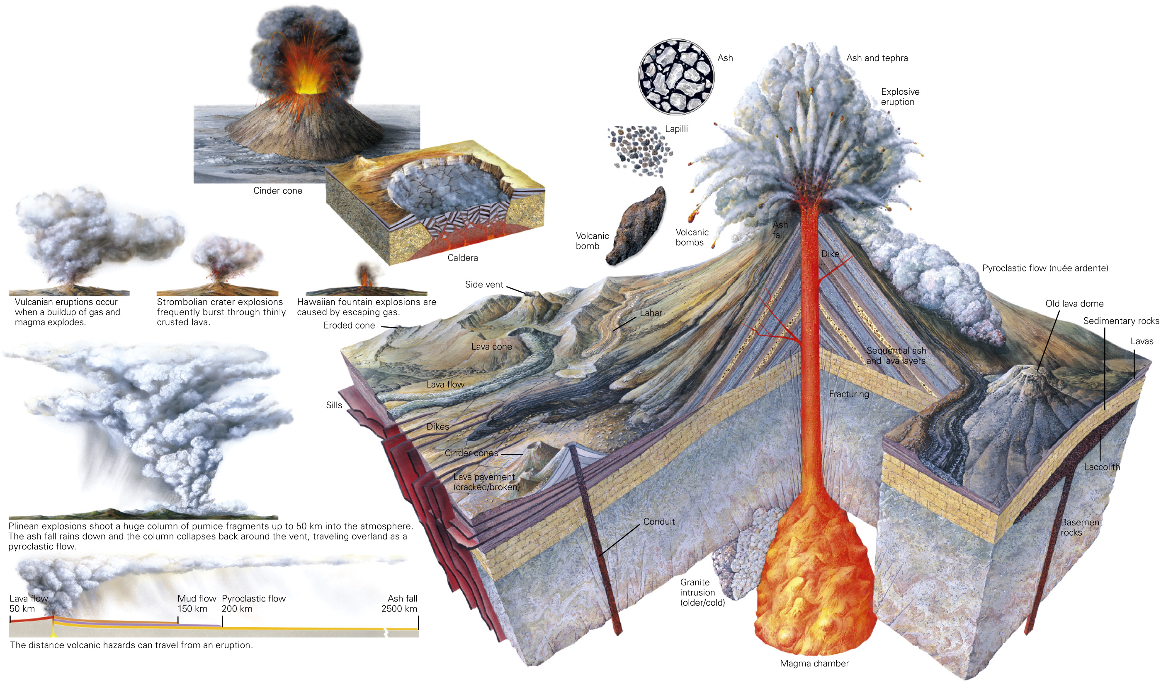
Notes:
GEOLOGY AT A GLANCE
Volcanoes

Slide 51
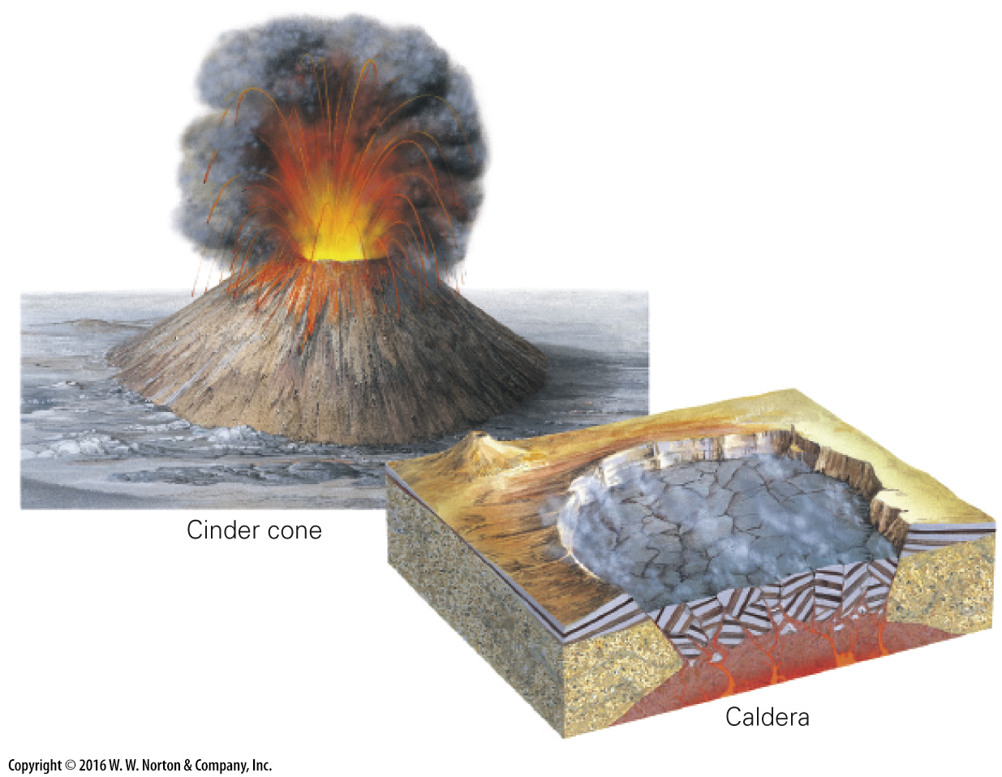
Notes:
GEOLOGY AT A GLANCE
Volcanoes

Slide 52
Notes:
GEOLOGY AT A GLANCE
Volcanoes

Slide 53
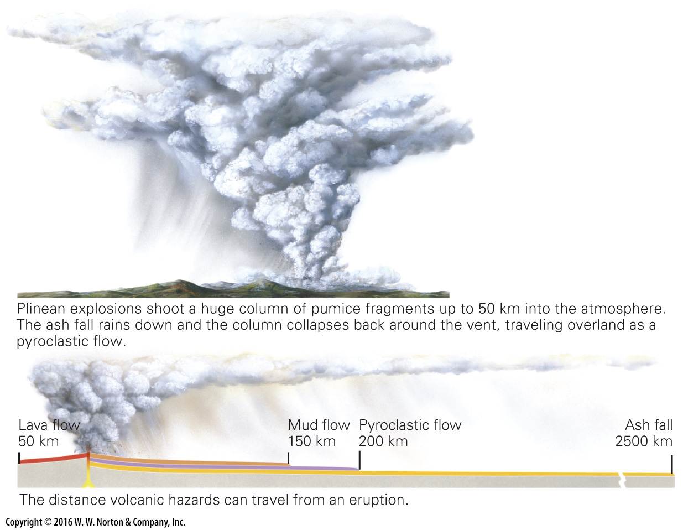
Notes:
GEOLOGY AT A GLANCE
Volcanoes

Slide 54
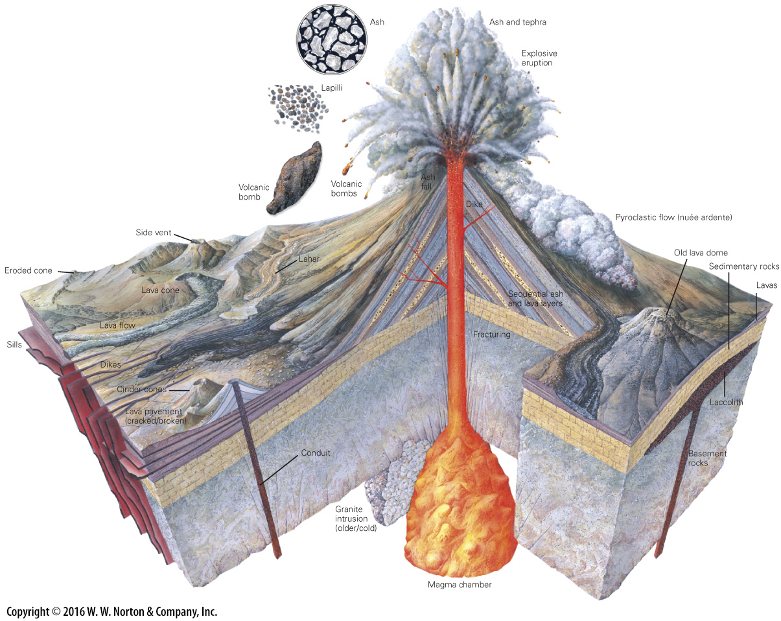
Notes:
GEOLOGY AT A GLANCE
Volcanoes

Slide 55
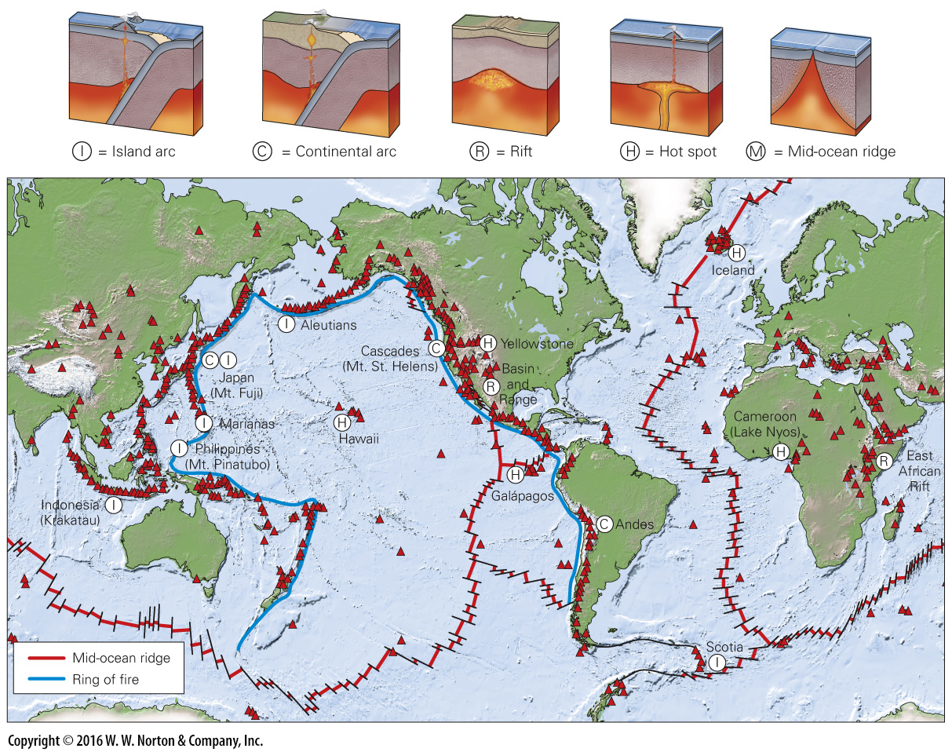
Notes:
FIGURE 5.13 Volcanoes of the world. The map shows the distribution of volcanoes around the world, and the diagrams illustrate basic geologic settings in which volcanoes form, in the context of plate tectonics theory.

Slide 56
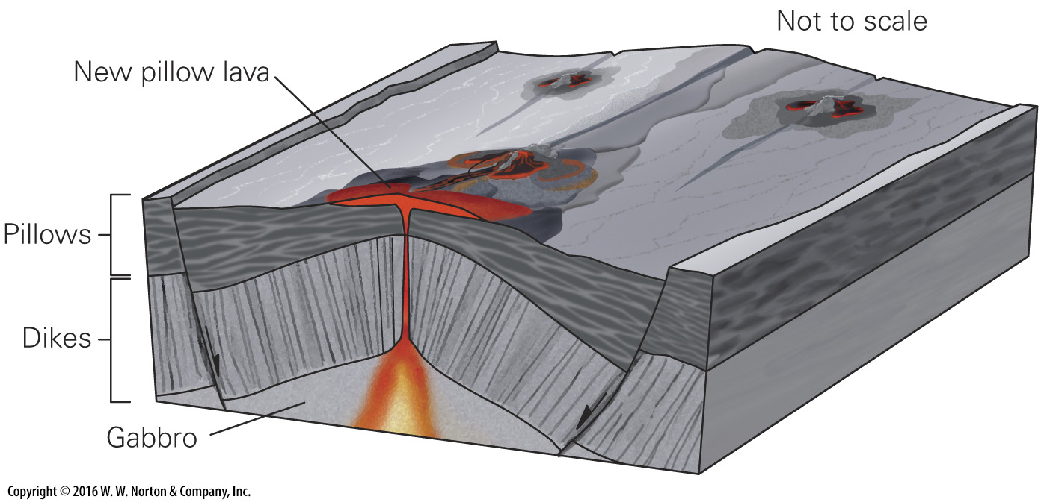
Notes:
FIGURE 5.14a Igneous activity at plate boundaries.
(a) Along a mid-ocean ridge axis at a divergent boundary, small mounds of pillow basalt erupt.

Slide 57
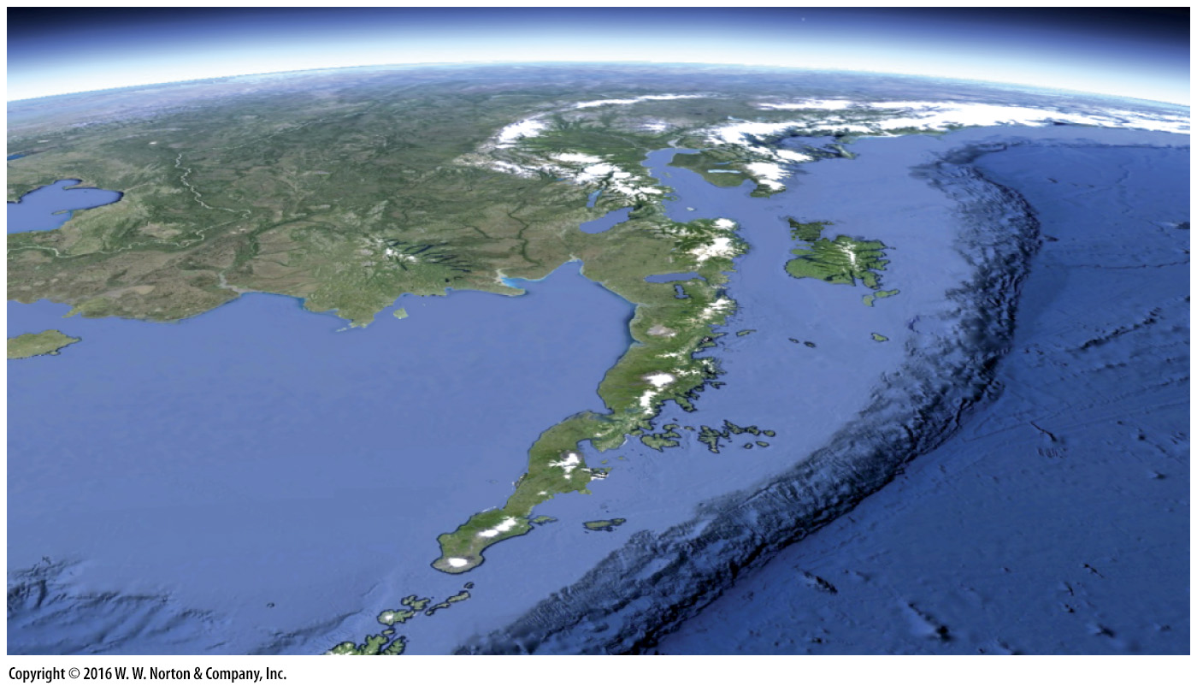
Notes:
FIGURE 5.14b Igneous activity at plate boundaries.
(b) The Aleutian volcanic arc, of Alaska, viewed looking northeast. The white peaks are volcanoes. This chain formed at a convergent plate boundary.

Slide 58
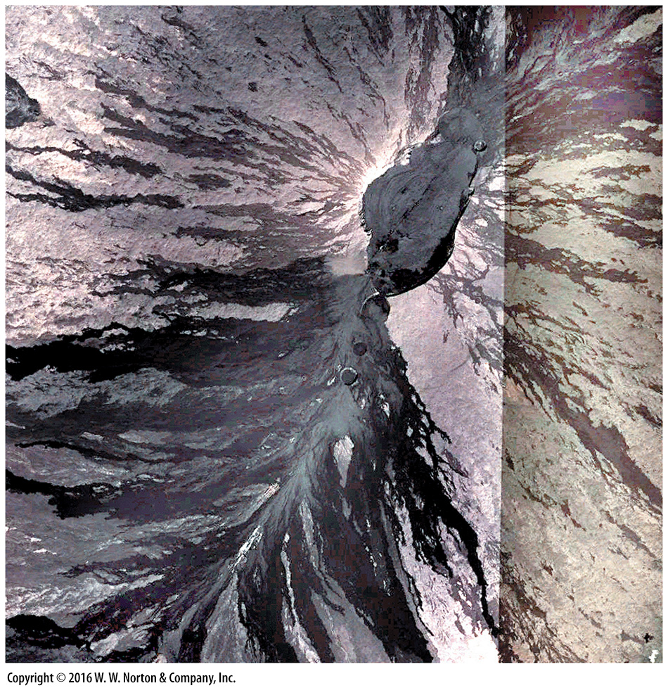
Notes:
SEE FOR YOURSELF…
MAUNA LOA, HAWAII

Slide 59
Notes:
FIGURE 5.15a Oceanic hot-spot volcanoes.
(a) The interior of an oceanic hot-spot volcano is complicated. Initially, eruption produces pillow basalts. When the volcano emerges above sea level, it becomes a shield volcano. The margins of the island frequently undergo slumping, and the weight of the volcano pushes down the surface of the lithosphere. The Hawaiian Islands exemplify this architecture.

Slide 60
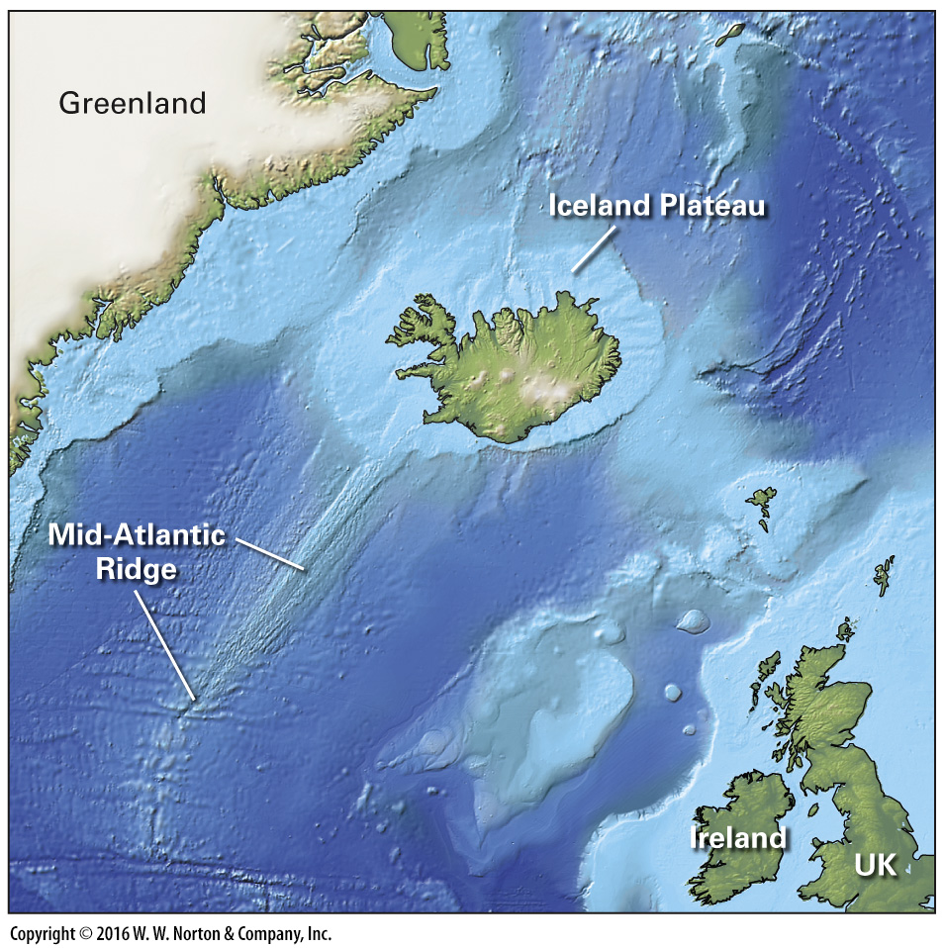
Notes:
FIGURE 5.15b Oceanic hot-spot volcanoes.
(b) A bathymetric map shows that Iceland sits atop a huge plateau straddling the Mid-Atlantic Ridge. Light blue is shallower water; dark blue is deeper.

Slide 61
Notes:
FIGURE 5.15c Oceanic hot-spot volcanoes.
(c) A geologic map of Iceland shows how the youngest volcanoes occur in the central rift, effectively the on-land portion of the Mid-Atlantic Ridge.

Slide 62
Notes:
FIGURE 5.16ab Hot-spot volcanic activity in Yellowstone National Park.
(a) Yellowstone lies at the end of a continental hot-spot track. Progressively older calderas follow the Snake River Plain. The blue arrow indicates plate motion.
(b) Yellowstone overlies a caldera that exploded twice during the past 2 Ma.

Slide 63
Notes:
FIGURE 5.16a Hot-spot volcanic activity in Yellowstone National Park.
(a) Yellowstone lies at the end of a continental hot-spot track. Progressively older calderas follow the Snake River Plain. The blue arrow indicates plate motion.

Slide 64
Notes:
FIGURE 5.16b Hot-spot volcanic activity in Yellowstone National Park.
(b) Yellowstone overlies a caldera that exploded twice during the past 2 Ma.

Slide 65
Notes:
FIGURE 5.16c Hot-spot volcanic activity in Yellowstone National Park.
(c) The ash produced by explosions of the Yellowstone calderas covered vast areas—much more than Mt. St. Helens.

Slide 66
Notes:
FIGURE 5.16d Hot-spot volcanic activity in Yellowstone National Park.
(d) Felsic tuffs form the colorful walls of Yellowstone Canyon.

Slide 67
Notes:
FIGURE 5.17 Flood-basalt layers exposed on the wall of a canyon in Idaho.

Slide 68
Notes:
FIGURE 5.18 Hazards due to lava and ash from volcanic eruptions.
(a) A lava flow reaches a house in Hawaii and sets it on fire. (b) Lava from Mt. Etna threatens a town and olive grove in Sicily. (c) Residents rescue household goods after a lava flow filled the streets of Goma, along the East African Rift. (d) This empty school bus was engulfed by lava in Hawaii. (e) A pyroclastic flow from the 1991 eruption of Mt. Pinatubo chases a fleeing vehicle. (f) A blizzard of ash fell from the cloud erupted by Mt. Pinatubo in the Philippines. (g) Lapilli falls from an eruption in Iceland. (h) A lahar submerges farmland in Colombia.

Slide 69
Notes:
FIGURE 5.18a Hazards due to lava and ash from volcanic eruptions.
(a) A lava flow reaches a house in Hawaii and sets it on fire.

Slide 70
Notes:
FIGURE 5.18b Hazards due to lava and ash from volcanic eruptions.
(b) Lava from Mt. Etna threatens a town and olive grove in Sicily.

Slide 71
Notes:
FIGURE 5.18c Hazards due to lava and ash from volcanic eruptions.
(c) Residents rescue household goods after a lava flow filled the streets of Goma, along the East African Rift.

Slide 72
Notes:
FIGURE 5.18d Hazards due to lava and ash from volcanic eruptions.
(d) This empty school bus was engulfed by lava in Hawaii.

Slide 73
Notes:
FIGURE 5.18e Hazards due to lava and ash from volcanic eruptions.
(e) A pyroclastic flow from the 1991 eruption of Mt. Pinatubo chases a fleeing vehicle.

Slide 74
Notes:
FIGURE 5.18f Hazards due to lava and ash from volcanic eruptions.
(f) A blizzard of ash fell from the cloud erupted by Mt. Pinatubo in the Philippines.

Slide 75
Notes:
FIGURE 5.18g Hazards due to lava and ash from volcanic eruptions.
(g) Lapilli falls from an eruption in Iceland.

Slide 76
Notes:
FIGURE 5.18h Hazards due to lava and ash from volcanic eruptions.
(h) A lahar submerges farmland in Colombia.

Slide 77
Notes:
FIGURE 5.19a The CO₂ disaster at Lake Nyos.
(a) CO₂ dissolved in the colder bottom water. When a landslide or wind disturbed the water, it rose and the CO₂ came out of solution and, in gas form, flowed out of the crater.

Slide 78
Notes:
FIGURE 5.19b The CO₂ disaster at Lake Nyos.
(b) Cattle died by suffocation when the CO₂ cloud engulfed them.

Slide 79
Notes:
FIGURE 5.20 Devils Tower, Wyoming, is not an eroded volcano but probably an intrusion into sedimentary rocks beneath a volcano. It has been exposed by erosion. Volcanism at this location is extinct.

Slide 80
Notes:
FIGURE 5.21 The shape of a volcano changes as it is eroded.

Slide 81
Notes:
FIGURE 5.22 To produce this InSAR map of the Three Sisters Wilderness in Oregon, a satellite measures the elevation at two different times. If the land has warped between measurement times, interference of the radar-beam waves, when superimposed, appears as color bands.

Slide 82
Notes:
FIGURE 5.23 A volcanic-hazard assessment map for Mt. Rainier, Washington, showing the regions that might be affected by flows and lahars.

Slide 83
Notes:
FIGURE 5.24a Efforts to divert lava flows away from inhabited locations.
(a) Workers spray the lava flow to solidify it and use a bulldozer to build an embankment to divert it on the flanks of Mt. Etna.

Slide 84
Notes:
FIGURE 5.24b Efforts to divert lava flows away from inhabited locations.
(b) Firefighters pumping 6 million cubic meters of water on a lava flow in Iceland, in an effort to freeze it and stop it.

Slide 85
Notes:
FIGURE 5.25 Volcanic eruptions may affect climate.
(a) A graph of global average air temperature shows a drop after the Mt. Pinatubo eruption.
(b) The eruption of Santorini may have contributed to the demise of the Minoans, who left behind ruins of elaborate palaces.

Slide 86
Notes:
FIGURE 5.25a Volcanic eruptions may affect climate.
(a) A graph of global average air temperature shows a drop after the Mt. Pinatubo eruption.

Slide 87
Notes:
FIGURE 5.25b Volcanic eruptions may affect climate.
(b) The eruption of Santorini may have contributed to the demise of the Minoans, who left behind ruins of elaborate palaces.

Slide 88
Notes:
FIGURE 5.26 Volcanism on other planets and moons in the Solar System. (a) Maria of the Moon were seas of basaltic lava. (b) A volcano rises above the plains of Venus. (c) Olympus Mons rises 27 km above the surface of Mars. It’s the largest volcano in our Solar System. (d) An active volcano erupts sulfur on Io, a moon of Jupiter. (e) Large cracks at the southern end of Enceladus, a moon of Saturn, erupt water vapor.

Slide 89
Notes:
FIGURE 5.26a Volcanism on other planets and moons in the Solar System. (a) Maria of the Moon were seas of basaltic lava.

Slide 90
Notes:
FIGURE 5.26b Volcanism on other planets and moons in the Solar System. (b) A volcano rises above the plains of Venus.

Slide 91
Notes:
FIGURE 5.26c Volcanism on other planets and moons in the Solar System. (c) Olympus Mons rises 27 km above the surface of Mars. It’s the largest volcano in our Solar System.

Slide 92
Notes:
FIGURE 5.26d Volcanism on other planets and moons in the Solar System. (d) An active volcano erupts sulfur on Io, a moon of Jupiter.

Slide 93
Notes:
FIGURE 5.26e Volcanism on other planets and moons in the Solar System. (e) Large cracks at the southern end of Enceladus, a moon of Saturn, erupt water vapor.

Slide 94
Notes:
Another View The ash cloud from the 2011 eruption of a volcano in the Puyehue-Cordón Caulle chain of Chile. The ash circled the globe within two weeks, disrupting air traffic throughout the southern hemisphere.

