Slide 1
Stephen Marshak
ESSENTIALS OF
Geology
FIFTH EDITION
Chapter 6
Pages of Earth's Past:
Sedimentary Rocks
©2016 W. W. Norton & Company, Inc.

Slide 2
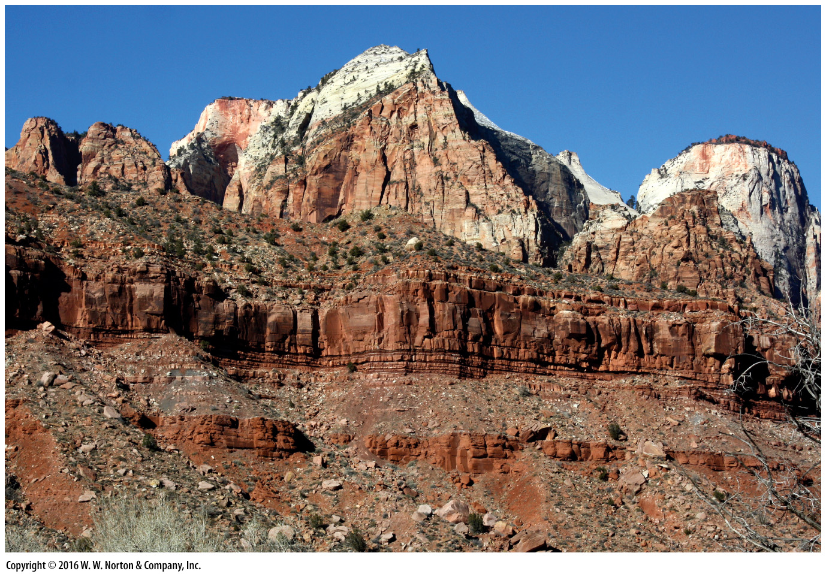
Notes:
Look closely at this cliff in southern Nevada. You’ll see layer upon layer of sedimentary strata. The ledges expose resistant sandstone. Slopes are underlain by weaker shale. These rocks formed when sediments were buried and lithified long ago.

Slide 3
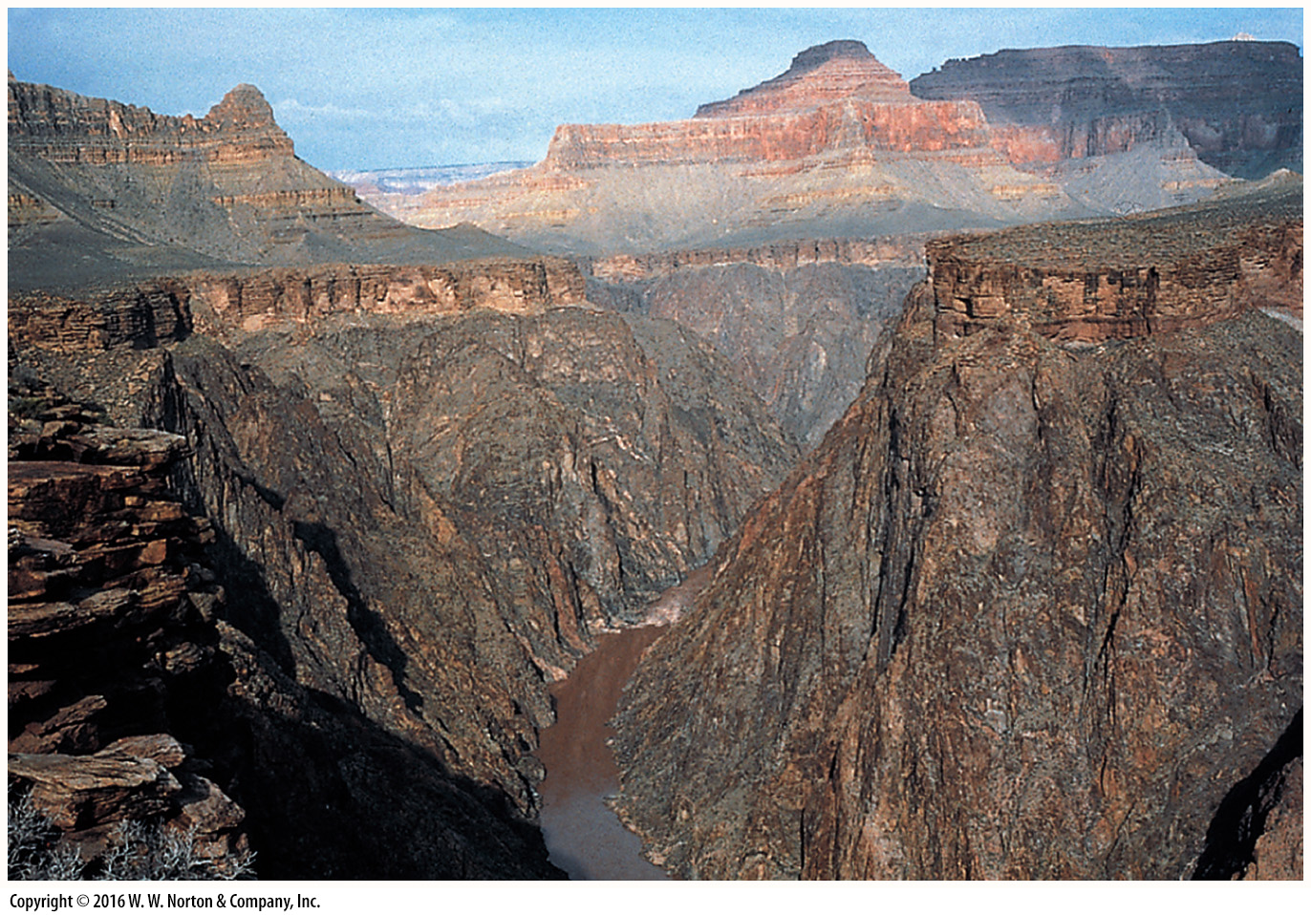
Notes:
FIGURE 6.1a In this close-up of the inner gorge of the Grand Canyon, we see a sedimentary-rock blanket that forms a cover over an older basement of metamorphic and igneous rock.
(a) The contact between the sedimentary cover and underlying basement lies at the top of the inner gorge.

Slide 4
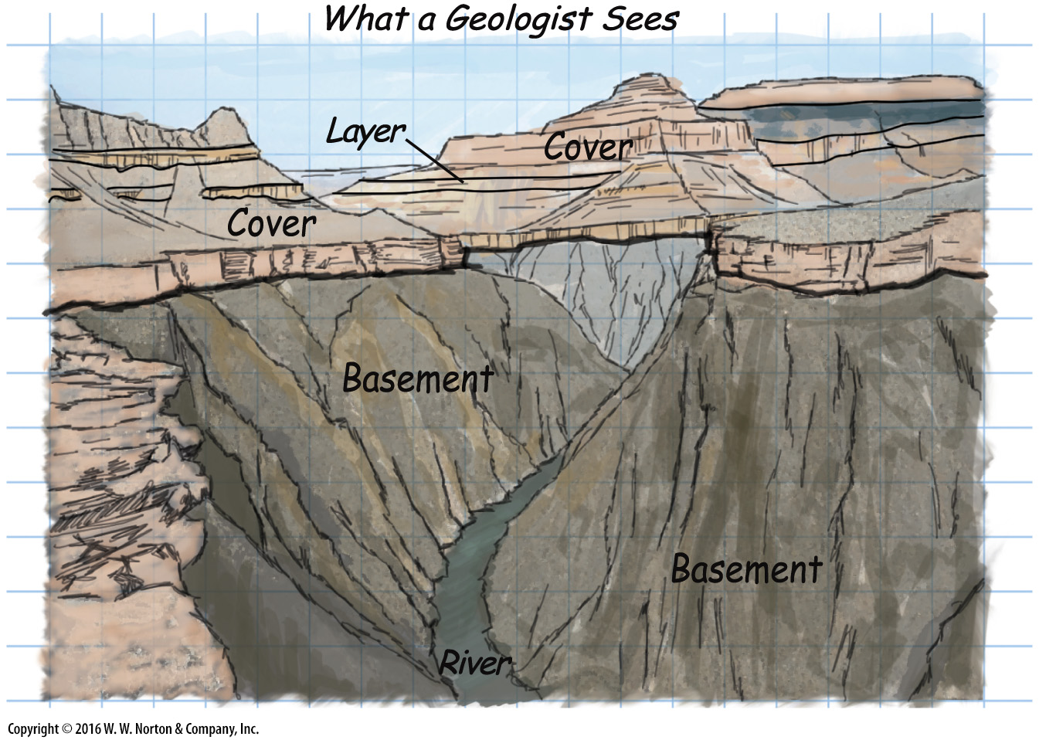
Notes:
FIGURE 6.1b In this close-up of the inner gorge of the Grand Canyon, we see a sedimentary-rock blanket that forms a cover over an older basement of metamorphic and igneous rock.
(b) A geologist‘s sketch emphasizes the contact. Here the basement consist of metamorphic and igneous rock.

Slide 5
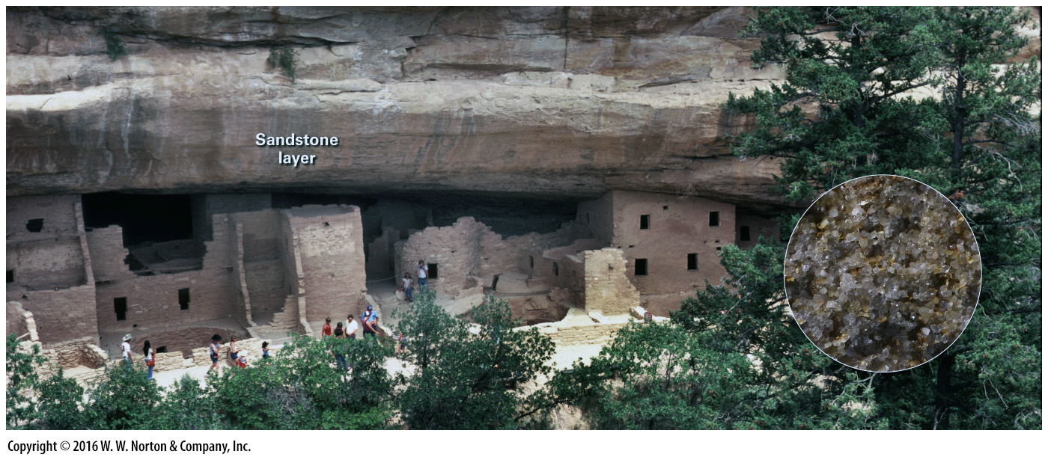
Notes:
FIGURE 6.2 The cliff dwellings nestled beneath a ledge at Mesa Verde, Colorado, are made of sandstone blocks. The inset shows the grainy character of the rock.

Slide 6
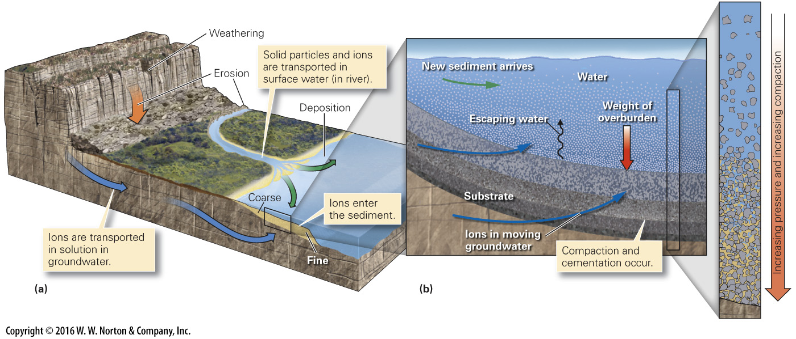
Notes:
FIGURE 6.3 The five steps in clastic sedimentary rock formation.
(a) Clasts produced by weathering undergo erosion, transportation, and deposition. Dissolved ions may eventually become cement. (b) The process of lithification takes place during progressive burial.

Slide 7
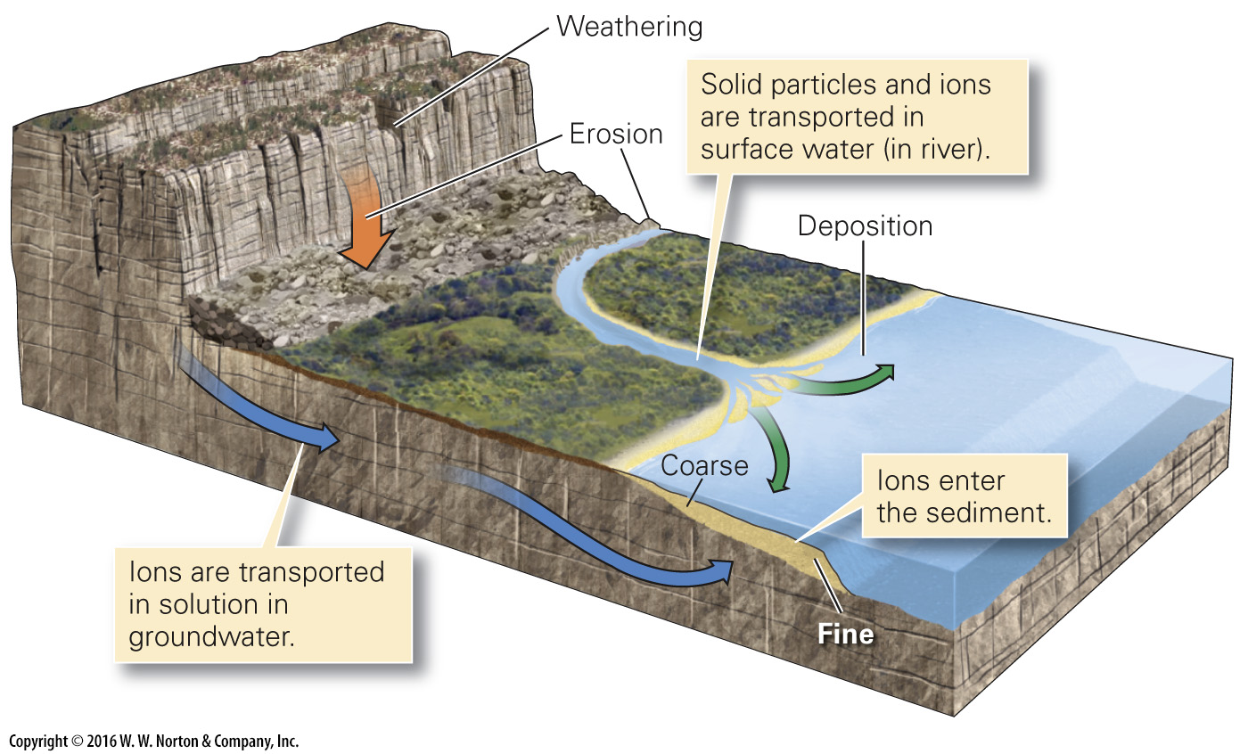
Notes:
FIGURE 6.3a The five steps in clastic sedimentary rock formation.
(a) Clasts produced by weathering undergo erosion, transportation, and deposition. Dissolved ions may eventually become cement.

Slide 8
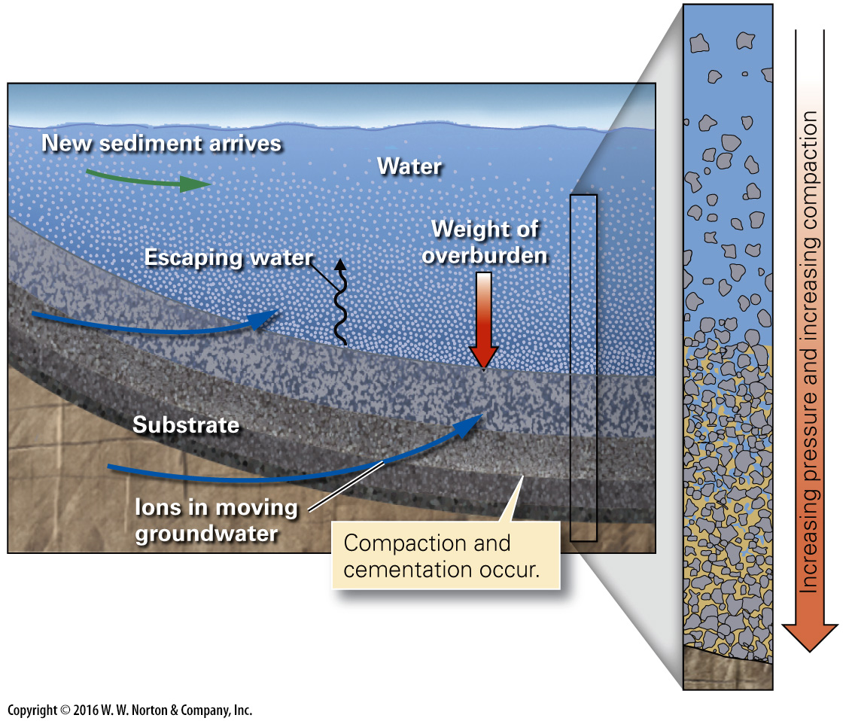
Notes:
FIGURE 6.3b The five steps in clastic sedimentary rock formation.
(b) The process of lithification takes place during progressive burial.

Slide 9
Notes:
FIGURE 6.4a Grain characteristics and their evolution with increasing transport.
(a) Individual clasts also tend to become more rounded and smoother.

Slide 10
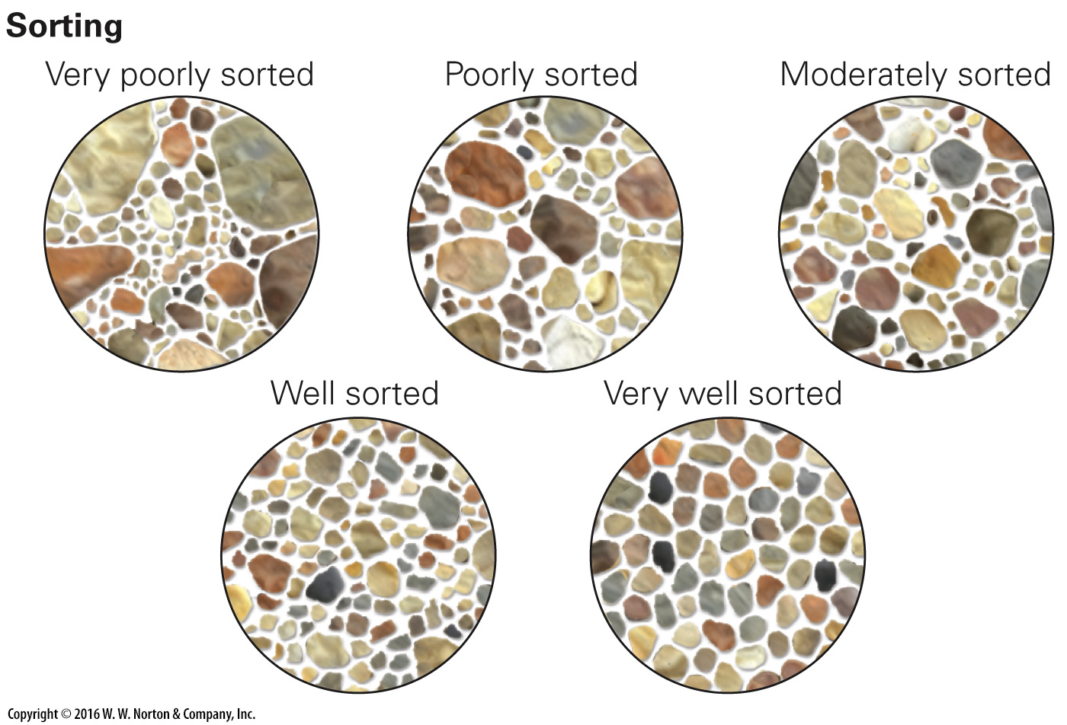
Notes:
FIGURE 6.4b Grain characteristics and their evolution with increasing transport.
(b) If transport sifts grains, carrying smaller ones farther and leaving coarser ones behind, grains in a sediment tend to be the same size.

Slide 11
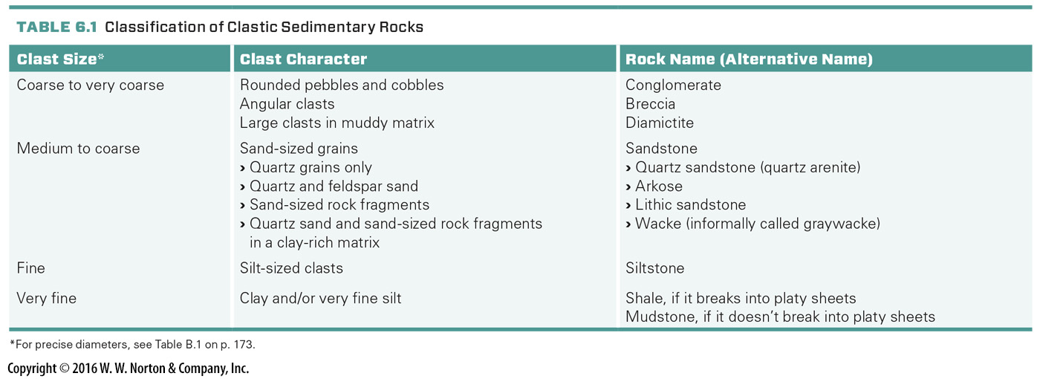
Notes:
TABLE 6.1 Classification of Clastic Sedimentary Rocks

Slide 12
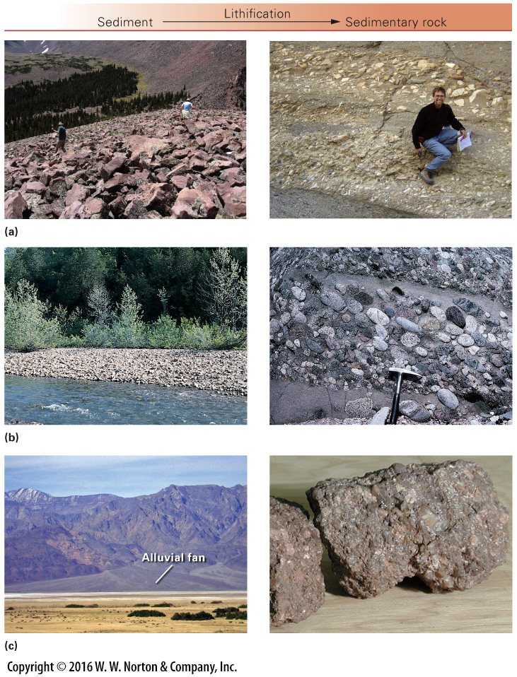
Notes:
FIGURE 6.5a–c Different kinds of clasts lithify into different kinds of sedimentary rocks.
(a) Lithification of an accumulation of angular clasts yields breccia. (b) Layers of river gravel lithify into conglomerate. (c) Sediment deposited in an alluvial fan, close to its source, can be feldspar rich. Lithification of this sediment yields arkose.

Slide 13
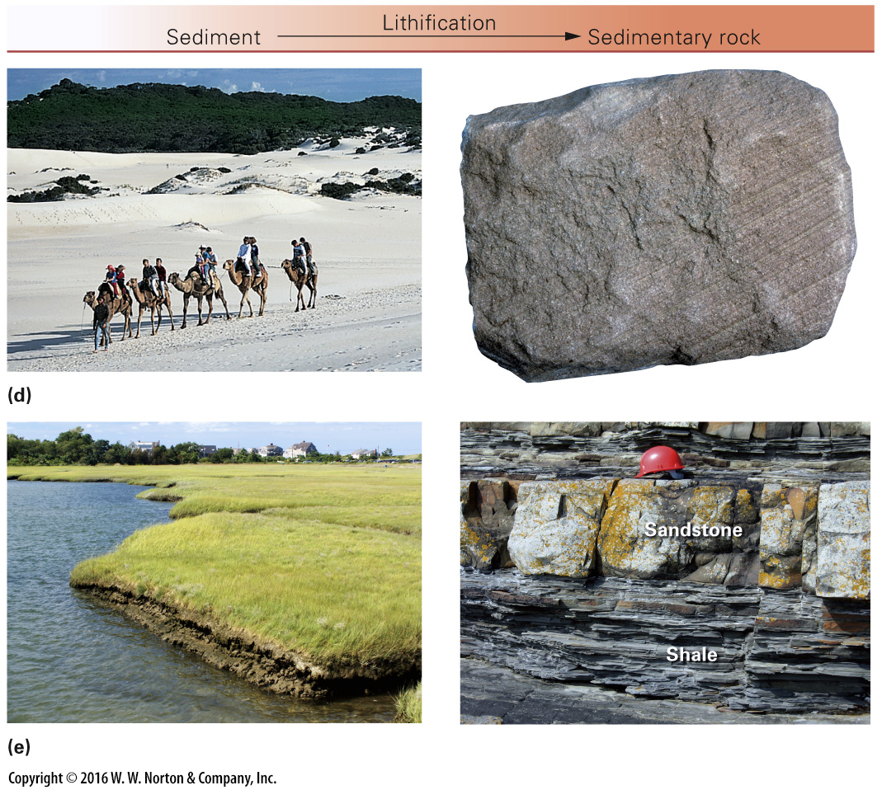
Notes:
FIGURE 6.5d–e Different kinds of clasts lithify into different kinds of sedimentary rocks.
(d) Layers of beach or dune sand lithify into sandstone. (e) Layers of mud, exposed beneath marsh grass, lithify to form shale. Here the thin-bedded shale is interbedded with sandstone.

Slide 14
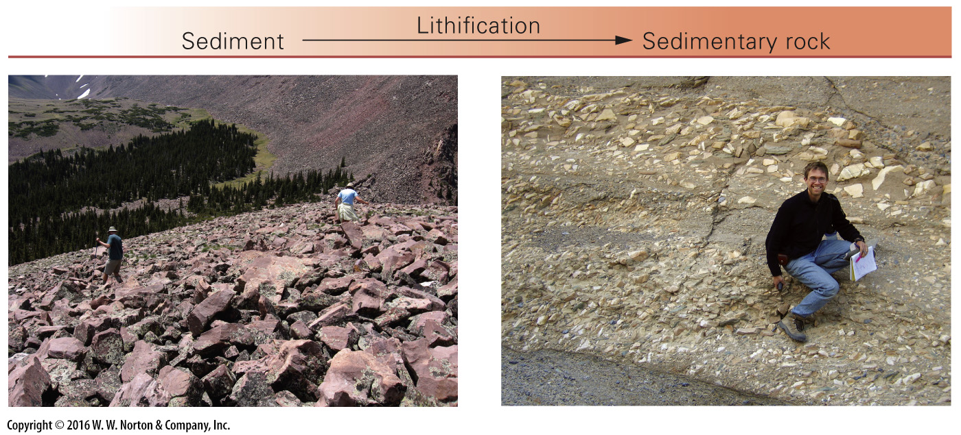
Notes:
FIGURE 6.5a Different kinds of clasts lithify into different kinds of sedimentary rocks.
(a) Lithification of an accumulation of angular clasts yields breccia.

Slide 15
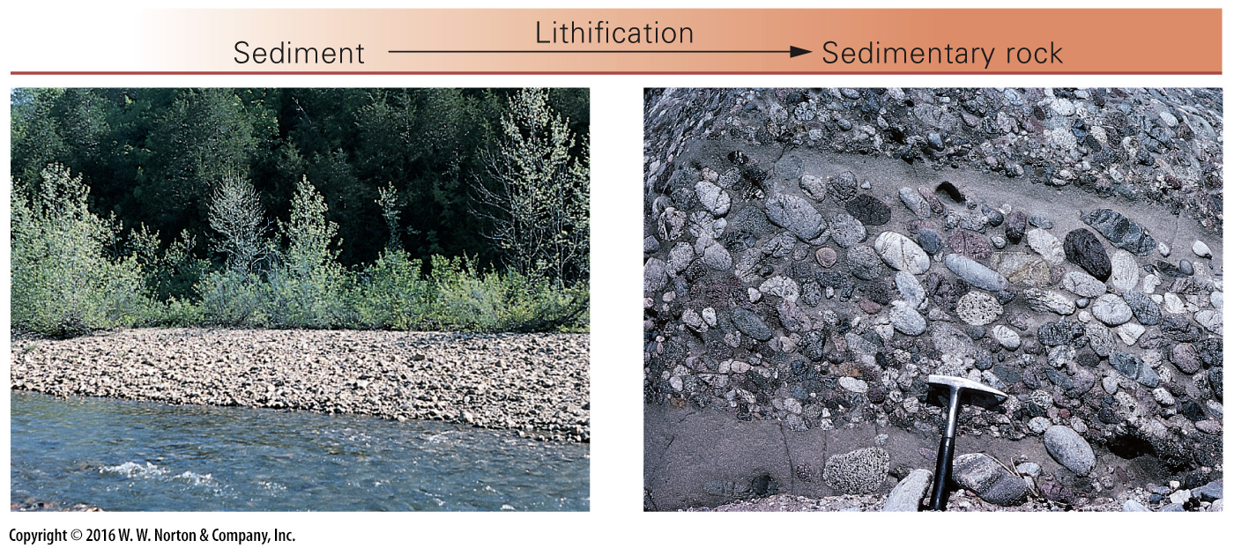
Notes:
FIGURE 6.5b Different kinds of clasts lithify into different kinds of sedimentary rocks.
(b) Layers of river gravel lithify into conglomerate.

Slide 16
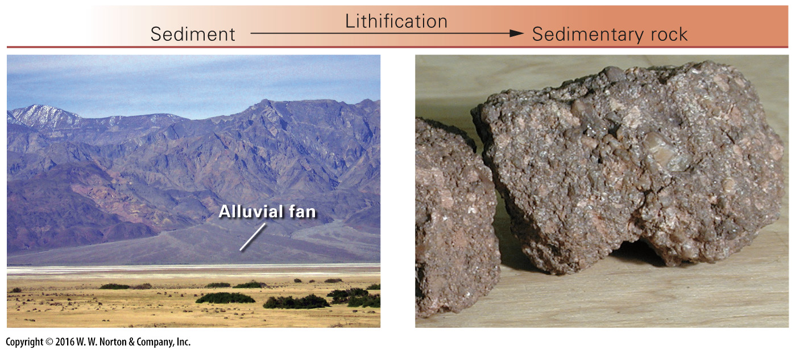
Notes:
FIGURE 6.5c Different kinds of clasts lithify into different kinds of sedimentary rocks.
(c) Sediment deposited in an alluvial fan, close to its source, can be feldspar rich. Lithification of this sediment yields arkose.

Slide 17
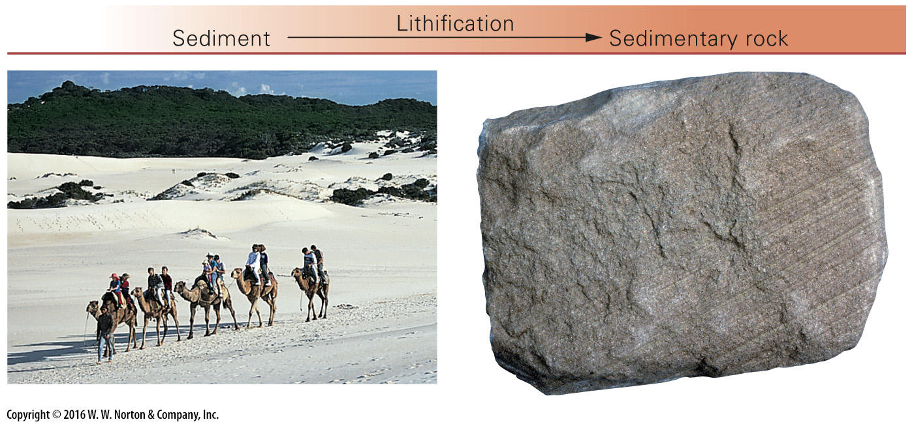
Notes:
FIGURE 6.5d Different kinds of clasts lithify into different kinds of sedimentary rocks.
(d) Layers of beach or dune sand lithify into sandstone.

Slide 18
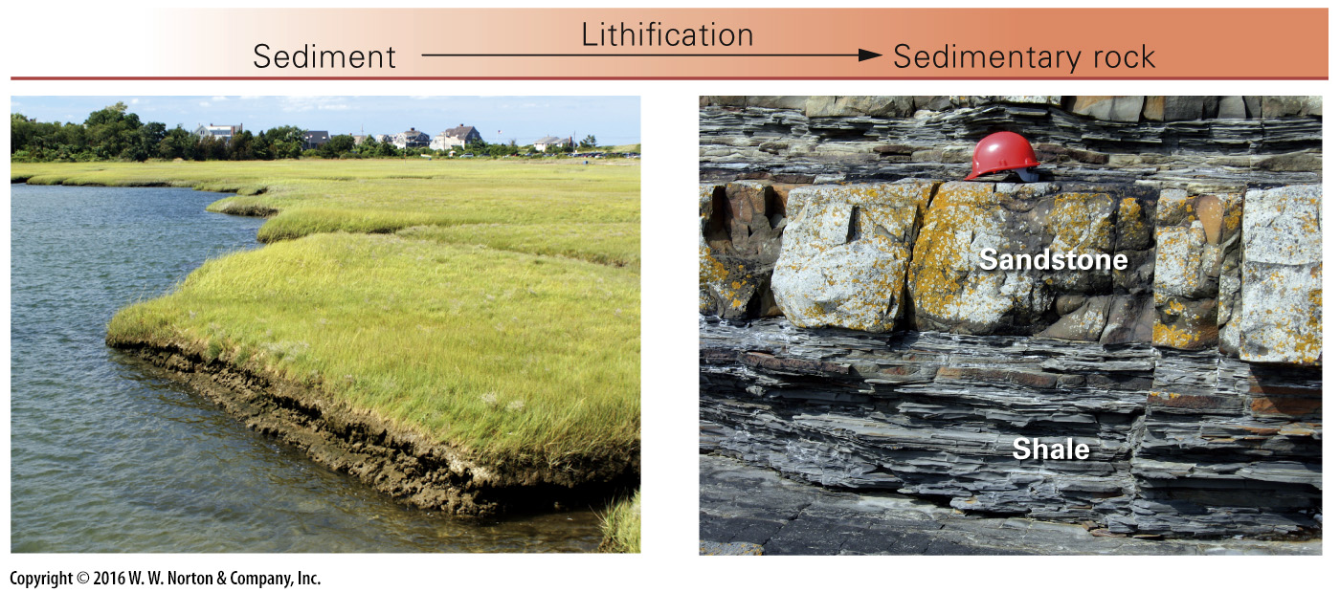
Notes:
FIGURE 6.5e Different kinds of clasts lithify into different kinds of sedimentary rocks.
(e) Layers of mud, exposed beneath marsh grass, lithify to form shale. Here the thin-bedded shale is interbedded with sandstone.

Slide 19
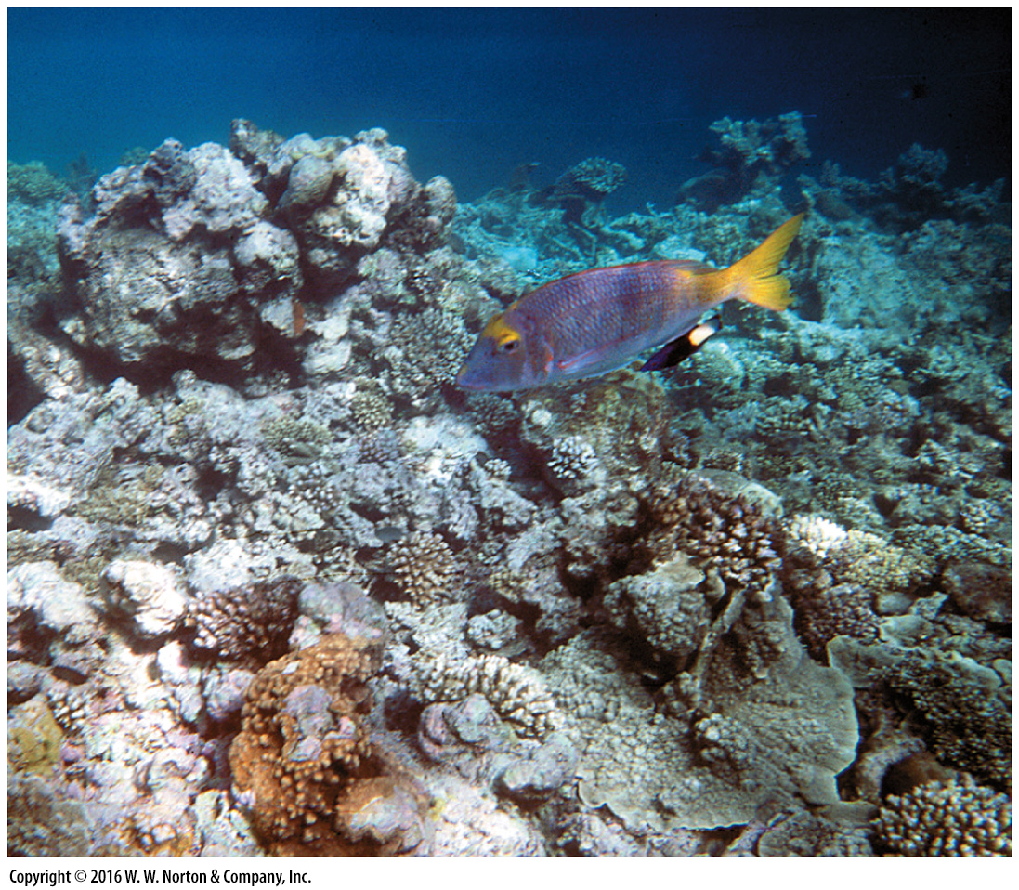
Notes:
FIGURE 6.6a The formation of carbonate rocks (limestone).
(a) In this modern coral reef, corals produce shells. If buried and preserved, these become limestone.

Slide 20
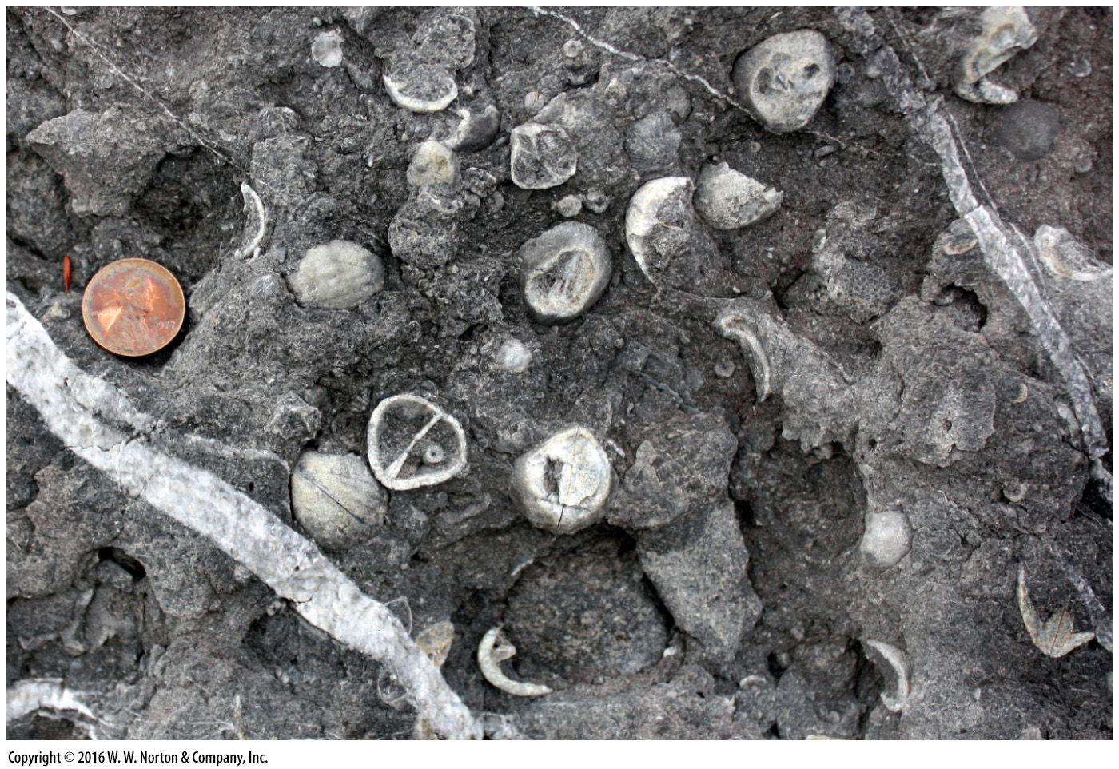
Notes:
FIGURE 6.6b The formation of carbonate rocks (limestone).
(b) Wave energy breaks up shells, forming carbonate clasts that later become cemented together.

Slide 21
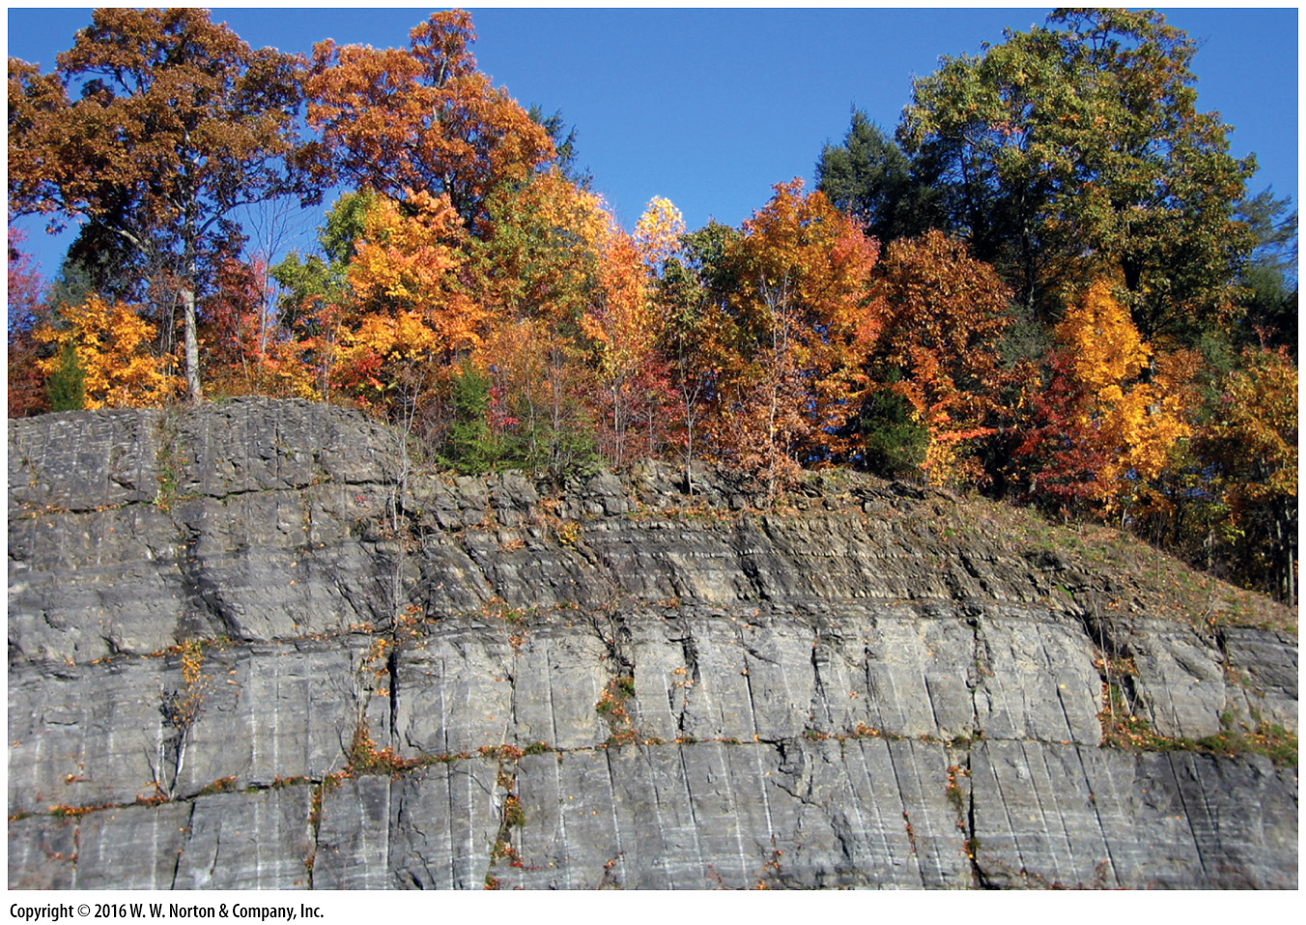
Notes:
FIGURE 6.6c The formation of carbonate rocks (limestone).
(c) This road cut near Kingston, New York, exposes beds of limestone. The vertical stripes are drillholes

Slide 22
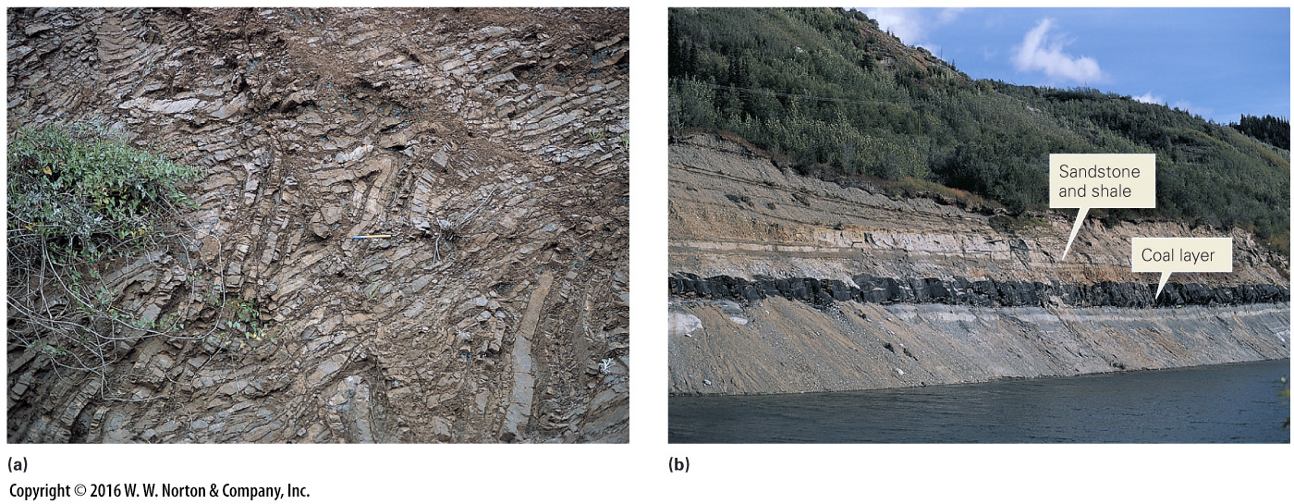
Notes:
FIGURE 6.7 Examples of biochemical and organic sedimentary rocks.
(a) This bedded chert developed on the deep seafloor by the deposition of plankton that secrete silica shells. (b) Coal is deposited in layers (beds), just like other kinds of sedimentary rocks.

Slide 23
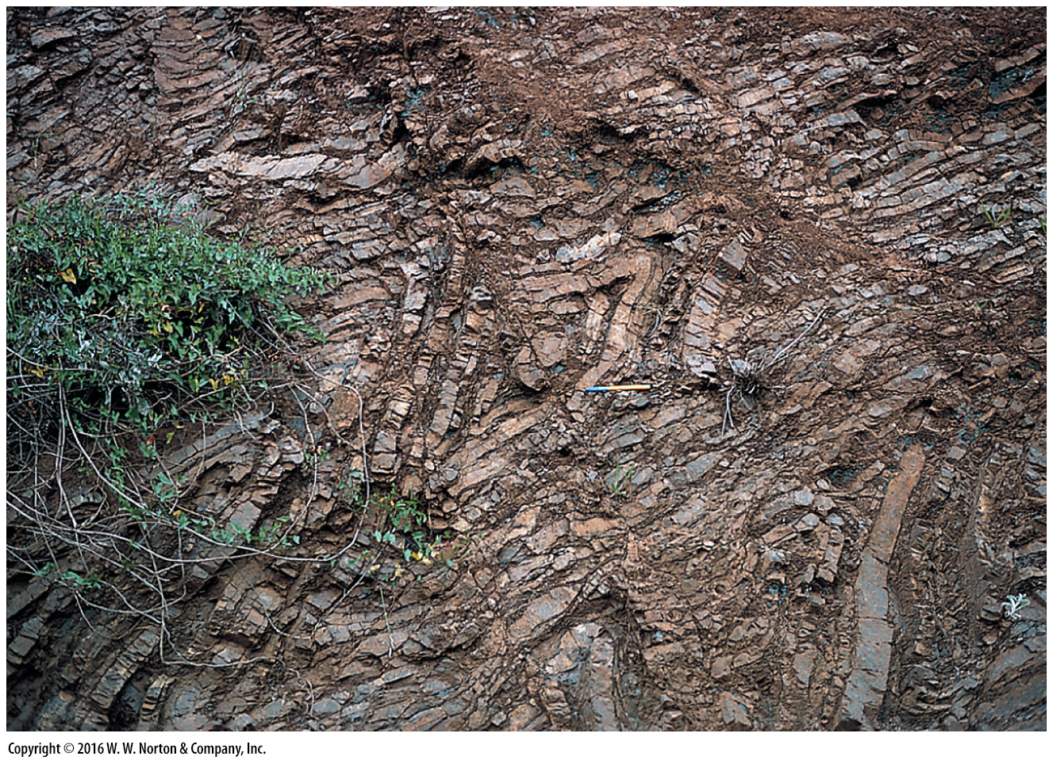
Notes:
FIGURE 6.7a Examples of biochemical and organic sedimentary rocks.
(a) This bedded chert developed on the deep seafloor by the deposition of plankton that secrete silica shells.

Slide 24
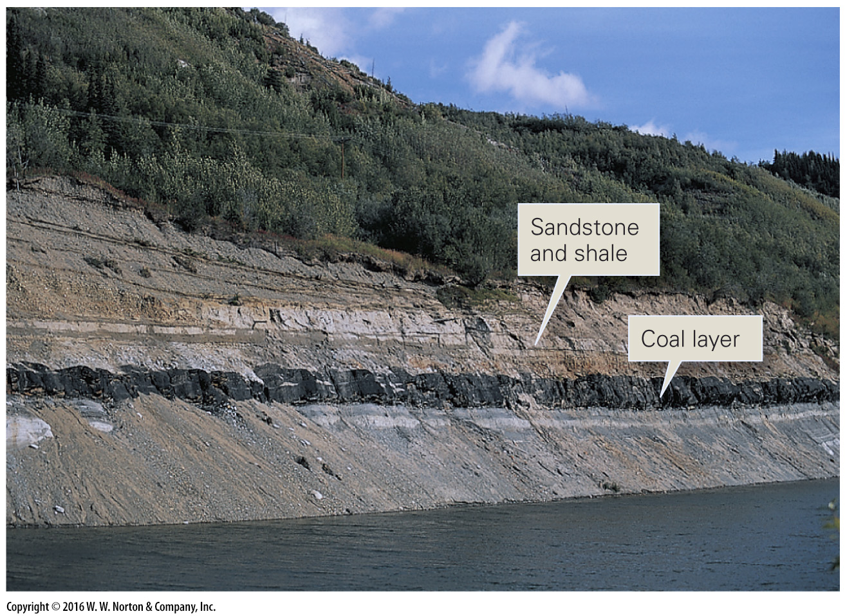
Notes:
FIGURE 6.7b Examples of biochemical and organic sedimentary rocks.
(b) Coal is deposited in layers (beds), just like other kinds of sedimentary rocks.

Slide 25
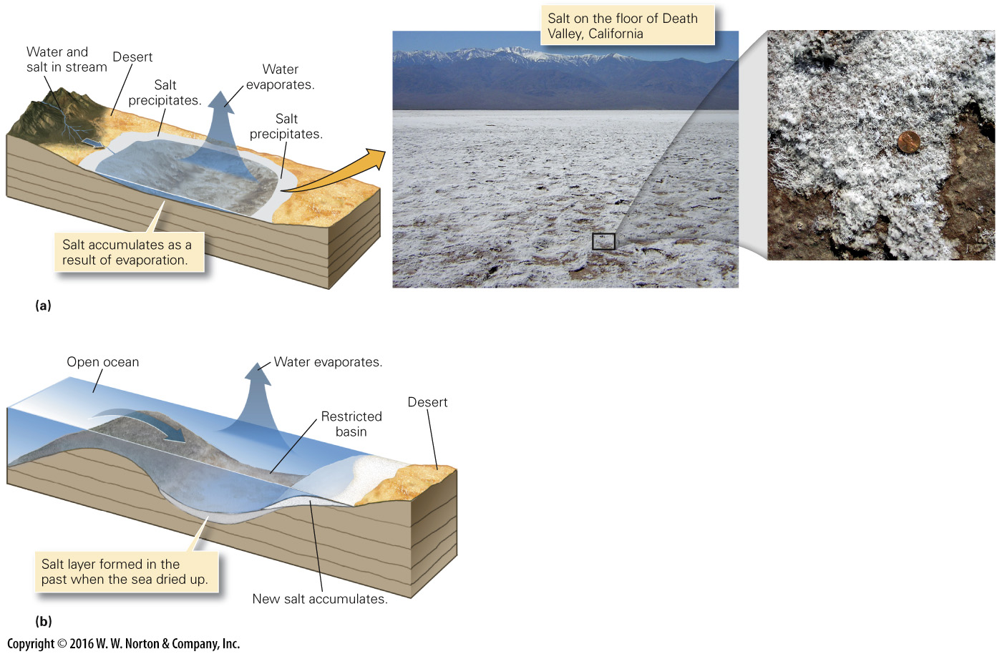
Notes:
FIGURE 6.8 The formation of evaporite deposits.
(a) In lakes with no outlet, tiny amounts of salt brought in by streams stay behind as the water evaporates. When the water evaporates entirely, a white crust of salt remains. (b) Salt precipitation can also occur along the margins of a restricted marine basin, if salt water evaporates faster than it can be resupplied.

Slide 26
Notes:
FIGURE 6.8a The formation of evaporite deposits.
(a) In lakes with no outlet, tiny amounts of salt brought in by streams stay behind as the water evaporates. When the water evaporates entirely, a white crust of salt remains.

Slide 27
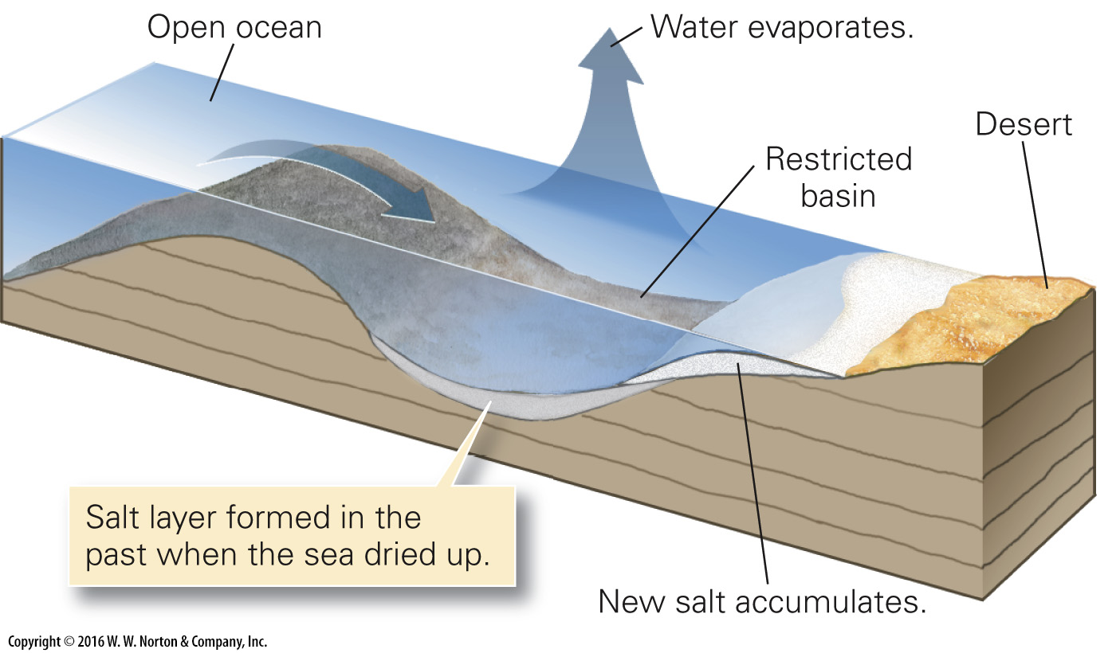
Notes:
FIGURE 6.8b The formation of evaporite deposits.
(b) Salt precipitation can also occur along the margins of a restricted marine basin, if salt water evaporates faster than it can be resupplied.

Slide 28
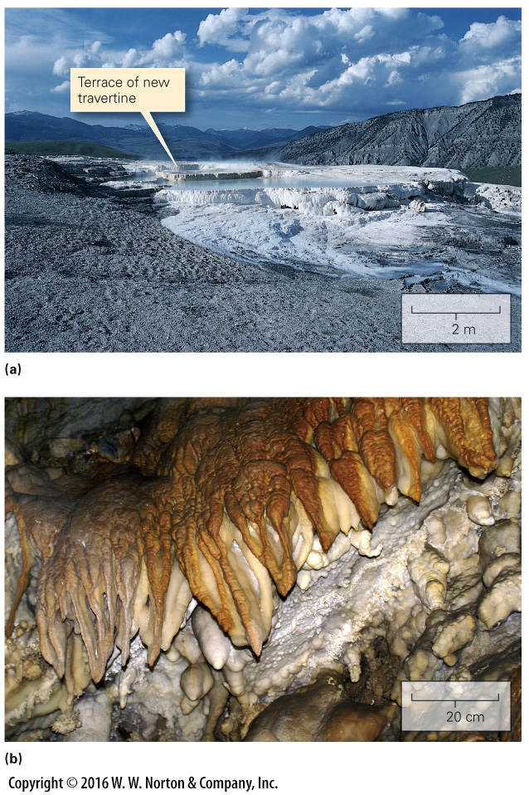
Notes:
FIGURE 6.9 Examples of travertine (chemical limestone) deposits.
(a) Travertine accumulates in terraces at Mammoth Hot Springs in Yellowstone Park, Wyoming. (b) Travertine speleothems form as calcite-rich water drips from the ceiling of Timpanogos Cave in Utah.

Slide 29
Notes:
FIGURE 6.9a Examples of travertine (chemical limestone) deposits.
(a) Travertine accumulates in terraces at Mammoth Hot Springs in Yellowstone Park, Wyoming.

Slide 30
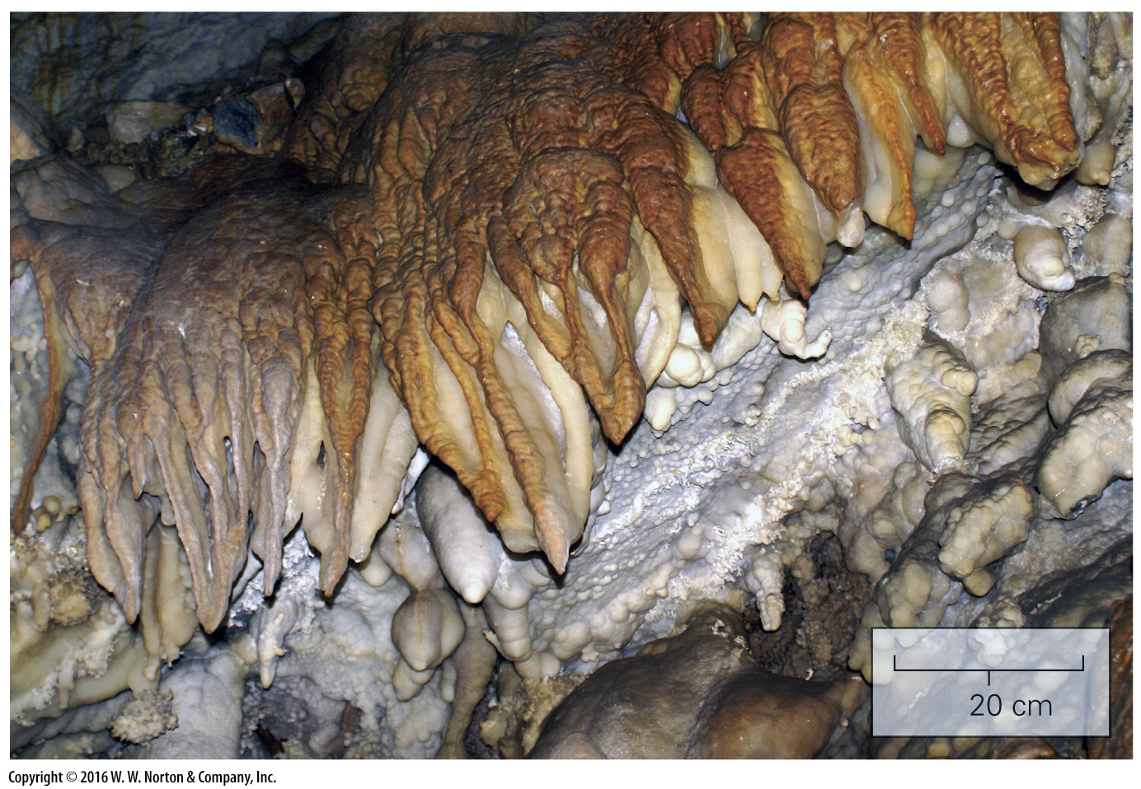
Notes:
FIGURE 6.9b Examples of travertine (chemical limestone) deposits.
(b) Travertine speleothems form as calcite-rich water drips from the ceiling of Timpanogos Cave in Utah.

Slide 31
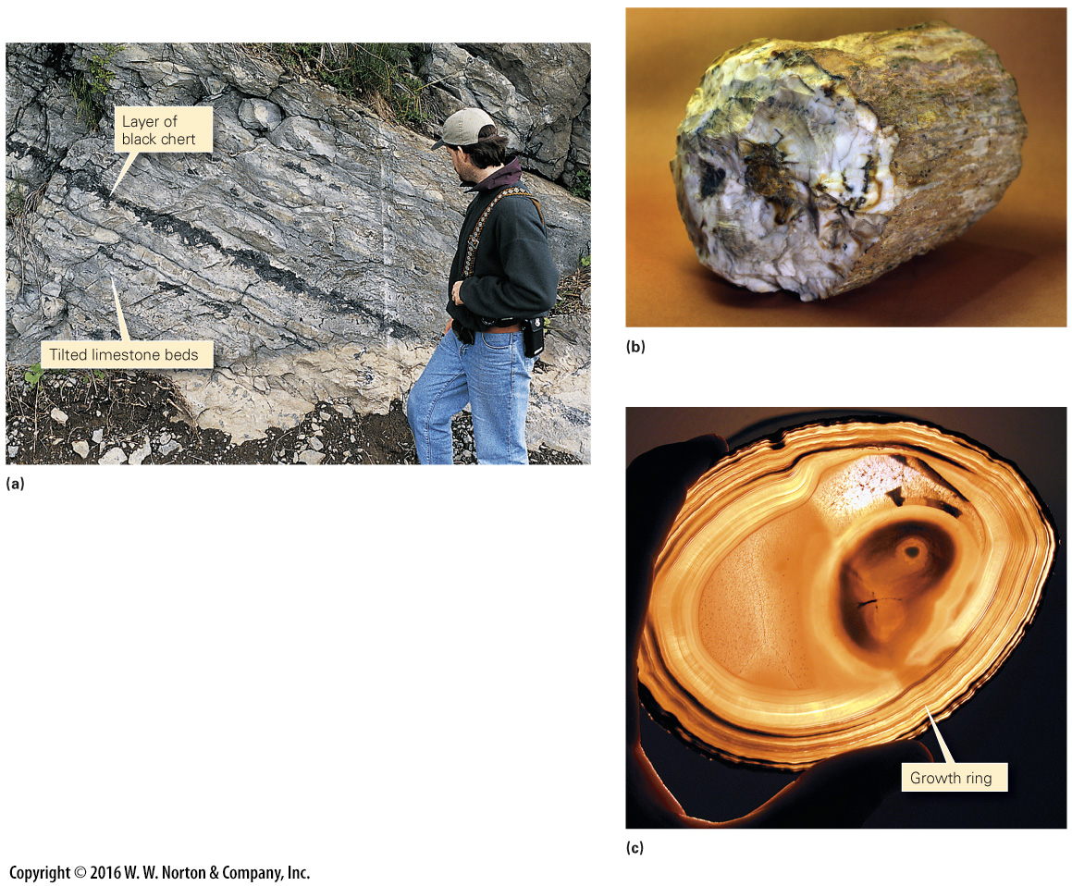
Notes:
FIGURE 6.10 Examples of chert that precipitated in place.
(a) Replacement chert forms as layers of nodules between tilted limestone beds in New York. (b) This 14 cm-diameter log of petrified wood from Wyoming formed about 50 Ma. (c) A thin slice of Brazilian agate, lit from the back, shows growth rings.

Slide 32
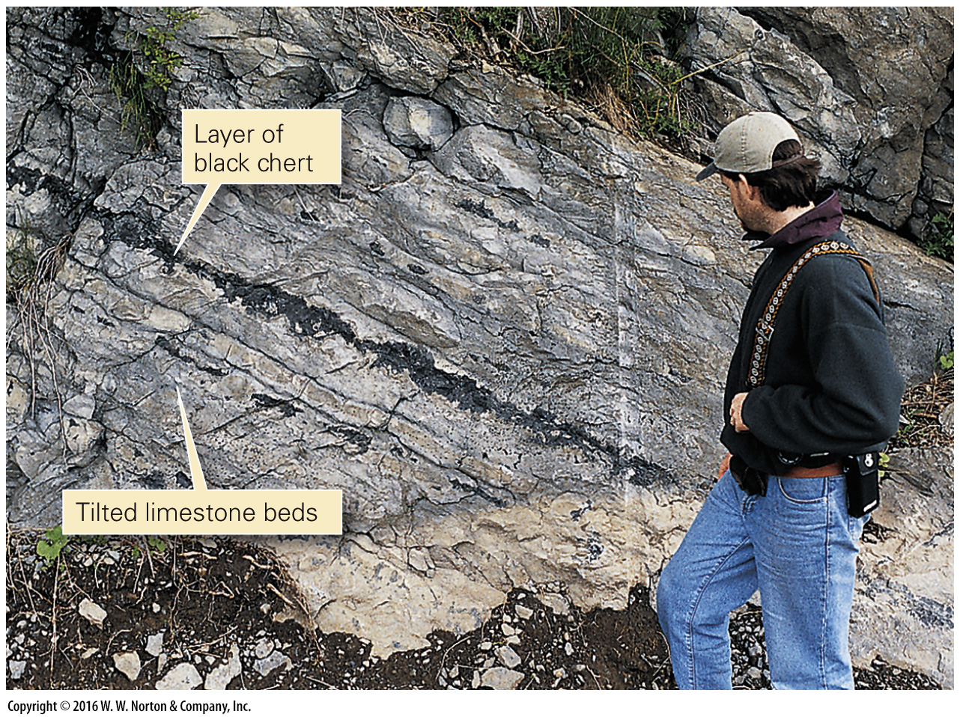
Notes:
FIGURE 6.10a Examples of chert that precipitated in place.
(a) Replacement chert forms as layers of nodules between tilted limestone beds in New York.

Slide 33
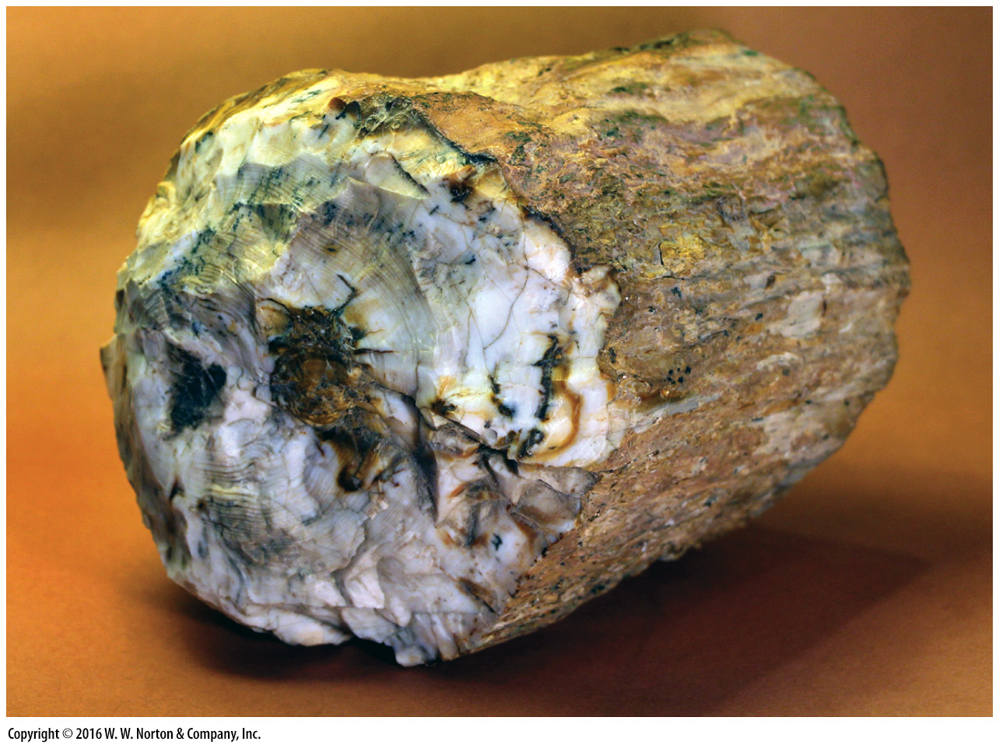
Notes:
FIGURE 6.10b Examples of chert that precipitated in place.
(b) This 14 cm-diameter log of petrified wood from Wyoming formed about 50 Ma.

Slide 34
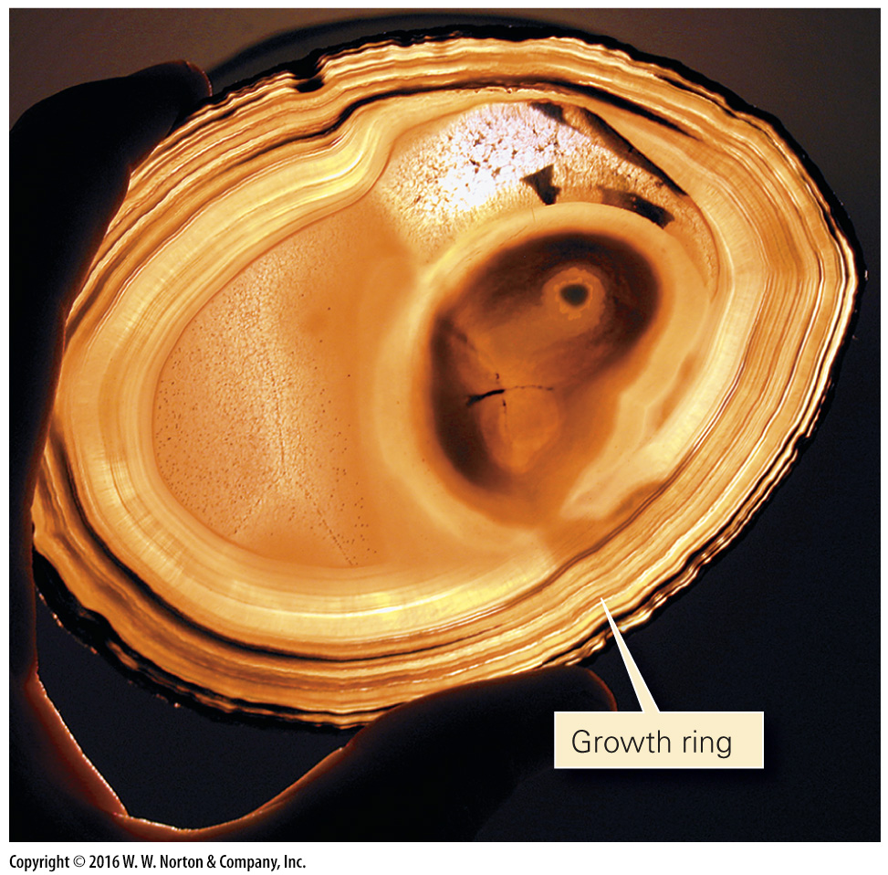
Notes:
FIGURE 6.10c Examples of chert that precipitated in place.
(c) A thin slice of Brazilian agate, lit from the back, shows growth rings.

Slide 35
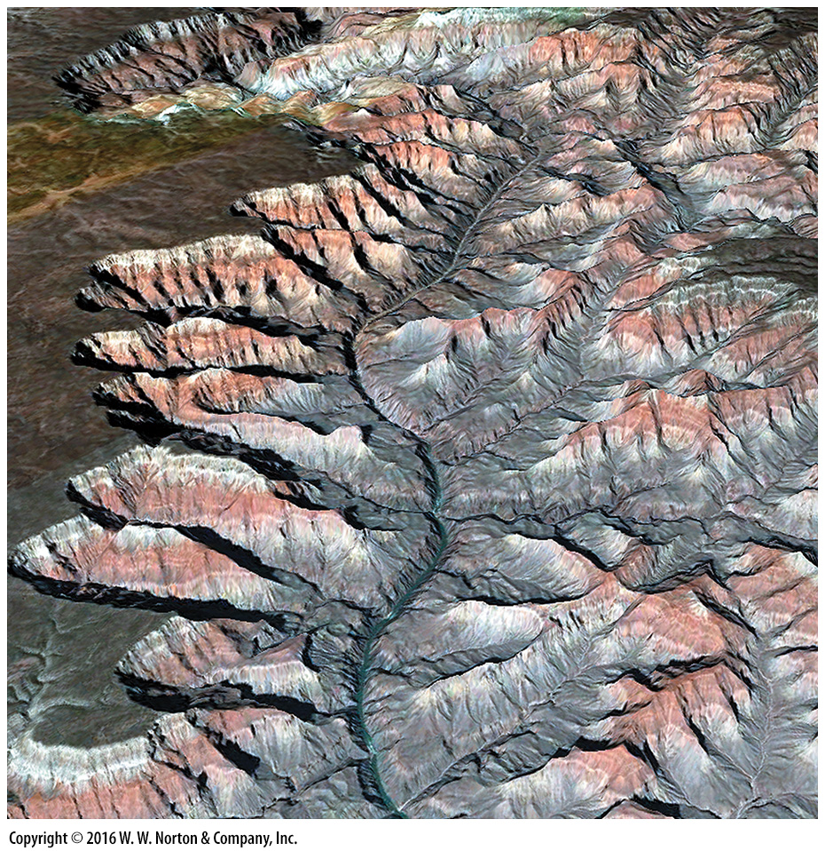
Notes:
SEE FOR YOURSELF…
GRAND CANYON, ARIZONA

Slide 36
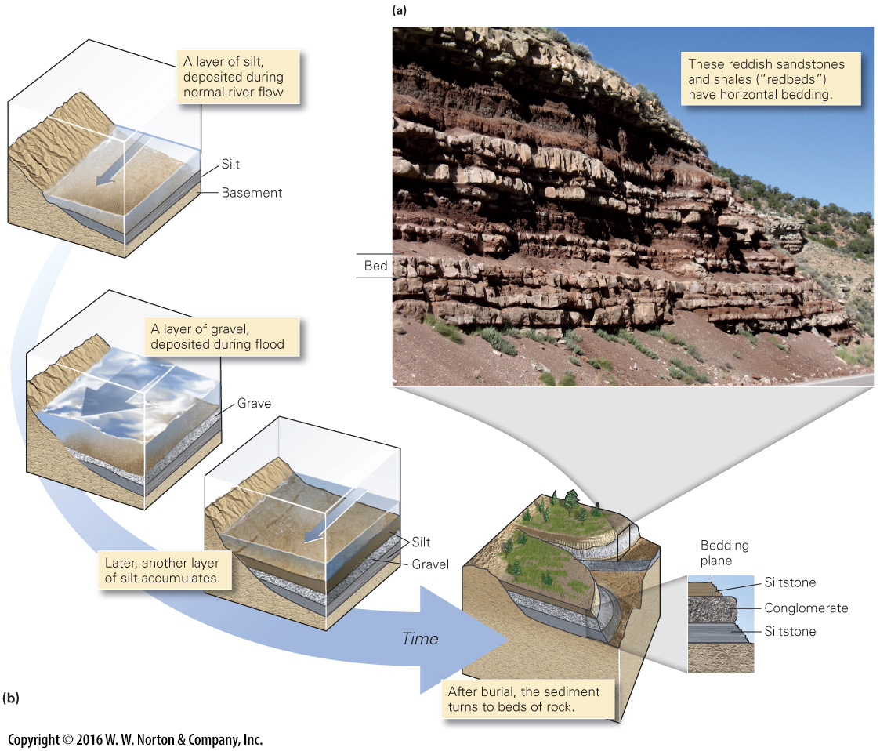
Notes:
FIGURE 6.11 Bedding in sedimentary rocks.
(a) Beds of sedimentary rock exposed along a road in Utah. (b) An example of the formation of bedding during deposition of sediment by a stream.

Slide 37
Notes:
FIGURE 6.11a Bedding in sedimentary rocks.
(a) Beds of sedimentary rock exposed along a road in Utah.

Slide 38
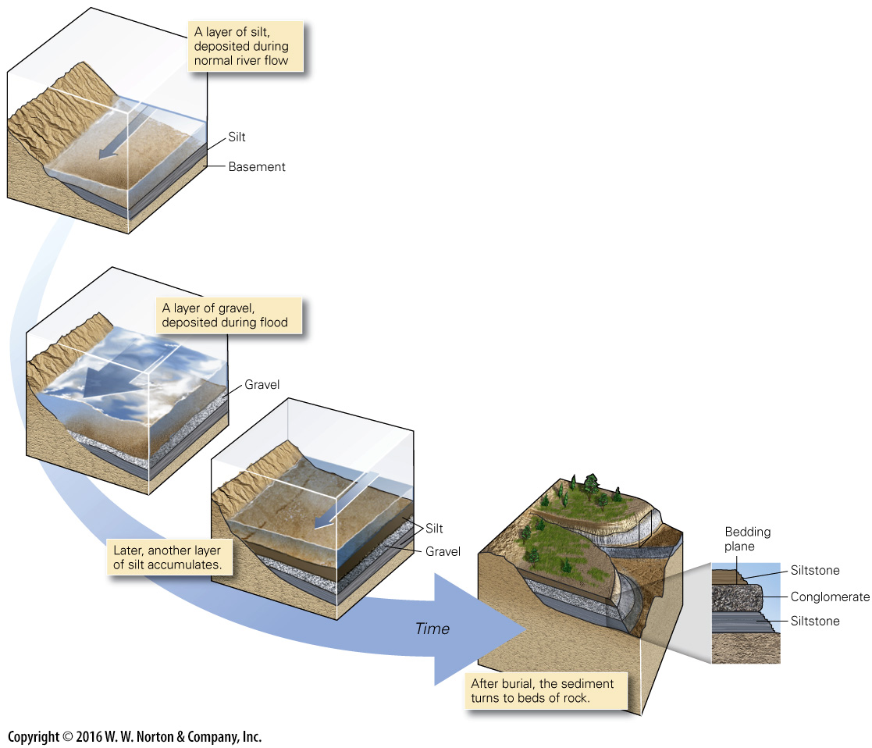
Notes:
FIGURE 6.11b Bedding in sedimentary rocks.
(b) An example of the formation of bedding during deposition of sediment by a stream.

Slide 39
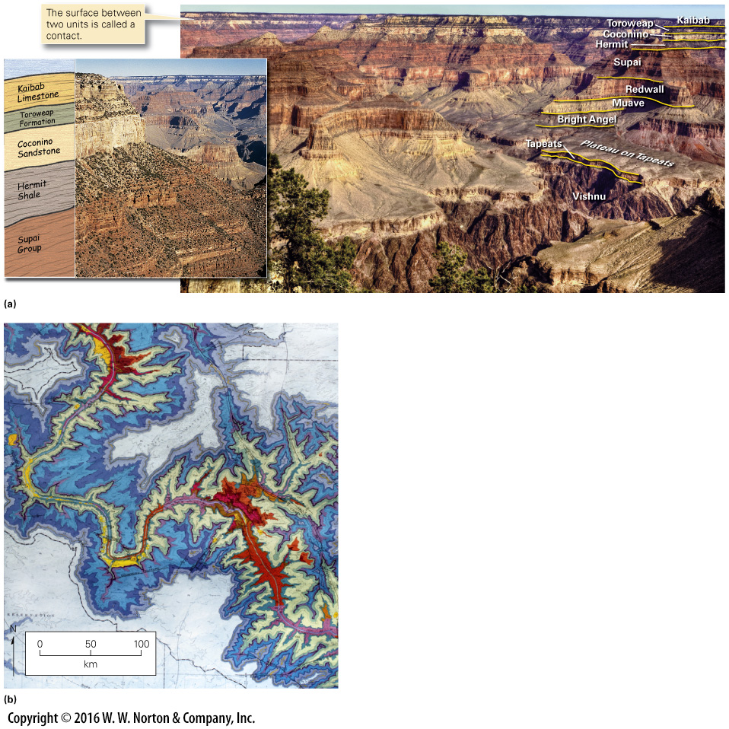
Notes:
FIGURE 6.12 The concept of a stratigraphic formation.
(a) A panoramic view of the Grand Canyon reveals many formations; the inset shows a close-up. The names of formations consisting of one rock type may indicate the rock type (e.g., Kaibab Limestone). The name of a formation including more than one rock type includes the word formation (Toroweap Formation). Several related formations comprise a group (Supai Group). (b) A geologic map portrays the distribution of formations in a portion of the Grand Canyon. Each color band is a specific formation.

Slide 40
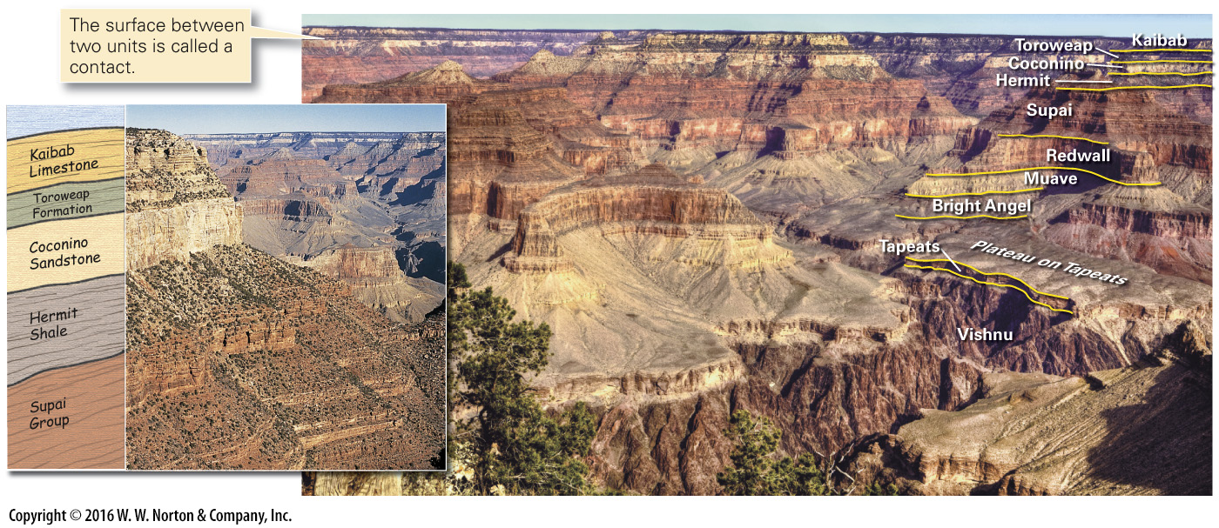
Notes:
FIGURE 6.12a The concept of a stratigraphic formation.
(a) A panoramic view of the Grand Canyon reveals many formations; the inset shows a close-up. The names of formations consisting of one rock type may indicate the rock type (e.g., Kaibab Limestone). The name of a formation including more than one rock type includes the word formation (Toroweap Formation). Several related formations comprise a group (Supai Group).

Slide 41
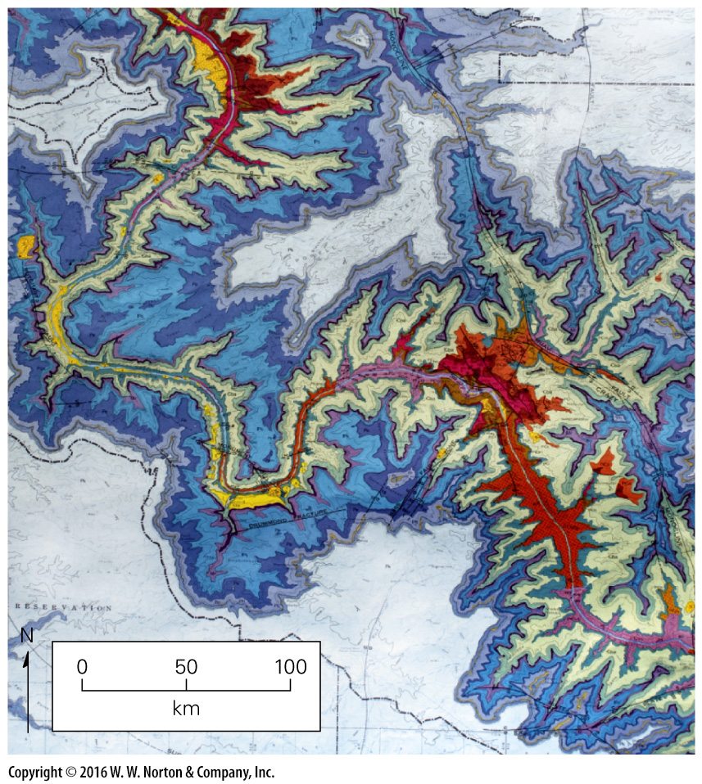
Notes:
FIGURE 6.12b The concept of a stratigraphic formation.
(b) A geologic map portrays the distribution of formations in a portion of the Grand Canyon. Each color band is a specific formation.

Slide 42
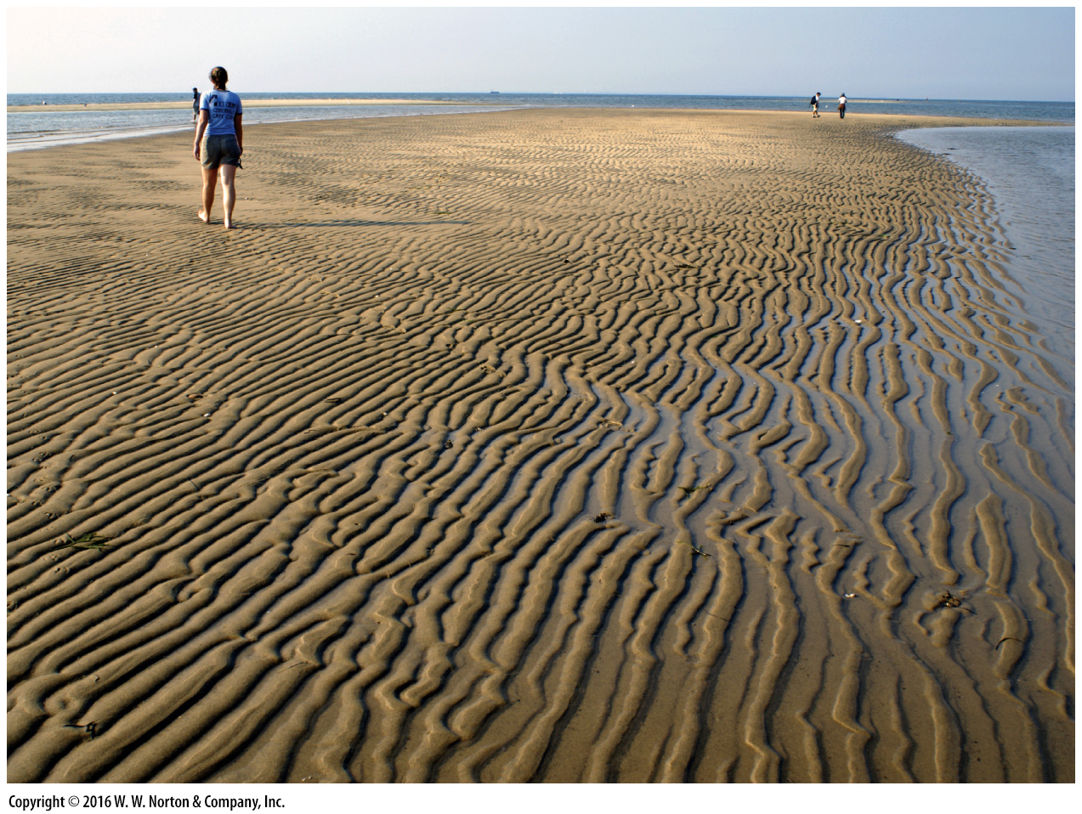
Notes:
FIGURE 6.13a Ripple marks, a type of sedimentary structure, are visible on the surface of modern and ancient beds.
(a) Modern ripples exposed at low tide along a sandy beach on the shore of Cape Cod, Massachusetts.

Slide 43
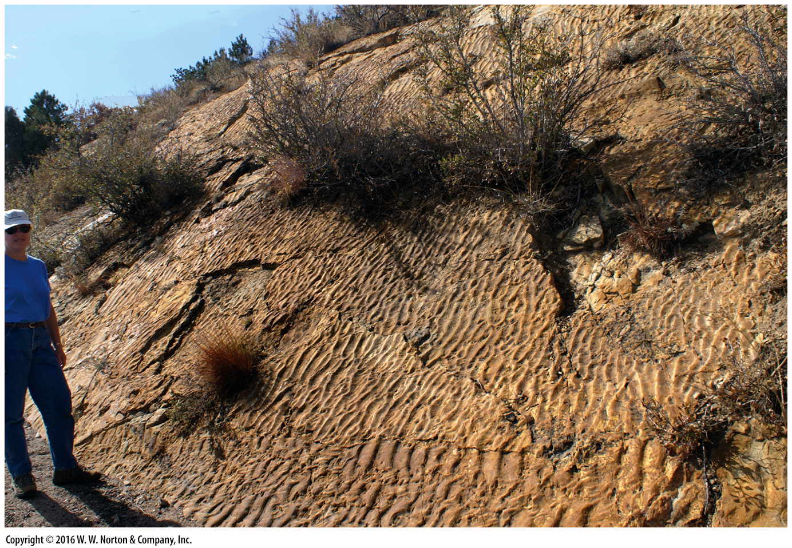
Notes:
FIGURE 6.13b Ripple marks, a type of sedimentary structure, are visible on the surface of modern and ancient beds.
(b) These 145-Ma ripples are preserved on a tilted bed of solid sandstone at Dinosaur Ridge, Colorado.

Slide 44
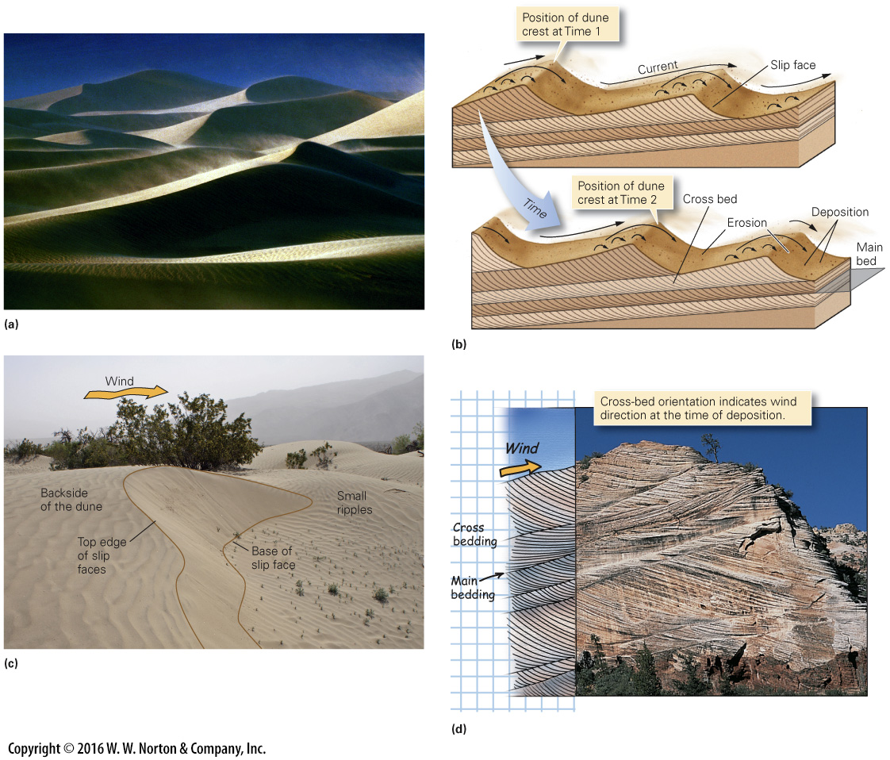
Notes:
FIGURE 6.14 Cross bedding, a type of sedimentary structure within a bed.
(a) Dunes in Death Valley, California. (b) Cross beds form as sand blows up the windward side of a dune or ripple and then accumulates on the slip face. With time, the dune crest moves. (c) Slip face of a small sand dune, Death Valley. The edges of the slip face are outlined. (d) A cliff face in Zion National Park, Utah, displays large cross beds formed between 200 and 180 Ma, when the region was a desert with large sand dunes.

Slide 45
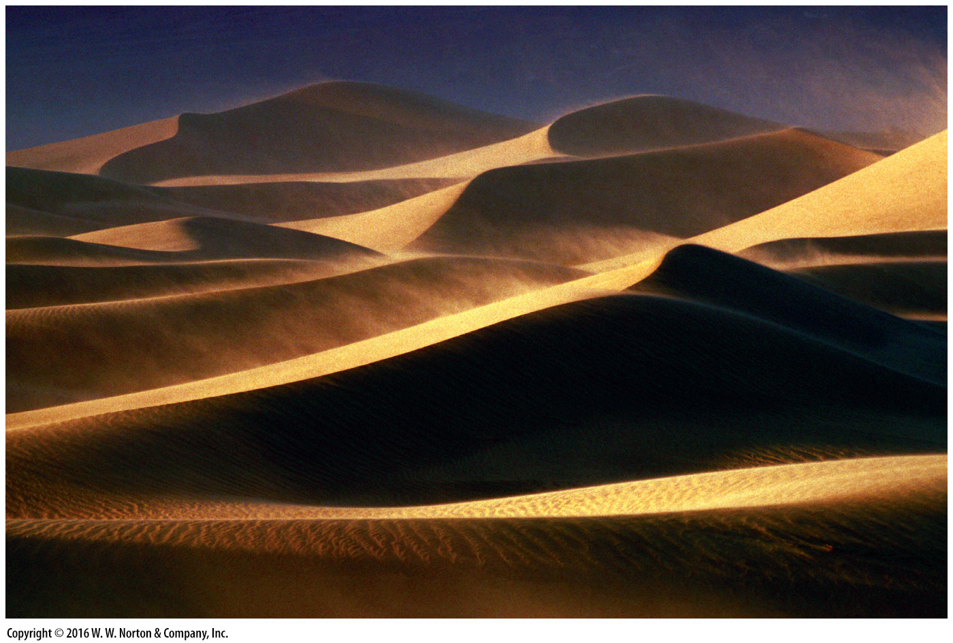
Notes:
FIGURE 6.14a Cross bedding, a type of sedimentary structure within a bed.
(a) Dunes in Death Valley, California.

Slide 46
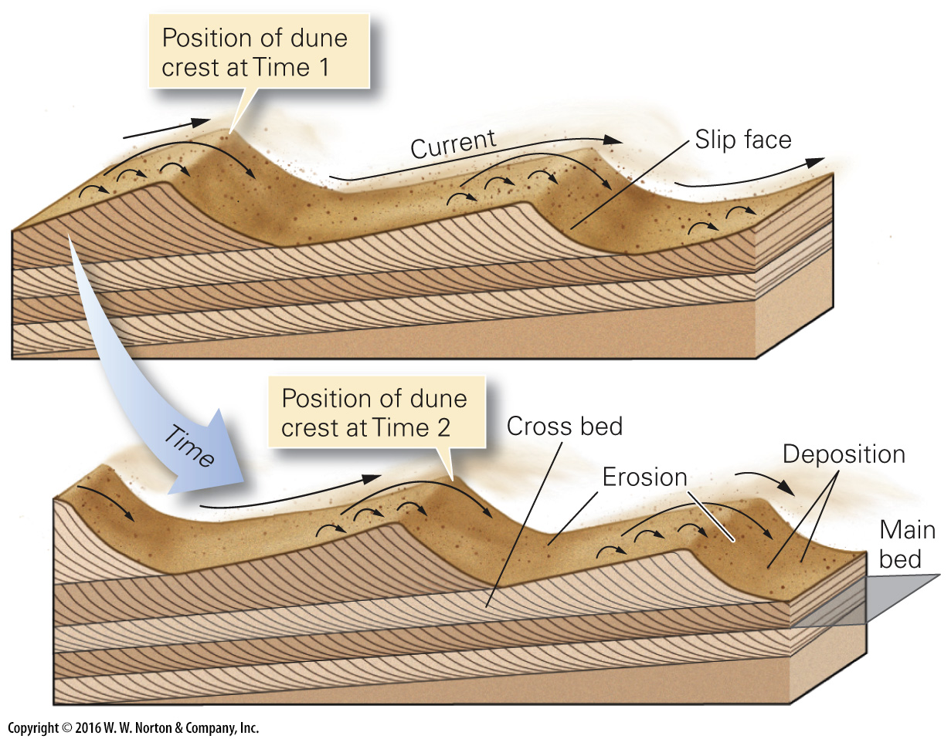
Notes:
FIGURE 6.14b Cross bedding, a type of sedimentary structure within a bed.
(b) Cross beds form as sand blows up the windward side of a dune or ripple and then accumulates on the slip face. With time, the dune crest moves.

Slide 47
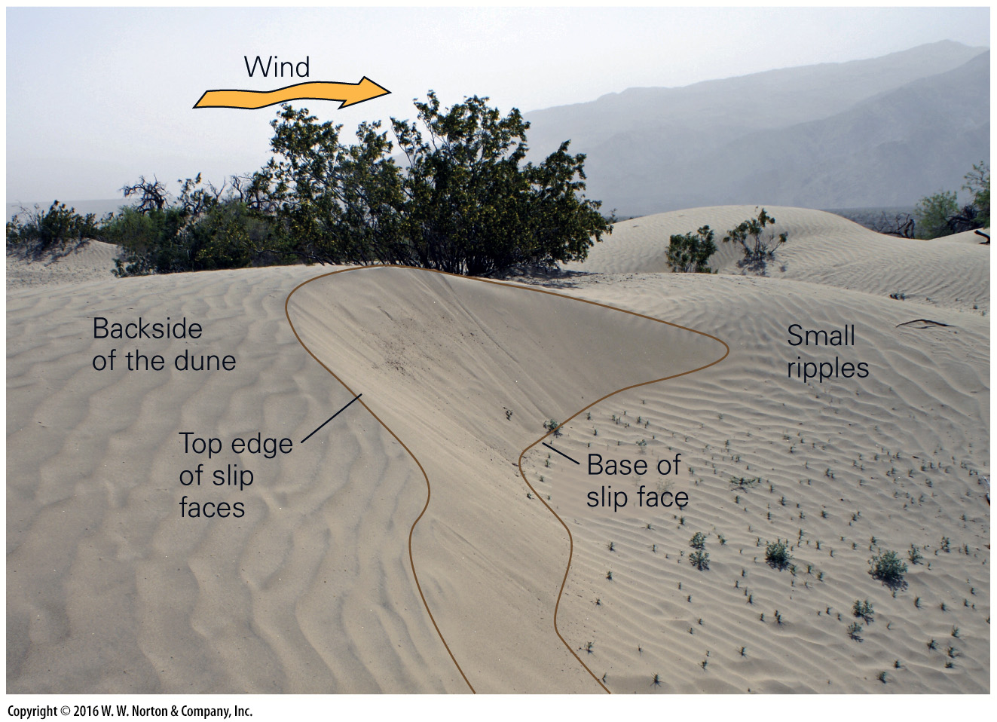
Notes:
FIGURE 6.14c Cross bedding, a type of sedimentary structure within a bed.
(c) Slip face of a small sand dune, Death Valley. The edges of the slip face are outlined.

Slide 48
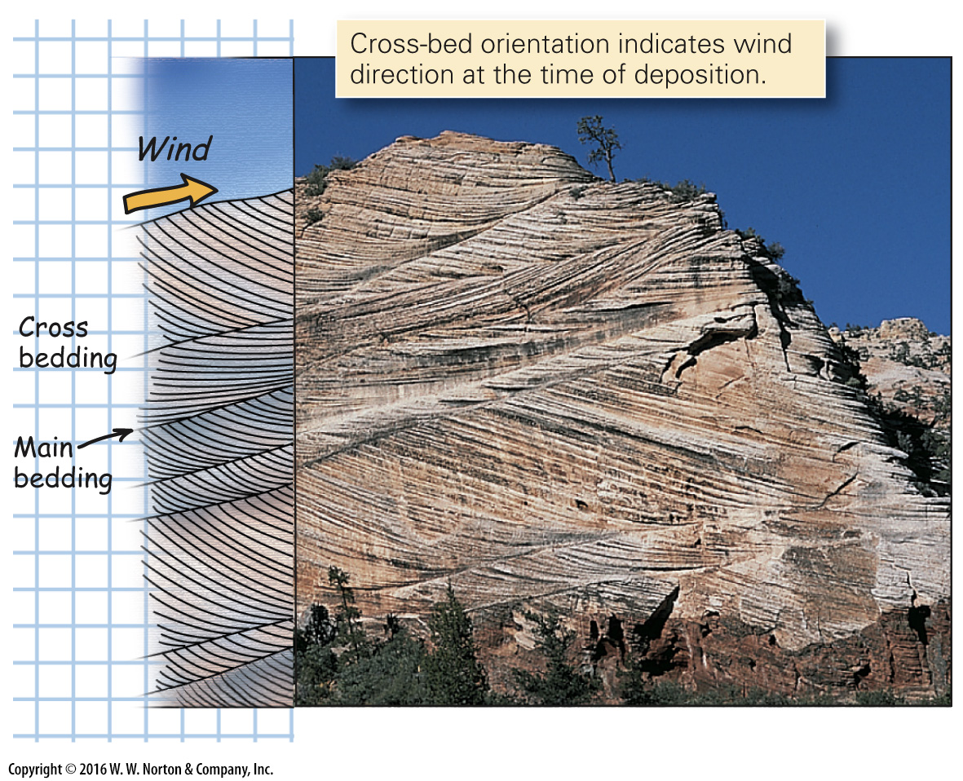
Notes:
FIGURE 6.14d Cross bedding, a type of sedimentary structure within a bed.
(d) A cliff face in Zion National Park, Utah, displays large cross beds formed between 200 and 180 Ma, when the region was a desert with large sand dunes.

Slide 49
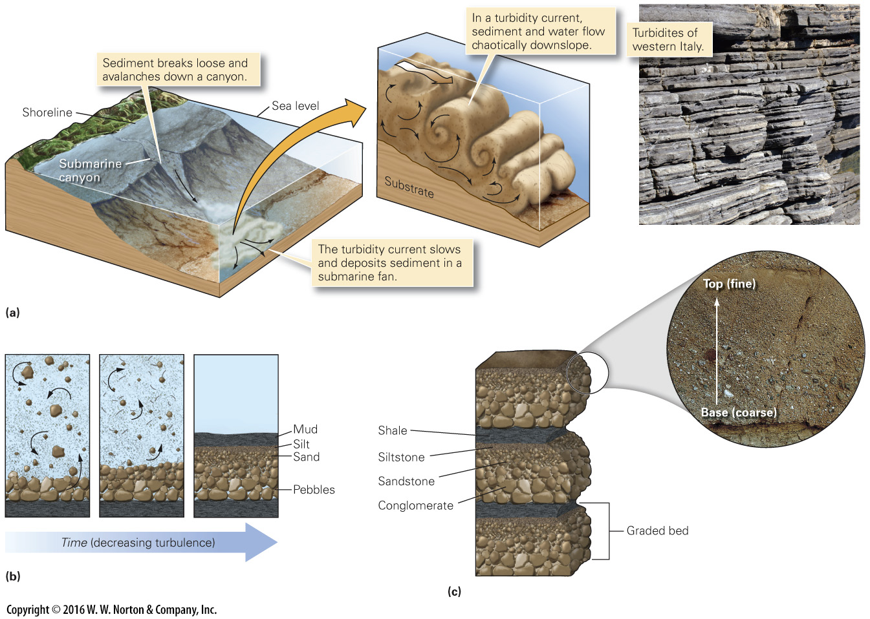
Notes:
FIGURE 6.15 The development of graded bedding from turbidity currents.
(a) An earthquake or storm triggers an underwater avalanche (turbidity current). (b) As the turbidity current slows, larger grains settle first, followed by progressively finer grains. (c) As the process repeats, a succession of graded beds accumulates.

Slide 50
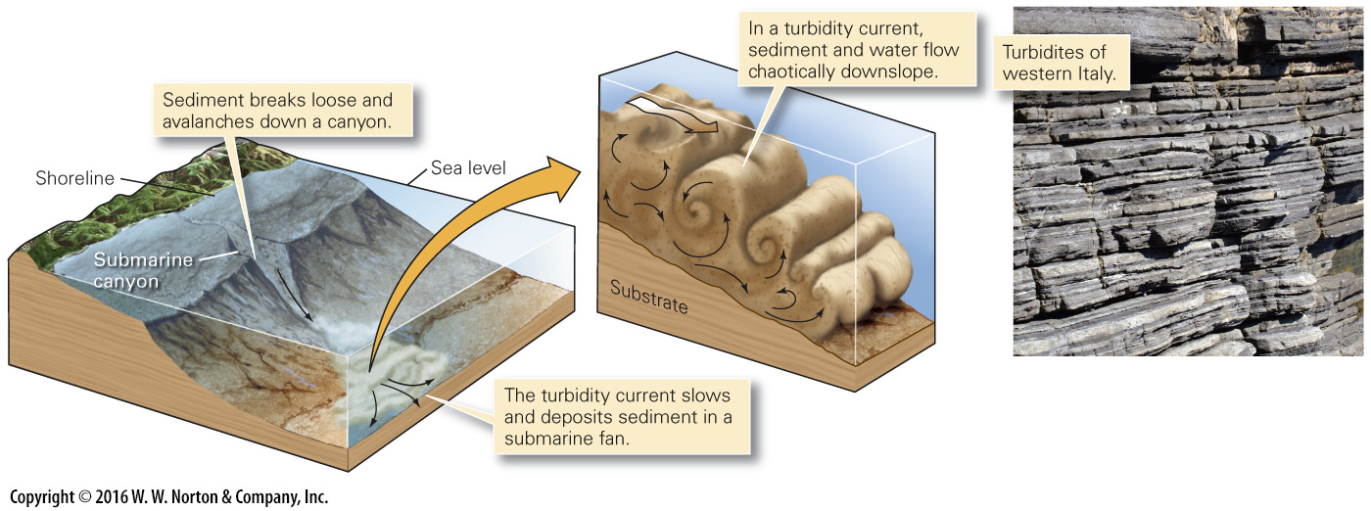
Notes:
FIGURE 6.15a The development of graded bedding from turbidity currents.
(a) An earthquake or storm triggers an underwater avalanche (turbidity current).

Slide 51
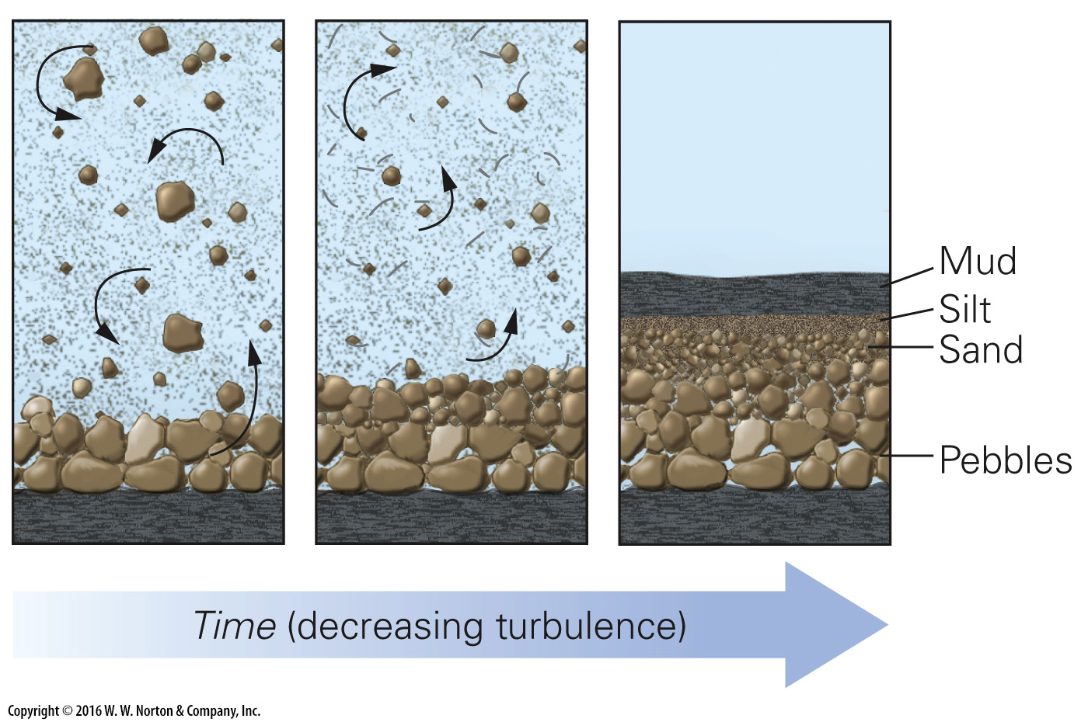
Notes:
FIGURE 6.15b The development of graded bedding from turbidity currents.
(b) As the turbidity current slows, larger grains settle first, followed by progressively finer grains.

Slide 52
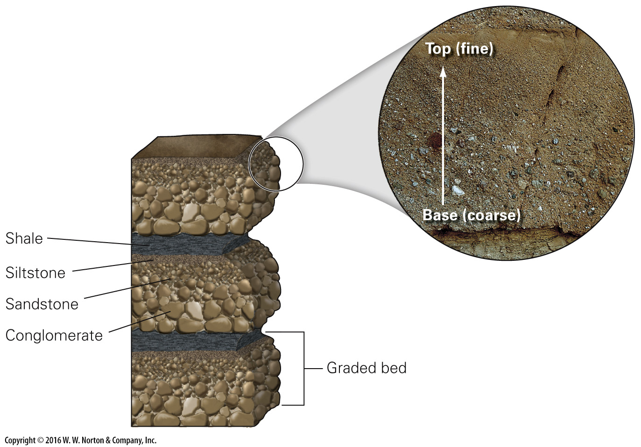
Notes:
FIGURE 6.15c The development of graded bedding from turbidity currents.
(c) As the process repeats, a succession of graded beds accumulates.

Slide 53
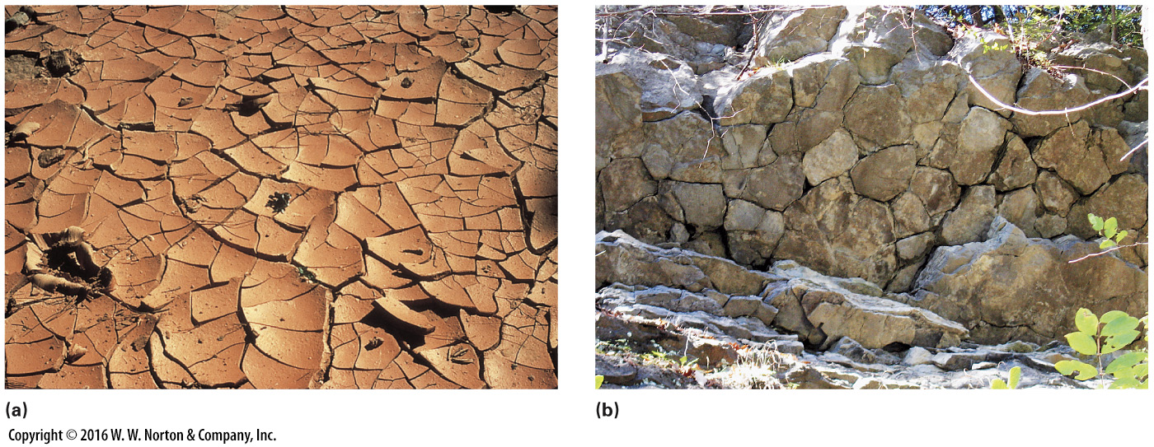
Notes:
FIGURE 6.16 Mud cracks, a sedimentary structure formed by the drying out of mud.
(a) Mud cracks in red mud at Bryce Canyon, Utah. Note how the edges of the mud plates curl up. (b) Mud cracks visible on the surface of a 410-Ma bed exposed on a cliff in New York.

Slide 54
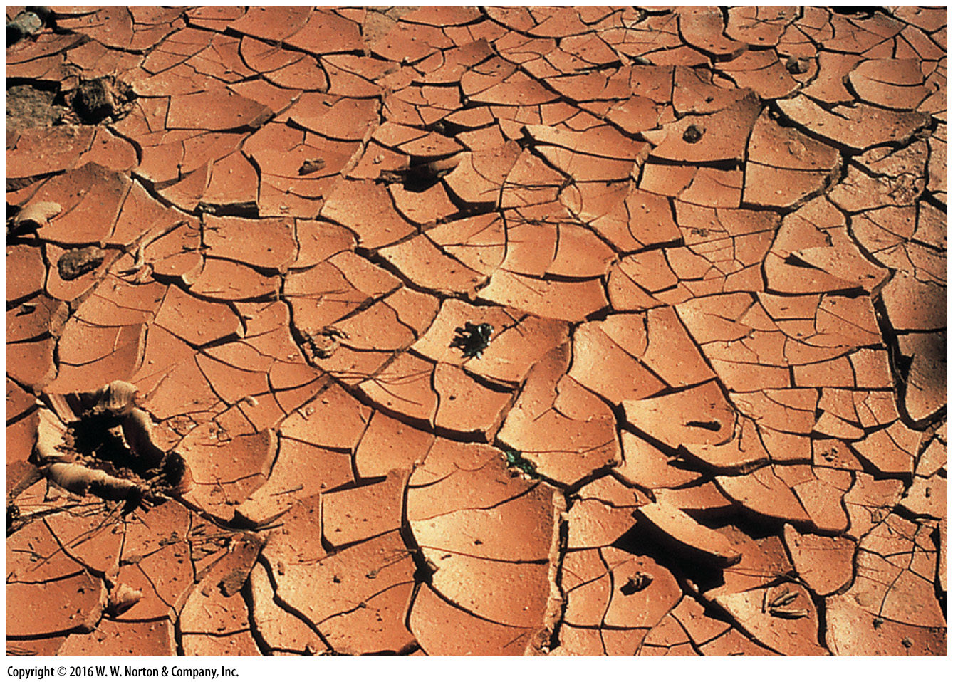
Notes:
FIGURE 6.16a Mud cracks, a sedimentary structure formed by the drying out of mud.
(a) Mud cracks in red mud at Bryce Canyon, Utah. Note how the edges of the mud plates curl up.

Slide 55
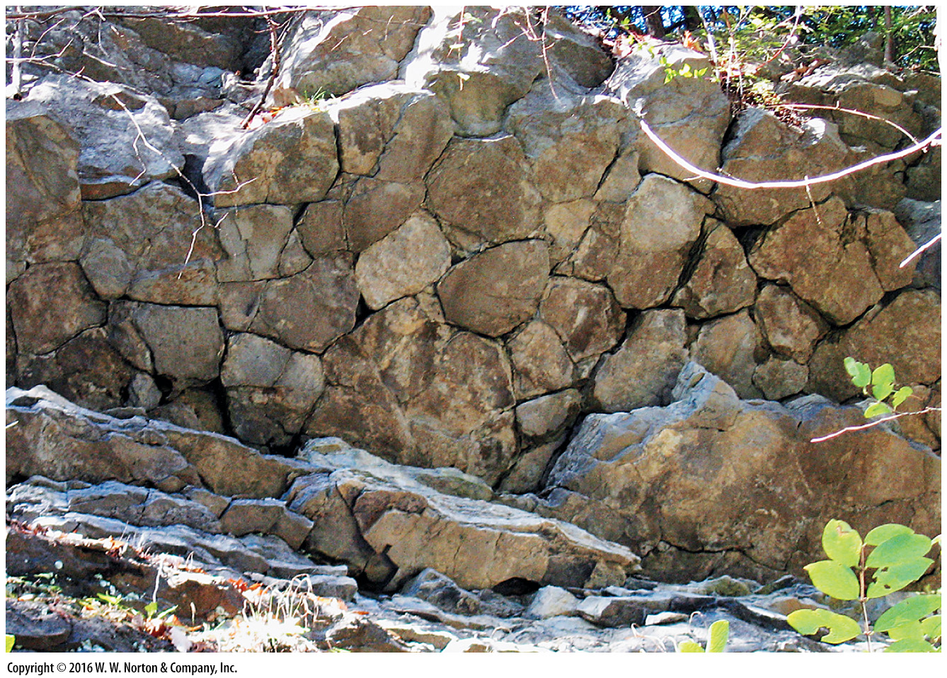
Notes:
FIGURE 6.16b Mud cracks, a sedimentary structure formed by the drying out of mud.
(b) Mud cracks visible on the surface of a 410-Ma bed exposed on a cliff in New York.

Slide 56
Notes:
SEE FOR YOURSELF…
ALLUVIAL FANS AND EVAPORITES, DEATH VALLEY, CALIFORNIA

Slide 57
Notes:
FIGURE 6.17 Examples of nonmarine depositional environments.
(a) Glacial till at the end of a glacier in France. (b) Boulders and cobbles deposited by a mountain stream in Colorado. (c) An alluvial fan in Death Valley, California. (d) Sand dunes in Brazil. Dune buggy for scale. (e) Deposits of an ancient river channel in Indiana. Note how the floor of the channel cuts across older strata. The geologist’s sketch emphasizes the relationship. (f) Laminated mud from a lake bed.

Slide 58
Notes:
FIGURE 6.17 part 1 Examples of nonmarine depositional environments.

Slide 59
Notes:
FIGURE 6.17a Examples of nonmarine depositional environments.
(a) Glacial till at the end of a glacier in France.

Slide 60
Notes:
FIGURE 6.17b Examples of nonmarine depositional environments.
(b) Boulders and cobbles deposited by a mountain stream in Colorado.

Slide 61
Notes:
FIGURE 6.17c Examples of nonmarine depositional environments.
(c) An alluvial fan in Death Valley, California.

Slide 62
Notes:
FIGURE 6.17d Examples of nonmarine depositional environments.
(d) Sand dunes in Brazil. Dune buggy for scale.

Slide 63
Notes:
FIGURE 6.17e Examples of nonmarine depositional environments.
(e) Deposits of an ancient river channel in Indiana. Note how the floor of the channel cuts across older strata. The geologist’s sketch emphasizes the relationship.

Slide 64
Notes:
FIGURE 6.17f Examples of nonmarine depositional environments.
(f) Laminated mud from a lake bed.

Slide 65
Notes:
FIGURE 6.18 A simple “Gilbert-type” delta formed where a stream enters a lake.

Slide 66
Notes:
SEE FOR YOURSELF…
MURRAY RIVER FLOODPLAIN, AUSTRALIA

Slide 67
Notes:
SEE FOR YOURSELF…
SHALLOW MARINE ENVIRONMENTS, RED SEA, EGYPT

Slide 68
Notes:
GEOLOGY AT A GLANCE
The Formation of Sedimentary Rocks

Slide 69
Notes:
FIGURE 6.19 Examples of coastal depositional environments.
(a) A major river delta along an ocean coast is a complex depositional environment. Sea-level changes affect locations of depositional settings. (b) Waves on this California beach wash and sort the sand.

Slide 70
Notes:
FIGURE 6.19a Examples of coastal depositional environments.
(a) A major river delta along an ocean coast is a complex depositional environment. Sea-level changes affect locations of depositional settings.

Slide 71
Notes:
FIGURE 6.19b Examples of coastal depositional environments.
(b) Waves on this California beach wash and sort the sand.

Slide 72
Notes:
FIGURE 6.20 Reef environments for the deposition of carbonate rocks.
(a) Carbonate reefs form along shorelines in warm-water environments. In detail, reefs include many distinct depositional environments. (b) A dramatic reef surrounds an island in the tropical Pacific. Deeper water is darker. Note the surf along the edge of the reef.

Slide 73
Notes:
FIGURE 6.20a Reef environments for the deposition of carbonate rocks.
(a) Carbonate reefs form along shorelines in warm-water environments. In detail, reefs include many distinct depositional environments.

Slide 74
Notes:
FIGURE 6.20b Reef environments for the deposition of carbonate rocks.
(b) A dramatic reef surrounds an island in the tropical Pacific. Deeper water is darker. Note the surf along the edge of the reef.

Slide 75
Notes:
FIGURE 6.21 Examples of deep-marine sediment.
(a) These plankton shells, which make up some kinds of deep-marine sediment, are so small that they could pass through the eye of a needle. (b) The chalk cliffs of southeastern England consist of plankton shells deposited on the sea floor tens of millions of years ago.

Slide 76
Notes:
FIGURE 6.21a Examples of deep-marine sediment.
(a) These plankton shells, which make up some kinds of deep-marine sediment, are so small that they could pass through the eye of a needle.

Slide 77
Notes:
FIGURE 6.21b Examples of deep-marine sediment.
(b) The chalk cliffs of southeastern England consist of plankton shells deposited on the sea floor tens of millions of years ago.

Slide 78
Notes:
FIGURE 6.22 The geologic setting of sedimentary basins.

Slide 79
Notes:
FIGURE 6.23 The concept of transgression and regression during deposition of sedimentary sequence.

Slide 80
Notes:
Another View These cliffs in the Canadian Rockies consist of sedimentary rock. You can see the stratification.

