Slide 1
Stephen Marshak
ESSENTIALS OF
Geology
FIFTH EDITION
Chapter 7
Metamorphism:
A Process of Change
©2016 W. W. Norton & Company, Inc.

Slide 2
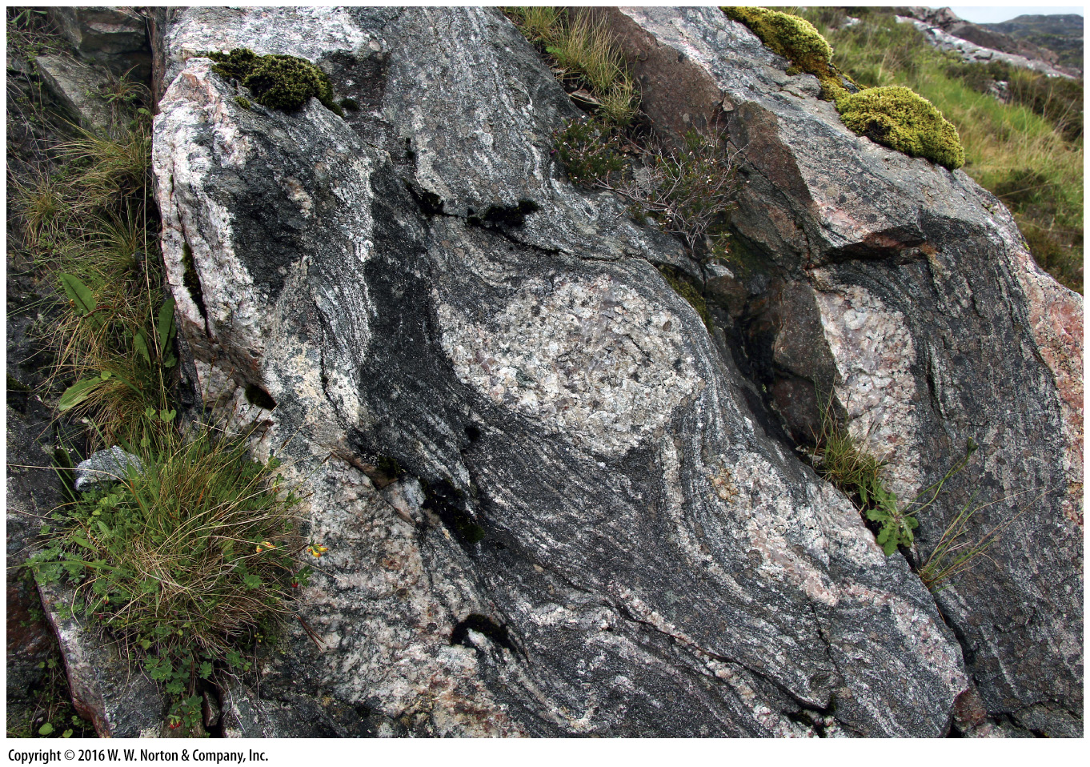
Notes:
In the stark mountains of northwestern Scotland, outcrops of Lewisian Gneiss poke up from the scruffy grass. The rock formed when pre-existing rocks were subjected to high pressures and temperatures, as well as compression and shear, during Precambrian mountain building.

Slide 3
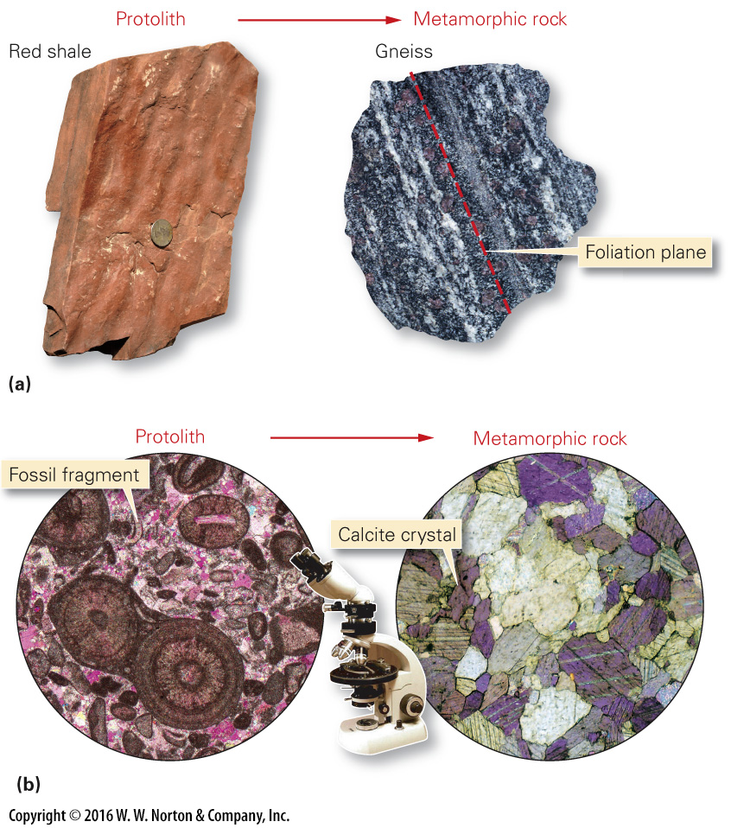
Notes:
FIGURE 7.1 Metamorphism causes changes in mineral makeup and texture.
(a) A specimen of red shale (left) contains clay, quartz, and iron oxide. When this rock undergoes intense metamorphism, it may change into a gneiss containing different minerals. This gneiss sample (right) contains biotite, quartz, feldspar, and purple garnet. (b) The contrast in texture between a protolith of fossiliferous limestone and a marble formed by metamorphism is evident when viewed through a microscope.

Slide 4
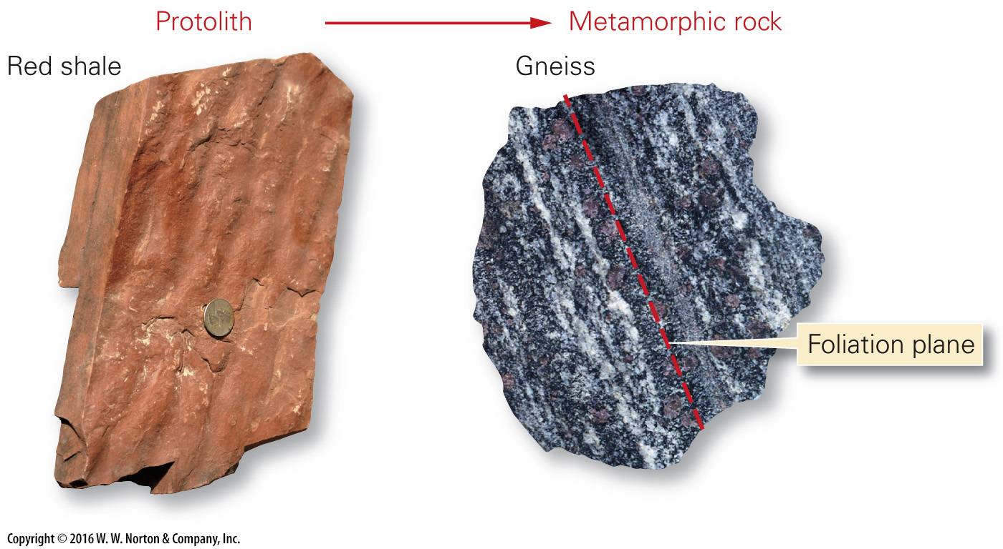
Notes:
FIGURE 7.1a Metamorphism causes changes in mineral makeup and texture.
(a) A specimen of red shale (left) contains clay, quartz, and iron oxide. When this rock undergoes intense metamorphism, it may change into a gneiss containing different minerals. This gneiss sample (right) contains biotite, quartz, feldspar, and purple garnet.

Slide 5
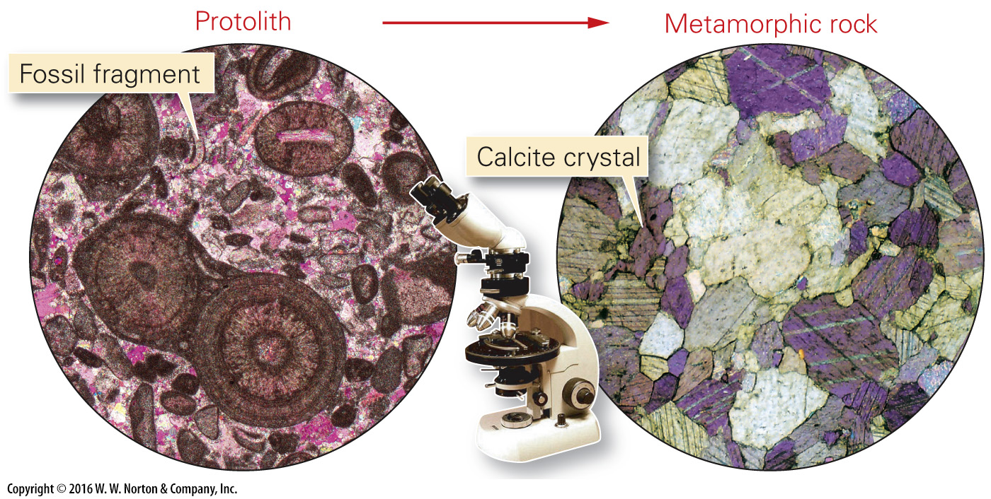
Notes:
FIGURE 7.1b Metamorphism causes changes in mineral makeup and texture.
(b) The contrast in texture between a protolith of fossiliferous limestone and a marble formed by metamorphism is evident when viewed through a microscope.

Slide 6
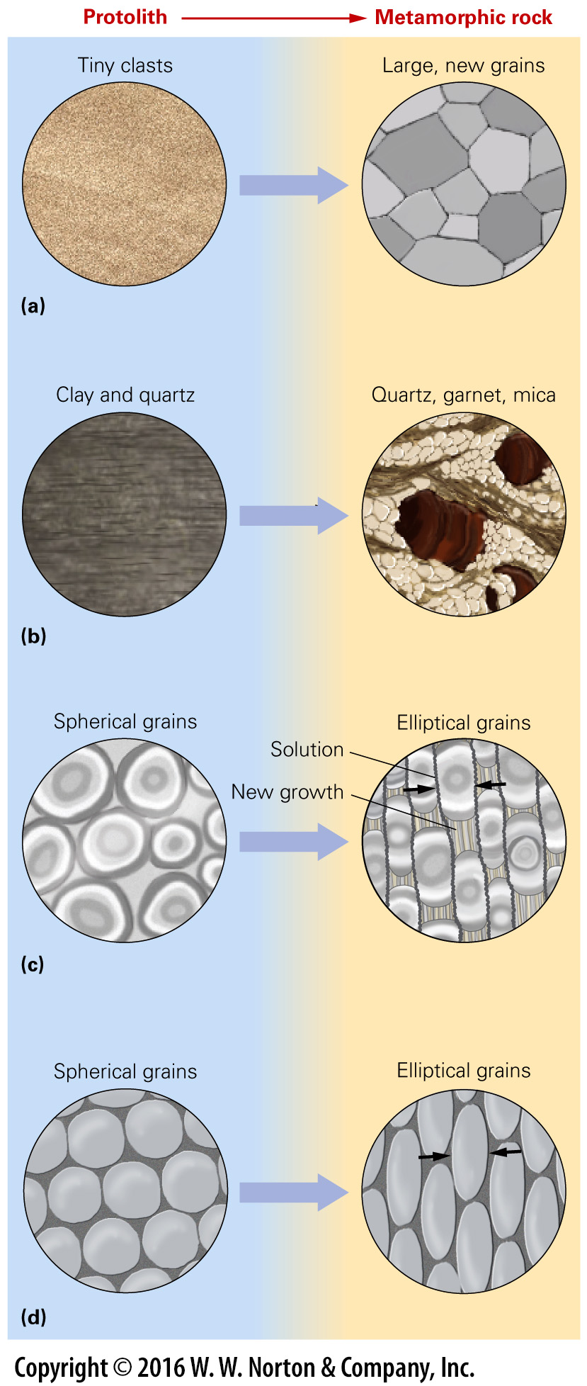
Notes:
FIGURE 7.2 Metamorphic processes, as seen through a microscope.
(a) Mineral grains recrystallize to form new, interlocking grains of the same mineral. Typically, grains get larger. (b) Chemical reactions change the original assemblage of minerals into a new, metamorphic assemblage of minerals. (c) Pressure solution dissolves grains on the sides undergoing more pressure and precipitates new mineral material where the pressure is lower. Arrows indicate the squeezing direction. (d) Plastic deformation changes the shape of grains—without breaking them—as a result of squeezing or shear at high temperatures.

Slide 7
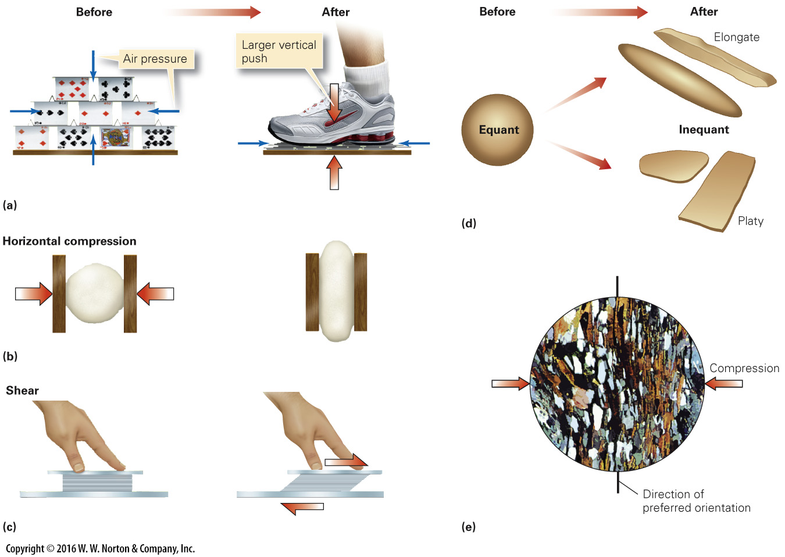
Notes:
FIGURE 7.3 Compression and shear change rock grains during metamorphism.
(a) A standing house of cards is subject only to air pressure, which is equal from all sides. When you step on the cards, they are pushed downward because of the vertical compression. (b) Here horizontal compression flattens a dough ball between wood blocks. (c) A shear stress acts parallel to a surface. Here shear smears out a deck of cards parallel to a table top. (d) Compression and shear can transform equant grains into inequant grains. Inequant grains can be elongate (cigar-shaped) or platy (pancake-shaped). (e) In metamorphic rock, inequant grains may be aligned to form a preferred orientation. As seen through a microscope, the flat planes of grains are perpendicular to the compression direction.

Slide 8
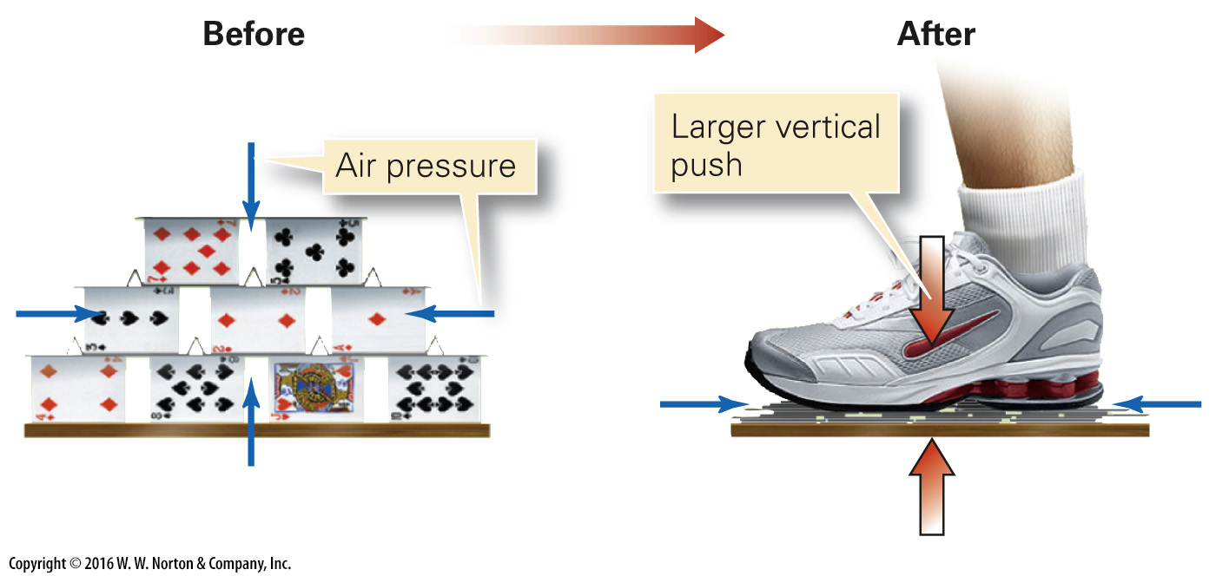
Notes:
FIGURE 7.3a Compression and shear change rock grains during metamorphism.
(a) A standing house of cards is subject only to air pressure, which is equal from all sides. When you step on the cards, they are pushed downward because of the vertical compression.

Slide 9
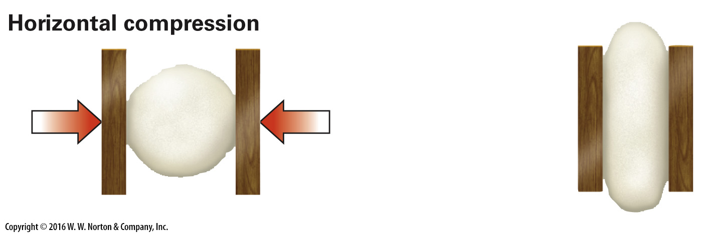
Notes:
FIGURE 7.3b Compression and shear change rock grains during metamorphism.
(b) Here horizontal compression flattens a dough ball between wood blocks.

Slide 10
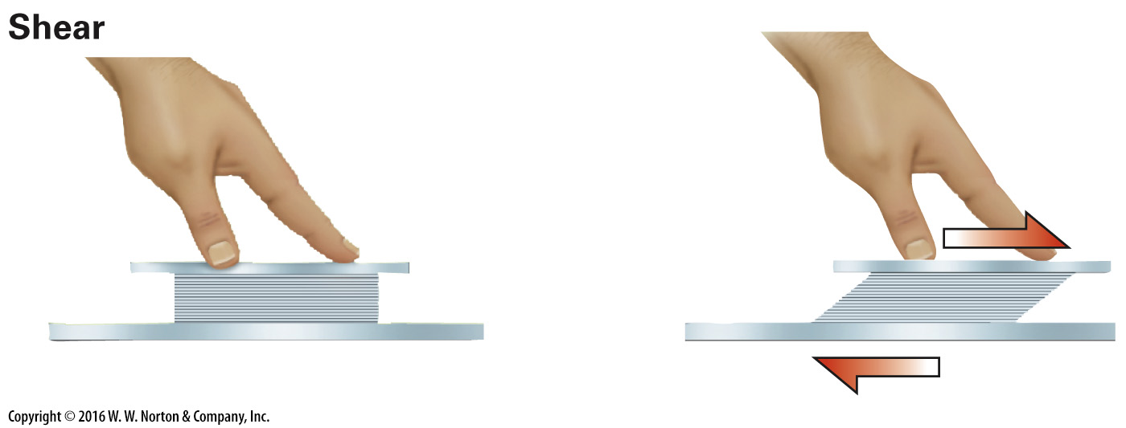
Notes:
FIGURE 7.3c Compression and shear change rock grains during metamorphism.
(c) A shear stress acts parallel to a surface. Here shear smears out a deck of cards parallel to a table top.

Slide 11
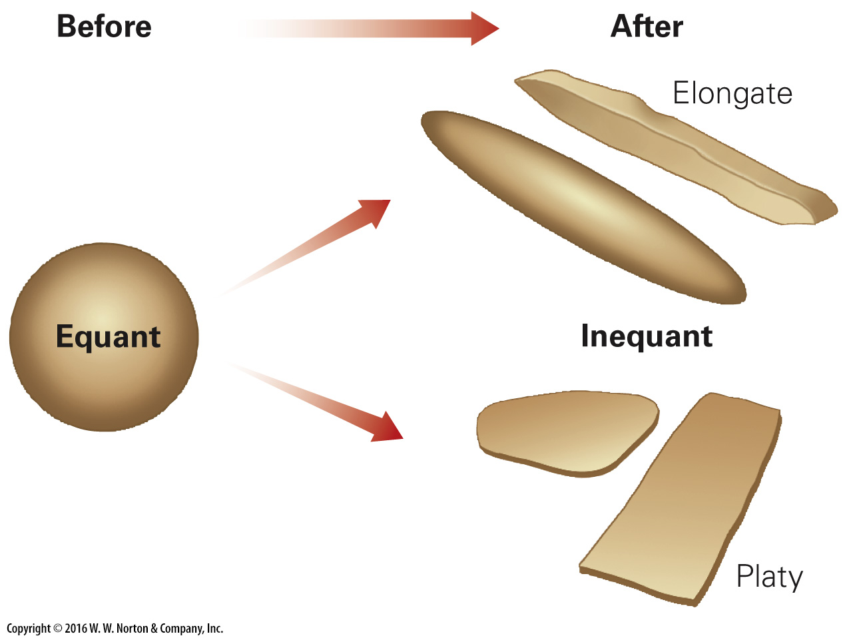
Notes:
FIGURE 7.3d Compression and shear change rock grains during metamorphism.
(d) Compression and shear can transform equant grains into inequant grains. Inequant grains can be elongate (cigar-shaped) or platy (pancake-shaped).

Slide 12
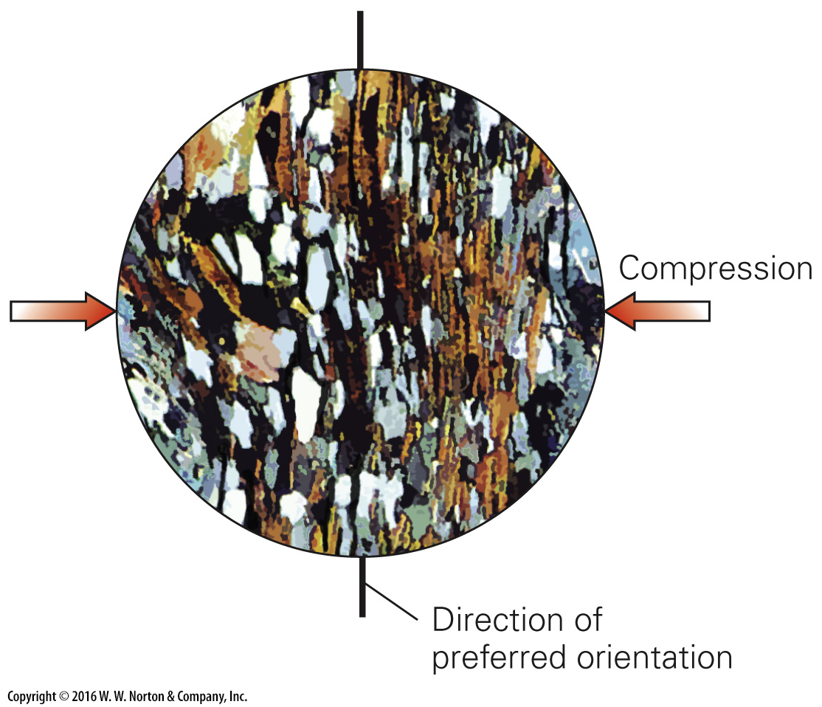
Notes:
FIGURE 7.3e Compression and shear change rock grains during metamorphism.
(e) In metamorphic rock, inequant grains may be aligned to form a preferred orientation. As seen through a microscope, the flat planes of grains are perpendicular to the compression direction.

Slide 13
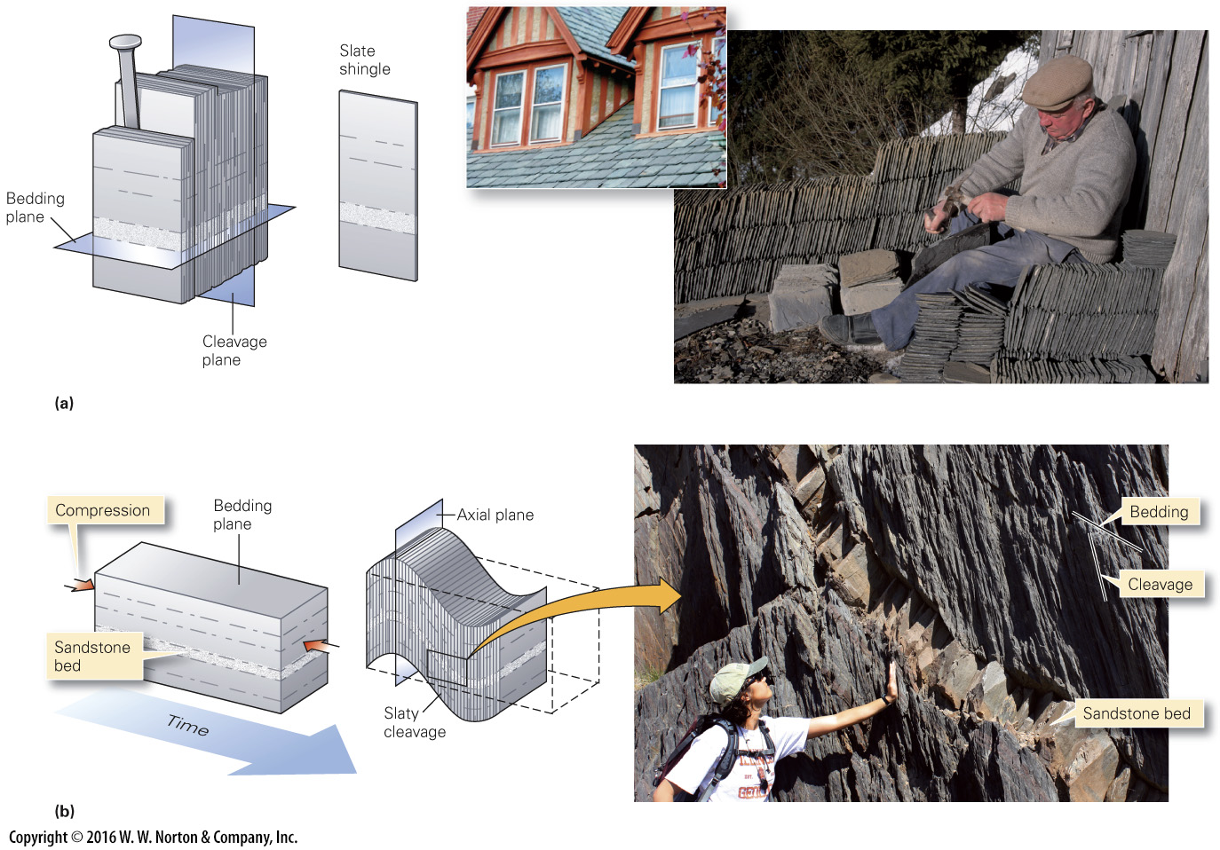
Notes:
FIGURE 7.4 Slate is a foliated metamorphic rock that forms at relatively low temperatures and pressures.
(a) A block of slate splits easily along cleavage planes, which may be at a high angle to the bedding planes. Workers split slate to produce roof shingles that, when overlapped, make a watertight surface (see inset). (b) Slaty cleavage forms in response to compressive stress. In this example, layers also bend to form folds, as slaty cleavage develops. The cleavage tends to be oriented parallel to the axial plane, an imaginary surface that, simplistically, divides the fold in half.

Slide 14
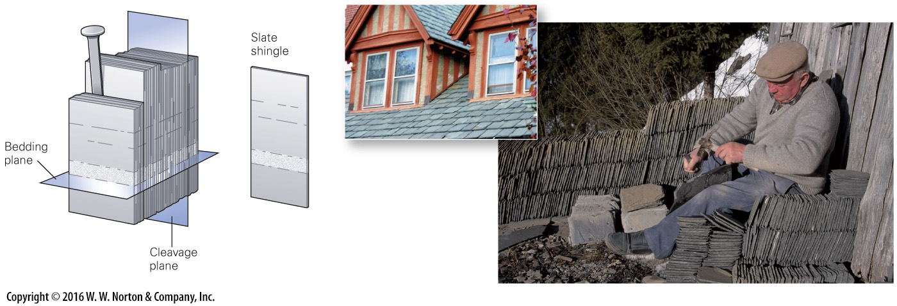
Notes:
FIGURE 7.4a Slate is a foliated metamorphic rock that forms at relatively low temperatures and pressures.
(a) A block of slate splits easily along cleavage planes, which may be at a high angle to the bedding planes. Workers split slate to produce roof shingles that, when overlapped, make a watertight surface (see inset).

Slide 15
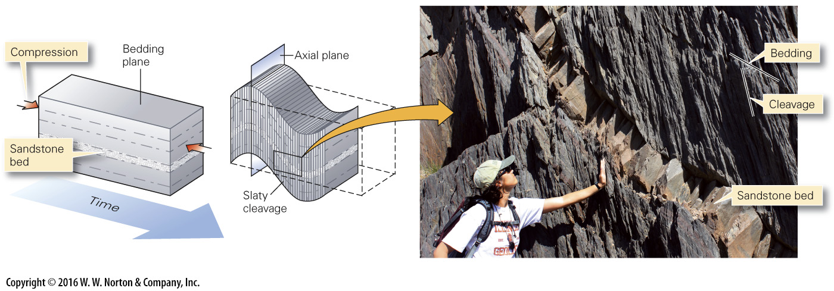
Notes:
FIGURE 7.4b Slate is a foliated metamorphic rock that forms at relatively low temperatures and pressures.
(b) Slaty cleavage forms in response to compressive stress. In this example, layers also bend to form folds, as slaty cleavage develops. The cleavage tends to be oriented parallel to the axial plane, an imaginary surface that, simplistically, divides the fold in half.

Slide 16
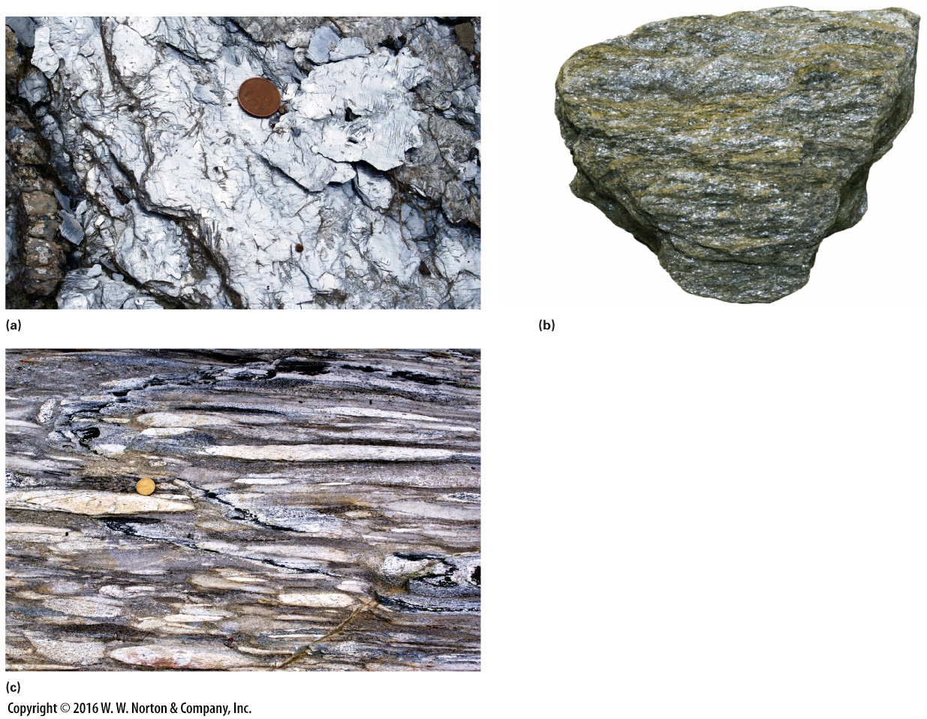
Notes:
FIGURE 7.5 Examples of foliated metamorphic rocks formed at higher temperatures and pressures.
(a) During formation of phyllite, clay recrystallizes to form tiny mica flakes that reflect light, giving the rock a sheen. (b) A schist contains coarse mica flakes, along with other metamorphic minerals. (c) In metaconglomerate, pebbles and cobbles flatten into a pancake shape without cracking.

Slide 17
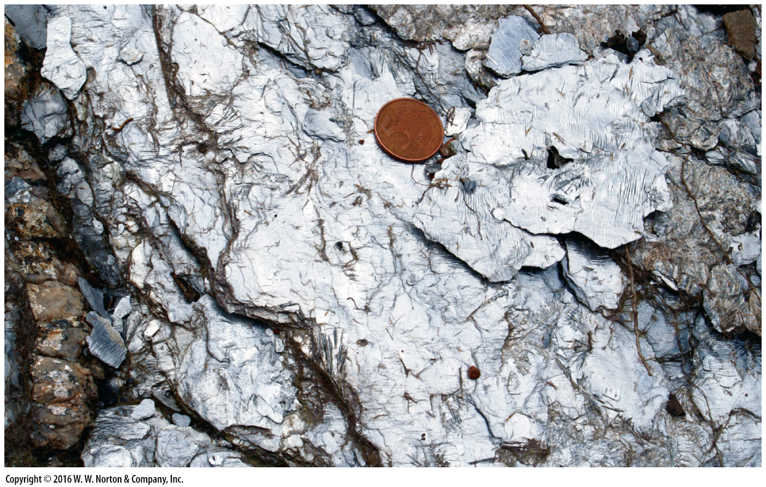
Notes:
FIGURE 7.5a Examples of foliated metamorphic rocks formed at higher temperatures and pressures.
(a) During formation of phyllite, clay recrystallizes to form tiny mica flakes that reflect light, giving the rock a sheen.

Slide 18
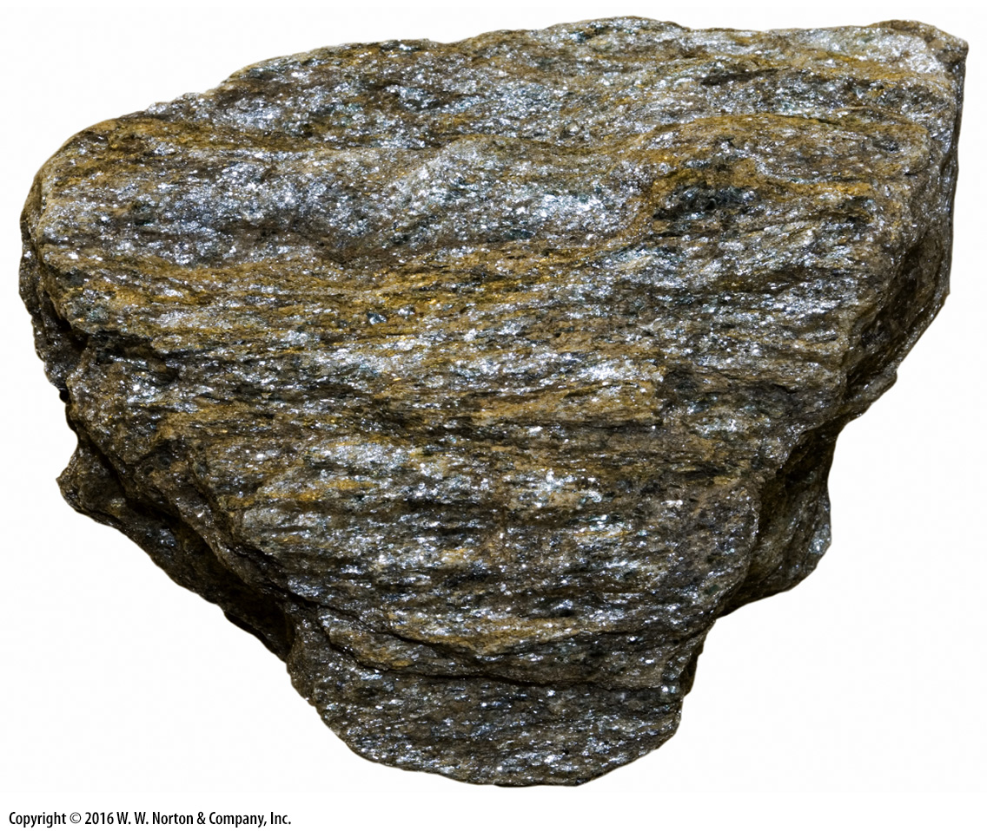
Notes:
FIGURE 7.5b Examples of foliated metamorphic rocks formed at higher temperatures and pressures.
(b) A schist contains coarse mica flakes, along with other metamorphic minerals.

Slide 19
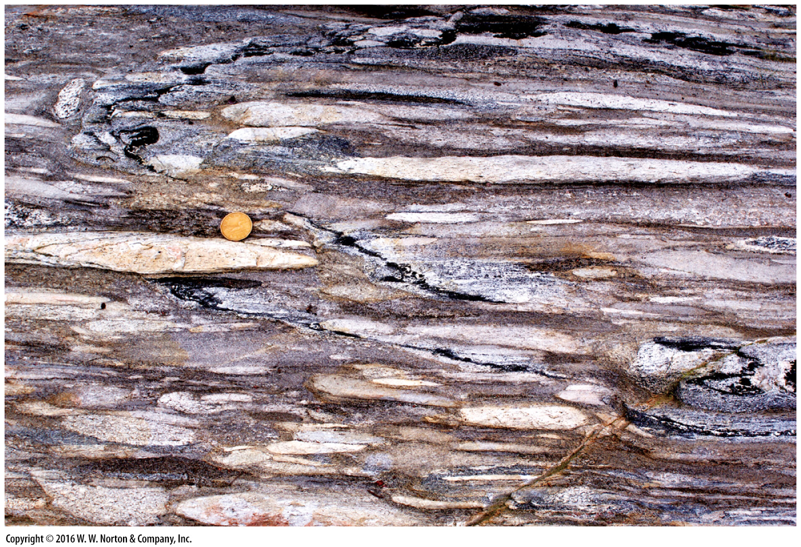
Notes:
FIGURE 7.5c Examples of foliated metamorphic rocks formed at higher temperatures and pressures.
(c) In metaconglomerate, pebbles and cobbles flatten into a pancake shape without cracking.

Slide 20
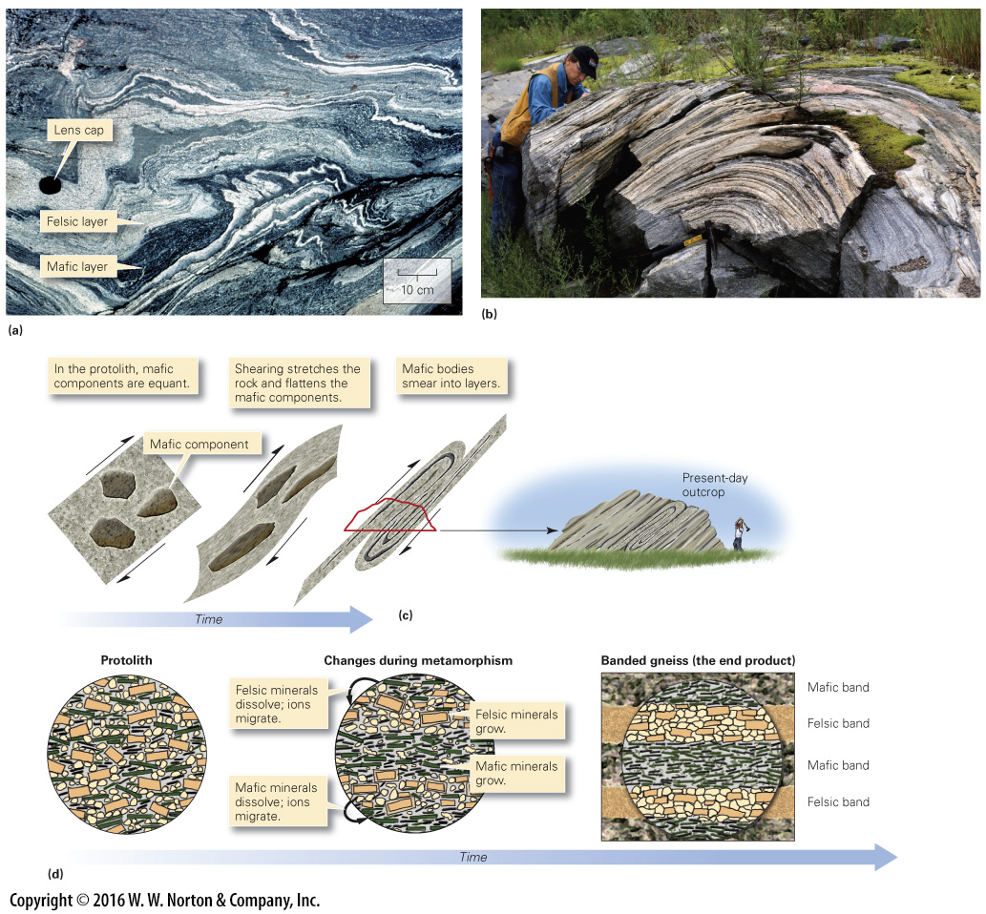
Notes:
FIGURE 7.6 The formation of gneiss, which takes place at very high temperatures and pressures.
(a) In this outcrop of gneiss in Brazil, some of the layers are only centimeters across. (b) An outcrop of 2.7-billion-year-old metamorphic rock in Ontario, Canada, shows a distinct foliation, in this case defined by alternating bands of light and dark minerals. (c) Formation of gneiss, in some cases, involves extreme shear. Original contrasting rock types are smeared into parallel layers. (d) Gneiss may also form by metamorphic differentiation, during which chemical reactions cause felsic and mafic minerals to grow in distinct, separate layers.

Slide 21
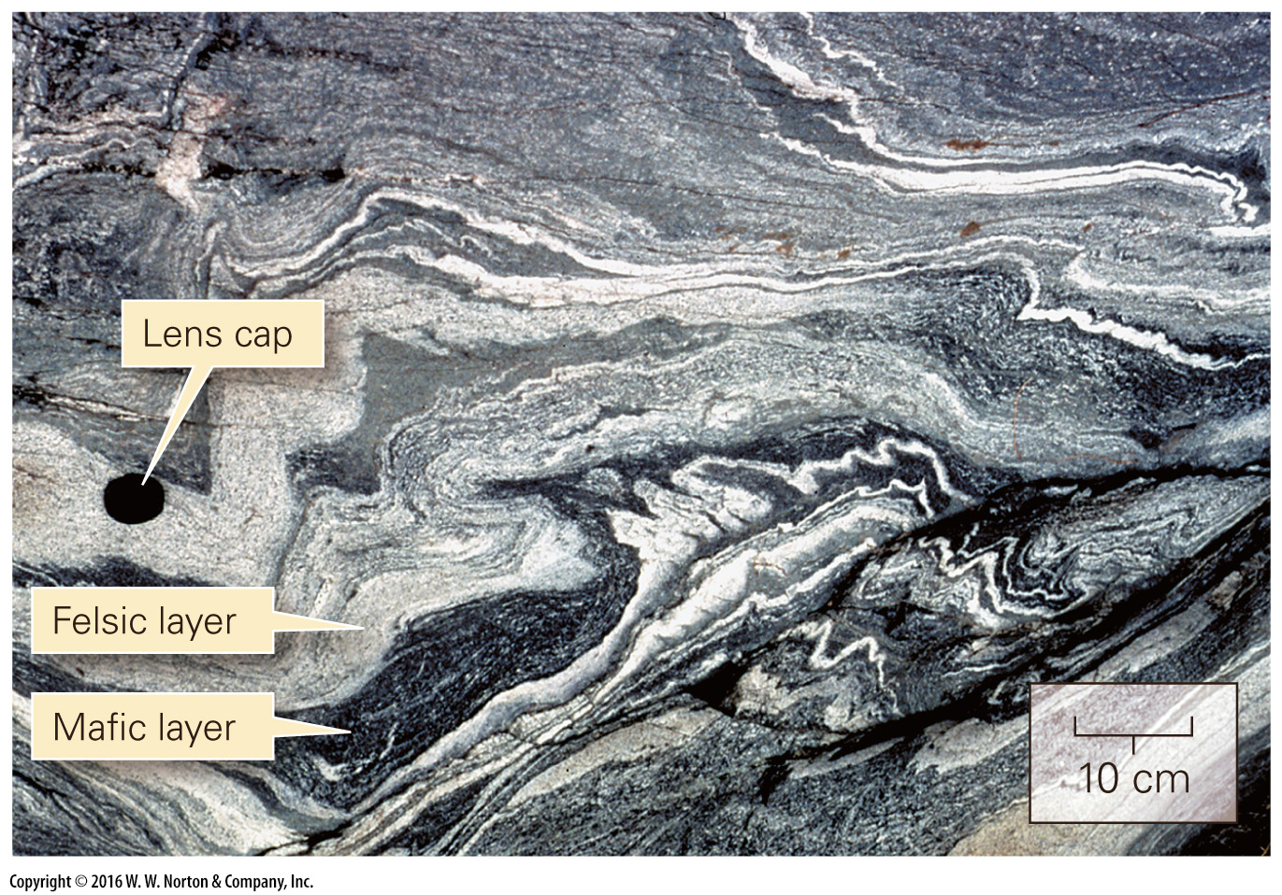
Notes:
FIGURE 7.6a The formation of gneiss, which takes place at very high temperatures and pressures.
(a) In this outcrop of gneiss in Brazil, some of the layers are only centimeters across.

Slide 22
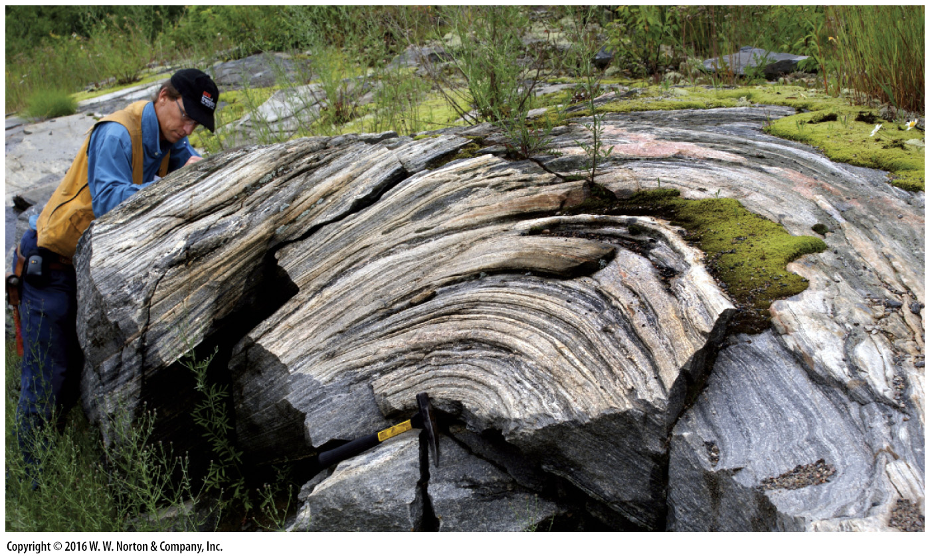
Notes:
FIGURE 7.6b The formation of gneiss, which takes place at very high temperatures and pressures.
(b) An outcrop of 2.7-billion-year-old metamorphic rock in Ontario, Canada, shows a distinct foliation, in this case defined by alternating bands of light and dark minerals.

Slide 23
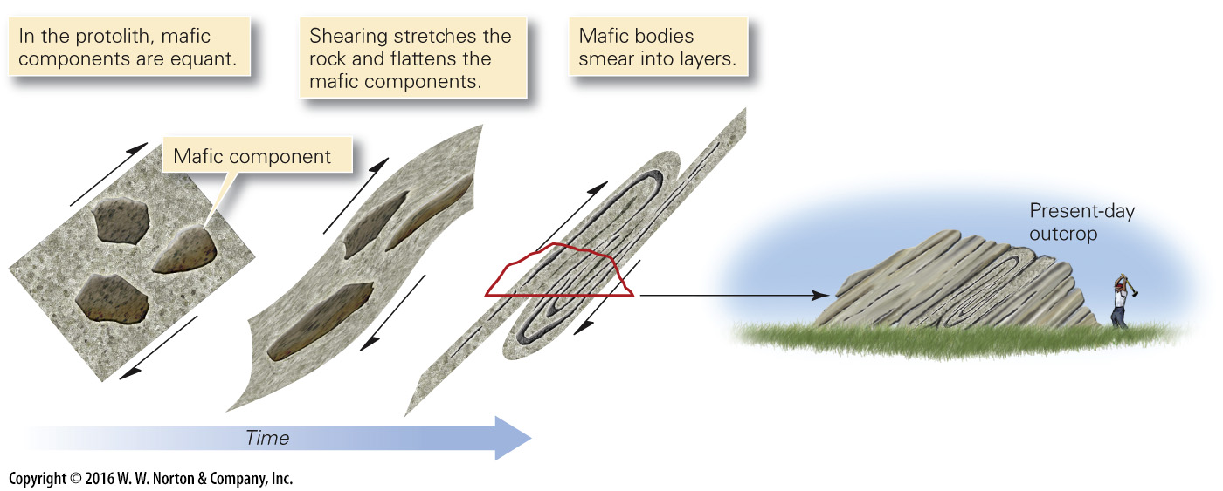
Notes:
FIGURE 7.6c The formation of gneiss, which takes place at very high temperatures and pressures.
(c) Formation of gneiss, in some cases, involves extreme shear. Original contrasting rock types are smeared into parallel layers.

Slide 24
Notes:
FIGURE 7.6d The formation of gneiss, which takes place at very high temperatures and pressures.
(d) Gneiss may also form by metamorphic differentiation, during which chemical reactions cause felsic and mafic minerals to grow in distinct, separate layers.

Slide 25
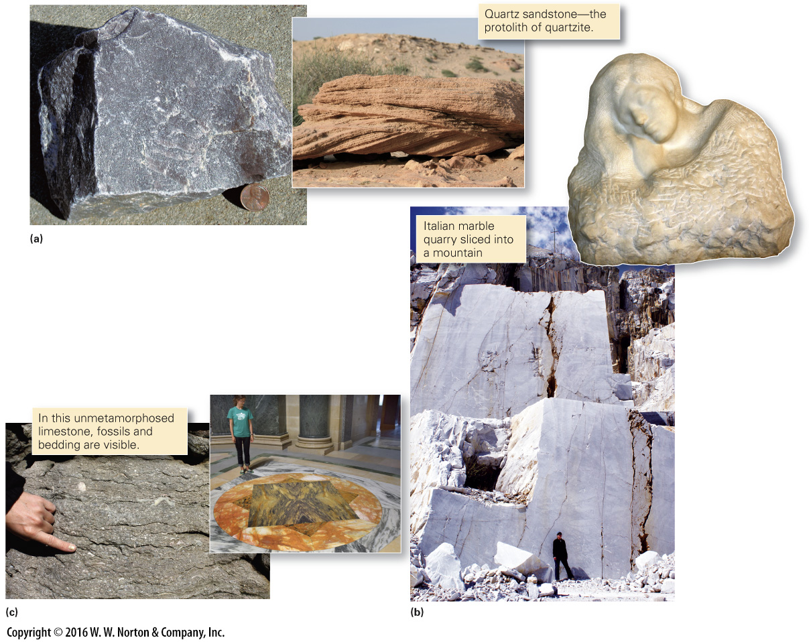
Notes:
FIGURE 7.7 Examples of quartzite and marble—typically, but not always, these are nonfoliated metamorphic rocks.
(a) This unfoliated maroon quartzite from Wisconsin breaks on smooth fractures that cut across grains. (b) Michelangelo used nonfoliated white marble for his spectacular sculptures. (c) This marble floor has color banding inherited from original bedding.

Slide 26
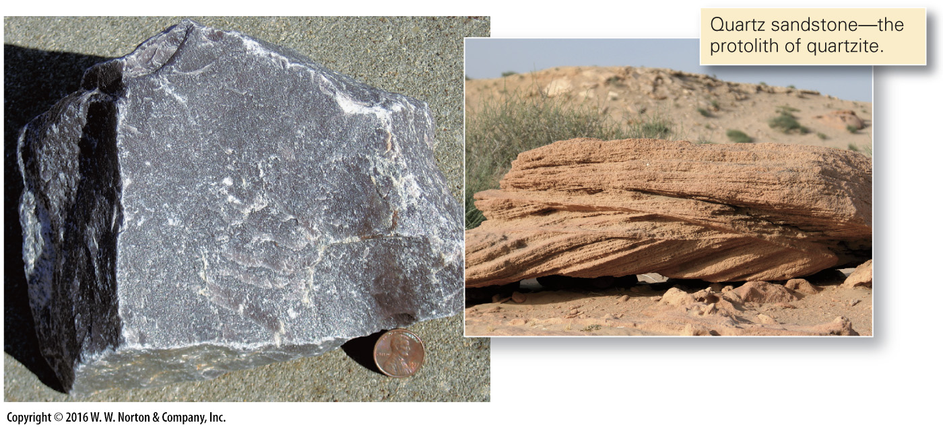
Notes:
FIGURE 7.7a Examples of quartzite and marble—typically, but not always, these are nonfoliated metamorphic rocks.
(a) This unfoliated maroon quartzite from Wisconsin breaks on smooth fractures that cut across grains.

Slide 27
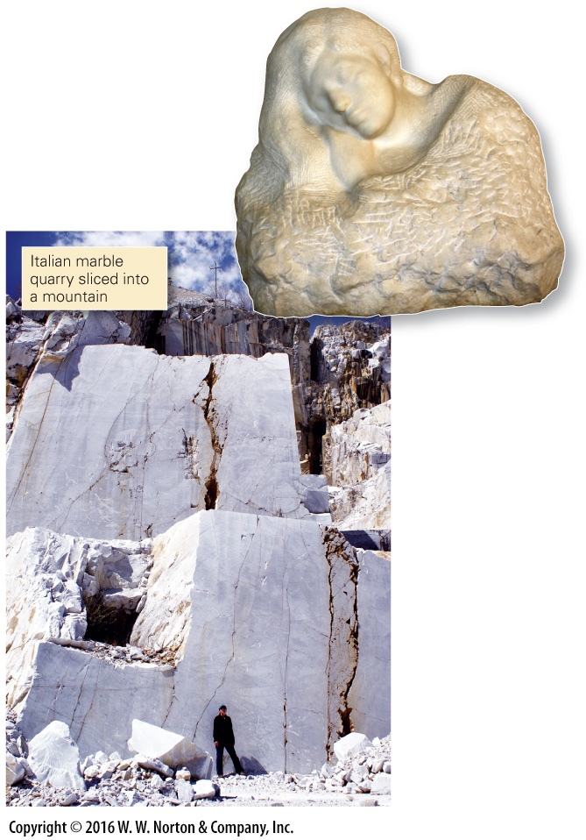
Notes:
FIGURE 7.7b Examples of quartzite and marble—typically, but not always, these are nonfoliated metamorphic rocks.
(b) Michelangelo used nonfoliated white marble for his spectacular sculptures.

Slide 28
Notes:
FIGURE 7.7c Examples of quartzite and marble—typically, but not always, these are nonfoliated metamorphic rocks.
(c) This marble floor has color banding inherited from original bedding.

Slide 29
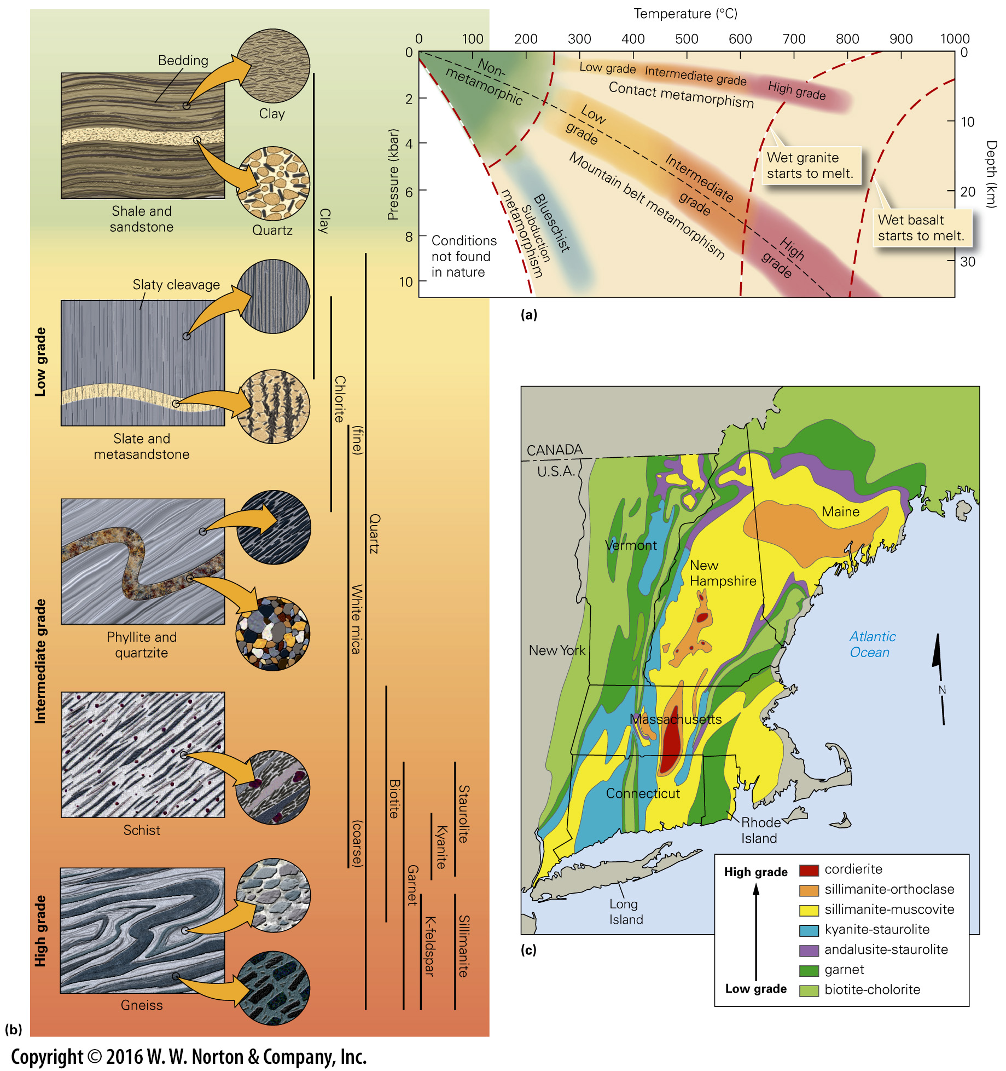
Notes:
FIGURE 7.8 Intensity of metamorphism is indicated by metamorphic grade.
(a) This graph depicts the approximate temperatures and pressures of metamorphic grades. Different conditions occur in different geologic settings. (b) Here we see the consequences of the progressive metamorphism of shale and sandstone from low grade to high grade during mountain building. Lines on the right indicate the range of grades in which key metamorphic minerals form. (c) Approximate metamorphic zones and isograds in the northeastern United States. The minerals listed are index minerals.

Slide 30
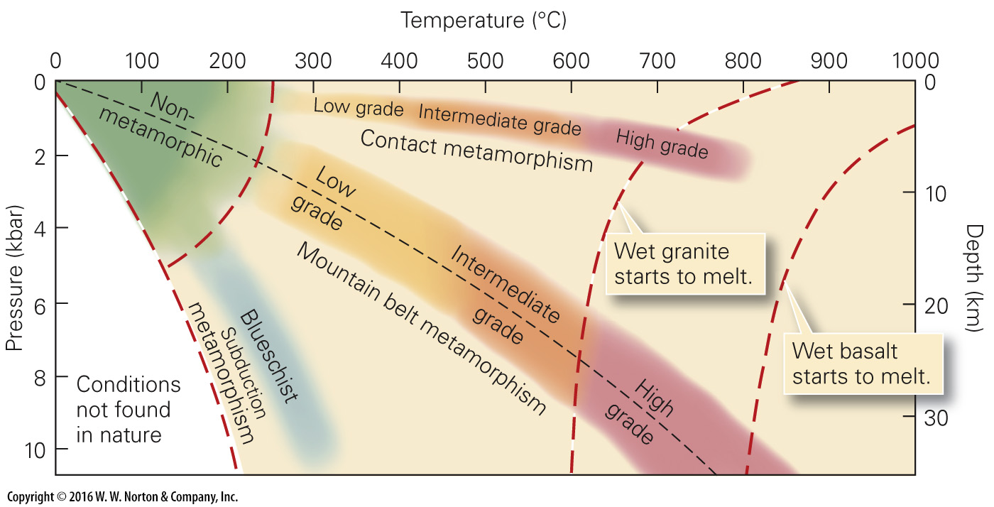
Notes:
FIGURE 7.8a Intensity of metamorphism is indicated by metamorphic grade.
(a) This graph depicts the approximate temperatures and pressures of metamorphic grades. Different conditions occur in different geologic settings.

Slide 31
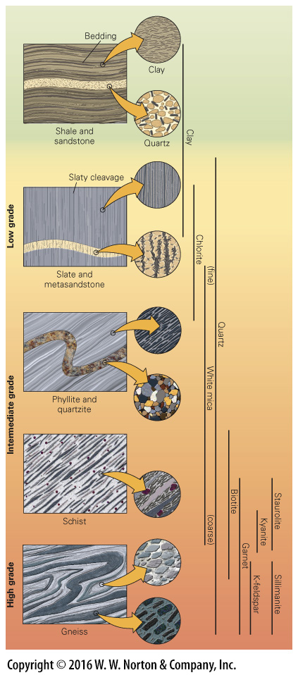
Notes:
FIGURE 7.8b Intensity of metamorphism is indicated by metamorphic grade.
(b) Here we see the consequences of the progressive metamorphism of shale and sandstone from low grade to high grade during mountain building. Lines on the right indicate the range of grades in which key metamorphic minerals form.

Slide 32
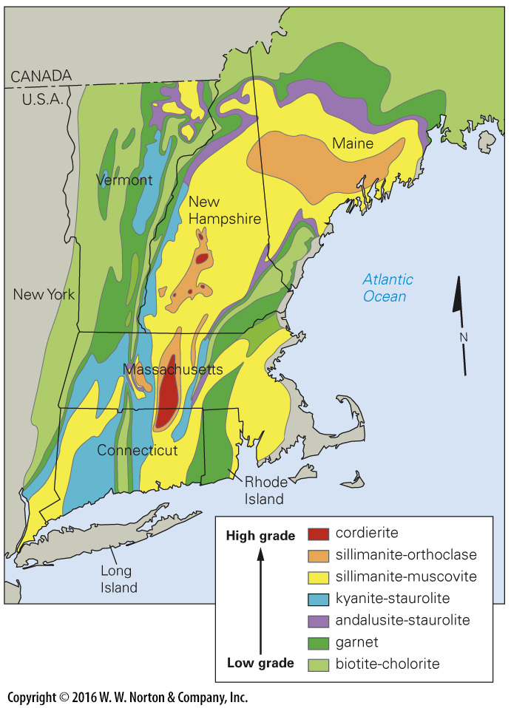
Notes:
FIGURE 7.8c Intensity of metamorphism is indicated by metamorphic grade.
(c) Approximate metamorphic zones and isograds in the northeastern United States. The minerals listed are index minerals.

Slide 33
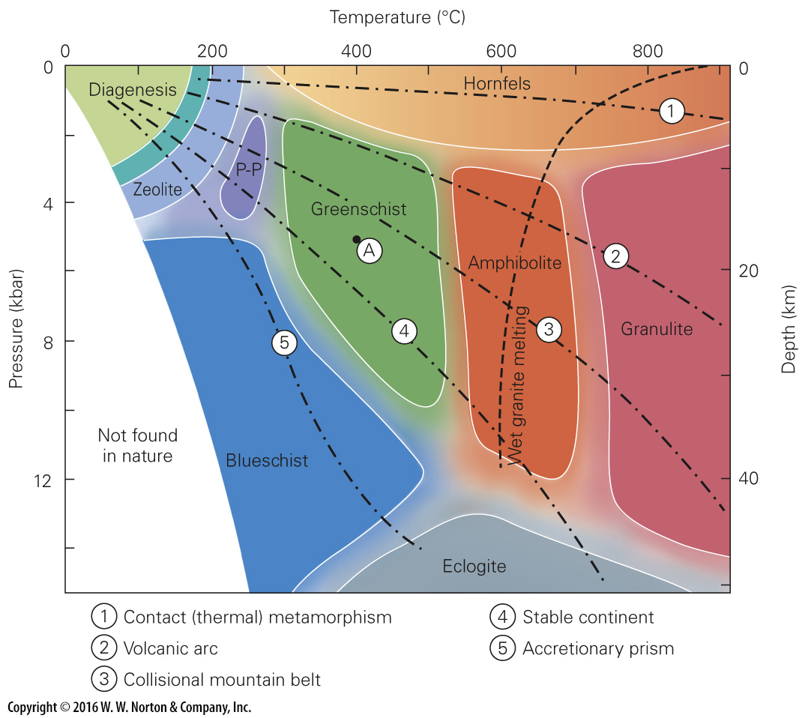
Notes:
FIGURE Bx7.1 The common metamorphic facies. The boundaries between the facies are depicted as wide bands because they are gradational and approximate. Note that some amphibolite-facies rocks and all granulite-facies rocks form at pressure-temperature conditions to the right of the melting curve for wet granite. Thus, such metamorphic rocks develop only if the protolith is dry. One of the facies depicted on the graph is not mentioned in the text: specifically, P-P (prehnite-pumpellyite) facies, named for two metamorphic minerals.

Slide 34
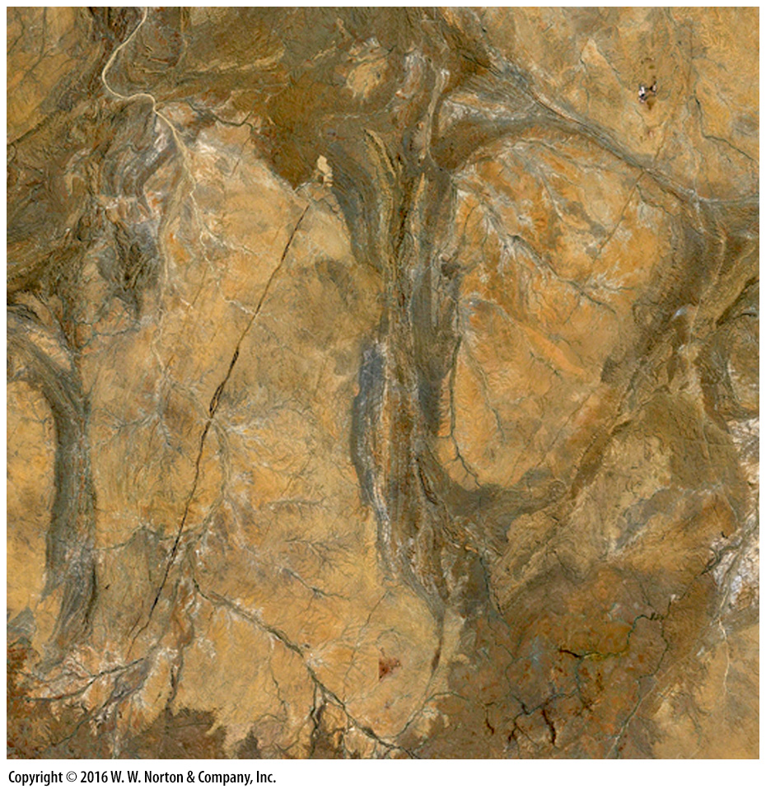
Notes:
SEE FOR YOURSELF…
PILBARA CRATON, WESTERN AUSTRALIA

Slide 35
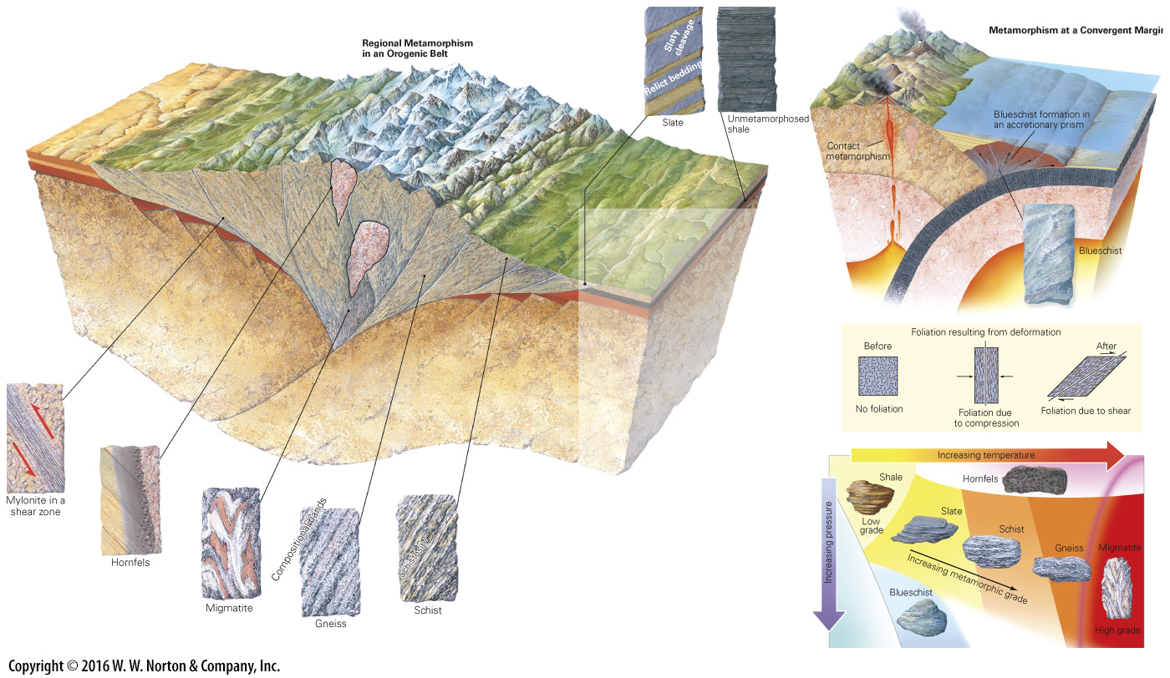
Notes:
GEOLOGY AT A GLANCE
Environments of Metamorphism

Slide 36
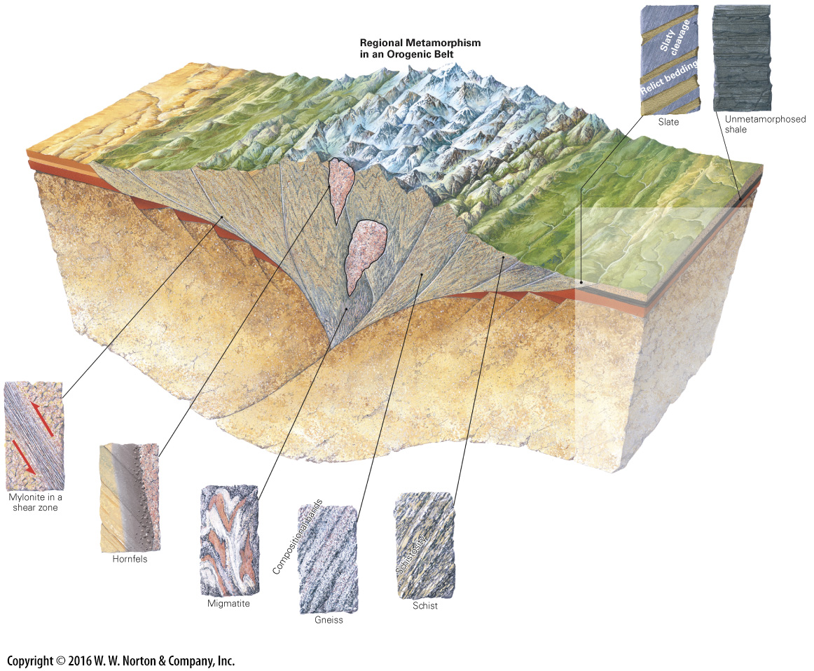
Notes:
GEOLOGY AT A GLANCE
Environments of Metamorphism

Slide 37
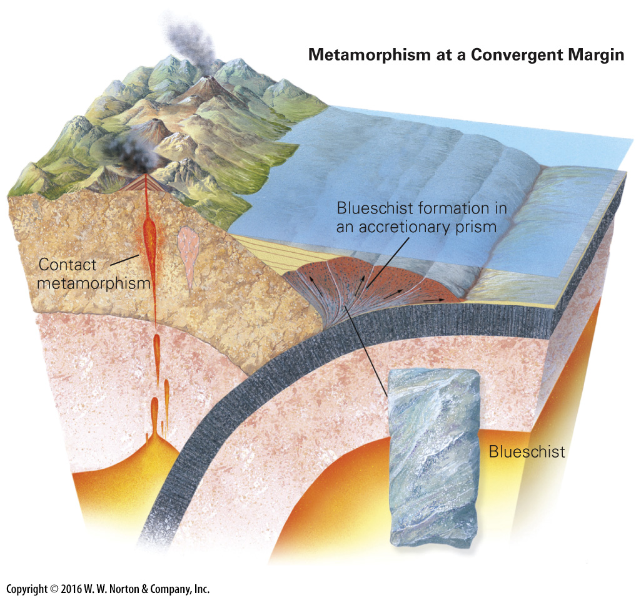
Notes:
GEOLOGY AT A GLANCE
Environments of Metamorphism

Slide 38
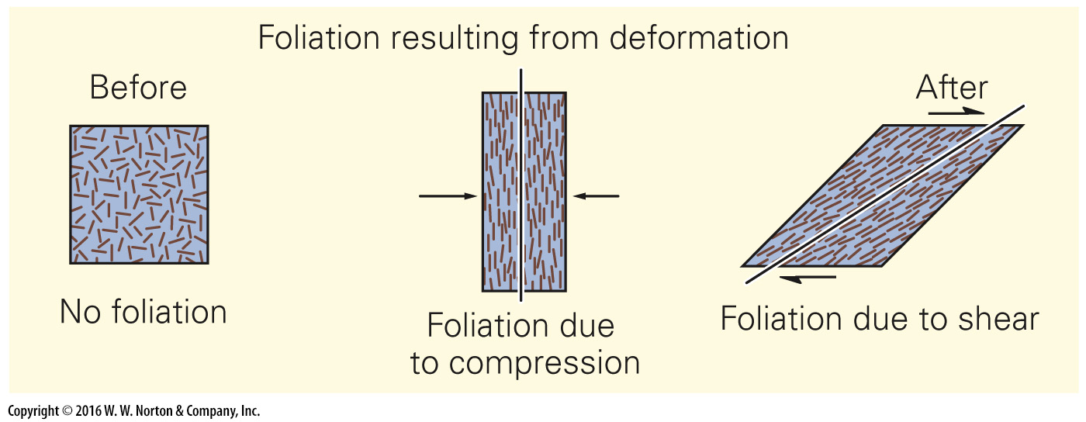
Notes:
GEOLOGY AT A GLANCE
Environments of Metamorphism

Slide 39
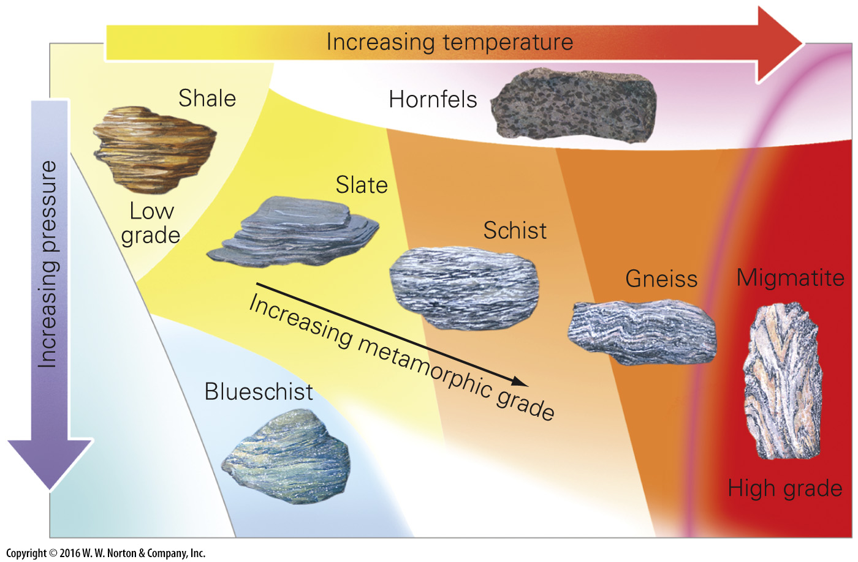
Notes:
GEOLOGY AT A GLANCE
Environments of Metamorphism

Slide 40
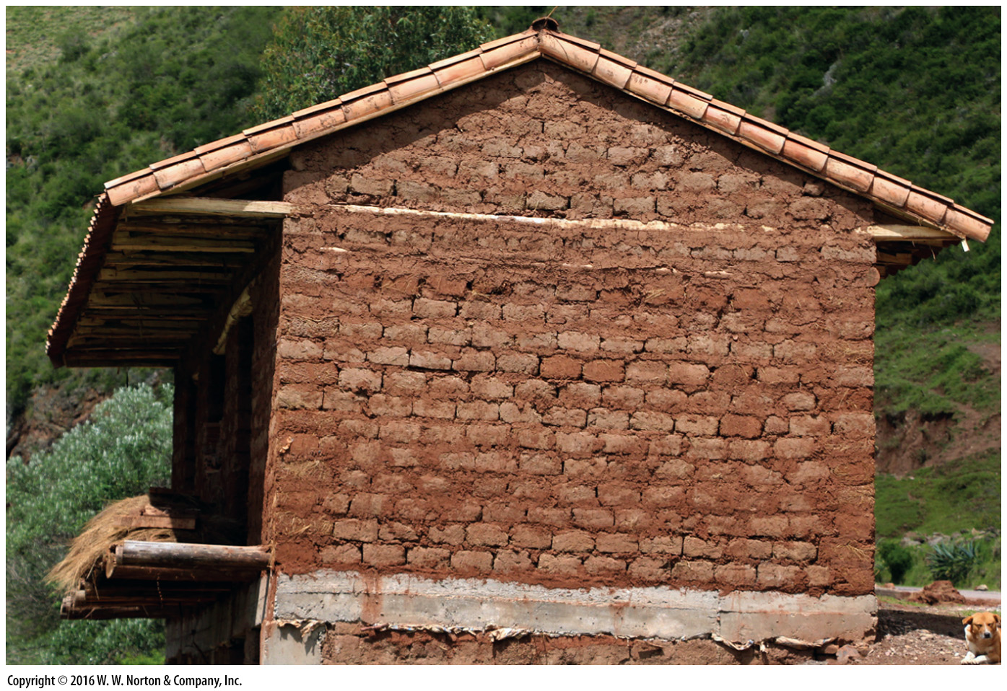
Notes:
FIGURE Bx7.2a When metamorphosed, common mud becomes stronger and more durable.
(a) Mud can be shaped into blocks that, when dried, were used to build this house in Peru.

Slide 41
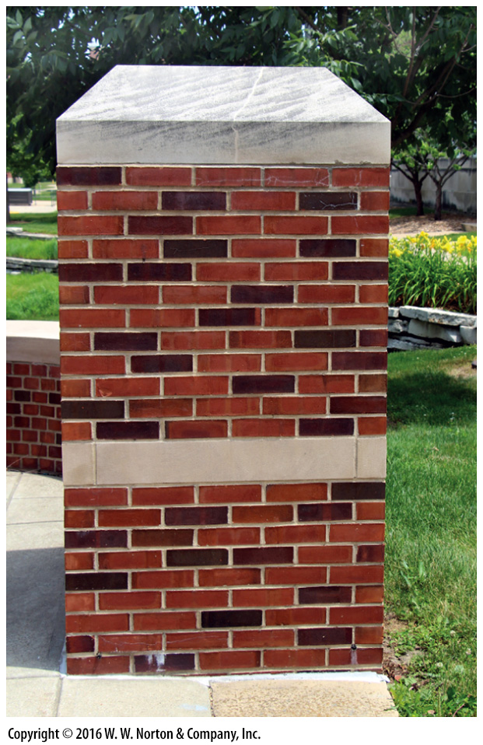
Notes:
FIGURE Bx7.2b When metamorphosed, common mud becomes stronger and more durable.
(b) Baking the mud turns it into much harder brick.

Slide 42
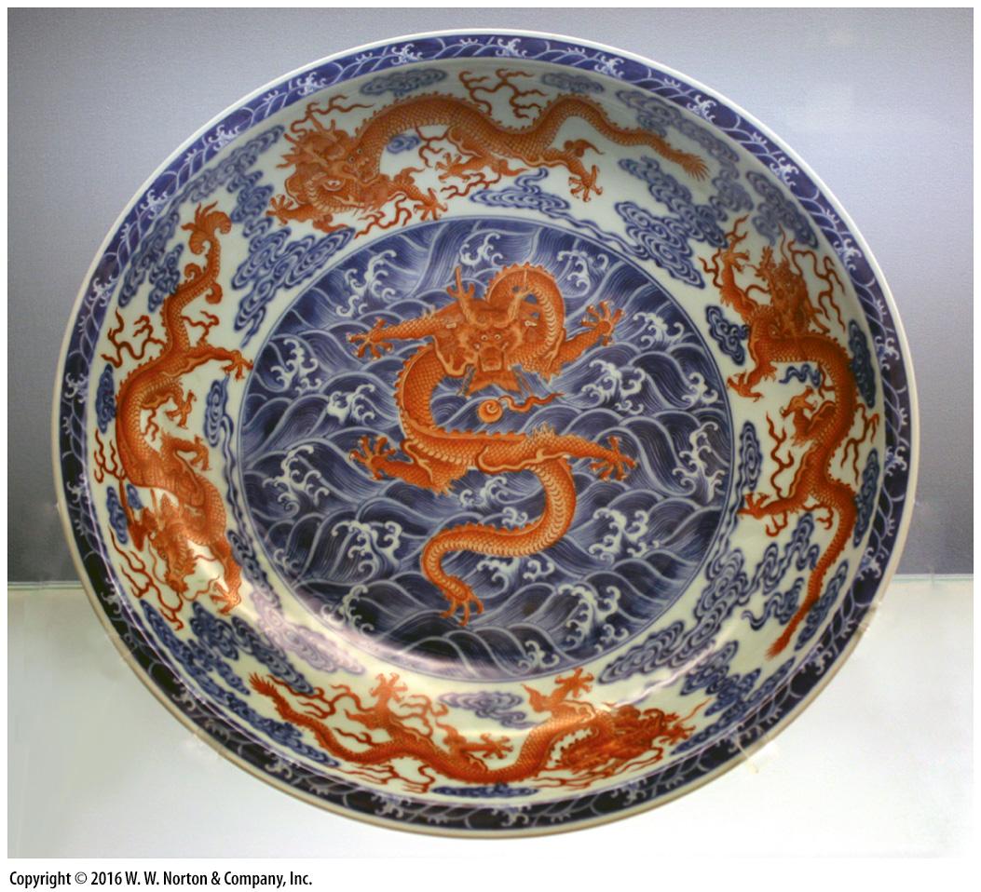
Notes:
FIGURE Bx7.2c When metamorphosed, common mud becomes stronger and more durable.
(c) At high temperatures, mud turns into porcelain, as in this plate from China.

Slide 43
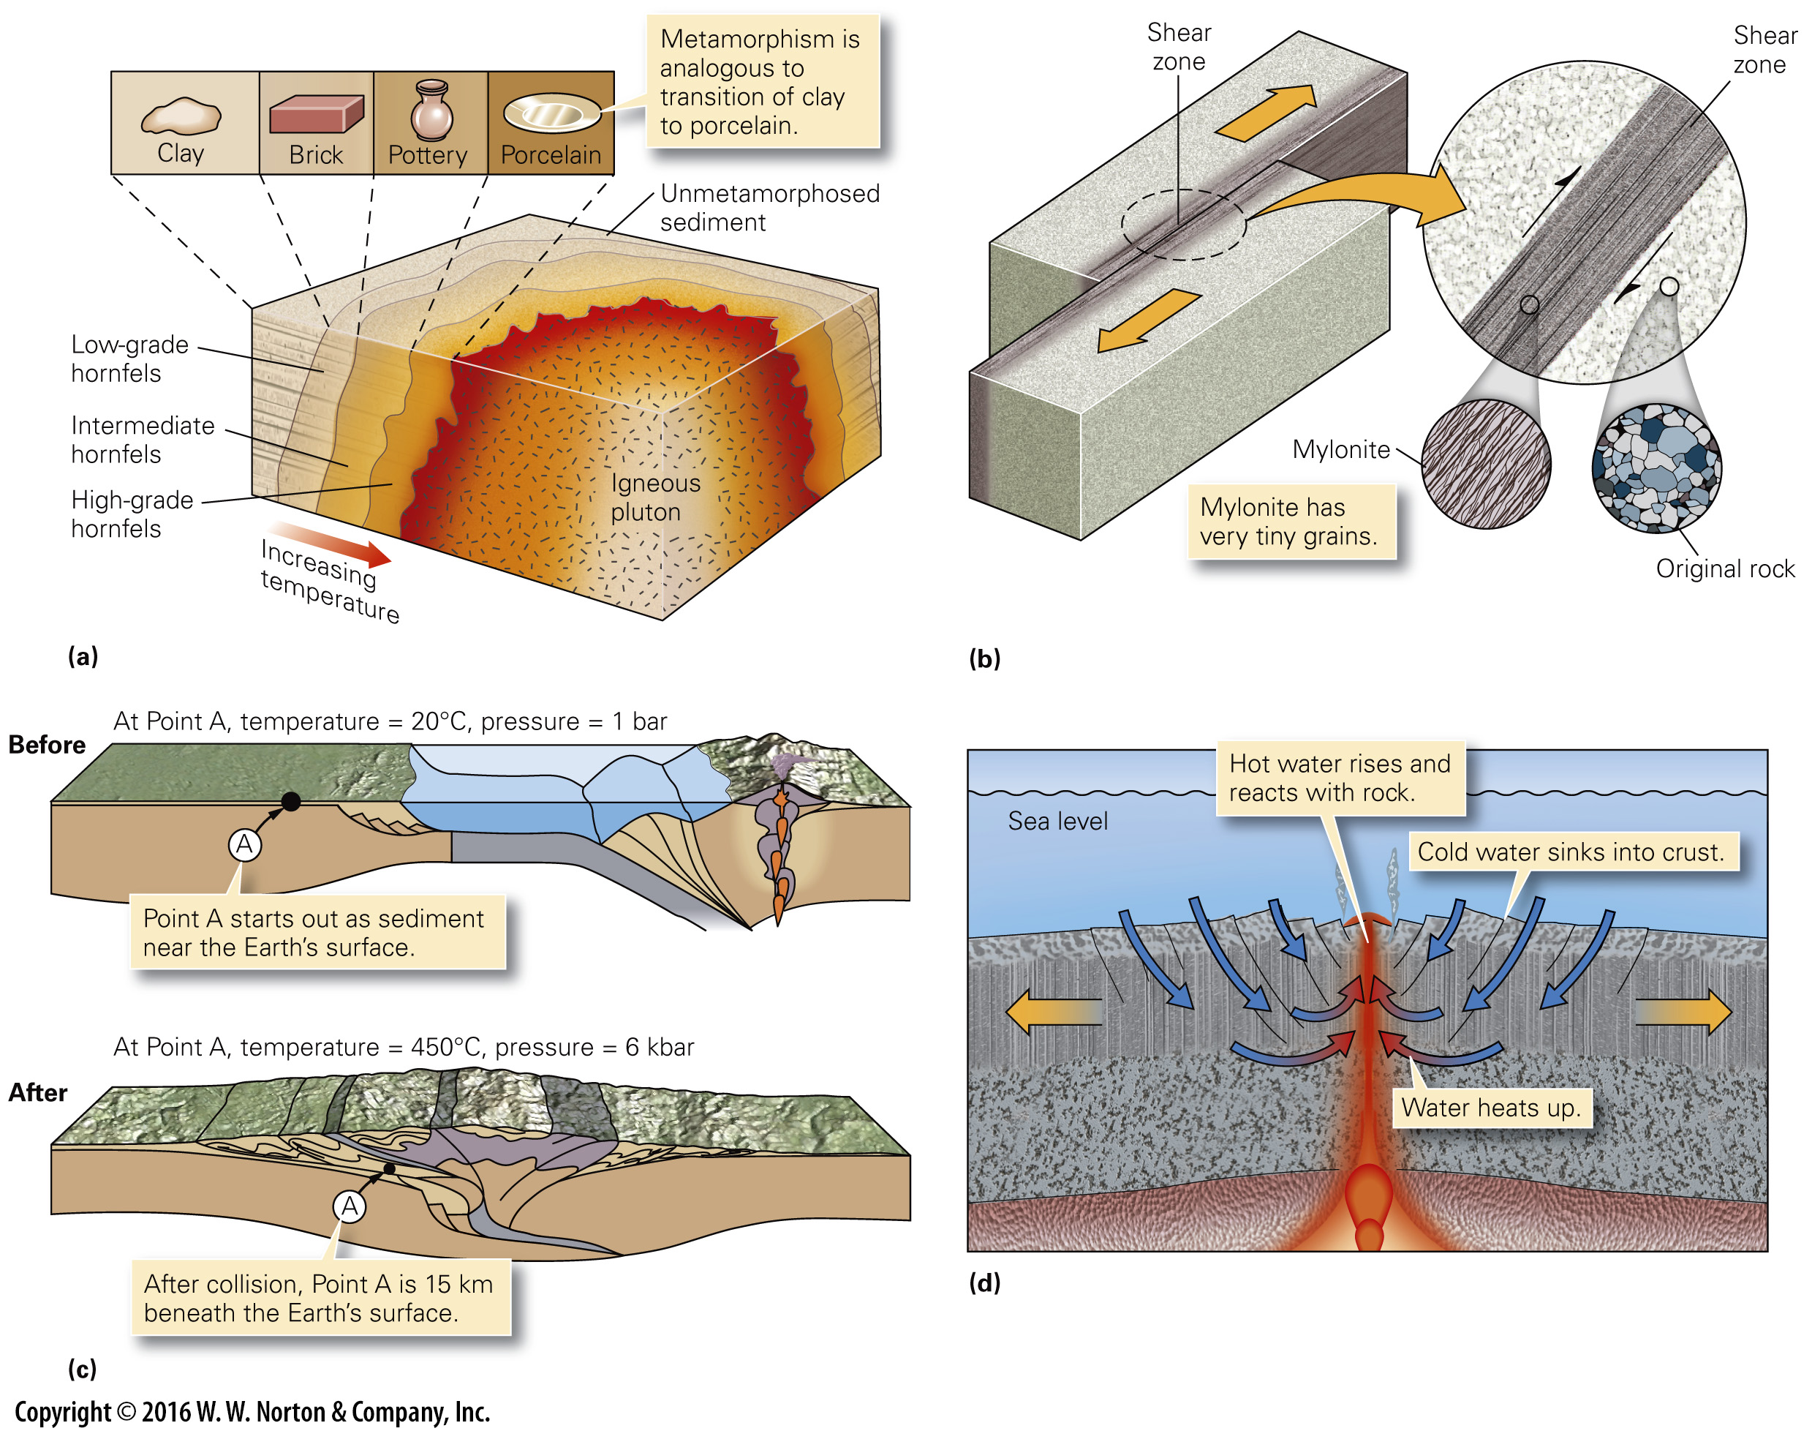
Notes:
FIGURE 7.9 Geologic settings of metamorphism.
(a) Heat radiated from a large pluton can produce a metamorphic aureole, in which hornfels develops. Grade decreases progressively away from the pluton contact. (b) Shearing of a rock under plastic conditions causes original crystals to divide into tiny crystals without breaking to form a mylonite. (c) Dynamothermal metamorphism happens when one part of the crust shoves over another part, so that rocks once near the surface end up at great depth. (d) The rising magma at a ridge axis heats water, which then convects. The hot water reacts with the crust and forms metamorphic minerals.

Slide 44
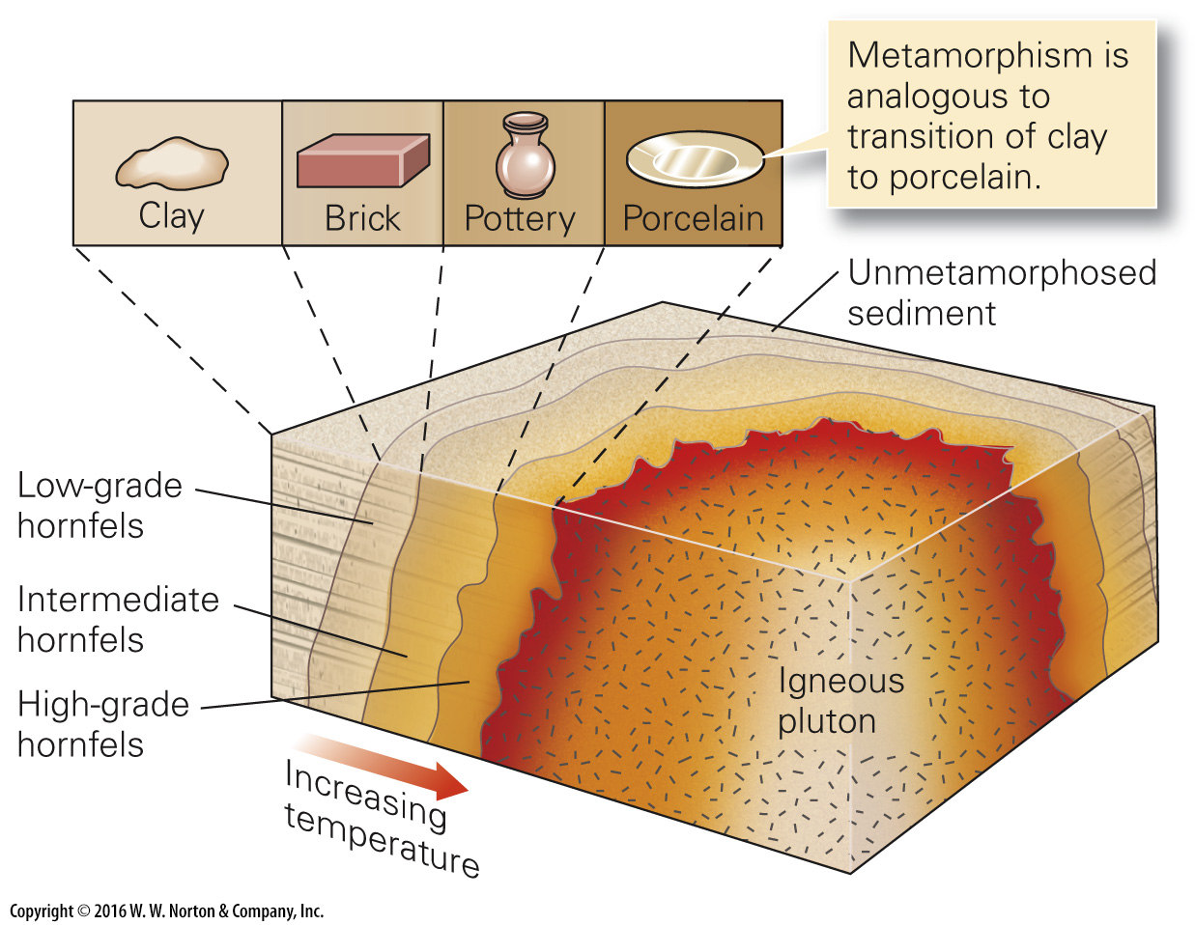
Notes:
FIGURE 7.9a Geologic settings of metamorphism.
(a) Heat radiated from a large pluton can produce a metamorphic aureole, in which hornfels develops. Grade decreases progressively away from the pluton contact.

Slide 45
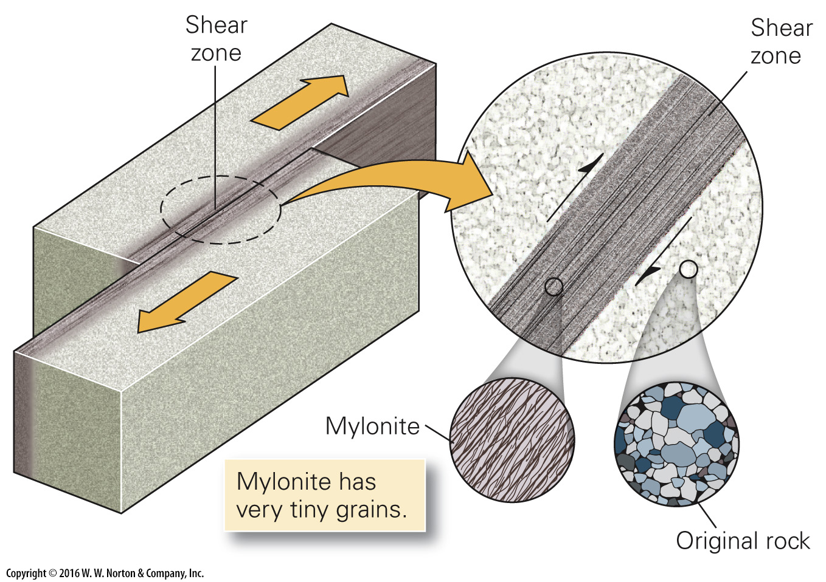
Notes:
FIGURE 7.9b Geologic settings of metamorphism.
(b) Shearing of a rock under plastic conditions causes original crystals to divide into tiny crystals without breaking to form a mylonite.

Slide 46
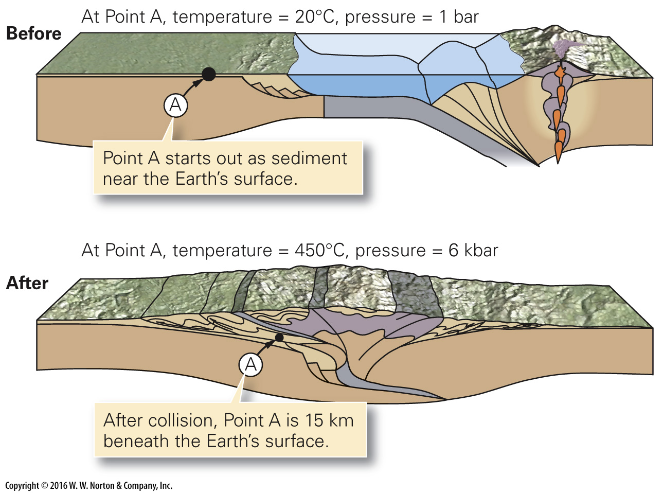
Notes:
FIGURE 7.9c Geologic settings of metamorphism.
(c) Dynamothermal metamorphism happens when one part of the crust shoves over another part, so that rocks once near the surface end up at great depth.

Slide 47
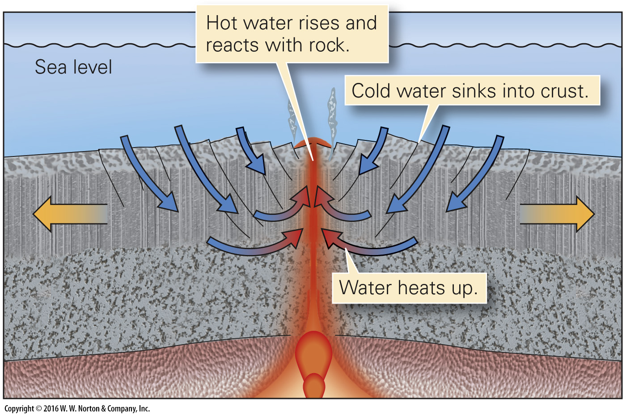
Notes:
FIGURE 7.9d Geologic settings of metamorphism.
(d) The rising magma at a ridge axis heats water, which then convects. The hot water reacts with the crust and forms metamorphic minerals.

Slide 48
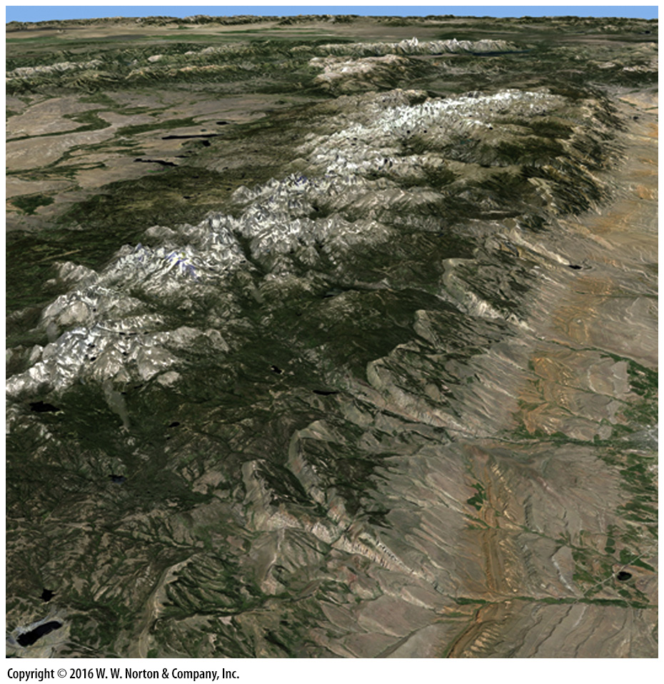
Notes:
SEE FOR YOURSELF…
WIND RIVER MOUNTAINS, WYOMING

Slide 49
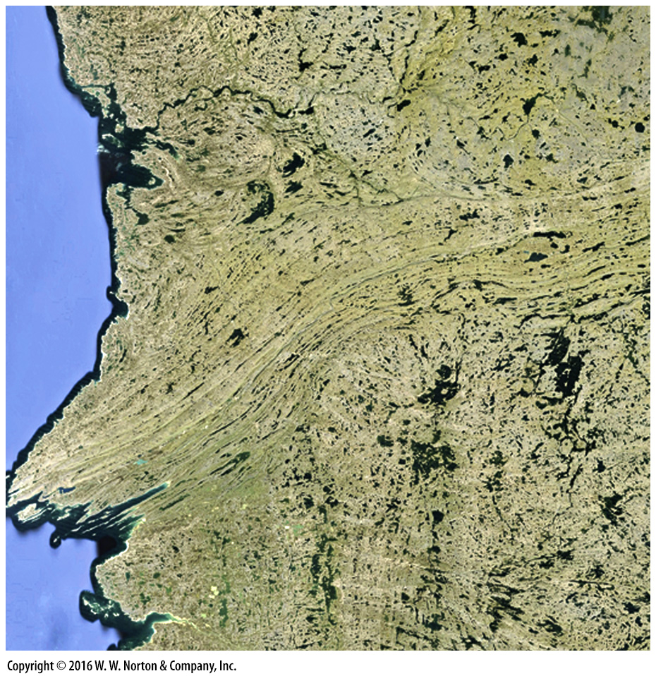
Notes:
SEE FOR YOURSELF…
CANADIAN SHIELD, EAST OF HUDSON BAY

Slide 50
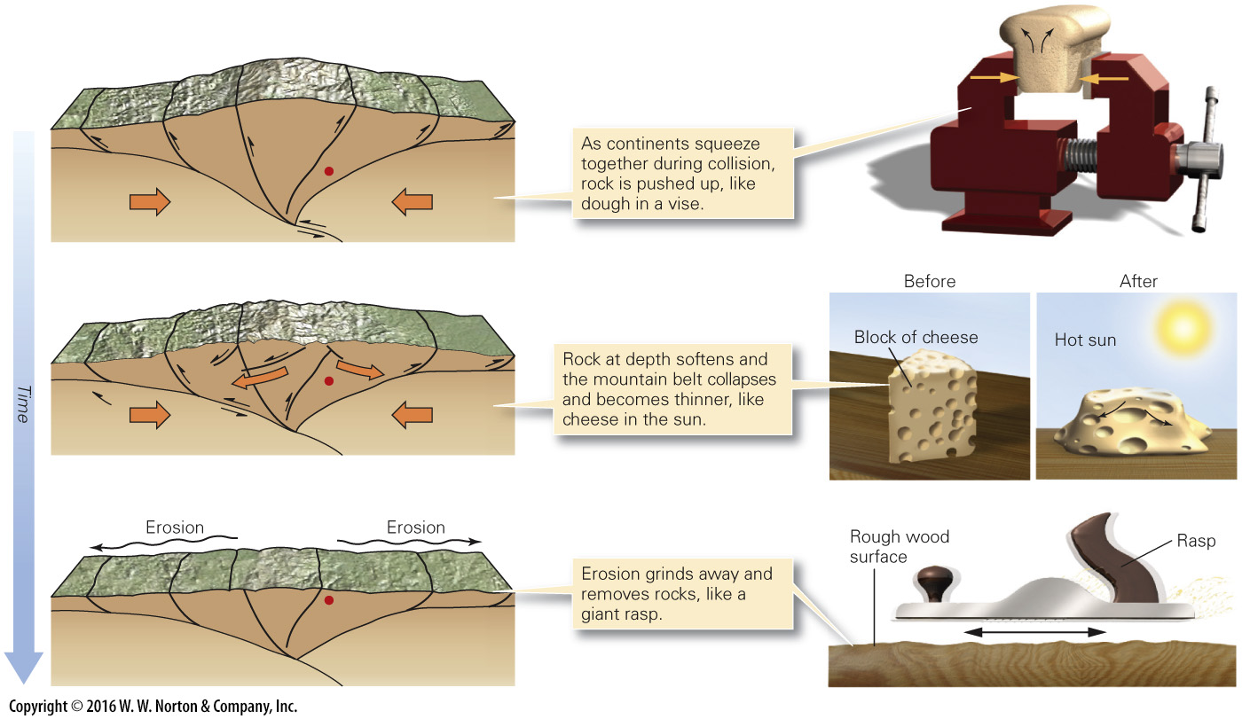
Notes:
FIGURE 7.10 Processes that bring metamorphic rock back to Earth’s surface. Three phenomena contribute to exhumation of rocks at depth. Here the red dot (representing metamorphic rocks formed at the base of a mountain range) gets progressively closer to the surface over time.

Slide 51
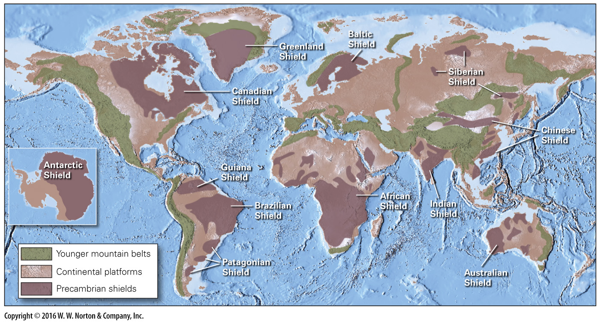
Notes:
FIGURE 7.11 A map showing the distribution of shields, areas where broad expanses of Precambrian crust, including Precambrian metamorphic rocks, crop out.

