Slide 1
Stephen Marshak
ESSENTIALS OF
Geology
FIFTH EDITION
Chapter 8
A Violent Pulse: Earthquakes
©2016 W. W. Norton & Company, Inc.

Slide 2
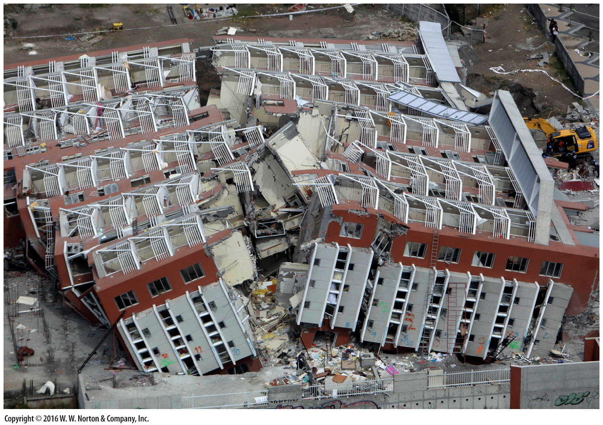
Notes:
A 20-story apartment building tipped over and broke in two during a major earthquake (magnitude 8.8) that struck Chile in 2010. Violent earthquakes, which are inevitable on our dynamic planet, can have catastrophic consequences.

Slide 3
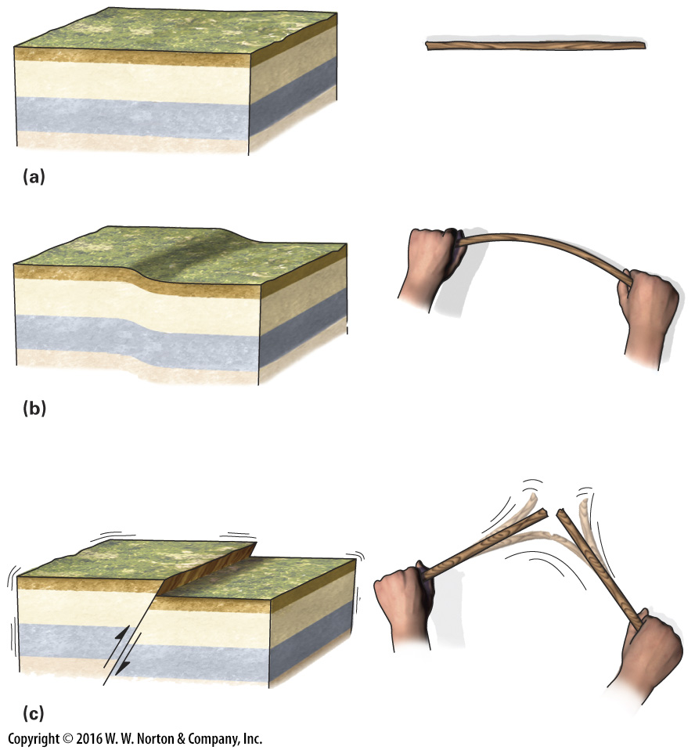
Notes:
FIGURE 8.1 What happens during an earthquake?
(a) Before deformation, rock layers in this example are not bent. (b) Before an earthquake, rock bends elastically, like a stick that you arch between your hands. The drawing exaggerates the amount of bending. (c) Eventually, the rock breaks, and sliding suddenly occurs on a fault. This break generates vibrations. You feel such vibrations when you break a stick.

Slide 4
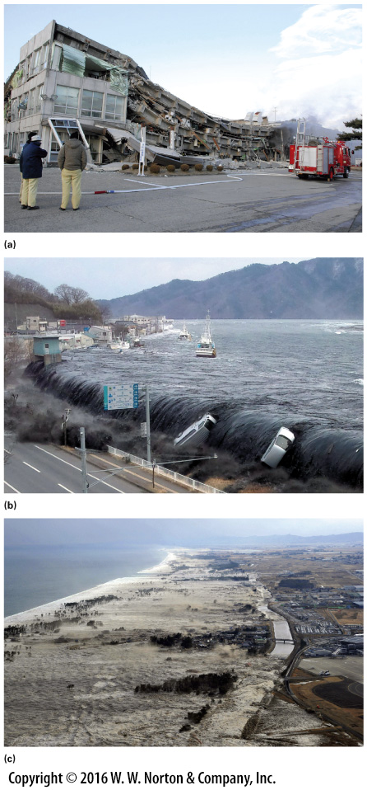
Notes:
FIGURE 8.2 The great Tōhoku earthquake and tsunami in Japan, 2011.
(a) Some buildings collapsed due to ground shaking. (b) The tsunami filled harbors and spilled over sea walls. (c) The tsunami washed over low coastal areas. In this photograph, the wave is moving from left to right and is just washing over a canal.

Slide 5
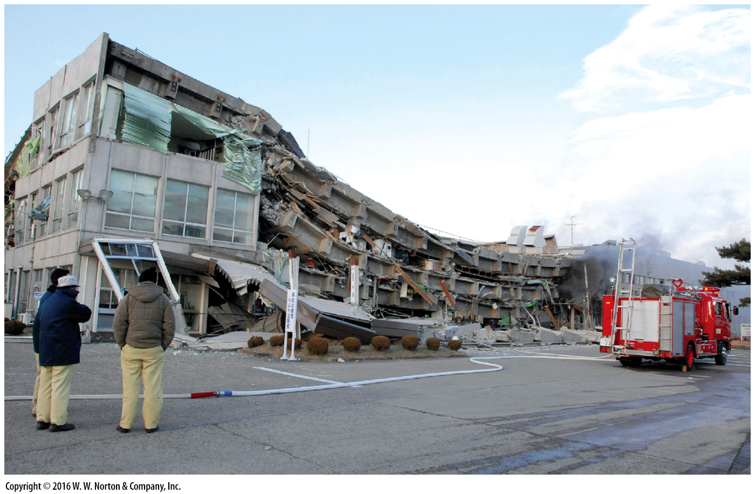
Notes:
FIGURE 8.2a The great Tōhoku earthquake and tsunami in Japan, 2011.
(a) Some buildings collapsed due to ground shaking.

Slide 6
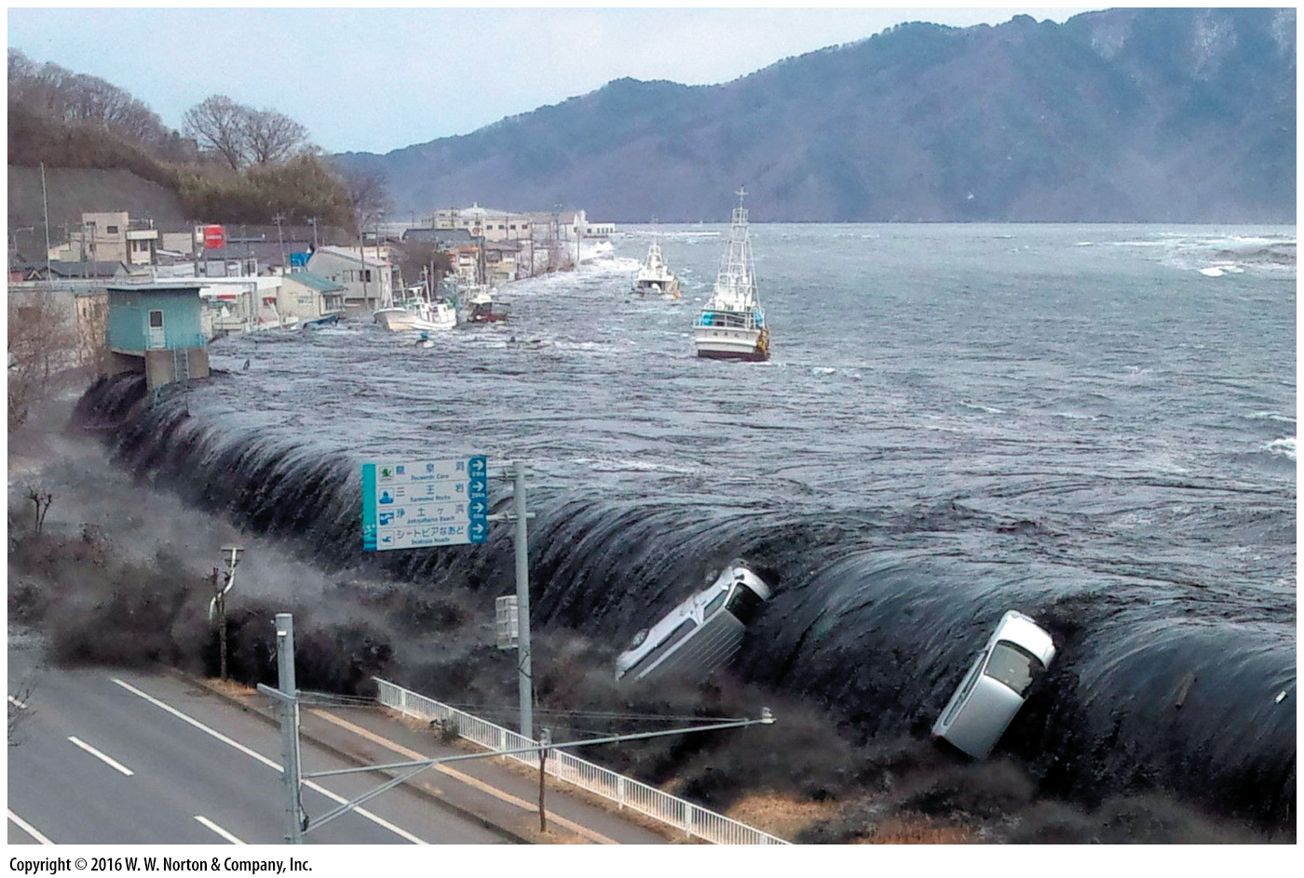
Notes:
FIGURE 8.2b The great Tōhoku earthquake and tsunami in Japan, 2011.
(b) The tsunami filled harbors and spilled over sea walls.

Slide 7
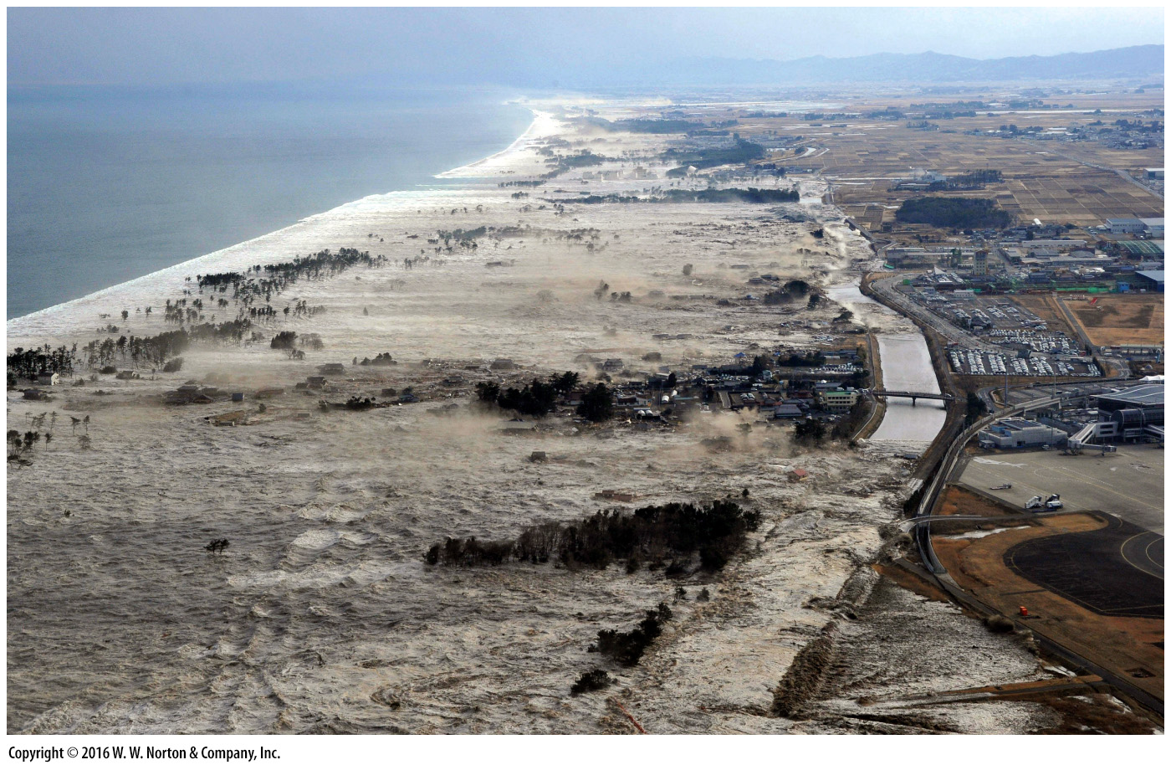
Notes:
FIGURE 8.2c The great Tōhoku earthquake and tsunami in Japan, 2011.
(c) The tsunami washed over low coastal areas. In this photograph, the wave is moving from left to right and is just washing over a canal.

Slide 8
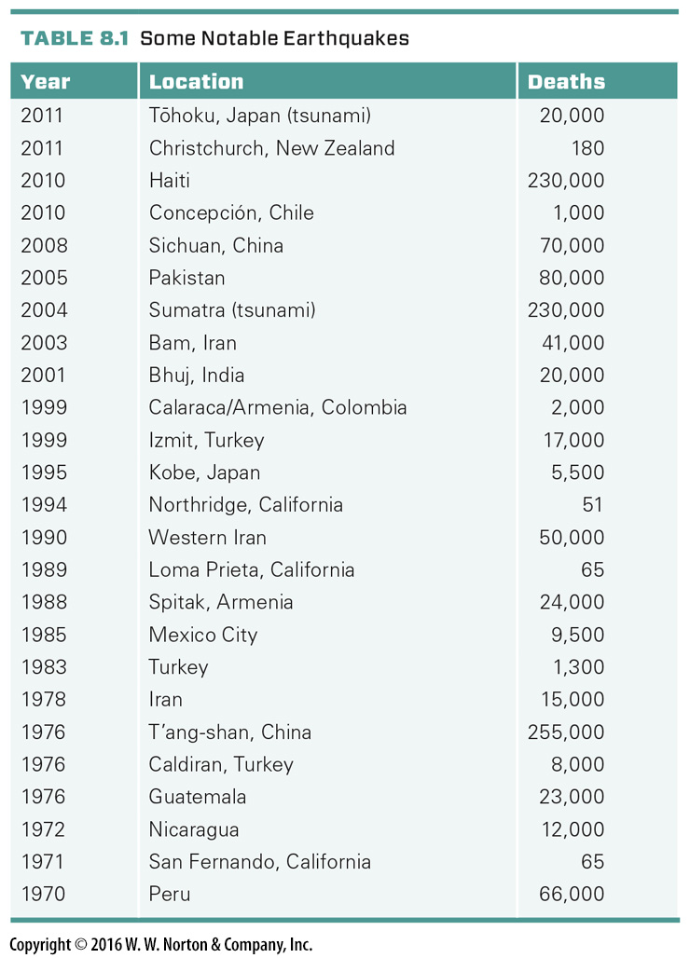
Notes:
TABLE 8.1 Some Notable Earthquakes

Slide 9
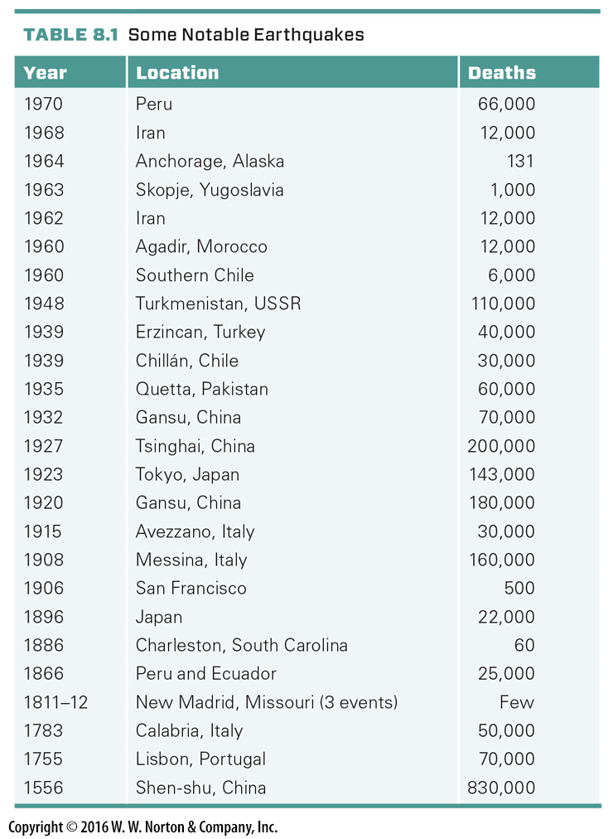
Notes:
TABLE 8.1 Some Notable Earthquakes

Slide 10
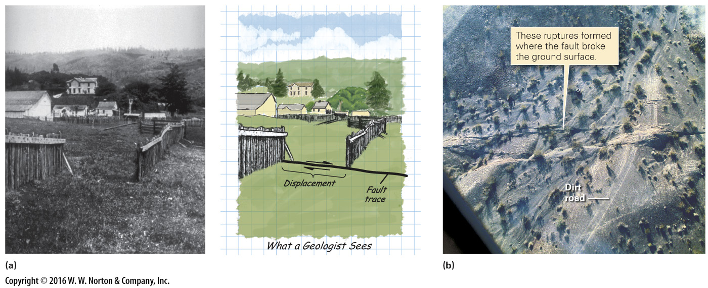
Notes:
FIGURE 8.3 Examples of fault displacement on the San Andreas fault in California.
(a) A wooden fence built across the fault was offset during the 1906 San Francisco earthquake. The displacement indicates that the motion was strike slip. (b) An aerial photograph shows offset of a dirt road by slip on the fault in 1999.

Slide 11
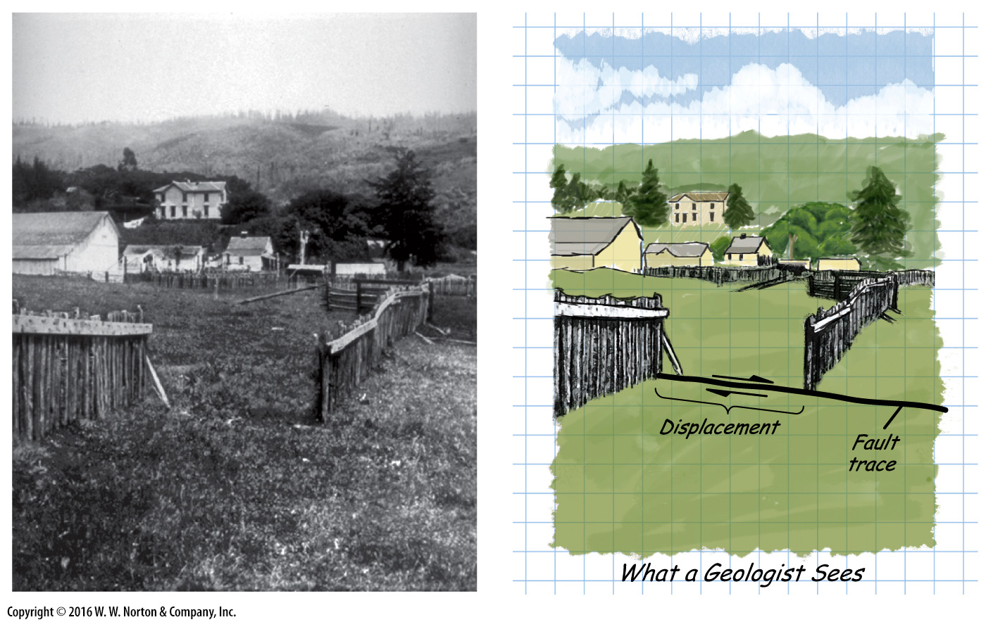
Notes:
FIGURE 8.3a Examples of fault displacement on the San Andreas fault in California.
(a) A wooden fence built across the fault was offset during the 1906 San Francisco earthquake. The displacement indicates that the motion was strike slip.

Slide 12
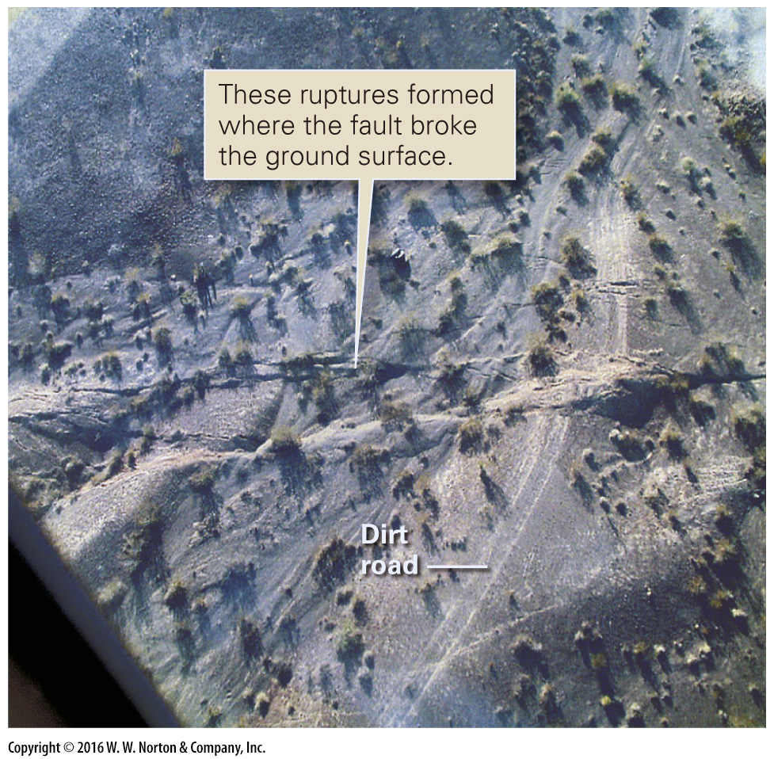
Notes:
FIGURE 8.3b Examples of fault displacement on the San Andreas fault in California.
(b) An aerial photograph shows offset of a dirt road by slip on the fault in 1999.

Slide 13
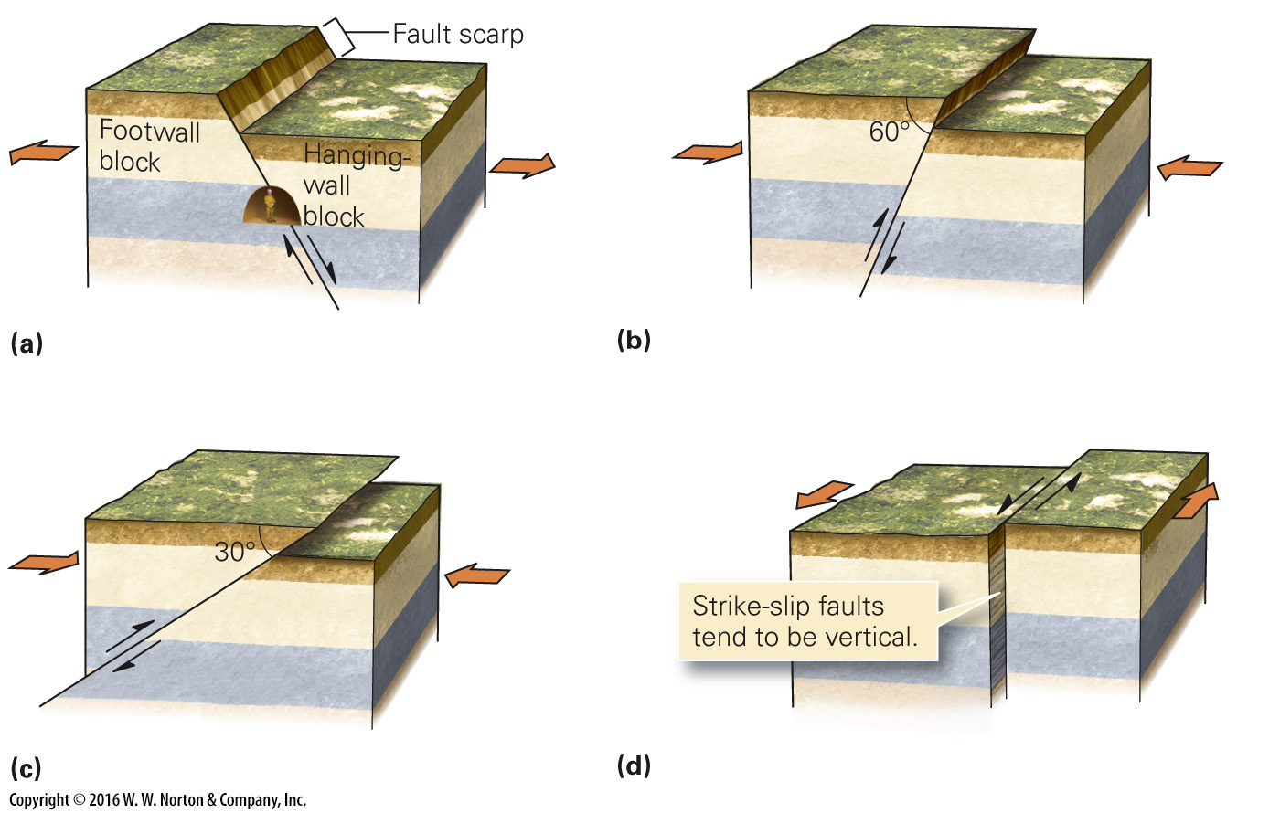
Notes:
FIGURE 8.4 The basic types of faults. Fault types are distinguished from one another by the direction of slip relative to the fault surface.
(a) Normal faults form during extension of the crust. The hanging wall moves down. (b) Reverse faults form during shortening of the crust. The hanging wall moves up and the fault is steep. (c) Thrust faults also form during shortening. The fault’s slope is gentle (less than 30°). (d) On a strike-slip fault, one block slides laterally past another, so no vertical displacement takes place.

Slide 14
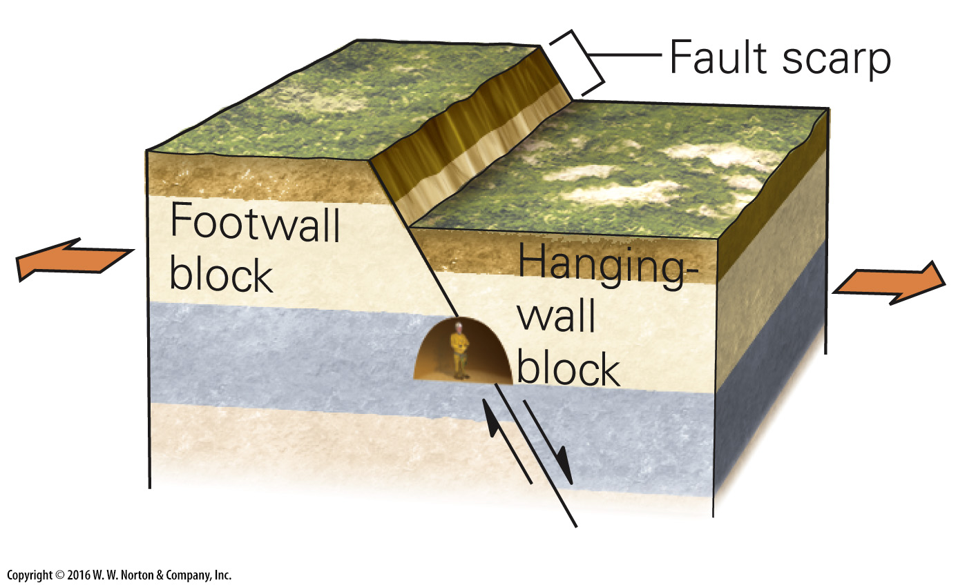
Notes:
FIGURE 8.4a The basic types of faults. Fault types are distinguished from one another by the direction of slip relative to the fault surface.
(a) Normal faults form during extension of the crust. The hanging wall moves down.

Slide 15
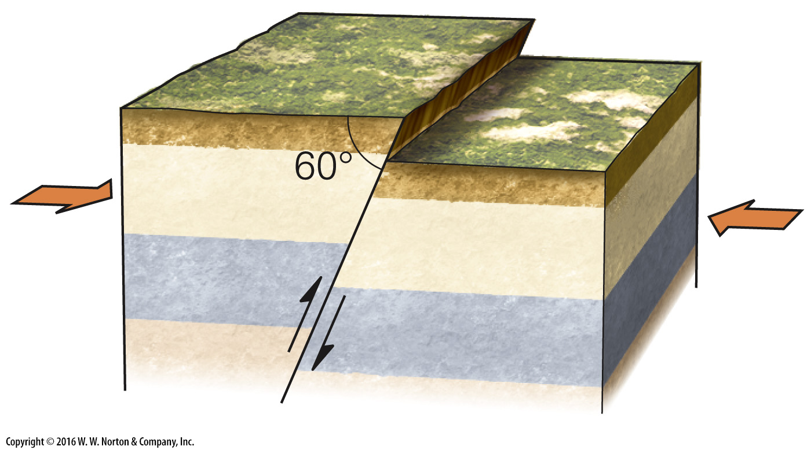
Notes:
FIGURE 8.4b The basic types of faults. Fault types are distinguished from one another by the direction of slip relative to the fault surface.
(b) Reverse faults form during shortening of the crust. The hanging wall moves up and the fault is steep.

Slide 16
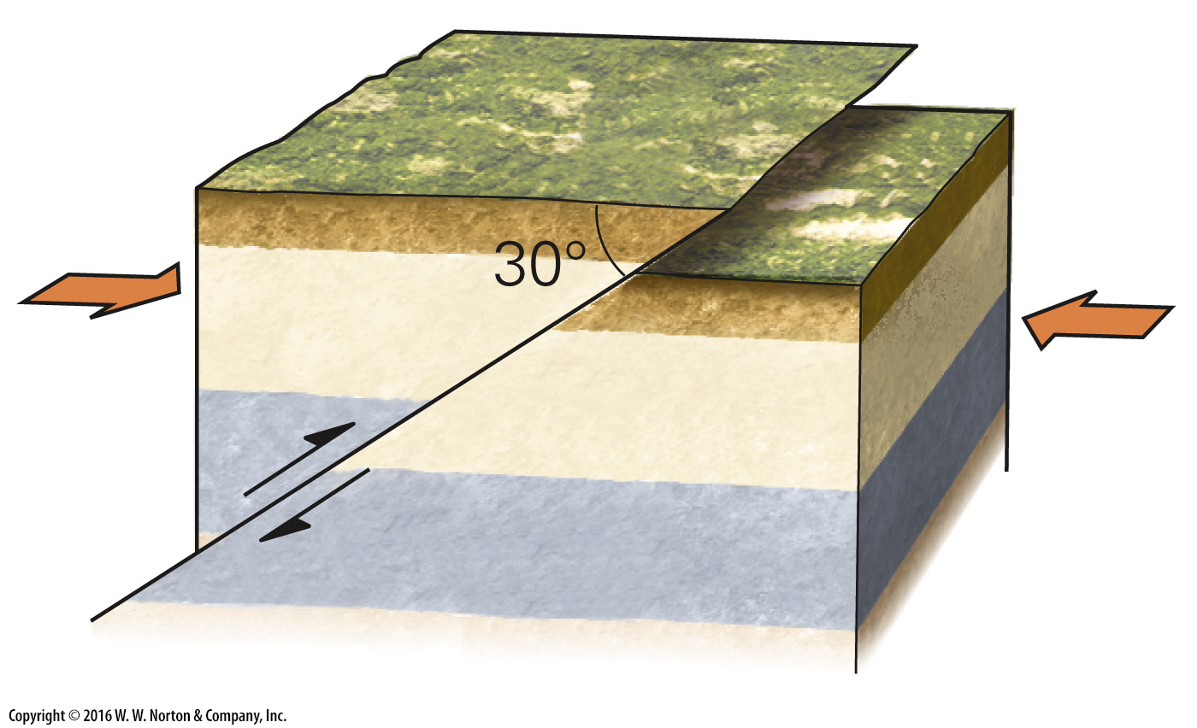
Notes:
FIGURE 8.4c The basic types of faults. Fault types are distinguished from one another by the direction of slip relative to the fault surface.
(c) Thrust faults also form during shortening. The fault’s slope is gentle (less than 30°).

Slide 17
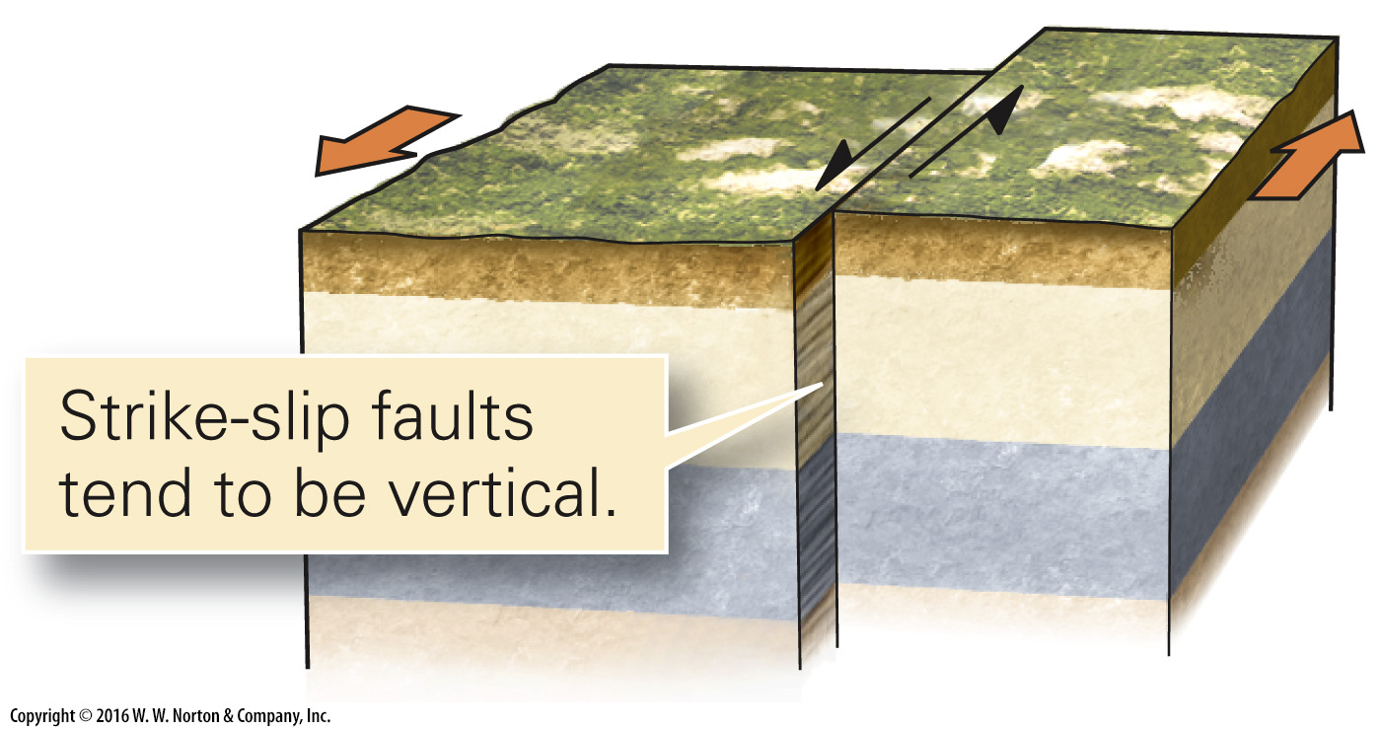
Notes:
FIGURE 8.4d The basic types of faults. Fault types are distinguished from one another by the direction of slip relative to the fault surface.
(d) On a strike-slip fault, one block slides laterally past another, so no vertical displacement takes place.

Slide 18
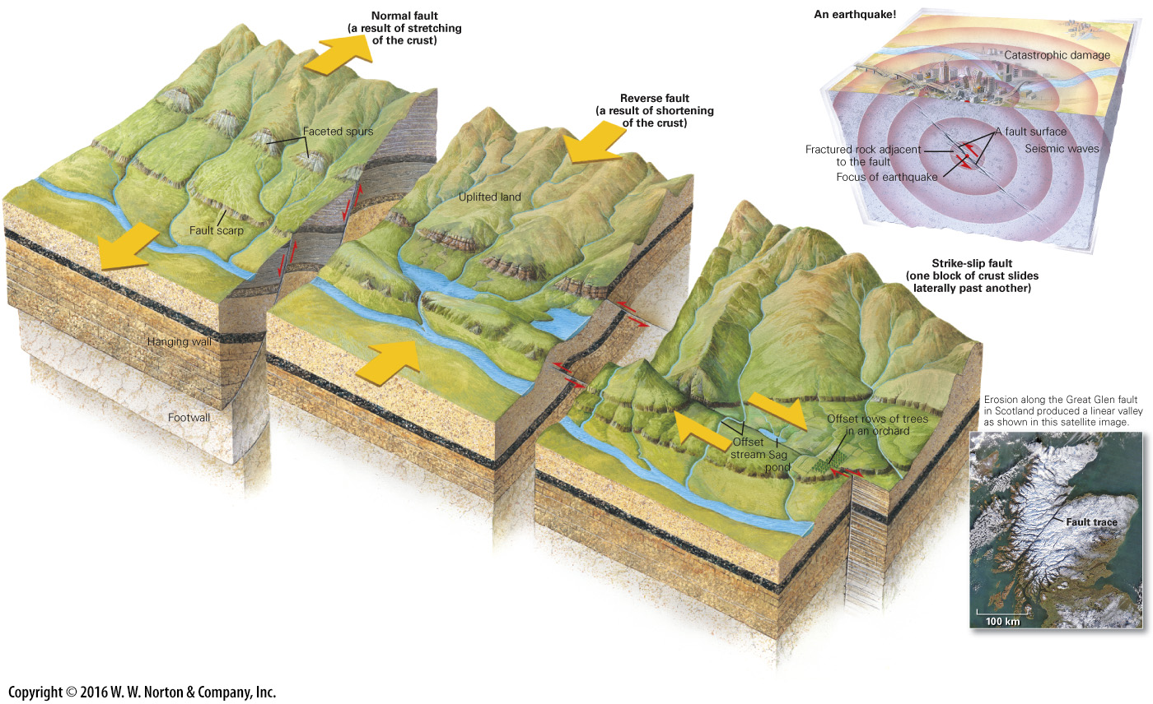
Notes:
GEOLOGY AT A GLANCE
Faulting in the Crust

Slide 19
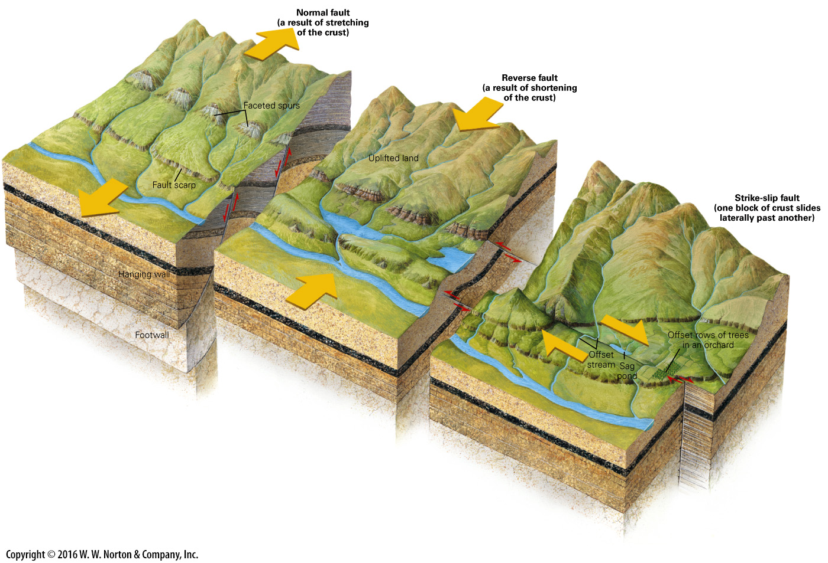
Notes:
GEOLOGY AT A GLANCE
Faulting in the Crust

Slide 20
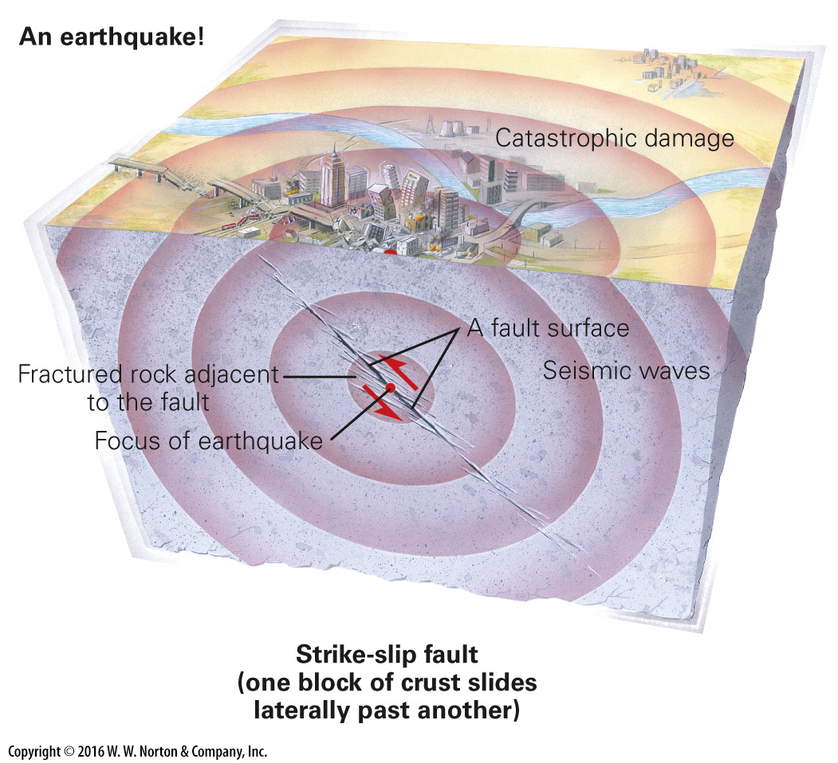
Notes:
GEOLOGY AT A GLANCE
Faulting in the Crust

Slide 21
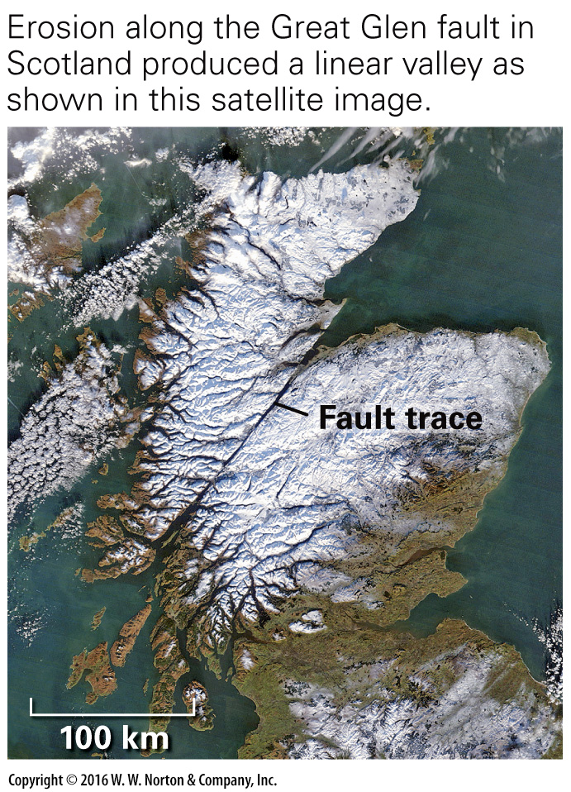
Notes:
GEOLOGY AT A GLANCE
Faulting in the Crust

Slide 22
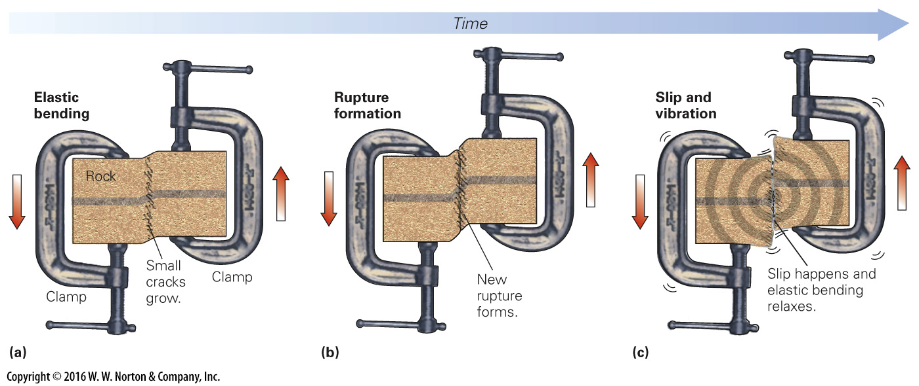
Notes:
FIGURE 8.5 A model representing the development of a new fault. Rupturing can generate earthquake-like vibrations.
(a) Imagine a block of rock gripped by two clamps. Move one clamp up, and the rock starts to bend. Small cracks develop along the bend. (b) Eventually, the cracks link. When this happens, a throughgoing rupture forms. (c) The instant that the rupture forms, the rock breaks into two pieces that slide past each other. The energy that is released generates vibrations (earthquake energy).

Slide 23
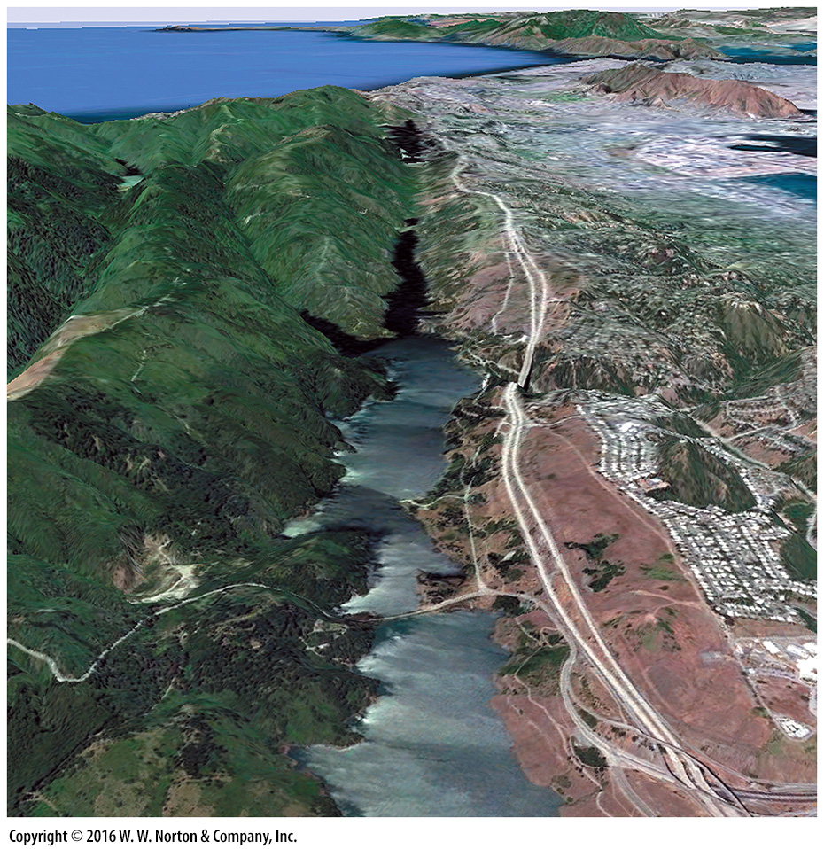
Notes:
SEE FOR YOURSELF…
SAN ANDREAS FAULT, NEAR SAN FRANCISCO, CALIFORNIA

Slide 24
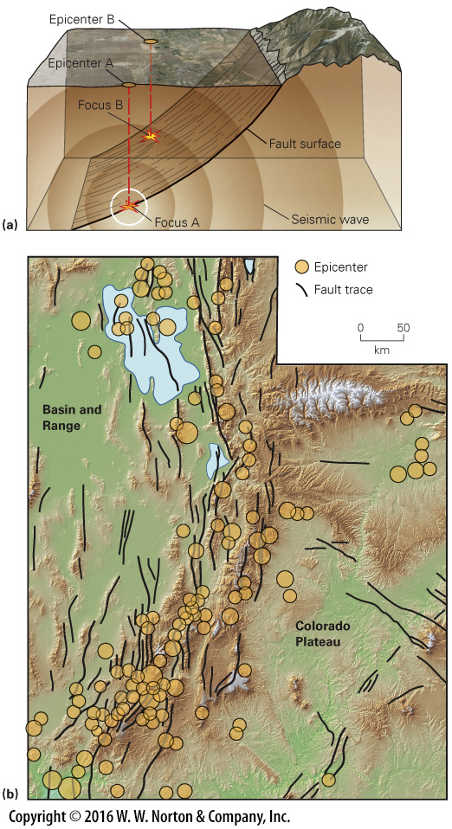
Notes:
FIGURE 8.6 Earthquake hypocenters and epicenters.
(a) The focus is the point on the fault where slip begins. Seismic energy starts radiating from it. The epicenter is the point on the Earth’s surface directly above the focus. Earthquake A just happened; earthquake B happened a while ago. (b) A map of Utah showing the distribution of earthquake epicenters, recorded over several years. The map indicates that seismic activity happens mostly in a distinct belt following the boundary between the Basin and Range rift and the Colorado Plateau. The size of the circle represents the size of the earthquake.

Slide 25
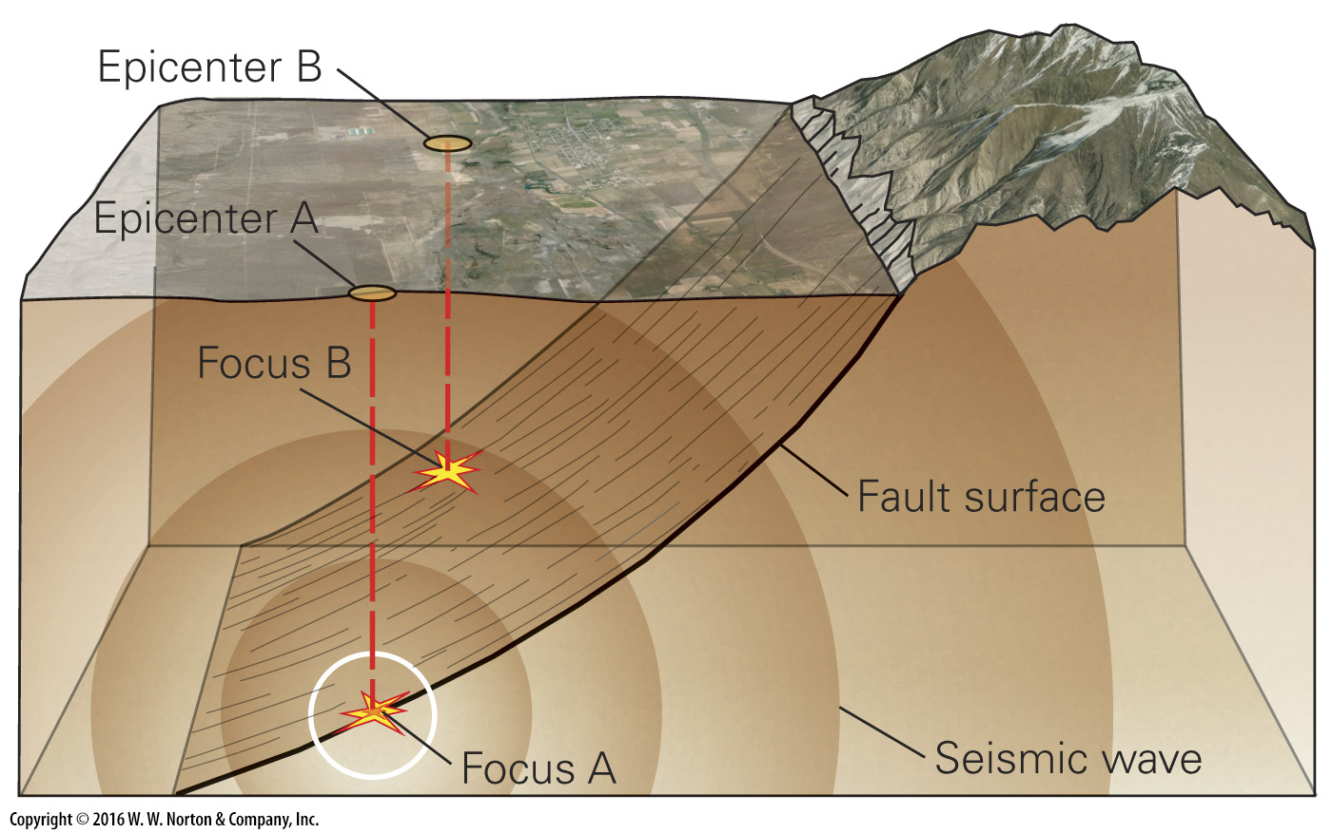
Notes:
FIGURE 8.6a Earthquake hypocenters and epicenters.
(a) The focus is the point on the fault where slip begins. Seismic energy starts radiating from it. The epicenter is the point on the Earth’s surface directly above the focus. Earthquake A just happened; earthquake B happened a while ago.

Slide 26
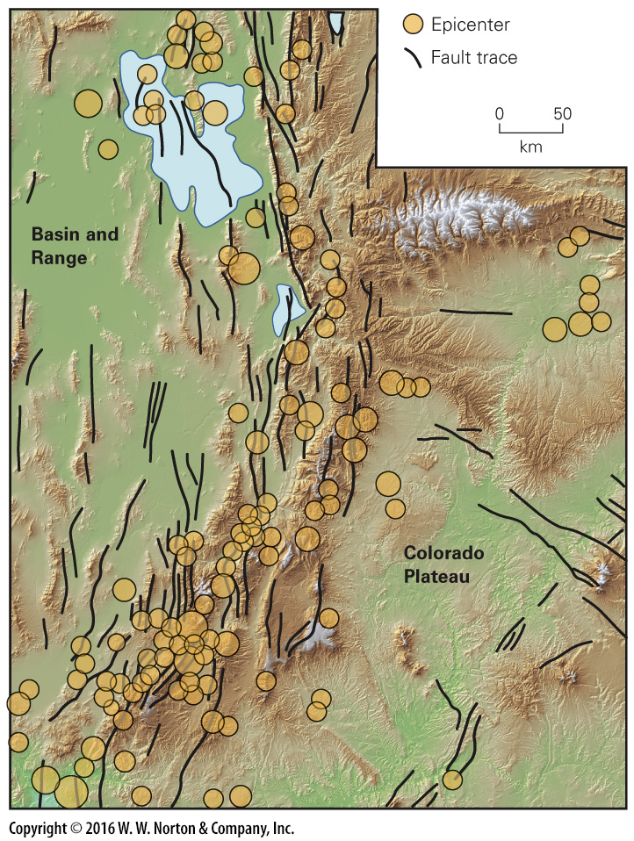
Notes:
FIGURE 8.6b Earthquake hypocenters and epicenters.
(b) A map of Utah showing the distribution of earthquake epicenters, recorded over several years. The map indicates that seismic activity happens mostly in a distinct belt following the boundary between the Basin and Range rift and the Colorado Plateau. The size of the circle represents the size of the earthquake.

Slide 27
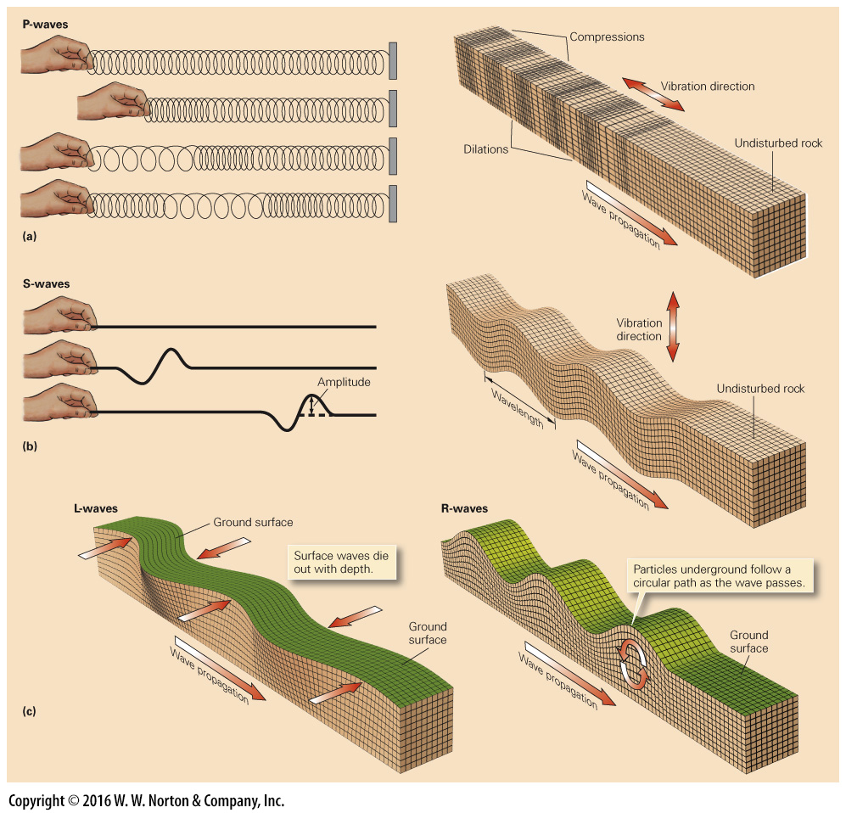
Notes:
FIGURE 8.7 Different types of earthquake waves.
(a) Compressional waves can be generated by pushing and pulling on the end of a spring. P-waves are compressional body waves, so the vibration direction is parallel to the direction of wave movement. (b) Shear waves can be produced by moving the end of a rope up and down. S-waves are shear body waves. As the waves pass through rock, the vibration direction is perpendicular to the direction of the wave movement. (c) There are two types of surface waves. When an L-wave passes, the ground surface moves back and forth like a slithering snake. R-waves make the ground surface go up and down. Both types of waves die out with increasing depth.

Slide 28
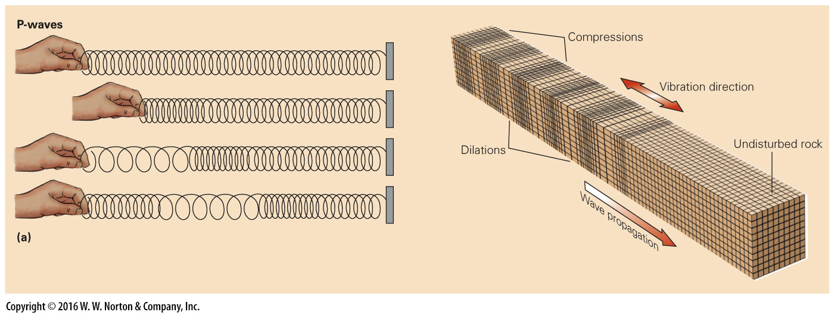
Notes:
FIGURE 8.7a Different types of earthquake waves.
(a) Compressional waves can be generated by pushing and pulling on the end of a spring. P-waves are compressional body waves, so the vibration direction is parallel to the direction of wave movement.

Slide 29
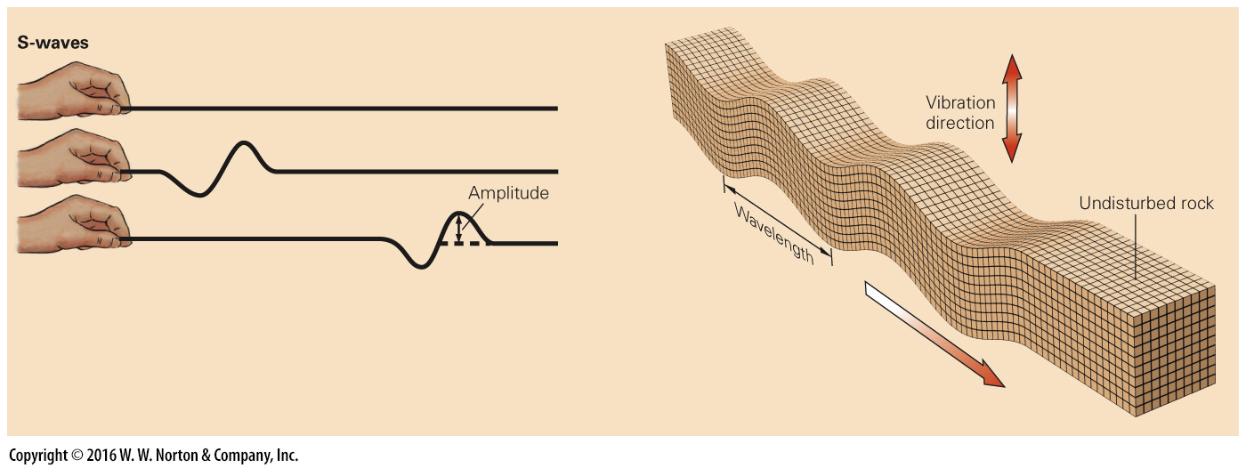
Notes:
FIGURE 8.7b Different types of earthquake waves.
(b) Shear waves can be produced by moving the end of a rope up and down. S-waves are shear body waves. As the waves pass through rock, the vibration direction is perpendicular to the direction of the wave movement.

Slide 30
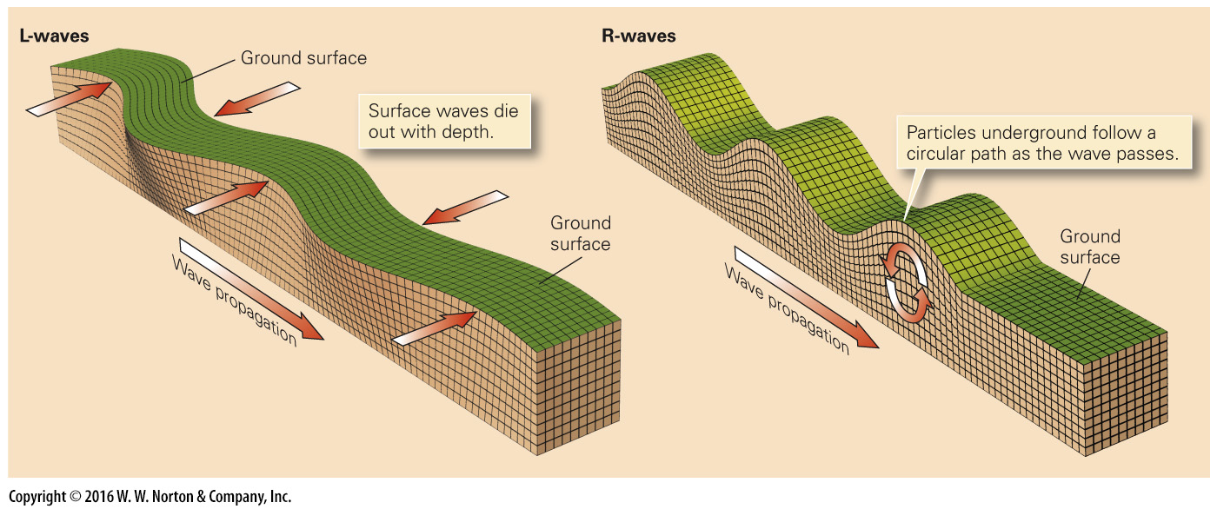
Notes:
FIGURE 8.7c Different types of earthquake waves.
(c) There are two types of surface waves. When an L-wave passes, the ground surface moves back and forth like a slithering snake. R-waves make the ground surface go up and down. Both types of waves die out with increasing depth.

Slide 31
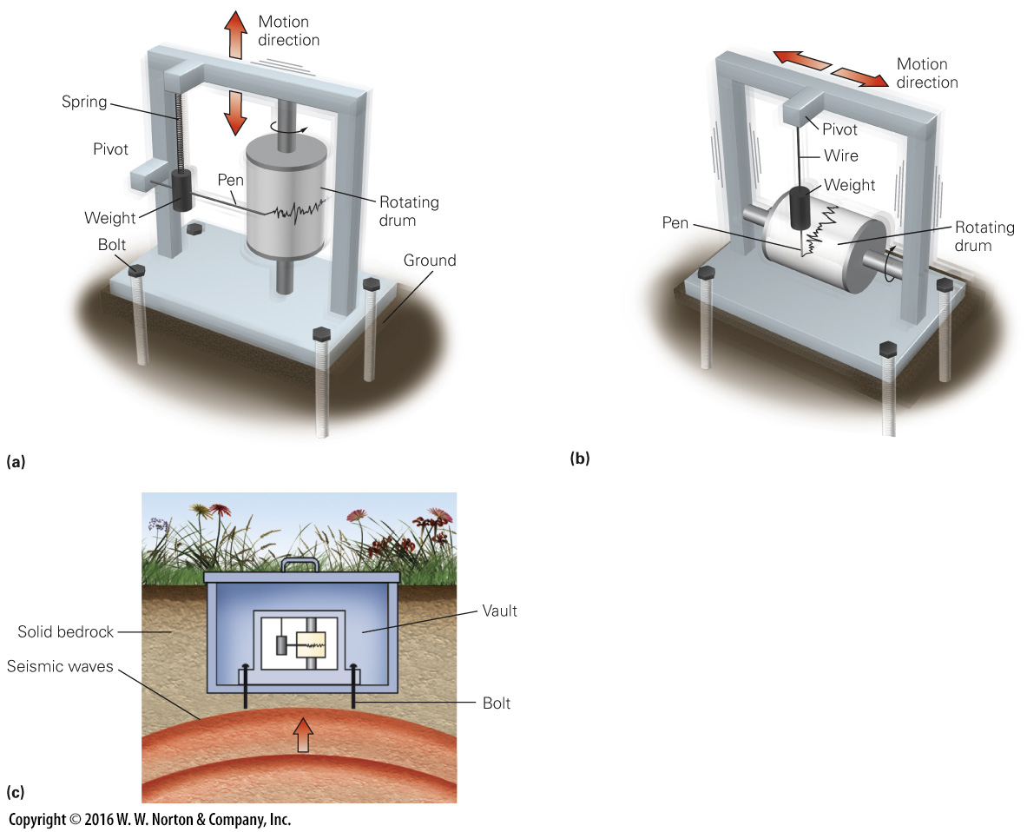
Notes:
FIGURE 8.8 The basic operation of a seismometer.
(a) A vertical-motion seismometer records up-and-down ground motion. (b) A horizontal-motion seismometer records back-and-forth ground motion. (c) Seismometers are bolted to bedrock in a protected shelter or vault.

Slide 32
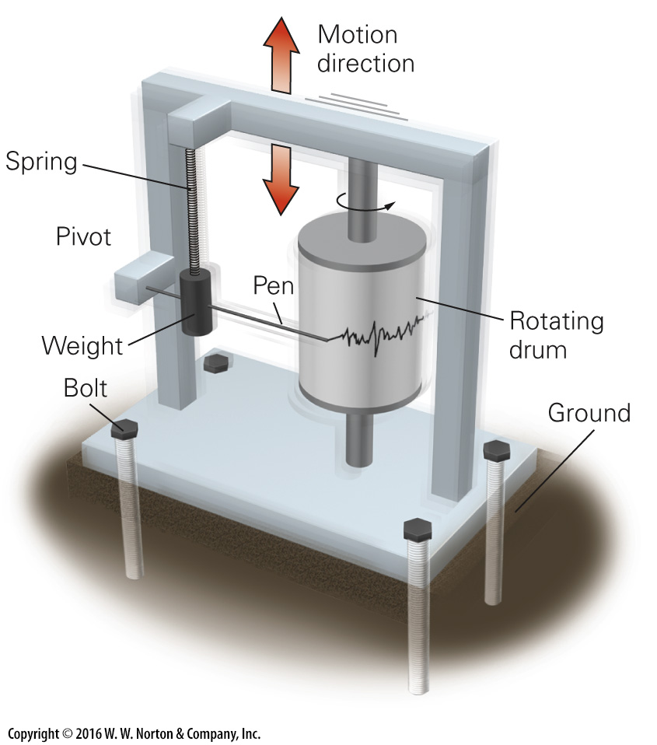
Notes:
FIGURE 8.8a The basic operation of a seismometer.
(a) A vertical-motion seismometer records up-and-down ground motion.

Slide 33
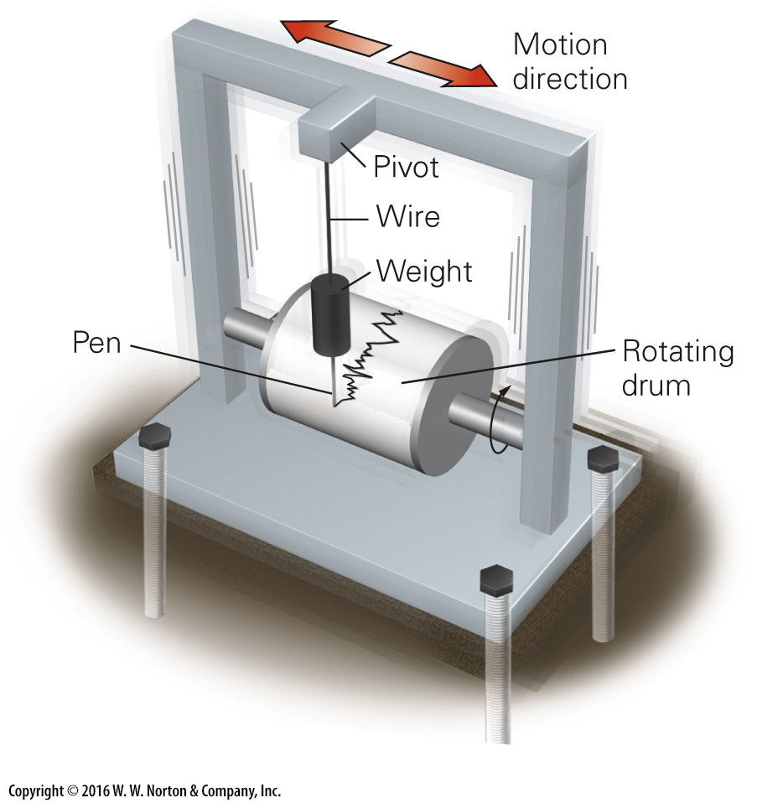
Notes:
FIGURE 8.8b The basic operation of a seismometer.
(b) A horizontal-motion seismometer records back-and-forth ground motion.

Slide 34
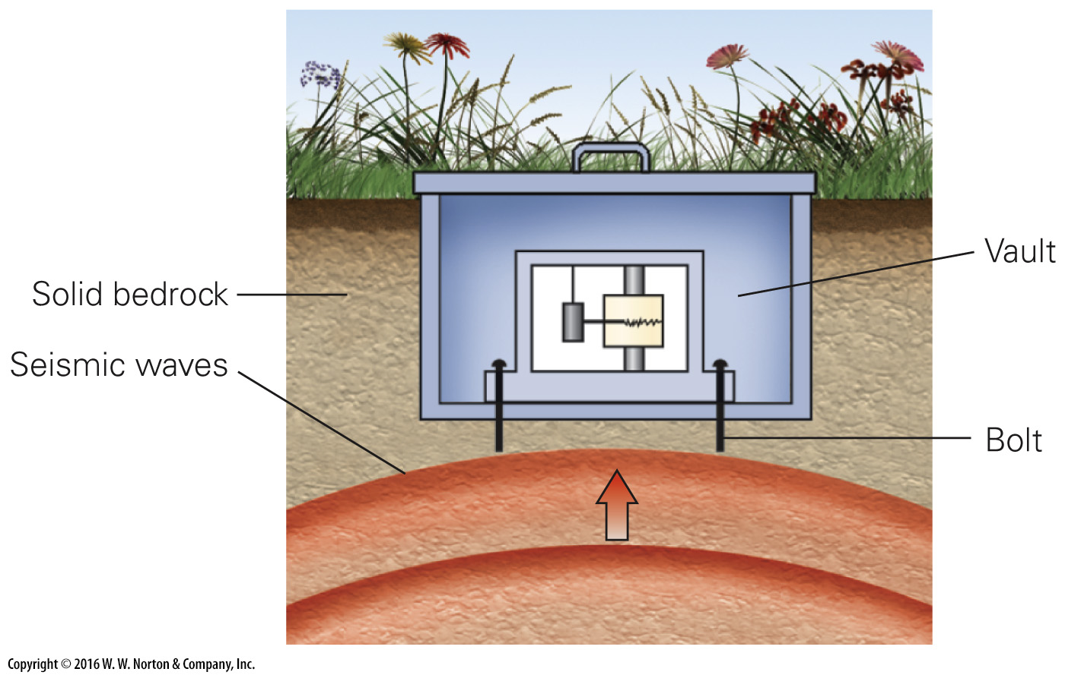
Notes:
FIGURE 8.8c The basic operation of a seismometer.
(c) Seismometers are bolted to bedrock in a protected shelter or vault.

Slide 35
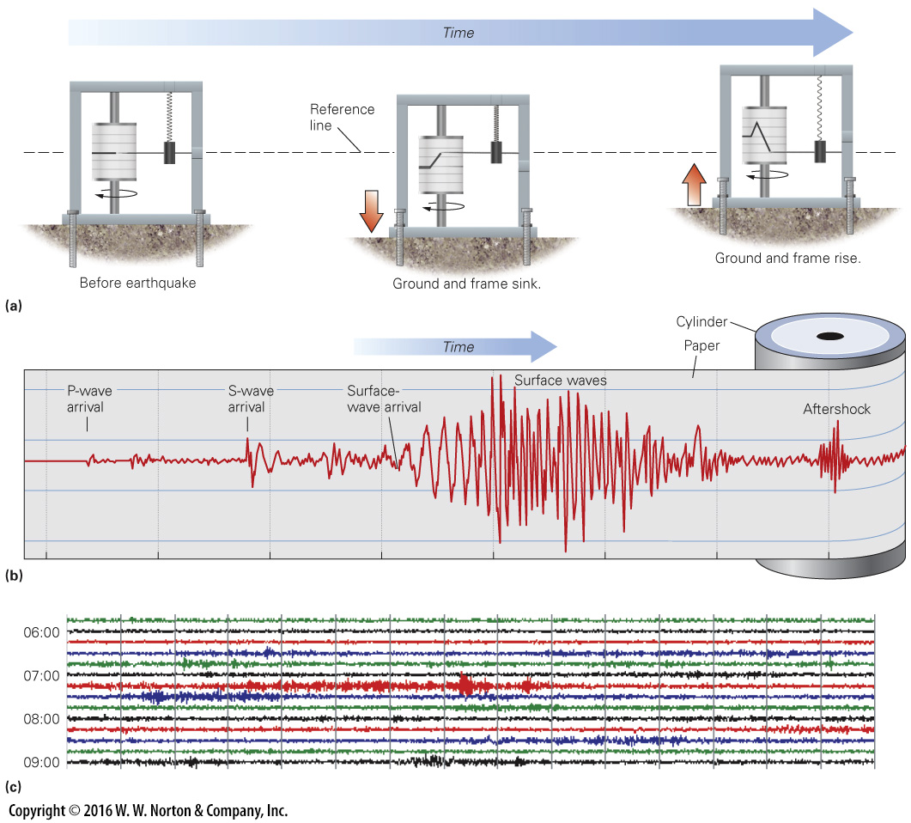
Notes:
FIGURE 8.9 The nature of seismograms.
(a) Before an earthquake, the pen traces a straight line. During an earthquake, the paper roll moves up and down while the pen stays in place. (b) This close-up of a seismogram shows the signals generated by different kinds of seismic waves. (c) A digital seismic record from a seismometer station in Arkansas. The space between vertical lines represents 1 minute. Colors have no meaning but make the figure more readable. Each color band represents the record of 15 minutes.

Slide 36
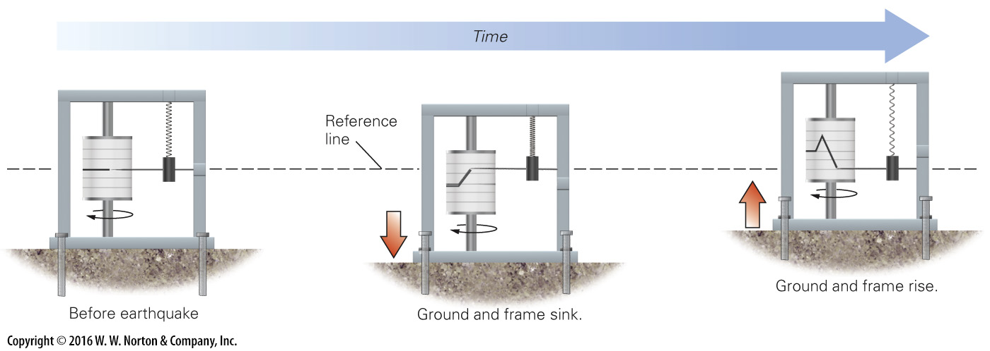
Notes:
FIGURE 8.9a The nature of seismograms.
(a) Before an earthquake, the pen traces a straight line. During an earthquake, the paper roll moves up and down while the pen stays in place.

Slide 37
Notes:
FIGURE 8.9b The nature of seismograms.
(b) This close-up of a seismogram shows the signals generated by different kinds of seismic waves.

Slide 38
Notes:
FIGURE 8.9c The nature of seismograms.
(c) A digital seismic record from a seismometer station in Arkansas. The space between vertical lines represents 1 minute. Colors have no meaning but make the figure more readable. Each color band represents the record of 15 minutes.

Slide 39
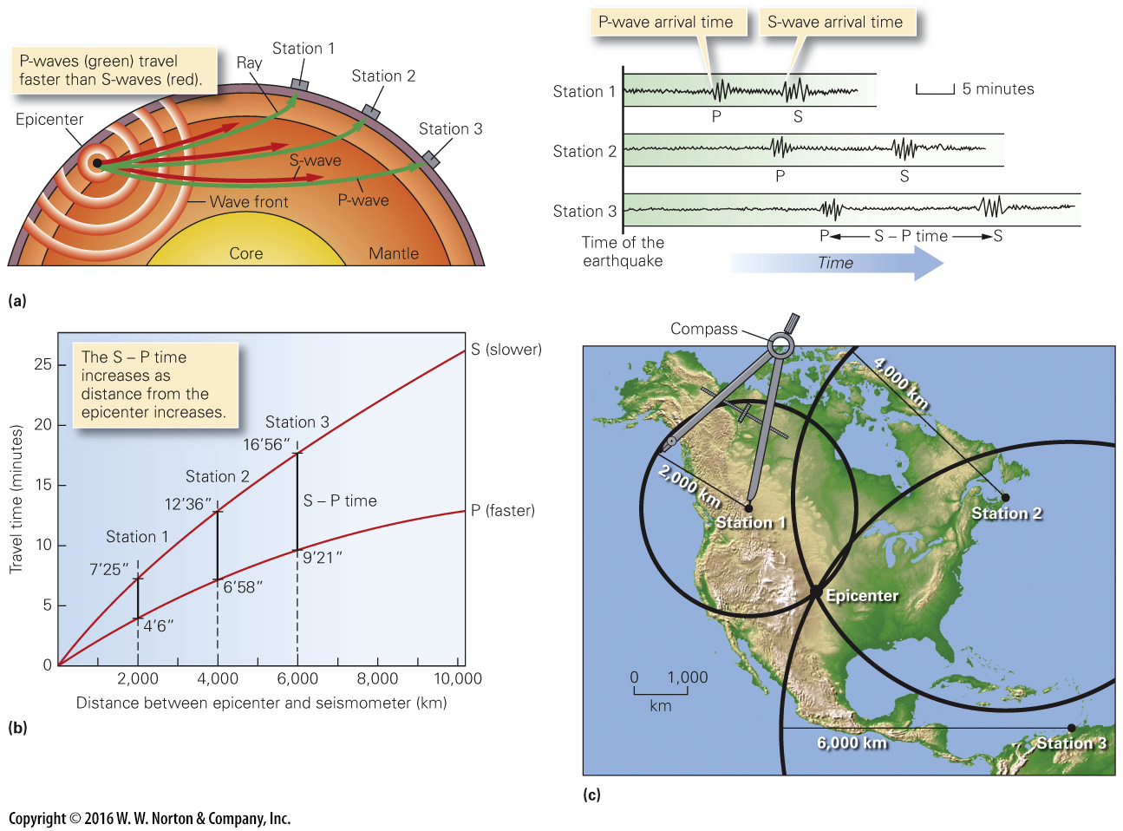
Notes:
FIGURE 8.10 The method for locating an earthquake epicenter.
(a) Seismic waves travel at different velocities. The greater the distance between the epicenter and the seismograph station, the longer it takes for earthquake waves to arrive and the greater the delay between the P-wave and S-wave arrival times. (b) We can represent the different arrival times of P-waves and S-waves on a graph of travel-time curves. (c) If an earthquake epicenter lies 2,000 km from Station 1, we draw a circle with a radius of 2,000 km around the station at the scale of the map. We repeat for the other two stations. The intersection is the epicenter.

Slide 40
Notes:
FIGURE 8.10a The method for locating an earthquake epicenter.
(a) Seismic waves travel at different velocities. The greater the distance between the epicenter and the seismograph station, the longer it takes for earthquake waves to arrive and the greater the delay between the P-wave and S-wave arrival times.

Slide 41
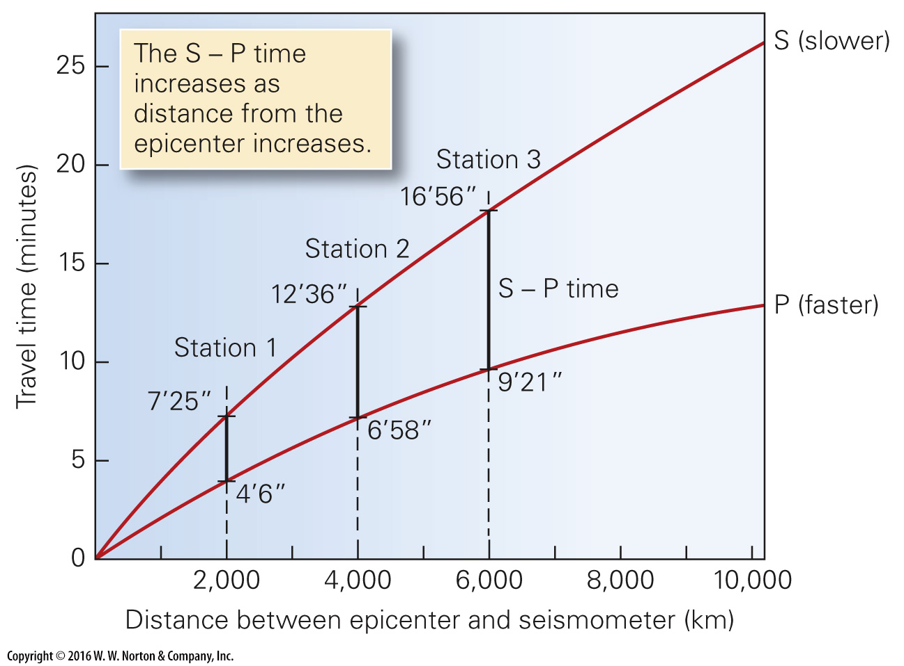
Notes:
FIGURE 8.10b The method for locating an earthquake epicenter.
(b) We can represent the different arrival times of P-waves and S-waves on a graph of travel-time curves.

Slide 42
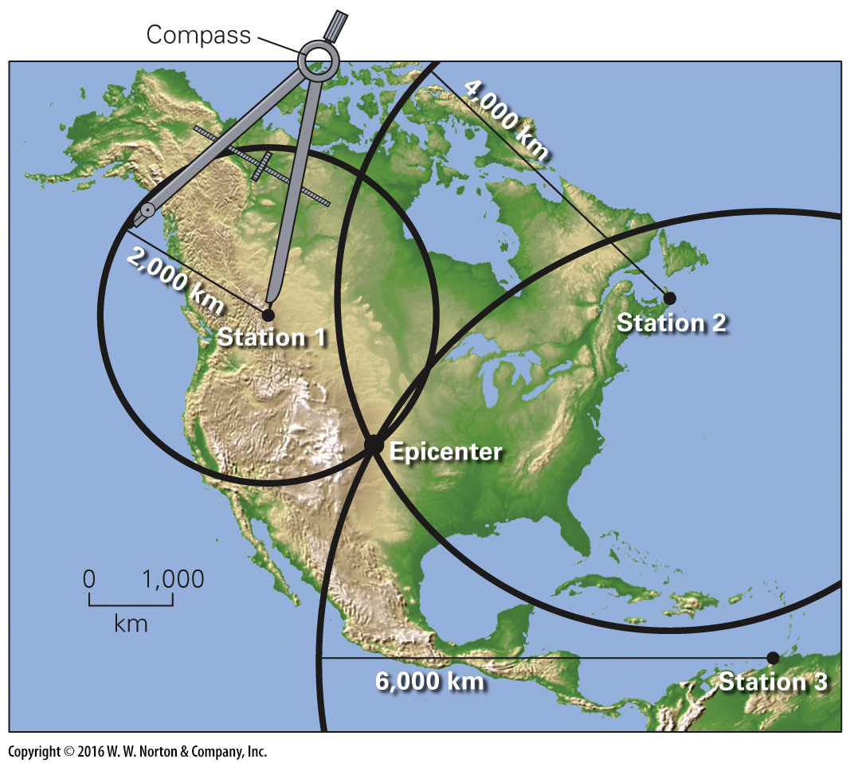
Notes:
FIGURE 8.10c The method for locating an earthquake epicenter.
(c) If an earthquake epicenter lies 2,000 km from Station 1, we draw a circle with a radius of 2,000 km around the station at the scale of the map. We repeat for the other two stations. The intersection is the epicenter.

Slide 43
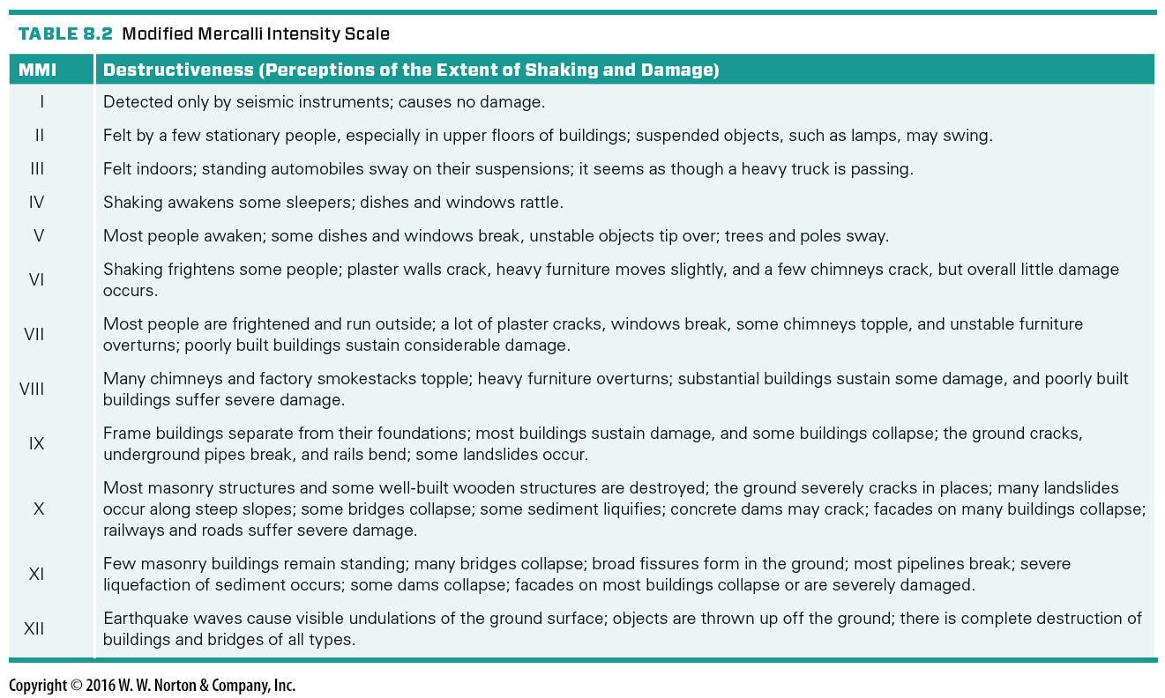
Notes:
TABLE 8.2 Modified Mercalli Intensity Scale

Slide 44
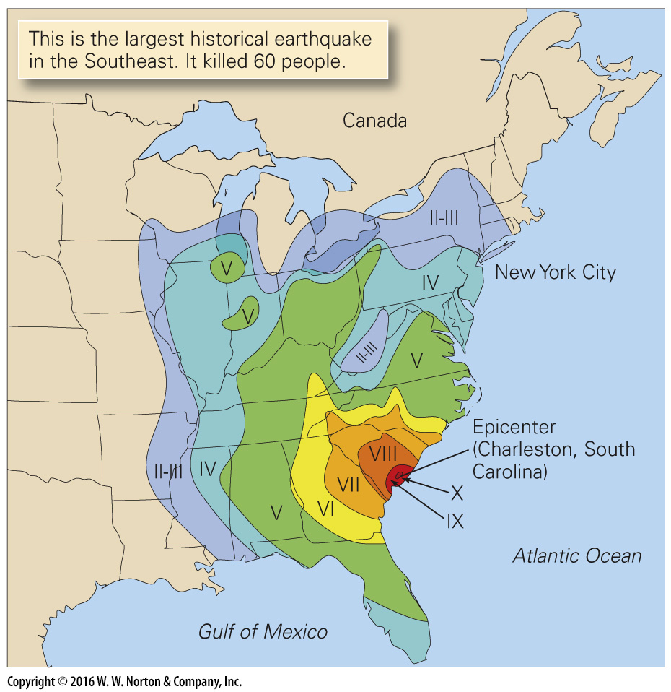
Notes:
FIGURE 8.11 This map shows Modified Mercalli Intensity contours for the 1886 Charleston, South Carolina, earthquake. Note that near the epicenter ground shaking reached an intensity of X, and in New York City ground shaking reached an intensity of II to III.

Slide 45
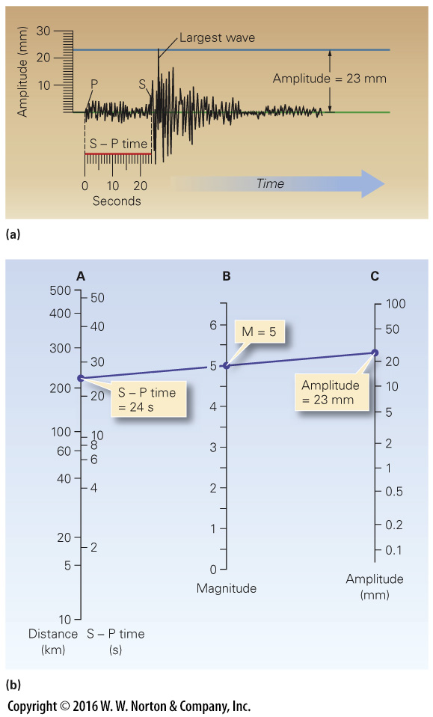
Notes:
FIGURE 8.12 Using the Richter magnitude scale.
(a) To calculate the Richter magnitude from a seismograph, first measure the S – P (S minus P) time, to determine the distance to the epicenter. Then measure the amplitude of the largest wave. (b) Draw a line from the point on Column A representing the S – P time or the distance to the epicenter, to the point on Column C representing the wave amplitude. Read the Richter magnitude off Column B.

Slide 46
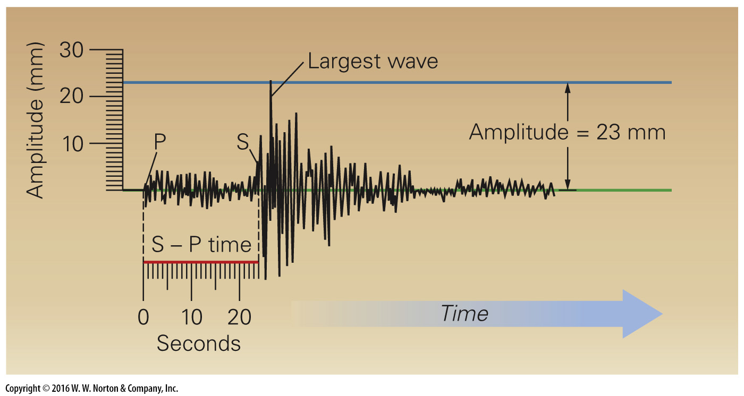
Notes:
FIGURE 8.12a Using the Richter magnitude scale.
(a) To calculate the Richter magnitude from a seismograph, first measure the S – P (S minus P) time, to determine the distance to the epicenter. Then measure the amplitude of the largest wave.

Slide 47
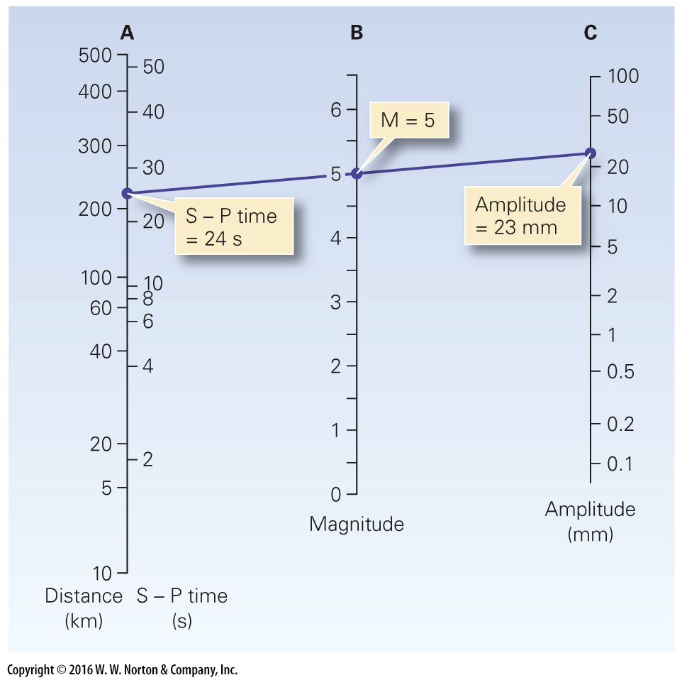
Notes:
FIGURE 8.12b Using the Richter magnitude scale.
(b) Draw a line from the point on Column A representing the S – P time or the distance to the epicenter, to the point on Column C representing the wave amplitude. Read the Richter magnitude off Column B.

Slide 48
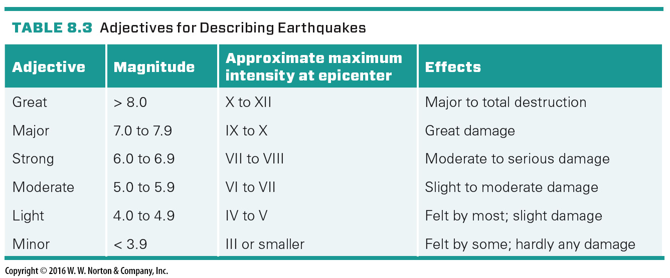
Notes:
TABLE 8.3 Adjectives for Describing Earthquakes

Slide 49
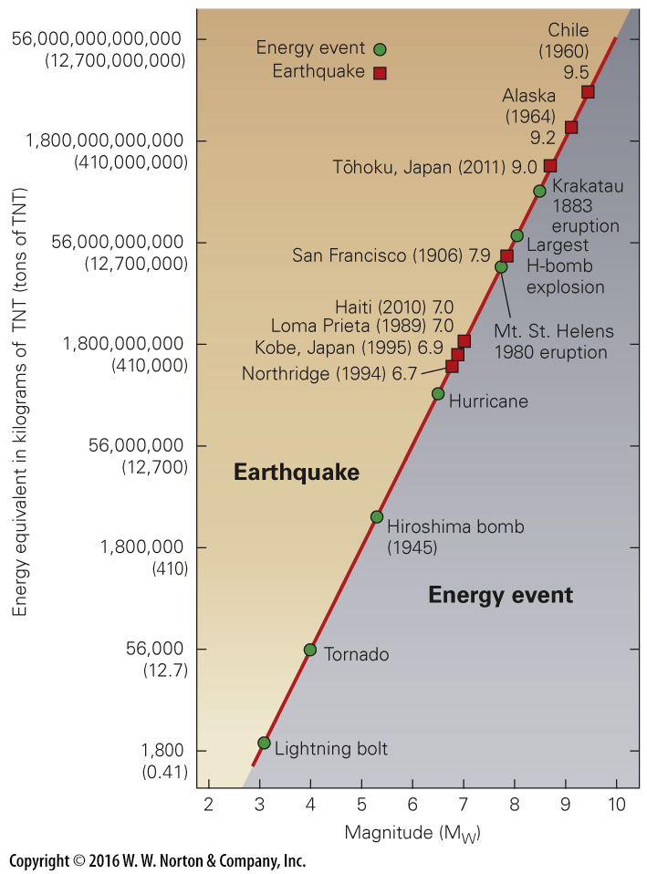
Notes:
FIGURE 8.13 Energy released by earthquakes increases dramatically with magnitude.

Slide 50
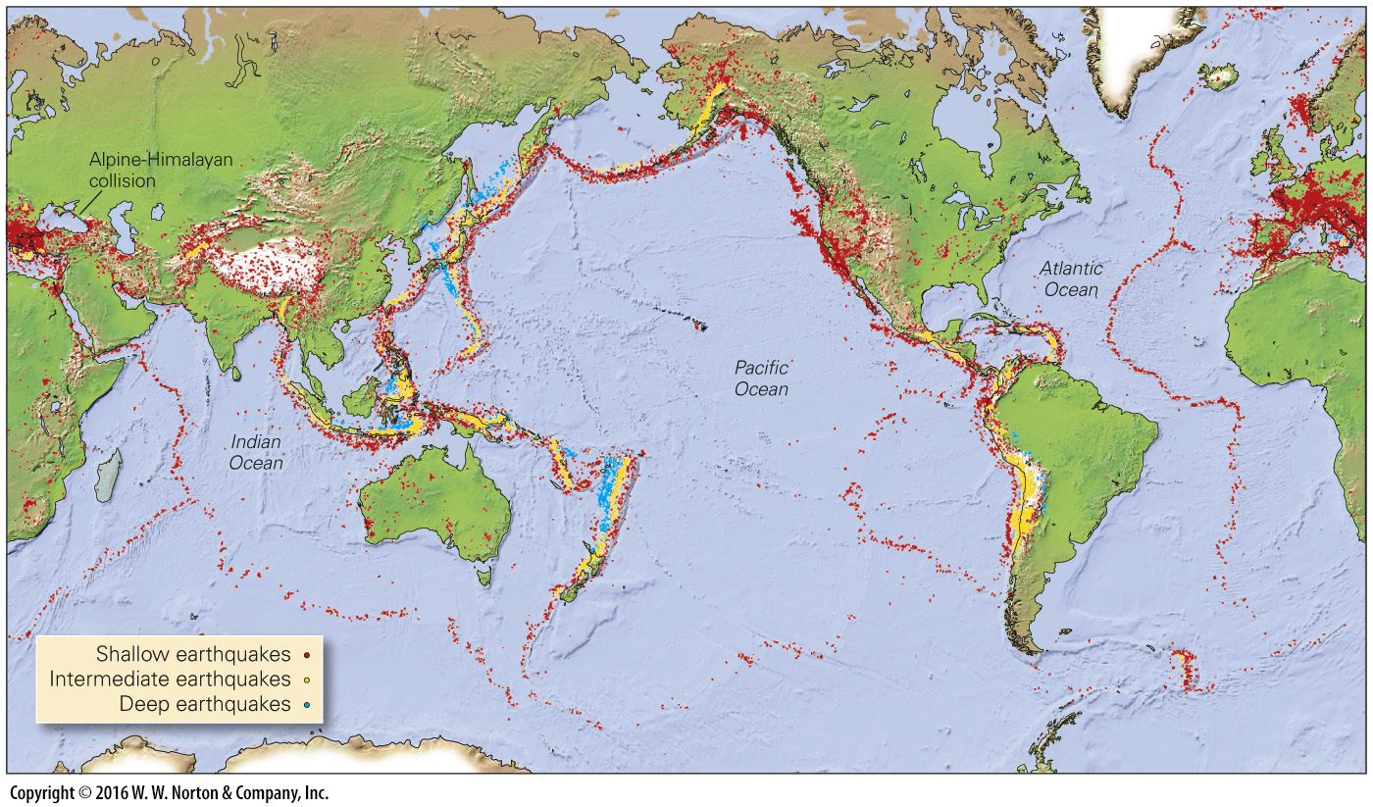
Notes:
FIGURE 8.14 A map of epicenters emphasizes that most earthquakes occur in distinct belts along plate boundaries.

Slide 51
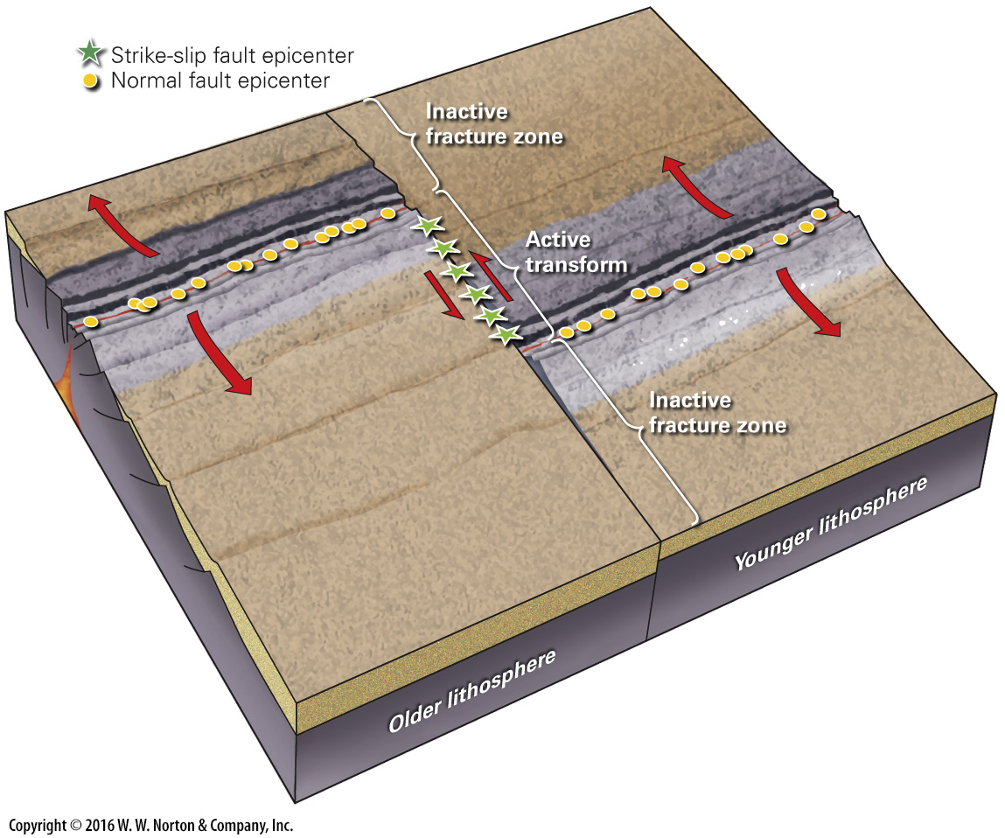
Notes:
FIGURE 8.15 The distribution of earthquakes at a mid-ocean ridge. Note that normal faults occur along the ridge axis, and strike-slip faults occur along active transform faults. Earthquakes don’t take place along inactive fracture zones.

Slide 52
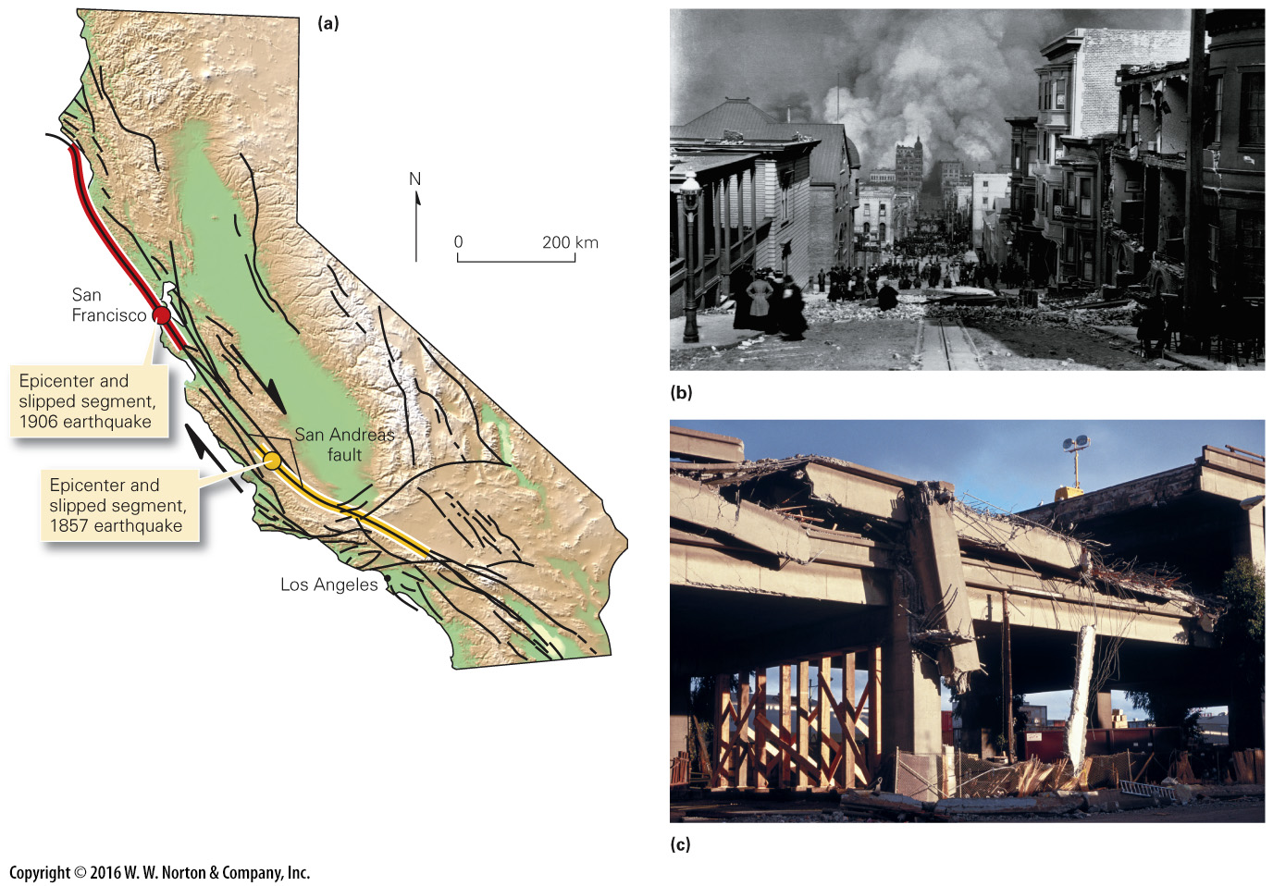
Notes:
FIGURE 8.16 The San Andreas fault system, a continental transform.
(a) The San Andreas fault system in California. Note that the system includes many faults in a 100-km-wide band. (b) A street in San Francisco after the 1906 earthquake. Huge fires swept through the city. (c) The 1989 Loma Prieta earthquake caused a double-decker freeway to collapse, as support columns gave way.

Slide 53
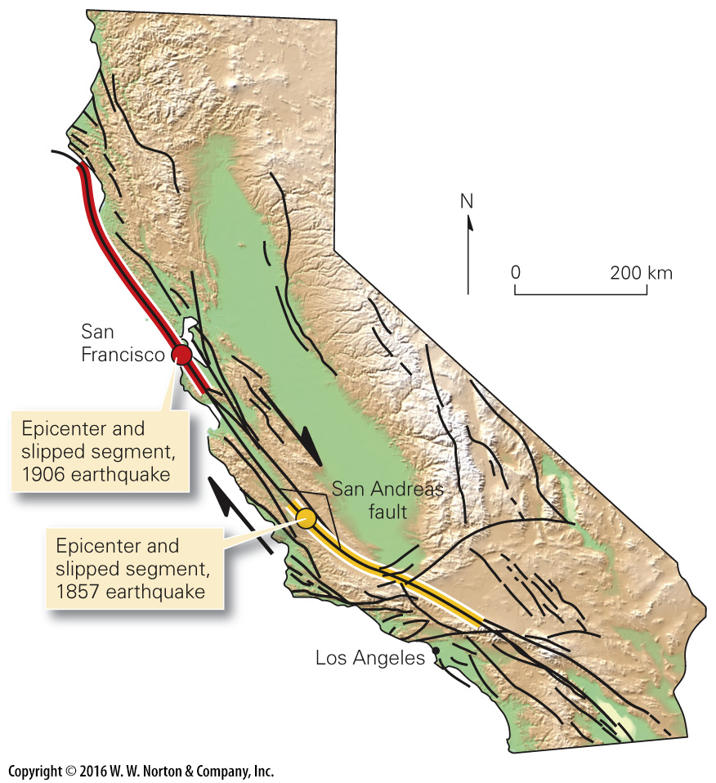
Notes:
FIGURE 8.16a The San Andreas fault system, a continental transform.
(a) The San Andreas fault system in California. Note that the system includes many faults in a 100-km-wide band.

Slide 54
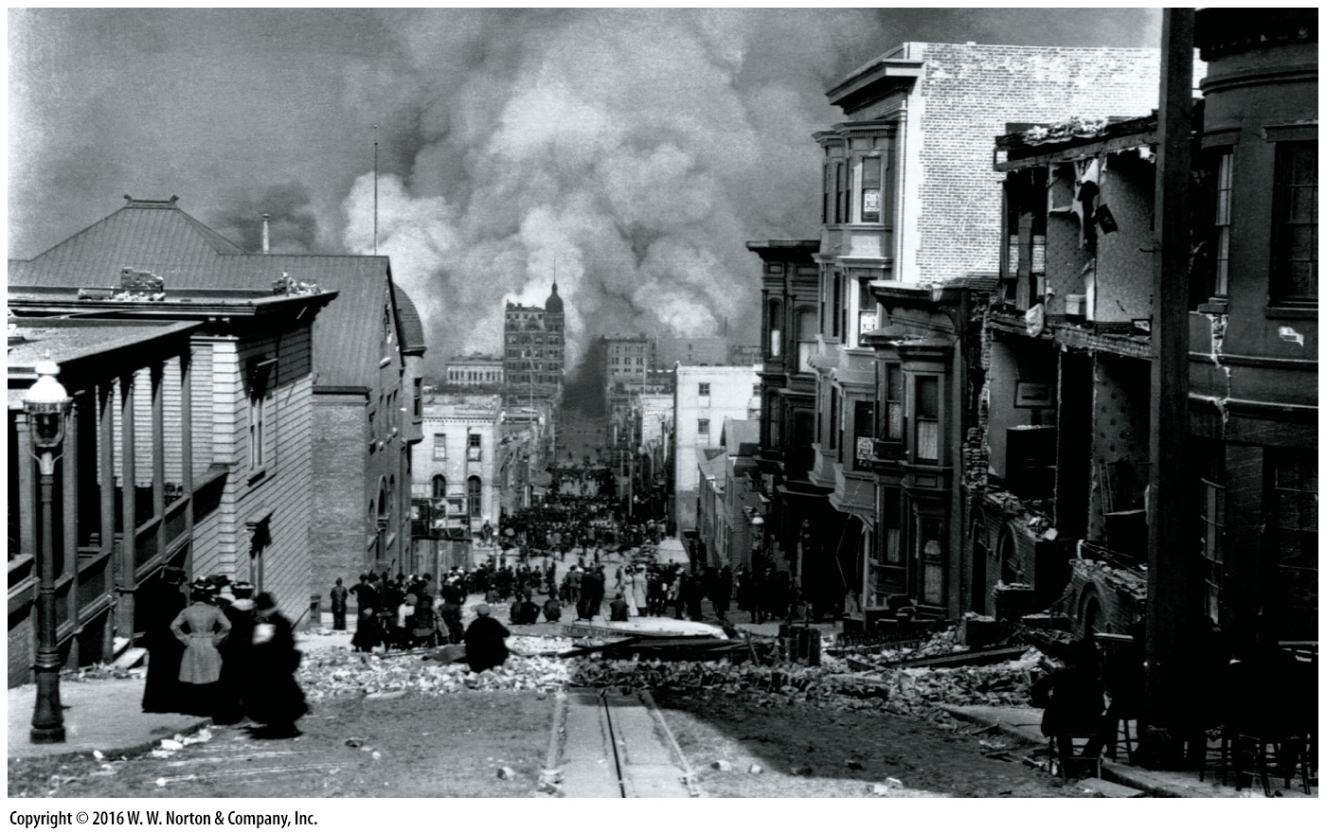
Notes:
FIGURE 8.16b The San Andreas fault system, a continental transform.
(b) A street in San Francisco after the 1906 earthquake. Huge fires swept through the city.

Slide 55
Notes:
FIGURE 8.16c The San Andreas fault system, a continental transform.
(c) The 1989 Loma Prieta earthquake caused a double-decker freeway to collapse, as support columns gave way.

Slide 56
Notes:
FIGURE 8.17 An example of a convergent-plate-boundary earthquake.
(a) At a convergent-plate boundary, earthquakes occur along the contact between the two plates, as well as in the downgoing plate and overriding plate. Deep earthquakes may be due to the phase change of olivine to spinel. In the asthenosphere, this change happens at 410 km, but in cooler lithosphere, it may happen at greater depths. (b) Map of earthquake epicenters and subduction zones in and near Japan. (c) A collapsed building after the Kobe earthquake in Japan.

Slide 57
Notes:
FIGURE 8.17a An example of a convergent-plate-boundary earthquake.
(a) At a convergent-plate boundary, earthquakes occur along the contact between the two plates, as well as in the downgoing plate and overriding plate. Deep earthquakes may be due to the phase change of olivine to spinel. In the asthenosphere, this change happens at 410 km, but in cooler lithosphere, it may happen at greater depths.

Slide 58
Notes:
FIGURE 8.17b An example of a convergent-plate-boundary earthquake.
(b) Map of earthquake epicenters and subduction zones in and near Japan.

Slide 59
Notes:
FIGURE 8.17c An example of a convergent-plate-boundary earthquake.
(c) A collapsed building after the Kobe earthquake in Japan.

Slide 60
Notes:
FIGURE 8.18 The tectonic settings in which earthquakes occur in continental lithosphere. Subduction-related earthquakes in continental crust are not shown.

Slide 61
Notes:
FIGURE 8.19 New Madrid, Missouri, is an example of intraplate seismic activity.
(a) The earthquakes of 1811–12 destroyed cabins and disrupted the Mississippi River. (b) The epicenters of recent small earthquakes in the New Madrid area, as recorded by modern seismic instruments. The region remains active.

Slide 62
Notes:
FIGURE 8.19a New Madrid, Missouri, is an example of intraplate seismic activity.
(a) The earthquakes of 1811–12 destroyed cabins and disrupted the Mississippi River.

Slide 63
Notes:
FIGURE 8.19b New Madrid, Missouri, is an example of intraplate seismic activity.
(b) The epicenters of recent small earthquakes in the New Madrid area, as recorded by modern seismic instruments. The region remains active.

Slide 64
Notes:
FIGURE 8.20 Types of ground motion during earthquakes. The ground can shake in many ways at once, causing surface structures to move.

Slide 65
Notes:
FIGURE 8.21 Examples of earthquake damage due to vibration.
(a) During a 1999 earthquake in Turkey, concrete buildings collapsed when supports gave way and floors piled on each other like pancakes. (b) An elevated bridge tipped over during the 1995 Kobe, Japan, earthquake. (c) Concrete bridge supports were crushed during the 1994 Northridge, California, earthquake when the overlying bridge bounced up and slammed back down. (d) A neighborhood of masonry buildings in Armenia collapsed during a 1999 earthquake because the walls broke apart.

Slide 66
Notes:
FIGURE 8.21a Examples of earthquake damage due to vibration.
(a) During a 1999 earthquake in Turkey, concrete buildings collapsed when supports gave way and floors piled on each other like pancakes.

Slide 67
Notes:
FIGURE 8.21b Examples of earthquake damage due to vibration.
(b) An elevated bridge tipped over during the 1995 Kobe, Japan, earthquake.

Slide 68
Notes:
FIGURE 8.21c Examples of earthquake damage due to vibration.
(c) Concrete bridge supports were crushed during the 1994 Northridge, California, earthquake when the overlying bridge bounced up and slammed back down.

Slide 69
Notes:
FIGURE 8.21d Examples of earthquake damage due to vibration.
(d) A neighborhood of masonry buildings in Armenia collapsed during a 1999 earthquake because the walls broke apart.

Slide 70
Notes:
FIGURE 8.22 Examples of landslide damage triggered by earthquakes.
(a) Shaking triggers landslides, which caused a steep slope along the coast of California to collapse, carrying part of a home with it. (b) During the 1964 Alaska earthquake, slumping caused the land to give way beneath parts of Anchorage.

Slide 71
Notes:
FIGURE 8.22a Examples of landslide damage triggered by earthquakes.
(a) Shaking triggers landslides, which caused a steep slope along the coast of California to collapse, carrying part of a home with it.

Slide 72
Notes:
FIGURE 8.22b Examples of landslide damage triggered by earthquakes.
(b) During the 1964 Alaska earthquake, slumping caused the land to give way beneath parts of Anchorage.

Slide 73
Notes:
FIGURE 8.23 Examples of liquefaction triggered by earthquakes.
(a) Liquefaction under their foundations caused these apartment buildings in Niigata, Japan, to tip over during a 1964 earthquake. (b) Liquefaction of a sand layer causes the ground to crack and sand volcanoes to erupt. (c) During the 2011 Christchurch, New Zealand, earthquake, liquefied sand spurted out and spread over the pavement. The process produced open space underground, so the pavement collapsed to form a sinkhole.

Slide 74
Notes:
FIGURE 8.23a Examples of liquefaction triggered by earthquakes.
(a) Liquefaction under their foundations caused these apartment buildings in Niigata, Japan, to tip over during a 1964 earthquake.

Slide 75
Notes:
FIGURE 8.23b Examples of liquefaction triggered by earthquakes.
(b) Liquefaction of a sand layer causes the ground to crack and sand volcanoes to erupt.

Slide 76
Notes:
FIGURE 8.23c Examples of liquefaction triggered by earthquakes.
(c) During the 2011 Christchurch, New Zealand, earthquake, liquefied sand spurted out and spread over the pavement. The process produced open space underground, so the pavement collapsed to form a sinkhole.

Slide 77
Notes:
FIGURE 8.24 The 1964 Turnagain Heights disaster.
(a) A landslide carried a neighborhood out to sea. (b) Slip occurred on a weak layer.

Slide 78
Notes:
FIGURE 8.24a The 1964 Turnagain Heights disaster.
(a) A landslide carried a neighborhood out to sea.

Slide 79
Notes:
FIGURE 8.24b The 1964 Turnagain Heights disaster.
(b) Slip occurred on a weak layer.

Slide 80
Notes:
FIGURE 8.25 Fire sometimes follows an earthquake.
(a) Broken gas tanks erupt in fountains of flame after the 2011 Tōhoku, Japan earthquake. (b) A firestorm develops when cool air rushes in to replace rising hot air above a huge fire. The cool air stokes the blaze, making it larger and hotter.

Slide 81
Notes:
FIGURE 8.25a Fire sometimes follows an earthquake.
(a) Broken gas tanks erupt in fountains of flame after the 2011 Tōhoku, Japan earthquake.

Slide 82
Notes:
FIGURE 8.25b Fire sometimes follows an earthquake.
(b) A firestorm develops when cool air rushes in to replace rising hot air above a huge fire. The cool air stokes the blaze, making it larger and hotter.

Slide 83
Notes:
SEE FOR YOURSELF…
BANDA ACEH, BEFORE TSUNAMI

Slide 84
Notes:
FIGURE 8.26 The formation and propagation of a tsunami.
(a) After initial uplift of a mound of water, gravity causes the wave to spread out. The waves travel almost as fast as a jet plane. (b) Storm waves can be high, but because they have short wavelengths, they contain relatively little water. Most waves run out of water by the upslope edge of the beach. (c) A tsunami is not very high out in the open ocean, but as it approaches the land, friction slows the front of the wave, so the rear catches up and the wave grows. It is so wide that it can cover an extensive area of low-lying land.

Slide 85
Notes:
FIGURE 8.26a The formation and propagation of a tsunami.
(a) After initial uplift of a mound of water, gravity causes the wave to spread out. The waves travel almost as fast as a jet plane.

Slide 86
Notes:
FIGURE 8.26b The formation and propagation of a tsunami.
(b) Storm waves can be high, but because they have short wavelengths, they contain relatively little water. Most waves run out of water by the upslope edge of the beach.

Slide 87
Notes:
FIGURE 8.26c The formation and propagation of a tsunami.
(c) A tsunami is not very high out in the open ocean, but as it approaches the land, friction slows the front of the wave, so the rear catches up and the wave grows. It is so wide that it can cover an extensive area of low-lying land.

Slide 88
Notes:
FIGURE 8.27a The great Indian Ocean tsunami of 2004.
(a) A devastating tsunami was triggered by an earthquake off Sumatra. Three hours later, the leading wave struck the coasts of Sri Lanka and India. A computer model shows the wave.

Slide 89
Notes:
FIGURE 8.27a The great Indian Ocean tsunami of 2004.
(a) A devastating tsunami was triggered by an earthquake off Sumatra. Three hours later, the leading wave struck the coasts of Sri Lanka and India. A computer model shows the wave.

Slide 90
Notes:
FIGURE 8.27a The great Indian Ocean tsunami of 2004.
(a) A devastating tsunami was triggered by an earthquake off Sumatra. Three hours later, the leading wave struck the coasts of Sri Lanka and India. A computer model shows the wave.

Slide 91
Notes:
FIGURE 8.27b The great Indian Ocean tsunami of 2004.
(b) This snapshot shows the wave rushing toward the coast of Sumatra. Recession of water in advance of the wave exposed a reef.

Slide 92
Notes:
FIGURE 8.27c The great Indian Ocean tsunami of 2004.
(c) The wave blasts through a grove of palm trees as it strikes the coast of Thailand.

Slide 93
Notes:
FIGURE 8.27d The great Indian Ocean tsunami of 2004.
(d) Satellite photos of the Indonesian province of Aceh on Sumatra before and after the tsunami struck. Note that the city of Banda Aceh was washed away and the beach vanished.

Slide 94
Notes:
FIGURE 8.28 Damage due to the 2011 Tōhoku tsunami.
(a) The complete destruction of a Japanese coastal town by a tsunami, which followed the Tōhoku, Japan, earthquake of March 2011. (b) Each cubic building houses a reactor of the Fukushima nuclear power plant. The tsunami washed over the seawalls and inundated the plant to a depth of 14 m (46 ft), destroying power to the cooling pumps. Hydrogen explosions destroyed the reactor buildings.

Slide 95
Notes:
FIGURE 8.28a Damage due to the 2011 Tōhoku tsunami.
(a) The complete destruction of a Japanese coastal town by a tsunami, which followed the Tōhoku, Japan, earthquake of March 2011.

Slide 96
Notes:
FIGURE 8.28b Damage due to the 2011 Tōhoku tsunami.
(b) Each cubic building houses a reactor of the Fukushima nuclear power plant. The tsunami washed over the seawalls and inundated the plant to a depth of 14 m (46 ft), destroying power to the cooling pumps. Hydrogen explosions destroyed the reactor buildings.

Slide 97
Notes:
FIGURE Bx8.1 The disastrous January 2010 earthquake in Haiti, and its geologic setting.
(a) Survivors salvage what they can in Port-au-Prince, the capital of Haiti, after the devastating earthquake of January 2010. (b) Ground shaking during the 2010 Haiti earthquake caused most of the houses in this residential neighborhood to collapse. (c) A map showing the Mercalli intensity of shaking in Haiti. The star marks the epicenter of the quake.

Slide 98
Notes:
FIGURE Bx8.1a The disastrous January 2010 earthquake in Haiti, and its geologic setting.
(a) Survivors salvage what they can in Port-au-Prince, the capital of Haiti, after the devastating earthquake of January 2010.

Slide 99
Notes:
FIGURE Bx8.1b The disastrous January 2010 earthquake in Haiti, and its geologic setting.
(b) Ground shaking during the 2010 Haiti earthquake caused most of the houses in this residential neighborhood to collapse.

Slide 100
Notes:
FIGURE Bx8.1c The disastrous January 2010 earthquake in Haiti, and its geologic setting.
(c) A map showing the Mercalli intensity of shaking in Haiti. The star marks the epicenter of the quake.

Slide 101
Notes:
FIGURE 8.29 Identifying recent fault movement and recurrence interval. The block shows the walls of two trenches cut into the ground at a fault zone.

Slide 102
Notes:
FIGURE 8.30 Examples of seismic-hazard maps.
(a) A seismic-hazard map of the United States. Red and pink regions have a greater probability of experiencing large earthquakes. The San Andreas fault plate boundary is particularly hazardous. Risk in the New Madrid area remains subject to debate. (b) A global seismic-hazard map. The redder regions have a greater probability of experiencing a large earthquake. Probability is high along plate boundaries.

Slide 103
Notes:
FIGURE 8.31 Preventing damage and injury during an earthquake.
(a) Damage can be prevented if buildings are designed to withstand vibration. (b) An unreinforced building will shear side to side in a way that causes floors to shift out of alignment. (c) Buoys can detect a tsunami in the open ocean, so people on land can be warned. (d) If an earthquake strikes, take cover under a sturdy table near a wall.

Slide 104
Notes:
FIGURE 8.31a Preventing damage and injury during an earthquake.
(a) Damage can be prevented if buildings are designed to withstand vibration.

Slide 105
Notes:
FIGURE 8.31b Preventing damage and injury during an earthquake.
(b) An unreinforced building will shear side to side in a way that causes floors to shift out of alignment.

Slide 106
Notes:
FIGURE 8.31c Preventing damage and injury during an earthquake.
(c) Buoys can detect a tsunami in the open ocean, so people on land can be warned.

