Slide 1
Stephen Marshak
ESSENTIALS OF
Geology
FIFTH EDITION
Chapter 9
Crags, Cracks and Crumples:
Geologic Structures and Mountain Building
©2016 W. W. Norton & Company, Inc.

Slide 2
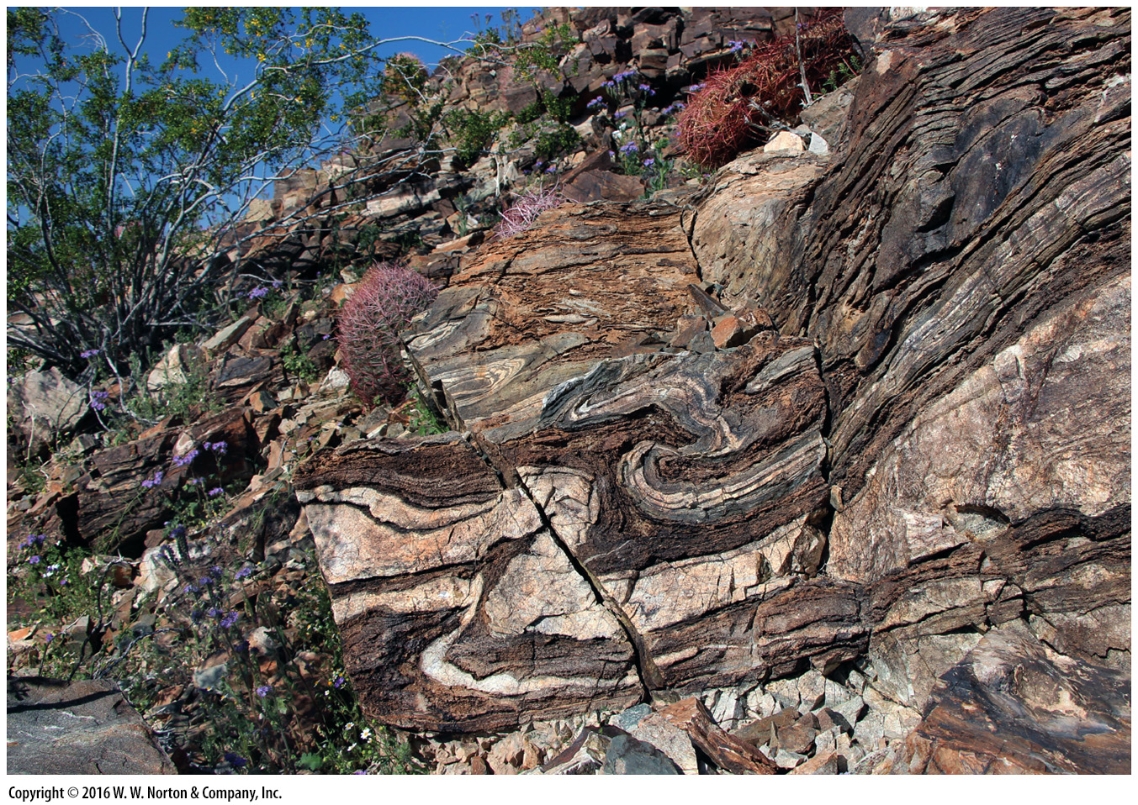
Notes:
Look closely at this small cliff face in Arizona. You can see layers that have been contorted into toothpaste-like curves and broken along jagged cracks. We’re seeing geologic structures, evidence that these rocks were subjected to deformation during mountain building.

Slide 3
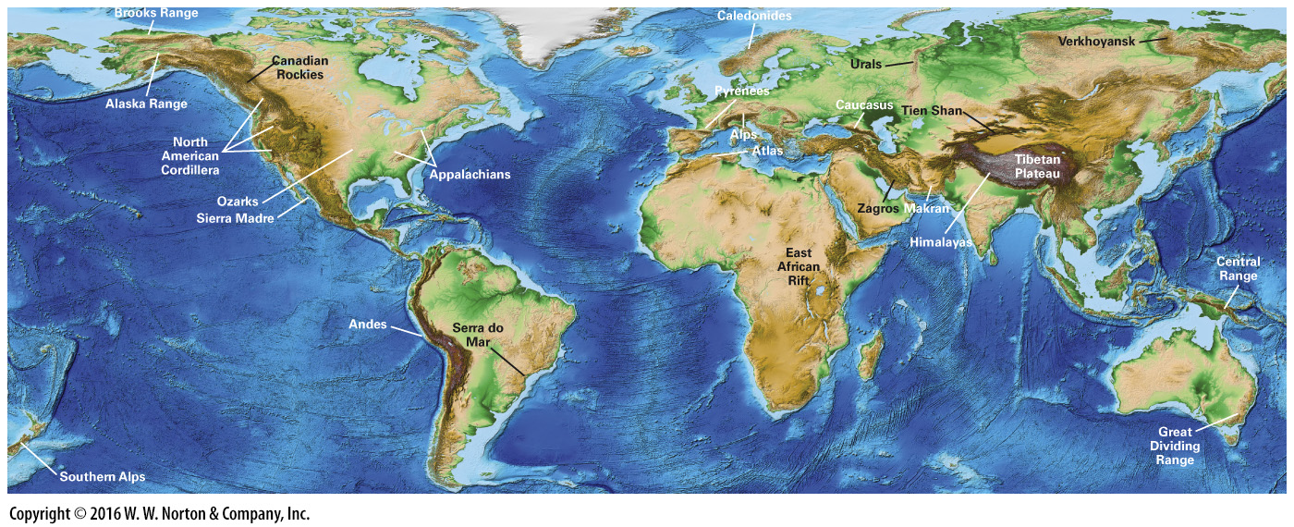
Notes:
FIGURE 9.1 Digital map of world topography, showing the locations of major mountain ranges.

Slide 4
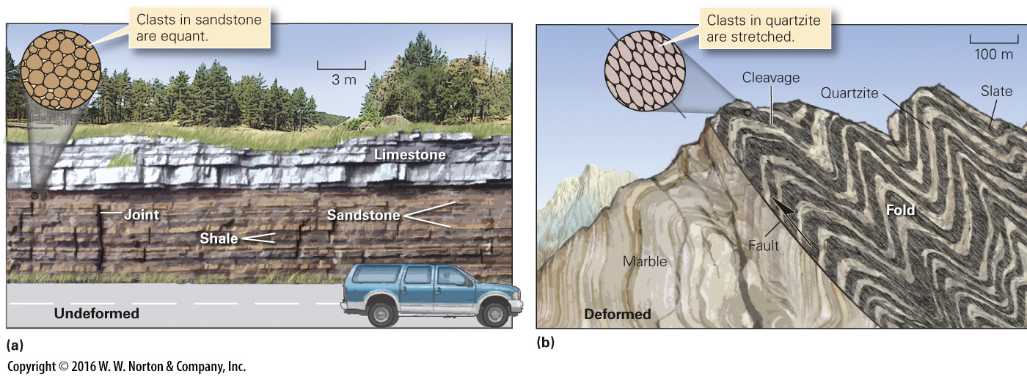
Notes:
FIGURE 9.2 Deformation changes the character and configuration of rocks.
(a) Flat-lying beds of strata along a highway in the Great Plains of North America are essentially undeformed. A few joints, formed when overlying rock eroded away, are visible. (b) In a mountain belt, deformation may cause layers to undergo folding and faulting. In addition, foliation (such as slaty cleavage) and stretched clasts may develop.

Slide 5
Notes:
FIGURE 9.2a Deformation changes the character and configuration of rocks.
(a) Flat-lying beds of strata along a highway in the Great Plains of North America are essentially undeformed. A few joints, formed when overlying rock eroded away, are visible.

Slide 6
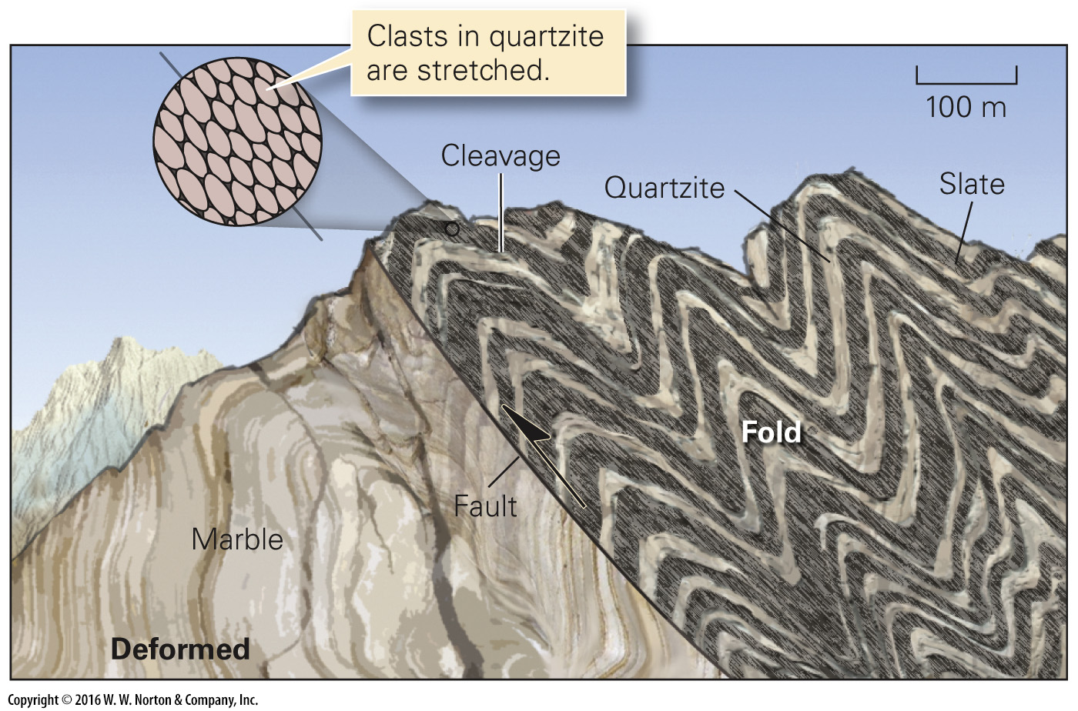
Notes:
FIGURE 9.2b Deformation changes the character and configuration of rocks.
(b) In a mountain belt, deformation may cause layers to undergo folding and faulting. In addition, foliation (such as slaty cleavage) and stretched clasts may develop.

Slide 7
Notes:
FIGURE 9.3 The components of deformation include displacement, rotation, and distortion.
(a) Displacement occurs when a block of rock moves from one place to another. (b) Rotation occurs when a body of rock undergoes tilting. (c) Distortion occurs when rock changes shape. The development of a fold represents one type of distortion.

Slide 8
Notes:
FIGURE 9.3a The components of deformation include displacement, rotation, and distortion.
(a) Displacement occurs when a block of rock moves from one place to another.

Slide 9
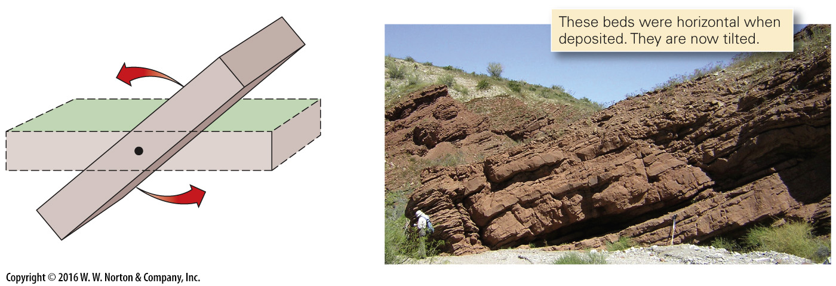
Notes:
FIGURE 9.3b The components of deformation include displacement, rotation, and distortion.
(b) Rotation occurs when a body of rock undergoes tilting.

Slide 10
Notes:
FIGURE 9.3c The components of deformation include displacement, rotation, and distortion.
(c) Distortion occurs when rock changes shape. The development of a fold represents one type of distortion.

Slide 11
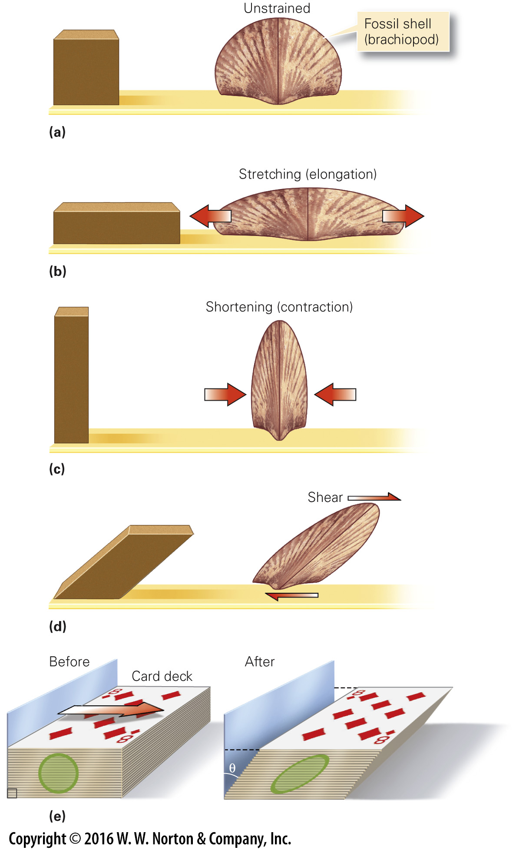
Notes:
FIGURE 9.4 Different kinds of strain in rock. Strain is a measure of the distortion, or change in shape, that takes place in rock during deformation.
(a) An unstrained cube and an unstrained fossil shell (brachiopod). (b) Horizontal stretching changes the cube into a horizontal brick and elongates the shell. (c) Horizontal shortening changes the cube into a vertical brick and makes the shell narrower. (d) Shear strain tilts the cube and transforms it into a parallelogram and changes angular relationships in the shell. (e) You can produce shear strain by moving a deck of cards so that each card slides a little with respect to the one below.

Slide 12
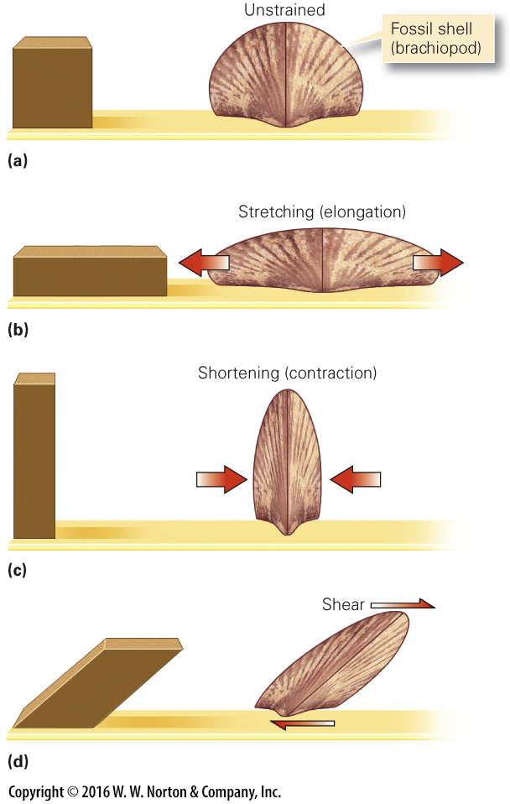
Notes:
FIGURE 9.4a–d Different kinds of strain in rock. Strain is a measure of the distortion, or change in shape, that takes place in rock during deformation.
(a) An unstrained cube and an unstrained fossil shell (brachiopod). (b) Horizontal stretching changes the cube into a horizontal brick and elongates the shell. (c) Horizontal shortening changes the cube into a vertical brick and makes the shell narrower. (d) Shear strain tilts the cube and transforms it into a parallelogram and changes angular relationships in the shell.

Slide 13
Notes:
FIGURE 9.4e Different kinds of strain in rock. Strain is a measure of the distortion, or change in shape, that takes place in rock during deformation.
(e) You can produce shear strain by moving a deck of cards so that each card slides a little with respect to the one below.

Slide 14
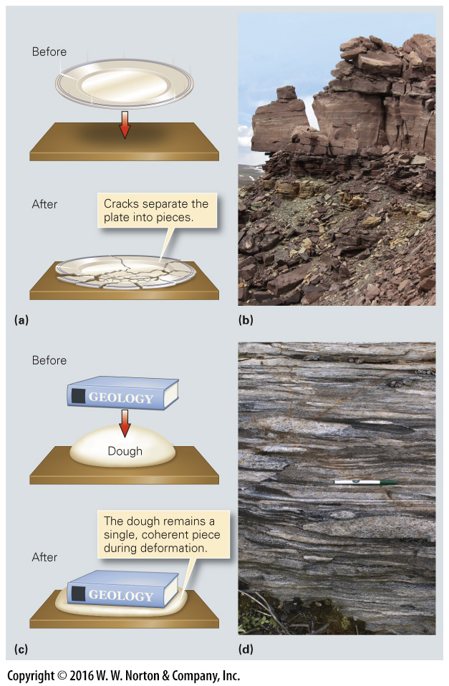
Notes:
FIGURE 9.5 Contrast between brittle and ductile deformation.
(a) Brittle deformation occurs when you drop a plate and it shatters. (b) Cracks in these quartzite beds in Utah are due to brittle deformation. (c) Ductile (plastic) deformation occurs when you press down on a ball of dough. (d) The quartzite cobbles in the conglomerate were flattened plastically.

Slide 15
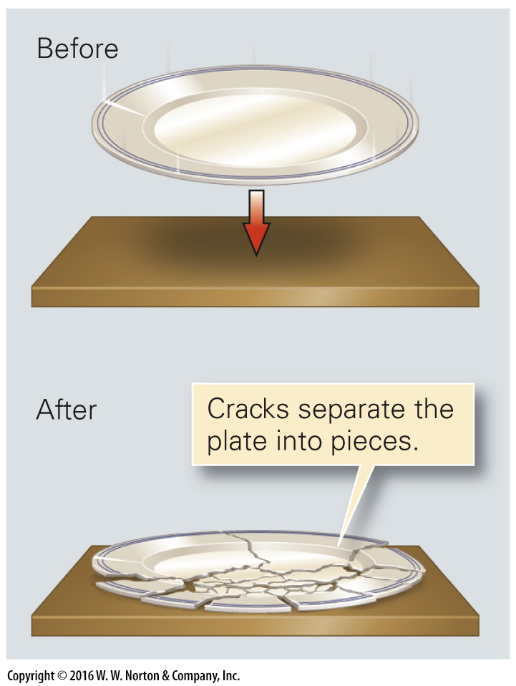
Notes:
FIGURE 9.5a Contrast between brittle and ductile deformation.
(a) Brittle deformation occurs when you drop a plate and it shatters.

Slide 16
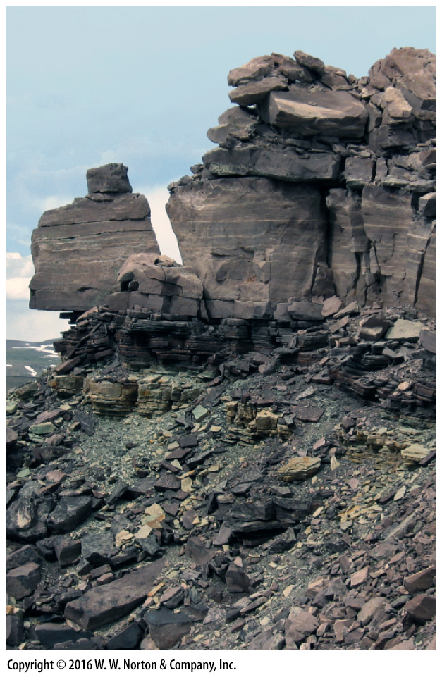
Notes:
FIGURE 9.5b Contrast between brittle and ductile deformation.
(b) Cracks in these quartzite beds in Utah are due to brittle deformation.

Slide 17
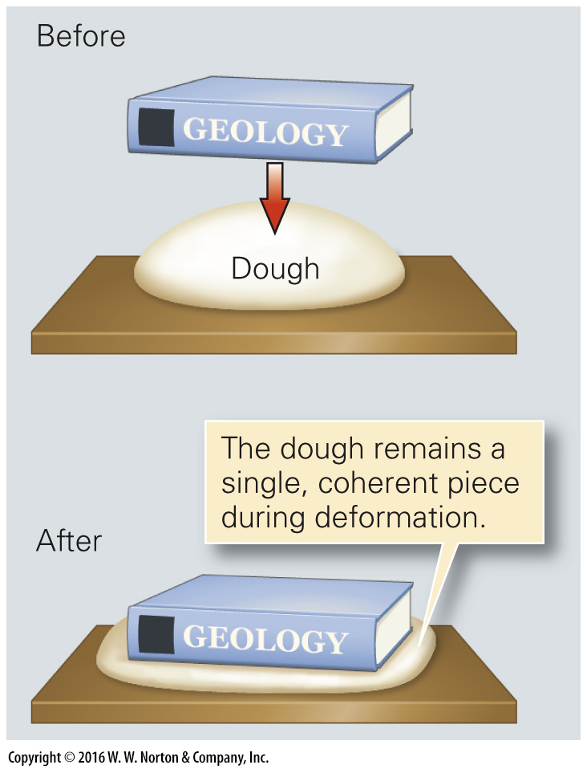
Notes:
FIGURE 9.5c Contrast between brittle and ductile deformation.
(c) Ductile (plastic) deformation occurs when you press down on a ball of dough.

Slide 18
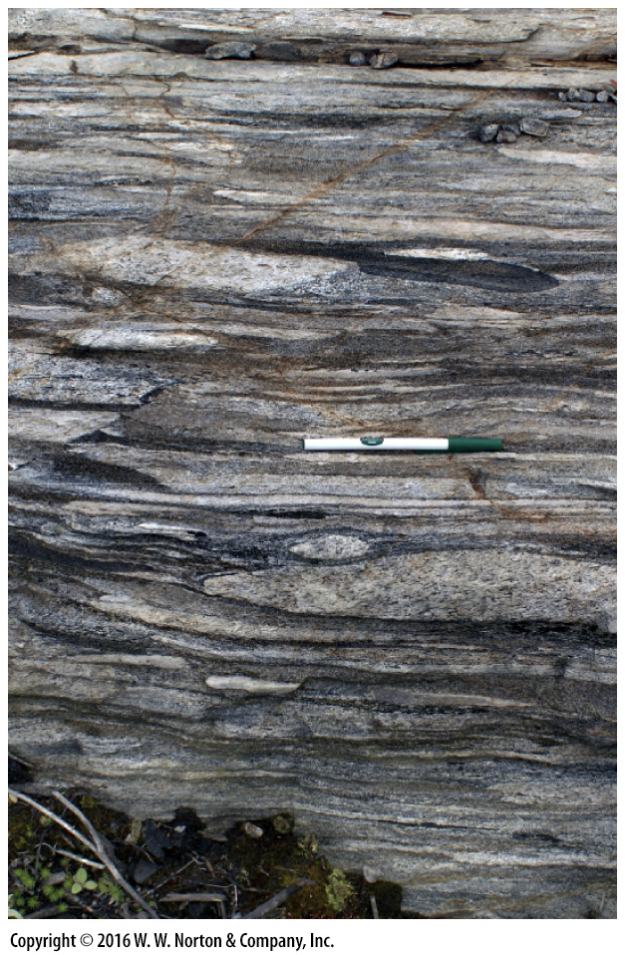
Notes:
FIGURE 9.5d Contrast between brittle and ductile deformation.
(d) The quartzite cobbles in the conglomerate were flattened plastically.

Slide 19
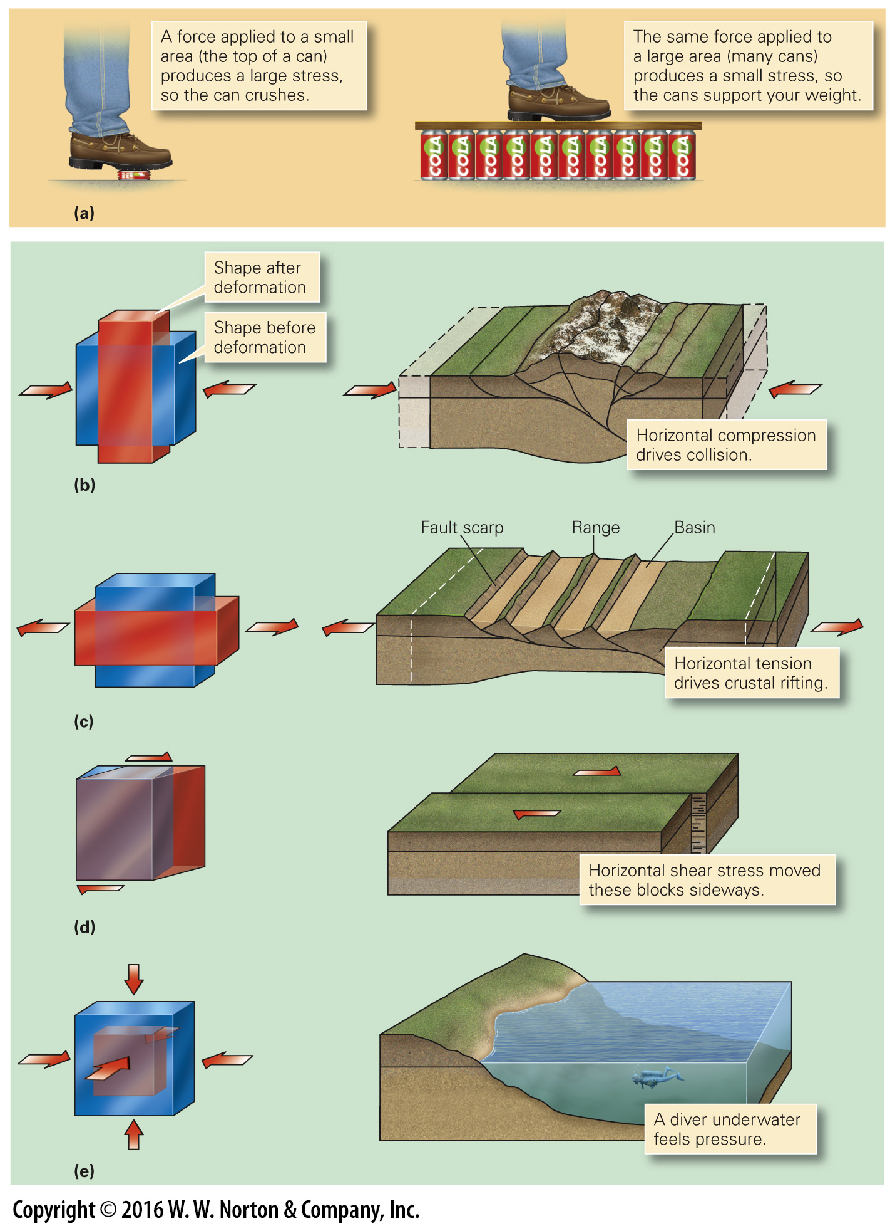
Notes:
FIGURE 9.6 There are several kinds of stress.
(a) The difference between stress and force. Stress is the force per unit area. (b) Compression takes place when an object is squeezed. (c) Tension occurs when the opposite ends of an object are pulled in opposite directions. (d) Shear stress develops when one surface of an object slides relative to the other surface. (e) Pressure occurs when an object feels the same stress on all sides.

Slide 20
Notes:
FIGURE 9.6a There are several kinds of stress.
(a) The difference between stress and force. Stress is the force per unit area.

Slide 21
Notes:
FIGURE 9.6b There are several kinds of stress.
(b) Compression takes place when an object is squeezed.

Slide 22
Notes:
FIGURE 9.6c There are several kinds of stress.
(c) Tension occurs when the opposite ends of an object are pulled in opposite directions.

Slide 23
Notes:
FIGURE 9.6d There are several kinds of stress.
(d) Shear stress develops when one surface of an object slides relative to the other surface.

Slide 24
Notes:
FIGURE 9.6e There are several kinds of stress.
(e) Pressure occurs when an object feels the same stress on all sides.

Slide 25
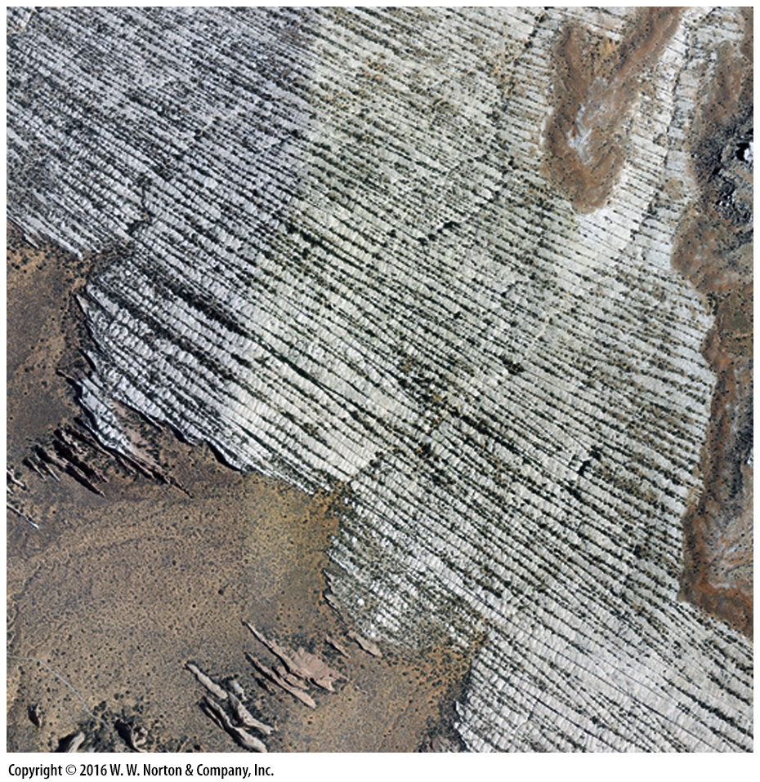
Notes:
SEE FOR YOURSELF…
JOINTS IN ARCHES NATIONAL PARK

Slide 26
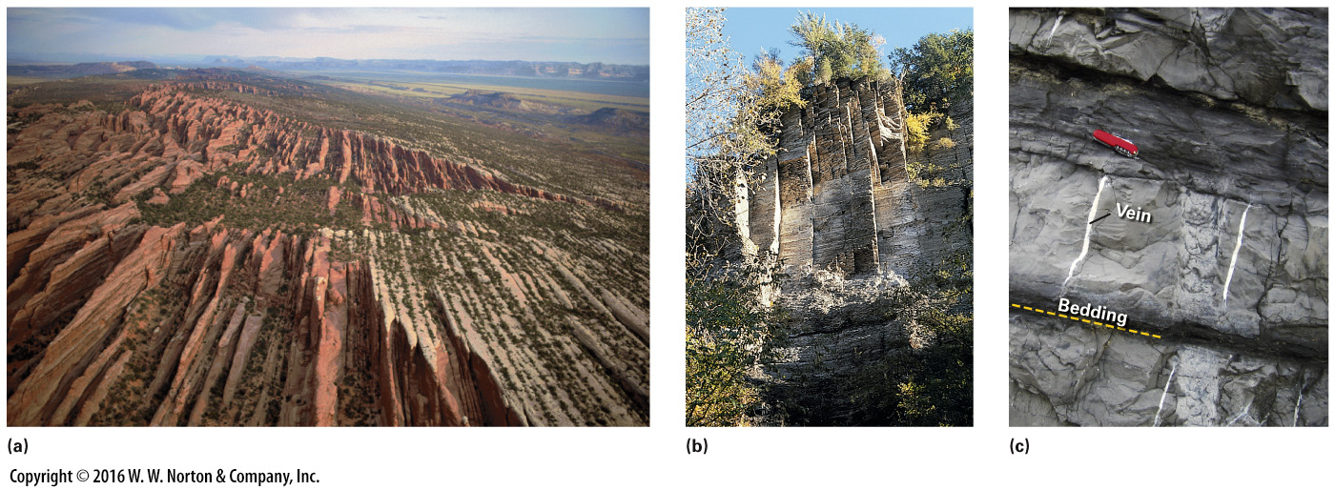
Notes:
FIGURE 9.7 Examples of joints and veins.
(a) Prominent vertical joints cut red sandstone beds in Arches National Park, Utah, as seen from the air. (b) Vertical joints on a cliff face in shale near Ithaca, New York. (c) Milky white quartz veins cut across gray limestone beds.

Slide 27
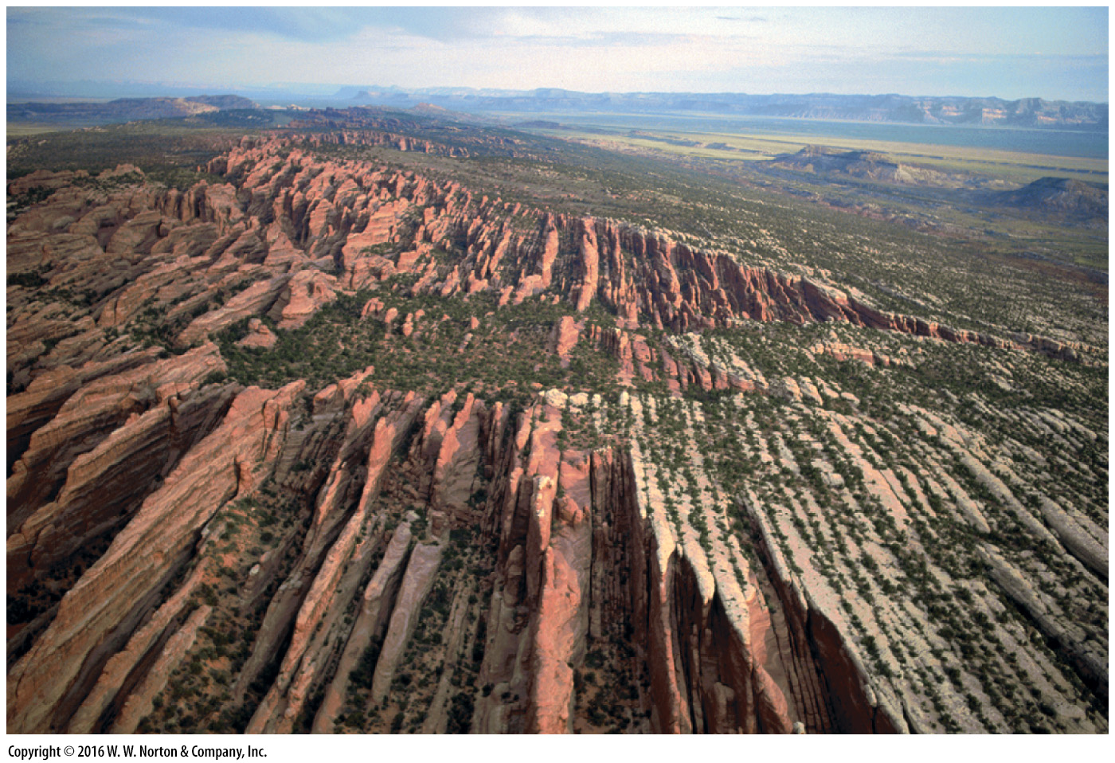
Notes:
FIGURE 9.7a Examples of joints and veins.
(a) Prominent vertical joints cut red sandstone beds in Arches National Park, Utah, as seen from the air.

Slide 28
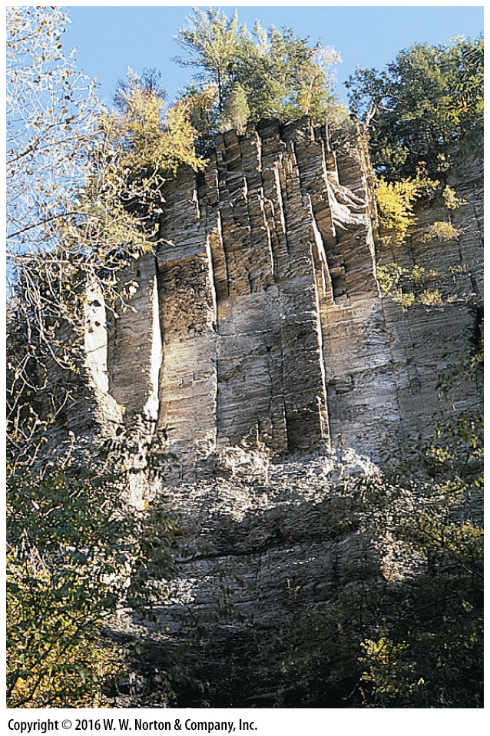
Notes:
FIGURE 9.7b Examples of joints and veins.
(b) Vertical joints on a cliff face in shale near Ithaca, New York.

Slide 29
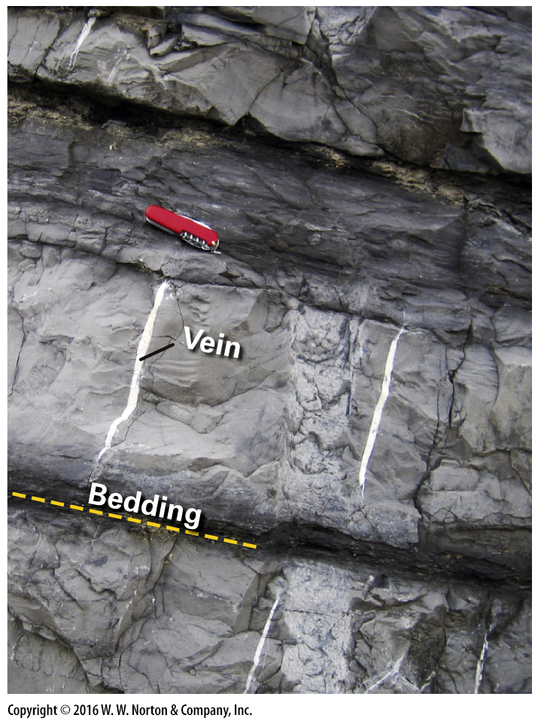
Notes:
FIGURE 9.7c Examples of joints and veins.
(c) Milky white quartz veins cut across gray limestone beds.

Slide 30
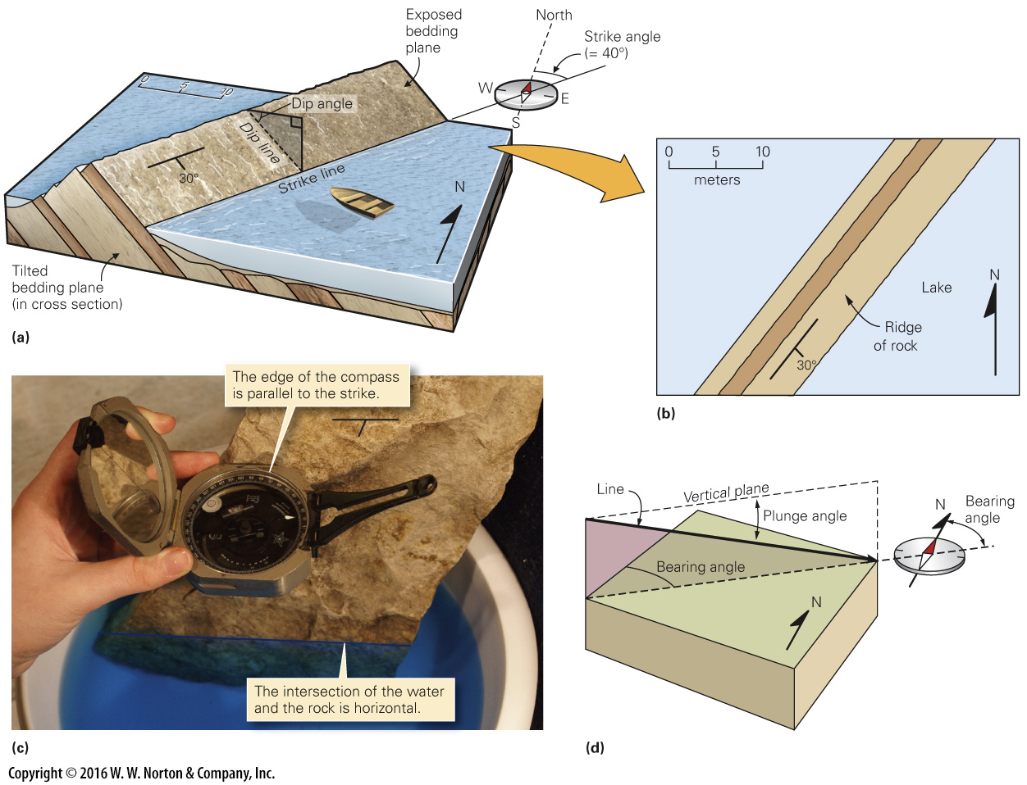
Notes:
FIGURE BX9.1 Specifying the orientation of planar and linear structures.
(a) We use strike and dip to measure the orientation of planar structures, such as these tilted beds. The shaded plane is vertical. (b) On a map, the line segment represents the strike direction and the tick on the segment represents the dip direction. The number indicates the dip angle as measured in degrees. (c) Geologists use a Brunton compass to measure strike and dip. (d) To specify the orientation of a line, we use plunge and bearing.

Slide 31
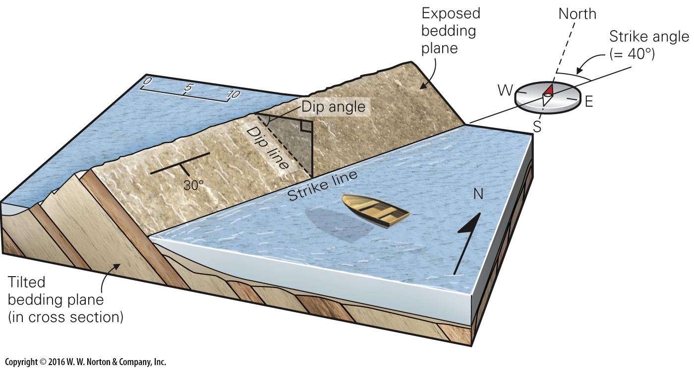
Notes:
FIGURE BX9.1a Specifying the orientation of planar and linear structures.
(a) We use strike and dip to measure the orientation of planar structures, such as these tilted beds. The shaded plane is vertical.

Slide 32
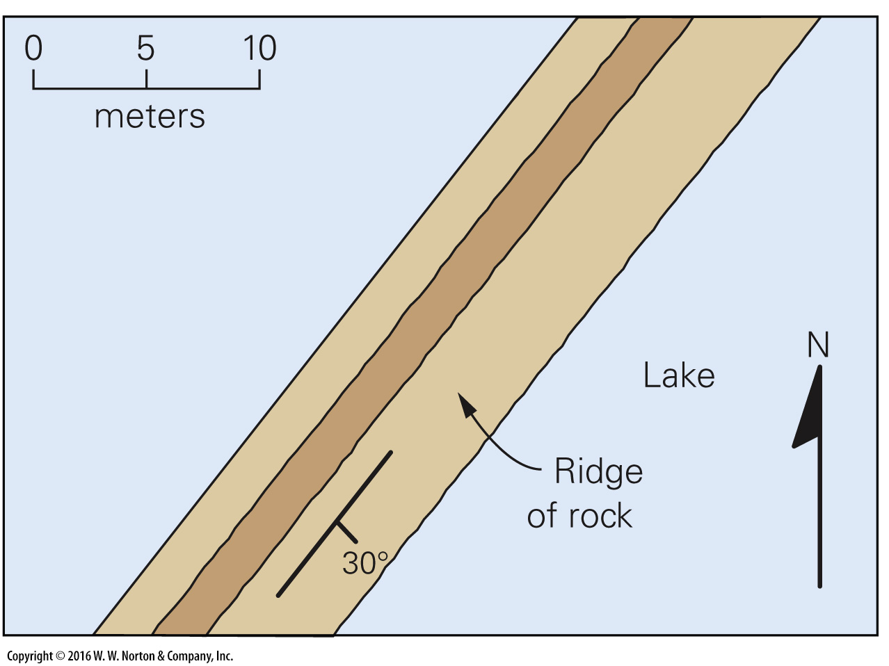
Notes:
FIGURE BX9.1b Specifying the orientation of planar and linear structures.
(b) On a map, the line segment represents the strike direction and the tick on the segment represents the dip direction. The number indicates the dip angle as measured in degrees.

Slide 33
Notes:
FIGURE BX9.1c Specifying the orientation of planar and linear structures.
(c) Geologists use a Brunton compass to measure strike and dip.

Slide 34
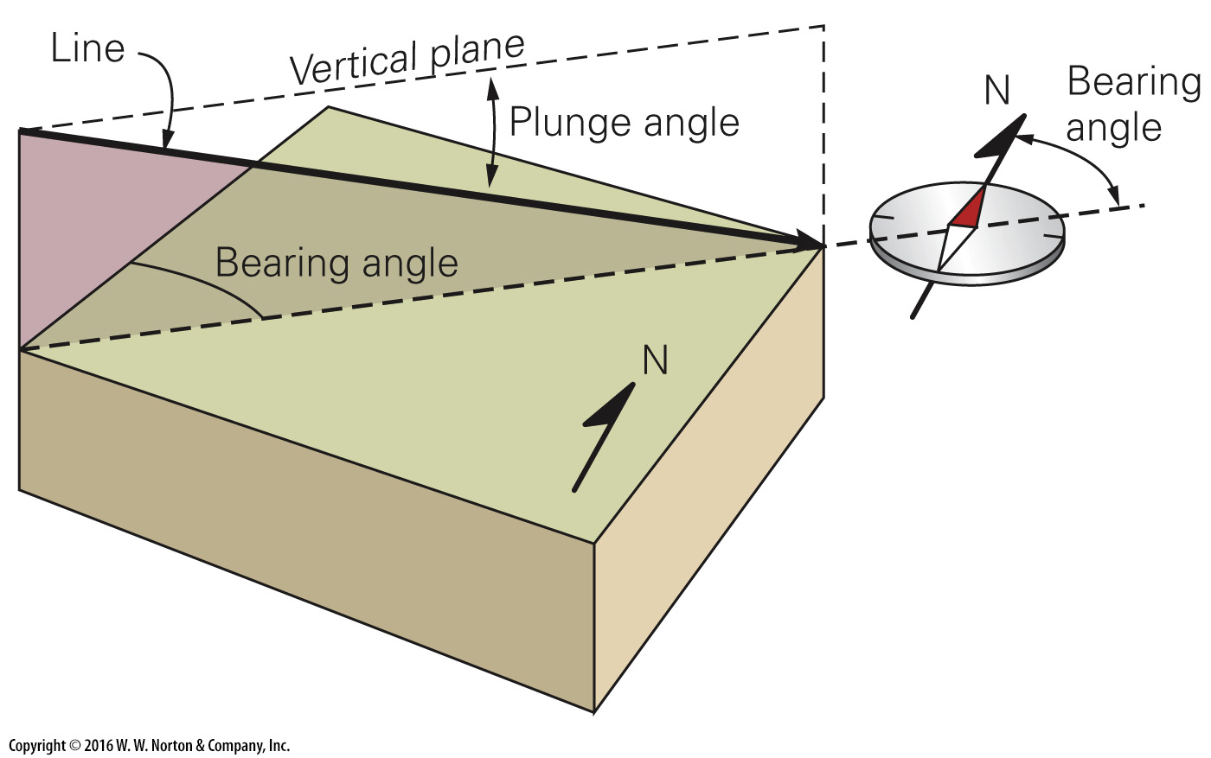
Notes:
FIGURE BX9.1d Specifying the orientation of planar and linear structures.
(d) To specify the orientation of a line, we use plunge and bearing.

Slide 35
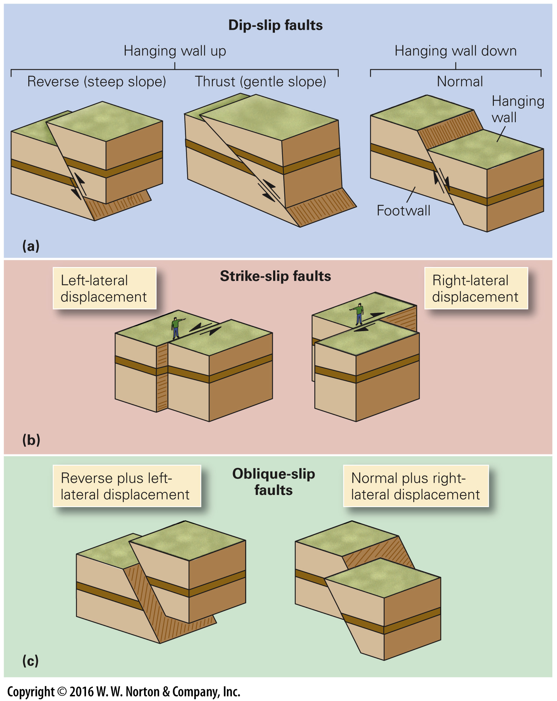
Notes:
FIGURE 9.8 The different categories of faults.
(a) Displacement on a dip-slip fault is parallel to the fault’s slope. (b) Displacement on a strike-slip fault moves one block horizontally with respect to the other. There is no up-and-down motion. (c) Displacement on an oblique-slip fault combines dip-slip and strike-slip displacement. One block moves diagonally relative to the other.

Slide 36
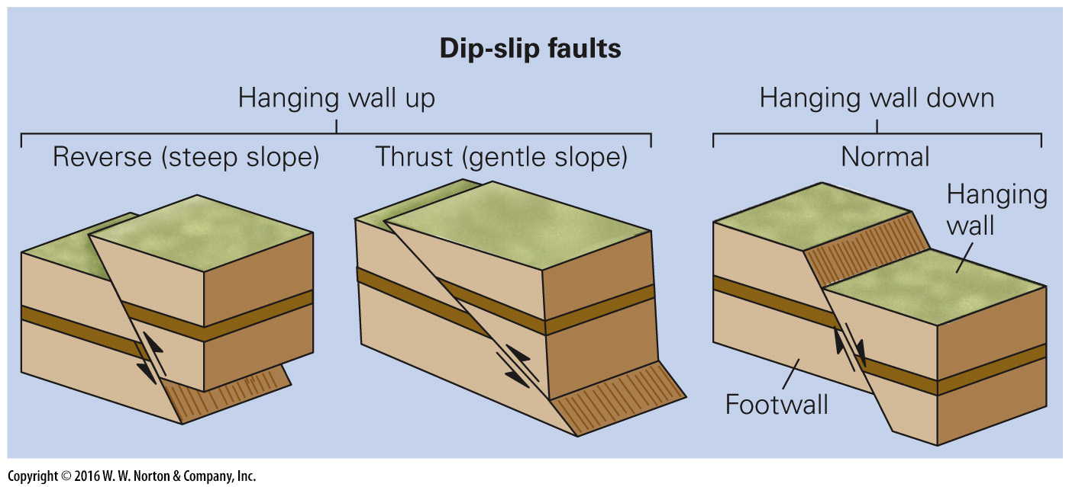
Notes:
FIGURE 9.8a The different categories of faults.
(a) Displacement on a dip-slip fault is parallel to the fault’s slope.

Slide 37
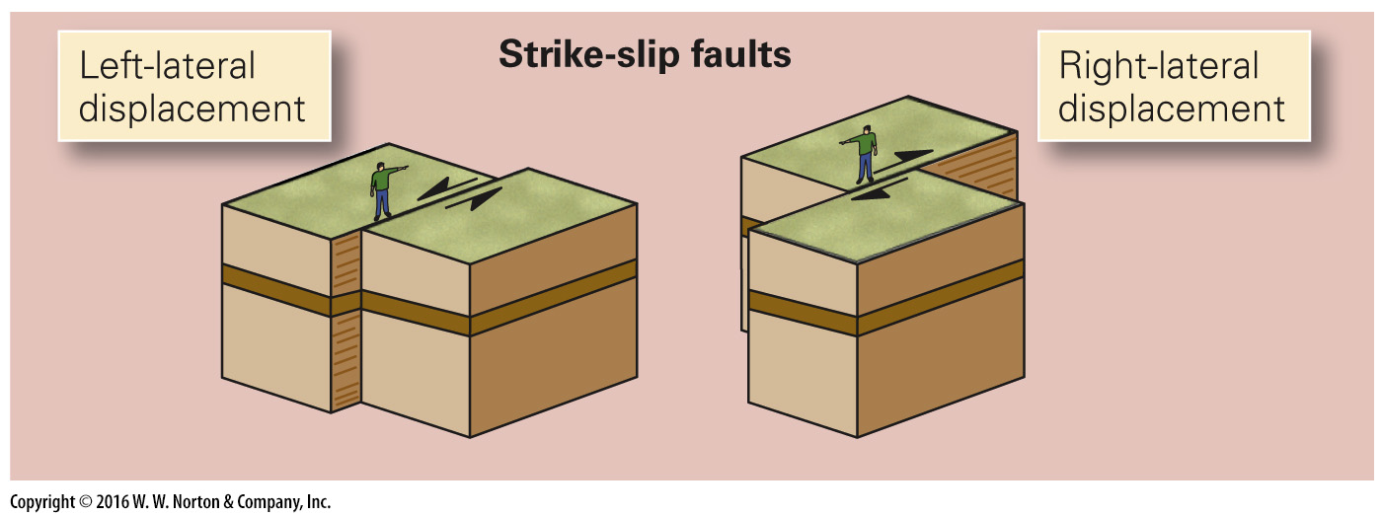
Notes:
FIGURE 9.8b The different categories of faults.
(b) Displacement on a strike-slip fault moves one block horizontally with respect to the other. There is no up-and-down motion.

Slide 38
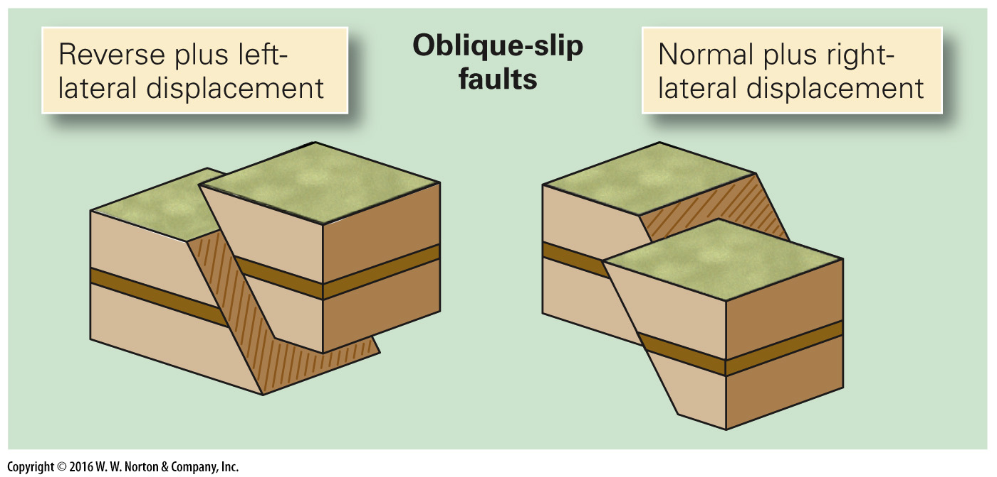
Notes:
FIGURE 9.8c The different categories of faults.
(c) Displacement on an oblique-slip fault combines dip-slip and strike-slip displacement. One block moves diagonally relative to the other.

Slide 39
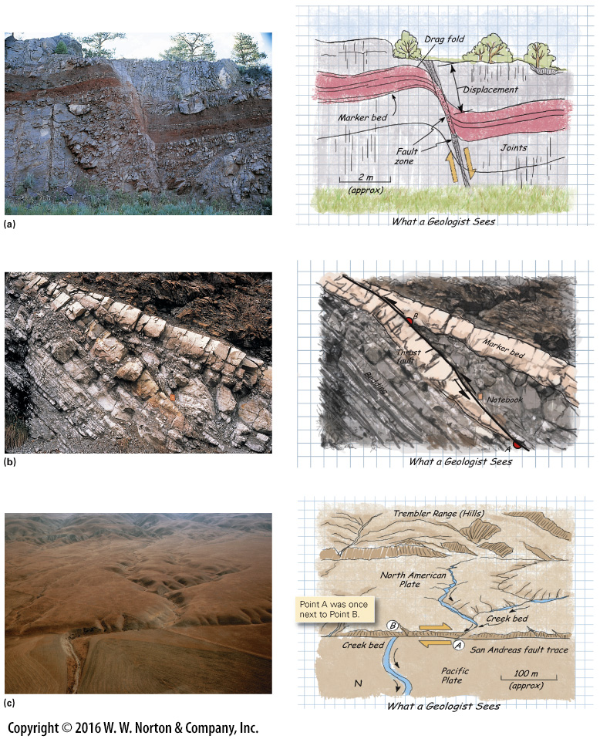
Notes:
FIGURE 9.9 Recognizing fault displacement in the field.
(a) A steep normal fault has displaced a distinctive red bed (a marker layer). Note that the displacement formed a 0.5-m-wide fault zone of broken rock. Drag folds developed adjacent to the fault. (b) Slip on a thrust fault caused one part of the light-colored marker bed to be shoved over another part, as emphasized in the drawing. Note that the beds are tilted to the right. The distance between the red dots is the displacement. (c) An aerial photograph of a portion of the San Andreas Fault. As emphasized by the sketch, the fault offsets a stream channel in a right-lateral sense.

Slide 40
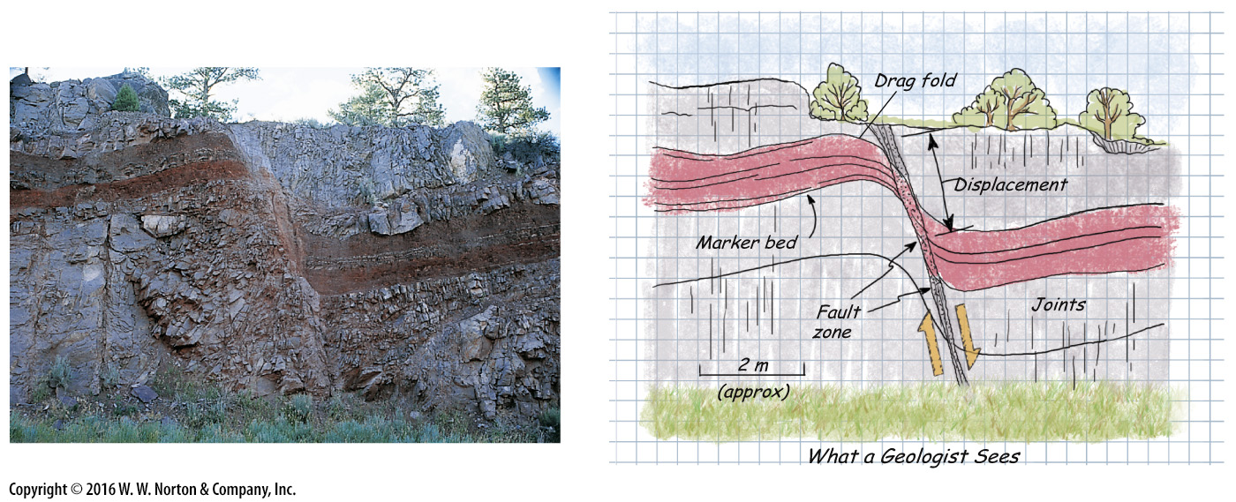
Notes:
FIGURE 9.9a Recognizing fault displacement in the field.
(a) A steep normal fault has displaced a distinctive red bed (a marker layer). Note that the displacement formed a 0.5-m-wide fault zone of broken rock. Drag folds developed adjacent to the fault.

Slide 41
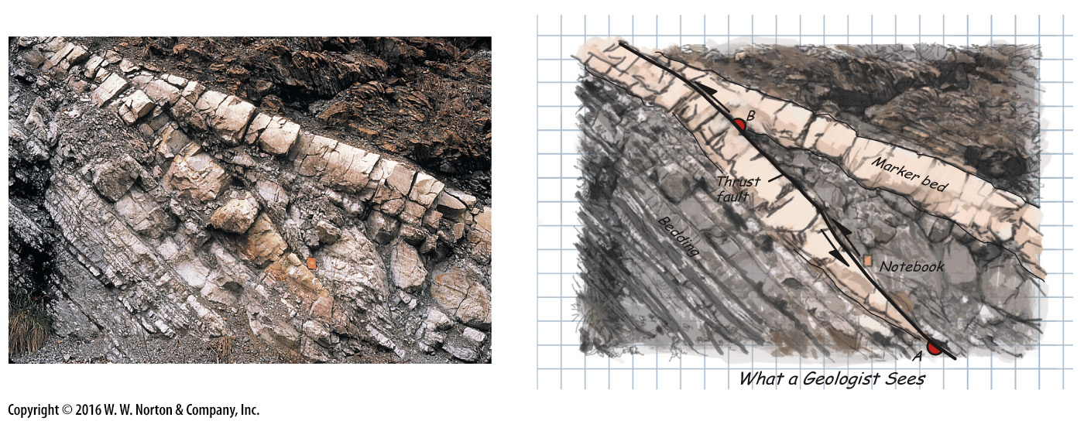
Notes:
FIGURE 9.9b Recognizing fault displacement in the field.
(b) Slip on a thrust fault caused one part of the light-colored marker bed to be shoved over another part, as emphasized in the drawing. Note that the beds are tilted to the right. The distance between the red dots is the displacement.

Slide 42
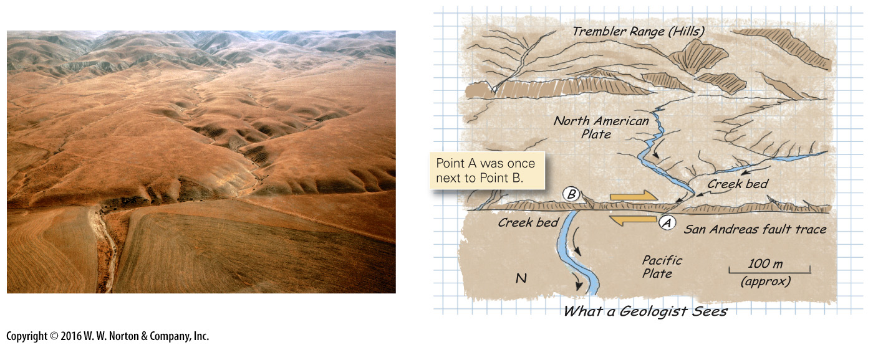
Notes:
FIGURE 9.9c Recognizing fault displacement in the field.
(c) An aerial photograph of a portion of the San Andreas Fault. As emphasized by the sketch, the fault offsets a stream channel in a right-lateral sense.

Slide 43
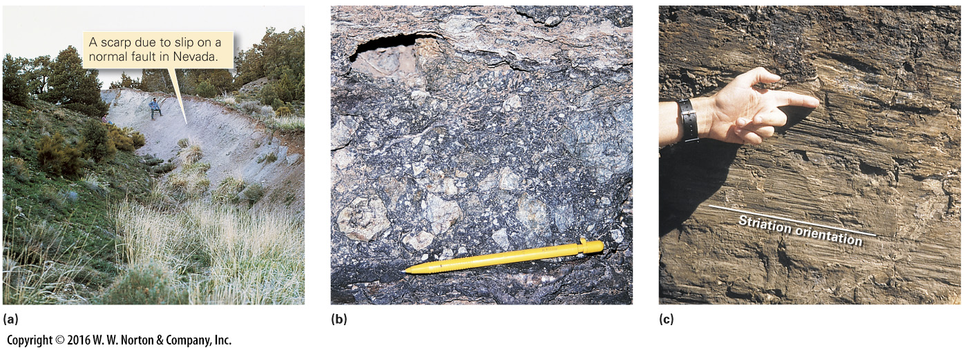
Notes:
FIGURE 9.10 Features of exposed fault surfaces.
(a) A fault scarp develops where faulting displaces the land surface. (b) This fault breccia consists of irregular fragments of light-colored rock. (c) Slip lineations or striations on the surface of a strike-slip fault may look like grooves or scratches.

Slide 44
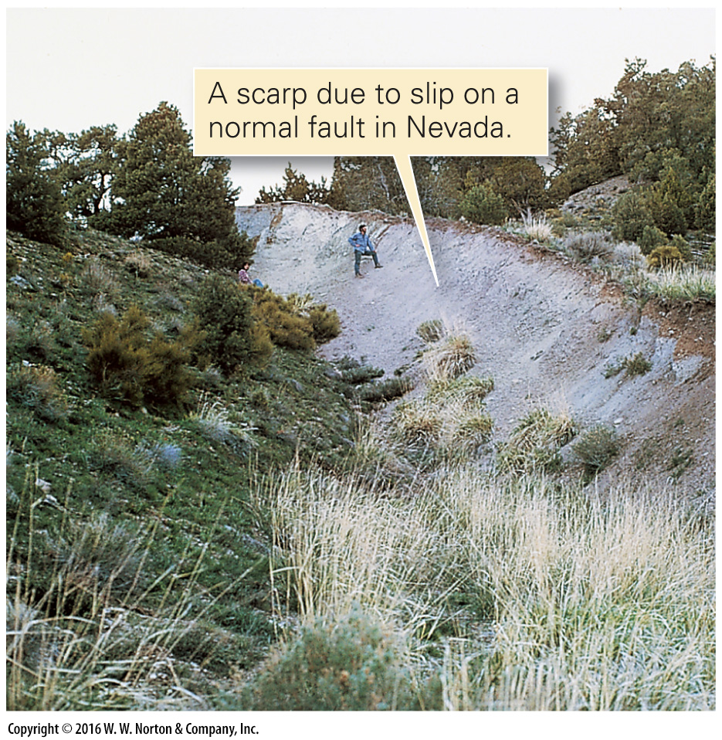
Notes:
FIGURE 9.10a Features of exposed fault surfaces.
(a) A fault scarp develops where faulting displaces the land surface.

Slide 45
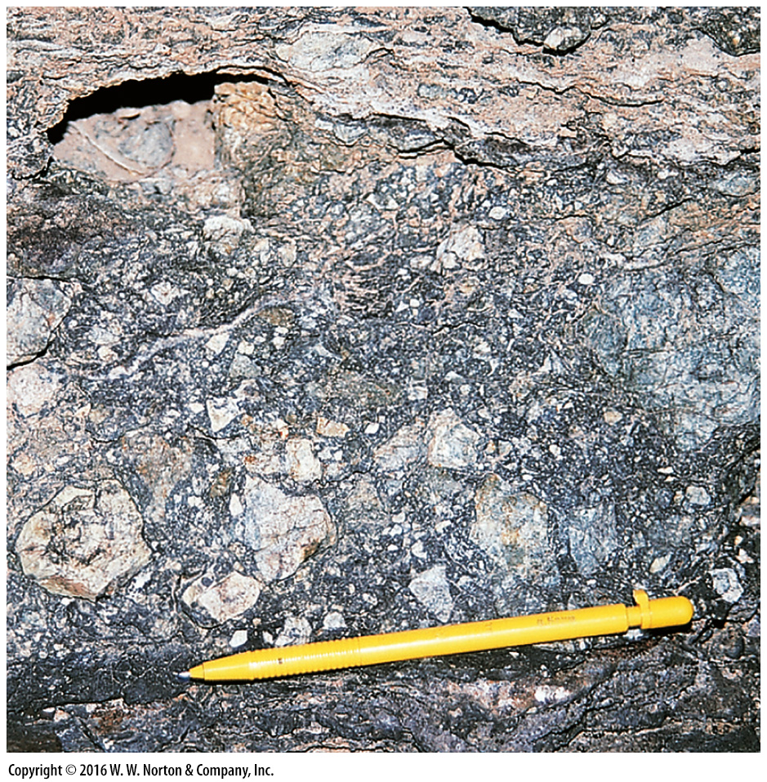
Notes:
FIGURE 9.10b Features of exposed fault surfaces.
(b) This fault breccia consists of irregular fragments of light-colored rock.

Slide 46
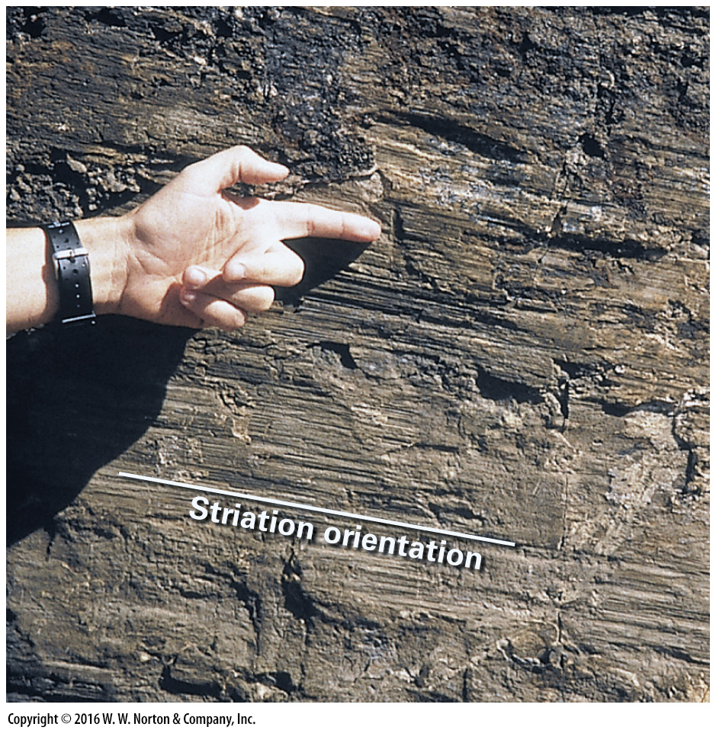
Notes:
FIGURE 9.10c Features of exposed fault surfaces.
(c) Slip lineations or striations on the surface of a strike-slip fault may look like grooves or scratches.

Slide 47
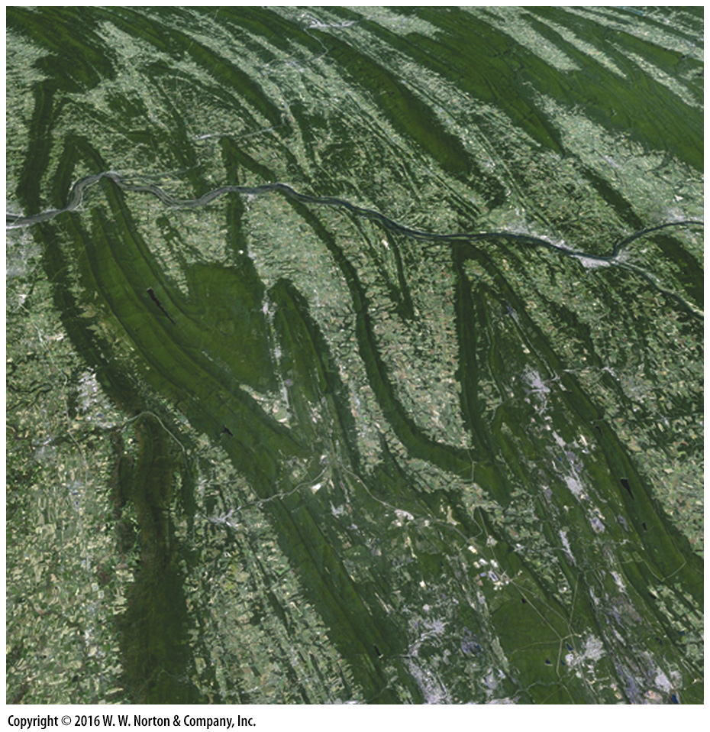
Notes:
SEE FOR YOURSELF…
APPALACHIAN FOLD BELT

Slide 48
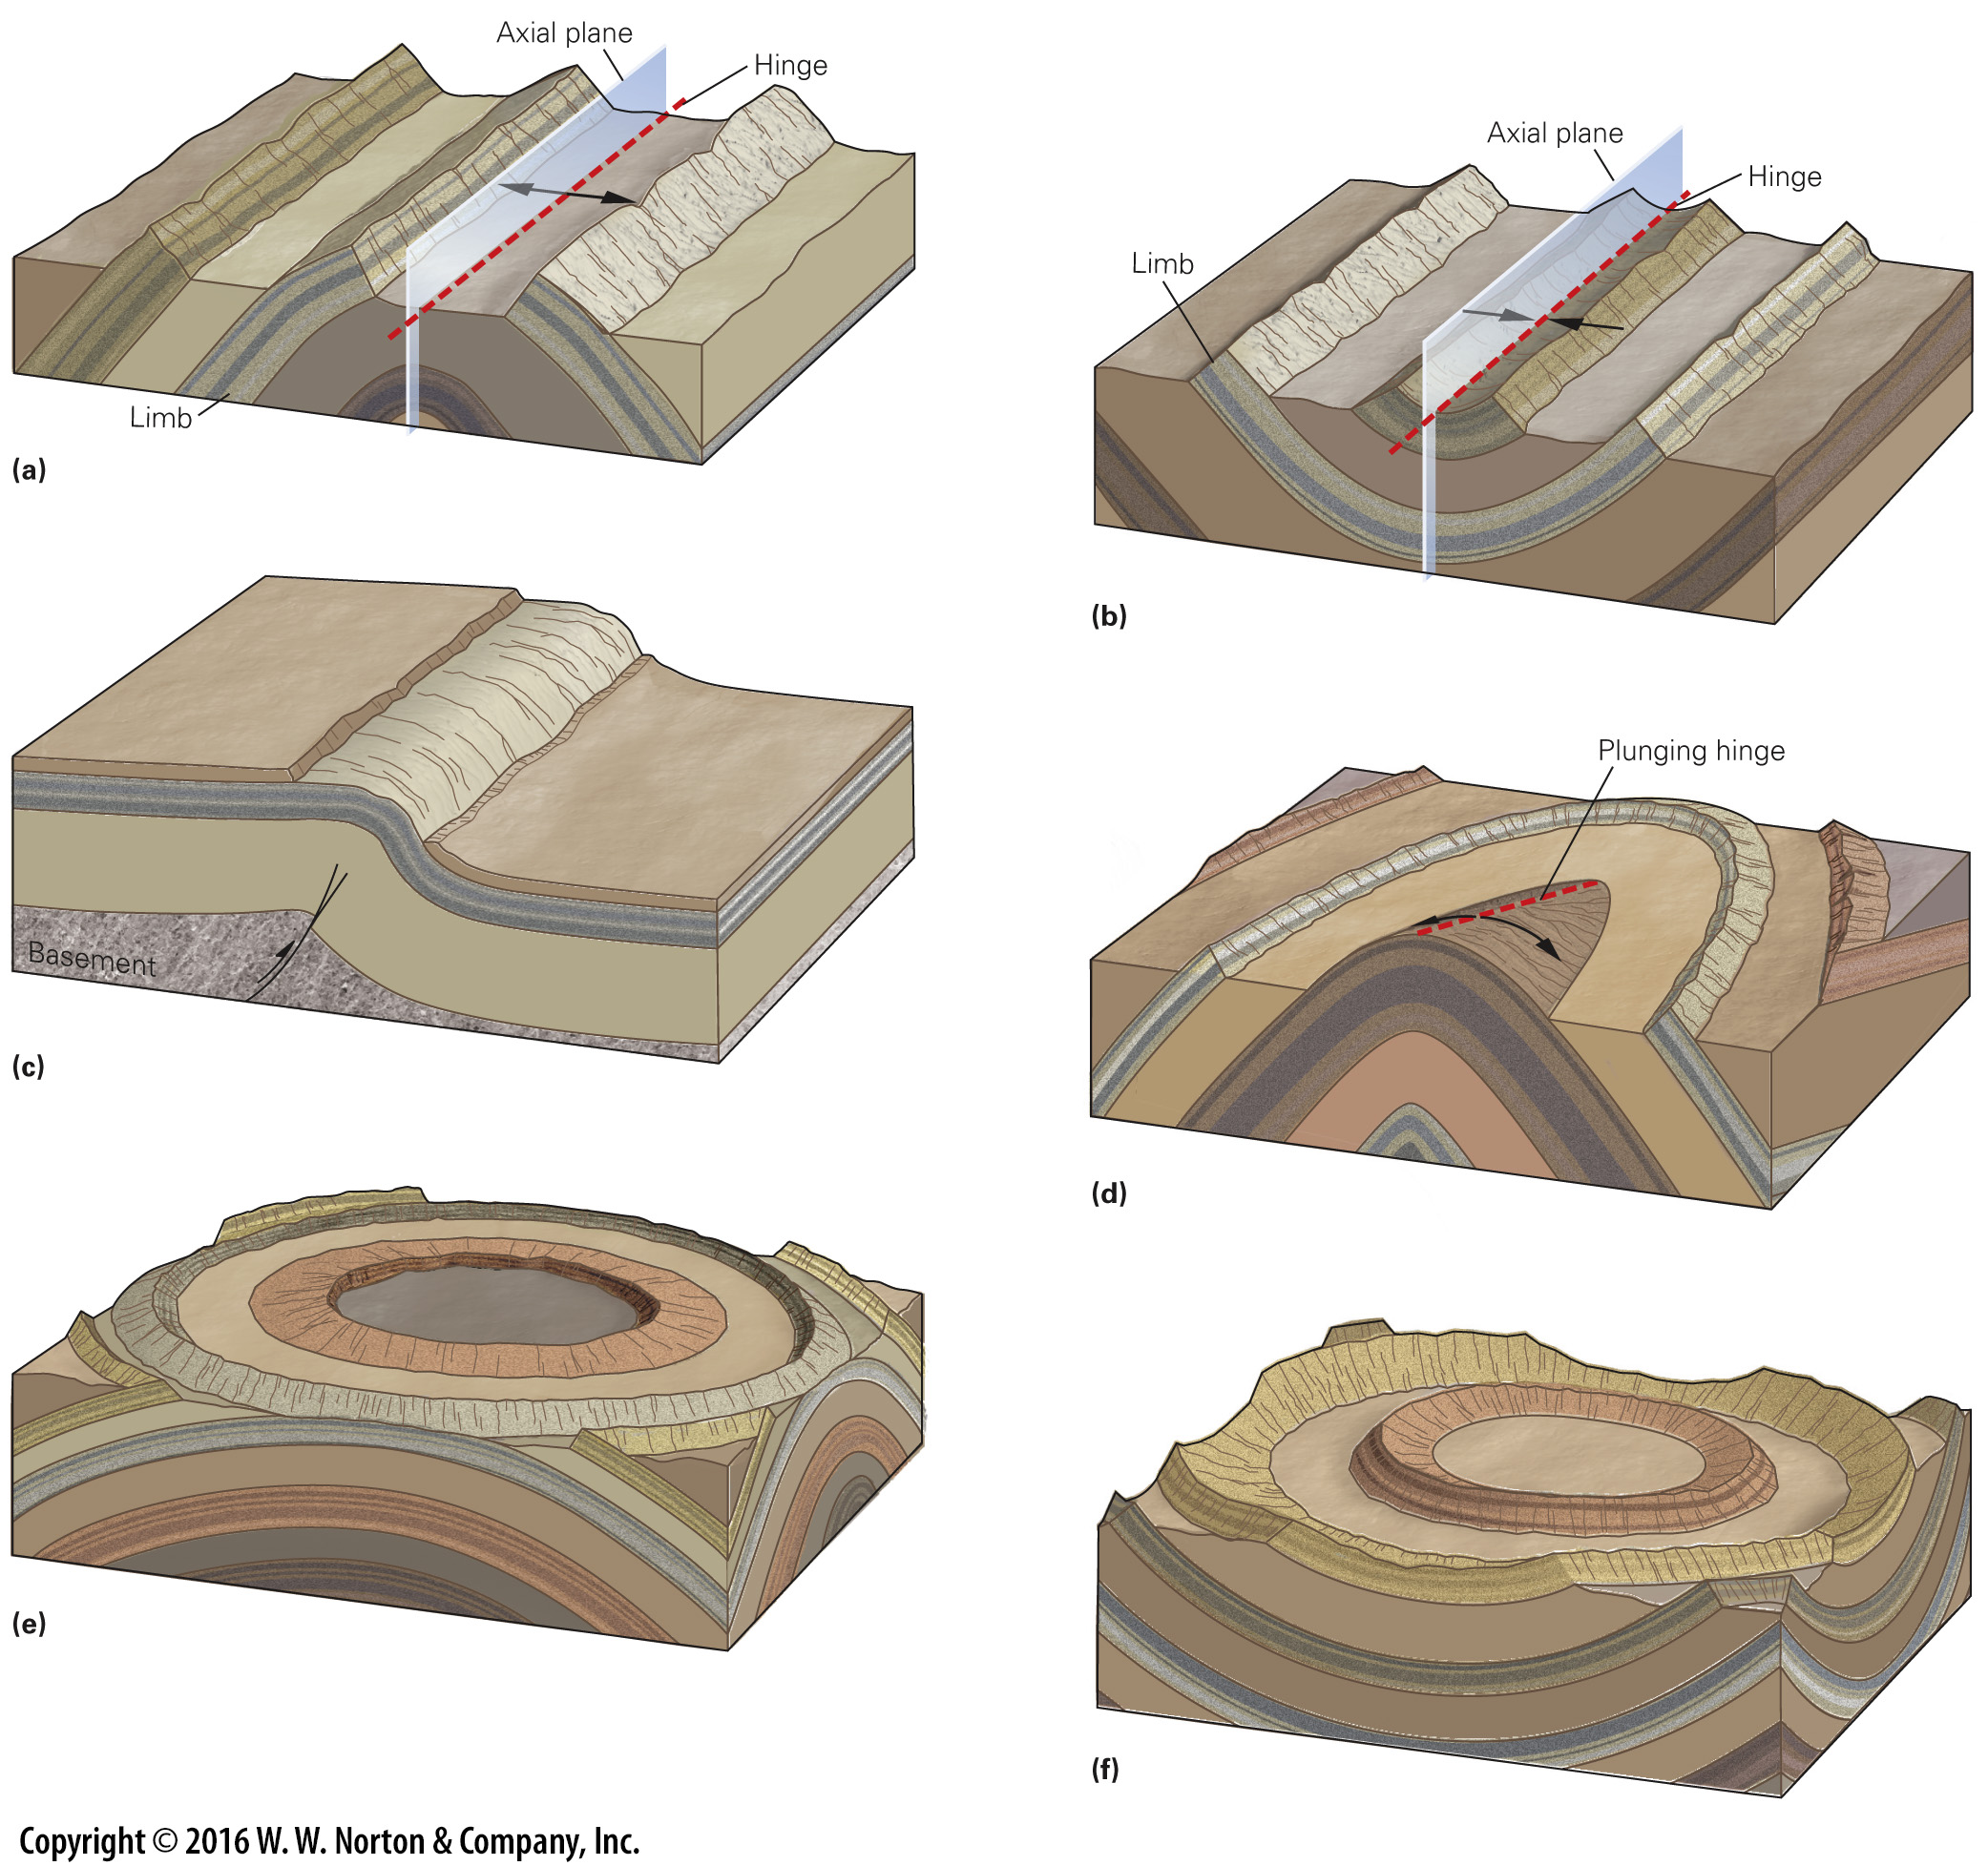
Notes:
FIGURE 9.11 Geometric characteristics of folds.
(a) An anticline looks like an arch. The beds dip away from the hinge. (b) A syncline looks like a trough. The beds dip toward the hinge. (c) A monocline looks like a stair step and is commonly draped over a fault block. (d) A plunging anticline has a tilted hinge. (e) A dome has the shape of an overturned bowl. (f) A basin has the shape of an upright bowl.

Slide 49
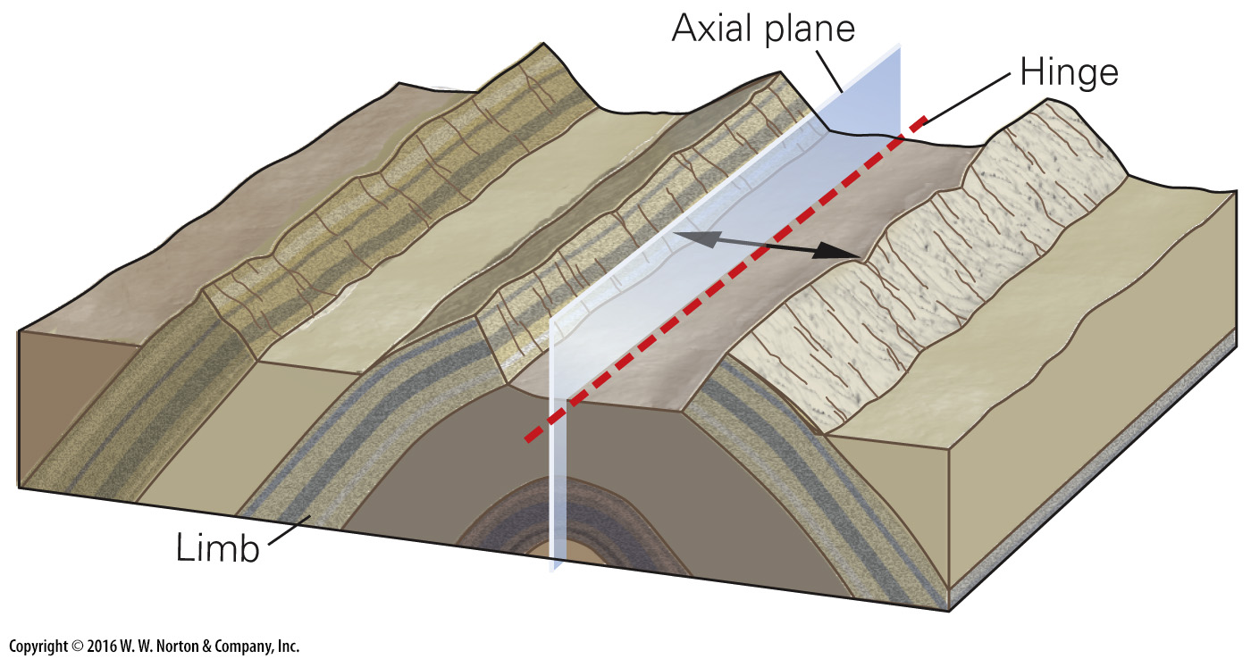
Notes:
FIGURE 9.11a Geometric characteristics of folds.
(a) An anticline looks like an arch. The beds dip away from the hinge.

Slide 50
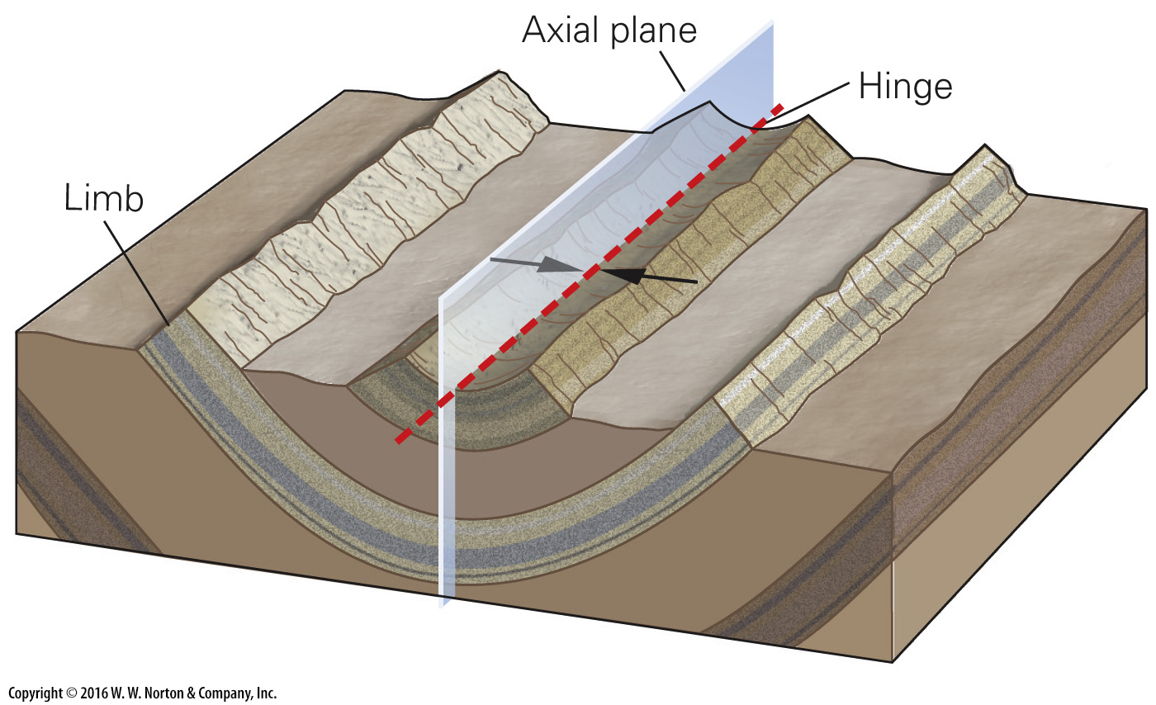
Notes:
FIGURE 9.11b Geometric characteristics of folds.
(b) A syncline looks like a trough. The beds dip toward the hinge.

Slide 51
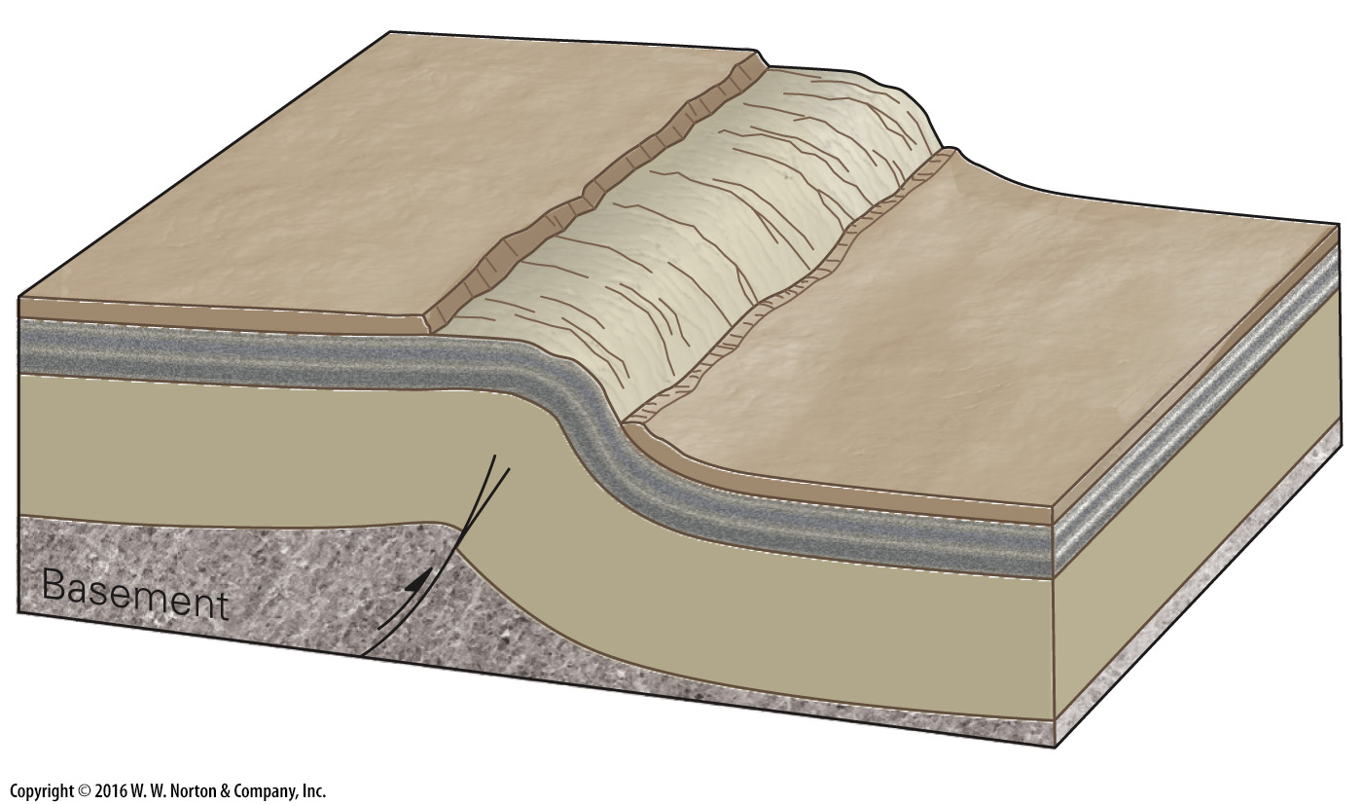
Notes:
FIGURE 9.11c Geometric characteristics of folds.
(c) A monocline looks like a stair step and is commonly draped over a fault block.

Slide 52
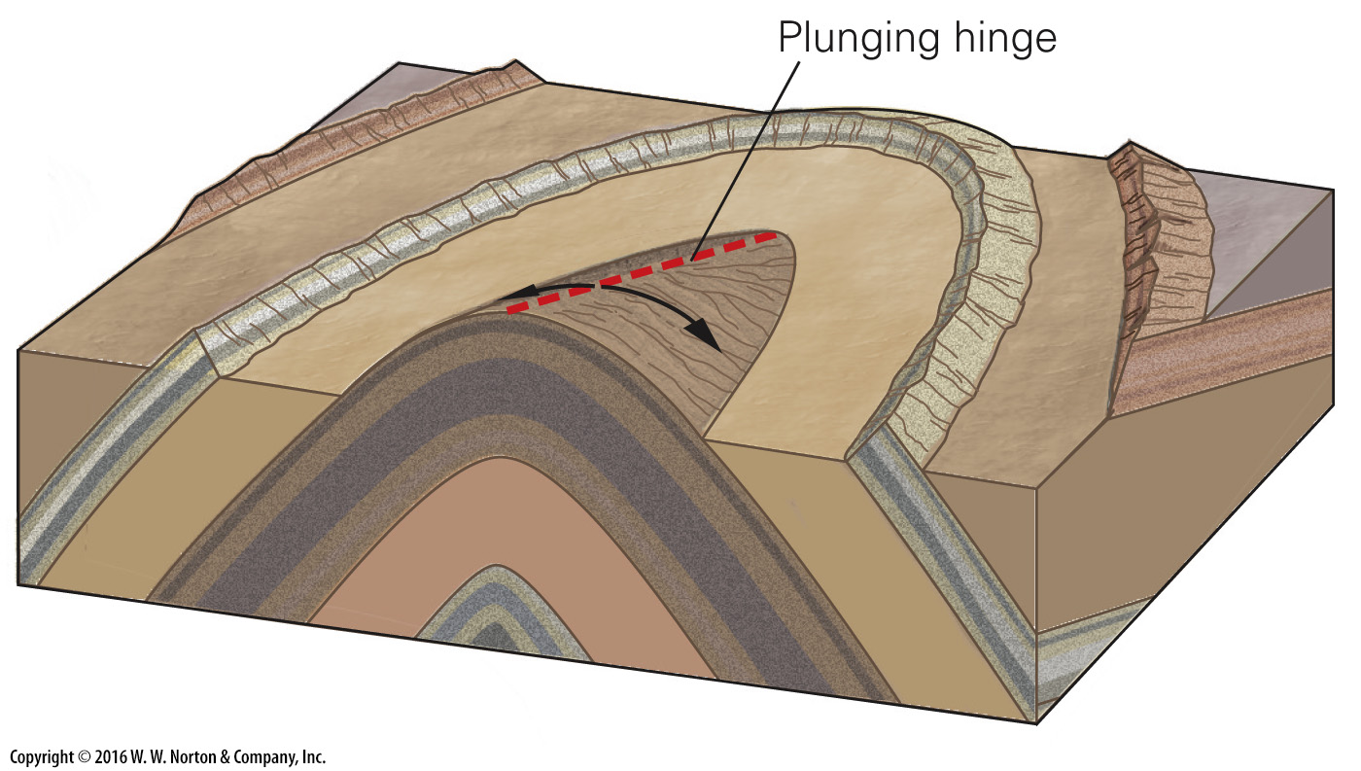
Notes:
FIGURE 9.11d Geometric characteristics of folds.
(d) A plunging anticline has a tilted hinge.

Slide 53
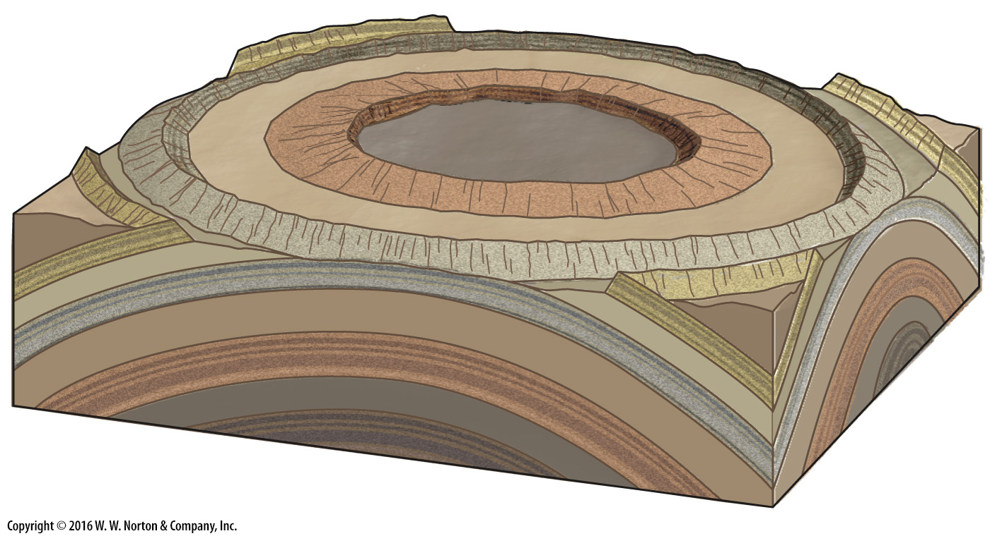
Notes:
FIGURE 9.11e Geometric characteristics of folds.
(e) A dome has the shape of an overturned bowl.

Slide 54
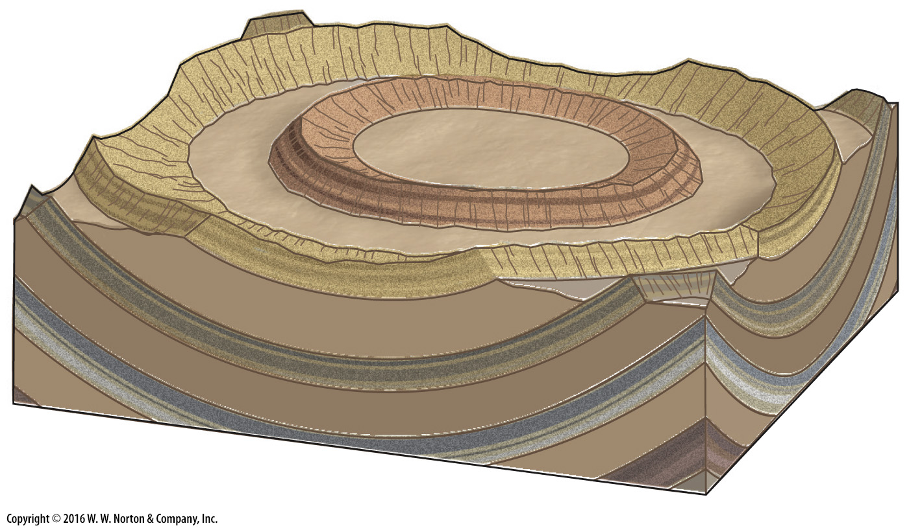
Notes:
FIGURE 9.11f Geometric characteristics of folds.
(f) A basin has the shape of an upright bowl.

Slide 55
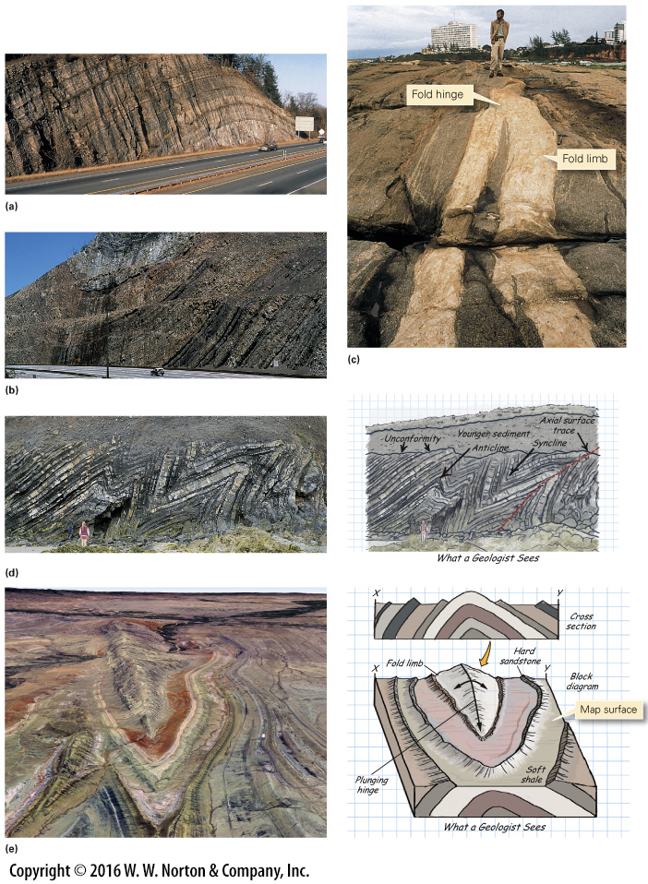
Notes:
FIGURE 9.12 Examples of folds on outcrops and in the landscape.
(a) This anticline, exposed in a road cut near Kingston, New York, involves beds of Paleozoic limestone. (b) This syncline, exposed in a road cut in Maryland, involves beds of Paleozoic sandstone and shale. (c) This fold, exposed along the coast of Brazil, occurs in Precambrian gneiss. (d) A train of folds exposed in sea cliffs in eastern Ireland includes anticlines and synclines. The folds affect beds of Paleozoic sandstone and shale. (e) The plunging anticline of Sheep Mountain, Wyoming, is easy to see because of the lack of vegetation. Resistant rock layers (sandstone) stand out as ridges, whereas weak rock layers (shale) erode away. A block diagram shows how surface exposures relate to underground structure.

Slide 56
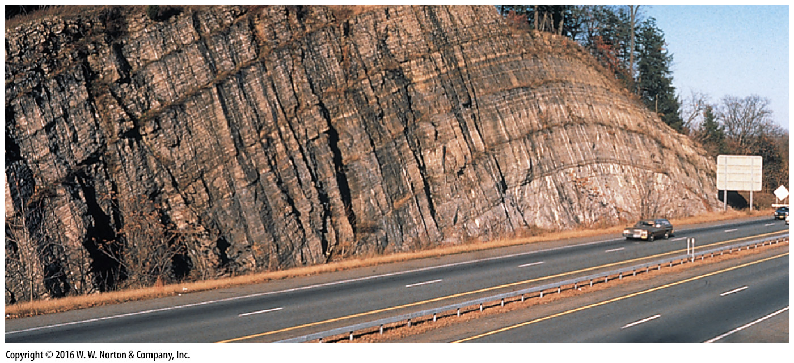
Notes:
FIGURE 9.12a Examples of folds on outcrops and in the landscape.
(a) This anticline, exposed in a road cut near Kingston, New York, involves beds of Paleozoic limestone.

Slide 57
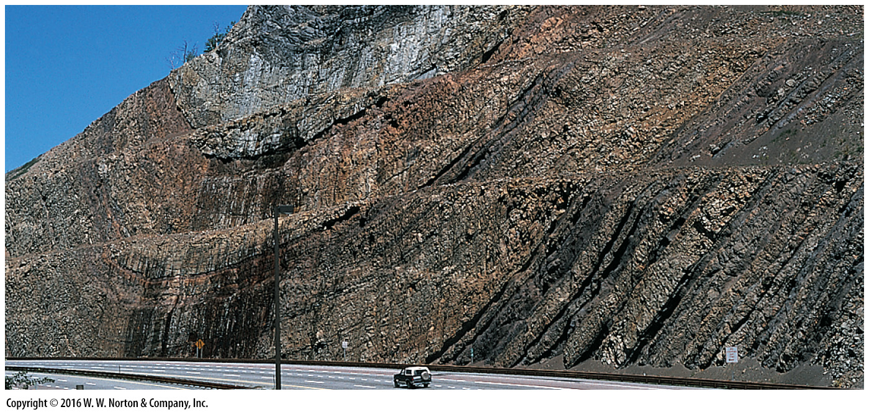
Notes:
FIGURE 9.12b Examples of folds on outcrops and in the landscape.
(b) This syncline, exposed in a road cut in Maryland, involves beds of Paleozoic sandstone and shale.

Slide 58
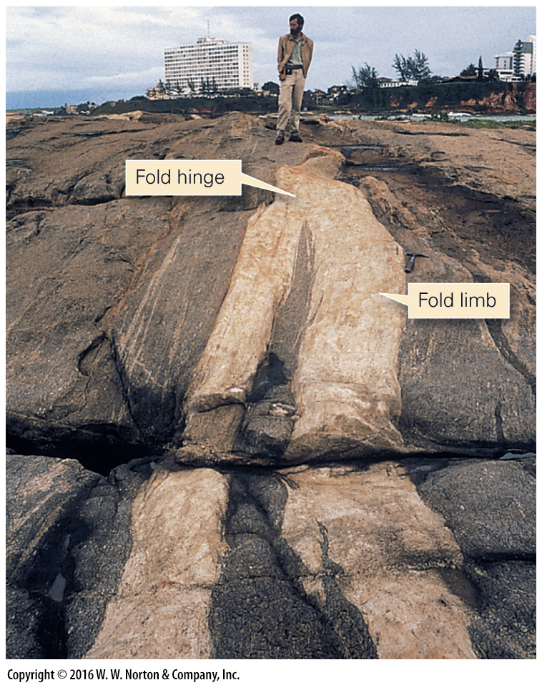
Notes:
FIGURE 9.12c Examples of folds on outcrops and in the landscape.
(c) This fold, exposed along the coast of Brazil, occurs in Precambrian gneiss.

Slide 59
Notes:
FIGURE 9.12d Examples of folds on outcrops and in the landscape.
(d) A train of folds exposed in sea cliffs in eastern Ireland includes anticlines and synclines. The folds affect beds of Paleozoic sandstone and shale.

Slide 60
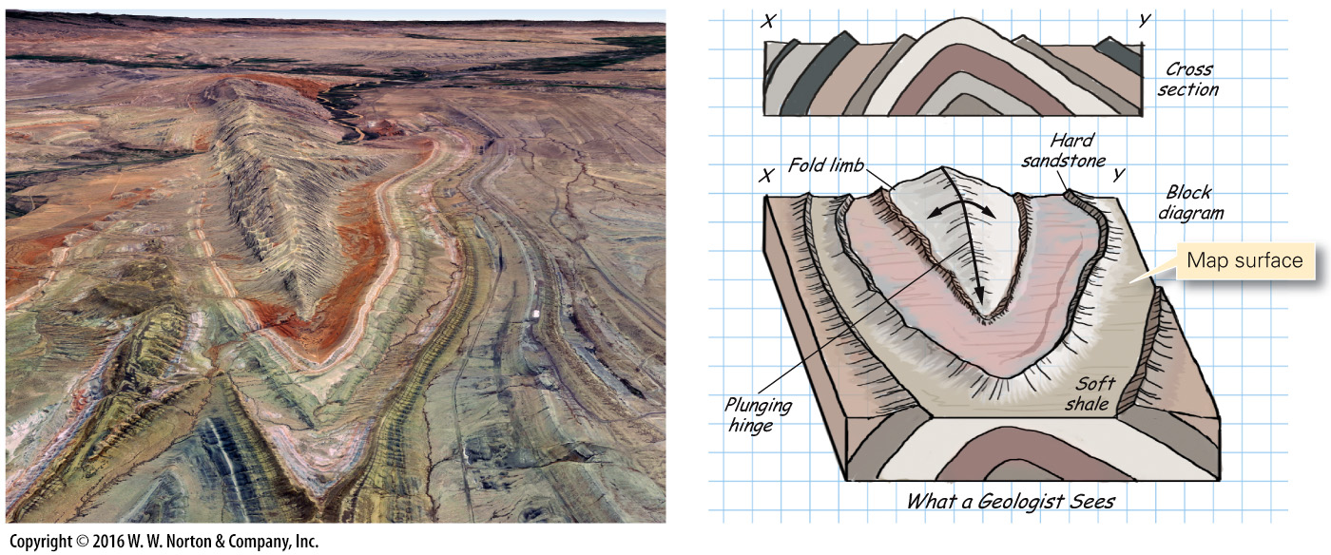
Notes:
FIGURE 9.12e Examples of folds on outcrops and in the landscape.
(e) The plunging anticline of Sheep Mountain, Wyoming, is easy to see because of the lack of vegetation. Resistant rock layers (sandstone) stand out as ridges, whereas weak rock layers (shale) erode away. A block diagram shows how surface exposures relate to underground structure.

Slide 61
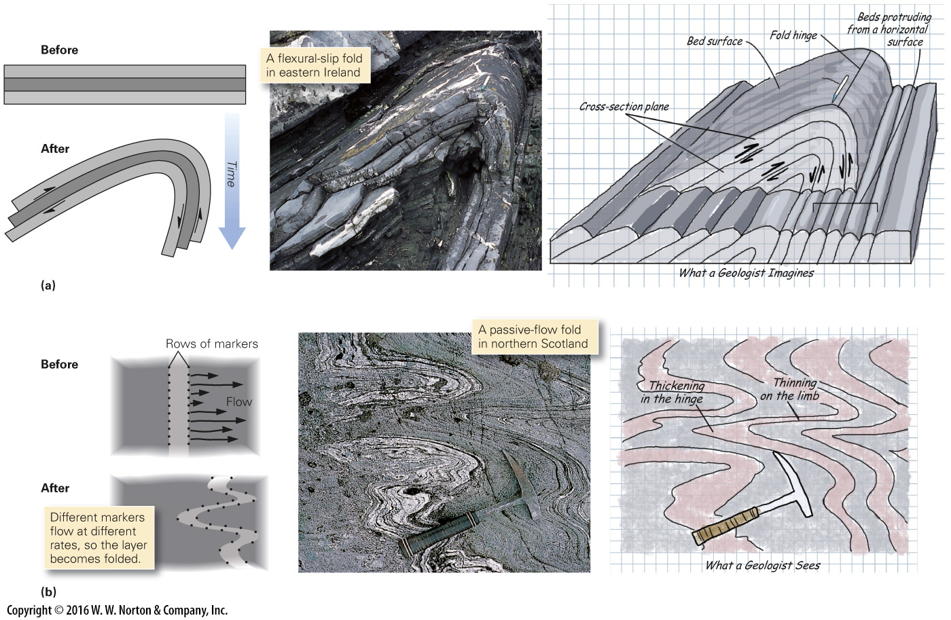
Notes:
FIGURE 9.13 Fold development in flexural-slip and passive-flow folding.
(a) During the formation of flexural-slip folds, layers maintain constant thickness, so for the fold to form, layers must bend. To accommodate the bending, each bed slips relative to its neighbor. (b) During the formation of passive-flow folds, the rock slowly flows. Different points along a marker line flow at different rates, causing the layer to become folded. Note that the layer’s thickness doesn’t stay constant during folding.

Slide 62
Notes:
FIGURE 9.13a Fold development in flexural-slip and passive-flow folding.
(a) During the formation of flexural-slip folds, layers maintain constant thickness, so for the fold to form, layers must bend. To accommodate the bending, each bed slips relative to its neighbor.

Slide 63
Notes:
FIGURE 9.13b Fold development in flexural-slip and passive-flow folding.
(b) During the formation of passive-flow folds, the rock slowly flows. Different points along a marker line flow at different rates, causing the layer to become folded. Note that the layer’s thickness doesn’t stay constant during folding.

Slide 64
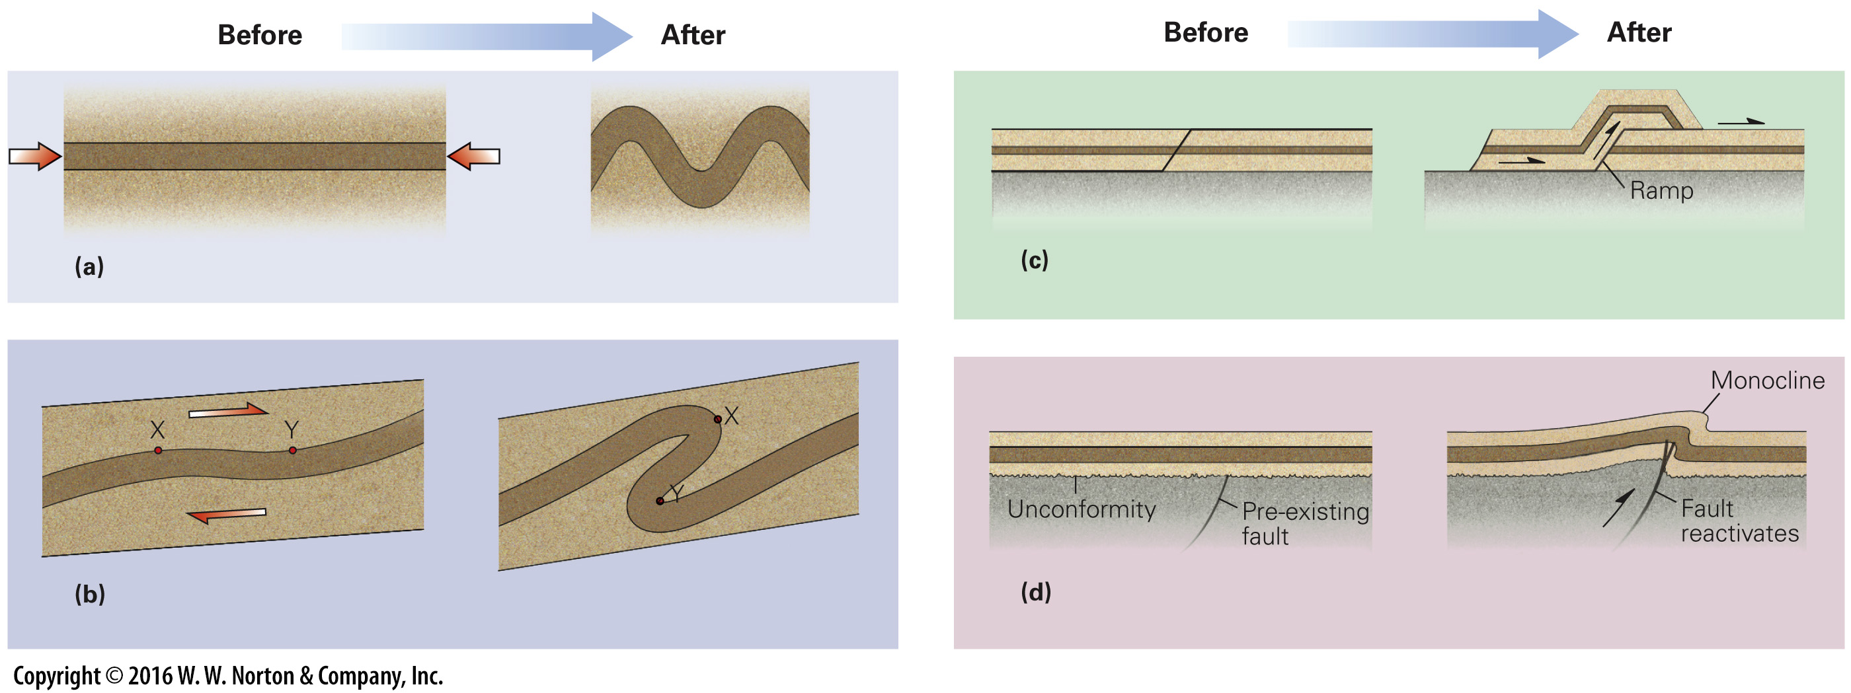
Notes:
FIGURE 9.14 Folding is caused by several different processes.
(a) If a layer is shortened along its length, it buckles. (b) If a layer is sheared, one part of the layer moves over another part to produce a fold. (c) When layers move up and over step-shaped faults, they must bend into folds. The step, where the fault cuts layers, is a “ramp.” (d) Faulting at depth may push up a block of crust and cause overlying beds to bend into a monocline.

Slide 65
Notes:
FIGURE 9.14a Folding is caused by several different processes.
(a) If a layer is shortened along its length, it buckles.

Slide 66
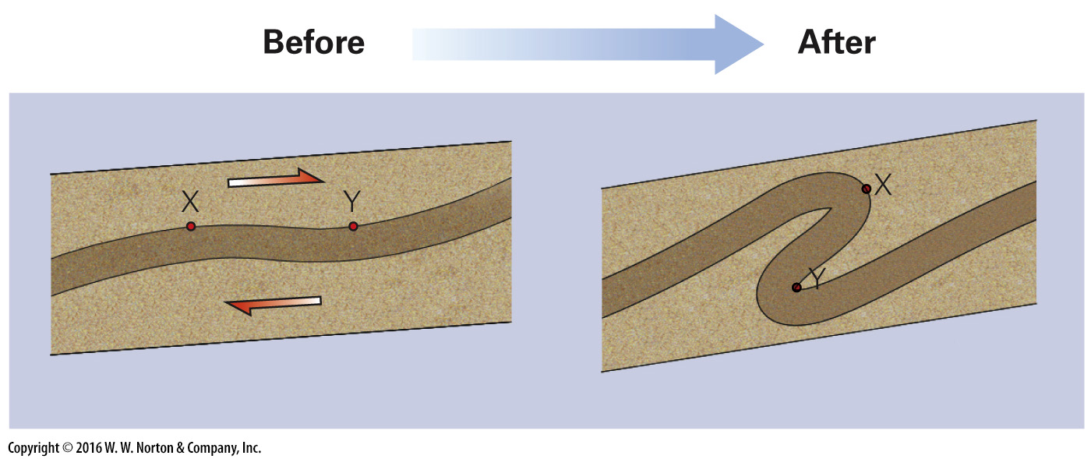
Notes:
FIGURE 9.14b Folding is caused by several different processes.
(b) If a layer is sheared, one part of the layer moves over another part to produce a fold.

Slide 67
Notes:
FIGURE 9.14c Folding is caused by several different processes.
(c) When layers move up and over step-shaped faults, they must bend into folds. The step, where the fault cuts layers, is a “ramp.”

Slide 68
Notes:
FIGURE 9.14d Folding is caused by several different processes.
(d) Faulting at depth may push up a block of crust and cause overlying beds to bend into a monocline.

Slide 69
Notes:
SEE FOR YOURSELF…
FOLDS, CENTRAL AUSTRALIA

Slide 70
Notes:
FIGURE 9.15 The development of tectonic foliation in rock.
(a) Compression shortens beds, flattens sand grains, and reorients clay flakes. Clay flakes were originally parallel to bedding, but they become parallel to slaty cleavage during deformation. Folding may accompany cleavage formation. (b) An example of slaty cleavage developed in Paleozoic strata exposed in a stream cut in New York. Relict bedding is still visible, but note that the rock breaks more easily on the cleavage. This cleavage formed in association with folding.

Slide 71
Notes:
FIGURE 9.15a The development of tectonic foliation in rock.
(a) Compression shortens beds, flattens sand grains, and reorients clay flakes. Clay flakes were originally parallel to bedding, but they become parallel to slaty cleavage during deformation. Folding may accompany cleavage formation.

Slide 72
Notes:
FIGURE 9.15b The development of tectonic foliation in rock.
(b) An example of slaty cleavage developed in Paleozoic strata exposed in a stream cut in New York. Relict bedding is still visible, but note that the rock breaks more easily on the cleavage. This cleavage formed in association with folding.

Slide 73
Notes:
FIGURE 9.16 Characteristics of convergent-margin orogens.
(a) At some convergent margins, compression between the downgoing and overriding plates uplifts a mountain range in which volcanism occurs. Subduction may bring in exotic crustal blocks that collide and become incorporated in the orogen. (b) A detailed cross section of a fold-thrust belt, composed of many thrust sheets pushed to the right. The different colors represent different rock ages. (c) The Andes in Chile formed along a convergent margin.

Slide 74
Notes:
FIGURE 9.16a Characteristics of convergent-margin orogens.
(a) At some convergent margins, compression between the downgoing and overriding plates uplifts a mountain range in which volcanism occurs. Subduction may bring in exotic crustal blocks that collide and become incorporated in the orogen.

Slide 75
Notes:
FIGURE 9.16b Characteristics of convergent-margin orogens.
(b) A detailed cross section of a fold-thrust belt, composed of many thrust sheets pushed to the right. The different colors represent different rock ages.

Slide 76
Notes:
FIGURE 9.16c Characteristics of convergent-margin orogens.
(c) The Andes in Chile formed along a convergent margin.

Slide 77
Notes:
FIGURE 9.17 Characteristics of collisional orogens.
(a) During collision, continents squeeze together and deform. Thrusting brings metamorphic rock up to shallower levels. (b) Geologists simulate collision in the laboratory using layers of colored sand. Dragging the left side of the model under the right produces structures and uplift, as shown in this sketch of a model. (c) Viewed from space, it’s clear that the Himalayas were uplifted when India collided and pushed into Asia. (d) The western portion of the North American Cordillera consists of accreted terranes that attached to the continent during the Mesozoic. During docking, a distinct terrane called Wrangelia (highlighted in red) was sliced into pieces that were displaced by strike-slip faults.

Slide 78
Notes:
FIGURE 9.17a Characteristics of collisional orogens.
(a) During collision, continents squeeze together and deform. Thrusting brings metamorphic rock up to shallower levels.

Slide 79
Notes:
FIGURE 9.17b Characteristics of collisional orogens.
(b) Geologists simulate collision in the laboratory using layers of colored sand. Dragging the left side of the model under the right produces structures and uplift, as shown in this sketch of a model.

Slide 80
Notes:
FIGURE 9.17c Characteristics of collisional orogens.
(c) Viewed from space, it’s clear that the Himalayas were uplifted when India collided and pushed into Asia.

Slide 81
Notes:
FIGURE 9.17d Characteristics of collisional orogens.
(d) The western portion of the North American Cordillera consists of accreted terranes that attached to the continent during the Mesozoic. During docking, a distinct terrane called Wrangelia (highlighted in red) was sliced into pieces that were displaced by strike-slip faults.

Slide 82
Notes:
SEE FOR YOURSELF…
MOUNT EVEREST, NEPAL

Slide 83
Notes:
FIGURE 9.18 Rift-related mountains.
(a) Rifting leads to the development of numerous narrow mountain ranges. Rift-margin mountains may also form. (b) The Basin and Range Province of the western United States formed during Cenozoic rifting.

Slide 84
Notes:
FIGURE 9.18a Rift-related mountains.
(a) Rifting leads to the development of numerous narrow mountain ranges. Rift-margin mountains may also form.

Slide 85
Notes:
FIGURE 9.18b Rift-related mountains.
(b) The Basin and Range Province of the western United States formed during Cenozoic rifting.

Slide 86
Notes:
GEOLOGY AT A GLANCE
The Collision of India with Asia

Slide 87
Notes:
FIGURE 9.19 GPS measurements of shortening in the Andes. The lines indicate the velocity of the red dots relative to the interior of South America. The line at the yellow dot indicates relative plate motion.

Slide 88
Notes:
FIGURE 9.20 An example of the various rocks formed during orogeny.
(a) In the internal zone of the range, metamorphic rocks and igneous rocks form. At the edge of the range, sedimentary rocks form. (b) The sedimentary basin develops because the mountain range acts as a weight that pushes down the surface of the lithosphere.

Slide 89
Notes:
FIGURE 9.20a An example of the various rocks formed during orogeny.
(a) In the internal zone of the range, metamorphic rocks and igneous rocks form. At the edge of the range, sedimentary rocks form.

Slide 90
Notes:
FIGURE 9.20b An example of the various rocks formed during orogeny.
(b) The sedimentary basin develops because the mountain range acts as a weight that pushes down the surface of the lithosphere.

Slide 91
Notes:
FIGURE 9.21 The concept of isostasy as applied to collisional mountain ranges.
(a) The Himalayas are the world’s highest mountain range. The crust beneath them is almost twice the normal thickness. (b) Collision thickens the crust. Mountains form where the low-density crust is thicker. (c) Because of isostasy, blocks of wood floating in water sink to a depth such that the mass of the water displaced is the same as the mass of the block.

Slide 92
Notes:
FIGURE 9.21a The concept of isostasy as applied to collisional mountain ranges.
(a) The Himalayas are the world’s highest mountain range. The crust beneath them is almost twice the normal thickness.

Slide 93
Notes:
FIGURE 9.21b The concept of isostasy as applied to collisional mountain ranges.
(b) Collision thickens the crust. Mountains form where the low-density crust is thicker.

Slide 94
Notes:
FIGURE 9.21c The concept of isostasy as applied to collisional mountain ranges.
(c) Because of isostasy, blocks of wood floating in water sink to a depth such that the mass of the water displaced is the same as the mass of the block.

Slide 95
Notes:
FIGURE 9.22 Uplift, due to delamination of the lithosphere root, may happen after collision.
(a) Soon after collision, the crust and lithospheric mantle have thickened. The lithospheric mantle root is like ballast, holding the surface of the crust down. (b) If the lithospheric mantle root detaches and sinks, a process called delamination, the surface of the lithosphere may rise, like a ship offloading cargo.

Slide 96
Notes:
FIGURE 9.23 Erosion sculpts the rugged peaks of mountain ranges. In this example, from the Canadian Rockies, glaciers—which have since melted away—carved the major valleys. Landslides bring debris down the cliff faces. Eventually, rivers carry the debris away.

Slide 97
Notes:
FIGURE 9.24 North America’s craton consists of a shield, where Precambrian rock is exposed, and a platform, where Phanerozoic sedimentary rock covers the Precambrian.

Slide 98
Notes:
FIGURE 9.25 Domes and basins of the North American cratonic platform.
(a) A geologic map of the U.S. mid-continent platform region showing the locations of basins and domes. (b) A cross section showing how strata thin toward the crest of a dome and thicken toward the center of a basin. The cross section is vertically exaggerated. This cross section symbolically represents the Ozark dome and Illinois basin.

Slide 99
Notes:
FIGURE 9.25a Domes and basins of the North American cratonic platform.
(a) A geologic map of the U.S. mid-continent platform region showing the locations of basins and domes.

Slide 100
Notes:
FIGURE 9.25b Domes and basins of the North American cratonic platform.
(b) A cross section showing how strata thin toward the crest of a dome and thicken toward the center of a basin. The cross section is vertically exaggerated. This cross section symbolically represents the Ozark dome and Illinois basin.

Slide 101
Notes:
Another View (left) The Matterhorn of the Alps along the Swiss-Italian border. The strata of the peak lay on the seafloor during the late Mesozoic. Mountain building thrust the strata upward, where they now reach an elevation of 4.5 km; (right) A fold resulting from shearing in South Australia.

