Slide 1
Stephen Marshak
ESSENTIALS OF
Geology
FIFTH EDITION
Chapter 10
Deep Time: How Old Is Old?
©2016 W. W. Norton & Company, Inc.

Slide 2
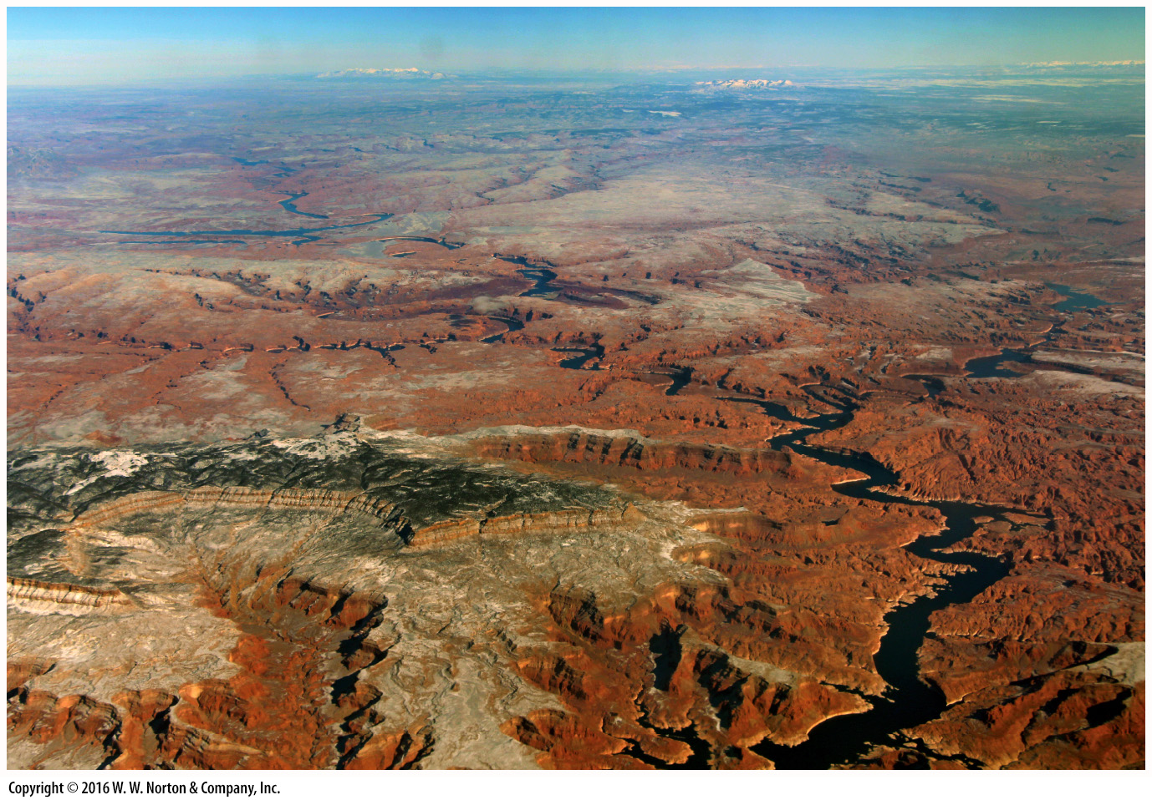
Notes:
The view from an airplane window of the Colorado Plateau region in Arizona and Utah reveals layer upon layer of strata deposited long ago and now exposed by erosion. These layers preserve a record of Earth’s very long history.

Slide 3
Notes:
FIGURE 10.1a Examples of the major geologic principles.
(a) Uniformitarianism: The processes that form cracks in the dried-up mud puddle on the left also formed the mudcracks preserved in the ancient, solid rock on the right. We can see the ancient mudcracks because erosion removed the adjacent bed.

Slide 4
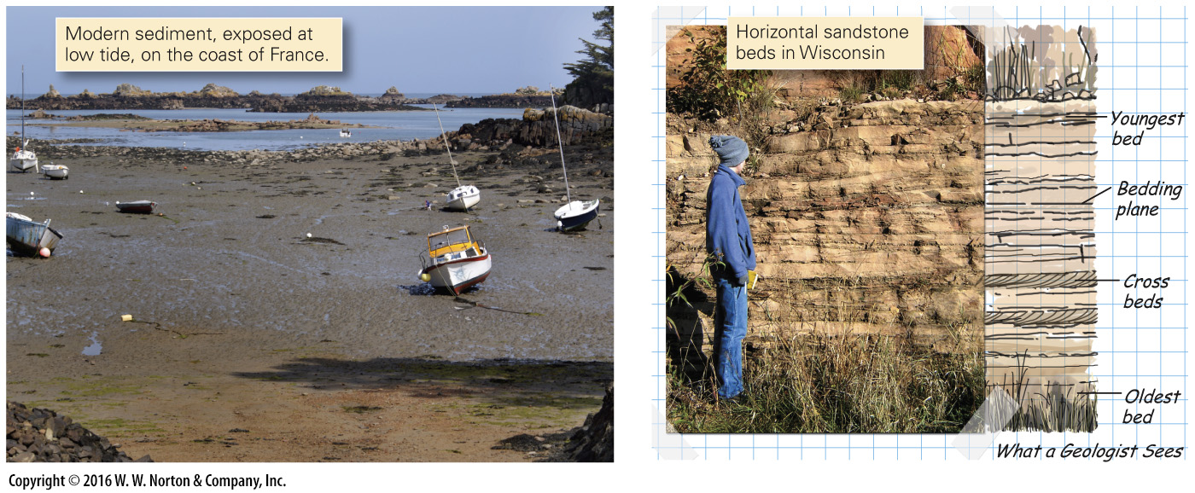
Notes:
FIGURE 10.1b Examples of the major geologic principles.
(b) Original horizontality: Gravity causes sediments to accumulate in horizontal sheets.

Slide 5
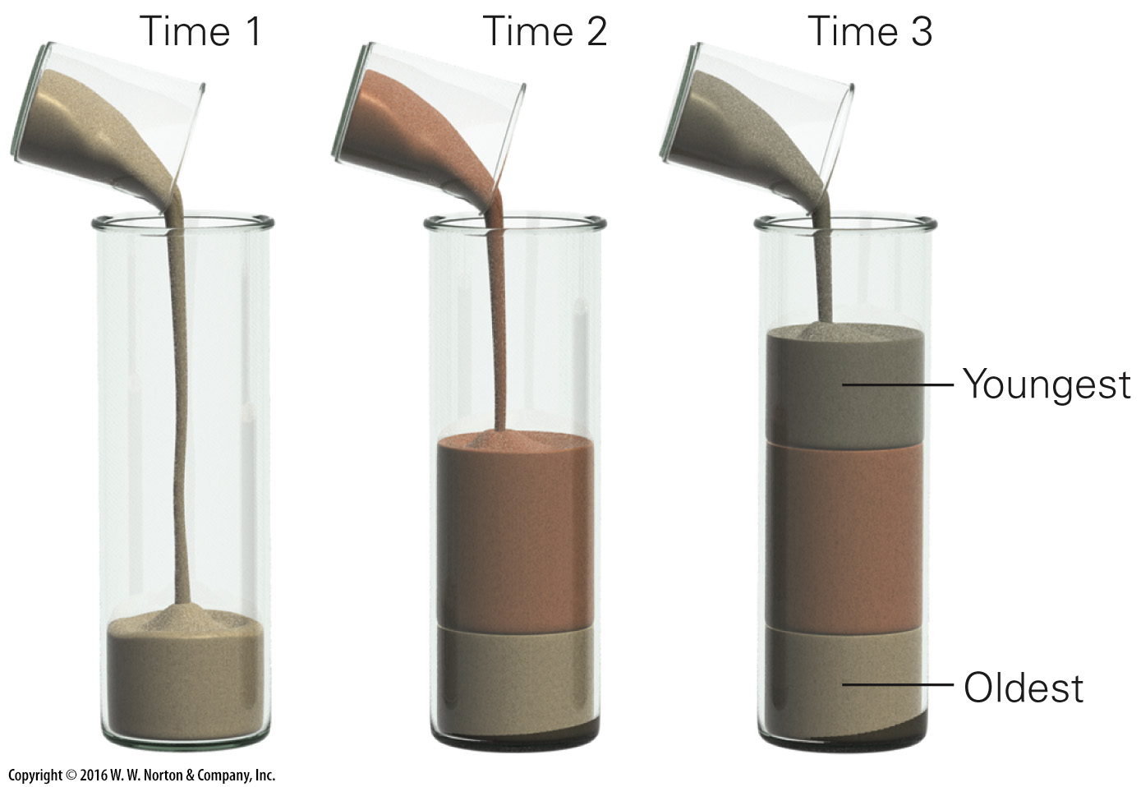
Notes:
FIGURE 10.1c Examples of the major geologic principles.
(c) Superposition: In a sequence of strata, the oldest bed is on the bottom, and the youngest on top. Pouring sand into a glass illustrates this point.

Slide 6
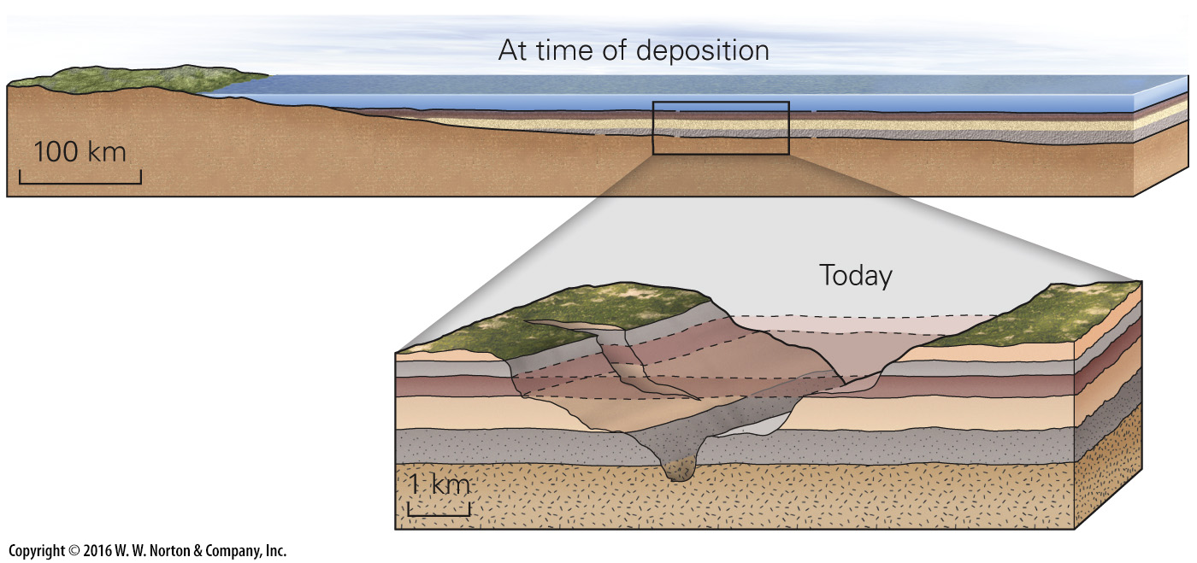
Notes:
FIGURE 10.1d Examples of the major geologic principles.
(d) Lateral continuity: Layers can be continuous over broad areas when first deposited. Erosion may later remove part of a layer.

Slide 7
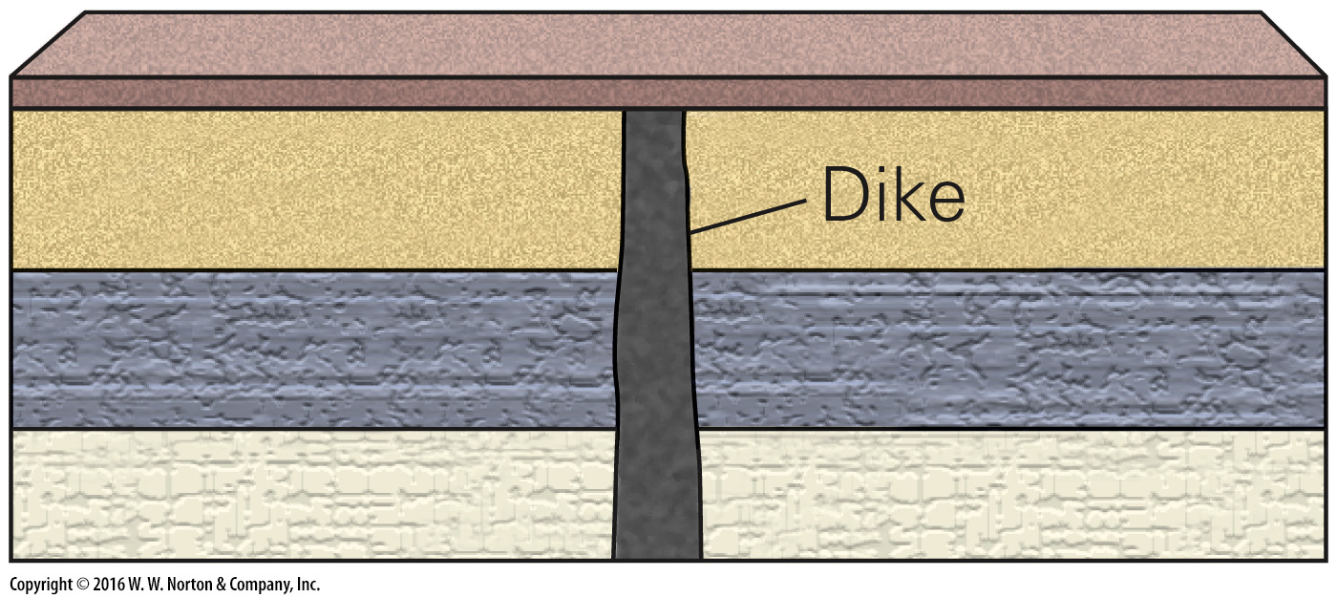
Notes:
FIGURE 10.1e Examples of the major geologic principles.
(e) Cross-cutting relations: The dike cuts across the lower three sedimentary beds, so the dike is younger. The top bed buries the dike, so it is younger than the dike.

Slide 8
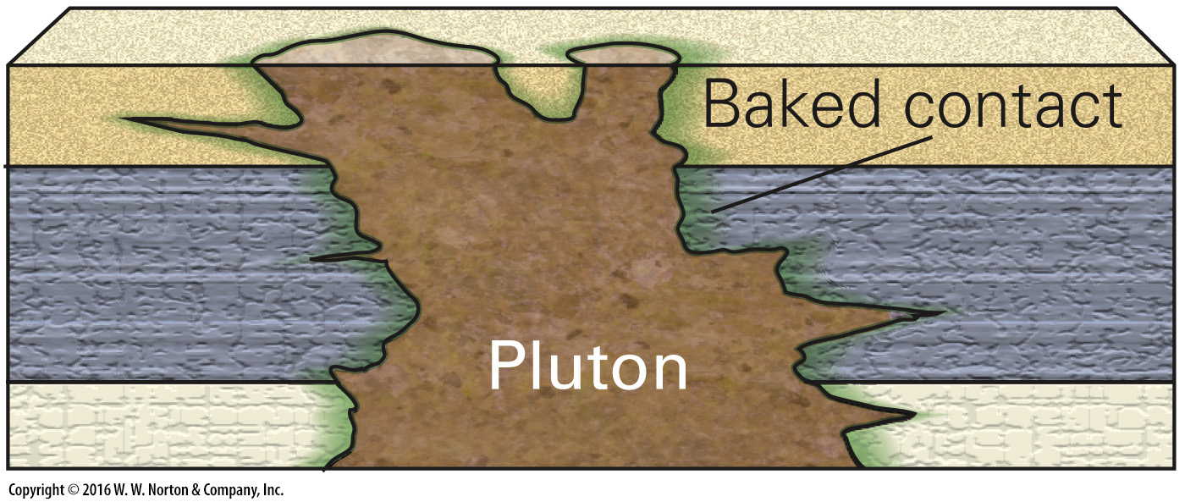
Notes:
FIGURE 10.1f Examples of the major geologic principles.
(f) Baked contacts: The pluton baked the adjacent rock, so the adjacent rock is older.

Slide 9
Notes:
FIGURE 10.1g Examples of the major geologic principles.
(g) By the principle of inclusions, the pebbles of basalt in a conglomerate must be older than the conglomerate and xenoliths of sandstone must be older than the basalt containing them.

Slide 10
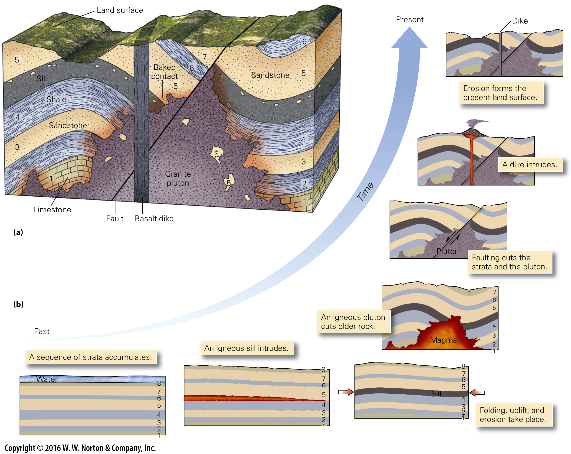
Notes:
FIGURE 10.2 Interpreting the geologic history of a region, using geologic principles as a guide.
(a) Geologic principles help us unravel the sequence of events leading to the development of the features shown above. Layers 1 to 7 were deposited first. Intrusion of the sill came next, followed by folding, intrusion of the granite pluton, faulting, intrusion of the dike, and erosion. (b) The sequence of geologic events leading to the geology shown above.

Slide 11
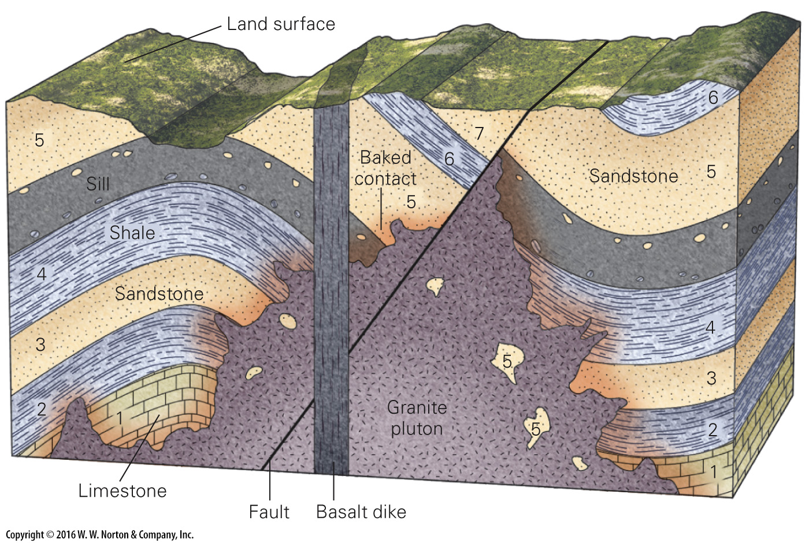
Notes:
FIGURE 10.2a Interpreting the geologic history of a region, using geologic principles as a guide.
(a) Geologic principles help us unravel the sequence of events leading to the development of the features shown above. Layers 1 to 7 were deposited first. Intrusion of the sill came next, followed by folding, intrusion of the granite pluton, faulting, intrusion of the dike, and erosion.

Slide 12
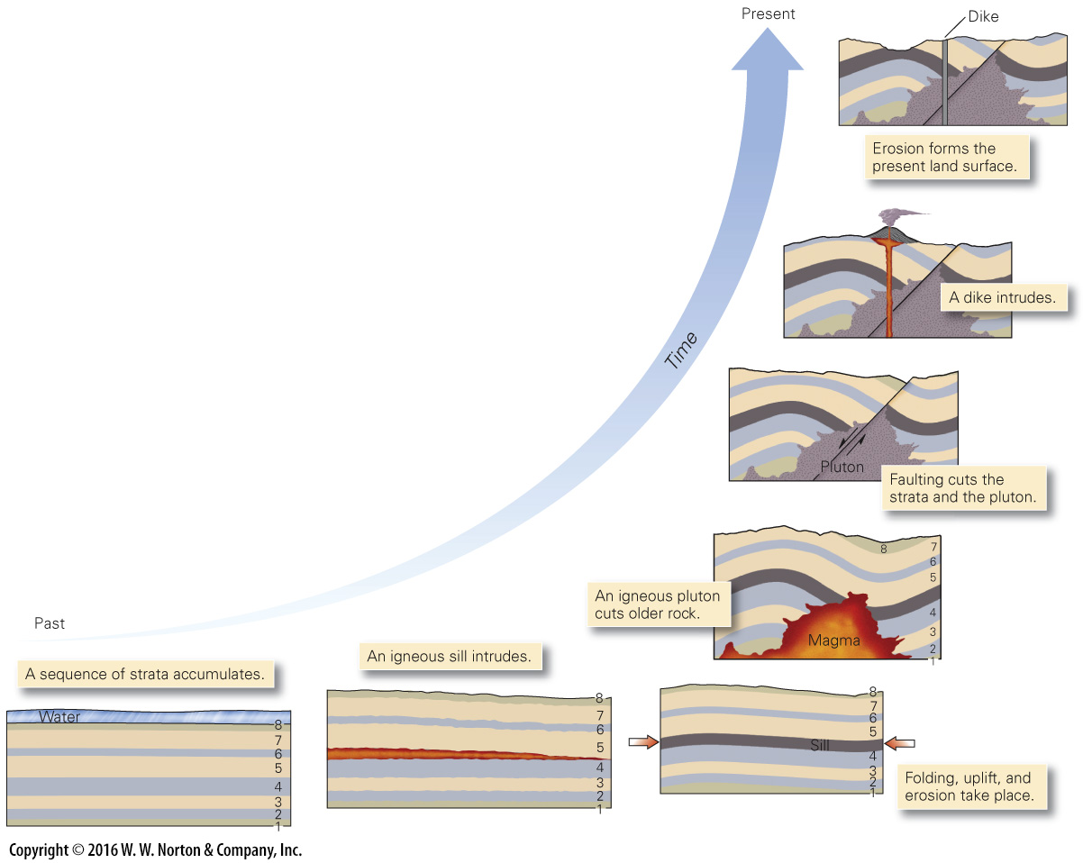
Notes:
FIGURE 10.2b Interpreting the geologic history of a region, using geologic principles as a guide.
(b) The sequence of geologic events leading to the geology shown above.

Slide 13
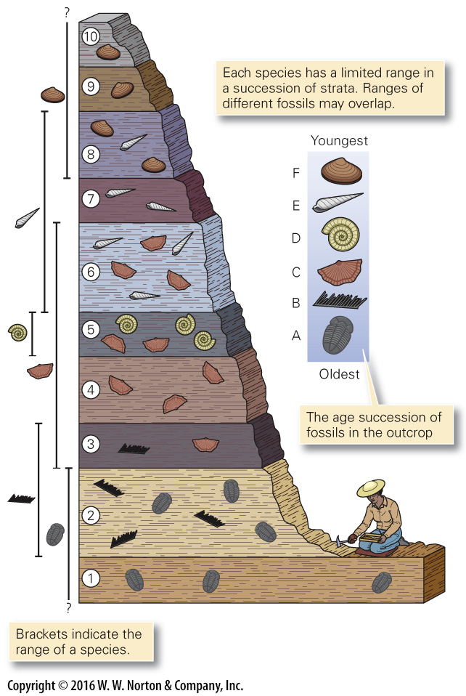
Notes:
FIGURE 10.3 The principle of fossil succession.

Slide 14
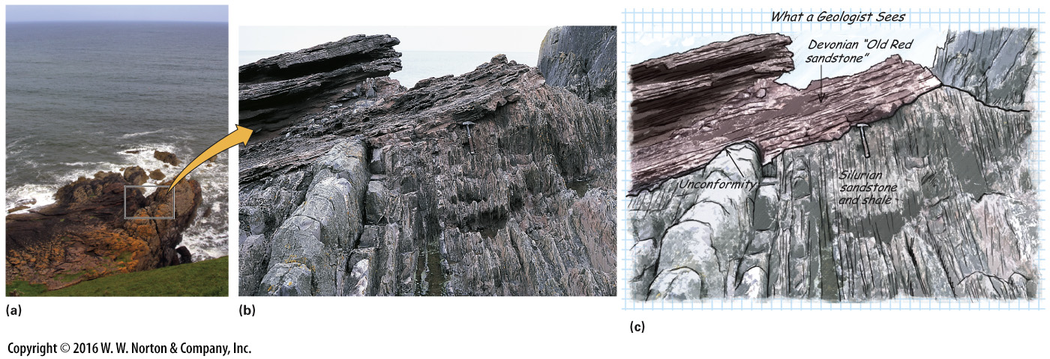
Notes:
FIGURE 10.4 The unconformity at Siccar Point, Scotland.
(a) Siccar Point juts out into the North Sea. (b) The layers above were deposited long after the beds below had been tilted. (c) The contact between the two units is an unconformity.

Slide 15
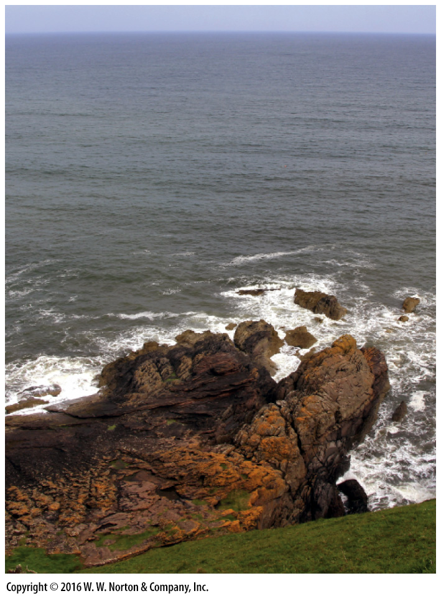
Notes:
FIGURE 10.4a The unconformity at Siccar Point, Scotland.
(a) Siccar Point juts out into the North Sea.

Slide 16
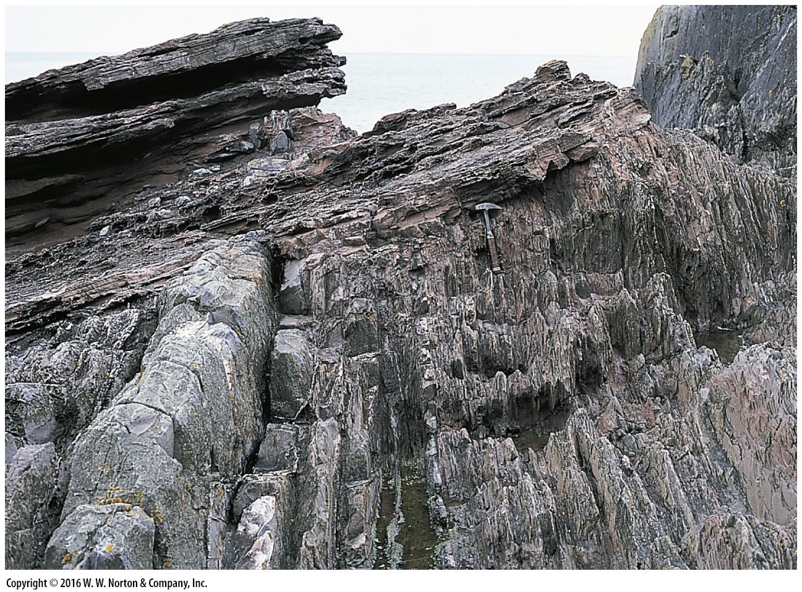
Notes:
FIGURE 10.4b The unconformity at Siccar Point, Scotland.
(b) The layers above were deposited long after the beds below had been tilted.

Slide 17
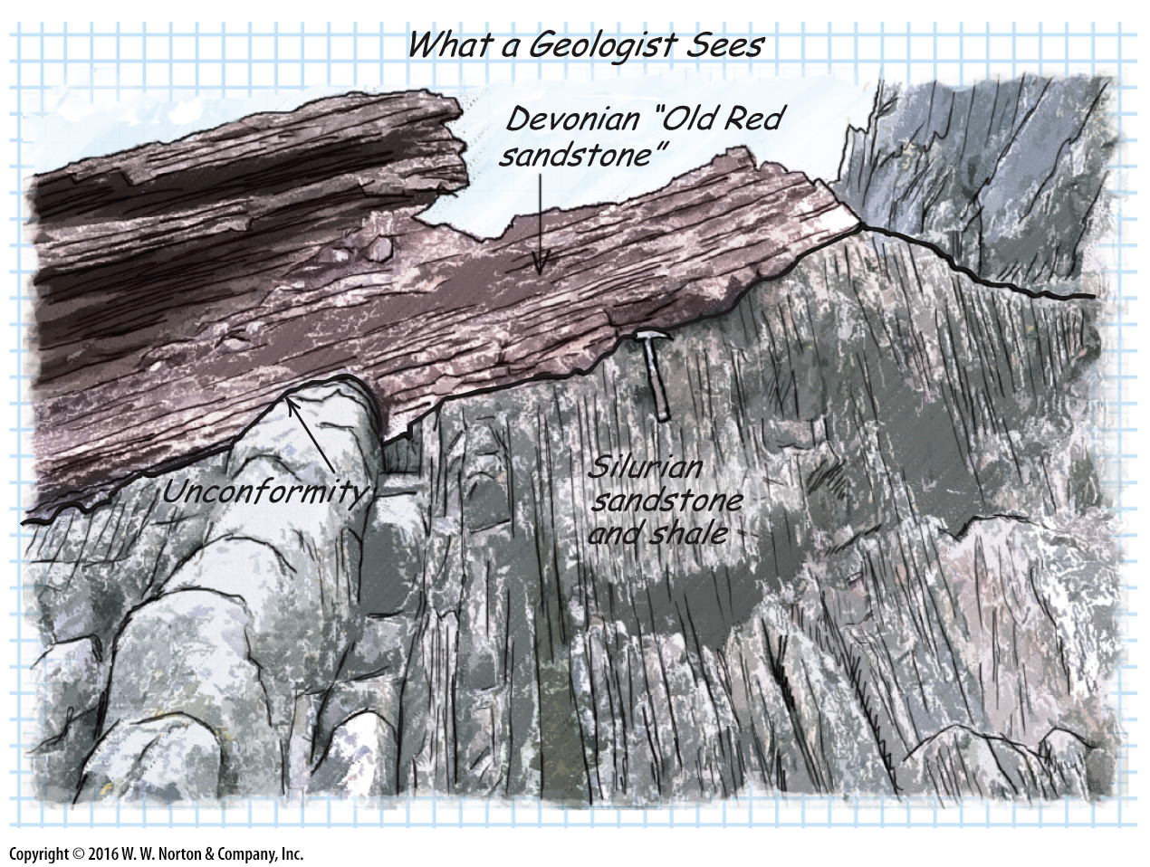
Notes:
FIGURE 10.4c The unconformity at Siccar Point, Scotland.
(c) The contact between the two units is an unconformity.

Slide 18
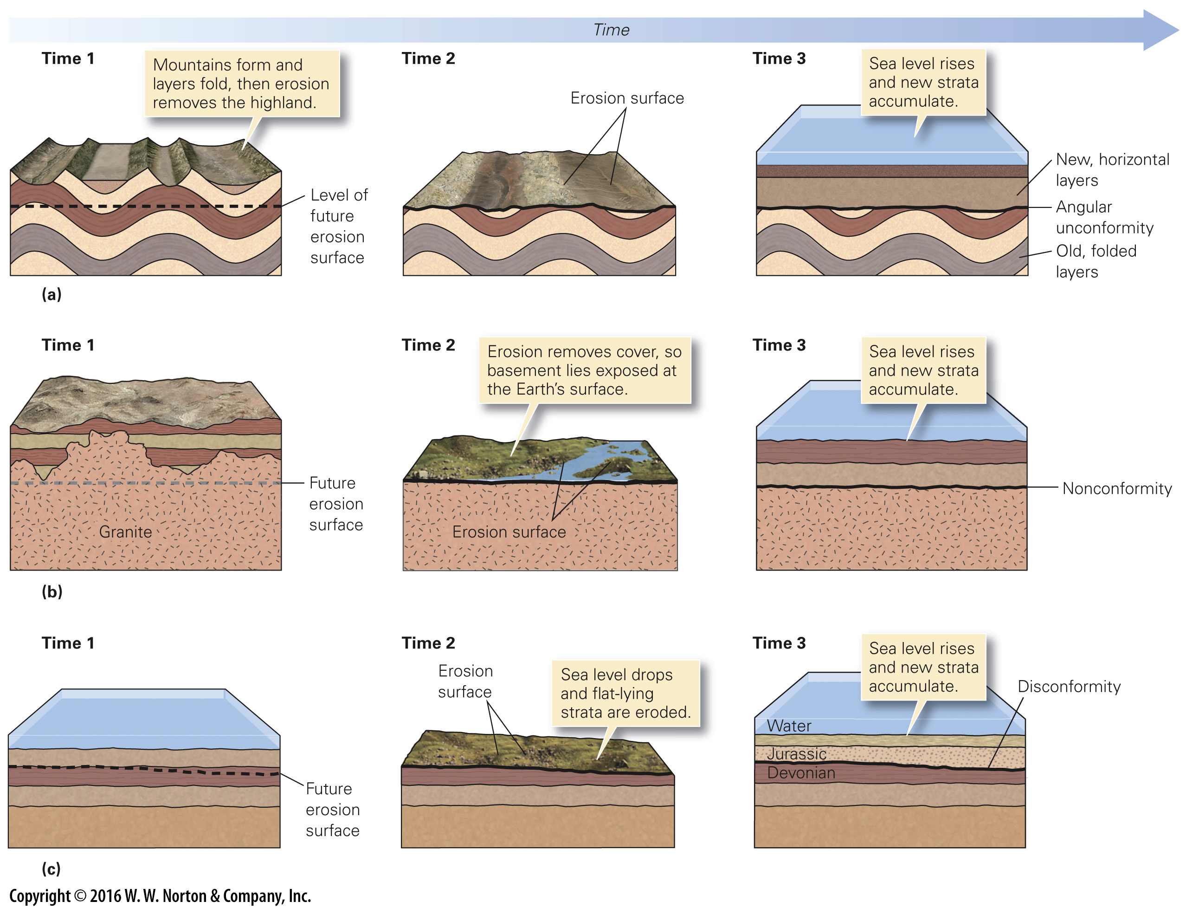
Notes:
FIGURE 10.5a-c The three kinds of unconformities and their formation.
(a) An angular unconformity: (1) layers undergo folding; (2) erosion produces a flat surface; (3) sea level rises and new layers of sediment accumulate. (b) A nonconformity: (1) a pluton intrudes; (2) erosion cuts down into the crystalline rock; (3) new sedimentary layers accumulate above the erosion surface. (c) A disconformity: (1) layers of sediment accumulate; (2) sea level drops and an erosion surface forms; (3) sea level rises and new sedimentary layers accumulate.

Slide 19
Notes:
FIGURE 10.5a The three kinds of unconformities and their formation.
(a) An angular unconformity: (1) layers undergo folding; (2) erosion produces a flat surface; (3) sea level rises and new layers of sediment accumulate.

Slide 20
Notes:
FIGURE 10.5b The three kinds of unconformities and their formation.
(b) A nonconformity: (1) a pluton intrudes; (2) erosion cuts down into the crystalline rock; (3) new sedimentary layers accumulate above the erosion surface.

Slide 21
Notes:
FIGURE 10.5c The three kinds of unconformities and their formation.
(c) A disconformity: (1) layers of sediment accumulate; (2) sea level drops and an erosion surface forms; (3) sea level rises and new sedimentary layers accumulate.

Slide 22
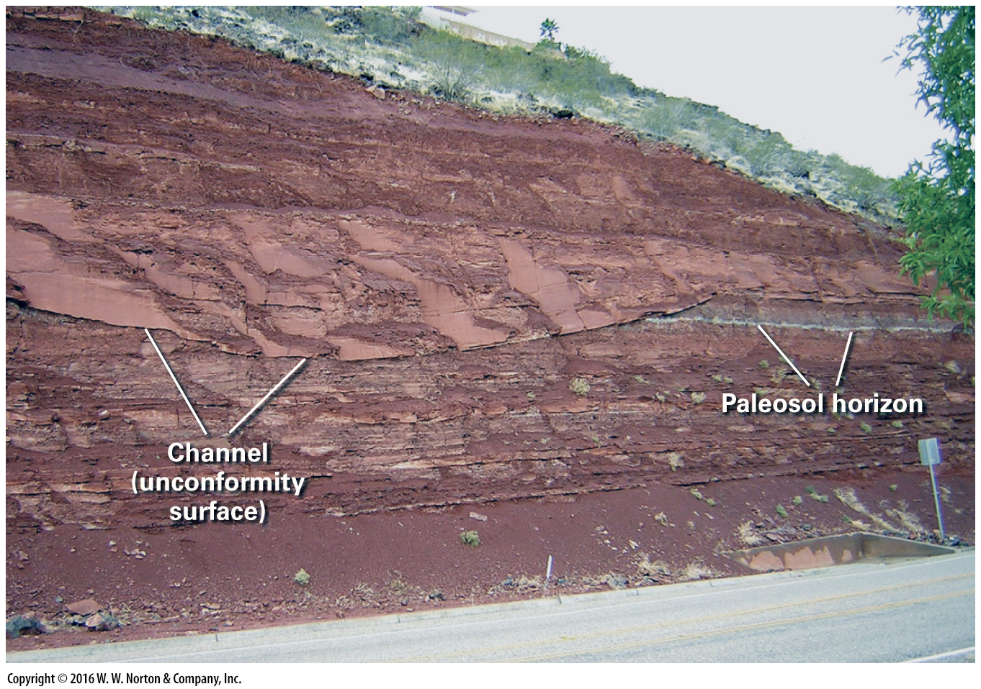
Notes:
FIGURE 10.5d The three kinds of unconformities and their formation.
(d) This road cut in Utah shows a sand-filled channel cut down into floodplain mud. The mud was exposed between floods, and a soil formed on it. When later buried, all the sediment turned into rock; the channel floor is now a disconformity, and the ancient soil is now a paleosol. Note that the channel cut across the paleosol. The paleosol also represents a disconformity, a time during which deposition did not occur.

Slide 23
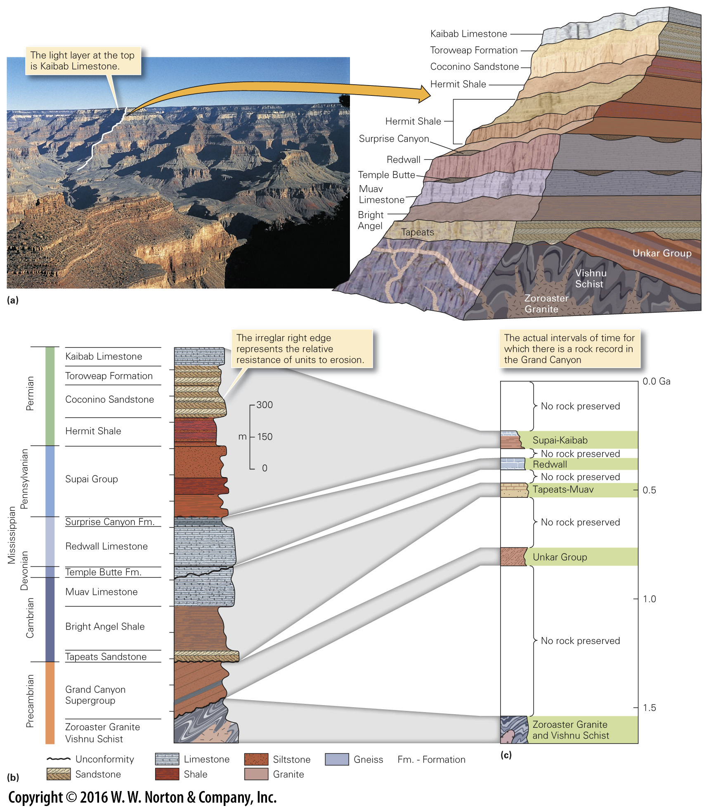
Notes:
FIGURE 10.6 The stratigraphic column and stratigraphic formation: examples from the Grand Canyon in Arizona.
(a) The walls of the Grand Canyon expose several formations. The distant cliff face (highlighted with white lines) exposes several formations, indicated in the sketch on the right. (b) A formalized stratigraphic column for strata of the Grand Canyon. The vertical scale indicates unit thickness. Patterns represent different rock types. The Unkar Group is one of three units that together comprise the Grand Canyon Supergroup. (c) Because of unconformities, the strata represent only a partial record of geologic time. This chart, with a time scale on the vertical axis, shows large gaps in the record.

Slide 24
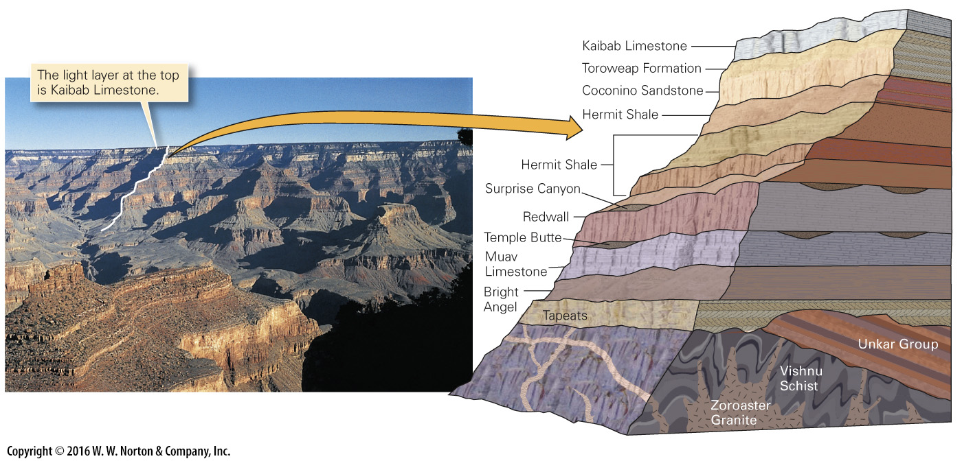
Notes:
FIGURE 10.6a The stratigraphic column and stratigraphic formation: examples from the Grand Canyon in Arizona.
(a) The walls of the Grand Canyon expose several formations. The distant cliff face (highlighted with white lines) exposes several formations, indicated in the sketch on the right.

Slide 25
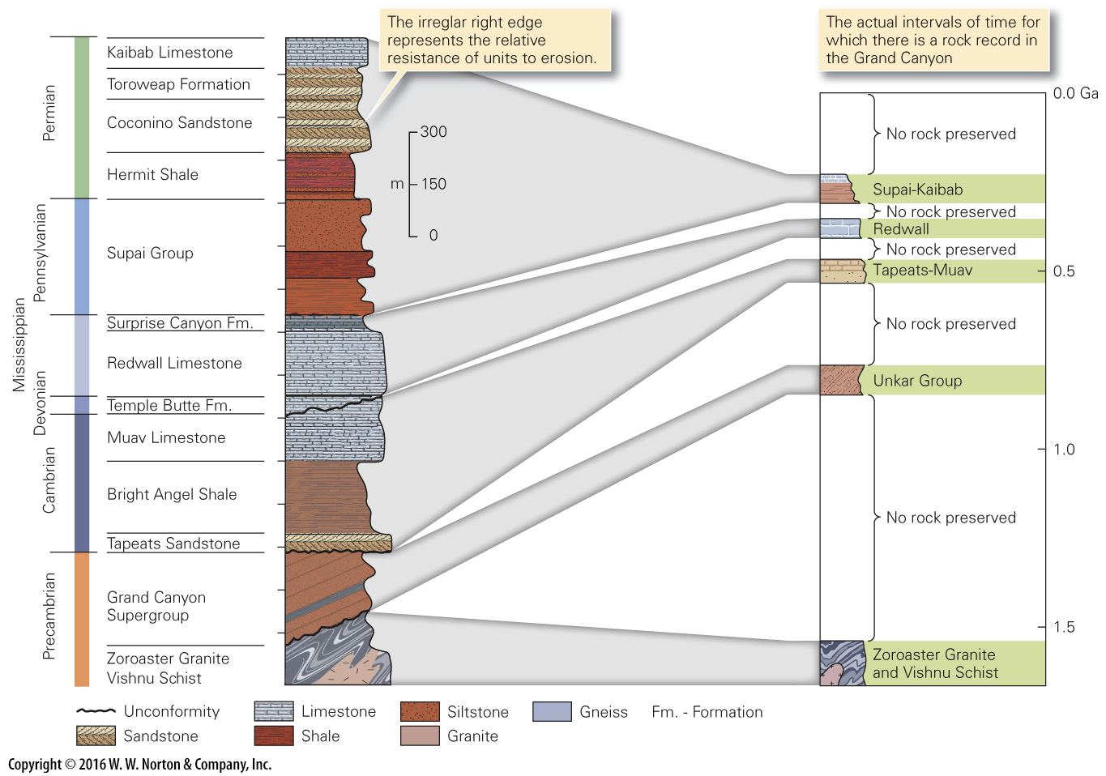
Notes:
FIGURE 10.6b–c The stratigraphic column and stratigraphic formation: examples from the Grand Canyon in Arizona.
(b) A formalized stratigraphic column for strata of the Grand Canyon. The vertical scale indicates unit thickness. Patterns represent different rock types. The Unkar Group is one of three units that together comprise the Grand Canyon Supergroup. (c) Because of unconformities, the strata represent only a partial record of geologic time. This chart, with a time scale on the vertical axis, shows large gaps in the record.

Slide 26
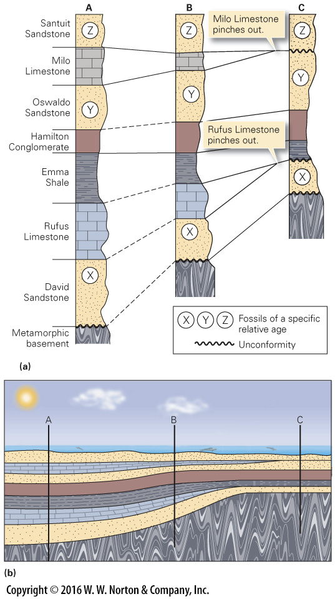
Notes:
FIGURE 10.7 The principles of correlation.
(a) Stratigraphic columns can be correlated by matching rock types (lithologic correlation). The Hamilton Conglomerate is a marker horizon. Because some strata pinch out, Column C contains unconformities. Fossil correlation indicates that the youngest beds in C are Santuit Sandstone. (b) At the time of deposition, locations A, B, and C (which correlate with the columns in part a) were in different parts of a basin. The basin floor was subsiding fastest at A.

Slide 27
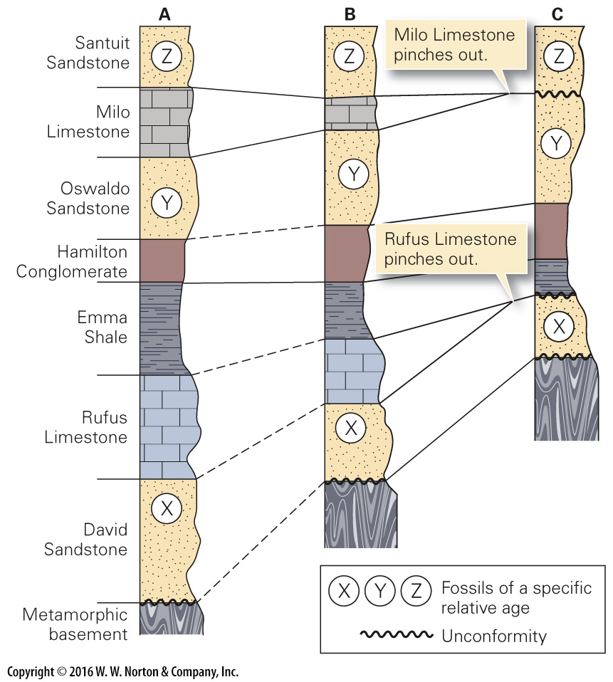
Notes:
FIGURE 10.7a The principles of correlation.
(a) Stratigraphic columns can be correlated by matching rock types (lithologic correlation). The Hamilton Conglomerate is a marker horizon. Because some strata pinch out, Column C contains unconformities. Fossil correlation indicates that the youngest beds in C are Santuit Sandstone.

Slide 28
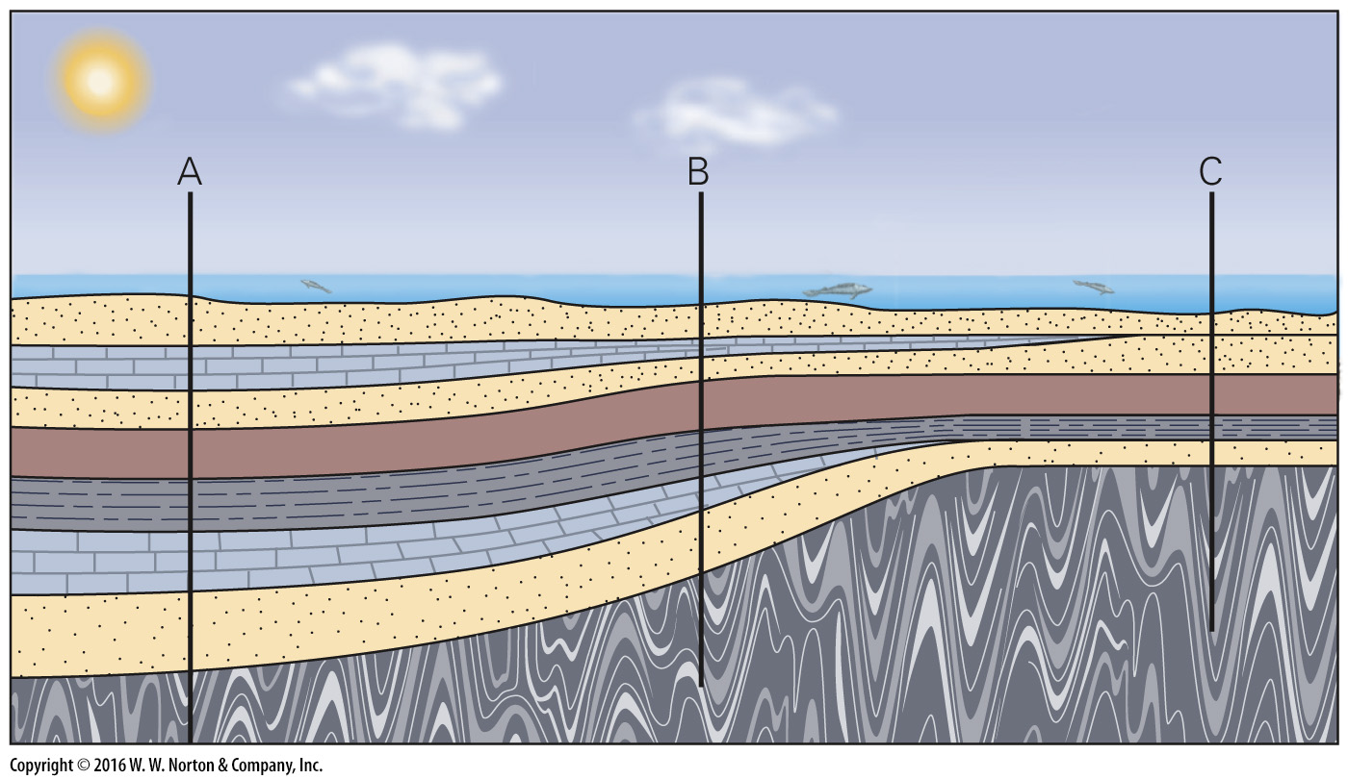
Notes:
FIGURE 10.7b The principles of correlation.
(b) At the time of deposition, locations A, B, and C (which correlate with the columns in part a) were in different parts of a basin. The basin floor was subsiding fastest at A.

Slide 29
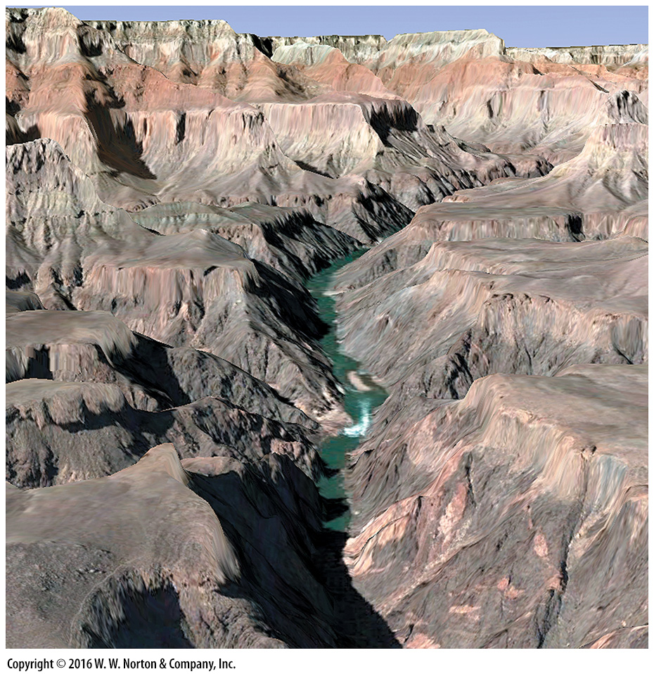
Notes:
SEE FOR YOURSELF…
GRAND CANYON, ARIZONA

Slide 30
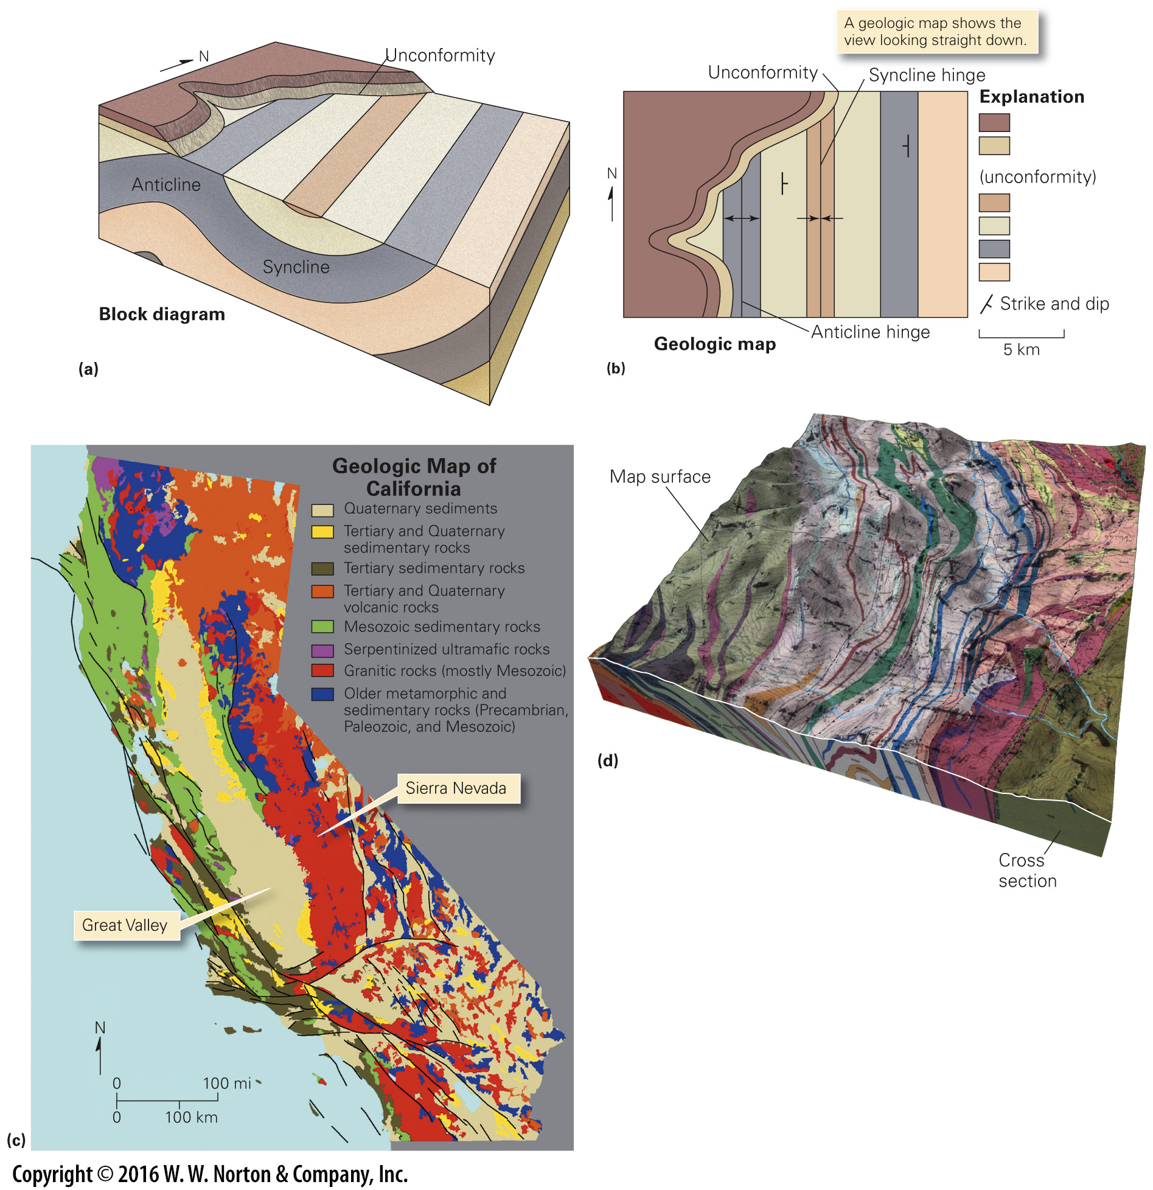
Notes:
FIGURE 10.8 A geologic map depicts the distribution of rock units and structures.
(a) A block diagram provides a three-dimensional representation. Here we see an angular unconformity over folded strata. (b) A geologic map shows the distribution of units. Contacts occur between units. Note that the map also shows geologic structures. (c) A geologic map of California indicates that the state is underlain by many different rock units. Granite underlies the Sierras, and Quaternary sediments underlie the Great Valley. The black lines are fault traces. (d) A modern digital geologic map, displayed on a three-dimensional land surface and linked to cross sections showing geological relationships underground. Each color is a different unit.

Slide 31
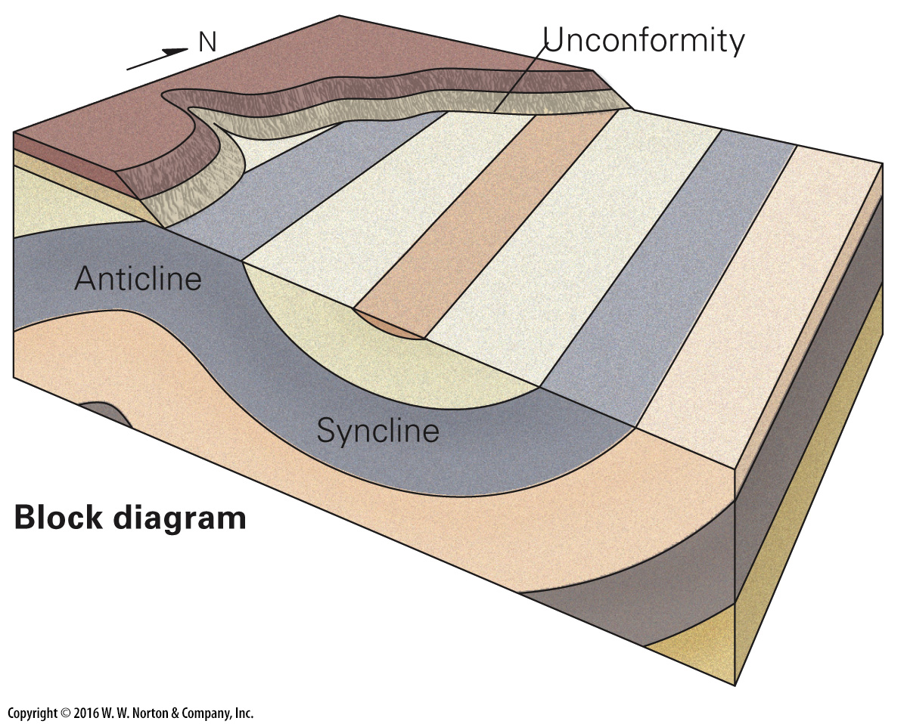
Notes:
FIGURE 10.8a A geologic map depicts the distribution of rock units and structures.
(a) A block diagram provides a three-dimensional representation. Here we see an angular unconformity over folded strata.

Slide 32
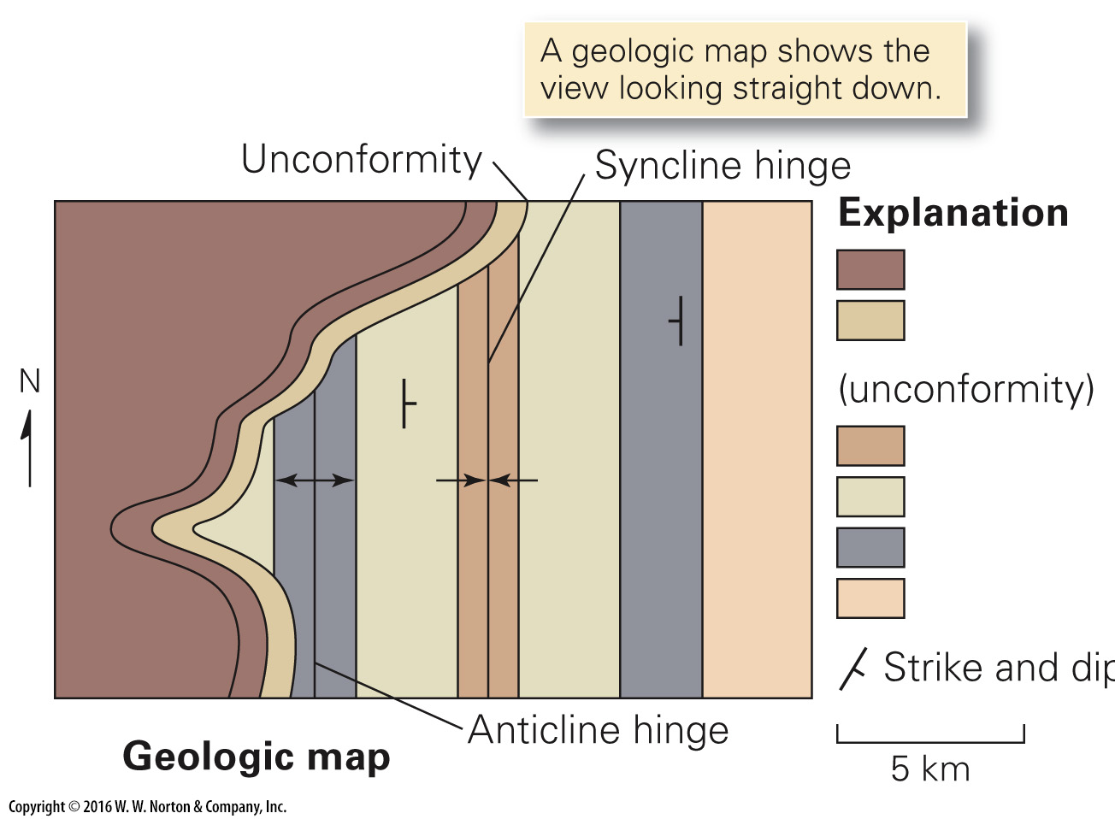
Notes:
FIGURE 10.8b A geologic map depicts the distribution of rock units and structures.
(b) A geologic map shows the distribution of units. Contacts occur between units. Note that the map also shows geologic structures.

Slide 33
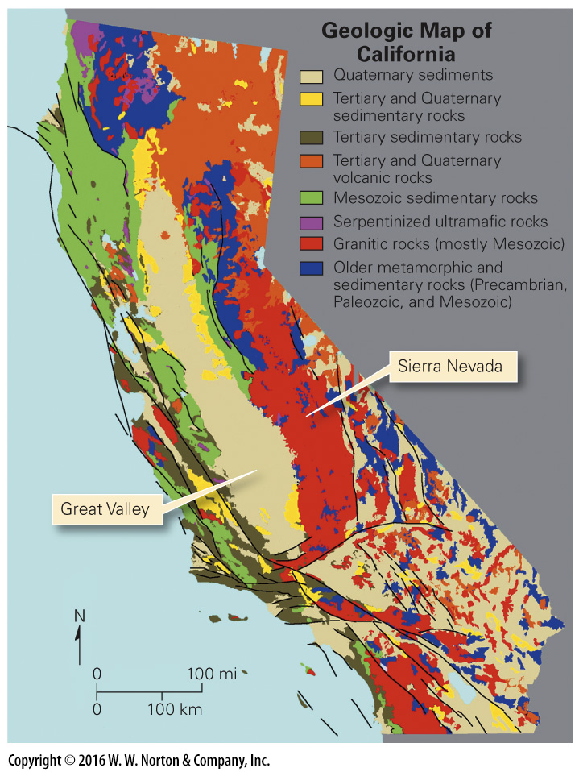
Notes:
FIGURE 10.8c A geologic map depicts the distribution of rock units and structures.
(c) A geologic map of California indicates that the state is underlain by many different rock units. Granite underlies the Sierras, and Quaternary sediments underlie the Great Valley. The black lines are fault traces.

Slide 34
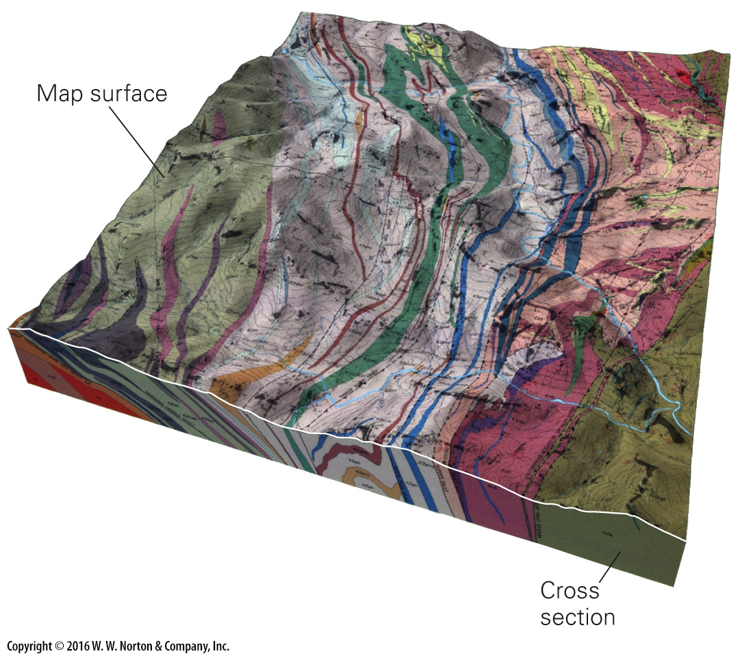
Notes:
FIGURE 10.8d A geologic map depicts the distribution of rock units and structures.
(d) A modern digital geologic map, displayed on a three-dimensional land surface and linked to cross sections showing geological relationships underground. Each color is a different unit.

Slide 35
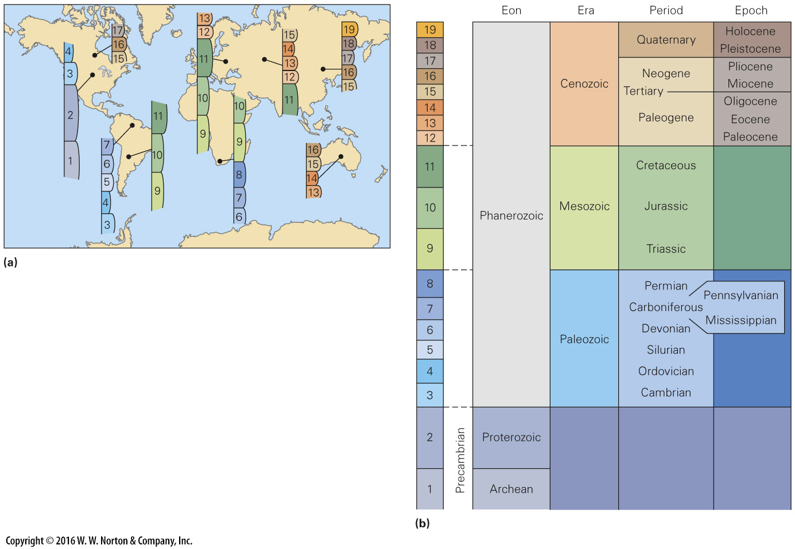
Notes:
FIGURE 10.9 Global correlation of strata led to the development of the geologic column. (Not to scale.)
(a) Each of these small columns represents the stratigraphy at a given location. By correlating these columns, geologists determined their relative ages, filled in the gaps in the record, and produced the geologic column. (b) By correlation, the strata from localities around the world were stacked in a chart representing geologic time to create the geologic column. Geologists assigned names to time intervals, but since the column was built without knowledge of numerical ages, it does not depict the duration of these intervals. Subdivisions of eons in the Precambrian are not shown. The Hadean is not shown because rocks do not preserve a record of it.

Slide 36
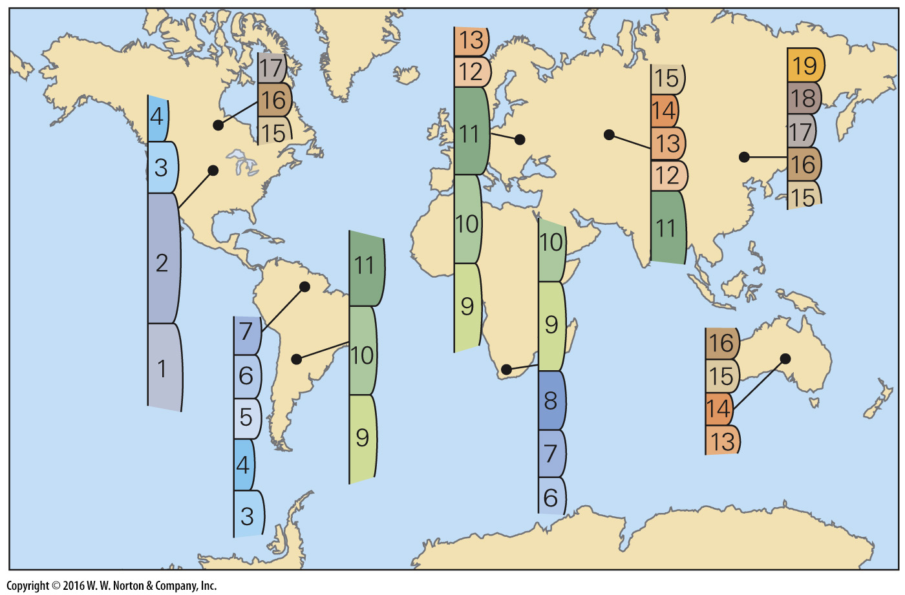
Notes:
FIGURE 10.9a Global correlation of strata led to the development of the geologic column. (Not to scale.)
(a) Each of these small columns represents the stratigraphy at a given location. By correlating these columns, geologists determined their relative ages, filled in the gaps in the record, and produced the geologic column.

Slide 37
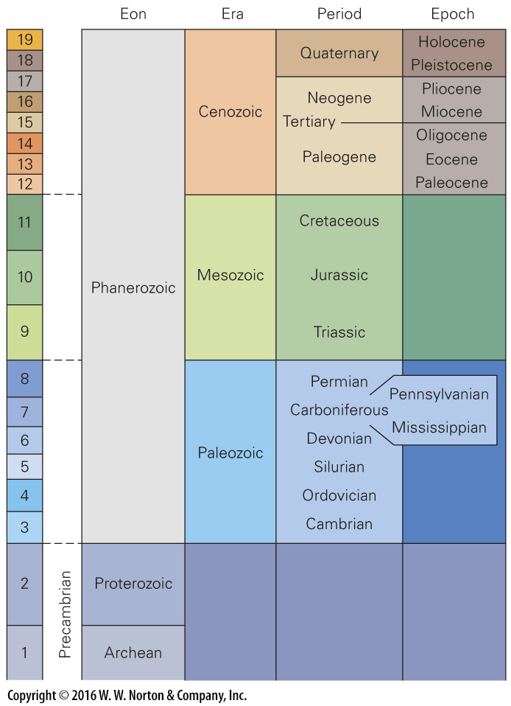
Notes:
FIGURE 10.9b Global correlation of strata led to the development of the geologic column. (Not to scale.)
(b) By correlation, the strata from localities around the world were stacked in a chart representing geologic time to create the geologic column. Geologists assigned names to time intervals, but since the column was built without knowledge of numerical ages, it does not depict the duration of these intervals. Subdivisions of eons in the Precambrian are not shown. The Hadean is not shown because rocks do not preserve a record of it.

Slide 38
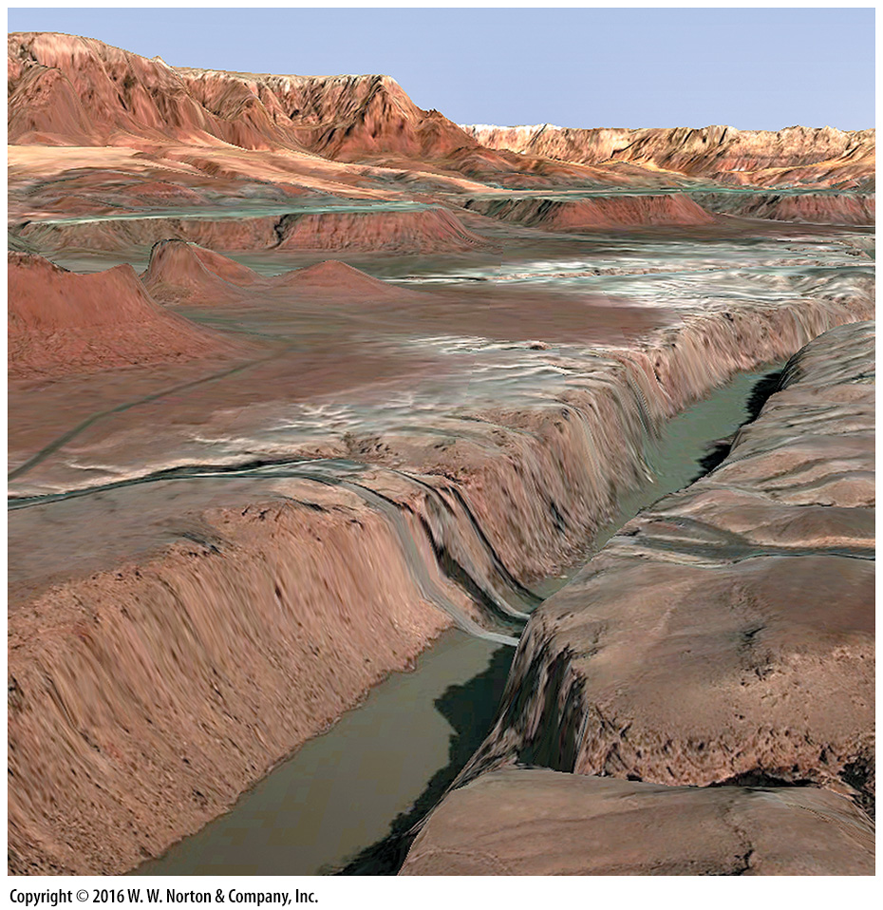
Notes:
SEE FOR YOURSELF…
VERMILION CLIFFS, ARIZONA

Slide 39
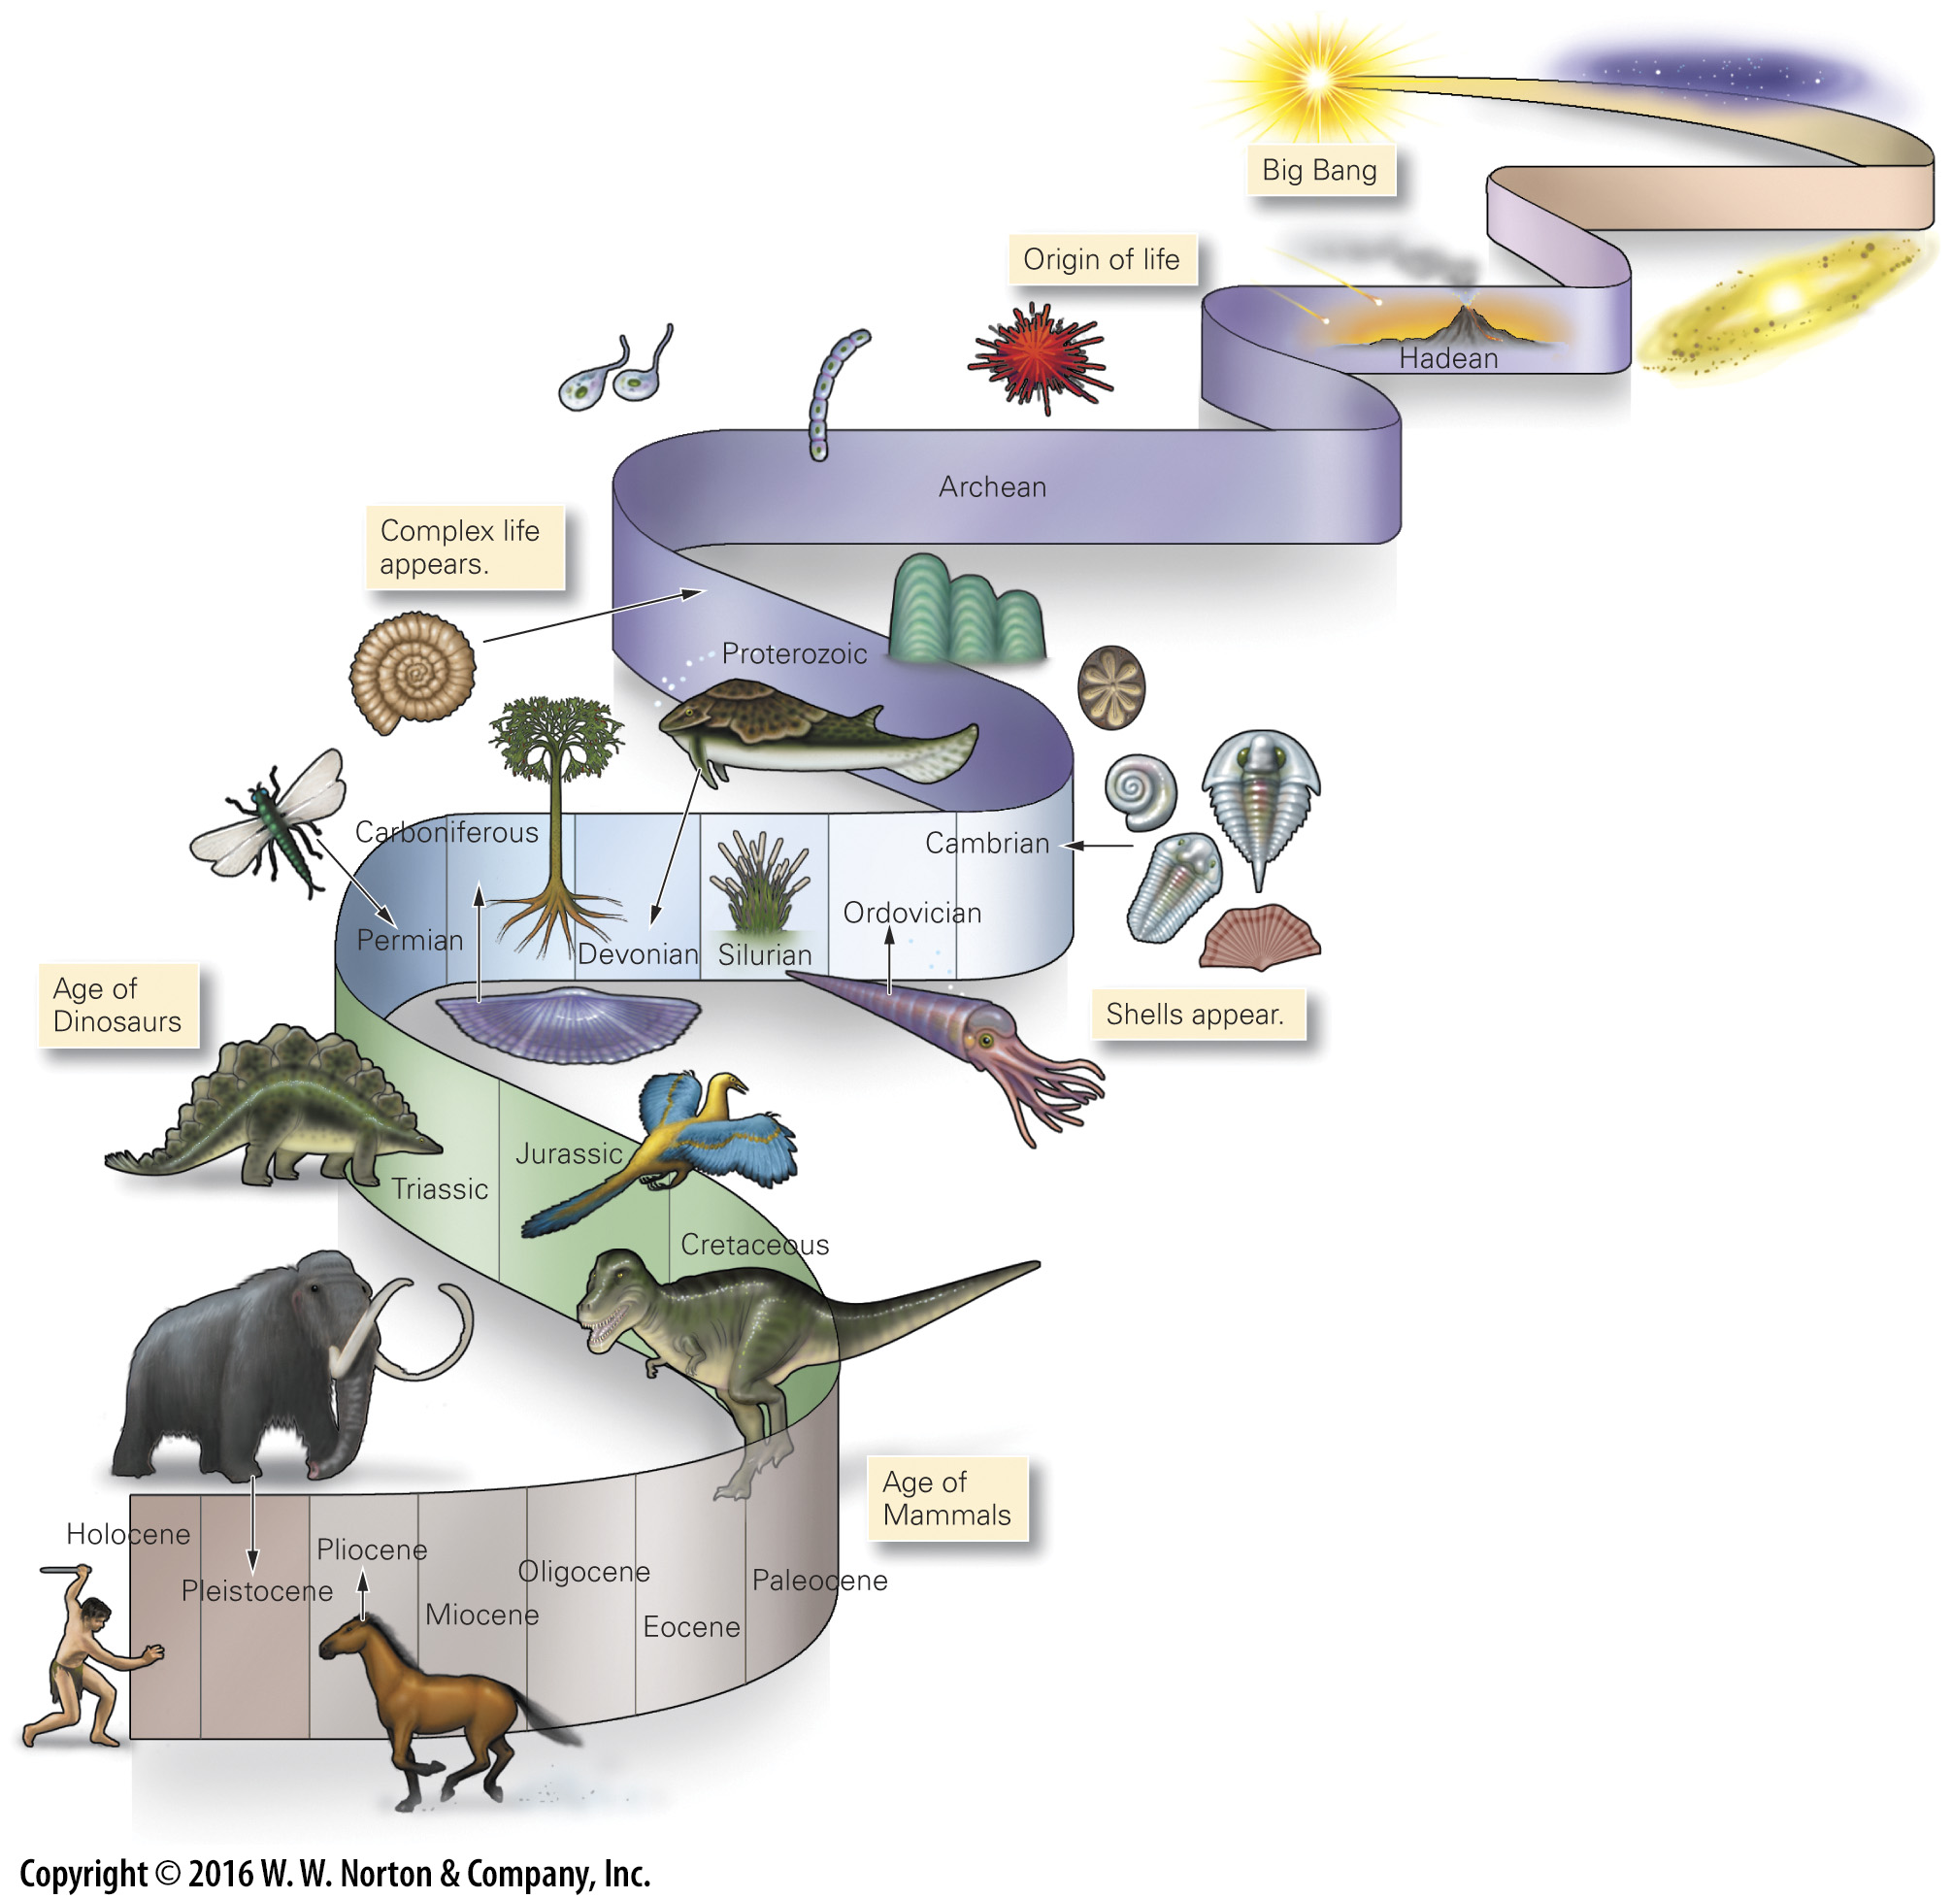
Notes:
FIGURE 10.10 Life evolution in the context of the geologic column. The Earth formed at the beginning of the Hadean Eon.

Slide 40
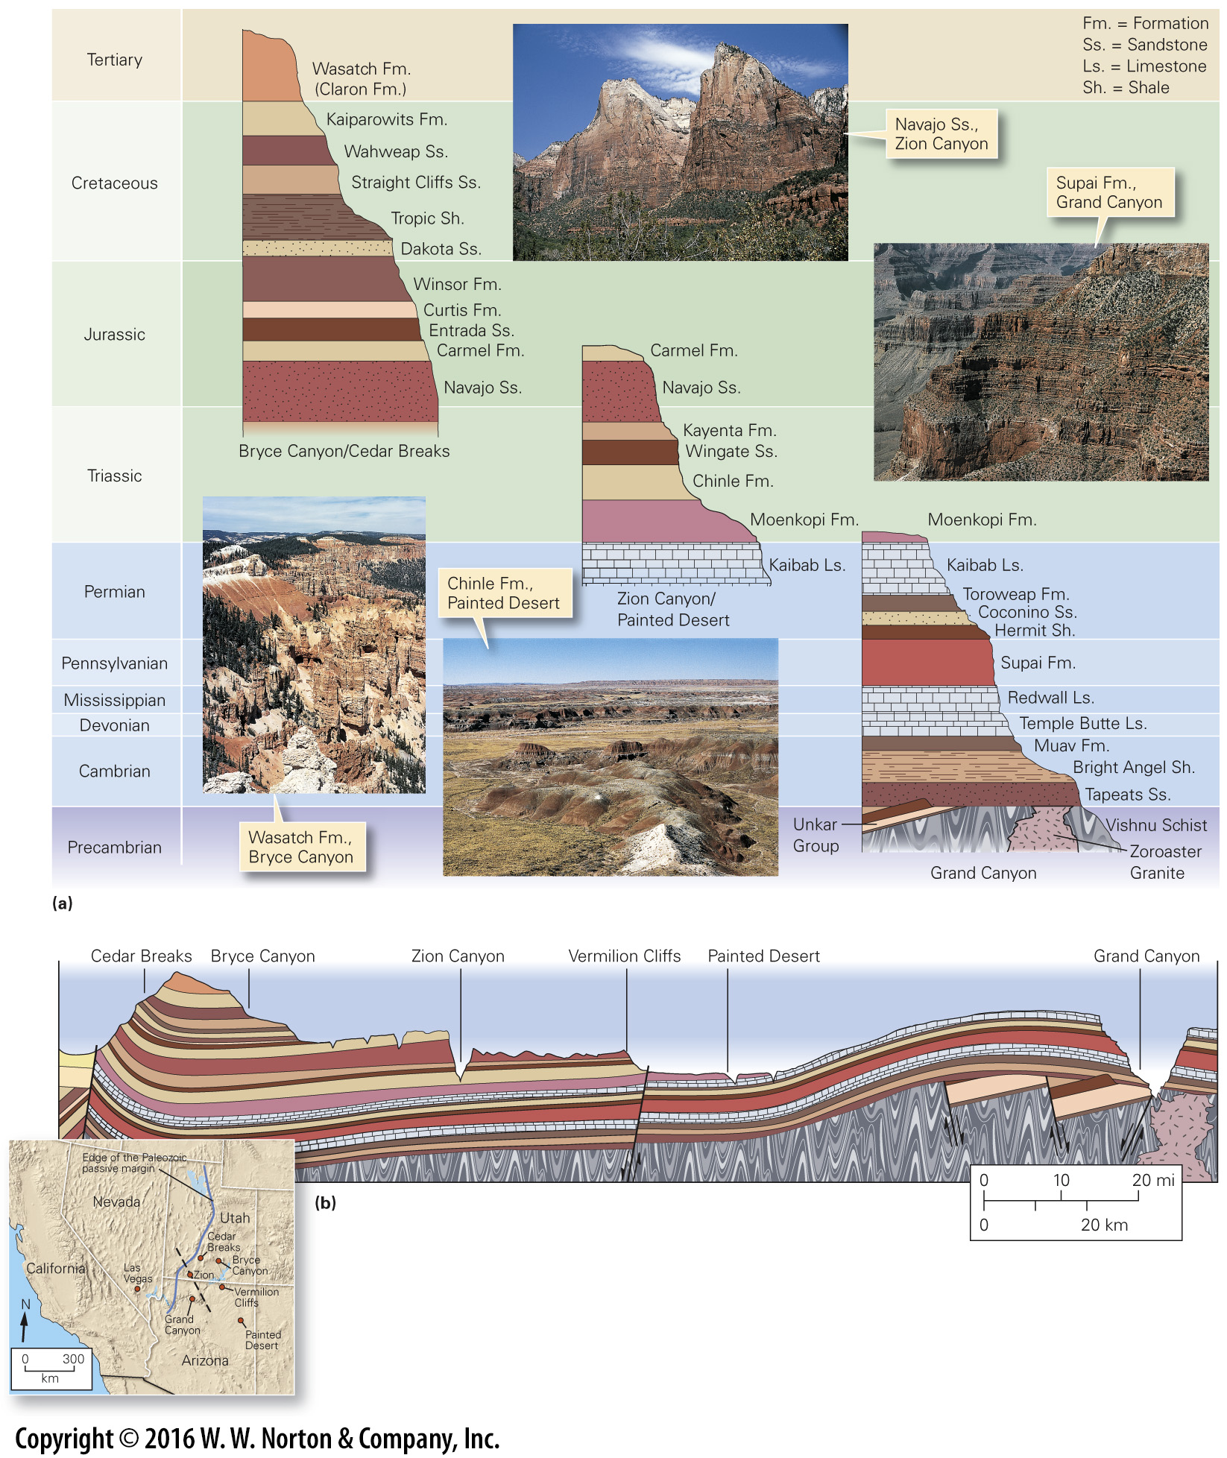
Notes:
FIGURE 10.11 Correlation of strata among the national parks of Arizona and Utah.
(a) Different intervals of geologic time are represented by the strata of different parks. (b) This cross-section sketch (vertically exaggerated) shows how the Phanerozoic strata cover the basement of the Colorado Plateau region. Faults cut and warp these strata, and canyons cut into them. The dashed black line in the inset map represents the cross section seen in the art above.

Slide 41
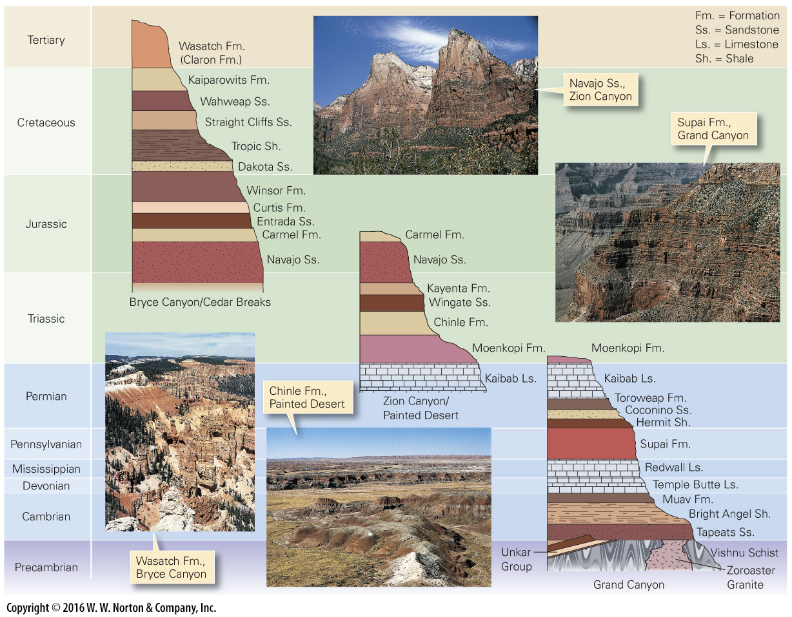
Notes:
FIGURE 10.11a Correlation of strata among the national parks of Arizona and Utah.
(a) Different intervals of geologic time are represented by the strata of different parks.

Slide 42
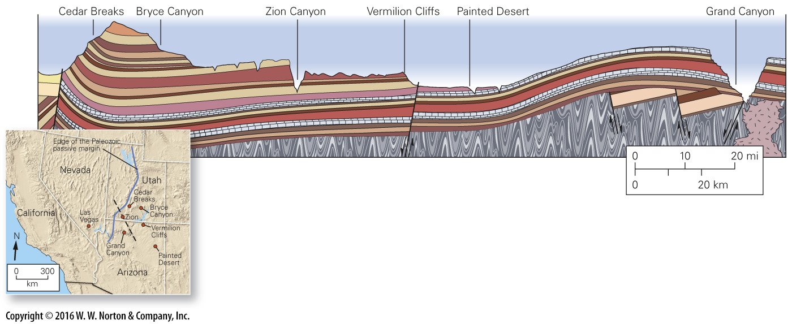
Notes:
FIGURE 10.11b Correlation of strata among the national parks of Arizona and Utah.
(b) This cross-section sketch (vertically exaggerated) shows how the Phanerozoic strata cover the basement of the Colorado Plateau region. Faults cut and warp these strata, and canyons cut into them. The dashed black line in the inset map represents the cross section seen in the art above.

Slide 43
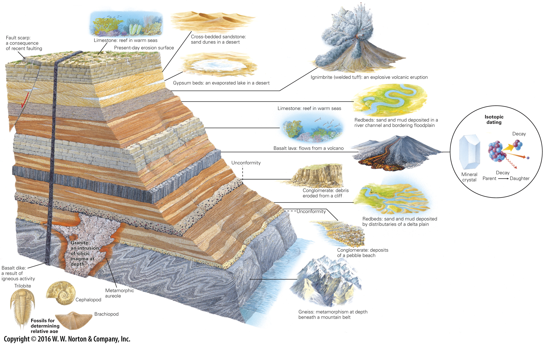
Notes:
GEOLOGY AT A GLANCE
The Record in Rocks: Reconstructing Geologic History

Slide 44
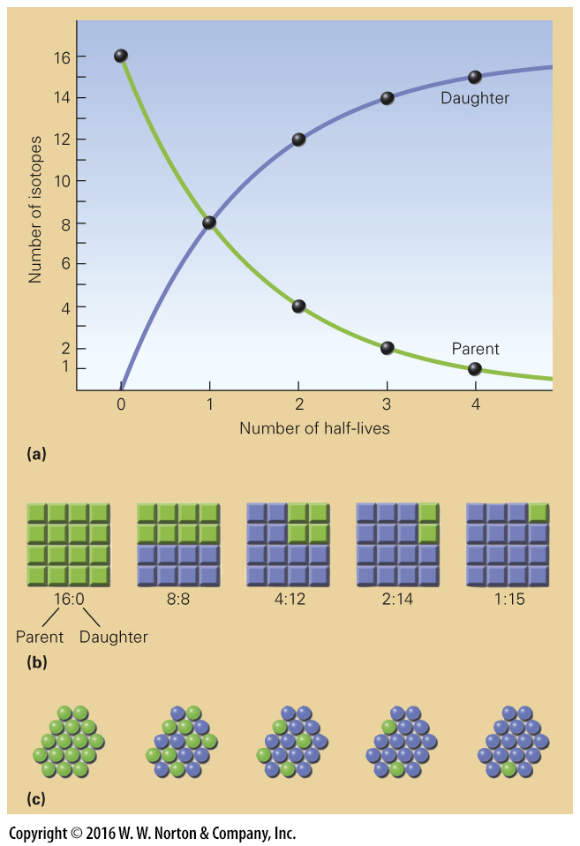
Notes:
FIGURE 10.12 The concept of a half-life, in the context of
radiaoctive decay.
(a) This graph shows how the number of parent isotopes decreases and the number of daughter isotopes increases as time passes. The rate of change decreases with time. (b) The ratio of parent-to-daughter isotopes changes with the passage of each successive half-life. (c) In a cluster of isotopes undergoing decay, there is no way to predict which parent will decay next.

Slide 45
Notes:
TABLE 10.1 Isotopes Used in the Isotopic Dating of Rock

Slide 46
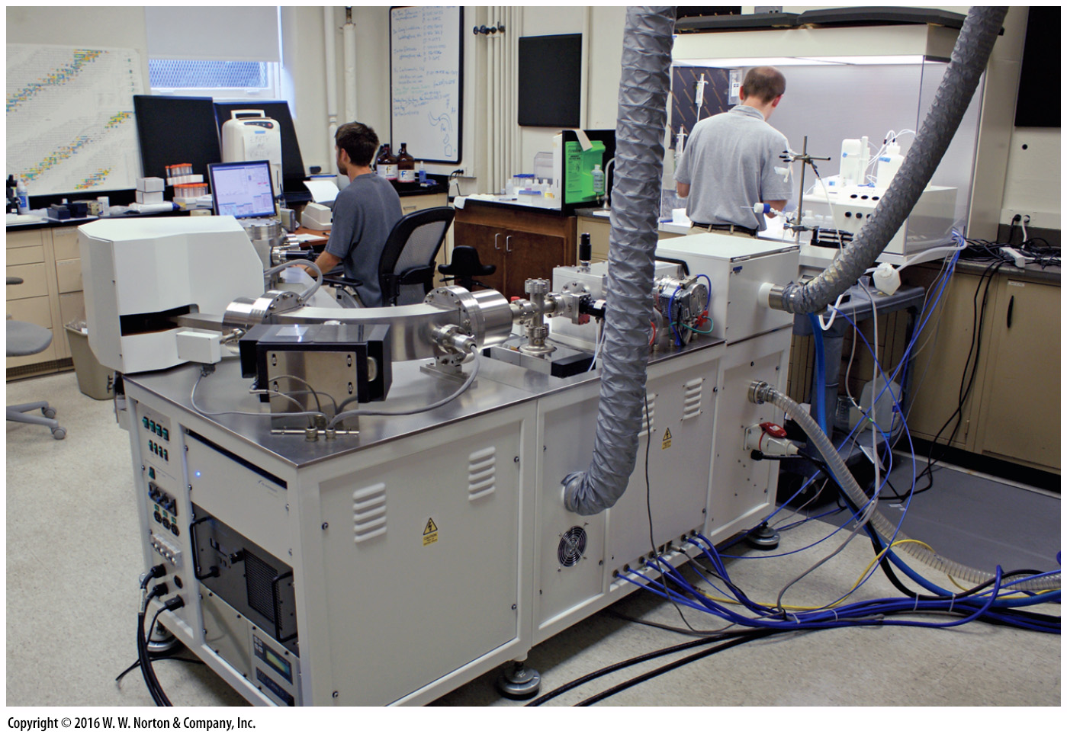
Notes:
FIGURE 10.13 In an isotopic dating laboratory, samples are analyzed using a mass spectrometer. This instrument measures the ratio of parent-to-daughter isotopes.

Slide 47
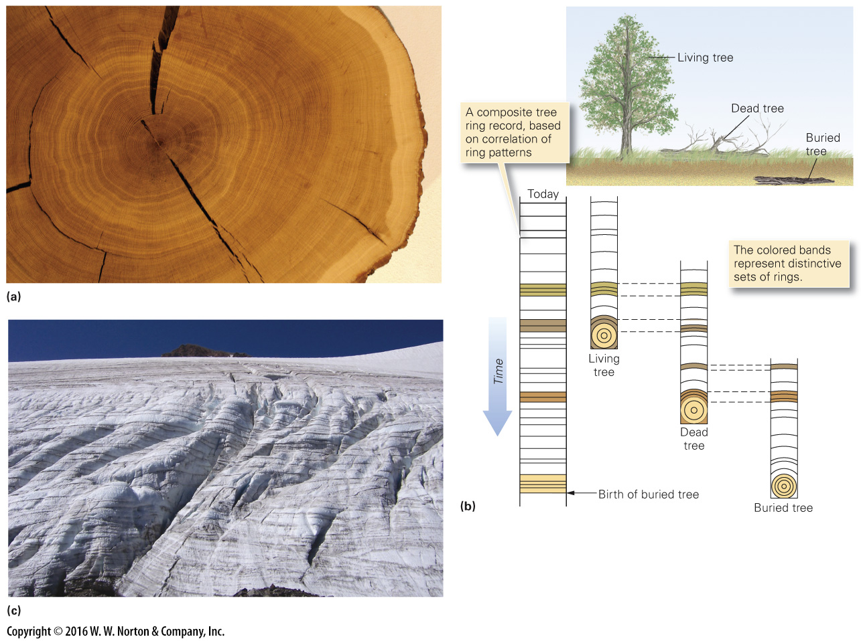
Notes:
FIGURE 10.14 Ways to determine numerical ages.
(a) Patterns of tree rings are like bar codes. Each ring in this slice of wood represents the growth of one year. (b) Dendrochronology is based on the correlation of tree rings. Each of the columns in the diagram represents a core drilled out of a tree. Distinctive clusters of closely spaced rings indicate dry seasons. By correlation, researchers extend the climate record back in time before the oldest living tree started to grow. (c) Dust settling during the summer highlights boundaries between snow layers, now turned to ice in this Oregon glacier.

Slide 48
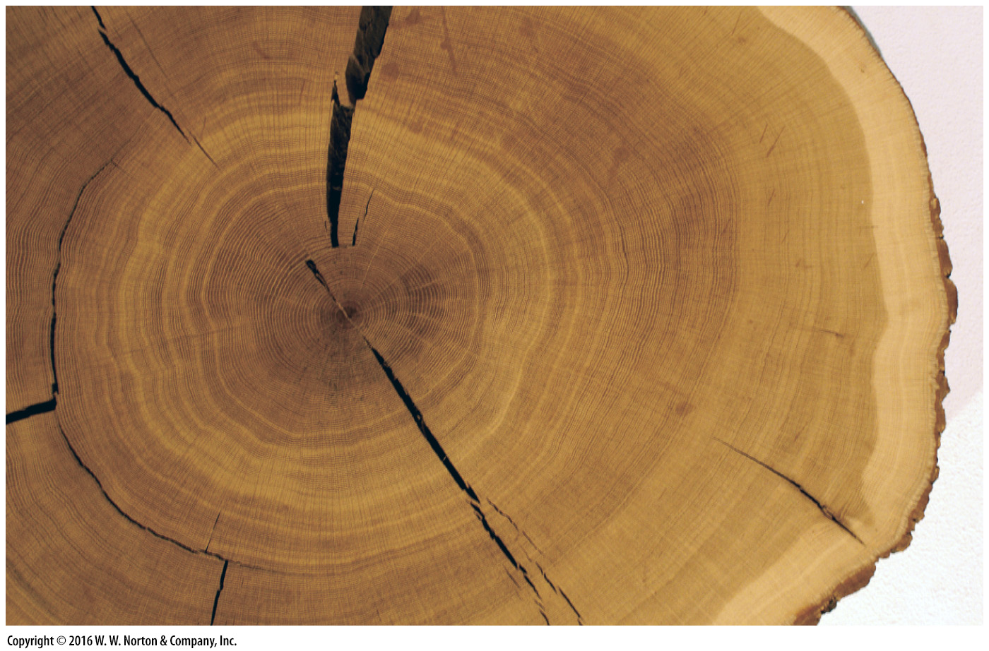
Notes:
FIGURE 10.14a Ways to determine numerical ages.
(a) Patterns of tree rings are like bar codes. Each ring in this slice of wood represents the growth of one year.

Slide 49
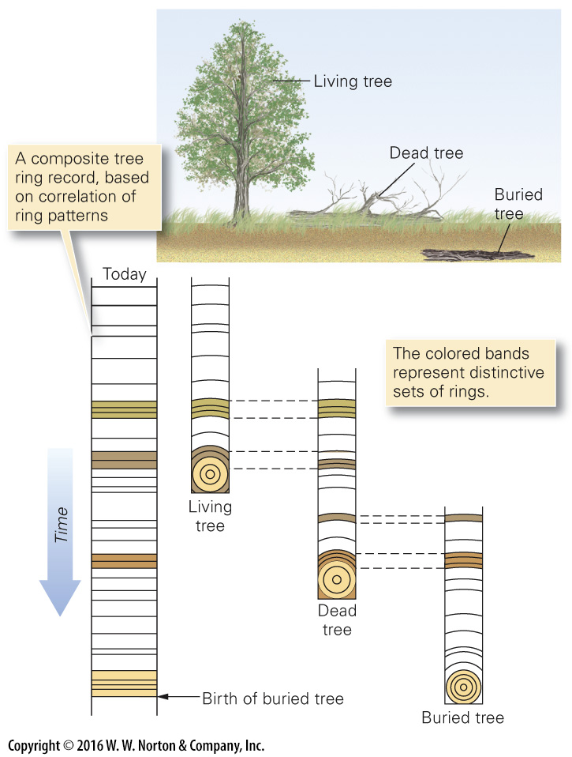
Notes:
FIGURE 10.14b Ways to determine numerical ages.
(b) Dendrochronology is based on the correlation of tree rings. Each of the columns in the diagram represents a core drilled out of a tree. Distinctive clusters of closely spaced rings indicate dry seasons. By correlation, researchers extend the climate record back in time before the oldest living tree started to grow.

Slide 50
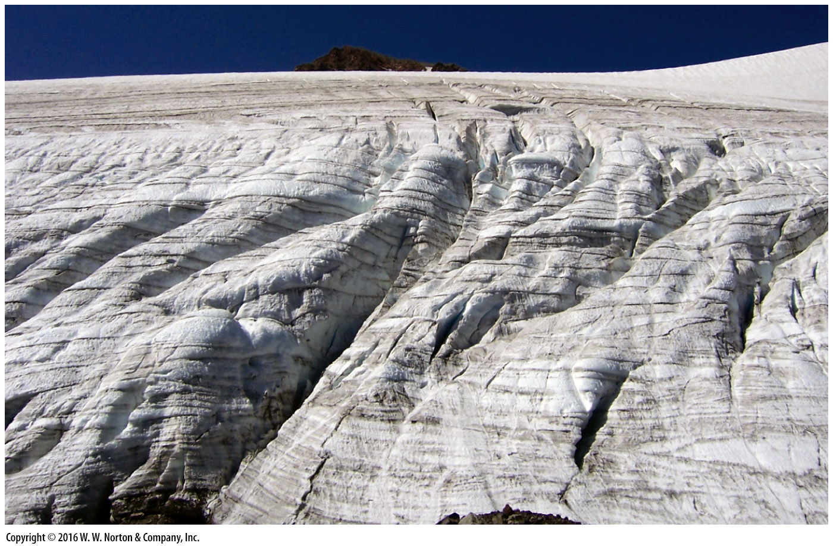
Notes:
FIGURE 10.14c Ways to determine numerical ages.
(c) Dust settling during the summer highlights boundaries between snow layers, now turned to ice in this Oregon glacier.

Slide 51
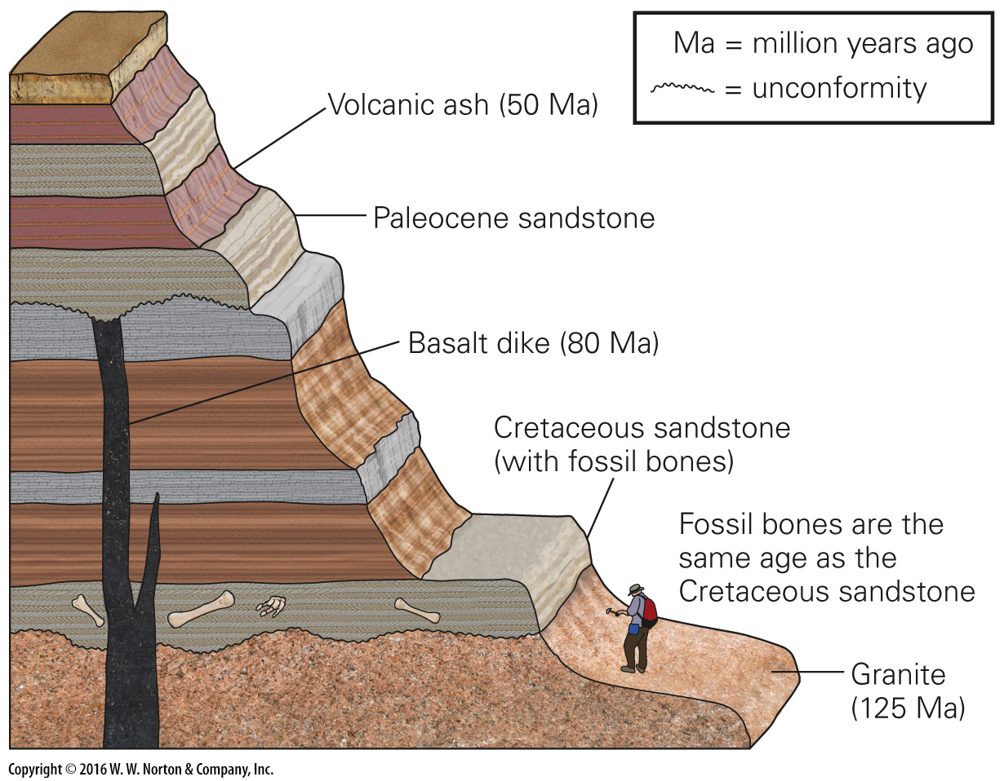
Notes:
FIGURE 10.15 The Cretaceous sandstone bed was deposited on the granite, so it must be younger than 125 Ma. The dike cuts the bed, so the bed must be older than 80 Ma. Thus, the Cretaceous bed was deposited between 125 and 80 Ma. The Paleocene sandstone was unconformably deposited over the dike and lies beneath a 50-million-year-old layer of ash. Therefore, it must have been deposited between 80 and 50 Ma.

Slide 52
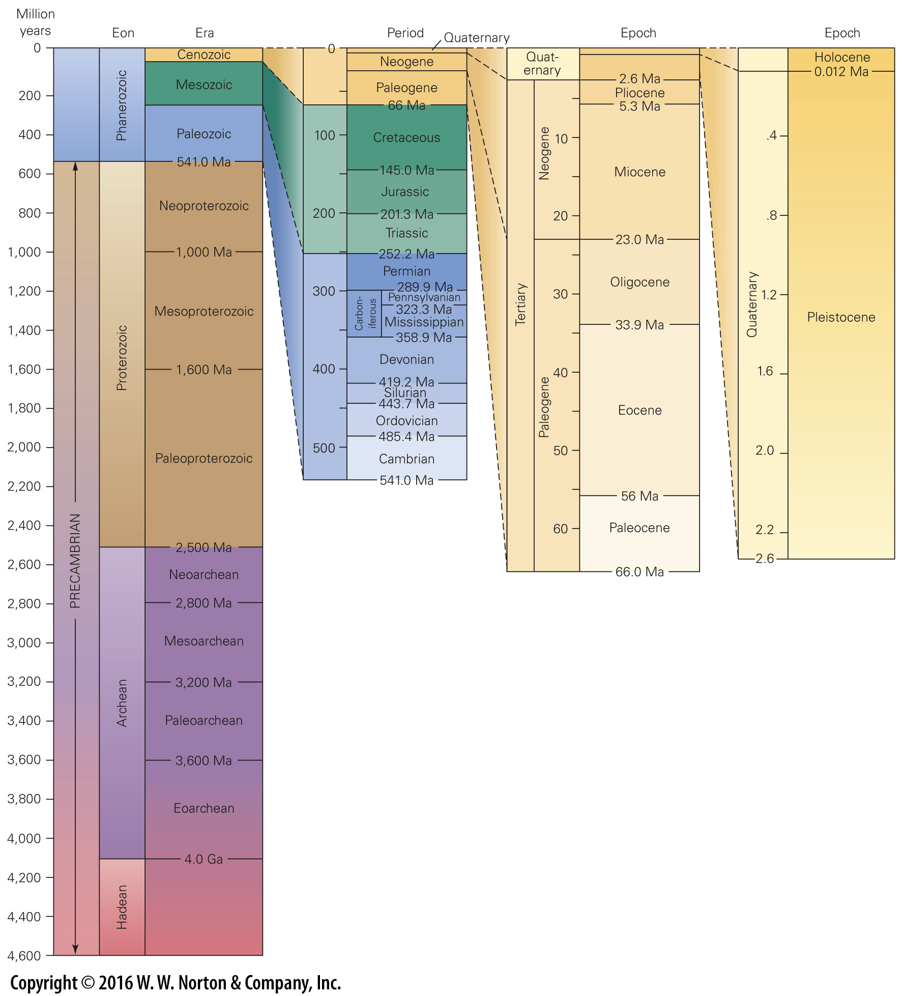
Notes:
FIGURE 10.16 The geologic time scale assigns numerical ages to the intervals on the geologic column. Note that we have to change to a larger scale to portray the ages of intervals higher in the column, because these are shorter subdivisions. This time scale utilizes numbers favored by the International Commission on Stratigraphy.

Slide 53
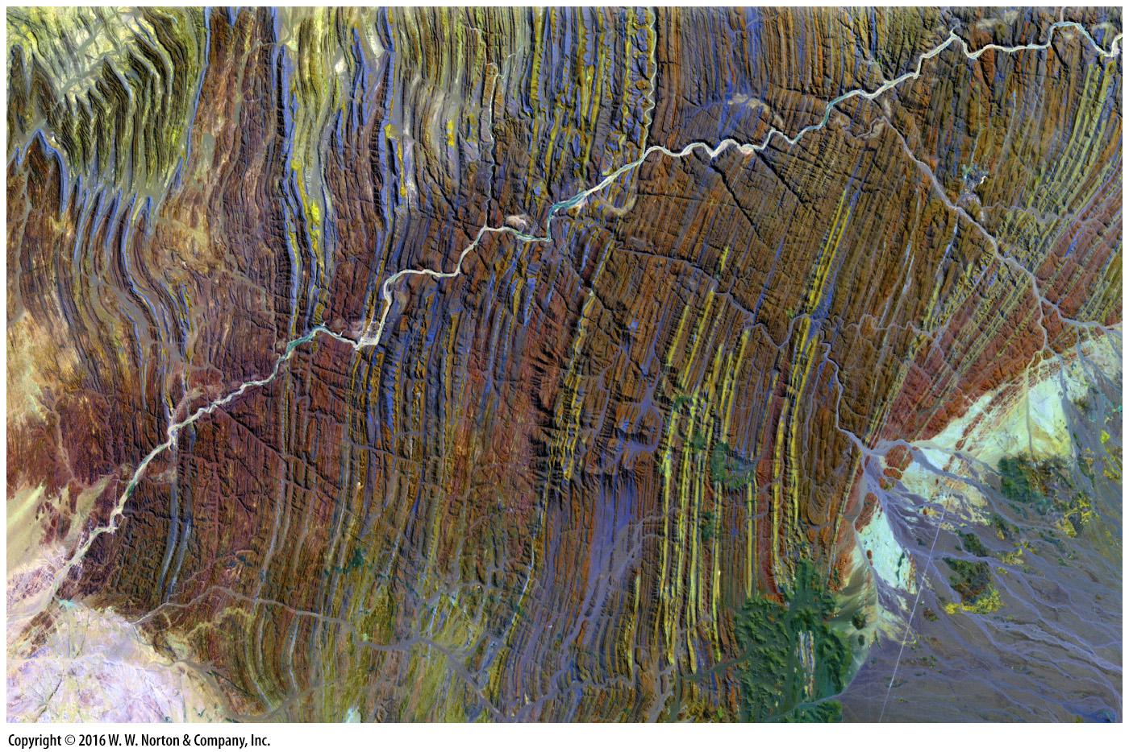
Notes:
Another View The pages of Earth history stand on end in Namibia, southwestern Africa. Here, in a false-color image, the Ugab River cuts across layer upon layer of strata that were tilted to near vertical by a Precambrian mountain-building event. Subsequent erosion exposed the strata, and the desert climate keeps it clear of vegetation. The field of view is 45 km.

Slide 54
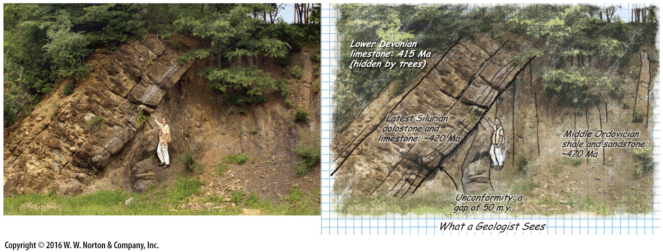
Notes:
Page 363

