Slide 1
Stephen Marshak
ESSENTIALS OF
Geology
FIFTH EDITION
Chapter 11
A Biography of Earth
©2016 W. W. Norton & Company, Inc.

Slide 2
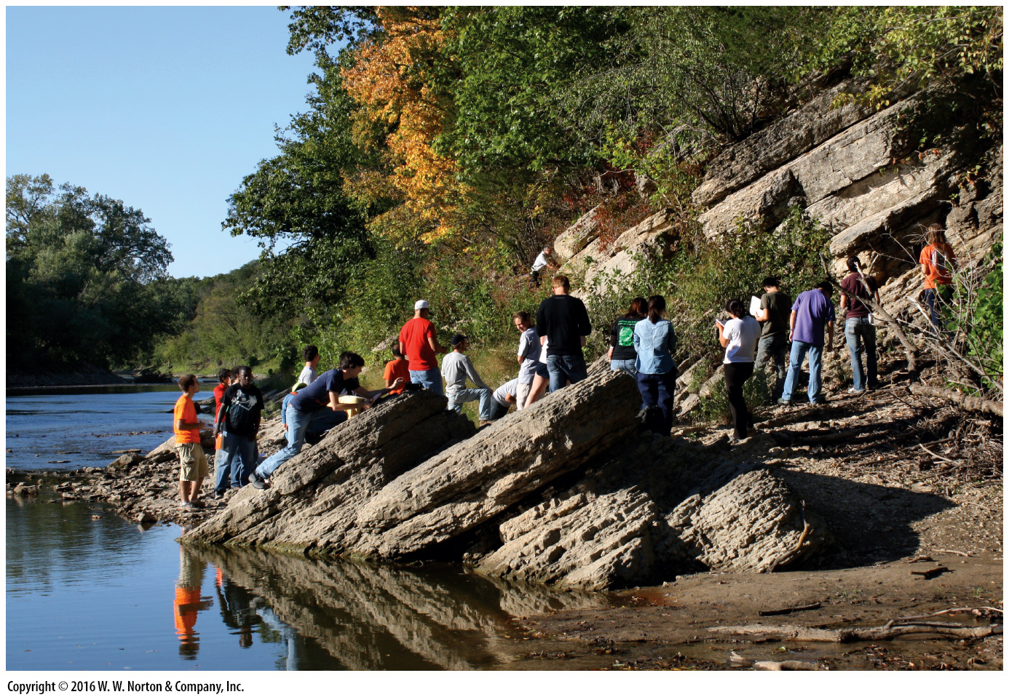
Notes:
The presence of these fossiliferous limestone beds in Illinois tells us that the middle of North America was once covered by a shallow sea. The dip of the strata tells us that long after the sediment turned to rock, tectonics deformed this part of the continent. Much later, uplift and erosion exposed the rock. Clearly, the Earth has a history!

Slide 3
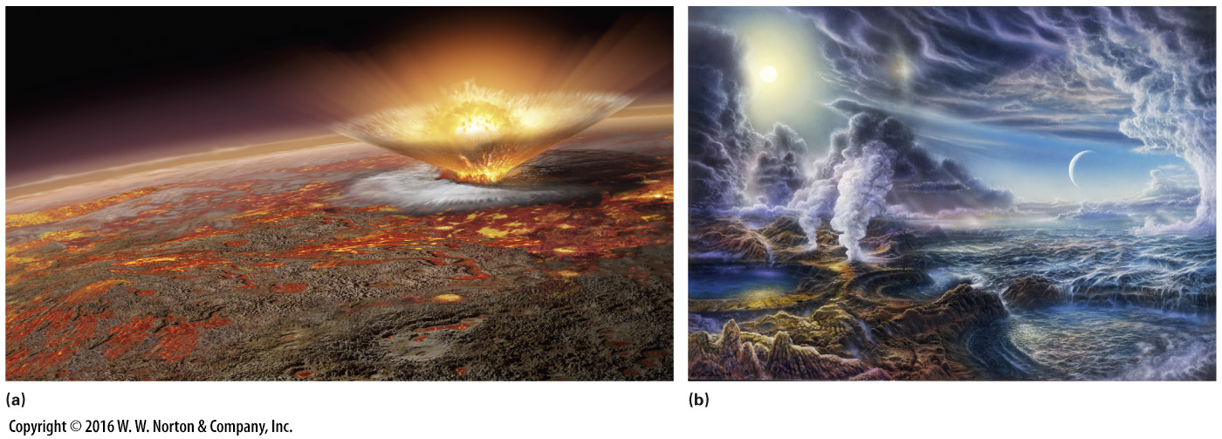
Notes:
FIGURE 11.1 Visualizing the early Earth is a challenge, but by using geologic interpretations, artists have provided useful images.
(a) At a very early stage, during or after differentiation, the surface may have been largely molten. The loss of heat to space would have allowed patches of solid ultramafic solid crust to form. Meteorite impacts would have been fairly frequent. (b) When Earth’s surface fell below the boiling point of water, water from the atmosphere rained onto the surface, submerging it with early oceans.

Slide 4
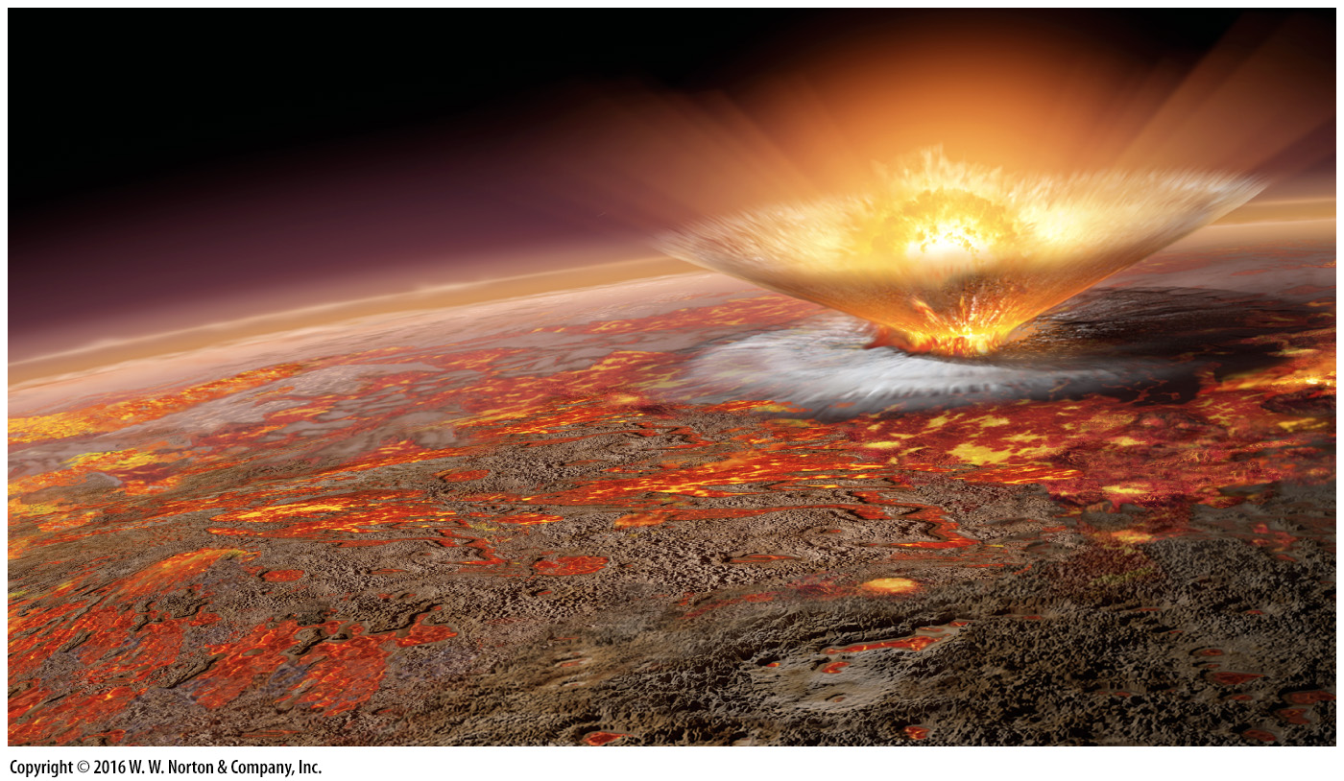
Notes:
FIGURE 11.1a Visualizing the early Earth is a challenge, but by using geologic interpretations, artists have provided useful images.
(a) At a very early stage, during or after differentiation, the surface may have been largely molten. The loss of heat to space would have allowed patches of solid ultramafic solid crust to form. Meteorite impacts would have been fairly frequent.

Slide 5
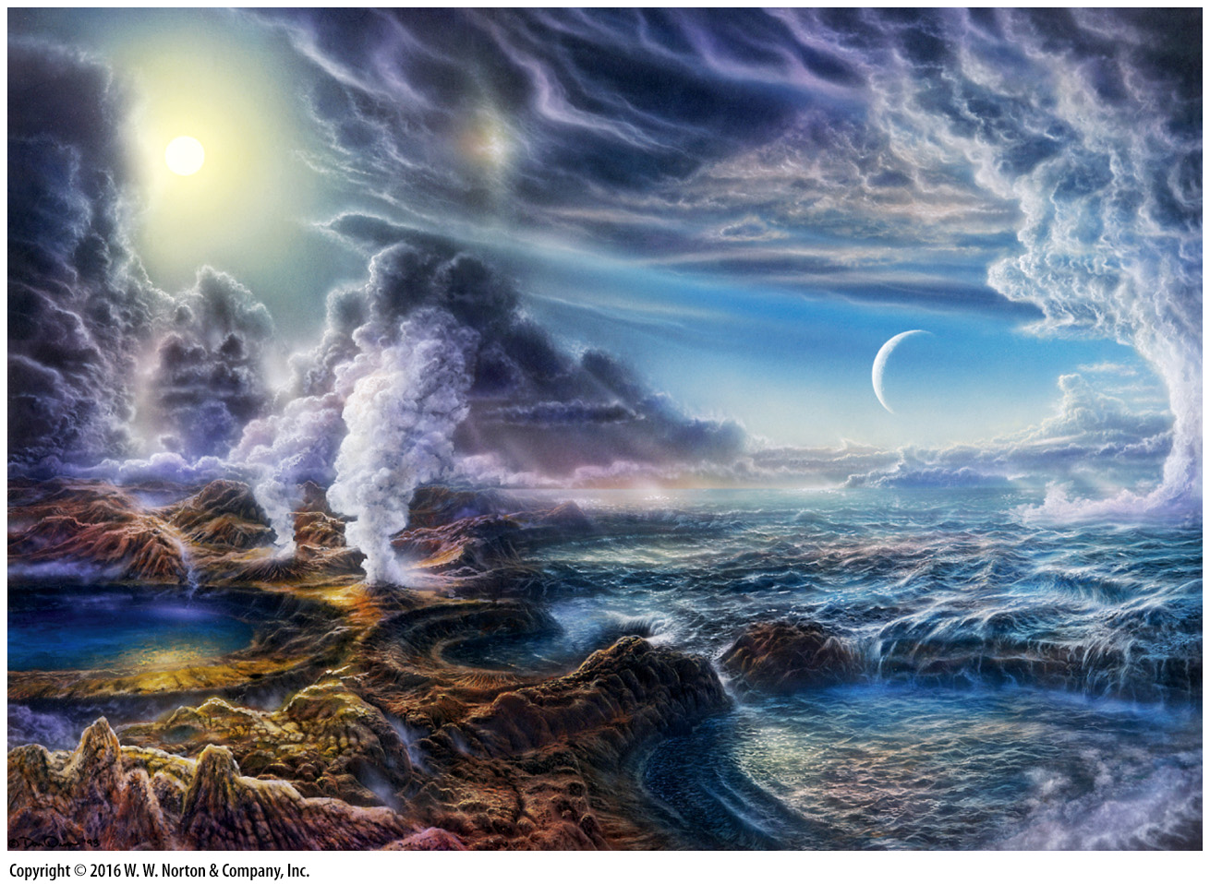
Notes:
FIGURE 11.1b Visualizing the early Earth is a challenge, but by using geologic interpretations, artists have provided useful images.
(b) When Earth’s surface fell below the boiling point of water, water from the atmosphere rained onto the surface, submerging it with early oceans.

Slide 6
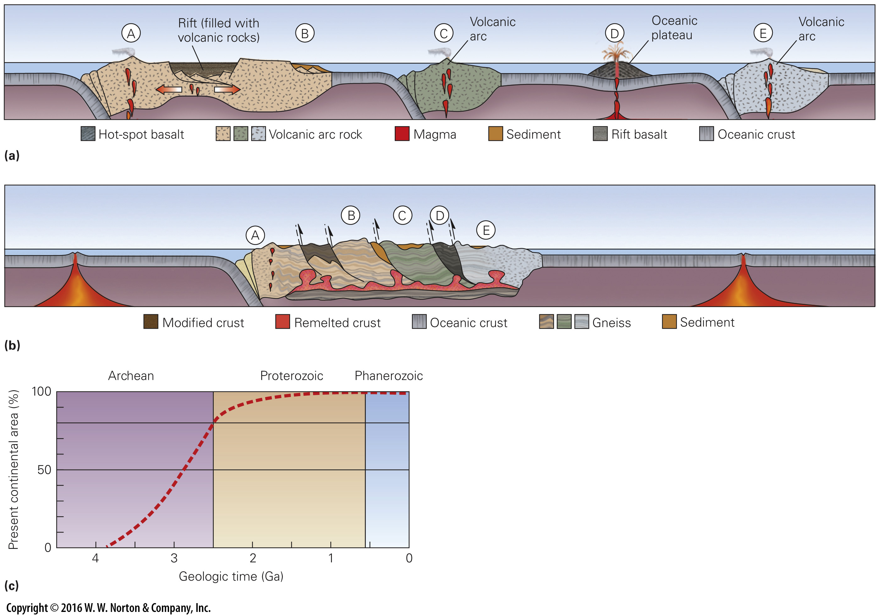
Notes:
FIGURE 11.2 A model for crust formation during the Archean Eon.
(a) In the Archean, island arcs and hot-spot volcanoes built small blocks of buoyant crust. Rifting of these blocks may have produced flood basalts, and erosion of the blocks produced sediment. (b) Buoyant blocks collided and sutured together, forming protocontinents. Melting at depth produced granite. Eventually, regions of crust cooled, stabilized, and became cratons. (c) As time progressed, the area of the Earth covered by continental crust increased. Most crust had formed by the beginning of the Proterozoic.

Slide 7
Notes:
FIGURE 11.2a A model for crust formation during the Archean Eon.
(a) In the Archean, island arcs and hot-spot volcanoes built small blocks of buoyant crust. Rifting of these blocks may have produced flood basalts, and erosion of the blocks produced sediment.

Slide 8
Notes:
FIGURE 11.2b A model for crust formation during the Archean Eon.
(b) Buoyant blocks collided and sutured together, forming protocontinents. Melting at depth produced granite. Eventually, regions of crust cooled, stabilized, and became cratons.

Slide 9
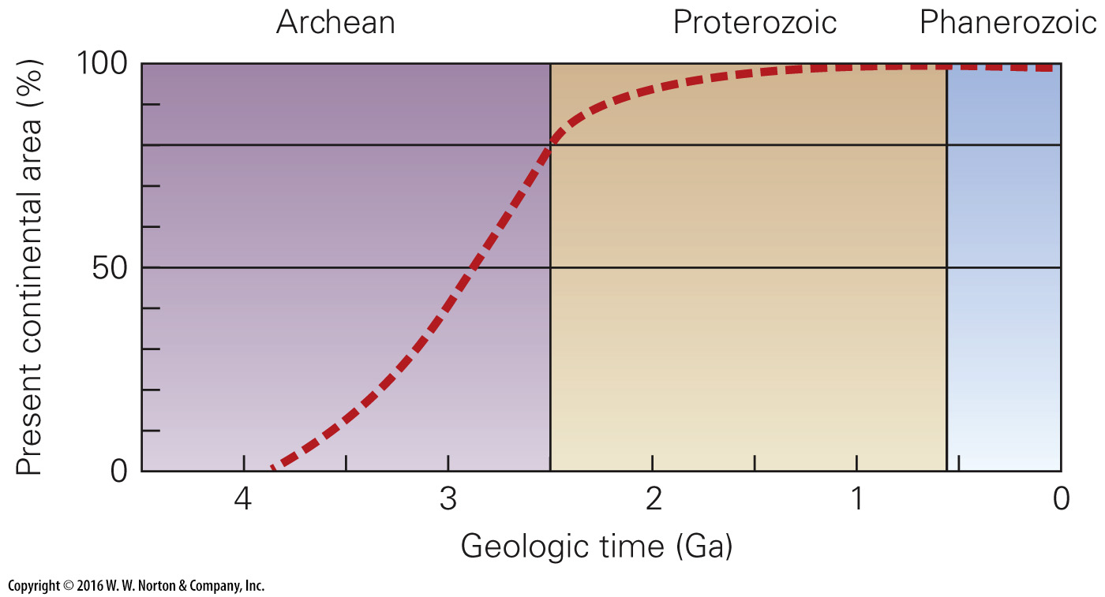
Notes:
FIGURE 11.2c A model for crust formation during the Archean Eon.
(c) As time progressed, the area of the Earth covered by continental crust increased. Most crust had formed by the beginning of the Proterozoic.

Slide 10
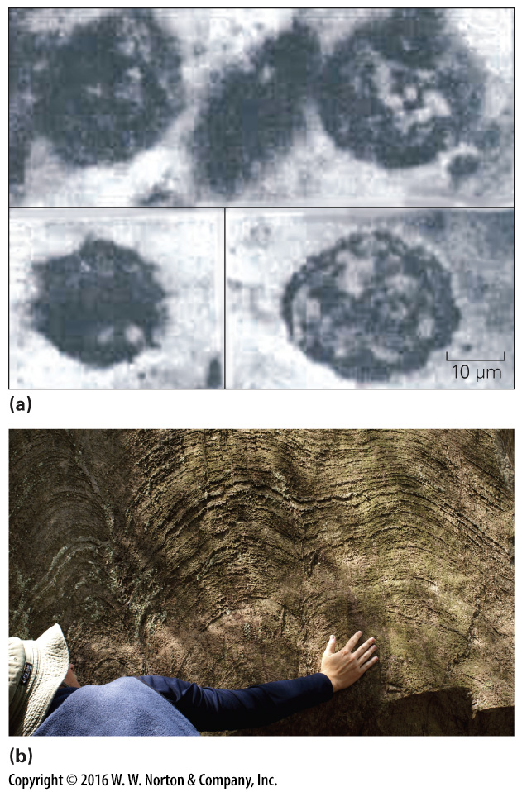
Notes:
FIGURE 11.3 Archean life forms.
(a) These shapes in 3.2-Ga chert from South America are thought to be fossil bacteria or archaea. (b) This weathered outcrop of 1.85-Ga dolostone near Marquette, Michigan, reveals the layer-like structure of stromatolites. The delicate ridges represent the fossilized remnants of bacterial mats. Similar stromatolites also occur in exposures of Archean rocks.

Slide 11
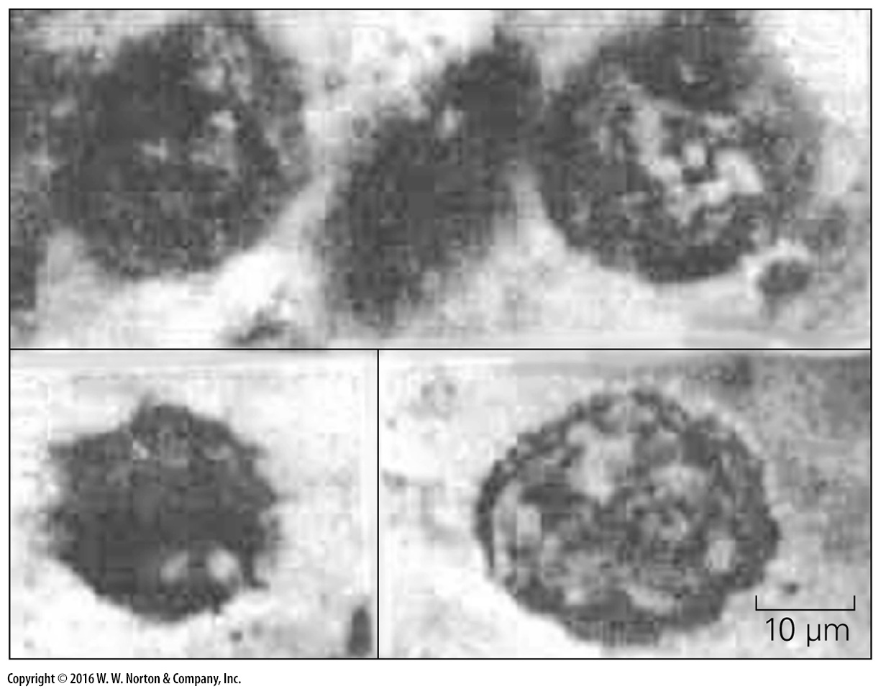
Notes:
FIGURE 11.3a Archean life forms.
(a) These shapes in 3.2-Ga chert from South America are thought to be fossil bacteria or archaea.

Slide 12
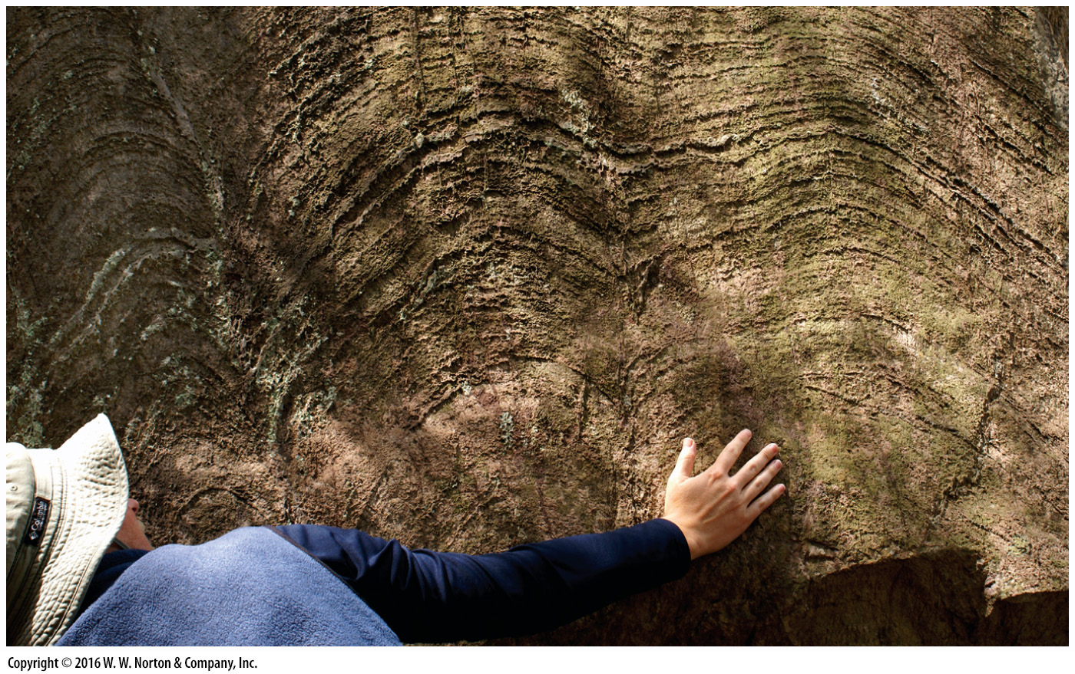
Notes:
FIGURE 11.3b Archean life forms.
(b) This weathered outcrop of 1.85-Ga dolostone near Marquette, Michigan, reveals the layer-like structure of stromatolites. The delicate ridges represent the fossilized remnants of bacterial mats. Similar stromatolites also occur in exposures of Archean rocks.

Slide 13
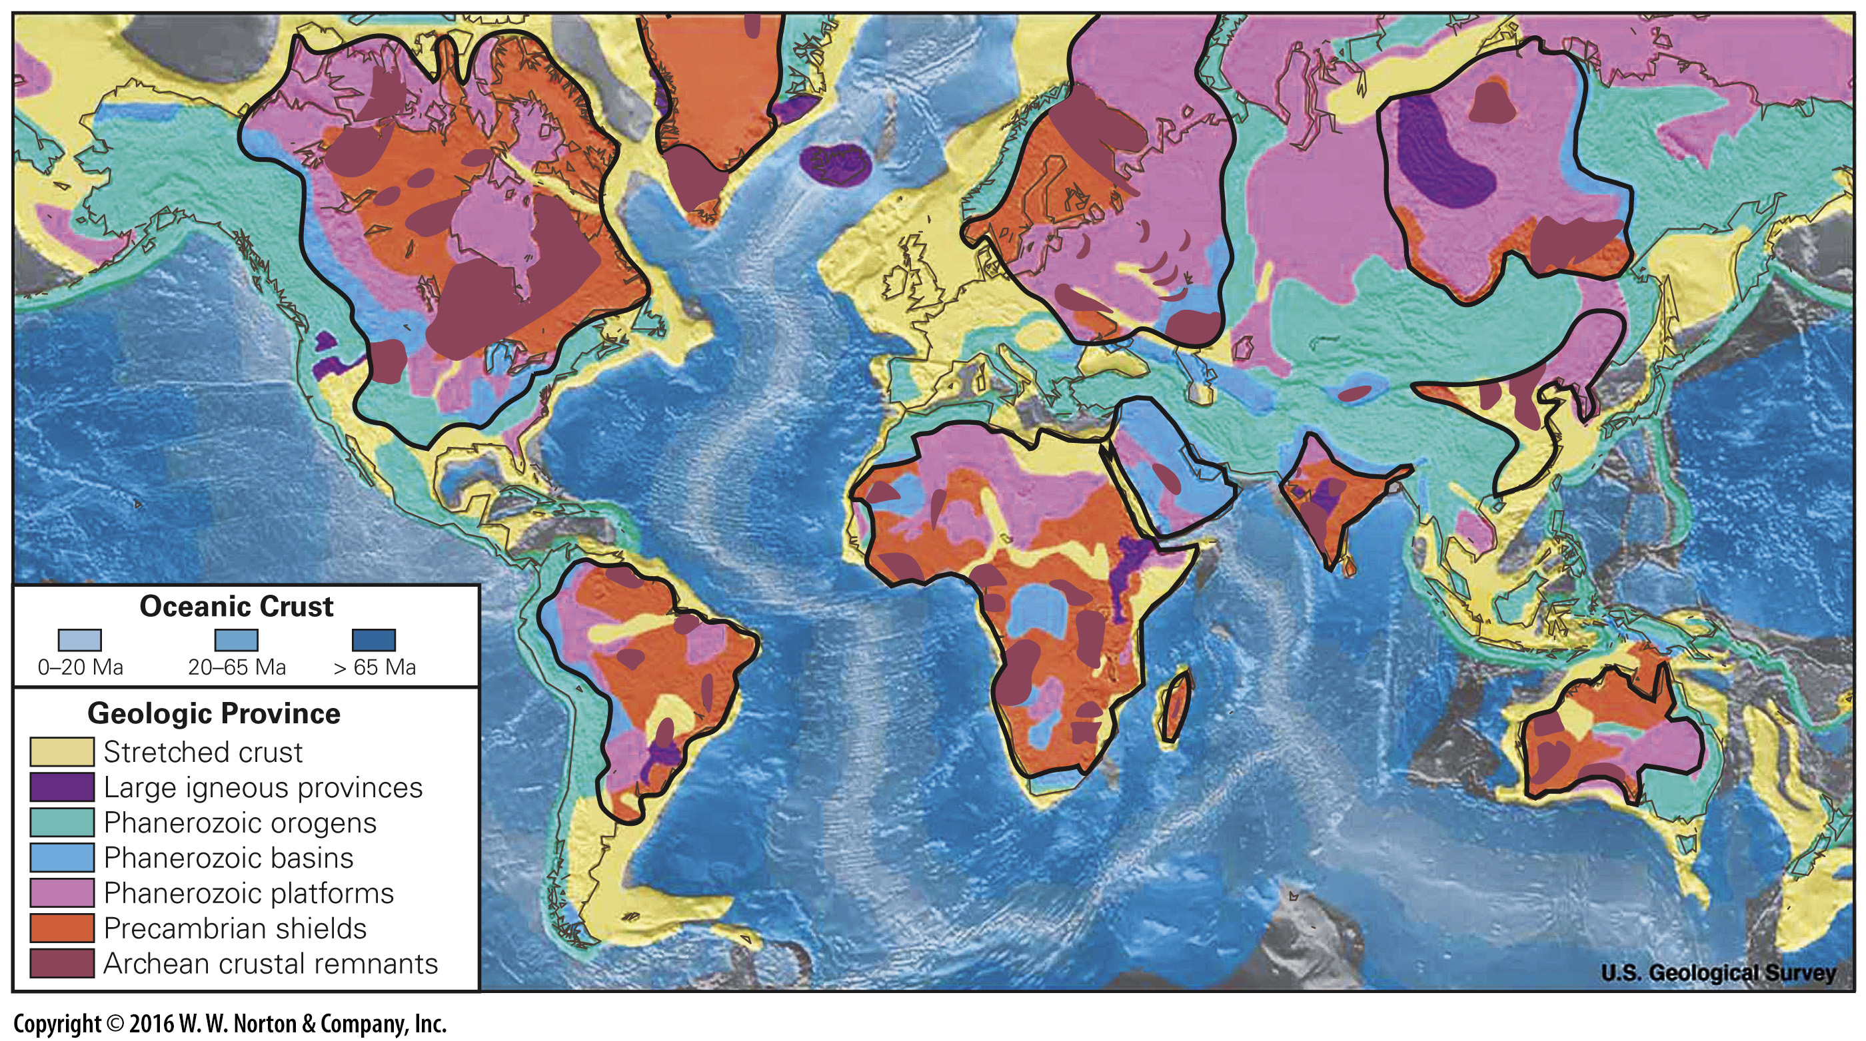
Notes:
FIGURE 11.4 Major crustal provinces of Earth. The black lines indicate the borders of regions underlain by Precambrian crust. Shields are regions where broad areas of Precambrian rocks are exposed.

Slide 14
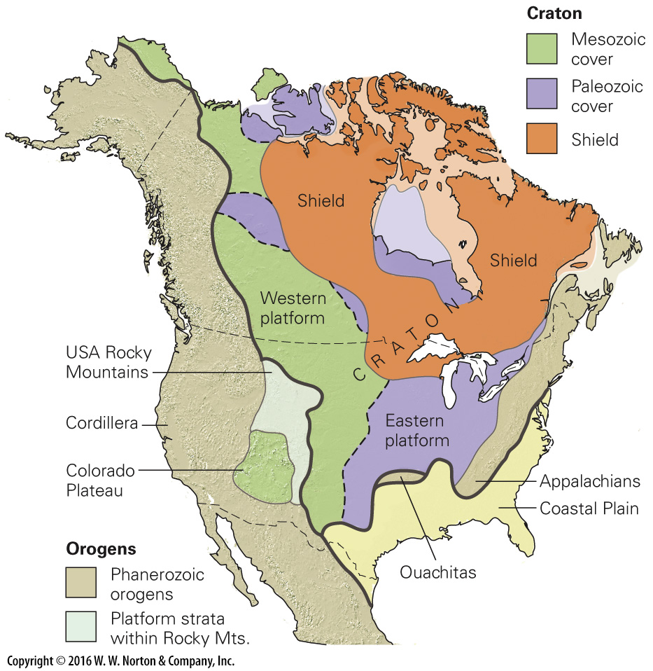
Notes:
FIGURE 11.5a North America’s craton, and the blocks and belts that comprise it.
(a) The craton lies between the Cordillera and the Appalachians. Precambrian rocks crop out in the shield, and are covered by sedimentary strata in the platform.

Slide 15
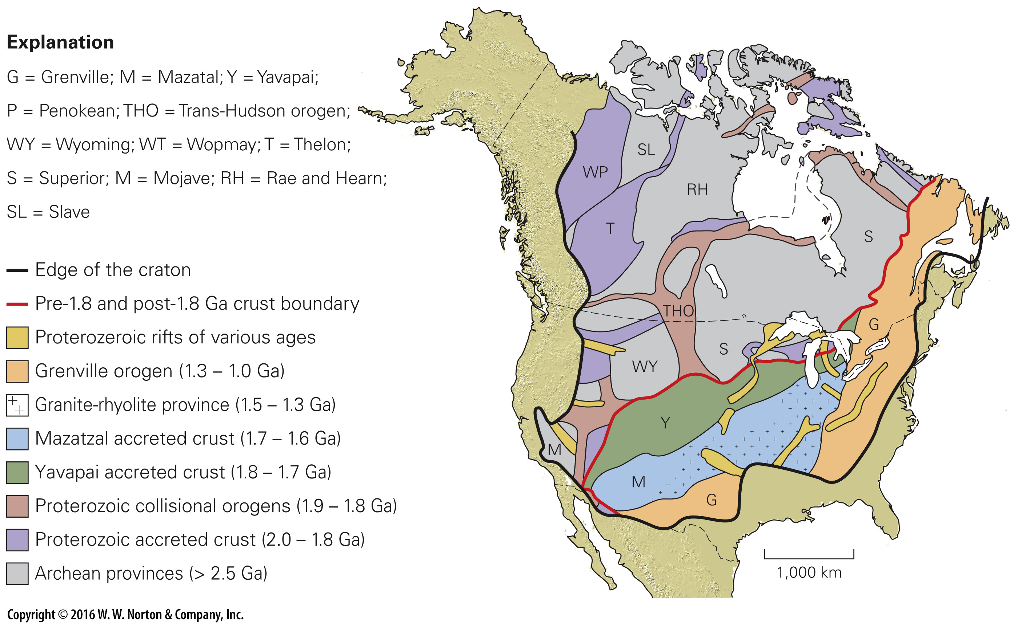
Notes:
FIGURE 11.5b North America’s craton, and the blocks and belts that comprise it.
(b) The craton consists of many different blocks, each of which has a name. Most of Canada, and the northwestern United States, had assembled by 1.8 Ga. Belts of younger terranes accreted to southeastern margin nucleus between 1.8 and 1.1 Ga.

Slide 16
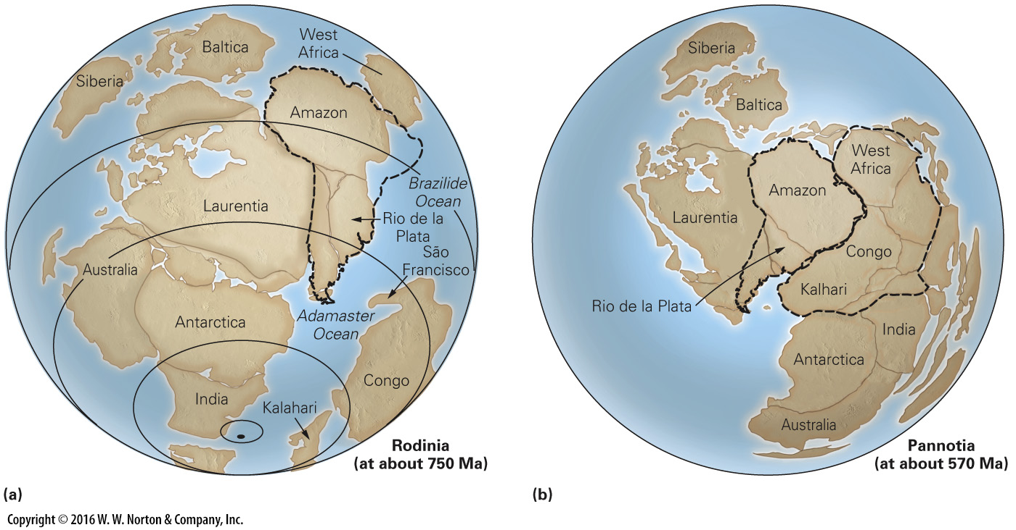
Notes:
FIGURE 11.6 Supercontinents in the late Precambrian.
(a) Rodinia formed around 1 Ga and lasted until about 700 Ma. North America and Greenland together comprise Laurentia. (b) According to one model, by 570 Ma Rodinia had broken apart; continents that once lay to the west of Laurentia ended up to the east of Africa. The resulting supercontinent, Pannotia, broke up soon after it formed.

Slide 17
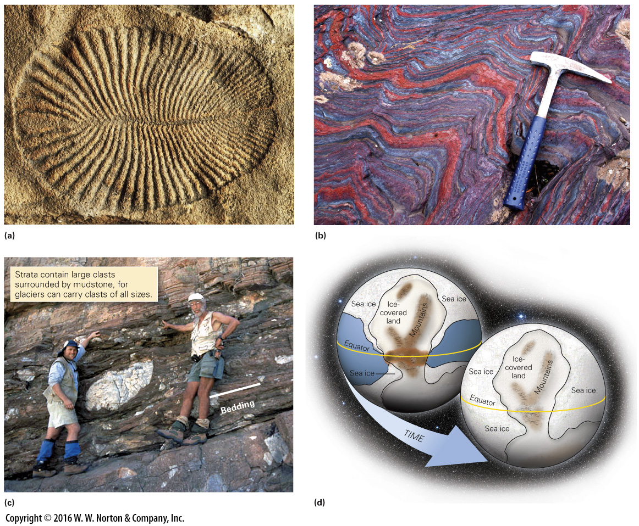
Notes:
FIGURE 11.7 Major changes in the Earth System during the Proterozoic Eon.
(a) Dickinsonia, a fossil of the Ediacaran fauna. These complex, soft-bodied marine organisms appeared in the late Proterozoic. This specimen is 10 cm long. (b) An outcrop of BIF in the Iron Ranges of Michigan. The red stripes are jasper (red chert) and the gray stripes are hematite. The rock was folded during a mountain-building event long after deposition. (c) Layers of Proterozoic glacial till crop out in Africa, indicating that low-latitude landmasses were glaciated during the Proterozoic. (d) This planet may have frozen over completely to form “snowball Earth.” Glaciers first grew on land, and eventually the sea surface froze over.

Slide 18
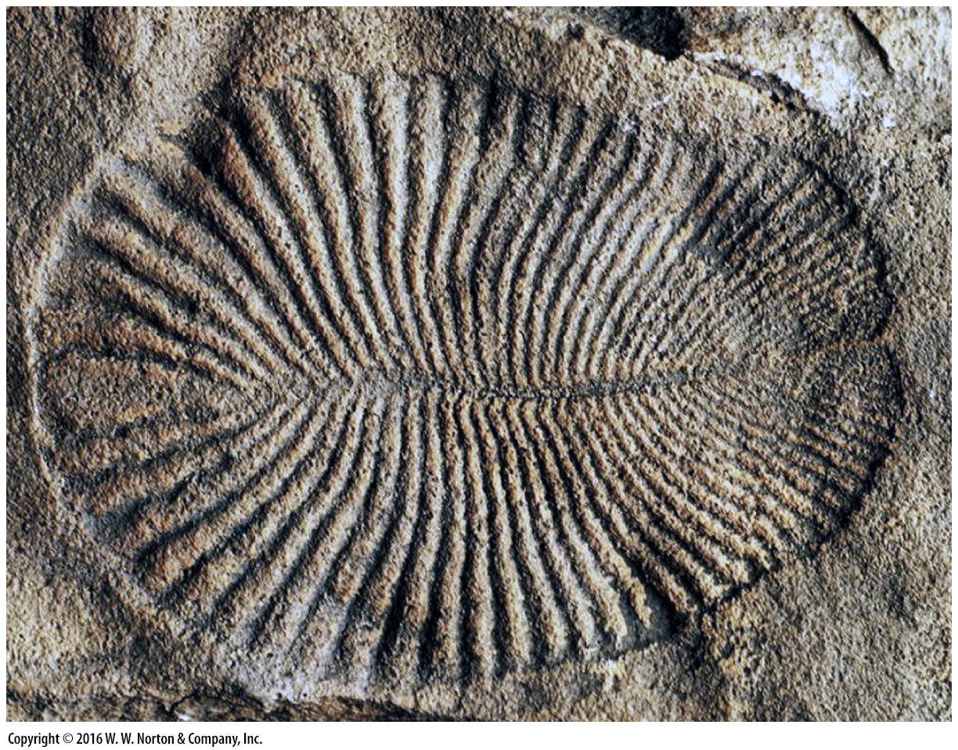
Notes:
FIGURE 11.7a Major changes in the Earth System during the Proterozoic Eon.
(a) Dickinsonia, a fossil of the Ediacaran fauna. These complex, soft-bodied marine organisms appeared in the late Proterozoic. This specimen is 10 cm long.

Slide 19
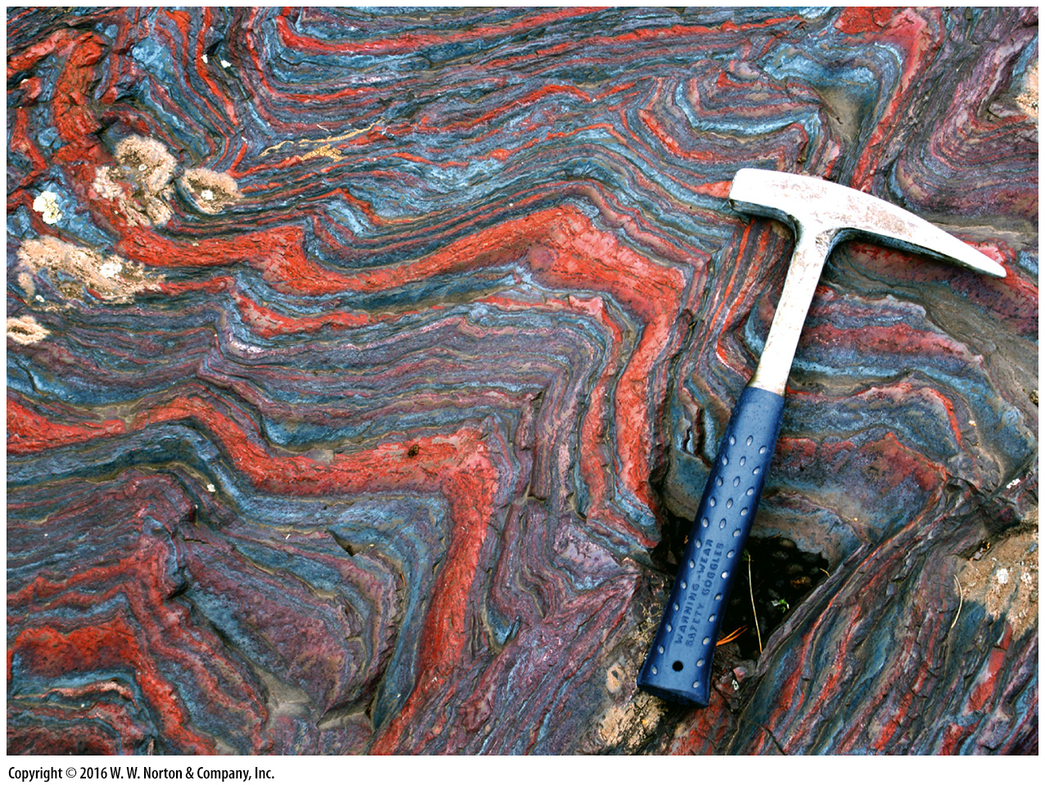
Notes:
FIGURE 11.7b Major changes in the Earth System during the Proterozoic Eon.
(b) An outcrop of BIF in the Iron Ranges of Michigan. The red stripes are jasper (red chert) and the gray stripes are hematite. The rock was folded during a mountain-building event long after deposition.

Slide 20
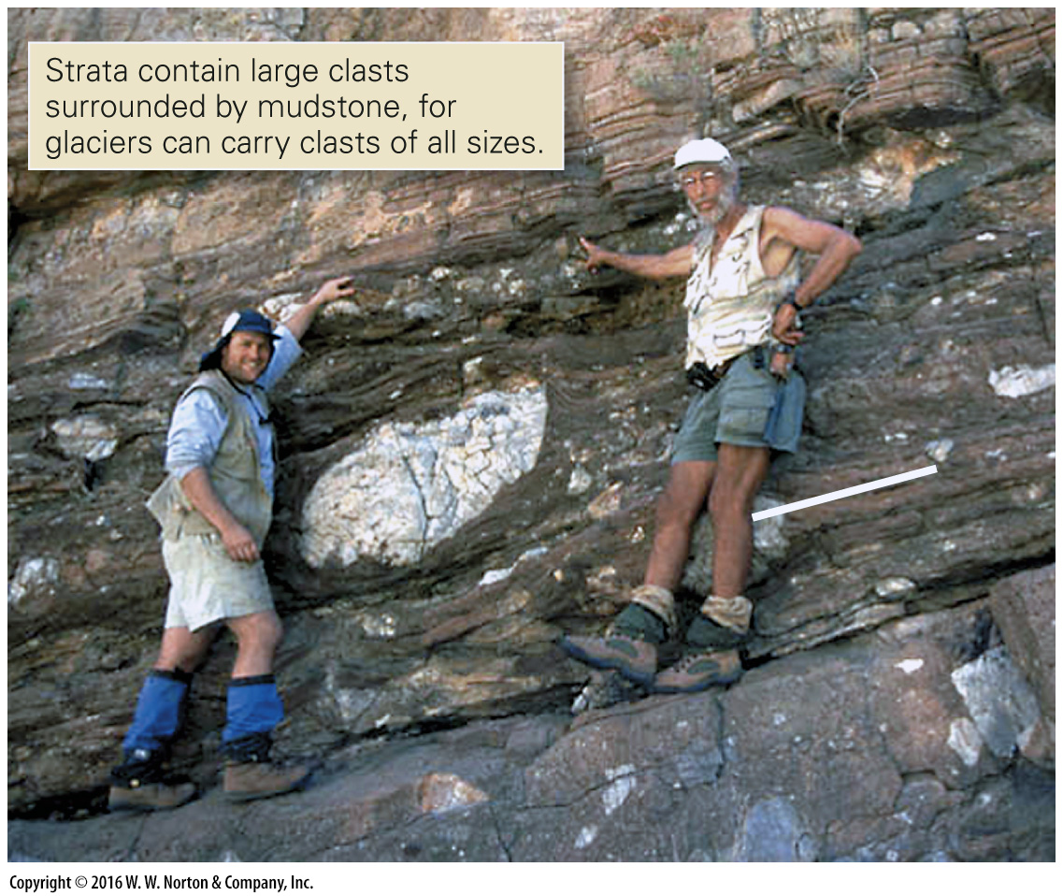
Notes:
FIGURE 11.7c Major changes in the Earth System during the Proterozoic Eon.
(c) Layers of Proterozoic glacial till crop out in Africa, indicating that low-latitude landmasses were glaciated during the Proterozoic.

Slide 21
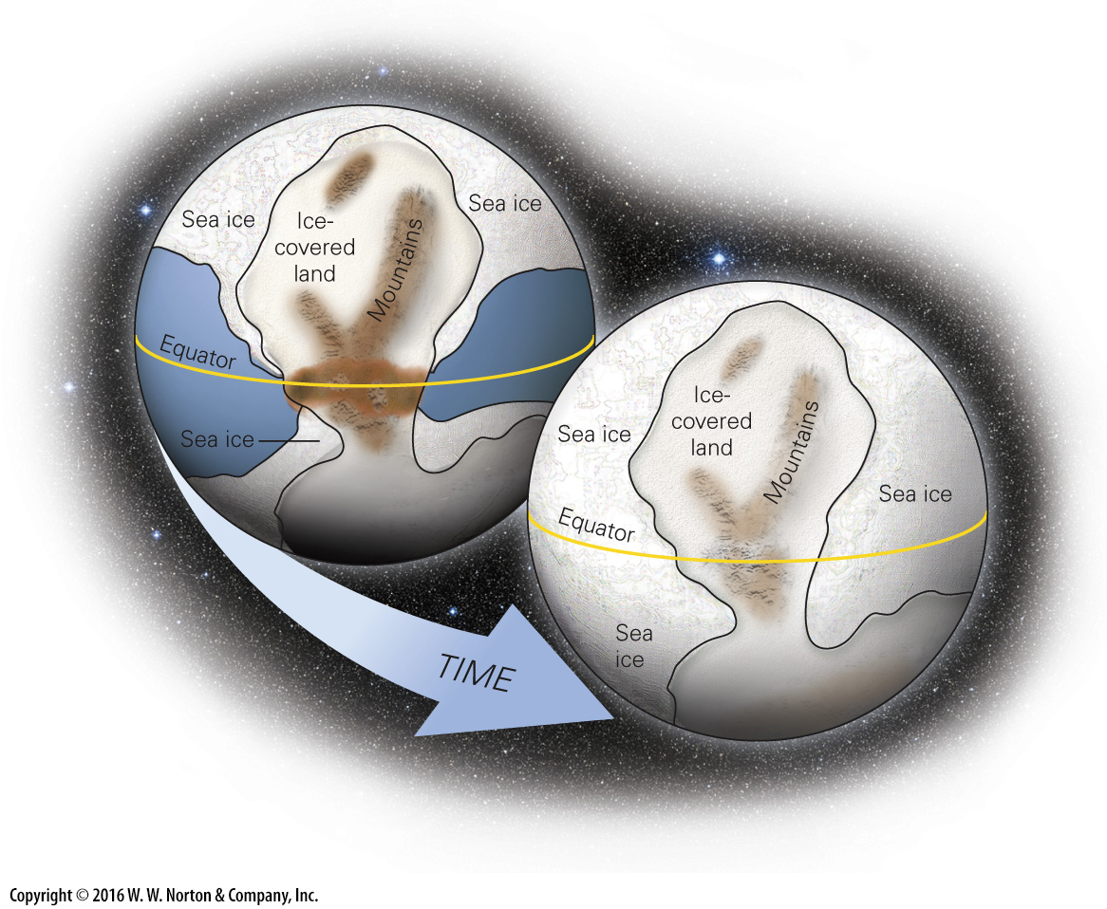
Notes:
FIGURE 11.7d Major changes in the Earth System during the Proterozoic Eon.
(d) This planet may have frozen over completely to form “snowball Earth.” Glaciers first grew on land, and eventually the sea surface froze over.

Slide 22
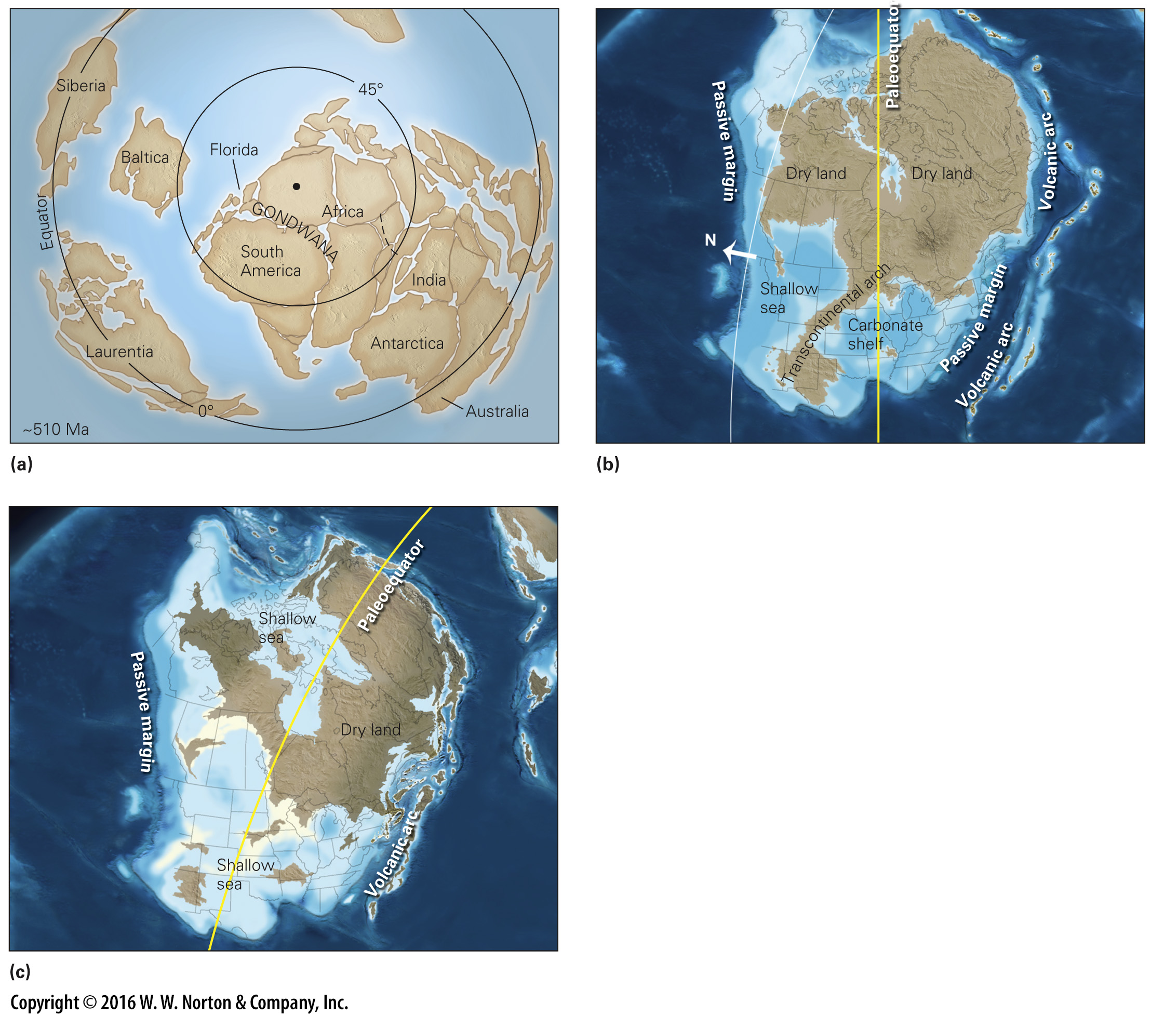
Notes:
FIGURE 11.8 Land and sea in the early Paleozoic Era.
(a) The distribution of continents in the Cambrian Period (510 Ma), as viewed looking down on the South Pole. (b) A paleogeographic map of North America shows the regions of dry land and shallow sea in the Late Cambrian Period. (c) During the Middle Ordovician Period, shallow seas covered much of North America. A volcanic arc formed off the east coast.

Slide 23
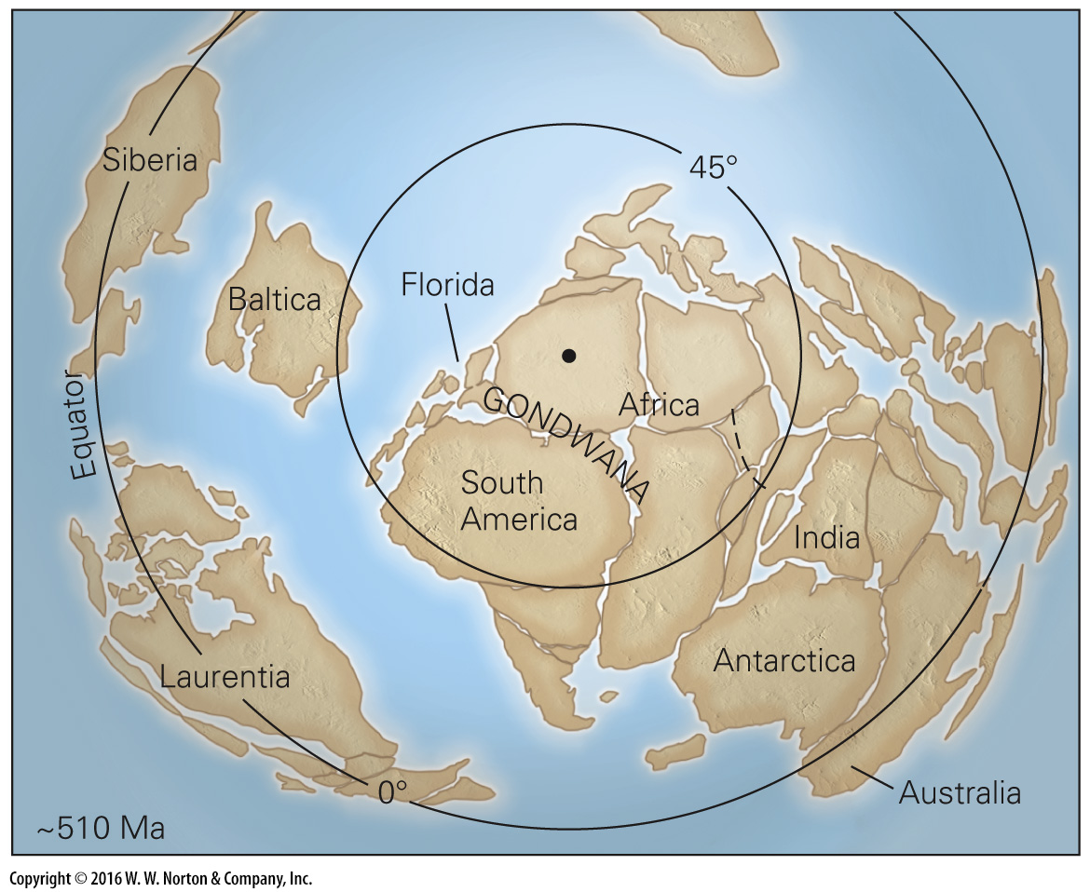
Notes:
FIGURE 11.8a Land and sea in the early Paleozoic Era.
(a) The distribution of continents in the Cambrian Period (510 Ma), as viewed looking down on the South Pole.

Slide 24
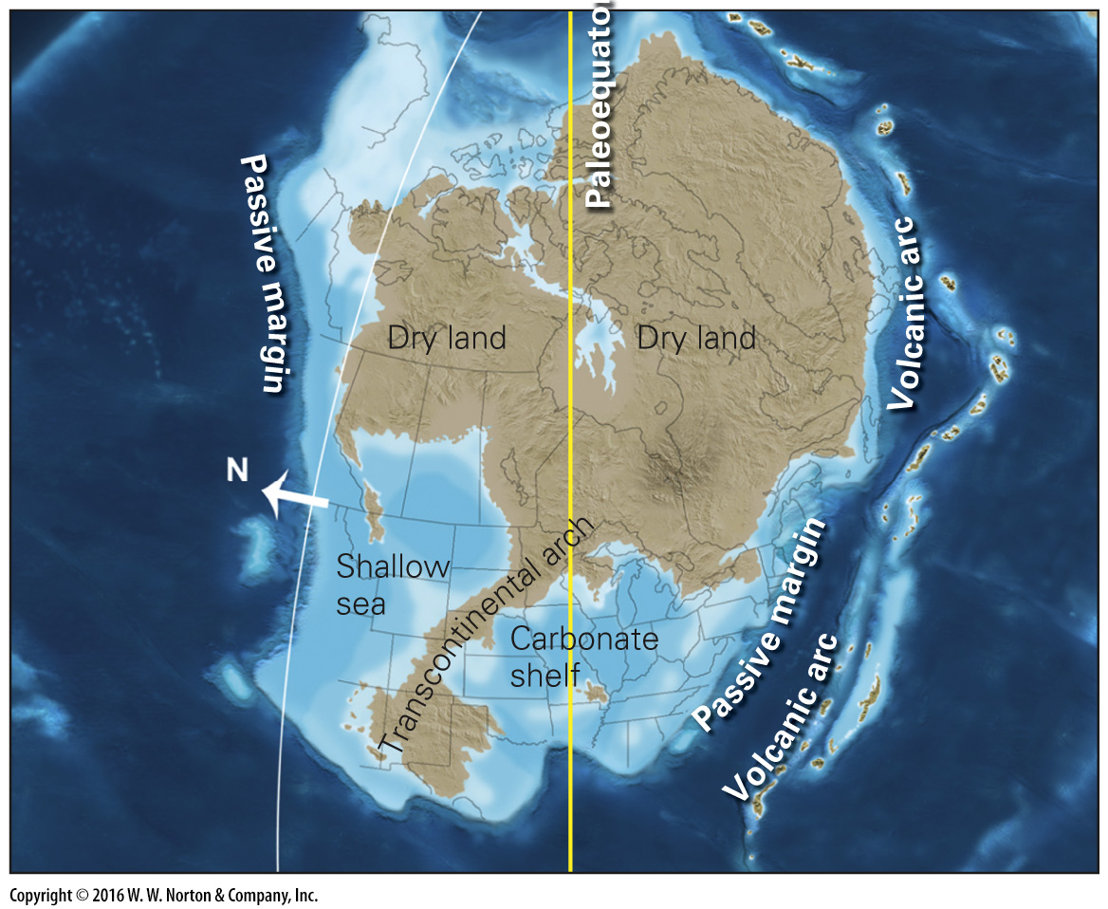
Notes:
(b) A paleogeographic map of North America shows the regions of dry land and shallow sea in the Late Cambrian Period.

Slide 25
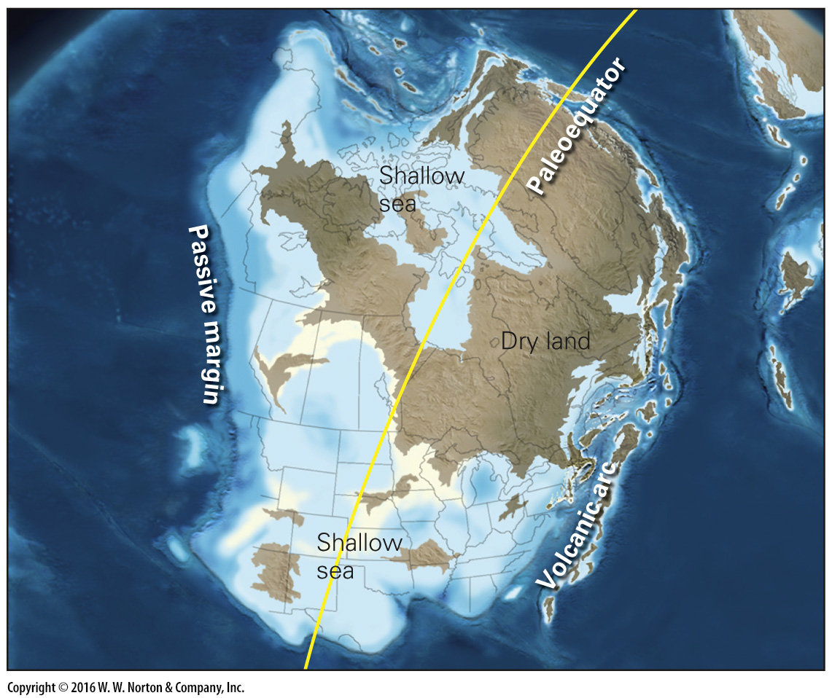
Notes:
FIGURE 11.8c Land and sea in the early Paleozoic Era.
(c) During the Middle Ordovician Period, shallow seas covered much of North America. A volcanic arc formed off the east coast.

Slide 26
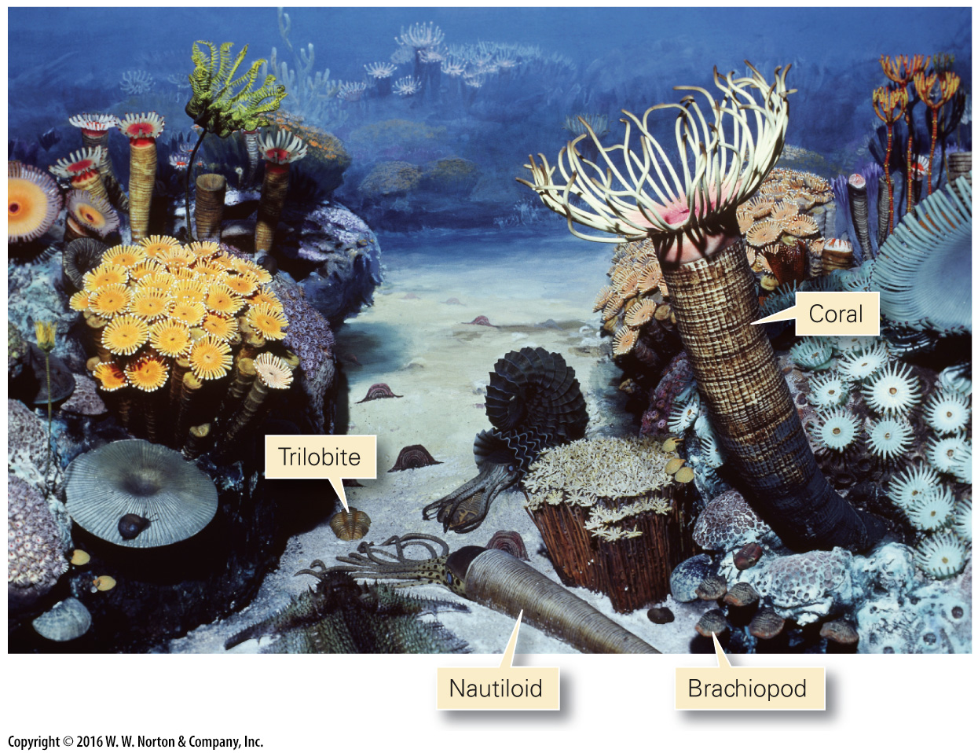
Notes:
FIGURE 11.9 A museum diorama illustrates what early Paleozoic marine organisms may have looked like.

Slide 27
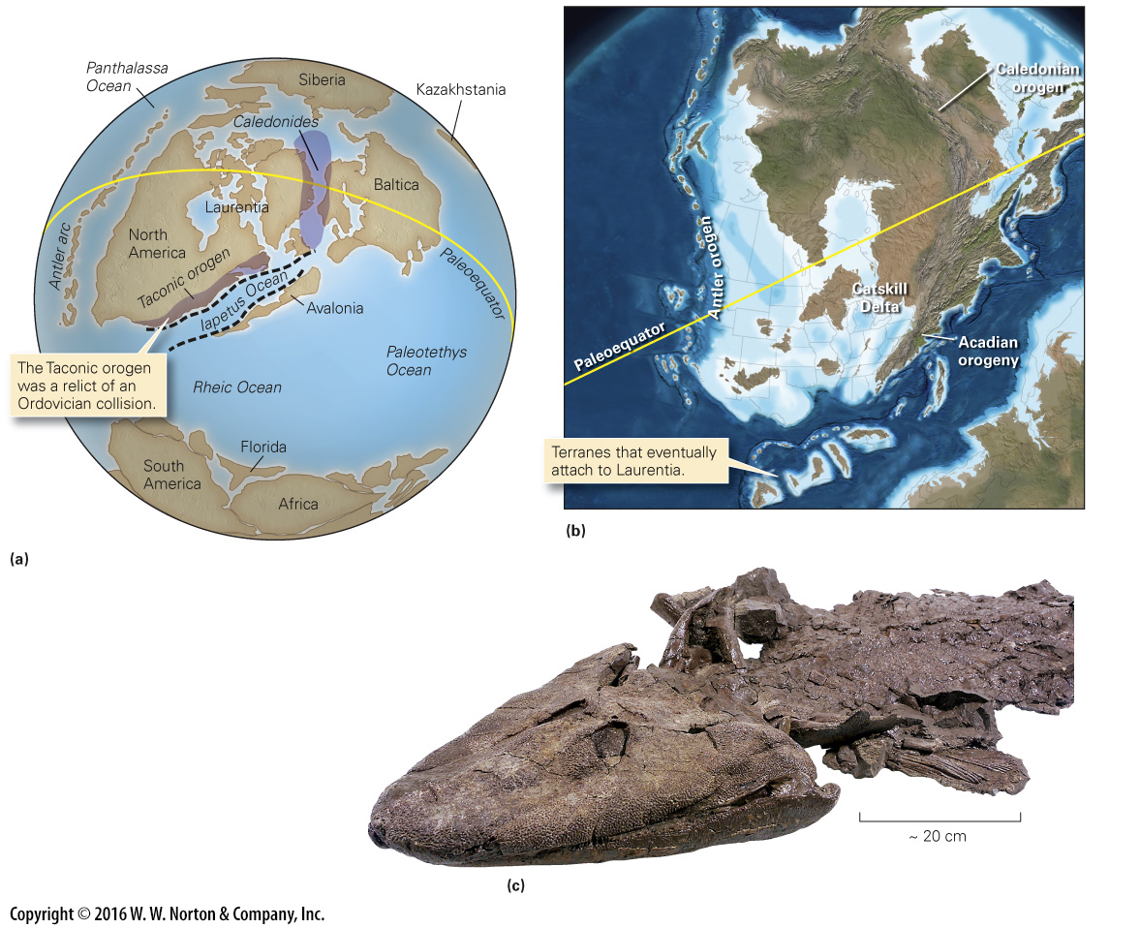
Notes:
FIGURE 11.10 Paleogeography and fossils of Silurian and Devonian time.
(a) During the Silurian and Devonian Periods, Laurentia collided with Baltica, Avalonia, and South America in succession, as oceans in between were consumed. The Antler arc formed off the west coast. (b) During the Devonian Period, the Acadian orogeny shed sediments into a shallow sea to form the Catskill Delta on the east coast of Laurentia. The Antler orogeny shed sediments in the west. (c) A Late Devonian fossil skeleton of Tiktaalik; this lobe-finned fish was one of the first animals to walk on land.

Slide 28
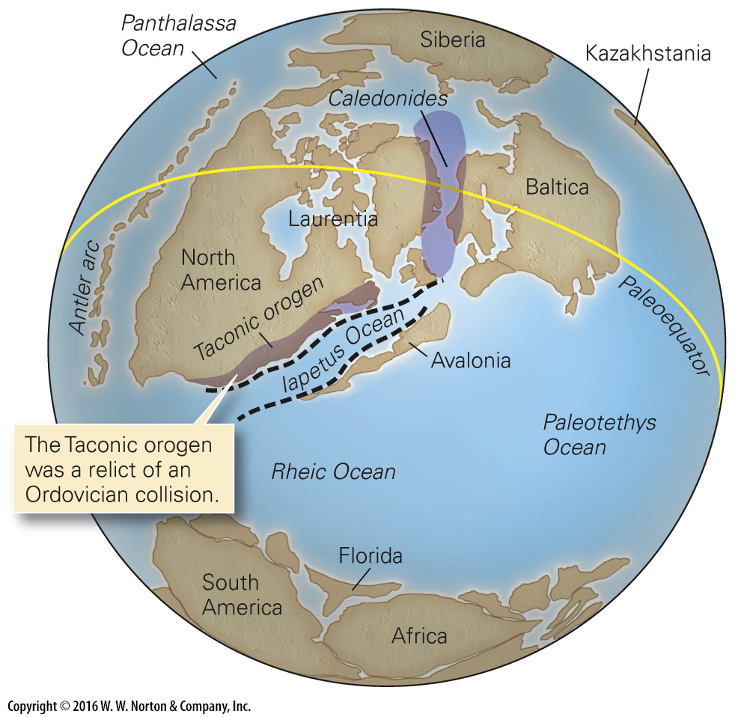
Notes:
FIGURE 11.10a Paleogeography and fossils of Silurian and Devonian time.
(a) During the Silurian and Devonian Periods, Laurentia collided with Baltica, Avalonia, and South America in succession, as oceans in between were consumed. The Antler arc formed off the west coast.

Slide 29
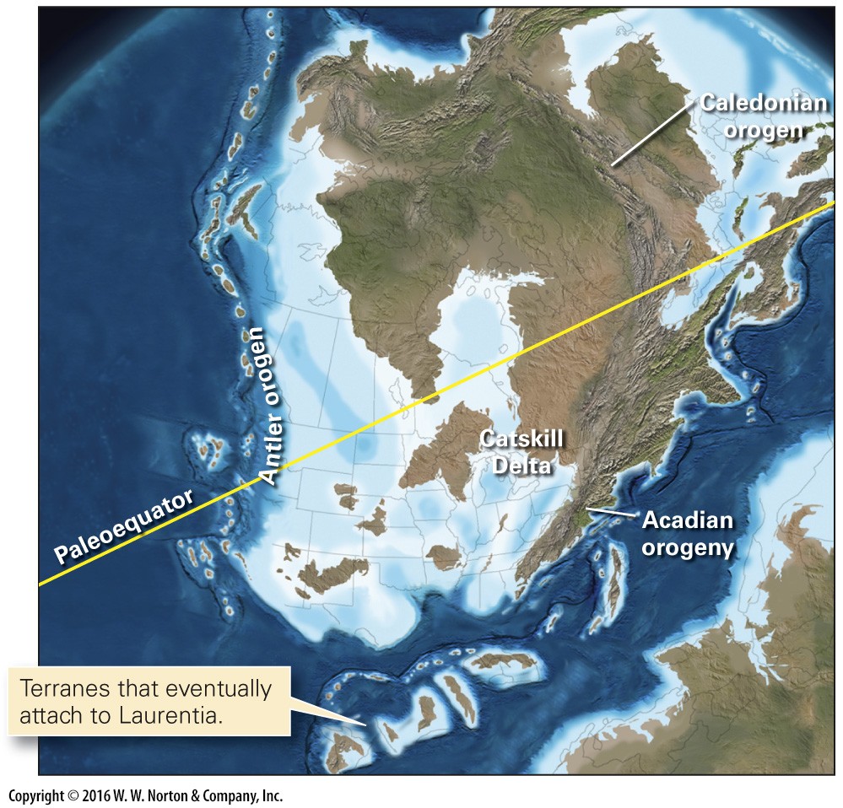
Notes:
FIGURE 11.10b Paleogeography and fossils of Silurian and Devonian time.
(b) During the Devonian Period, the Acadian orogeny shed sediments into a shallow sea to form the Catskill Delta on the east coast of Laurentia. The Antler orogeny shed sediments in the west.

Slide 30
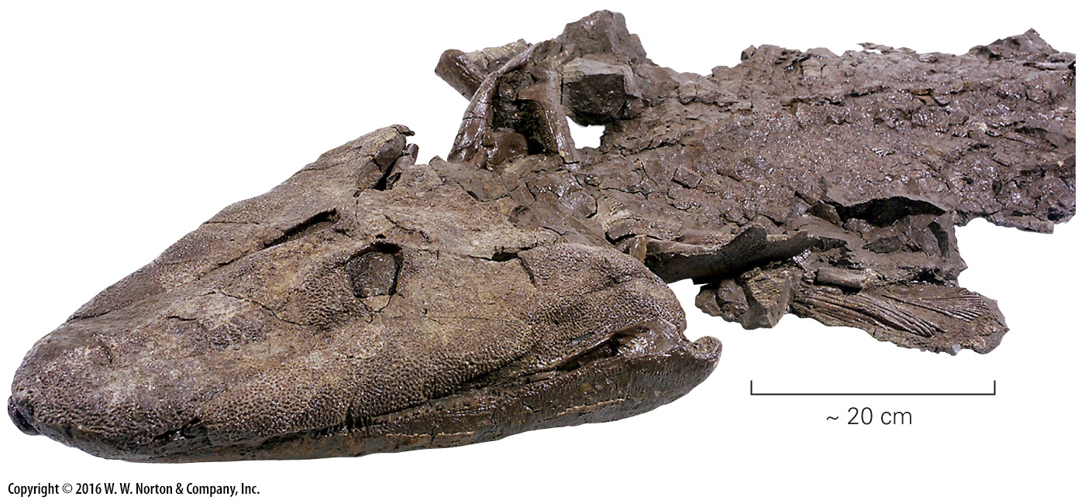
Notes:
FIGURE 11.10c Paleogeography and fossils of Silurian and Devonian time.
(c) A Late Devonian fossil skeleton of Tiktaalik; this lobe-finned fish was one of the first animals to walk on land.

Slide 31
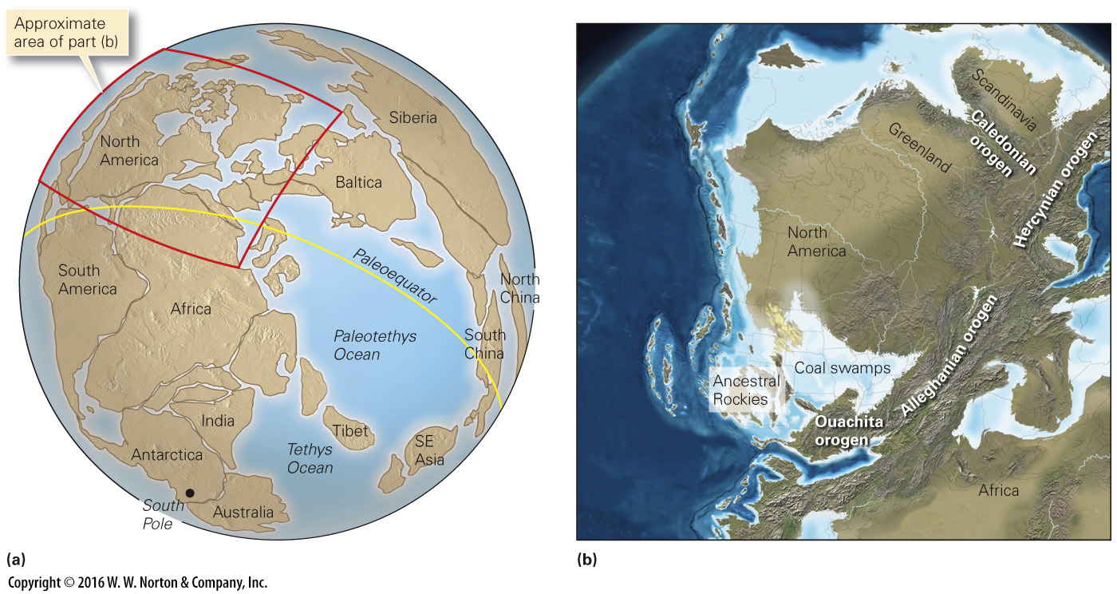
Notes:
FIGURE 11.11 Paleogeography at the end of the Paleozoic Era.
(a) At the end of the Paleozoic, almost all land had combined into a single supercontinent called Pangaea. (b) During the Alleghanian and Hercynian orogenies, a huge mountain belt formed. The Caledonian orogeny had formed earlier. Coal swamps bordered interior seas, and the Ancestral Rockies rose.

Slide 32
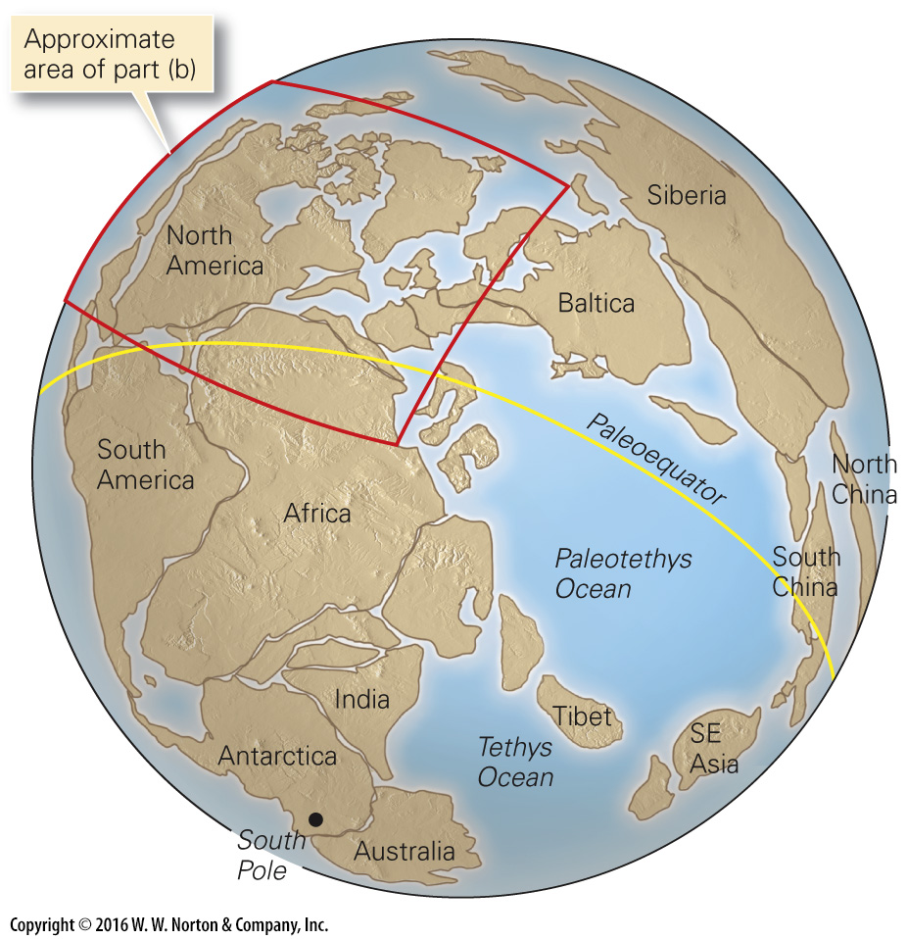
Notes:
FIGURE 11.11a Paleogeography at the end of the Paleozoic Era.
(a) At the end of the Paleozoic, almost all land had combined into a single supercontinent called Pangaea.

Slide 33
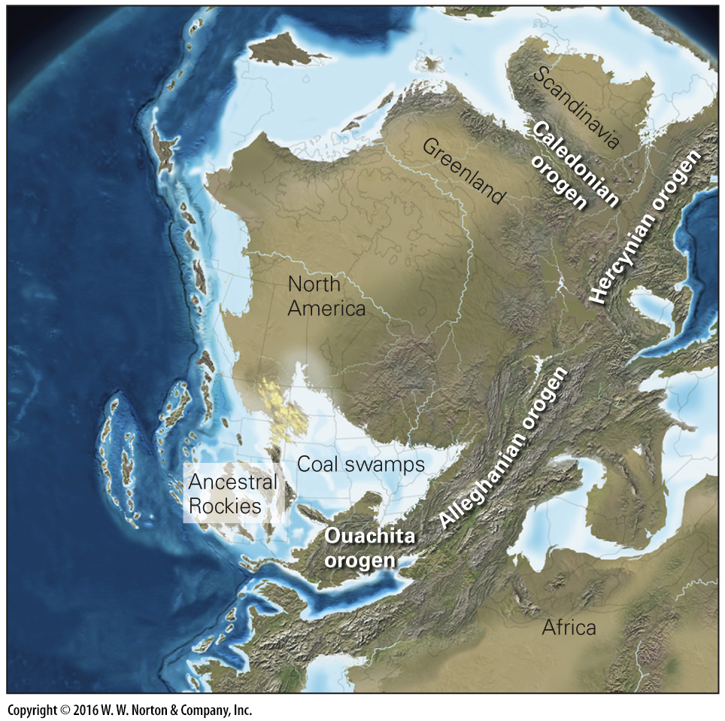
Notes:
FIGURE 11.11b Paleogeography at the end of the Paleozoic Era.
(b) During the Alleghanian and Hercynian orogenies, a huge mountain belt formed. The Caledonian orogeny had formed earlier. Coal swamps bordered interior seas, and the Ancestral Rockies rose.

Slide 34
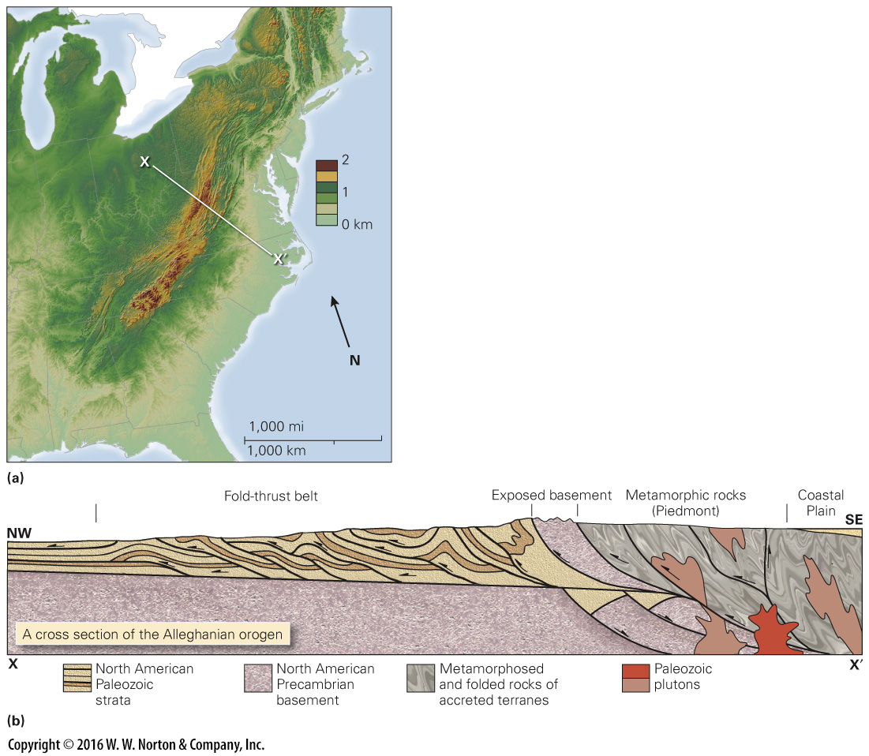
Notes:
FIGURE 11.12 Features of the Appalachian Mountains in the eastern United States.
(a) The eroded remnants of the Appalachian orogen stand out in the eastern United States. Line XX shows the position of the cross section below.

Slide 35
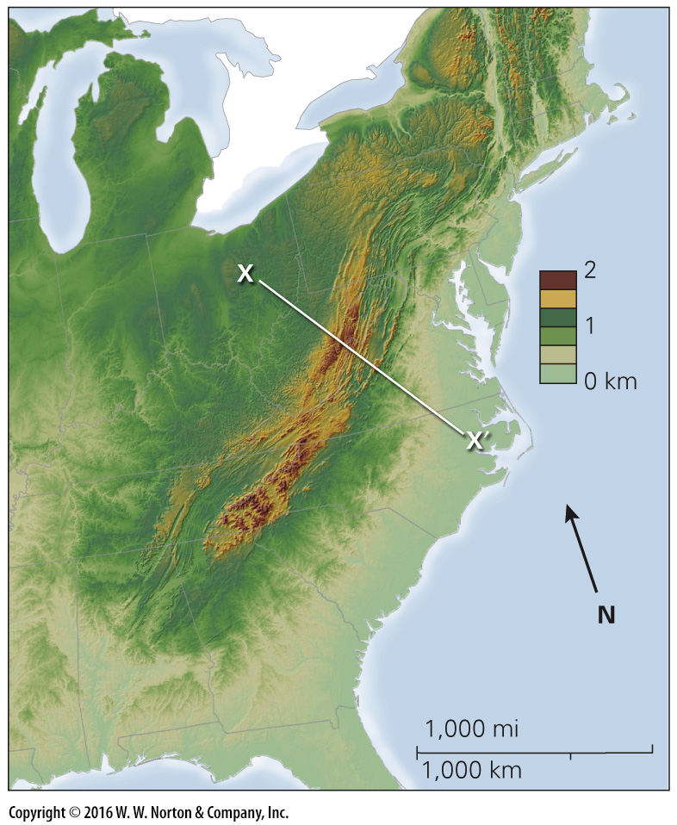
Notes:
FIGURE 11.12a Features of the Appalachian Mountains in the eastern United States.
(a) The eroded remnants of the Appalachian orogen stand out in the eastern United States. Line XX shows the position of the cross section below.

Slide 36
Notes:
FIGURE 11.12b Features of the Appalachian Mountains in the eastern United States.
(a) The eroded remnants of the Appalachian orogen stand out in the eastern United States. Line XX shows the position of the cross section below.

Slide 37
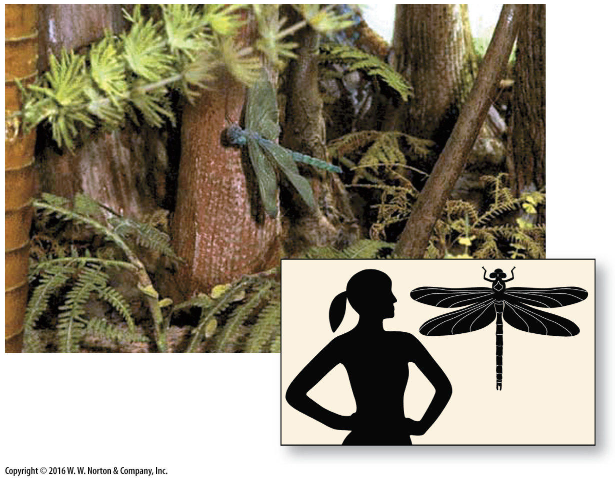
Notes:
FIGURE 11.13 A museum diorama of a Carboniferous coal swamp includes a giant dragonfly with a wingspan of about 1 m. The inset gives a sense of its size relative to a human.

Slide 38
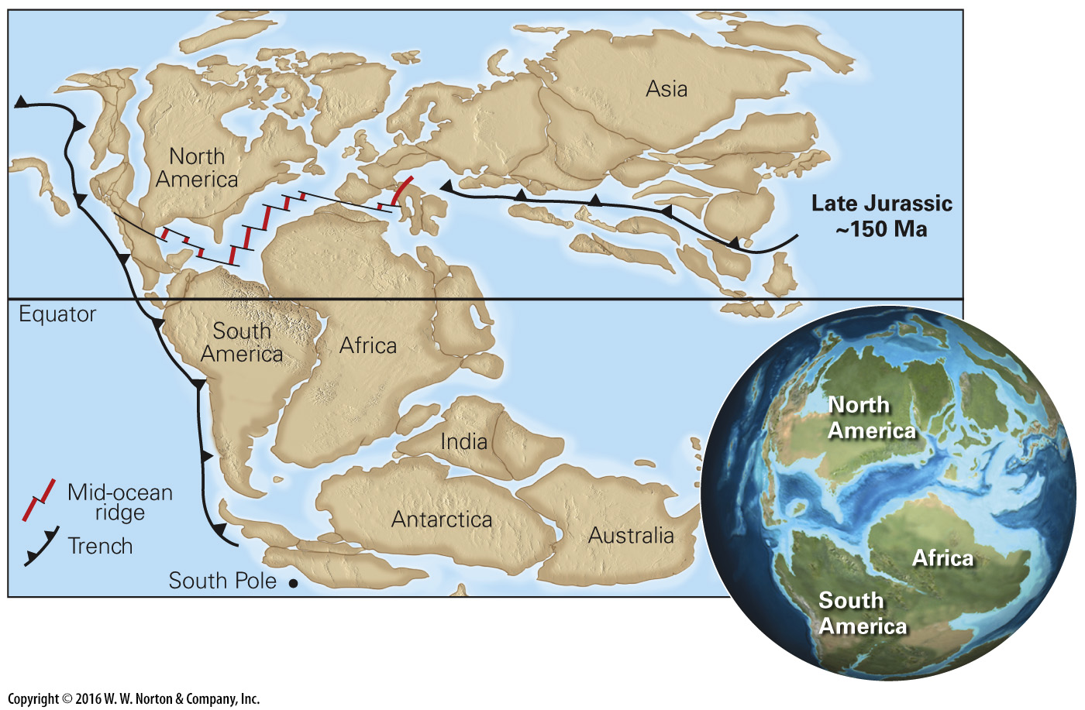
Notes:
FIGURE 11.14 Pangaea began to break up in the Triassic, and by Jurassic time a narrow North Atlantic Ocean existed.

Slide 39
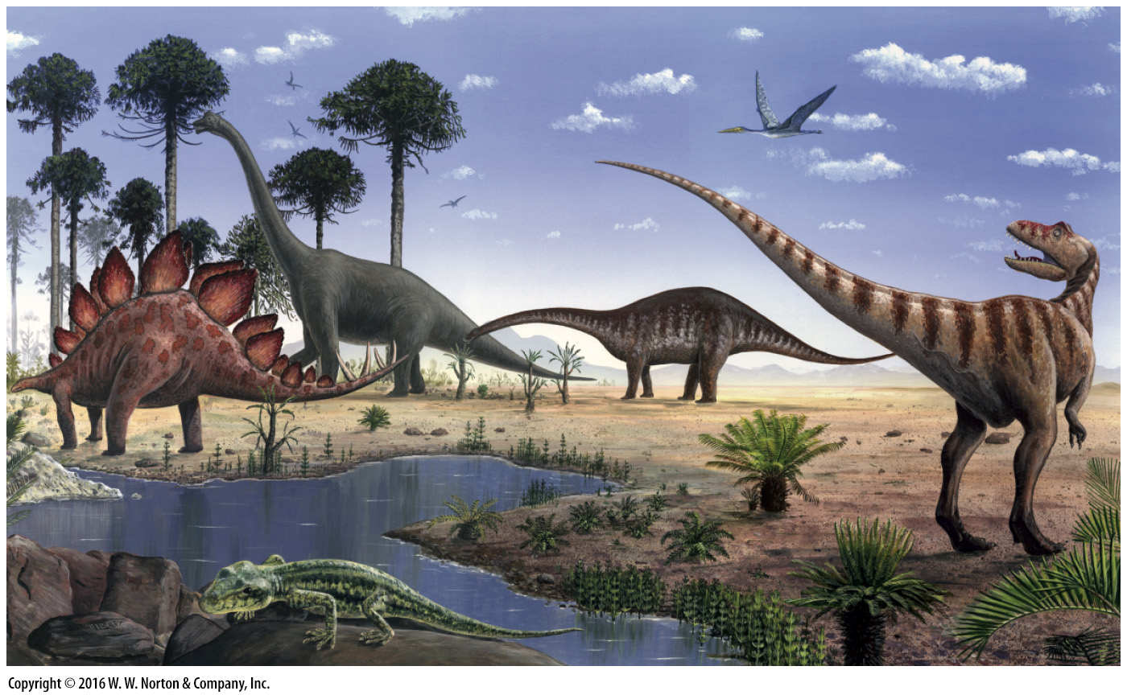
Notes:
FIGURE 11.15 During the Jurassic, giant dinosaurs roamed the land. This painting shows several species.

Slide 40
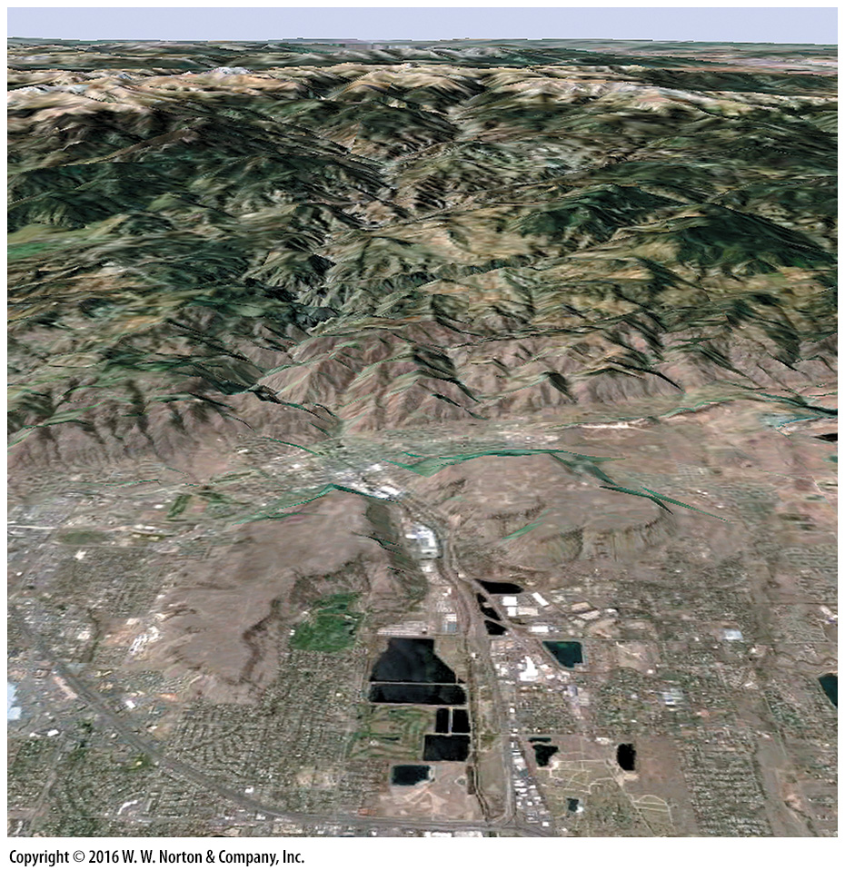
Notes:
SEE FOR YOURSELF…
ROCKY MOUNTAIN FRONT, COLORADO

Slide 41
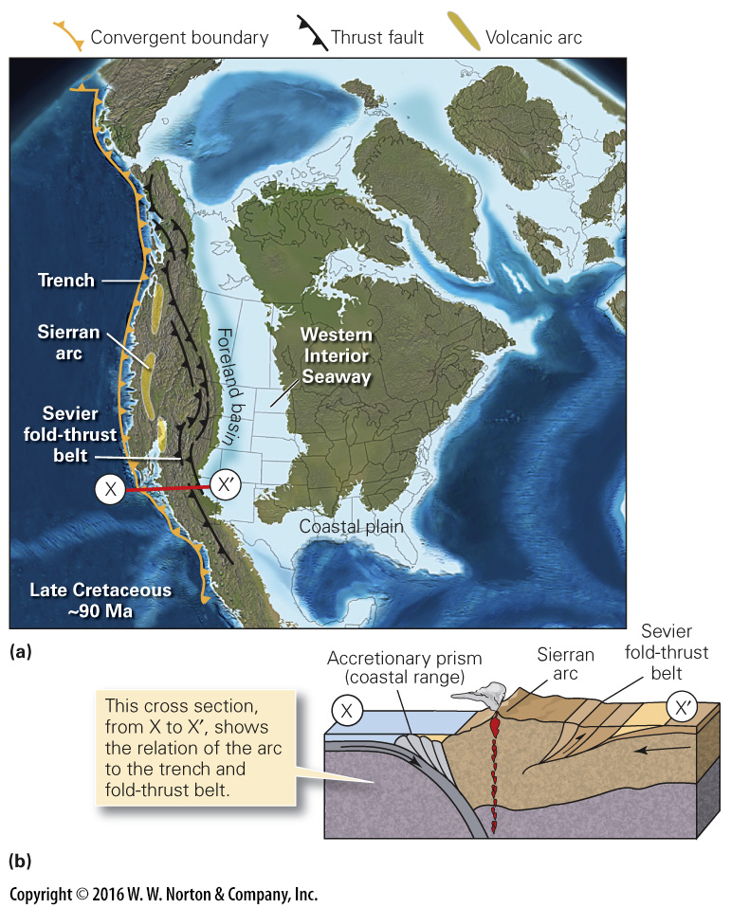
Notes:
IGURE 11.16 Cretaceous paleogeography.
(a) A long seaway flooded the western interior. (b) In Late Cretaceous, a continental volcanic arc formed. A fold-thrust belt formed to the east, as did a transcontinental seaway.

Slide 42
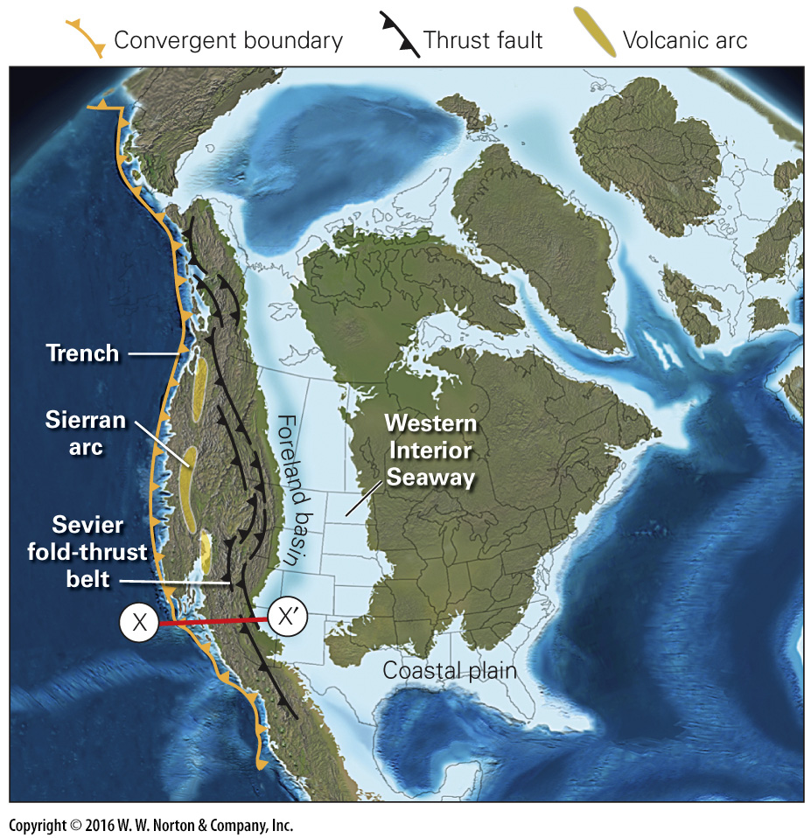
Notes:
IGURE 11.16a Cretaceous paleogeography.
(a) A long seaway flooded the western interior.

Slide 43
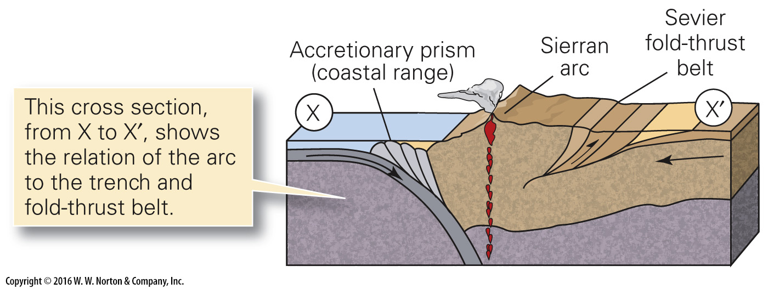
Notes:
IGURE 11.16b Cretaceous paleogeography.
(b) In Late Cretaceous, a continental volcanic arc formed. A fold-thrust belt formed to the east, as did a transcontinental seaway.

Slide 44
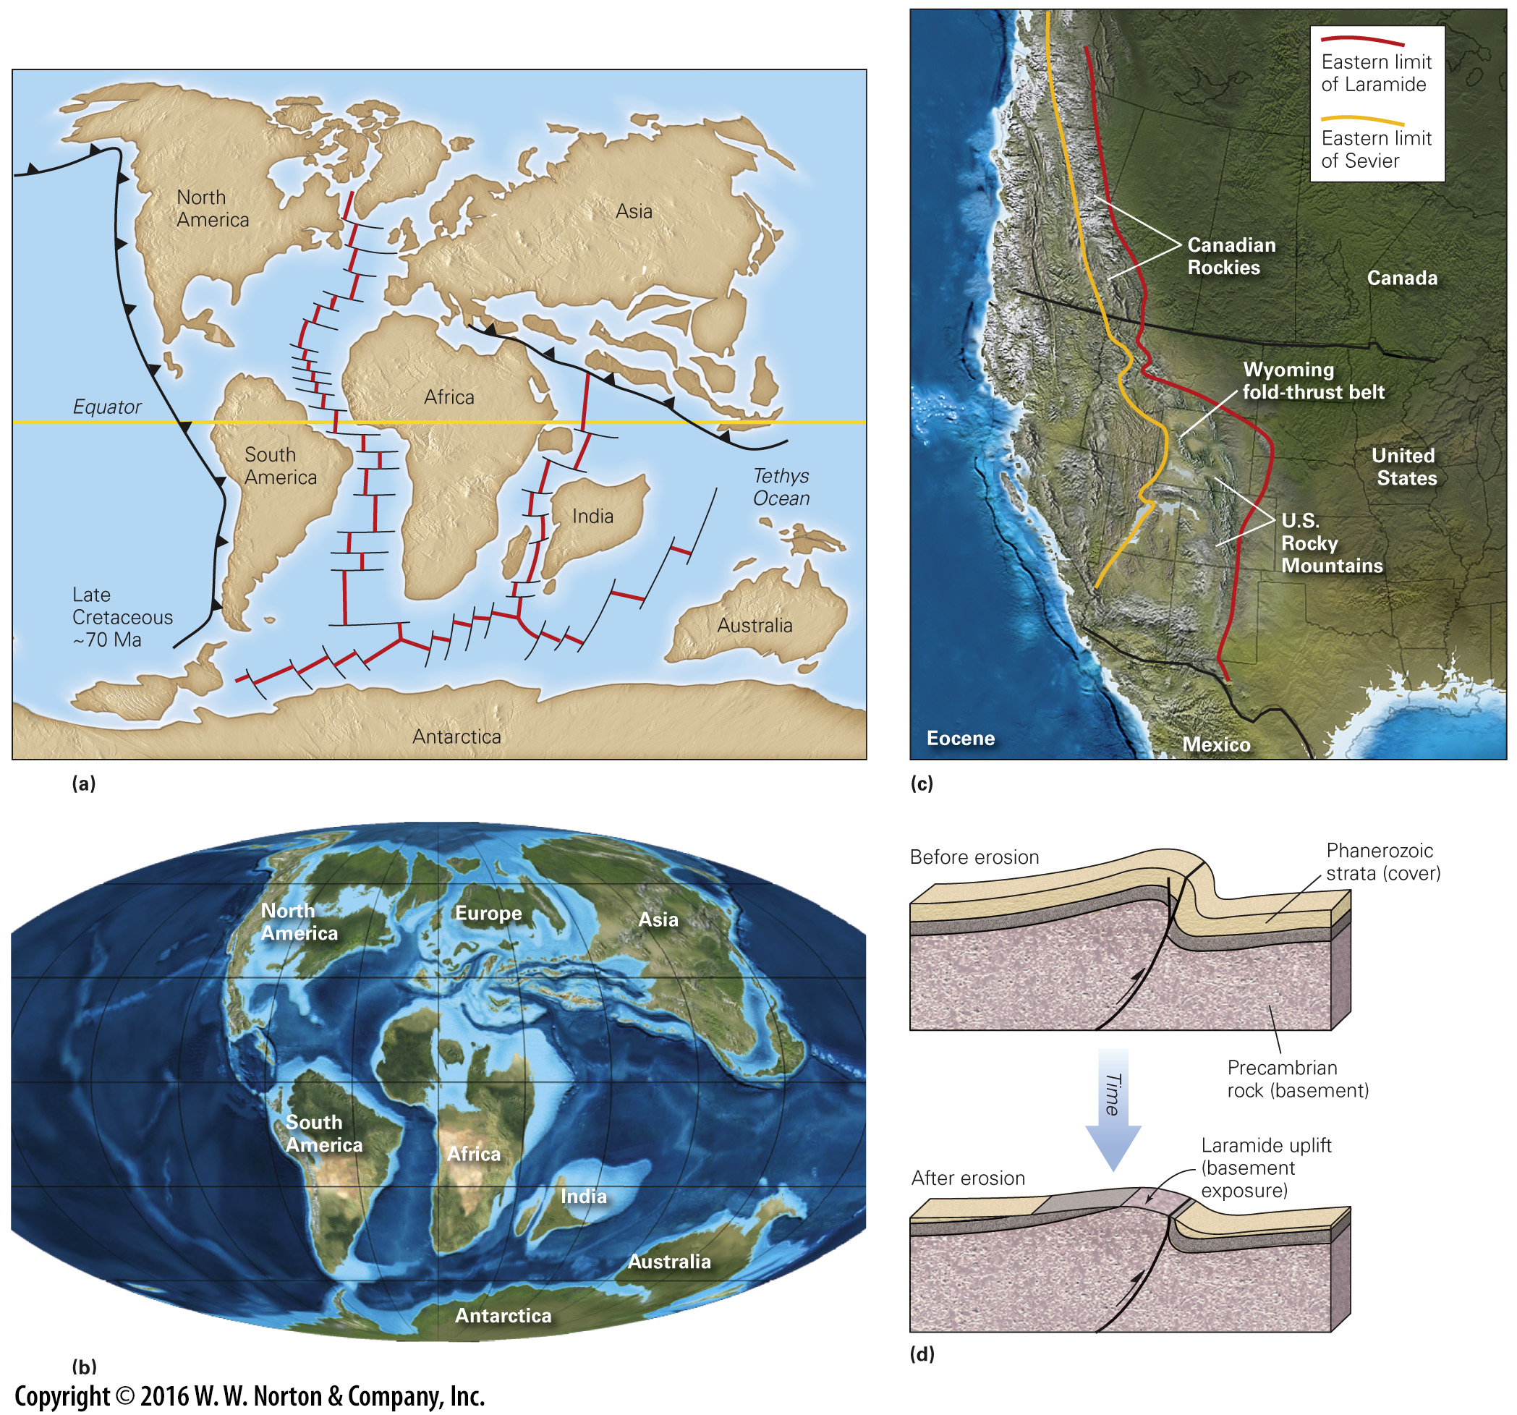
Notes:
FIGURE 11.17 Paleogeography in Late Cretaceous through Eocene time.
(a) By the Late Cretaceous Period, the Atlantic Ocean had formed, and India was moving rapidly northward to eventually collide with Asia. (b) In this Late Cretaceous paleogeographic reconstruction, southern Europe and Asia are beginning to form from a collage of many crustal blocks. (c) During the Laramide orogeny, deformation shifted eastward in the United States, moving from the Sevier belt to the Rocky Mountains, and the style of deformation changed. (d) The Laramide orogeny produced “basement-cored uplifts.” In these, faults lifted up blocks of basement, causing the overlying strata to bend into a stair-step-like fold.

Slide 45
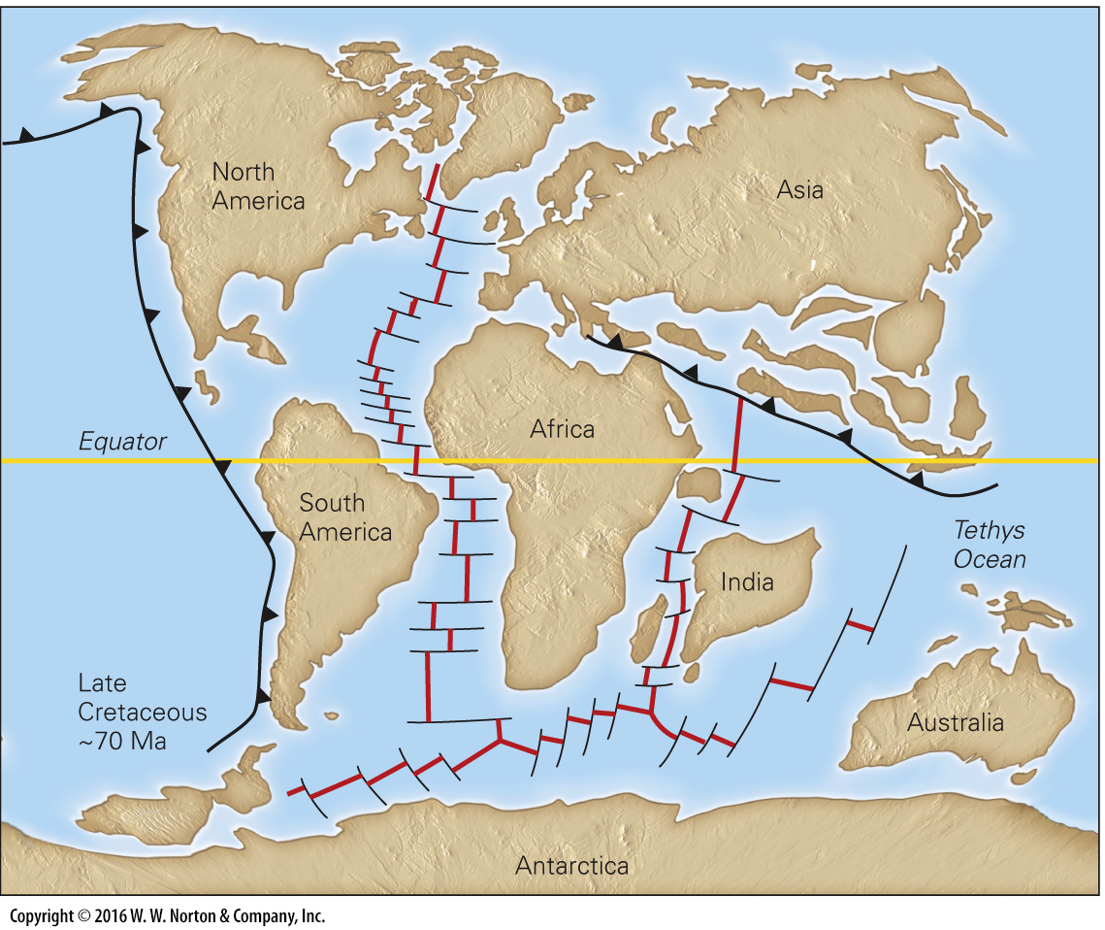
Notes:
FIGURE 11.17a Paleogeography in Late Cretaceous through Eocene time.
(a) By the Late Cretaceous Period, the Atlantic Ocean had formed, and India was moving rapidly northward to eventually collide with Asia.

Slide 46
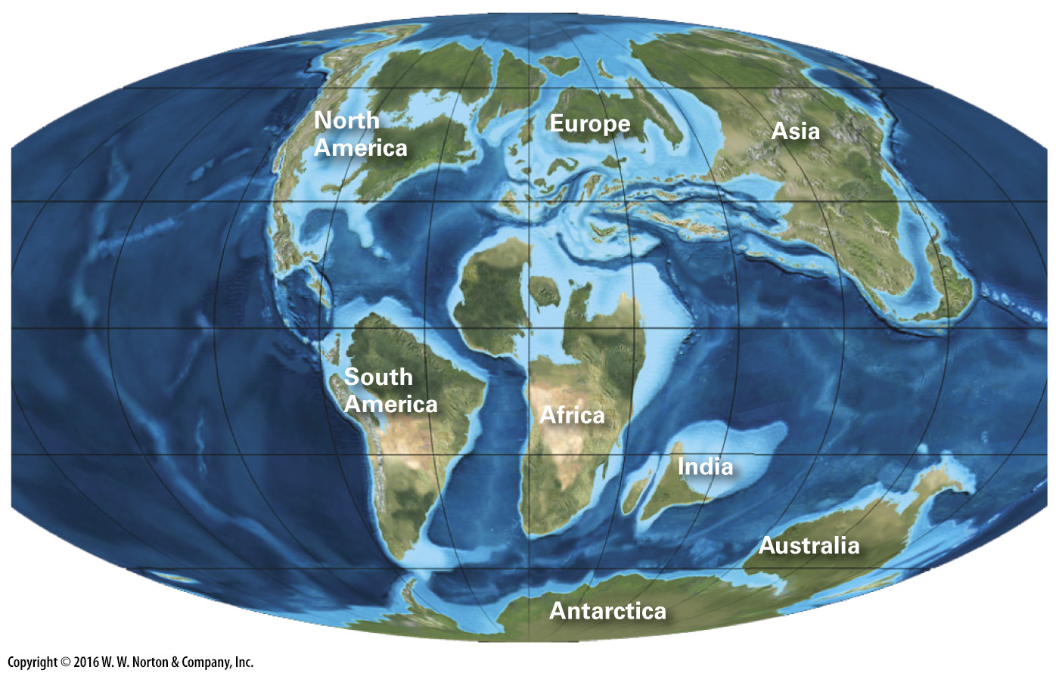
Notes:
FIGURE 11.17b Paleogeography in Late Cretaceous through Eocene time.
(b) In this Late Cretaceous paleogeographic reconstruction, southern Europe and Asia are beginning to form from a collage of many crustal blocks.

Slide 47
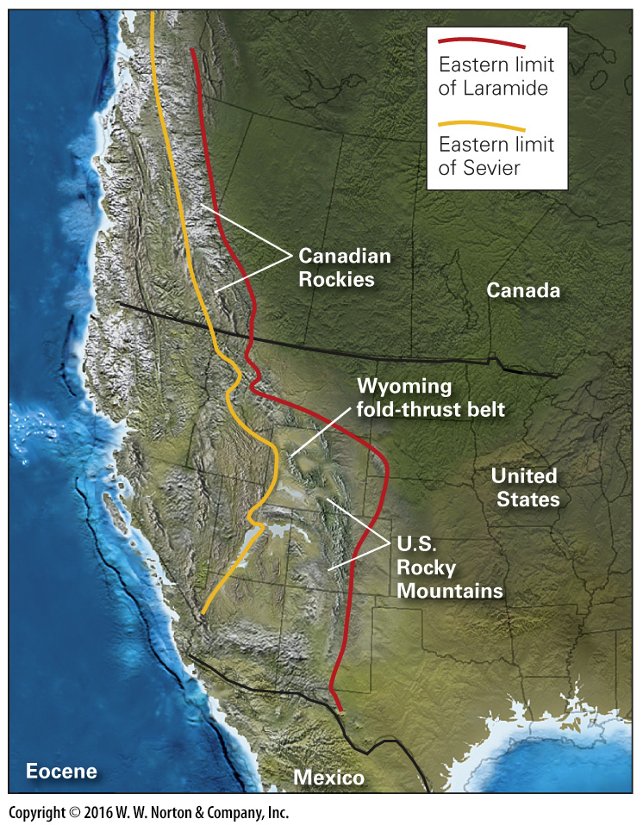
Notes:
FIGURE 11.17c Paleogeography in Late Cretaceous through Eocene time.
(c) During the Laramide orogeny, deformation shifted eastward in the United States, moving from the Sevier belt to the Rocky Mountains, and the style of deformation changed.

Slide 48
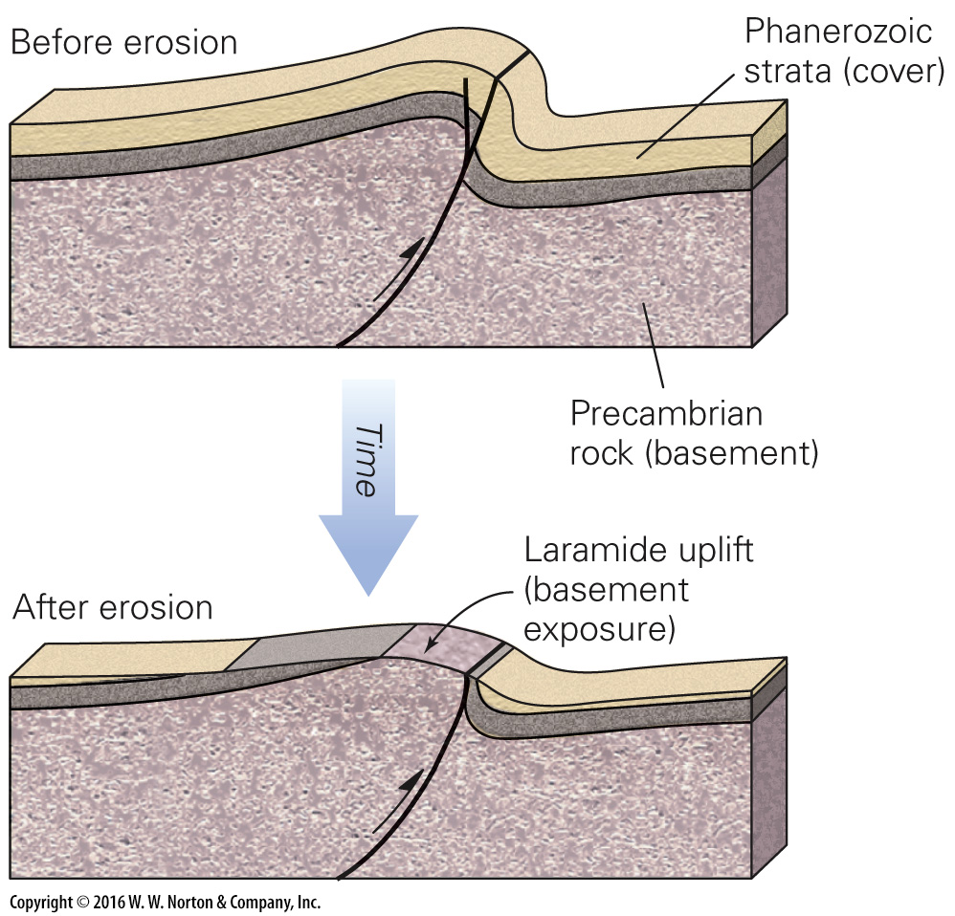
Notes:
FIGURE 11.17d Paleogeography in Late Cretaceous through Eocene time.
(d) The Laramide orogeny produced “basement-cored uplifts.” In these, faults lifted up blocks of basement, causing the overlying strata to bend into a stair-step-like fold.

Slide 49
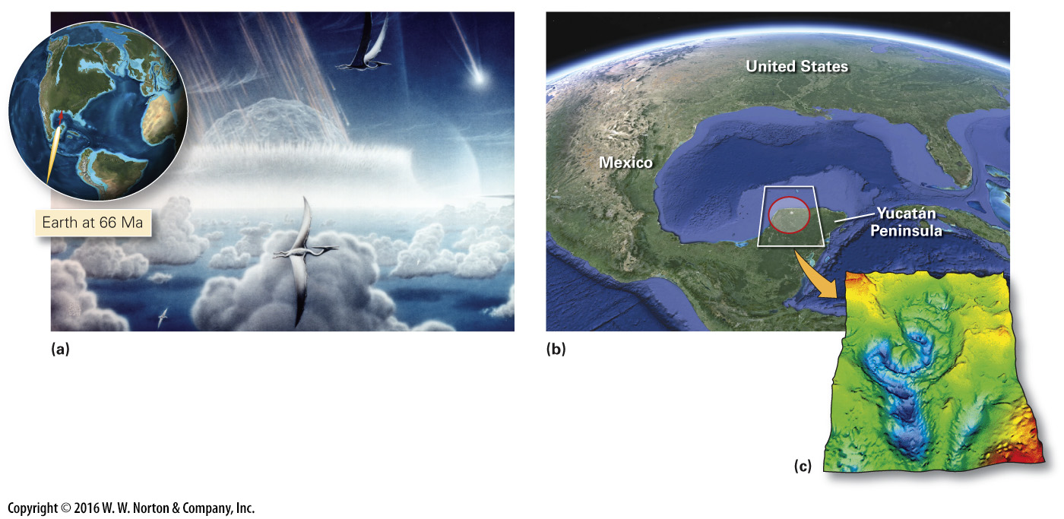
Notes:
FIGURE 11.18 The Cretaceous-Tertiary (K-T) impact. The event caused a mass extinction.
(a) An artist’s image of the 13-km-wide object as it hit. (b) The location of the buried crater today. Gravity anomalies reveal the shape of the crater. (c) The crater is now buried, but gravity anomalies outline its shape (see Interlude D).

Slide 50
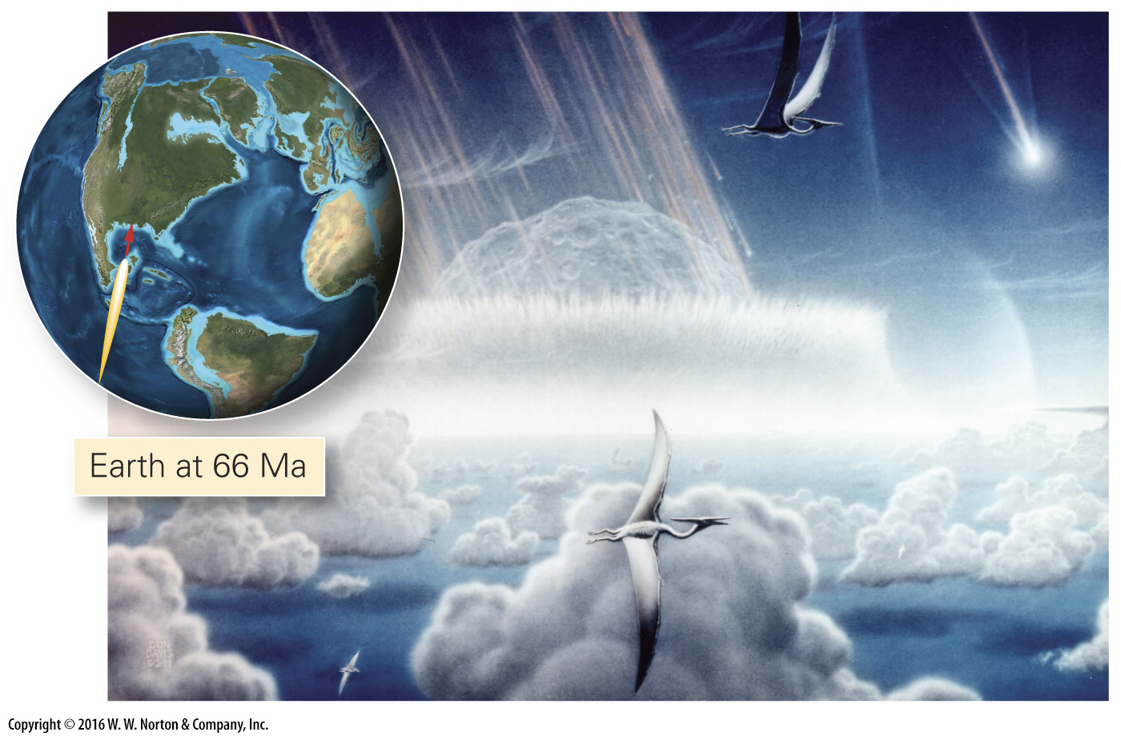
Notes:
FIGURE 11.18a The Cretaceous-Tertiary (K-T) impact. The event caused a mass extinction.
(a) An artist’s image of the 13-km-wide object as it hit.

Slide 51
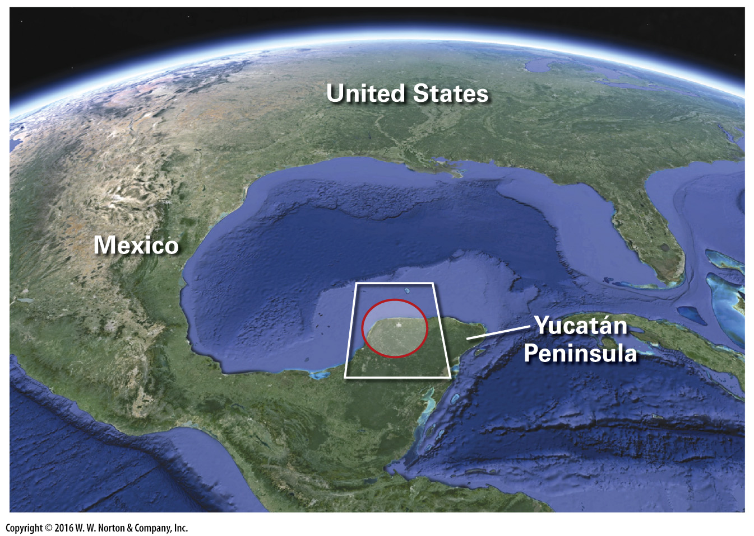
Notes:
FIGURE 11.18b The Cretaceous-Tertiary (K-T) impact. The event caused a mass extinction.
(b) The location of the buried crater today. Gravity anomalies reveal the shape of the crater.

Slide 52
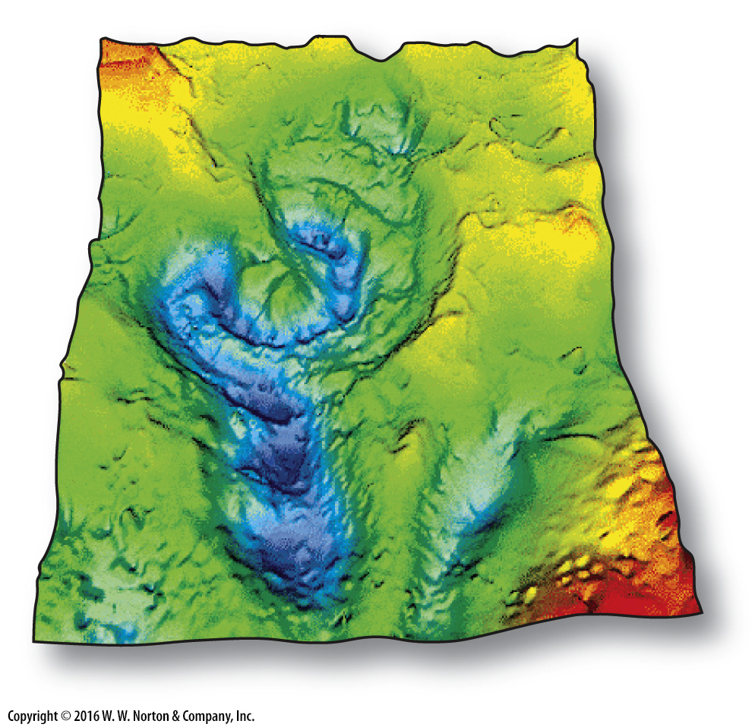
Notes:
FIGURE 11.18c The Cretaceous-Tertiary (K-T) impact. The event caused a mass extinction.
(c) The crater is now buried, but gravity anomalies outline its shape (see Interlude D).

Slide 53
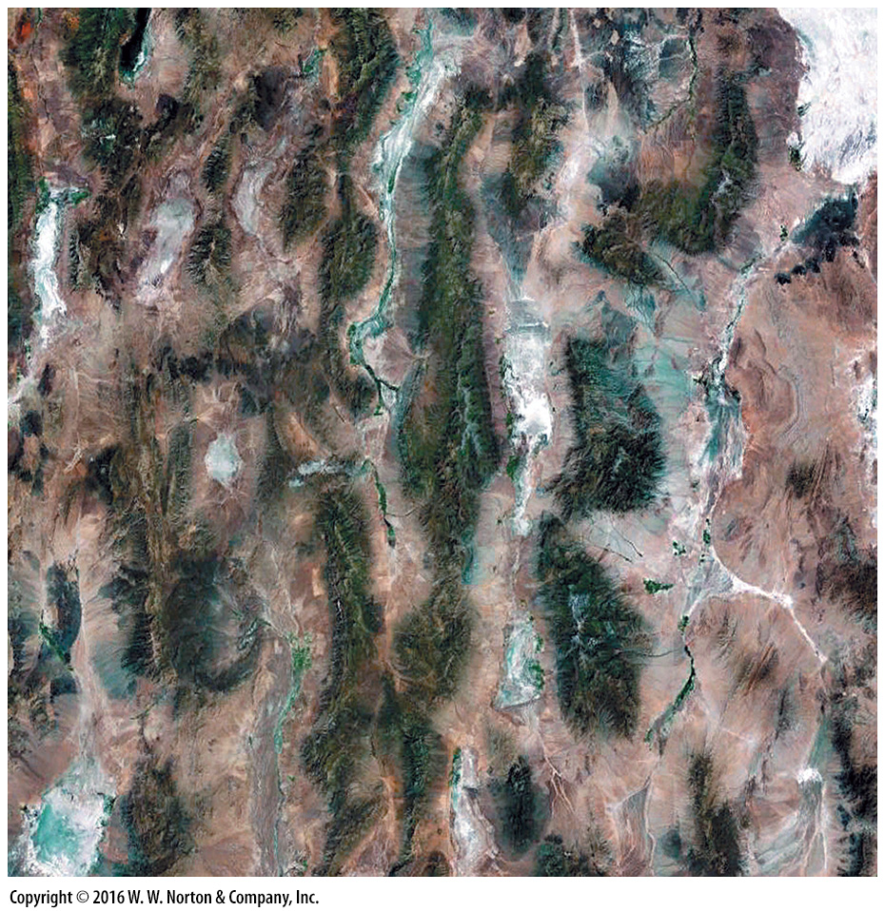
Notes:
SEE FOR YOURSELF…
BASIN AND RANGE RIFT, UTAH

Slide 54
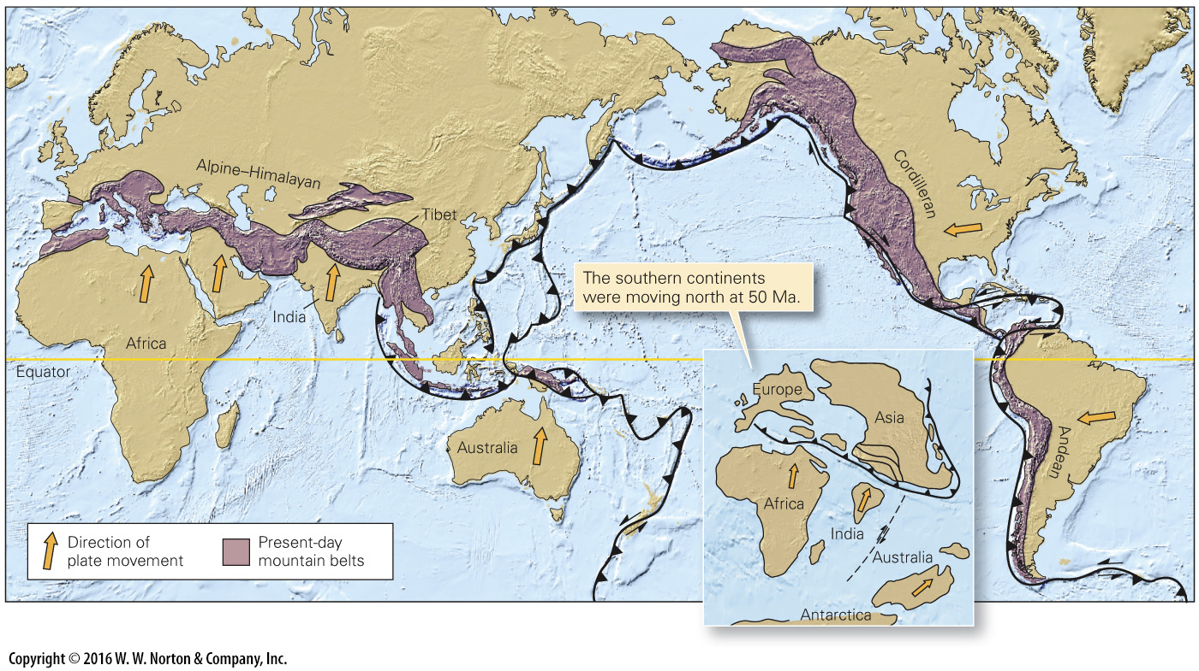
Notes:
FIGURE 11.19 The two main active continental orogenic systems on the Earth today. The Alpine-Himalayan system formed when Africa, India, and Australia collided with Asia (inset). The Cordilleran and Andean systems reflect the consequences of convergent-boundary tectonism along the eastern Pacific Ocean.

Slide 55
Notes:
FIGURE 11.20 The Basin and Range Province is a rift. The inset shows a cross section along the red line.

Slide 56
Notes:
FIGURE 11.21 The maximum advance of the Pleistocene ice sheet in North America.

Slide 57
Notes:
Another View The present-day Bahamas serve as an example of what the interior of the United States might have looked like during intervals of the Paleozoic. Shallow land areas were submerged and became the site of shallow-marine sedimentation.

Slide 58
Notes:
GEOLOGY AT A GLANCE
Earth Has a History

