Slide 1
Stephen Marshak
ESSENTIALS OF
Geology
FIFTH EDITION
Chapter 12
Riches in Rock:
Energy and Mineral Resources
©2016 W. W. Norton & Company, Inc.

Slide 2
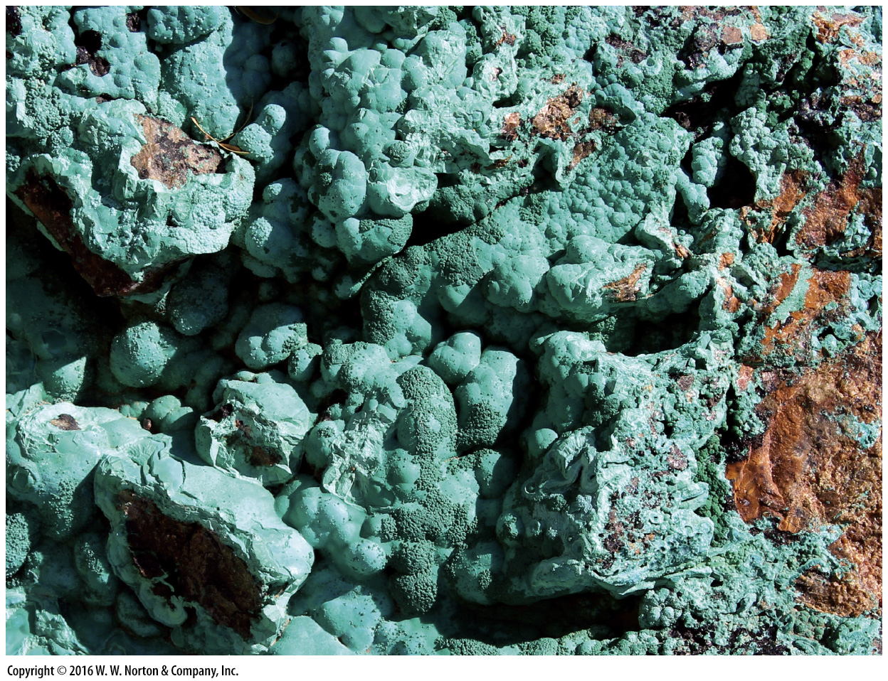
Notes:
An exposed fracture surface reveals a weathered coating of malachite, a beautiful green mineral sometimes used for jewelry. Malachite is also a copper ore mineral, meaning that its crystals contain a significant proportion of copper atoms. The copper we use for wires and coins comes from this and other ore minerals. The Earth provides many of the resources essential to society.

Slide 3
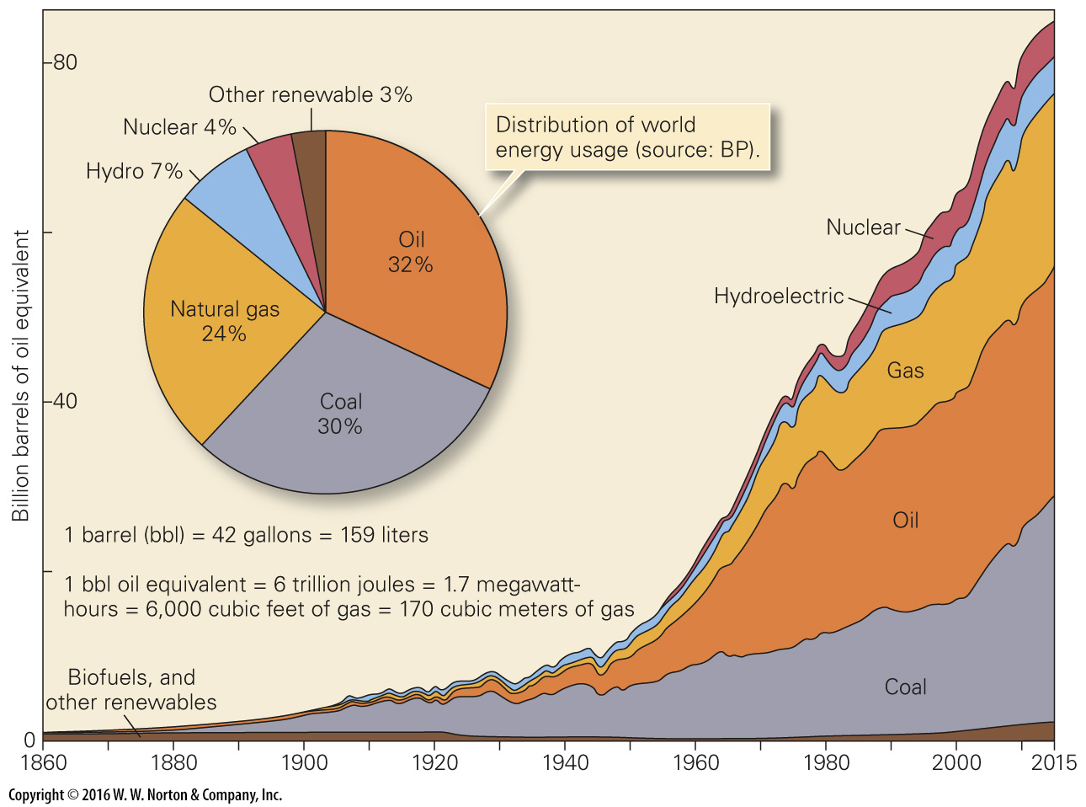
Notes:
FIGURE 12.1 The proportion of different sources of energy that people use has changed over time, and the amount of energy used almost continuously increases.

Slide 4
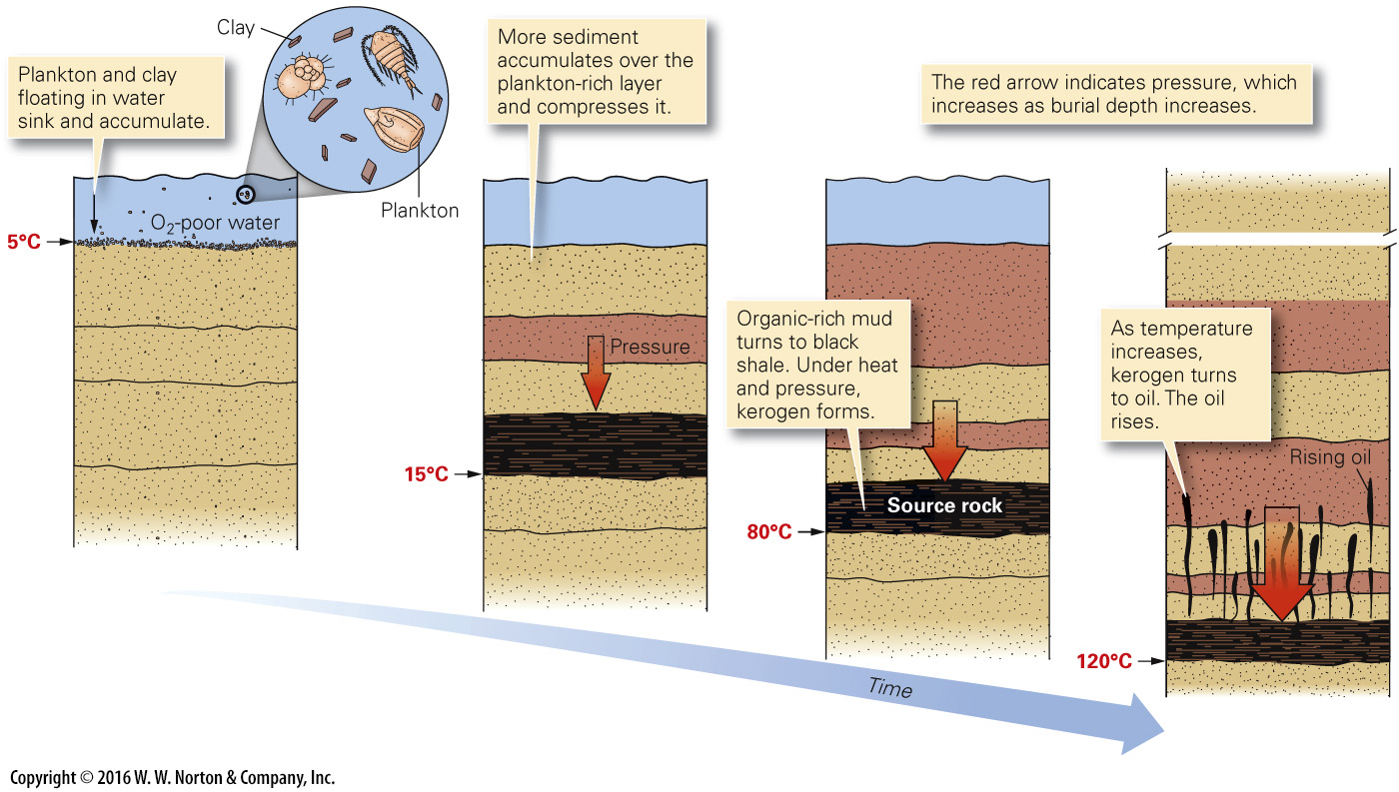
Notes:
FIGURE 12.2 The formation of oil. The process begins when organic debris settles with sediment. As burial depth increases, heat and pressure transform the sediment into black shale in which organic matter becomes kerogen. At appropriate temperatures, kerogen becomes oil, which then seeps upward.

Slide 5
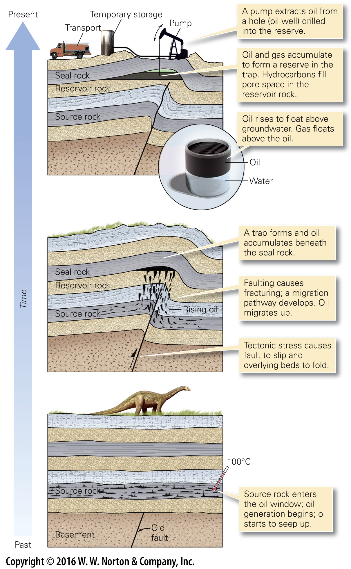
Notes:
FIGURE 12.3 Initially, oil resides in the source rock. Because it is buoyant relative to groundwater, the oil migrates into the overlying reservoir rock. The oil accumulates beneath a seal rock in a trap.

Slide 6
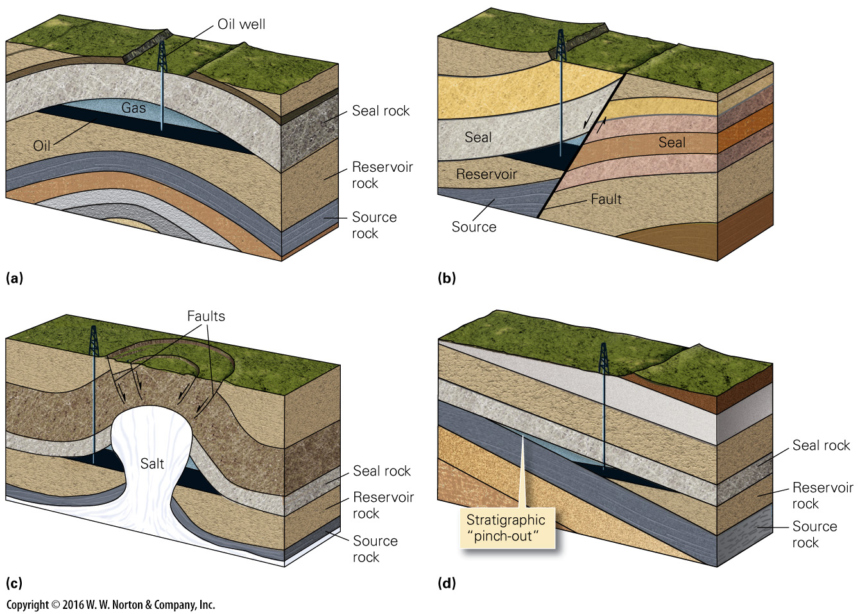
Notes:
FIGURE Bx12.1 Examples of oil traps. A trap is a configuration of a seal rock over a reservoir rock in a geometry that keeps the oil underground.
(a) Anticline trap. Oil and gas rise to the crest of the fold. (b) Fault trap. Oil and gas collect in tilted strata adjacent to the fault. (c) Salt-dome trap. Oil and gas collect in strata on the flanks of the dome, beneath salt. (d) Stratigraphic trap. Oil and gas collect where the reservoir layer pinches out.

Slide 7
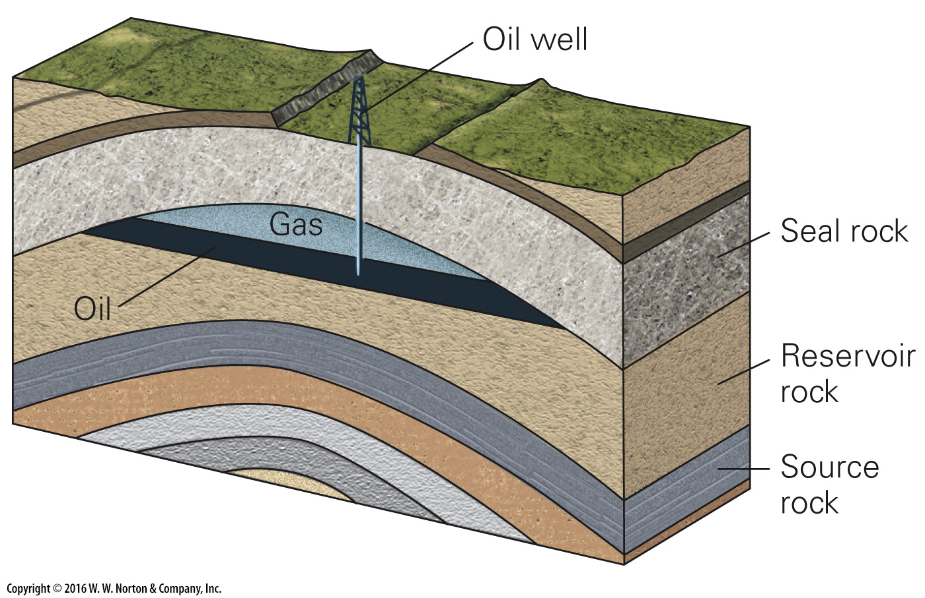
Notes:
FIGURE Bx12.1a Examples of oil traps. A trap is a configuration of a seal rock over a reservoir rock in a geometry that keeps the oil underground.
(a) Anticline trap. Oil and gas rise to the crest of the fold.

Slide 8
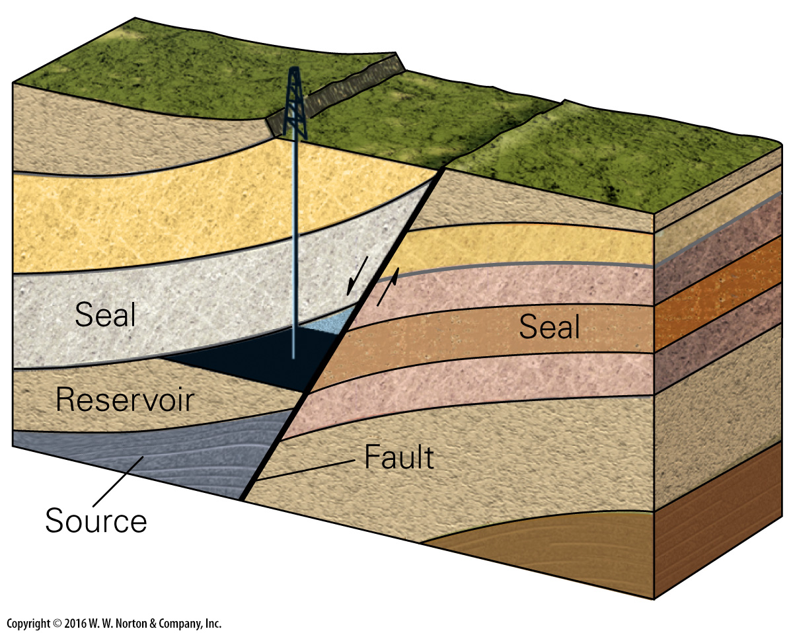
Notes:
FIGURE Bx12.1b Examples of oil traps. A trap is a configuration of a seal rock over a reservoir rock in a geometry that keeps the oil underground.
(b) Fault trap. Oil and gas collect in tilted strata adjacent to the fault.

Slide 9
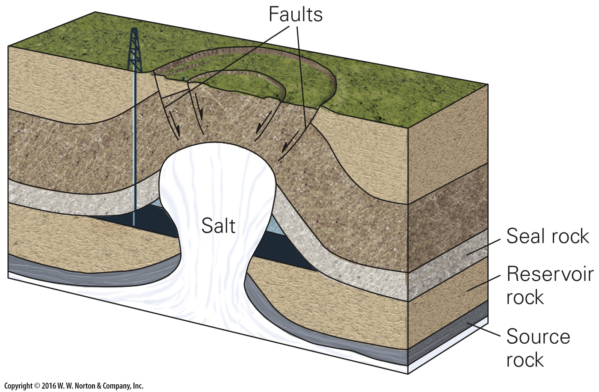
Notes:
FIGURE Bx12.1c Examples of oil traps. A trap is a configuration of a seal rock over a reservoir rock in a geometry that keeps the oil underground.
(c) Salt-dome trap. Oil and gas collect in strata on the flanks of the dome, beneath salt.

Slide 10
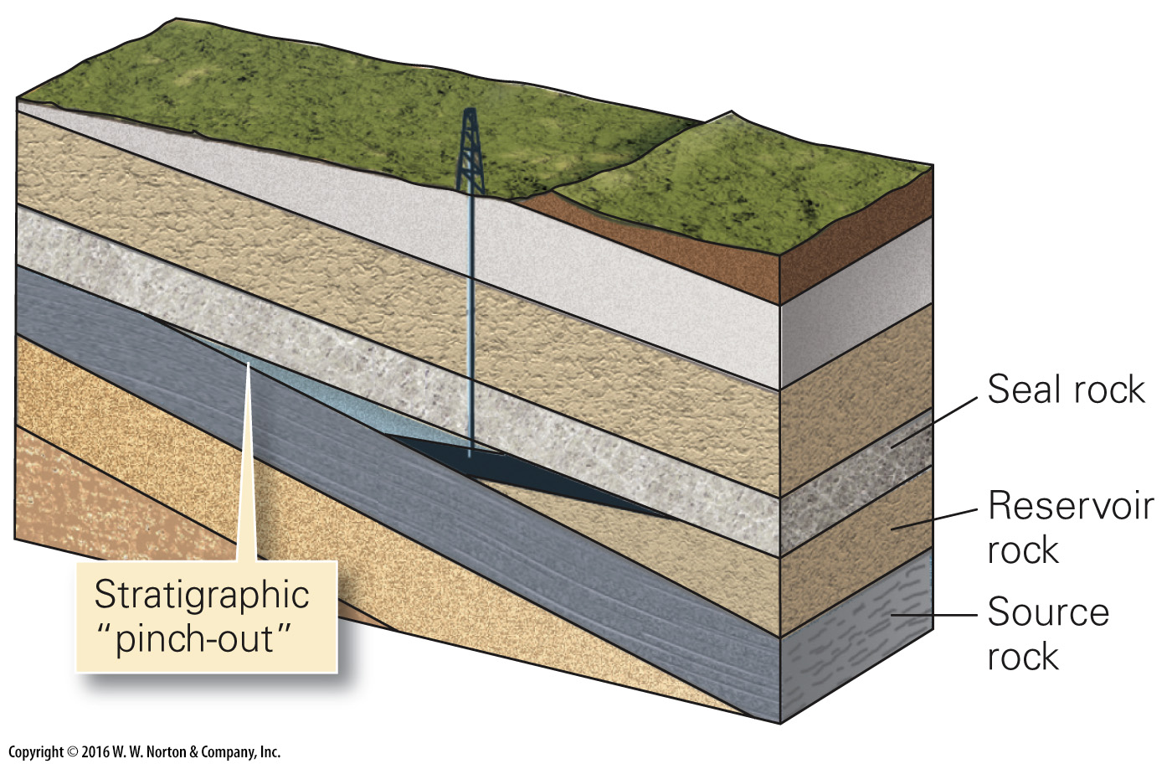
Notes:
FIGURE Bx12.1d Examples of oil traps. A trap is a configuration of a seal rock over a reservoir rock in a geometry that keeps the oil underground.
(d) Stratigraphic trap. Oil and gas collect where the reservoir layer pinches out.

Slide 11
Notes:
FIGURE 12.4 Exploring for oil and gas.
(a) Obtaining a seismic-reflection profile. The source truck sends vibrations downward. These reflect off layer boundaries up to small seismometers (geophones). The travel time indicates the depth to the boundary. (b) An example of a seismic-reflection profile. The colored bands represent underground sedimentary beds.

Slide 12
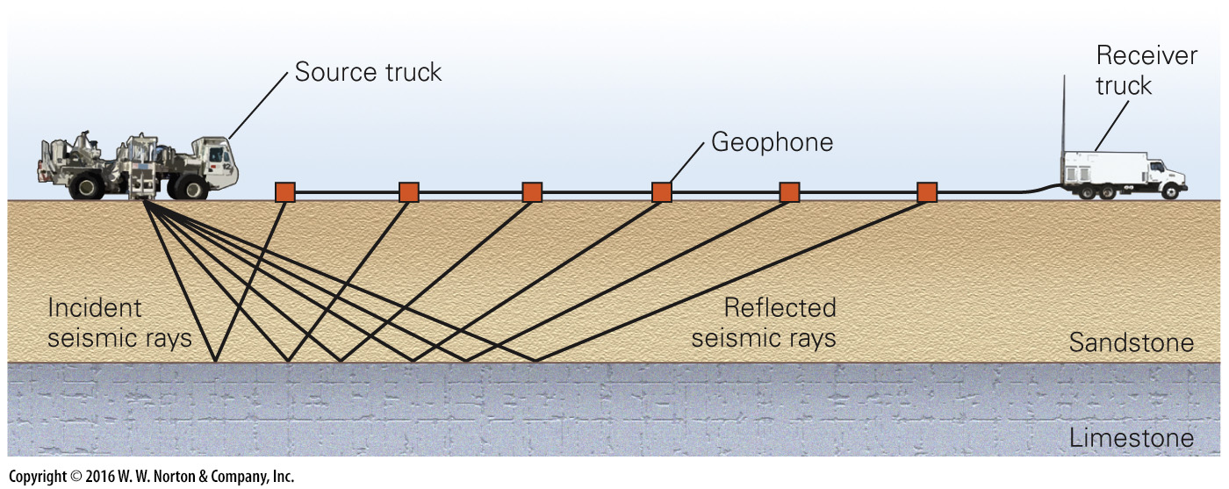
Notes:
FIGURE 12.4a Exploring for oil and gas.
(a) Obtaining a seismic-reflection profile. The source truck sends vibrations downward. These reflect off layer boundaries up to small seismometers (geophones). The travel time indicates the depth to the boundary.

Slide 13
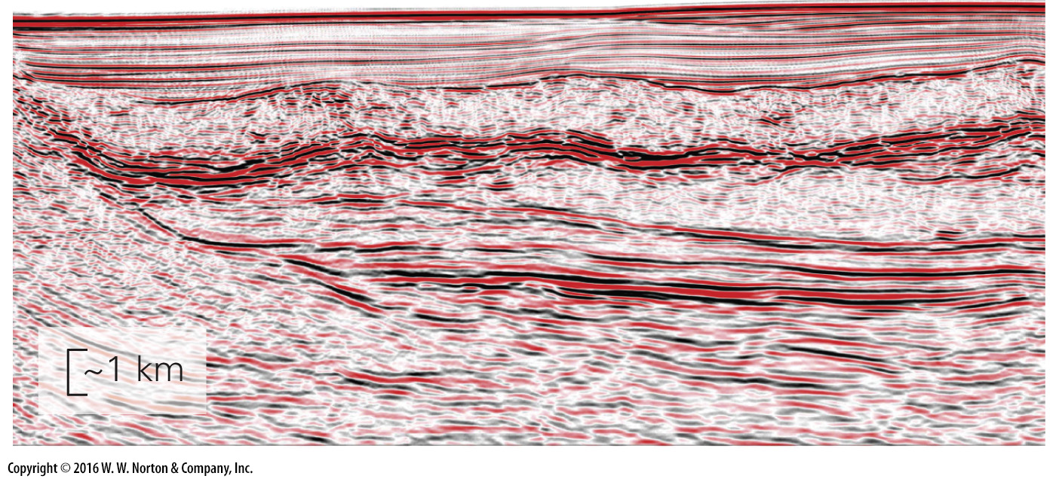
Notes:
FIGURE 12.4b Exploring for oil and gas.
(b) An example of a seismic-reflection profile. The colored bands represent underground sedimentary beds.

Slide 14
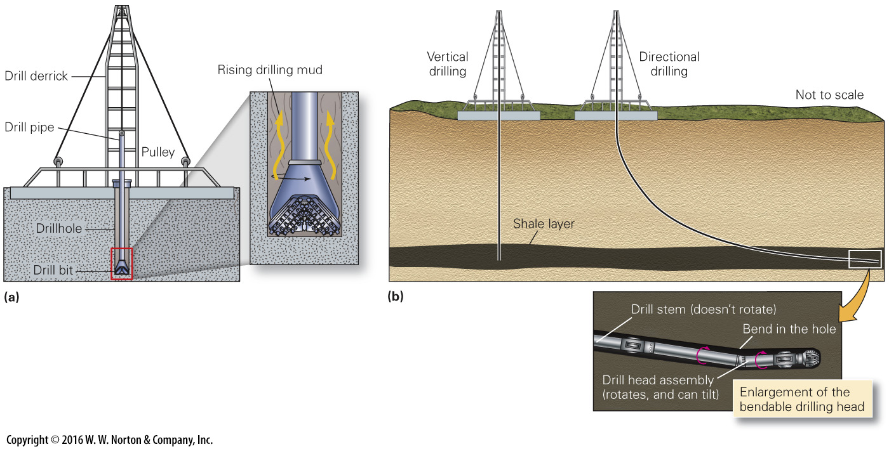
Notes:
FIGURE 12.5 Drilling for oil. The process is challenging.
(a) A pipe tipped by a rotating drill bit grinds a hole into the ground. Drilling mud, pumped down through the pipe, cools the bit and flushes up cuttings. (b) Conventional vertical holes go straight down; directional drilling allows drillers to bend holes and hit specific targets. Note the head can bend at an elbow.

Slide 15
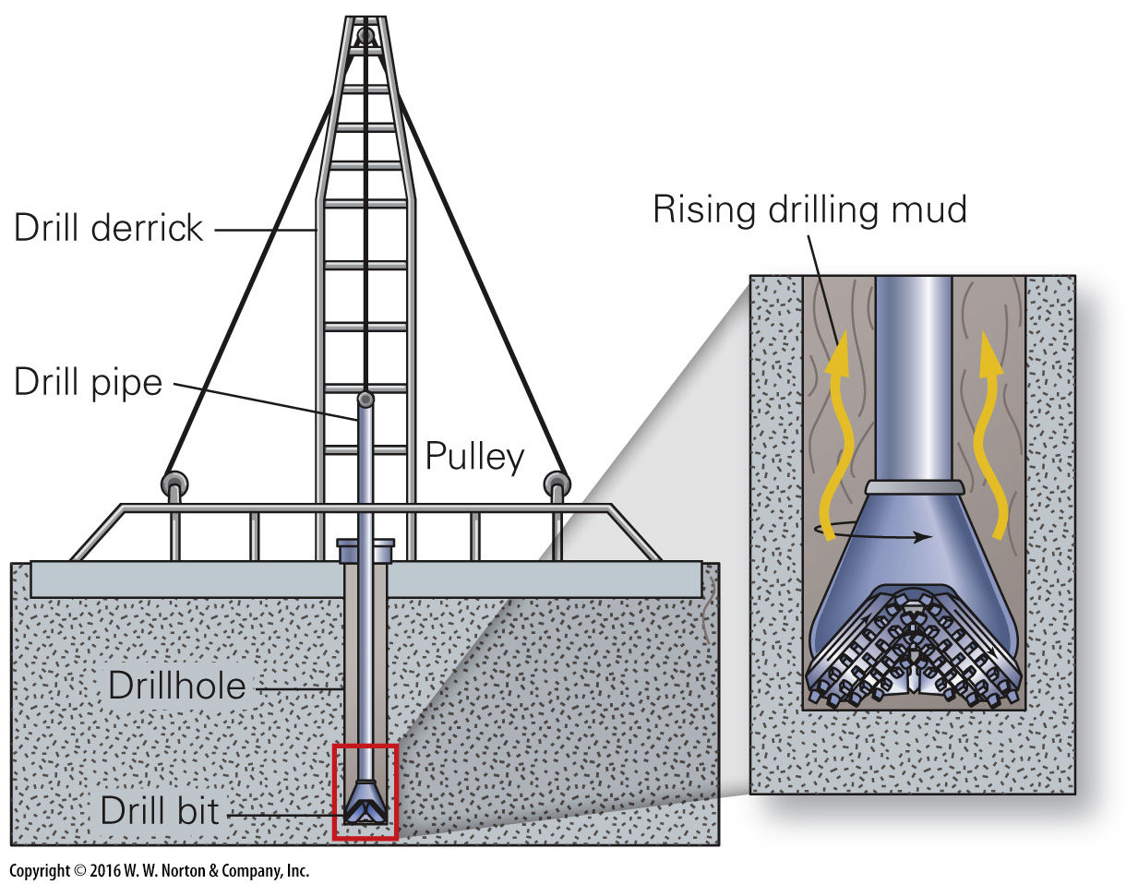
Notes:
FIGURE 12.5a Drilling for oil. The process is challenging.
(a) A pipe tipped by a rotating drill bit grinds a hole into the ground. Drilling mud, pumped down through the pipe, cools the bit and flushes up cuttings.

Slide 16
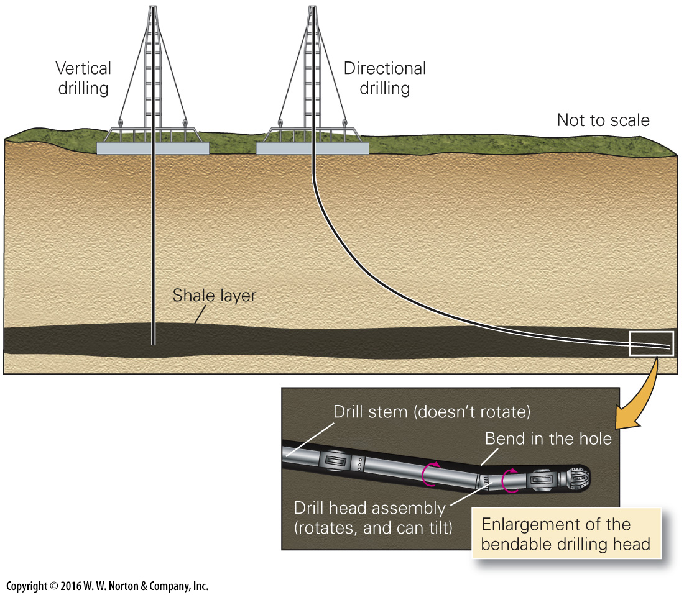
Notes:
FIGURE 12.5b Drilling for oil. The process is challenging.
(b) Conventional vertical holes go straight down; directional drilling allows drillers to bend holes and hit specific targets. Note the head can bend at an elbow.

Slide 17
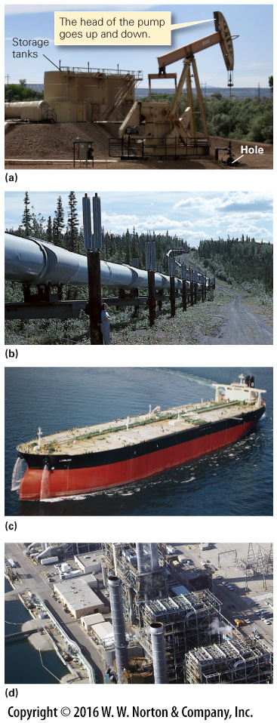
Notes:
FIGURE 12.6 Pumping, transporting, and refining oil.
(a) When drilling is complete, the derrick is replaced by a pump, which sucks oil out of the ground. This design is called a pumpjack. (b) The Trans-Alaska Pipeline transports oil from fields on the Arctic coast to a tanker port on the southern coast of Alaska. (c) An oil tanker capable of carrying 2.6 million barrels (enough to supply the entire United States for 7 hours). (d) Distilling columns of an oil refinery transform crude oil into gasoline and other hydrocarbon products.

Slide 18
Notes:
FIGURE 12.6a Pumping, transporting, and refining oil.
(a) When drilling is complete, the derrick is replaced by a pump, which sucks oil out of the ground. This design is called a pumpjack.

Slide 19
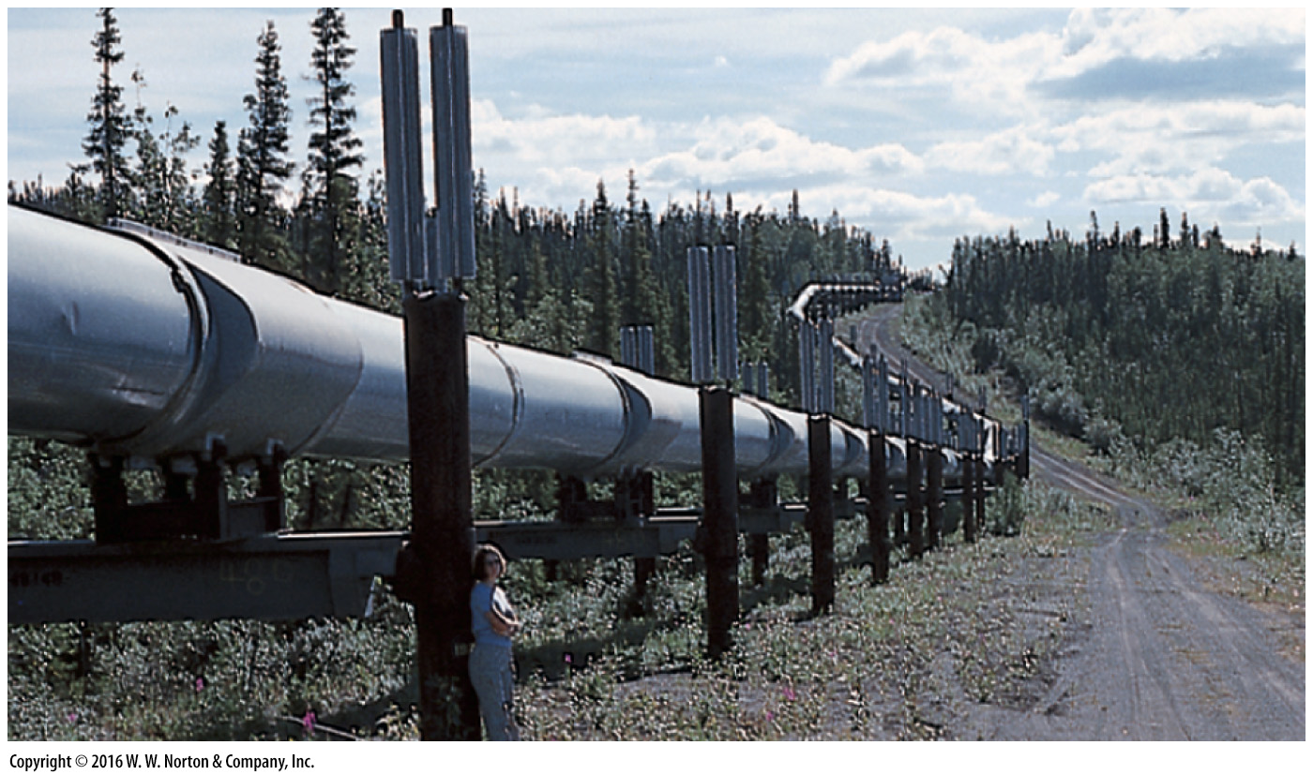
Notes:
FIGURE 12.6b Pumping, transporting, and refining oil.
(b) The Trans-Alaska Pipeline transports oil from fields on the Arctic coast to a tanker port on the southern coast of Alaska.

Slide 20
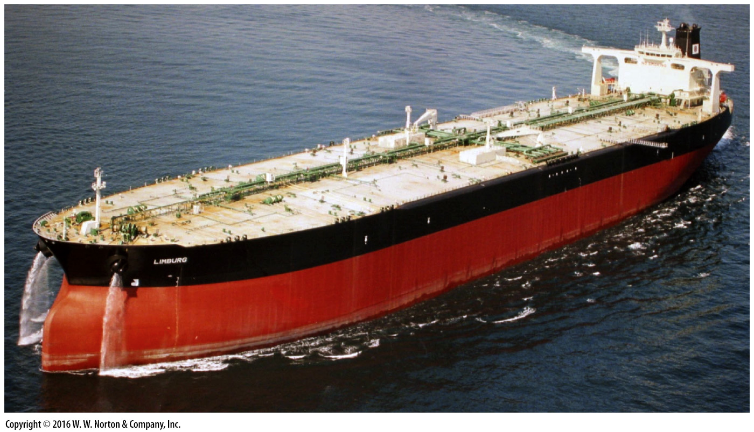
Notes:
FIGURE 12.6c Pumping, transporting, and refining oil.
(c) An oil tanker capable of carrying 2.6 million barrels (enough to supply the entire United States for 7 hours).

Slide 21
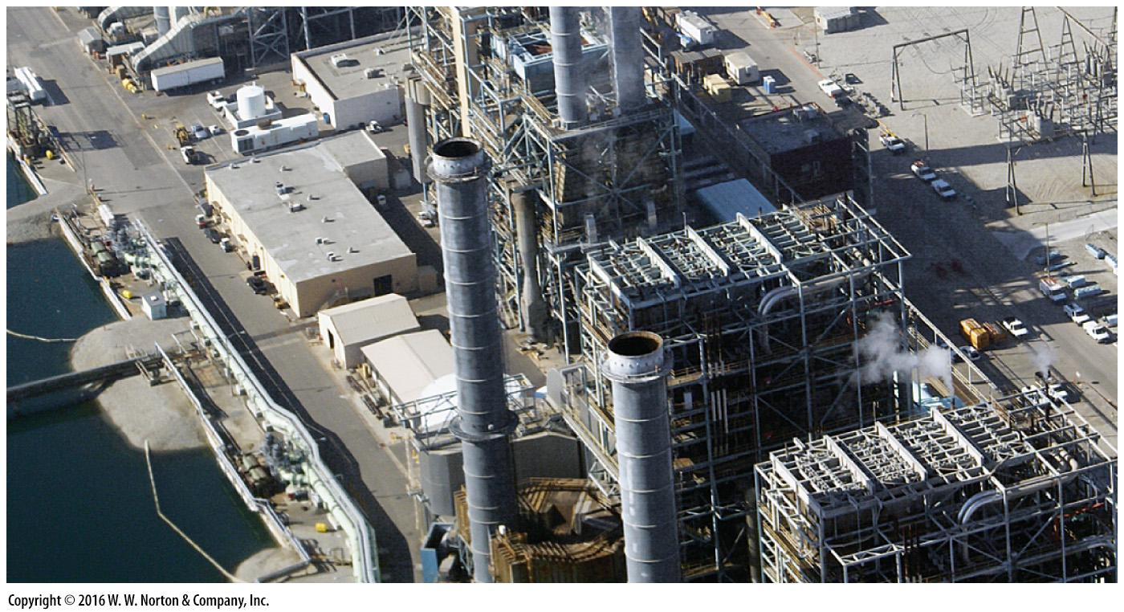
Notes:
FIGURE 12.6d Pumping, transporting, and refining oil.
(d) Distilling columns of an oil refinery transform crude oil into gasoline and other hydrocarbon products.

Slide 22
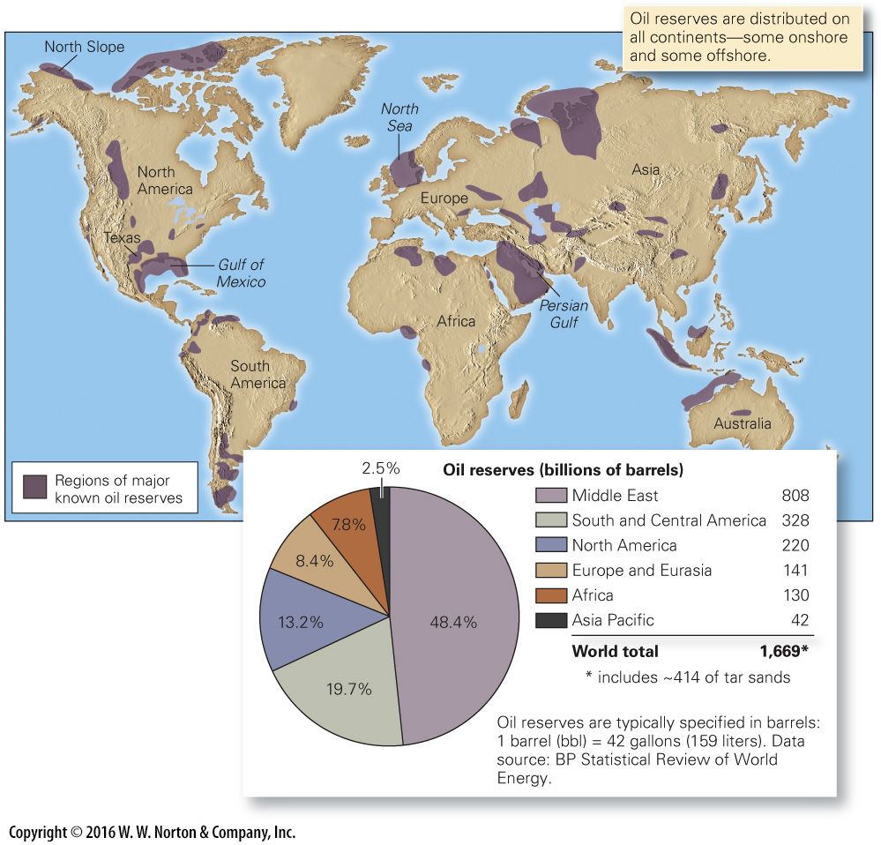
Notes:
FIGURE 12.7 The distribution of oil reserves around the world.

Slide 23
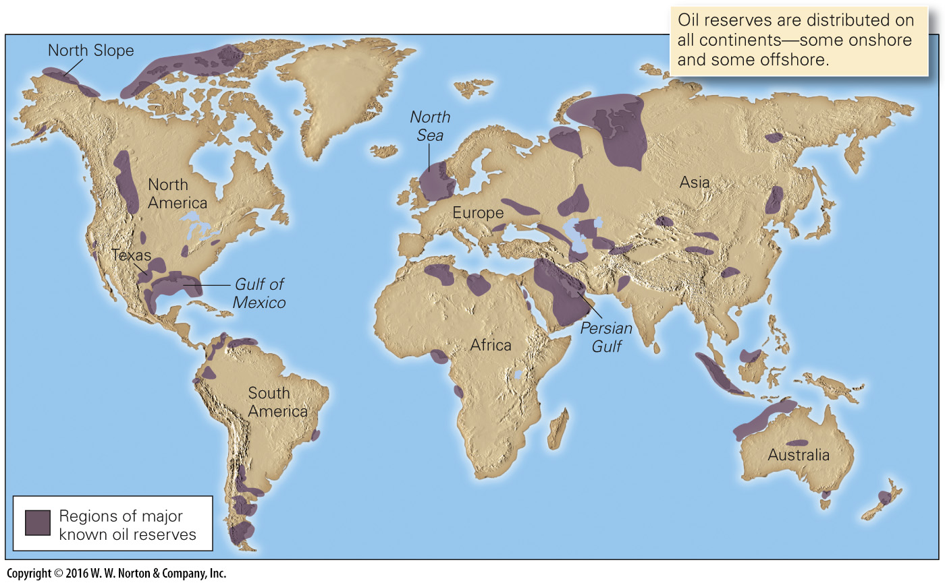
Notes:
FIGURE 12.7 (Part 1) The distribution of oil reserves around the world.

Slide 24
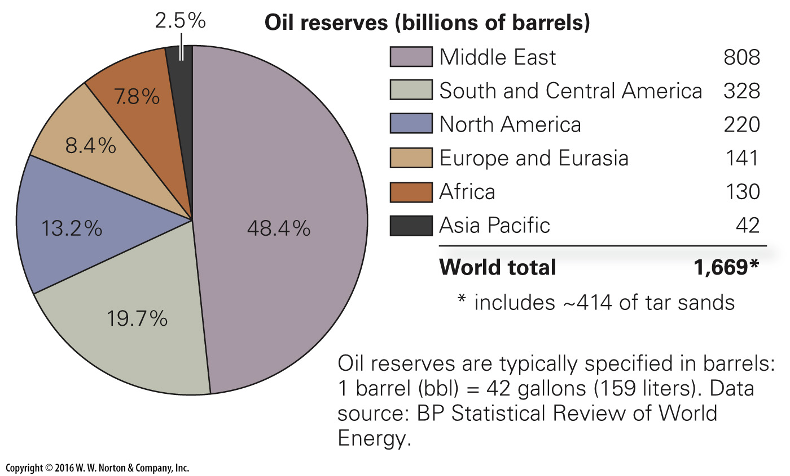
Notes:
FIGURE 12.7 (Part 2) The distribution of oil reserves around the world.

Slide 25
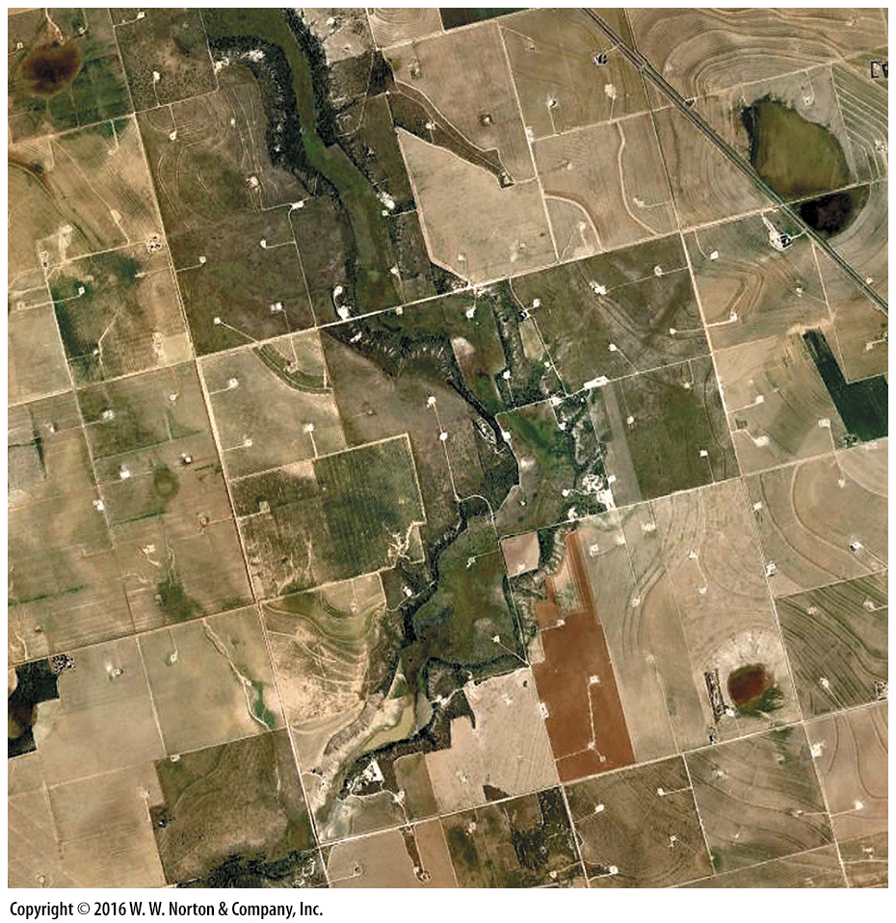
Notes:
SEE FOR YOURSELF…
OIL FIELD NEAR LAMESA, TEXAS

Slide 26
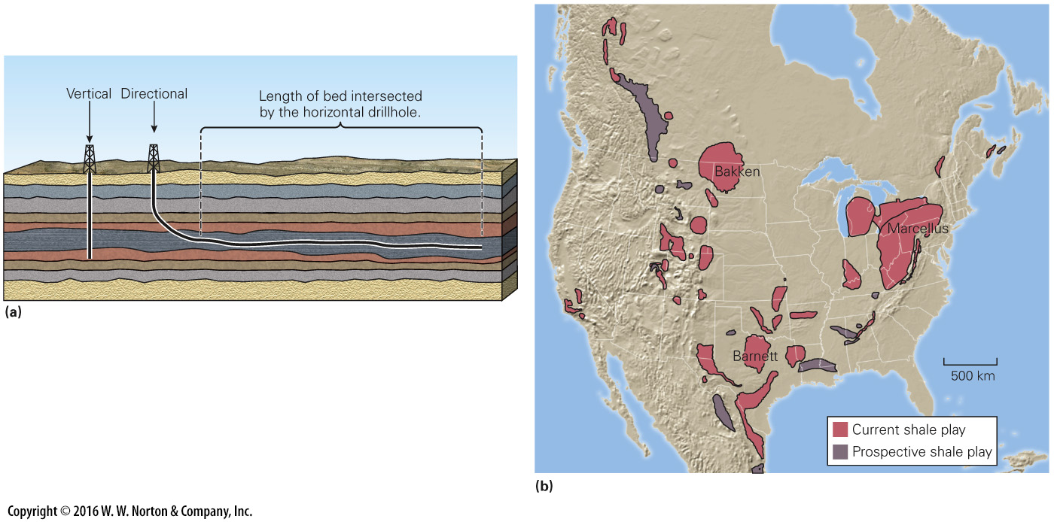
Notes:
FIGURE 12.8 Unconventional shale oil and shale gas fields in North America.
(a) Horizontal directional drilling can allow a very large area of a source bed to be accessed. The length of the hole must be hydrofractured, to provide permeability. (b) A map of the major unconventional fields in North America. The three largest are labeled. A “play” is a region being drilled.

Slide 27
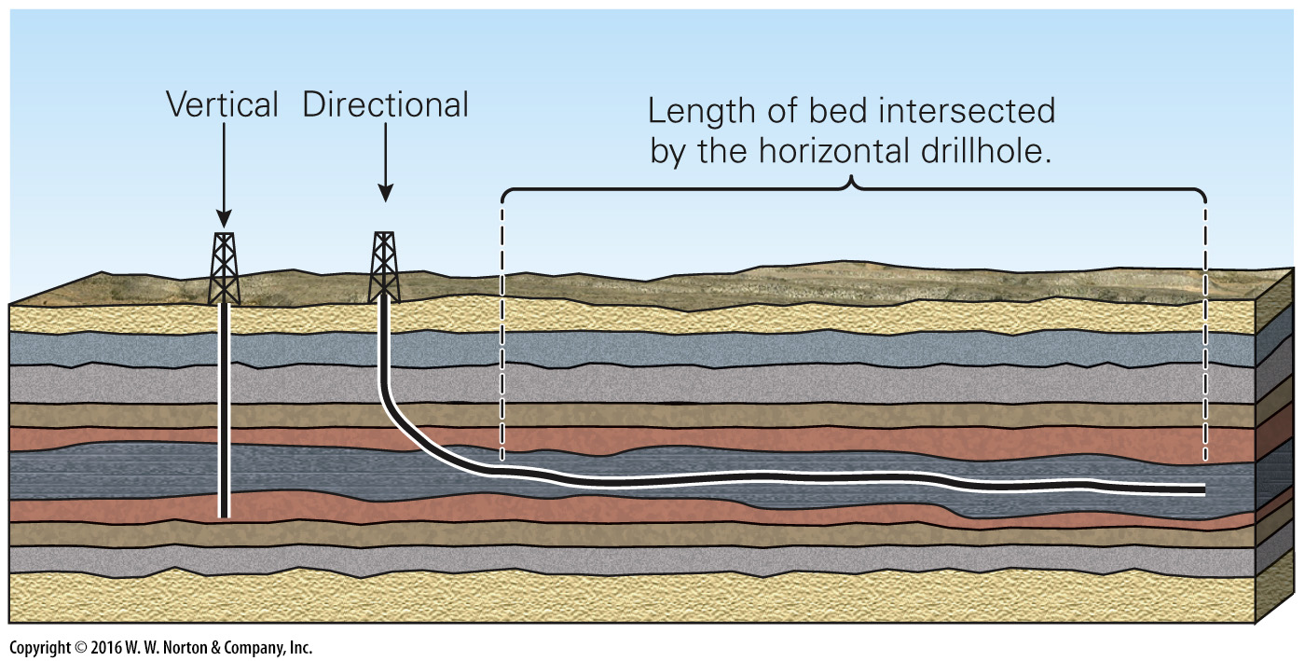
Notes:
FIGURE 12.8a Unconventional shale oil and shale gas fields in North America.
(a) Horizontal directional drilling can allow a very large area of a source bed to be accessed. The length of the hole must be hydrofractured, to provide permeability.

Slide 28
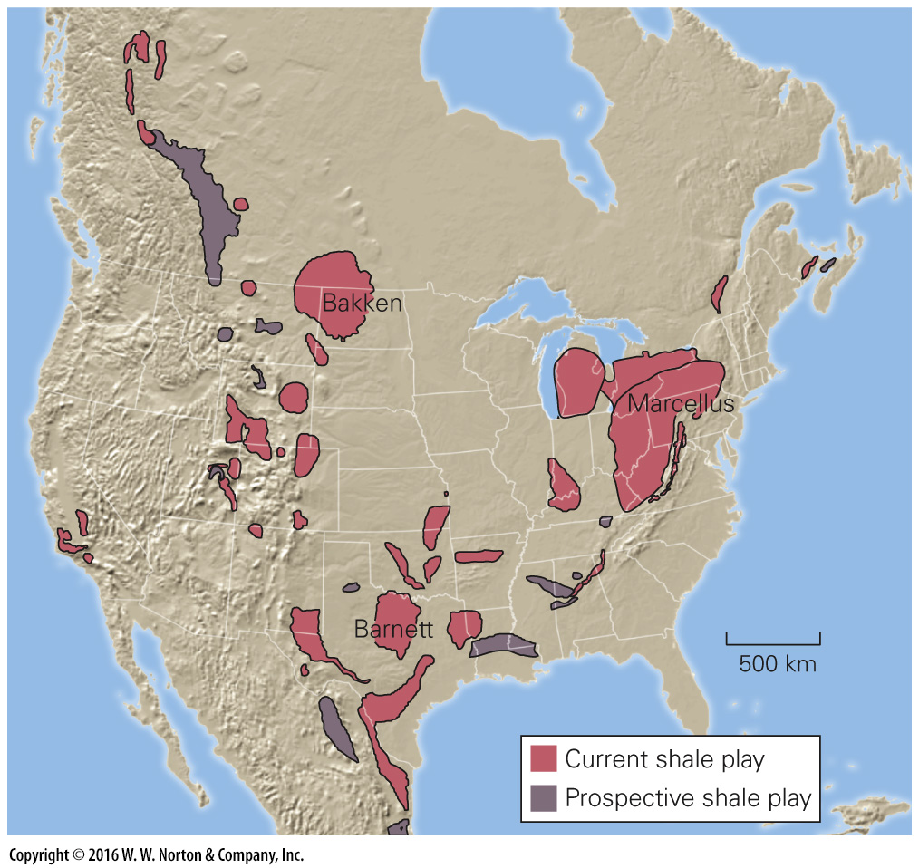
Notes:
FIGURE 12.8b Unconventional shale oil and shale gas fields in North America.
(b) A map of the major unconventional fields in North America. The three largest are labeled. A “play” is a region being drilled.

Slide 29
Notes:
FIGURE 12.9 The formation of coal. Coal forms when plant debris becomes deeply buried.
(a) A museum diorama depicting a Carboniferous coal swamp. (b) If there is a transgression, peat formed in the coal swamp can be buried and preserved. (c) Burial of peat leads to the formation of coal of progressively higher rank. (d) An example of coal beds interlayered with beds of sandstone and shale.

Slide 30
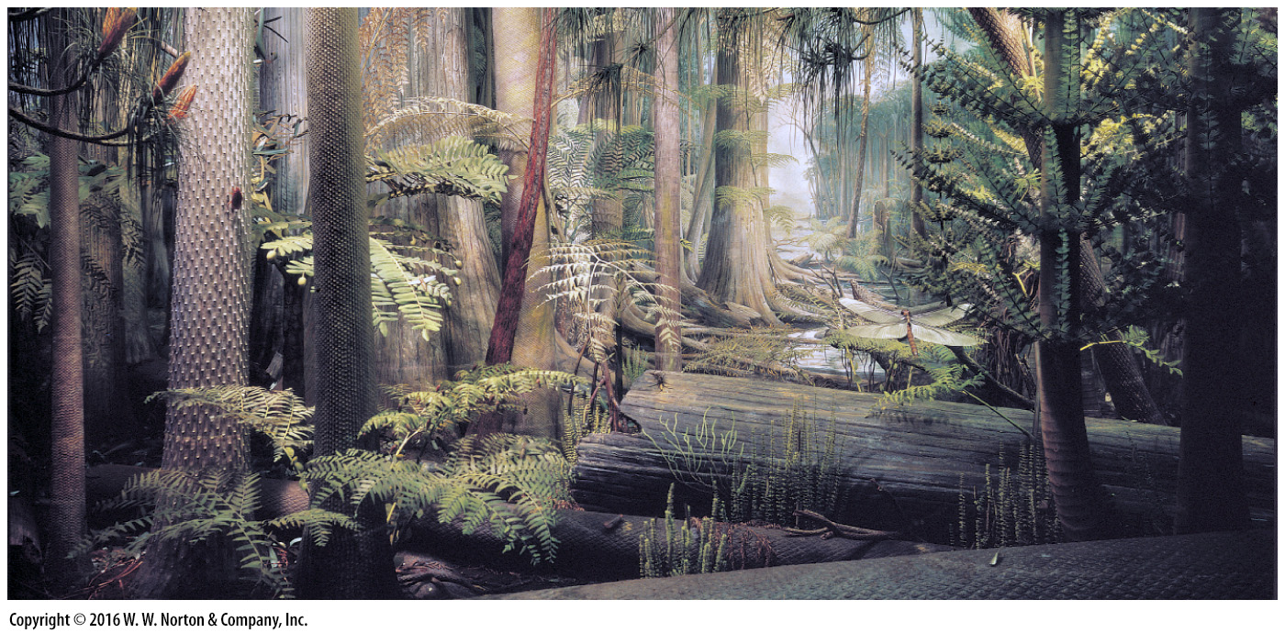
Notes:
FIGURE 12.9a The formation of coal. Coal forms when plant debris becomes deeply buried.
(a) A museum diorama depicting a Carboniferous coal swamp.

Slide 31
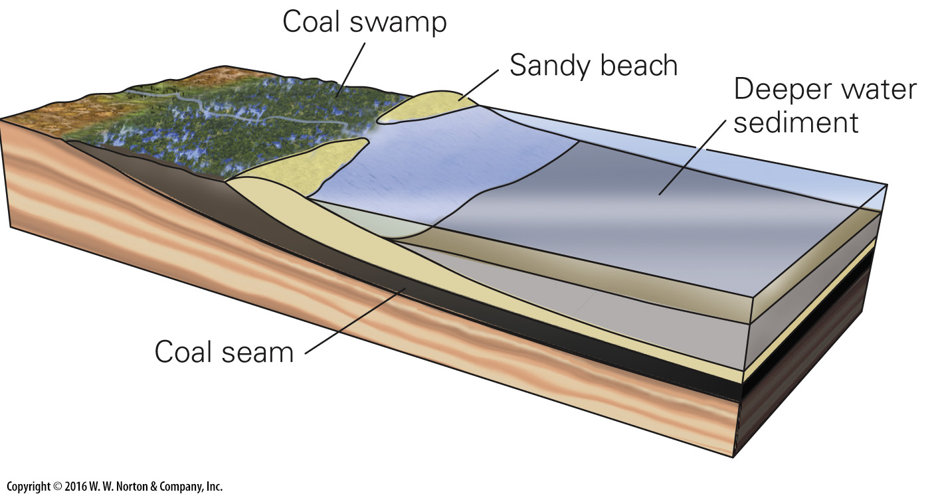
Notes:
FIGURE 12.9b The formation of coal. Coal forms when plant debris becomes deeply buried.
(b) If there is a transgression, peat formed in the coal swamp can be buried and preserved.

Slide 32
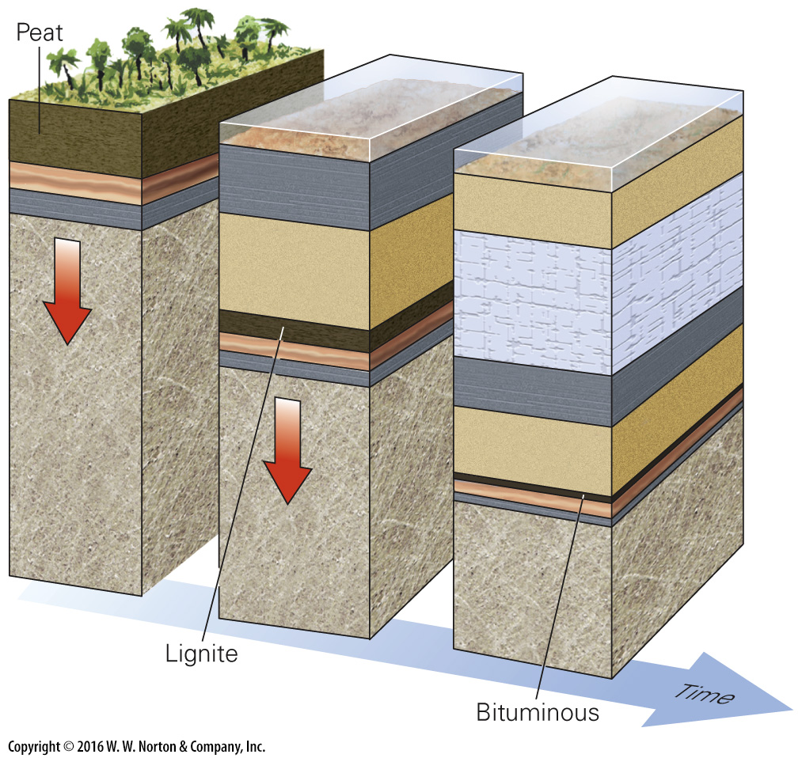
Notes:
FIGURE 12.9c The formation of coal. Coal forms when plant debris becomes deeply buried.
(c) Burial of peat leads to the formation of coal of progressively higher rank.

Slide 33
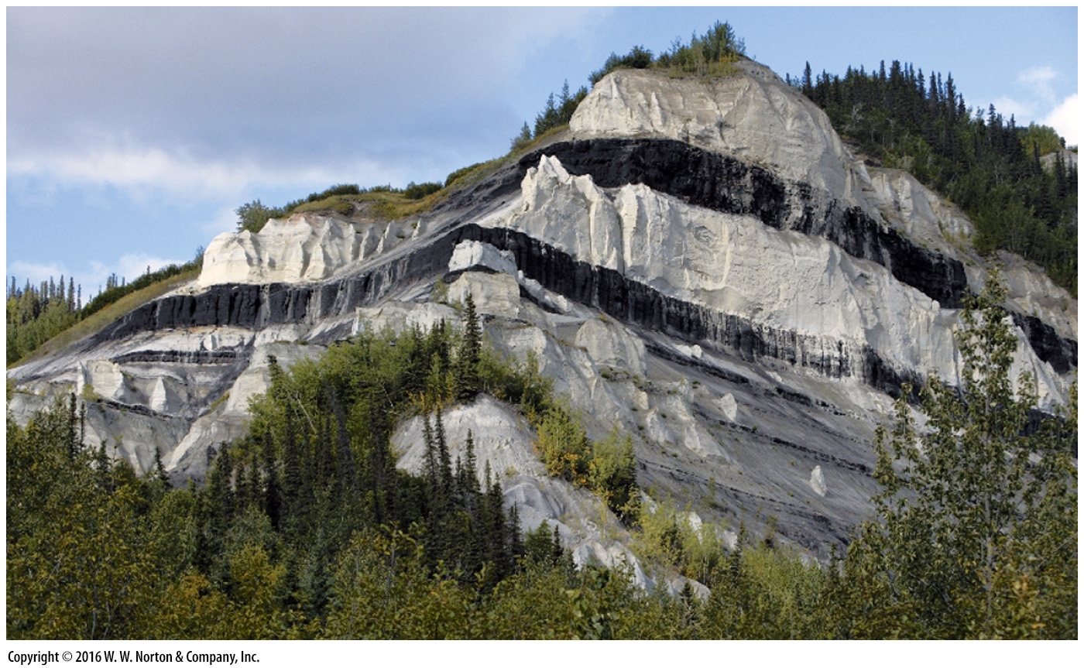
Notes:
FIGURE 12.9d The formation of coal. Coal forms when plant debris becomes deeply buried.
(d) An example of coal beds interlayered with beds of sandstone and shale.

Slide 34
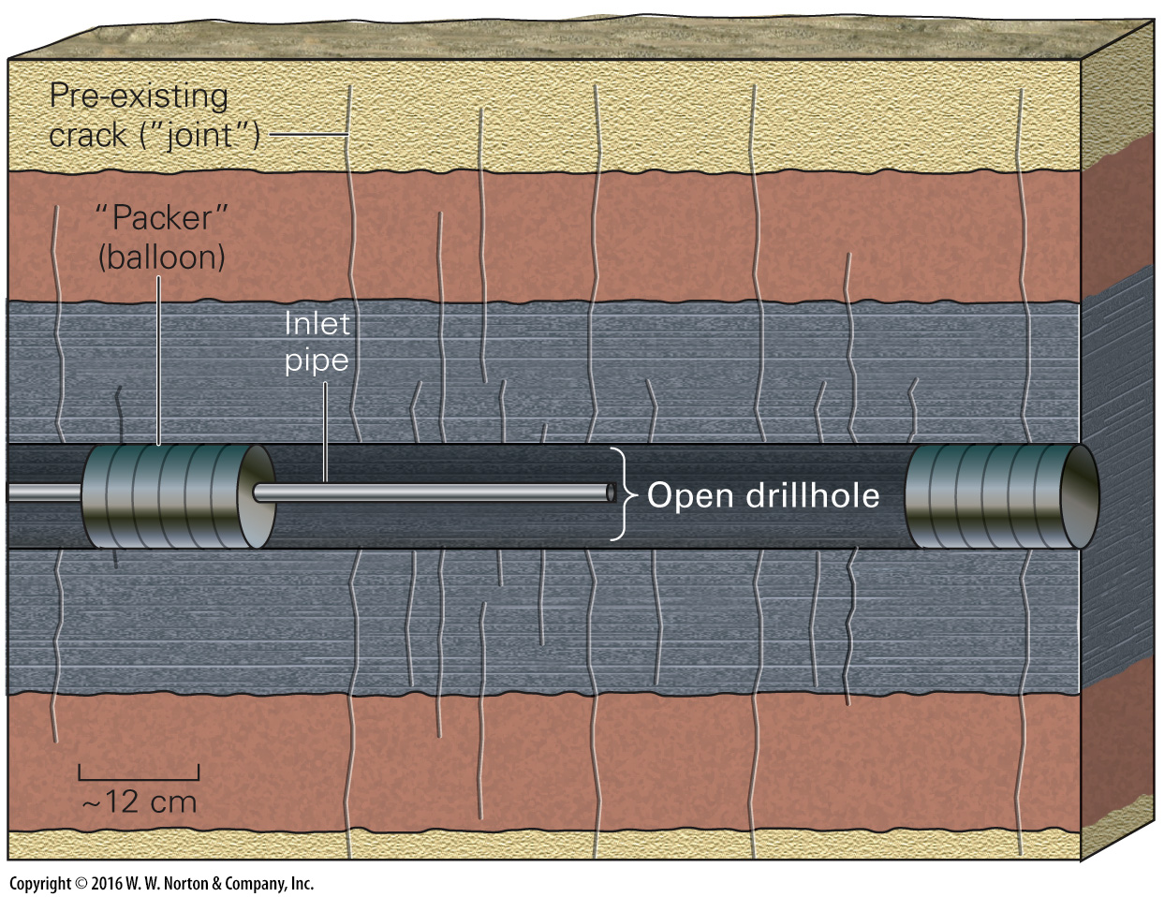
Notes:
FIGURE Bx12.2a Hydrofracturing in a horizontal shale bed.
(a) The first step in hydrofracturing. After the hole has been drilled, packers seal off a portion, and a pipe is inserted through one of the packers.

Slide 35
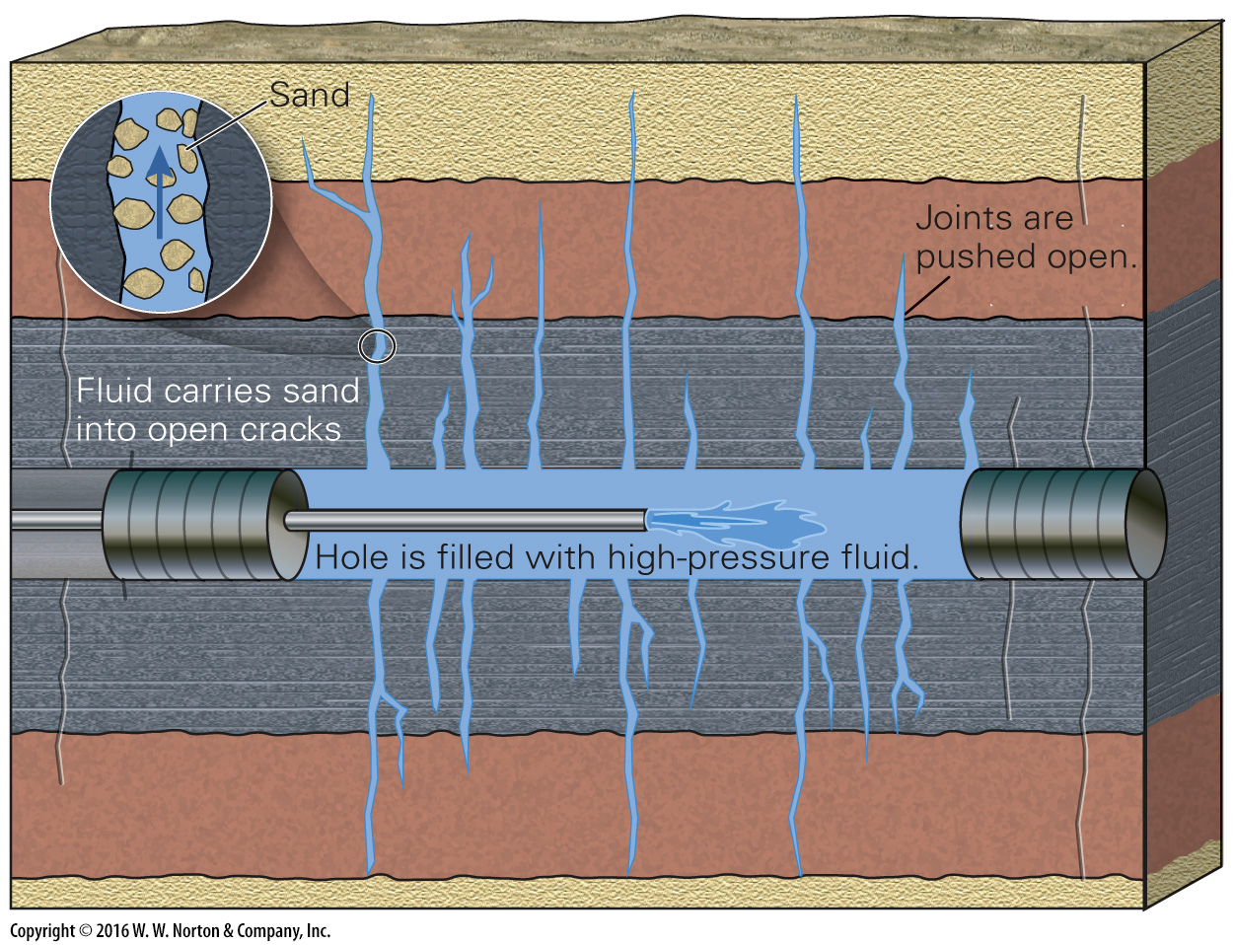
Notes:
FIGURE Bx12.2b Hydrofracturing in a horizontal shale bed.
(b) High-pressure fluid is pumped into the segment of hole. The pressure pushes open cracks and forms new ones. Sand injected with the fluid keeps the cracks from closing.

Slide 36
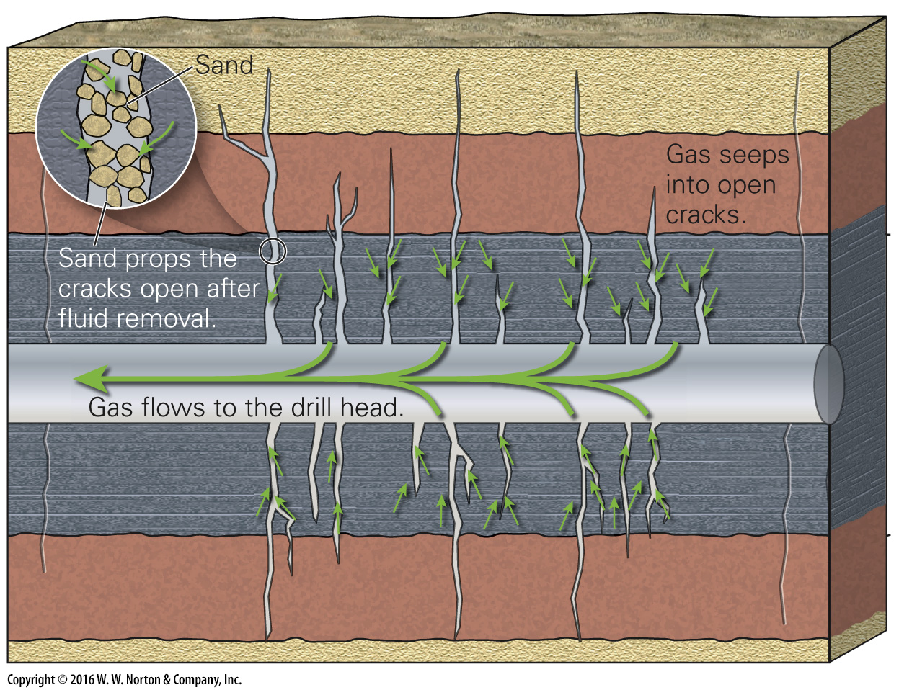
Notes:
FIGURE Bx12.2c Hydrofracturing in a horizontal shale bed.
(c) After the packers and the fluid are removed, gas can seep into the pipe and flow to the drill head.

Slide 37
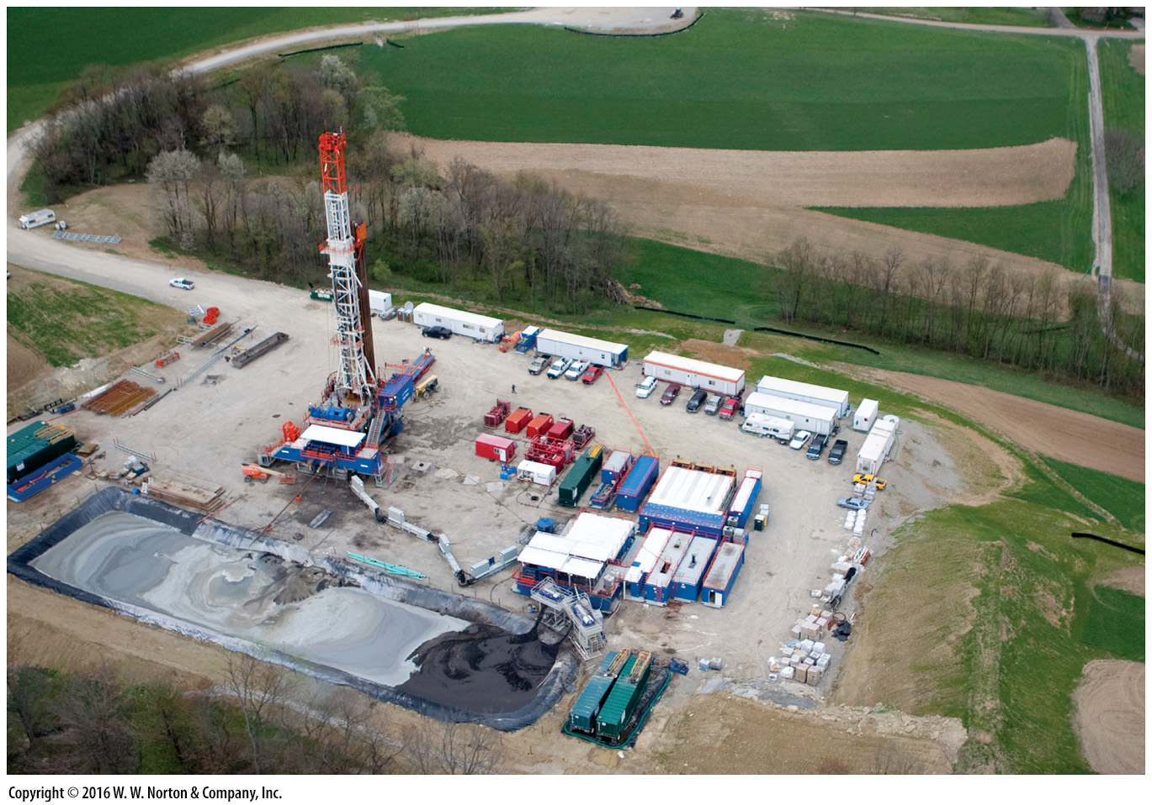
Notes:
FIGURE Bx12.2d Hydrofracturing in a horizontal shale bed.
(d) A drilling site. The trucks and the holding pond are used during hydrofracturing. Many holes can be drilled from this site, like spokes of a wheel.

Slide 38
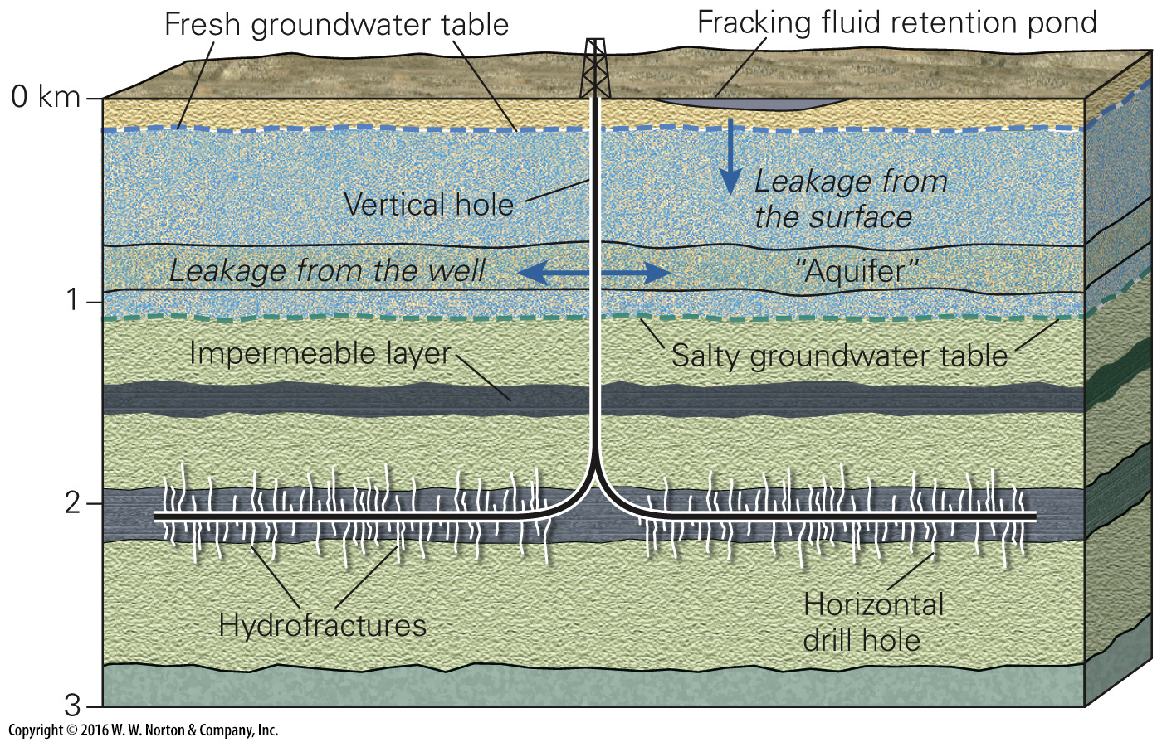
Notes:
FIGURE Bx12.2e Hydrofracturing in a horizontal shale bed.
(e) Potential for the contamination of groundwater by hydrofracturing.

Slide 39
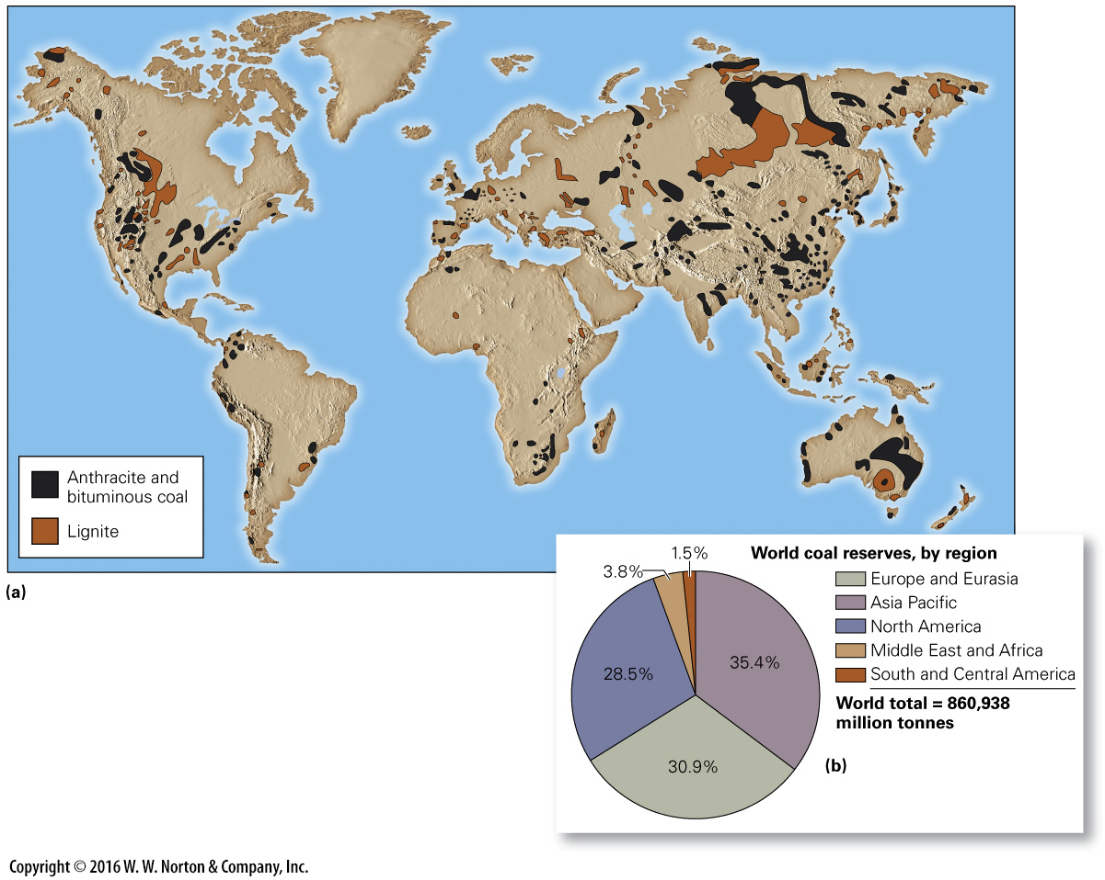
Notes:
FIGURE 12.10 The distribution of coal reserves.
(a) A map showing global distribution of coal reserves. Most coal accumulated in continental interior basins. (b) A graph illustrating the distribution of coal reserve quantities, by region. Data source: BP Statistical Review of World Energy.

Slide 40
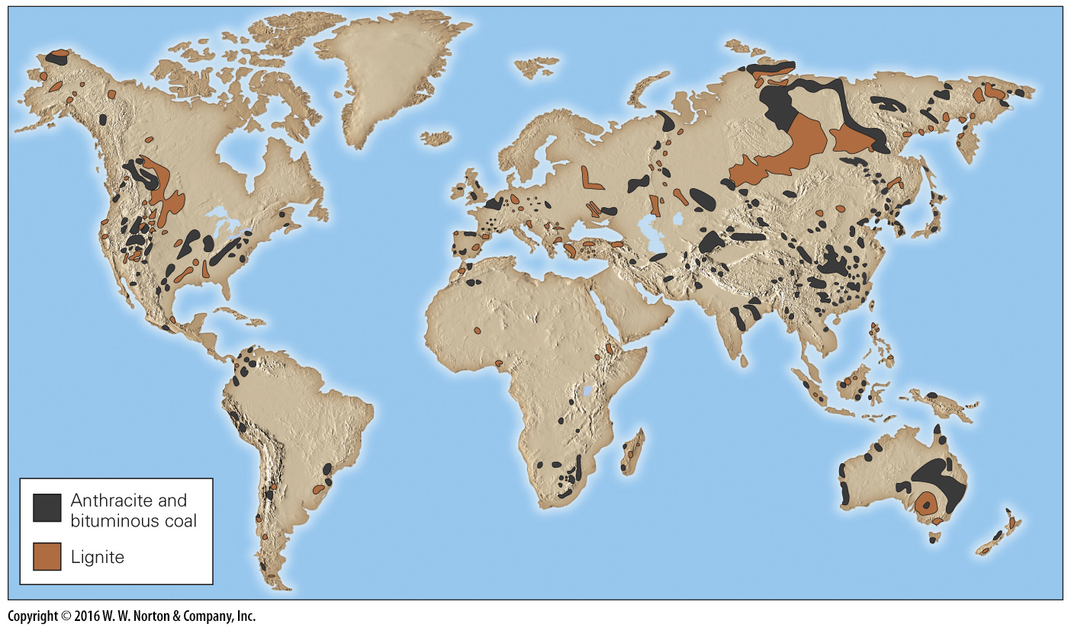
Notes:
FIGURE 12.10a The distribution of coal reserves.
(a) A map showing global distribution of coal reserves. Most coal accumulated in continental interior basins.

Slide 41
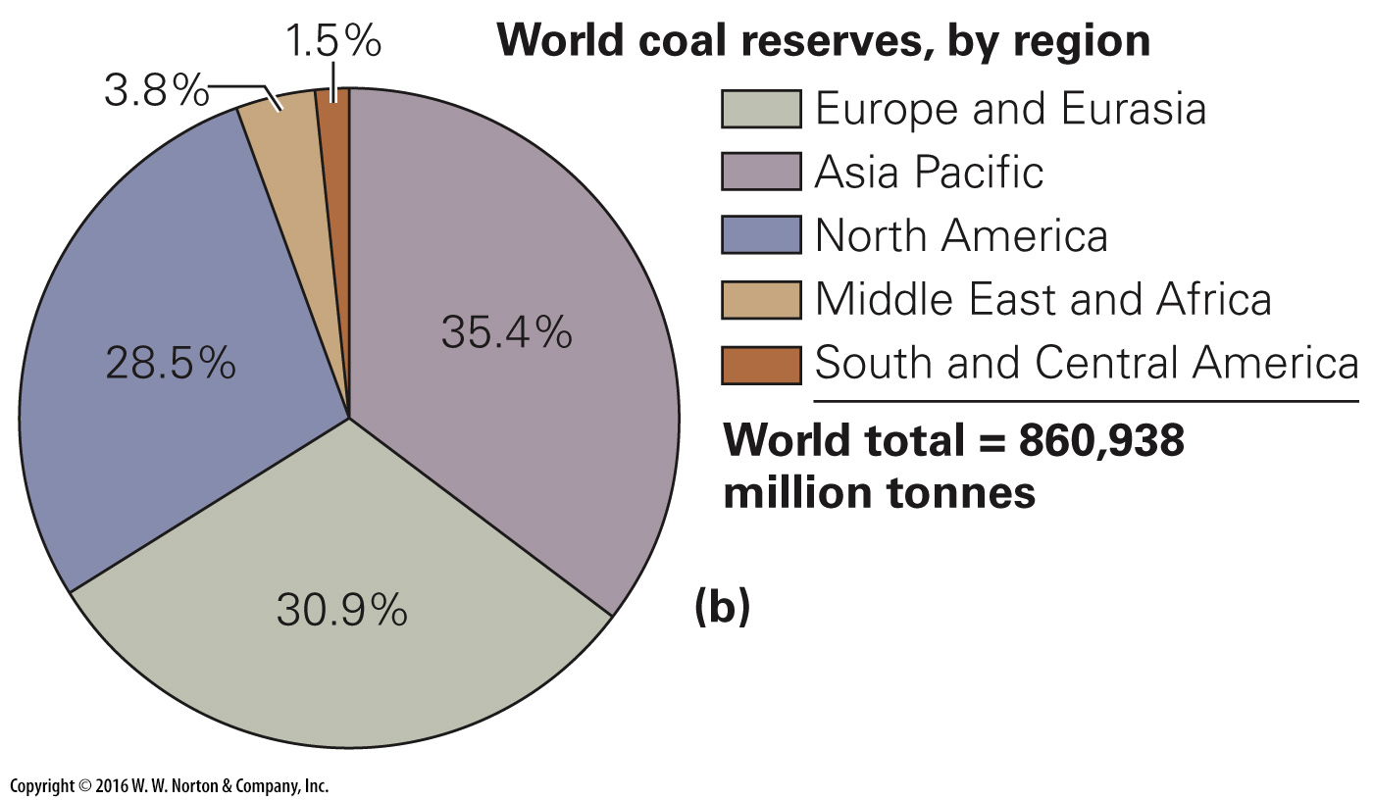
Notes:
FIGURE 12.10b The distribution of coal reserves.
(b) A graph illustrating the distribution of coal reserve quantities, by region. Data source: BP Statistical Review of World Energy.

Slide 42
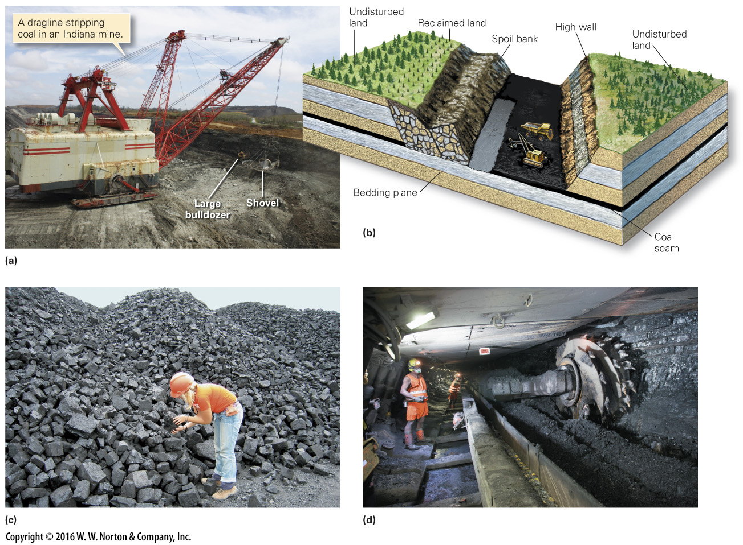
Notes:
FIGURE 12.11 Coal can be mined in strip mines or in underground mines.
(a) A dragline stripping overburden. (b) Digging up the coal seam and reclamining the stripped area. (c) Piles of recently mined coal. (d) Underground coal mining.

Slide 43
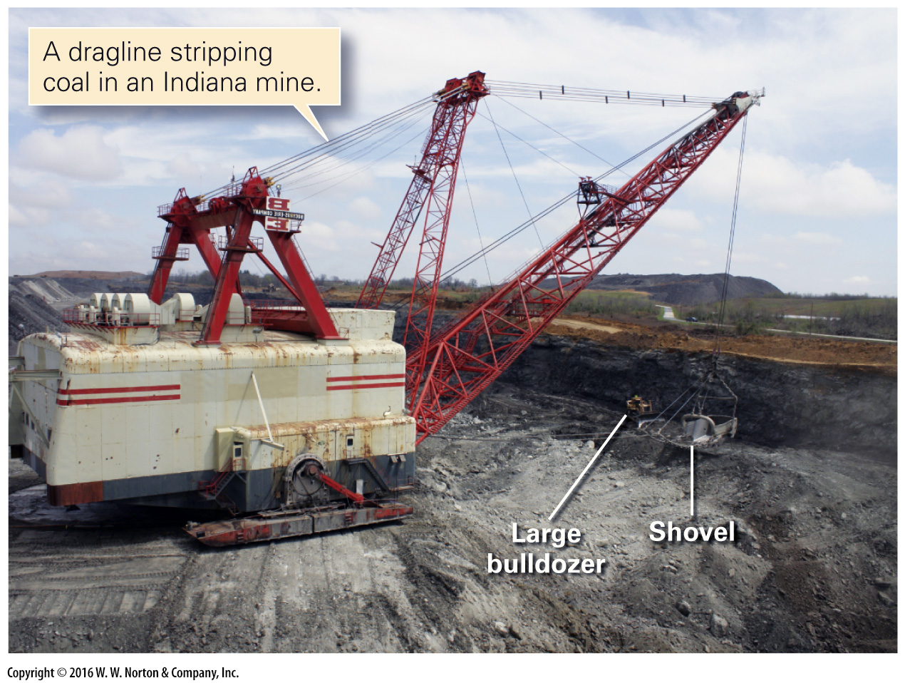
Notes:
FIGURE 12.11a Coal can be mined in strip mines or in underground mines.
(a) A dragline stripping overburden.

Slide 44
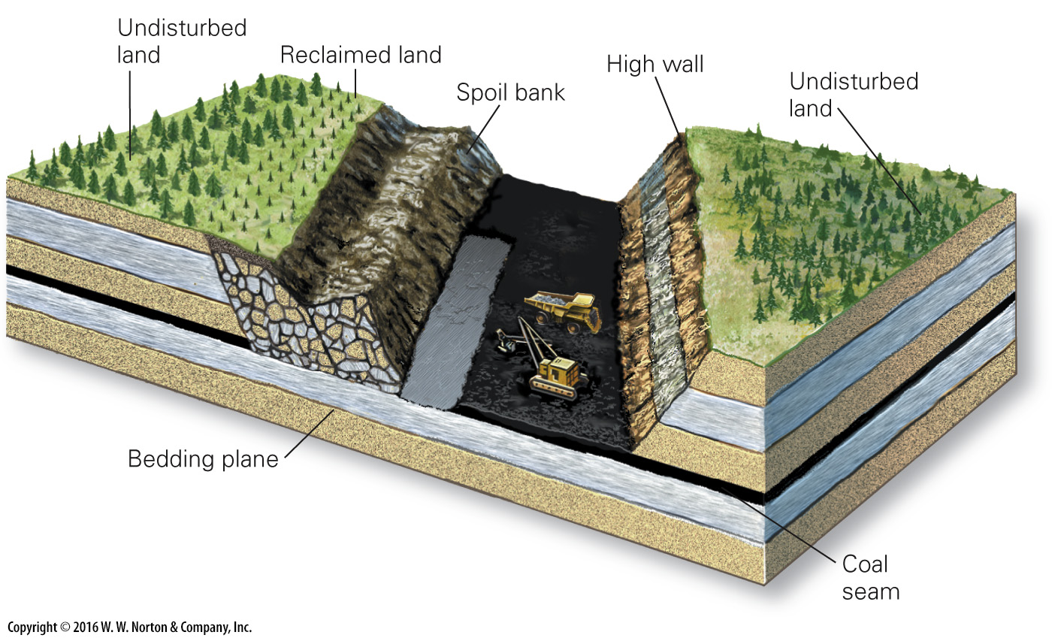
Notes:
FIGURE 12.11b Coal can be mined in strip mines or in underground mines.
(b) Digging up the coal seam and reclamining the stripped area.

Slide 45
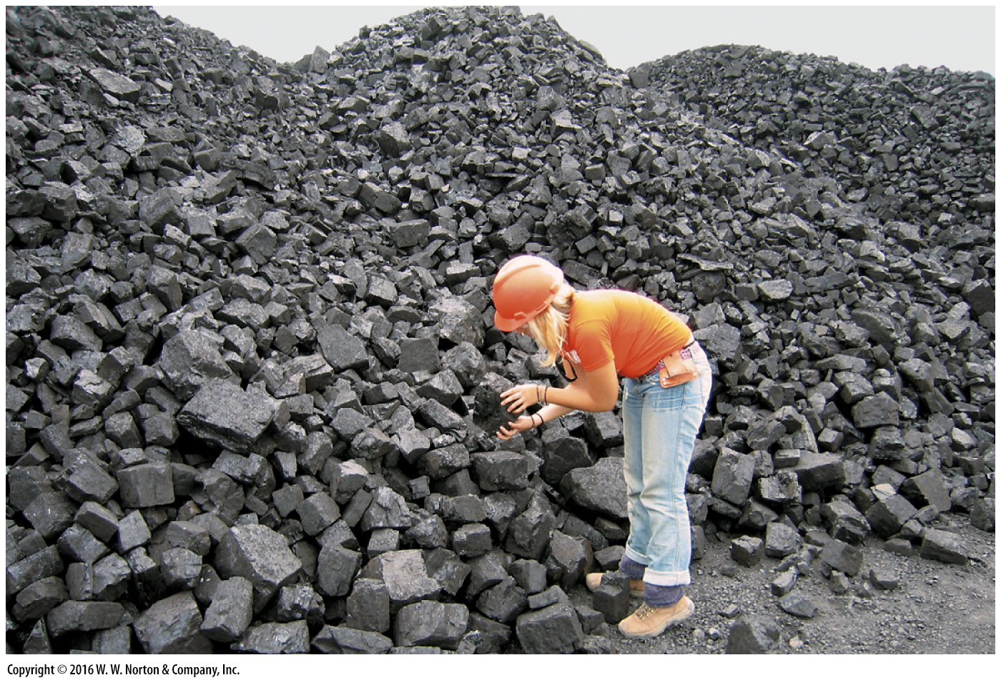
Notes:
FIGURE 12.11d Coal can be mined in strip mines or in underground mines.
(c) Piles of recently mined coal.

Slide 46
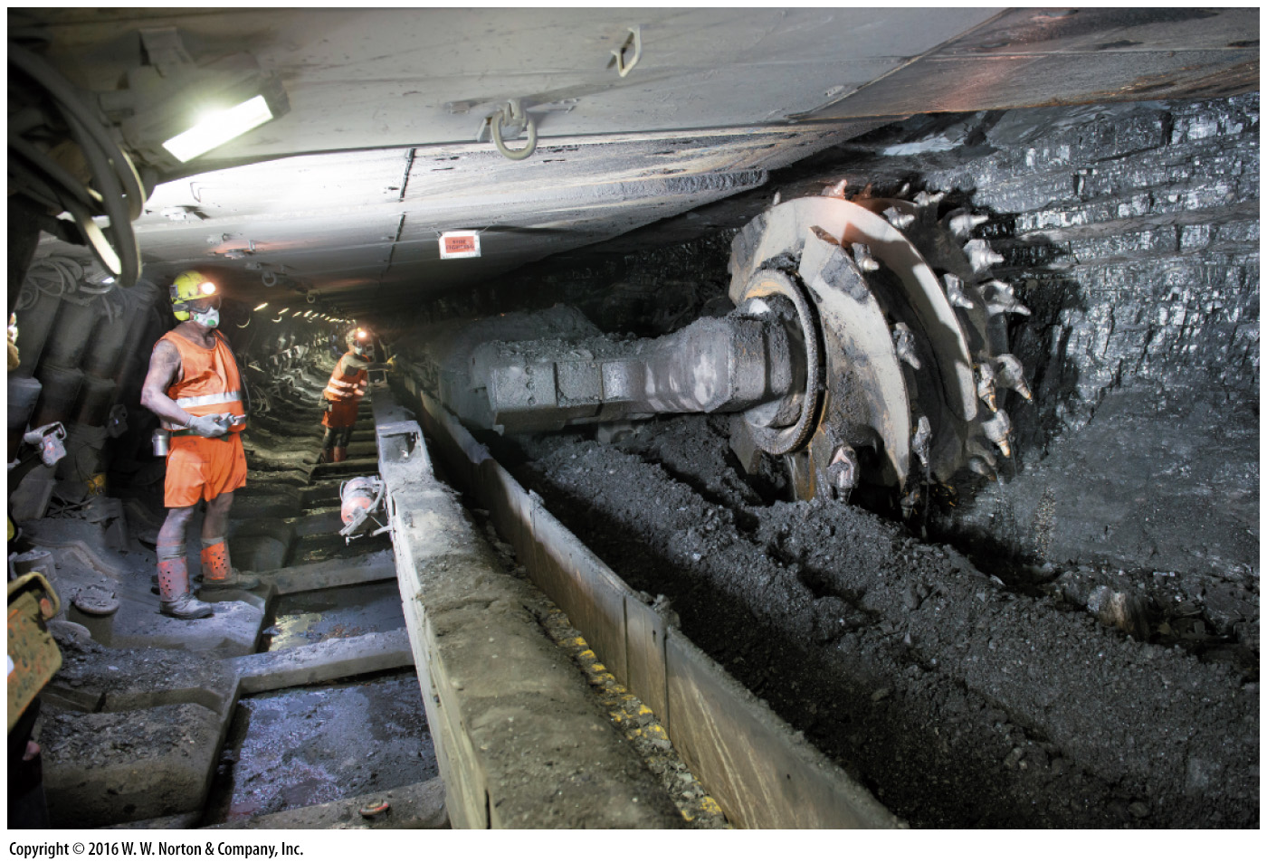
Notes:
FIGURE 12.11d Coal can be mined in strip mines or in underground mines.
(d) Underground coal mining.

Slide 47
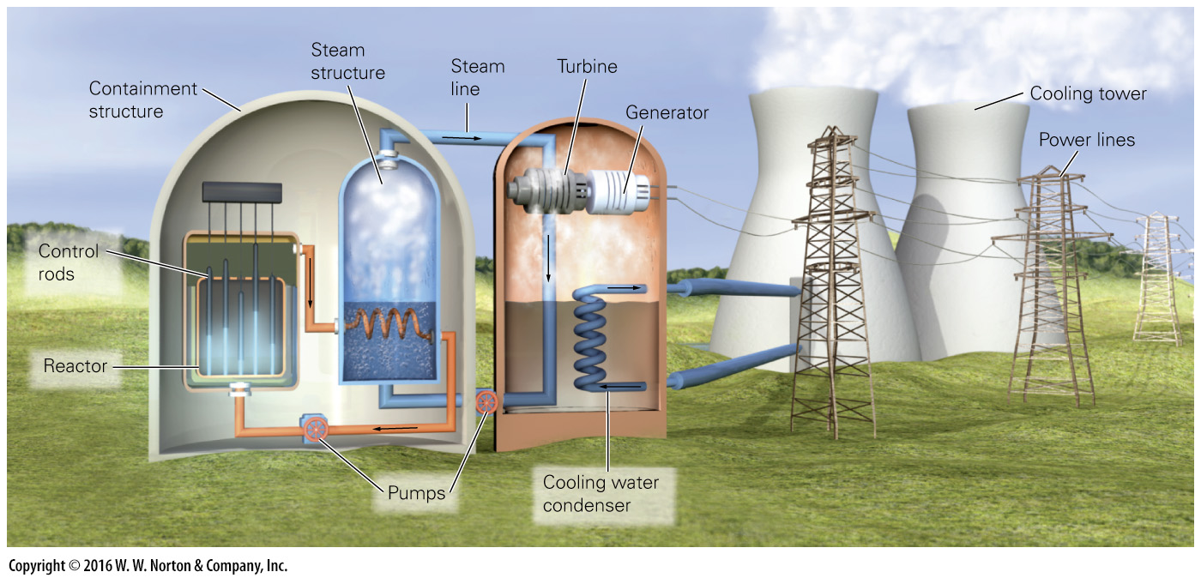
Notes:
FIGURE 12.12a Producing electricity at a nuclear power plant.
(a) In a nuclear power plant, a reactor heats water, which produces high-pressure steam. The steam drives a turbine that in turn drives a generator to produce electricity. A condenser transforms the steam back into water.

Slide 48
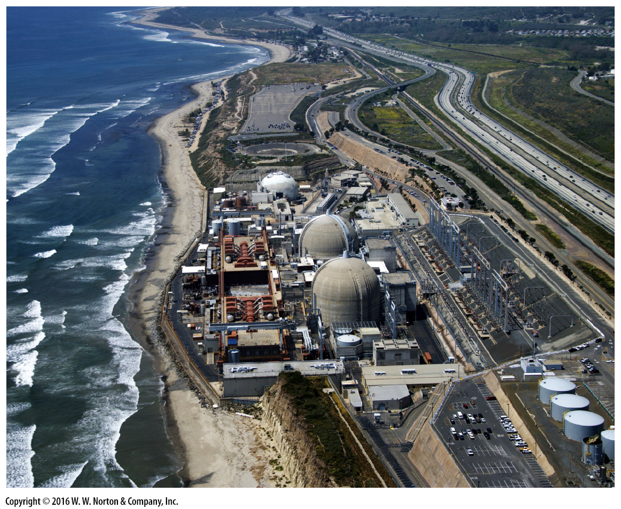
Notes:
FIGURE 12.12b Producing electricity at a nuclear power plant.
(b) This nuclear power plant in California has two reactors, each in its own containment building.

Slide 49
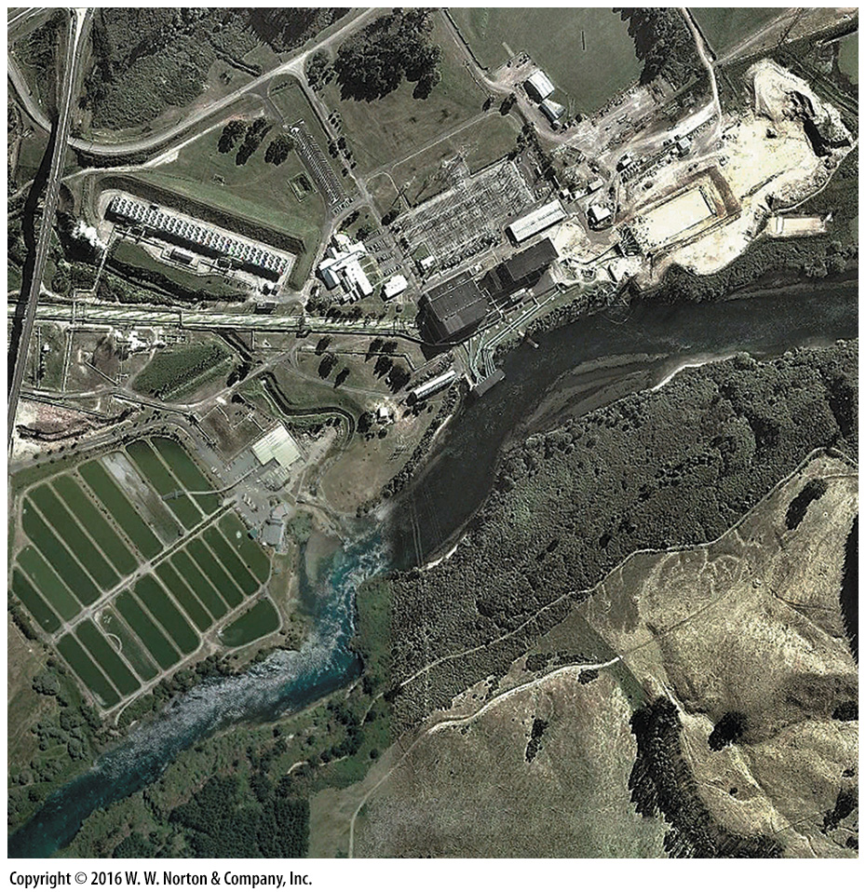
Notes:
SEE FOR YOURSELF…
GEOTHERMAL POWER PLANT, NEW ZEALAND

Slide 50
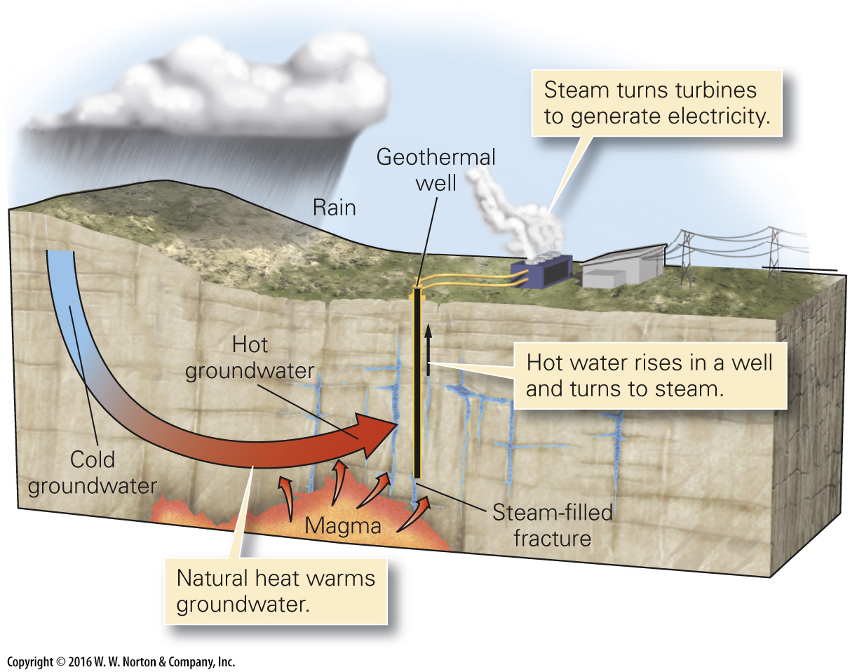
Notes:
FIGURE 12.13 (Part 1) Geothermal power plants utilize hot groundwater. In some cases, the water is so hot that it becomes steam when it rises and undergoes decompression. Most geothermal plants are in volcanic areas.

Slide 51
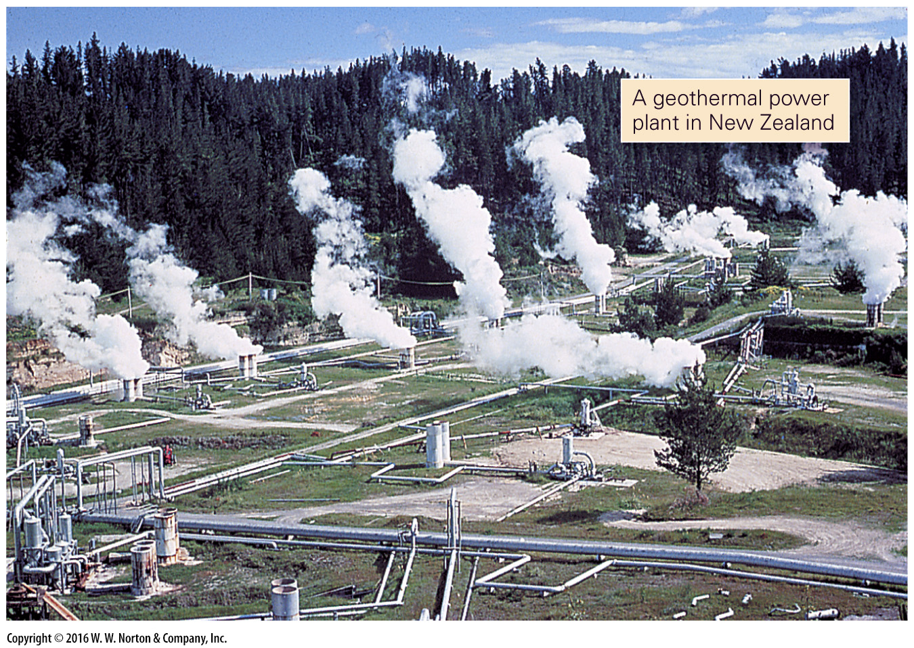
Notes:
FIGURE 12.13 (Part 2) Geothermal power plants utilize hot groundwater. In some cases, the water is so hot that it becomes steam when it rises and undergoes decompression. Most geothermal plants are in volcanic areas.

Slide 52
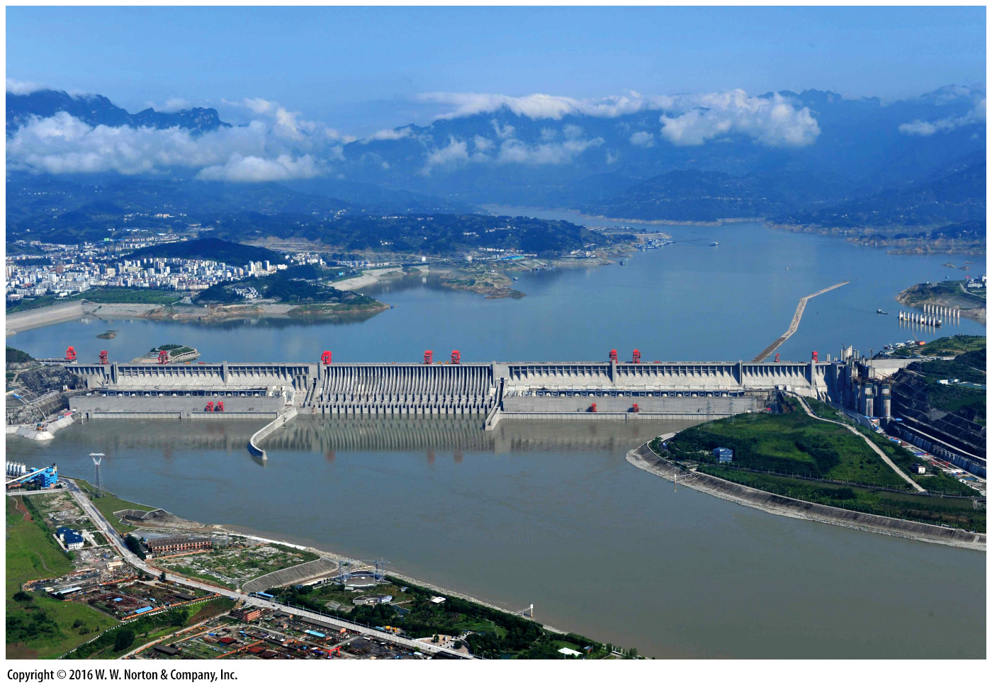
Notes:
FIGURE 12.14a Alternative energy sources.
(a) Gravity causes water held back by the Three Gorges Dam to flow through turbines and generate electricity.

Slide 53
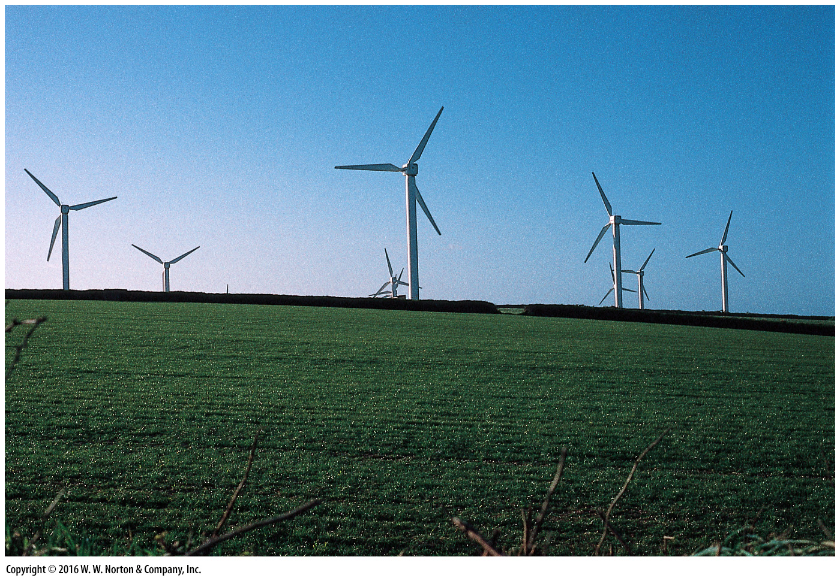
Notes:
FIGURE 12.14b Alternative energy sources.
(b) A wind farm in southwestern England. The towers are about 50 m high.

Slide 54
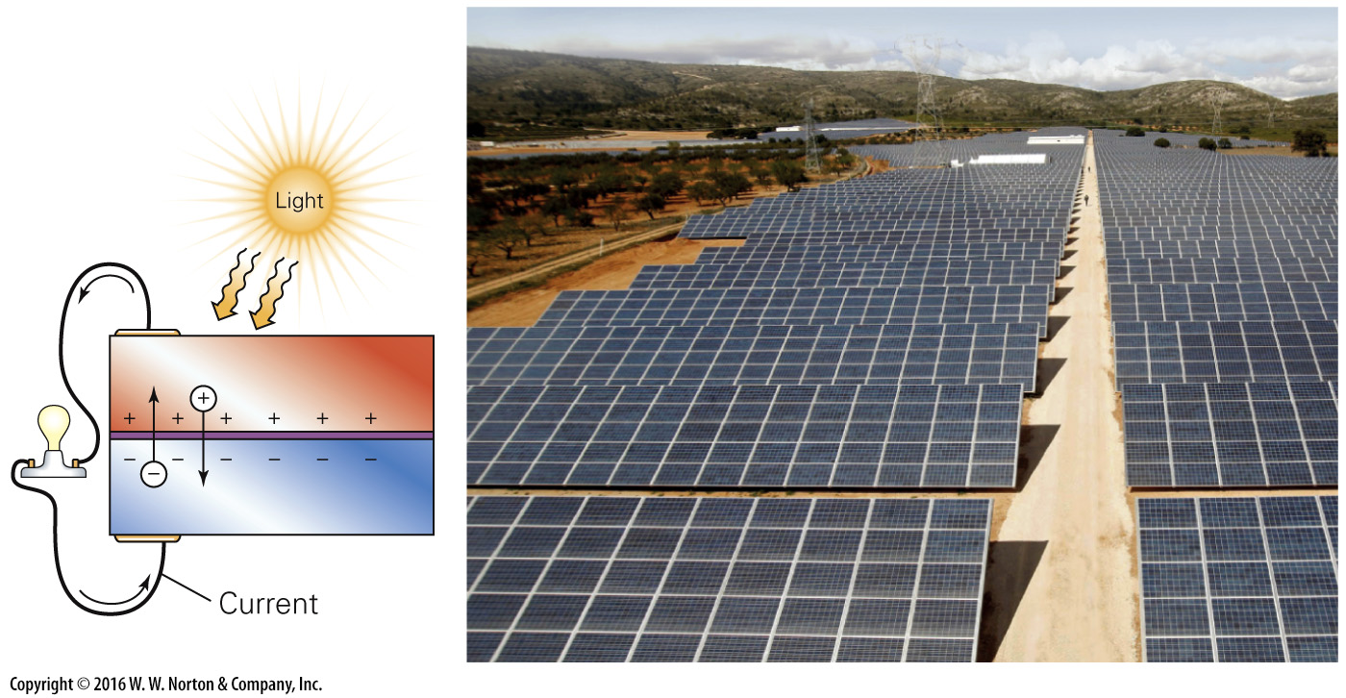
Notes:
FIGURE 12.14c Alternative energy sources.
(c) A photovoltaic cell produces electricity directly from solar radiation.

Slide 55
Notes:
FIGURE 12.14d Alternative energy sources.
(d) A hydrogen fuel cell.

Slide 56
Notes:
FIGURE 12.15 Price, discovery, and consumption of oil.
(a) The price of oil held fairly steady for almost 100 years. Starting in 1970, it has risen and fallen dramatically. Data source: BP Statistical Review of World Energy. (b) A plot of production vs. time suggests that some time in the early 21st century, the production of oil globally will start to decrease.

Slide 57
Notes:
FIGURE 12.15a Price, discovery, and consumption of oil.
(a) The price of oil held fairly steady for almost 100 years. Starting in 1970, it has risen and fallen dramatically. Data source: BP Statistical Review of World Energy.

Slide 58
Notes:
FIGURE 12.15b Price, discovery, and consumption of oil.
(b) A plot of production vs. time suggests that some time in the early 21st century, the production of oil globally will start to decrease.

Slide 59
Notes:
FIGURE 12.16a Marine oil spills. These can come from drilling rigs, or from tankers.
(a) An oil tanker leaking oil on the sea surface.

Slide 60
Notes:
FIGURE 12.16b Marine oil spills. These can come from drilling rigs, or from tankers.
(b) Oil spills can contaminate the shore and can be very difficult to clean.

Slide 61
Notes:
FIGURE Bx12.3a The Deepwater Horizon disaster (2010).
(a) Fireboats dousing the burning rig before the rig sank.

Slide 62
Notes:
FIGURE Bx12.3b The Deepwater Horizon disaster (2010).
(b) A satellite image of the oil slick in the Gulf of Mexico, southeast of the Mississippi delta.

Slide 63
Notes:
FIGURE 12.17 Gold occurs as native metal within quartz veins. The quartz breaks up to form sand, leaving nuggets of gold.

Slide 64
Notes:
FIGURE 12.18 Examples of ore minerals.
(a) This lead ore, from Missouri, consists of galena (PbS) crystals that grew in dolostone. (b) Most copper comes from ore minerals that look nothing like metallic copper. This ore consists of azurite (blue) and malachite (green).

Slide 65
Notes:
FIGURE 12.18a Examples of ore minerals.
(a) This lead ore, from Missouri, consists of galena (PbS) crystals that grew in dolostone.

Slide 66
Notes:
FIGURE 12.18b Examples of ore minerals.
(b) Most copper comes from ore minerals that look nothing like metallic copper. This ore consists of azurite (blue) and malachite (green).

Slide 67
Notes:
FIGURE 12.19a Various processes that form ore deposits.
(a) Massive sulfide deposits can form when sulfide ore minerals form concentrations in a magma chamber.

Slide 68
Notes:
FIGURE 12.19b Various processes that form ore deposits.
(b) Hydrothermal deposits form when water circulating around and through magma dissolves and redistributes metals (arrows indicate owing water).

Slide 69
Notes:
FIGURE 12.19c Various processes that form ore deposits.
(c) Massive sulfide deposits also form when ore minerals precipitate around hydrothermal vents (black smokers) along a mid-ocean ridge.

Slide 70
Notes:
FIGURE 12.20 Precambrian BIF from northern Michigan consists of hematite interbedded with jasper.

Slide 71
Notes:
FIGURE 12.21 Placer deposits form where erosion produces clasts of native metals. Sorting by the stream concentrates the metals.

Slide 72
Notes:
FIGURE 12.22a Mining ore deposits.
(a) The three-dimensional shape of an ore body underground. Shafts and tunnels access the body.

Slide 73
Notes:
FIGURE 12.22b Mining ore deposits.
(b) Open-pit mining utilizes ore that lies fairly close to the ground surface. Terracing the mine walls helps to stabilize them.

Slide 74
Notes:
SEE FOR YOURSELF…
BINGHAM COPPER MINE, UTAH

Slide 75
Notes:
FIGURE 12.23a Stone production in quarries.
(a) An active quarrying operation in Missouri that produces large blocks of cut dimension stone.

Slide 76
Notes:
FIGURE 12.23b Stone production in quarries.
(b) Sheets of cut dimension stone being measured for cutting to become a kitchen countertop.

Slide 77
Notes:
FIGURE 12.23c Stone production in quarries.
(c) A large crushed-stone quarry in Silurian limestone of Illinois. Drillers are working on the shelf in the distance.

Slide 78
Notes:
TABLE 12.1 Yearly per Capita Usage of Geologic Materials (USA)

Slide 79
Notes:
TABLE 12.2 Expected Lifetimes of Currently Known Ore Resources (in Years)

Slide 80
Notes:
FIGURE 12.24a Environmental consequences of producing metallic mineral resources.
(a) The orange color in this mine runoff is due to iron and sulfide in the water.

Slide 81
Notes:
FIGURE 12.24b Environmental consequences of producing metallic mineral resources.
(b) Acidic smelter smoke killed off vegetation near Sudbury, Ontario, in the 1970s. A large tailings pile can be seen in the distance.

