Slide 1
Stephen Marshak
ESSENTIALS OF
Geology
FIFTH EDITION
Chapter 13
Unsafe Ground: Landslides and Other Mass Movements
©2016 W. W. Norton & Company, Inc.

Slide 2
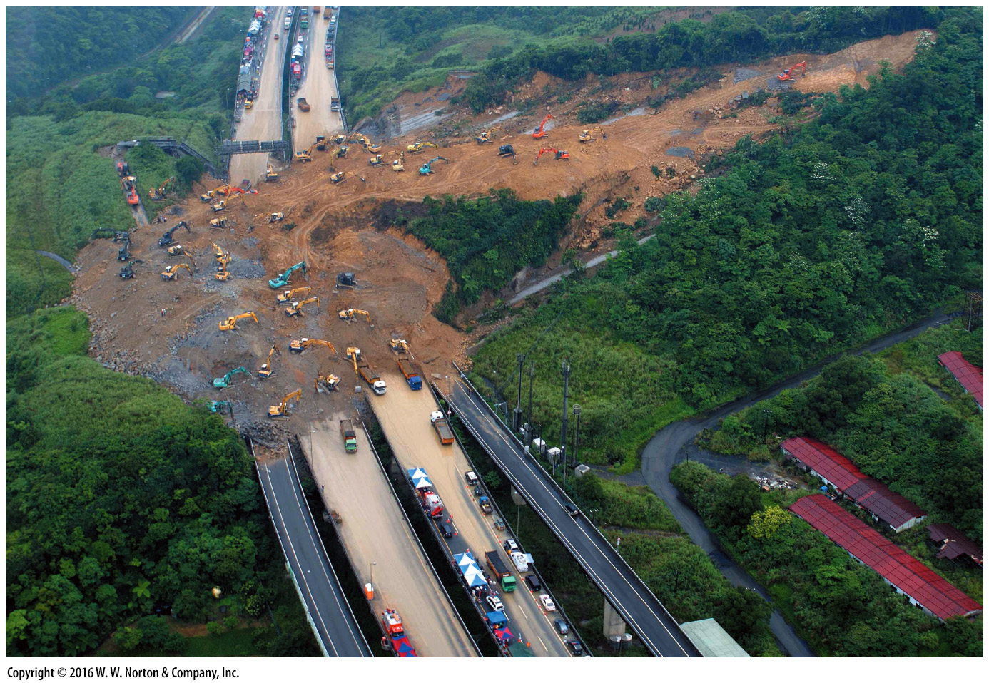
Notes:
A 2010 earthquake triggered a landslide on a rain-soaked hillslope in Taiwan. The debris buried a highway. Where there are slopes, unstable ground can develop and become a natural hazard.

Slide 3
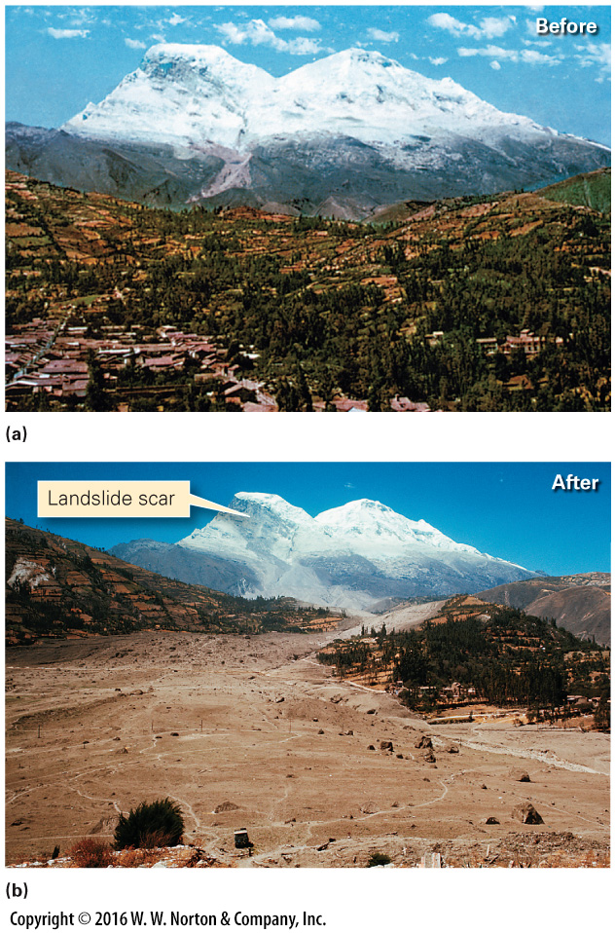
Notes:
FIGURE 13.1 The May 1970 Yungay landslide disaster in Peru.
(a) Before the landslide, the town of Yungay perched on a hill near the ice-covered mountain Nevado Huascarán. (b) The landslide completely buried the town beneath debris. A landslide scar is visible on the mountain in the distance.

Slide 4
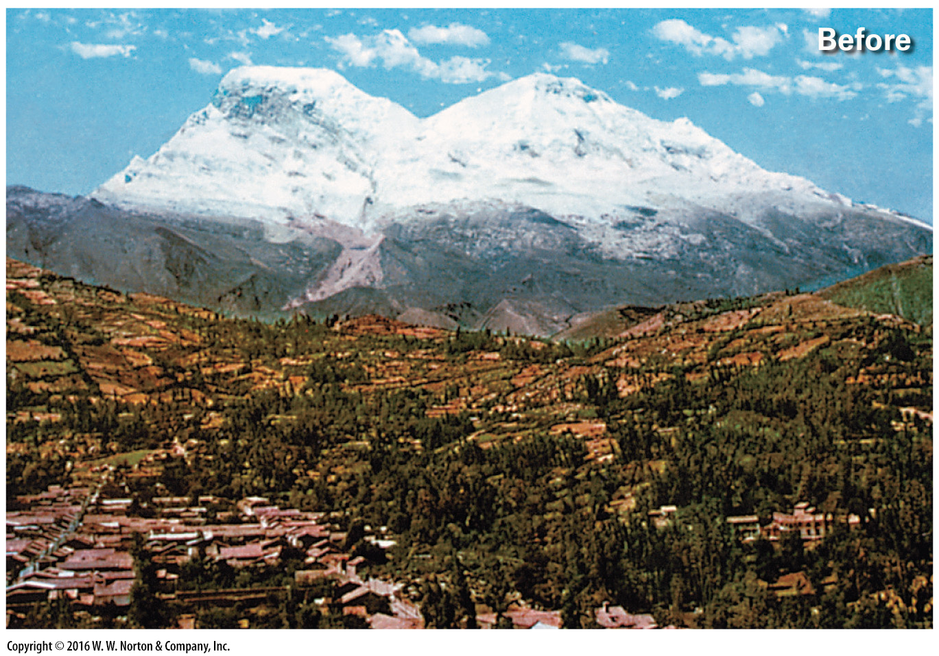
Notes:
FIGURE 13.1a The May 1970 Yungay landslide disaster in Peru.
(a) Before the landslide, the town of Yungay perched on a hill near the ice-covered mountain Nevado Huascarán.

Slide 5
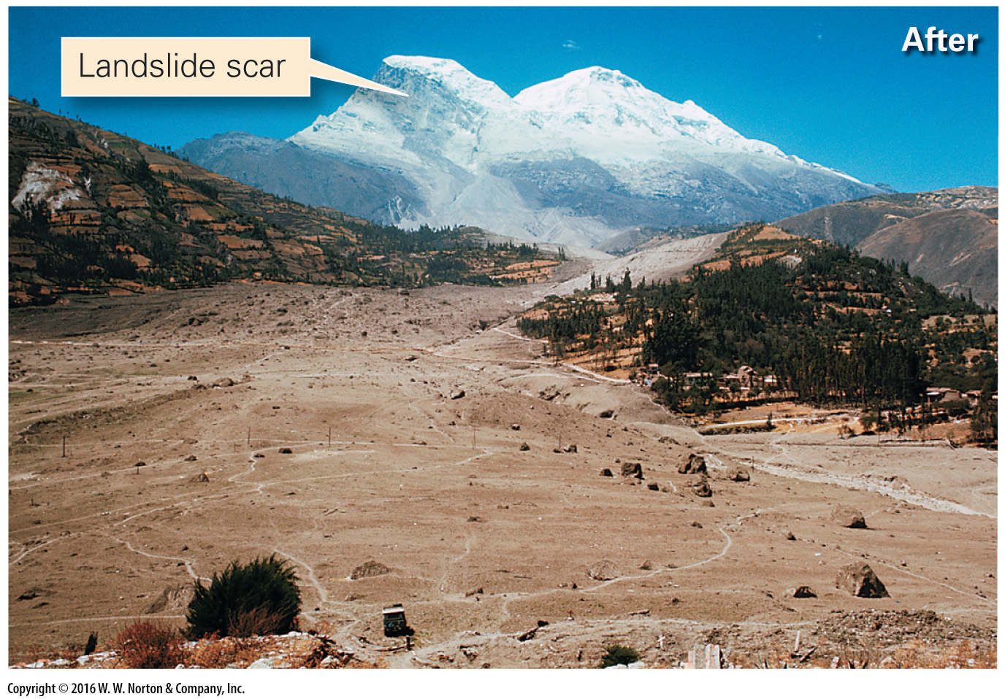
Notes:
FIGURE 13.1b The May 1970 Yungay landslide disaster in Peru.
(b) The landslide completely buried the town beneath debris. A landslide scar is visible on the mountain in the distance.

Slide 6
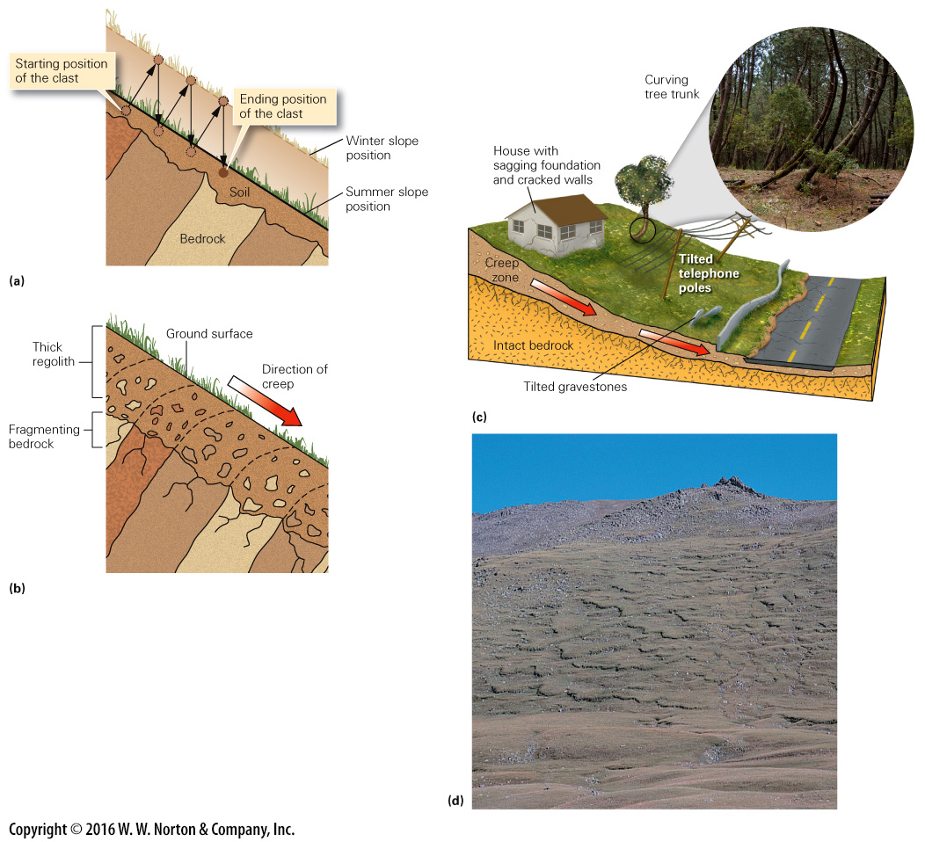
Notes:
FIGURE 13.2 The process and consequences of slow mass movements (creep and solifluction).
(a) Creep due to freezing and thawing: The clast rises perpendicular to the ground during freezing and sinks vertically during thawing. After 3 years, it migrates to the position shown. (b) As rock layers weather and break up, the resulting debris creeps downslope. (c) Soil creep causes walls to bend and crack, building foundations to sink, trees to bend, and power poles and gravestones to tilt. (d) Solifluction on a hillslope in the tundra.

Slide 7
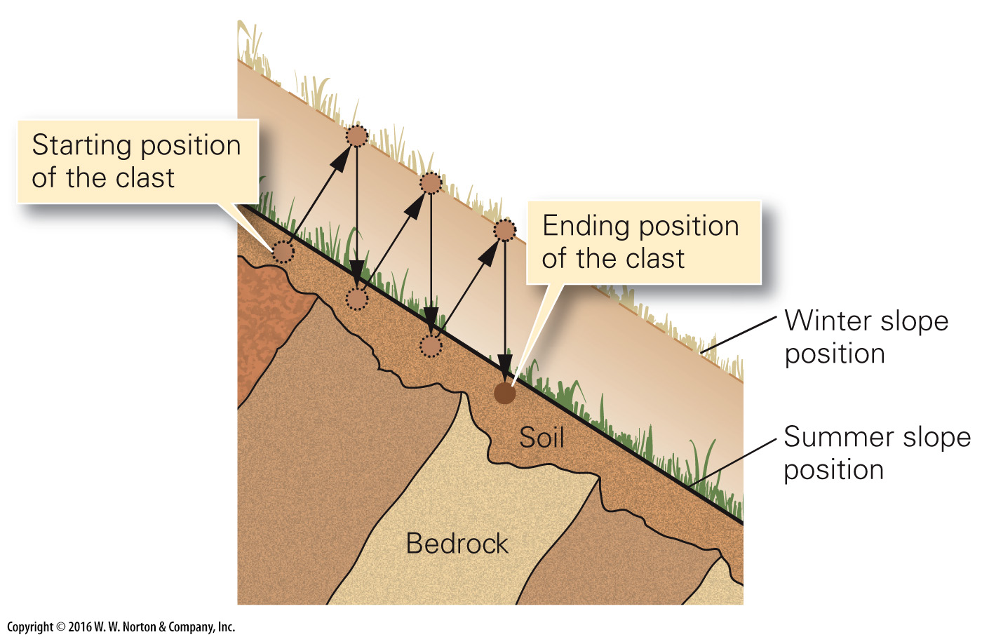
Notes:
FIGURE 13.2a The process and consequences of slow mass movements (creep and solifluction).
(a) Creep due to freezing and thawing: The clast rises perpendicular to the ground during freezing and sinks vertically during thawing. After 3 years, it migrates to the position shown.

Slide 8
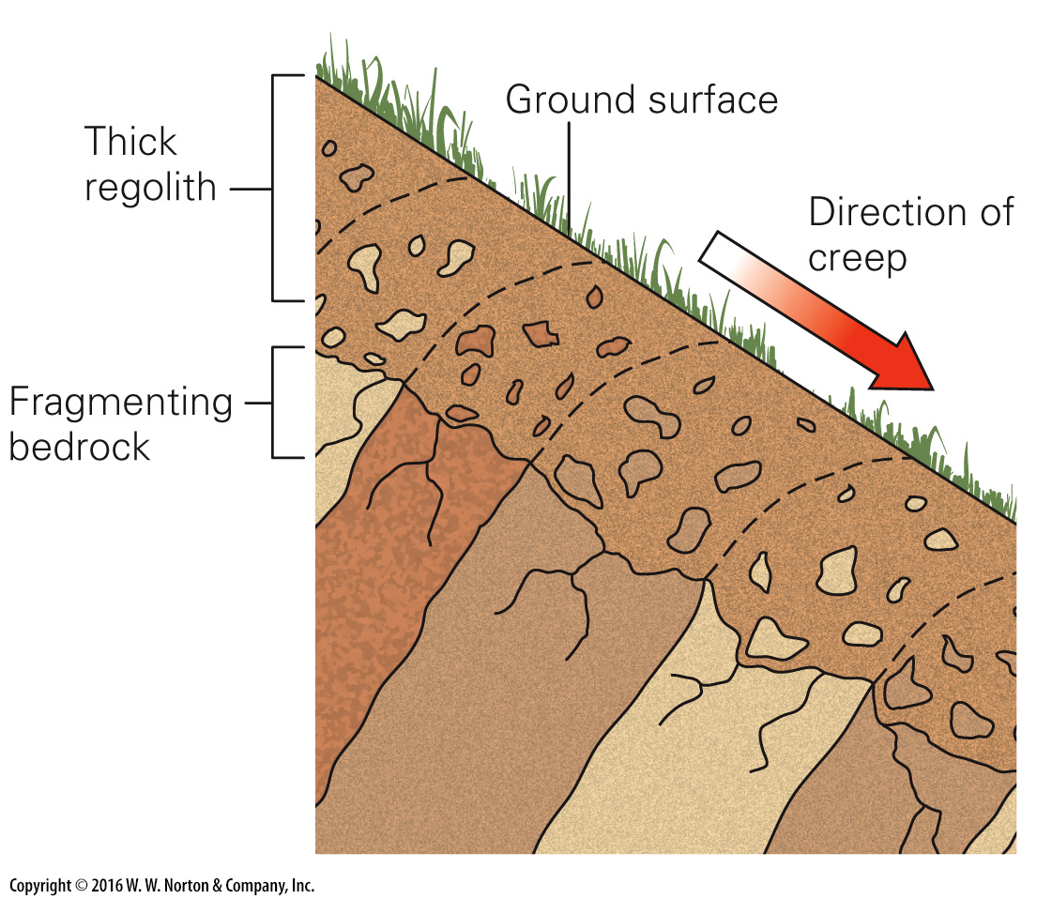
Notes:
FIGURE 13.2b The process and consequences of slow mass movements (creep and solifluction).
(b) As rock layers weather and break up, the resulting debris creeps downslope.

Slide 9
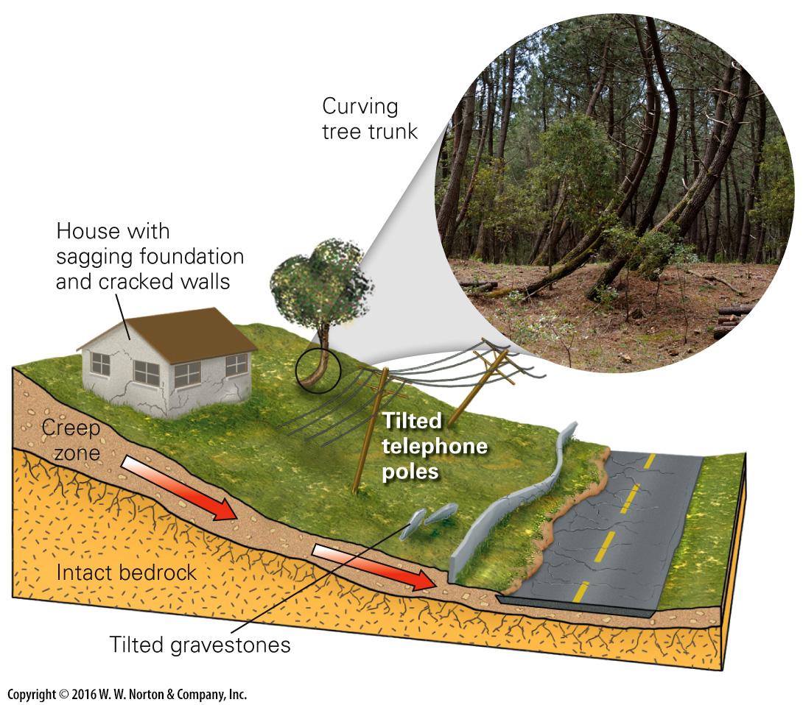
Notes:
FIGURE 13.2c The process and consequences of slow mass movements (creep and solifluction).
(c) Soil creep causes walls to bend and crack, building foundations to sink, trees to bend, and power poles and gravestones to tilt.

Slide 10
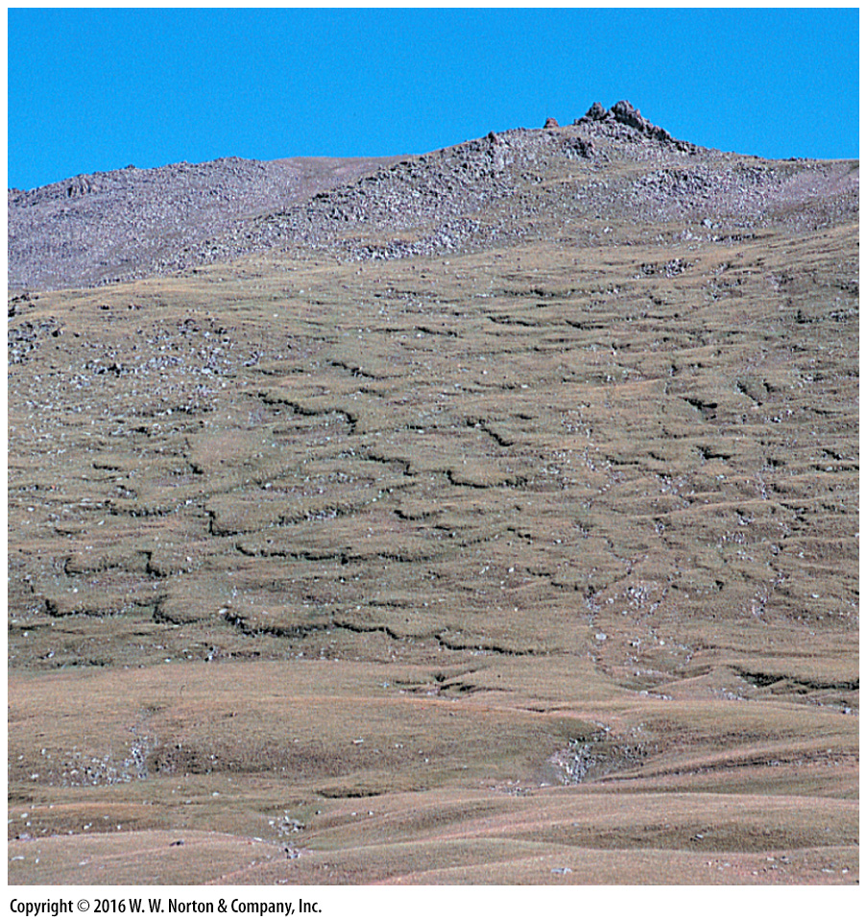
Notes:
FIGURE 13.2d The process and consequences of slow mass movements (creep and solifluction).
(d) Solifluction on a hillslope in the tundra.

Slide 11
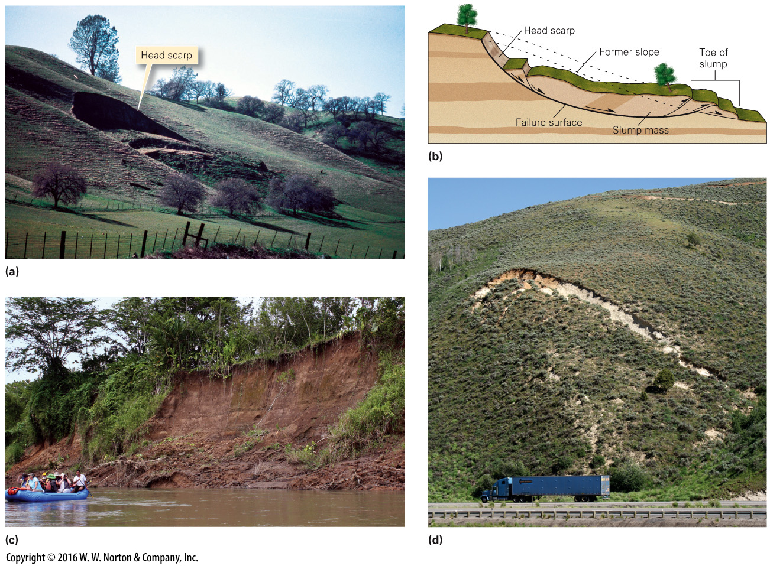
Notes:
FIGURE 13.3 The process of slumping on a hillslope. Note the scarps that form at the head of the slump.
(a) A head scarp on the hillslope. (b) Cross section of a slump. (c) Slumping dumped sediment into this river in Costa Rica. (d) A slump beginning to form along a highway in Utah.

Slide 12
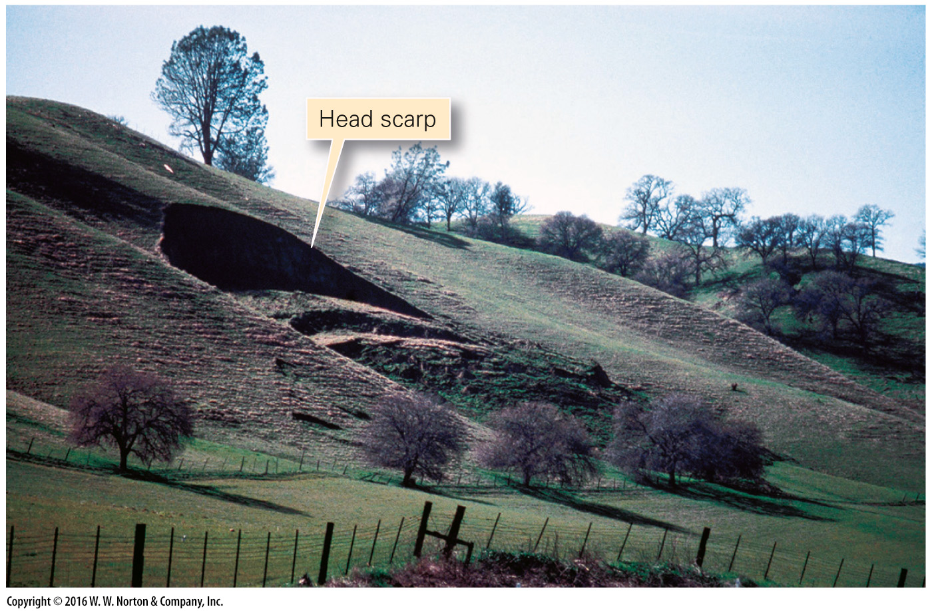
Notes:
FIGURE 13.3a The process of slumping on a hillslope. Note the scarps that form at the head of the slump.
(a) A head scarp on the hillslope.

Slide 13
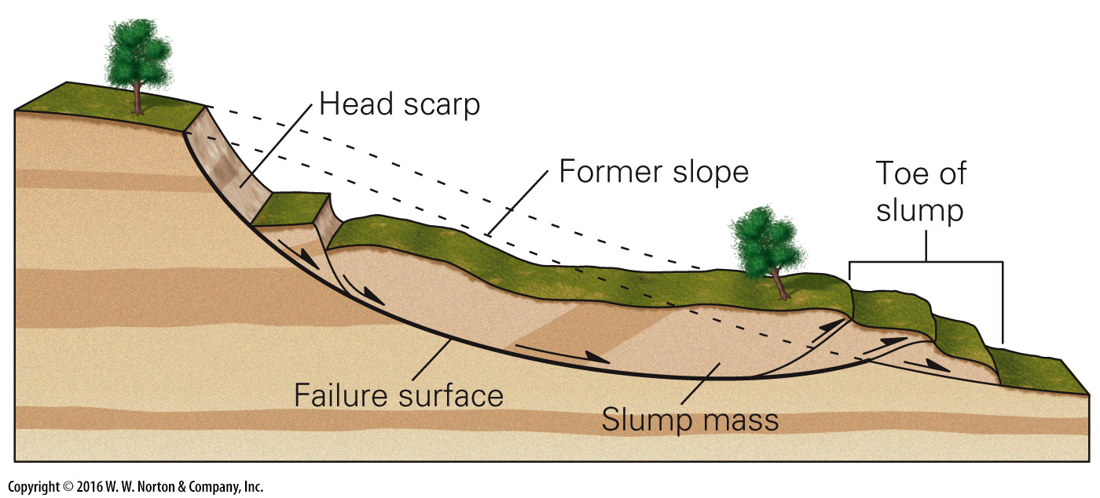
Notes:
FIGURE 13.3b The process of slumping on a hillslope. Note the scarps that form at the head of the slump.
(b) Cross section of a slump.

Slide 14
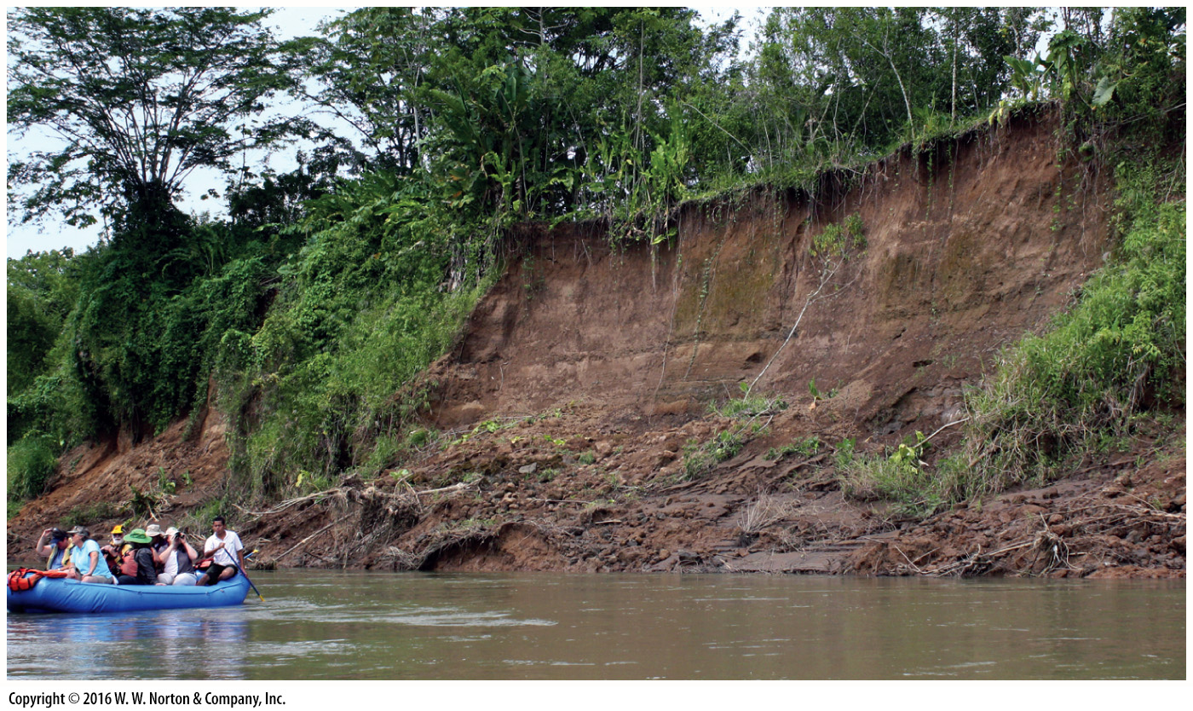
Notes:
FIGURE 13.3c The process of slumping on a hillslope. Note the scarps that form at the head of the slump.
(c) Slumping dumped sediment into this river in Costa Rica.

Slide 15
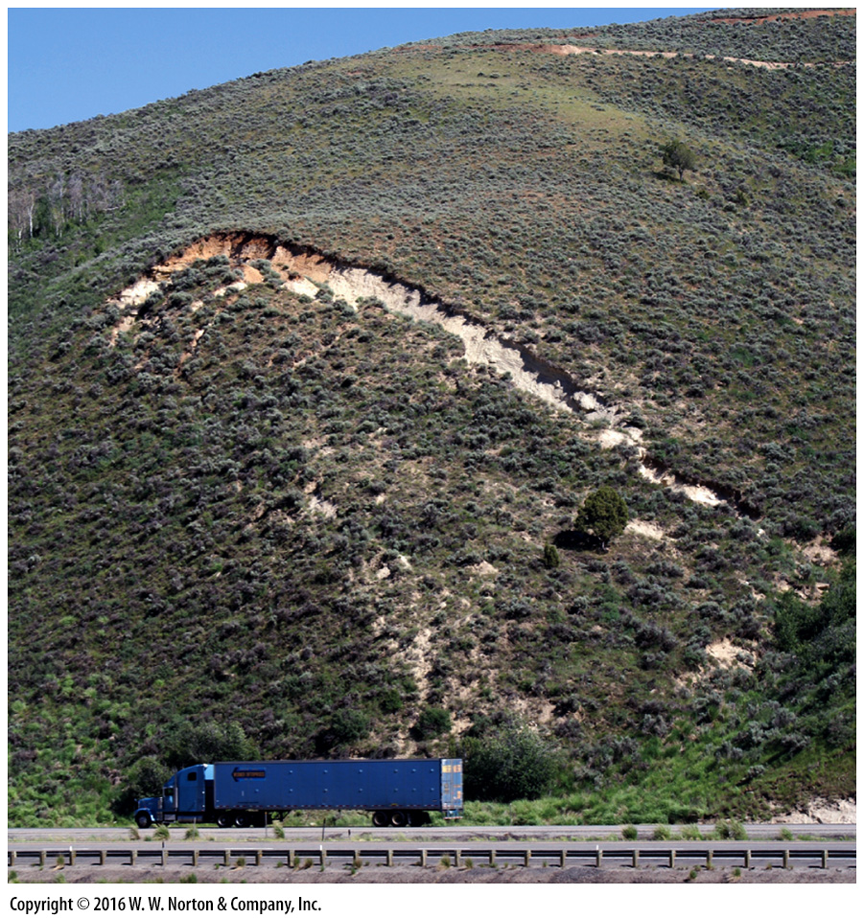
Notes:
FIGURE 13.3d The process of slumping on a hillslope. Note the scarps that form at the head of the slump.
(d) A slump beginning to form along a highway in Utah.

Slide 16
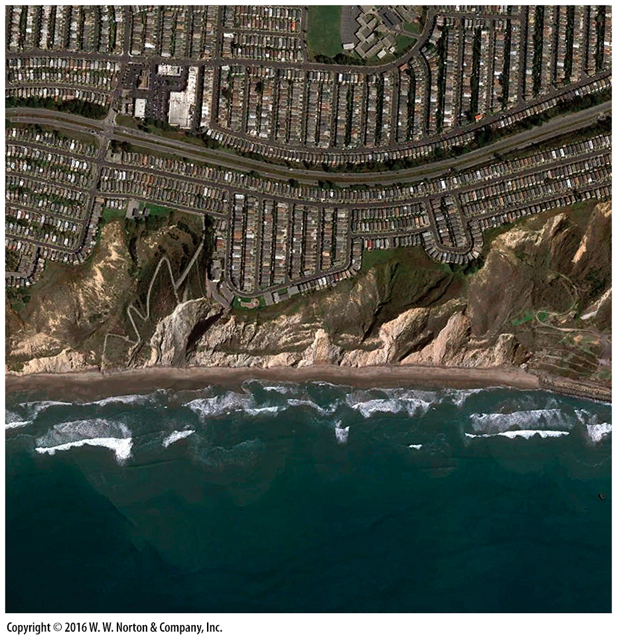
Notes:
SEE FOR YOURSELF…
SLUMPS NEAR SAN FRANCISCO

Slide 17
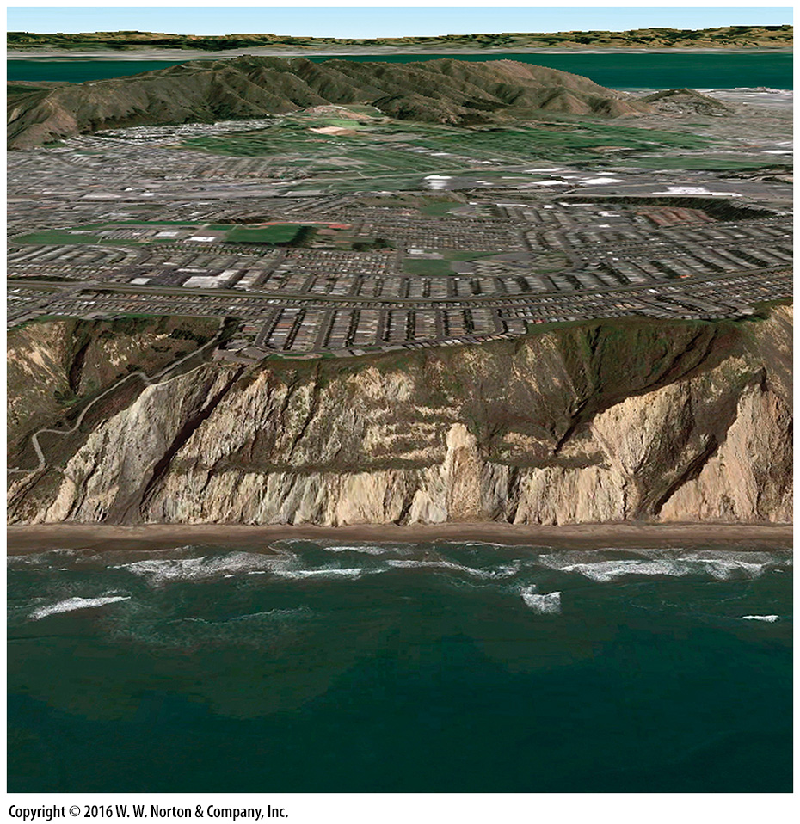
Notes:
SEE FOR YOURSELF…
SLUMPS NEAR SAN FRANCISCO

Slide 18
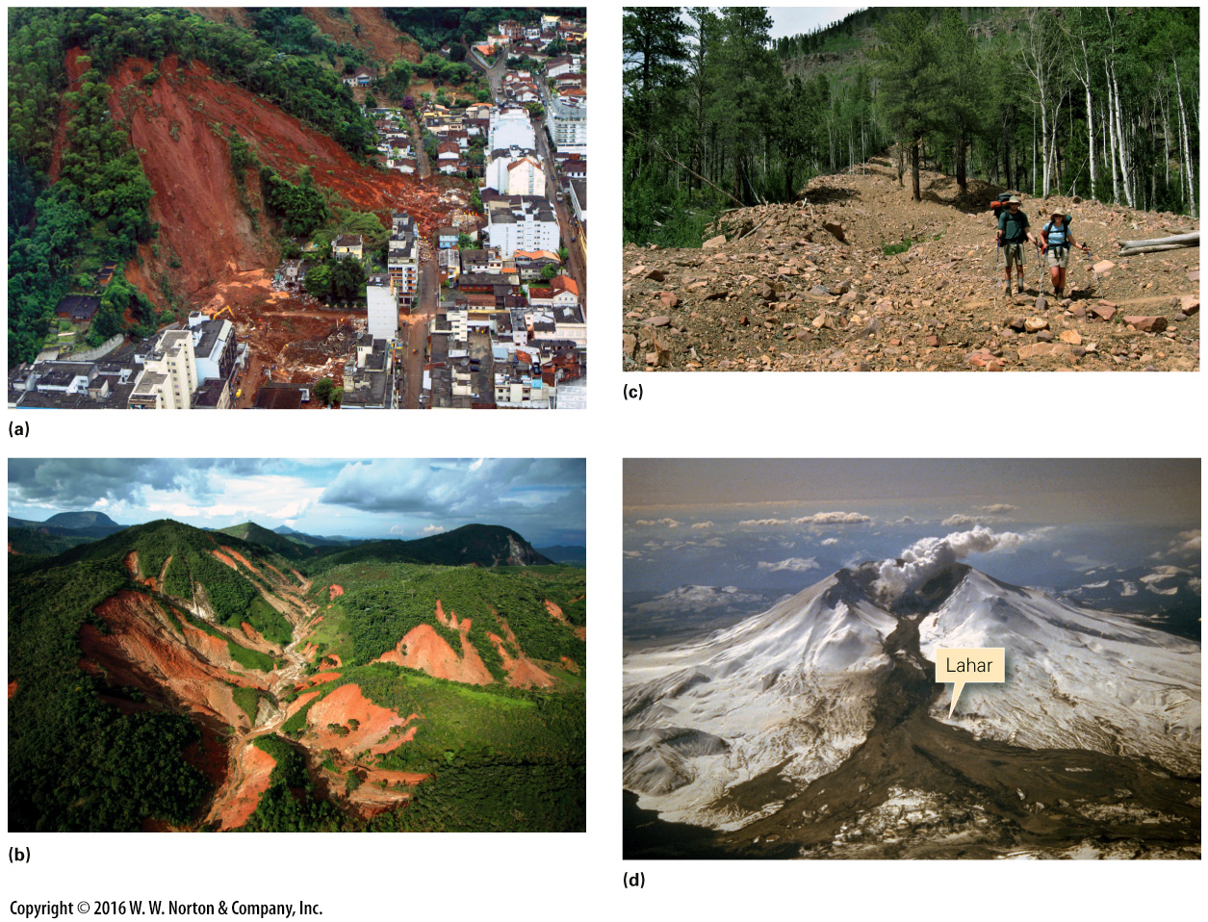
Notes:
FIGURE 13.4 Examples of mudflows and lahars.
(a) A 2011 mudslide destroyed a high-rise building at the base of the hill. (b) Mudslides of 2011 stripped away forests on hillslopes in Brazil. (c) A recent debris flow in Utah. Note the chaotic mixture of rock chunks and mud. (d) A lahar that rushed down the side of Mt. St. Helens, Washington

Slide 19
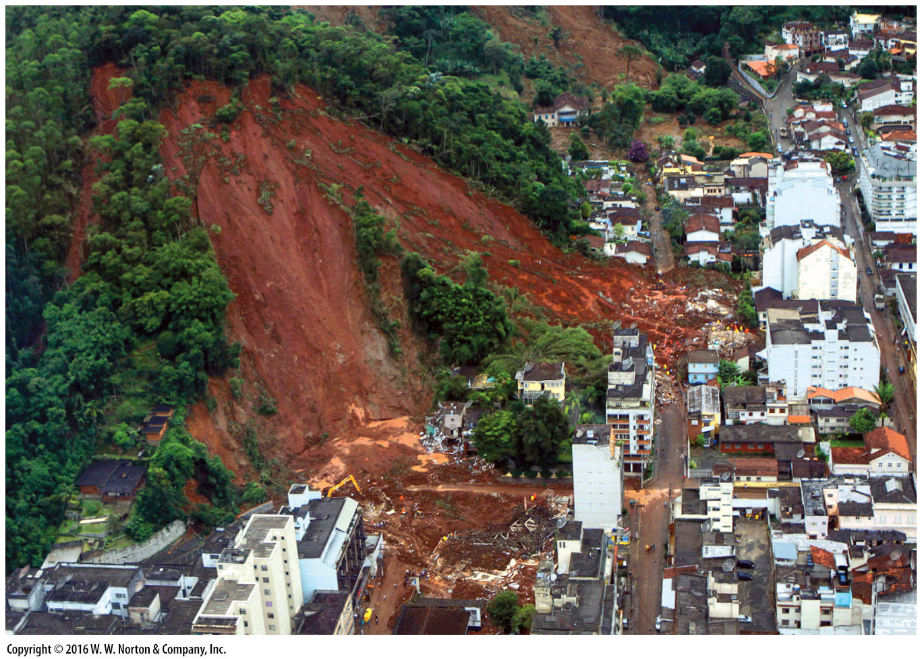
Notes:
FIGURE 13.4a Examples of mudflows and lahars.
(a) A 2011 mudslide destroyed a high-rise building at the base of the hill.

Slide 20
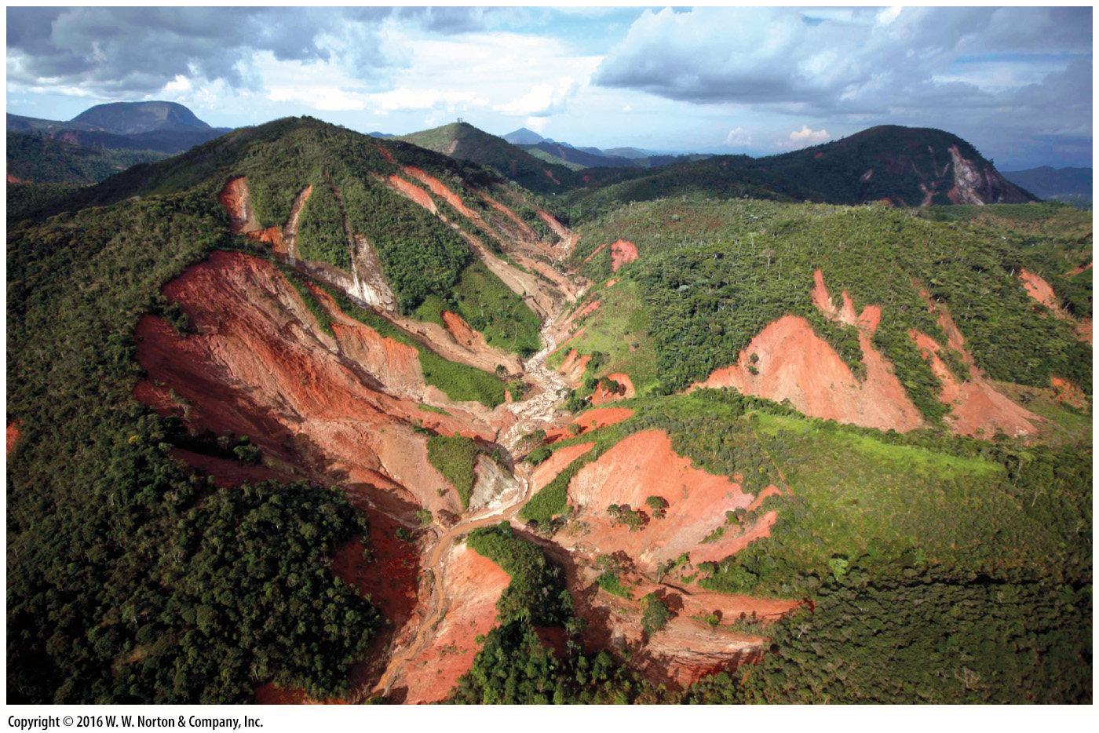
Notes:
FIGURE 13.4b Examples of mudflows and lahars.
(b) Mudslides of 2011 stripped away forests on hillslopes in Brazil.

Slide 21
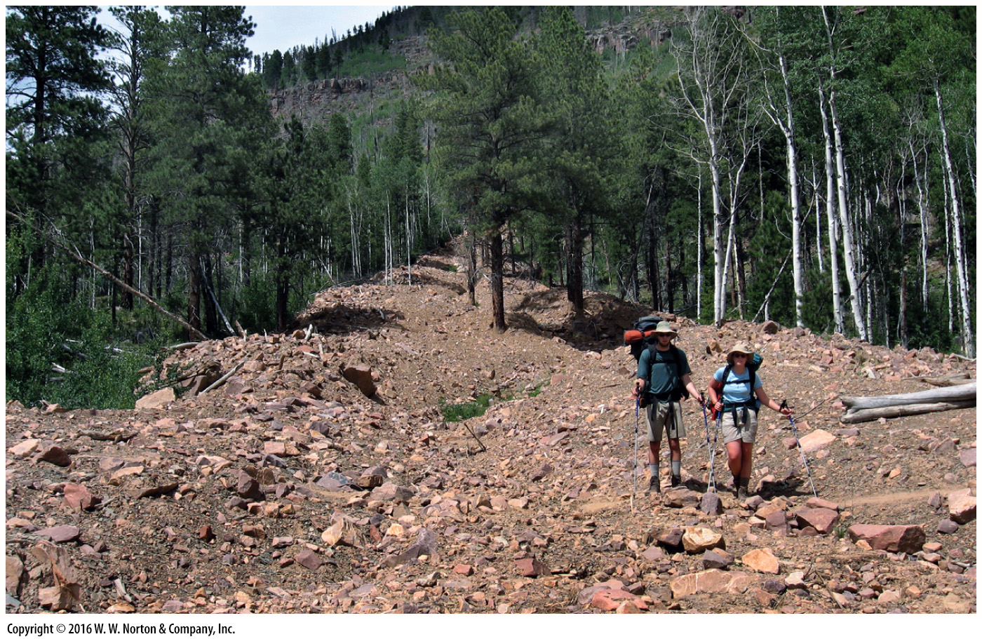
Notes:
FIGURE 13.4c Examples of mudflows and lahars.
(c) A recent debris flow in Utah. Note the chaotic mixture of rock chunks and mud.

Slide 22
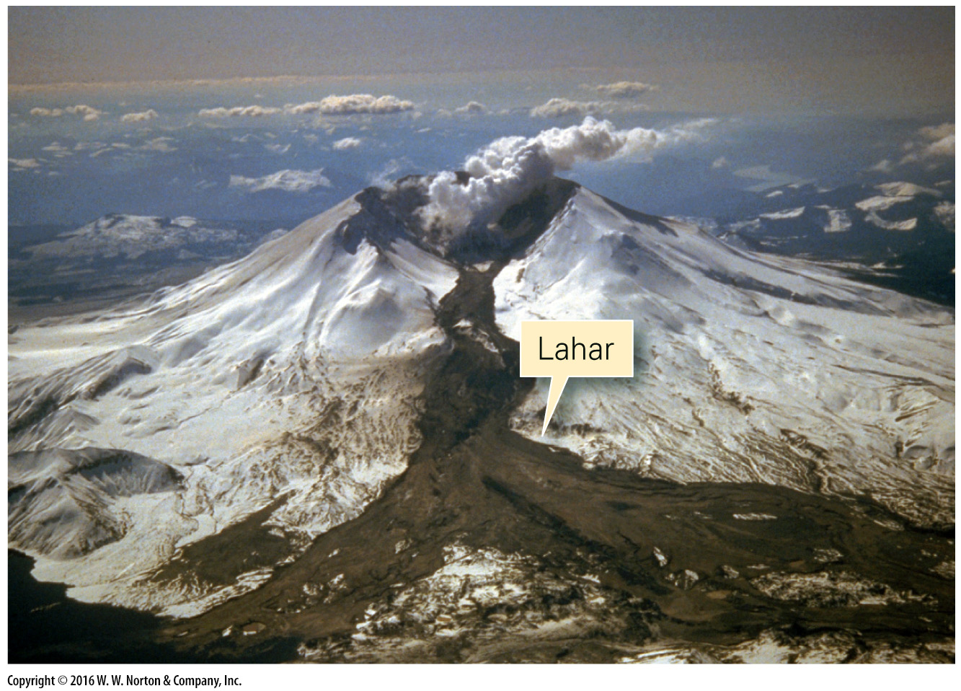
Notes:
FIGURE 13.4d Examples of mudflows and lahars.
(d) A lahar that rushed down the side of Mt. St. Helens, Washington

Slide 23
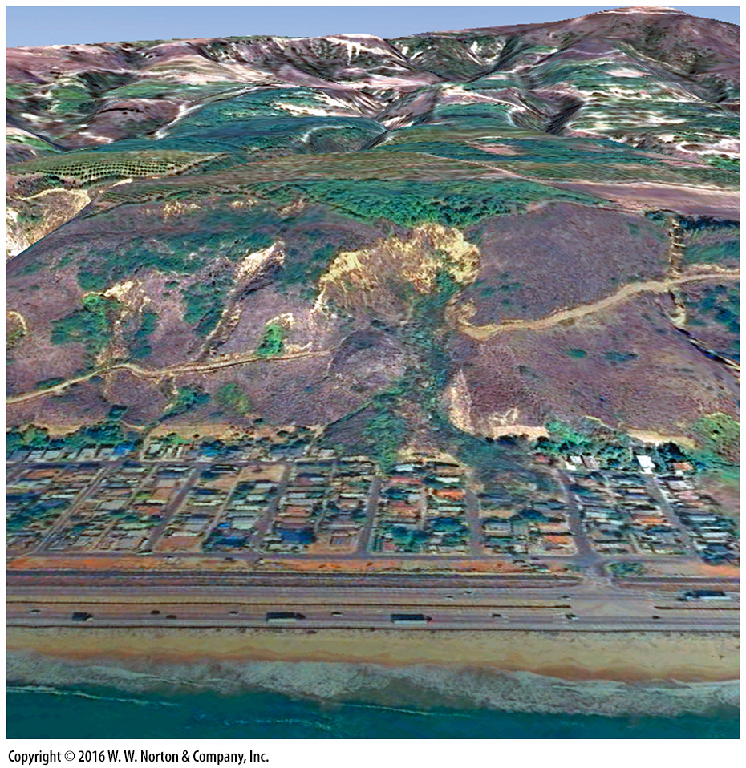
Notes:
SEE FOR YOURSELF…
LA CONCHITA MUDSLIDE, CALIFORNIA

Slide 24
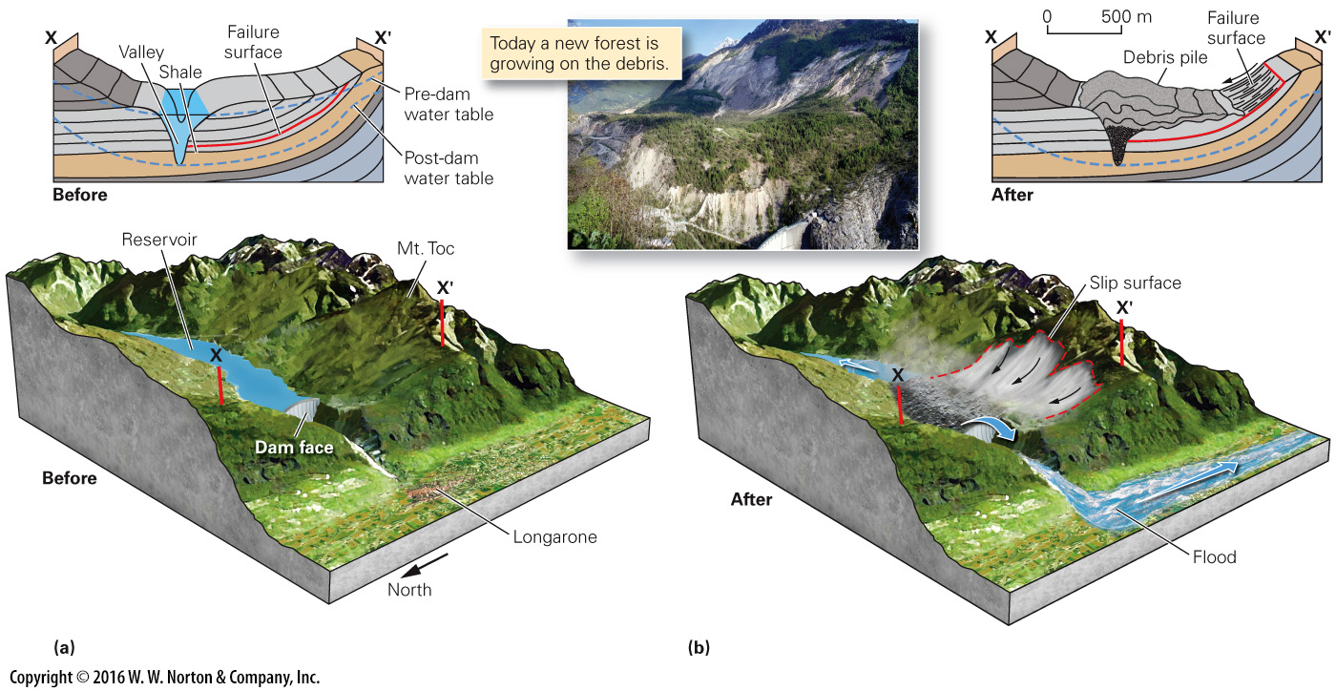
Notes:
FIGURE 13.5 The Vaiont Dam disaster happened when a landslide suddenly dumped rock debris into a reservoir. The debris pushed the water over the dam.
(a) Before the landslide, the north flank of Monte Toc was forested. When the reservoir filled, the slope became unstable. A shale bed a few hundred meters below the ground surface became a failure surface. (b) Thirty-three million cubic meters of debris slid and displaced water in the reservoir. The water surged over the dam and swept away a village in the valley below.

Slide 25
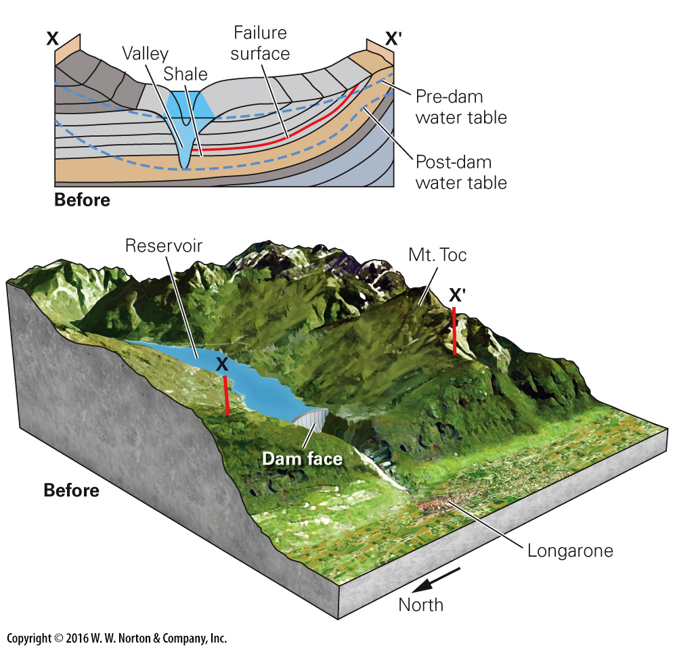
Notes:
FIGURE 13.5a The Vaiont Dam disaster happened when a landslide suddenly dumped rock debris into a reservoir. The debris pushed the water over the dam.
(a) Before the landslide, the north flank of Monte Toc was forested. When the reservoir filled, the slope became unstable. A shale bed a few hundred meters below the ground surface became a failure surface.

Slide 26
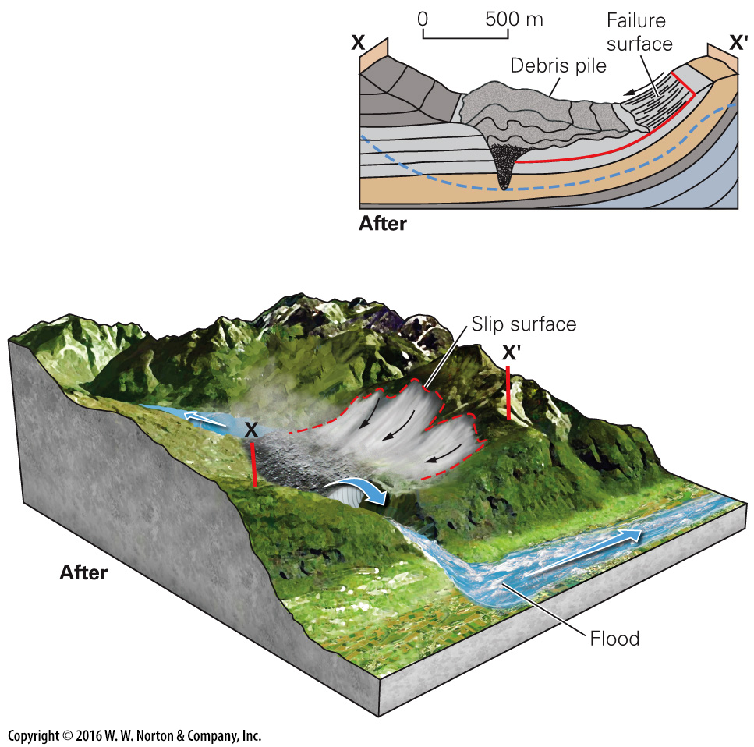
Notes:
FIGURE 13.5b The Vaiont Dam disaster happened when a landslide suddenly dumped rock debris into a reservoir. The debris pushed the water over the dam.
(b) Thirty-three million cubic meters of debris slid and displaced water in the reservoir. The water surged over the dam and swept away a village in the valley below.

Slide 27
Notes:
FIGURE 13.5b The Vaiont Dam disaster happened when a landslide suddenly dumped rock debris into a reservoir. The debris pushed the water over the dam.
(b) Thirty-three million cubic meters of debris slid and displaced water in the reservoir. The water surged over the dam and swept away a village in the valley below.

Slide 28
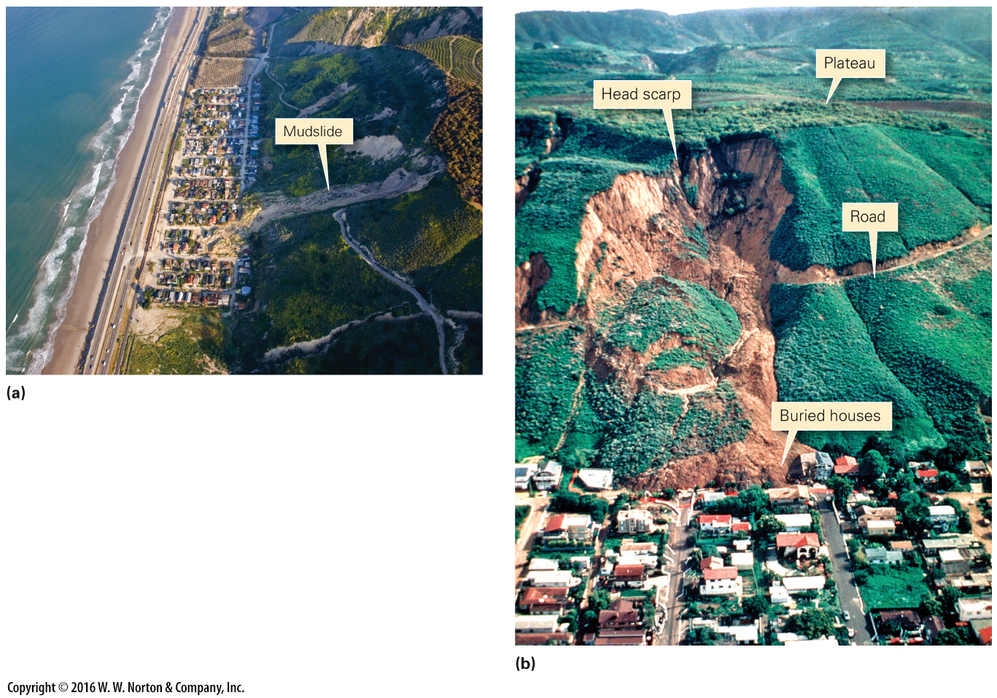
Notes:
FIGURE Bx13.1 The 2005 La Conchita mudslide along the coast of California.
(a) A housing development was built in a narrow strip between the beach and steep cliffs. (b) During heavy rains, the slope gave way and heavy mud flowed down, burying houses and taking several lives.

Slide 29
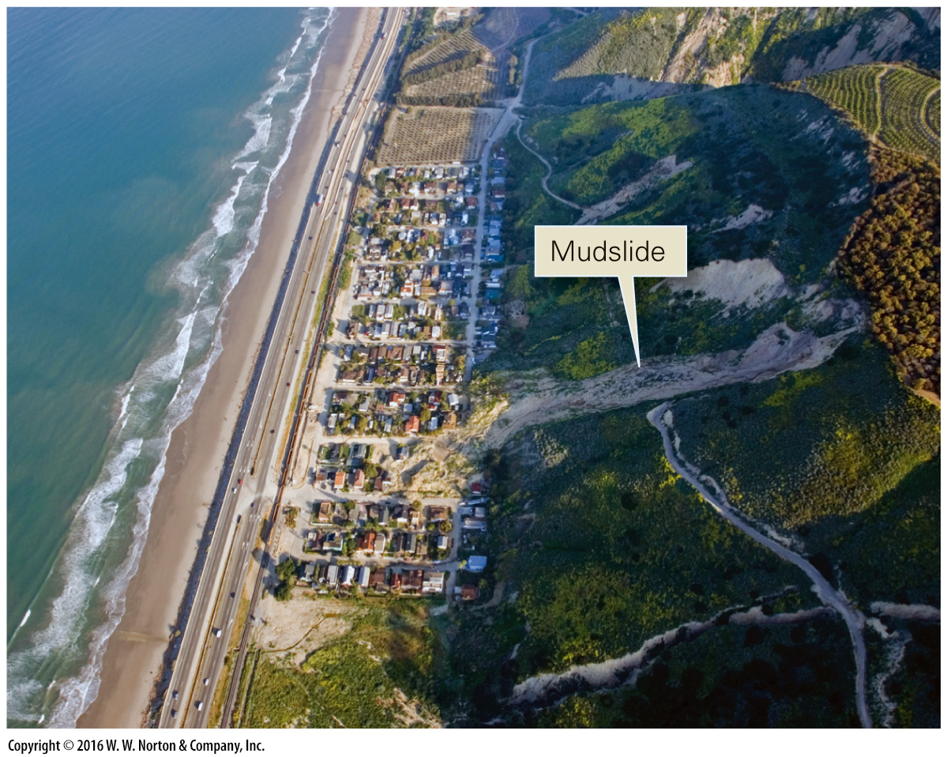
Notes:
FIGURE Bx13.1a The 2005 La Conchita mudslide along the coast of California.
(a) A housing development was built in a narrow strip between the beach and steep cliffs.

Slide 30
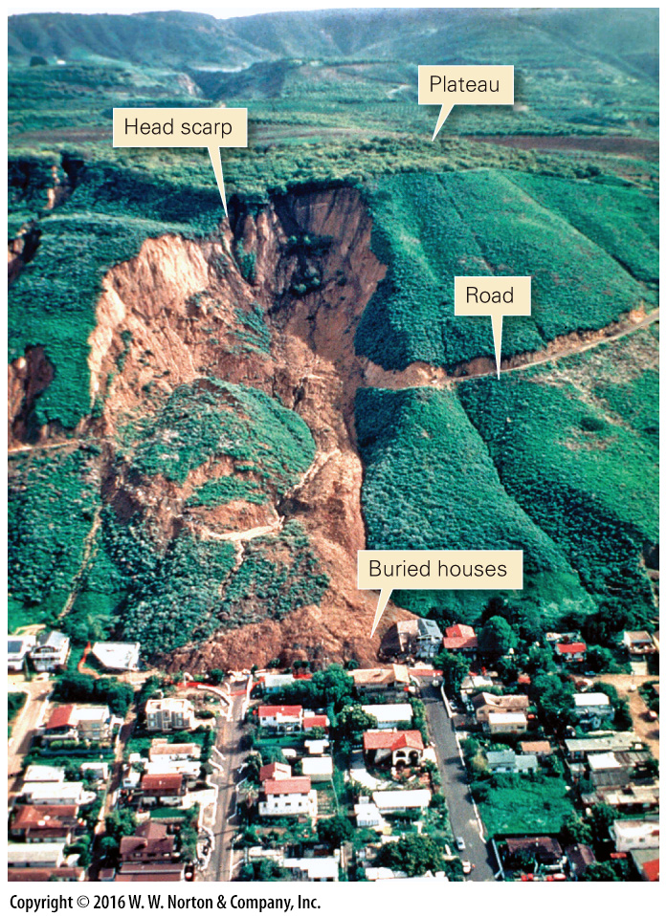
Notes:
FIGURE Bx13.1b The 2005 La Conchita mudslide along the coast of California.
(b) During heavy rains, the slope gave way and heavy mud flowed down, burying houses and taking several lives.

Slide 31
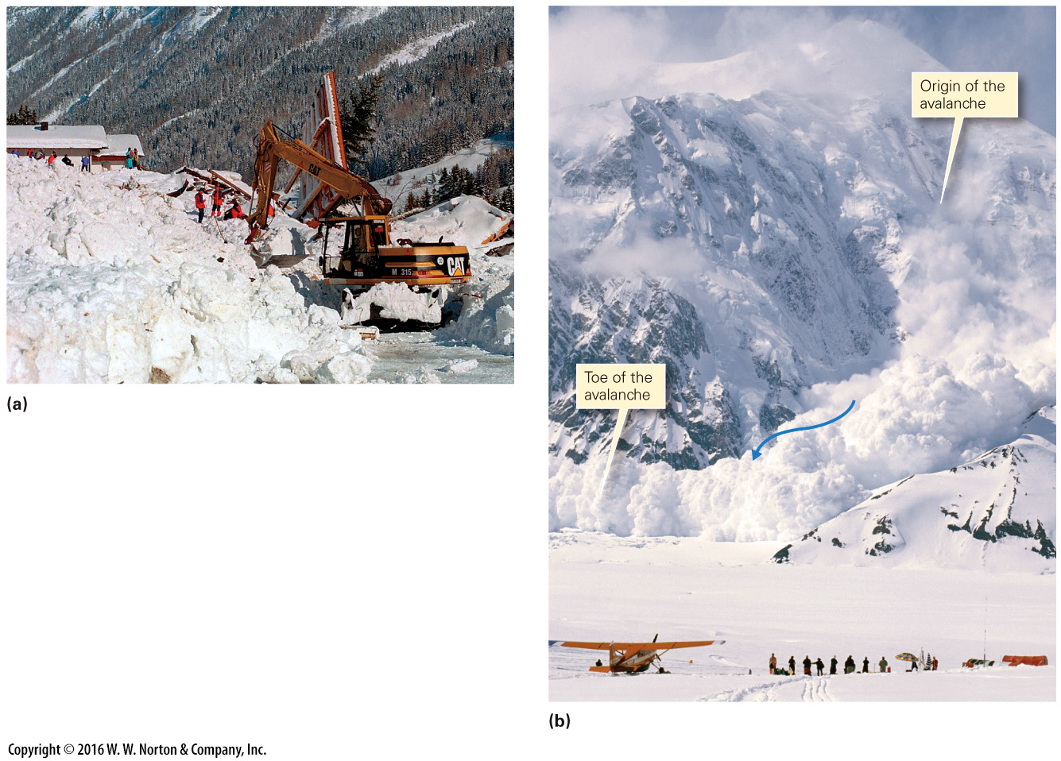
Notes:
FIGURE 13.6 Examples of avalanches.
(a) Aftermath of a 1999 avalanche in the Austrian Alps. Masses of snow buried several homes. (b) A dry-snow avalanche in Alaska is a turbulent cloud.

Slide 32
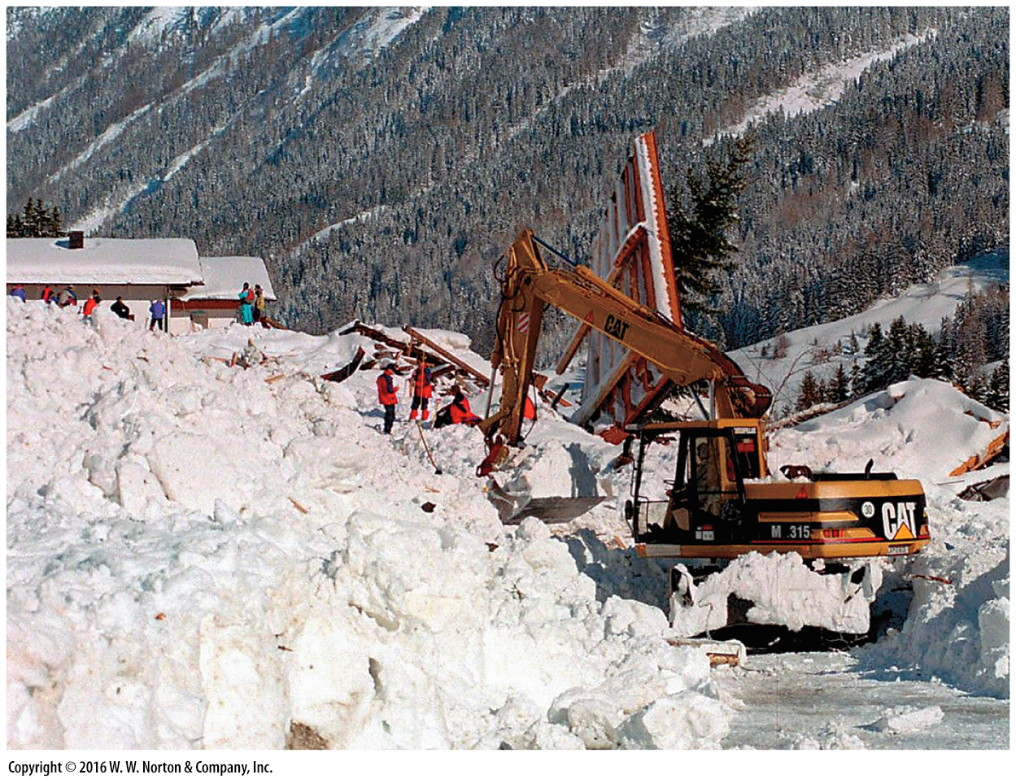
Notes:
FIGURE 13.6a Examples of avalanches.
(a) Aftermath of a 1999 avalanche in the Austrian Alps. Masses of snow buried several homes.

Slide 33
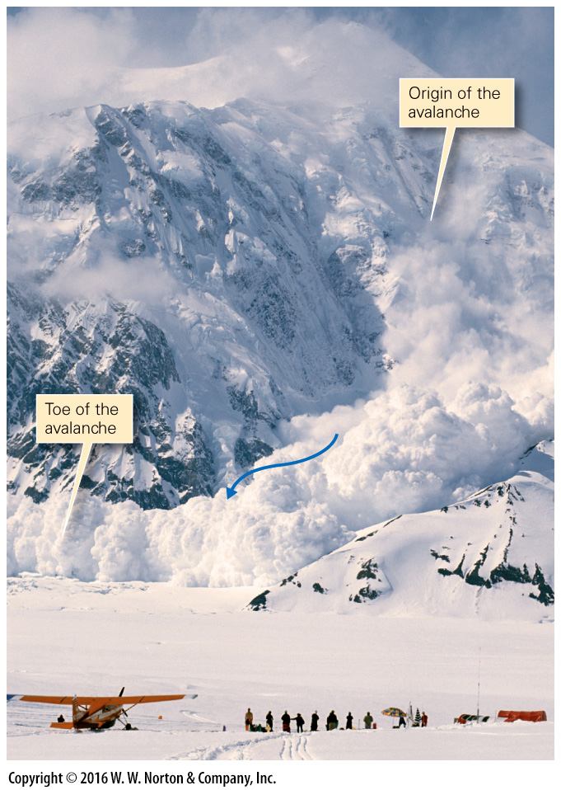
Notes:
FIGURE 13.6b Examples of avalanches.
(b) A dry-snow avalanche in Alaska is a turbulent cloud.

Slide 34
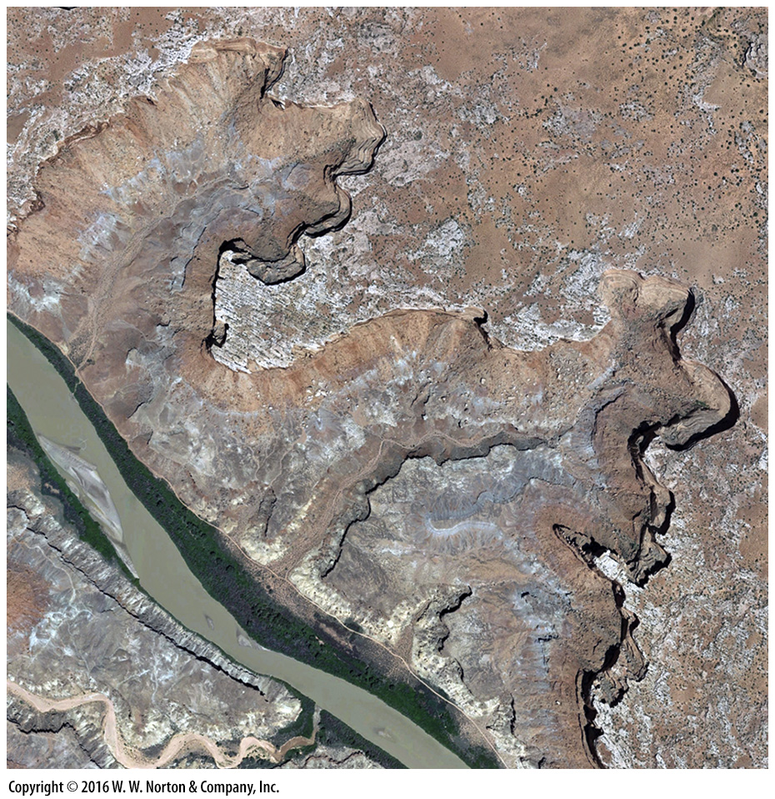
Notes:
SEE FOR YOURSELF…
ROCKFALLS IN CANYONLANDS, UTAH

Slide 35
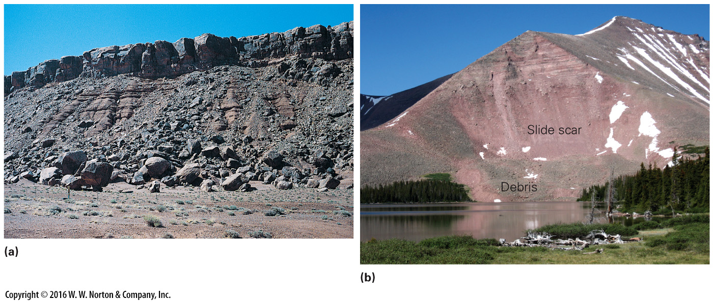
Notes:
FIGURE 13.7 Examples of rockfalls.
(a) Successive rockfalls have littered the base of this sandstone cliff with boulders. Note the talus at the base of the cliff. (b) A rockslide buried the forest bordering a lake in the Uinta Mountains, Utah. Fresh rock exposed by the slide has a lighter color.

Slide 36
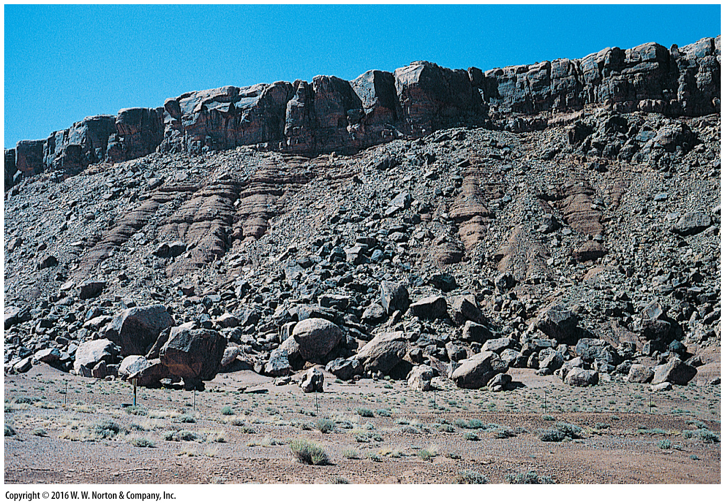
Notes:
FIGURE 13.7a Examples of rockfalls.
(a) Successive rockfalls have littered the base of this sandstone cliff with boulders. Note the talus at the base of the cliff.

Slide 37
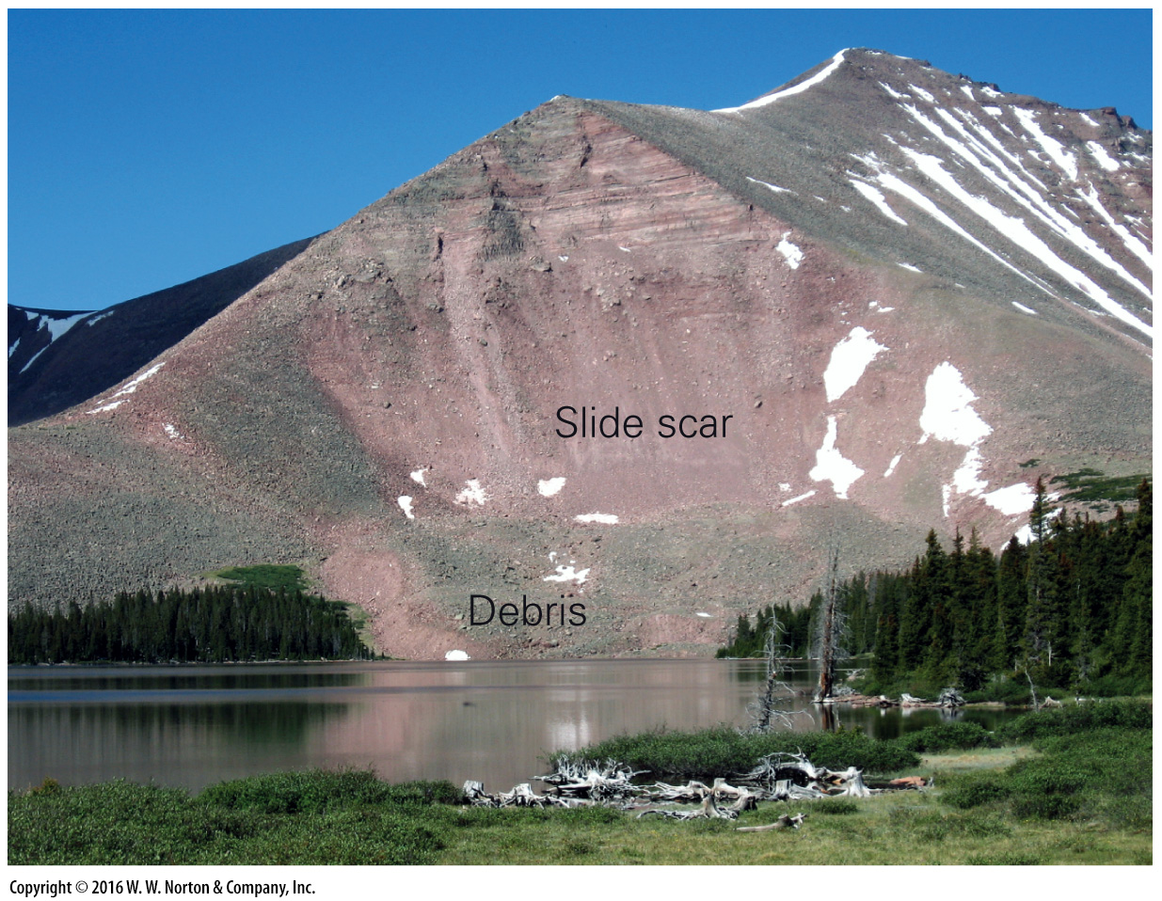
Notes:
FIGURE 13.7b Examples of rockfalls.
(b) A rockslide buried the forest bordering a lake in the Uinta Mountains, Utah. Fresh rock exposed by the slide has a lighter color.

Slide 38
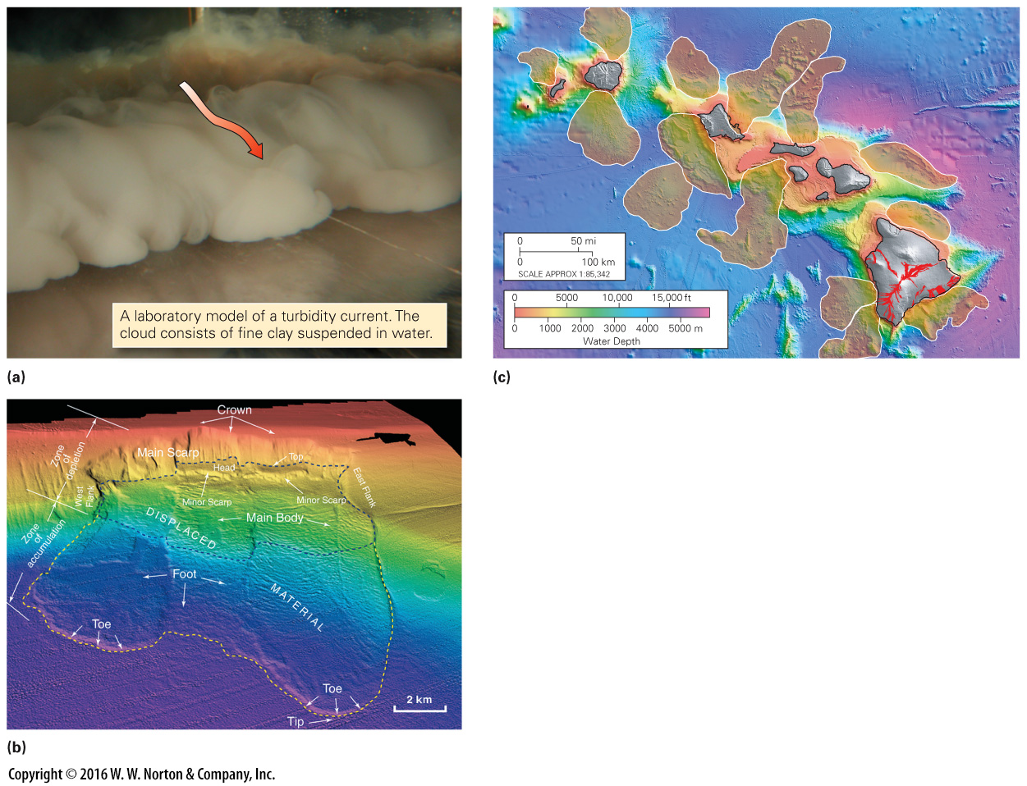
Notes:
FIGURE 13.8 Examples of huge submarine slumps and debris flows.
(a) A turbidity current is a cloud of sediment suspended in water; it flows near the seafloor because it is denser than clear water. (b) A digital bathymetric map of a slip along the coast of California. The parts of the slump are labeled. (c) A bathymetric map of the area around Hawaii shows several huge slumps, shaded in tan.

Slide 39
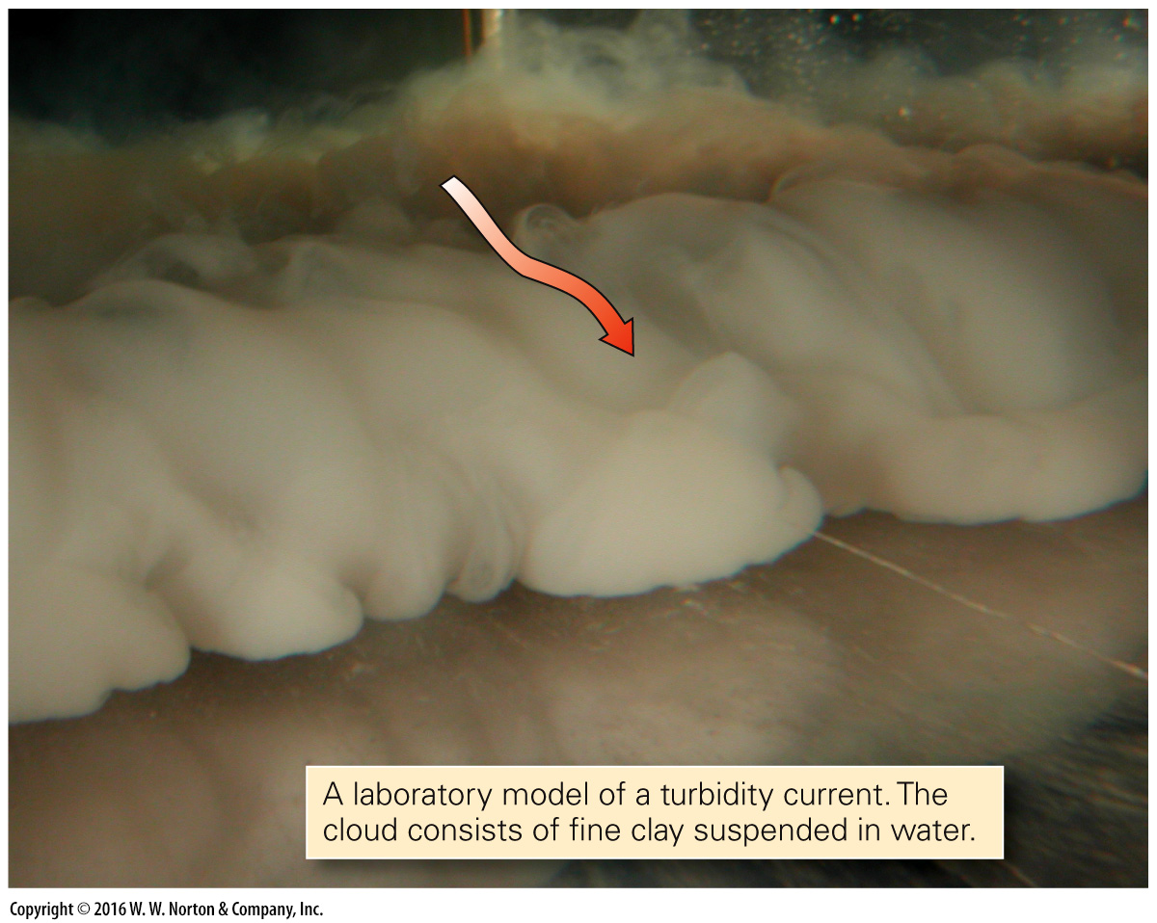
Notes:
FIGURE 13.8a Examples of huge submarine slumps and debris flows.
(a) A turbidity current is a cloud of sediment suspended in water; it flows near the seafloor because it is denser than clear water.

Slide 40
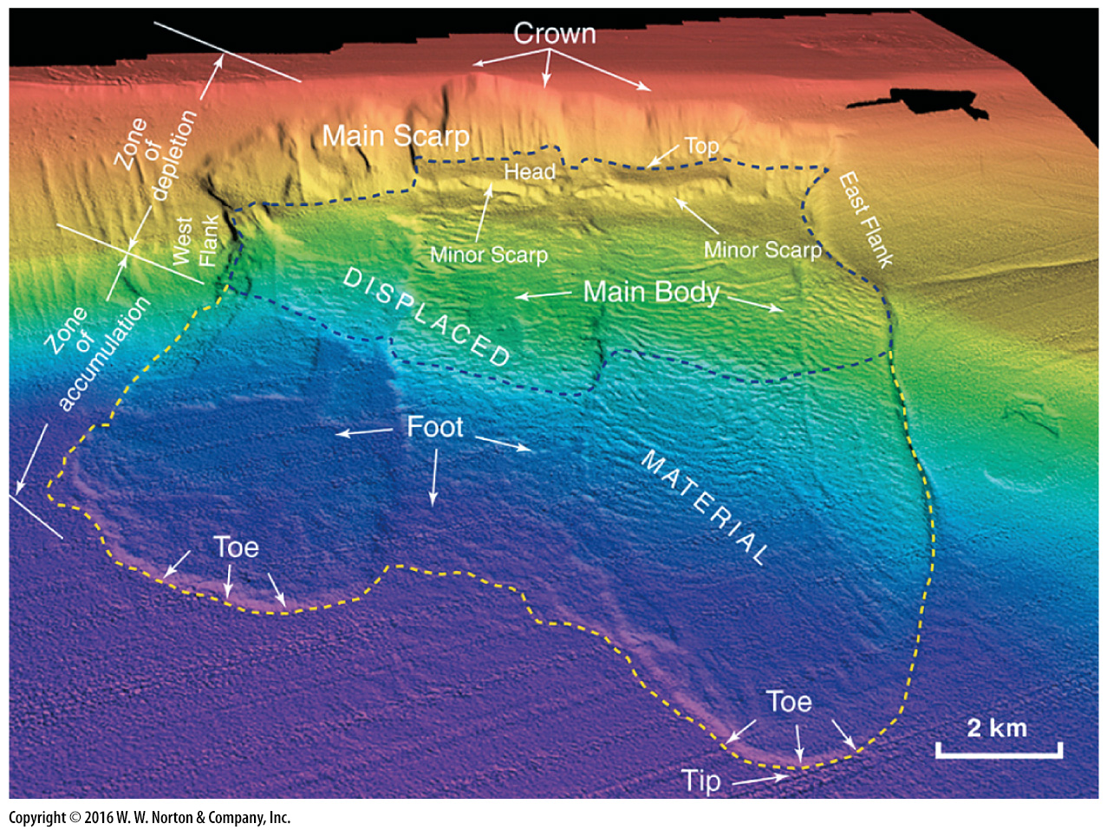
Notes:
FIGURE 13.8b Examples of huge submarine slumps and debris flows.
(b) A digital bathymetric map of a slip along the coast of California. The parts of the slump are labeled.

Slide 41
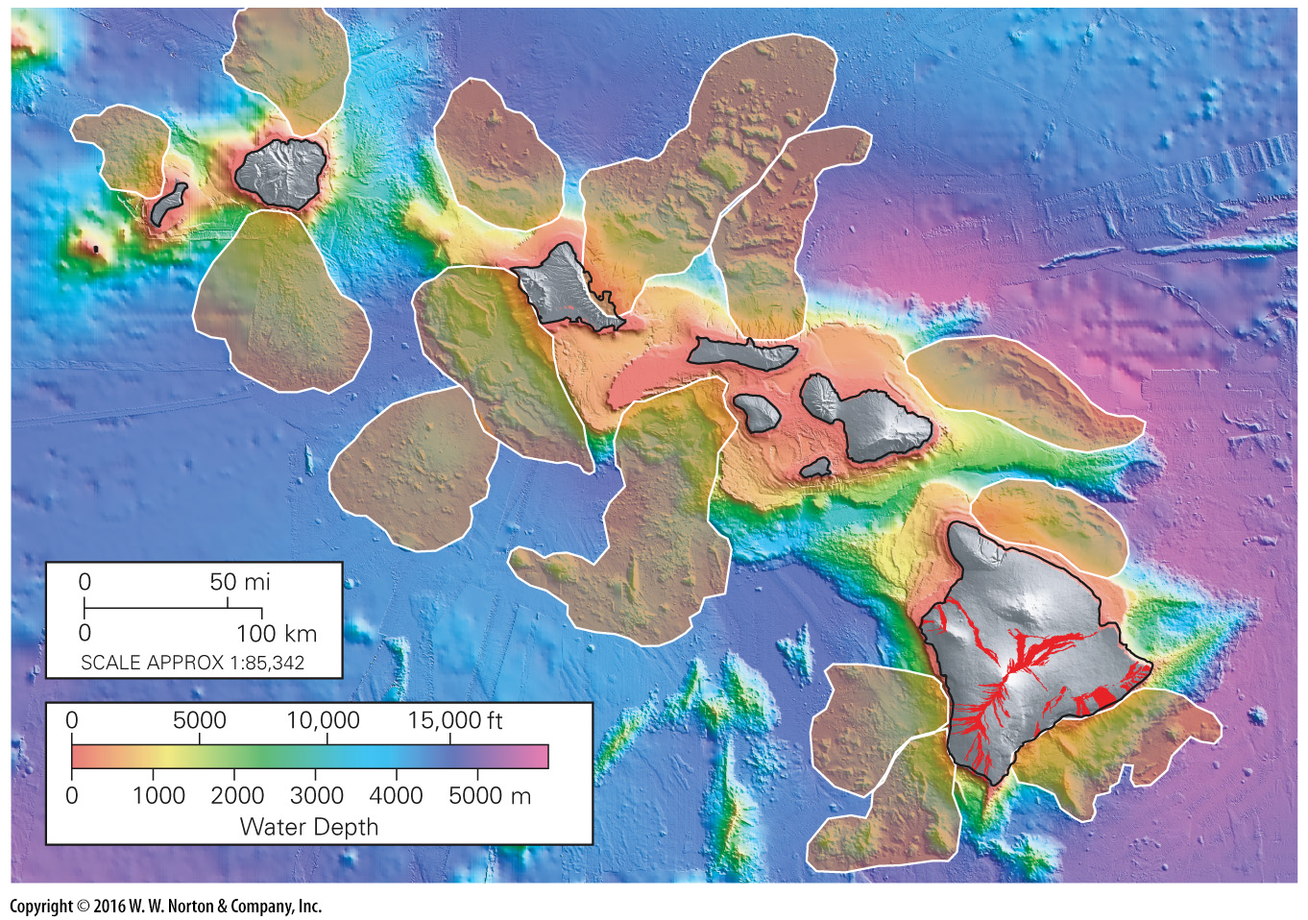
Notes:
FIGURE 13.8c Examples of huge submarine slumps and debris flows.
(c) A bathymetric map of the area around Hawaii shows several huge slumps, shaded in tan.

Slide 42
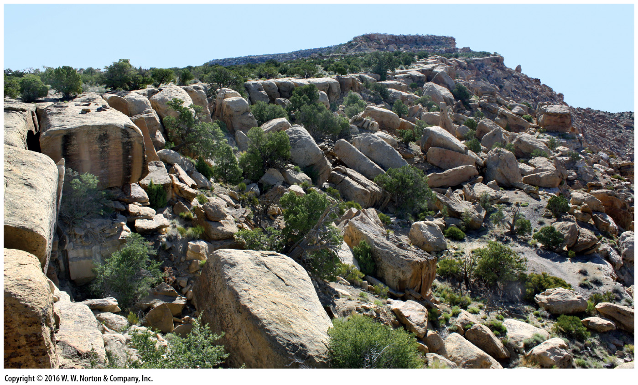
Notes:
FIGURE 13.9 Jointing broke up this thick sandstone bed along a cliff in Utah. Blocks of sandstone break free along joints and tumble downslope.

Slide 43
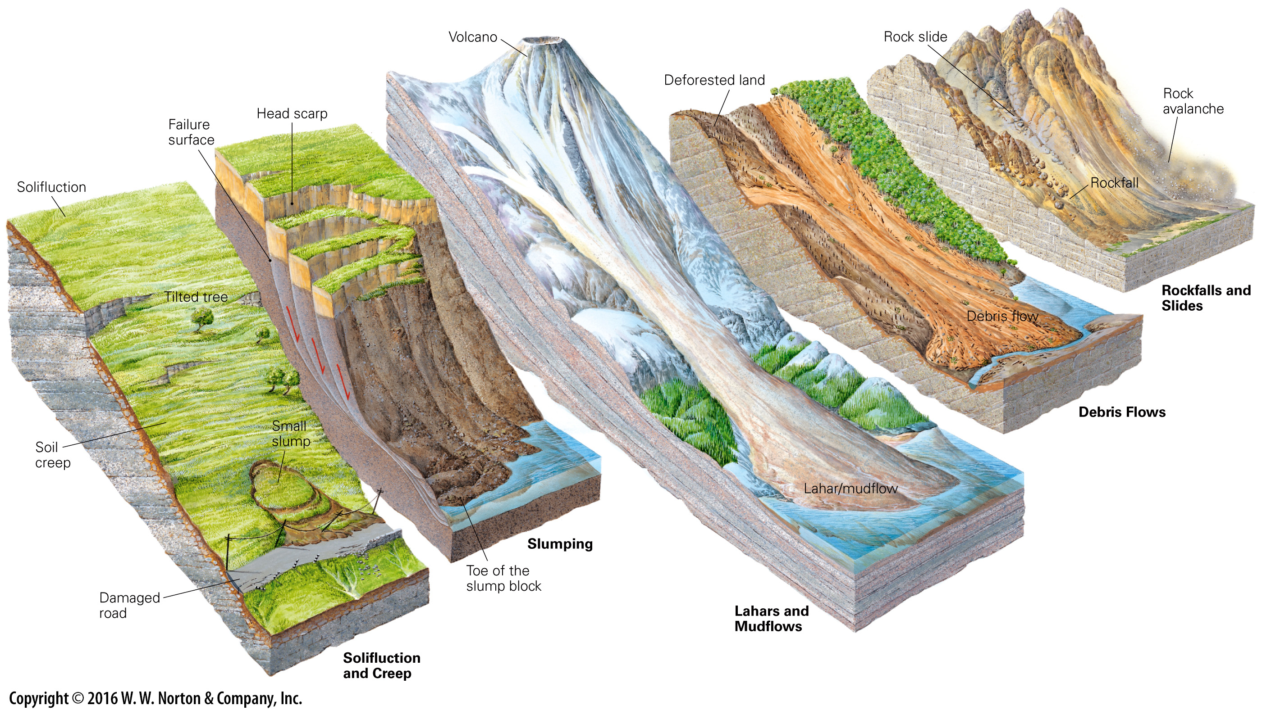
Notes:
GEOLOGY AT A GLANCE
Mass Movement

Slide 44
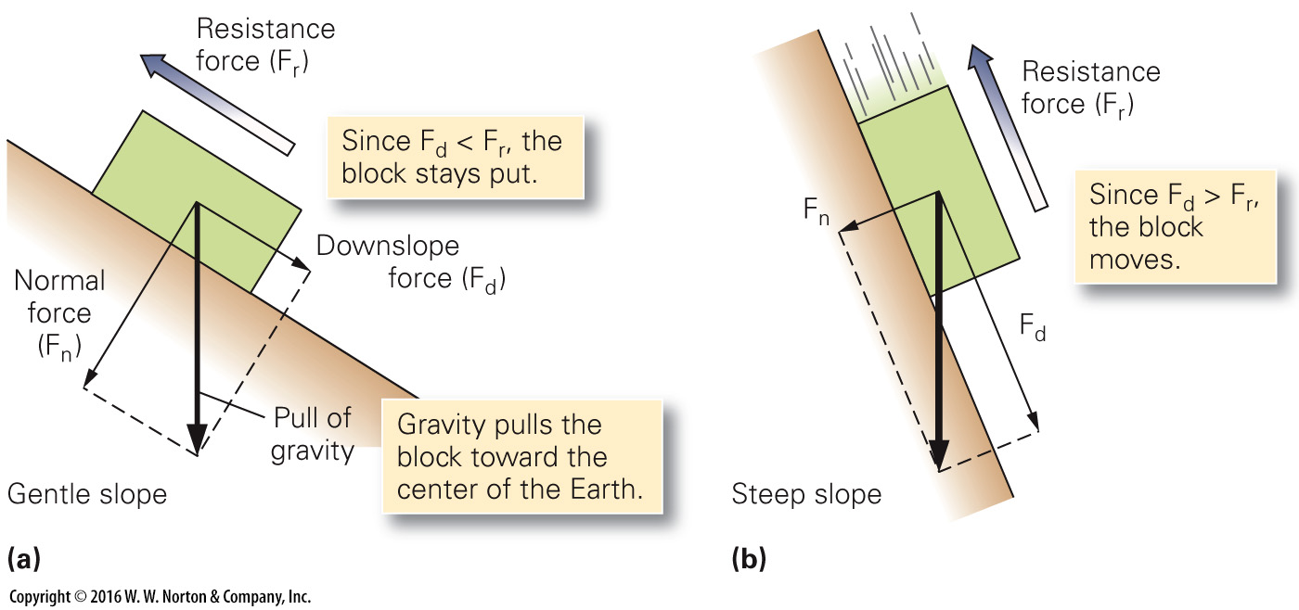
Notes:
FIGURE 13.10 Forces that trigger downslope movement.
(a) Gravity can be divided into a normal force and a downslope force. If the resistance force, caused by friction, is greater than the downslope force, the block does not move. (b) If the slope angle increases, the downslope force due to gravity increases. If the downslope force becomes greater than the resistance force, the block starts to move.

Slide 45
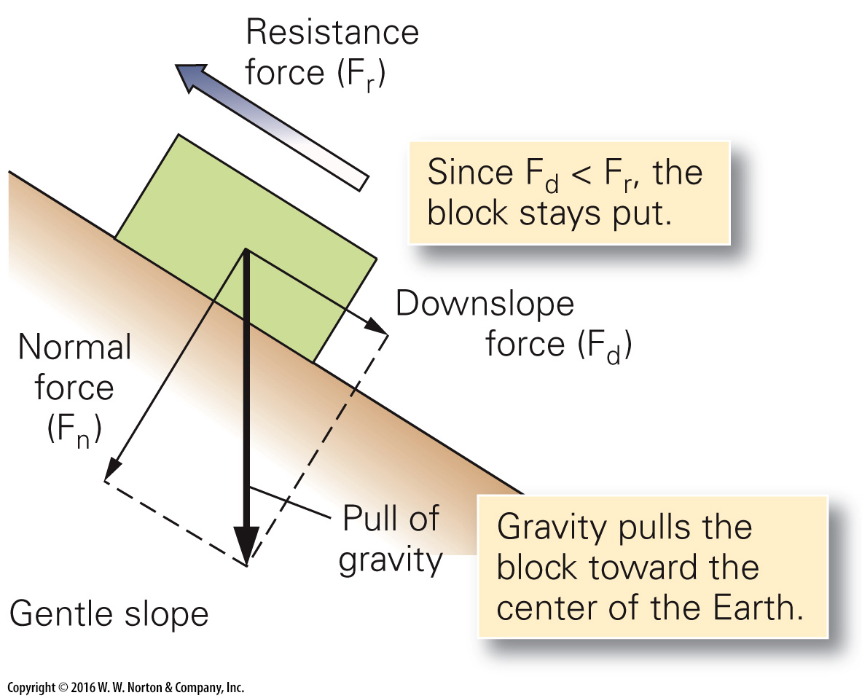
Notes:
FIGURE 13.10a Forces that trigger downslope movement.
(a) Gravity can be divided into a normal force and a downslope force. If the resistance force, caused by friction, is greater than the downslope force, the block does not move.

Slide 46
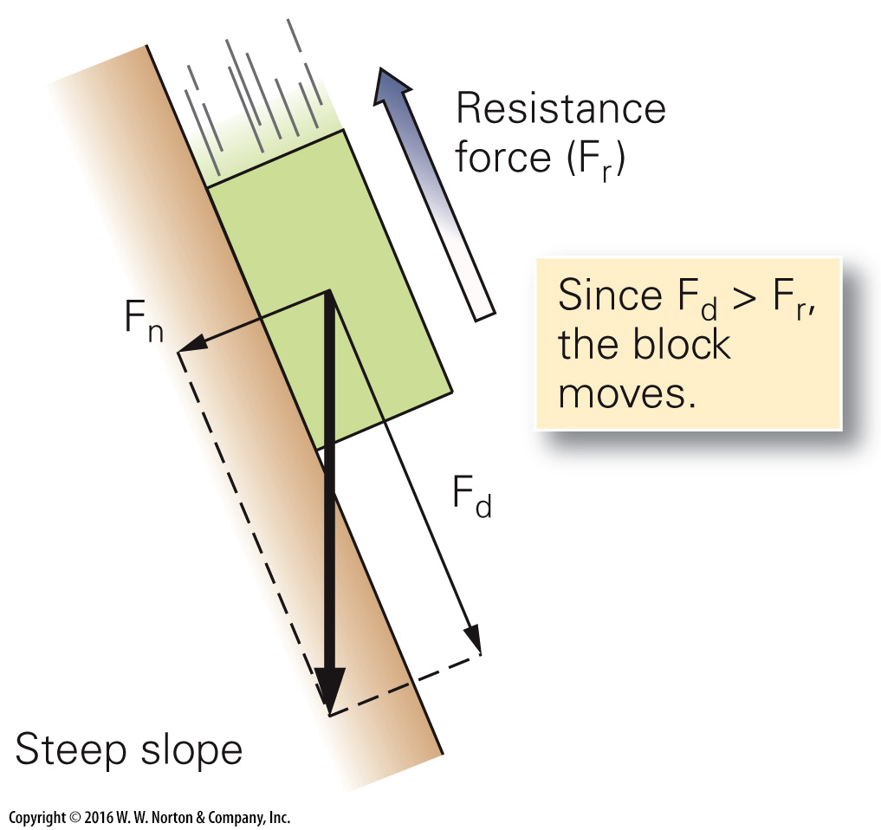
Notes:
FIGURE 13.10b Forces that trigger downslope movement.
(b) If the slope angle increases, the downslope force due to gravity increases. If the downslope force becomes greater than the resistance force, the block starts to move.

Slide 47
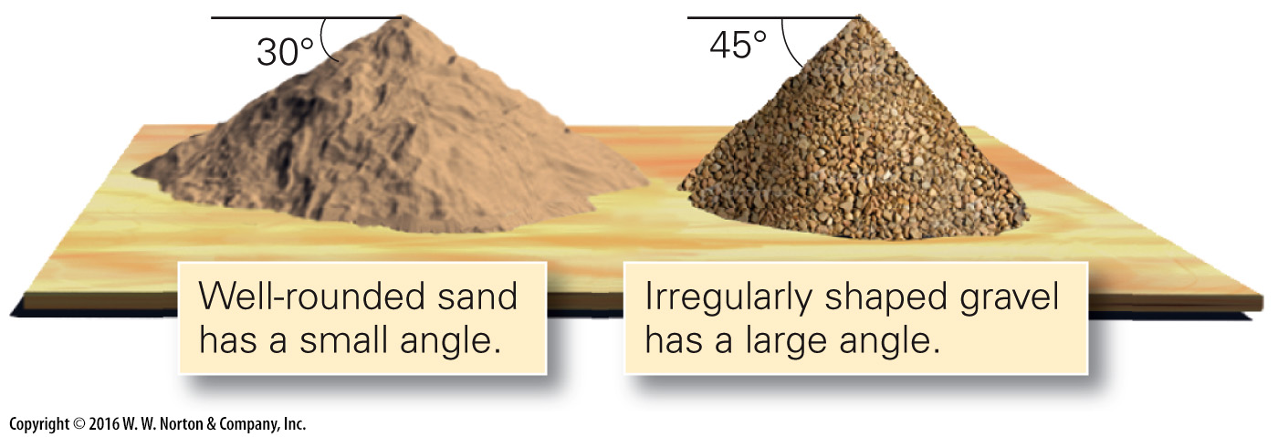
Notes:
FIGURE 13.11 The angle of repose is the steepest slope that a pile of unconsolidated sediment can have and remain stable. The angle depends on the shape and size of grains.

Slide 48
Notes:
FIGURE 13.12 Different kinds of weak surfaces can become failure surfaces.
(a) Exfoliation joints form parallel to slope surfaces in granite and become failure surfaces. (b) In sedimentary rocks, bedding planes (particularly in weak shale) become failure surfaces. (c) In metamorphic rock, foliation planes (particularly in mica-rich schist) become failure surfaces.

Slide 49
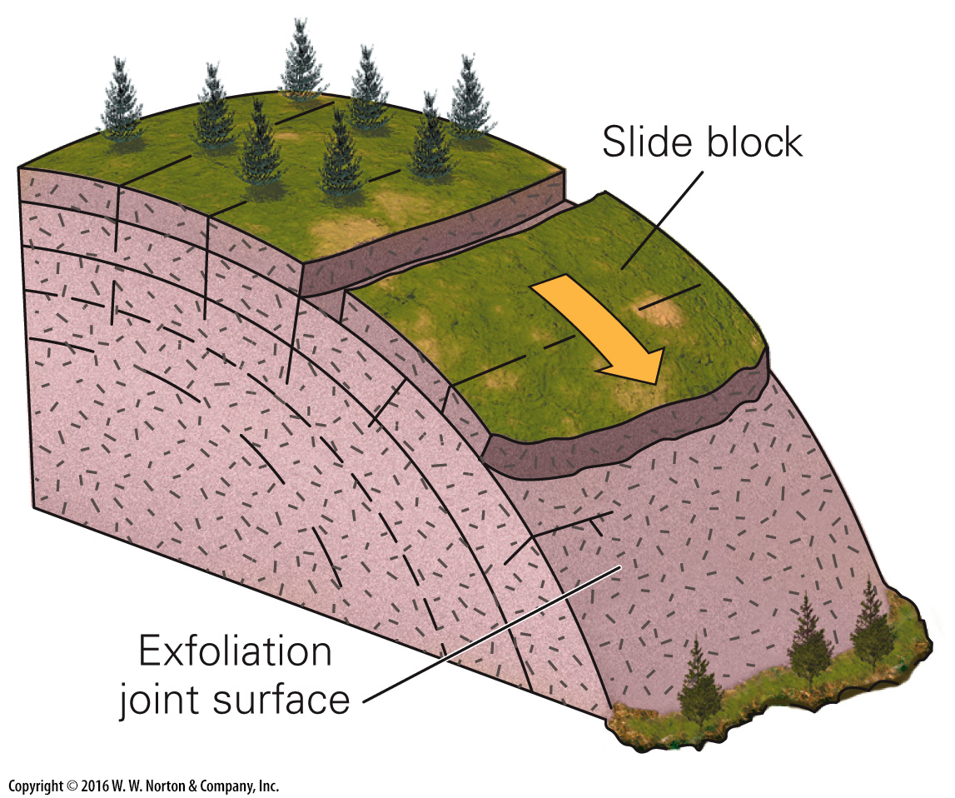
Notes:
FIGURE 13.12a Different kinds of weak surfaces can become failure surfaces.
(a) Exfoliation joints form parallel to slope surfaces in granite and become failure surfaces.

Slide 50
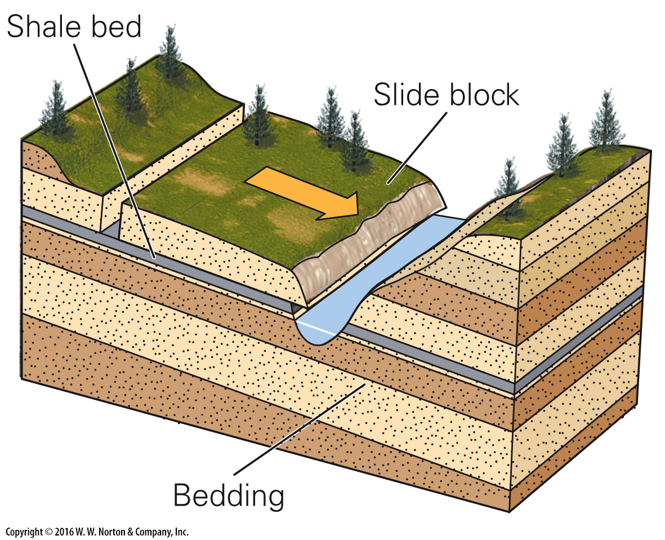
Notes:
FIGURE 13.12b Different kinds of weak surfaces can become failure surfaces.
(b) In sedimentary rocks, bedding planes (particularly in weak shale) become failure surfaces.

Slide 51
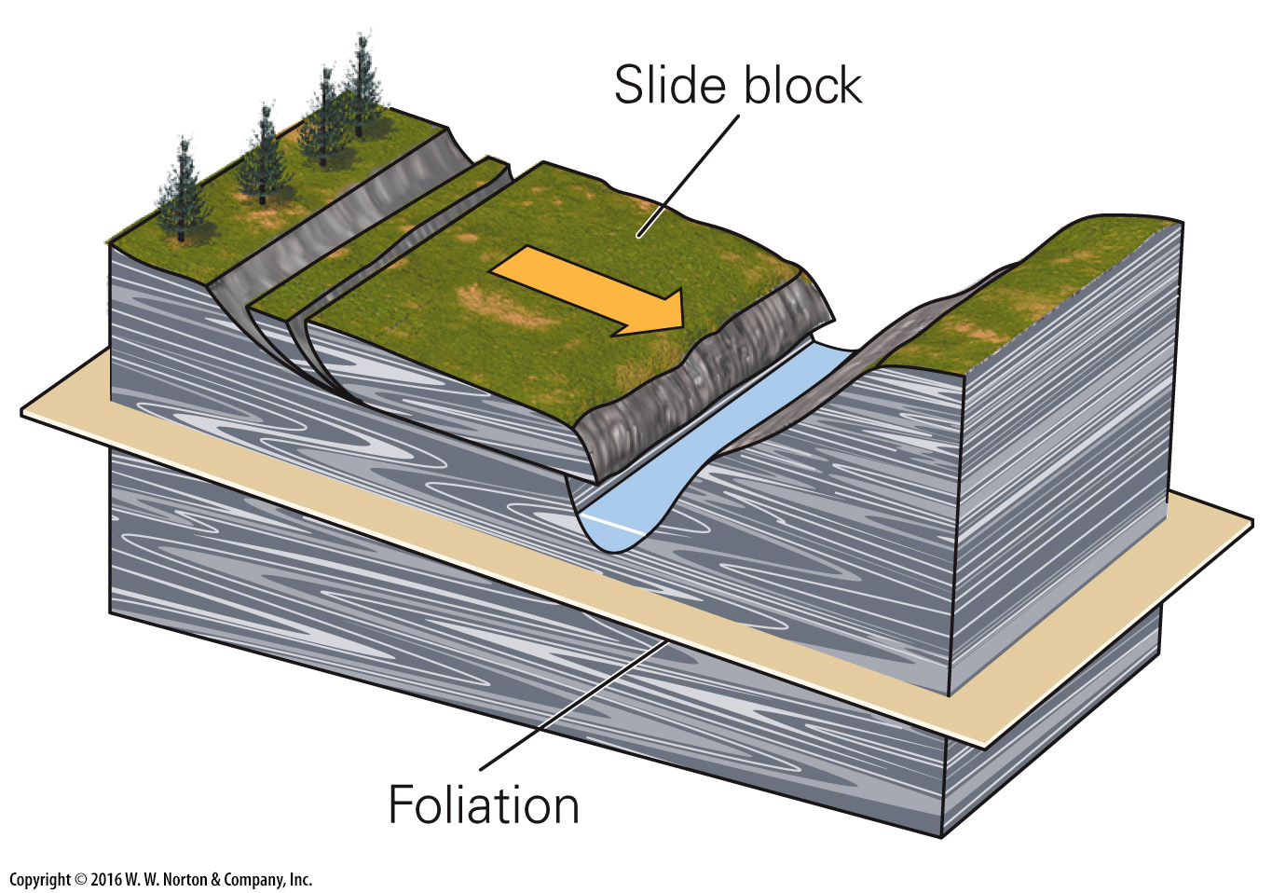
Notes:
FIGURE 13.12c Different kinds of weak surfaces can become failure surfaces.
(c) In metamorphic rock, foliation planes (particularly in mica-rich schist) become failure surfaces.

Slide 52
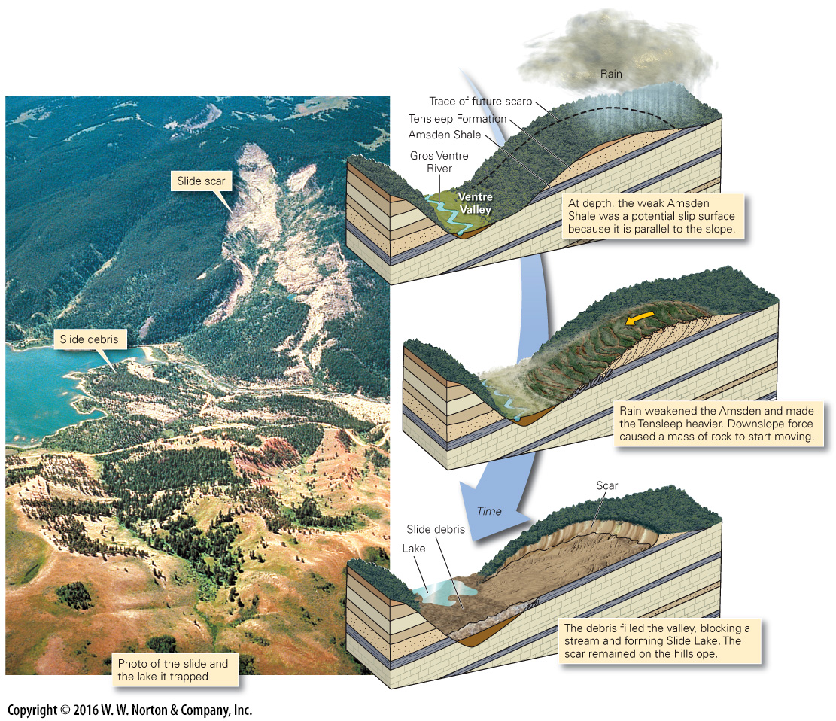
Notes:
FIGURE 13.13 Stages leading to the 1925 Gros Ventre Slide in Wyoming.

Slide 53
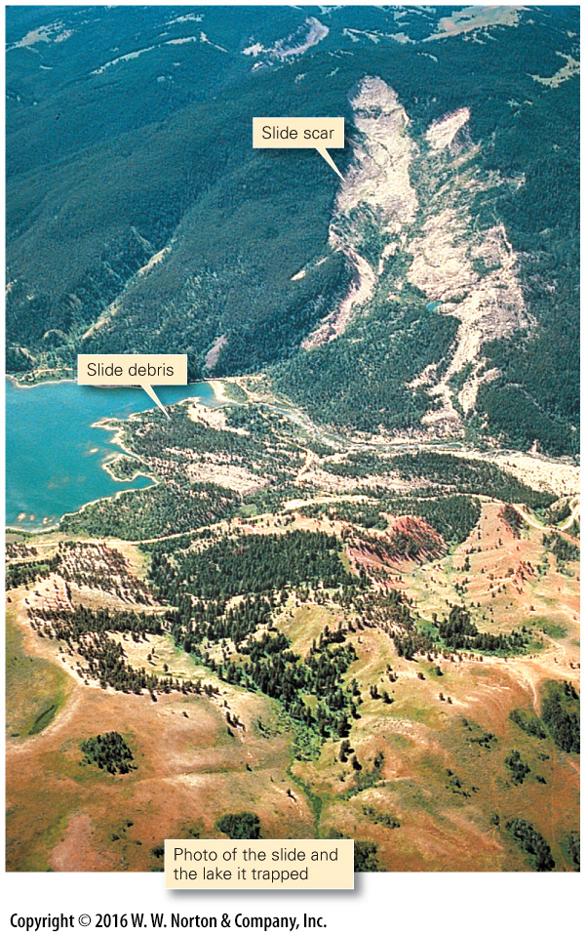
Notes:
FIGURE 13.13a Stages leading to the 1925 Gros Ventre Slide in Wyoming.

Slide 54
Notes:
FIGURE 13.13b Stages leading to the 1925 Gros Ventre Slide in Wyoming.

Slide 55
Notes:
FIGURE 13.14 Undercutting and collapse of a sea cliff.
(a) Undercutting by waves removes the support beneath an overhang. (b) Eventually, the overhang breaks off along joints, and a rockfall takes place.

Slide 56
Notes:
FIGURE 13.15 Surface features warn that a large slump is beginning to develop. Cracks that appear at the head scarp may drain water and kill trees. Power-line poles tilt and the lines become tight. Fences, roads, and houses on the slump begin to crack.

Slide 57
Notes:
FIGURE 13.16 A landslide hazard map of the western United States.

Slide 58
Notes:
FIGURE 13.17 A variety of remedial steps can stabilize unstable ground.
(a) Revegetating a slope results in the growth of roots that can hold a slope together. (b) Redistributing the mass on a slope can stabilize it. Terracing can help catch debris. (c) Lowering the level of the water table can strengthen a potential failure surface. (d) Relocating a river channel can prevent undercutting. (e) Adding riprap can slow undercutting of coastal cliffs. (f) A retaining wall can trap falling rock. (g) Bolting or screening a cliff face can hold loose rocks in place. (h) An avalanche shed diverts debris or snow over a roadway.

Slide 59
Notes:
FIGURE 13.17a A variety of remedial steps can stabilize unstable ground.
(a) Revegetating a slope results in the growth of roots that can hold a slope together.

Slide 60
Notes:
FIGURE 13.17b A variety of remedial steps can stabilize unstable ground.
b) Redistributing the mass on a slope can stabilize it. Terracing can help catch debris.

Slide 61
Notes:
FIGURE 13.17c A variety of remedial steps can stabilize unstable ground.
(c) Lowering the level of the water table can strengthen a potential failure surface.

Slide 62
Notes:
FIGURE 13.17d A variety of remedial steps can stabilize unstable ground.
(d) Relocating a river channel can prevent undercutting.

Slide 63
Notes:
FIGURE 13.17e A variety of remedial steps can stabilize unstable ground.
(e) Adding riprap can slow undercutting of coastal cliffs.

Slide 64
Notes:
FIGURE 13.17f A variety of remedial steps can stabilize unstable ground.
(f) A retaining wall can trap falling rock.

Slide 65
Notes:
FIGURE 13.17g A variety of remedial steps can stabilize unstable ground.
(g) Bolting or screening a cliff face can hold loose rocks in place.

Slide 66
Notes:
FIGURE 13.17h A variety of remedial steps can stabilize unstable ground.
(h) An avalanche shed diverts debris or snow over a roadway.

