Slide 1
Stephen Marshak
ESSENTIALS OF
Geology
FIFTH EDITION
Chapter 14
Streams and Floods:
The Geology of Running Water
©2016 W. W. Norton & Company, Inc.

Slide 2
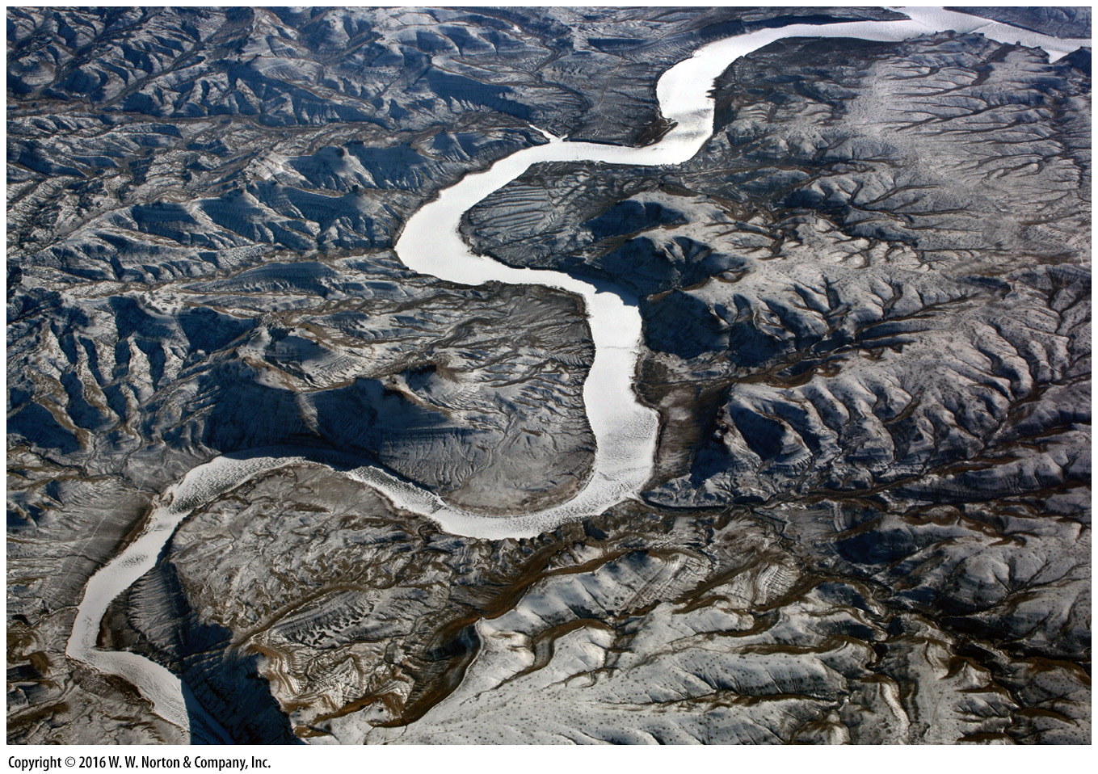
Notes:
This winter view from an airplane illustrates how running water, flowing down slopes in response to the pull of gravity, cuts channels into the landscape to produce drainage networks.

Slide 3
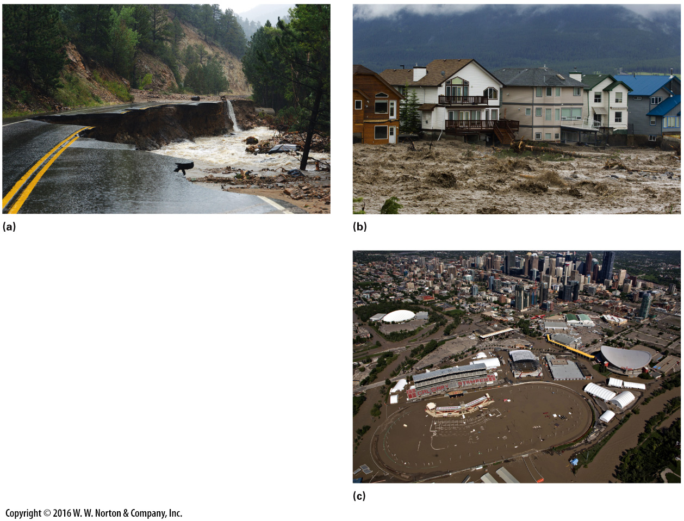
Notes:
FIGURE 14.1 Examples of flooding damage illustrate the power of running water.
(a) A stream roaring down a canyon in Colorado undercut and carried away part of a highway. (b) Heavy rains in the Canadian Rockies caused extensive flooding in Alberta. (c) The water inundated parts of Calgary, including the stadium for the city’s Stampede (rodeo).

Slide 4
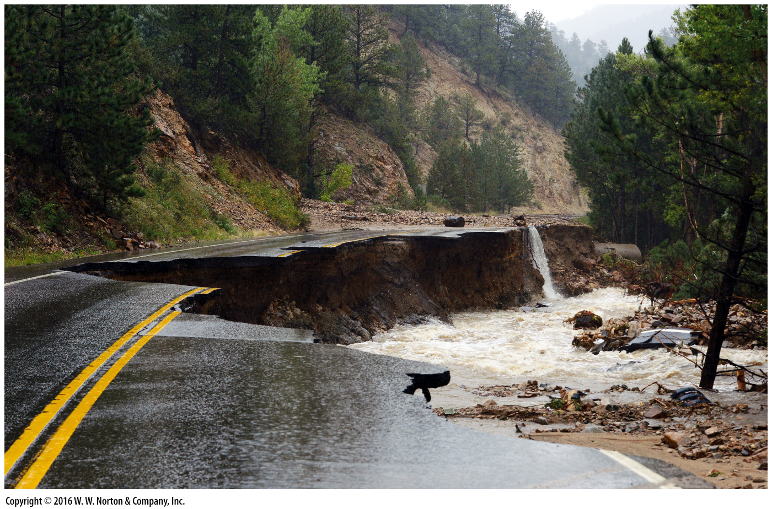
Notes:
FIGURE 14.1a Examples of flooding damage illustrate the power of running water.
(a) A stream roaring down a canyon in Colorado undercut and carried away part of a highway.

Slide 5
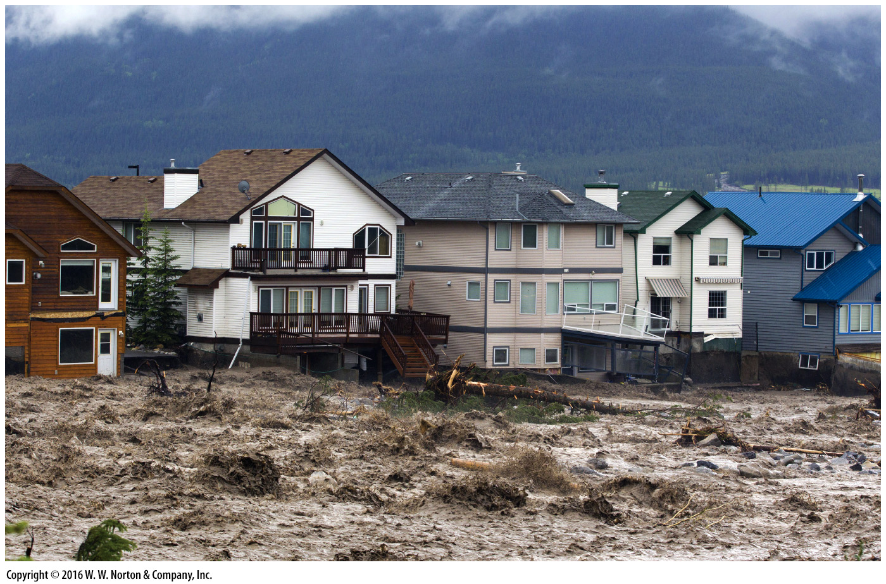
Notes:
FIGURE 14.1b Examples of flooding damage illustrate the power of running water.
(b) Heavy rains in the Canadian Rockies caused extensive flooding in Alberta.

Slide 6
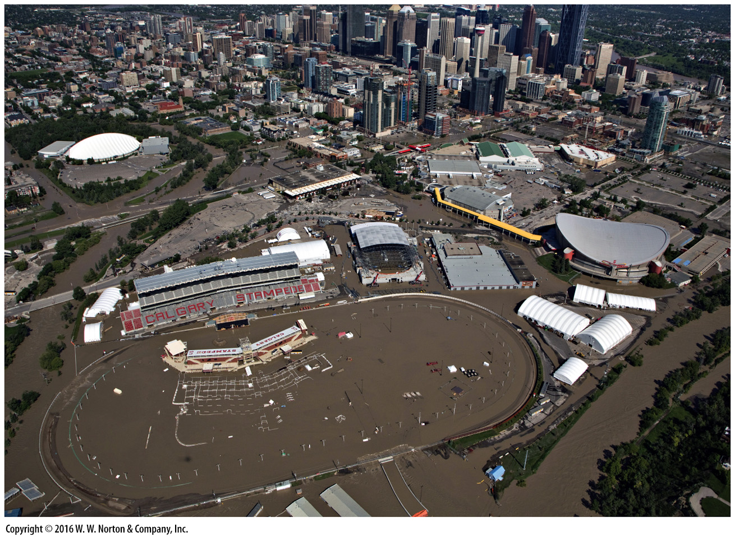
Notes:
FIGURE 14.1c Examples of flooding damage illustrate the power of running water.
(c) The water inundated parts of Calgary, including the stadium for the city’s Stampede (rodeo).

Slide 7
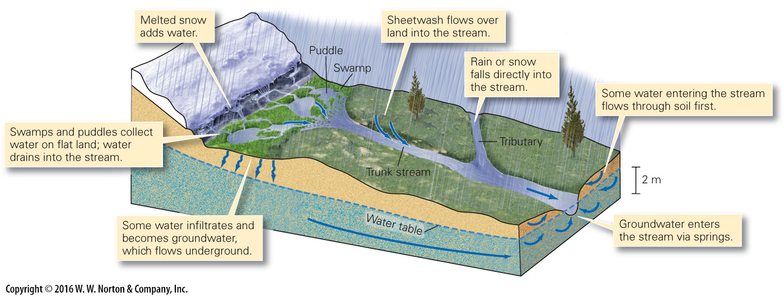
Notes:
FIGURE 14.2 Excess surface water (runoff) comes from rain, melting ice or snow, and groundwater springs. On flat ground, water accumulates in puddles or swamps, but on slopes it flows downslope in streams.

Slide 8
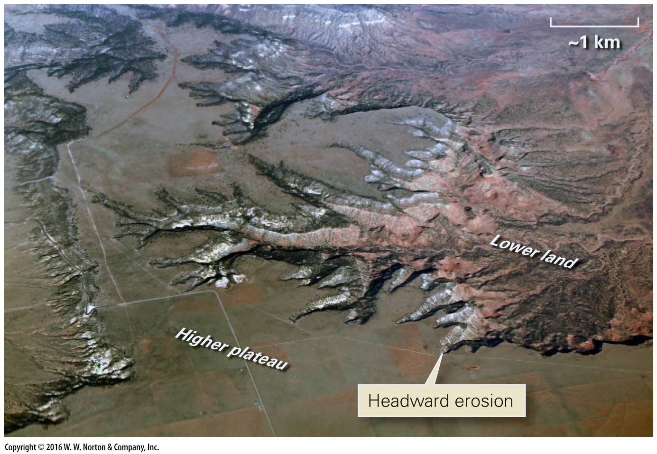
Notes:
FIGURE 14.3 An example of headward erosion. The main stream flows in a deep valley. Side streams are cutting into the bordering plateau.

Slide 9
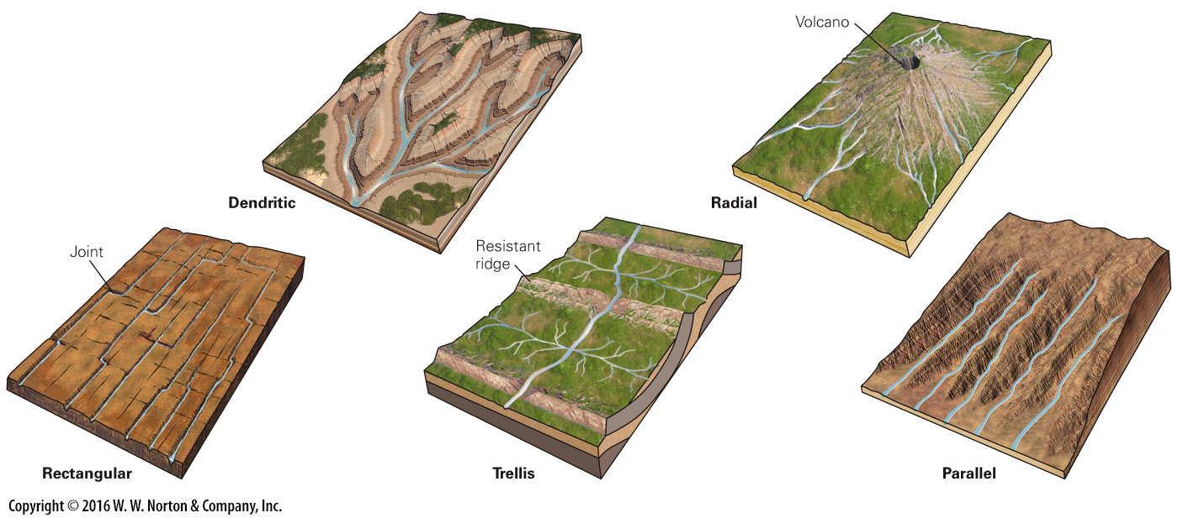
Notes:
FIGURE 14.4 Block diagrams illustrating five types of drainage networks.

Slide 10
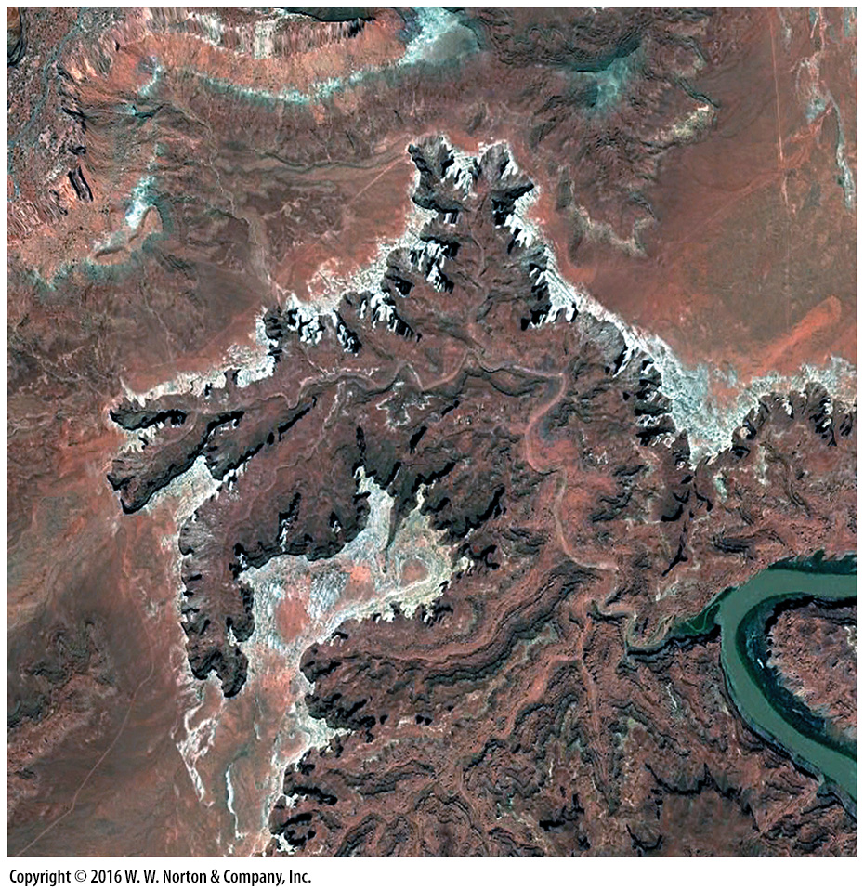
Notes:
SEE FOR YOURSELF…
HEADWARD EROSION, UTAH

Slide 11
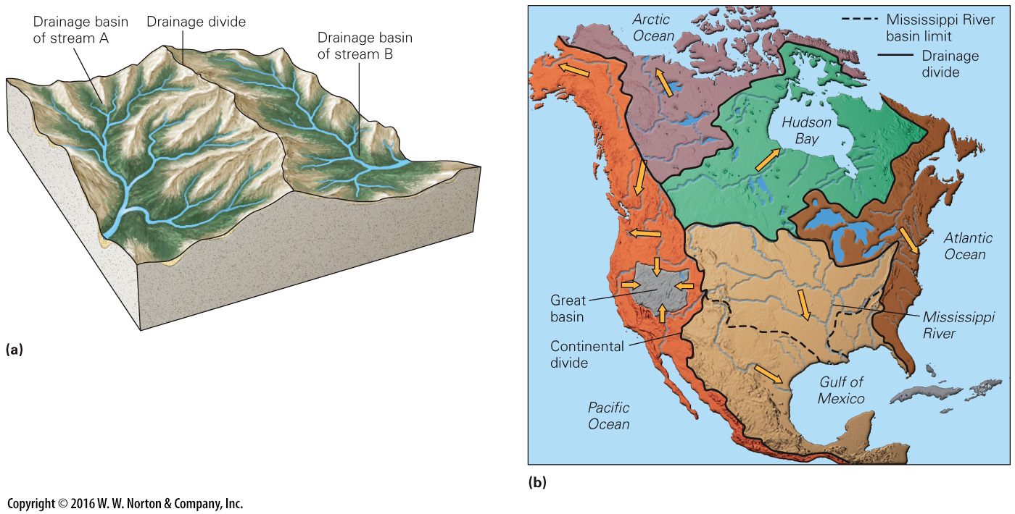
Notes:
FIGURE 14.5 Drainage divides and basins.
(a) A drainage divide is a relatively high ridge that separates two drainage basins. (b) The major drainage basins of North America.

Slide 12
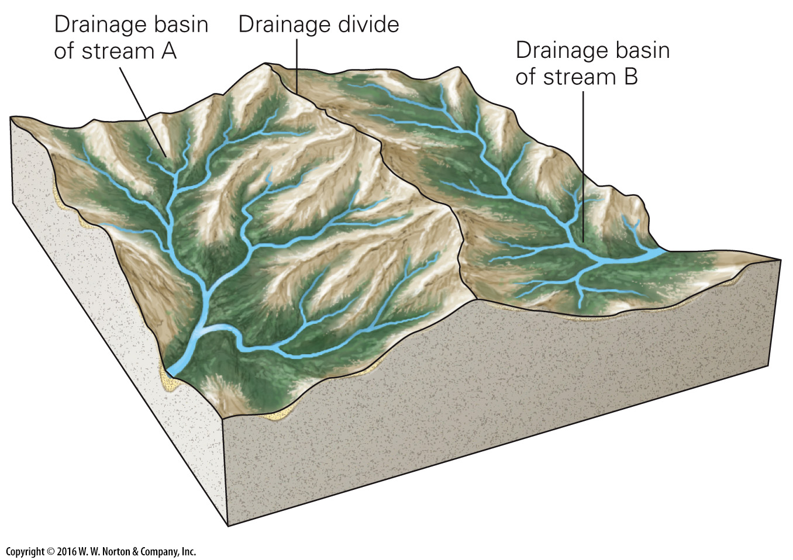
Notes:
FIGURE 14.5a Drainage divides and basins.
(a) A drainage divide is a relatively high ridge that separates two drainage basins.

Slide 13
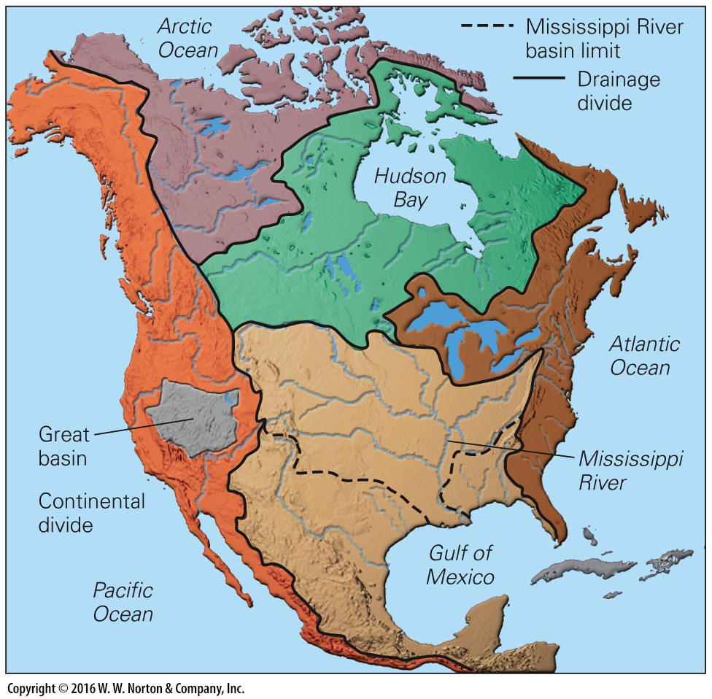
Notes:
FIGURE 14.5b Drainage divides and basins.
(b) The major drainage basins of North America.

Slide 14
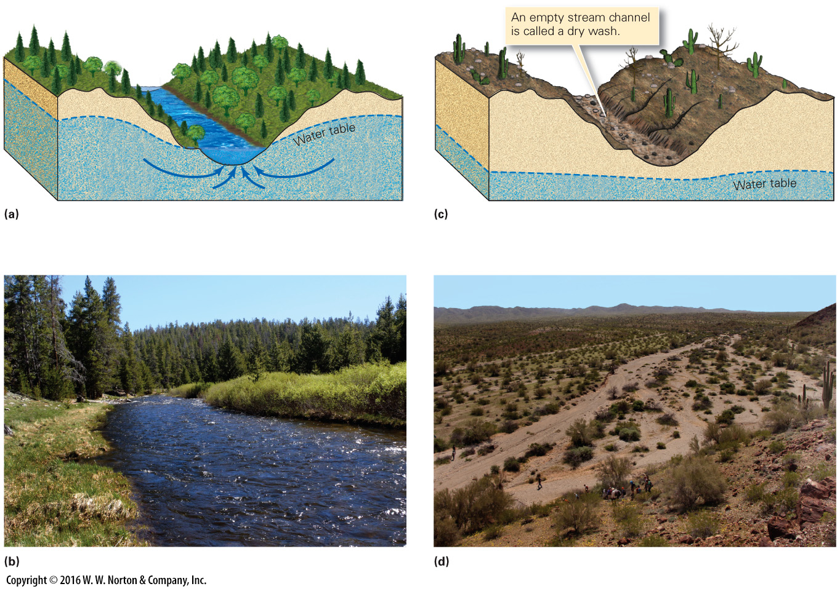
Notes:
FIGURE 14.6 The contrast between permanent and ephemeral streams.
(a) The floor of a permanent stream in a temperate climate lies below the water table. Springs add water from below, so the stream contains water even between rains. (b) An example of a permanent stream in the Wind River Mountains, Wyoming. (c) The channel of an ephemeral stream lies above the water table, so the stream flows only when water enters the stream faster than it can infiltrate into the ground. (d) An example of a dry wash in the Buckskin Mountains, Arizona.

Slide 15
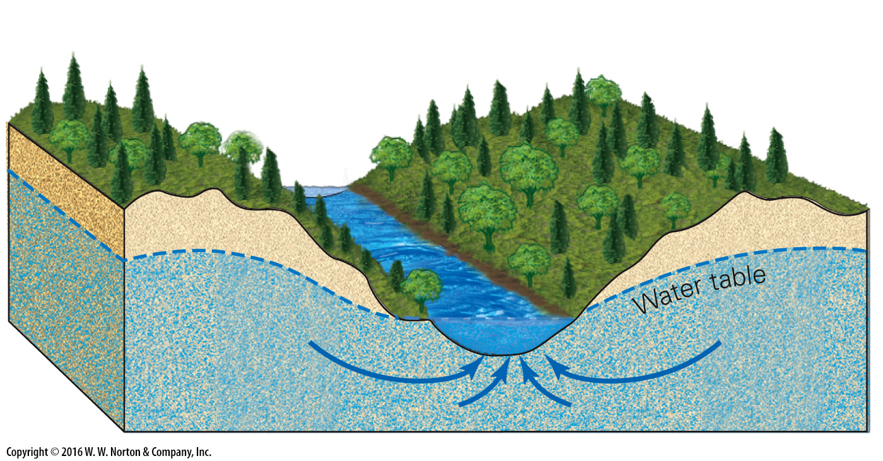
Notes:
FIGURE 14.6a The contrast between permanent and ephemeral streams.
(a) The floor of a permanent stream in a temperate climate lies below the water table. Springs add water from below, so the stream contains water even between rains.

Slide 16
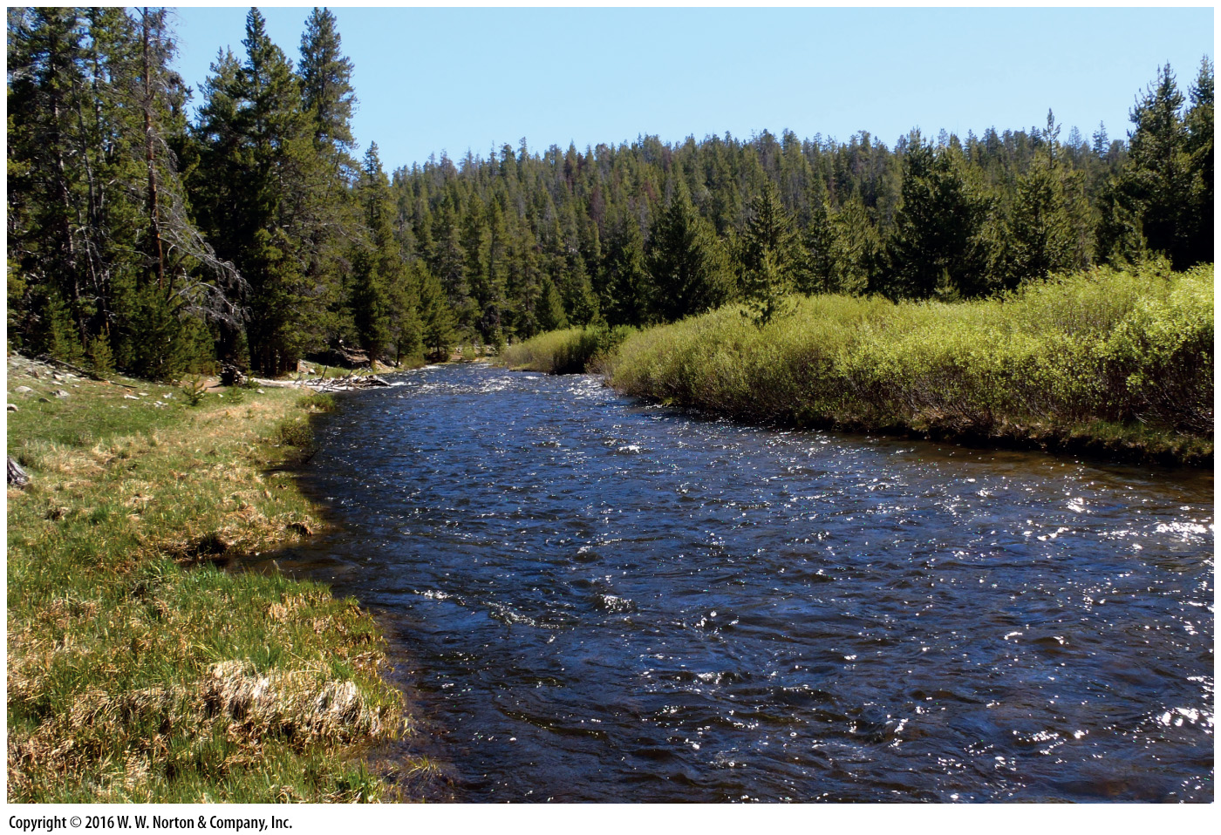
Notes:
FIGURE 14.6b The contrast between permanent and ephemeral streams.
(b) An example of a permanent stream in the Wind River Mountains, Wyoming.

Slide 17
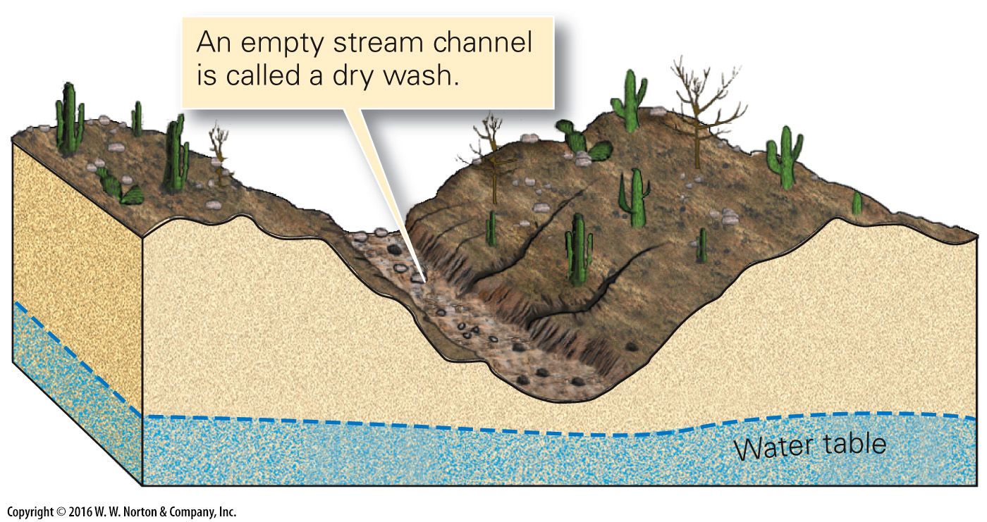
Notes:
FIGURE 14.6c The contrast between permanent and ephemeral streams.
(c) The channel of an ephemeral stream lies above the water table, so the stream flows only when water enters the stream faster than it can infiltrate into the ground.

Slide 18
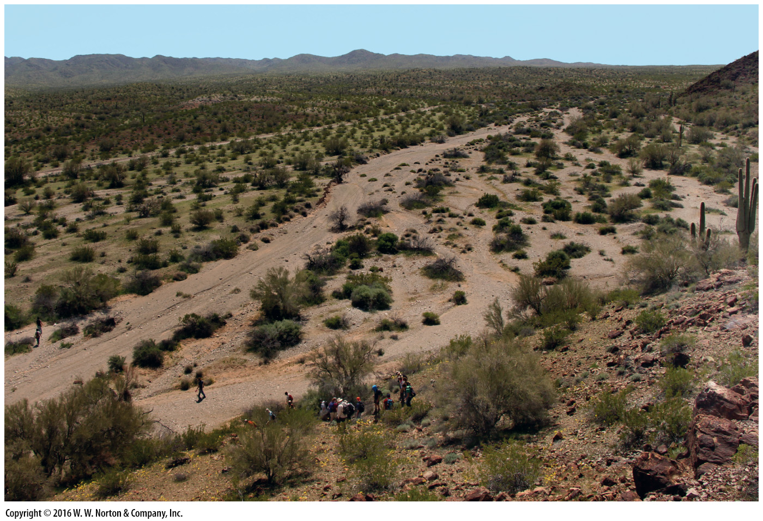
Notes:
FIGURE 14.6d The contrast between permanent and ephemeral streams.
(d) An example of a dry wash in the Buckskin Mountains, Arizona.

Slide 19
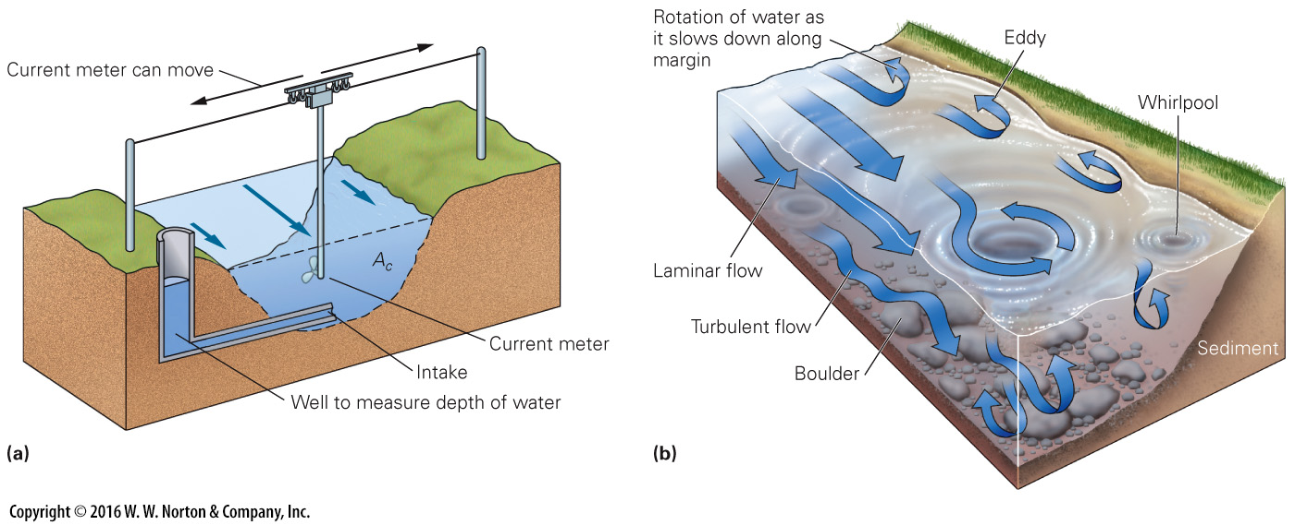
Notes:
FIGURE 14.7 Flow velocity and turbulence in streams.
(a) At a stream-gauging station, geologists measure the cross-sectional area (Ac), the depth, and the average velocity of the stream. Velocity is slower near the banks. (b) In detail, flow is turbulent. Turbulence can make measuring velocity difficult.

Slide 20
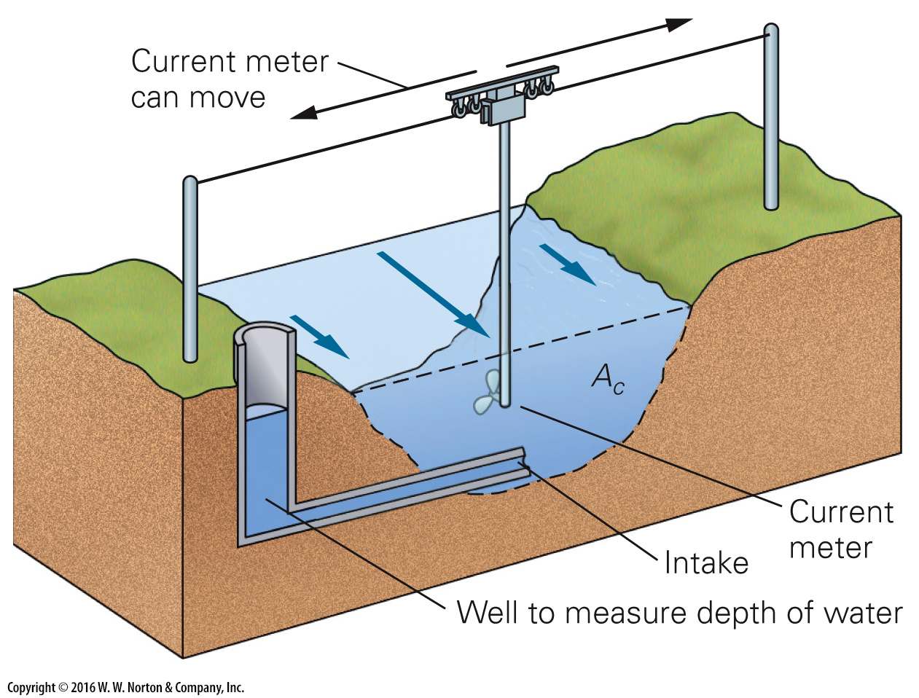
Notes:
FIGURE 14.7a Flow velocity and turbulence in streams.
(a) At a stream-gauging station, geologists measure the cross-sectional area (Ac), the depth, and the average velocity of the stream. Velocity is slower near the banks.

Slide 21
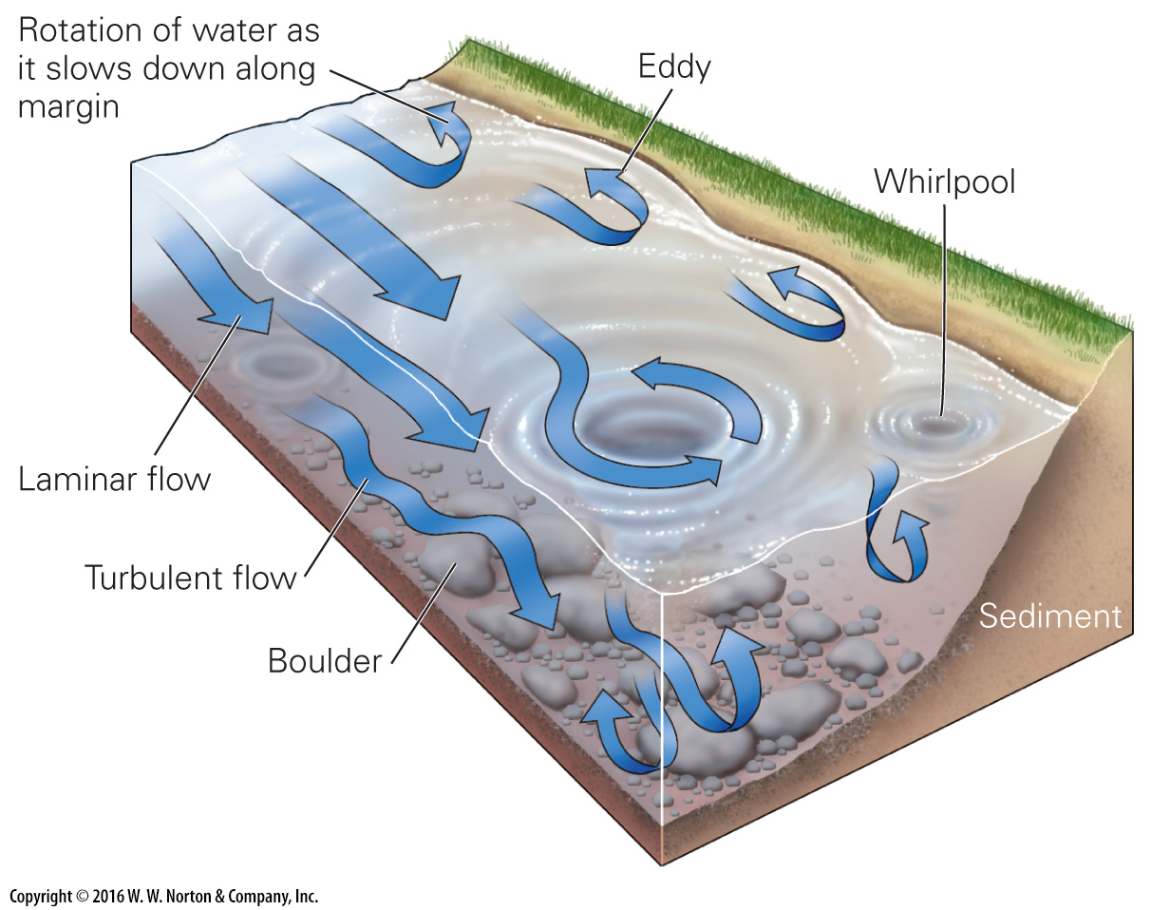
Notes:
FIGURE 14.7b Flow velocity and turbulence in streams.
(b) In detail, flow is turbulent. Turbulence can make measuring velocity difficult.

Slide 22
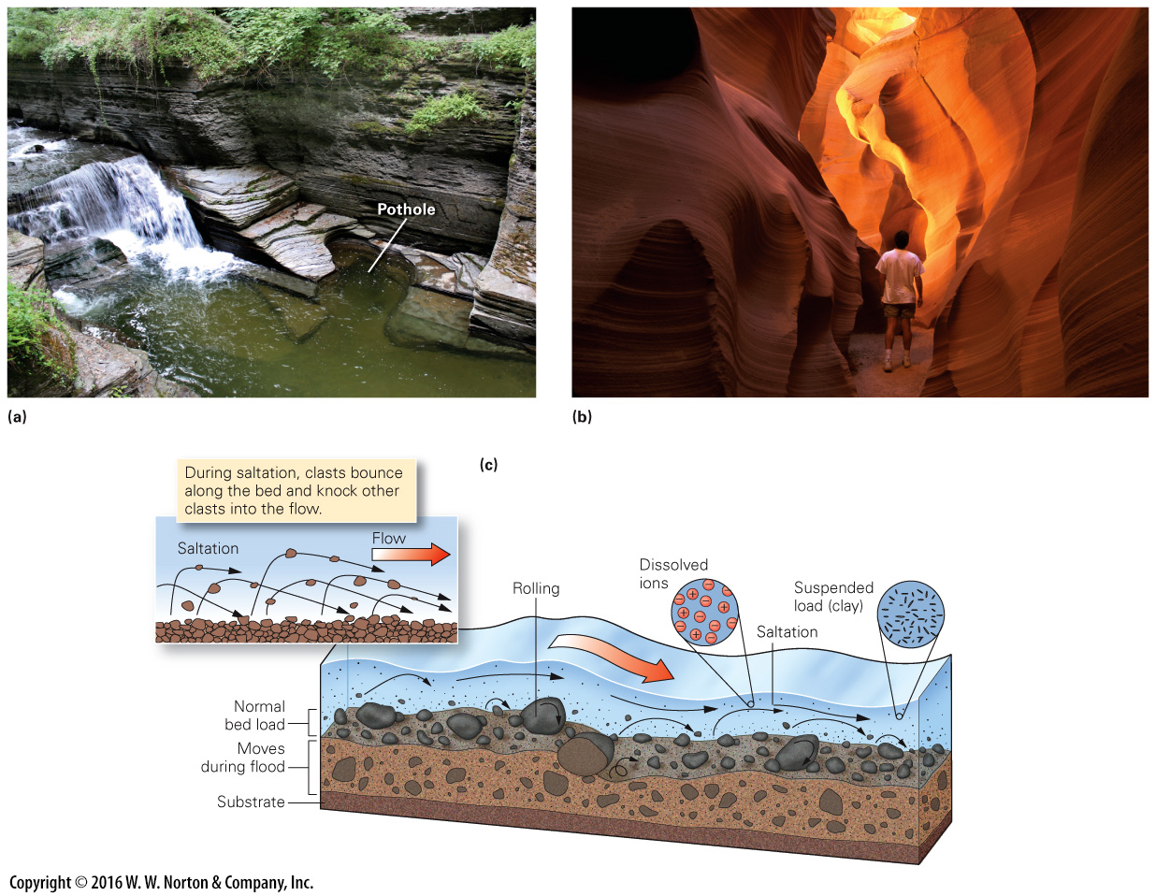
Notes:
FIGURE 14.8 Erosion and transportation in streams.
(a) A pothole in the bed of a stream near Ithaca, New York. (b) This slot canyon in Arizona formed when many potholes linked together. (c) Streams transport sediment in many forms: dissolved ions are in solution; tiny suspended grains are distributed through the water; and the bed load slides, rolls, and/or undergoes saltation.

Slide 23
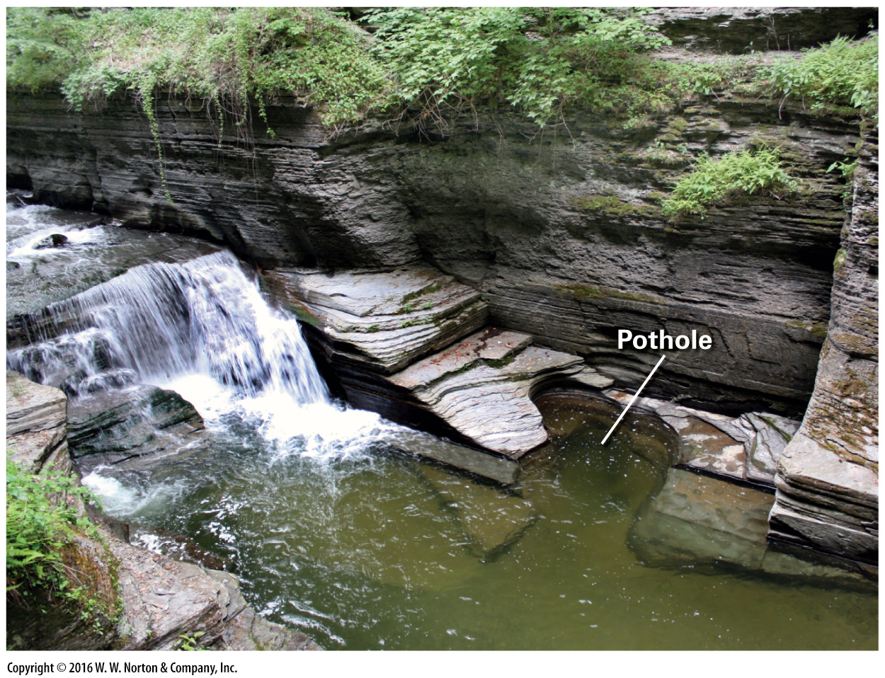
Notes:
FIGURE 14.8a Erosion and transportation in streams.
(a) A pothole in the bed of a stream near Ithaca, New York.

Slide 24
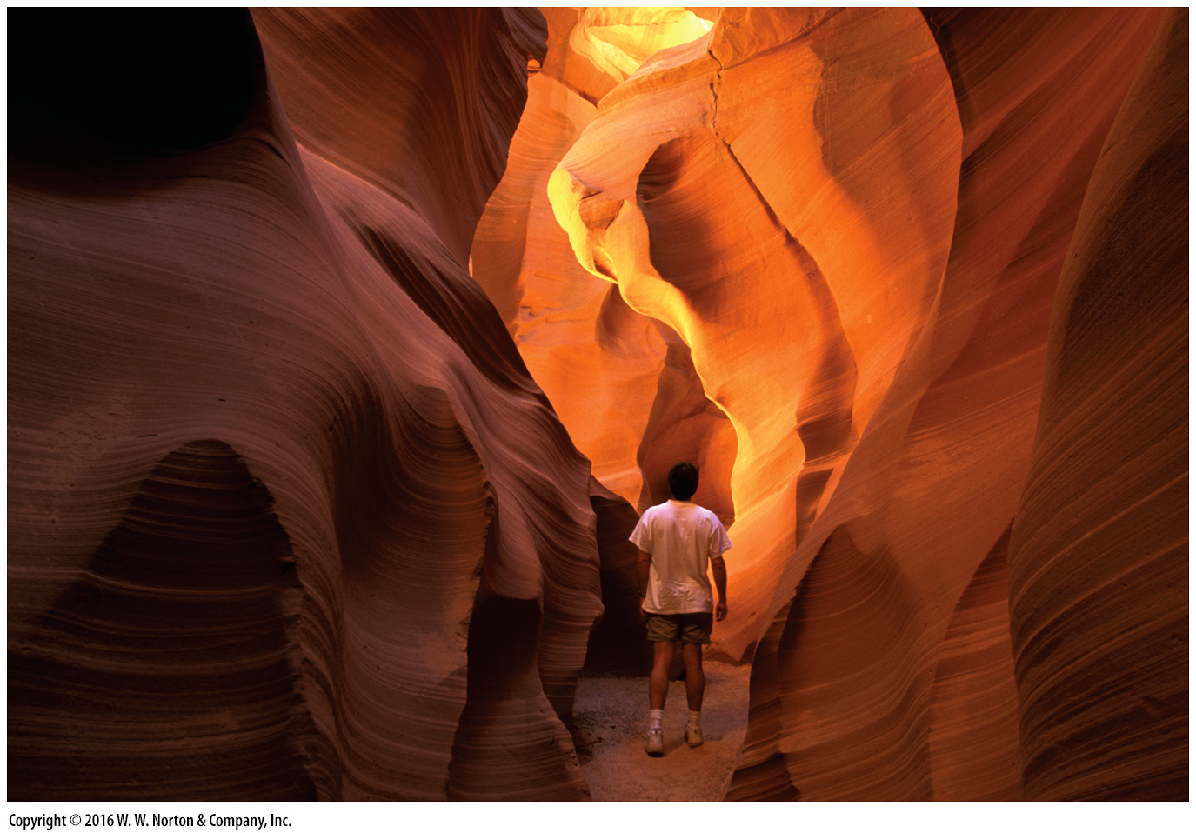
Notes:
FIGURE 14.8b Erosion and transportation in streams.
(b) This slot canyon in Arizona formed when many potholes linked together.

Slide 25
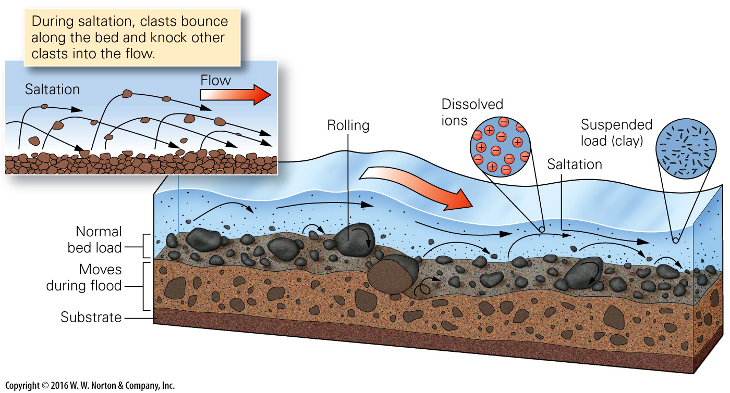
Notes:
FIGURE 14.8c Erosion and transportation in streams.
(c) Streams transport sediment in many forms: dissolved ions are in solution; tiny suspended grains are distributed through the water; and the bed load slides, rolls, and/or undergoes saltation.

Slide 26
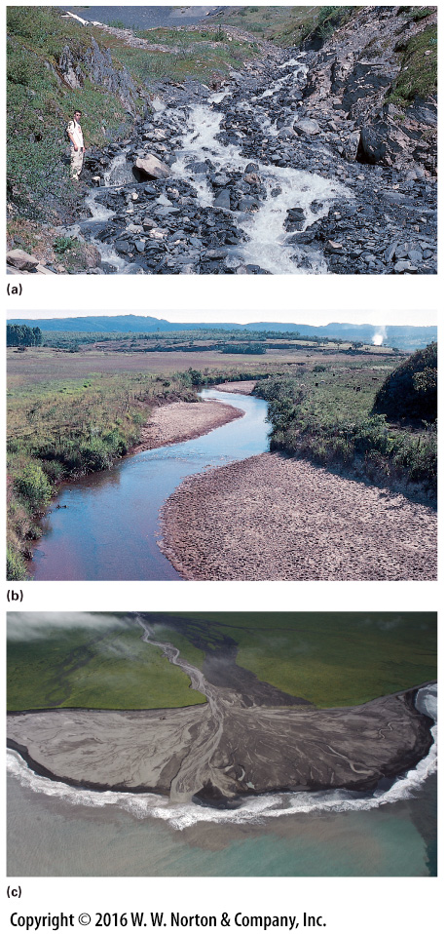
Notes:
FIGURE 14.9 Sediment, carried and deposited by streams. The clast size depends on stream velocity.
(a) Gravel in a streambed of a mountain stream in Denali National Park, Alaska. The large clasts were carried during floods. (b) Point bars of mud deposited along a gentle, slow-moving stream in Brazil. (c) An example of a small delta formed where sediment from a stream has spilled into standing water.

Slide 27
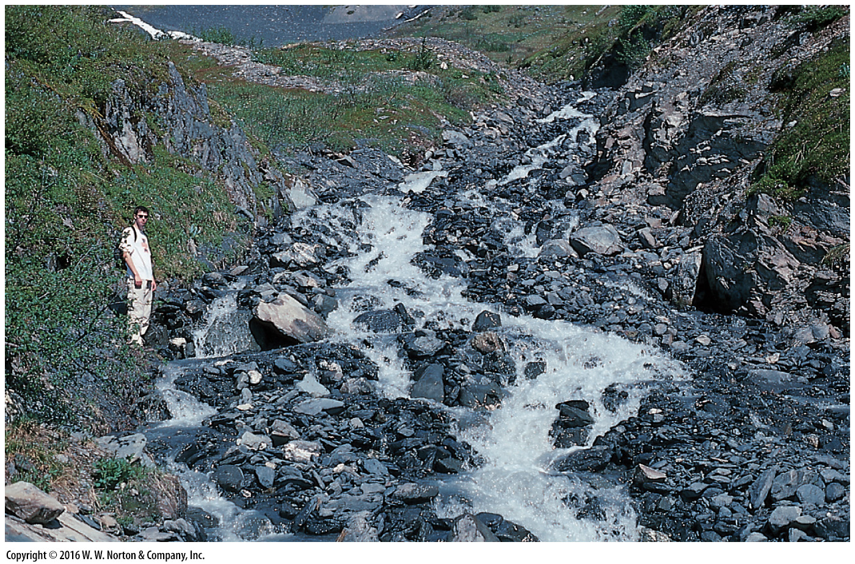
Notes:
FIGURE 14.9a Sediment, carried and deposited by streams. The clast size depends on stream velocity.
(a) Gravel in a streambed of a mountain stream in Denali National Park, Alaska. The large clasts were carried during floods.

Slide 28
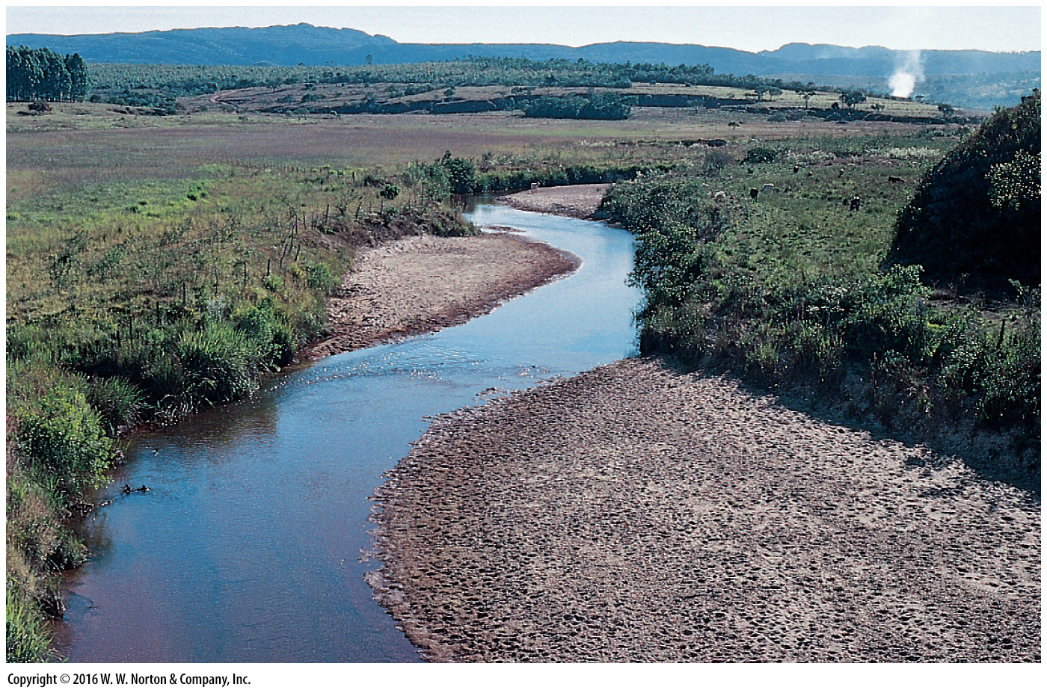
Notes:
FIGURE 14.9b Sediment, carried and deposited by streams. The clast size depends on stream velocity.
(b) Point bars of mud deposited along a gentle, slow-moving stream in Brazil.

Slide 29
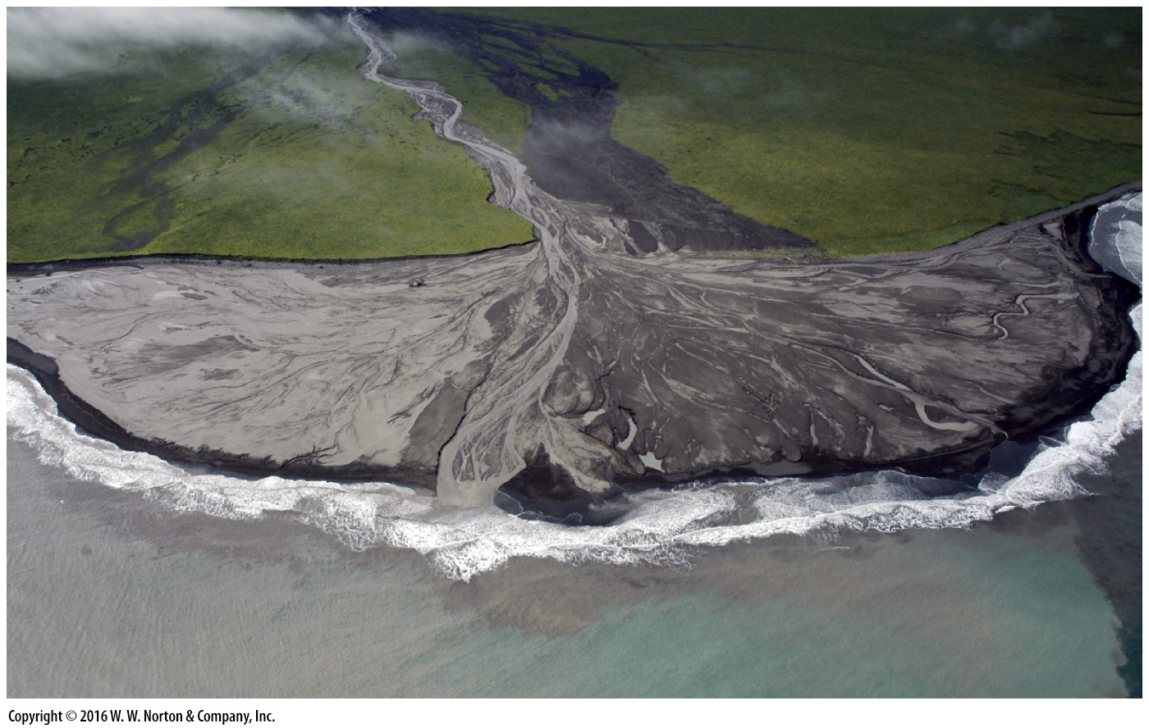
Notes:
FIGURE 14.9c Sediment, carried and deposited by streams. The clast size depends on stream velocity.
(c) An example of a small delta formed where sediment from a stream has spilled into standing water.

Slide 30
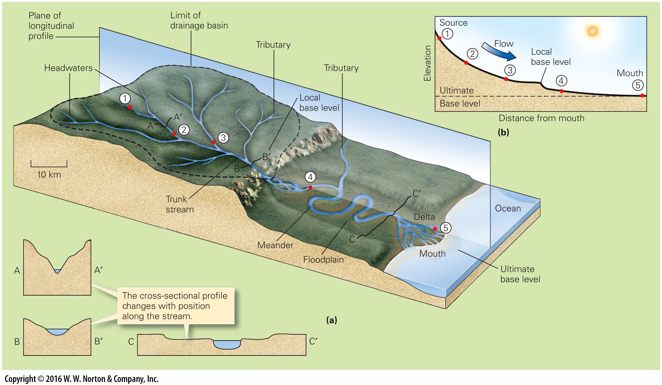
Notes:
FIGURE 14.10 Drainage basins and the change in character of a stream along its longitudinal profile.
(a) A drainage network collects water from a broad drainage basin, or watershed, via numerous tributaries. These carry water to a trunk stream and eventually to a standing body of water. Points 1 to 5 refer to locations along the longitudinal profile (b). (b) In general, the longitudinal profile of a stream (elevation change along its length) is concave up.

Slide 31
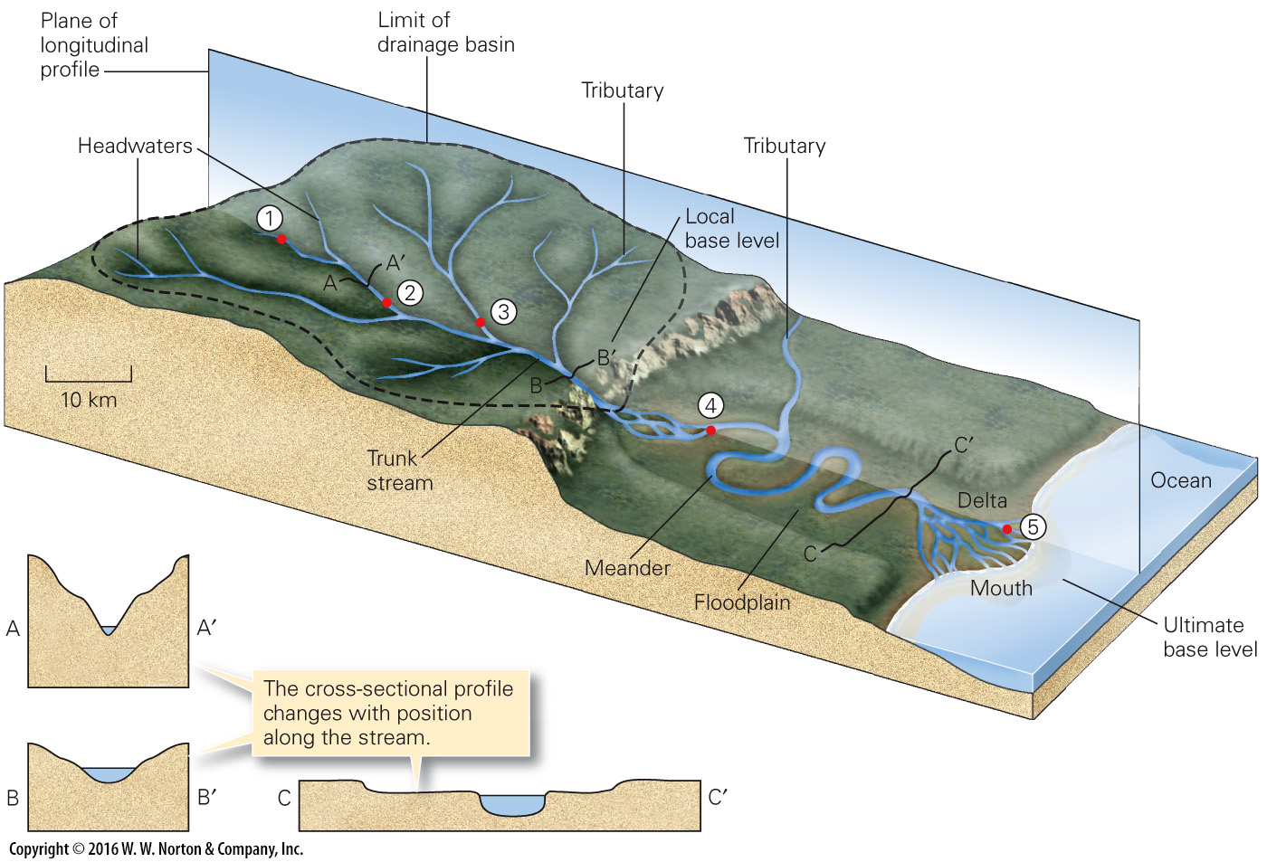
Notes:
FIGURE 14.10a Drainage basins and the change in character of a stream along its longitudinal profile.
(a) A drainage network collects water from a broad drainage basin, or watershed, via numerous tributaries. These carry water to a trunk stream and eventually to a standing body of water. Points 1 to 5 refer to locations along the longitudinal profile (b).

Slide 32
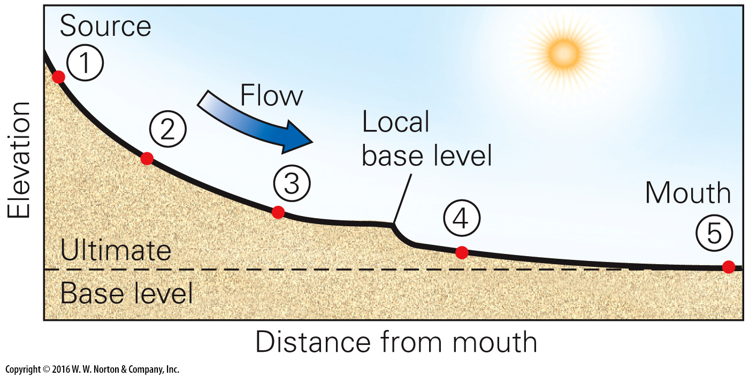
Notes:
FIGURE 14.10b Drainage basins and the change in character of a stream along its longitudinal profile.
(b) In general, the longitudinal profile of a stream (elevation change along its length) is concave up.

Slide 33
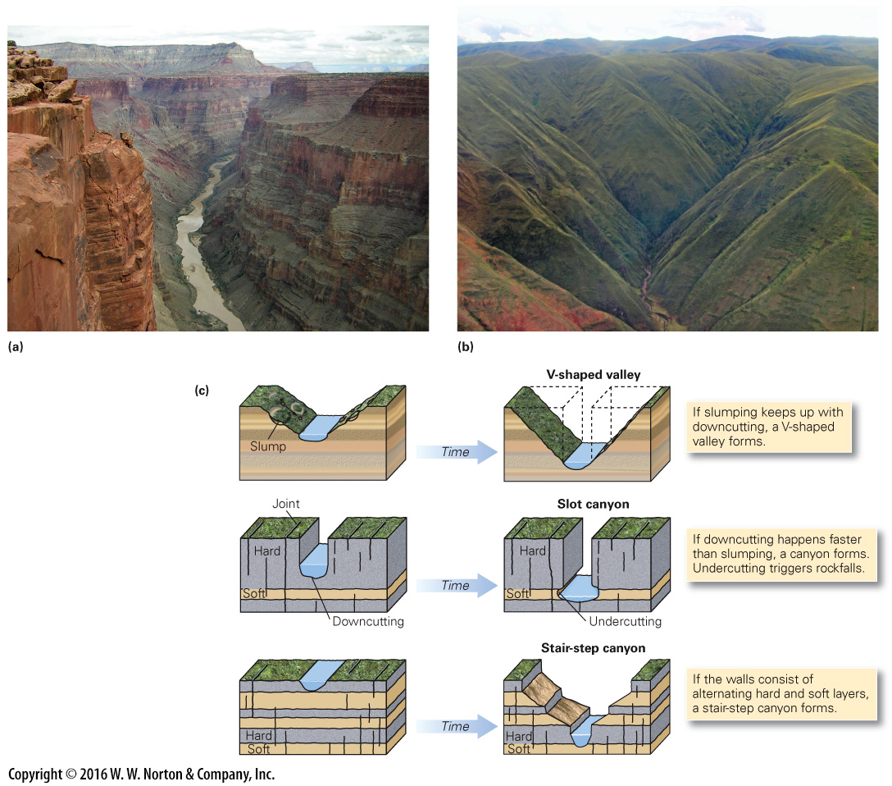
Notes:
FIGURE 14.11 The formation of valleys and canyons.
(a) The Colorado River carved the Grand Canyon, here seen near its west end. (b) V-shaped valleys in the Andes of Peru. (c) The shape of a canyon or valley depends on the relative resistance of walls to erosion, and the rate of downcutting relative to the rate of mass movement.

Slide 34
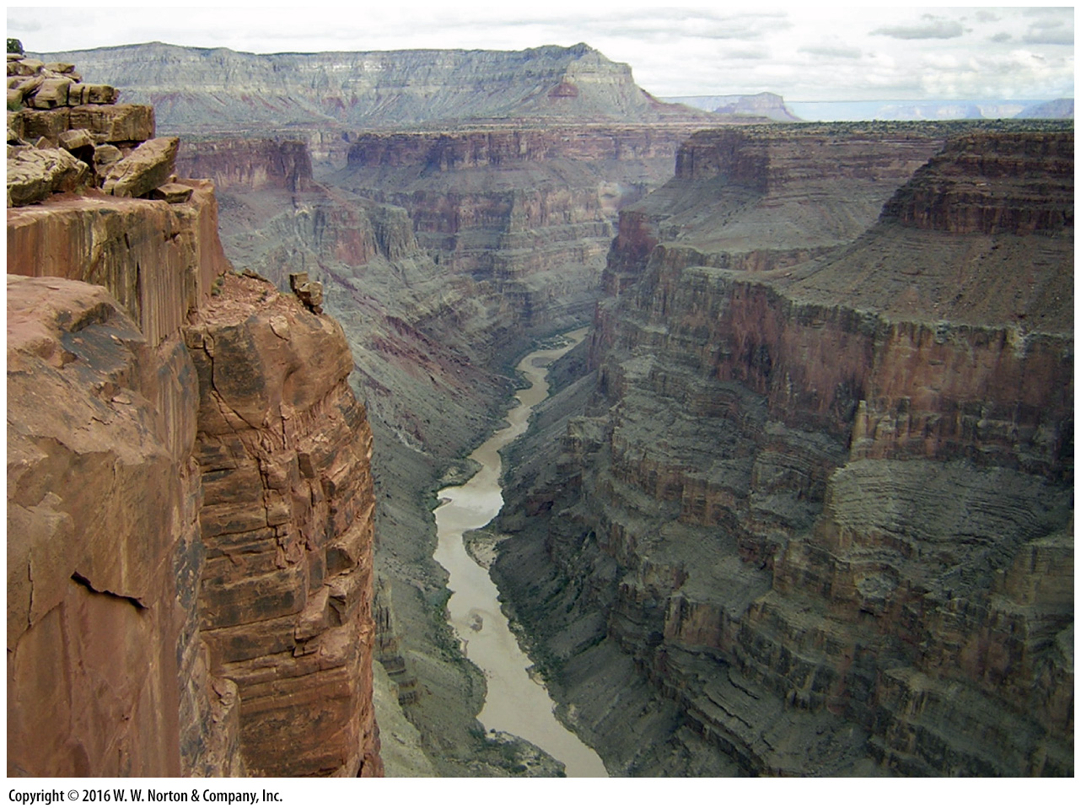
Notes:
FIGURE 14.11a The formation of valleys and canyons.
(a) The Colorado River carved the Grand Canyon, here seen near its west end. (b) V-shaped valleys in the Andes of Peru.

Slide 35
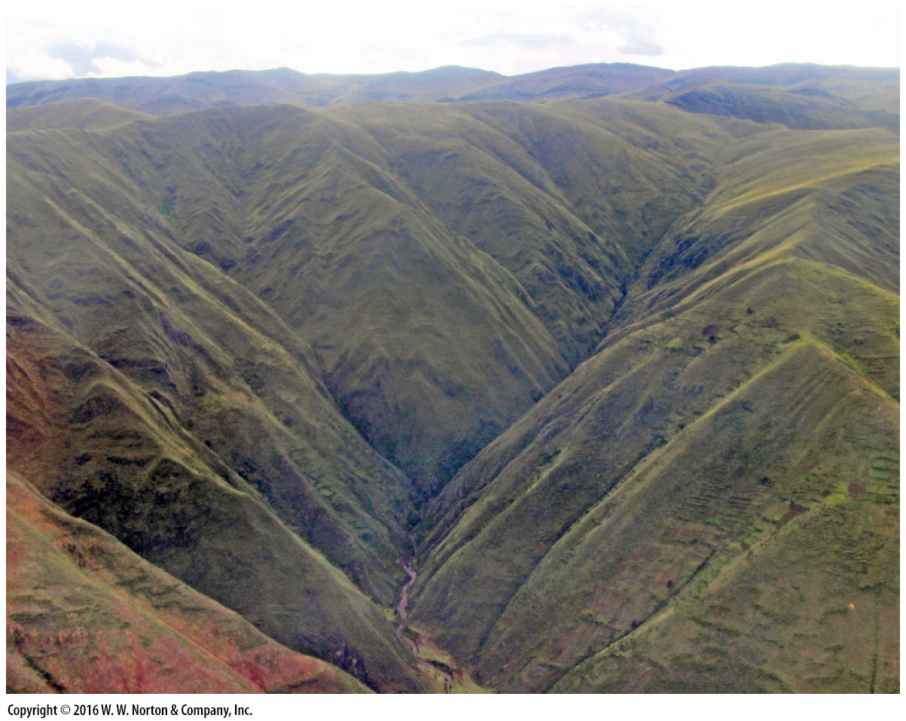
Notes:
FIGURE 14.11b The formation of valleys and canyons.
(b) V-shaped valleys in the Andes of Peru.

Slide 36
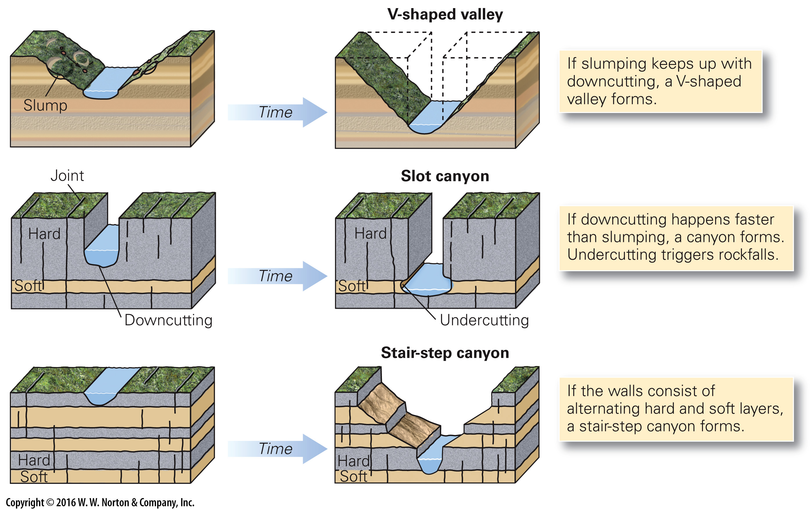
Notes:
FIGURE 14.11c The formation of valleys and canyons.
(c) The shape of a canyon or valley depends on the relative resistance of walls to erosion, and the rate of downcutting relative to the rate of mass movement.

Slide 37
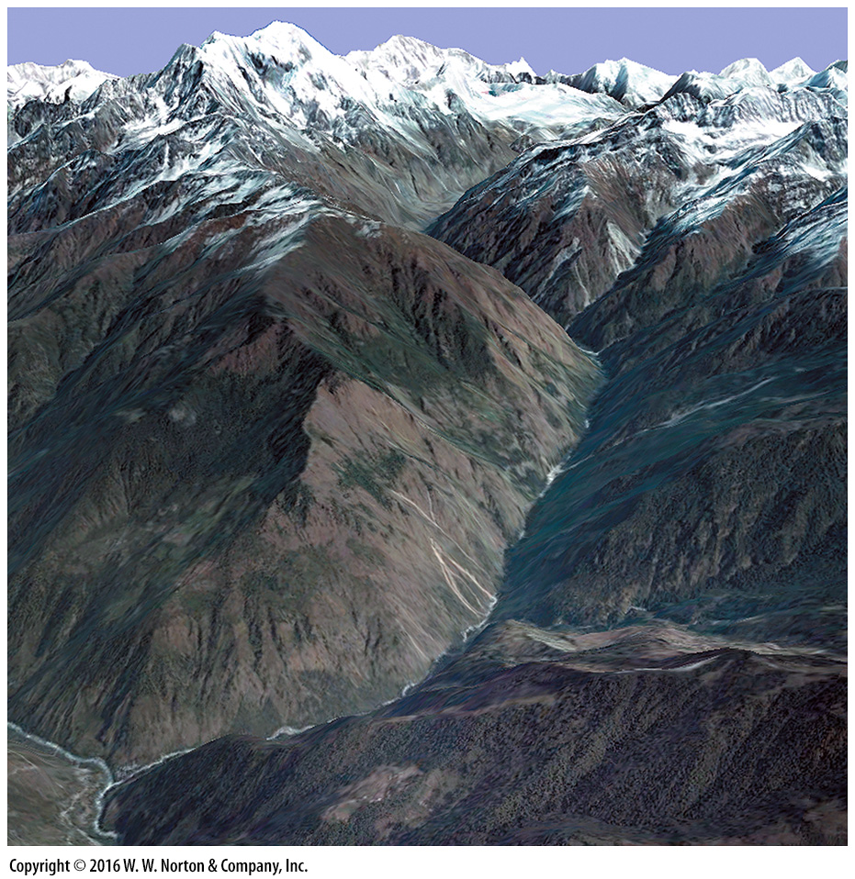
Notes:
SEE FOR YOURSELF…
RIVER-CUT GORGE IN THE HIMALAYAS

Slide 38
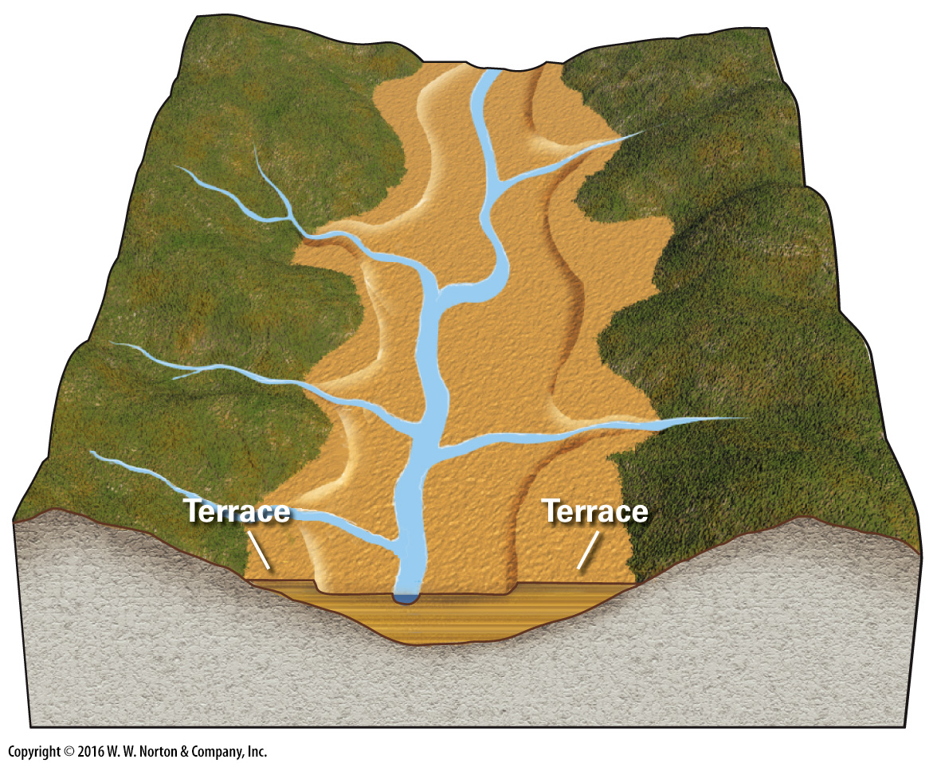
Notes:
FIGURE 14.12 A rise in base level or a decrease in discharge can cause a valley to fill with alluvium. If base level drops, or discharge increases, the stream will cut down into the alluvium, leaving terraces.

Slide 39
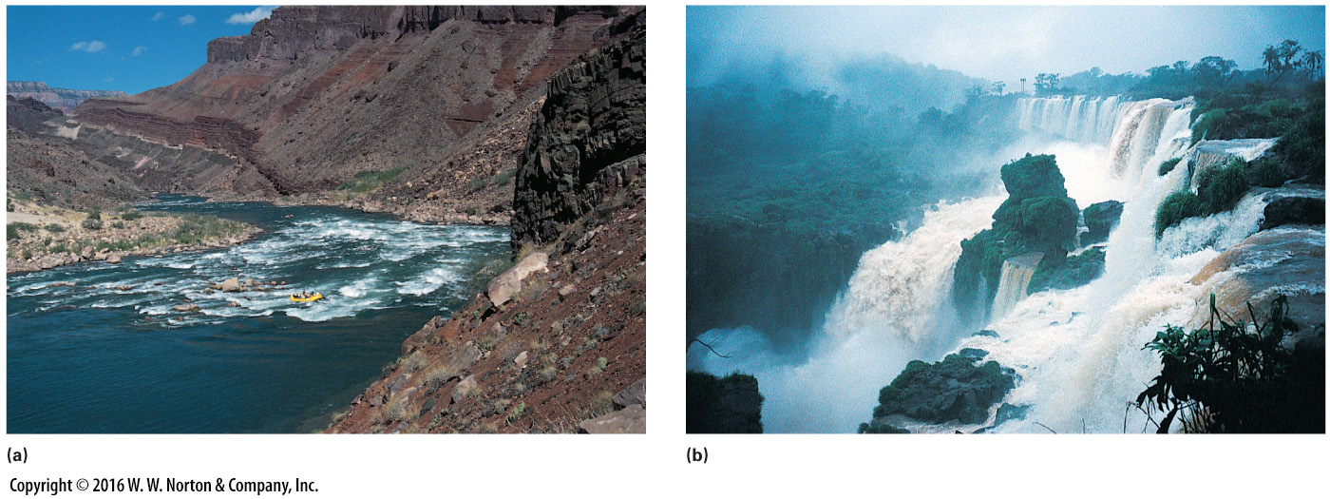
Notes:
FIGURE 14.13 Examples of rapids and waterfalls.
(a) These rapids in the Grand Canyon formed when a flood from a side canyon dumped debris into the channel of the Colorado River. (b) Iguaçu Falls, at the Brazil-Argentina border, spills across layers of basalt. The basalt acts as a resistant ledge.

Slide 40
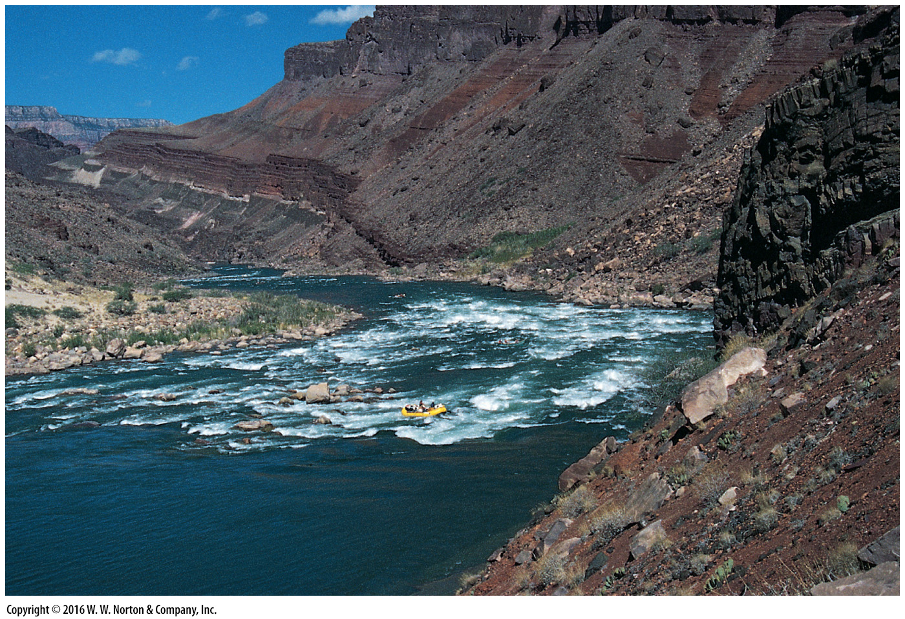
Notes:
FIGURE 14.13a Examples of rapids and waterfalls.
(a) These rapids in the Grand Canyon formed when a flood from a side canyon dumped debris into the channel of the Colorado River.

Slide 41
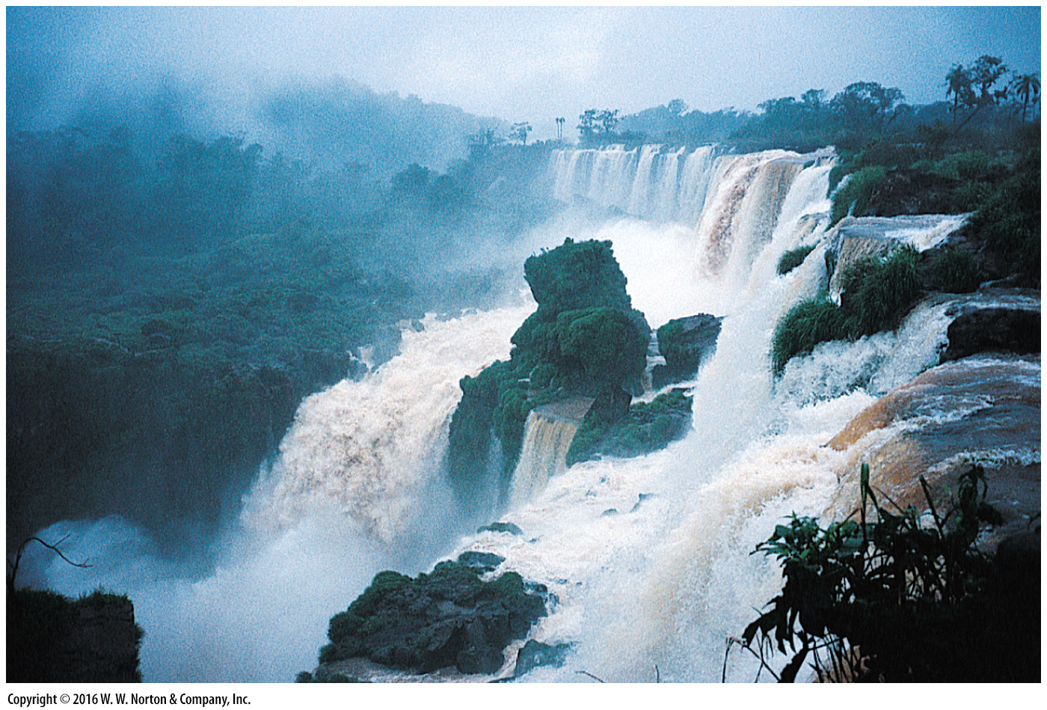
Notes:
FIGURE 14.13b Examples of rapids and waterfalls.
(b) Iguaçu Falls, at the Brazil-Argentina border, spills across layers of basalt. The basalt acts as a resistant ledge.

Slide 42
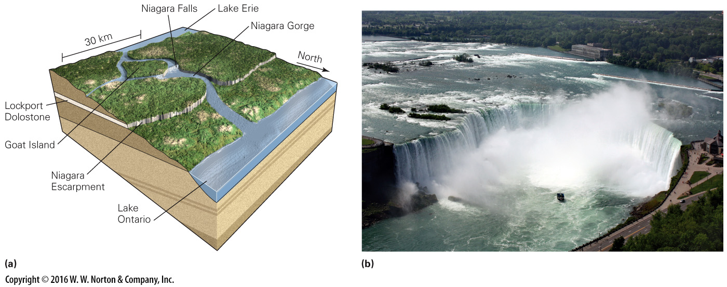
Notes:
FIGURE 14.14 The formation of Niagara Falls, at the border between Ontario, Canada, and New York State. The falls tumble over the Lockport Dolomite, a relatively strong rock layer.
(a) Niagara Falls formed where the outlet of Lake Erie flowed over the Niagara escarpment. (b) At Horseshoe Falls—part of Niagara Falls—headward erosion, on average, causes the lip of the falls to retreat by about 0.5 m per year.

Slide 43
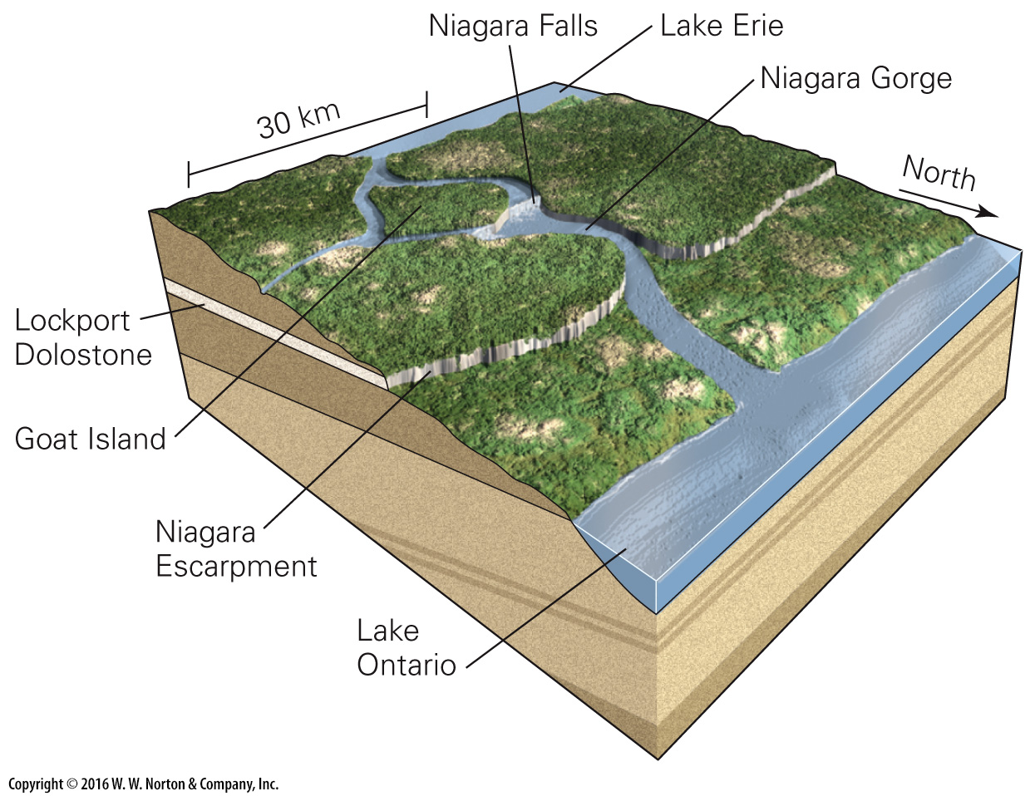
Notes:
FIGURE 14.14a The formation of Niagara Falls, at the border between Ontario, Canada, and New York State. The falls tumble over the Lockport Dolomite, a relatively strong rock layer.
(a) Niagara Falls formed where the outlet of Lake Erie flowed over the Niagara escarpment.

Slide 44
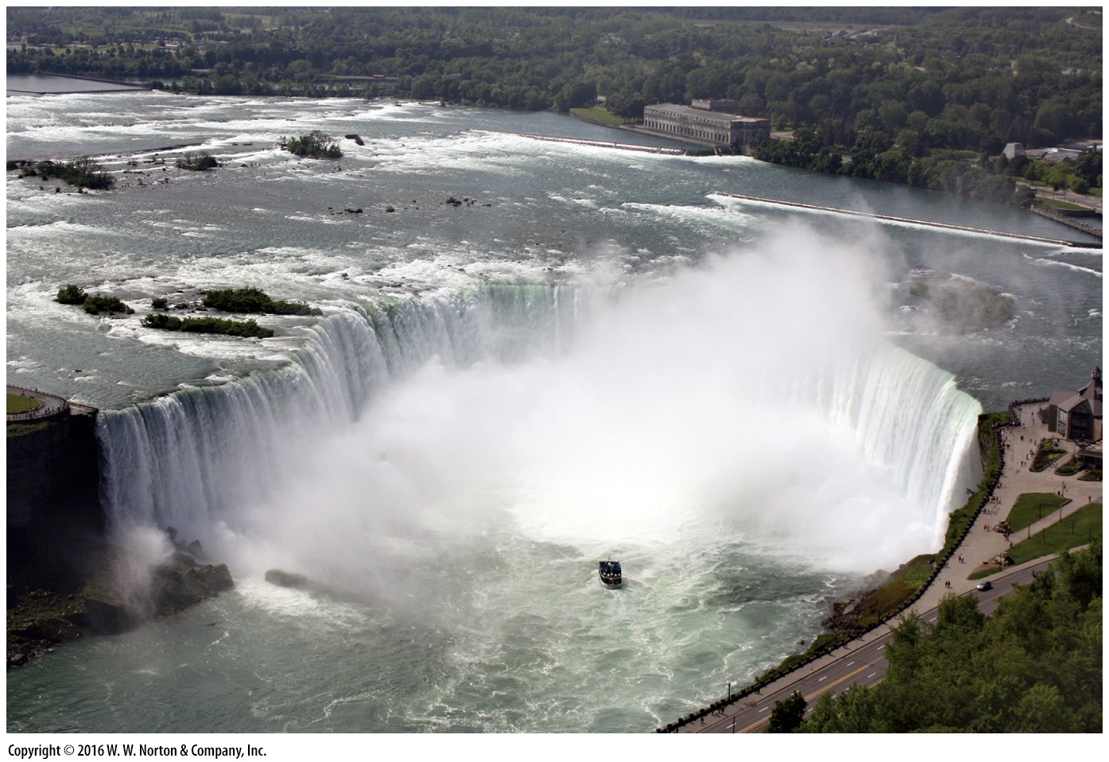
Notes:
FIGURE 14.14b The formation of Niagara Falls, at the border between Ontario, Canada, and New York State. The falls tumble over the Lockport Dolomite, a relatively strong rock layer.
(b) At Horseshoe Falls—part of Niagara Falls—headward erosion, on average, causes the lip of the falls to retreat by about 0.5 m per year.

Slide 45
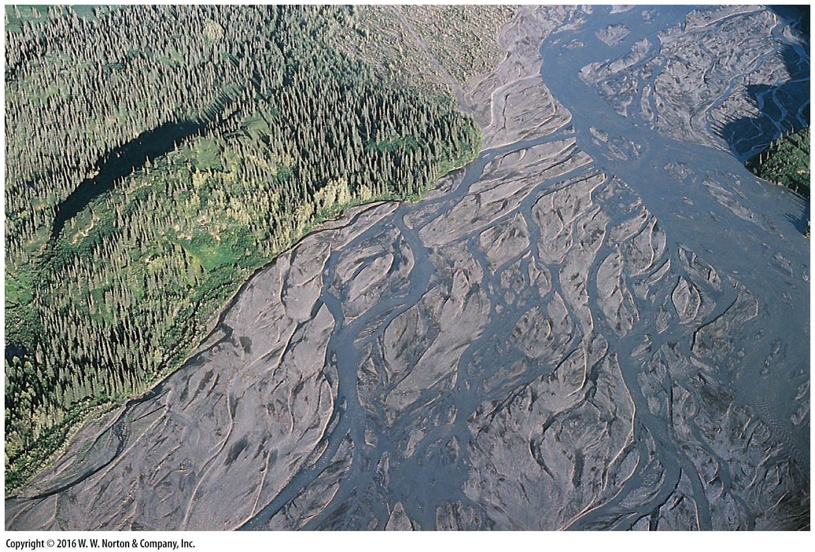
Notes:
FIGURE 14.15a Examples of depositional landforms produced from stream sediment.
(a) A braided stream, carrying meltwater from a glacier near Denali, Alaska, deposits elongate bars of gravel.

Slide 46
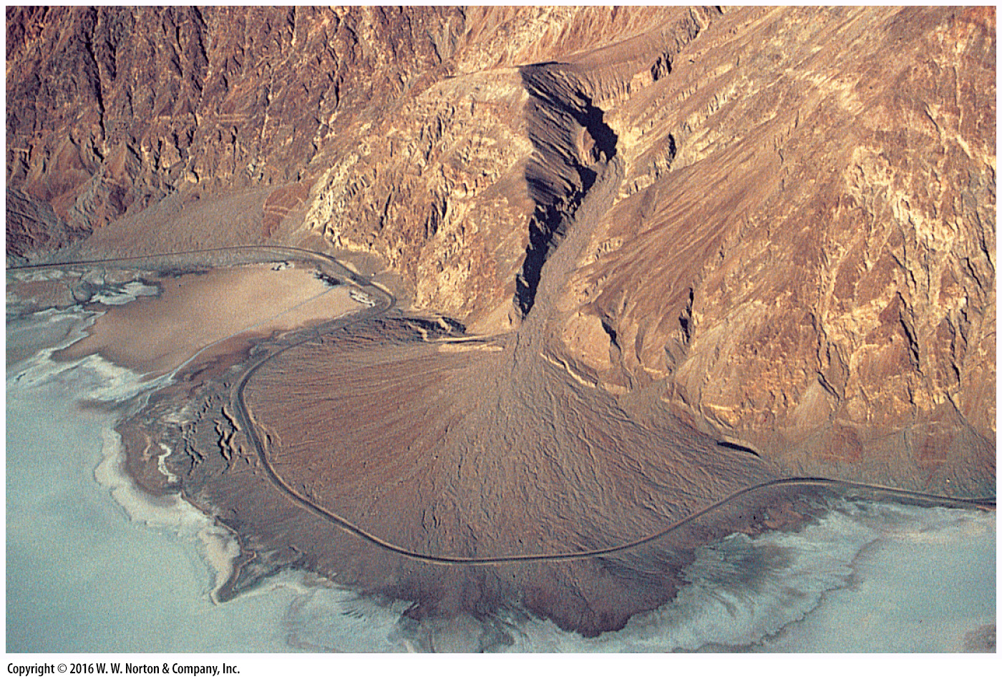
Notes:
FIGURE 14.15b Examples of depositional landforms produced from stream sediment.
(b) An alluvial fan in Death Valley, California, consists of sand, gravel, and debris flows. The curving black line is a road.

Slide 47
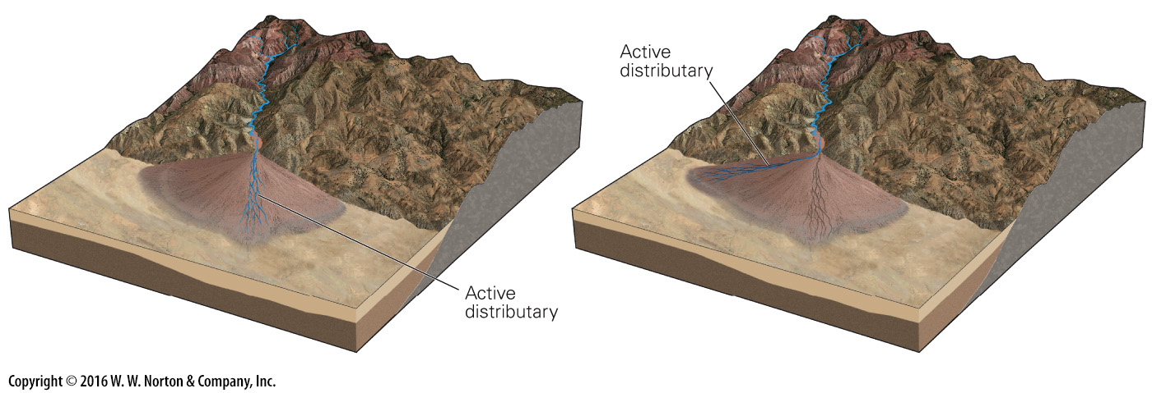
Notes:
FIGURE 14.15c Examples of depositional landforms produced from stream sediment.
(c) Typically, a given flood, bringing sediment, covers only part of the fan. When the gradient in that location decreases, the flow moves to a different, steeper part of the fan.

Slide 48
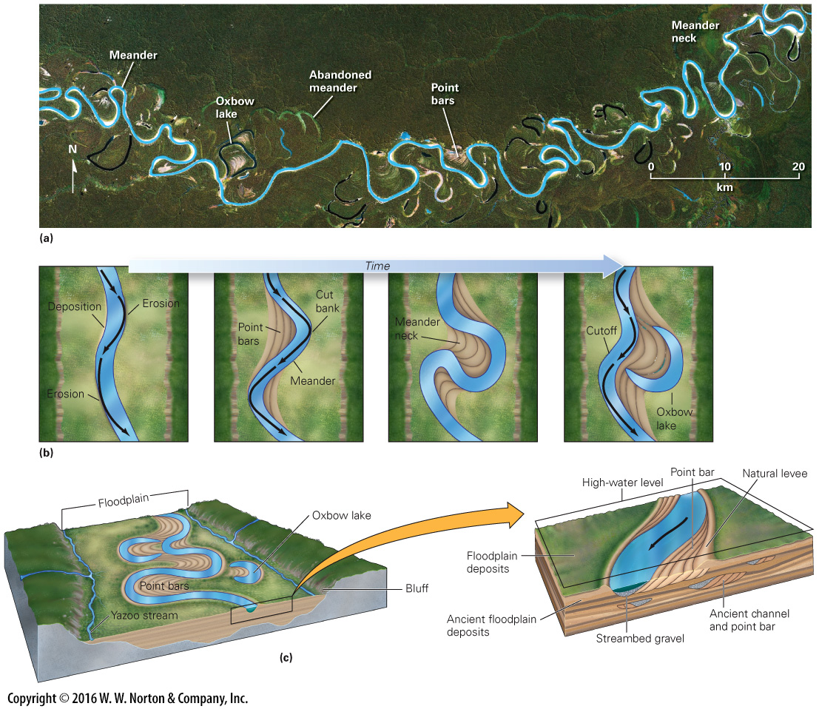
Notes:
FIGURE 14.16 The character and evolution of meandering streams and floodplains.
(a) A meandering stream in Brazil, as viewed from space. Note the oxbows, cutoffs, and abandoned meanders. (b) Meanders evolve because erosion occurs faster on the outer bank of a curve, and deposition takes place on the inner curve. Eventually, a cutoff isolates an oxbow lake. (c) Landforms along meandering streams include natural levees, point bars, and floodplains. Older deposits record the position of ancient channels and floodplains. (d) The flat land of this floodplain hosts farm fields. Trees delineate the channel.

Slide 49
Notes:
FIGURE 14.16a The character and evolution of meandering streams and floodplains.
(a) A meandering stream in Brazil, as viewed from space. Note the oxbows, cutoffs, and abandoned meanders.

Slide 50
Notes:
FIGURE 14.16b The character and evolution of meandering streams and floodplains.
(b) Meanders evolve because erosion occurs faster on the outer bank of a curve, and deposition takes place on the inner curve. Eventually, a cutoff isolates an oxbow lake.

Slide 51
Notes:
FIGURE 14.16c The character and evolution of meandering streams and floodplains.
(c) Landforms along meandering streams include natural levees, point bars, and floodplains. Older deposits record the position of ancient channels and floodplains.

Slide 52
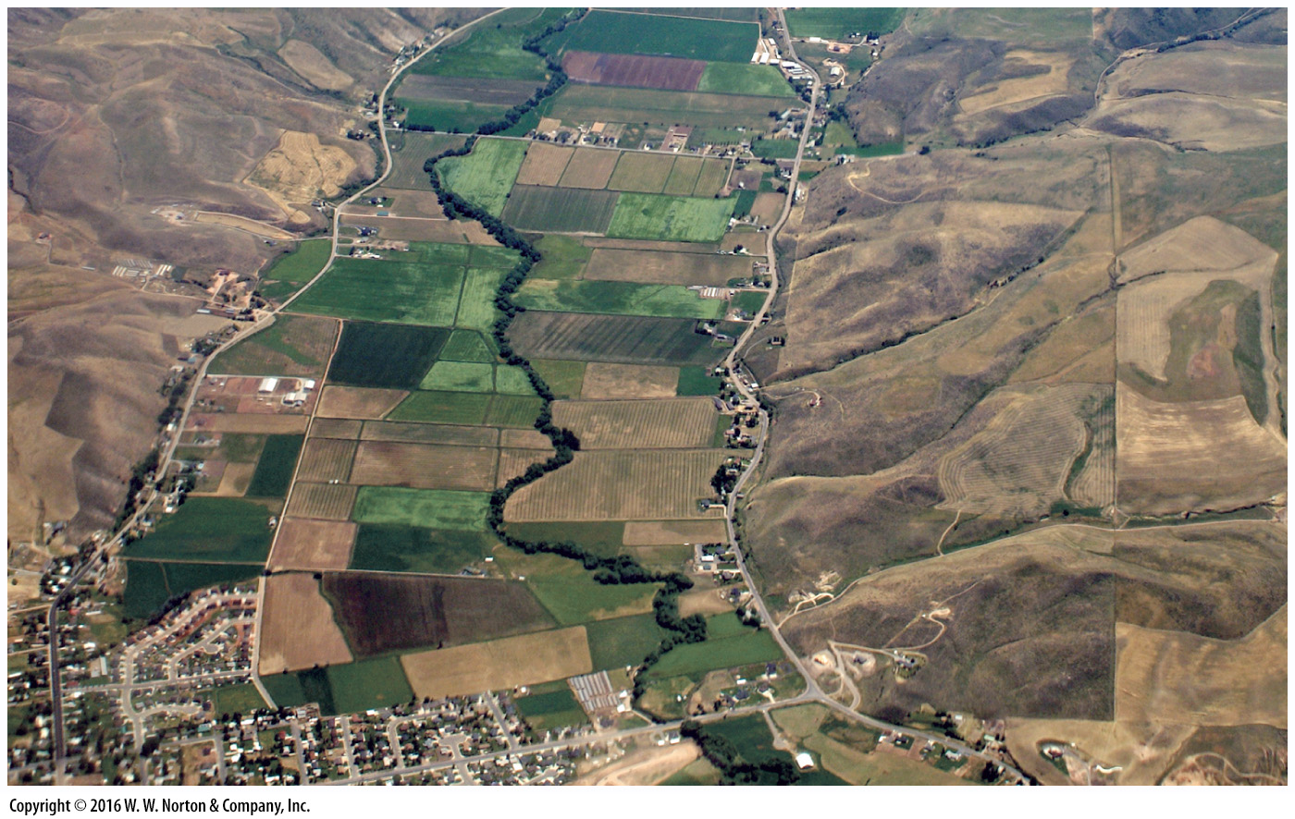
Notes:
FIGURE 14.16d The character and evolution of meandering streams and floodplains.
(d) The flat land of this floodplain hosts farm fields. Trees delineate the channel.

Slide 53
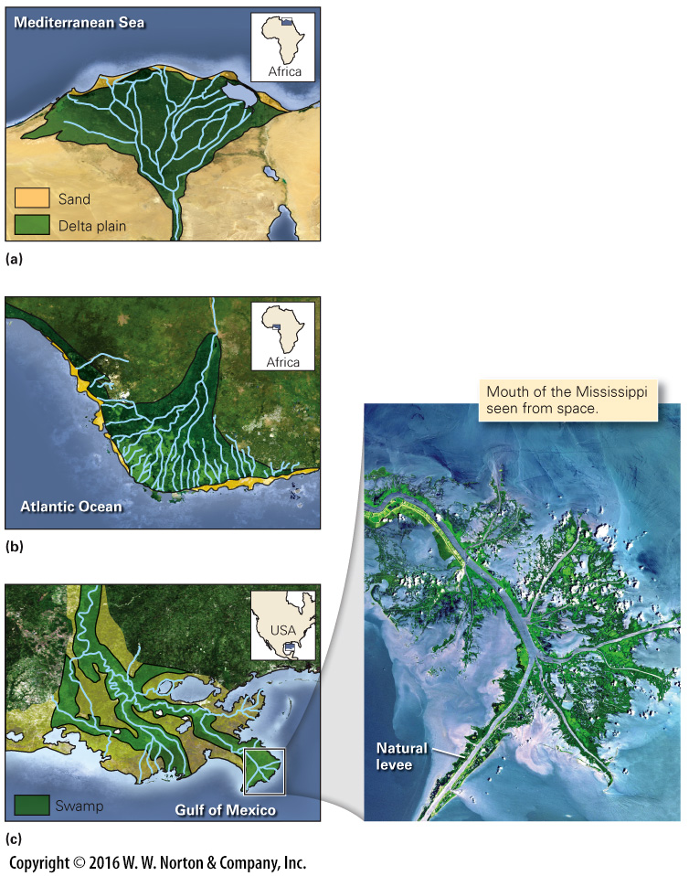
Notes:
FIGURE 14.17 Delta shape varies depending on current activity, waves, and vegetation.
(a) The Nile is a Δ-shaped delta. (b) The Niger is an arc-like delta. (c) The Mississippi is a bird‘s-foot delta.

Slide 54
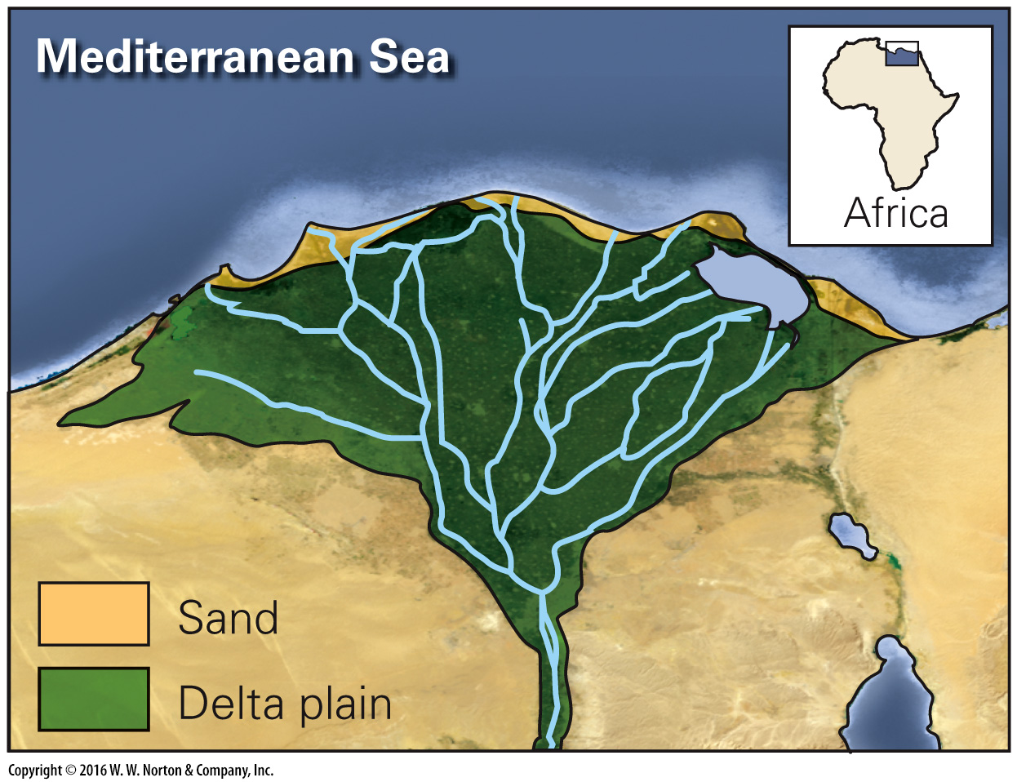
Notes:
FIGURE 14.17a Delta shape varies depending on current activity, waves, and vegetation.
(a) The Nile is a Δ-shaped delta.

Slide 55
Notes:
FIGURE 14.17b Delta shape varies depending on current activity, waves, and vegetation.
(b) The Niger is an arc-like delta.

Slide 56
Notes:
FIGURE 14.17c Delta shape varies depending on current activity, waves, and vegetation.
(c) The Mississippi is a bird‘s-foot delta.

Slide 57
Notes:
FIGURE 14.18 A map showing ancient lobes of the Mississippi Delta. A major flood could divert water from the Mississippi into the channel of the Atchafalaya.

Slide 58
Notes:
FIGURE 14.19a Fluvial landscapes evolve over time.
(a) Evolution of a fluvial landscape when base level drops.

Slide 59
Notes:
FIGURE 14.19b Fluvial landscapes evolve over time.
(b) The “goosenecks” of the San Juan River, Utah, are incised meanders.

Slide 60
Notes:
FIGURE 14.20 The concept of stream capture or piracy.
(a) A drainage divide separates the Hades River from the Persephone River. Headward erosion eventually breaches the divide. (b) The Hades captures the Persephone and carries its water to the Styx Sea. A water gap, where a stream cuts through a ridge, forms and the former Persephone channel becomes a dry canyon.

Slide 61
Notes:
FIGURE 14.20a The concept of stream capture or piracy.
(a) A drainage divide separates the Hades River from the Persephone River. Headward erosion eventually breaches the divide.

Slide 62
Notes:
FIGURE 14.20b The concept of stream capture or piracy.
(b) The Hades captures the Persephone and carries its water to the Styx Sea. A water gap, where a stream cuts through a ridge, forms and the former Persephone channel becomes a dry canyon.

Slide 63
Notes:
FIGURE 14.21 Formation of superposed drainage.
(a) A superposed stream establishes its geometry while flowing over a uniform substrate above an unconformity. (b) When erosion exposes underlying rock with a different structure, the river is superposed on the structure. As a result, it cuts across resistant ridges instead of flowing around them.

Slide 64
Notes:
FIGURE 14.22 Development of antecedent and diverted streams.
(a) Prior to mountain building, a stream flows across a flat landscape to the sea. (b) If stream erosion is faster than mountain uplift, the stream cuts across the range and is antecedent. (c) If uplift happens faster than erosion, the stream is diverted and flows along the edge of the range.

Slide 65
Notes:
FIGURE 14.23 Examples of seasonal floodplain flooding.
(a) Satellite images show how the rivers in the Midwestern United States covered their floodplains. (b) Flooding along the Missouri River, in 1993. (c) Seasonal floods of Bangladesh submerge whole villages.

Slide 66
Notes:
FIGURE 14.23a Examples of seasonal floodplain flooding.
(a) Satellite images show how the rivers in the Midwestern United States covered their floodplains.

Slide 67
Notes:
FIGURE 14.23b Examples of seasonal floodplain flooding.
(b) Flooding along the Missouri River, in 1993.

Slide 68
Notes:
FIGURE 14.23c Examples of seasonal floodplain flooding.
(c) Seasonal floods of Bangladesh submerge whole villages.

Slide 69
Notes:
FIGURE 14.24 Flash floods can occur after torrential rains.
(a) A flash flood in a desert region of Israel has washed over a highway, forcing the evacuation of truckers. (b) During the 1976 Big Thompson River flash flood, this house was carried off its foundation and dropped on a bridge.

Slide 70
Notes:
FIGURE 14.24a Flash floods can occur after torrential rains.
(a) A flash flood in a desert region of Israel has washed over a highway, forcing the evacuation of truckers.

Slide 71
Notes:
FIGURE 14.24b Flash floods can occur after torrential rains.
(b) During the 1976 Big Thompson River flash flood, this house was carried off its foundation and dropped on a bridge.

Slide 72
Notes:
FIGURE Bx14.1 During the 1889 Johnstown flood, raging waters could tumble large houses.

Slide 73
Notes:
FIGURE 14.25 Holding back rivers to prevent floods.
(a) Engineers build artificial levees to keep floodwater in the channel. Levees weaken and may fail when infiltrated by water. (b) Breaching of a levee lets water spill into the floodplain. (c) Floodwalls, which can be closed to protect Cape Girardeau, Missouri, from Mississippi River floods.

Slide 74
Notes:
FIGURE 14.25a Holding back rivers to prevent floods.
(a) Engineers build artificial levees to keep floodwater in the channel. Levees weaken and may fail when infiltrated by water.

Slide 75
Notes:
FIGURE 14.25b Holding back rivers to prevent floods.
(b) Breaching of a levee lets water spill into the floodplain.

Slide 76
Notes:
FIGURE 14.25c Holding back rivers to prevent floods.
(c) Floodwalls, which can be closed to protect Cape Girardeau, Missouri, from Mississippi River floods.

Slide 77
Notes:
GEOLOGY AT A GLANCE
River Systems

Slide 78
Notes:
GEOLOGY AT A GLANCE
River Systems

Slide 79
Notes:
GEOLOGY AT A GLANCE
River Systems

Slide 80
Notes:
GEOLOGY AT A GLANCE
River Systems

Slide 81
Notes:
GEOLOGY AT A GLANCE
River Systems

Slide 82
Notes:
GEOLOGY AT A GLANCE
River Systems

Slide 83
Notes:
GEOLOGY AT A GLANCE
River Systems

Slide 84
Notes:
GEOLOGY AT A GLANCE
River Systems

Slide 85
Notes:
FIGURE 14.26 The conceptual relationship between flood size and probability.
(a) A 100-year flood covers a larger area than a 2-year flood and occurs less frequently. (b) A flood-frequency graph shows the relationship between the recurrence interval and the discharge for an idealized river. (c) A flood-hazard map shows areas likely to be flooded. Here, near Rock Island, Illinois, even large floods are confined to the floodplain.

Slide 86
Notes:
FIGURE 14.26a The conceptual relationship between flood size and probability.
(a) A 100-year flood covers a larger area than a 2-year flood and occurs less frequently.

Slide 87
Notes:
FIGURE 14.26b The conceptual relationship between flood size and probability.
(b) A flood-frequency graph shows the relationship between the recurrence interval and the discharge for an idealized river.

Slide 88
Notes:
FIGURE 14.26c The conceptual relationship between flood size and probability.
(c) A flood-hazard map shows areas likely to be flooded. Here, near Rock Island, Illinois, even large floods are confined to the floodplain.

Slide 89
Notes:
FIGURE 14.27 The Central Arizona Project canal shunts water from the Colorado River to Phoenix.

