Slide 1
Stephen Marshak
ESSENTIALS OF
Geology
FIFTH EDITION
Chapter 15
Restless Realm:
Oceans and Coasts
©2016 W. W. Norton & Company, Inc.

Slide 2
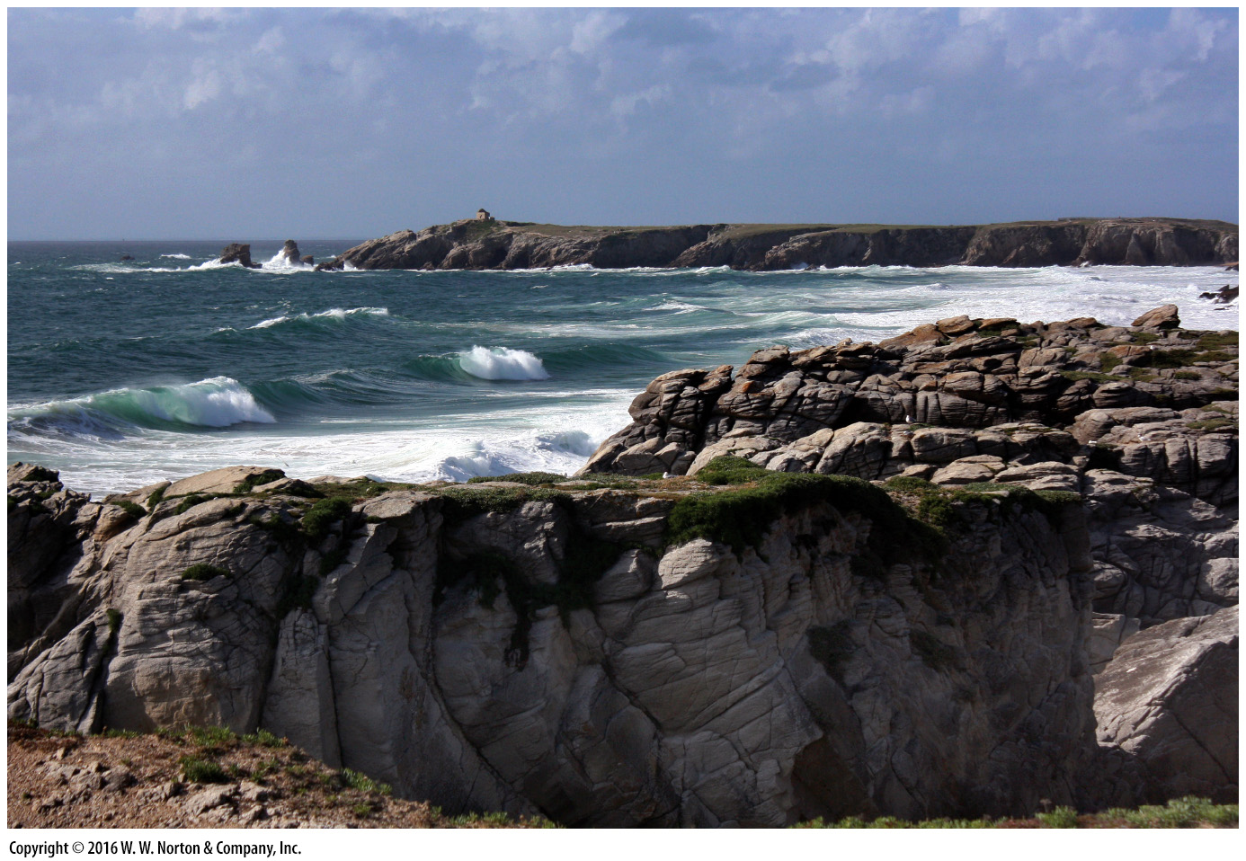
Notes:
The rocky coast of Brittany in northwestern France gets pounded by waves, which gradually carve headlands and bays. The ocean is constantly in motion.

Slide 3
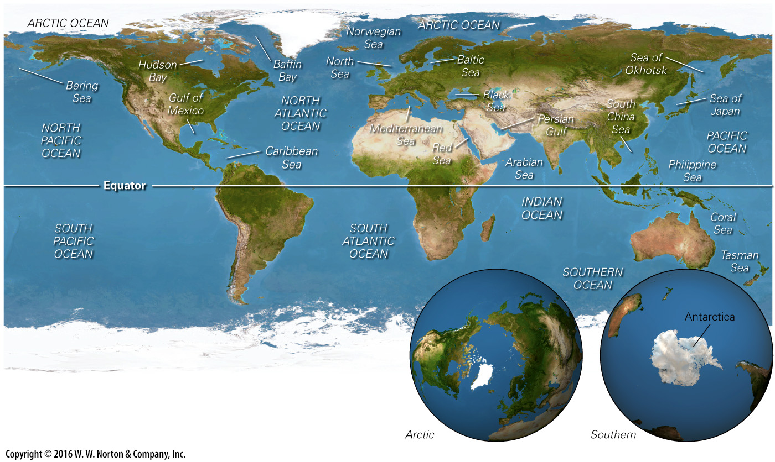
Notes:
FIGURE 15.1 The oceans of the world. The Pacific is the largest, covering almost half the planet. The Arctic region is an ocean covered by a thin coating of ice, whereas the Antarctic region is a continent.

Slide 4
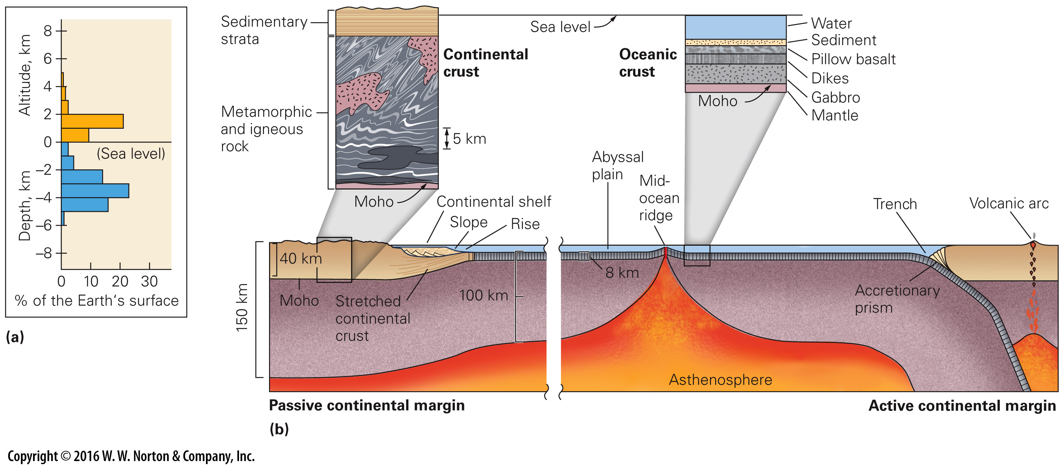
Notes:
FIGURE 15.2 Contrasts between continental lithosphere and oceanic lithosphere
(a) A graph showing the percentage of Earth’s surface at different altitudes above or below sea level. (b) The crustal portion of the continental lithosphere differs markedly from that of oceanic lithosphere.

Slide 5
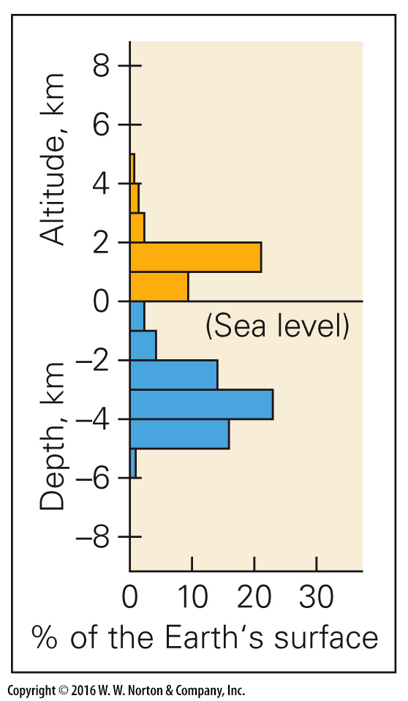
Notes:
FIGURE 15.2a Contrasts between continental lithosphere and oceanic lithosphere
(a) A graph showing the percentage of Earth’s surface at different altitudes above or below sea level.

Slide 6
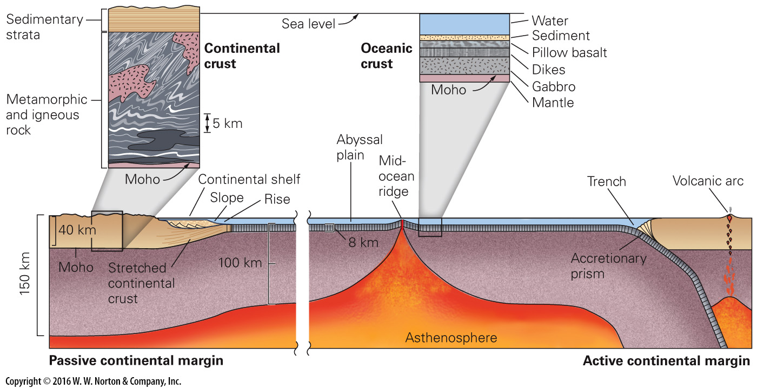
Notes:
FIGURE 15.2b Contrasts between continental lithosphere and oceanic lithosphere
(b) The crustal portion of the continental lithosphere differs markedly from that of oceanic lithosphere.

Slide 7
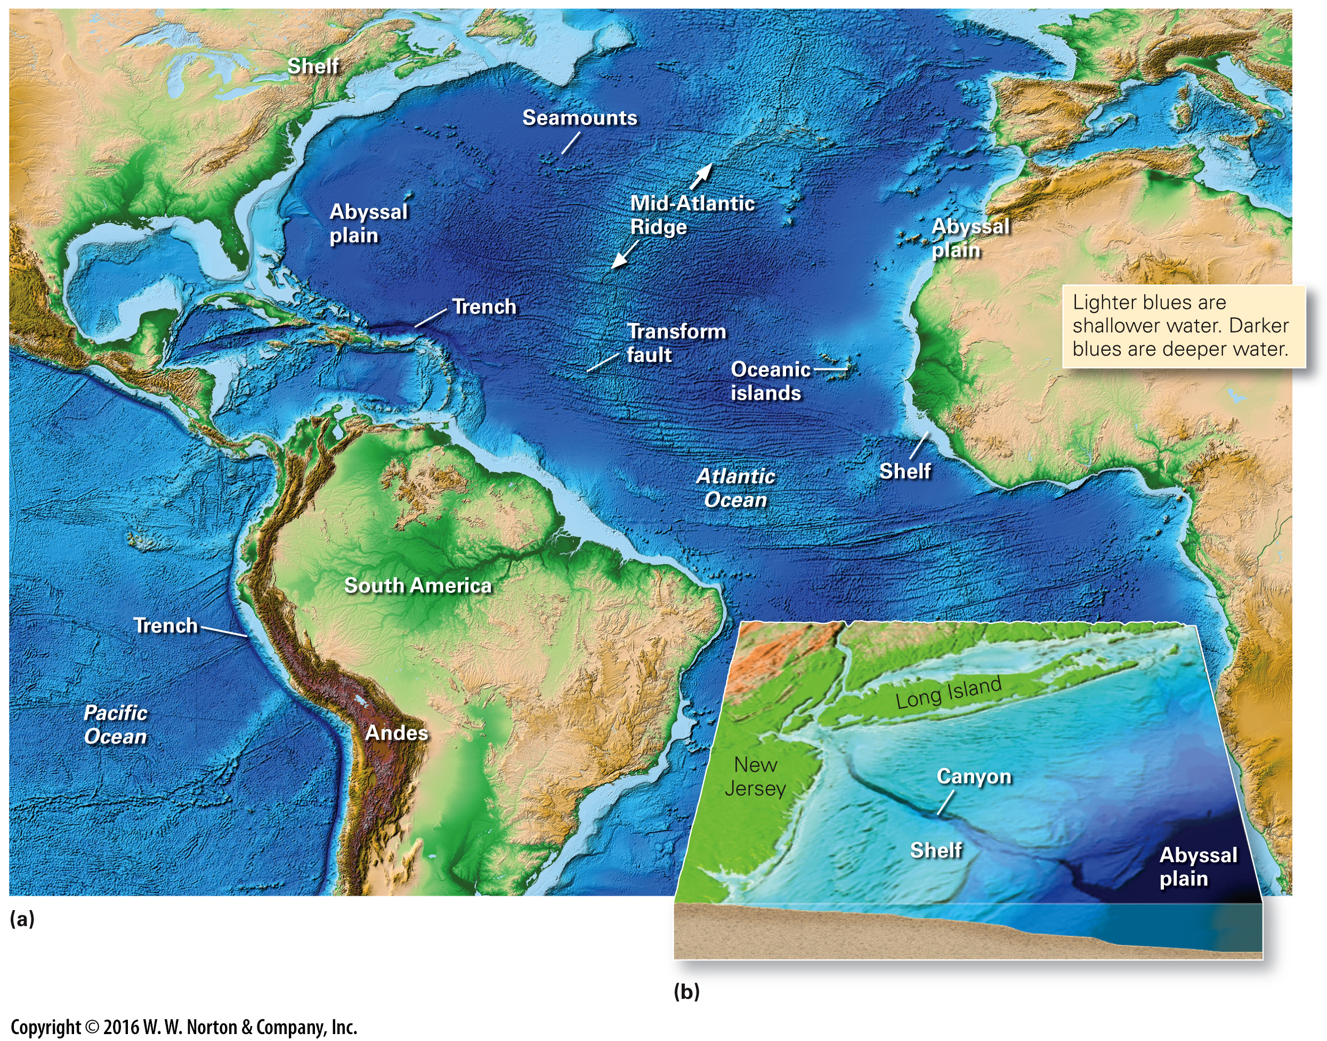
Notes:
FIGURE 15.3 Bathymetric features of the seafloor. The maps are produced by computer using measurements from satellites or submersibles.
(a) Passive margins appear on both sides of the Atlantic and in the Gulf of Mexico. Active margins border the Caribbean Sea and the western coast of South America. (b) A submarine canyon along the coast of New Jersey. Turbidity currents in submarine canyons carry sediment to the abyssal plain.

Slide 8
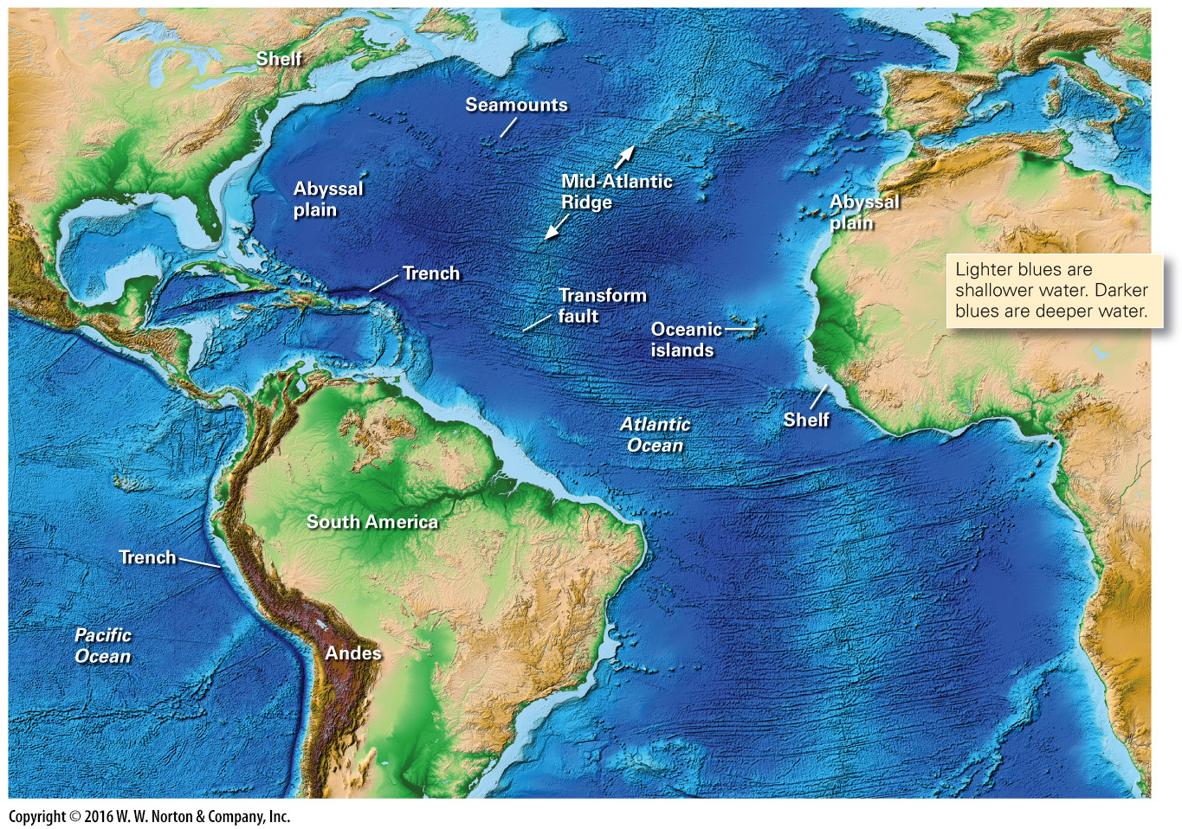
Notes:
FIGURE 15.3a Bathymetric features of the seafloor. The maps are produced by computer using measurements from satellites or submersibles.
(a) Passive margins appear on both sides of the Atlantic and in the Gulf of Mexico. Active margins border the Caribbean Sea and the western coast of South America.

Slide 9
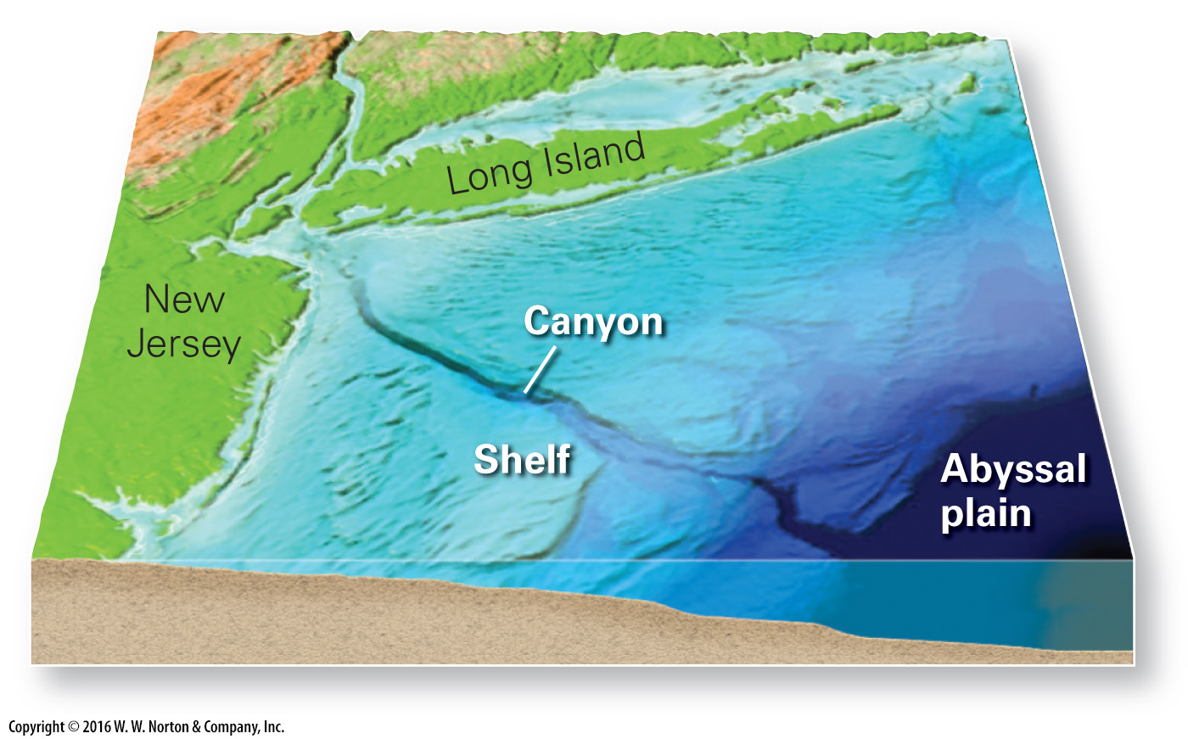
Notes:
FIGURE 15.3b Bathymetric features of the seafloor. The maps are produced (b) A submarine canyon along the coast of New Jersey. Turbidity currents in submarine canyons carry sediment to the abyssal plain.

Slide 10
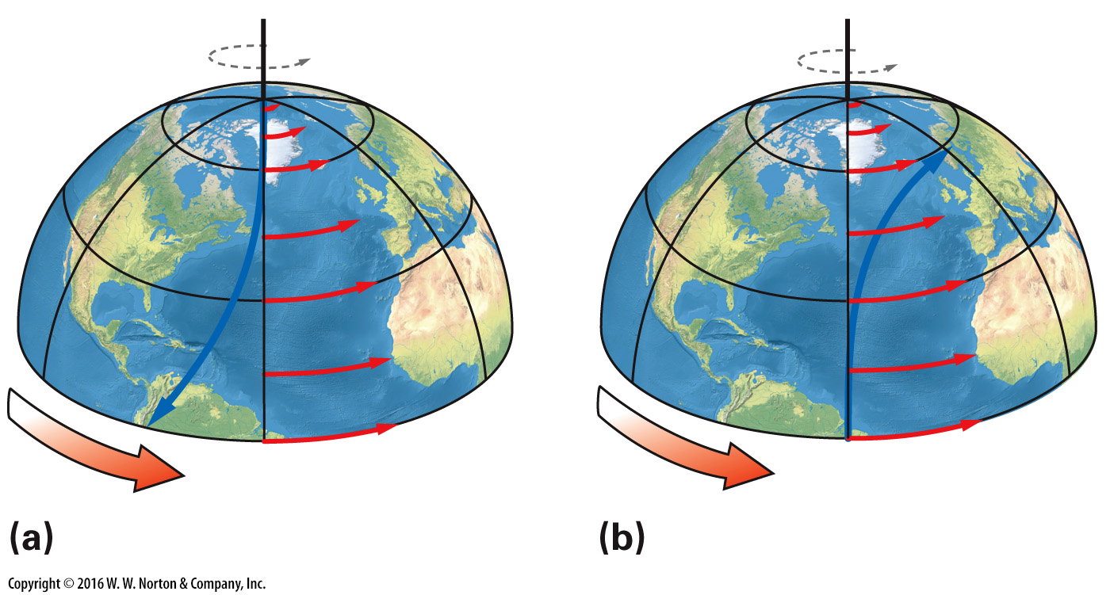
Notes:
FIGURE Bx15.1 The Coriolis effect occurs because the velocity of a point at the equator, in the direction of the Earth’s spin, is greater than that of a point near the pole.
(a) A projectile shot from the pole to the equator deflects to the west. (b) A projectile shot from the equator to the pole deflects to the east.

Slide 11
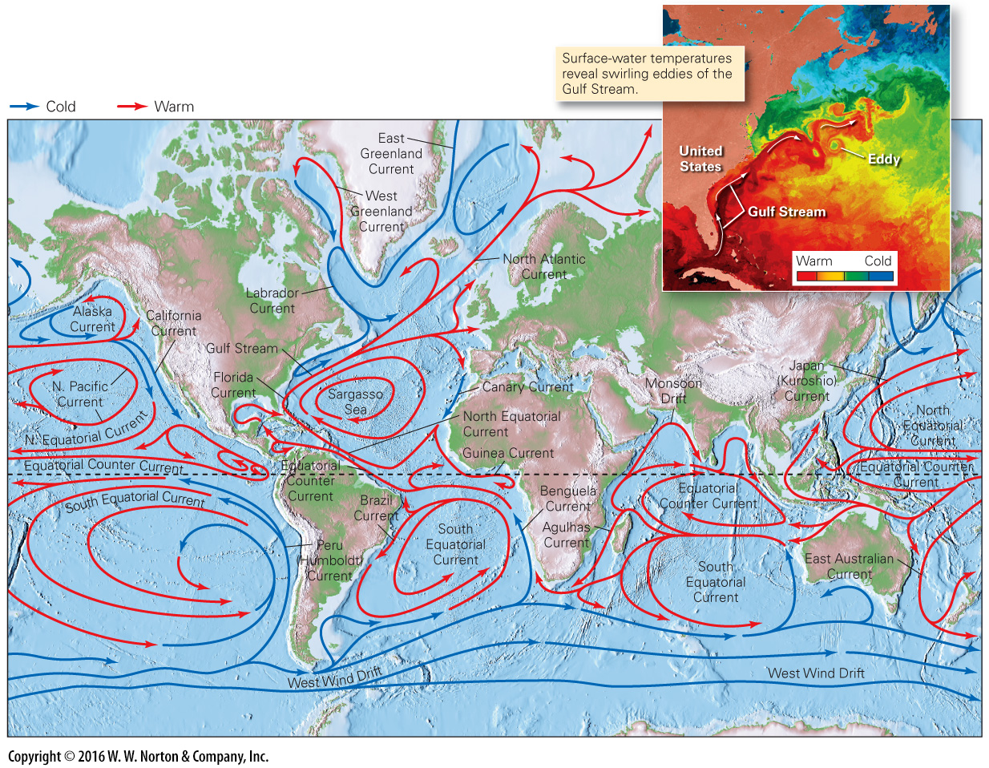
Notes:
FIGURE 15.4 A simplified map showing the major surface currents of the world’s oceans. The color key distinguishes cold from warm currents, and the inset shows a detail of the Gulf Stream, which carries warm water to the northeast.

Slide 12
Notes:
FIGURE 15.5 Animations of ocean currents, prepared by NASA based on data collected over a two-year period, show the complexities that develop where currents shear against the margins of the continents or are squeezed between land masses. The circular flows are eddies.

Slide 13
Notes:
FIGURE 15.6 Global-scale upwelling and downwelling of ocean water.
(a) Thermohaline circulation results in a global-scale conveyor belt that circulates water throughout the entire ocean system. The ocean mixes entirely in a 1,500-year period. (b) Due to variations in density, the oceans are stratified into distinct water masses.

Slide 14
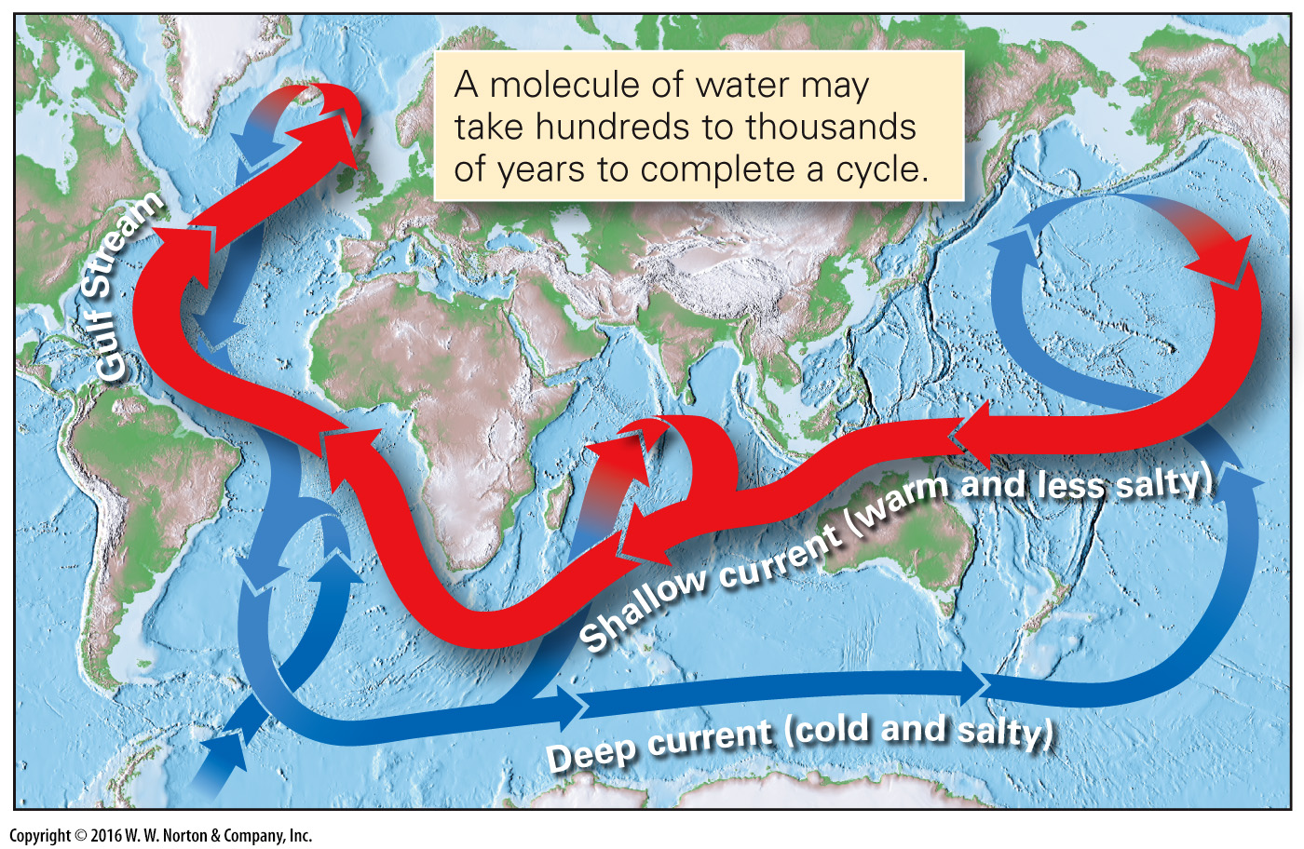
Notes:
FIGURE 15.6a Global-scale upwelling and downwelling of ocean water.
(a) Thermohaline circulation results in a global-scale conveyor belt that circulates water throughout the entire ocean system. The ocean mixes entirely in a 1,500-year period.

Slide 15
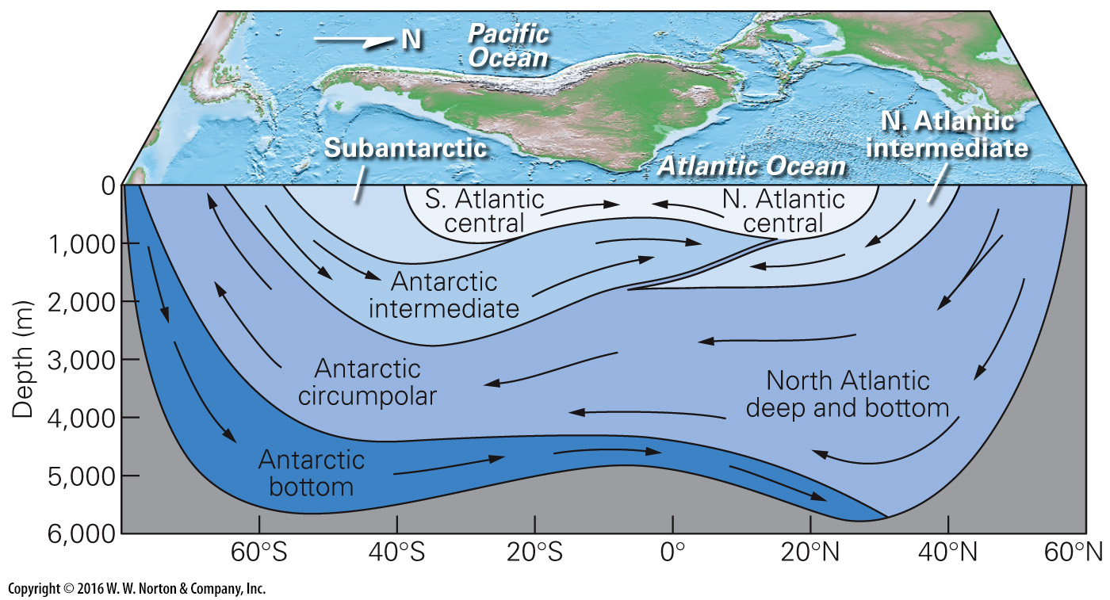
Notes:
FIGURE 15.6b Global-scale upwelling and downwelling of ocean water.
(b) Due to variations in density, the oceans are stratified into distinct water masses.

Slide 16
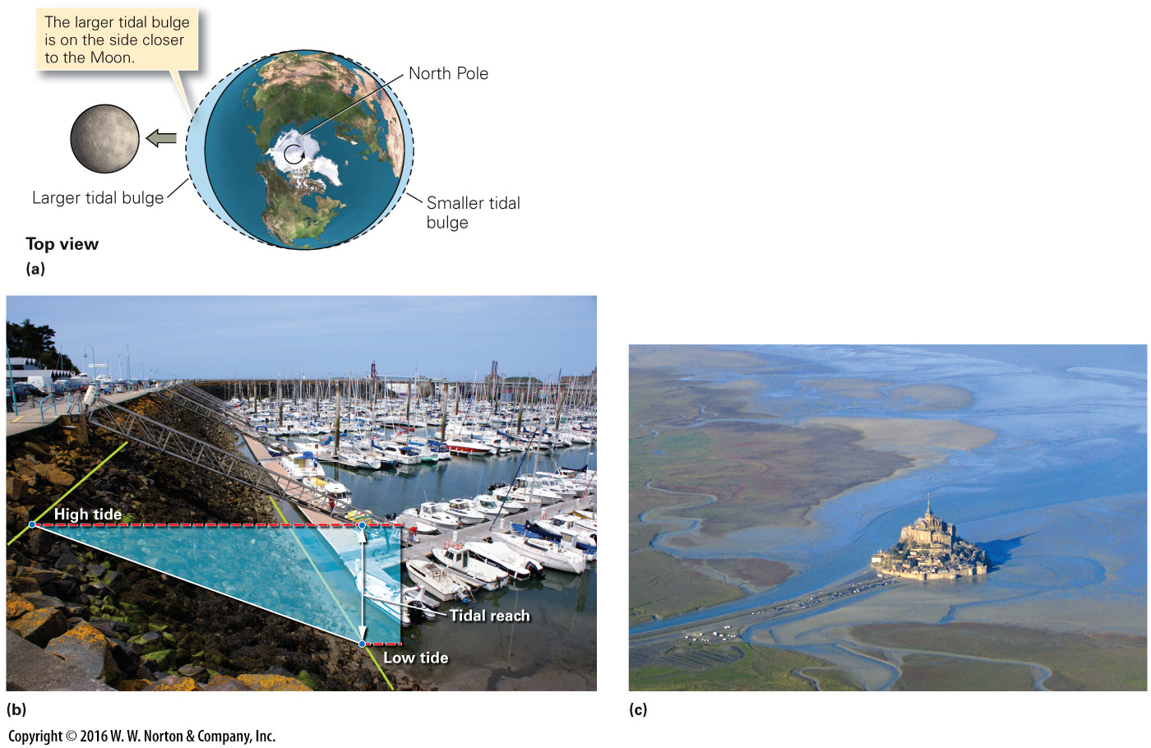
Notes:
FIGURE 15.7 Ocean tides and their manifestation.
(a) Tides develop as the Earth spins relative to the two tidal bulges. (b) The tidal reach is the vertical distance between low tide and high tide. This photo of a French harbor was taken at low tide. (c) A broad tidal flat is exposed at low tide around Mont Saint-Michel, on the coast of France.

Slide 17
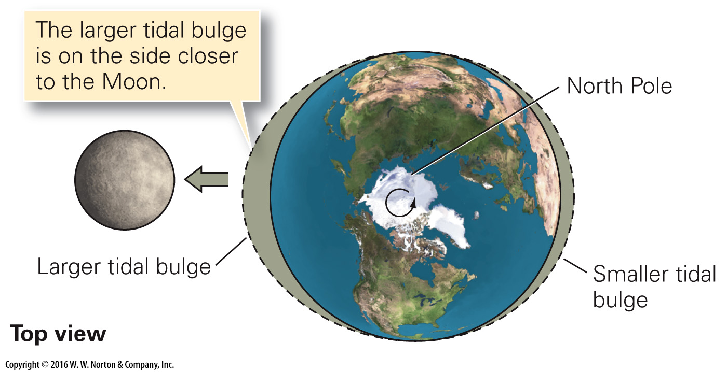
Notes:
FIGURE 15.7a Ocean tides and their manifestation.
(a) Tides develop as the Earth spins relative to the two tidal bulges.

Slide 18
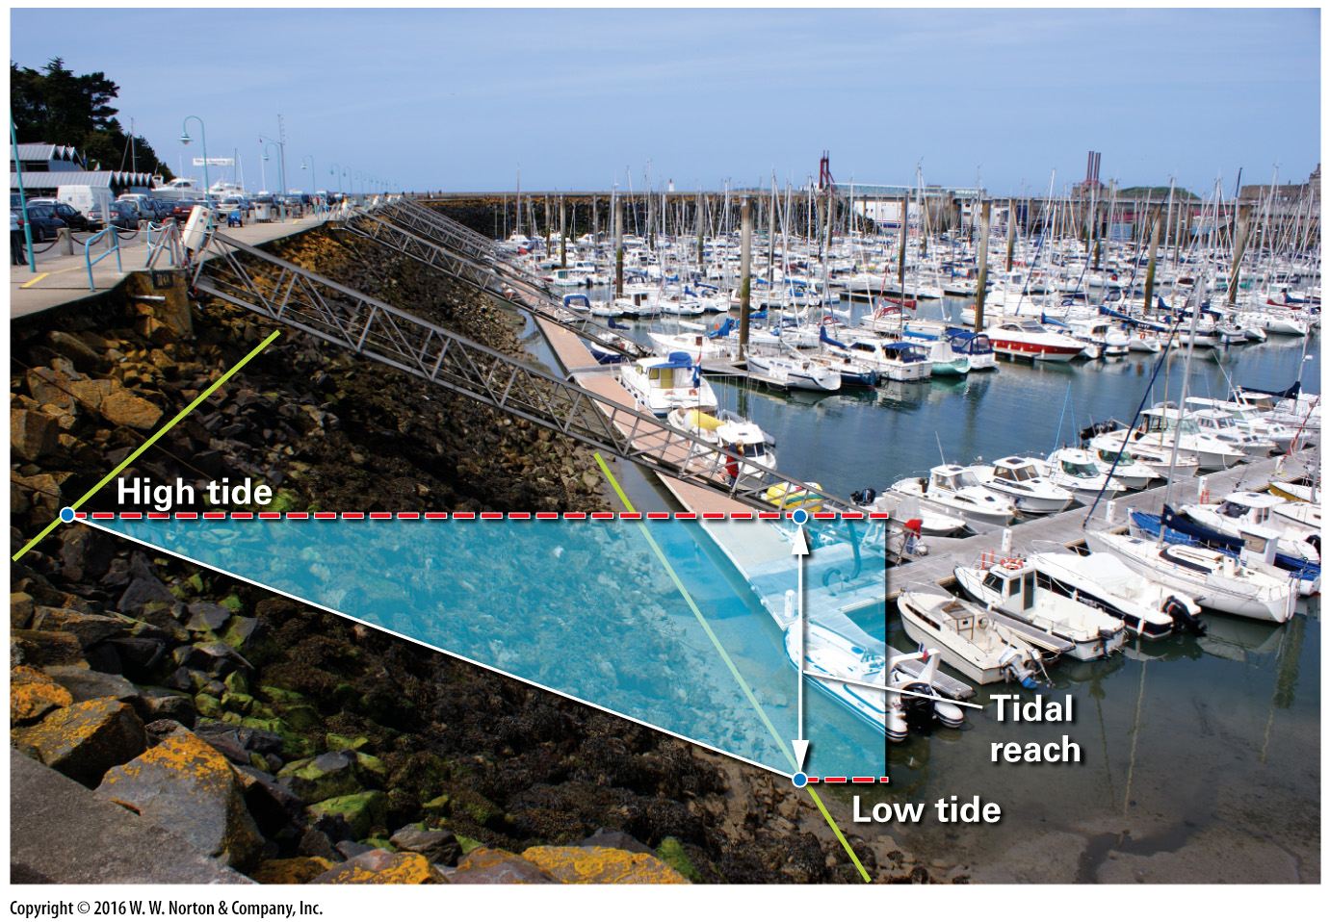
Notes:
FIGURE 15.7b Ocean tides and their manifestation.
(b) The tidal reach is the vertical distance between low tide and high tide. This photo of a French harbor was taken at low tide.

Slide 19
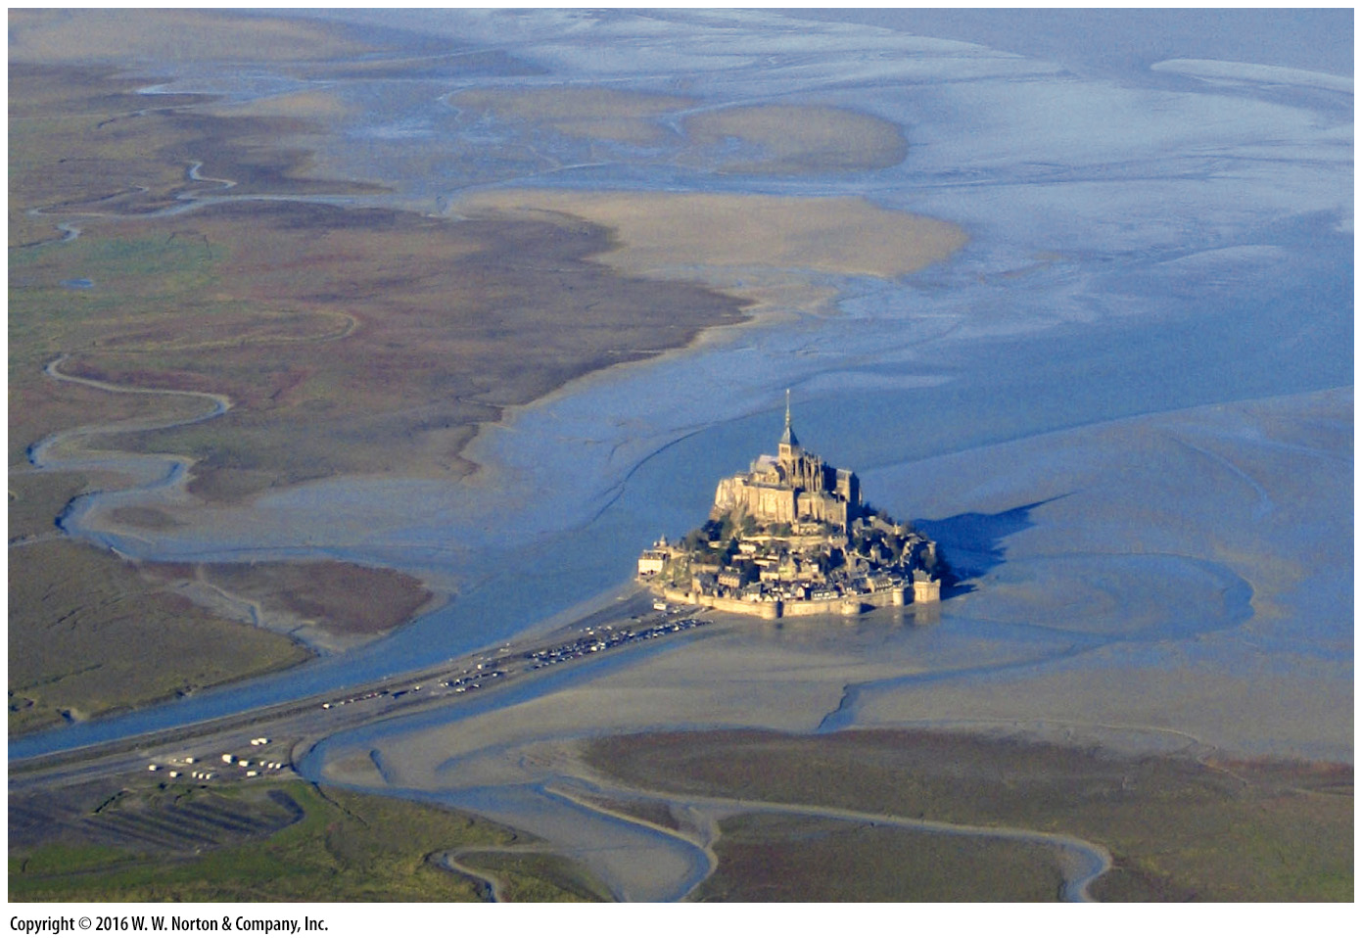
Notes:
FIGURE 15.7c Ocean tides and their manifestation.
(c) A broad tidal flat is exposed at low tide around Mont Saint-Michel, on the coast of France.

Slide 20
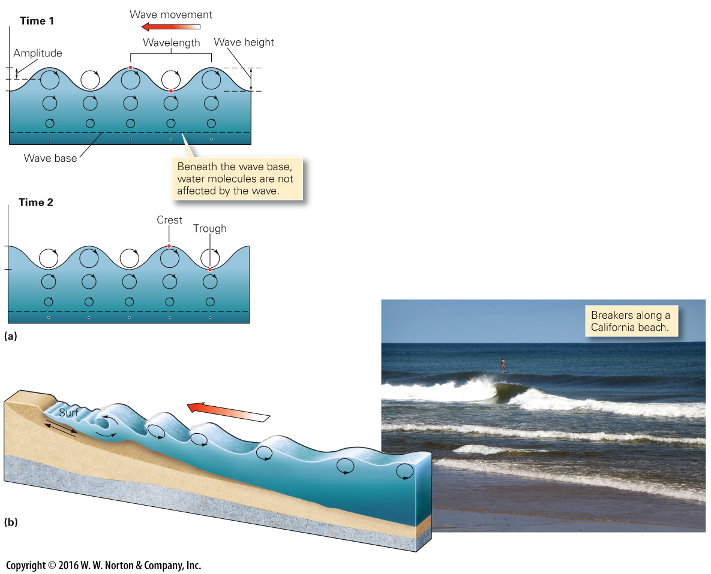
Notes:
FIGURE 15.8 Ocean waves build in response to the shear of wind blowing over the water surface.
(a) Within a deep-ocean wave, water molecules follow a circular path. The radius of the circle decreases with depth. Note that the wave height is twice the amplitude. (b) As the wave approaches shore, friction slows its base. Water motion in the wave becomes more elliptical, and the wave becomes a breaker.

Slide 21
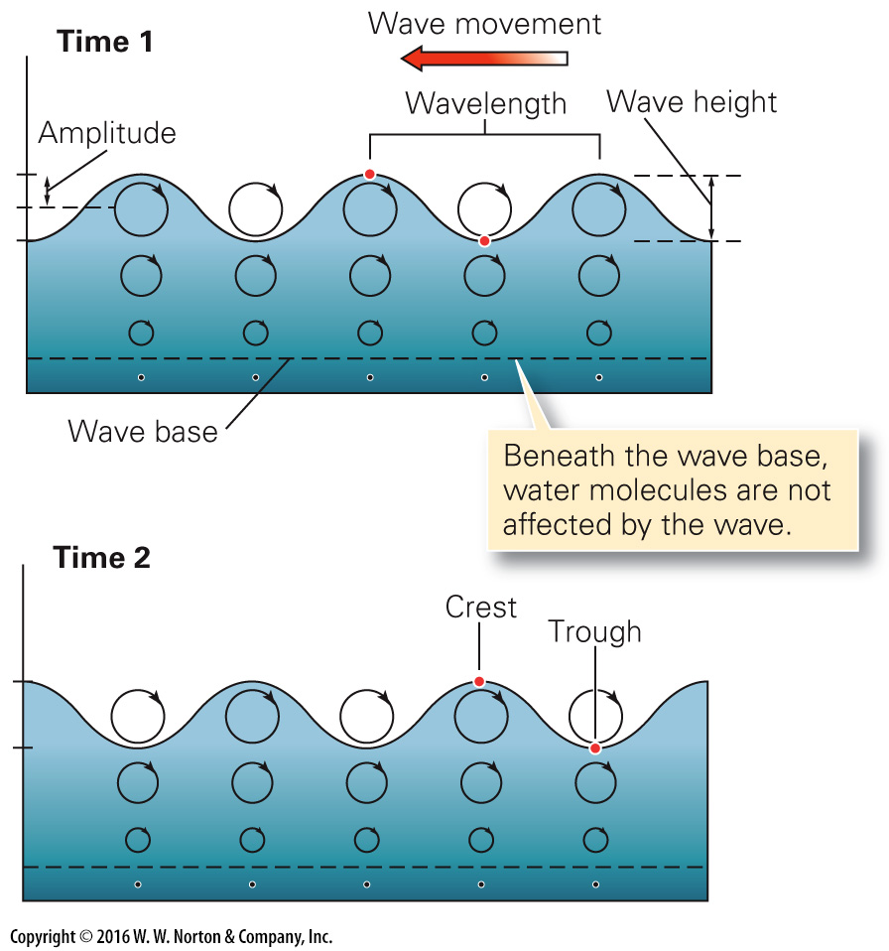
Notes:
FIGURE 15.8a Ocean waves build in response to the shear of wind blowing over the water surface.
(a) Within a deep-ocean wave, water molecules follow a circular path. The radius of the circle decreases with depth. Note that the wave height is twice the amplitude.

Slide 22
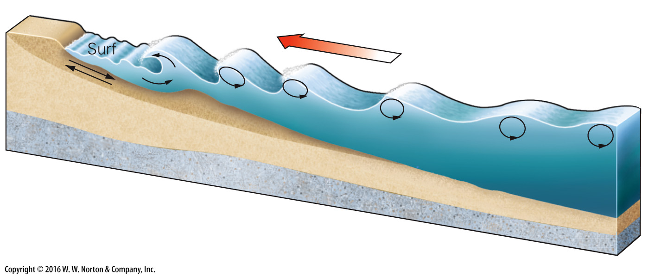
Notes:
FIGURE 15.8b Ocean waves build in response to the shear of wind blowing over the water surface.
(b) As the wave approaches shore, friction slows its base. Water motion in the wave becomes more elliptical, and the wave becomes a breaker.

Slide 23
Notes:
FIGURE 15.8b Ocean waves build in response to the shear of wind blowing over the water surface.
(b) As the wave approaches shore, friction slows its base. Water motion in the wave becomes more elliptical, and the wave becomes a breaker.

Slide 24
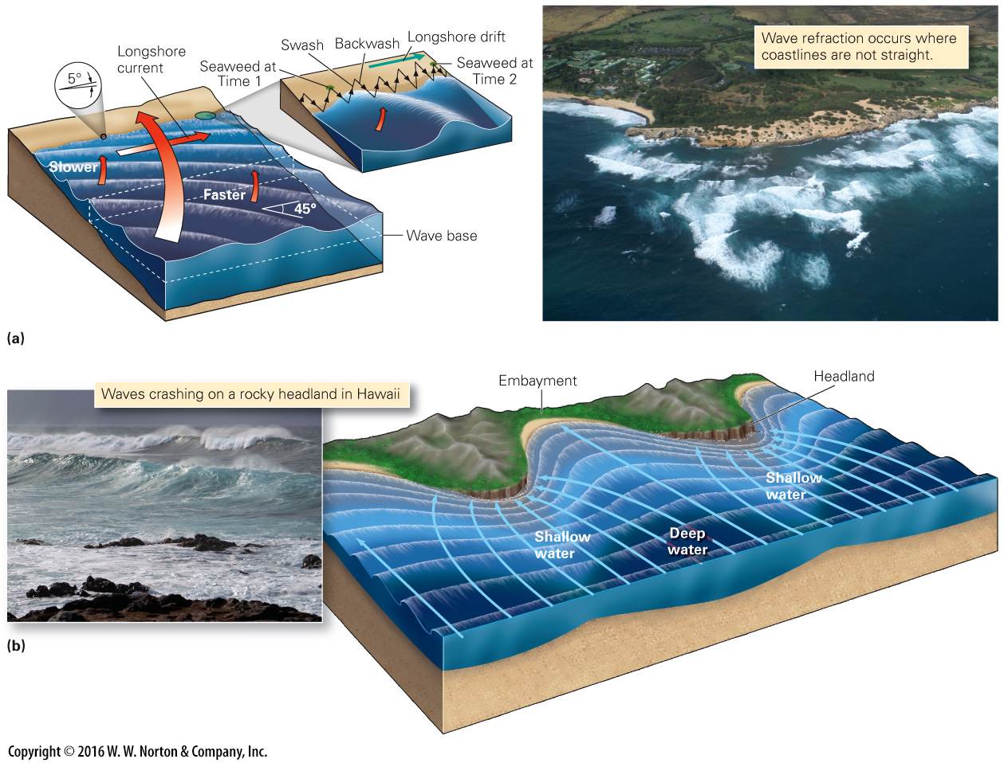
Notes:
FIGURE 15.9 Wave refraction and its consequences along the shore.
(a) Wave refraction occurs when waves approach the shore at an angle. If the wave reaches the beach at an angle, it causes a longshore current and beach drift of sand. (b) Like a lens, wave refraction focuses wave energy on a headland, so erosion occurs. Wave energy weakens in embayments, so deposition occurs.

Slide 25
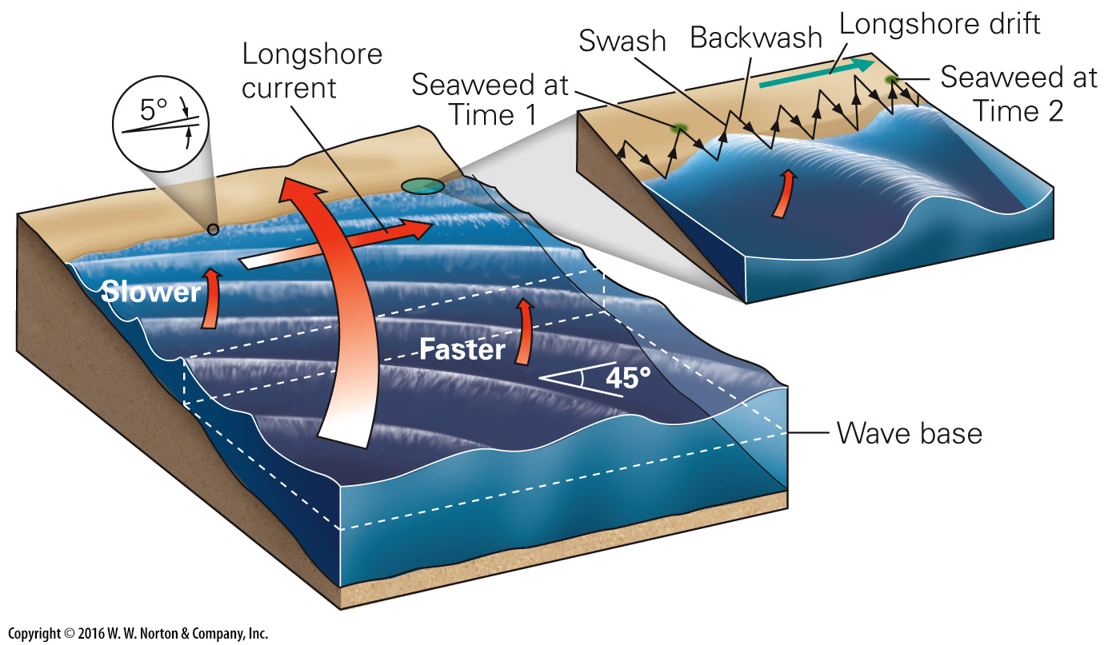
Notes:
FIGURE 15.9a Wave refraction and its consequences along the shore.
(a) Wave refraction occurs when waves approach the shore at an angle. If the wave reaches the beach at an angle, it causes a longshore current and beach drift of sand.

Slide 26
Notes:
FIGURE 15.9a Wave refraction and its consequences along the shore.
(a) Wave refraction occurs when waves approach the shore at an angle. If the wave reaches the beach at an angle, it causes a longshore current and beach drift of sand.

Slide 27
Notes:
FIGURE 15.9b Wave refraction and its consequences along the shore.
(b) Like a lens, wave refraction focuses wave energy on a headland, so erosion occurs. Wave energy weakens in embayments, so deposition occurs.

Slide 28
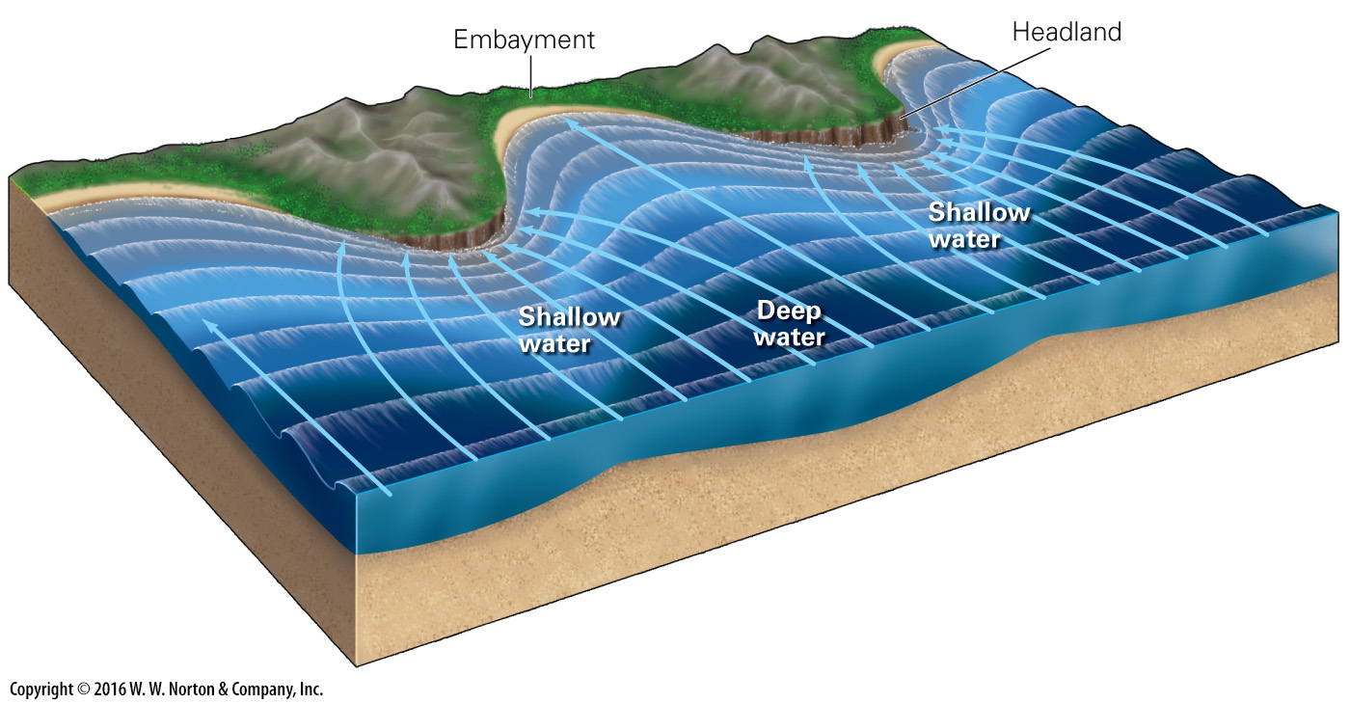
Notes:
FIGURE 15.9b Wave refraction and its consequences along the shore.
(b) Like a lens, wave refraction focuses wave energy on a headland, so erosion occurs. Wave energy weakens in embayments, so deposition occurs.

Slide 29
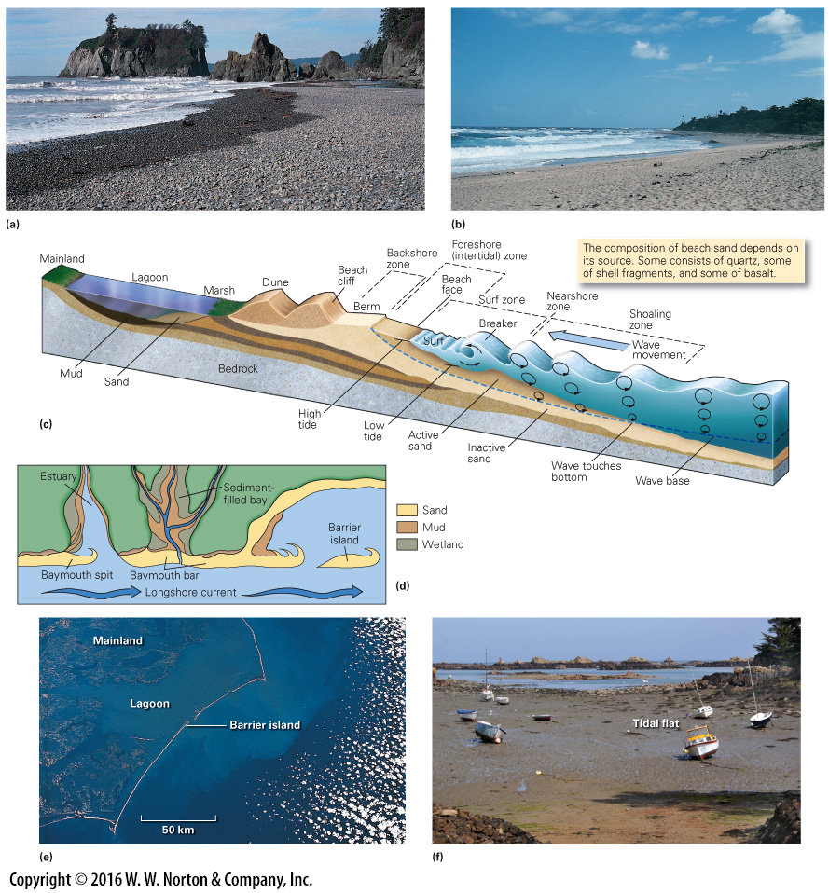
Notes:
FIGURE 15.10 Characteristics of beaches, barrier islands, and tidal flats.
(a) A gravel beach along the Olympic Peninsula, Washington. The clasts were derived from erosion of adjacent cliffs. (b) A sand beach on the western coast of Puerto Rico. Wave action has carried away finer sediment. (c) This profile shows the components of the beach environment. (d) Longshore drift can generate sand spits and baymouth bars. Sedimentation eventually fills in the region behind a baymouth bar. (e) A satellite image showing barrier islands off the coast of North Carolina. (f) At low tide, boats rest in the mud of a tidal flat on the coast of Brittany.

Slide 30
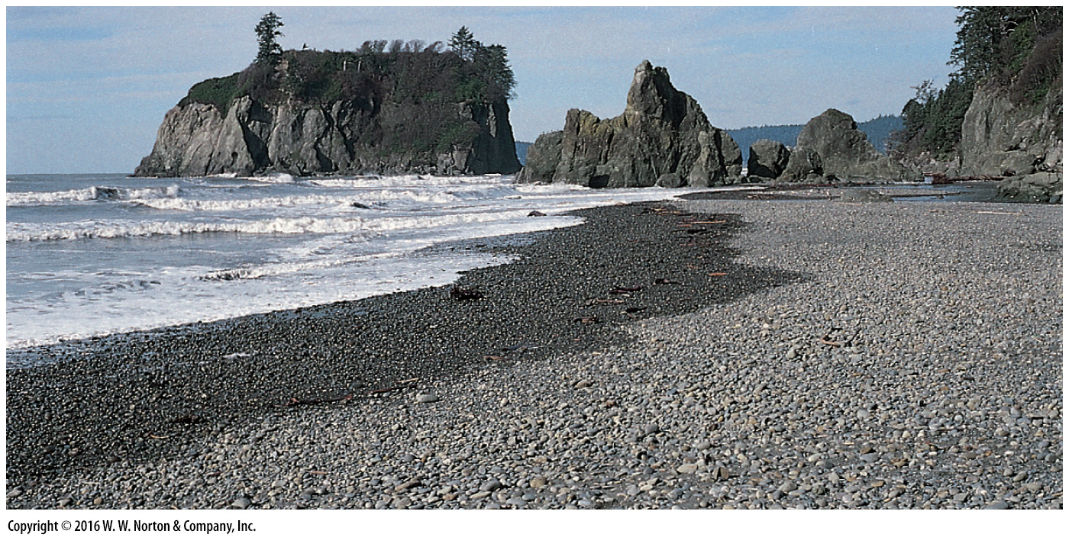
Notes:
FIGURE 15.10a Characteristics of beaches, barrier islands, and tidal flats.
(a) A gravel beach along the Olympic Peninsula, Washington. The clasts were derived from erosion of adjacent cliffs.

Slide 31
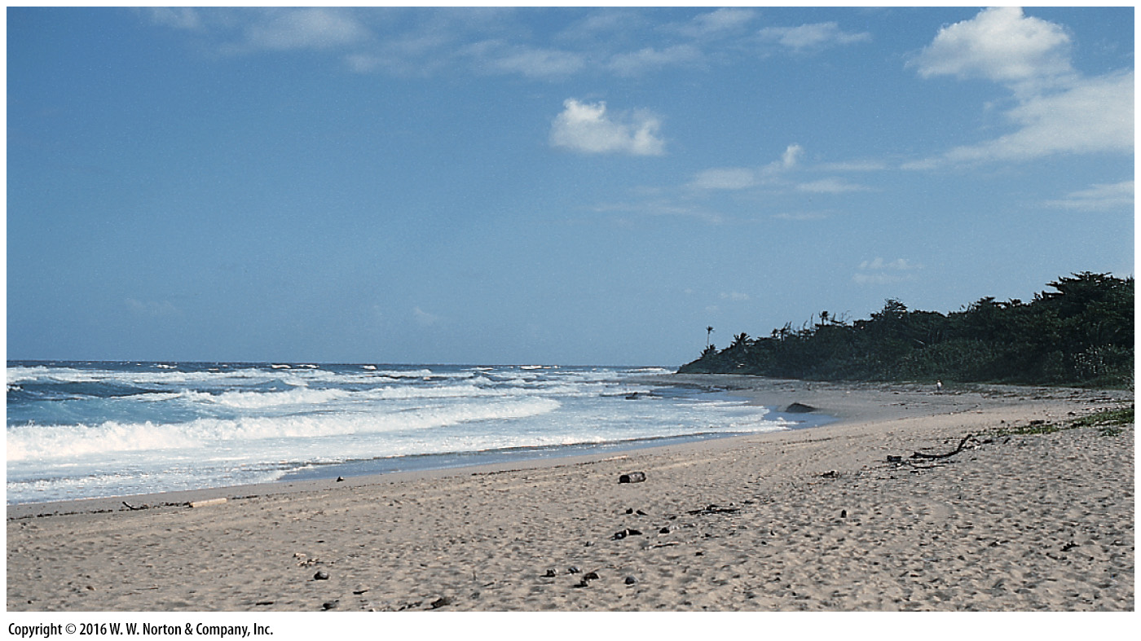
Notes:
FIGURE 15.10b Characteristics of beaches, barrier islands, and tidal flats.
(b) A sand beach on the western coast of Puerto Rico. Wave action has carried away finer sediment.

Slide 32
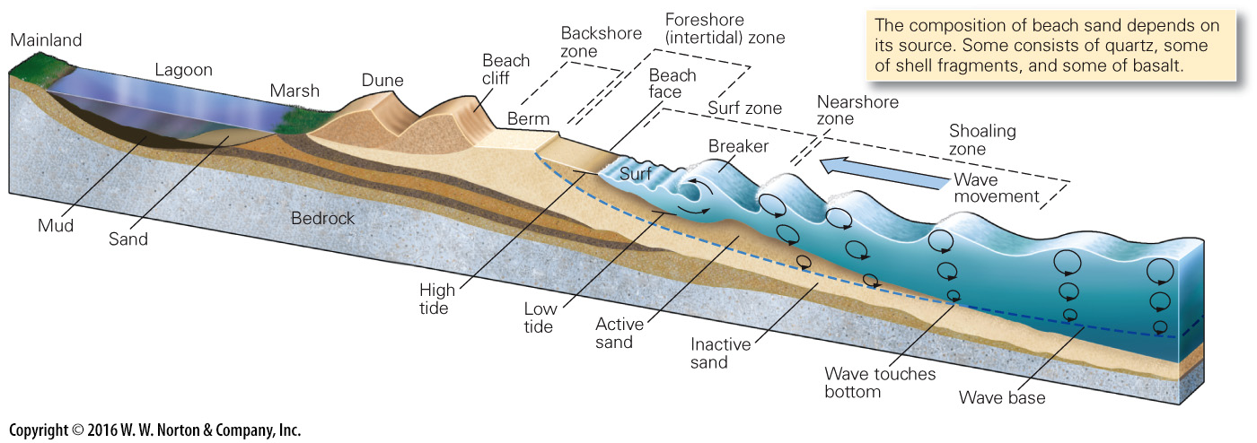
Notes:
FIGURE 15.10c Characteristics of beaches, barrier islands, and tidal flats.
(c) This profile shows the components of the beach environment.

Slide 33
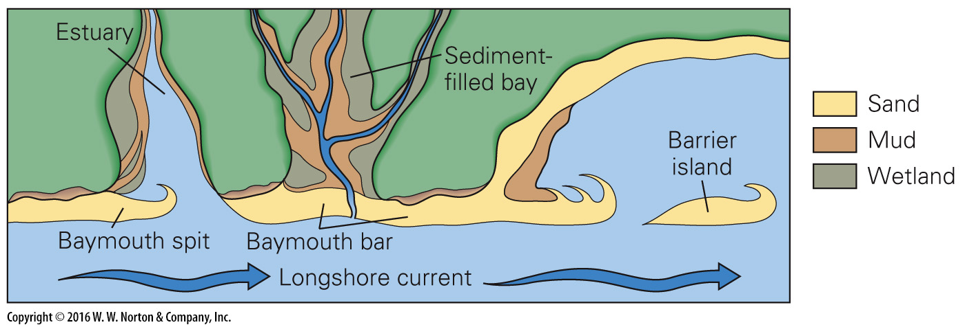
Notes:
FIGURE 15.10d Characteristics of beaches, barrier islands, and tidal flats.
(d) Longshore drift can generate sand spits and baymouth bars. Sedimentation eventually fills in the region behind a baymouth bar.

Slide 34
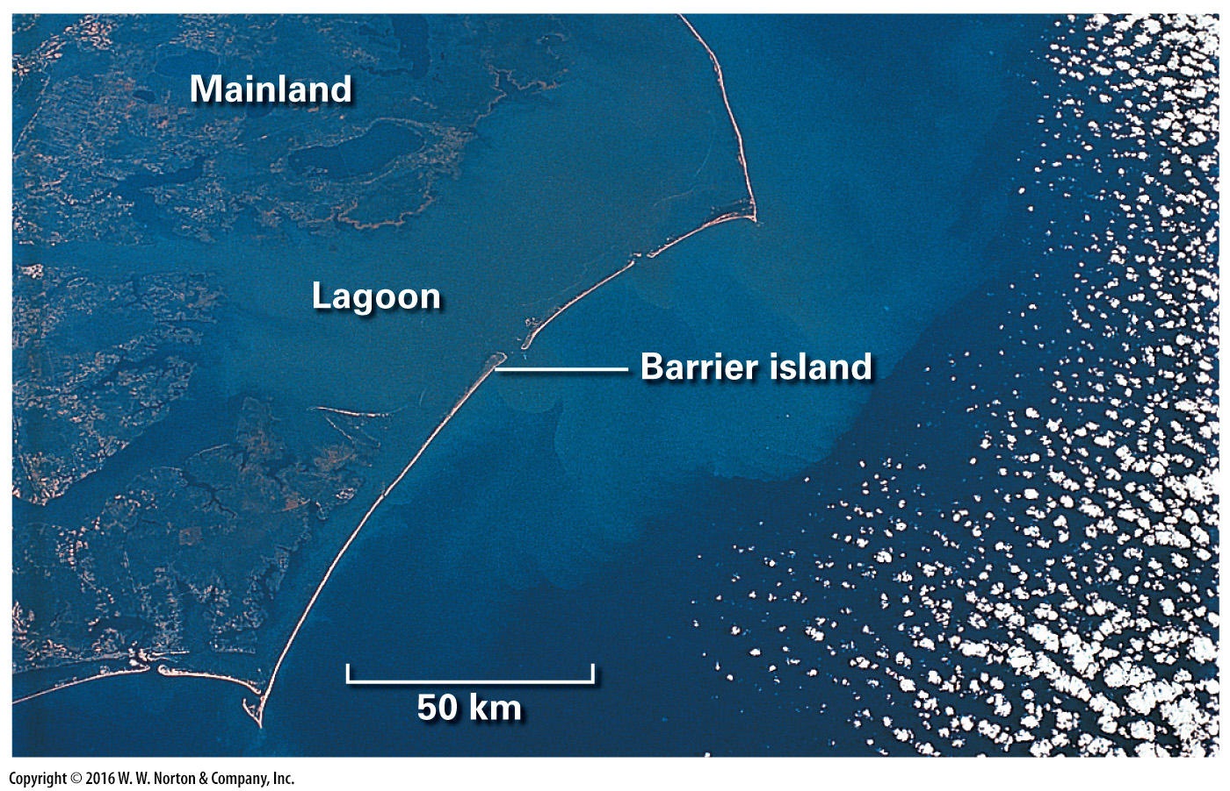
Notes:
FIGURE 15.10e Characteristics of beaches, barrier islands, and tidal flats.
(e) A satellite image showing barrier islands off the coast of North Carolina.

Slide 35
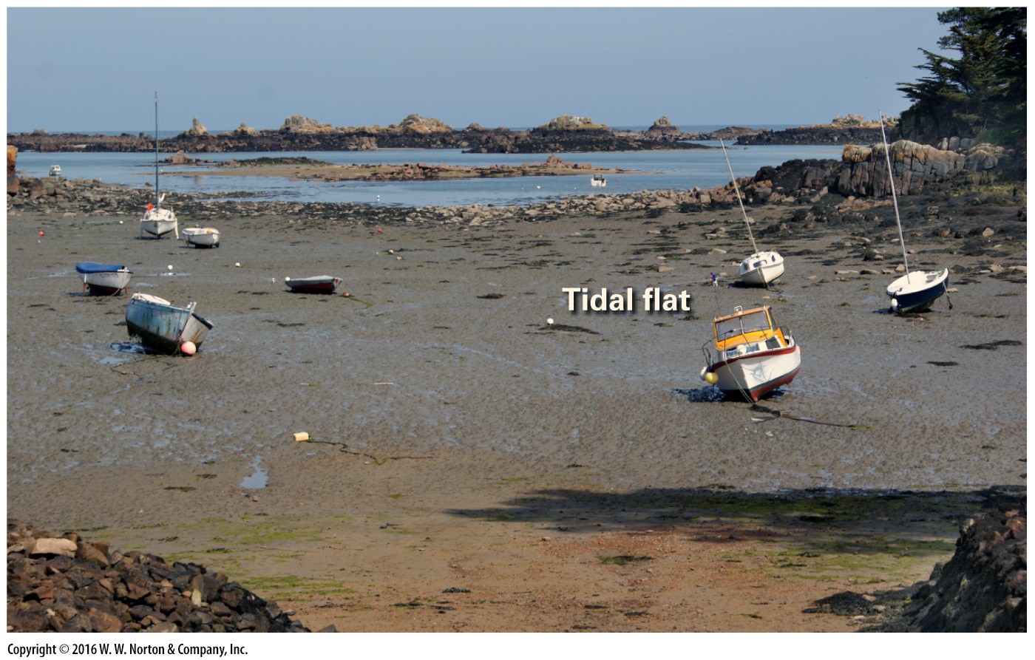
Notes:
FIGURE 15.10f Characteristics of beaches, barrier islands, and tidal flats.
(f) At low tide, boats rest in the mud of a tidal flat on the coast of Brittany.

Slide 36
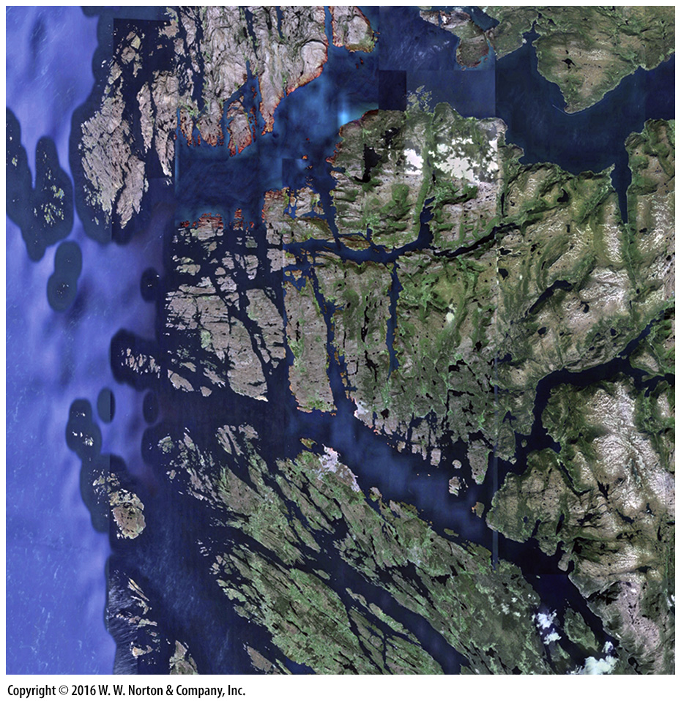
Notes:
SEE FOR YOURSELF…
FJORDS OF NORWAY

Slide 37
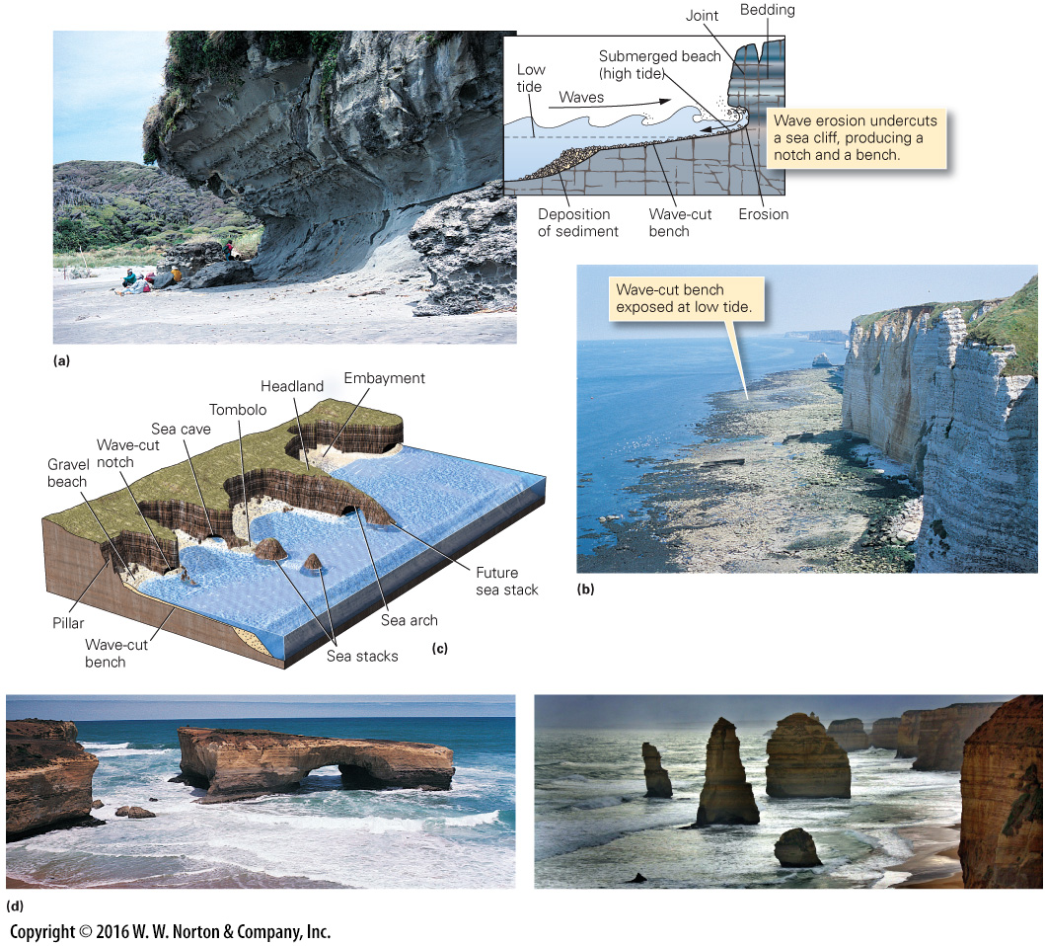
Notes:
FIGURE 15.11 Erosion landforms of rocky shorelines.
(a) A wave-cut notch. (b) A wave-cut bench at the foot of the cliffs at Étretat, France. (c) Landforms of a rocky shore. Beaches collect in embayments, whereas erosion concentrates at headlands. (d) Coastal erosion along Australia’s southern coast produced a sea arch (left). Eventually, the bridge will collapse, and only sea stacks will remain (right). These sea stacks are among several that together are known locally as the Twelve Apostles.

Slide 38
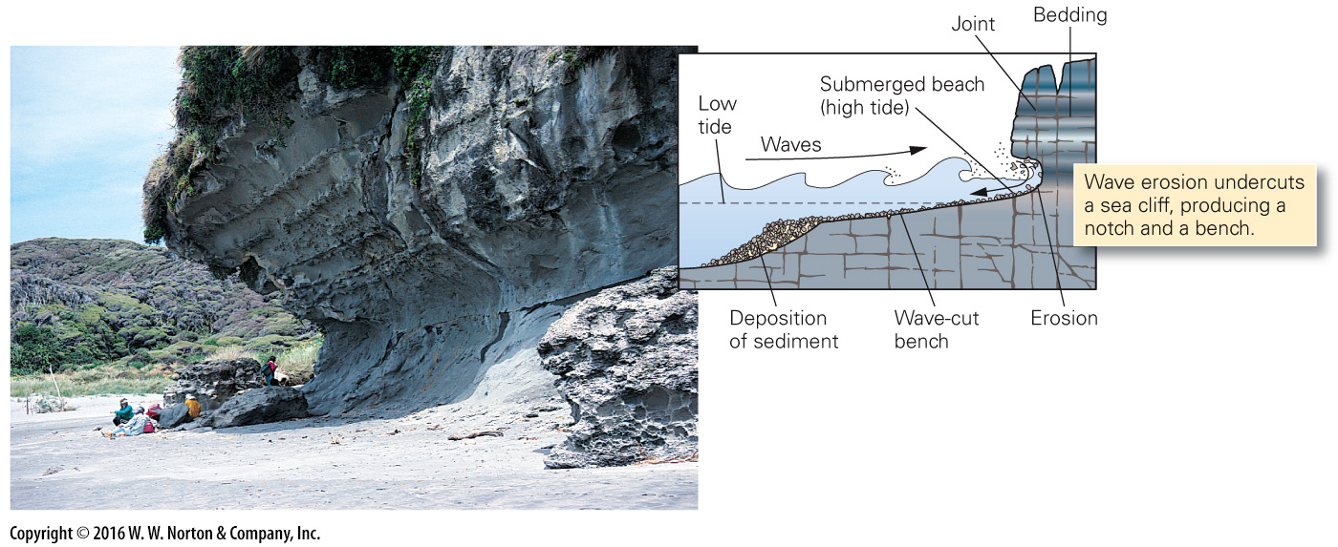
Notes:
FIGURE 15.11a Erosion landforms of rocky shorelines.
(a) A wave-cut notch.

Slide 39
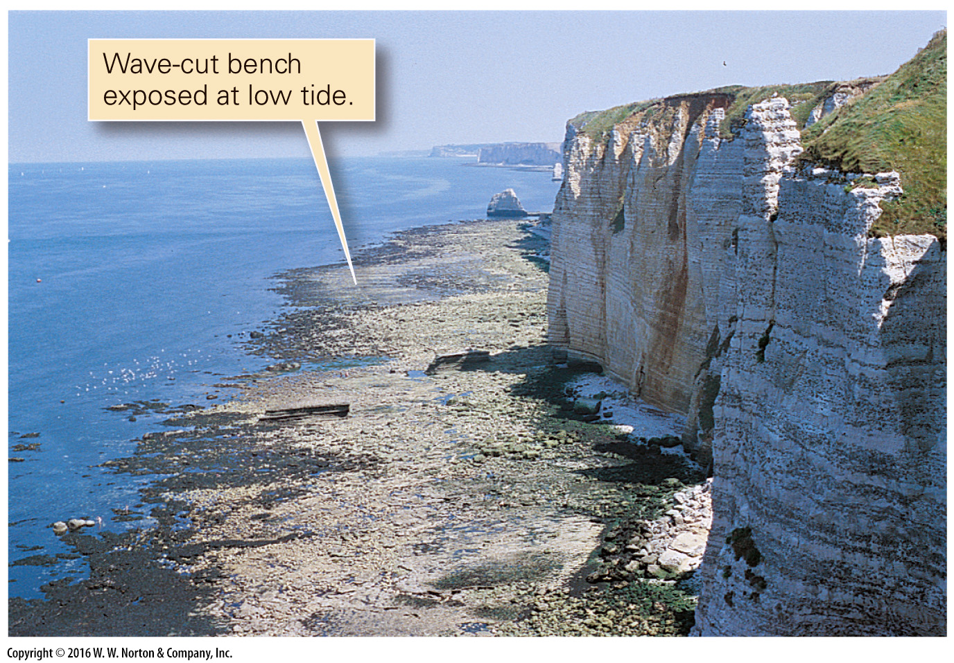
Notes:
FIGURE 15.11b Erosion landforms of rocky shorelines.
(b) A wave-cut bench at the foot of the cliffs at Étretat, France.

Slide 40
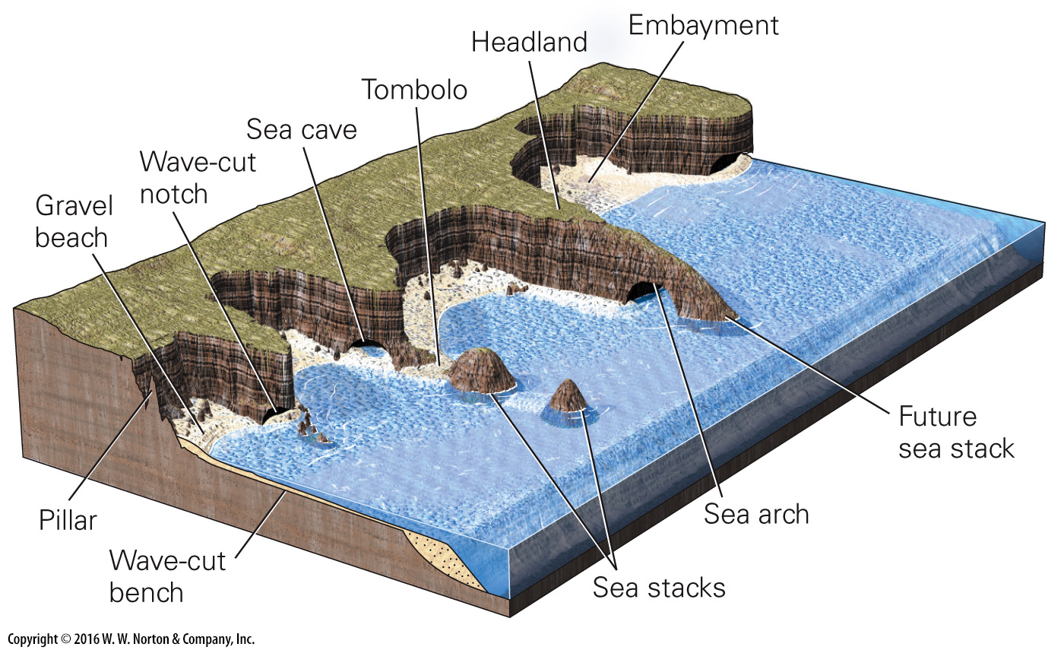
Notes:
FIGURE 15.11c Erosion landforms of rocky shorelines.
(c) Landforms of a rocky shore. Beaches collect in embayments, whereas erosion concentrates at headlands.

Slide 41
Notes:
FIGURE 15.11d Erosion landforms of rocky shorelines.
(d) Coastal erosion along Australia’s southern coast produced a sea arch (left). Eventually, the bridge will collapse, and only sea stacks will remain (right). These sea stacks are among several that together are known locally as the Twelve Apostles.

Slide 42
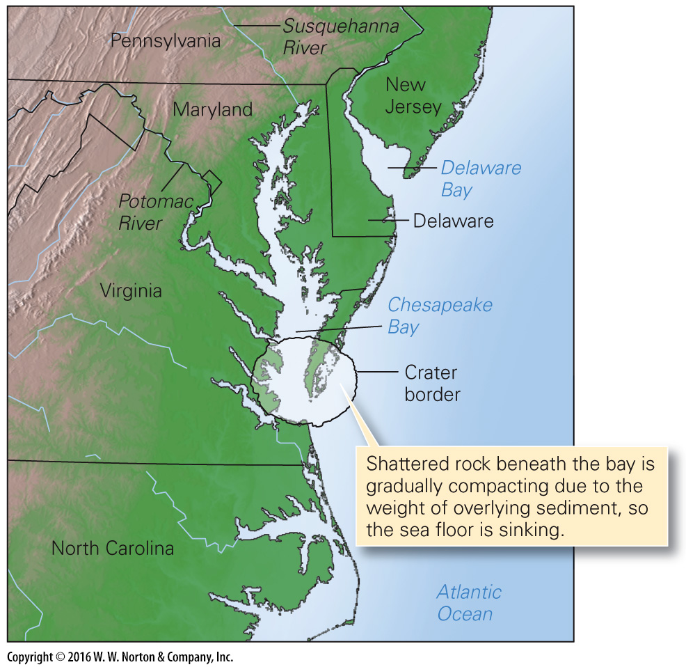
Notes:
FIGURE 15.12 The Chesapeake Bay estuary formed when the sea flooded river valleys. The region is sinking relative to other coast areas because it overlies a buried meteor crater.

Slide 43
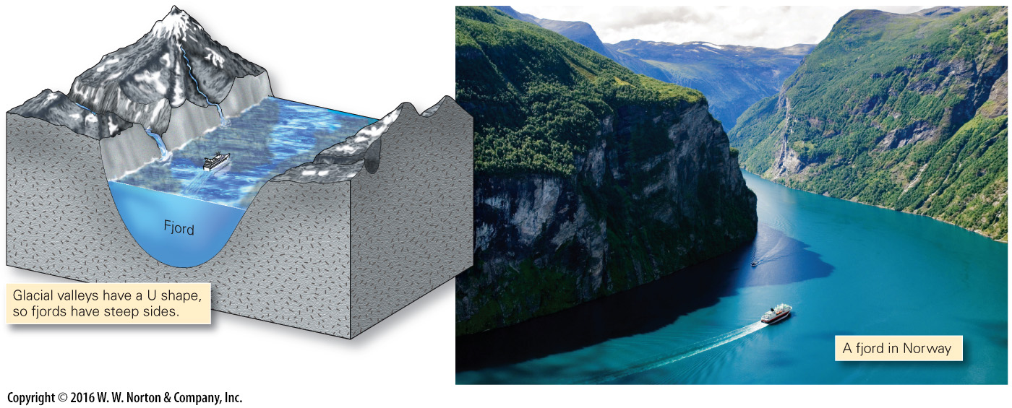
Notes:
FIGURE 15.13 Fjord landscapes form where relative sea-level rise drowns glacially carved valleys.

Slide 44
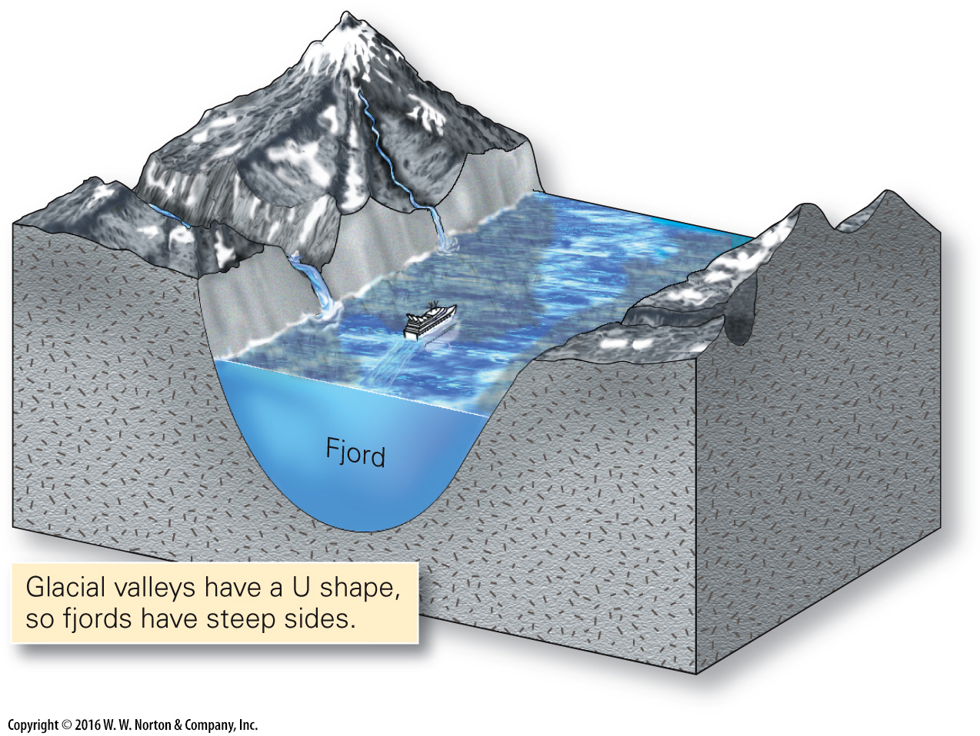
Notes:
FIGURE 15.13 Fjord landscapes form where relative sea-level rise drowns glacially carved valleys.

Slide 45
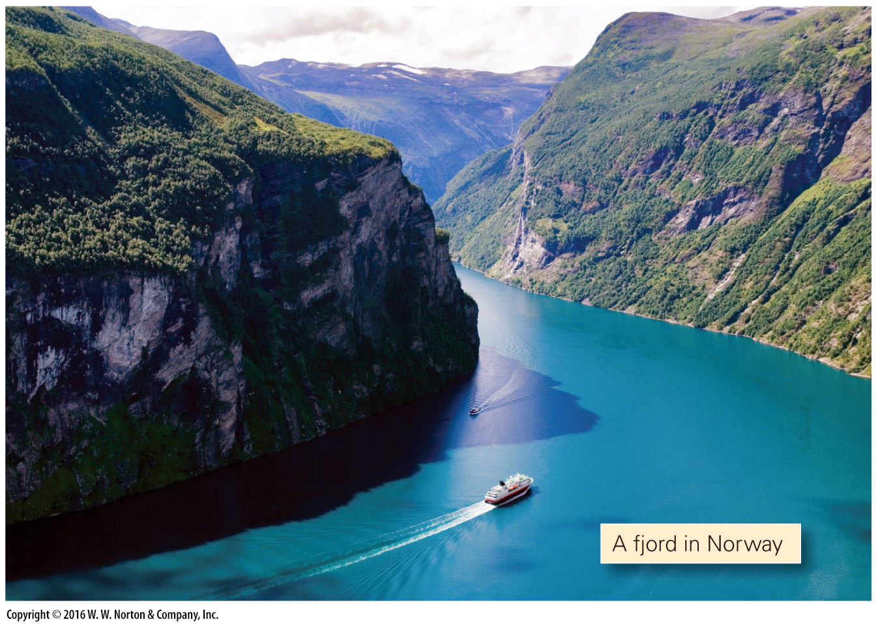
Notes:
FIGURE 15.13 Fjord landscapes form where relative sea-level rise drowns glacially carved valleys.

Slide 46
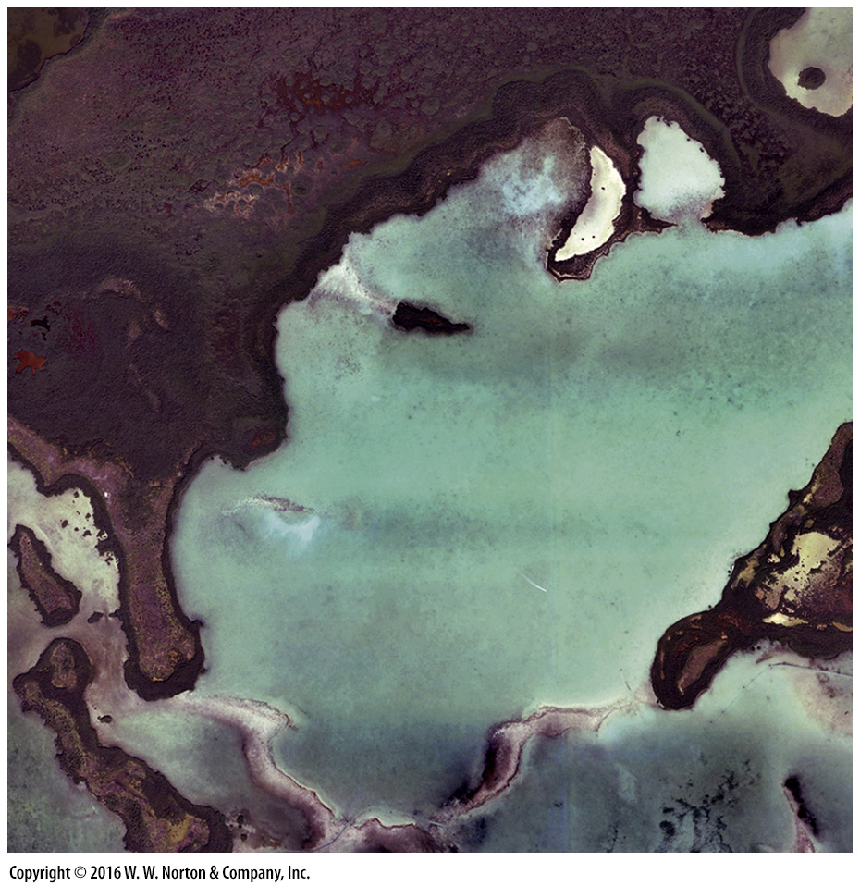
Notes:
SEE FOR YOURSELF…
ORGANIC COAST, FLORIDA

Slide 47
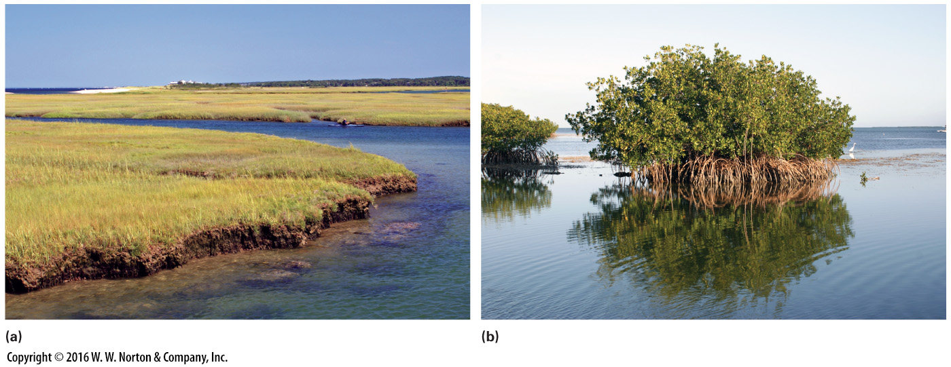
Notes:
FIGURE 15.14 Examples of coastal wetlands.
(a) A salt marsh along the coast of Cape Cod. (b) A mangrove growing along the shore of southern Florida.

Slide 48
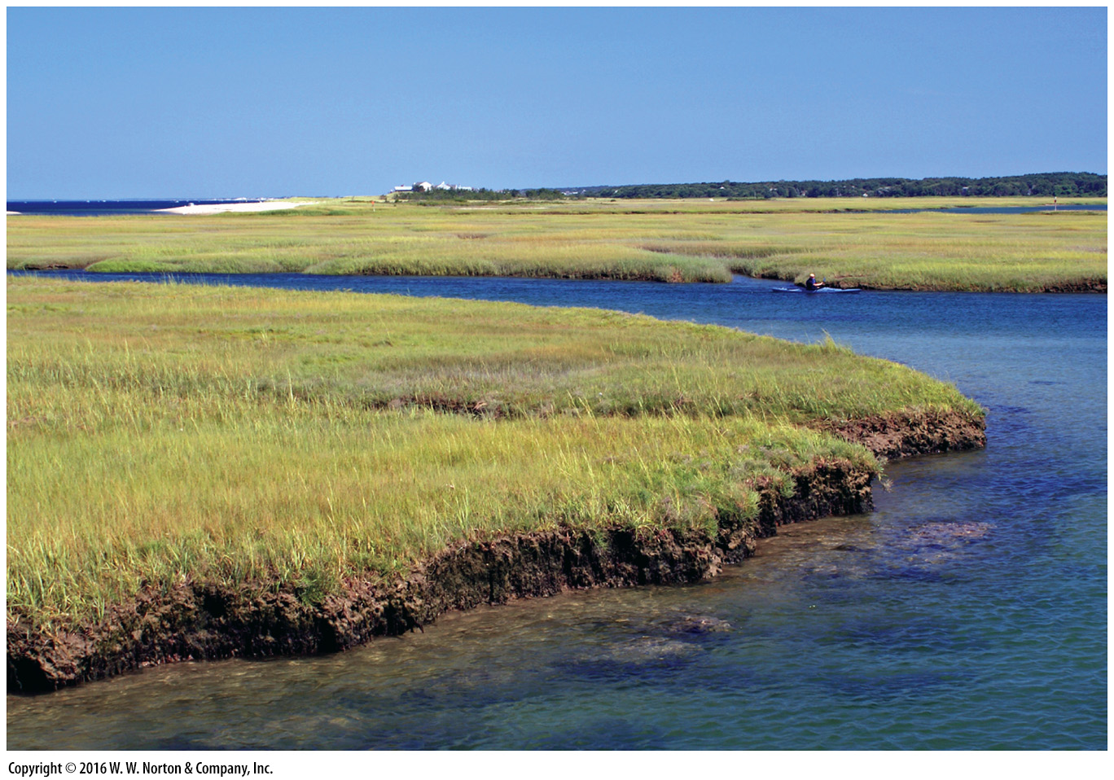
Notes:
FIGURE 15.14a Examples of coastal wetlands.
(a) A salt marsh along the coast of Cape Cod.

Slide 49
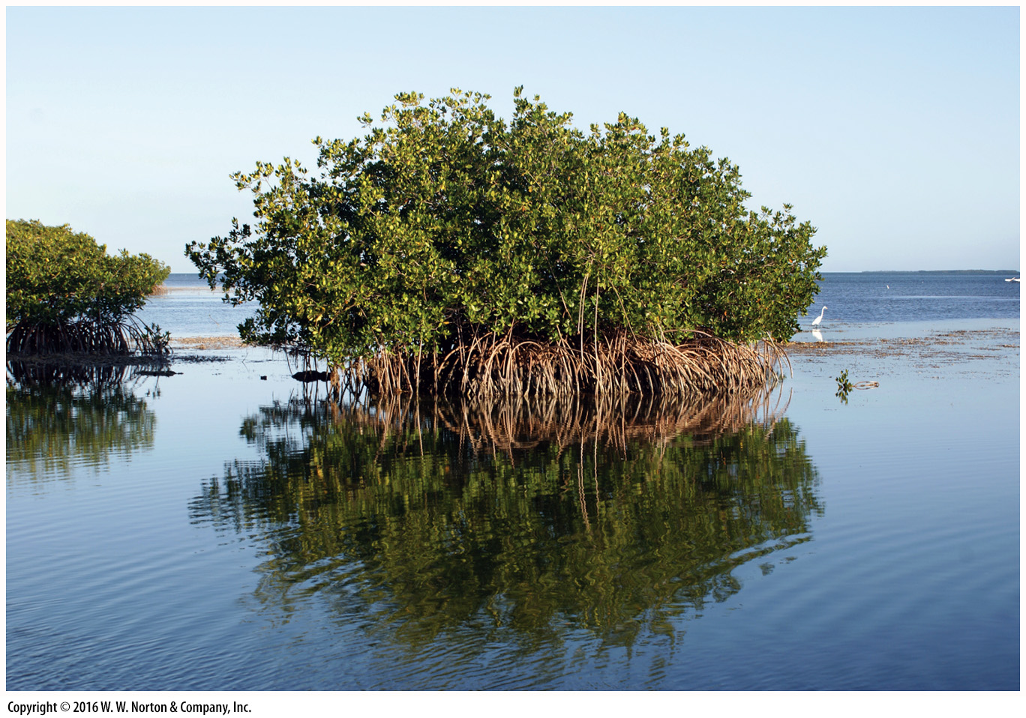
Notes:
FIGURE 15.14b Examples of coastal wetlands.
(b) A mangrove growing along the shore of southern Florida.

Slide 50
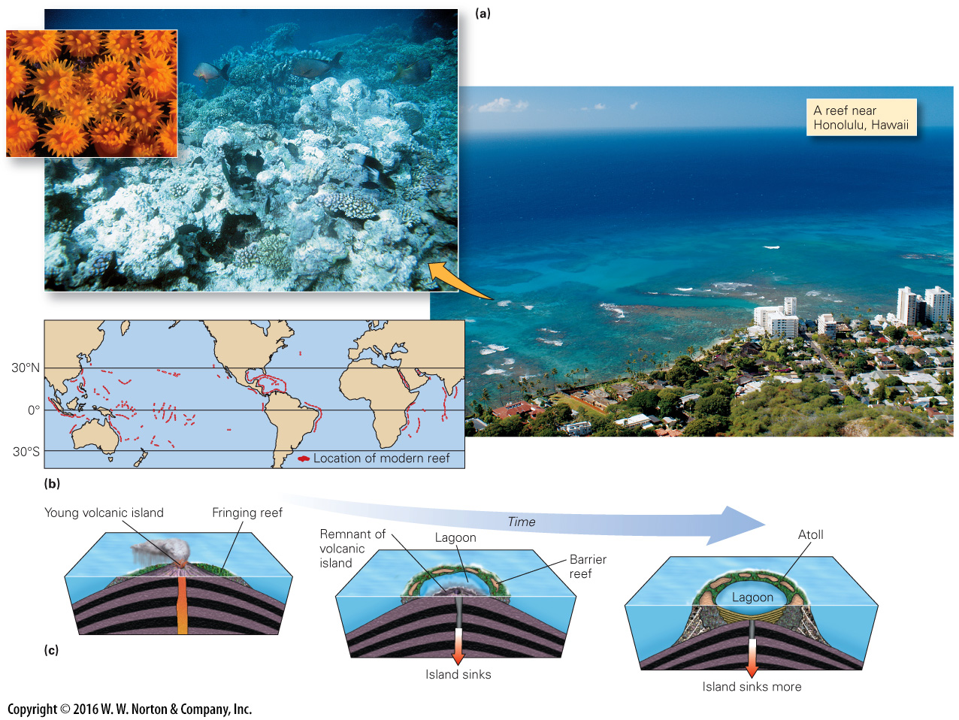
Notes:
FIGURE 15.15 The character and evolution of coral reefs.
(a) The surface of this Hawaiian coral reef protects the shore from wave erosion. The underwater view emphasizes that a reef hosts a great variety of organisms. A close-up shows individual coral polyps. (b) The distribution of warm-water coral reefs on Earth today. (c) The progressive evolution of a reef surrounding an oceanic island.

Slide 51
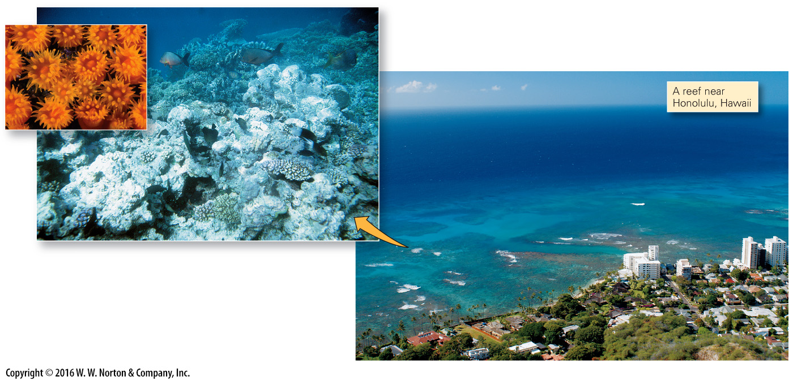
Notes:
FIGURE 15.15a The character and evolution of coral reefs.
(a) The surface of this Hawaiian coral reef protects the shore from wave erosion. The underwater view emphasizes that a reef hosts a great variety of organisms. A close-up shows individual coral polyps.

Slide 52
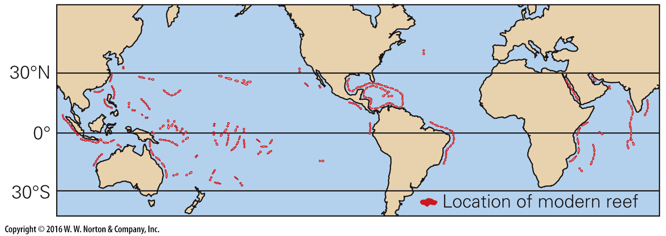
Notes:
FIGURE 15.15b The character and evolution of coral reefs.
(b) The distribution of warm-water coral reefs on Earth today.

Slide 53
Notes:
FIGURE 15.15c The character and evolution of coral reefs.
(c) The progressive evolution of a reef surrounding an oceanic island.

Slide 54
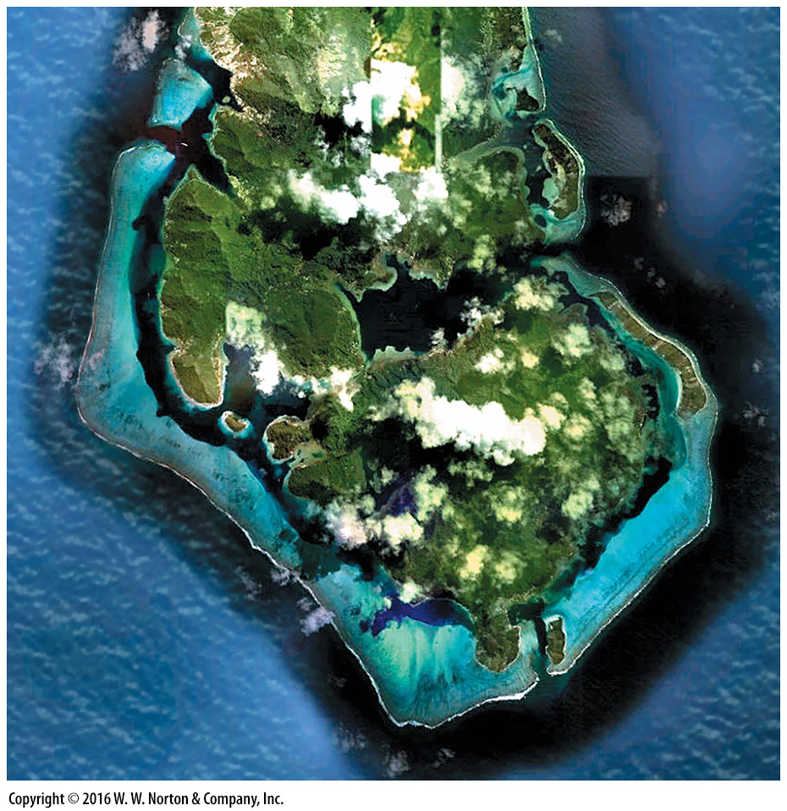
Notes:
SEE FOR YOURSELF…
CORAL REEFS, PACIFIC

Slide 55
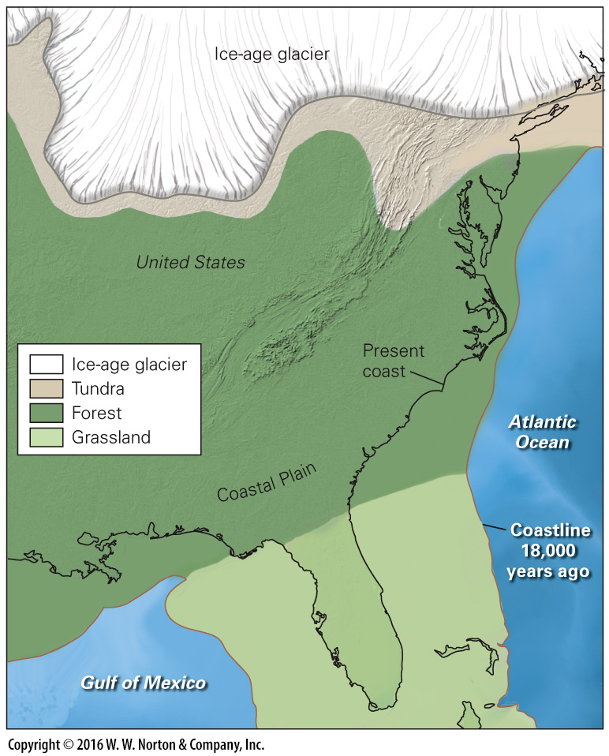
Notes:
FIGURE 15.16 Because of sea-level drop during the ice age, there was more dry land exposed along eastern North America.

Slide 56
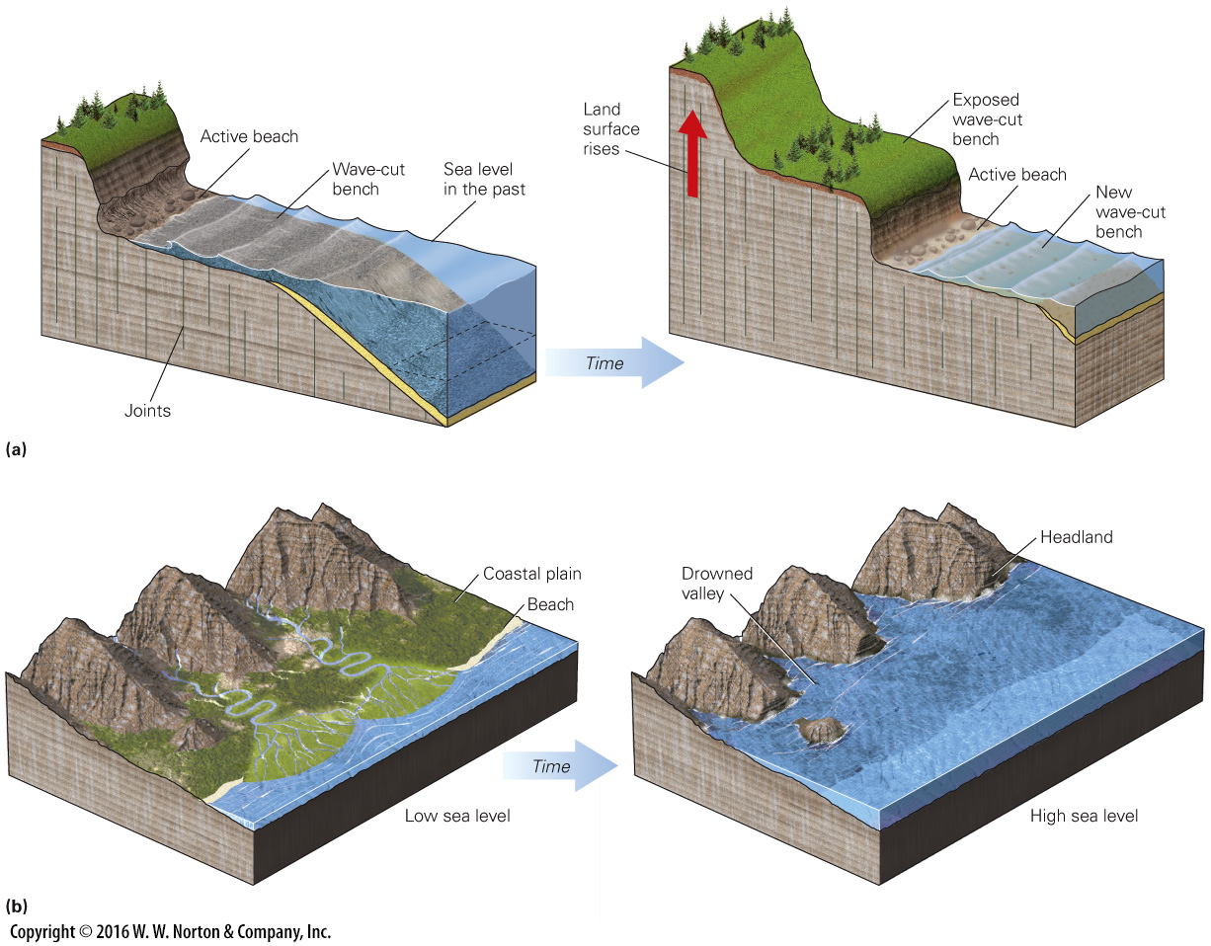
Notes:
FIGURE 15.17 Features of emergent coastlines (relative sea level is falling) and submergent coastlines (relative sea level is rising).
(a) Emergent coasts: Wave erosion produces a wave-cut bench along an emergent coast. As the land rises, the bench becomes a terrace, and a new wave-cut bench forms. (b) Submergent coasts: A coast before sea level rises. Rivers drain valleys and deposit sediment on a coastal plain. As a submergent coast forms, sea level rises and floods the valleys, and waves erode the headlands.

Slide 57
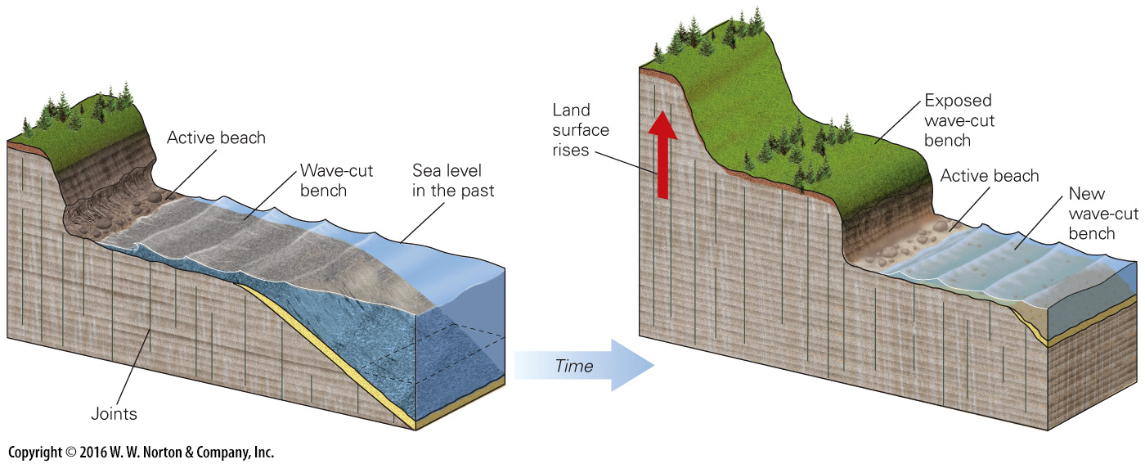
Notes:
FIGURE 15.17a Features of emergent coastlines (relative sea level is falling) and submergent coastlines (relative sea level is rising).
(a) Emergent coasts: Wave erosion produces a wave-cut bench along an emergent coast. As the land rises, the bench becomes a terrace, and a new wave-cut bench forms.

Slide 58
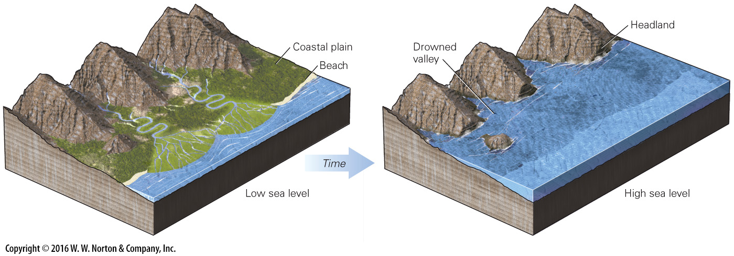
Notes:
FIGURE 15.17b Features of emergent coastlines (relative sea level is falling) and submergent coastlines (relative sea level is rising).
(b) Submergent coasts: A coast before sea level rises. Rivers drain valleys and deposit sediment on a coastal plain. As a submergent coast forms, sea level rises and floods the valleys, and waves erode the headlands.

Slide 59
Notes:
FIGURE 15.18 Areas that may be submerged if sea level rises by about 1.0 to 1.5 m.

Slide 60
Notes:
GEOLOGY AT A GLANCE
Oceans and Coasts

Slide 61
Notes:
FIGURE 15.19 Examples of beach erosion.
(a) When Hurricane Ike hit Galveston, Texas, in September 2008, many beachfront homes were washed away. (b) Wave erosion has completely removed the beach and has started to erode a beach cliff along the coast of Cape Cod.

Slide 62
Notes:
FIGURE 15.19a Examples of beach erosion.
(a) When Hurricane Ike hit Galveston, Texas, in September 2008, many beachfront homes were washed away.

Slide 63
Notes:
FIGURE 15.19b Examples of beach erosion.
(b) Wave erosion has completely removed the beach and has started to erode a beach cliff along the coast of Cape Cod.

Slide 64
Notes:
SEE FOR YOURSELF…
CHICAGO LAKEFRONT PRESERVATION

Slide 65
Notes:
FIGURE 15.20 Techniques used to preserve beaches.
(a) The construction of groins may produce a sawtooth beach. (b) Jetties extend a river farther into the sea but may cause a sandbar to form at the end of the channel. (c) A beach may grow seaward behind a breakwater. (d) Riprap will slow erosion of a parking lot along a California beach.

Slide 66
Notes:
FIGURE 15.20a Techniques used to preserve beaches.
(a) The construction of groins may produce a sawtooth beach.

Slide 67
Notes:
FIGURE 15.20b Techniques used to preserve beaches.
(b) Jetties extend a river farther into the sea but may cause a sandbar to form at the end of the channel.

Slide 68
Notes:
FIGURE 15.20c Techniques used to preserve beaches.
(c) A beach may grow seaward behind a breakwater.

Slide 69
Notes:
FIGURE 15.20d Techniques used to preserve beaches.
(d) Riprap will slow erosion of a parking lot along a California beach.

Slide 70
Notes:
FIGURE 15.21 The structure and distribution of hurricanes.
(a) Hurricanes form only in certain regions of the ocean, where water temperatures are high. They generally follow regional tracks and occur during certain times of the year. (b) Hurricane Sandy approaches the east coast of the United States in 2012, as seen from space. (c) In this cutaway drawing, we can see the spirals of clouds, the eye, and the eye wall of a hurricane. Dry air descends in the eye.

Slide 71
Notes:
FIGURE 15.21a The structure and distribution of hurricanes.
(a) Hurricanes form only in certain regions of the ocean, where water temperatures are high. They generally follow regional tracks and occur during certain times of the year.

Slide 72
Notes:
FIGURE 15.21b The structure and distribution of hurricanes.
(b) Hurricane Sandy approaches the east coast of the United States in 2012, as seen from space.

Slide 73
Notes:
FIGURE 15.21c The structure and distribution of hurricanes.
(c) In this cutaway drawing, we can see the spirals of clouds, the eye, and the eye wall of a hurricane. Dry air descends in the eye.

Slide 74
Notes:
FIGURE Bx15.2a Hurricane Katrina and the disaster it caused.
(a) A satellite photo of Hurricane Katrina over the hot water of the Gulf of Mexico. The arrow shows the path of the hurricane.

Slide 75
Notes:
FIGURE Bx15.2b Hurricane Katrina and the disaster it caused.
(b) A wind-swath map of Hurricane Katrina. Red areas represent hurricane winds; orange areas represent tropical-storm winds.

Slide 76
Notes:
FIGURE Bx15.2c Hurricane Katrina and the disaster it caused.
(c) The track of the storm lay just east of New Orleans.

Slide 77
Notes:
FIGURE Bx15.2d Hurricane Katrina and the disaster it caused.
(d) Surge from the storm destroyed homes along the Alabama coast.

Slide 78
Notes:
FIGURE Bx15.2e Hurricane Katrina and the disaster it caused.
(e) Officials survey the storm damage.

Slide 79
Notes:
FIGURE Bx15.2f Hurricane Katrina and the disaster it caused.
(f) Much of New Orleans lies below sea level, between the Mississippi River and Lake Pontchartrain. Natural levees form high areas bordering the river. Low areas filled with water, up to the level of the lake, when artificial levees along the canals failed. The inset shows a cross section from the river to the lake.

Slide 80
Notes:
FIGURE Bx15.2g Hurricane Katrina and the disaster it caused.
(g) Water flowing across the levees bordering the 17th Street Canal after the hurricane had passed.

Slide 81
Notes:
FIGURE Bx15.2h Hurricane Katrina and the disaster it caused.
(h) Damage due to flooding in a New Orleans home.

