Slide 1
Stephen Marshak
ESSENTIALS OF
Geology
FIFTH EDITION
Chapter 16
A Hidden Reserve: Groundwater
©2016 W. W. Norton & Company, Inc.

Slide 2
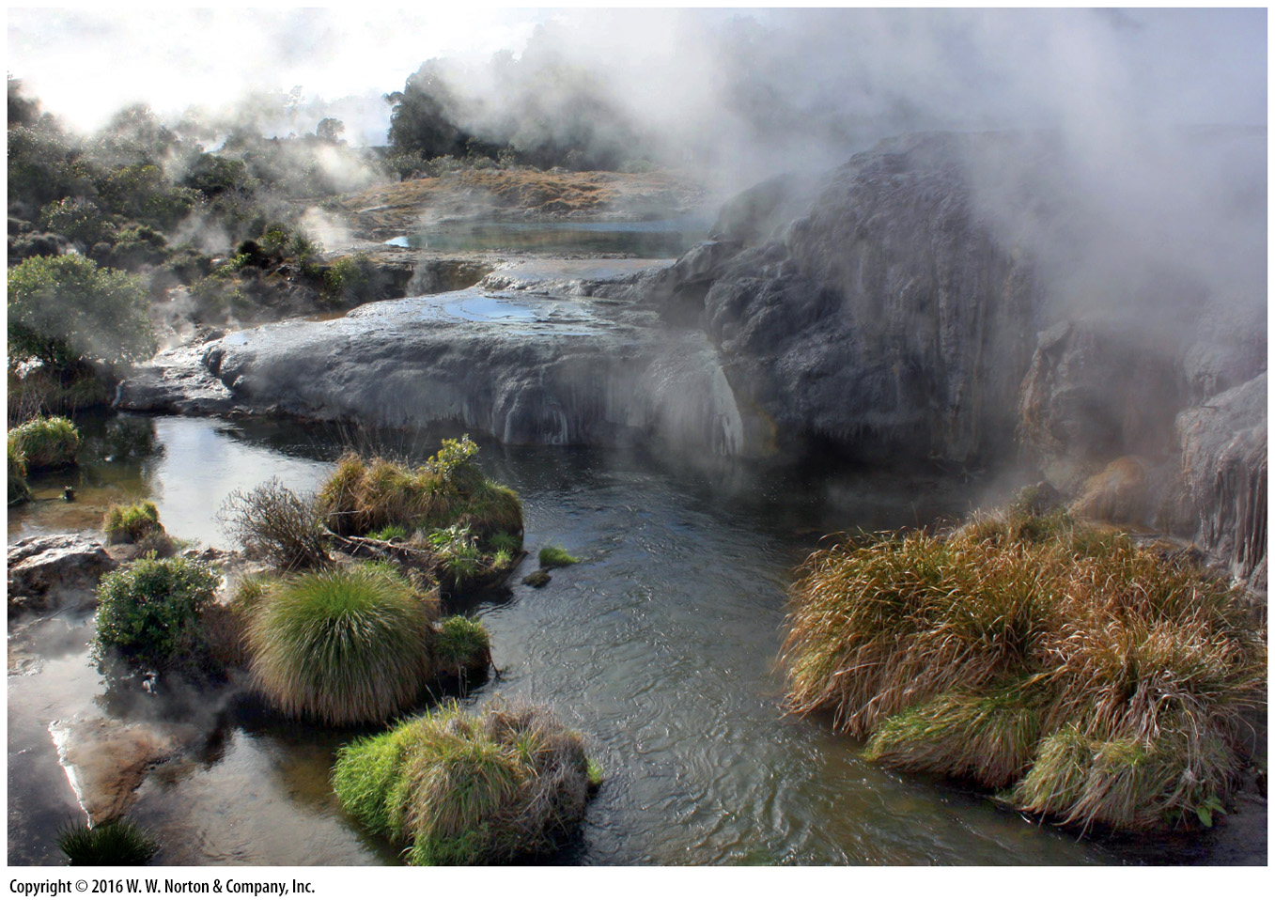
Notes:
Steaming pools and travertine ledges have developed where groundwater bubbles to the surface from the hot springs of Rotorua, New Zealand.

Slide 3
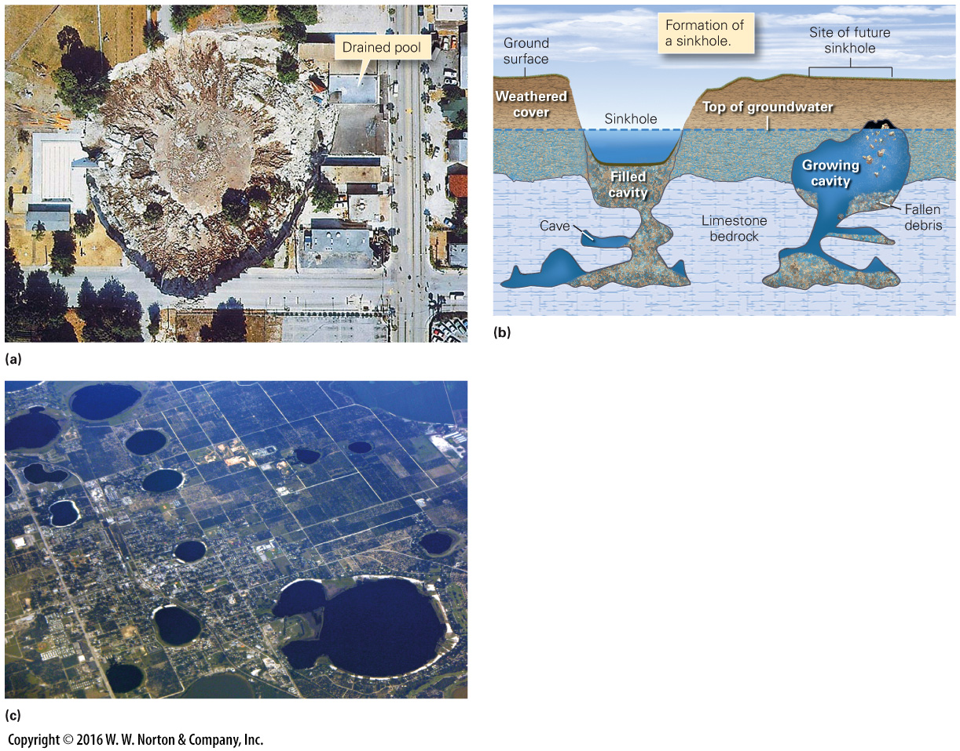
Notes:
FIGURE 16.1 Development of sinkholes in central Florida.
(a) The Winter Park sinkhole, as seen from a helicopter. (b) As overburden slowly washes into underlying caves, a cavity forms. When the roof of this cavity collapses, a sinkhole forms (not to scale). (c) An airplane view of Florida sinkholes that have become lakes.

Slide 4
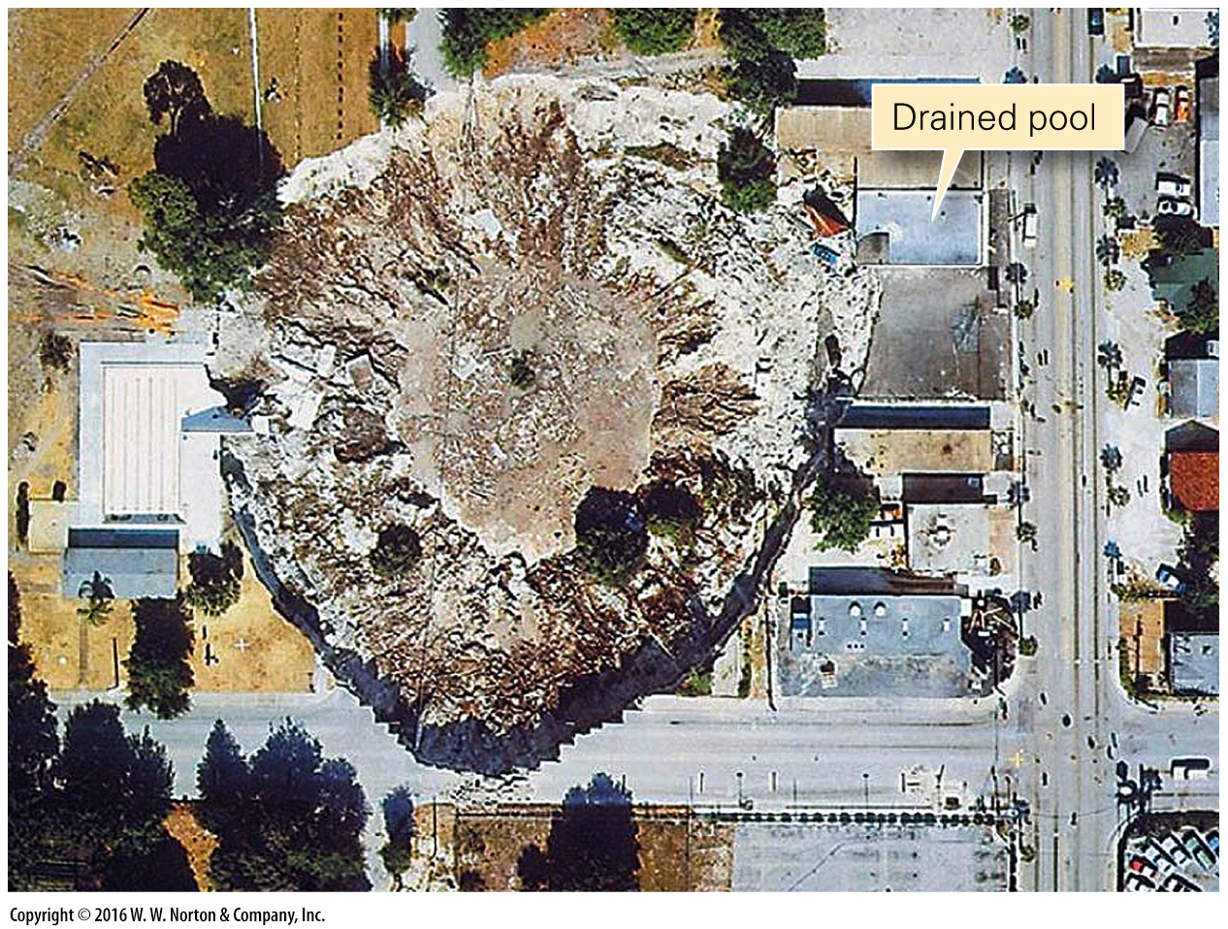
Notes:
FIGURE 16.1a Development of sinkholes in central Florida.
(a) The Winter Park sinkhole, as seen from a helicopter.

Slide 5
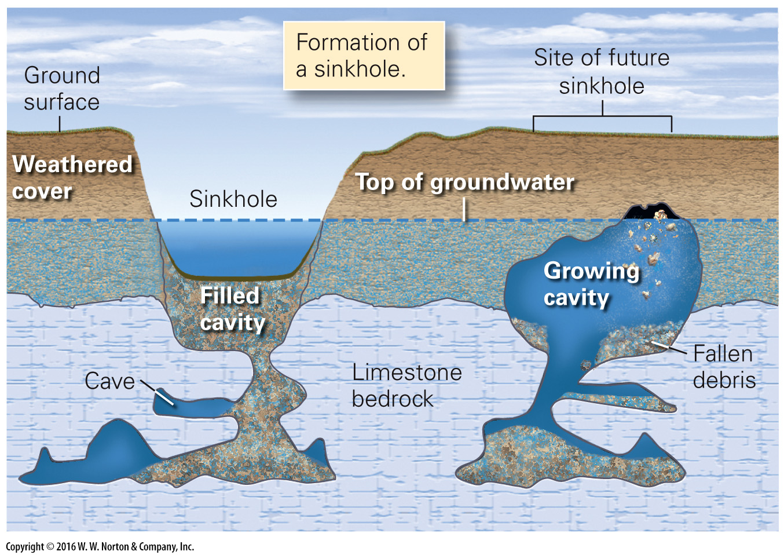
Notes:
FIGURE 16.1b Development of sinkholes in central Florida.
(b) As overburden slowly washes into underlying caves, a cavity forms. When the roof of this cavity collapses, a sinkhole forms (not to scale).

Slide 6
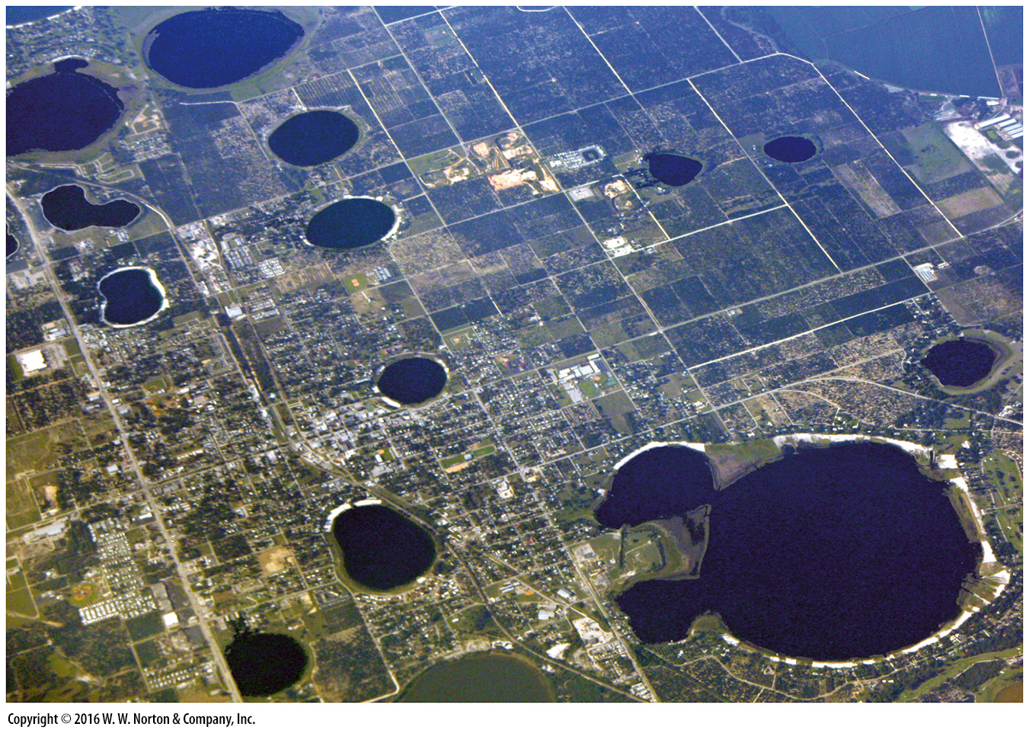
Notes:
FIGURE 16.1c Development of sinkholes in central Florida.
(c) An airplane view of Florida sinkholes that have become lakes.

Slide 7
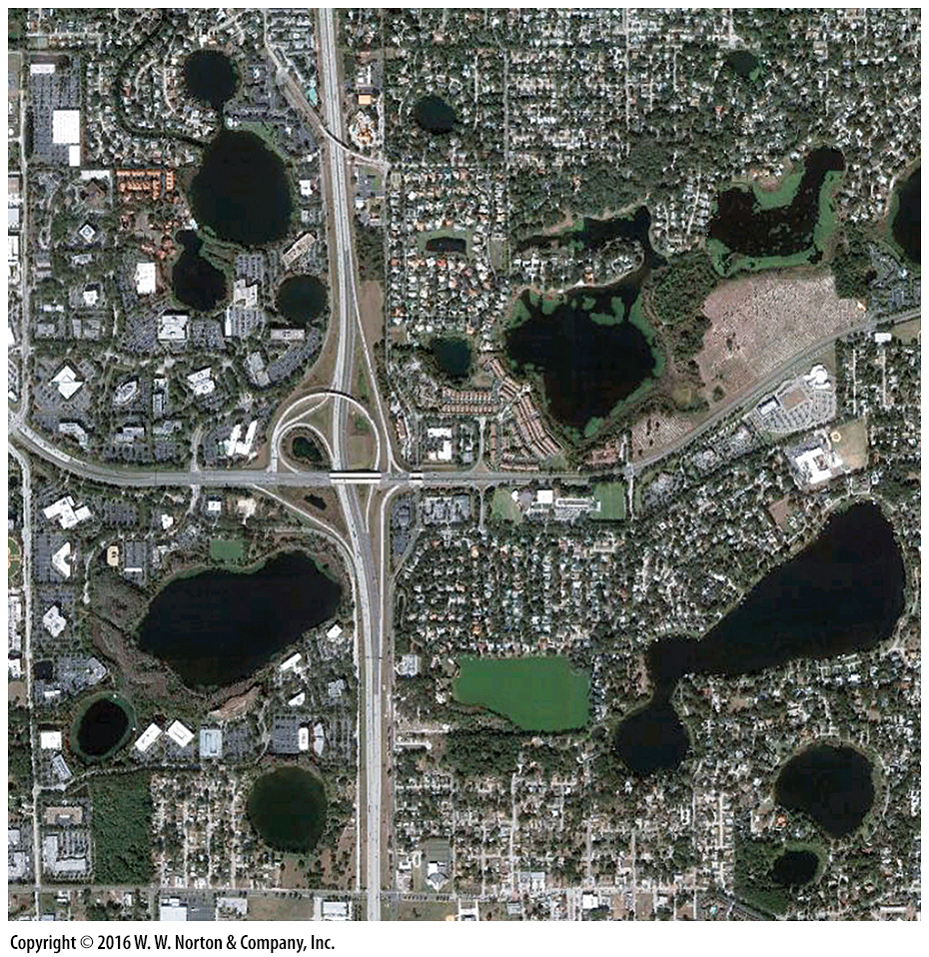
Notes:
SEE FOR YOURSELF…
SINKHOLES IN CENTRAL FLORIDA

Slide 8
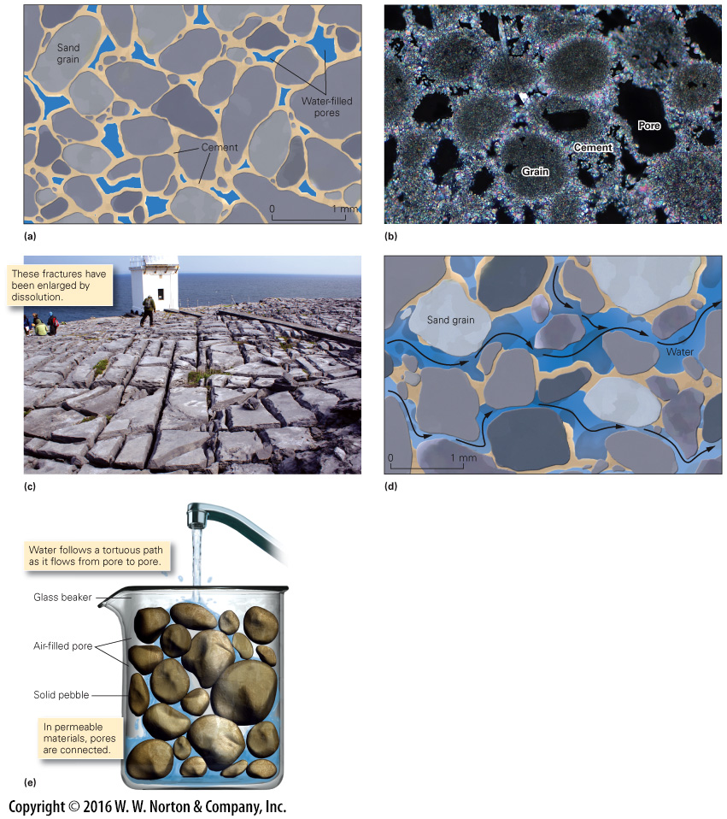
Notes:
FIGURE 16.2 The concepts of porosity and permeability.
(a) Isolated pores in a sandstone occur in the spaces between grains. Water or air can fill pores. (b) This photo of a sedimentary rock, as seen through a microscope, shows grains, cement, and pores. The field of view is about 3 mm. (c) Limestone outcrop on the coast of Ireland contains abundant fractures that provide secondary porosity. (d) Permemability is the degree to which pores are linked, so water can move from pore to pore and move through rock or sediment. (e) Gravel contains pore space because clasts don’t fit together tightly. The connection of pores produces permeability, so water can flow through gravel.

Slide 9
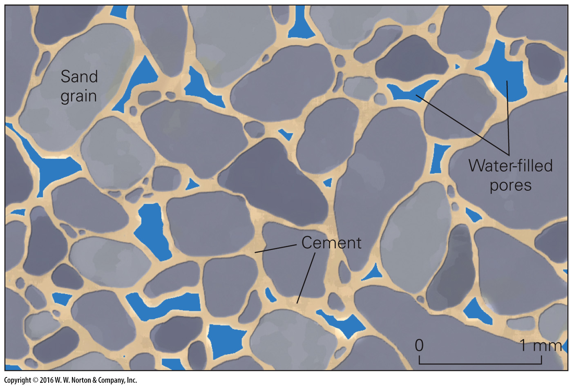
Notes:
FIGURE 16.2a The concepts of porosity and permeability.
(a) Isolated pores in a sandstone occur in the spaces between grains. Water or air can fill pores.

Slide 10
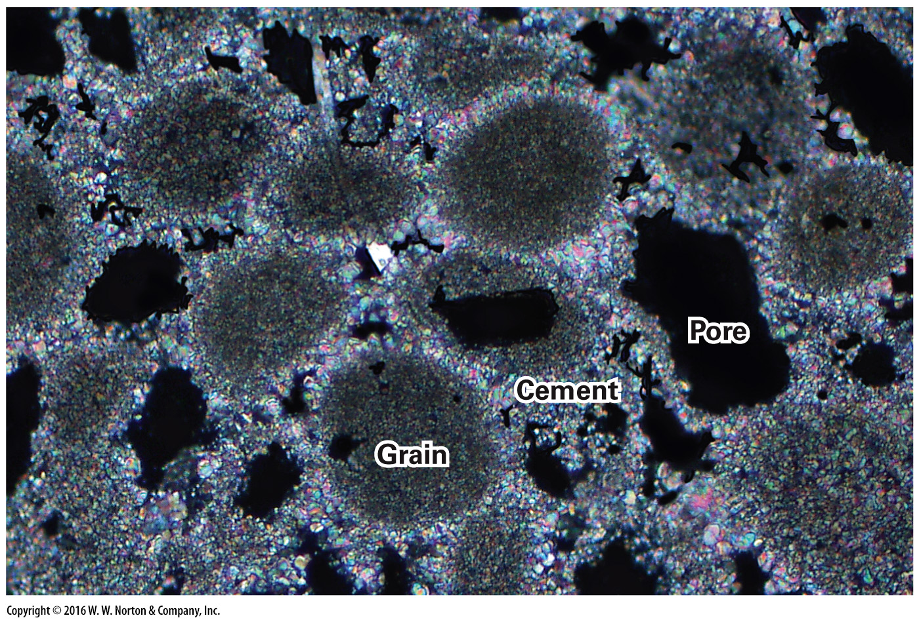
Notes:
FIGURE 16.2b The concepts of porosity and permeability.
(b) This photo of a sedimentary rock, as seen through a microscope, shows grains, cement, and pores. The field of view is about 3 mm.

Slide 11
Notes:
FIGURE 16.2c The concepts of porosity and permeability.
(c) Limestone outcrop on the coast of Ireland contains abundant fractures that provide secondary porosity.

Slide 12
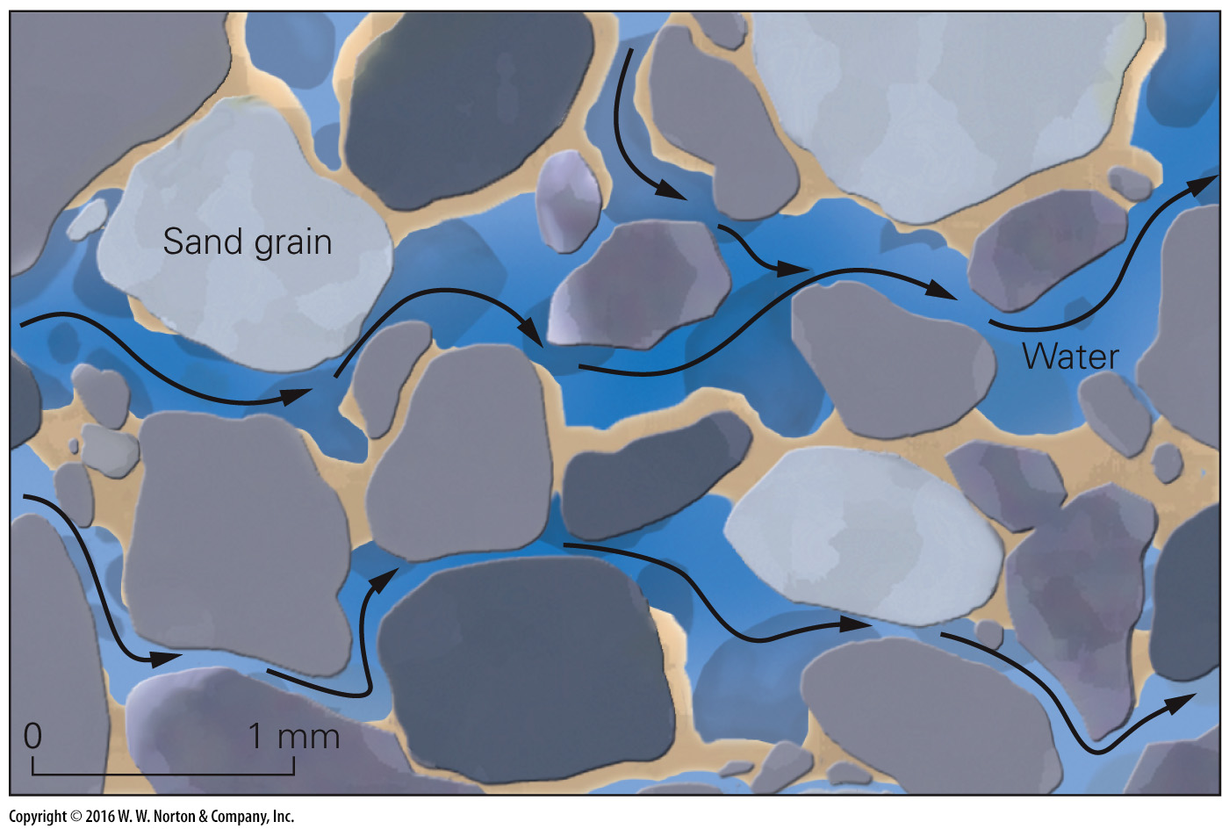
Notes:
FIGURE 16.2d The concepts of porosity and permeability.
(d) Permemability is the degree to which pores are linked, so water can move from pore to pore and move through rock or sediment.

Slide 13
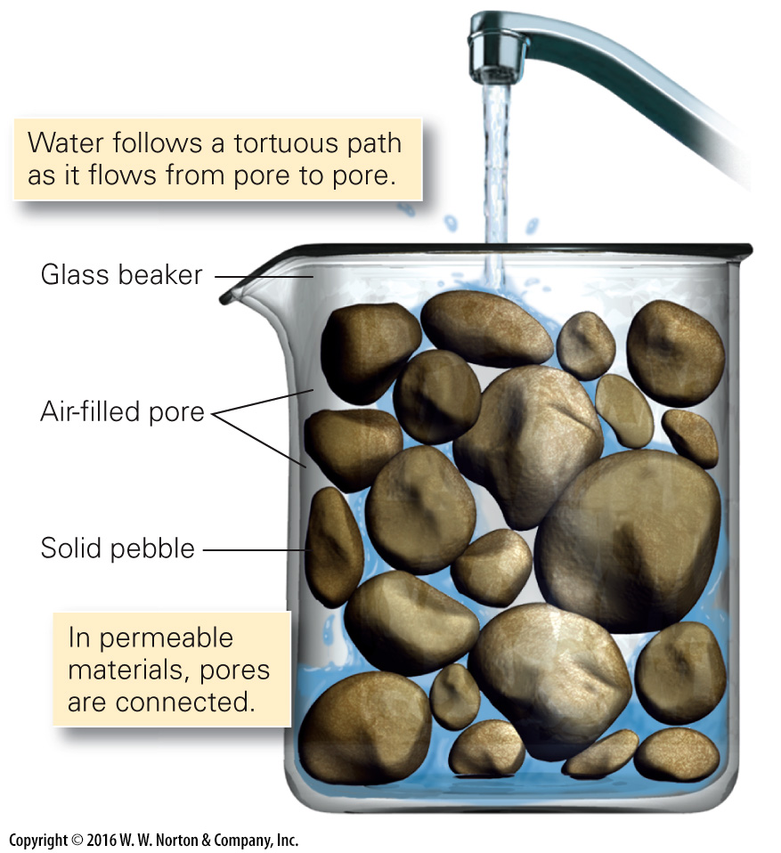
Notes:
FIGURE 16.2e The concepts of porosity and permeability.
(e) Gravel contains pore space because clasts don’t fit together tightly. The connection of pores produces permeability, so water can flow through gravel.

Slide 14
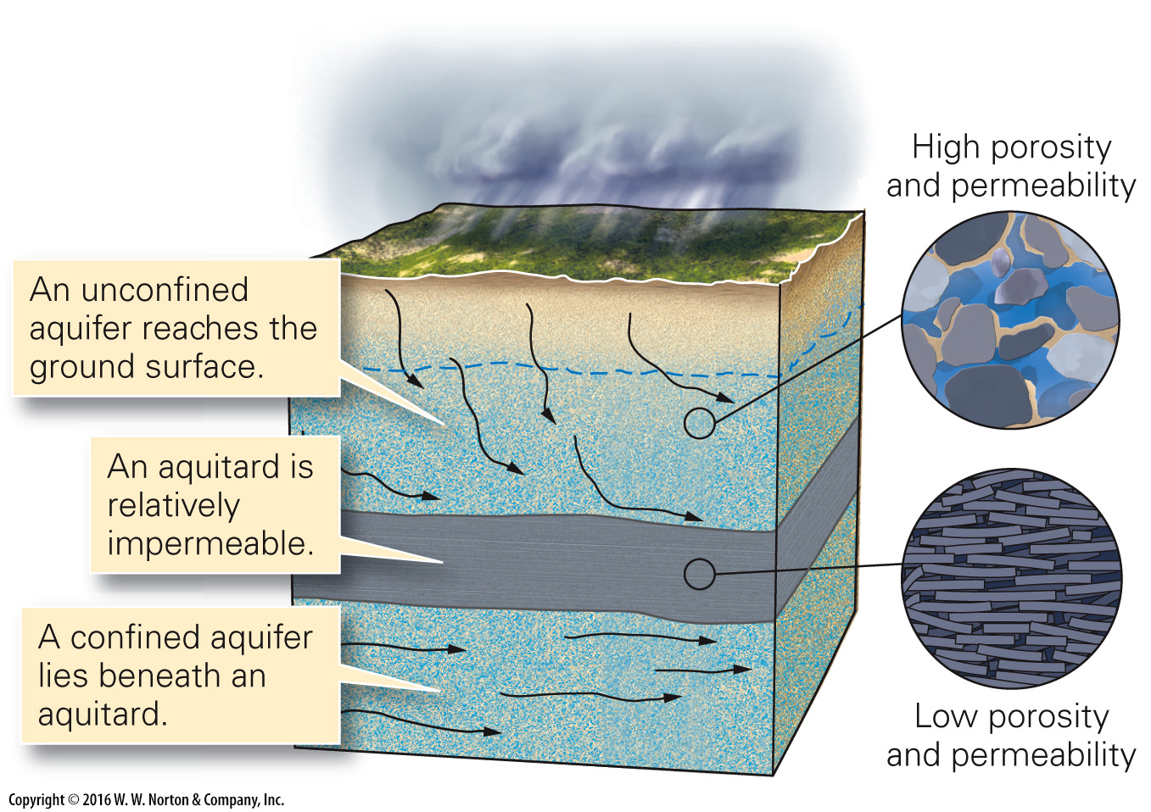
Notes:
FIGURE 16.3a Water underground—aquifers, aquitards, and the water table.
(a) An aquifer is a high-porosity, high-permeability rock. Some aquifers are unconfined, and some are confined.

Slide 15
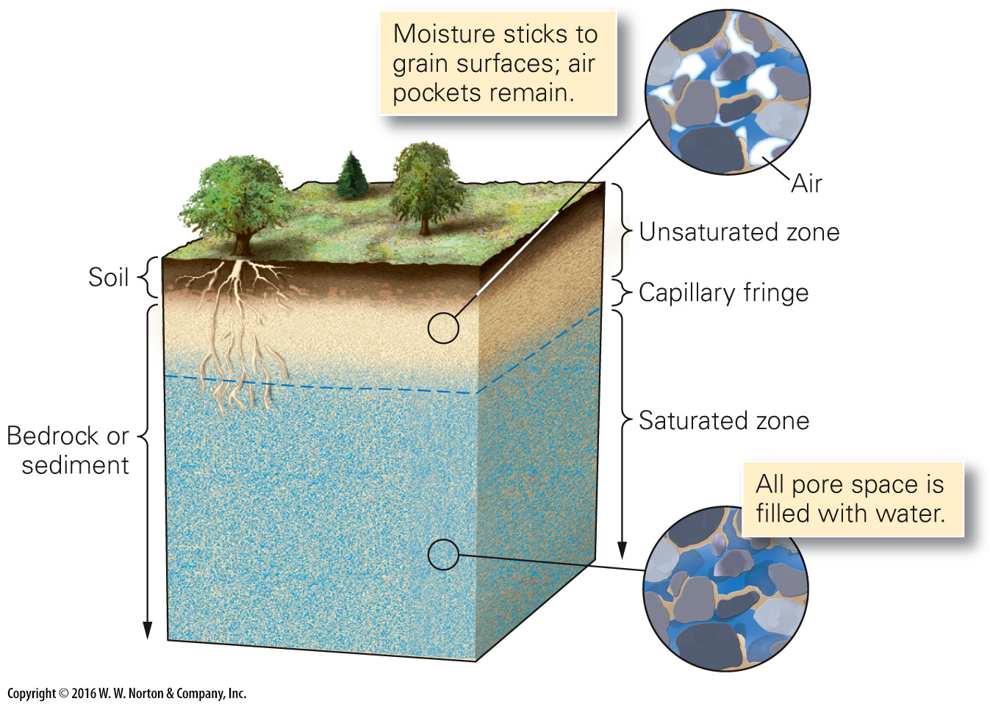
Notes:
FIGURE 16.3b Water underground—aquifers, aquitards, and the water table.
(b) The water table is the top of the groundwater reservoir in the subsurface. It separates the unsaturated (vadose) zone above from the unsaturated zone below. A capillary fringe forms at the boundary.

Slide 16
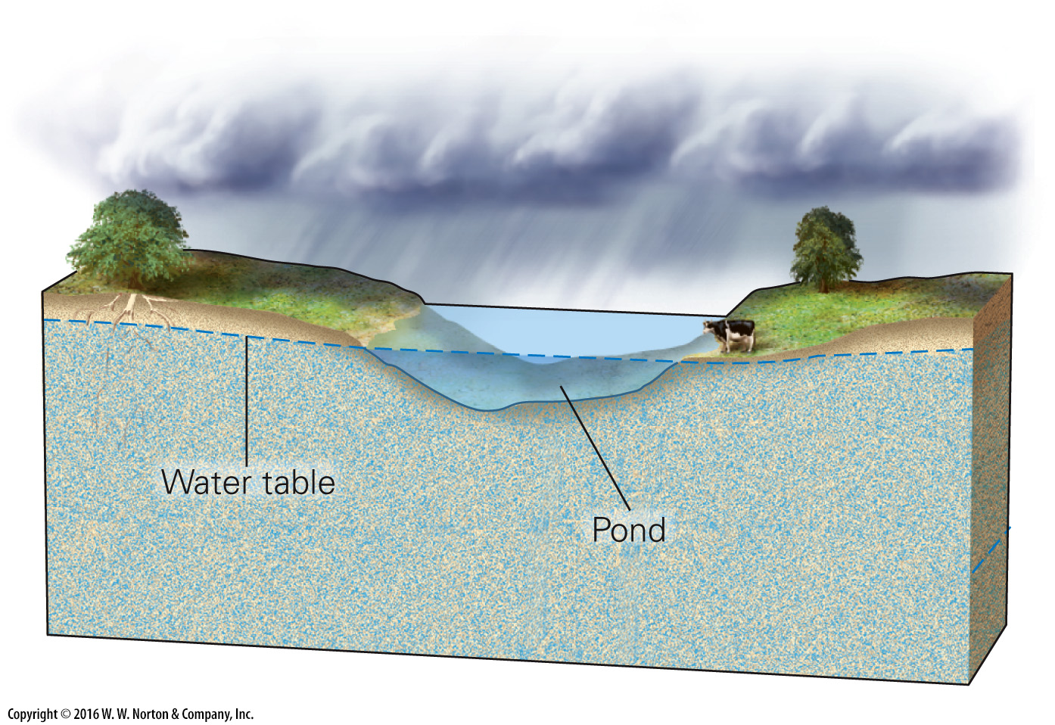
Notes:
FIGURE 16.3c Water underground—aquifers, aquitards, and the water table.
(c) Where the water table lies close to the ground surface, ponds remain filled—the water table is the surface of the pond.

Slide 17
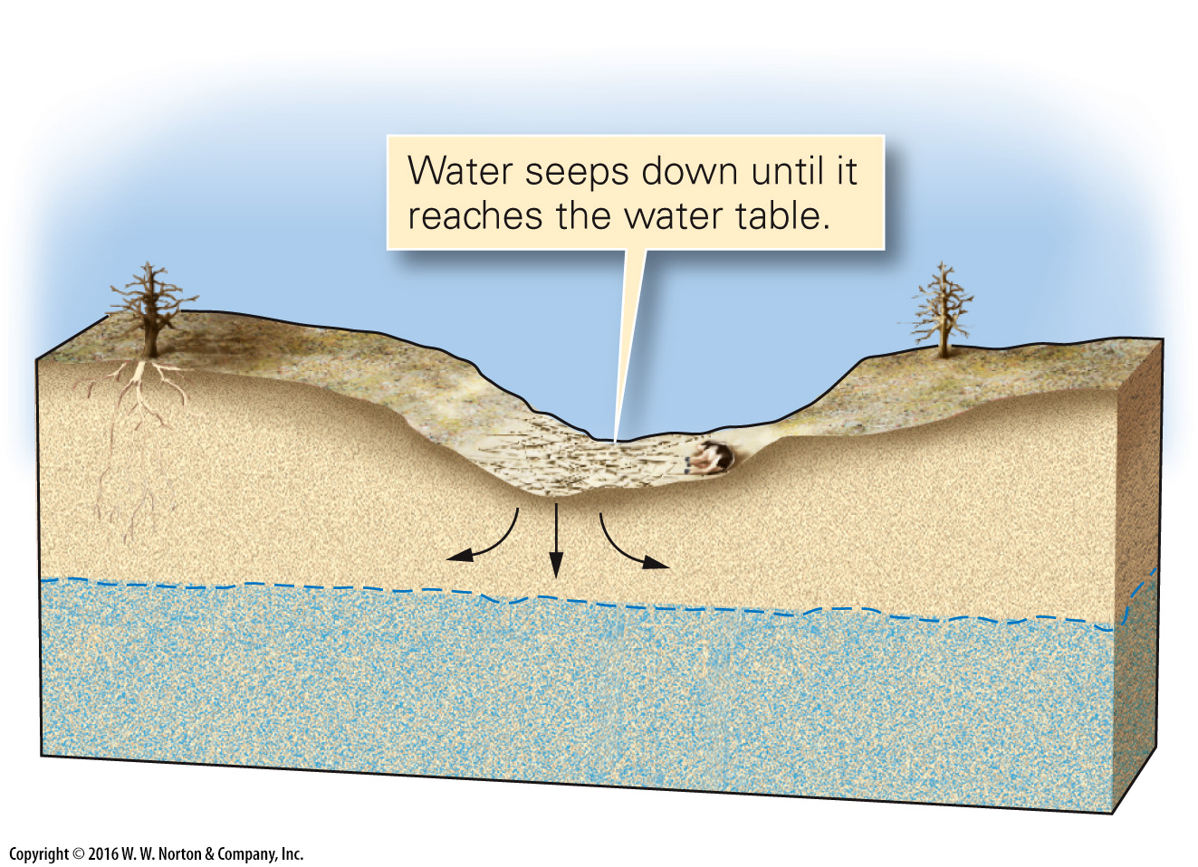
Notes:
FIGURE 16.3d Water underground—aquifers, aquitards, and the water table.
(d) In dry regions, the water table sinks deep below the surface. Water that collects temporarily in low areas sinks into the subsurface.

Slide 18
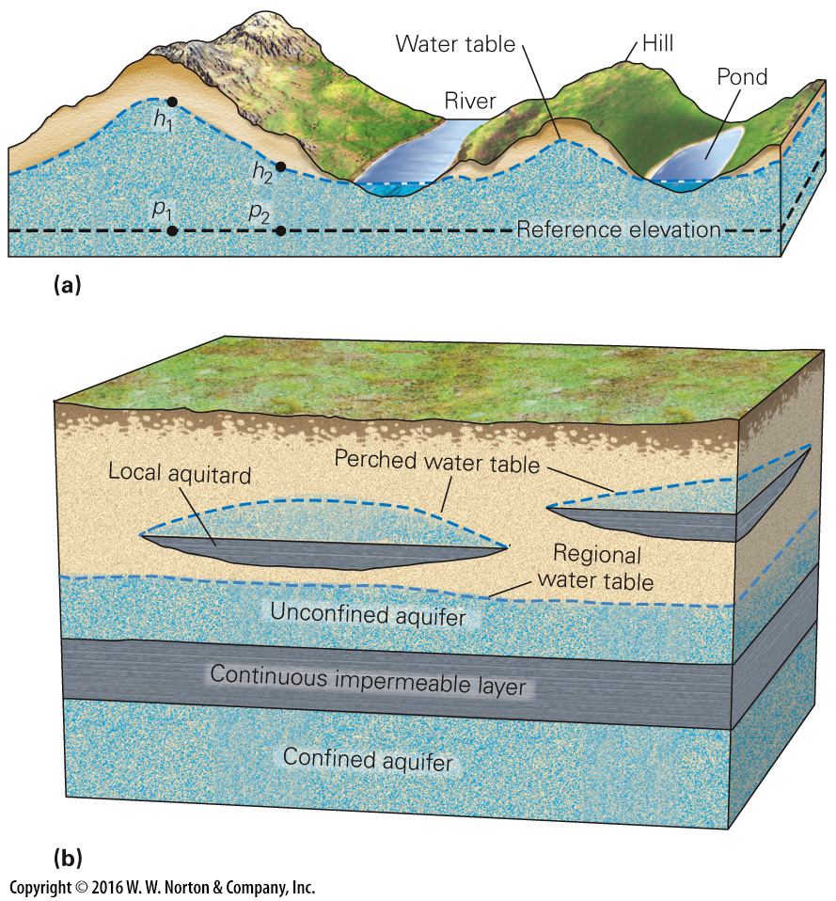
Notes:
FIGURE 16.4 Factors that influence the position of the water table.
(a) The shape of a water table beneath hilly topography. Point h₁ on the water table is higher than Point h₂, relative to a reference elevation. The pressure at p₁ is, therefore, more than the pressure at p₂. (b) A perched water table occurs where a mound of groundwater becomes trapped above a localized aquitard that lies above the regional water table.

Slide 19
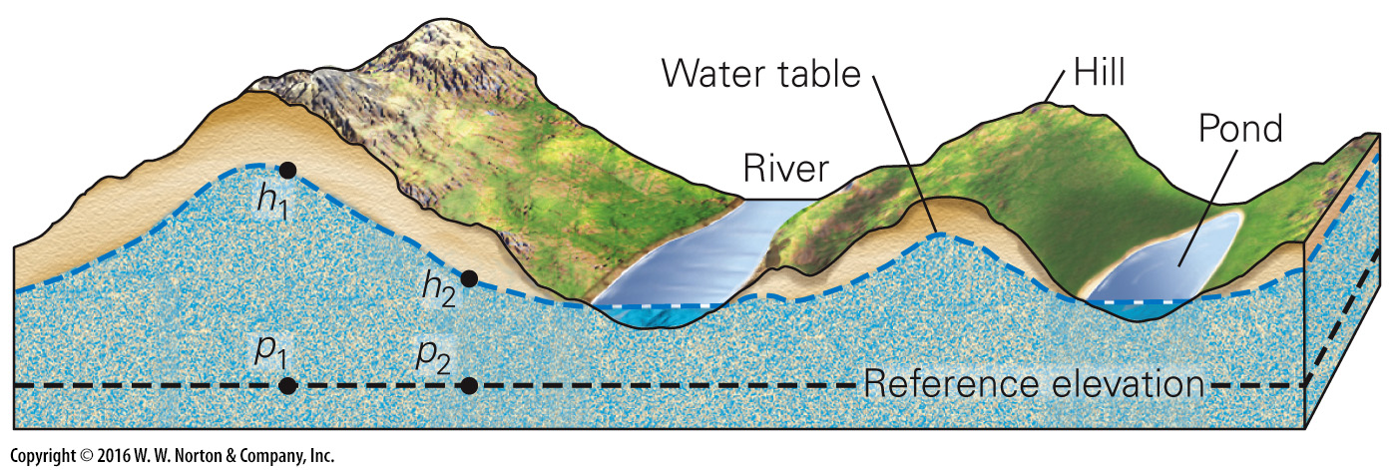
Notes:
FIGURE 16.4a Factors that influence the position of the water table.
(a) The shape of a water table beneath hilly topography. Point h₁ on the water table is higher than Point h₂, relative to a reference elevation. The pressure at p₁ is, therefore, more than the pressure at p₂.

Slide 20
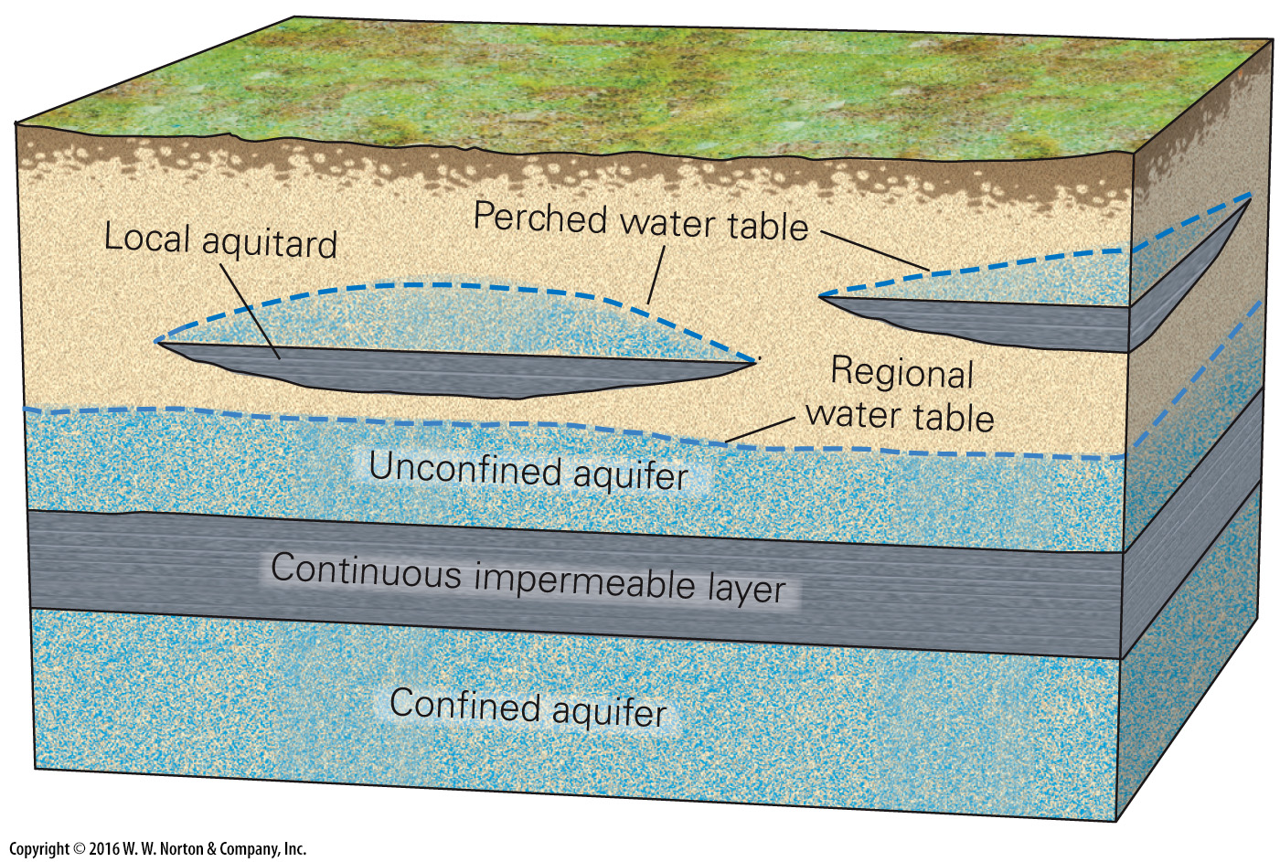
Notes:
FIGURE 16.4b Factors that influence the position of the water table.
(b) A perched water table occurs where a mound of groundwater becomes trapped above a localized aquitard that lies above the regional water table.

Slide 21
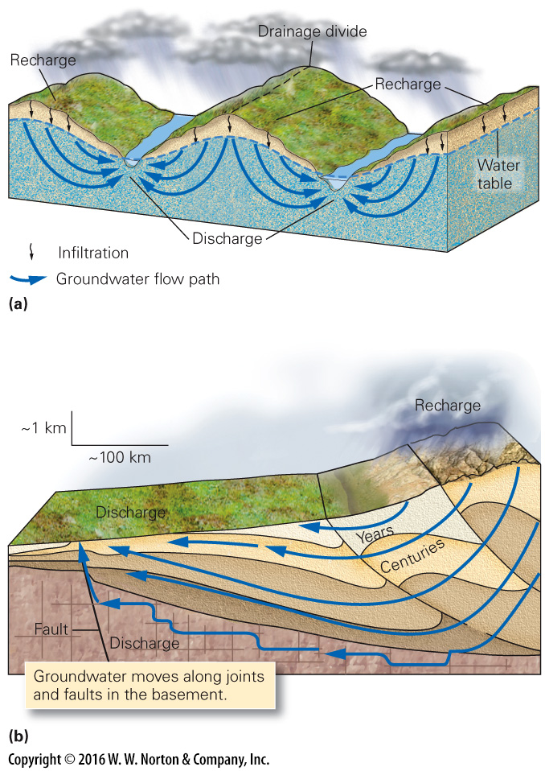
Notes:
FIGURE 16.5 The flow of groundwater.
(a) Groundwater flows from recharge areas to discharge areas. Typically, the flow follows curving paths. (b) The large hydraulic head resulting from uplift of a mountain belt may drive groundwater hundreds of kilometers across regional sedimentary basins. Deeper flow paths take longer.

Slide 22
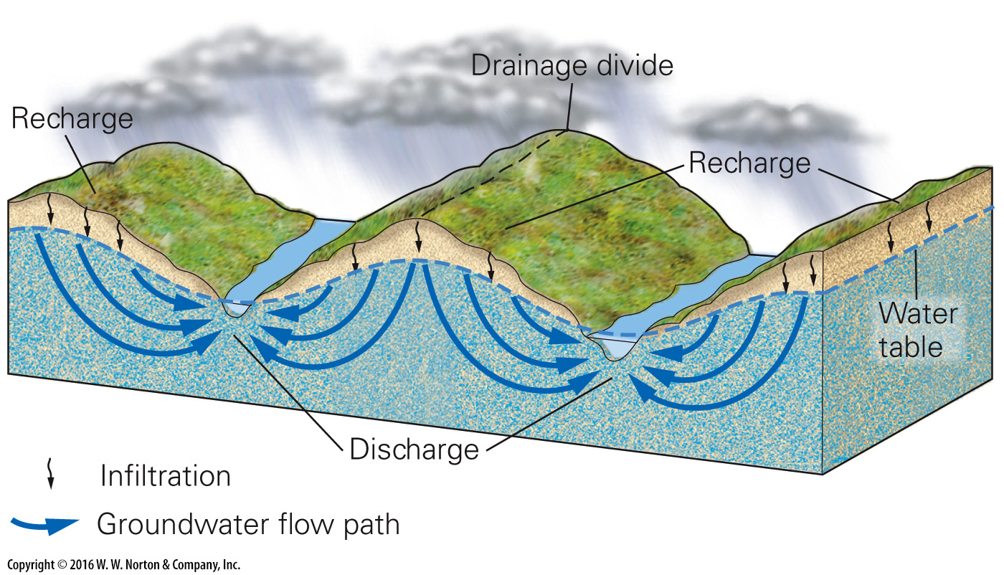
Notes:
FIGURE 16.5a The flow of groundwater.
(a) Groundwater flows from recharge areas to discharge areas. Typically, the flow follows curving paths.

Slide 23
Notes:
FIGURE 16.5b The flow of groundwater.
(b) The large hydraulic head resulting from uplift of a mountain belt may drive groundwater hundreds of kilometers across regional sedimentary basins. Deeper flow paths take longer.

Slide 24
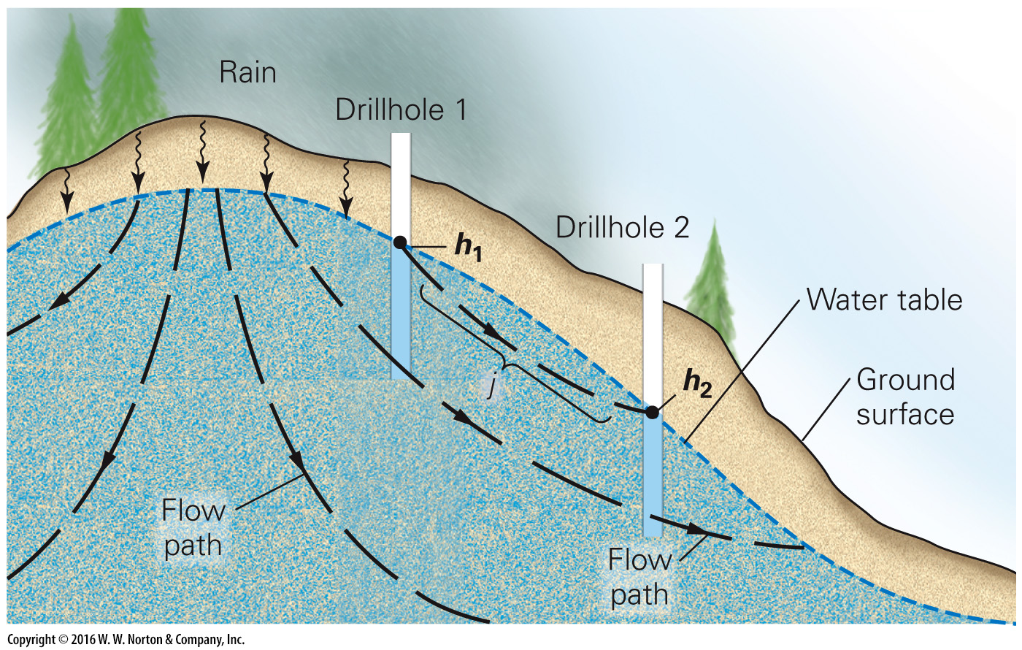
Notes:
FIGURE Bx16.1 The level to which water rises in a drillhole is the hydraulic head (h). The hydraulic gradient (i) is the difference in head divided by the length of the flow path (j).

Slide 25
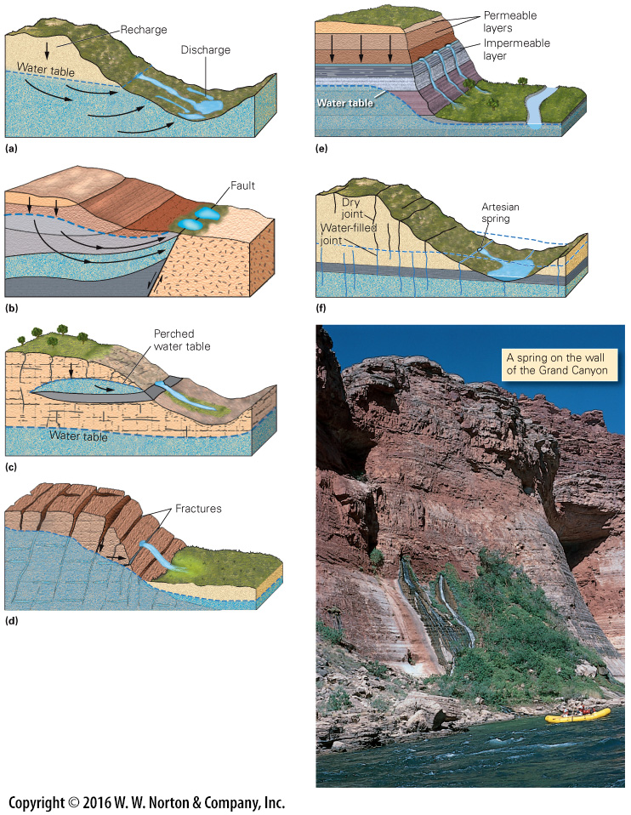
Notes:
FIGURE 16.6 Geologic settings in which springs form.
(a) Groundwater reaches the ground surface in a discharge zone. (b) Where groundwater reaches an impermeable barrier, it rises. (c) Groundwater seeps where a perched water table intersects a slope. (d) A network of interconnected fractures channels water to the surface of the hill. (e) Groundwater seeps out of a cliff face at the top of a relatively impermeable bed. (f) In cases where water under pressure lies below an aquitard, a crack may provide a pathway for an artesian spring to form.

Slide 26
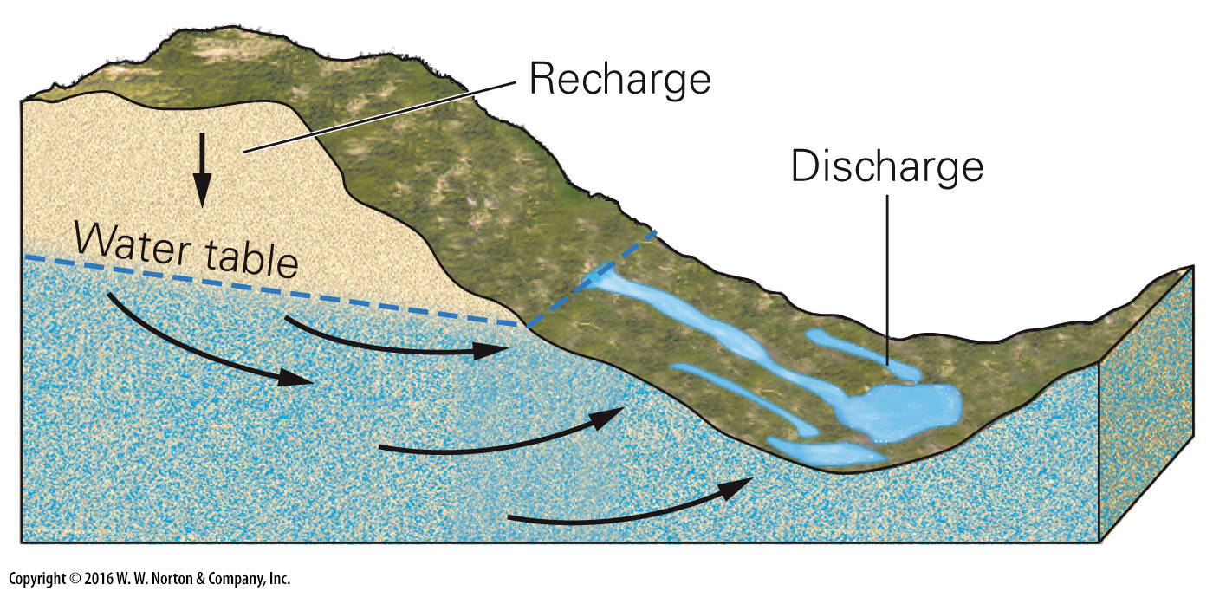
Notes:
FIGURE 16.6a Geologic settings in which springs form.
(a) Groundwater reaches the ground surface in a discharge zone.

Slide 27
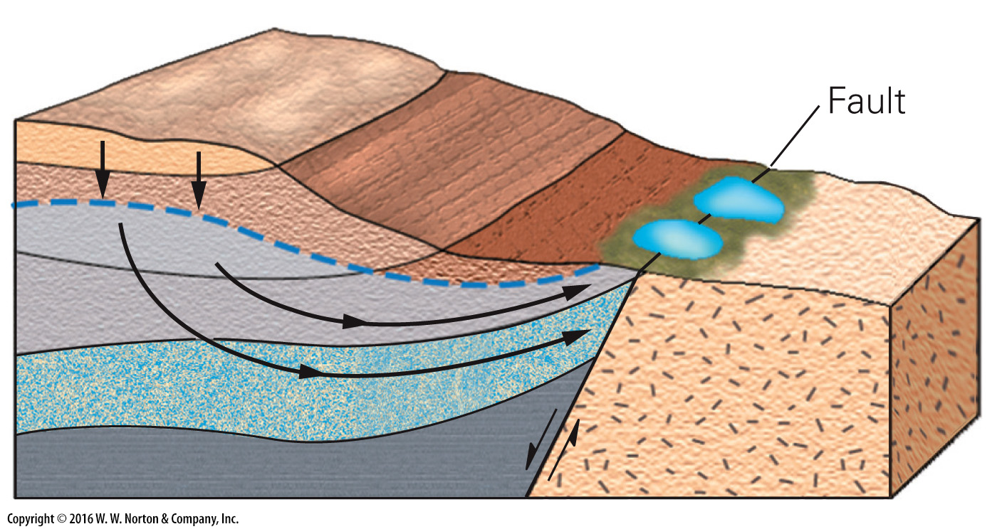
Notes:
FIGURE 16.6b Geologic settings in which springs form.
(b) Where groundwater reaches an impermeable barrier, it rises.

Slide 28
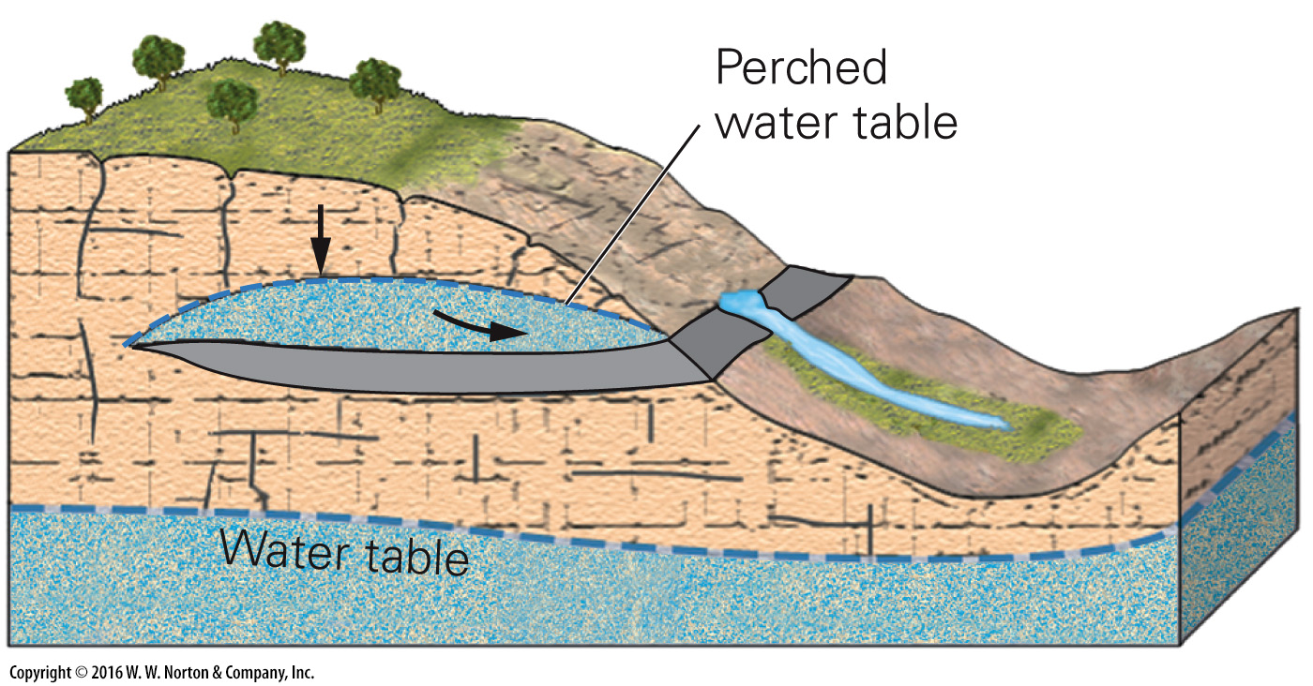
Notes:
FIGURE 16.6c Geologic settings in which springs form.
(c) Groundwater seeps where a perched water table intersects a slope.

Slide 29
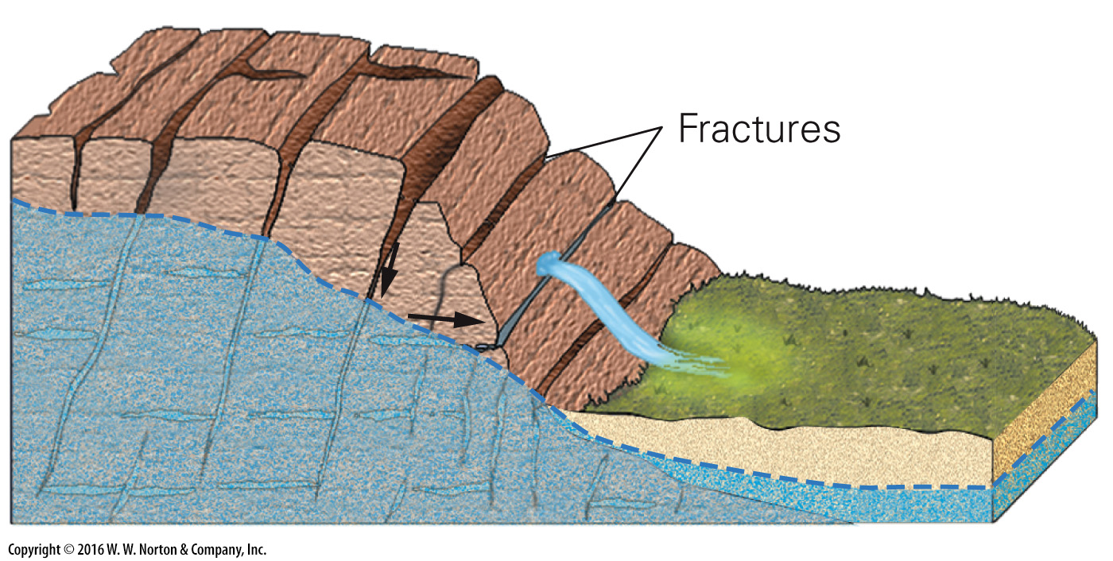
Notes:
FIGURE 16.6d Geologic settings in which springs form.
(d) A network of interconnected fractures channels water to the surface of the hill.

Slide 30
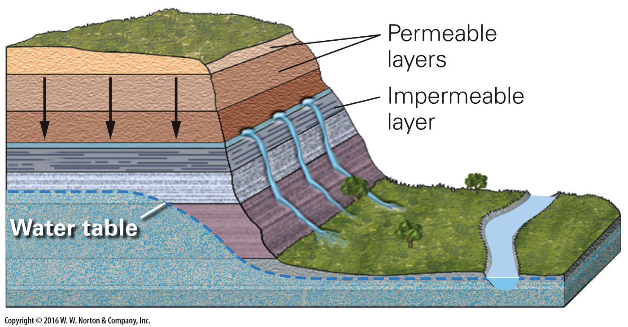
Notes:
FIGURE 16.6e Geologic settings in which springs form.
(e) Groundwater seeps out of a cliff face at the top of a relatively impermeable bed.

Slide 31
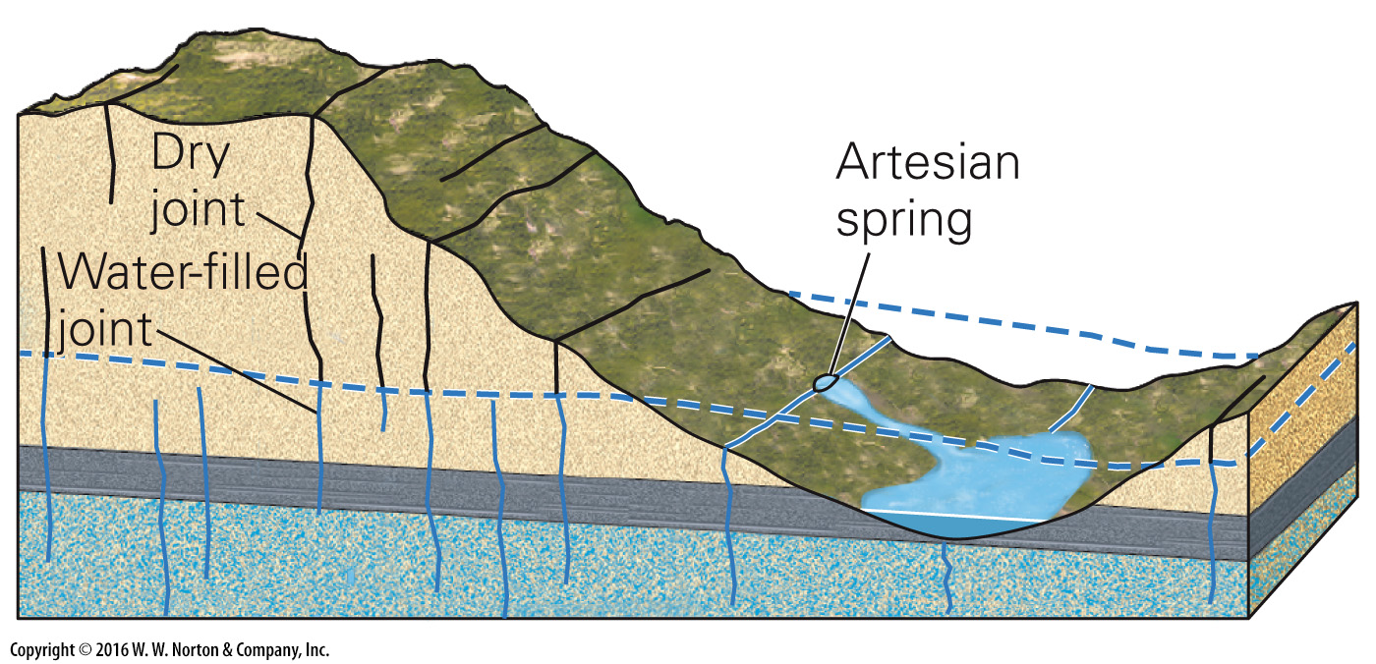
Notes:
FIGURE 16.6f Geologic settings in which springs form.
(f) In cases where water under pressure lies below an aquitard, a crack may provide a pathway for an artesian spring to form.

Slide 32
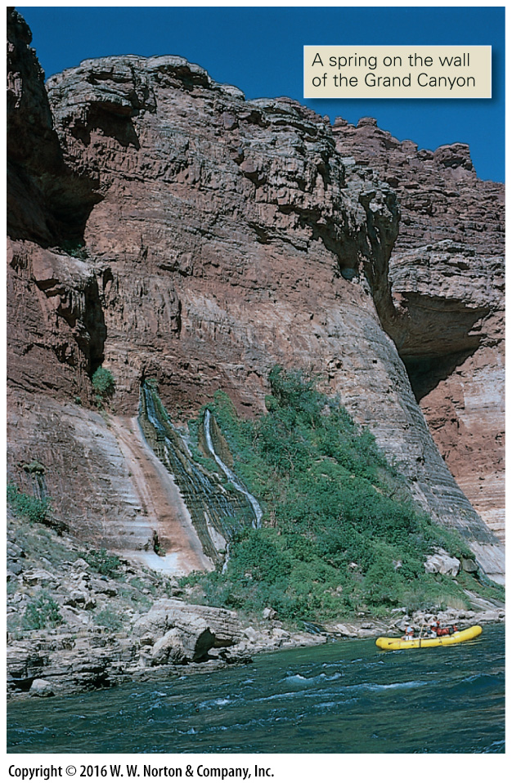
Notes:
FIGURE 16.6f Geologic settings in which springs form.
(f) In cases where water under pressure lies below an aquitard, a crack may provide a pathway for an artesian spring to form.

Slide 33
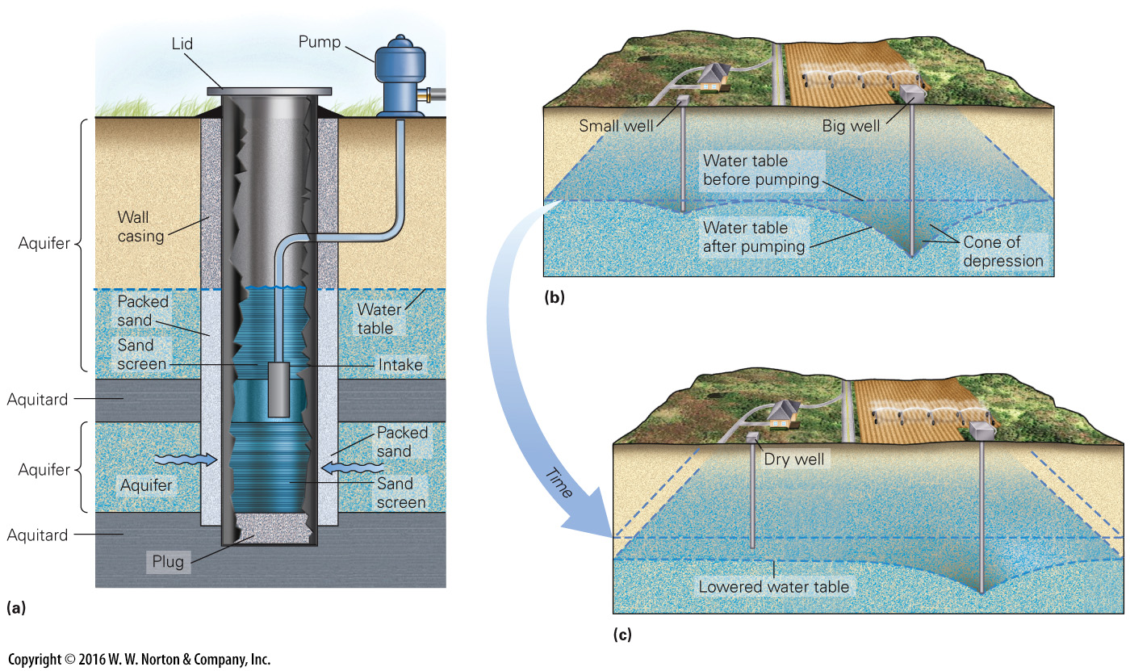
Notes:
FIGURE 16.7 Pumping groundwater from a normal well can affect the water table
(a) A modern ordinary well sucks up water with an electric pump. The packed sand filters the water. (b) Pumping forms a cone of depression in the water table. (c) Pumping by the big well may be enough to make a small well run dry.

Slide 34
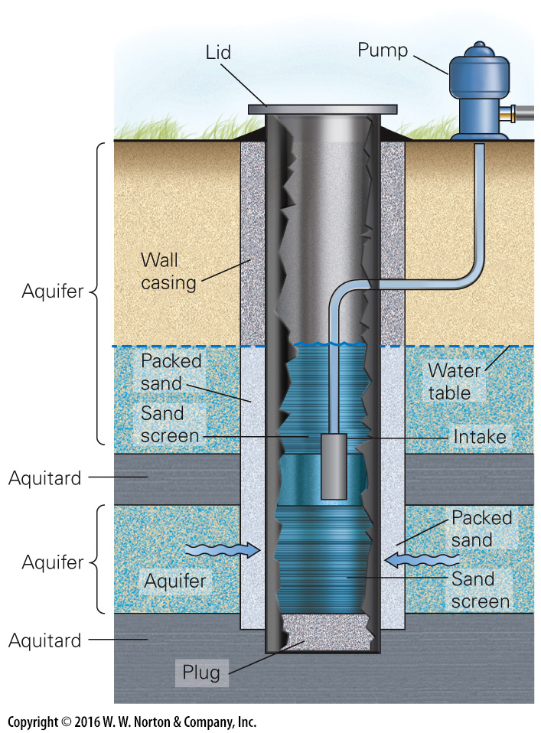
Notes:
FIGURE 16.7a Pumping groundwater from a normal well can affect the water table
(a) A modern ordinary well sucks up water with an electric pump. The packed sand filters the water.

Slide 35
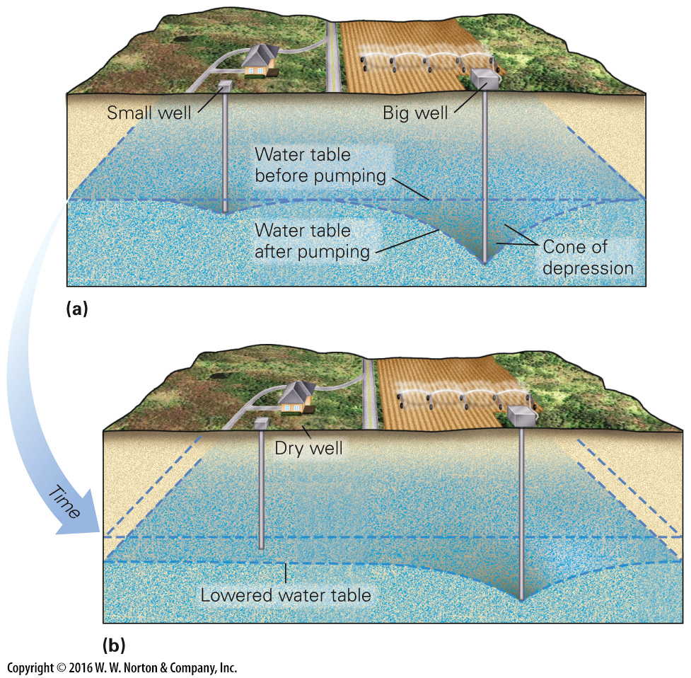
Notes:
FIGURE 16.7bc Pumping groundwater from a normal well can affect the water table
(b) Pumping forms a cone of depression in the water table. (c) Pumping by the big well may be enough to make a small well run dry.

Slide 36
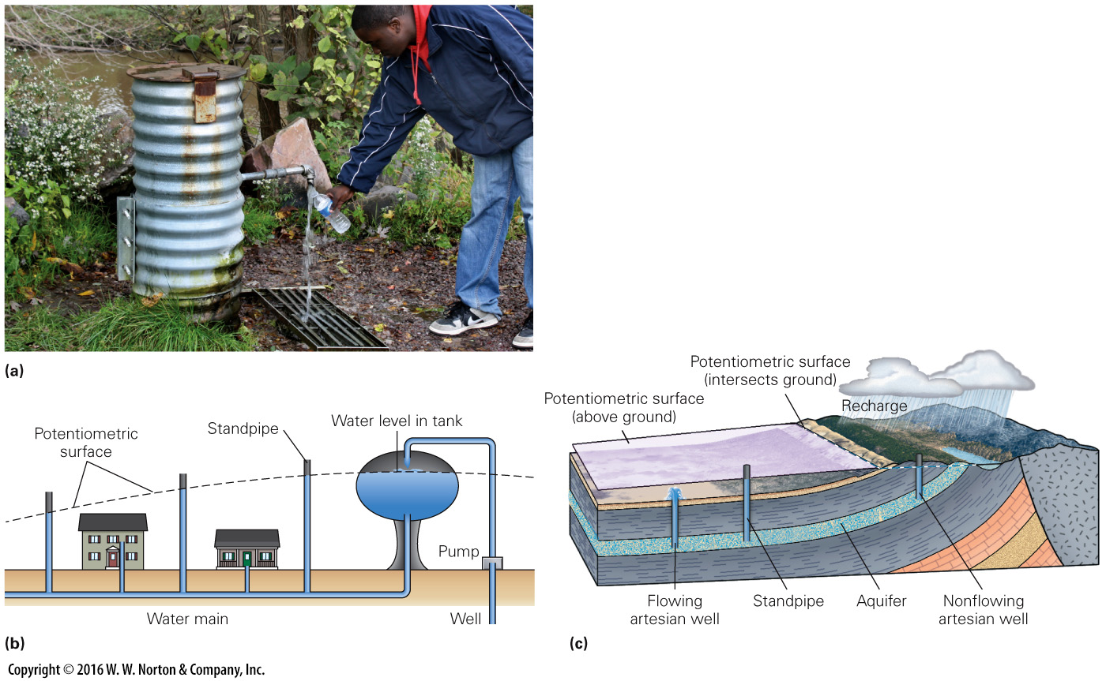
Notes:
FIGURE 16.8 Artesian wells, where water rises from the aquifer without pumping.
(a) A flowing artesian well in Wisconsin; the water rises from underground in the corrugated pipe without the need of pumping, and it continuously flows out of the pipe. (b) The configuration of a city water supply. Water rises in vertical pipes up to the level of the potentiometric surface. (c) The configuration of a regional artesian system.

Slide 37
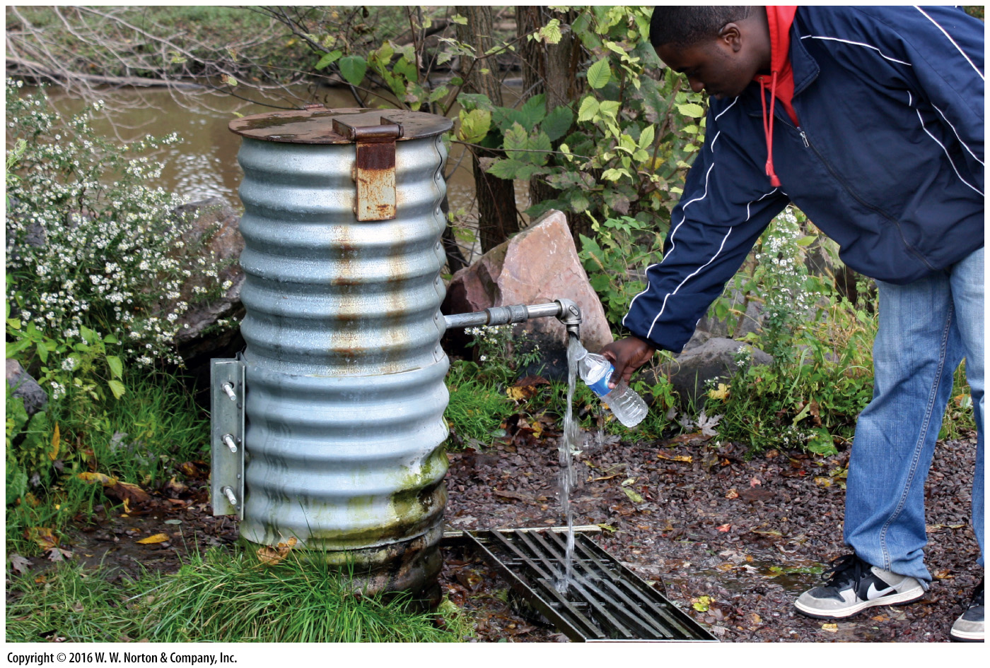
Notes:
FIGURE 16.8a Artesian wells, where water rises from the aquifer without pumping.
(a) A flowing artesian well in Wisconsin; the water rises from underground in the corrugated pipe without the need of pumping, and it continuously flows out of the pipe.

Slide 38
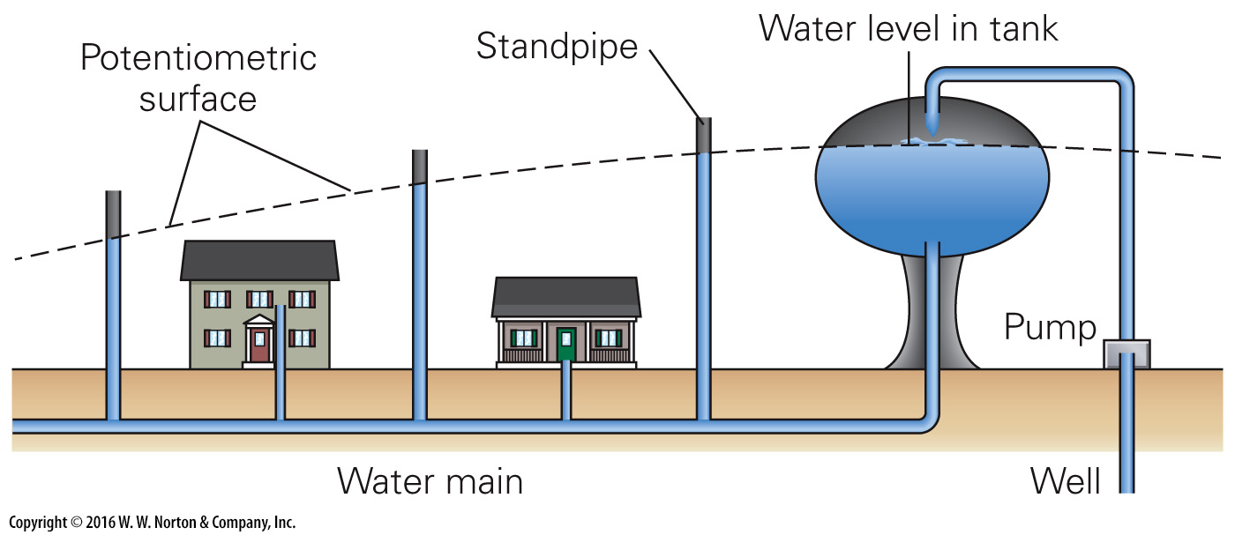
Notes:
FIGURE 16.8b Artesian wells, where water rises from the aquifer without pumping.
(b) The configuration of a city water supply. Water rises in vertical pipes up to the level of the potentiometric surface.

Slide 39
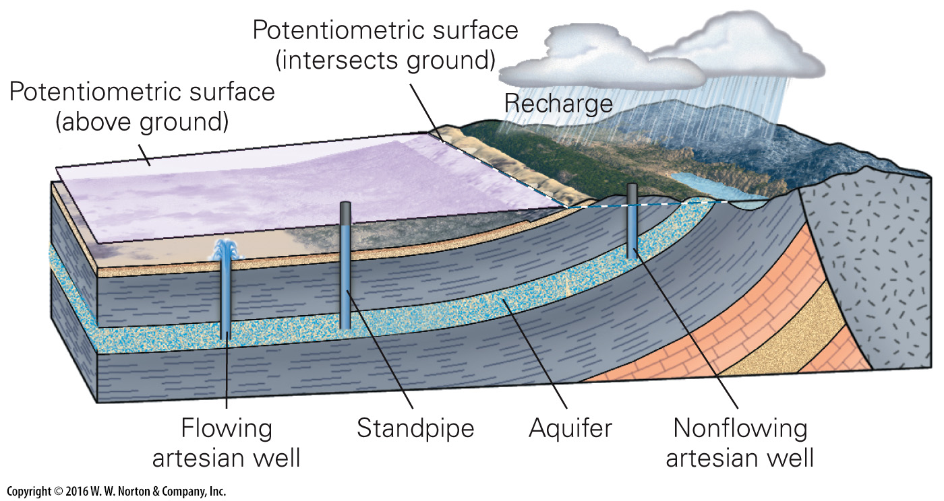
Notes:
FIGURE 16.8c Artesian wells, where water rises from the aquifer without pumping.
(c) The configuration of a regional artesian system.

Slide 40
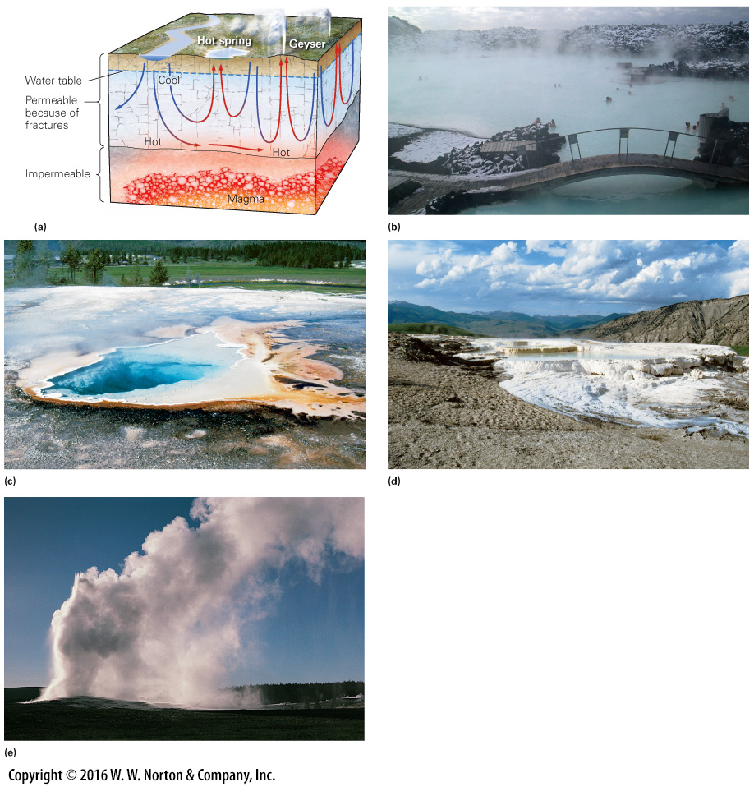
Notes:
FIGURE 16.9 Geothermal waters and examples of their manifestation in the landscape.
(a) Geysers and hot springs occur where groundwater, heated at depth, rises to the surface. (b) Hot springs in Iceland, warmed by magma below, attract tourists from around the world. (c) Colorful bacteria- and archaea-laden pools, Yellowstone National Park, Wyoming. (d) Terraces of minerals precipitated at Mammoth Hot Springs, Yellowstone. (e) The Old Faithful geyser in Yellowstone erupts predictably.

Slide 41
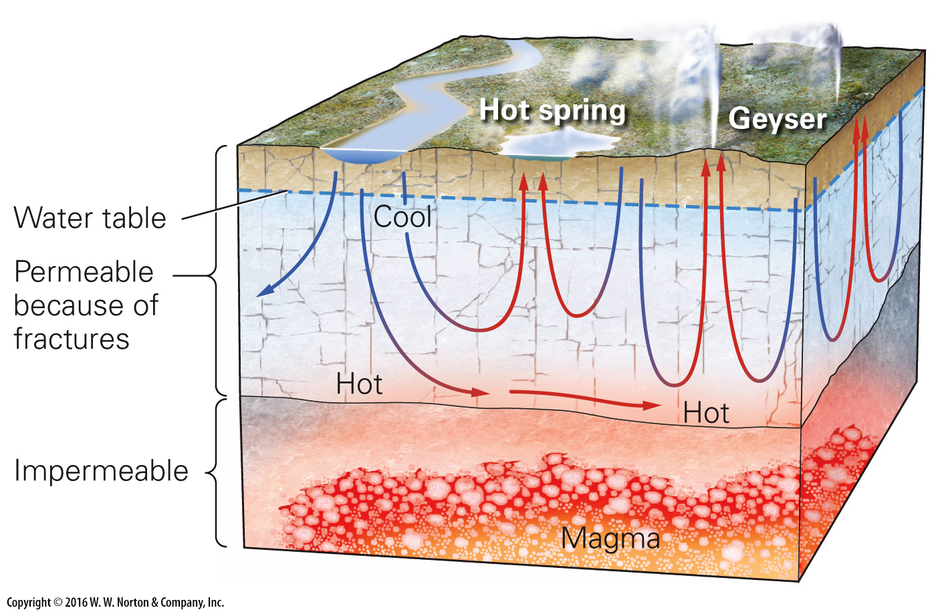
Notes:
FIGURE 16.9a Geothermal waters and examples of their manifestation in the landscape.
(a) Geysers and hot springs occur where groundwater, heated at depth, rises to the surface.

Slide 42
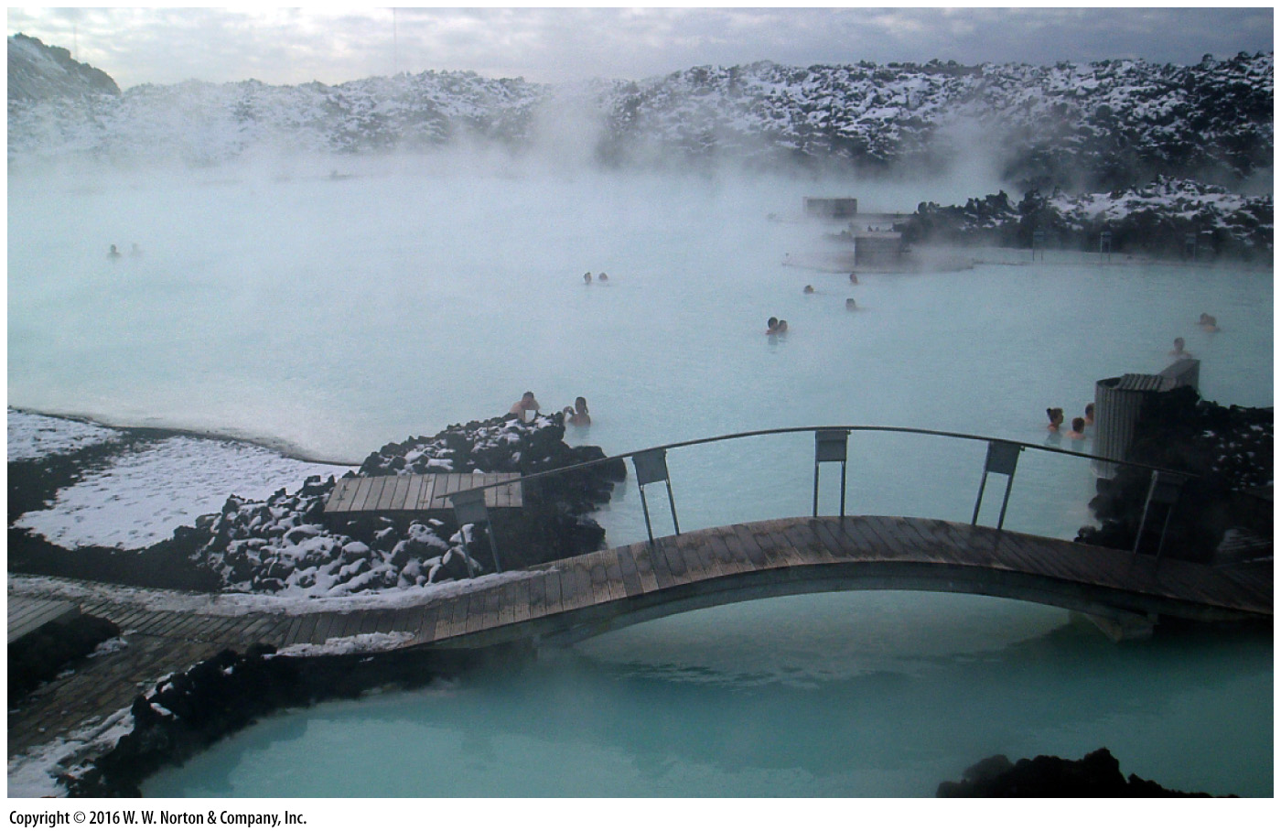
Notes:
FIGURE 16.9b Geothermal waters and examples of their manifestation in the landscape.
(b) Hot springs in Iceland, warmed by magma below, attract tourists from around the world.

Slide 43
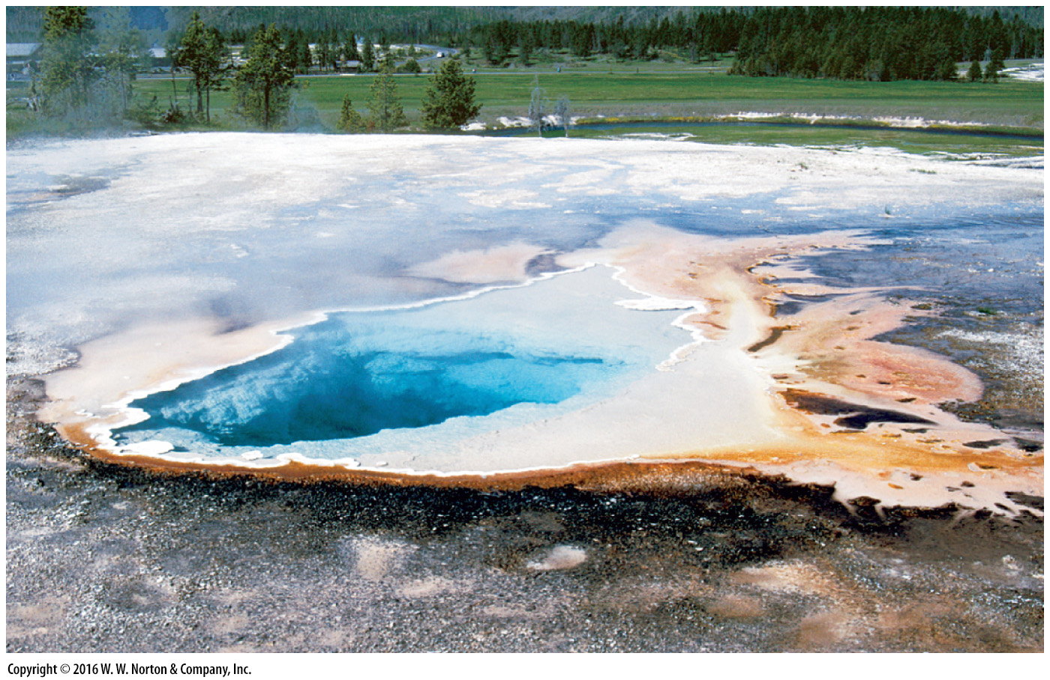
Notes:
FIGURE 16.9c Geothermal waters and examples of their manifestation in the landscape.
(c) Colorful bacteria- and archaea-laden pools, Yellowstone National Park, Wyoming.

Slide 44
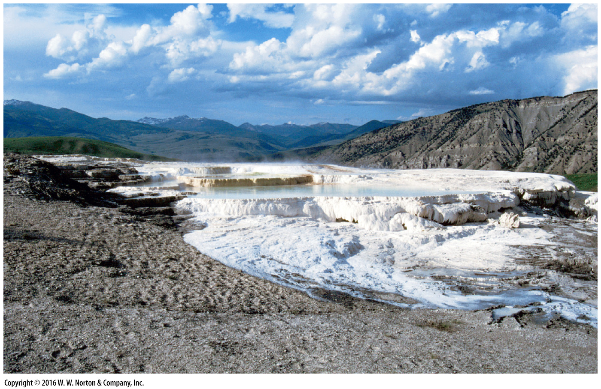
Notes:
FIGURE 16.9d Geothermal waters and examples of their manifestation in the landscape.
(d) Terraces of minerals precipitated at Mammoth Hot Springs, Yellowstone.

Slide 45
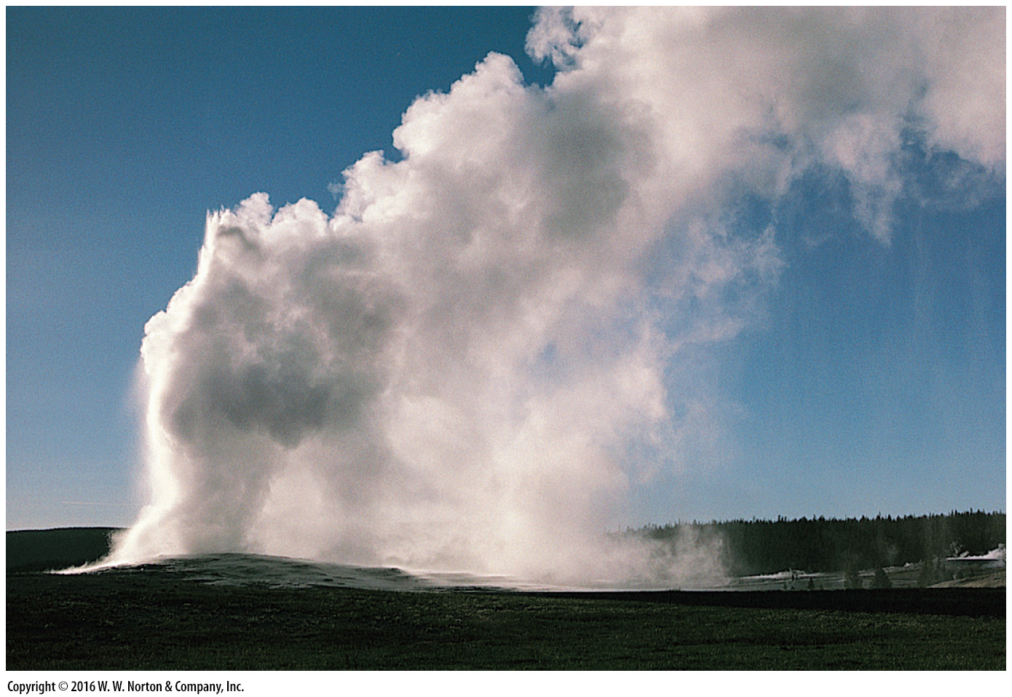
Notes:
FIGURE 16.9e Geothermal waters and examples of their manifestation in the landscape.
(e) The Old Faithful geyser in Yellowstone erupts predictably.

Slide 46
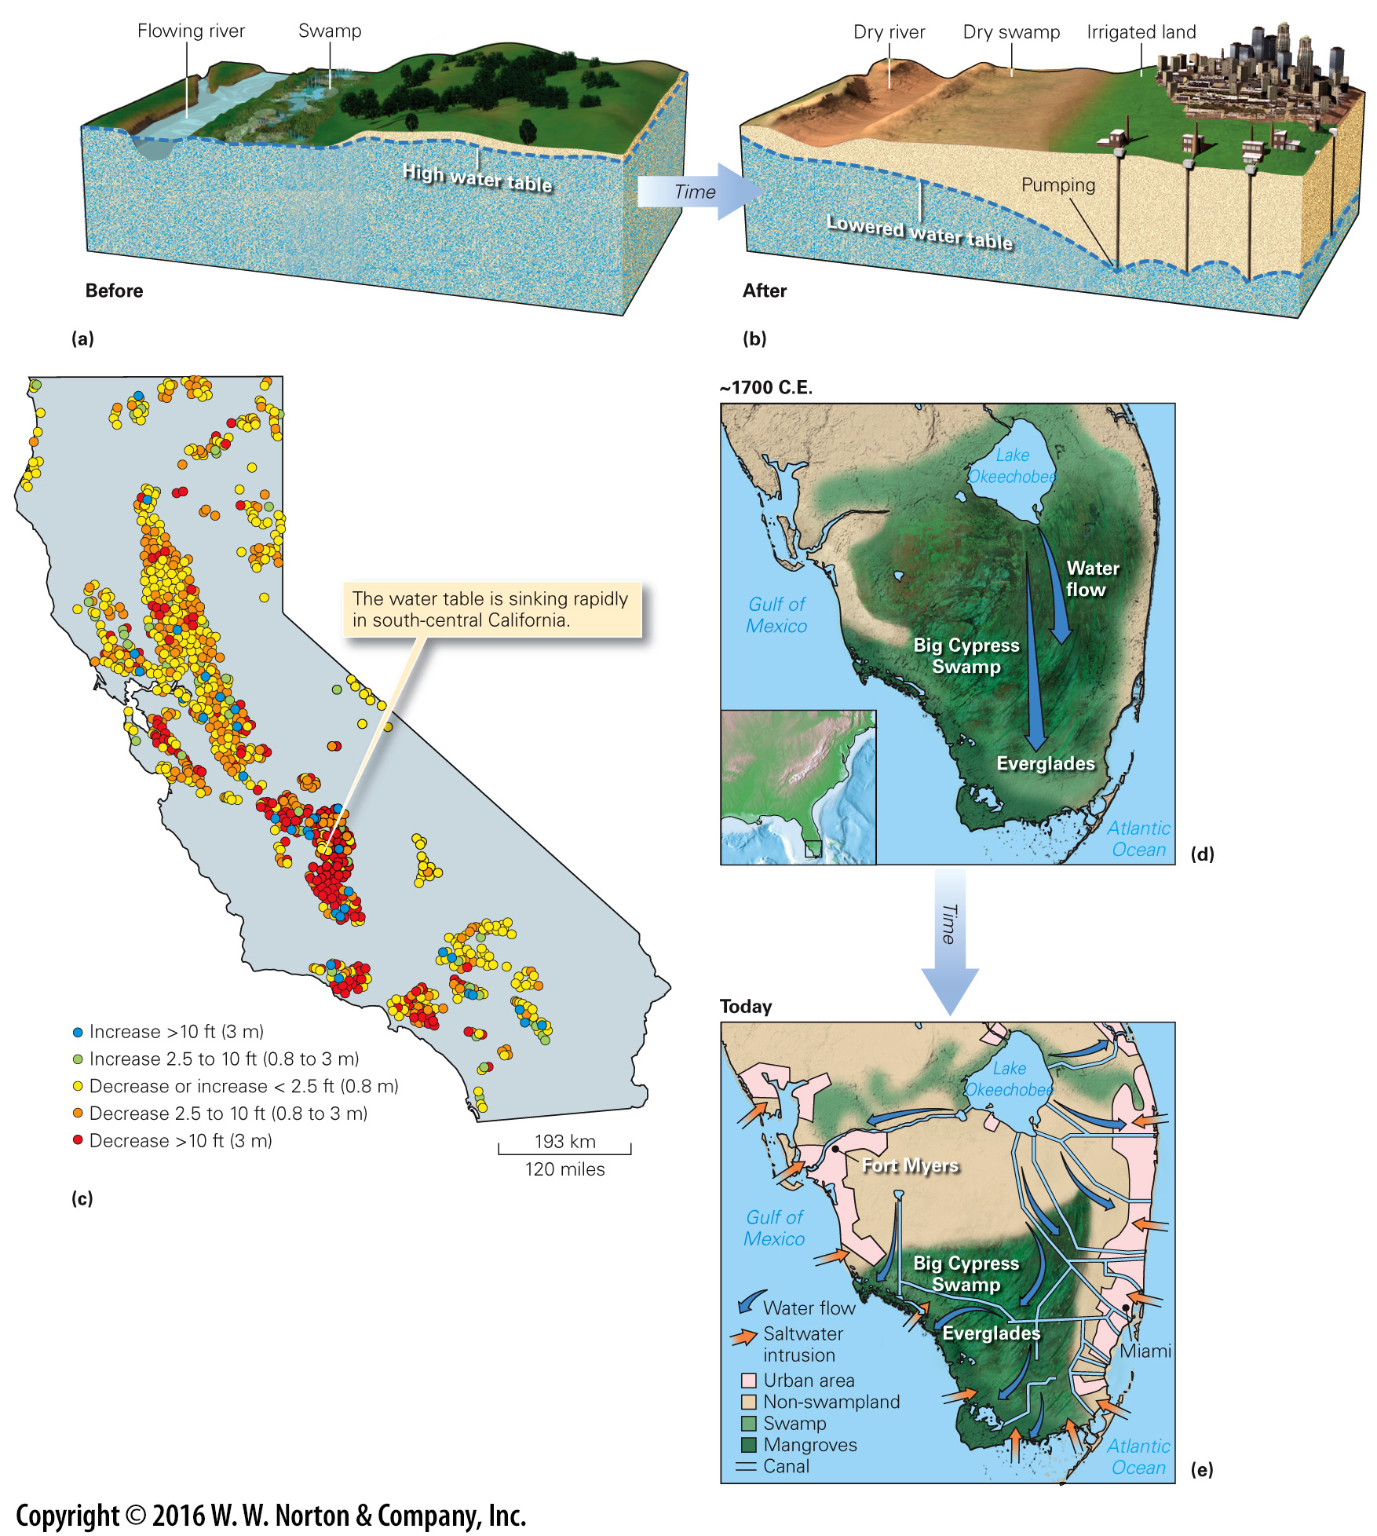
Notes:
FIGURE 16.10 Effects of human modification of the water table.
(a) Before humans start pumping groundwater, the water table is high. A swamp and permanent stream exist. (b) Pumping for consumers in a nearby city causes the water table to fall, so the swamp dries up. (c) A map showing variations in the drop of the water table in California, from the spring of 2013 to the spring of 2014, as measured in wells. (d) The Florida Everglades before the advent of urban growth and intensive agriculture. (e) Channelization and urbanization have removed water from recharge areas, disrupting flow paths.

Slide 47
Notes:
FIGURE 16.10ab Effects of human modification of the water table.
(a) Before humans start pumping groundwater, the water table is high. A swamp and permanent stream exist. (b) Pumping for consumers in a nearby city causes the water table to fall, so the swamp dries up.

Slide 48
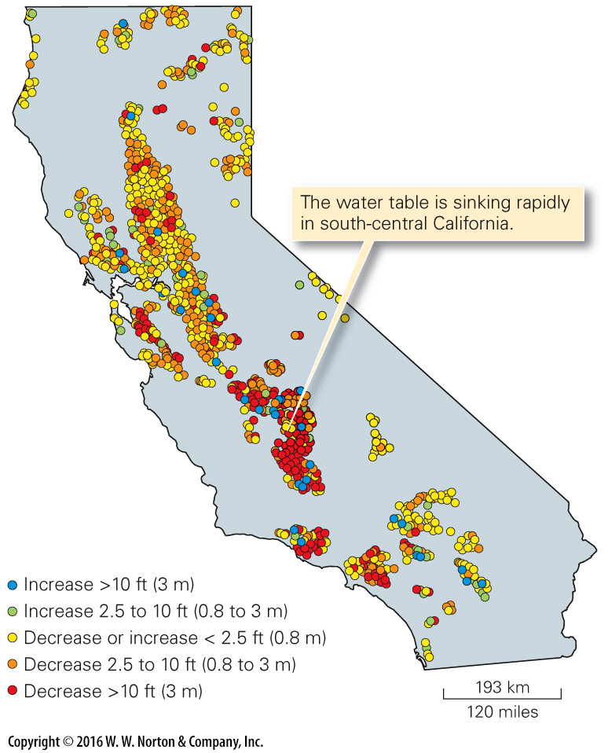
Notes:
FIGURE 16.10c Effects of human modification of the water table.
(c) A map showing variations in the drop of the water table in California, from the spring of 2013 to the spring of 2014, as measured in wells.

Slide 49
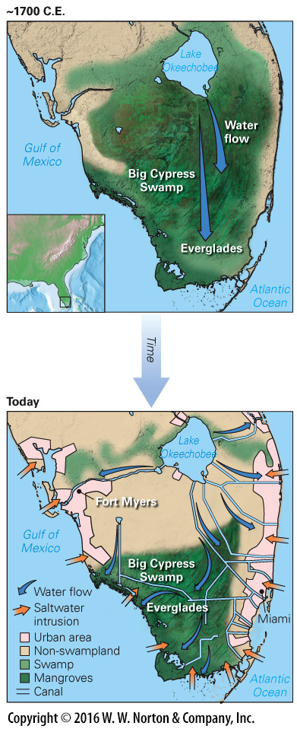
Notes:
FIGURE 16.10de Effects of human modification of the water table.
(d) The Florida Everglades before the advent of urban growth and intensive agriculture. (e) Channelization and urbanization have removed water from recharge areas, disrupting flow paths.

Slide 50
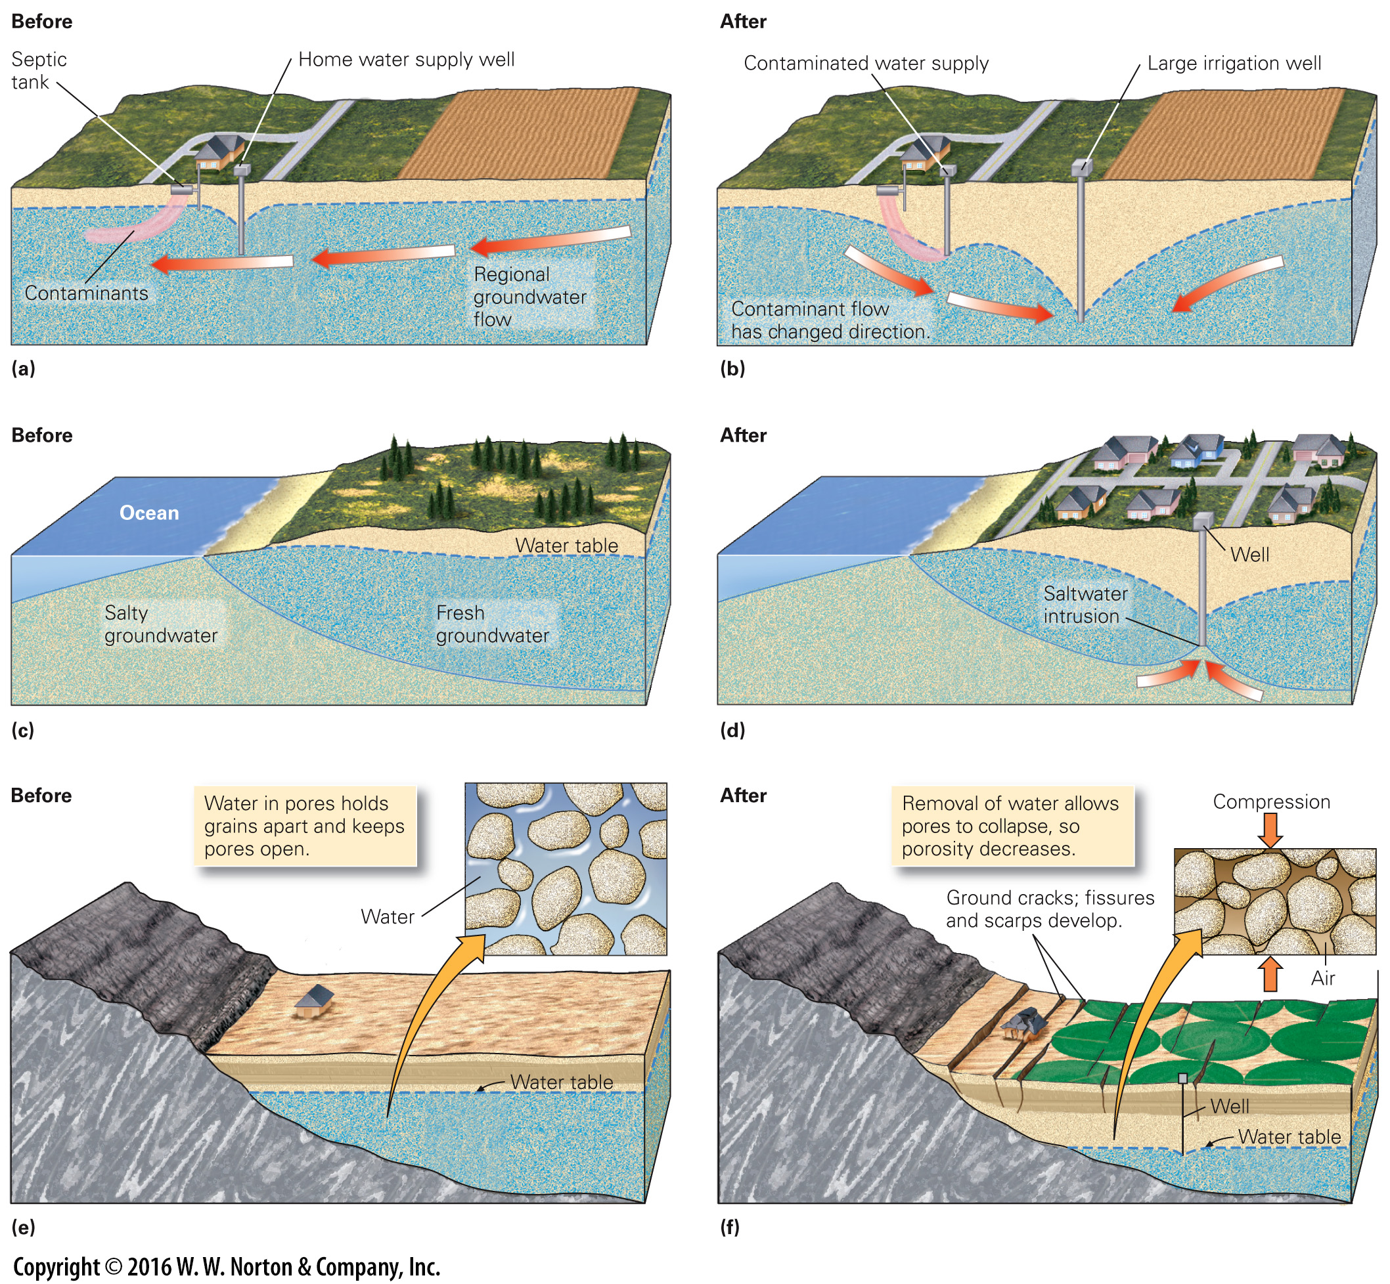
Notes:
FIGURE 16.11 Some causes of groundwater problems.
(a) Before pumping, effluent from a septic tank drifts with the regional groundwater flow, and the home well pumps clean water. (b) After pumping by a nearby irrigation well, effluent flows into the home well in response to the new local slope of the water table. (c) Before pumping, fresh groundwater forms a lens below the ground. (d) If the freshwater is pumped too fast, saltwater from below is sucked up into the well. This is saltwater intrusion. (e) When intensive irrigation removes groundwater, pore space in an aquifer collapses. (f) As a result, the land surface sinks, leading to the formation of ground fissures and causing houses to crack.

Slide 51
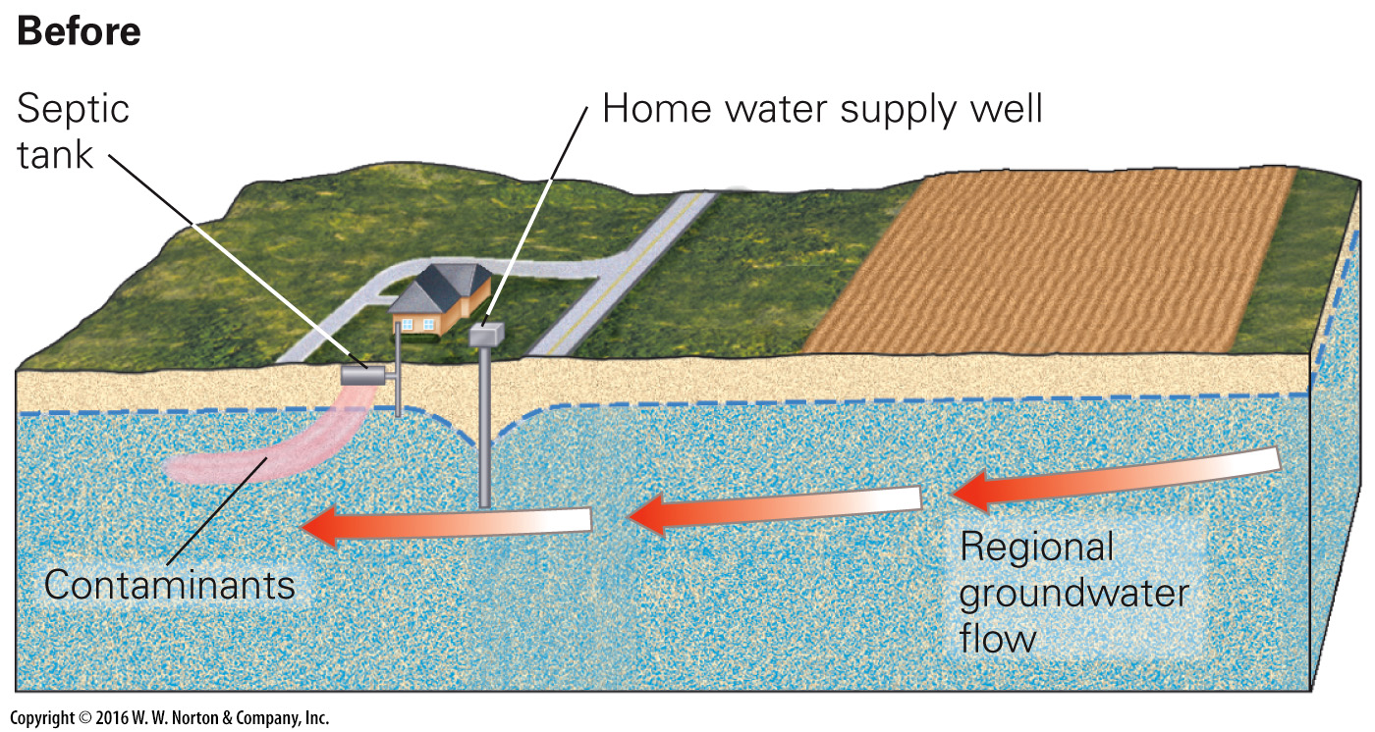
Notes:
FIGURE 16.11a Some causes of groundwater problems.
(a) Before pumping, effluent from a septic tank drifts with the regional groundwater flow, and the home well pumps clean water.

Slide 52
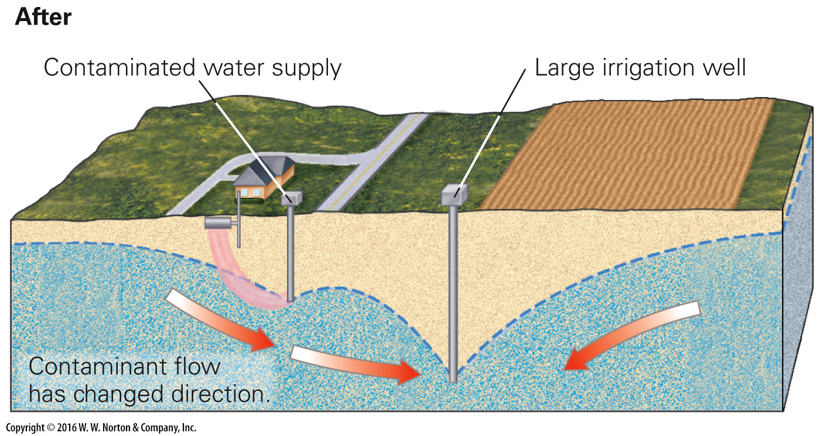
Notes:
FIGURE 16.11b Some causes of groundwater problems.
(b) After pumping by a nearby irrigation well, effluent flows into the home well in response to the new local slope of the water table.

Slide 53
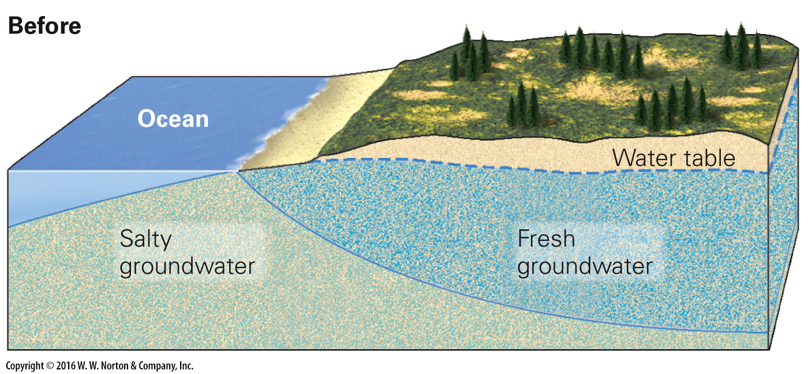
Notes:
FIGURE 16.11c Some causes of groundwater problems.
(c) Before pumping, fresh groundwater forms a lens below the ground.

Slide 54
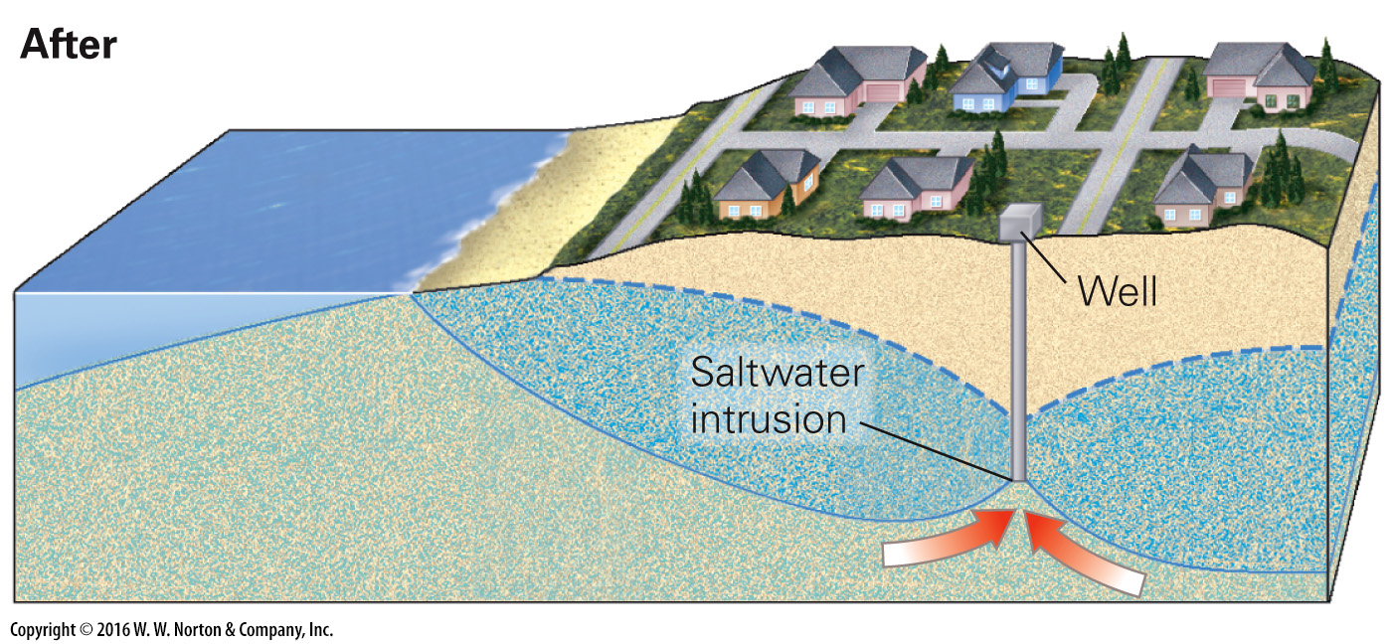
Notes:
FIGURE 16.11d Some causes of groundwater problems.
(d) If the freshwater is pumped too fast, saltwater from below is sucked up into the well. This is saltwater intrusion.

Slide 55
Notes:
FIGURE 16.11e Some causes of groundwater problems.
(e) When intensive irrigation removes groundwater, pore space in an aquifer collapses.

Slide 56
Notes:
FIGURE 16.11f Some causes of groundwater problems.
(f) As a result, the land surface sinks, leading to the formation of ground fissures and causing houses to crack.

Slide 57
Notes:
FIGURE 16.12 Contamination plumes in groundwater.
(a) Various sources of groundwater contamination. (b) A contaminant plume as seen in cross section. The darker the color, the greater the concentration of contaminant. (c) Steam injected beneath the contamination drives the contaminated water upward in the aquifer, where pumping wells remove it.

Slide 58
Notes:
FIGURE 16.12a Contamination plumes in groundwater.
(a) Various sources of groundwater contamination.

Slide 59
Notes:
FIGURE 16.12b Contamination plumes in groundwater.
(b) A contaminant plume as seen in cross section. The darker the color, the greater the concentration of contaminant.

Slide 60
Notes:
FIGURE 16.12c Contamination plumes in groundwater.
(c) Steam injected beneath the contamination drives the contaminated water upward in the aquifer, where pumping wells remove it.

Slide 61
Notes:
FIGURE 16.13 Development of karst, dripstone, and flowstone.
(a) Joints act as conduits for water in cave networks. Caves and passageways follow joints and preferentially form in more-soluble beds. (b) The evolution of a soda straw stalactite into a limestone column. (c) Flowstone on the wall of a cave in Vietnam.

Slide 62
Notes:
FIGURE 16.13a Development of karst, dripstone, and flowstone.
(a) Joints act as conduits for water in cave networks. Caves and passageways follow joints and preferentially form in more-soluble beds.

Slide 63
Notes:
FIGURE 16.13b Development of karst, dripstone, and flowstone.
(b) The evolution of a soda straw stalactite into a limestone column.

Slide 64
Notes:
FIGURE 16.13c Development of karst, dripstone, and flowstone.
(c) Flowstone on the wall of a cave in Vietnam.

Slide 65
Notes:
FIGURE 16.14 Features of karst landscapes.
(a) Karst terrains typically have a rough, rocky surface. (b) A small disappearing stream in the Hudson Valley region of New York; the water is dropping into a subsurface cave.

Slide 66
Notes:
FIGURE 16.14a Features of karst landscapes.
(a) Karst terrains typically have a rough, rocky surface.

Slide 67
Notes:
FIGURE 16.14b Features of karst landscapes.
(b) A small disappearing stream in the Hudson Valley region of New York; the water is dropping into a subsurface cave.

Slide 68
Notes:
GEOLOGY AT A GLANCE
Caves and Karst Landscapes

Slide 69
Notes:
GEOLOGY AT A GLANCE
Caves and Karst Landscapes

Slide 70
Notes:
GEOLOGY AT A GLANCE
Caves and Karst Landscapes

Slide 71
Notes:
GEOLOGY AT A GLANCE
Caves and Karst Landscapes

Slide 72
Notes:
GEOLOGY AT A GLANCE
Caves and Karst Landscapes

Slide 73
Notes:
GEOLOGY AT A GLANCE
Caves and Karst Landscapes

Slide 74
Notes:
GEOLOGY AT A GLANCE
Caves and Karst Landscapes

Slide 75
Notes:
SEE FOR YOURSELF…
KARST LANDSCAPE IN PUERTO RICO

Slide 76
Notes:
FIGURE 16.15 Tower karst forms a spectacular landscape in southern China.

Slide 77
Notes:
FIGURE 16.15a Tower karst forms a spectacular landscape in southern China.

Slide 78
Notes:
FIGURE 16.15b Tower karst forms a spectacular landscape in southern China.

Slide 79
Notes:
FIGURE 16.16 The progressive formation of caves and a karst landscape.
(a) Dissolution takes place near the water table in an uplifted sequence of limestone. (b) Downcutting by an adjacent river lowers the water table, and the caves empty. Speleothems grow. (c) After roof collapse, the landscape becomes pockmarked with sinkholes.

Slide 80
Notes:
Another View Swamps are swamps because the land surface lies just below the water table. The bald cypress trees of this swamp in southern Illinois have adapted to life in soggy ground. During dry seasons, the water table sinks below the ground surface and the land dries out.

