Slide 1
Stephen Marshak
ESSENTIALS OF
Geology
FIFTH EDITION
Chapter 17
Dry Regions:
The Geology of Deserts
©2016 W. W. Norton & Company, Inc.

Slide 2
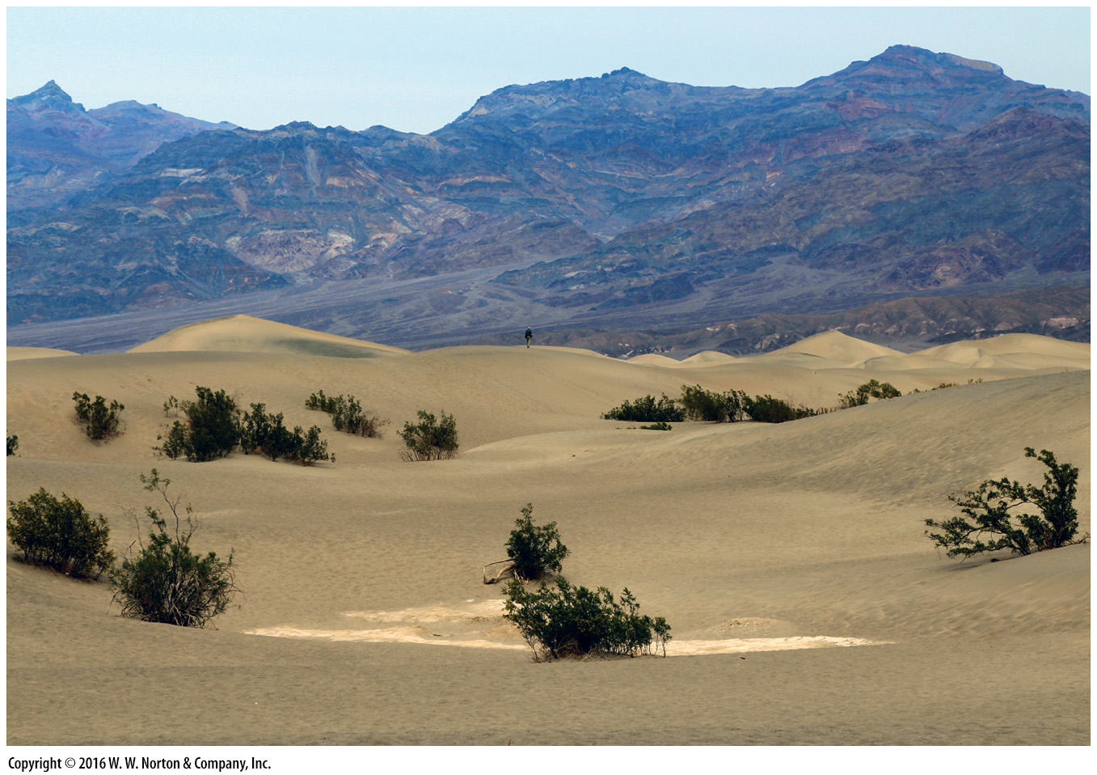
Notes:
Only particularly hardy shrubs can survive in this field of sand dunes, at the base of a barren rock ridge in the desert of Death Valley, California.

Slide 3
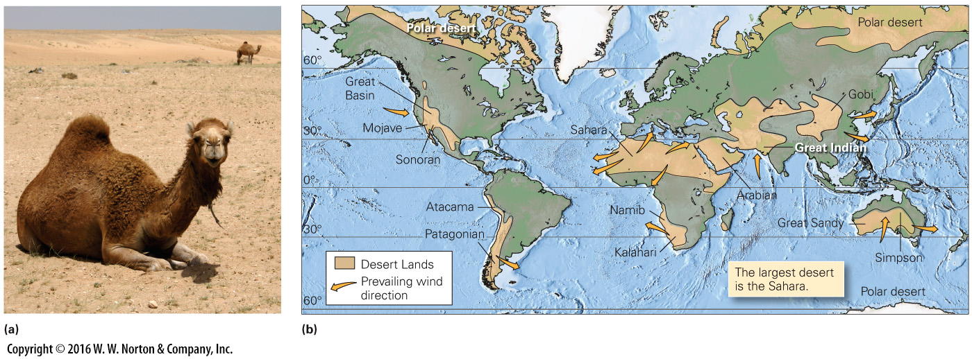
Notes:
FIGURE 17.1 Deserts and their hardy inhabitants.
(a) Camels can survive the harsh conditions of a desert. (b) The global distribution of deserts. Arid regions cover 25% of Earth’s land surface.

Slide 4
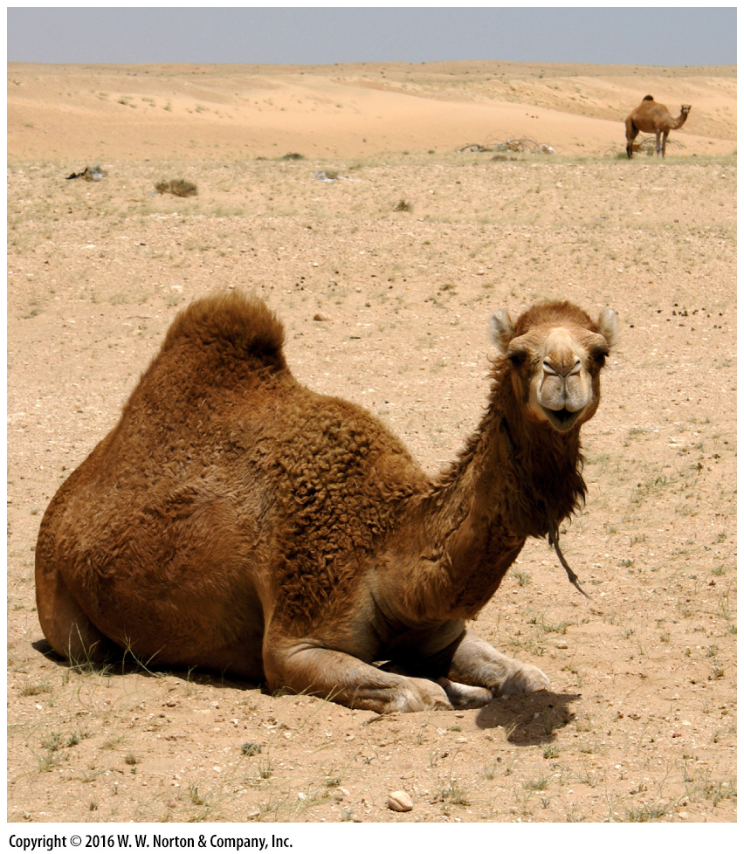
Notes:
FIGURE 17.1a Deserts and their hardy inhabitants.
(a) Camels can survive the harsh conditions of a desert.

Slide 5
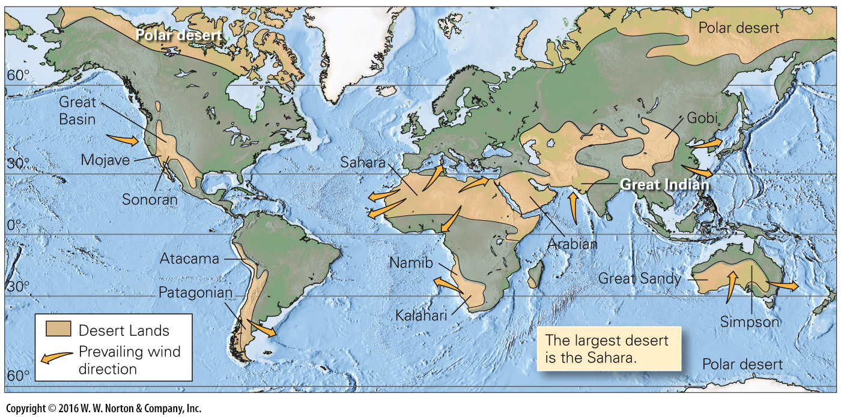
Notes:
FIGURE 17.1b Deserts and their hardy inhabitants.
(b) The global distribution of deserts. Arid regions cover 25% of Earth’s land surface.

Slide 6
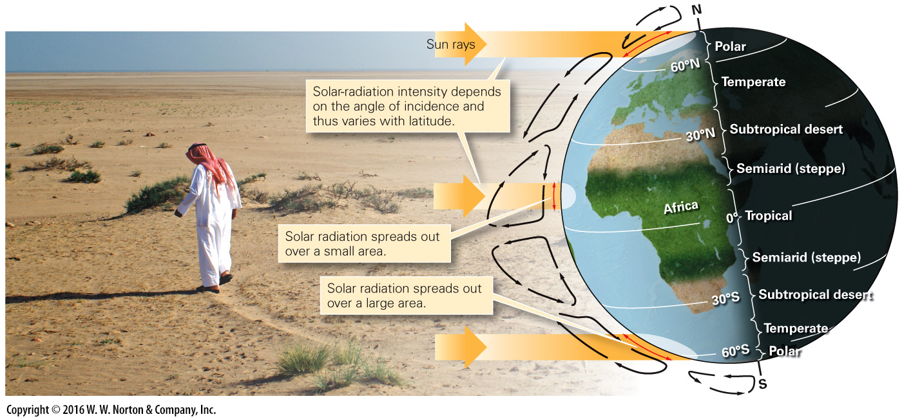
Notes:
FIGURE 17.2 Subtropical deserts form because the air that convectively flows downward in the subtropics warms and absorbs water as it sinks.

Slide 7
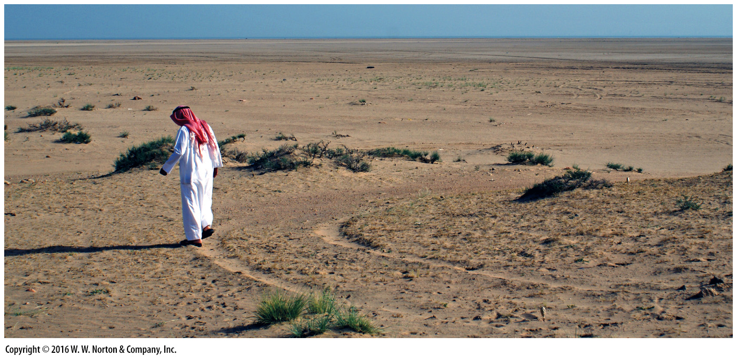
Notes:
FIGURE 17.2 Subtropical deserts form because the air that convectively flows downward in the subtropics warms and absorbs water as it sinks.

Slide 8
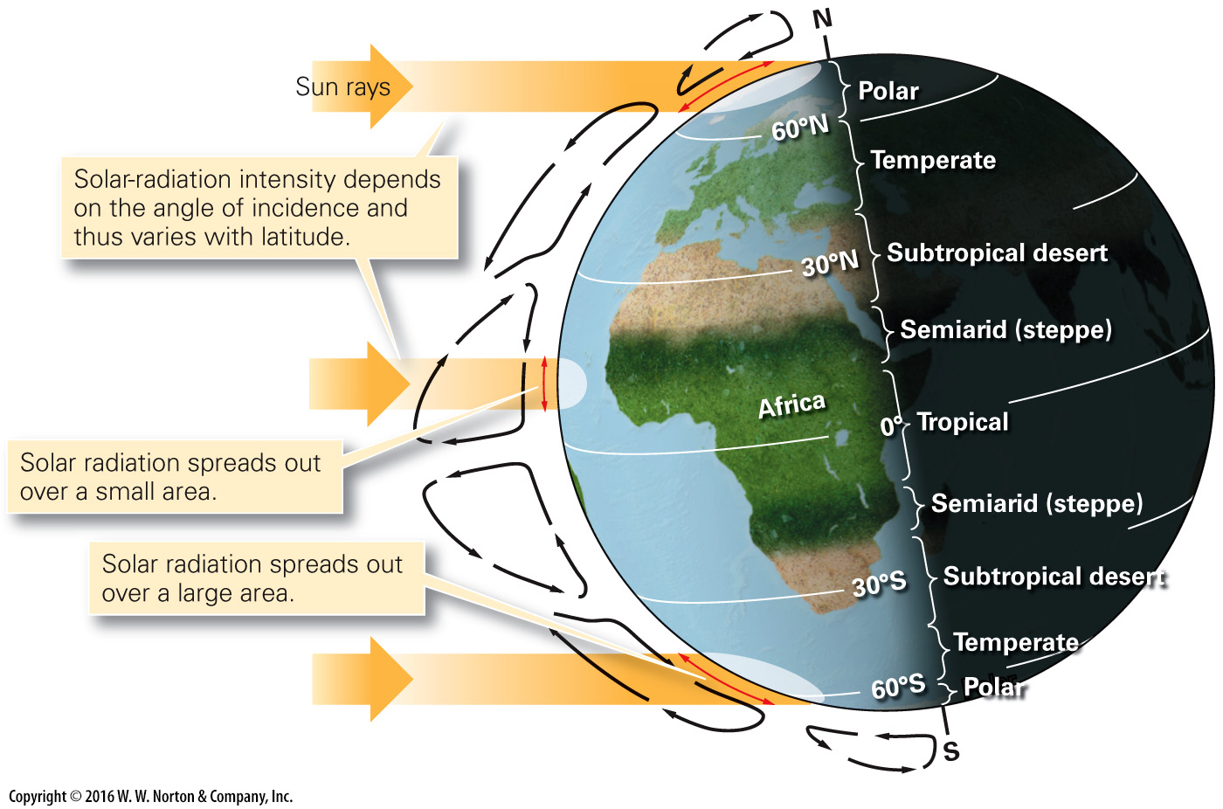
Notes:
FIGURE 17.2 Subtropical deserts form because the air that convectively flows downward in the subtropics warms and absorbs water as it sinks.

Slide 9
Notes:
FIGURE 17.3 The formation of a rain-shadow desert. Moist air rises and drops rain on the coastal side of the range. By the time the air has crossed the mountains, it is dry.

Slide 10
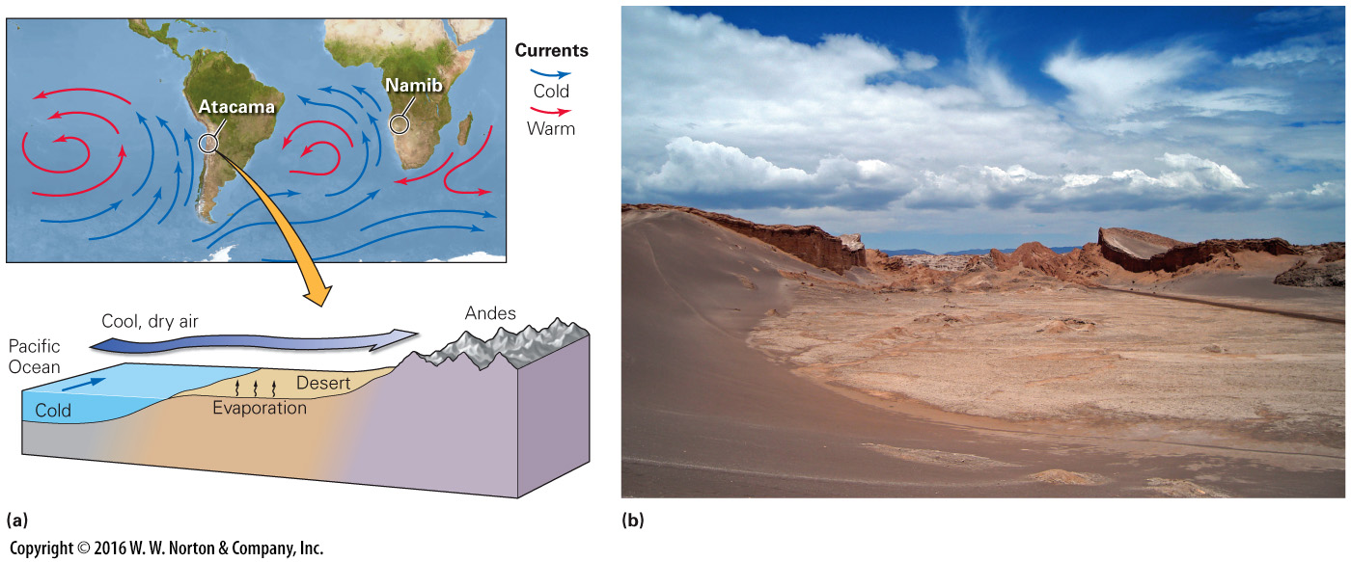
Notes:
FIGURE 17.4 The formation of a coastal desert.
(a) Cold ocean currents cool and dry the air along the coast. This air absorbs moisture from adjacent coastal land. (b) The Atacama Desert is the driest place on Earth.

Slide 11
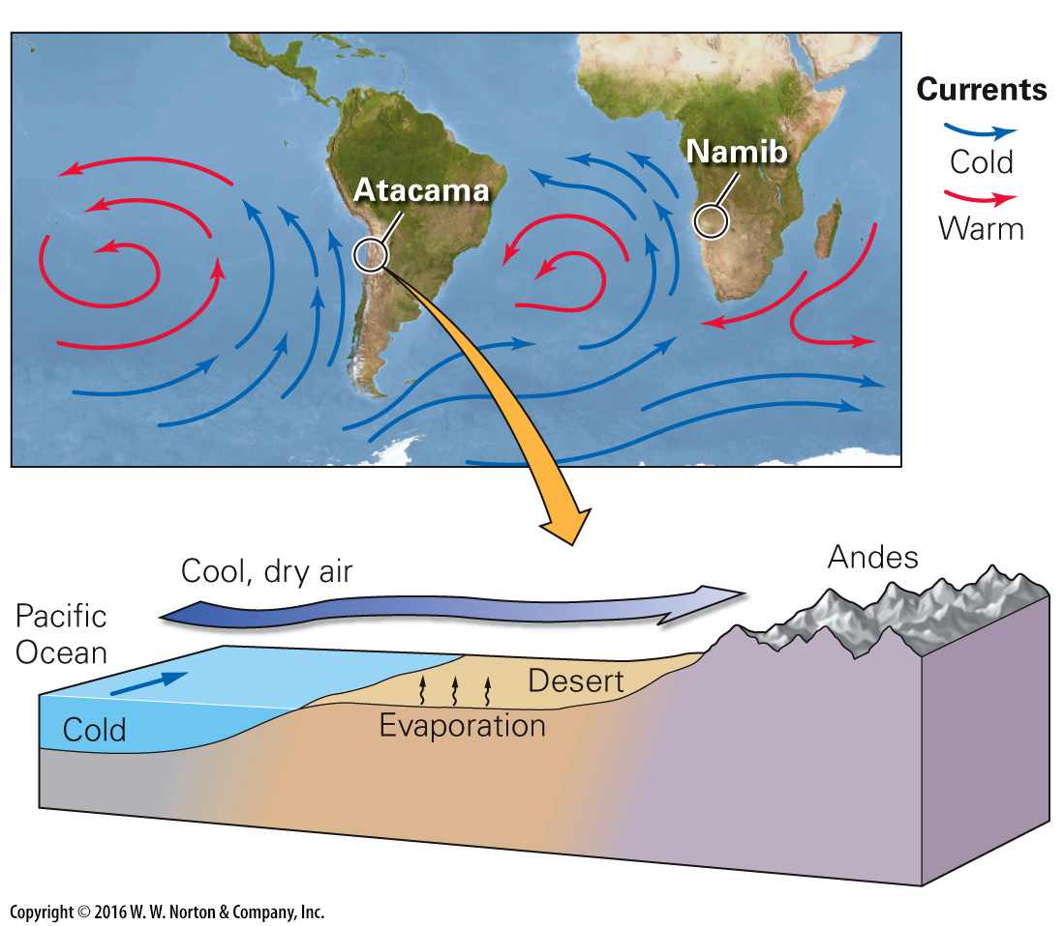
Notes:
FIGURE 17.4a The formation of a coastal desert.
(a) Cold ocean currents cool and dry the air along the coast. This air absorbs moisture from adjacent coastal land.

Slide 12
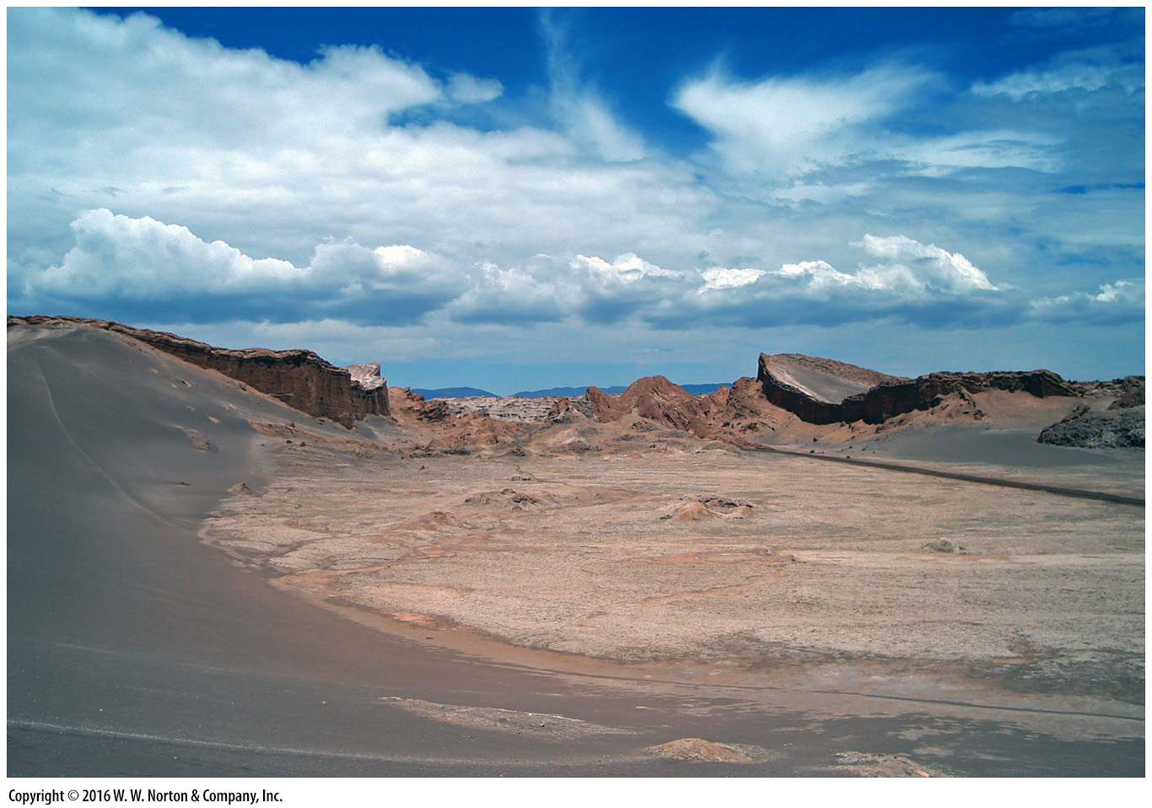
Notes:
FIGURE 17.4b The formation of a coastal desert.
(b) The Atacama Desert is the driest place on Earth.

Slide 13
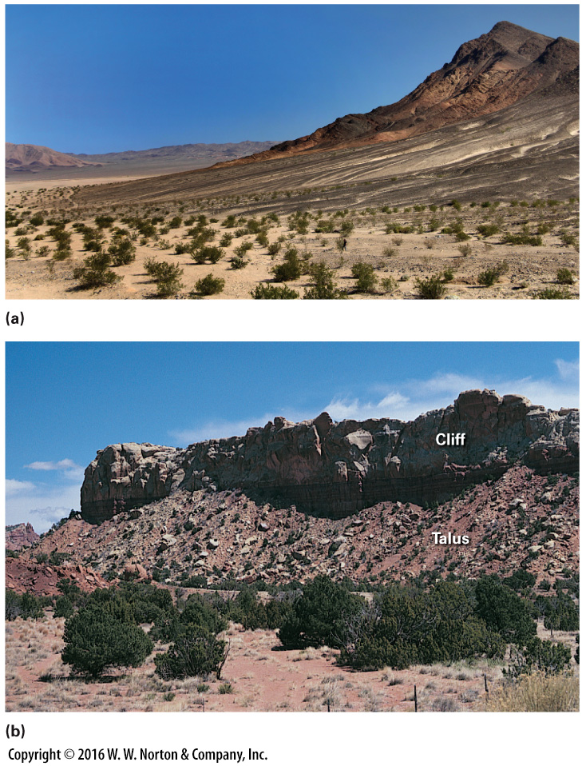
Notes:
FIGURE 17.5 Rocky surfaces in deserts.
(a) The dark gravel on this slope, beneath a cliff in the Mojave Desert, washed down from the cliffs above. (b) This talus apron along the base of a desert cliff formed from rocks that broke off and tumbled down the cliff.

Slide 14
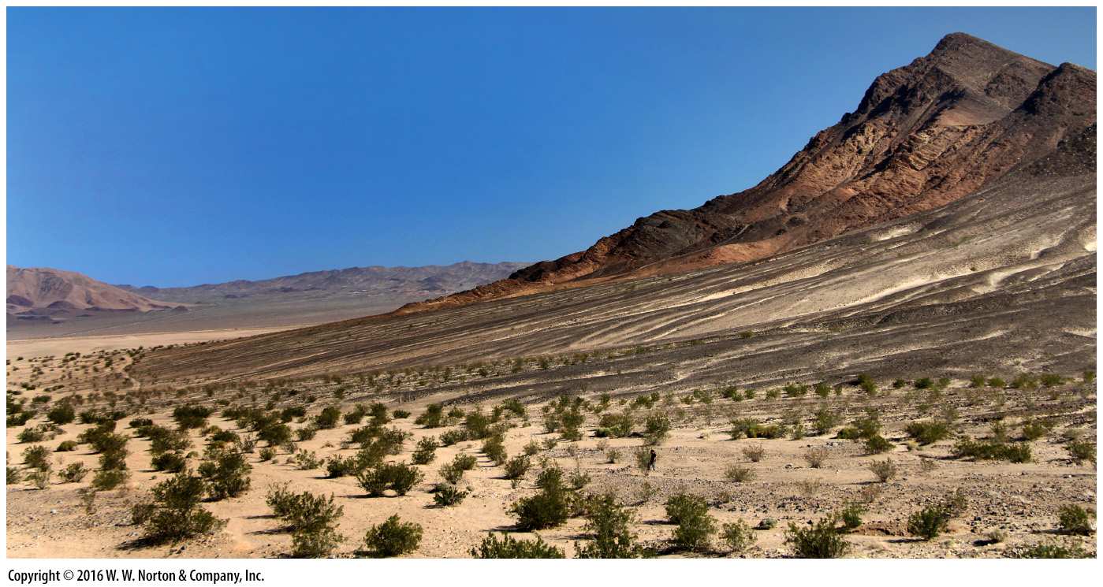
Notes:
FIGURE 17.5a Rocky surfaces in deserts.
(a) The dark gravel on this slope, beneath a cliff in the Mojave Desert, washed down from the cliffs above.

Slide 15
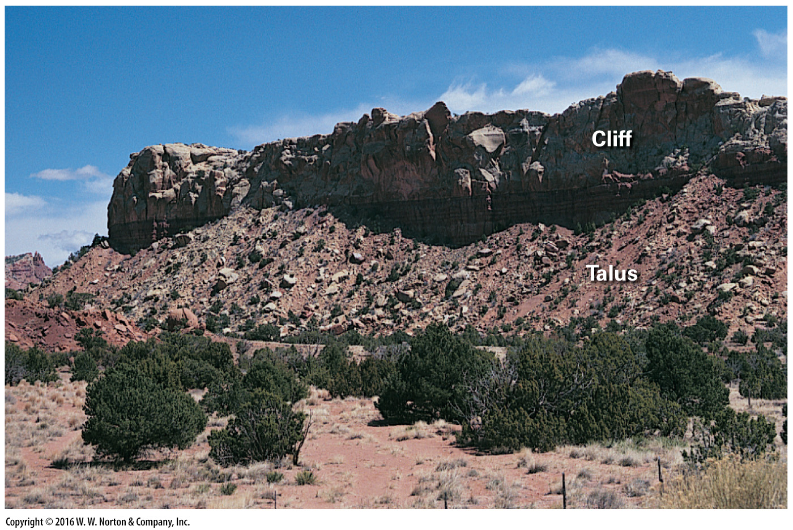
Notes:
FIGURE 17.5b Rocky surfaces in deserts.
(b) This talus apron along the base of a desert cliff formed from rocks that broke off and tumbled down the cliff.

Slide 16
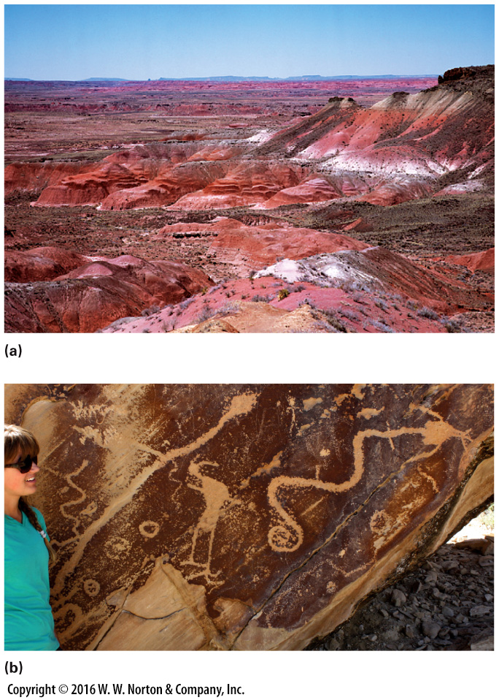
Notes:
FIGURE 17.6 Soil formation and chemical weathering in deserts.
(a) The red hues of the Painted Desert in Arizona are due to the oxidation of iron in the rock. (b) By chipping away desert varnish to reveal the lighter rock beneath, Native Americans created art and symbols.

Slide 17
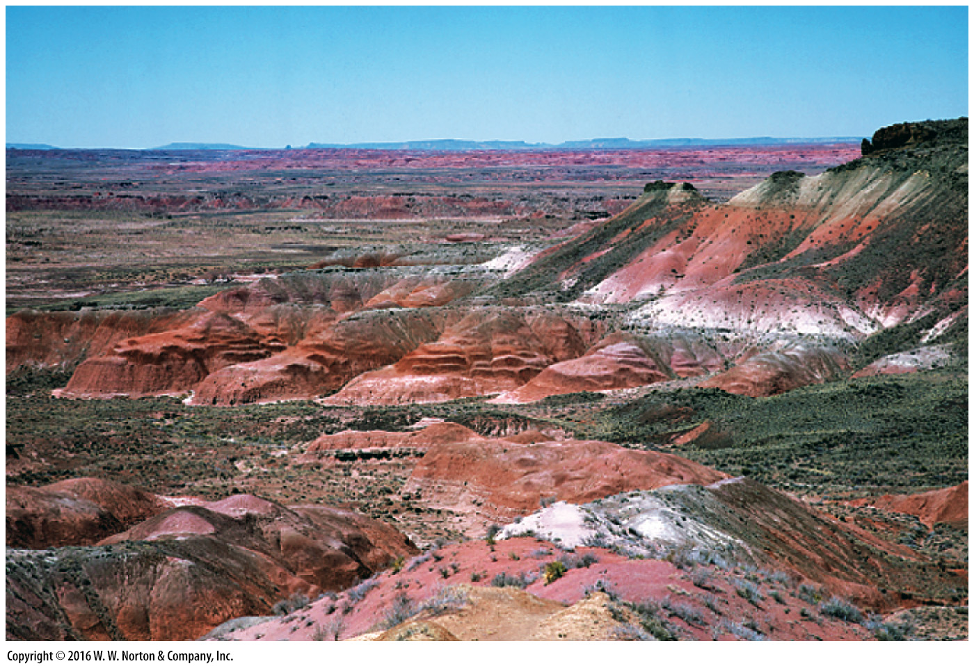
Notes:
FIGURE 17.6a Soil formation and chemical weathering in deserts.
(a) The red hues of the Painted Desert in Arizona are due to the oxidation of iron in the rock.

Slide 18
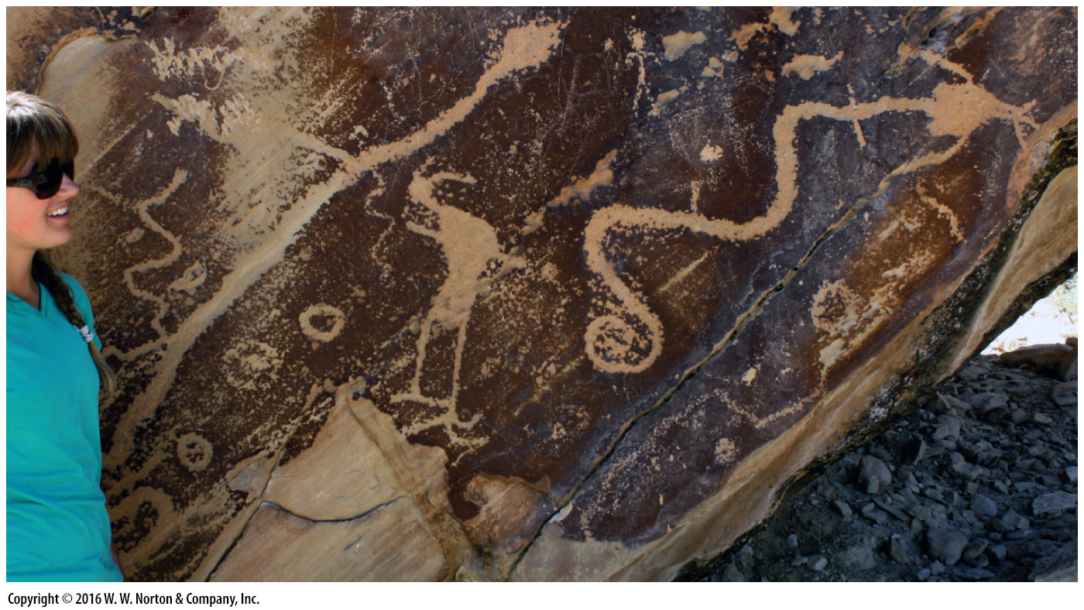
Notes:
FIGURE 17.6b Soil formation and chemical weathering in deserts.
(b) By chipping away desert varnish to reveal the lighter rock beneath, Native Americans created art and symbols.

Slide 19
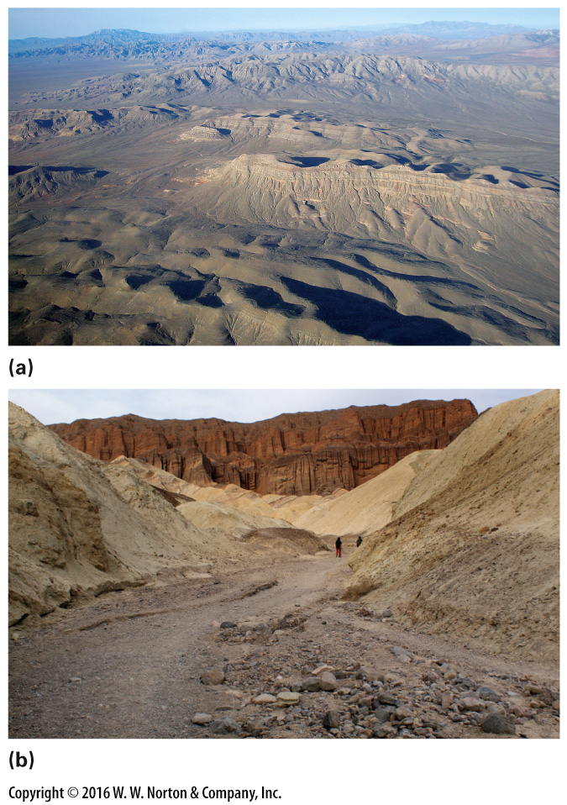
Notes:
FIGURE 17.7 Evidence of erosion by running water in deserts.
(a) Even though these hills in the desert near Las Vegas, Nevada, are bone dry, their shape indicates erosion by water. Note the numerous stream channels. (b) A flash flood left behind gravel and sand on the floor of a dry wash after a flash flood in Death Valley. Erosion by the water is cutting a channel.

Slide 20
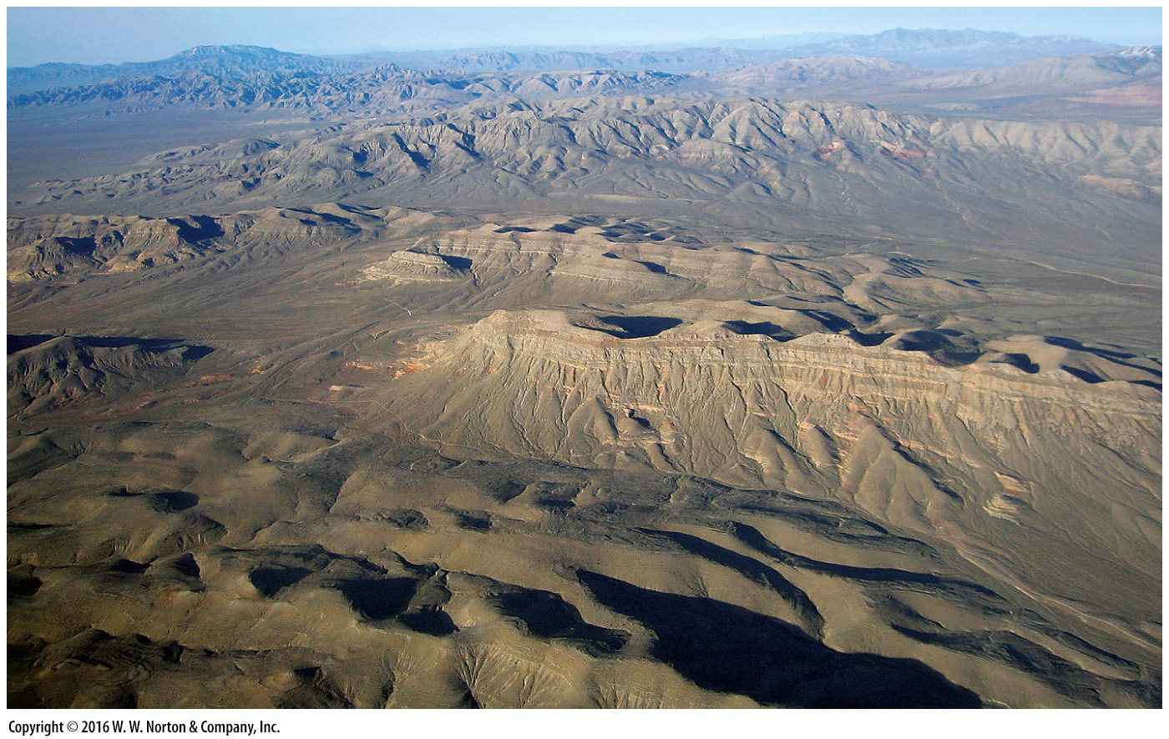
Notes:
FIGURE 17.7a Evidence of erosion by running water in deserts.
(a) Even though these hills in the desert near Las Vegas, Nevada, are bone dry, their shape indicates erosion by water. Note the numerous stream channels.

Slide 21
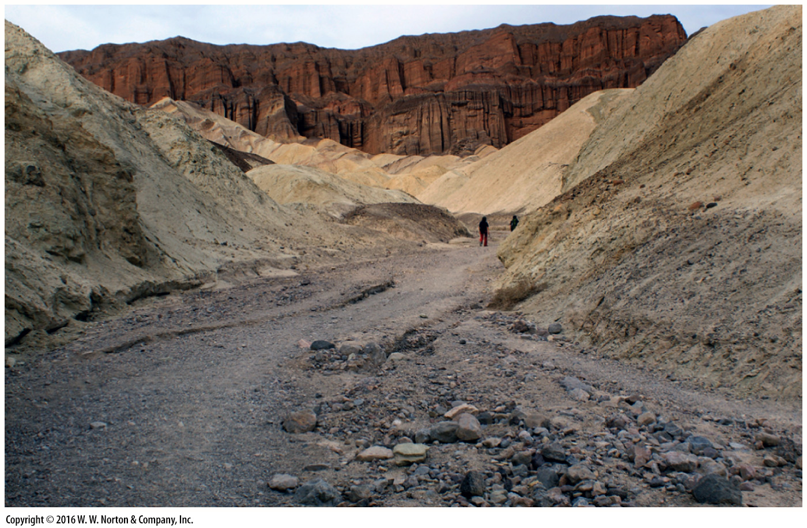
Notes:
FIGURE 17.7b Evidence of erosion by running water in deserts.
(b) A flash flood left behind gravel and sand on the floor of a dry wash after a flash flood in Death Valley. Erosion by the water is cutting a channel.

Slide 22
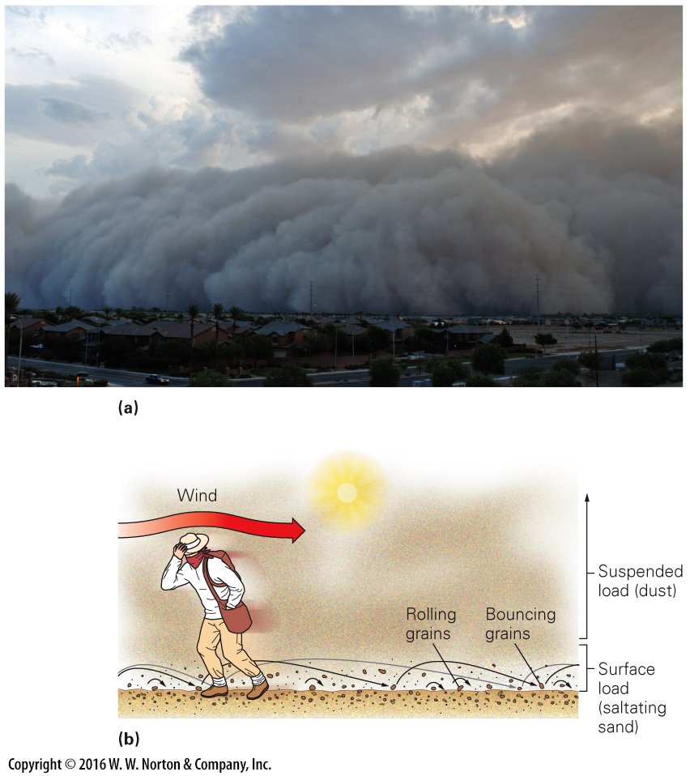
Notes:
FIGURE 17.8 Sediment transport by wind in deserts.
(a) A huge dust storm approaching Phoenix, Arizona. (b) Wind transports desert sediment as suspended load and surface load.

Slide 23
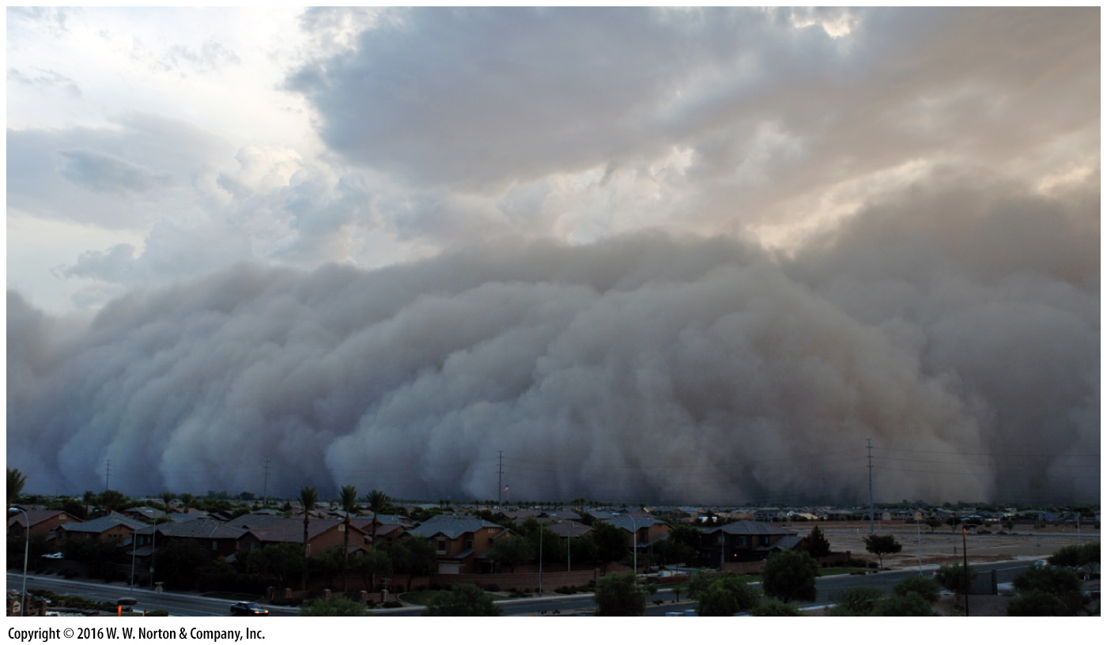
Notes:
FIGURE 17.8a Sediment transport by wind in deserts.
(a) A huge dust storm approaching Phoenix, Arizona.

Slide 24
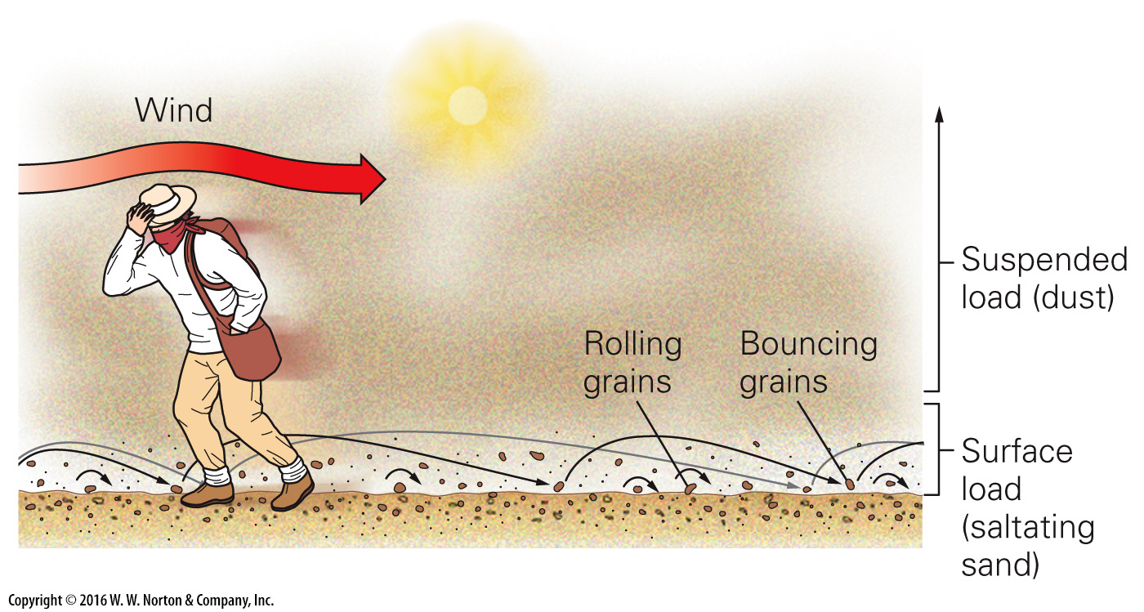
Notes:
FIGURE 17.8b Sediment transport by wind in deserts.
(b) Wind transports desert sediment as suspended load and surface load.

Slide 25
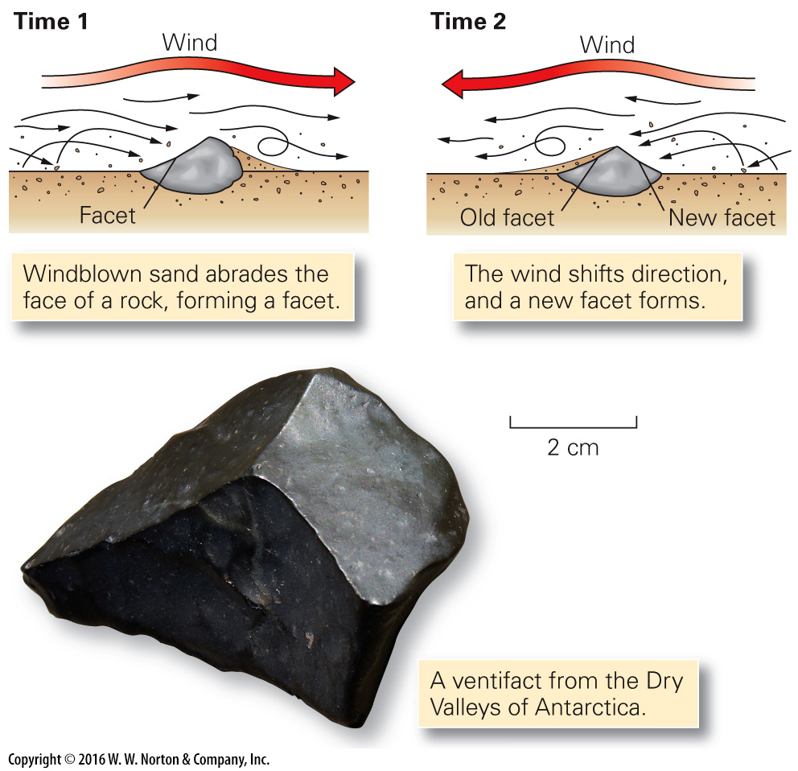
Notes:
FIGURE 17.9 The progressive development of a ventifact.

Slide 26
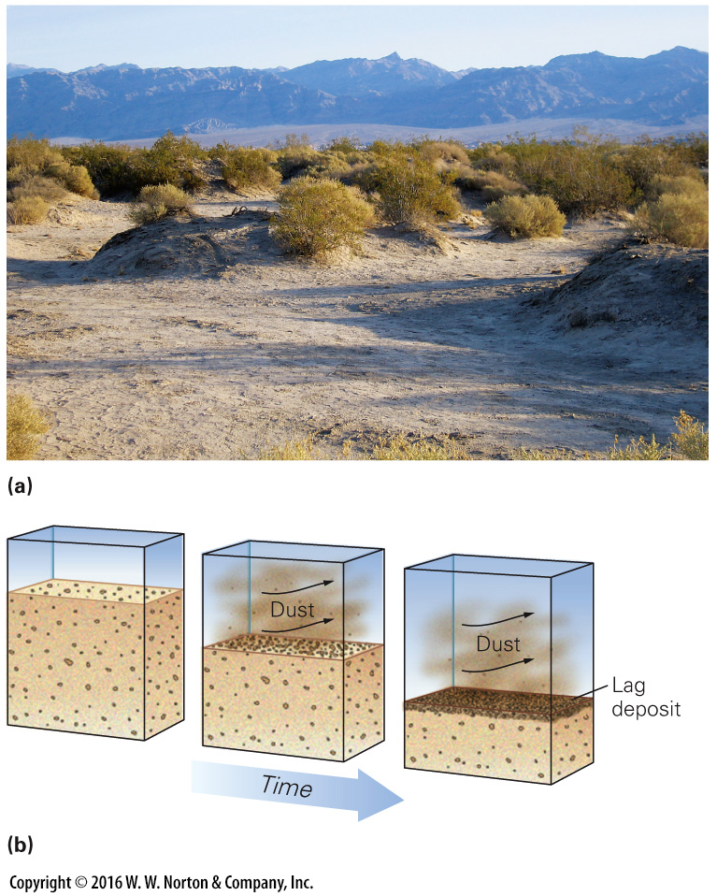
Notes:
FIGURE 17.10 Erosion of sediment by desert winds.
(a) Wind erosion in Death Valley has left bushes perched on mounds; roots keep soil from blowing away. (b) A lag deposit develops when wind blows away finer sediment, leaving behind a layer of coarser grains.

Slide 27
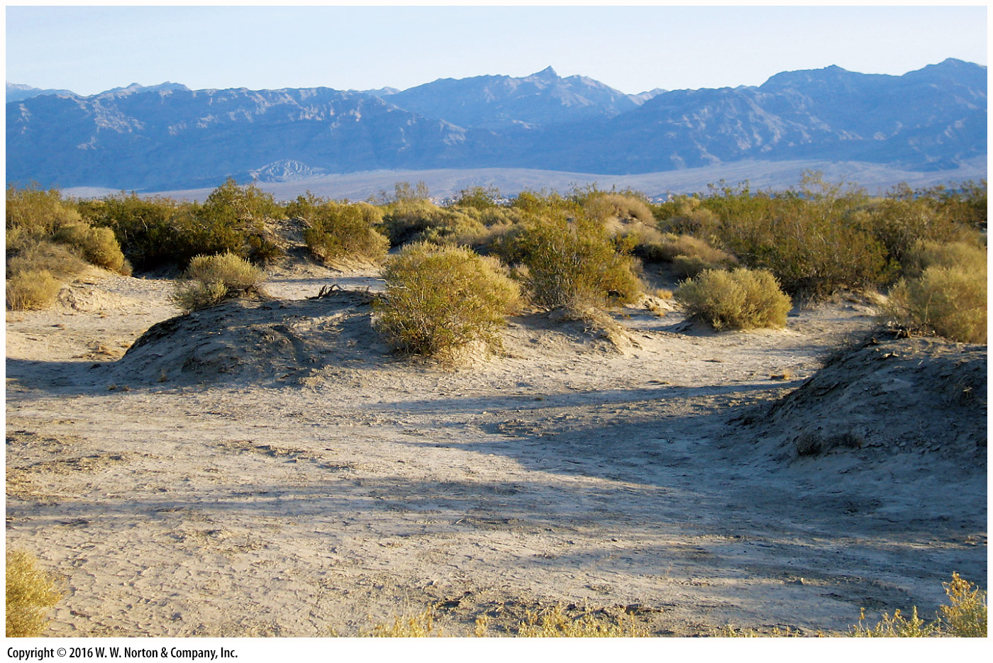
Notes:
FIGURE 17.10a Erosion of sediment by desert winds.
(a) Wind erosion in Death Valley has left bushes perched on mounds; roots keep soil from blowing away.

Slide 28
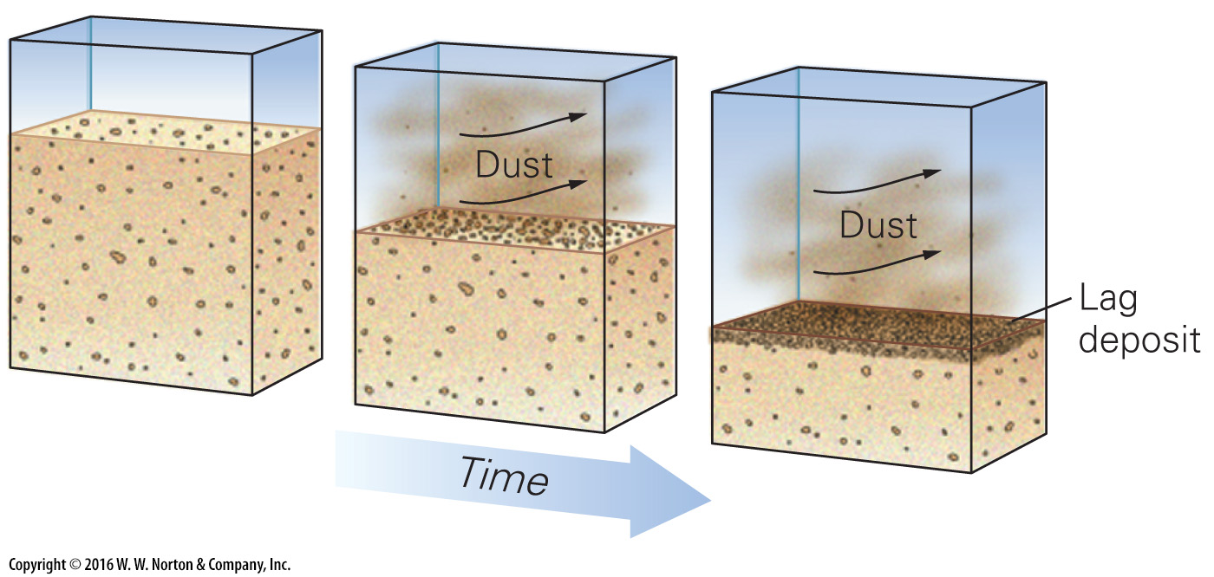
Notes:
FIGURE 17.10b Erosion of sediment by desert winds.
(b) A lag deposit develops when wind blows away finer sediment, leaving behind a layer of coarser grains.

Slide 29
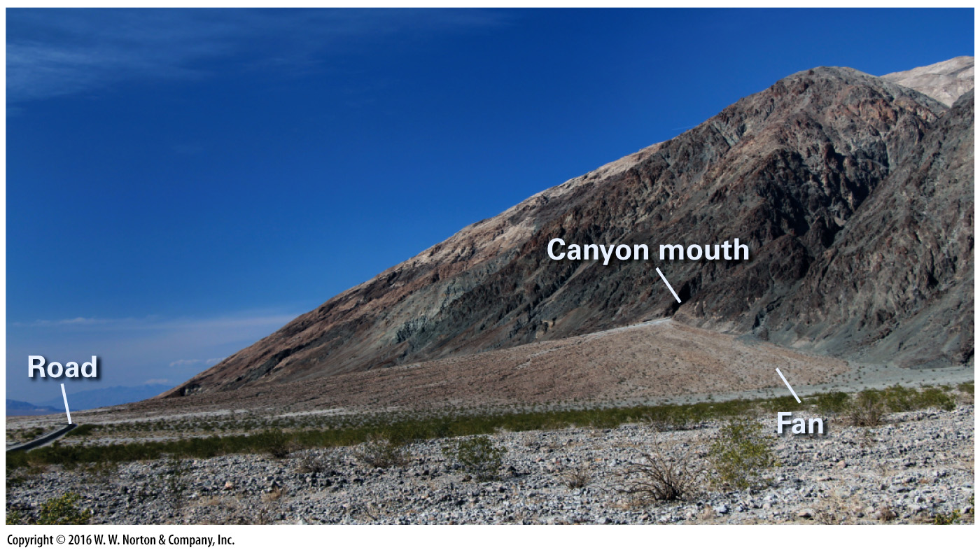
Notes:
FIGURE 17.11 This alluvial fan accumulated at the mouth of a small canyon in Death Valley, California.

Slide 30
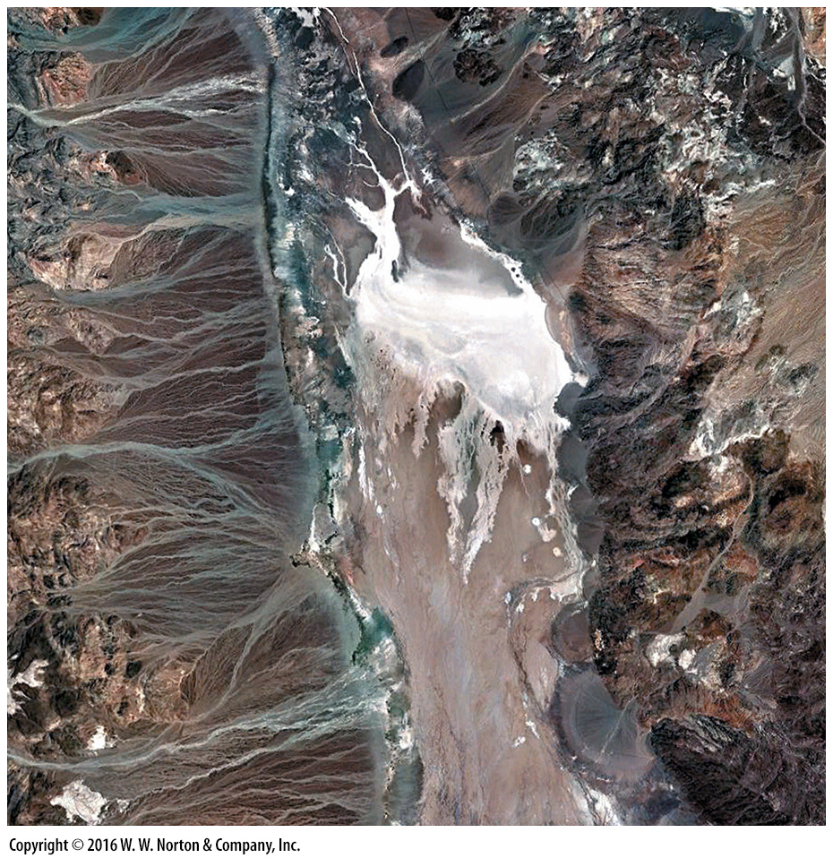
Notes:
SEE FOR YOURSELF…
DEATH VALLEY, CALIFORNIA

Slide 31
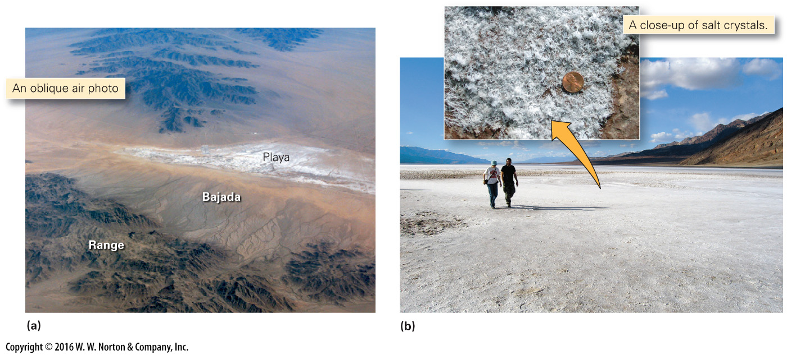
Notes:
FIGURE 17.12 Playas form where a shallow, salty lake dries up.
(a) This playa in California formed at the base of a bajada. (b) White salt crystals encrust the floor of a playa in Death Valley.

Slide 32
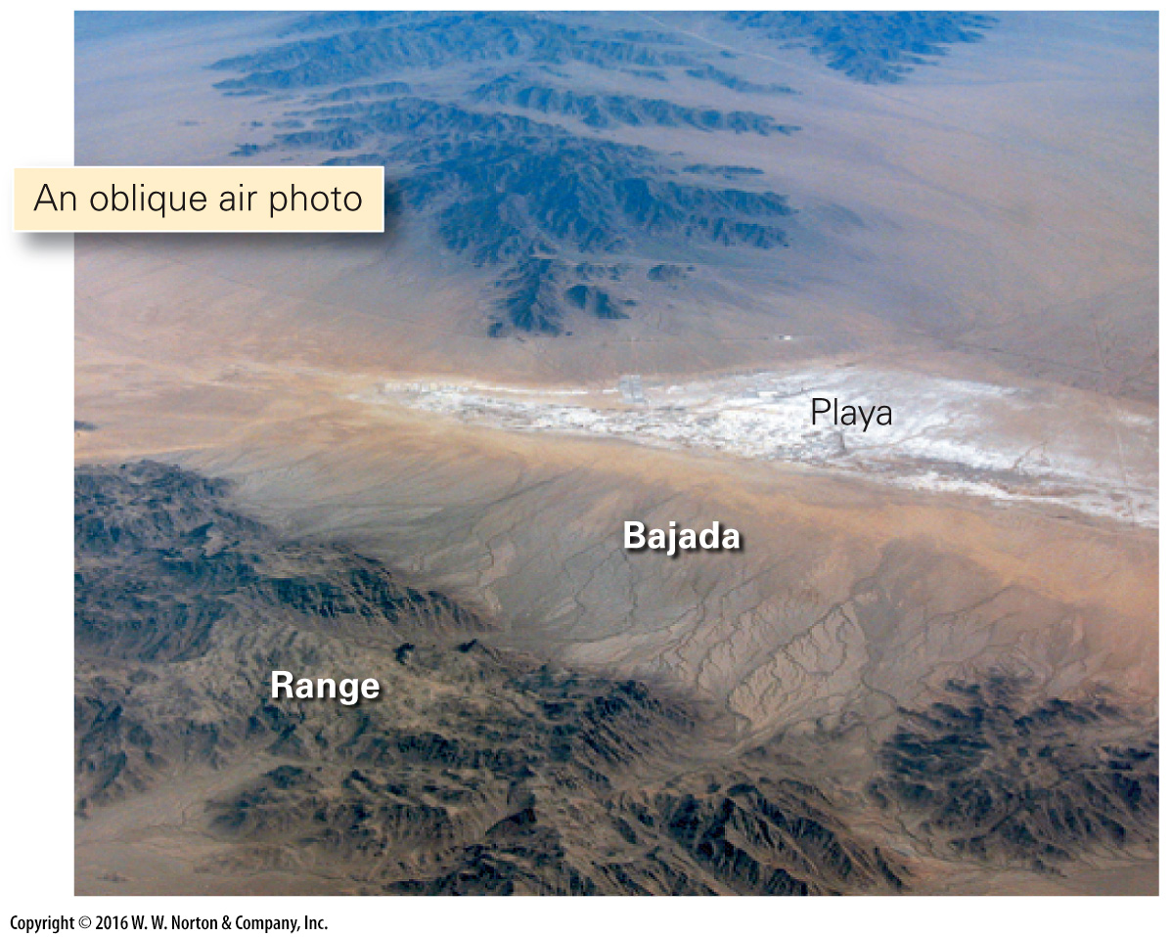
Notes:
FIGURE 17.12a Playas form where a shallow, salty lake dries up.
(a) This playa in California formed at the base of a bajada.

Slide 33
Notes:
FIGURE 17.12b Playas form where a shallow, salty lake dries up.
(b) White salt crystals encrust the floor of a playa in Death Valley.

Slide 34
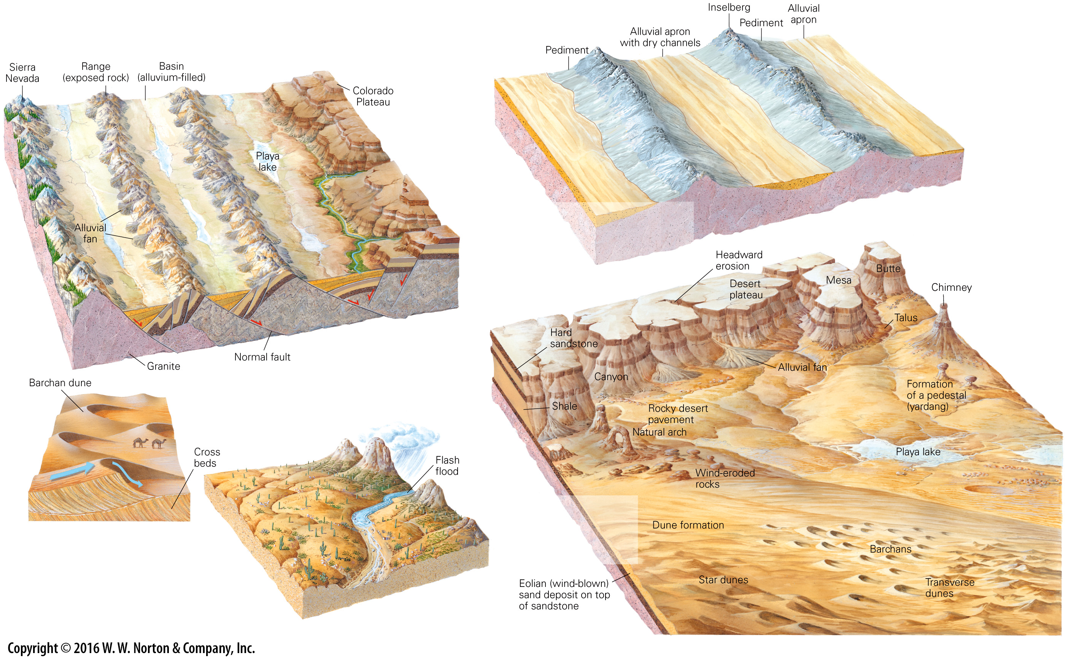
Notes:
GEOLOGY AT A GLANCE
The Desert Realm

Slide 35
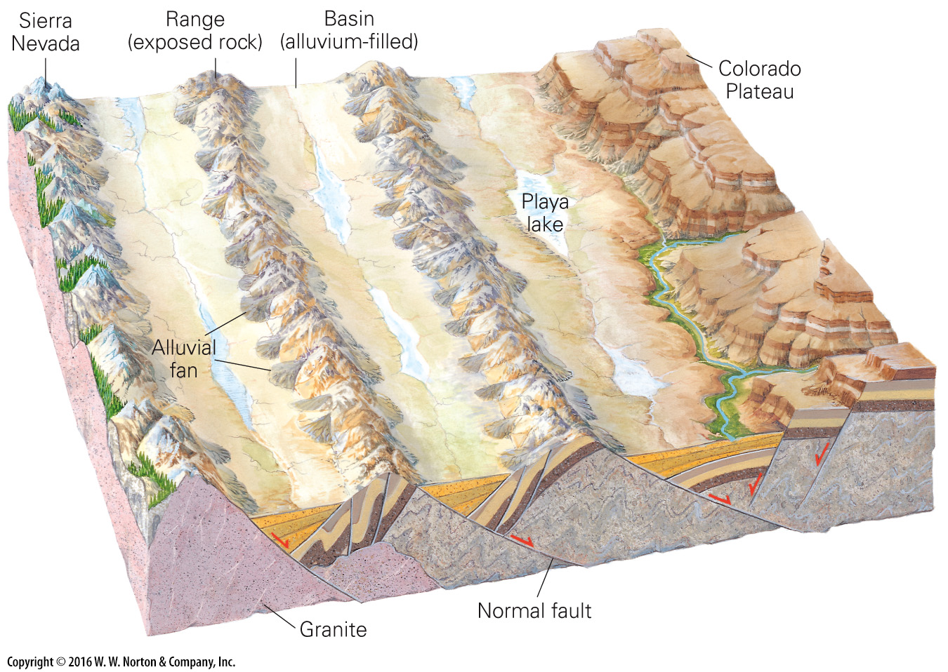
Notes:
GEOLOGY AT A GLANCE
The Desert Realm

Slide 36
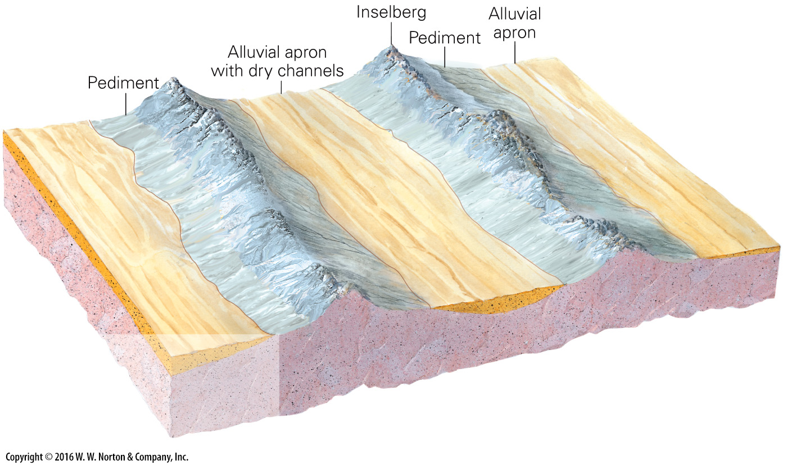
Notes:
GEOLOGY AT A GLANCE
The Desert Realm

Slide 37
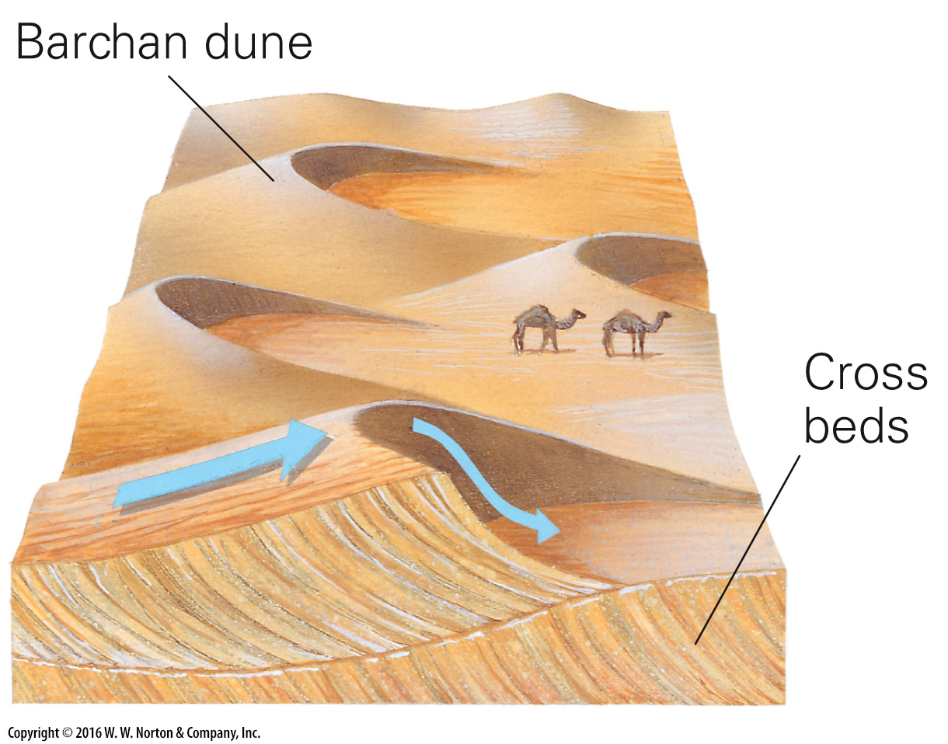
Notes:
GEOLOGY AT A GLANCE
The Desert Realm

Slide 38
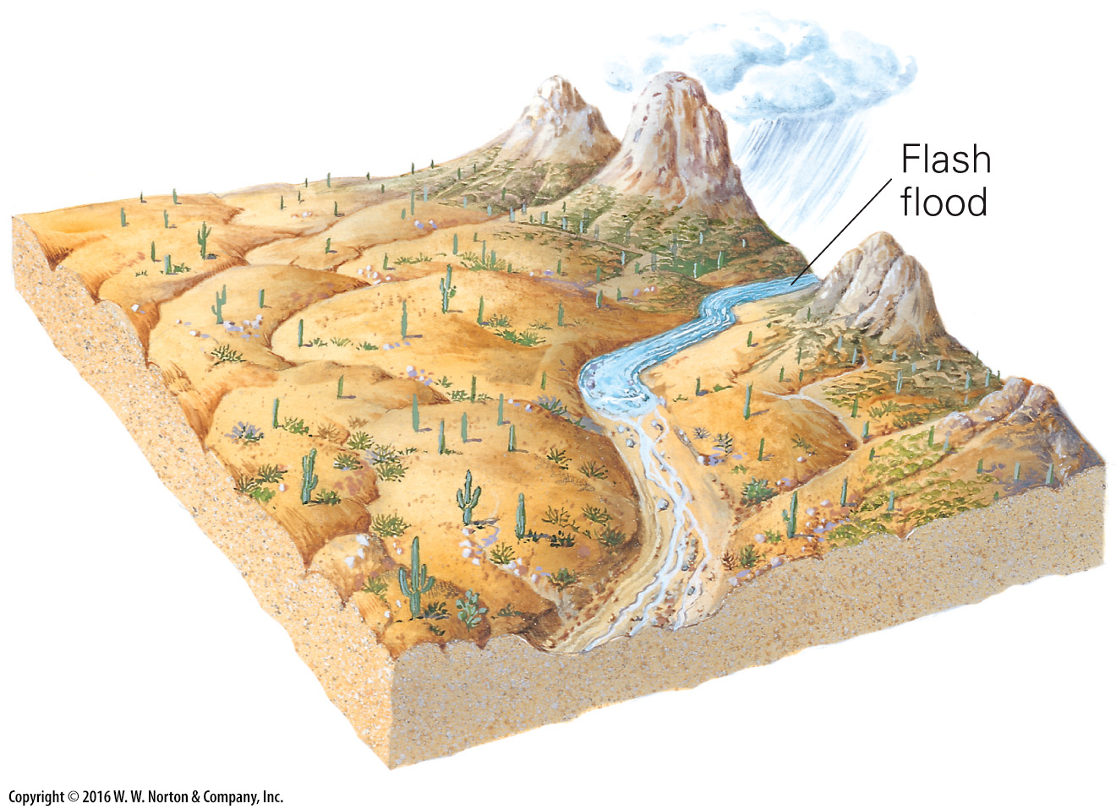
Notes:
GEOLOGY AT A GLANCE
The Desert Realm

Slide 39
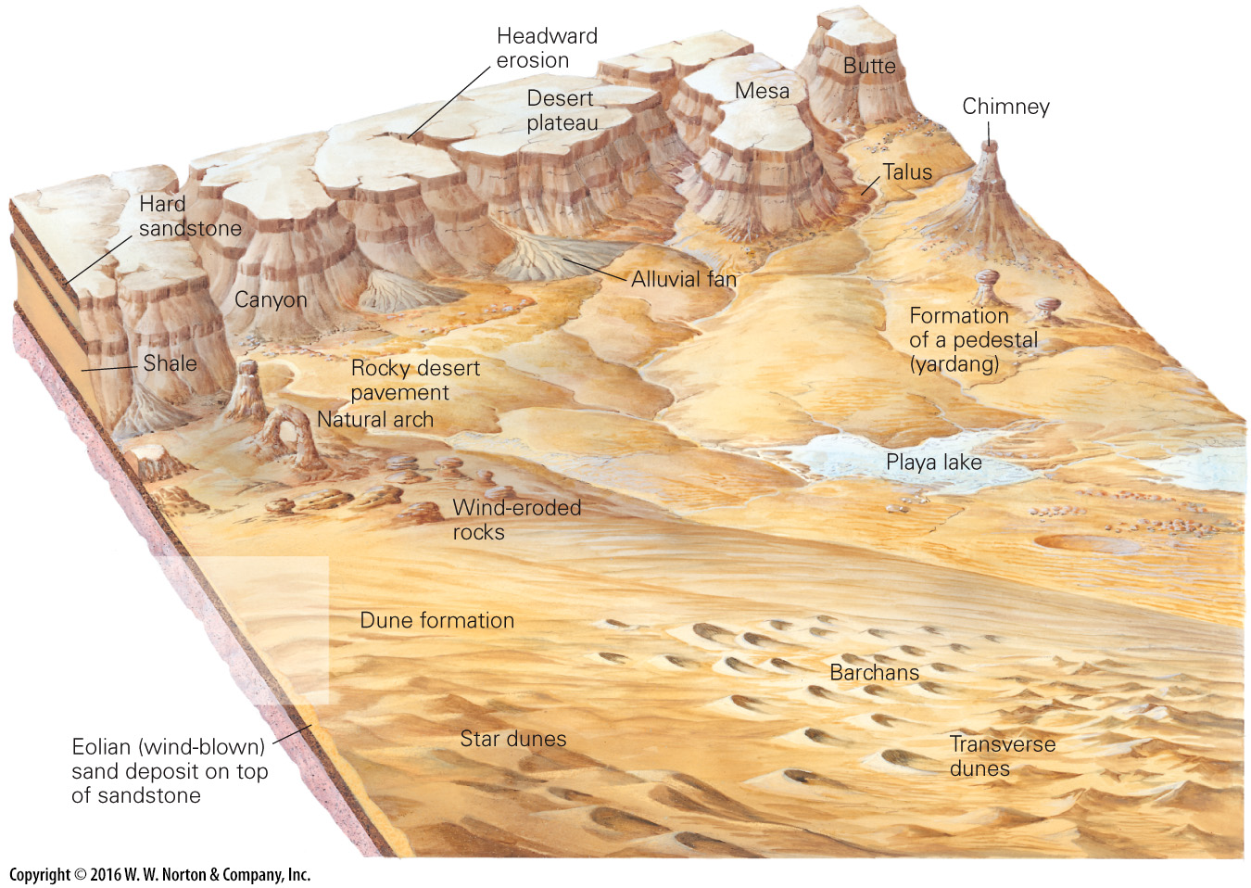
Notes:
GEOLOGY AT A GLANCE
The Desert Realm

Slide 40
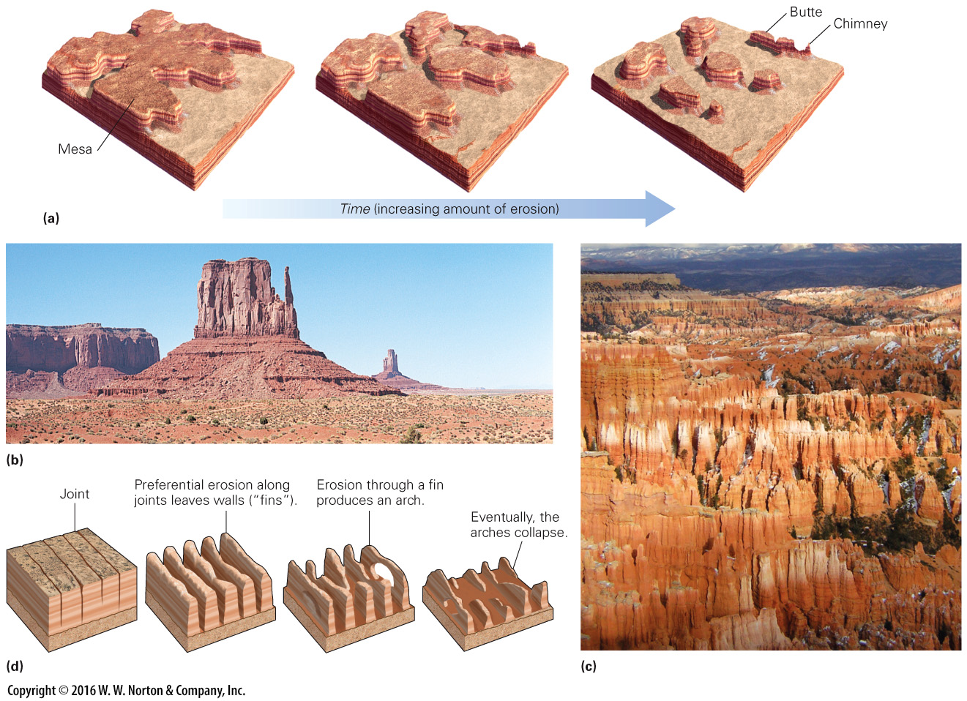
Notes:
FIGURE 17.13 Mesas and buttes form in deserts as cliffs retreat over time.
(a) Because of cliff retreat, a once-continuous layer of rock evolves into a series of isolated remnants. If the bedding is horizontal, the resulting landforms have flat tops. (b) Buttes and mesas tower above the floor of Monument Valley, Arizona. (c) Erosion produced hoodoos, chimney-like columns of rock, in Bryce Canyon, Utah. (d) Natural arches form when erosion occurs preferentially along joints, to produce wall-like fins of rock. When the lower part of a fin erodes, an arch remains.

Slide 41
Notes:
FIGURE 17.13a Mesas and buttes form in deserts as cliffs retreat over time.
(a) Because of cliff retreat, a once-continuous layer of rock evolves into a series of isolated remnants. If the bedding is horizontal, the resulting landforms have flat tops.

Slide 42
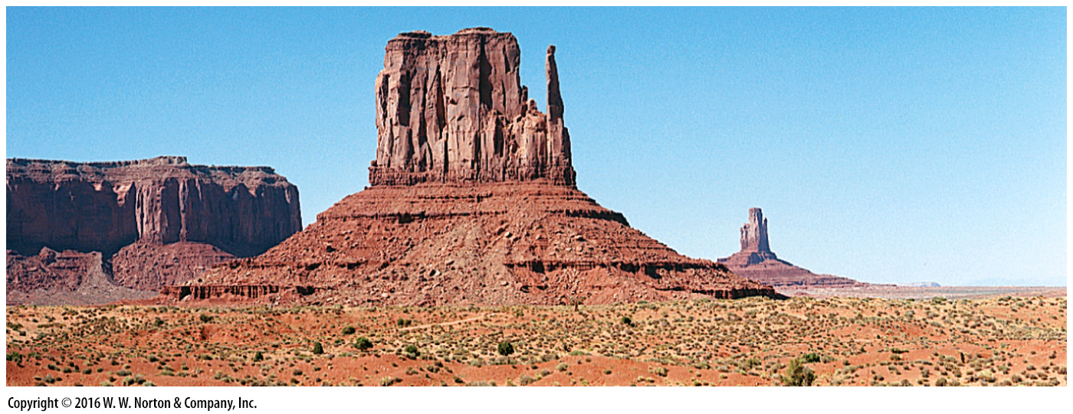
Notes:
FIGURE 17.13b Mesas and buttes form in deserts as cliffs retreat over time.
(b) Buttes and mesas tower above the floor of Monument Valley, Arizona.

Slide 43
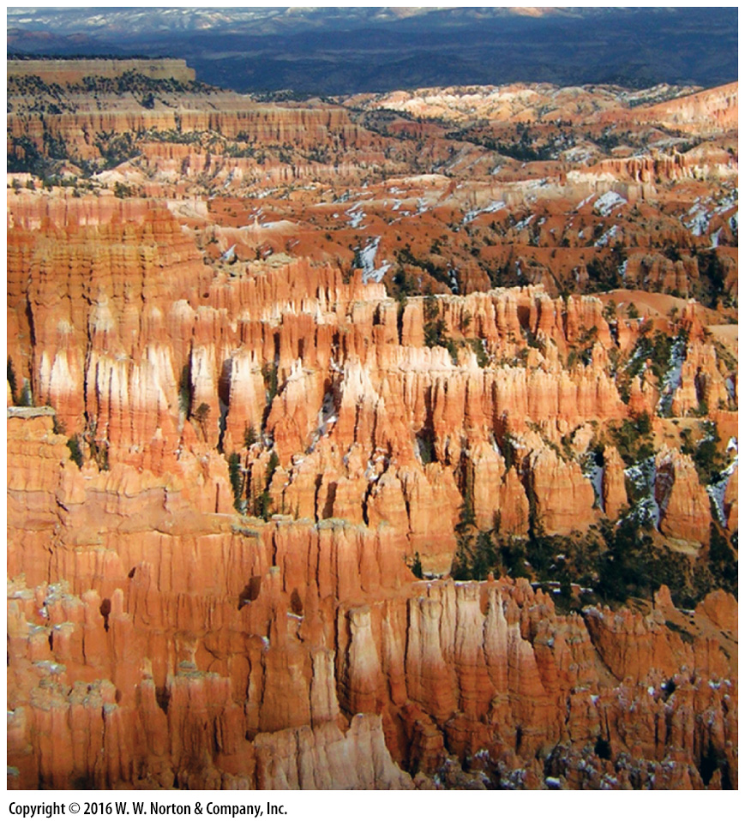
Notes:
FIGURE 17.13c Mesas and buttes form in deserts as cliffs retreat over time.
(c) Erosion produced hoodoos, chimney-like columns of rock, in Bryce Canyon, Utah.

Slide 44
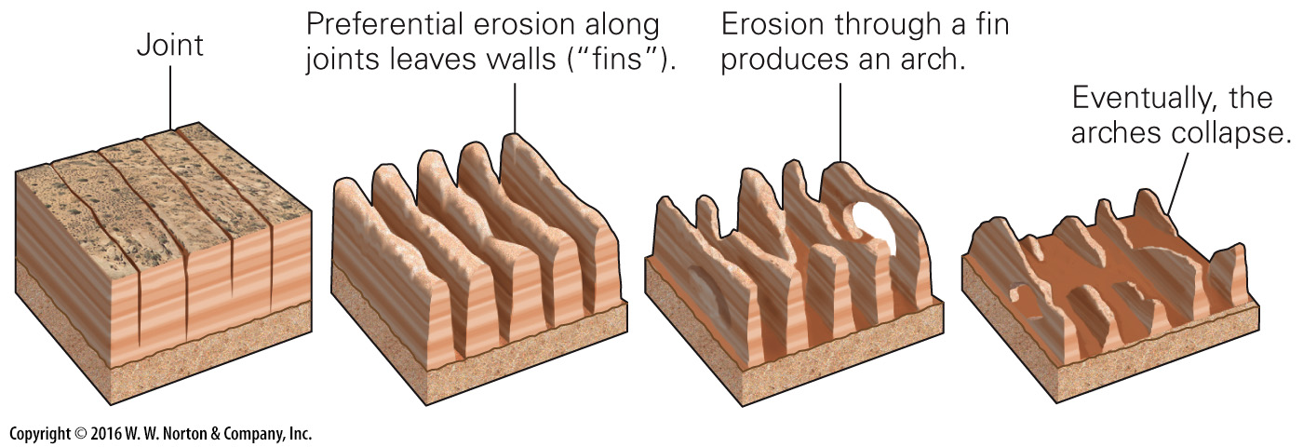
Notes:
FIGURE 17.13d Mesas and buttes form in deserts as cliffs retreat over time.
(d) Natural arches form when erosion occurs preferentially along joints, to produce wall-like fins of rock. When the lower part of a fin erodes, an arch remains.

Slide 45
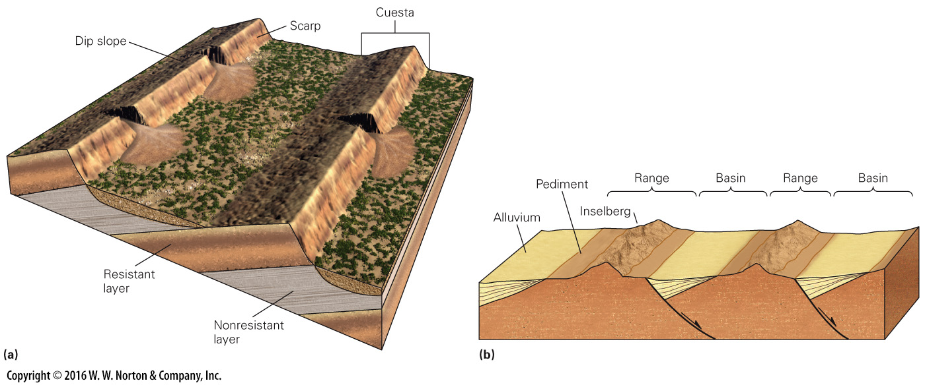
Notes:
FIGURE 17.14 Examples of erosional landscapes in deserts.
(a) Asymmetric ridges called cuestas develop where strata in a region are not horizontal. (b) In the Basin and Range Province of the southwestern United States, tilted fault-block ranges evolve into inselbergs, bordered by sediment-filled basins.

Slide 46
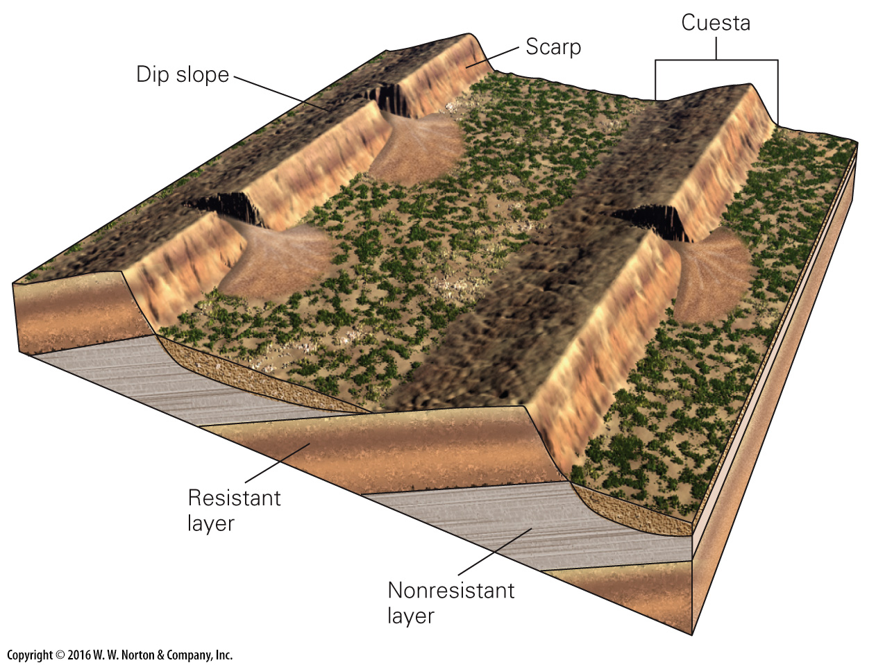
Notes:
FIGURE 17.14a Examples of erosional landscapes in deserts.
(b) In the Basin and Range Province of the southwestern United States, tilted fault-block ranges evolve into inselbergs, bordered by sediment-filled basins.

Slide 47
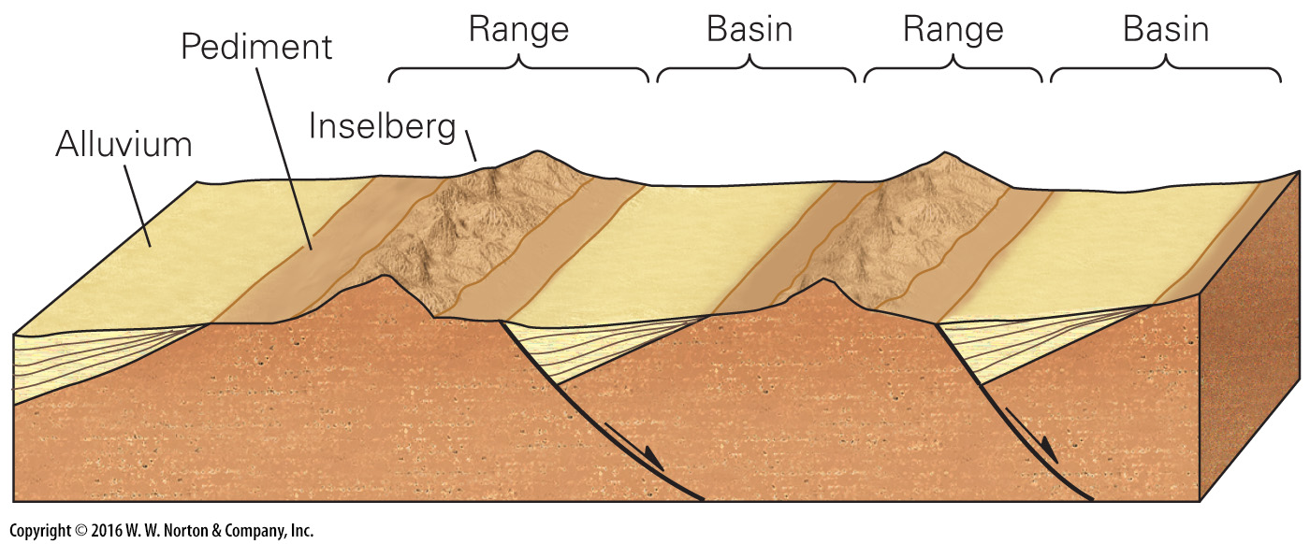
Notes:
FIGURE 17.14b Examples of erosional landscapes in deserts.
(b) In the Basin and Range Province of the southwestern United States, tilted fault-block ranges evolve into inselbergs, bordered by sediment-filled basins.

Slide 48
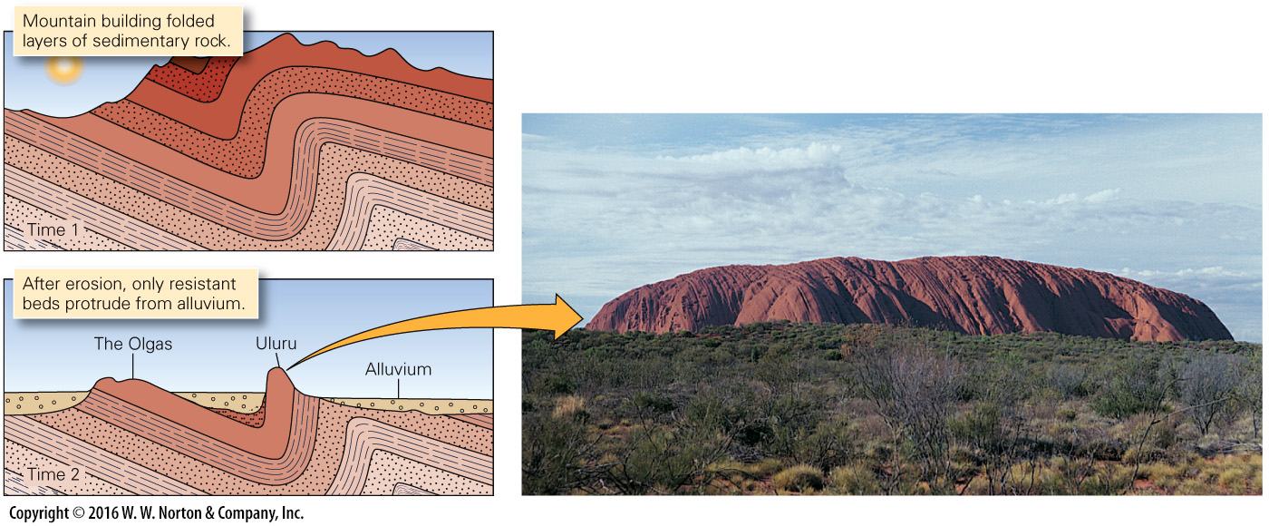
Notes:
FIGURE 17.15 Uluru (Ayers Rock) in central Australia is an inselberg. The red sandstone beds comprising it are the eroded remnant of the vertical limb of a large syncline. Alluvium buried the surrounding bedrock.

Slide 49
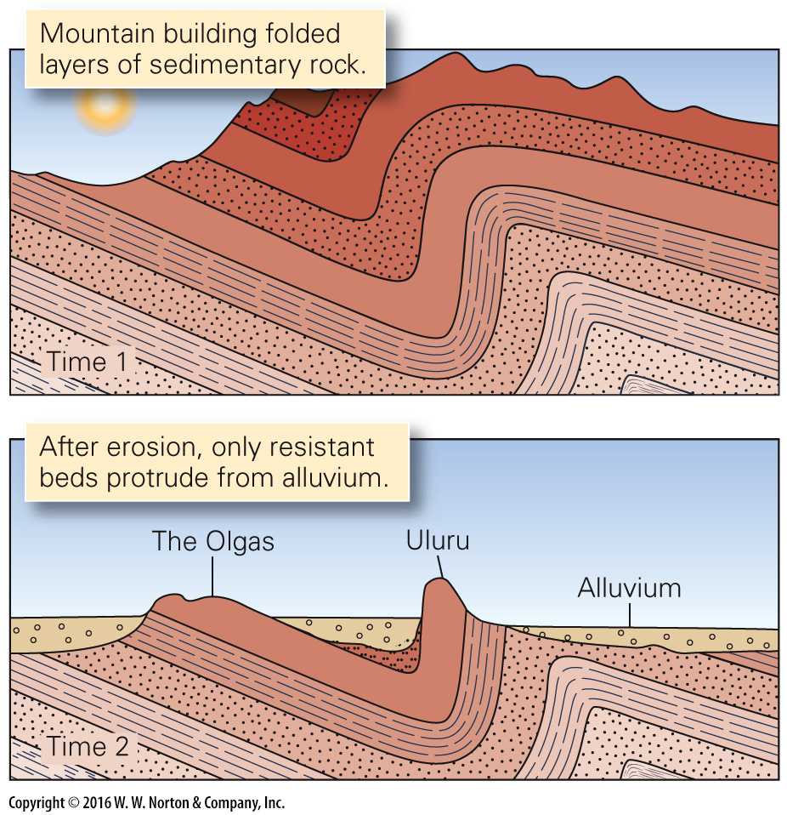
Notes:
FIGURE 17.15 Uluru (Ayers Rock) in central Australia is an inselberg. The red sandstone beds comprising it are the eroded remnant of the vertical limb of a large syncline. Alluvium buried the surrounding bedrock.

Slide 50
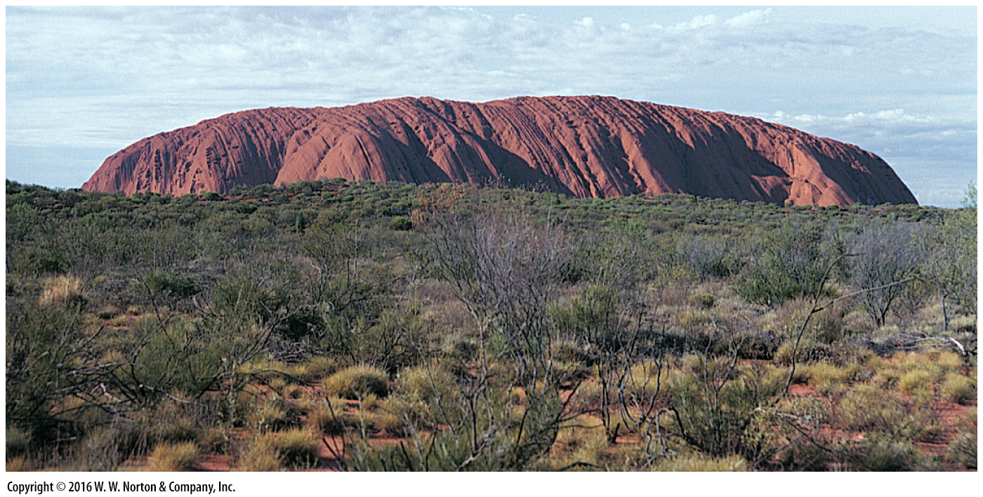
Notes:
FIGURE 17.15 Uluru (Ayers Rock) in central Australia is an inselberg. The red sandstone beds comprising it are the eroded remnant of the vertical limb of a large syncline. Alluvium buried the surrounding bedrock.

Slide 51
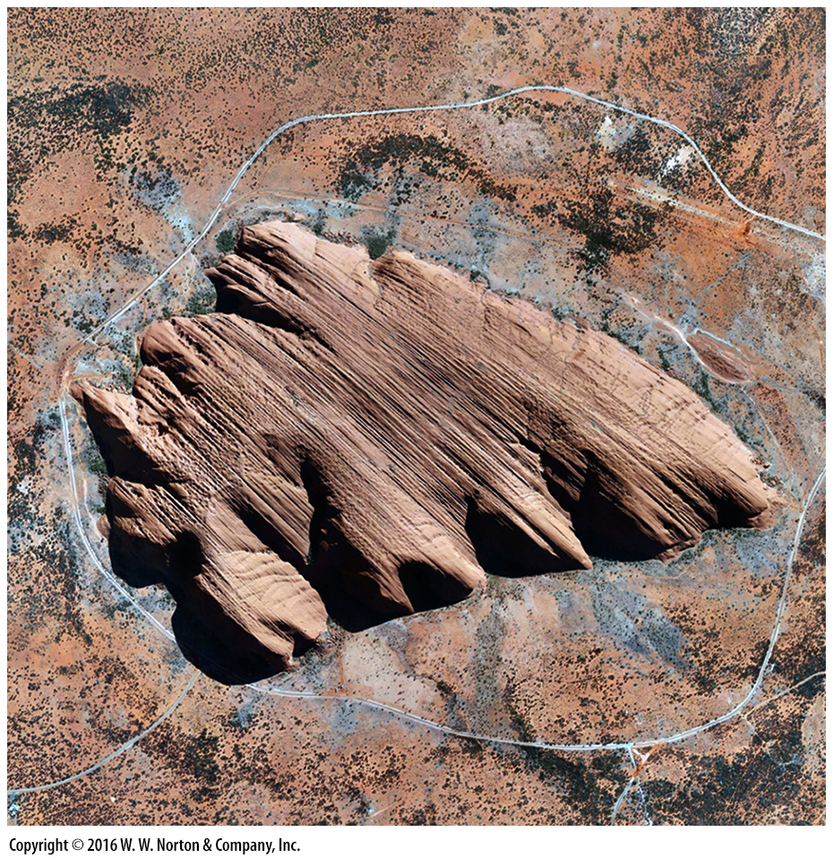
Notes:
SEE FOR YOURSELF…
ULURU, AUSTRALIA

Slide 52
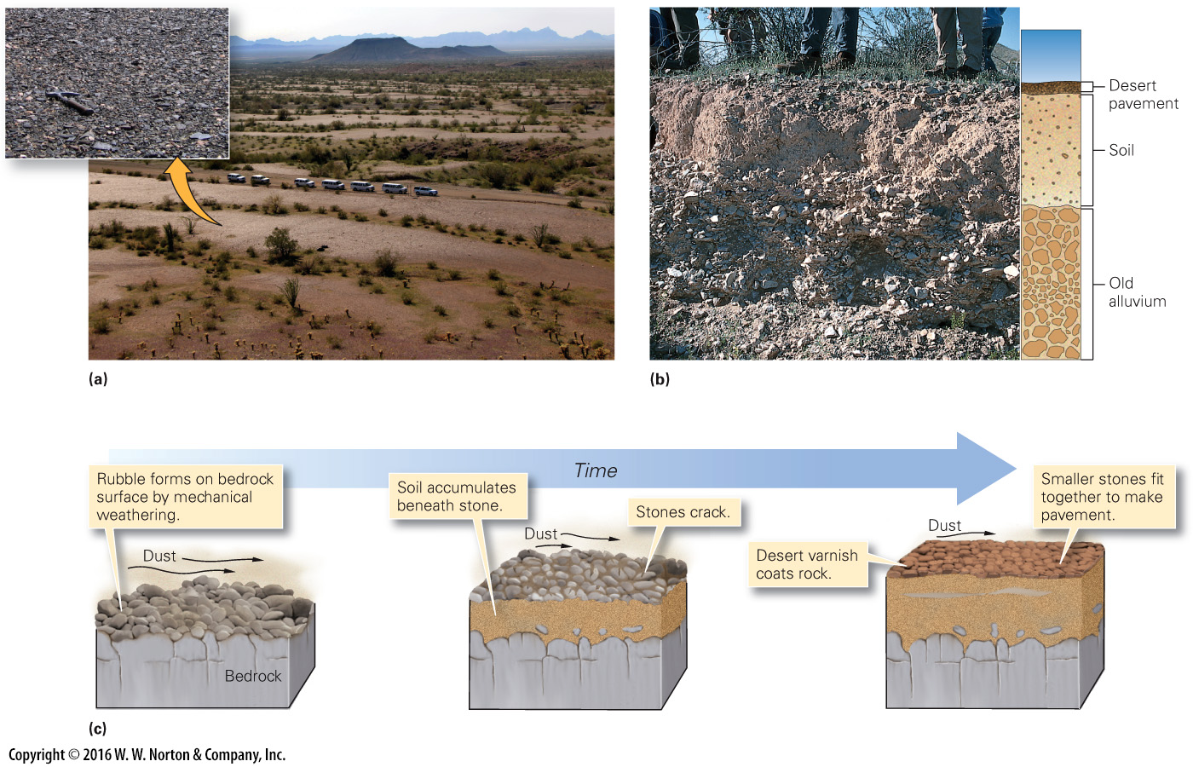
Notes:
FIGURE 17.16 Desert pavement and a hypothesis for how it forms by building up a soil from below.
(a) A well-developed desert pavement in the Sonoran Desert, Arizona. The inset shows a close-up of the pavement. (b) Students standing at the edge of a trench cut into desert pavement. Note the soil between the pavement and the underlying alluvium. (c) Desert pavement forms in stages. First, loose pebbles and cobbles collect at the surface. Dust settles among the stones and builds up a soil layer below. The stones eventually crack into smaller pieces and settle to form a mosaic-like pavement.

Slide 53
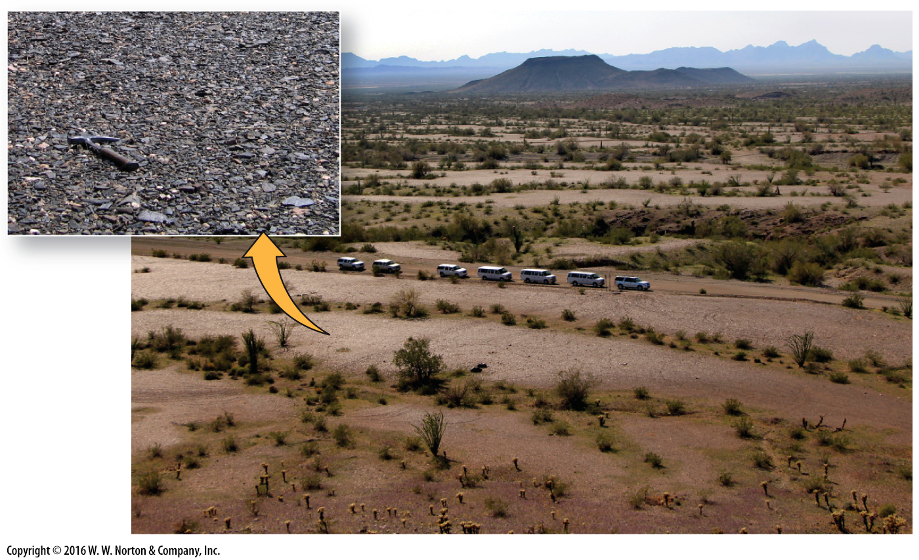
Notes:
FIGURE 17.16a Desert pavement and a hypothesis for how it forms by building up a soil from below.
(a) A well-developed desert pavement in the Sonoran Desert, Arizona. The inset shows a close-up of the pavement.

Slide 54
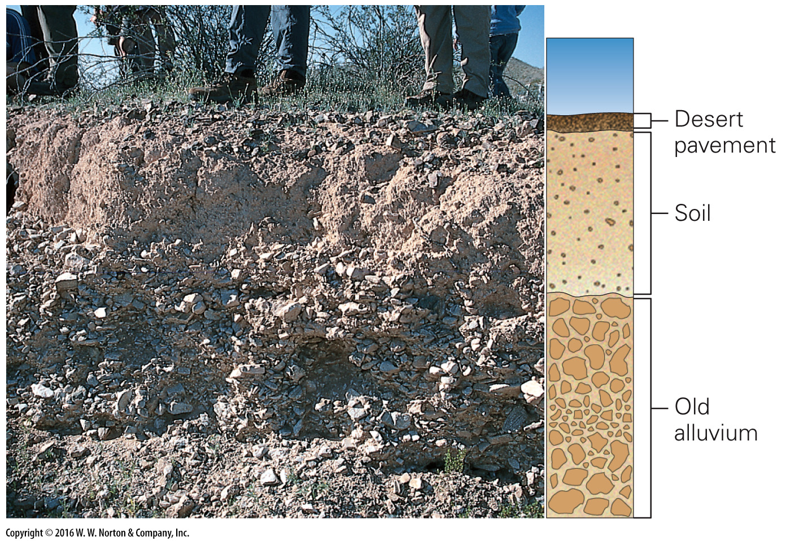
Notes:
FIGURE 17.16b Desert pavement and a hypothesis for how it forms by building up a soil from below.
(b) Students standing at the edge of a trench cut into desert pavement. Note the soil between the pavement and the underlying alluvium.

Slide 55
Notes:
FIGURE 17.16c Desert pavement and a hypothesis for how it forms by building up a soil from below.
(c) Desert pavement forms in stages. First, loose pebbles and cobbles collect at the surface. Dust settles among the stones and builds up a soil layer below. The stones eventually crack into smaller pieces and settle to form a mosaic-like pavement.

Slide 56
Notes:
FIGURE 17.17 The types of sand dunes and the cross beds within them.
(a) The various kinds of sand dunes. (b) A sand dune with surface ripples. (c) Cross bedding inside a dune.

Slide 57
Notes:
FIGURE 17.17a The types of sand dunes and the cross beds within them.
(a) The various kinds of sand dunes.

Slide 58
Notes:
FIGURE 17.17b The types of sand dunes and the cross beds within them.
(b) A sand dune with surface ripples.

Slide 59
Notes:
FIGURE 17.17c The types of sand dunes and the cross beds within them.
(c) Cross bedding inside a dune.

Slide 60
Notes:
SEE FOR YOURSELF…
NAMIB DESERT, NAMIBIA

Slide 61
Notes:
FIGURE 17.18 Desertification has been happening in the Sahel, a region of Africa.
(a) The Sahel is the semi-arid land along the southern edge of the Sahara. Large parts have undergone desertification. (b) In the Sahel, forests and grasslands have dried up.

Slide 62
Notes:
FIGURE 17.18a Desertification has been happening in the Sahel, a region of Africa.
(a) The Sahel is the semi-arid land along the southern edge of the Sahara. Large parts have undergone desertification.

Slide 63
Notes:
FIGURE 17.18b Desertification has been happening in the Sahel, a region of Africa.
(b) In the Sahel, forests and grasslands have dried up.

Slide 64
Notes:
SEE FOR YOURSELF…
SAHARA DESERT, EGYPT

Slide 65
Notes:
FIGURE 17.19 In this satellite image, a huge dust cloud that originated in the Sahara blows across the Atlantic.

Slide 66
Notes:
Another View The machinery of an abandoned farm in South Dakota lies buried in dust, as illustrated by this 1936 photograph.

