Slide 1
Stephen Marshak
ESSENTIALS OF
Geology
FIFTH EDITION
Chapter 18
Amazing Ice: Glaciers and Ice Ages
©2016 W. W. Norton & Company, Inc.

Slide 2
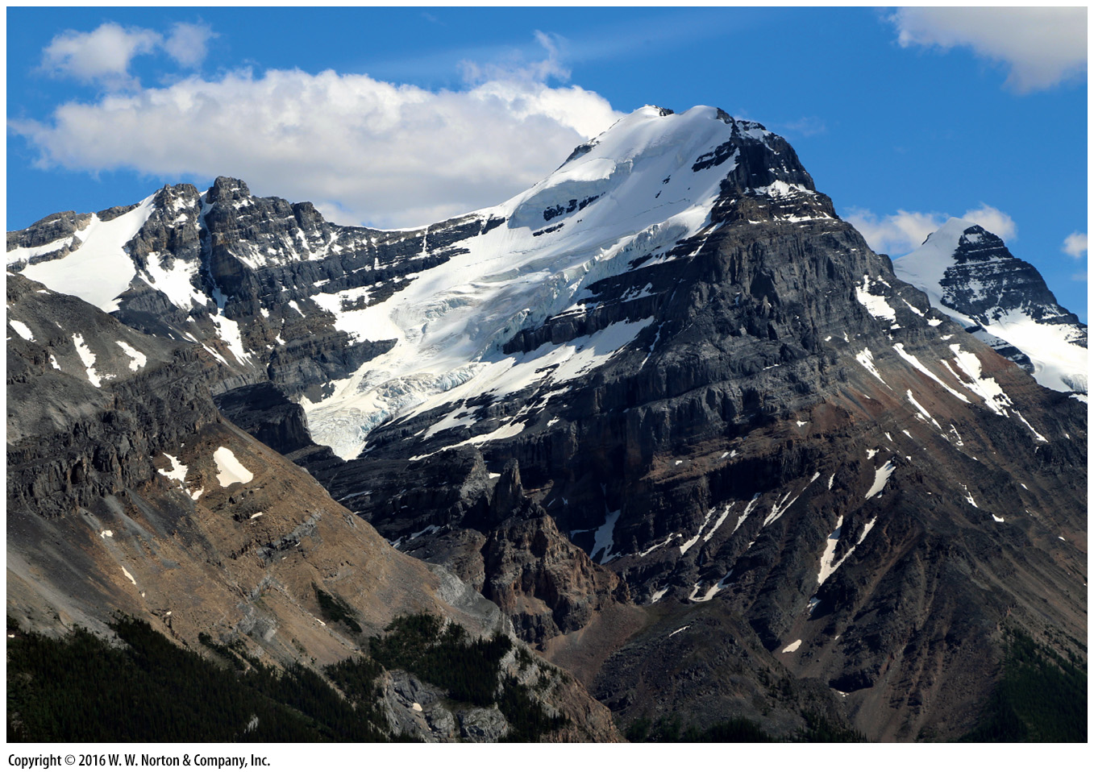
Notes:
A small glacier, all that remains of what was once a large ice cap, clings to the side of a mountain in the Canadian Rockies. The flow of glaciers contributed to carving this rugged landscape.

Slide 3
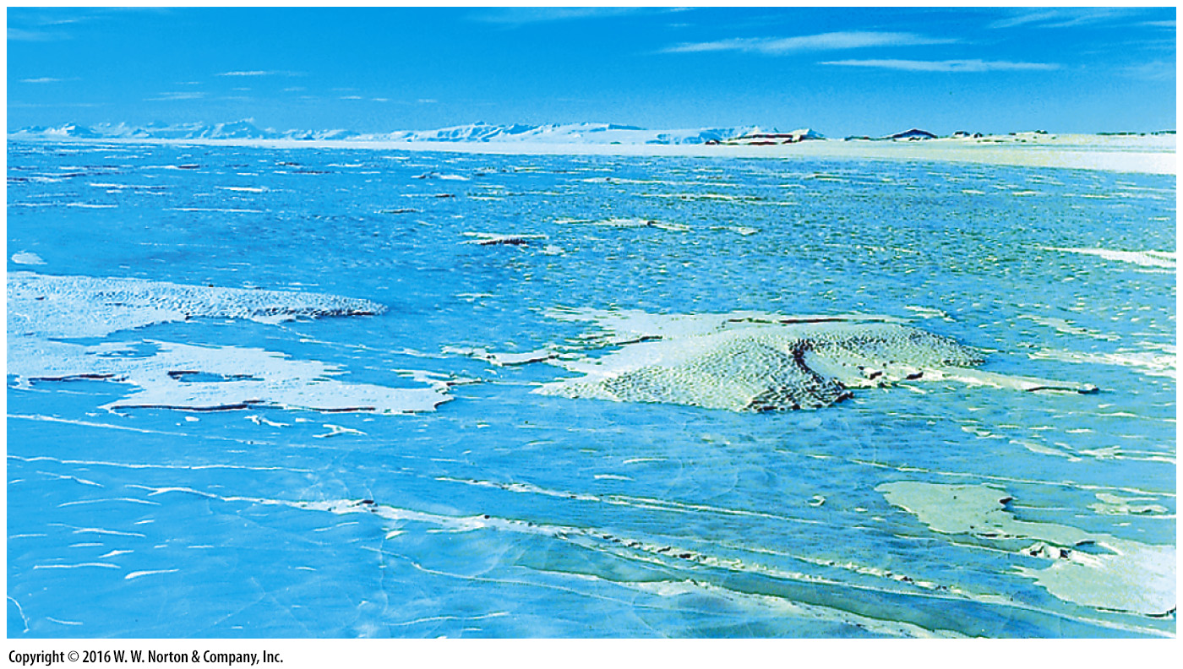
Notes:
FIGURE 18.1 Agassiz envisoned that extensive areas of the northern hemisphere were once covered by vast ice sheets comparable to the one covering Antarctica today.

Slide 4
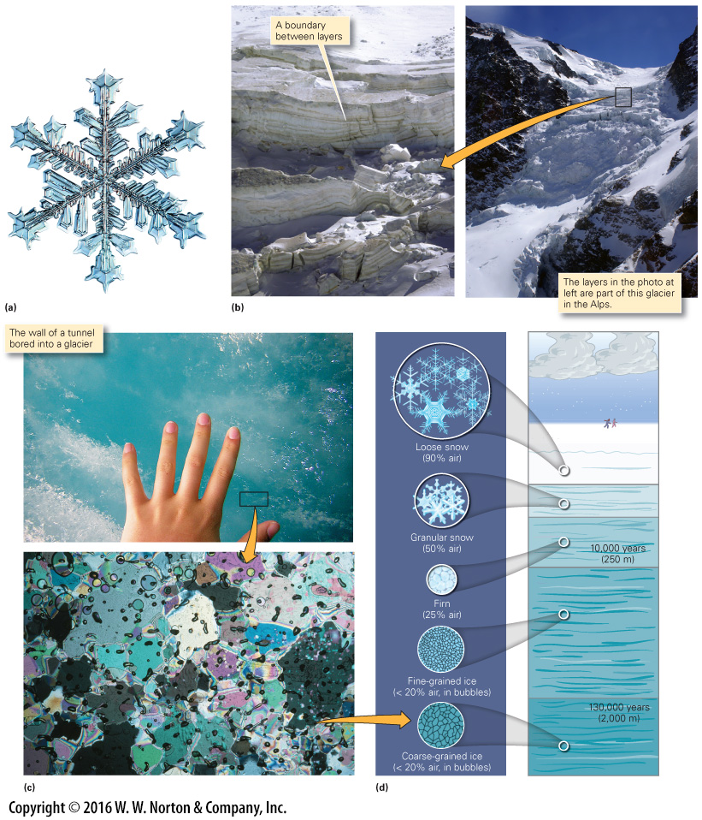
Notes:
FIGURE 18.2 The nature of ice and the formation of glaciers. Snow falls like sediment and metamorphoses to ice when buried.
(a) The hexagonal shape of snowflakes. No two are alike. (b) Layers of snow accumulate. They recrystallize to become ice. (c) As revealed by a microscope, glacial ice has coarse grains and contains air bubbles. (d) Snow compacts and melts to form firn, which recrystallizes into ice. Crystal size increases with depth.

Slide 5
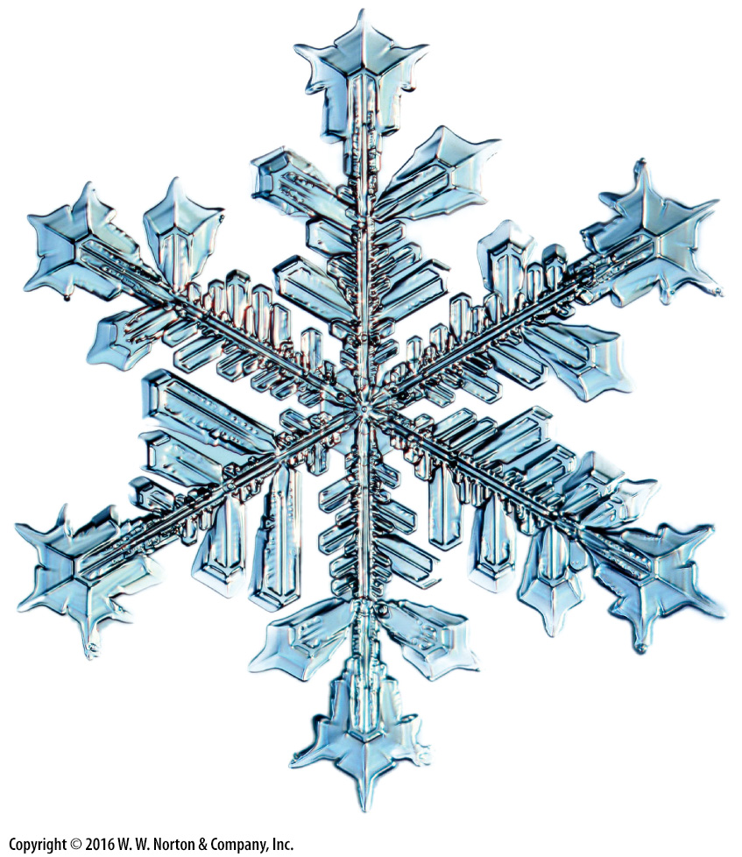
Notes:
FIGURE 18.2a The nature of ice and the formation of glaciers. Snow falls like sediment and metamorphoses to ice when buried.
(a) The hexagonal shape of snowflakes. No two are alike.

Slide 6
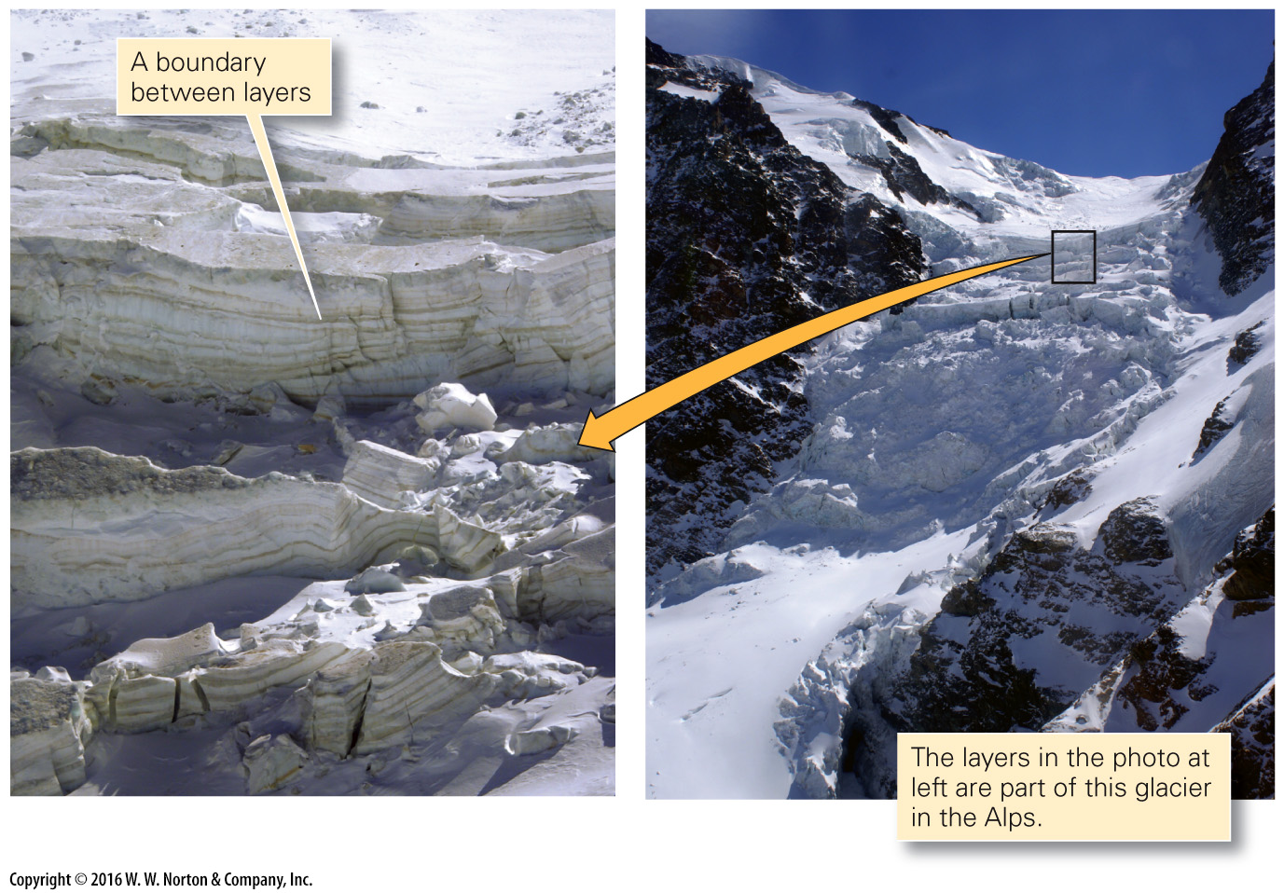
Notes:
FIGURE 18.2b The nature of ice and the formation of glaciers. Snow falls like sediment and metamorphoses to ice when buried.
(b) Layers of snow accumulate. They recrystallize to become ice.

Slide 7
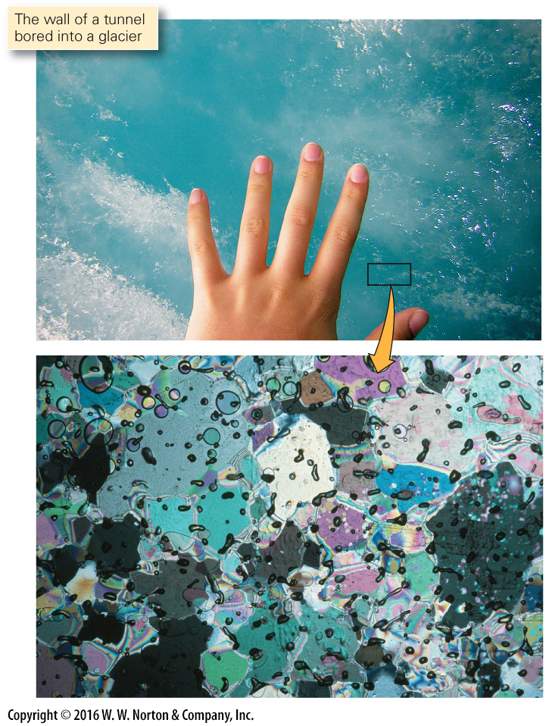
Notes:
FIGURE 18.2c The nature of ice and the formation of glaciers. Snow falls like sediment and metamorphoses to ice when buried.
(c) As revealed by a microscope, glacial ice has coarse grains and contains air bubbles.

Slide 8
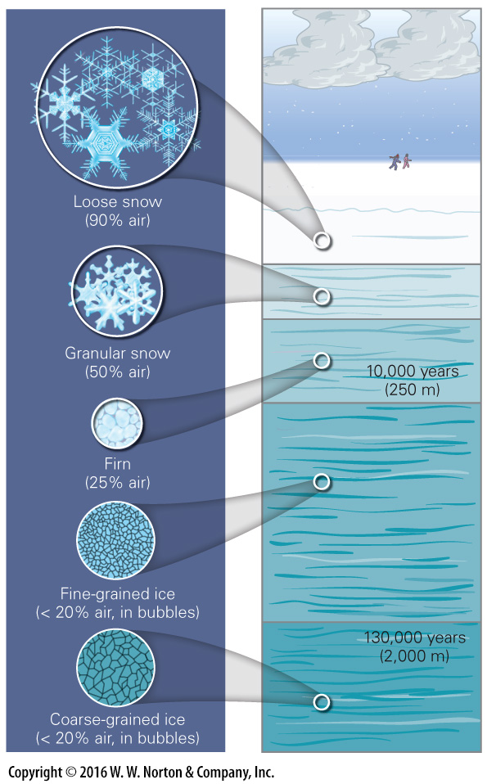
Notes:
FIGURE 18.2d The nature of ice and the formation of glaciers. Snow falls like sediment and metamorphoses to ice when buried.
(d) Snow compacts and melts to form firn, which recrystallizes into ice. Crystal size increases with depth.

Slide 9
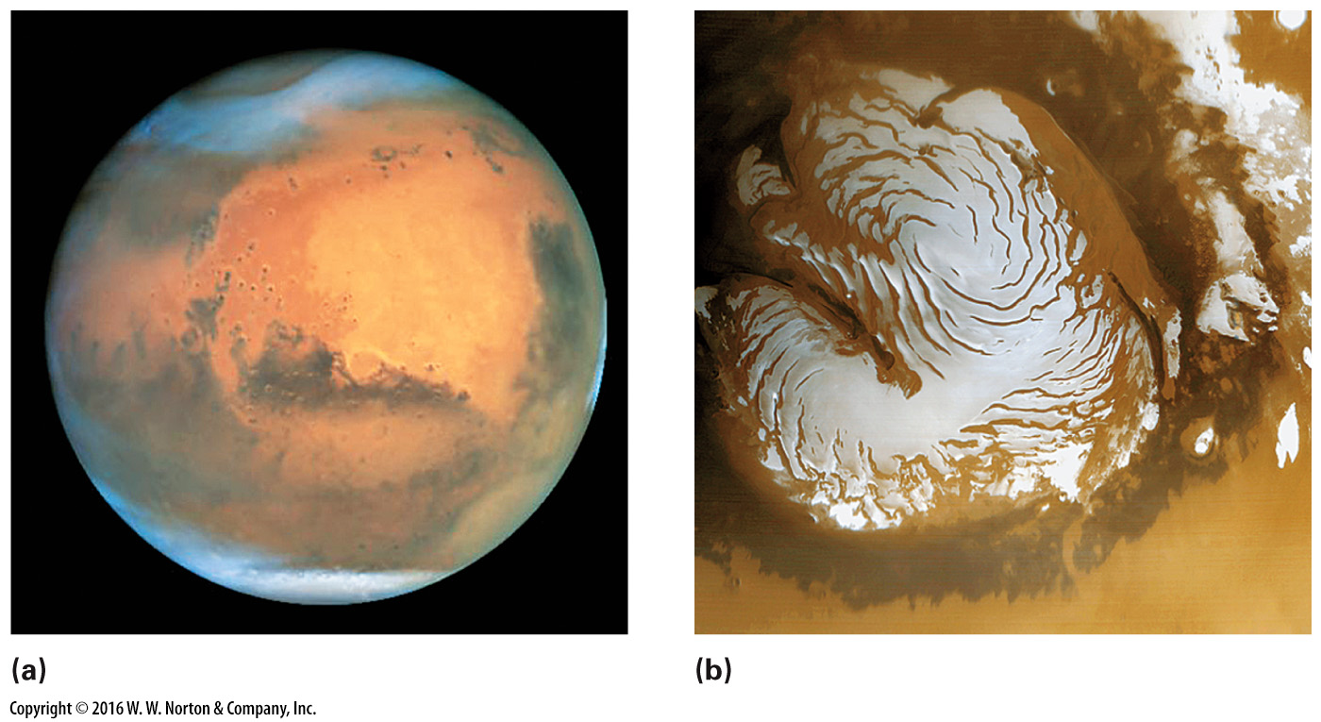
Notes:
FIGURE Bx18.1 The ice caps of Mars.
(a) During the winter, the ice caps expand to lower latitudes. (b) A close-up of the northern polar cap in summer.

Slide 10
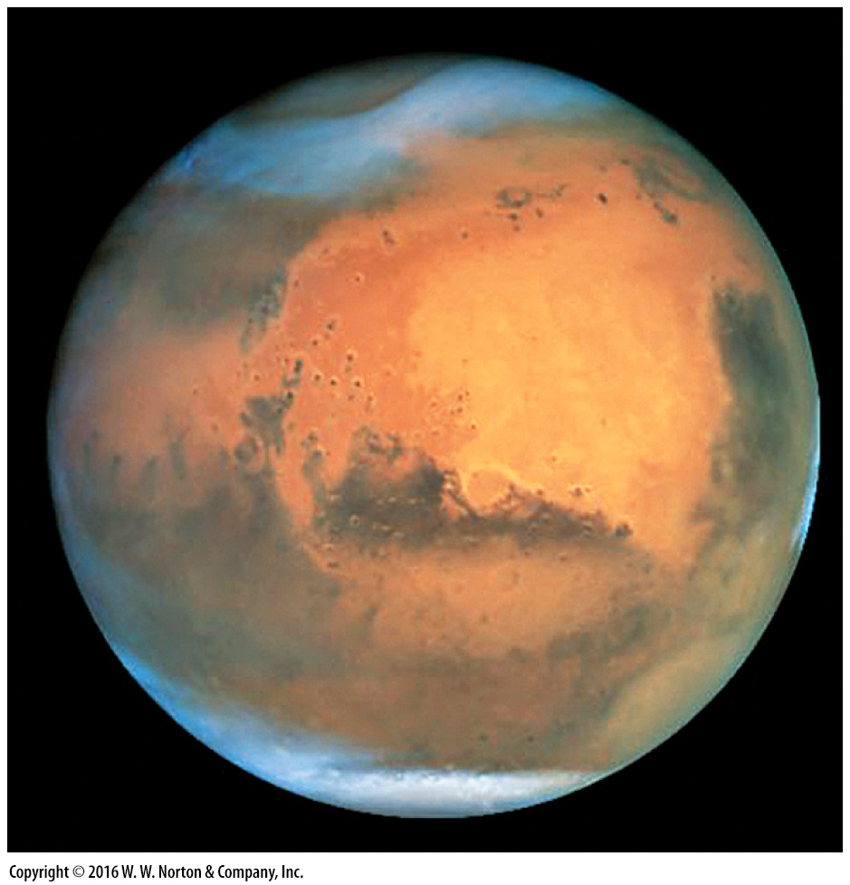
Notes:
FIGURE Bx18.1a The ice caps of Mars.
(a) During the winter, the ice caps expand to lower latitudes.

Slide 11
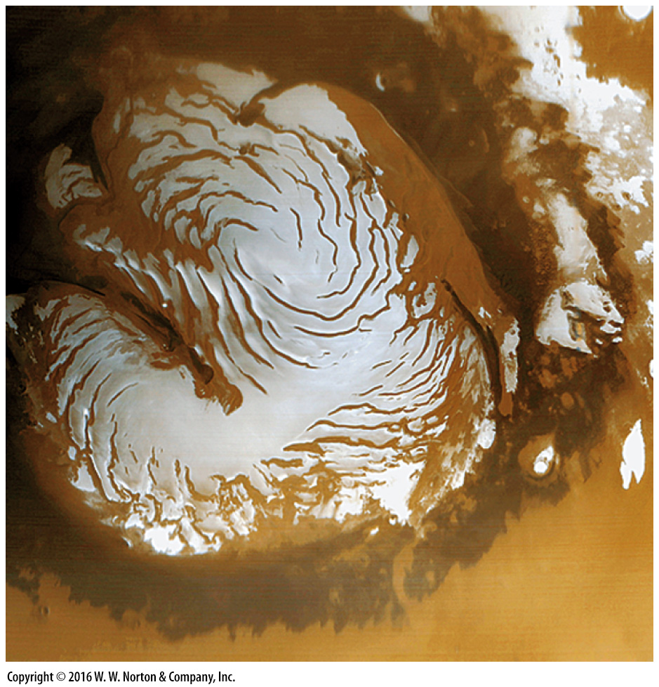
Notes:
FIGURE Bx18.1b The ice caps of Mars.
(b) A close-up of the northern polar cap in summer.

Slide 12
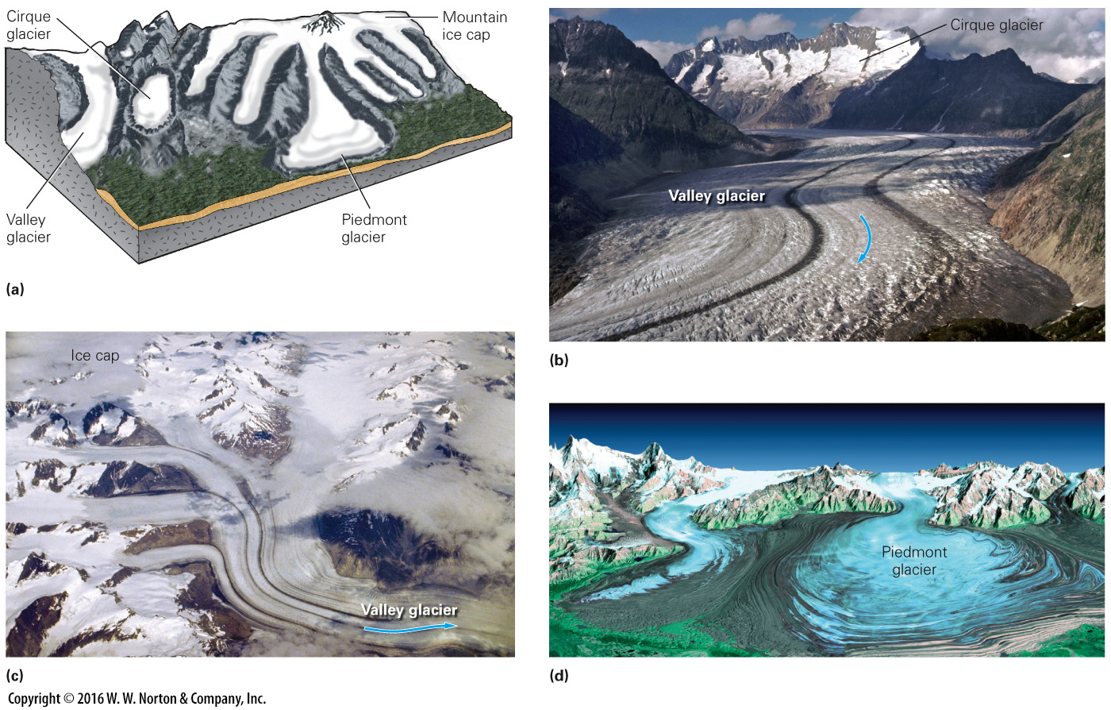
Notes:
FIGURE 18.3 A great variety of glaciers form in mountainous areas.
(a) Mountain glaciers are classified based on shape and position. (b) A valley glacier and cirque glaciers in Switzerland. (c) Valley glaciers draining a mountain ice cap in Alaska. (d) A piedmont glacier near the coast of Greenland.

Slide 13
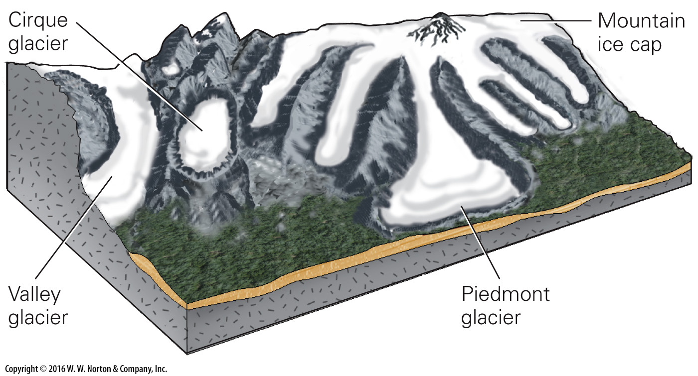
Notes:
FIGURE 18.3a A great variety of glaciers form in mountainous areas.
(a) Mountain glaciers are classified based on shape and position.

Slide 14
Notes:
FIGURE 18.3b A great variety of glaciers form in mountainous areas.
(b) A valley glacier and cirque glaciers in Switzerland.

Slide 15
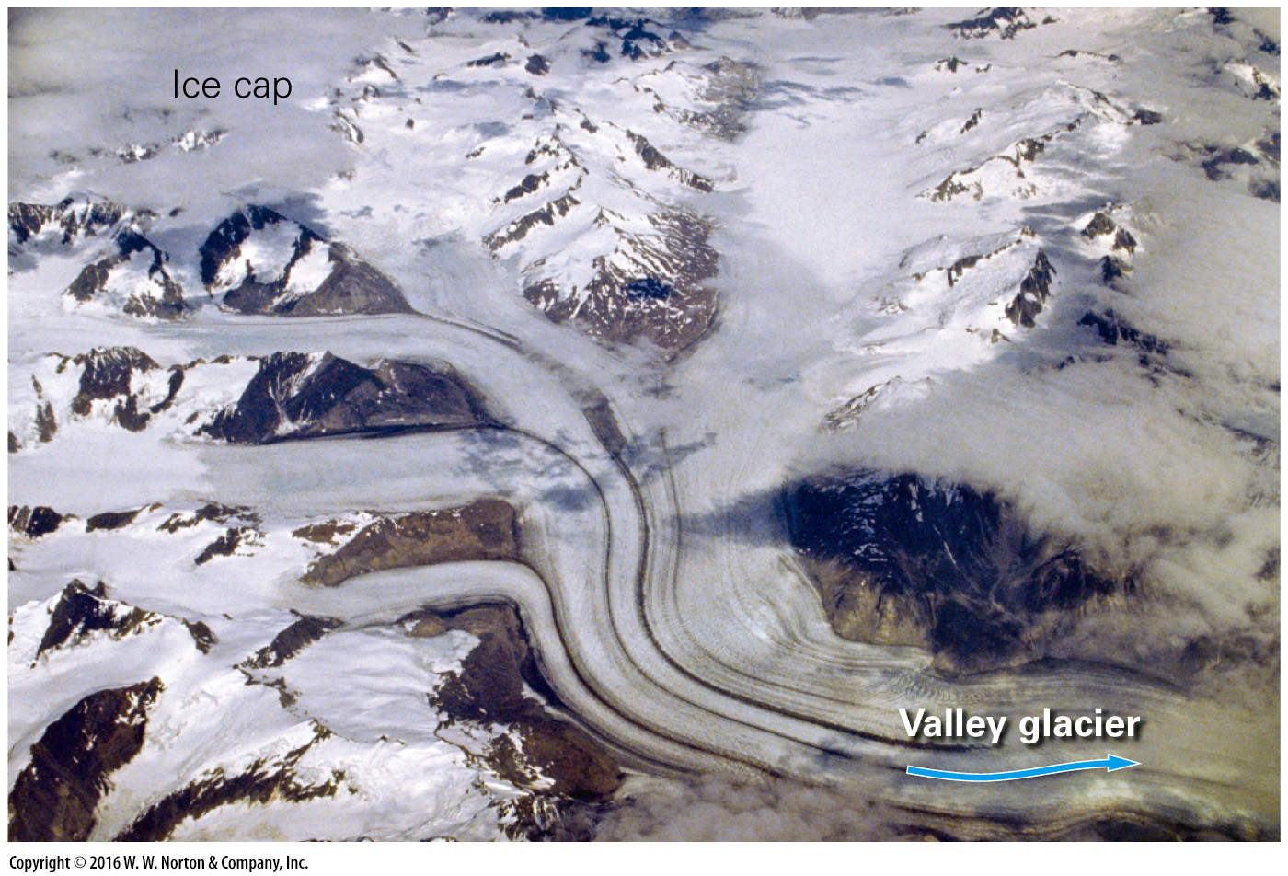
Notes:
FIGURE 18.3c A great variety of glaciers form in mountainous areas.
(c) Valley glaciers draining a mountain ice cap in Alaska.

Slide 16
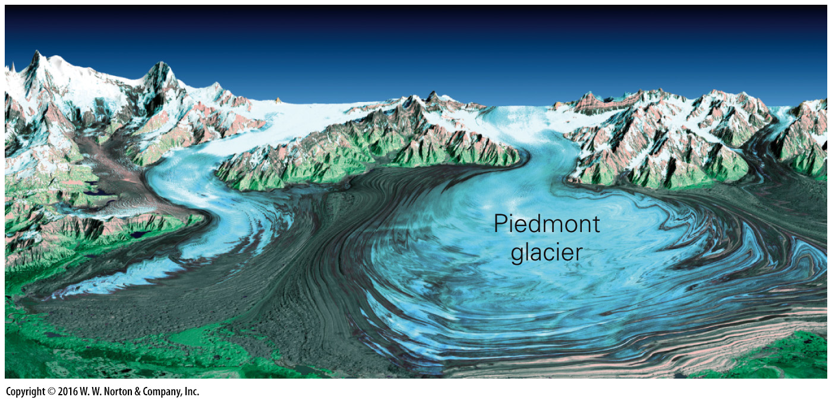
Notes:
FIGURE 18.3d A great variety of glaciers form in mountainous areas.
(d) A piedmont glacier near the coast of Greenland.

Slide 17
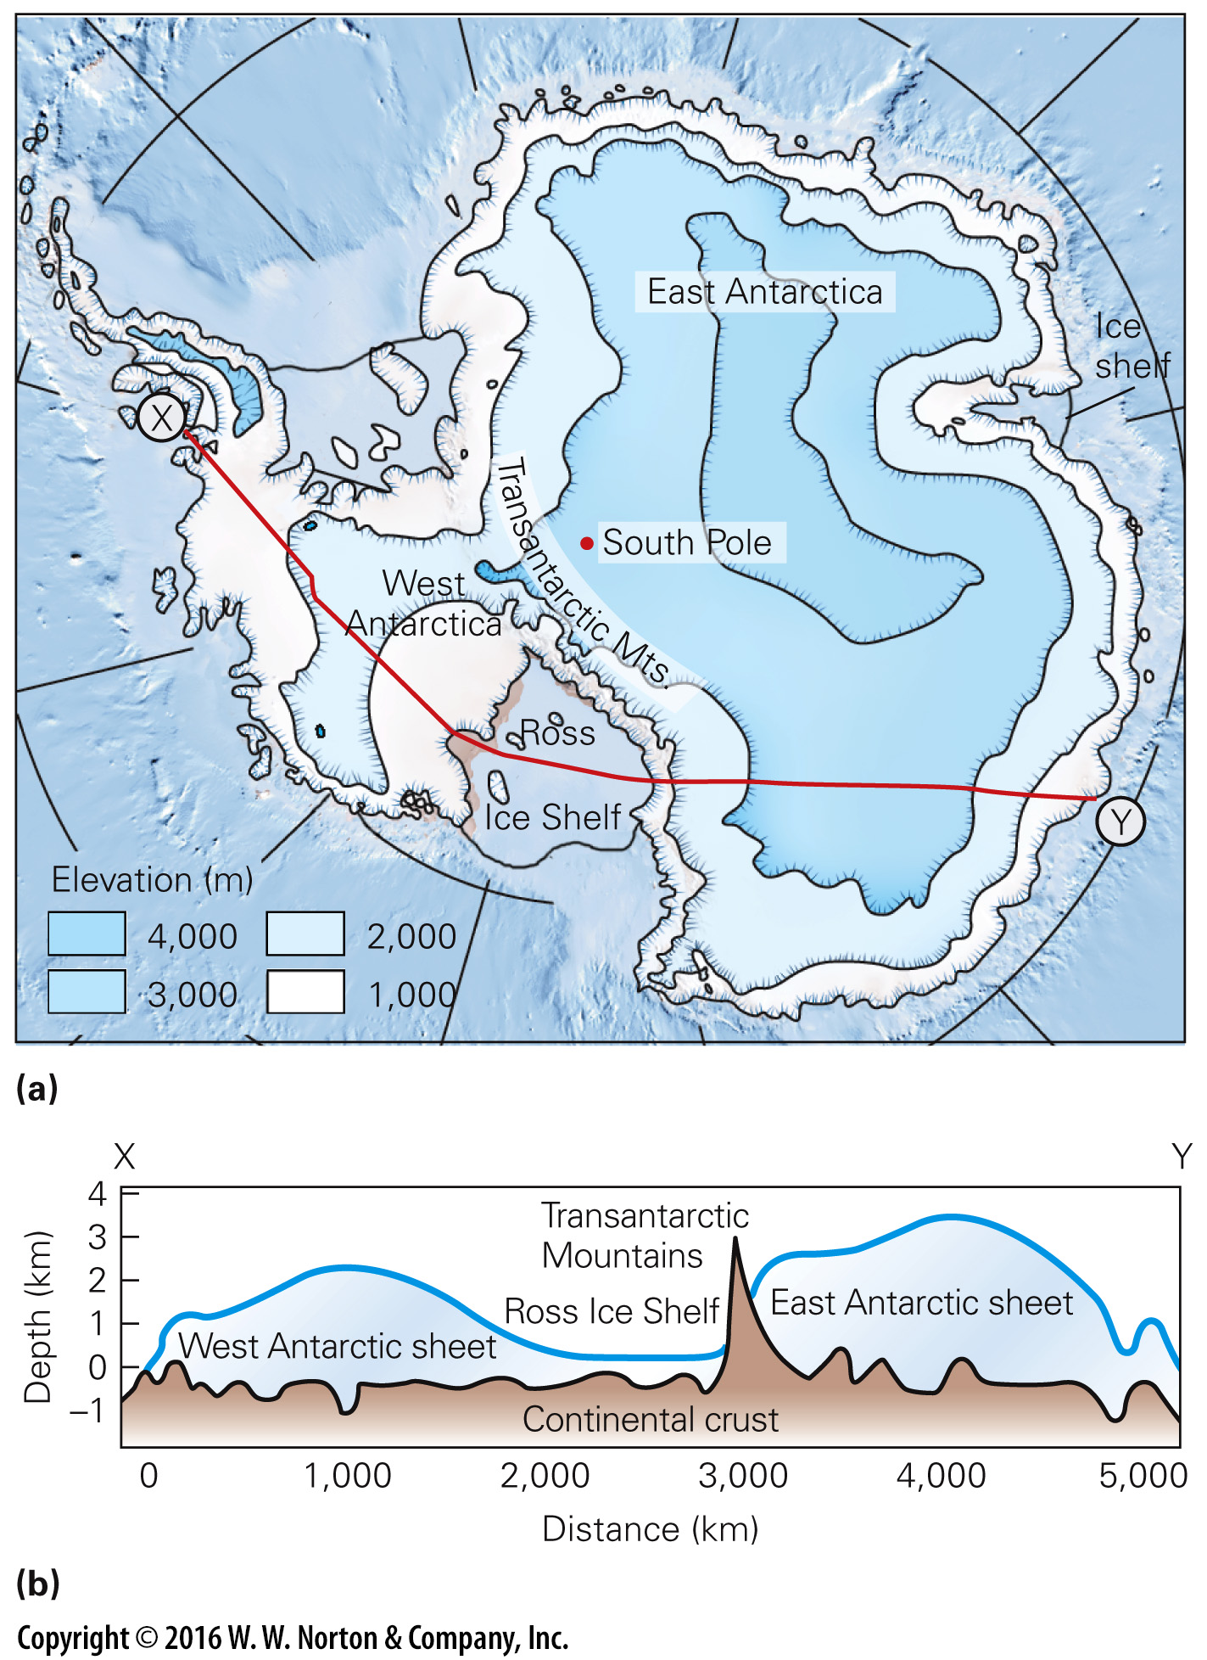
Notes:
FIGURE 18.4 Antarctica is an ice-covered continent.
(a) A contour map of the Antarctic ice sheet. Valley glaciers carry ice from the ice sheet of East Antarctica down to the Ross Ice Shelf. (b) A cross section X to Y of the Antarctic ice sheet. The Transantarctic Mountains separate East Antarctica from West Antarctica.

Slide 18
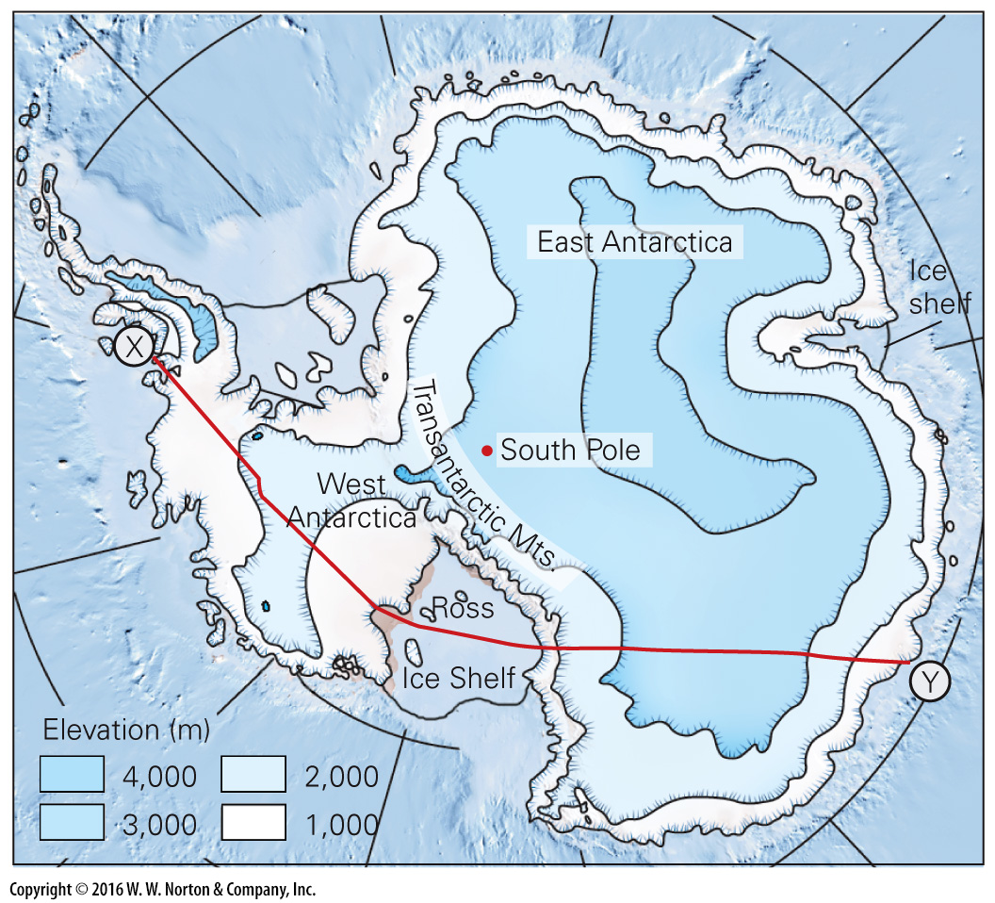
Notes:
FIGURE 18.4a Antarctica is an ice-covered continent.
(a) A contour map of the Antarctic ice sheet. Valley glaciers carry ice from the ice sheet of East Antarctica down to the Ross Ice Shelf.

Slide 19
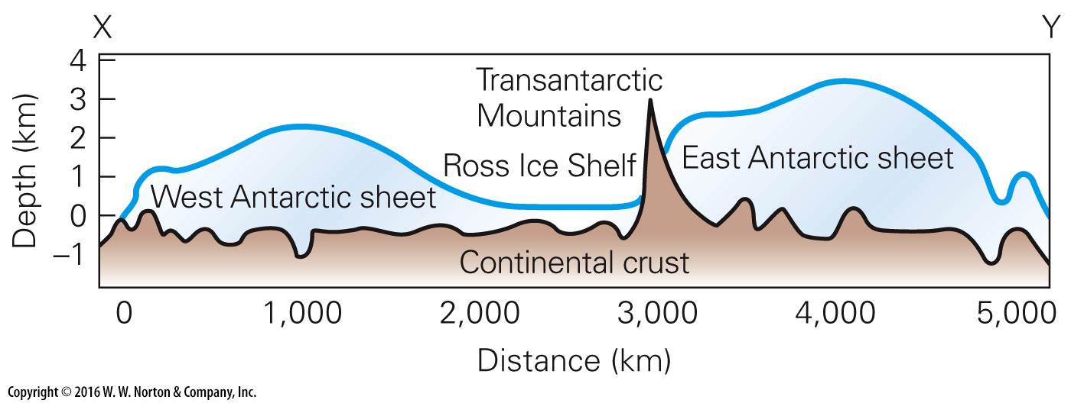
Notes:
FIGURE 18.4b Antarctica is an ice-covered continent.
(b) A cross section X to Y of the Antarctic ice sheet. The Transantarctic Mountains separate East Antarctica from West Antarctica.

Slide 20
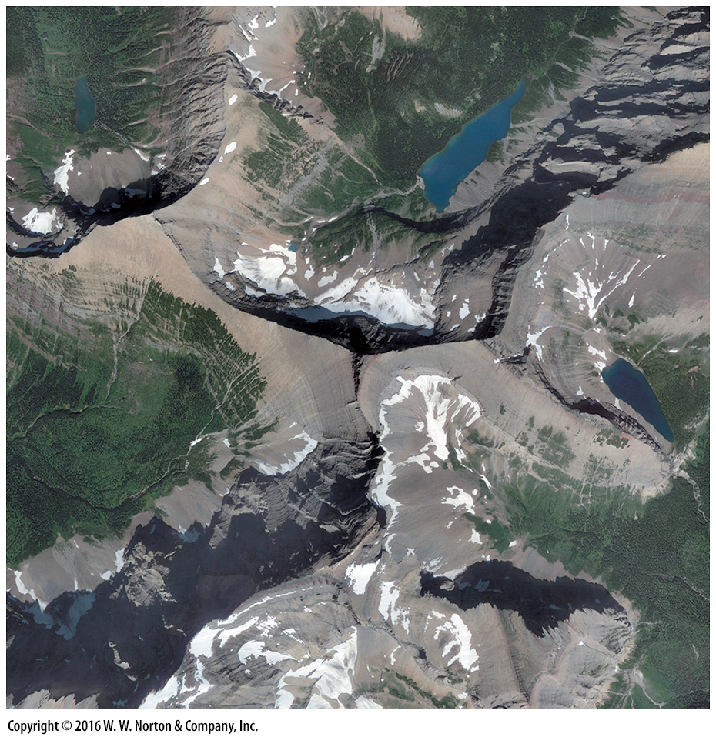
Notes:
SEE FOR YOURSELF…
GLACIALLY-CARVED PEAKS, MONTANA

Slide 21
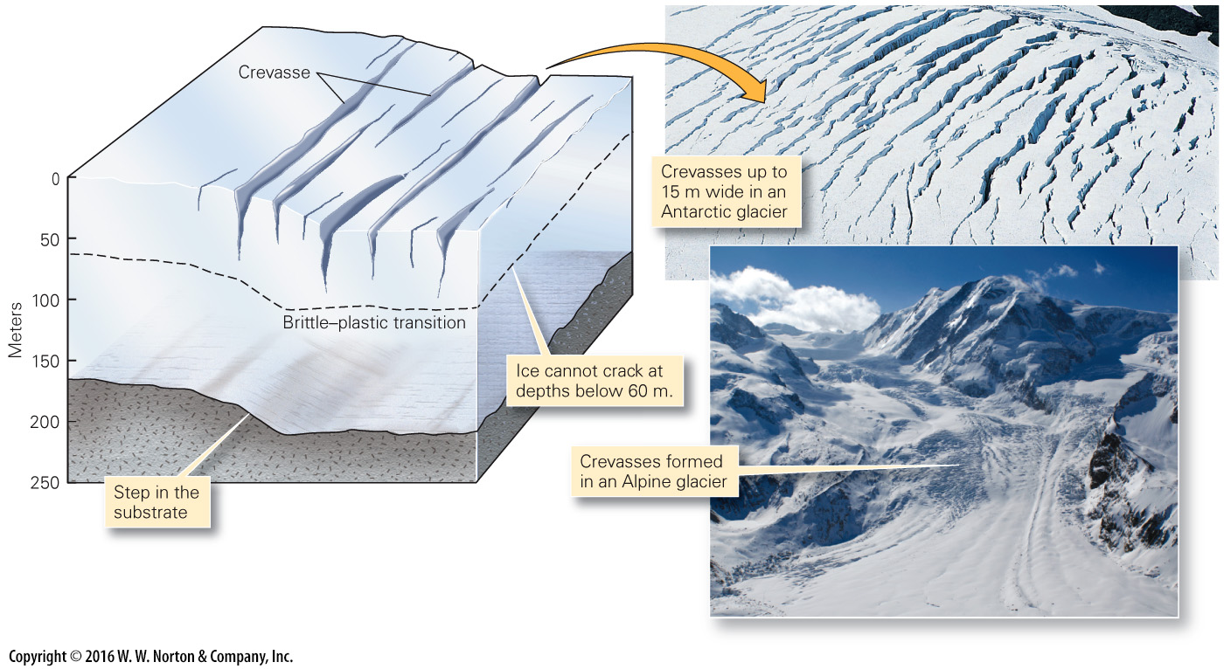
Notes:
FIGURE 18.5 Crevasses form in the upper layer of a glacier, in which the ice is brittle. Commonly, cracking takes place where the glacier bends while flowing over steps or ridges in its substrate.

Slide 22
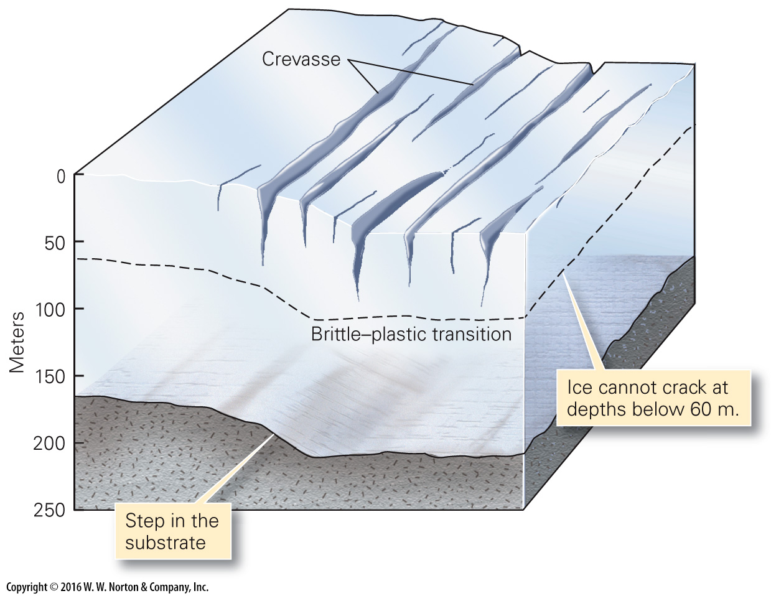
Notes:
FIGURE 18.5 Crevasses form in the upper layer of a glacier, in which the ice is brittle. Commonly, cracking takes place where the glacier bends while flowing over steps or ridges in its substrate.

Slide 23
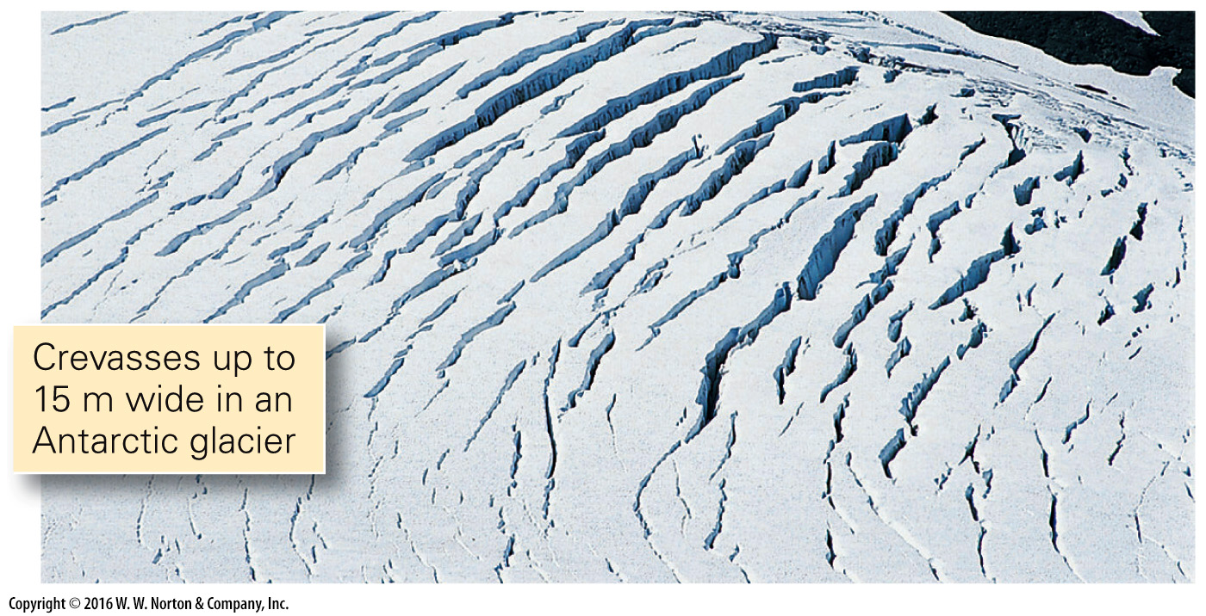
Notes:
FIGURE 18.5 Crevasses form in the upper layer of a glacier, in which the ice is brittle. Commonly, cracking takes place where the glacier bends while flowing over steps or ridges in its substrate.

Slide 24
Notes:
FIGURE 18.5 Crevasses form in the upper layer of a glacier, in which the ice is brittle. Commonly, cracking takes place where the glacier bends while flowing over steps or ridges in its substrate.

Slide 25
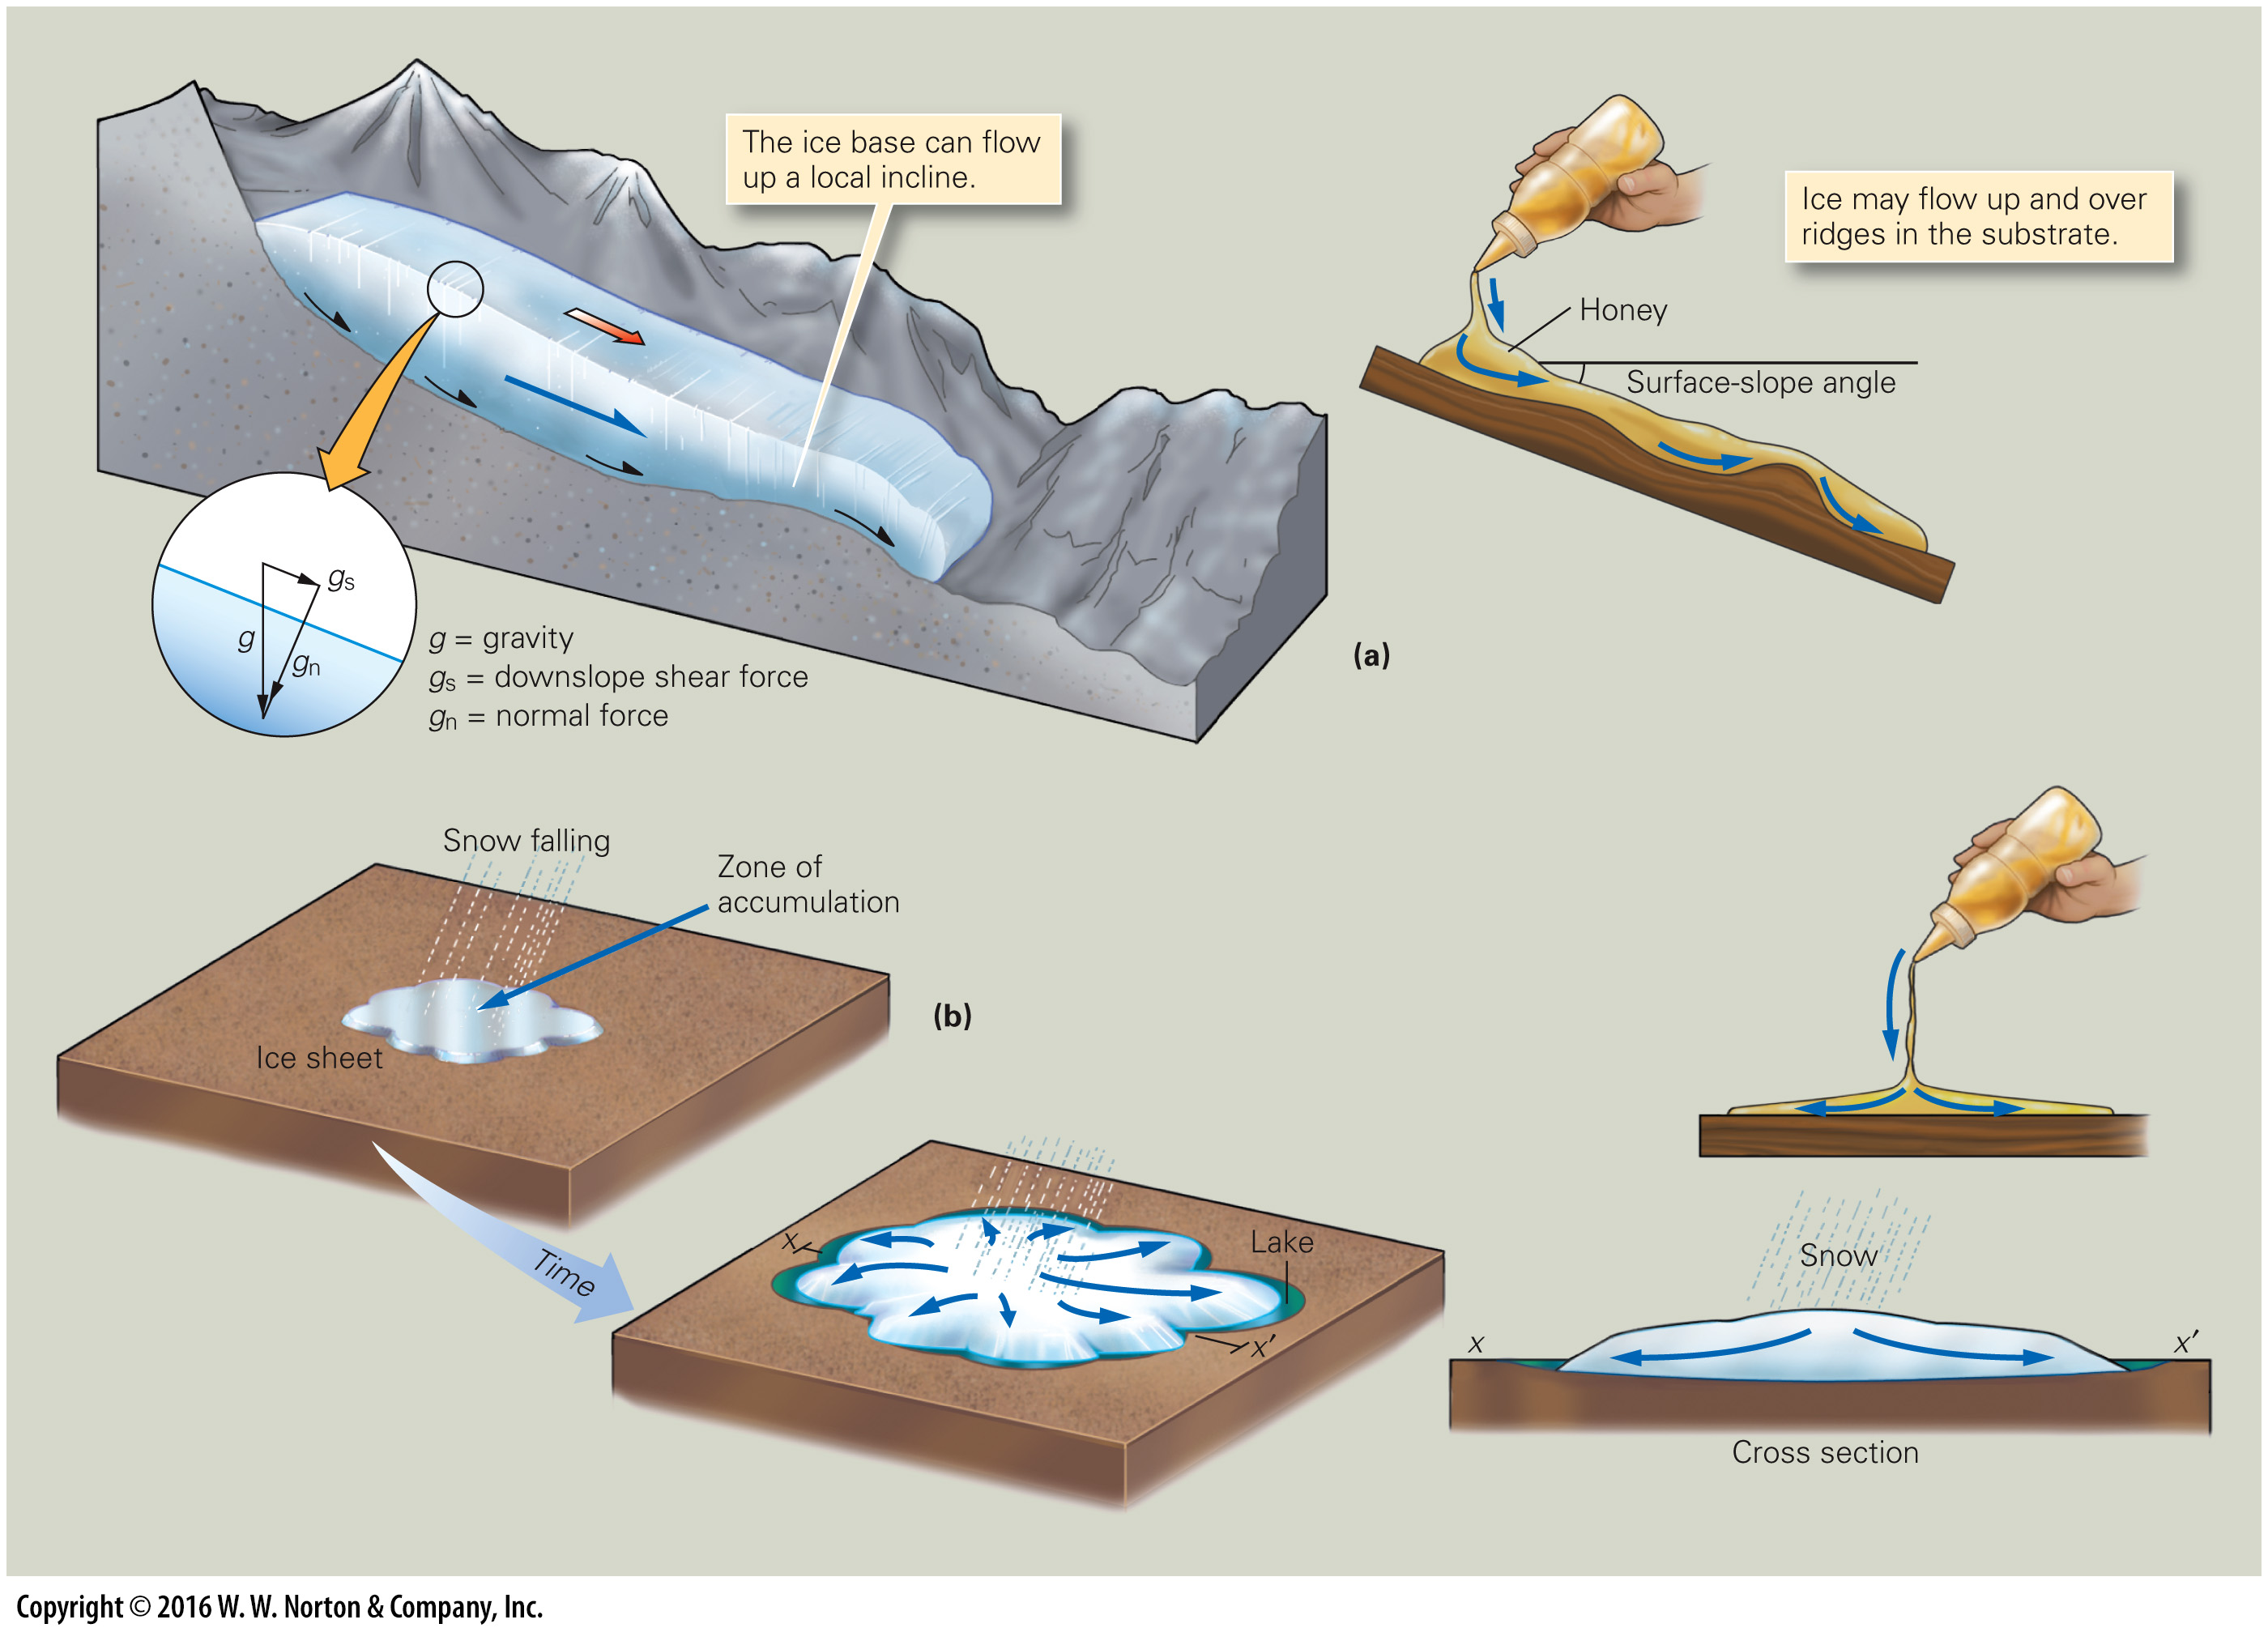
Notes:
FIGURE 18.6 Forces that drive the movement of glaciers.
(a) Movement of valley glaciers occurs if the top surface slopes down the valley so that gravity produces a downslope shear force. (b) The gravitational spreading of an ice sheet resembles honey spreading across a table. The ice sheet is higher in the middle, so it spreads sideways.

Slide 26
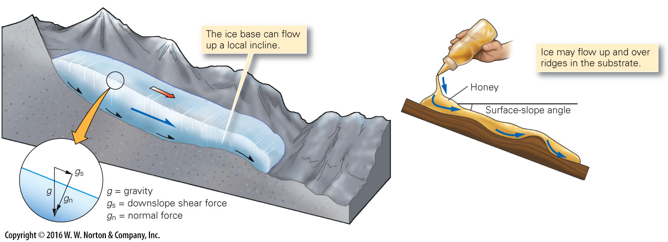
Notes:
FIGURE 18.6a Forces that drive the movement of glaciers.
(a) Movement of valley glaciers occurs if the top surface slopes down the valley so that gravity produces a downslope shear force.

Slide 27
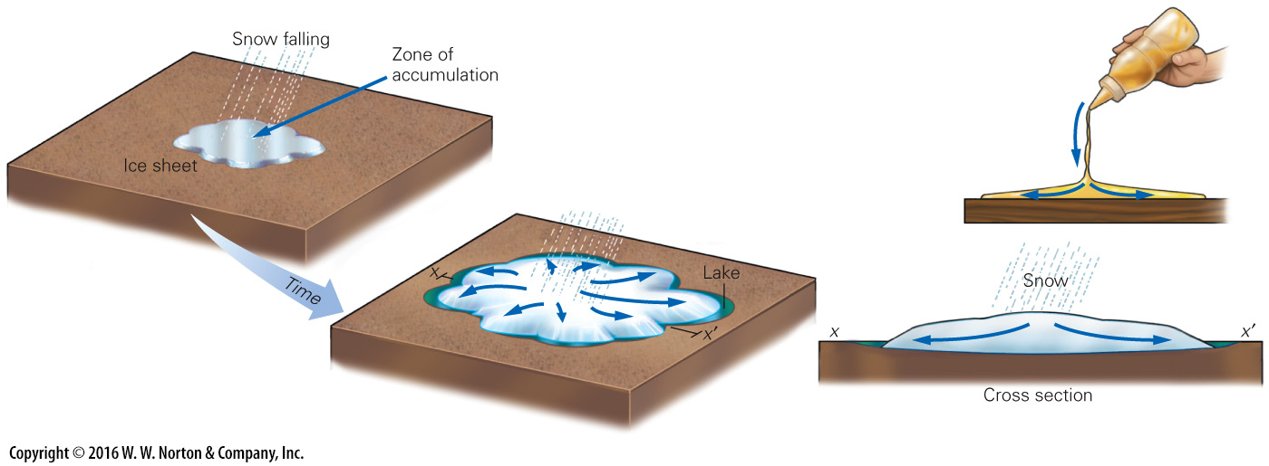
Notes:
FIGURE 18.6b Forces that drive the movement of glaciers.
(b) The gravitational spreading of an ice sheet resembles honey spreading across a table. The ice sheet is higher in the middle, so it spreads sideways.

Slide 28
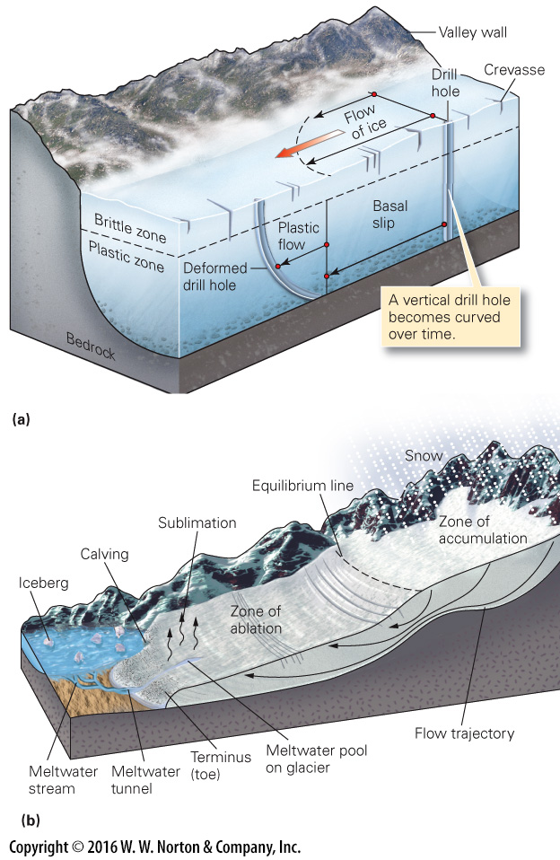
Notes:
FIGURE 18.7 Flow velocities vary with location in a glacier. Overall, ice flows from the zone of accumulation to the toe.
(a) Different parts of a glacier flow at different velocities due to friction with the substrate. The top and center regions flow fastest. (b) The equilibrium line separates the zone of accumulation from the zone of ablation. As indicated by arrows, ice flows down in the zone of accumulation and up in the zone of ablation.

Slide 29
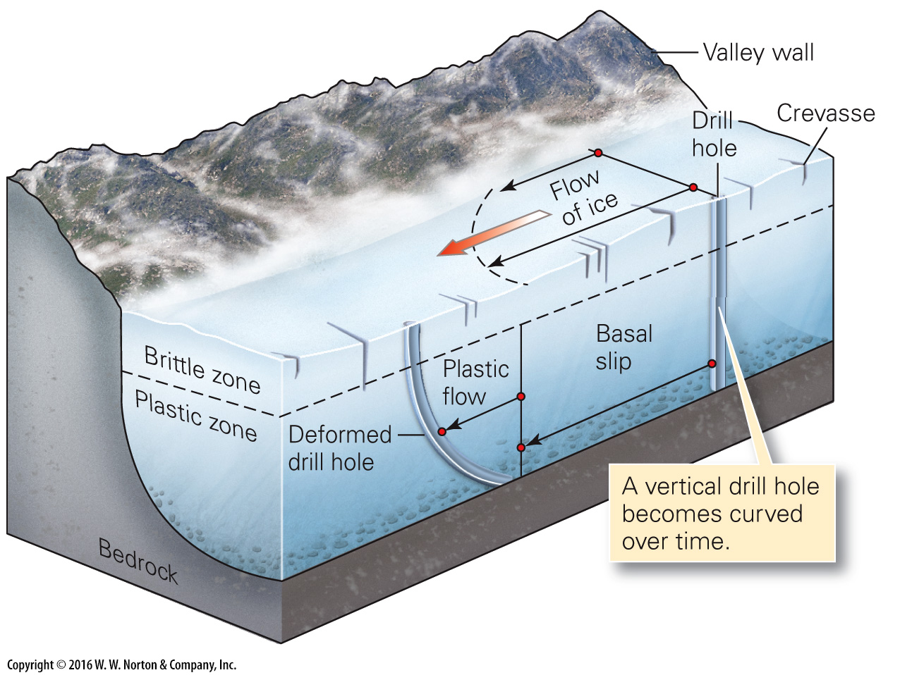
Notes:
FIGURE 18.7a Flow velocities vary with location in a glacier. Overall, ice flows from the zone of accumulation to the toe.
(a) Different parts of a glacier flow at different velocities due to friction with the substrate. The top and center regions flow fastest.

Slide 30
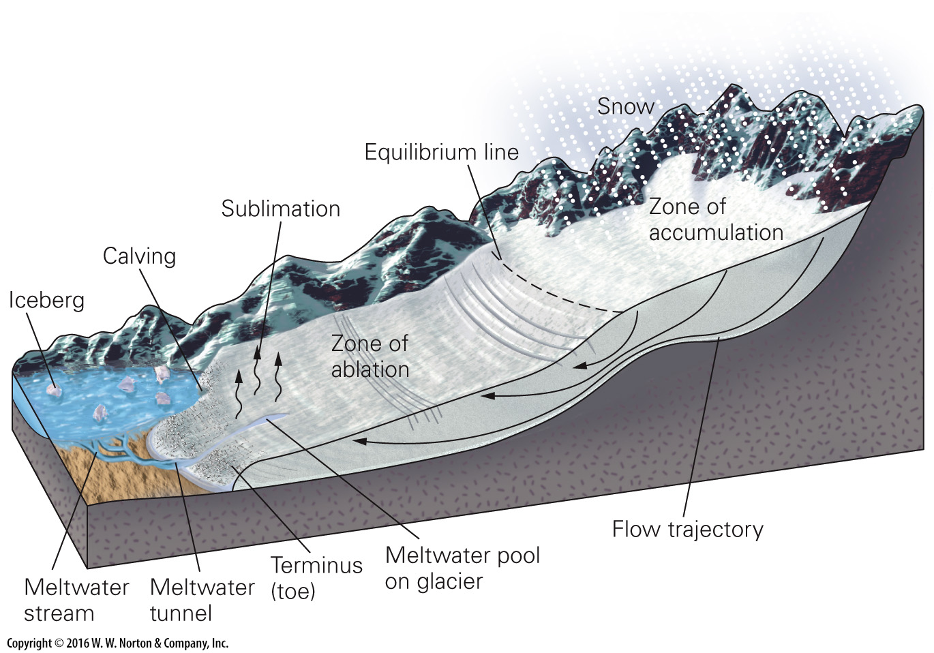
Notes:
FIGURE 18.7b Flow velocities vary with location in a glacier. Overall, ice flows from the zone of accumulation to the toe.
(b) The equilibrium line separates the zone of accumulation from the zone of ablation. As indicated by arrows, ice flows down in the zone of accumulation and up in the zone of ablation.

Slide 31
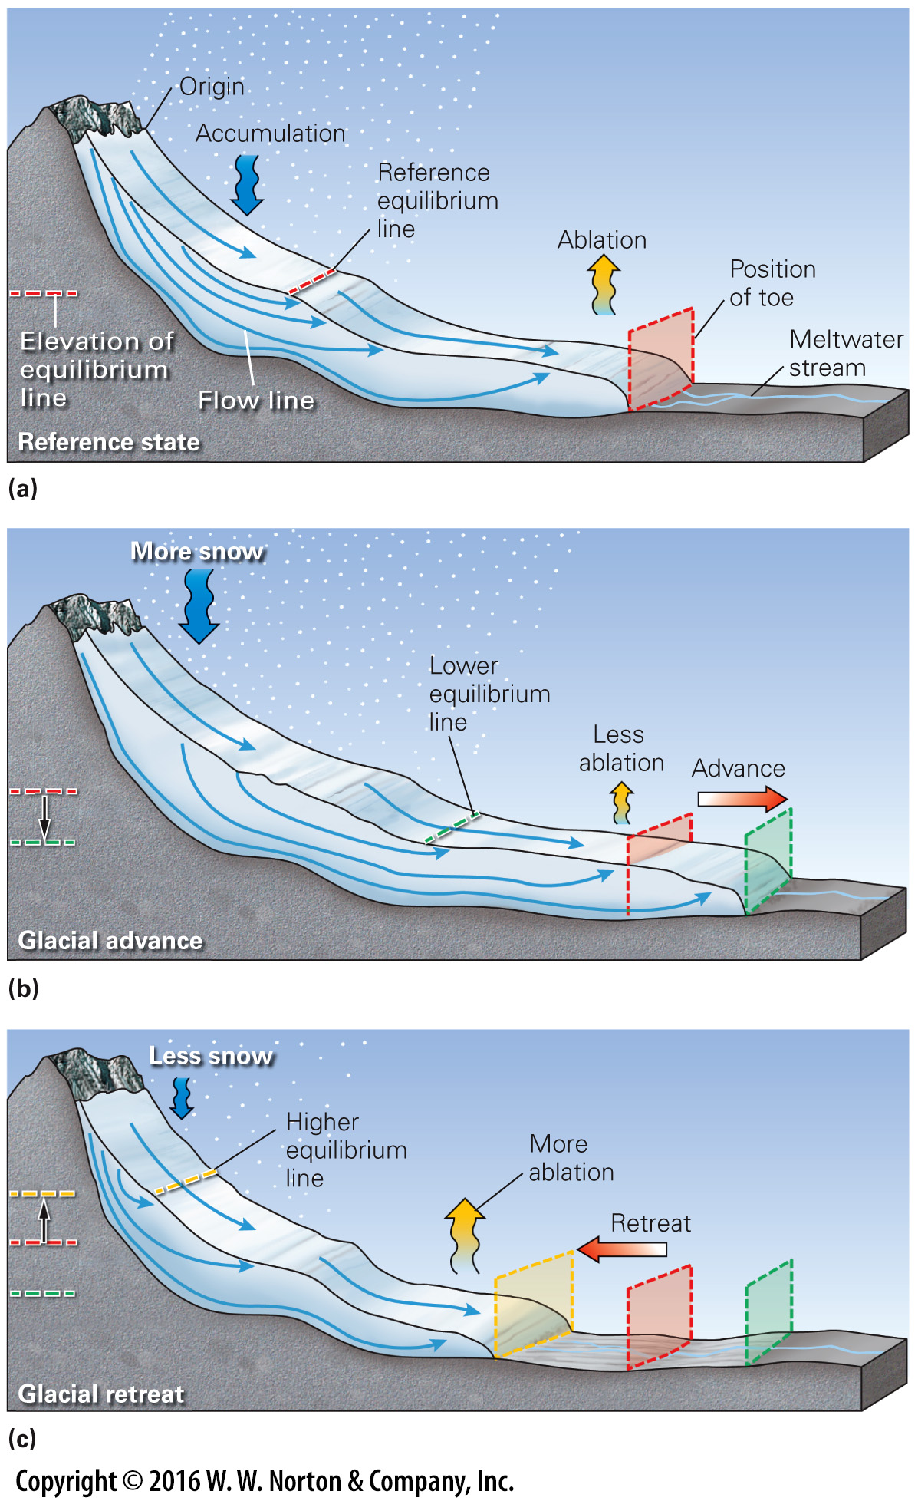
Notes:
FIGURE 18.8 Glacial advance and retreat.
(a) The position of the toe represents a balance between addition by accumulation and loss by ablation. (b) If accumulation exceeds ablation, the glacier advances, the toe moves farther from the origin, and the ice thickens. (c) If ablation exceeds accumulation, the glacier retreats and thins. The toe moves back, even though ice continues to flow toward the toe.

Slide 32
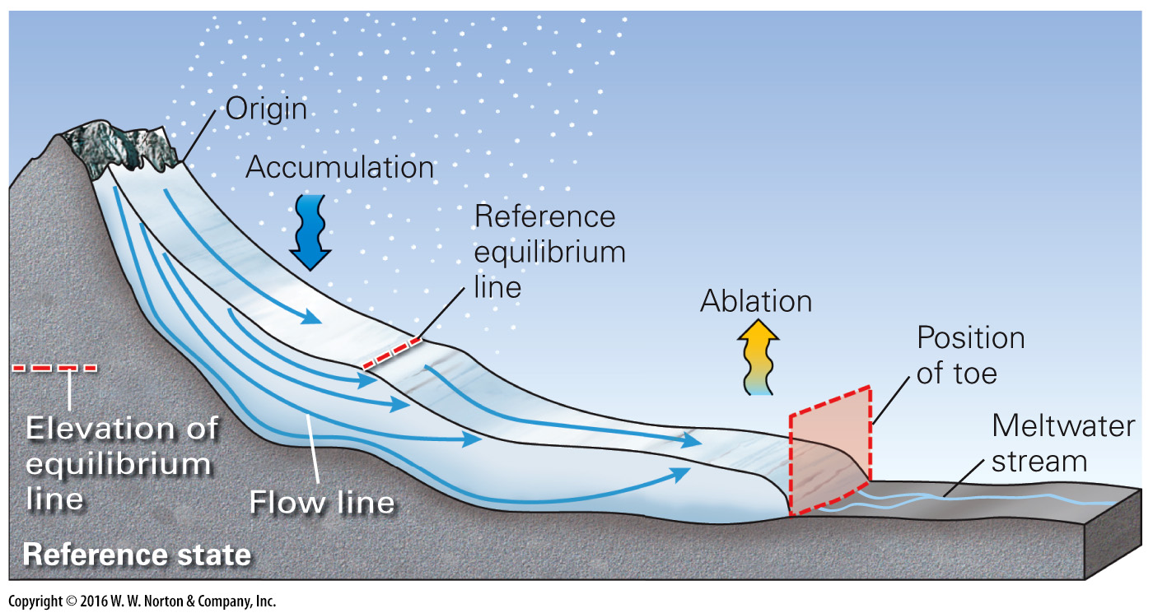
Notes:
FIGURE 18.8a Glacial advance and retreat.
(a) The position of the toe represents a balance between addition by accumulation and loss by ablation.

Slide 33
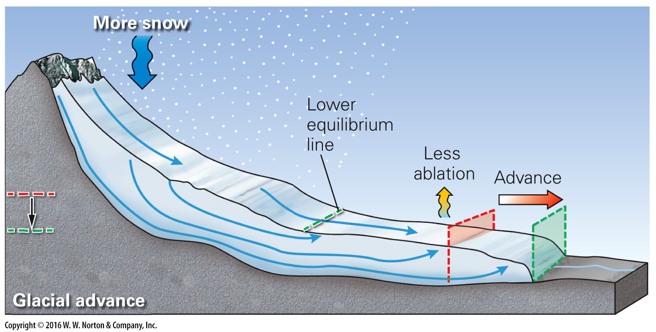
Notes:
FIGURE 18.8b Glacial advance and retreat.
(b) If accumulation exceeds ablation, the glacier advances, the toe moves farther from the origin, and the ice thickens.

Slide 34
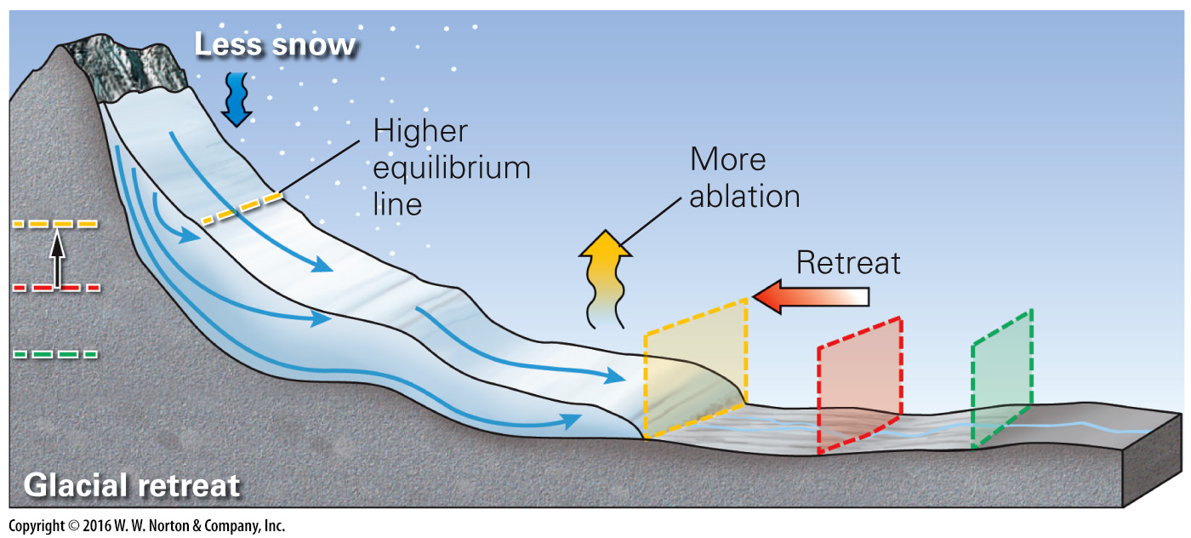
Notes:
FIGURE 18.8c Glacial advance and retreat.
(c) If ablation exceeds accumulation, the glacier retreats and thins. The toe moves back, even though ice continues to flow toward the toe.

Slide 35
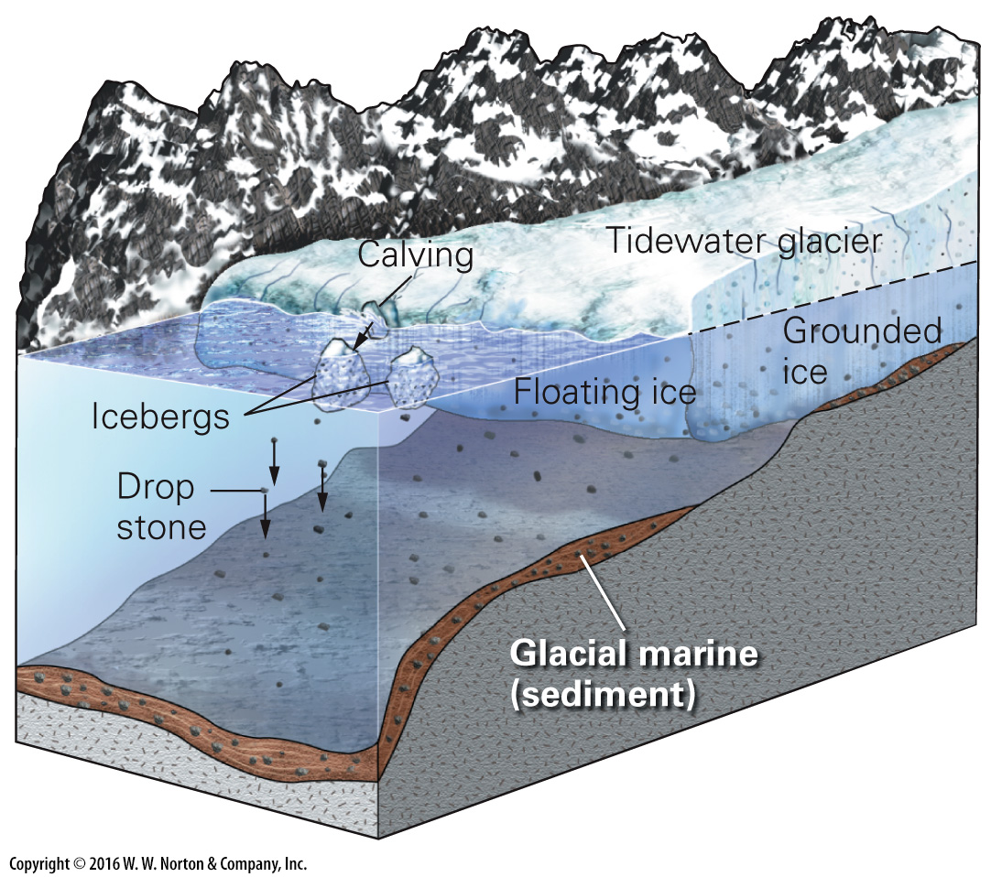
Notes:
FIGURE 18.9a Ice shelves, tidewater glaciers, and sea ice.
(a) Ice is grounded in shallow water but floats in deep water.

Slide 36
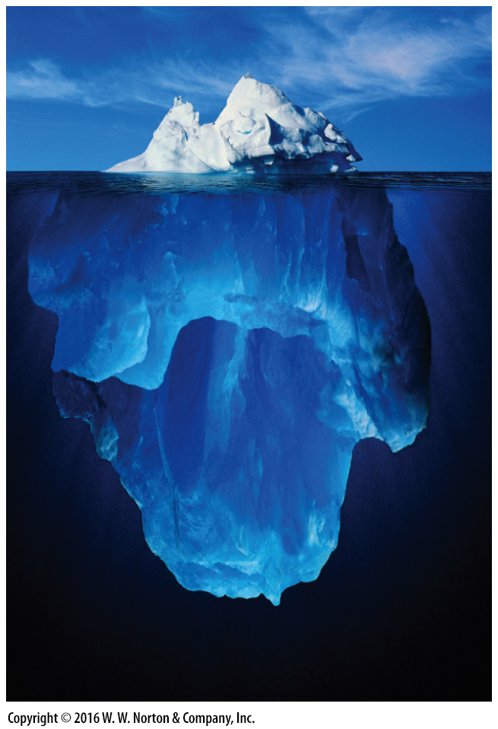
Notes:
FIGURE 18.9b Ice shelves, tidewater glaciers, and sea ice.
(b) This artist’s rendition of an iceberg emphasizes that most of the ice is underwater.

Slide 37
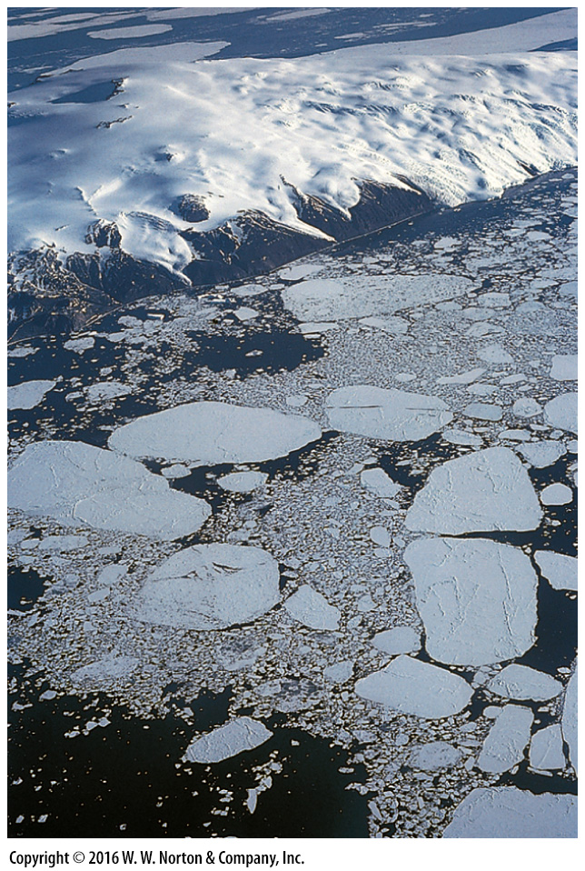
Notes:
FIGURE 18.9c Ice shelves, tidewater glaciers, and sea ice.
(c) In summer, some of the sea ice of Antarctica breaks up to form tabular icebergs.

Slide 38
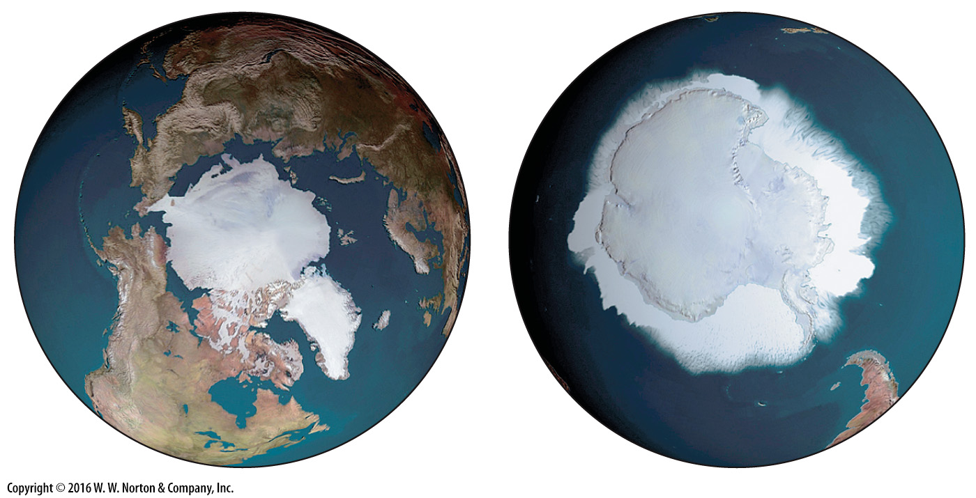
Notes:
FIGURE 18.9d Ice shelves, tidewater glaciers, and sea ice.
(d) Sea ice covers most of the Arctic Ocean (left) and surrounds Antarctica (right).

Slide 39
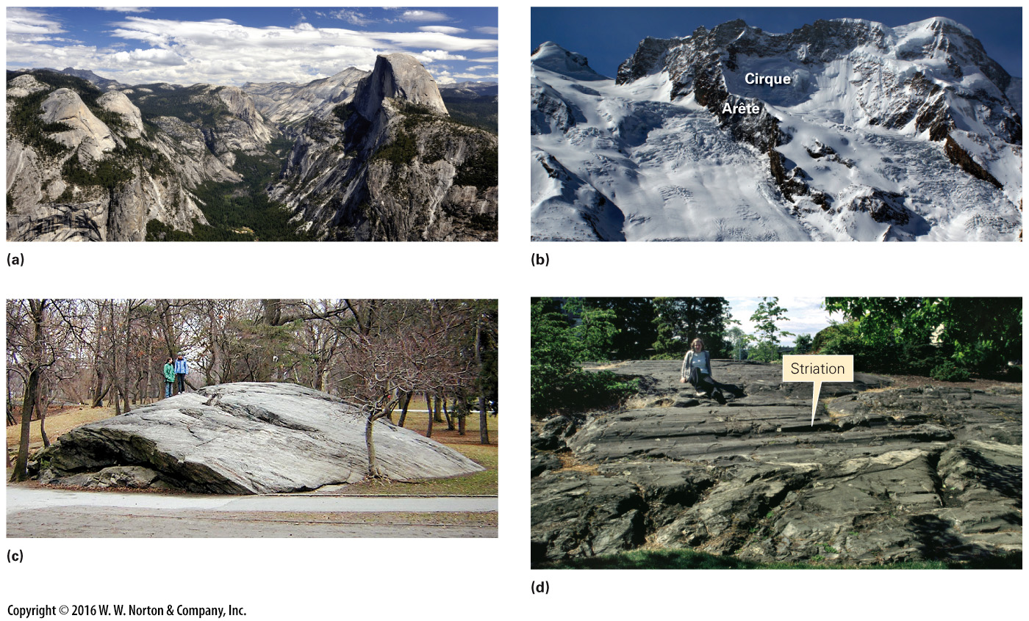
Notes:
FIGURE 18.10 Products of glacial erosion. Ice is a very aggressive agent of erosion.
(a) Half Dome in Yosemite National Park, California. (b) Examples of a cirque and an arête in the Swiss Alps. (c) Glacially polished outcrop in Central Park, New York City. (d) Glacial striations in Victoria, British Columbia.

Slide 40
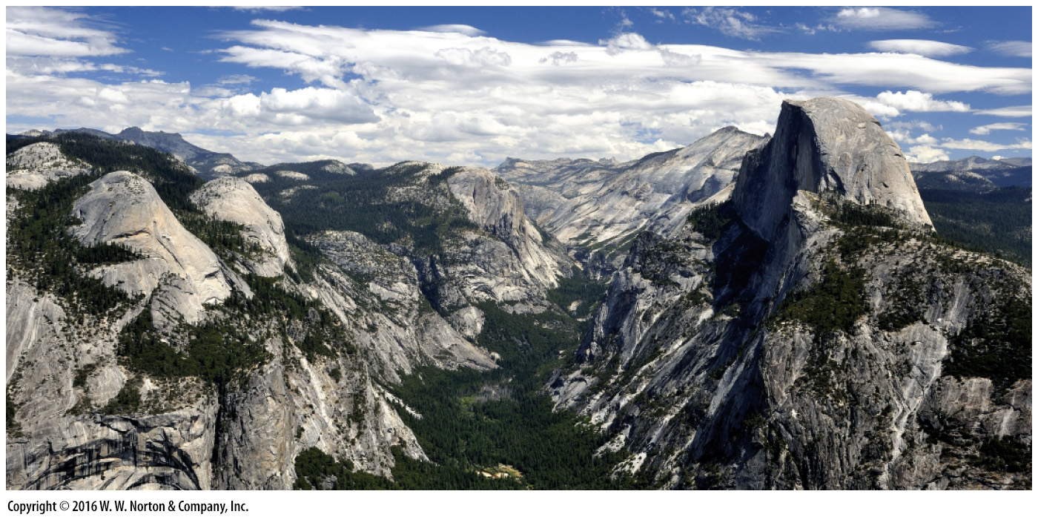
Notes:
FIGURE 18.10a Products of glacial erosion. Ice is a very aggressive agent of erosion.
(a) Half Dome in Yosemite National Park, California.

Slide 41
Notes:
FIGURE 18.10b Products of glacial erosion. Ice is a very aggressive agent of erosion.
(b) Examples of a cirque and an arête in the Swiss Alps.

Slide 42
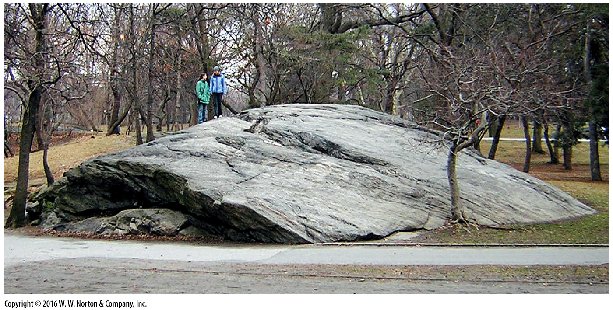
Notes:
FIGURE 18.10c Products of glacial erosion. Ice is a very aggressive agent of erosion.
(c) Glacially polished outcrop in Central Park, New York City.

Slide 43
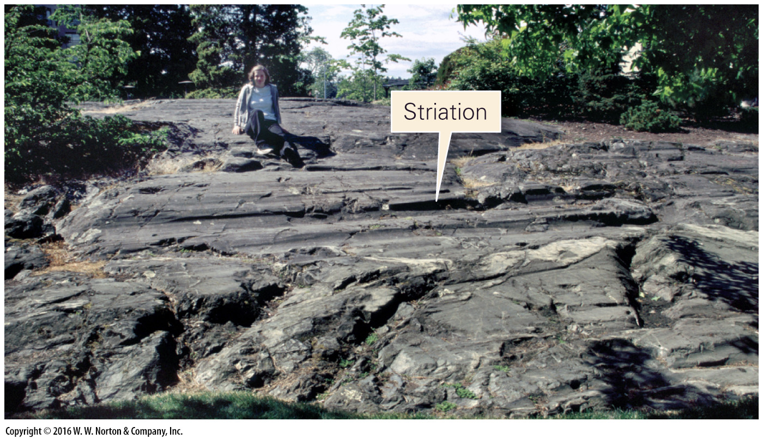
Notes:
FIGURE 18.10d Products of glacial erosion. Ice is a very aggressive agent of erosion.
(d) Glacial striations in Victoria, British Columbia.

Slide 44
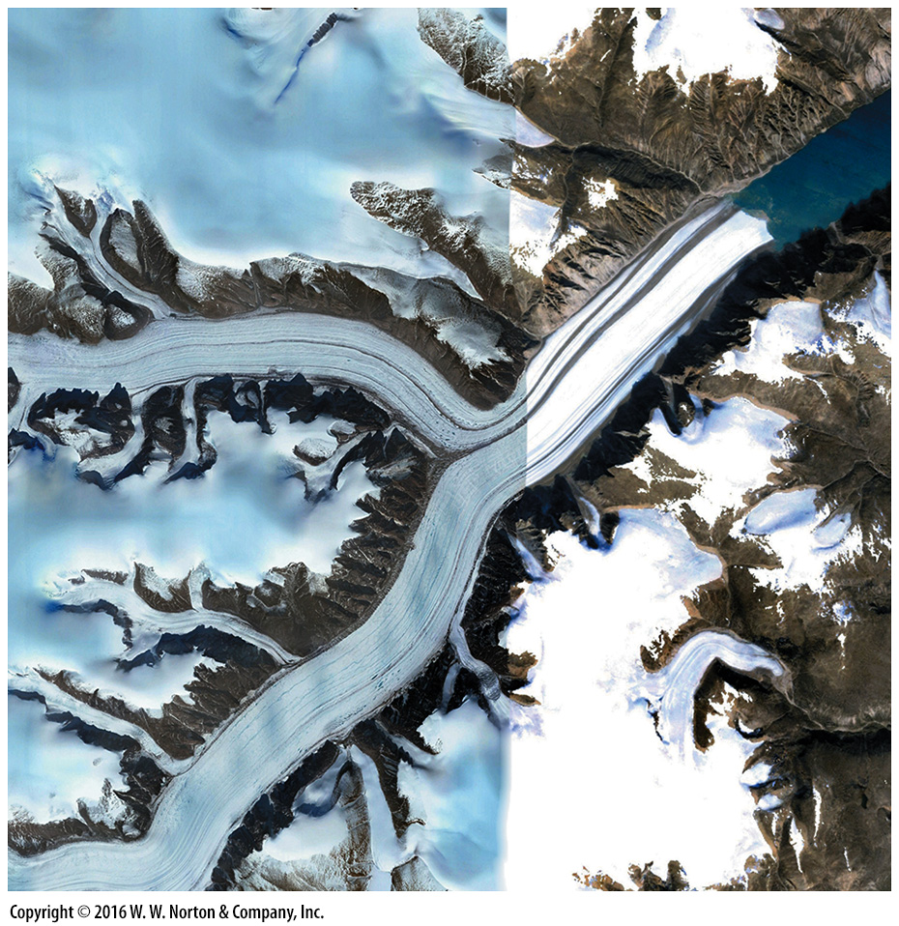
Notes:
SEE FOR YOURSELF…
BAFFIN ISLAND, CANADA

Slide 45
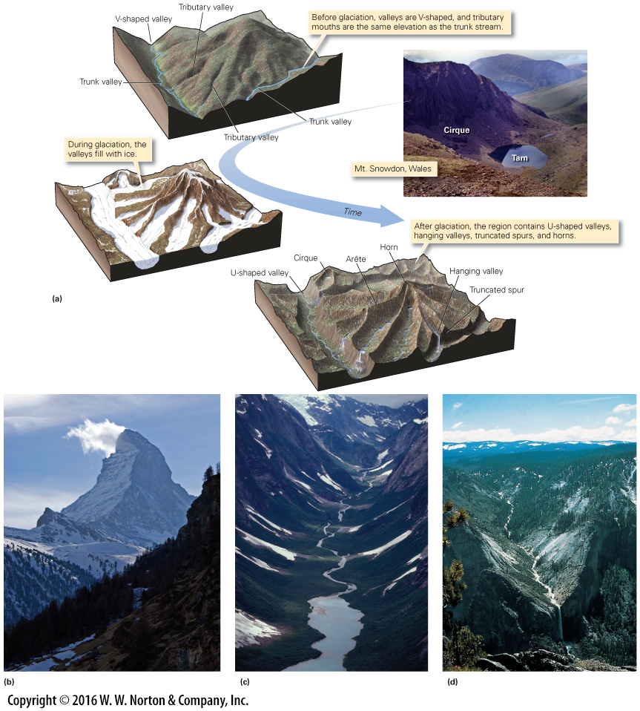
Notes:
FIGURE 18.11 Features formed by the glacial erosion of a mountainous landscape.
(a) Stages in the development of a glacially carved mountainous landscape. (b) The Matterhorn in Switzerland. The first ascent was in 1865. (c) A U-shaped glacial valley in the Tongass National Forest, Alaska. (d) A waterfall spilling out of a U-shaped hanging valley in the Sierra Nevada.

Slide 46
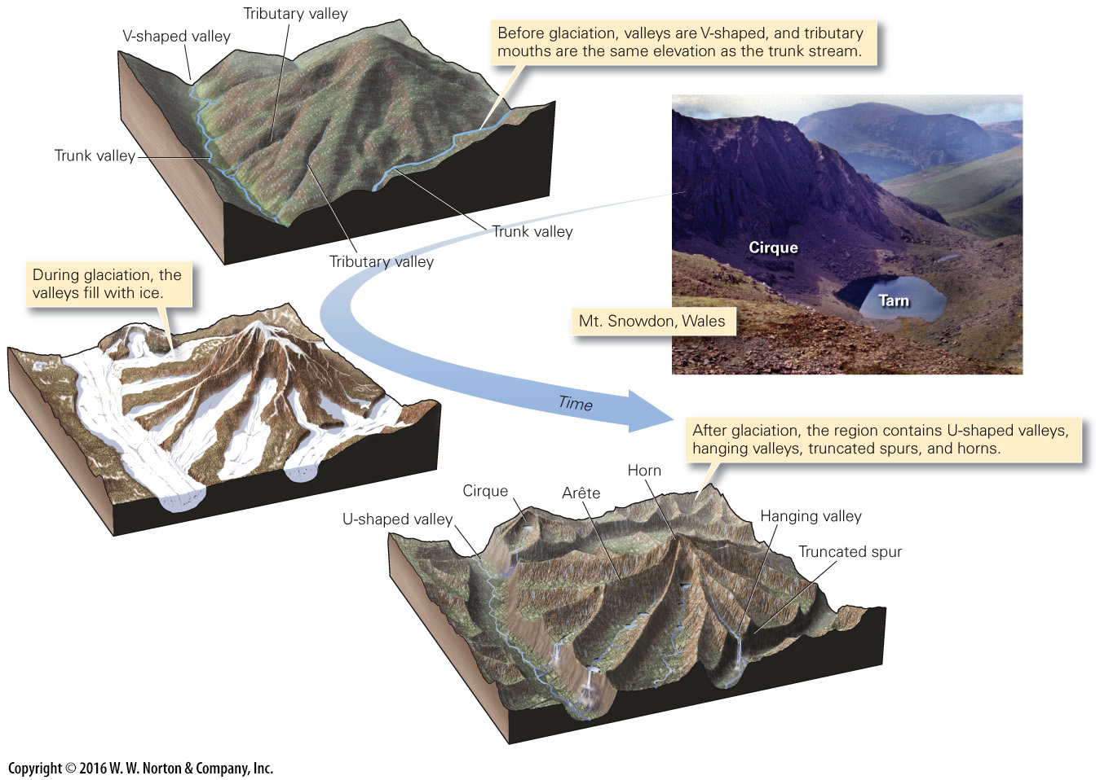
Notes:
FIGURE 18.11a Features formed by the glacial erosion of a mountainous landscape.
(a) Stages in the development of a glacially carved mountainous landscape.

Slide 47
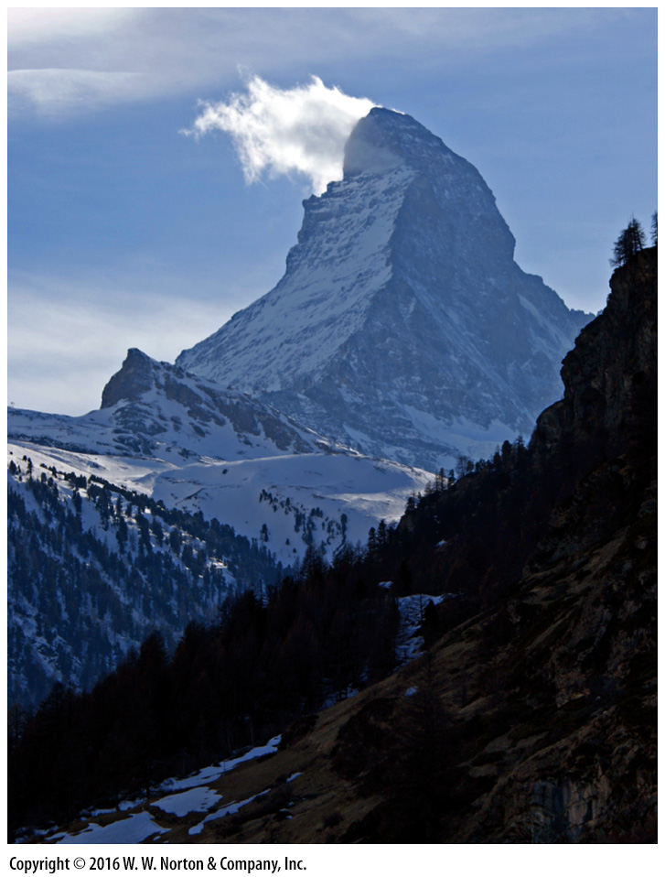
Notes:
FIGURE 18.11b Features formed by the glacial erosion of a mountainous landscape.
(b) The Matterhorn in Switzerland. The first ascent was in 1865.

Slide 48
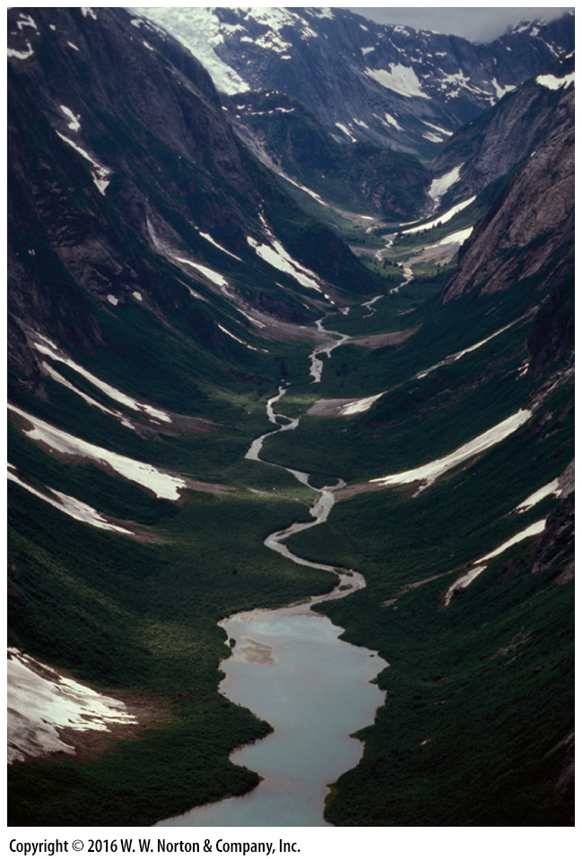
Notes:
FIGURE 18.11c Features formed by the glacial erosion of a mountainous landscape.
(c) A U-shaped glacial valley in the Tongass National Forest, Alaska.

Slide 49
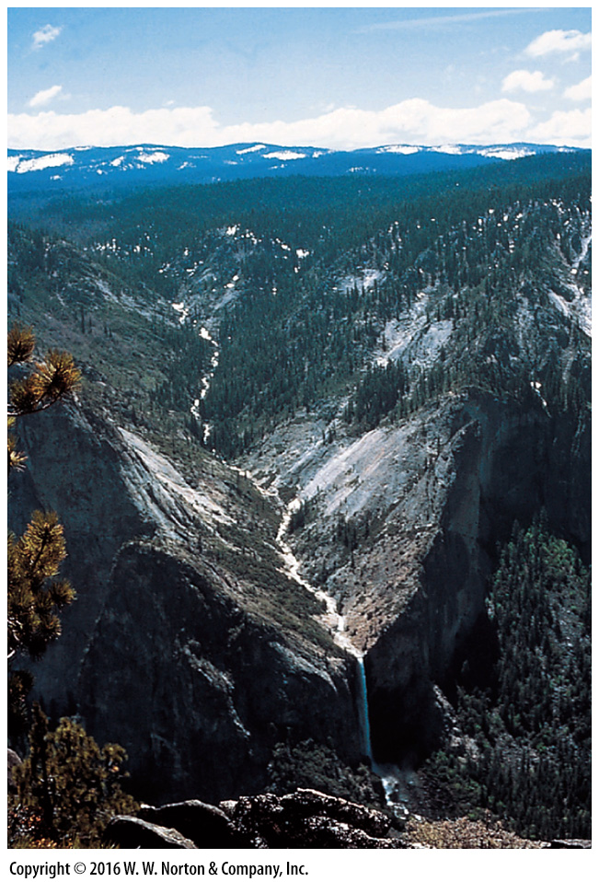
Notes:
FIGURE 18.11d Features formed by the glacial erosion of a mountainous landscape.
(d) A waterfall spilling out of a U-shaped hanging valley in the Sierra Nevada.

Slide 50
Notes:
FIGURE 18.12 A roche moutonnée is an asymmetric bedrock hill shaped by the flow of glacial ice.
(a) Abrasion rasps the upstream side, and plucking carries away fracture-bounded blocks on the downstream side. (b) An example of a roche moutonnée. The glacier flowed from right to left.

Slide 51
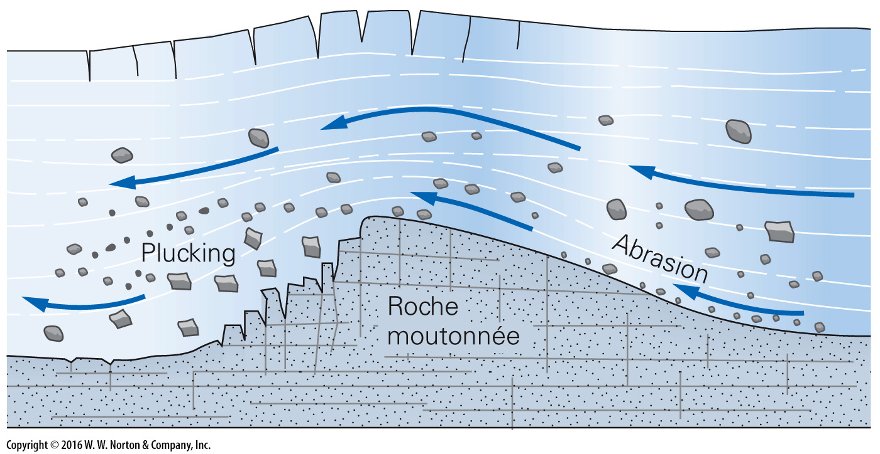
Notes:
FIGURE 18.12a A roche moutonnée is an asymmetric bedrock hill shaped by the flow of glacial ice.
(a) Abrasion rasps the upstream side, and plucking carries away fracture-bounded blocks on the downstream side.

Slide 52
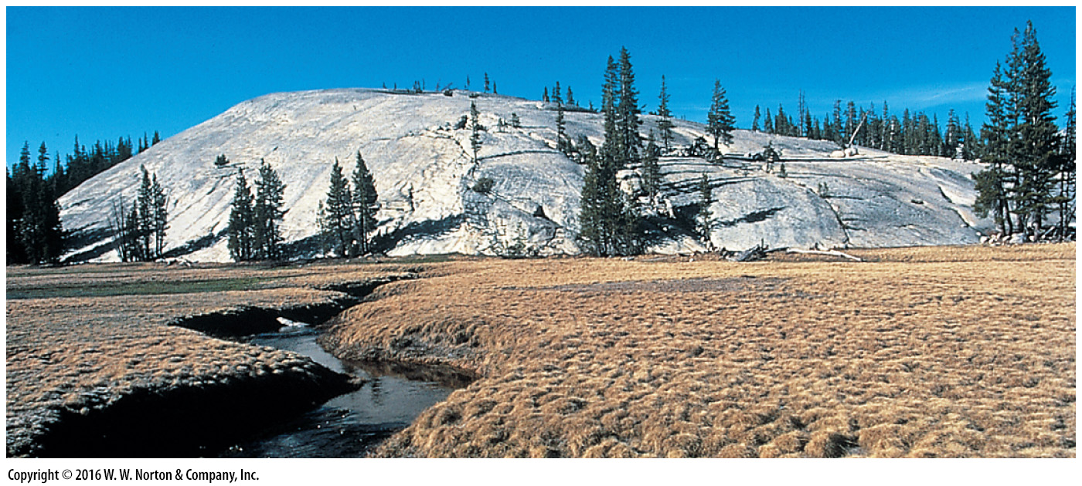
Notes:
FIGURE 18.12b A roche moutonnée is an asymmetric bedrock hill shaped by the flow of glacial ice.
(b) An example of a roche moutonnée. The glacier flowed from right to left.

Slide 53
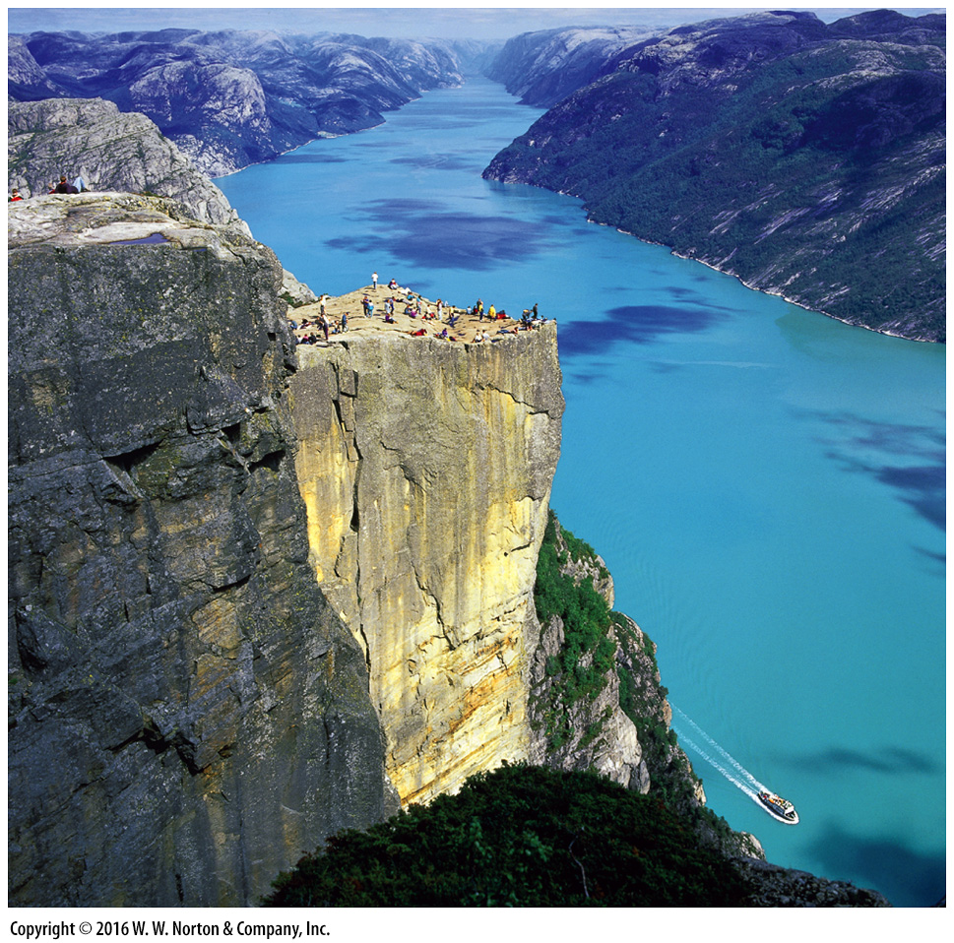
Notes:
FIGURE 18.13 One of the many spectacular fjords of Norway. The water is an arm of the sea that fills a glacially carved valley. Tourists are standing on Pulpit Rock (Prekestolen).

Slide 54
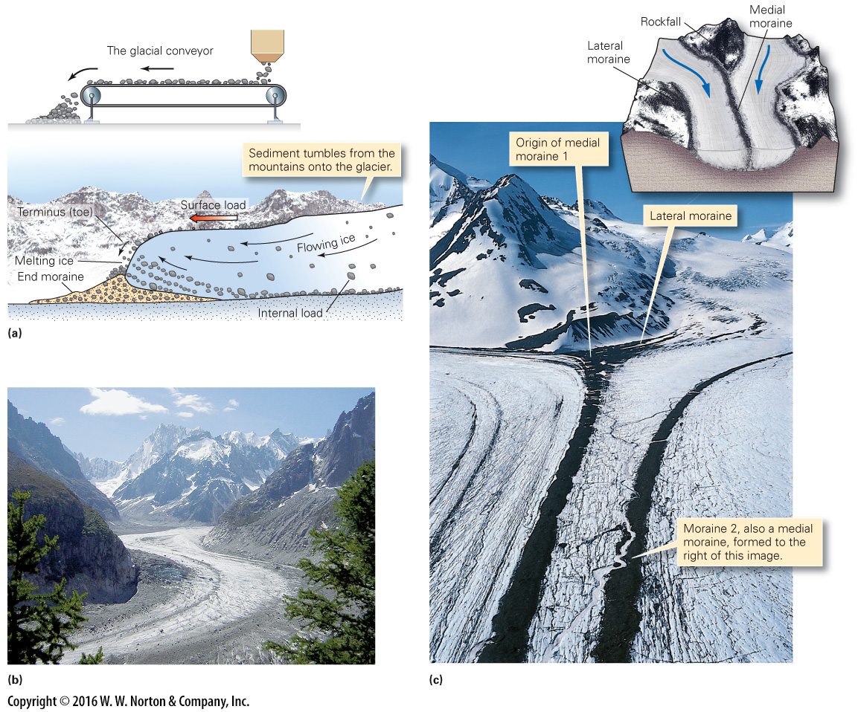
Notes:
FIGURE 18.14 The glacial conveyor and the formation of lateral and medial moraines on glaciers.
(a) Sediment falls on a glacier from bordering mountains and gets plucked up from below. Glaciers are like conveyor belts, moving sediment toward the toe of the glacier. (b) This glacier in the French Alps carries lots of sediment. (c) A medial moraine forms where lateral moraines of two valley glaciers merge.

Slide 55
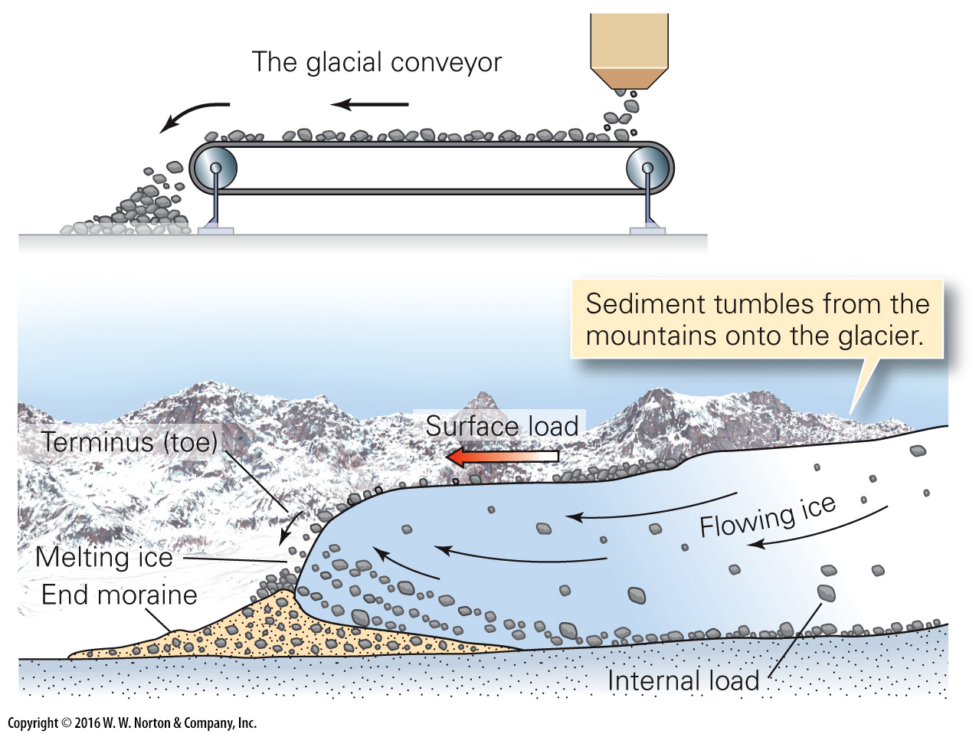
Notes:
FIGURE 18.14a The glacial conveyor and the formation of lateral and medial moraines on glaciers.
(a) Sediment falls on a glacier from bordering mountains and gets plucked up from below. Glaciers are like conveyor belts, moving sediment toward the toe of the glacier.

Slide 56
Notes:
FIGURE 18.14b The glacial conveyor and the formation of lateral and medial moraines on glaciers.
(b) This glacier in the French Alps carries lots of sediment.

Slide 57
Notes:
FIGURE 18.14c The glacial conveyor and the formation of lateral and medial moraines on glaciers.
(c) A medial moraine forms where lateral moraines of two valley glaciers merge.

Slide 58
Notes:
FIGURE 18.15 Sedimentation processes and products associated with glaciation. Glacial sediment is distinctive.
(a) This glacial till in Ireland is unsorted, because ice can carry sediment of all sizes. (b) Glacial erratics resting on a glacially polished surface in Wyoming. (c) Braided streams choked with glacial outwash in Alaska. The streams carry away finer sediment and leave the gravel behind. (d) Thick loess deposits underlie parts of the prairie in Illinois. (e) In the quiet water of an Alaskan glacial lake, fine-grained sediments accumulate. Alternating layers in the sediment (varves), now exposed in an outcrop near Puget Sound, Washington, reflect seasonal changes.

Slide 59
Notes:
FIGURE 18.15a Sedimentation processes and products associated with glaciation. Glacial sediment is distinctive.
(a) This glacial till in Ireland is unsorted, because ice can carry sediment of all sizes.

Slide 60
Notes:
FIGURE 18.15b Sedimentation processes and products associated with glaciation. Glacial sediment is distinctive.
(b) Glacial erratics resting on a glacially polished surface in Wyoming.

Slide 61
Notes:
FIGURE 18.15c Sedimentation processes and products associated with glaciation. Glacial sediment is distinctive.
(c) Braided streams choked with glacial outwash in Alaska. The streams carry away finer sediment and leave the gravel behind.

Slide 62
Notes:
FIGURE 18.15d Sedimentation processes and products associated with glaciation. Glacial sediment is distinctive.
(d) Thick loess deposits underlie parts of the prairie in Illinois.

Slide 63
Notes:
FIGURE 18.15e Sedimentation processes and products associated with glaciation. Glacial sediment is distinctive.
(e) In the quiet water of an Alaskan glacial lake, fine-grained sediments accumulate. Alternating layers in the sediment (varves), now exposed in an outcrop near Puget Sound, Washington, reflect seasonal changes.

Slide 64
Notes:
FIGURE 18.16 The formation of depositional landforms associated with continental glaciation.
(a) The ice in continental glaciers flows toward the toe; sediment accumulates at the base and at the toe of the ice sheet. (b) Several distinct depositional landforms form during glaciation; some developed under the ice and some at the toe. (c) Cape Cod, Long Island, and other landforms in the northeastern United States formed at the end of the continental ice sheet.

Slide 65
Notes:
FIGURE 18.16ab The formation of depositional landforms associated with continental glaciation.
(a) The ice in continental glaciers flows toward the toe; sediment accumulates at the base and at the toe of the ice sheet. (b) Several distinct depositional landforms form during glaciation; some developed under the ice and some at the toe.

Slide 66
Notes:
FIGURE 18.16c The formation of depositional landforms associated with continental glaciation.
(c) Cape Cod, Long Island, and other landforms in the northeastern United States formed at the end of the continental ice sheet.

Slide 67
Notes:
FIGURE 18.17 Drumlins and knob-and-kettle topography characterize some areas that were once glaciated.
(a) Ice blocks calve off glaciers and become buried by sediment. When the ice melts, a kettle forms. (b) If the water table is high, kettles fill with water and turn into roughly circular lakes. (c) Knob-and-kettle topography make the surface of this moraine in Yellowstone Park, Wyoming, very hummocky. (d) The formation of a drumlin beneath a glacier. (e) Drumlins dominate this landscape near Rochester, New York.

Slide 68
Notes:
FIGURE 18.17ab Drumlins and knob-and-kettle topography characterize some areas that were once glaciated.
(a) Ice blocks calve off glaciers and become buried by sediment. When the ice melts, a kettle forms. (b) If the water table is high, kettles fill with water and turn into roughly circular lakes.

Slide 69
Notes:
FIGURE 18.17c Drumlins and knob-and-kettle topography characterize some areas that were once glaciated.
(c) Knob-and-kettle topography make the surface of this moraine in Yellowstone Park, Wyoming, very hummocky.

Slide 70
Notes:
FIGURE 18.17d Drumlins and knob-and-kettle topography characterize some areas that were once glaciated.
(d) The formation of a drumlin beneath a glacier.

Slide 71
Notes:
FIGURE 18.17e Drumlins and knob-and-kettle topography characterize some areas that were once glaciated.
(e) Drumlins dominate this landscape near Rochester, New York.

Slide 72
Notes:
GEOLOGY AT A GLANCE
Glaciers and Glacial Landforms

Slide 73
Notes:
FIGURE 18.18 Eskers are snake-like ridges of sand and gravel that form when sediment fills meltwater tunnels at the base of a glacier.
(a) At the time of formation, an esker develops beneath an ice sheet. In cross section (inset), wedges of sand accumulate in the tunnel. (b) An example of an esker in an area once glaciated but now farmed.

Slide 74
Notes:
FIGURE 18.18a Eskers are snake-like ridges of sand and gravel that form when sediment fills meltwater tunnels at the base of a glacier.
(a) At the time of formation, an esker develops beneath an ice sheet. In cross section (inset), wedges of sand accumulate in the tunnel.

Slide 75
Notes:
FIGURE 18.18b Eskers are snake-like ridges of sand and gravel that form when sediment fills meltwater tunnels at the base of a glacier.
(b) An example of an esker in an area once glaciated but now farmed.

Slide 76
Notes:
FIGURE 18.19 The concept of subsidence and rebound due to continental glaciation and deglaciation.

Slide 77
Notes:
FIGURE 18.20 The link between sea level and global glaciation: glaciers store water on land, so when glaciers grow, sea level falls, and when glaciers melt, sea level rises.
(a) The red line shows the coastline during the last ice age; much of the continental shelf was dry. If present-day ice sheets melt, coastal lands will flood. (b) Prehistoric people migrated across the Bering Strait land bridge. (c) Sea-level rise between 17,000 and 7,000 B.C.E. was due to the melting of ice-age glaciers.

Slide 78
Notes:
FIGURE 18.20a The link between sea level and global glaciation: glaciers store water on land, so when glaciers grow, sea level falls, and when glaciers melt, sea level rises.
(a) The red line shows the coastline during the last ice age; much of the continental shelf was dry. If present-day ice sheets melt, coastal lands will flood.

Slide 79
Notes:
FIGURE 18.20b The link between sea level and global glaciation: glaciers store water on land, so when glaciers grow, sea level falls, and when glaciers melt, sea level rises.
(b) Prehistoric people migrated across the Bering Strait land bridge.

Slide 80
Notes:
FIGURE 18.20c The link between sea level and global glaciation: glaciers store water on land, so when glaciers grow, sea level falls, and when glaciers melt, sea level rises.
(c) Sea-level rise between 17,000 and 7,000 B.C.E. was due to the melting of ice-age glaciers.

Slide 81
Notes:
FIGURE 18.21 Ice-age lakes in North America.
(a) Glacial Lake Agassiz was an ice-margin lake that formed near the end of the last ice age. (b) Pluvial lakes occurred throughout the Basin and Range Province during the last ice age due to the wetter climate. The largest of these was Lake Bonneville. Subtle horizontal terraces define the remnants of beaches, now over 100 m above the present level of the Great Salt Lake.

Slide 82
Notes:
FIGURE 18.21a Ice-age lakes in North America.
(a) Glacial Lake Agassiz was an ice-margin lake that formed near the end of the last ice age.

Slide 83
Notes:
FIGURE 18.21b Ice-age lakes in North America.
(b) Pluvial lakes occurred throughout the Basin and Range Province during the last ice age due to the wetter climate. The largest of these was Lake Bonneville. Subtle horizontal terraces define the remnants of beaches, now over 100 m above the present level of the Great Salt Lake.

Slide 84
Notes:
FIGURE 18.22 Periglacial regions are not ice covered but do include substantial areas of permafrost.
(a) The distribution of periglacial environments in North America. (b) An example of patterned ground near a pond in Manitoba, Canada.

Slide 85
Notes:
FIGURE 18.22a Periglacial regions are not ice covered but do include substantial areas of permafrost.
(a) The distribution of periglacial environments in North America.

Slide 86
Notes:
FIGURE 18.22b Periglacial regions are not ice covered but do include substantial areas of permafrost.
(b) An example of patterned ground near a pond in Manitoba, Canada.

Slide 87
Notes:
FIGURE 18.23 Pleistocene ice sheets of the northern hemisphere.

Slide 88
Notes:
FIGURE 18.24 Climate belts during the Pleistocene.
(a) Tundra covered parts of the United States, and southern states had forests like those in New England today. (b) Regions of Europe that support large populations today would have been barren tundra during the Pleistocene. (c) Cold-adapted large mammals, now extinct, roamed regions that are now temperate.

Slide 89
Notes:
FIGURE 18.24a Climate belts during the Pleistocene.
(a) Tundra covered parts of the United States, and southern states had forests like those in New England today.

Slide 90
Notes:
FIGURE 18.24b Climate belts during the Pleistocene.
(b) Regions of Europe that support large populations today would have been barren tundra during the Pleistocene.

Slide 91
Notes:
FIGURE 18.24d Climate belts during the Pleistocene.
(c) Cold-adapted large mammals, now extinct, roamed regions that are now temperate.

Slide 92
Notes:
FIGURE 18.25 Pleistocene glacial deposits in the north-central United States. Curving moraines reflect the shape of glacial lobes.

Slide 93
Notes:
FIGURE 18.26 The timing of glaciations. Ice ages have occurred at several times in the geologic past.
(a) Oxygen–isotope ratios from marine sediment define 20 to 30 glaciations in the Pleistocene. Tan bands represent traditional glacial stages of the midwestern United States. (b) The Pleistocene is not the only ice-age time in Earth history. Glacial events happened in colder intervals of earlier eras, too.

Slide 94
Notes:
FIGURE 18.27 Milankovitch cycles influence the amount of insolation received at high latitudes.
(a) Variations caused by changes in orbital shape. (b) Variations caused by changes in axis tilt. (c) Variations caused by the precession of Earth's axis. (d) Combining the effects of eccentricity, tilt, and precession produces distinct periods of more or less insolation.

Slide 95
Notes:
FIGURE 18.27a Milankovitch cycles influence the amount of insolation received at high latitudes.
(a) Variations caused by changes in orbital shape.

Slide 96
Notes:
FIGURE 18.27b Milankovitch cycles influence the amount of insolation received at high latitudes.
(b) Variations caused by changes in axis tilt.

Slide 97
Notes:
FIGURE 18.27c Milankovitch cycles influence the amount of insolation received at high latitudes.
(c) Variations caused by the precession of Earth's axis.

Slide 98
Notes:
FIGURE 18.27d Milankovitch cycles influence the amount of insolation received at high latitudes.
(d) Combining the effects of eccentricity, tilt, and precession produces distinct periods of more or less insolation.

Slide 99
Notes:
FIGURE 18.28 Until recently, Earth’s atmosphere has been gradually cooling, overall, since the Cretaceous.

Slide 100
Notes:
FIGURE 18.29 The Little Ice Age and its demise. Glaciers that advanced between 1550 and 1850 have since retreated.
(a) A model of global temperature for the past 2,000 years. Overall trends display the Medieval Warm Period followed by the Little Ice Age. Since 1850, temperatures have warmed. (b) Skaters (ca. 1600) on the frozen canals of the Netherlands during the Little Ice Age. (c) During the Little Ice Age, a glacier filled this valley. In this 2003 photo, most of the glacier has vanished. Most of the retreat has happened in the last century.

Slide 101
Notes:
FIGURE 18.29a The Little Ice Age and its demise. Glaciers that advanced between 1550 and 1850 have since retreated.
(a) A model of global temperature for the past 2,000 years. Overall trends display the Medieval Warm Period followed by the Little Ice Age. Since 1850, temperatures have warmed.

Slide 102
Notes:
FIGURE 18.29b The Little Ice Age and its demise. Glaciers that advanced between 1550 and 1850 have since retreated.
(b) Skaters (ca. 1600) on the frozen canals of the Netherlands during the Little Ice Age.

Slide 103
Notes:
FIGURE 18.29c The Little Ice Age and its demise. Glaciers that advanced between 1550 and 1850 have since retreated.
(c) During the Little Ice Age, a glacier filled this valley. In this 2003 photo, most of the glacier has vanished. Most of the retreat has happened in the last century.

Slide 104
Notes:
FIGURE 18.30 Greenland’s melting glaciers. Melting has accelerated in the last few decades.
(a) Lakes of meltwater accumulate on the surface of the ice sheet during the summer. (b) Lakes suddenly drain through cracks that carry the water to the base of the glacier, 1 km down. Addition of liquid water to the base allows the glacier to move faster, causing a ”surge.“ (c) Where glaciers meet the sea, huge masses calve off and crash into the water. This is happening so fast that the ice front is retreating. (d) The melting area has increased dramatically in recent years.

Slide 105
Notes:
FIGURE 18.30a Greenland’s melting glaciers. Melting has accelerated in the last few decades.
(a) Lakes of meltwater accumulate on the surface of the ice sheet during the summer.

Slide 106
Notes:
FIGURE 18.30b Greenland’s melting glaciers. Melting has accelerated in the last few decades.
(b) Lakes suddenly drain through cracks that carry the water to the base of the glacier, 1 km down. Addition of liquid water to the base allows the glacier to move faster, causing a ”surge.“

Slide 107
Notes:
FIGURE 18.30c Greenland’s melting glaciers. Melting has accelerated in the last few decades.
(c) Where glaciers meet the sea, huge masses calve off and crash into the water. This is happening so fast that the ice front is retreating.

Slide 108
Notes:
FIGURE 18.30d Greenland’s melting glaciers. Melting has accelerated in the last few decades.
(d) The melting area has increased dramatically in recent years.

Slide 109
Notes:
Another View This mountainous landscape of southern Alaska, as viewed from an airplane, was carved by glaciers. We can see several cirques and arêtes. The view includes several valley glaciers, each cut by crevices, which look like dark gashes cut into the ice.

