Slide 1
Stephen Marshak
ESSENTIALS OF
Geology
FIFTH EDITION
Chapter 19
Global Change in the Earth System
©2016 W. W. Norton & Company, Inc.

Slide 2
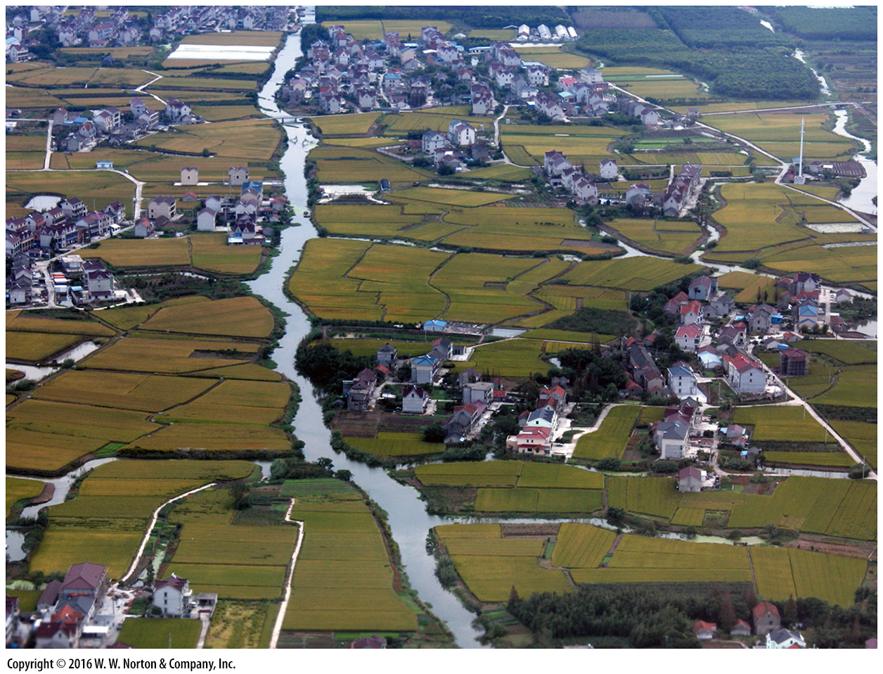
Notes:
Rice paddies and villages cover the countryside near Shanghai, China. The landscape here would have looked vastly different before the arrival of humanity. Land-use change affects many aspects of the Earth System.

Slide 3
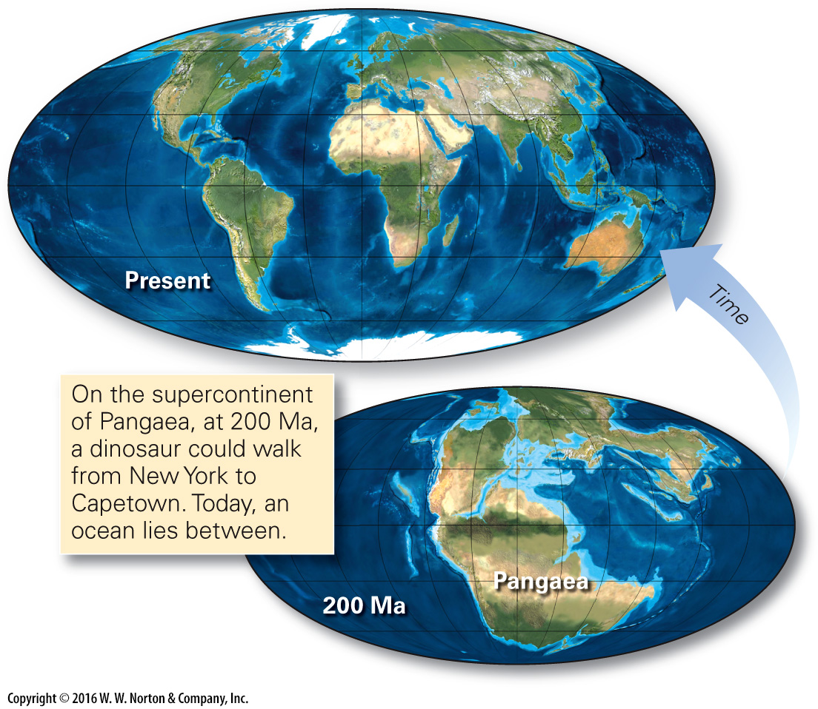
Notes:
FIGURE 19.1 The map of Earth’s surface changes over time because of plate motions.

Slide 4
Notes:
FIGURE 19.2 A popular model attributes the formation of the Moon to a collision with a planetesimal.

Slide 5
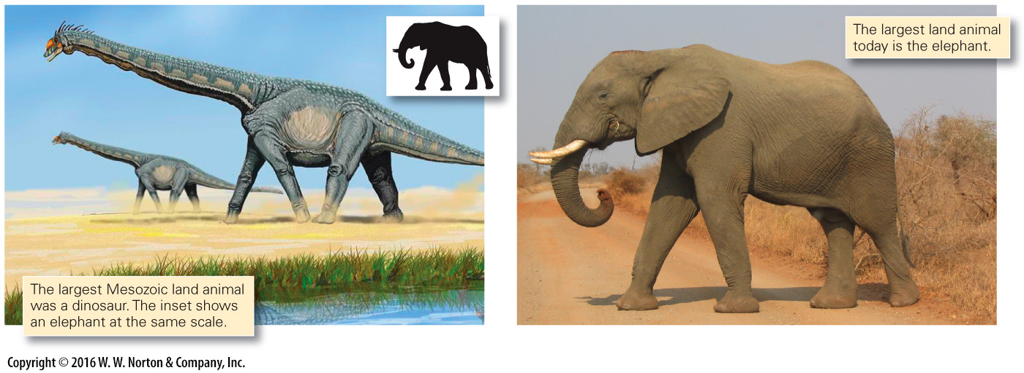
Notes:
FIGURE 19.3 Because of evolution, organisms inhabiting the Earth today are not the same as those that inhabited the planet in the past.

Slide 6
Notes:
FIGURE 19.3 Because of evolution, organisms inhabiting the Earth today are not the same as those that inhabited the planet in the past.

Slide 7
Notes:
FIGURE 19.3 Because of evolution, organisms inhabiting the Earth today are not the same as those that inhabited the planet in the past.

Slide 8
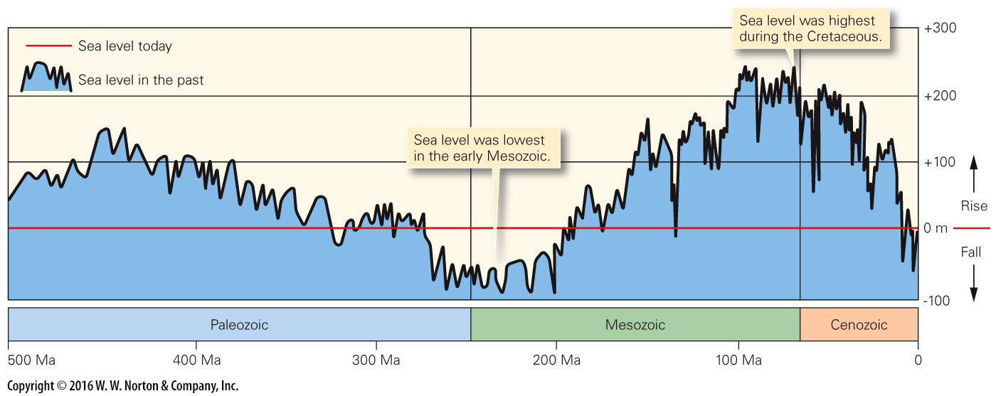
Notes:
FIGURE 19.4 This chart provides one interpretation of sea-level change during the past half billion years, based on the stratigraphic record.

Slide 9
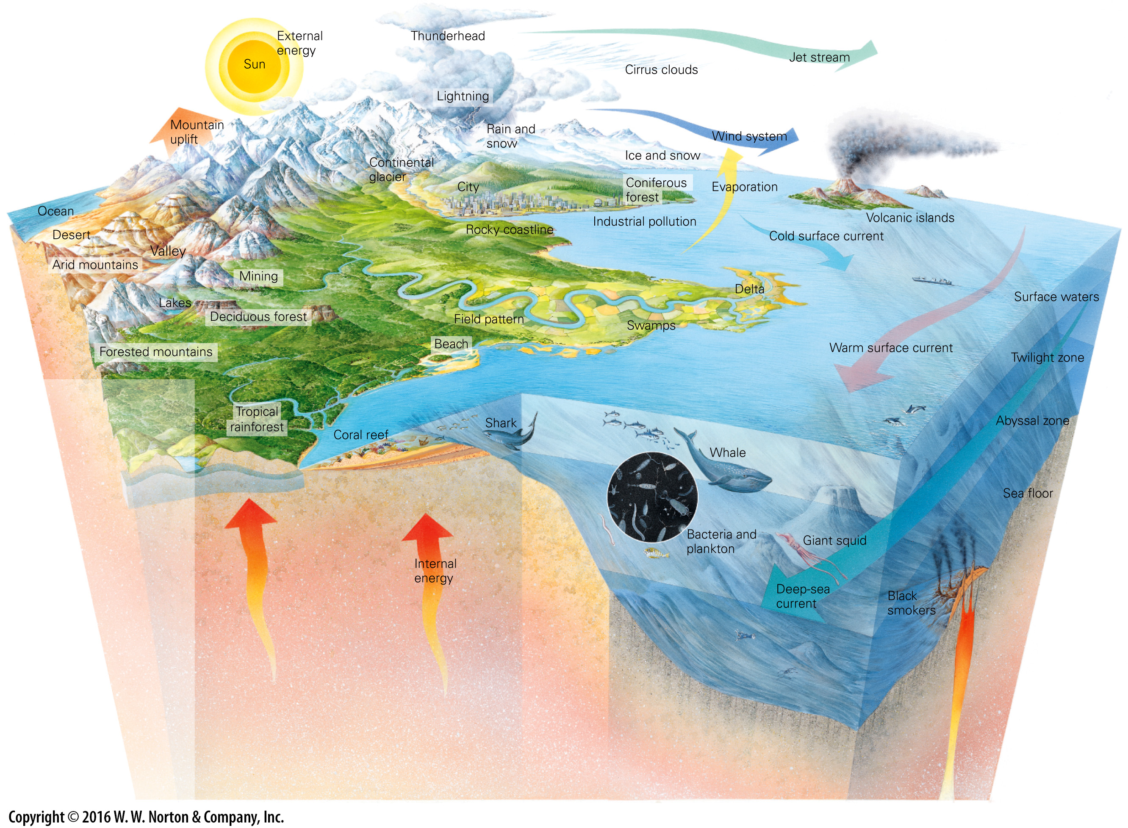
Notes:
GEOLOGY AT A GLANCE
The Earth System

Slide 10
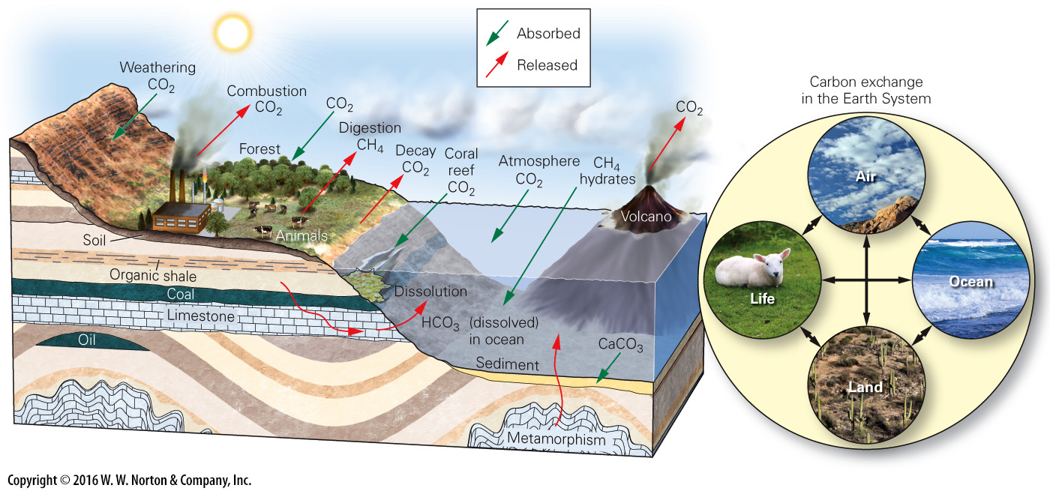
Notes:
FIGURE 19.5 In the carbon cycle, carbon transfers among various reservoirs at or near the Earth’s surface. Red arrows indicate release to the air, and green arrows indicate absorption from air.

Slide 11
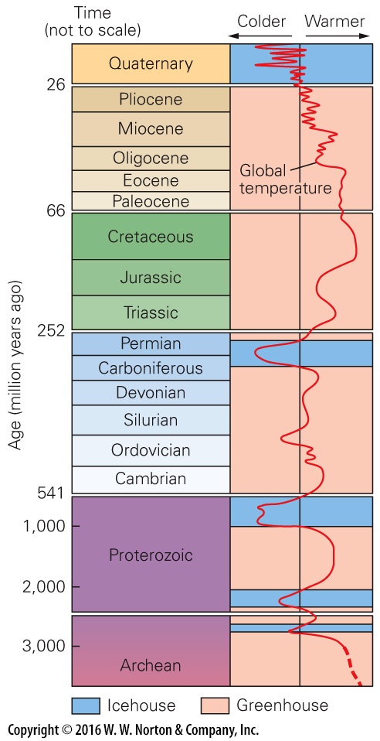
Notes:
FIGURE 19.6 The Earth has experienced icehouse and greenhouse periods at various times during Earth history.

Slide 12
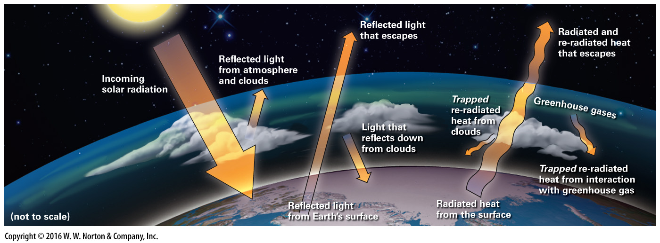
Notes:
FIGURE Bx19.1 The greenhouse effect shows how thermal energy can be trapped in the atmosphere.

Slide 13
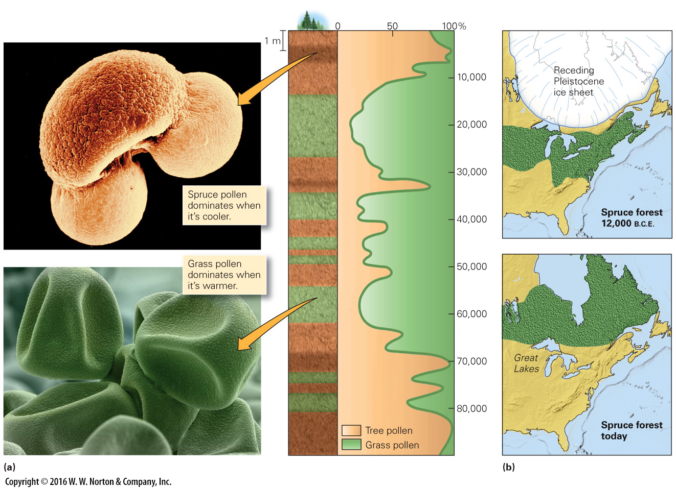
Notes:
FIGURE 19.7 Changes in the assemblage of pollen in sediment indicate a shift in climate belts.
(a) The proportion of tree pollen relative to grass pollen can change in a sedimentary sequence through time. Researchers plot changes in the proportion of pollen types over time by examining samples from a column of sediment. (b) Spruce forests (green) grew farther south 10,000 years ago than they do today.

Slide 14
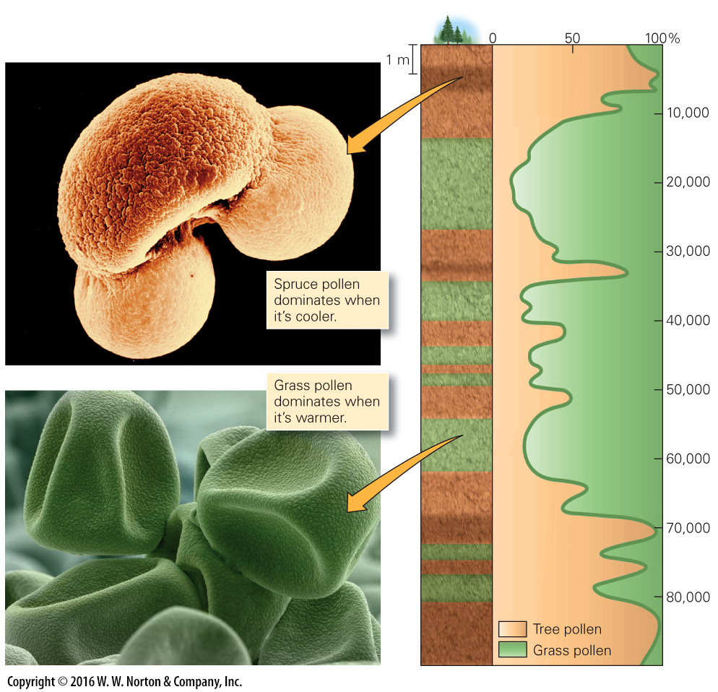
Notes:
FIGURE 19.7a Changes in the assemblage of pollen in sediment indicate a shift in climate belts.
(a) The proportion of tree pollen relative to grass pollen can change in a sedimentary sequence through time. Researchers plot changes in the proportion of pollen types over time by examining samples from a column of sediment.

Slide 15
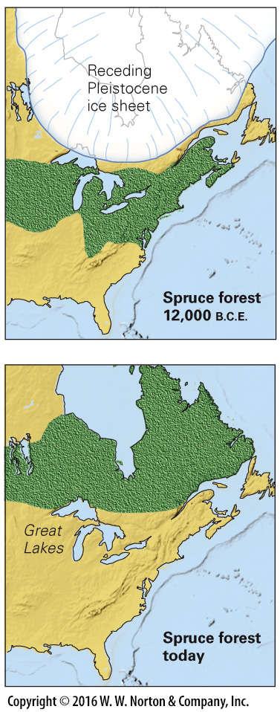
Notes:
FIGURE 19.7b Changes in the assemblage of pollen in sediment indicate a shift in climate belts.
(b) Spruce forests (green) grew farther south 10,000 years ago than they do today.

Slide 16
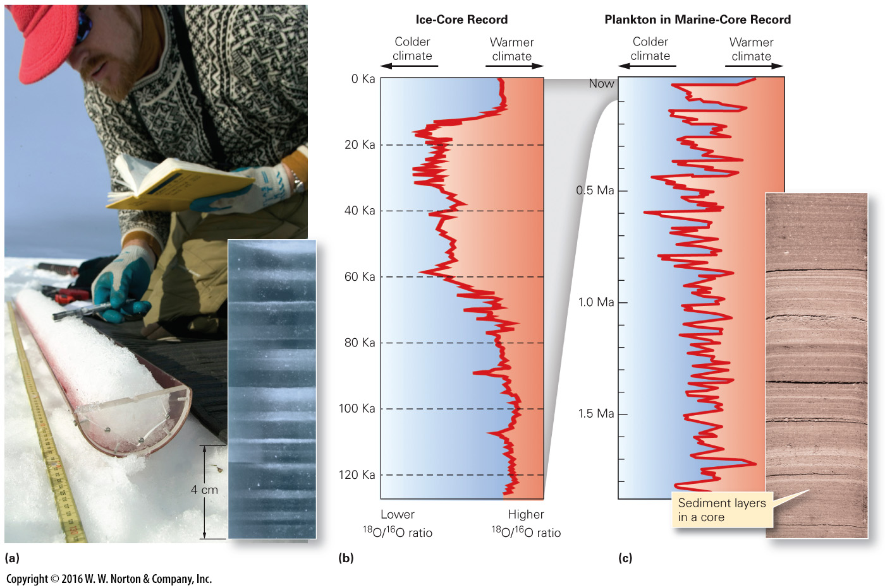
Notes:
FIGURE 19.8 The proportion of isotopes transferred between reservoirs during evaporation or precipitation depends on temperature. The ¹⁸O/¹⁶O ratio can be studied in glacial ice (H₂O) and fossil shells (CaCO₃).
(a) A researcher examines an ice core in the field. Lab photos reveal annual layers. (b) The ¹⁸O/16O ratios in an ice core represent temperature changes. (c) Studies of ¹⁸O/¹⁶O ratios in deep-sea cores also provide a climate record.

Slide 17
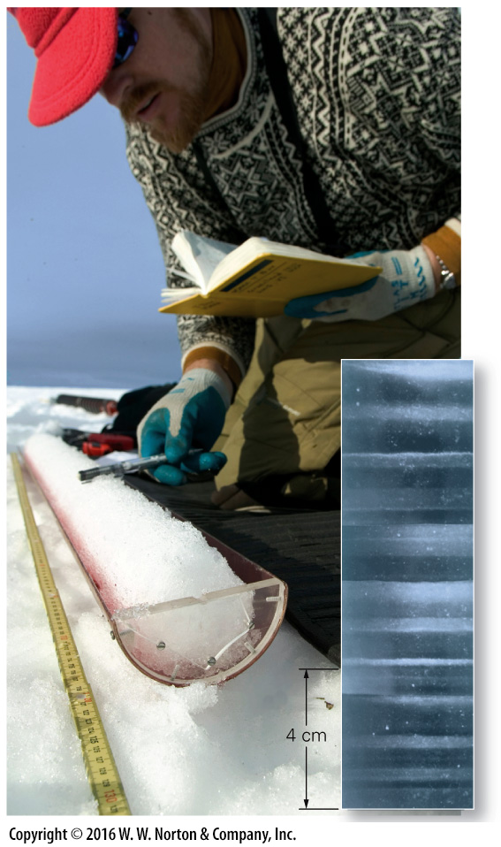
Notes:
FIGURE 19.8a The proportion of isotopes transferred between reservoirs during evaporation or precipitation depends on temperature. The ¹⁸O/¹⁶O ratio can be studied in glacial ice (H₂O) and fossil shells (CaCO₃).
(a) A researcher examines an ice core in the field. Lab photos reveal annual layers.

Slide 18
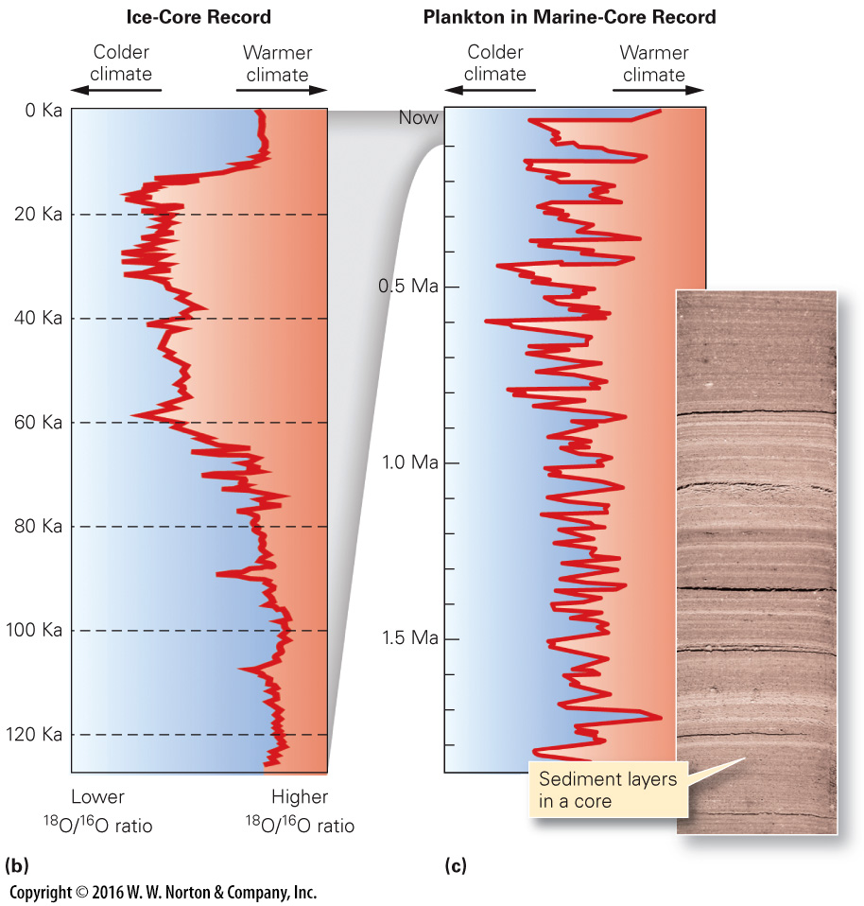
Notes:
FIGURE 19.8b The proportion of isotopes transferred between reservoirs during evaporation or precipitation depends on temperature. The ¹⁸O/¹⁶O ratio can be studied in glacial ice (H₂O) and fossil shells (CaCO₃).
(b) The ¹⁸O/16O ratios in an ice core represent temperature changes. (c) Studies of ¹⁸O/¹⁶O ratios in deep-sea cores also provide a climate record.

Slide 19
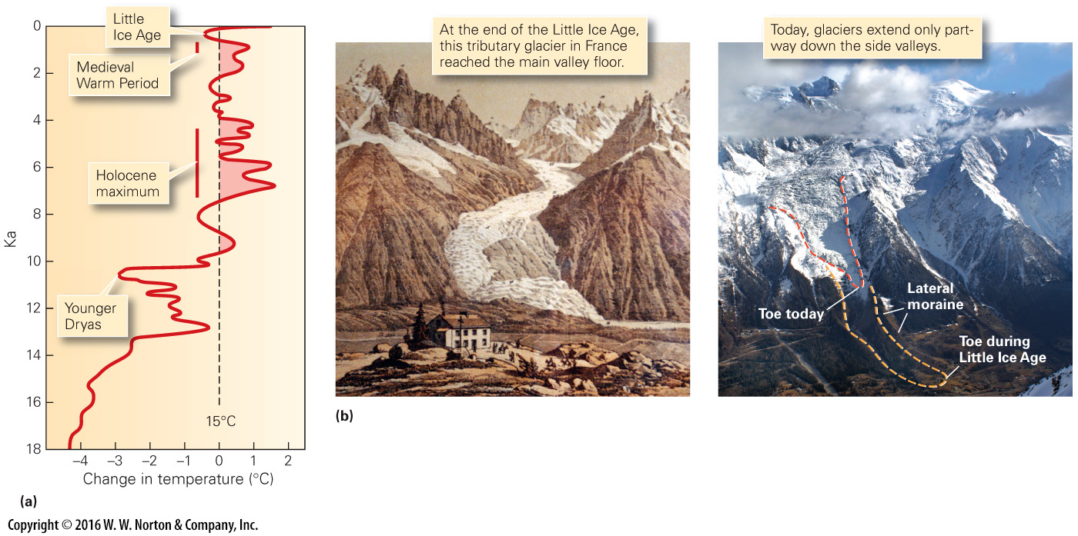
Notes:
FIGURE 19.9 Climate during the Holocene. Measurements suggest that temperature has varied significantly.
(a) There were several temperature highs and lows during the Holocene. (b) Glaciers advanced in Europe during the Little Ice Age, but have since been retreating due to warmer temperatures.

Slide 20
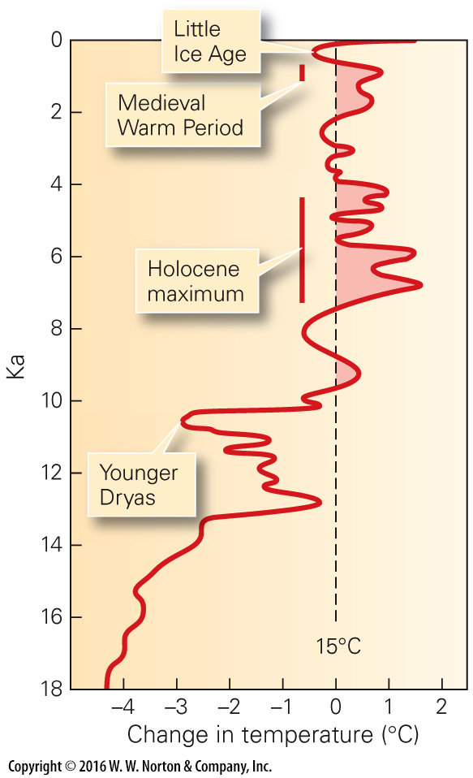
Notes:
FIGURE 19.9a Climate during the Holocene. Measurements suggest that temperature has varied significantly.
(a) There were several temperature highs and lows during the Holocene.

Slide 21
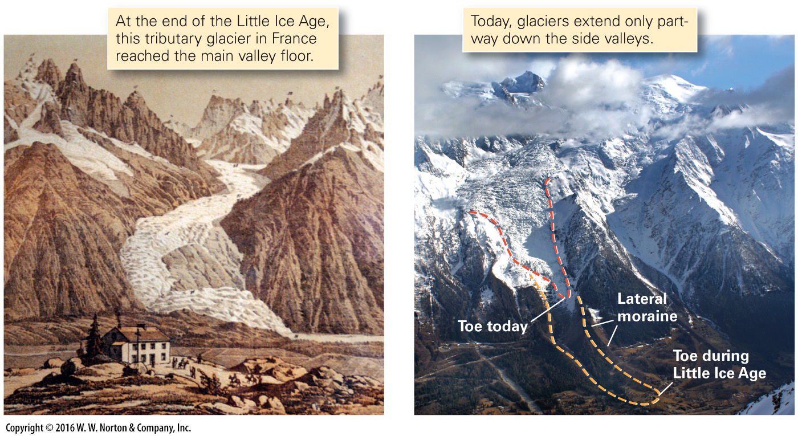
Notes:
FIGURE 19.9b Climate during the Holocene. Measurements suggest that temperature has varied significantly.
(b) Glaciers advanced in Europe during the Little Ice Age, but have since been retreating due to warmer temperatures.

Slide 22
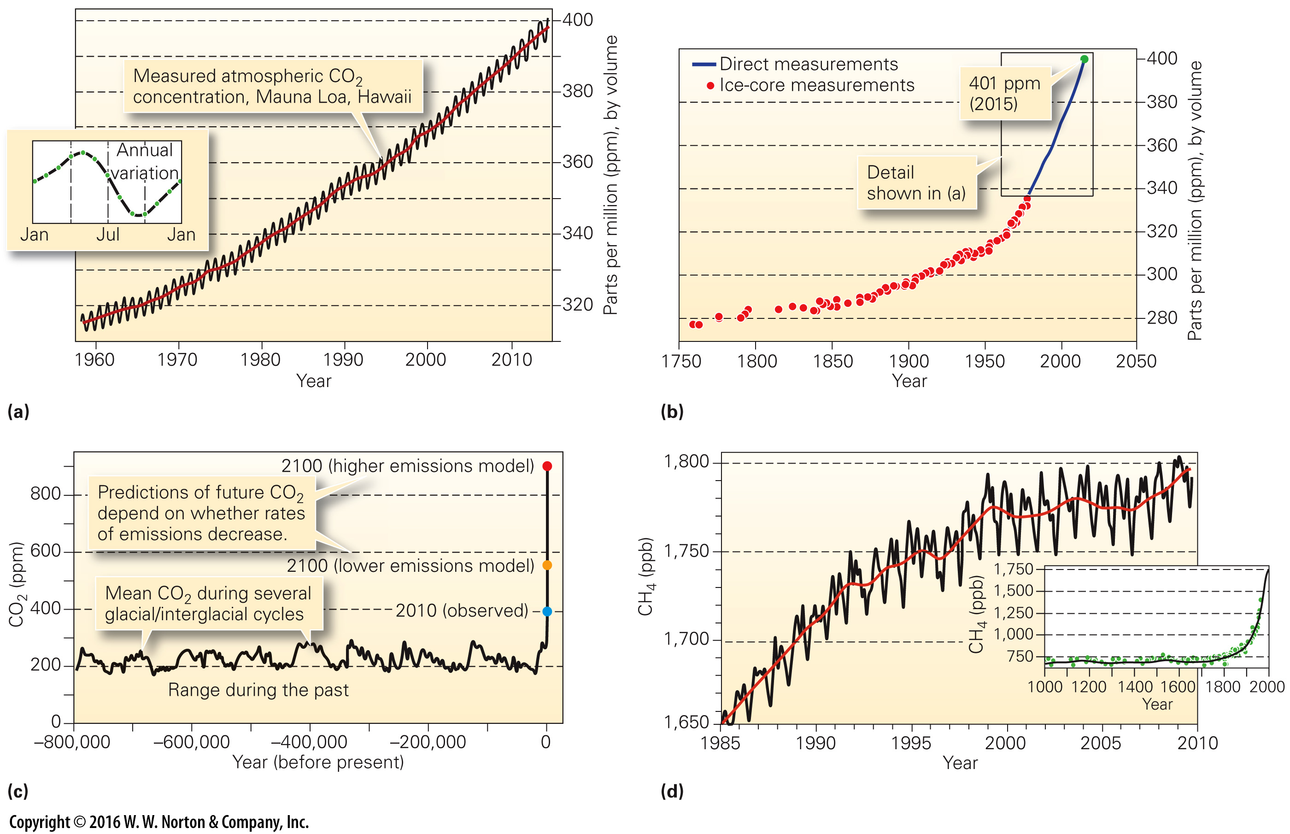
Notes:
FIGURE 19.10 Changes in carbon dioxide (CO₂) and methane (CH₄) concentrations over time.
(a) Monthly measurements begin in 1960. There is an annual cycle, related to seasons, but the overall increase is clear. (b) Since the industrial revolution, CO₂ concentration has steadily increased. (c) Based on ice-core studies in glaciers, researchers find that CO₂ concentration varied between 180 and 300 ppm throughout glacial advances and retreats. The current value, 401 ppm, is above this range. (d) Methane, another greenhouse gas, has been increasing, too. The inset shows change over the past millennium.

Slide 23
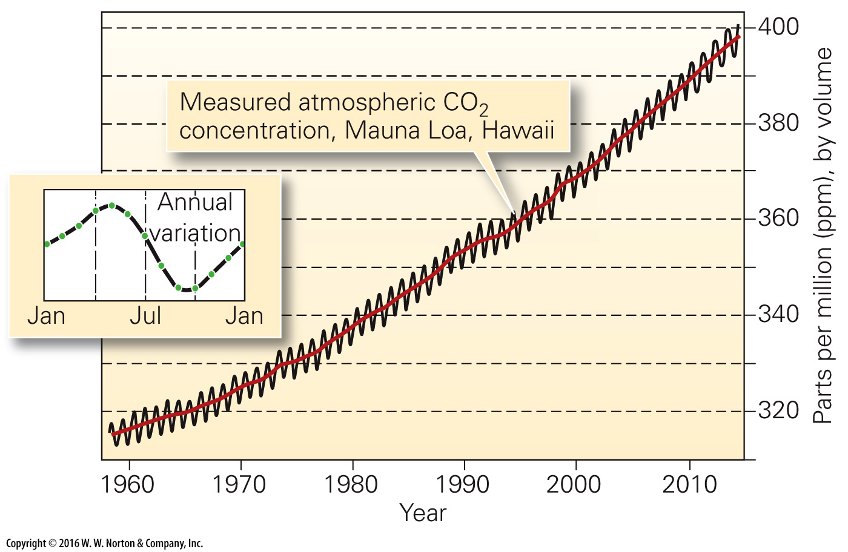
Notes:
FIGURE 19.10a Changes in carbon dioxide (CO₂) and methane (CH₄) concentrations over time.
(a) Monthly measurements begin in 1960. There is an annual cycle, related to seasons, but the overall increase is clear.

Slide 24
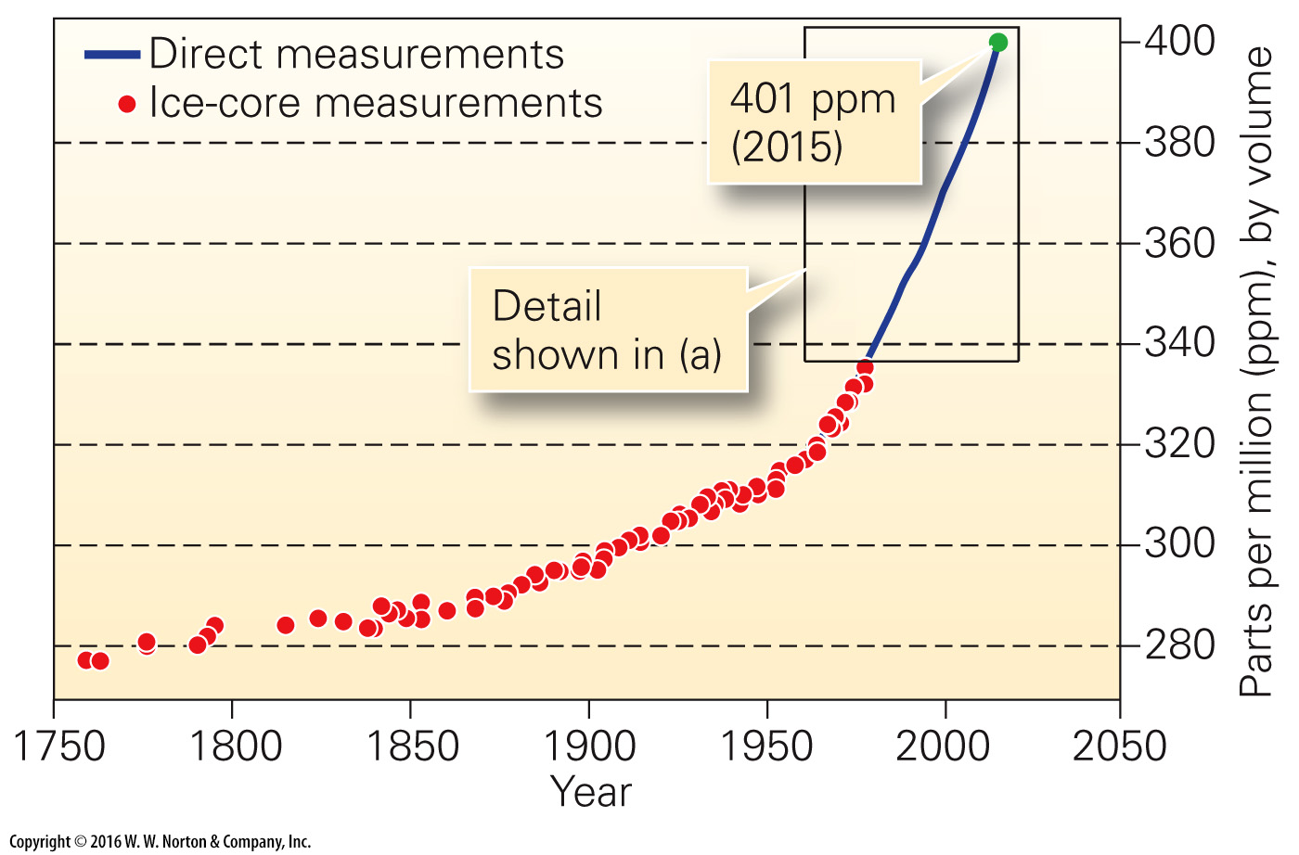
Notes:
FIGURE 19.10b Changes in carbon dioxide (CO₂) and methane (CH₄) concentrations over time.
(b) Since the industrial revolution, CO₂ concentration has steadily increased.

Slide 25
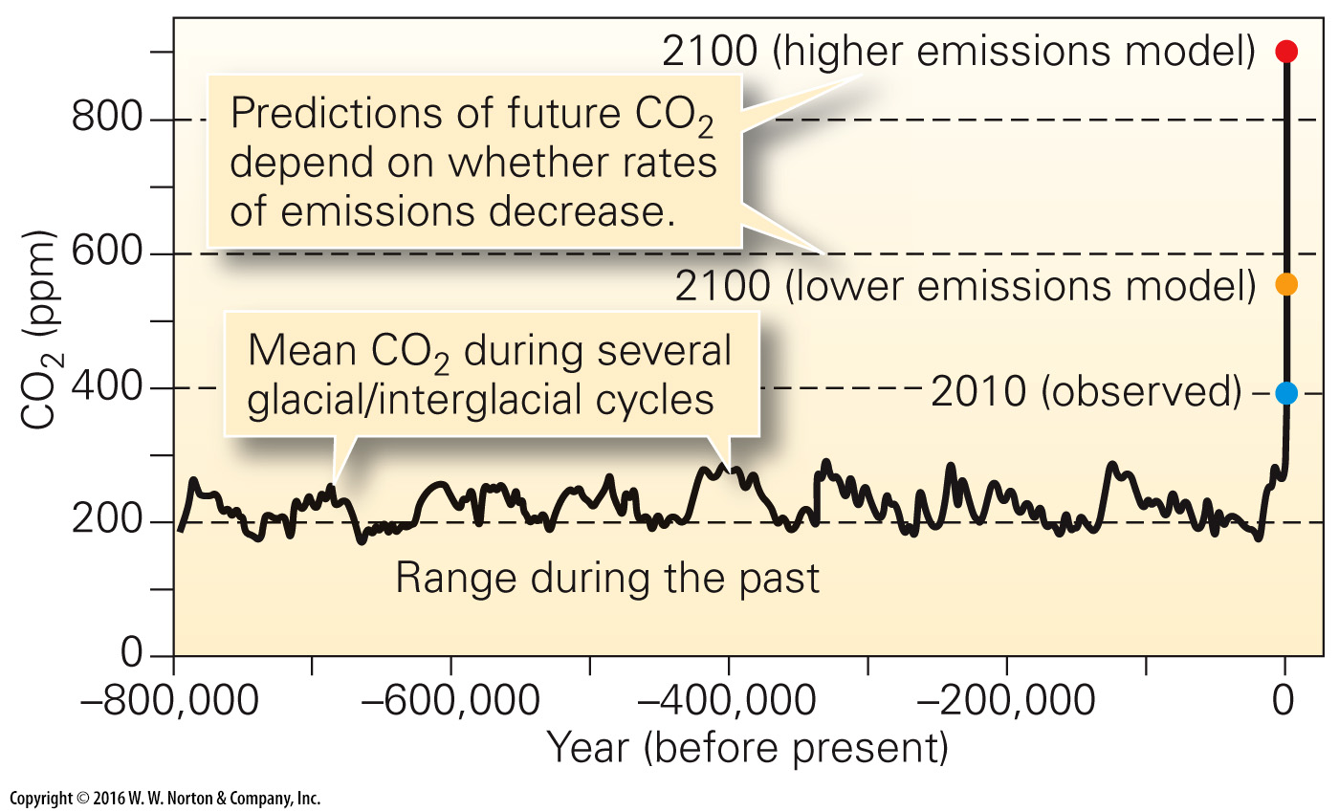
Notes:
FIGURE 19.10c Changes in carbon dioxide (CO₂) and methane (CH₄) concentrations over time.
(c) Based on ice-core studies in glaciers, researchers find that CO₂ concentration varied between 180 and 300 ppm throughout glacial advances and retreats. The current value, 401 ppm, is above this range.

Slide 26
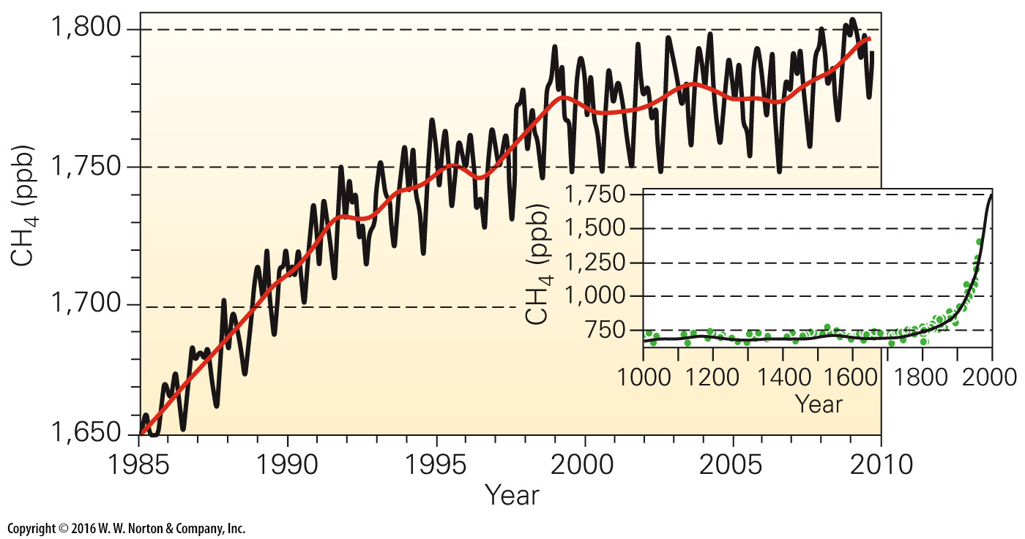
Notes:
FIGURE 19.10d Changes in carbon dioxide (CO₂) and methane (CH₄) concentrations over time.
(d) Methane, another greenhouse gas, has been increasing, too. The inset shows change over the past millennium.

Slide 27
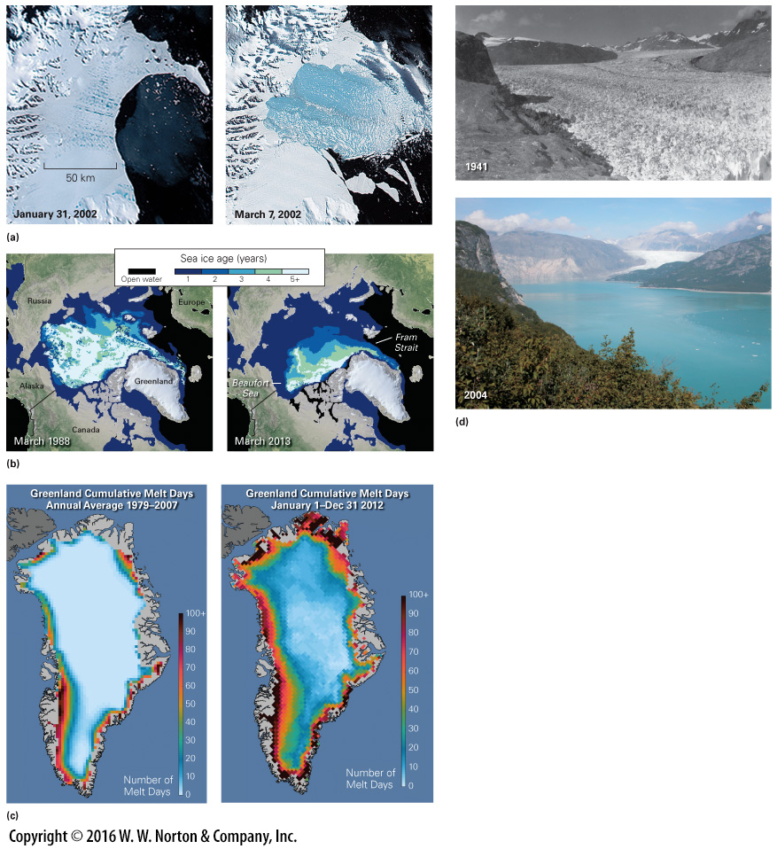
Notes:
FIGURE 19.11 Visible examples of changes in Earth’s ice cover.
(a) In 2002, the Larson B Ice Shelf of Antarctica disintegrated over the course of a month. (b) The age of sea ice in the Arctic Ocean has decreased substantially during the past 25 years. (c) The number of days during which melting of the Greenland Ice Sheet takes place has increased. (d) The Muir Glacier in Alaska retreated 12 km between 1941 and 2004.

Slide 28
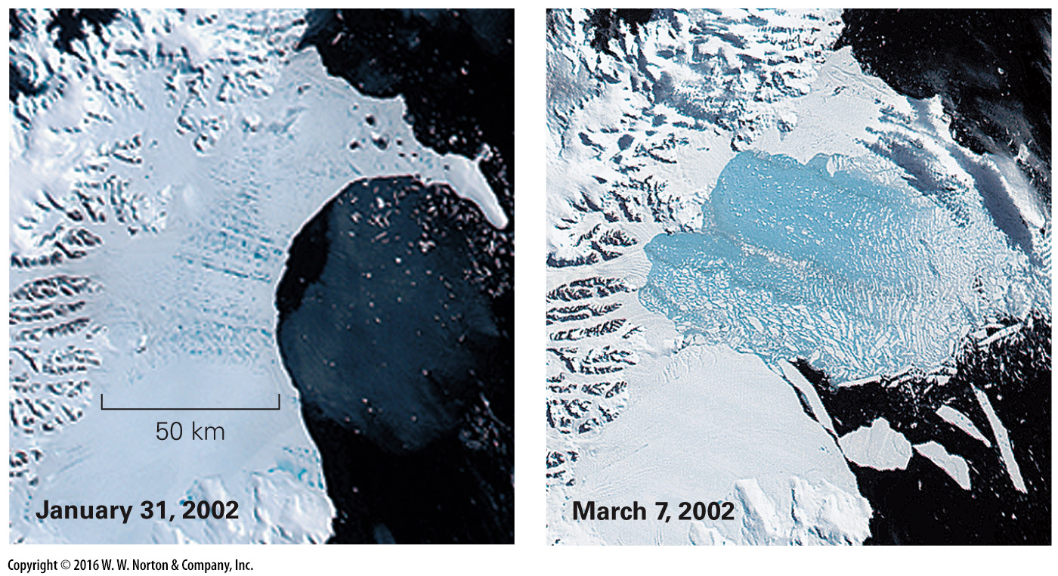
Notes:
FIGURE 19.11a Visible examples of changes in Earth’s ice cover.
(a) In 2002, the Larson B Ice Shelf of Antarctica disintegrated over the course of a month.

Slide 29
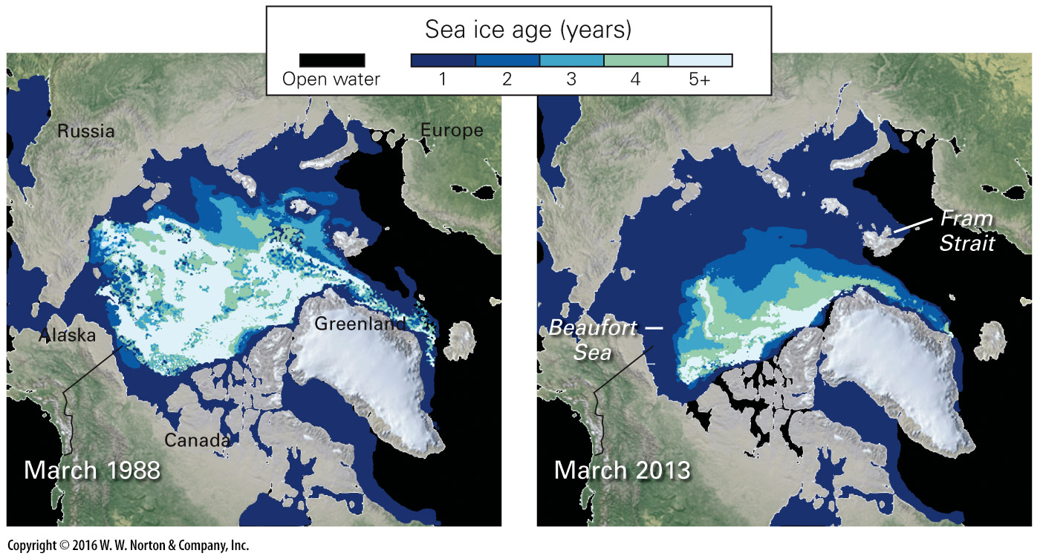
Notes:
FIGURE 19.11b Visible examples of changes in Earth’s ice cover.
(b) The age of sea ice in the Arctic Ocean has decreased substantially during the past 25 years.

Slide 30
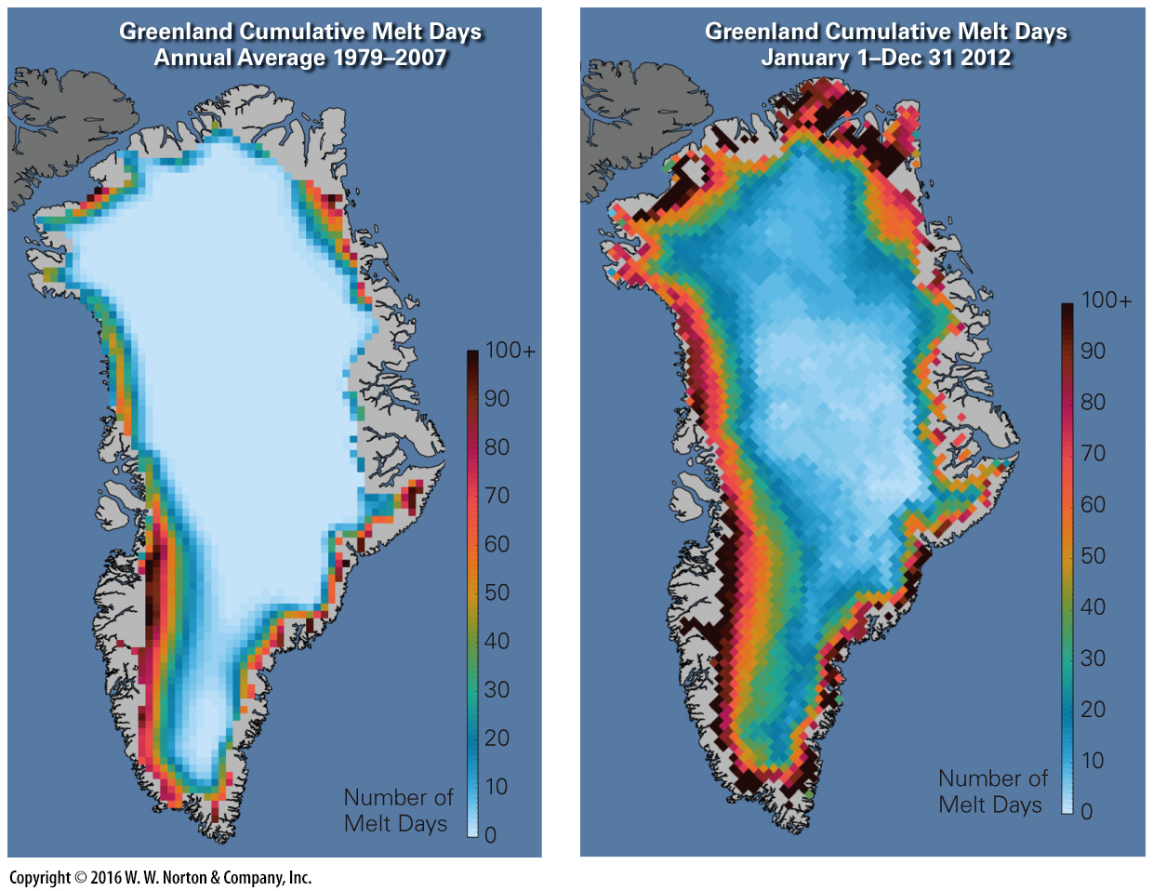
Notes:
FIGURE 19.11c Visible examples of changes in Earth’s ice cover.
(c) The number of days during which melting of the Greenland Ice Sheet takes place has increased.

Slide 31
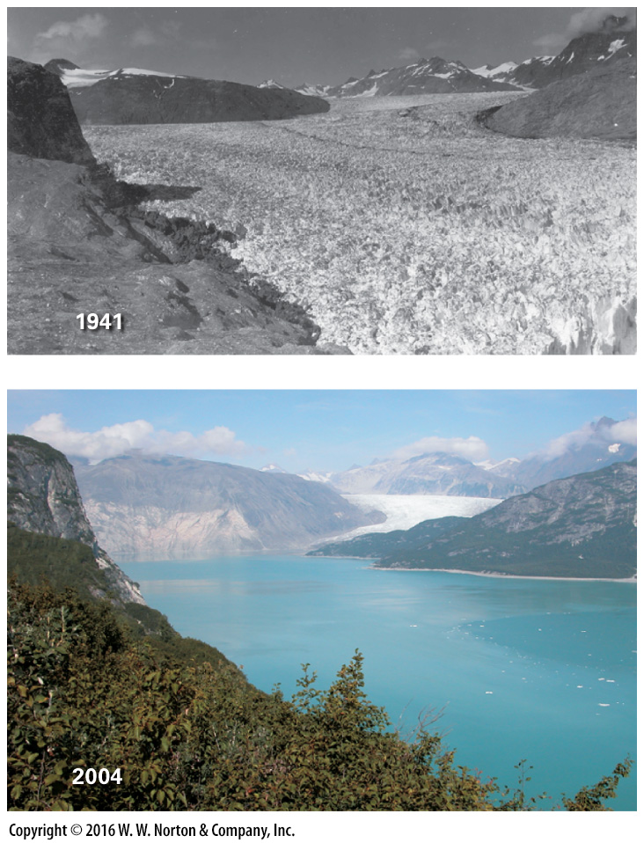
Notes:
FIGURE 19.11d Visible examples of changes in Earth’s ice cover.
(d) The Muir Glacier in Alaska retreated 12 km between 1941 and 2004.

Slide 32
Notes:
FIGURE 19.12 Plant hardiness zones have been migrating northward.

Slide 33
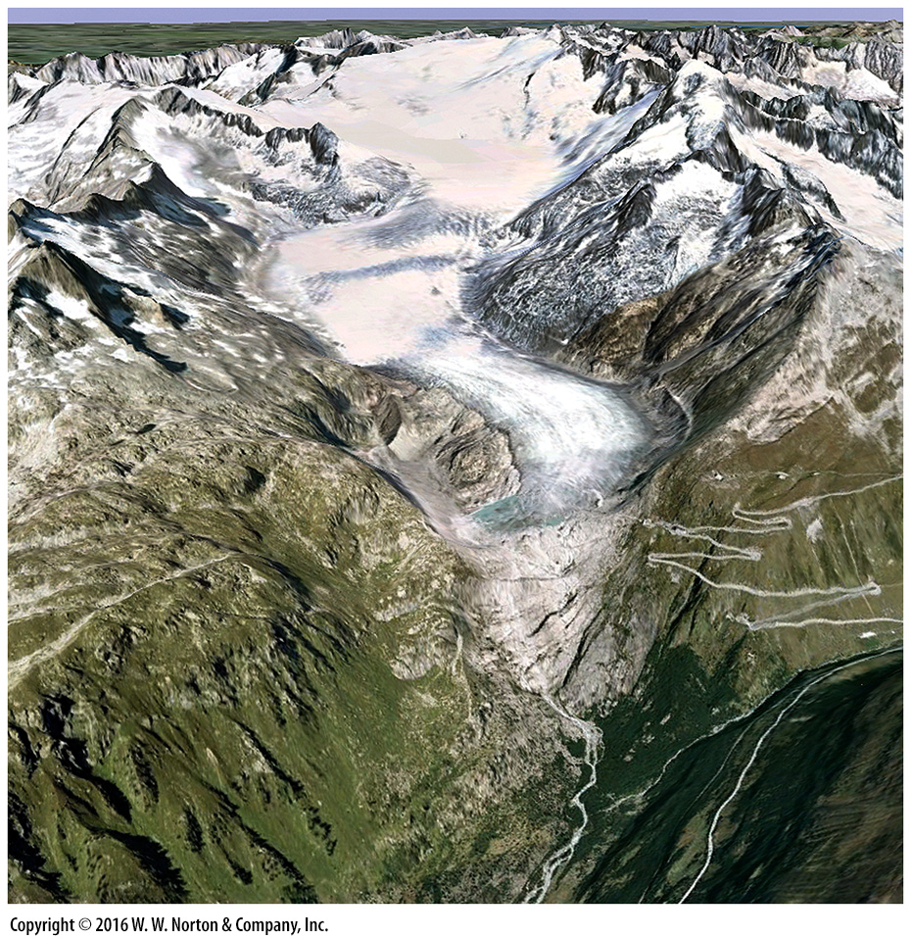
Notes:
SEE FOR YOURSELF…
RECEDING GLACIER, SWITZERLAND

Slide 34
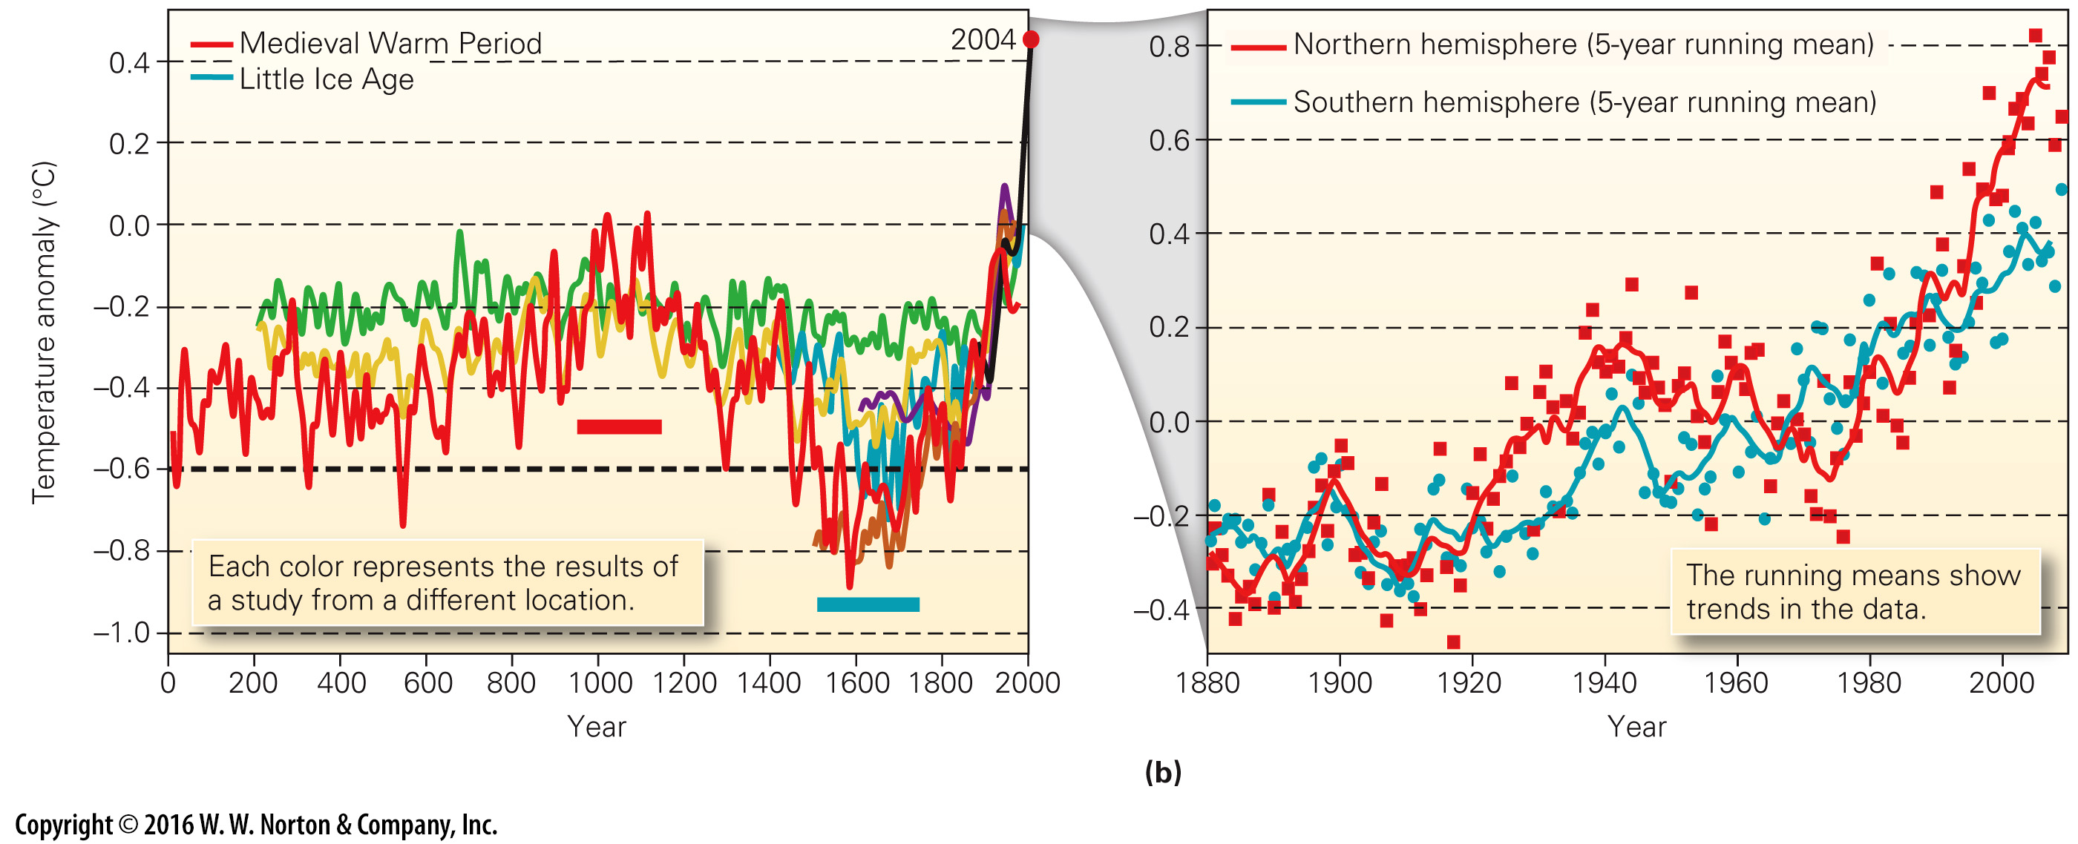
Notes:
FIGURE 19.13 Measurements of global warming and global temperature anomalies.
(a) Reconstructions of temperature during the past 2,000 years. Each color is a published estimate from a research team. The black line is the average of direct measurements. (b) Graph showing the change in global average temperature since 1880 relative to a reference value. Note that both the northern and southern hemispheres show a temperature increase.

Slide 35
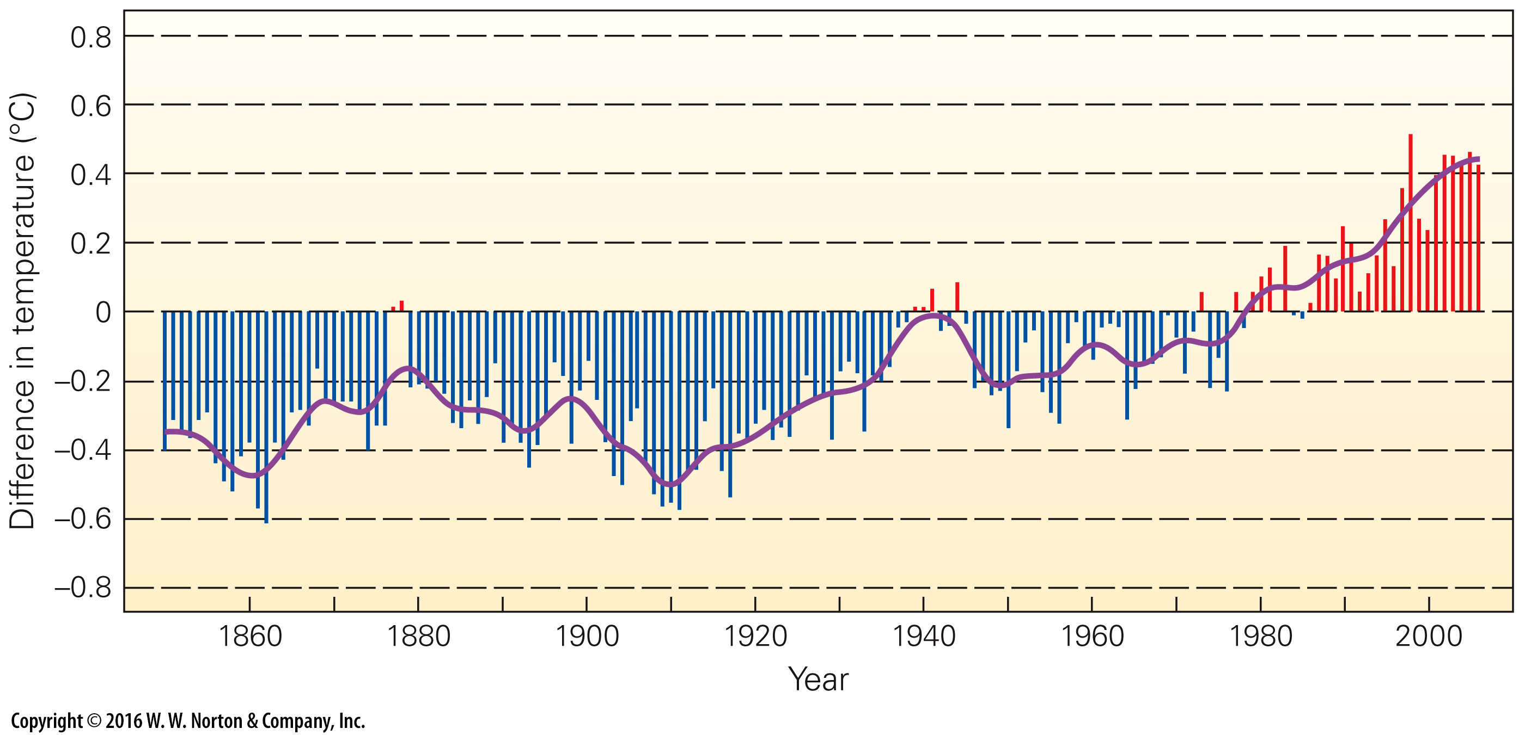
Notes:
FIGURE 19.14 The difference in global temperature of shallow ocean water, for the period of 1850 to 2005, relative to the average temperature between 1961 and 2006.

Slide 36
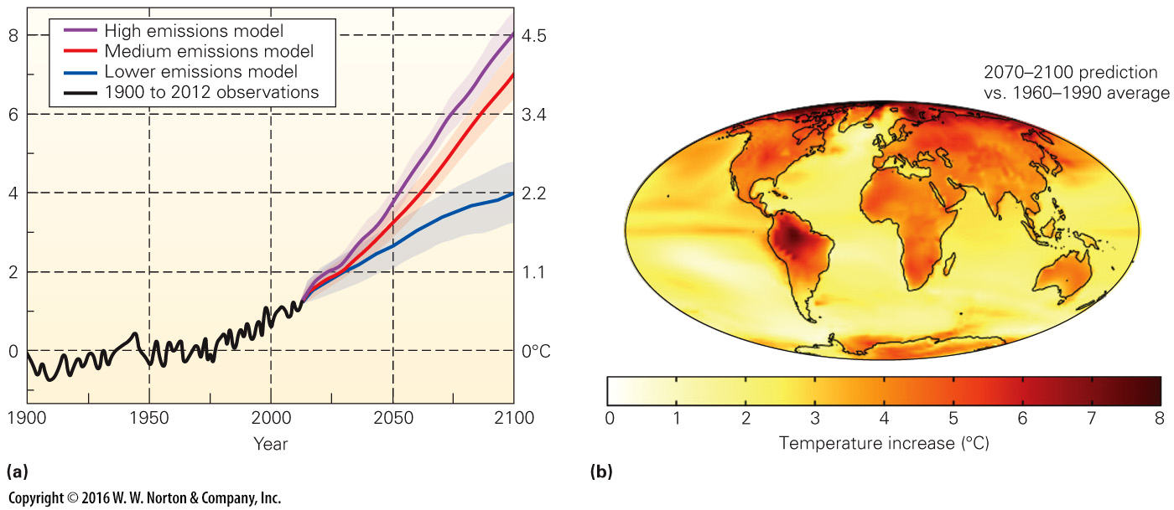
Notes:
FIGURE 19.15 Model predictions of future global warming.
(a) Model calculations of global warming. Different models assume different rates of CO₂ emissions. All suggest significant global temperature increase by 2100. (b) Global warming does not mean that all locations warm by the same amount. This map shows a model prediction of how temperature increase may vary with location for the time period 2070–2100.

Slide 37
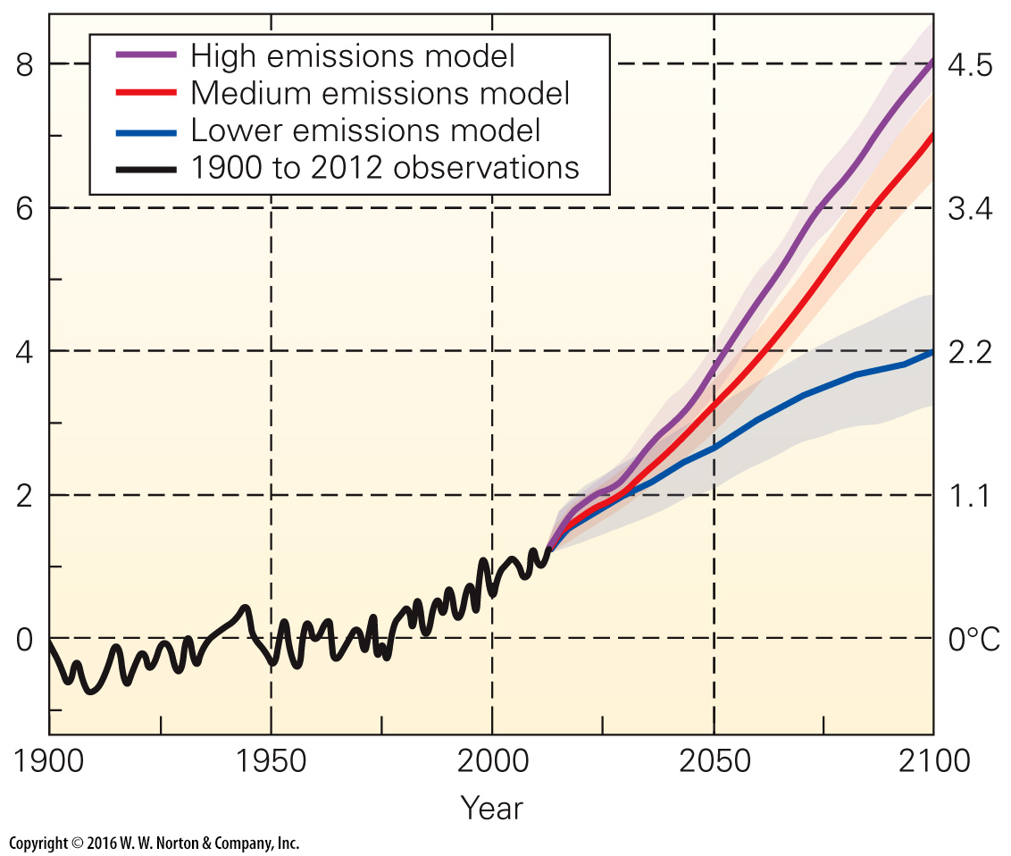
Notes:
FIGURE 19.15a Model predictions of future global warming.
(a) Model calculations of global warming. Different models assume different rates of CO₂ emissions. All suggest significant global temperature increase by 2100.

Slide 38
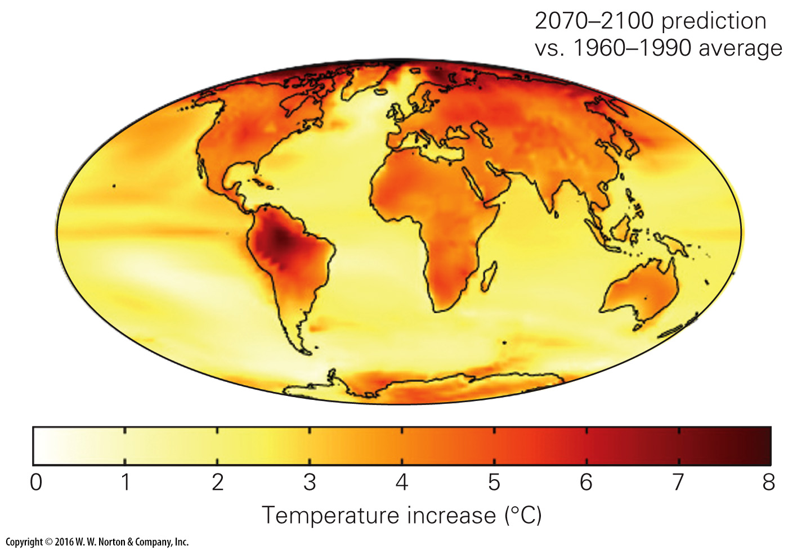
Notes:
FIGURE 19.15b Model predictions of future global warming.
(b) Global warming does not mean that all locations warm by the same amount. This map shows a model prediction of how temperature increase may vary with location for the time period 2070–2100.

Slide 39
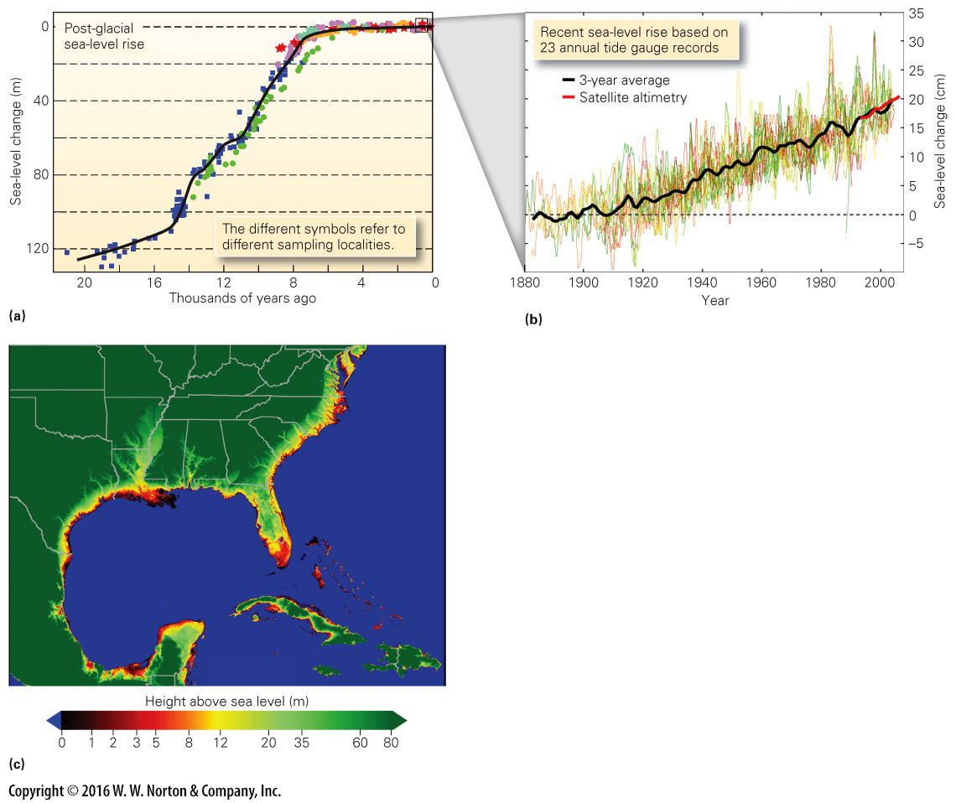
Notes:
FIGURE 19.16 Sea-level rise of the recent past and possible sea-level rise of the future.
(a) Sea level rose rapidly after the last ice age due to melting of continental glaciers. It is continuing to rise slowly. (b) Tide gauges document sea-level rise of the past 130 years. (c) The red and black areas of this map are so low that they could be flooded if sea level rose a few meters.

Slide 40
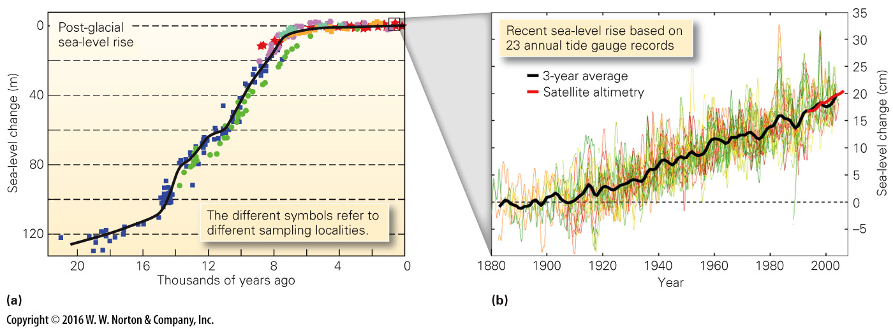
Notes:
FIGURE 19.16ab Sea-level rise of the recent past and possible sea-level rise of the future.
(c) The red and black areas of this map are so low that they could be flooded if sea level rose a few meters.

Slide 41
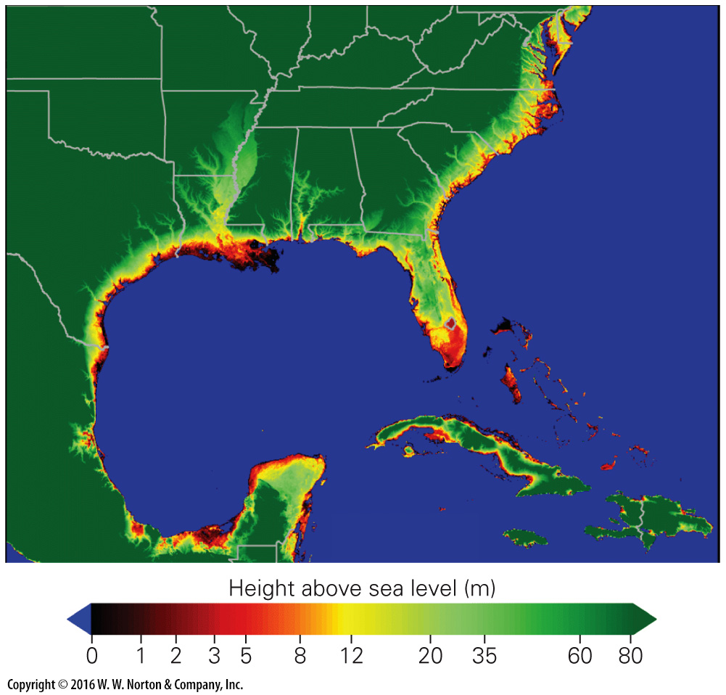
Notes:
FIGURE 19.16c Sea-level rise of the recent past and possible sea-level rise of the future.
(c) The red and black areas of this map are so low that they could be flooded if sea level rose a few meters.

Slide 42
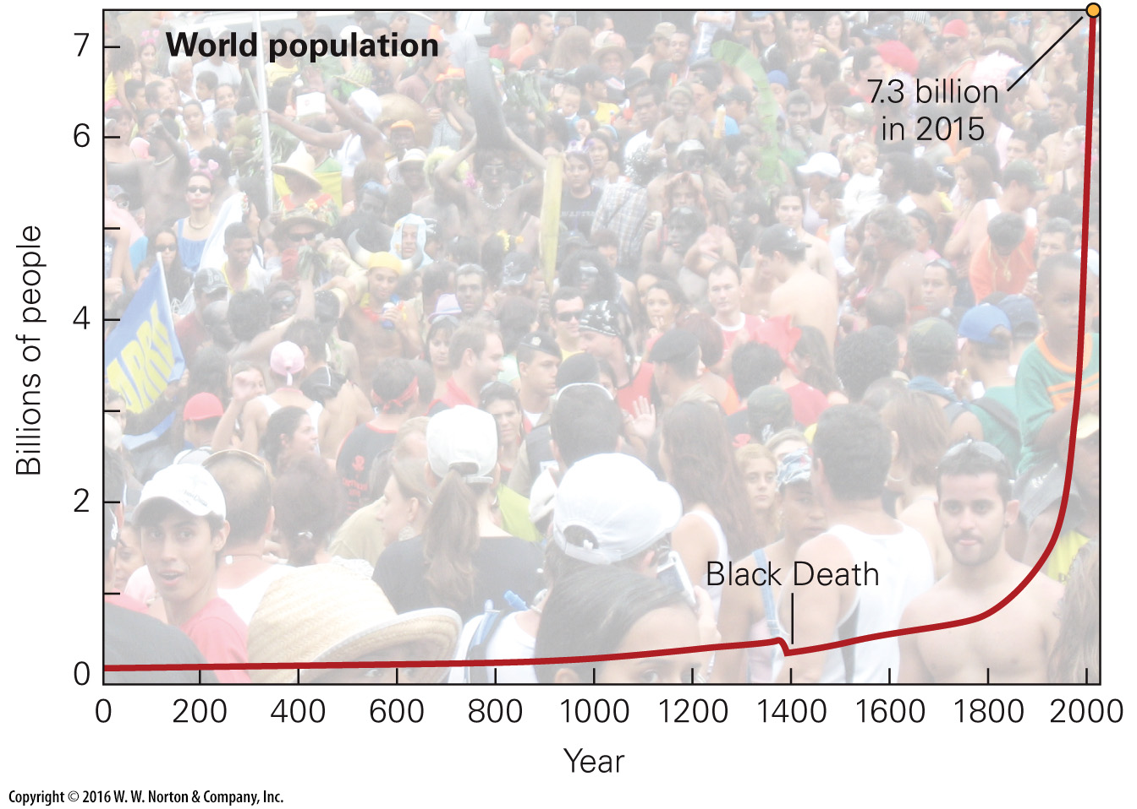
Notes:
FIGURE 19.17 Population now doubles about every 44 years. The Black Death pandemic caused an abrupt drop that lasted for a few decades.

Slide 43
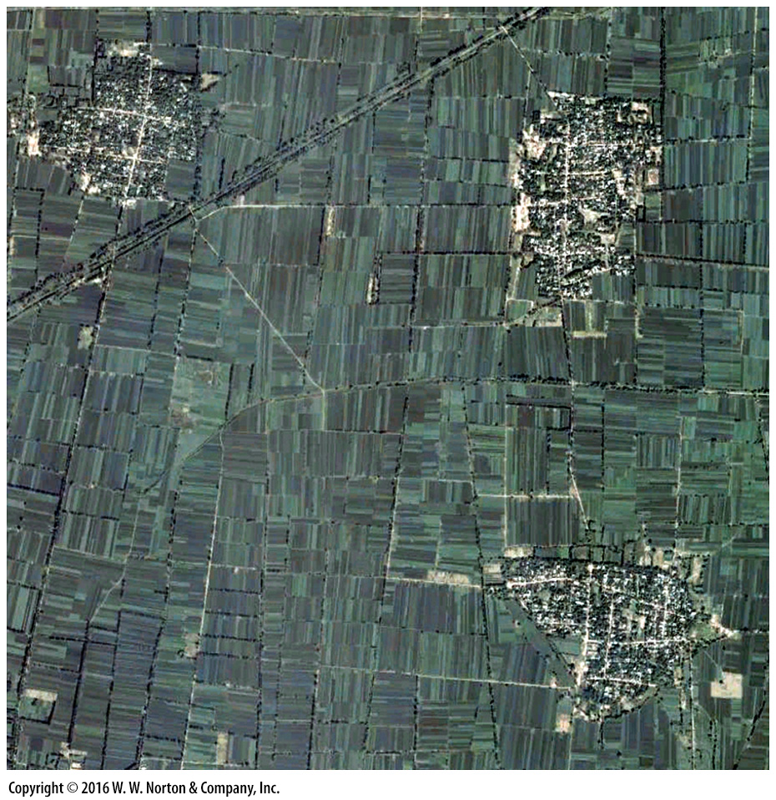
Notes:
SEE FOR YOURSELF…
FIELDS AND VILLAGES, CHINA

Slide 44
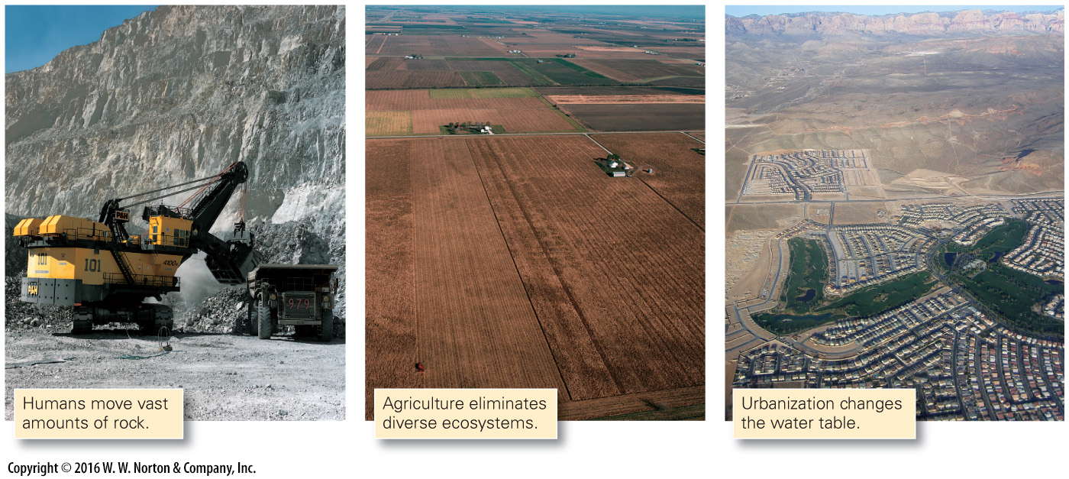
Notes:
FIGURE 19.18 Excavation, agriculture, and construction modify topography, drainage, infiltration, and ecology.

Slide 45
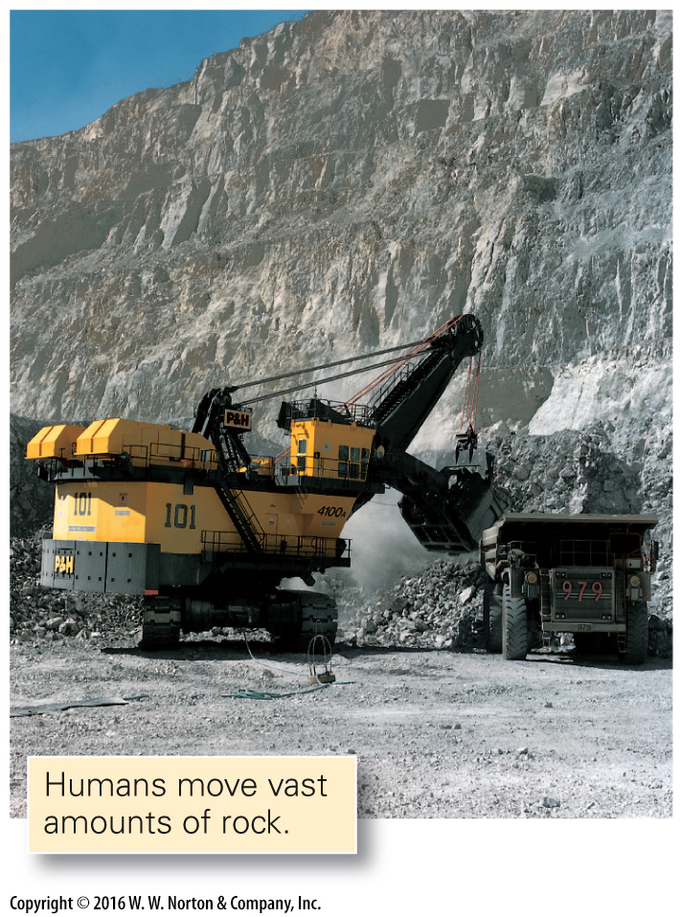
Notes:
FIGURE 19.18 Excavation, agriculture, and construction modify topography, drainage, infiltration, and ecology.

Slide 46
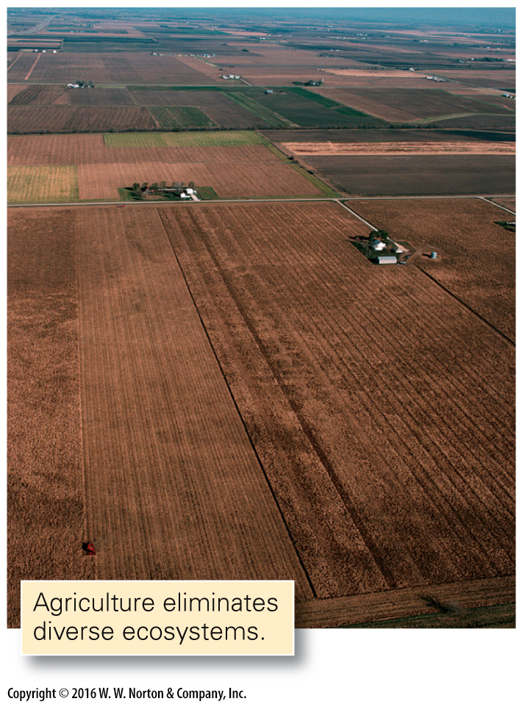
Notes:
FIGURE 19.18 Excavation, agriculture, and construction modify topography, drainage, infiltration, and ecology.

Slide 47
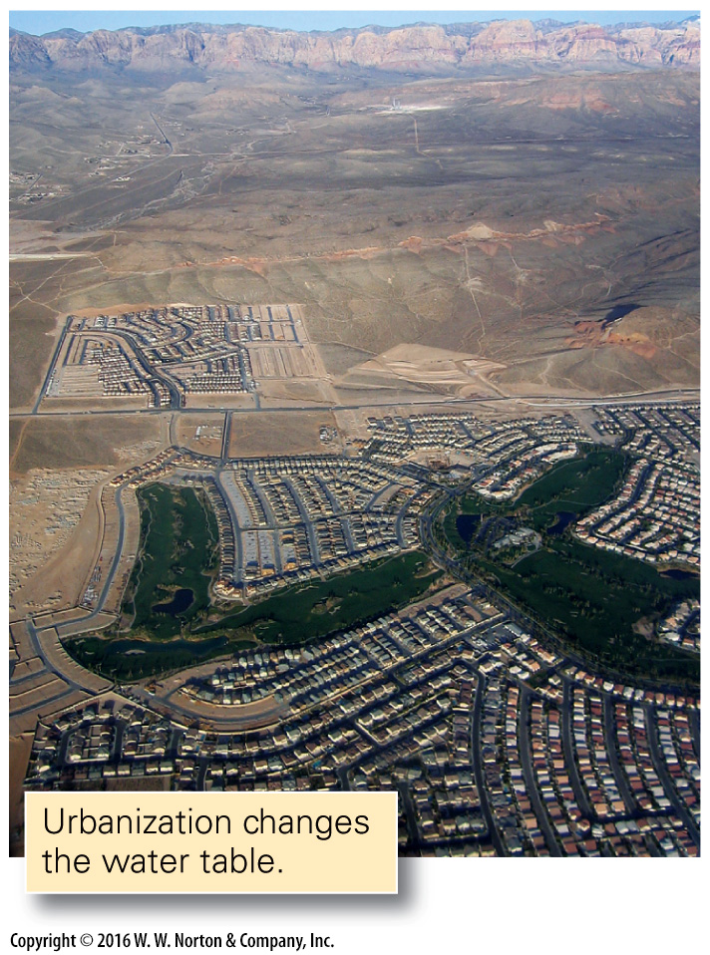
Notes:
FIGURE 19.18 Excavation, agriculture, and construction modify topography, drainage, infiltration, and ecology.

Slide 48
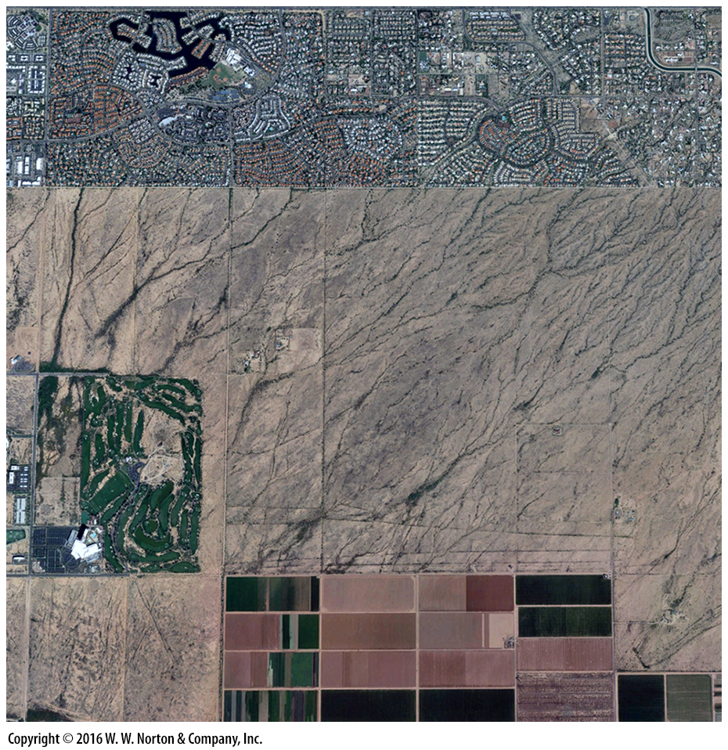
Notes:
SEE FOR YOURSELF…
URBANIZING A DESERT, ARIZONA

Slide 49
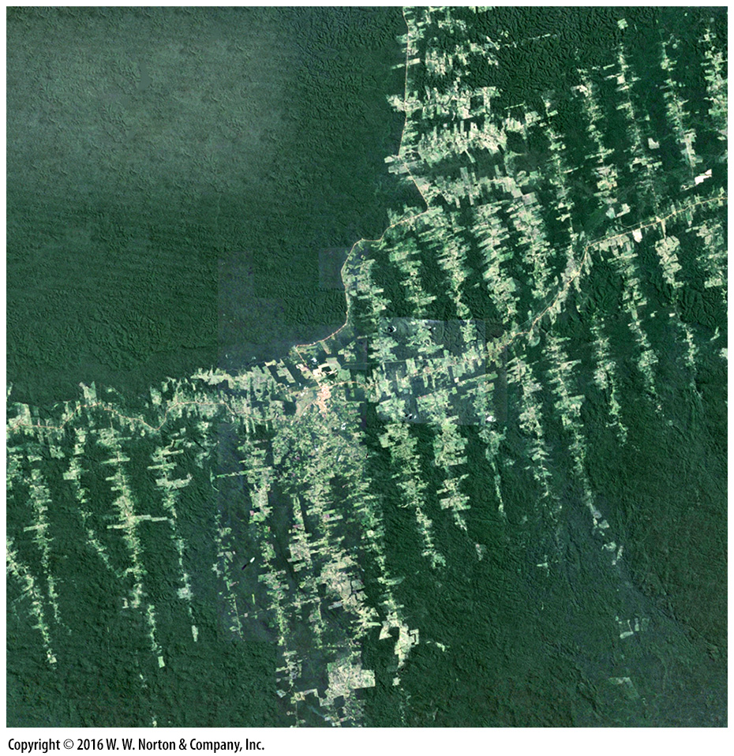
Notes:
SEE FOR YOURSELF…
DEFORESTATION, AMAZON

Slide 50
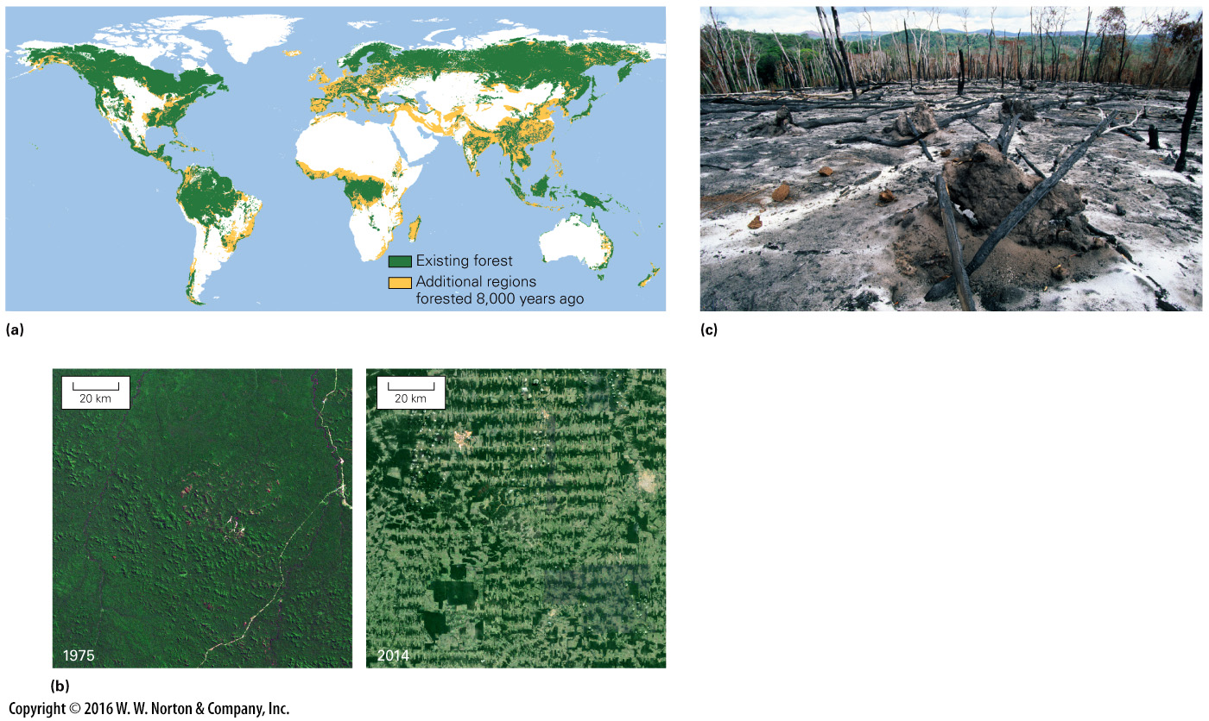
Notes:
FIGURE 19.19 The area of forests has been shrinking. For example, tropical rainforests are being logged or burned.
(a) Remaining forests today are much smaller than forests of 8,000 years ago. (b) Comparison of satellite imagery highlights areas that have undergone deforestation, such as this one near Ariquemes, Brazil. (c) Part of the Amazon rainforest’s destruction is due to slash-and-burn agriculture.

Slide 51
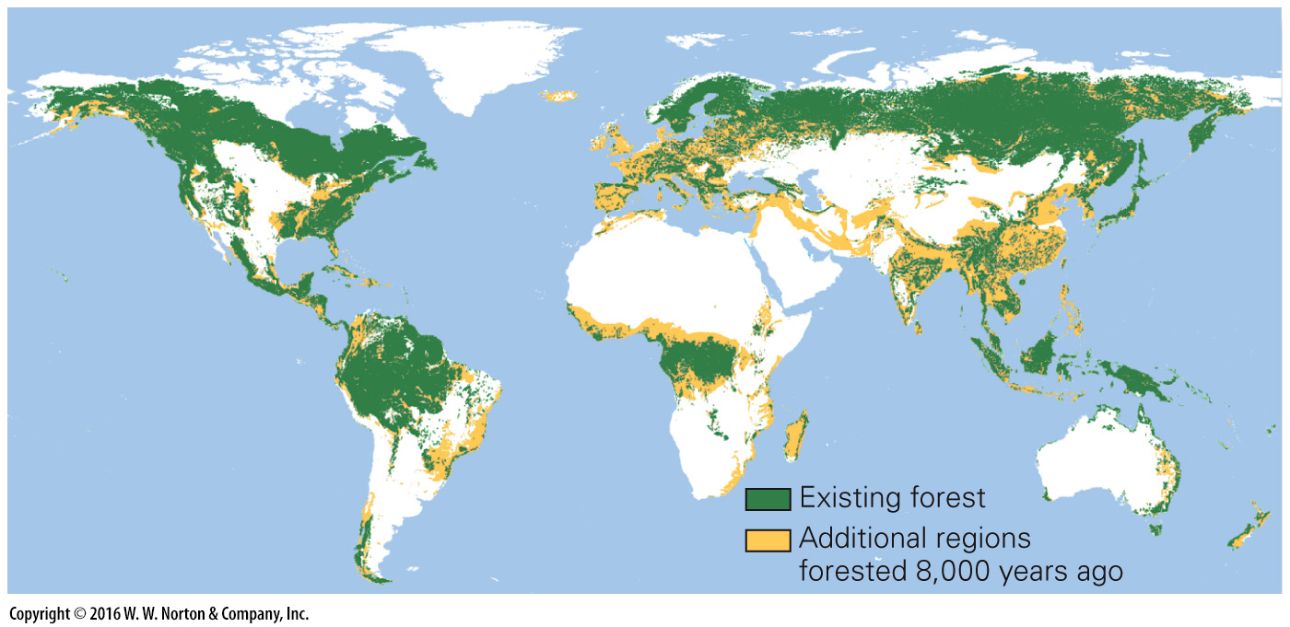
Notes:
FIGURE 19.19a The area of forests has been shrinking. For example, tropical rainforests are being logged or burned.
(a) Remaining forests today are much smaller than forests of 8,000 years ago.

Slide 52
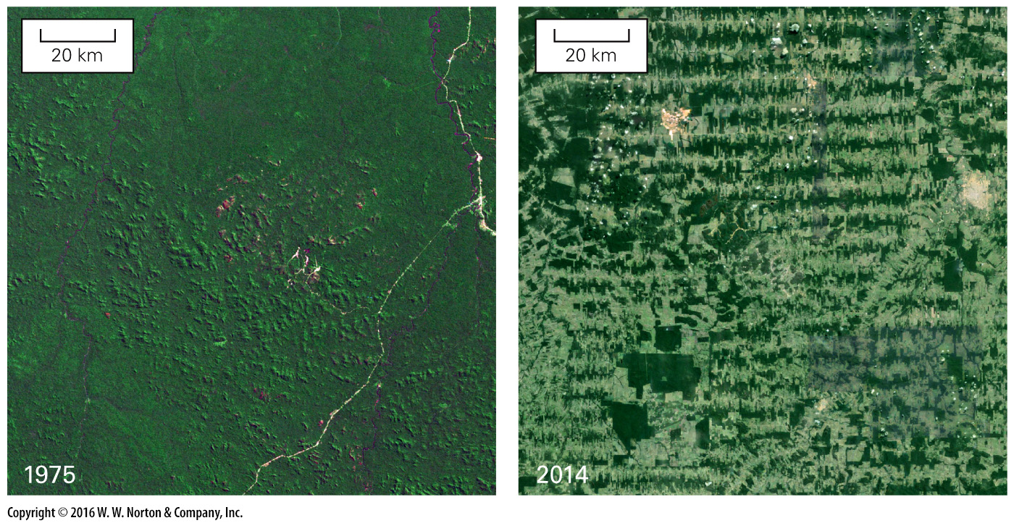
Notes:
FIGURE 19.19b The area of forests has been shrinking. For example, tropical rainforests are being logged or burned.
(b) Comparison of satellite imagery highlights areas that have undergone deforestation, such as this one near Ariquemes, Brazil.

Slide 53
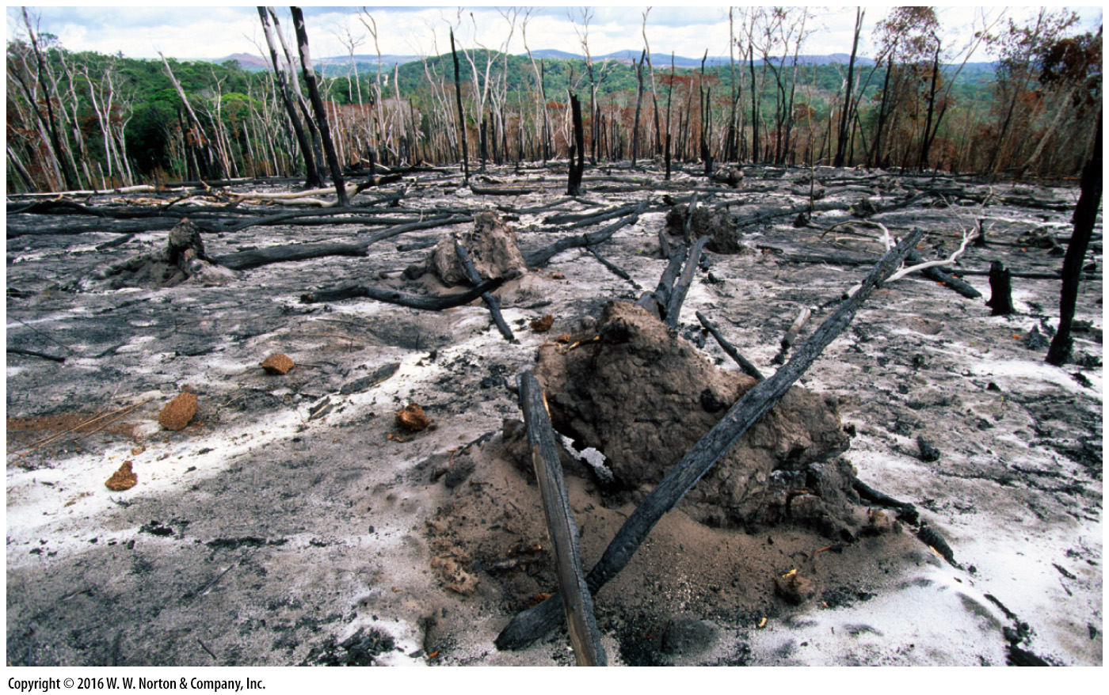
Notes:
FIGURE 19.19c The area of forests has been shrinking. For example, tropical rainforests are being logged or burned.
(c) Part of the Amazon rainforest’s destruction is due to slash-and-burn agriculture.

Slide 54
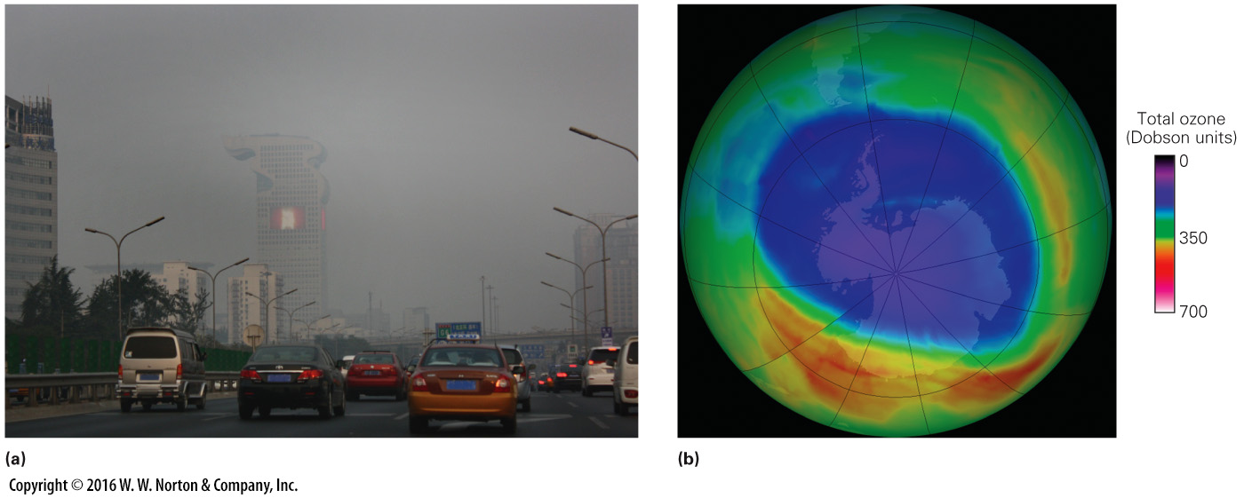
Notes:
FIGURE 19.20 Consequences of adding pollutants to the atmosphere.
(a) Photochemical smog hazes the view in Beijing, on an otherwise sunny day. (b) The ozone hole over Antarctica in 2014. A Dobson unit is a measure of the amount of ozone in the atmosphere; red is more, purple is less.

Slide 55
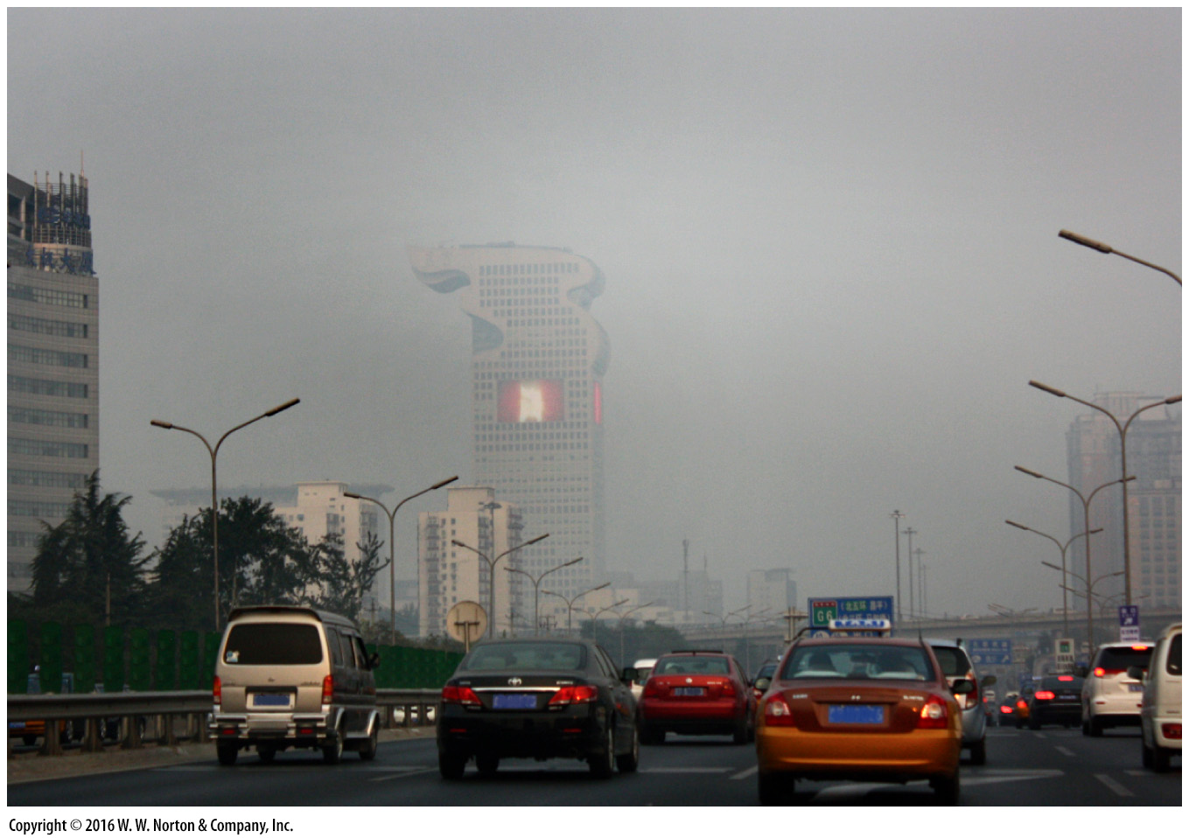
Notes:
FIGURE 19.20a Consequences of adding pollutants to the atmosphere.
(a) Photochemical smog hazes the view in Beijing, on an otherwise sunny day.

Slide 56
Notes:
FIGURE 19.20b Consequences of adding pollutants to the atmosphere.
(b) The ozone hole over Antarctica in 2014. A Dobson unit is a measure of the amount of ozone in the atmosphere; red is more, purple is less.

Slide 57
Notes:
FIGURE 19.21 In about 5 billion years, the Sun will become a red giant.
(a) As the surface of the red giant approaches Earth, the planet will evaporate like a giant comet. (b) At full size, the red giant will have a diameter twice that of Earth’s orbit, so Earth’s atoms will become part of the star.

Slide 58
Notes:
FIGURE 19.21a In about 5 billion years, the Sun will become a red giant.
(a) As the surface of the red giant approaches Earth, the planet will evaporate like a giant comet.

Slide 59
Notes:
FIGURE 19.21b In about 5 billion years, the Sun will become a red giant.
(b) At full size, the red giant will have a diameter twice that of Earth’s orbit, so Earth’s atoms will become part of the star.

