Slide 1
Stephen Marshak
ESSENTIALS OF
Geology
FIFTH EDITION
Interlude A
Rock Groups
©2016 W. W. Norton & Company, Inc.

Slide 2
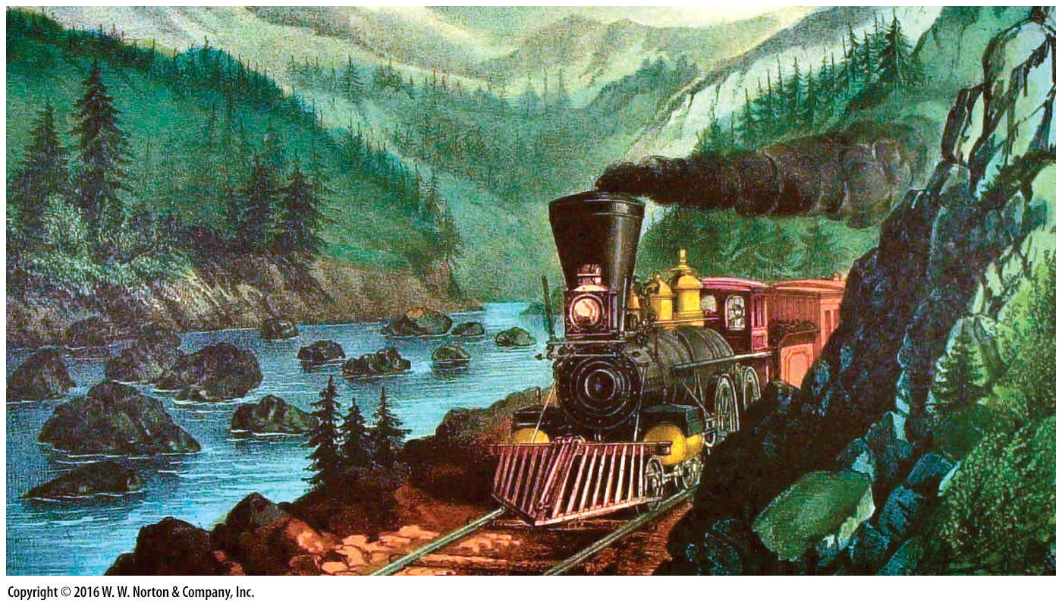
Notes:
The first railroad through the Sierra Nevada followed the Truckee River. Countless tons of rock had to be blasted and moved by laborers.

Slide 3
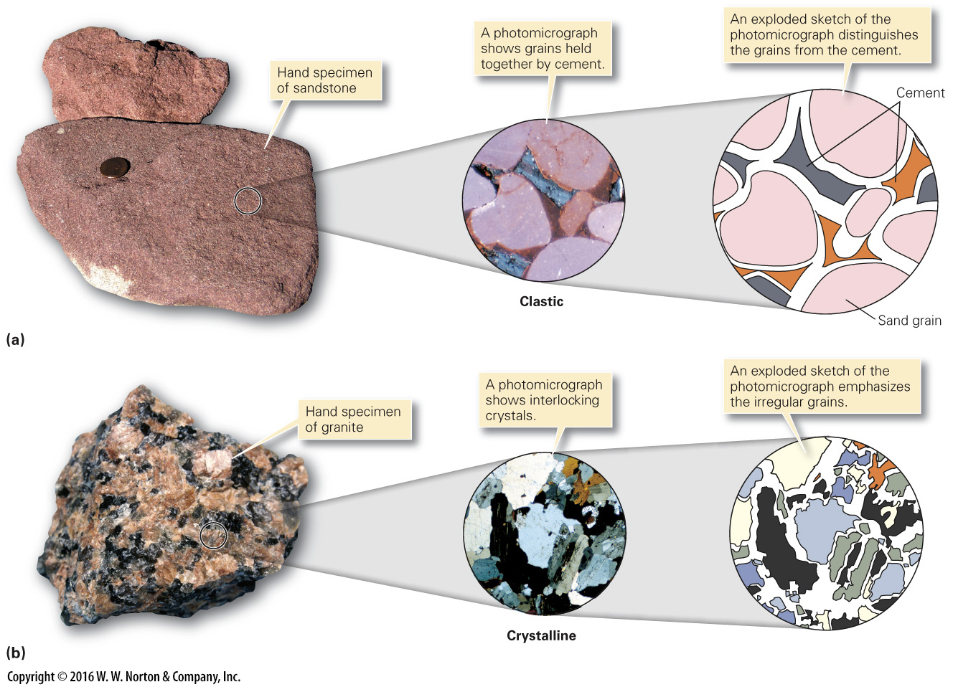
Notes:
FIGURE A.1 Rocks, aggregates of mineral grains and/or crystals, can be clastic or crystalline.
(a) Clastic texture is illustrated by the grains and cement in a sandstone. (b) Crystalline texture is illustrated by the interlocking crystals in a granite.

Slide 4
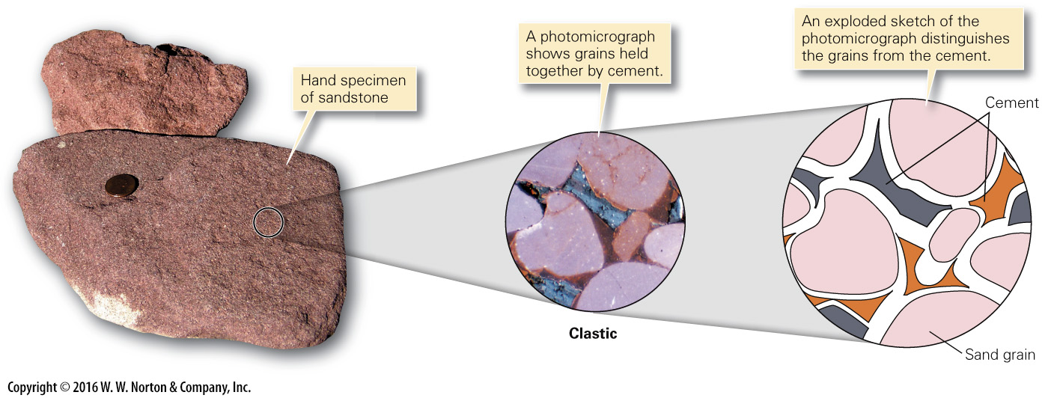
Notes:
FIGURE A.1a Rocks, aggregates of mineral grains and/or crystals, can be clastic or crystalline.
(a) Clastic texture is illustrated by the grains and cement in a sandstone.

Slide 5
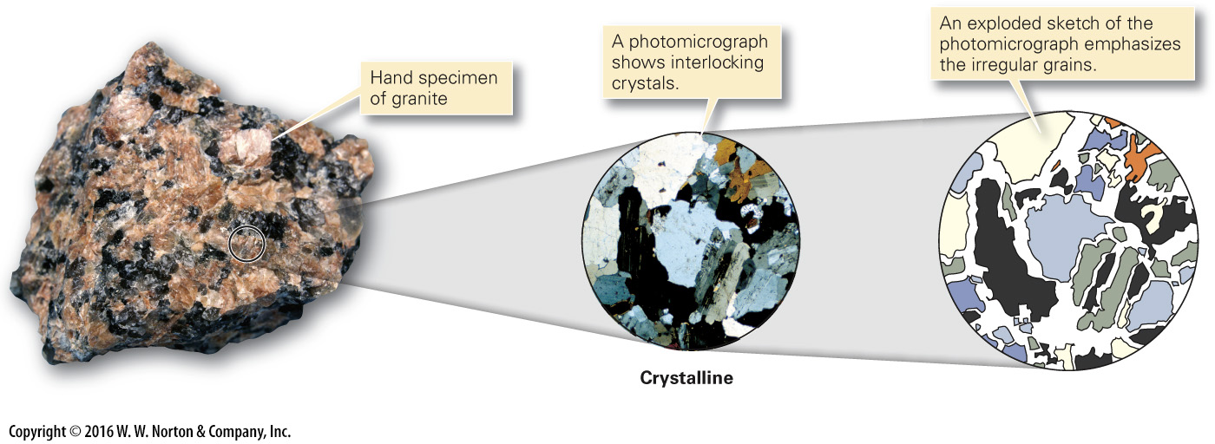
Notes:
FIGURE A.1b Rocks, aggregates of mineral grains and/or crystals, can be clastic or crystalline.
(b) Crystalline texture is illustrated by the interlocking crystals in a granite.

Slide 6
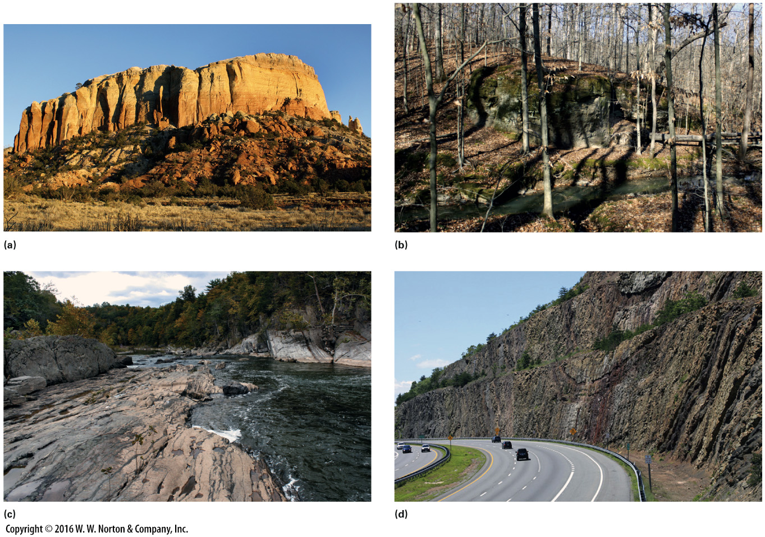
Notes:
FIGURE A.2 Examples of rock exposures.
(a) This outcrop in arid New Mexico consists of large cliffs. (b) A small outcrop, mostly hidden by trees, in Illinois. (c) A stream cut in New York where water stripped away soil and vegetation. (d) To produce a level grade for a highway in Maryland, engineers excavated this road cut.

Slide 7
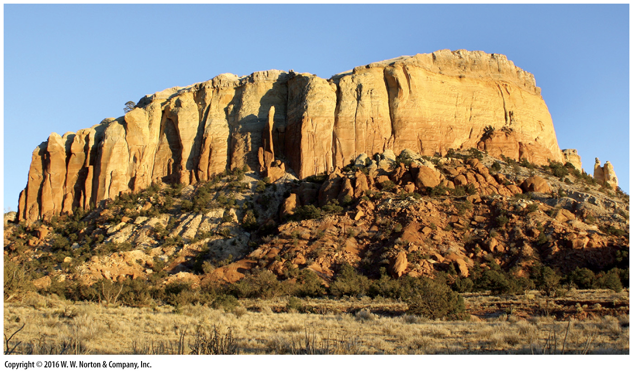
Notes:
FIGURE A.2a Examples of rock exposures.
(a) This outcrop in arid New Mexico consists of large cliffs.

Slide 8
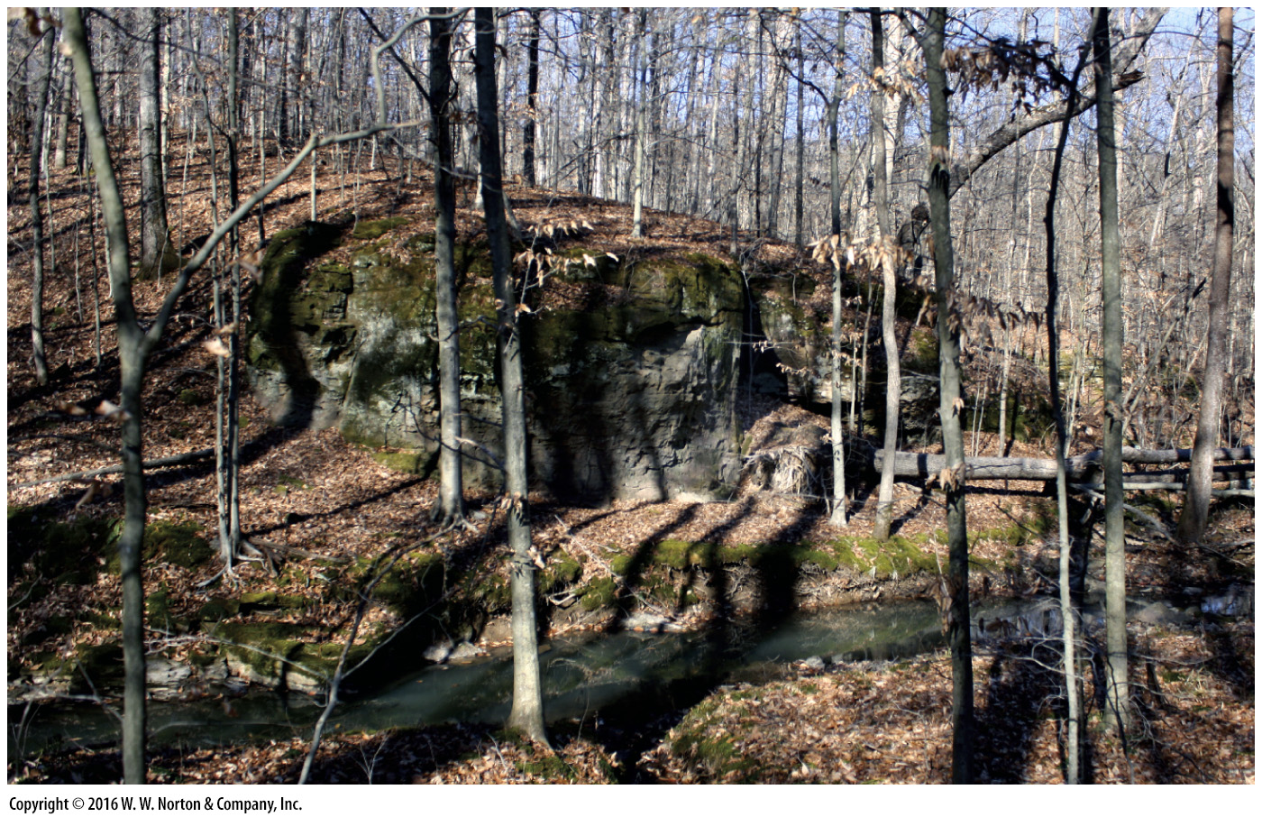
Notes:
FIGURE A.2b Examples of rock exposures.
(b) A small outcrop, mostly hidden by trees, in Illinois.

Slide 9
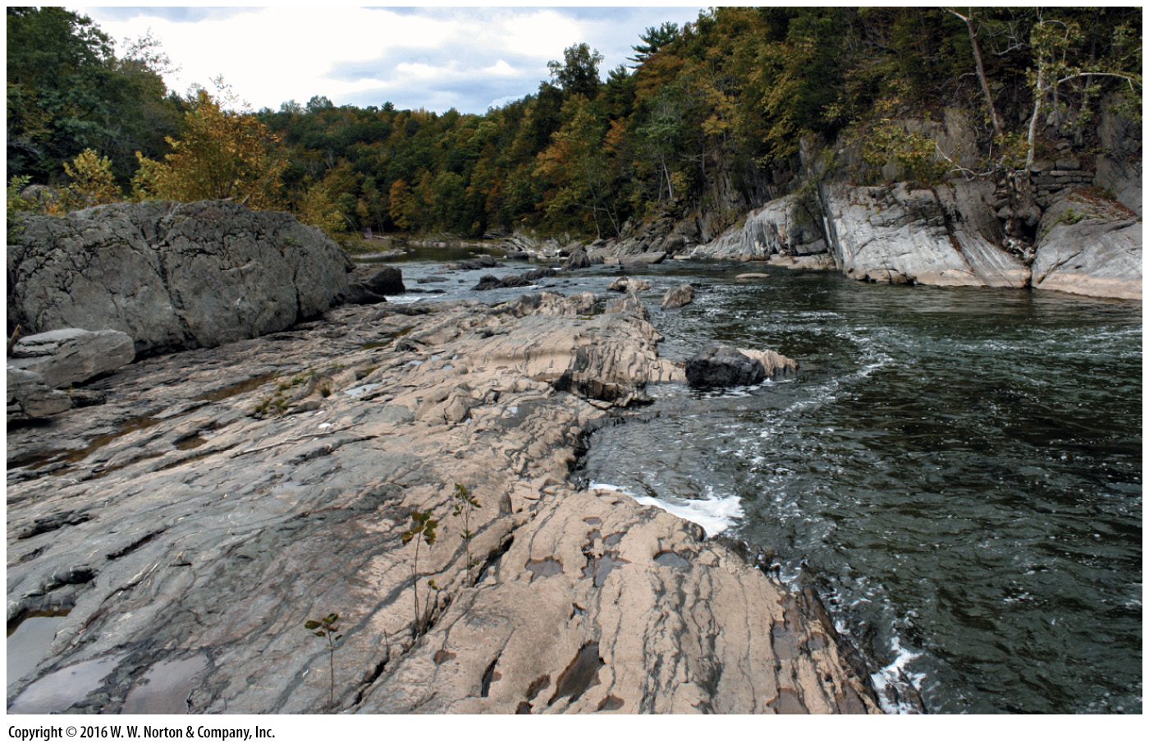
Notes:
FIGURE A.2c Examples of rock exposures.
(c) A stream cut in New York where water stripped away soil and vegetation.

Slide 10
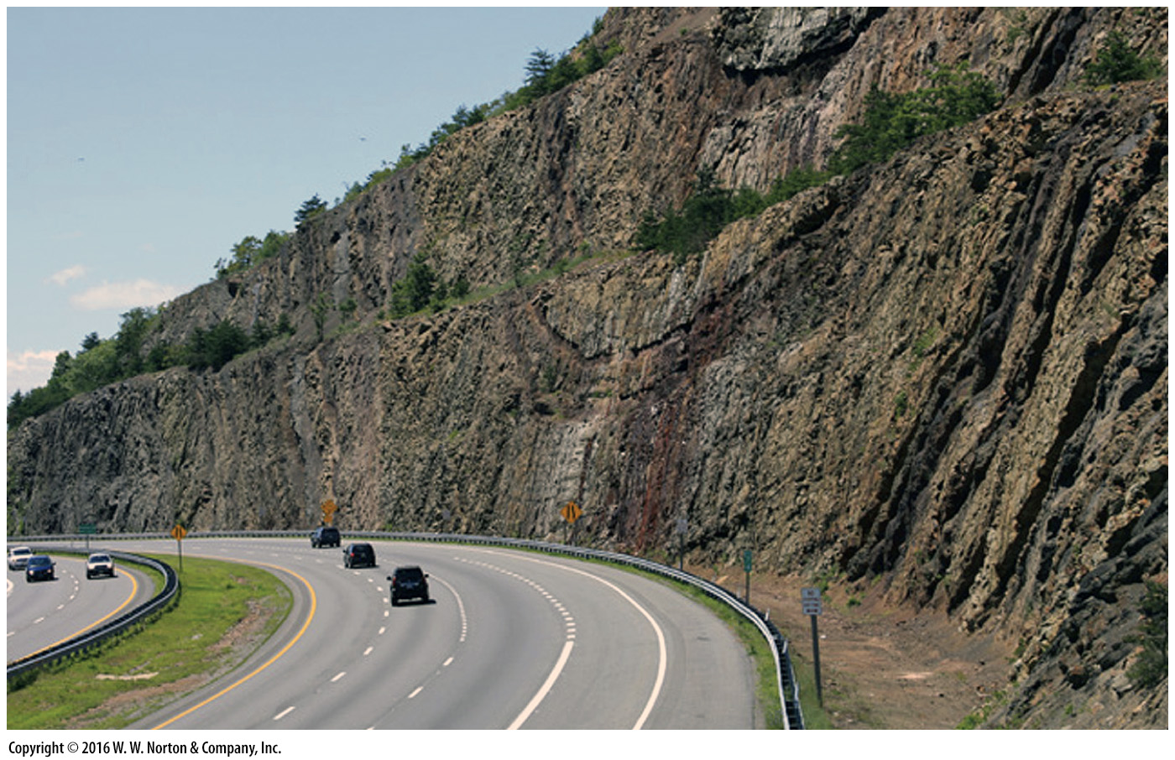
Notes:
FIGURE A.2d Examples of rock exposures.
(d) To produce a level grade for a highway in Maryland, engineers excavated this road cut.

Slide 11
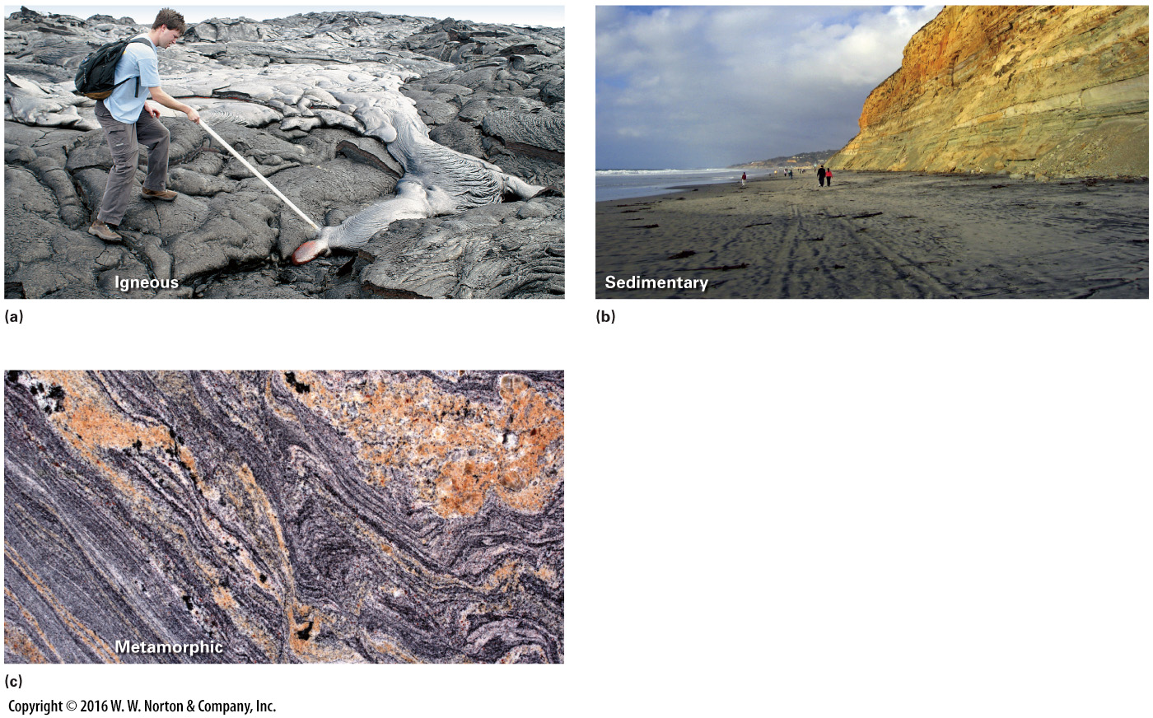
Notes:
FIGURE A.3 Examples of the three major classes of rocks.
(a) Lava (molten rock) freezes to form igneous rock. Here, the molten tip of a brand-new flow still glows red. Older flows are already solid. (b) Sand, formed from grains eroded off the rock cliffs, collects on the beach. If buried and turned to rock, it becomes layers of sandstone, such as those making up the cliffs. (c) Metamorphic rock forms when pre-existing rocks endure changes in temperature and pressure and/or are subjected to shearing, stretching, or shortening. New minerals and textures form.

Slide 12
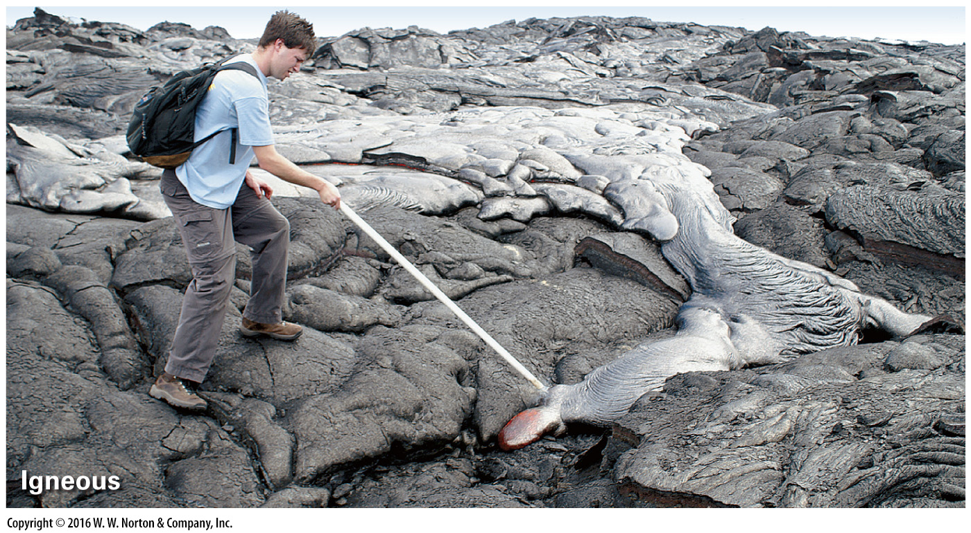
Notes:
FIGURE A.3a Examples of the three major classes of rocks.
(a) Lava (molten rock) freezes to form igneous rock. Here, the molten tip of a brand-new flow still glows red. Older flows are already solid.

Slide 13
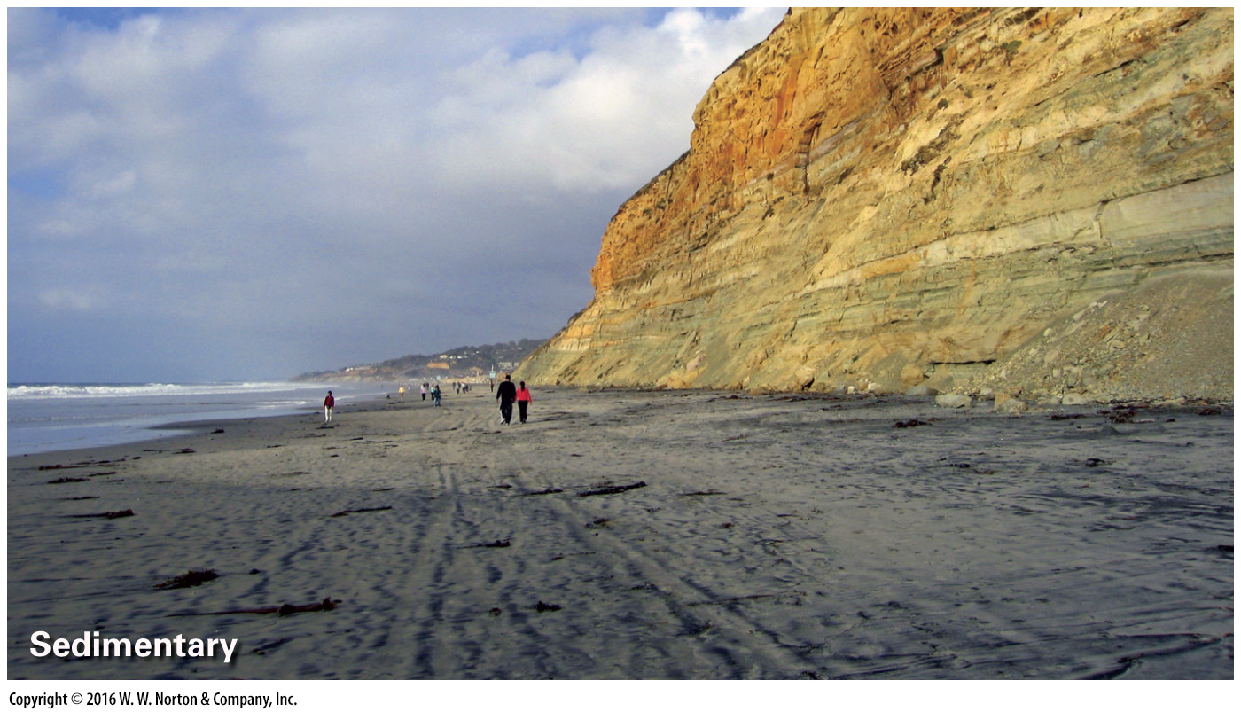
Notes:
FIGURE A.3b Examples of the three major classes of rocks.
(b) Sand, formed from grains eroded off the rock cliffs, collects on the beach. If buried and turned to rock, it becomes layers of sandstone, such as those making up the cliffs.

Slide 14
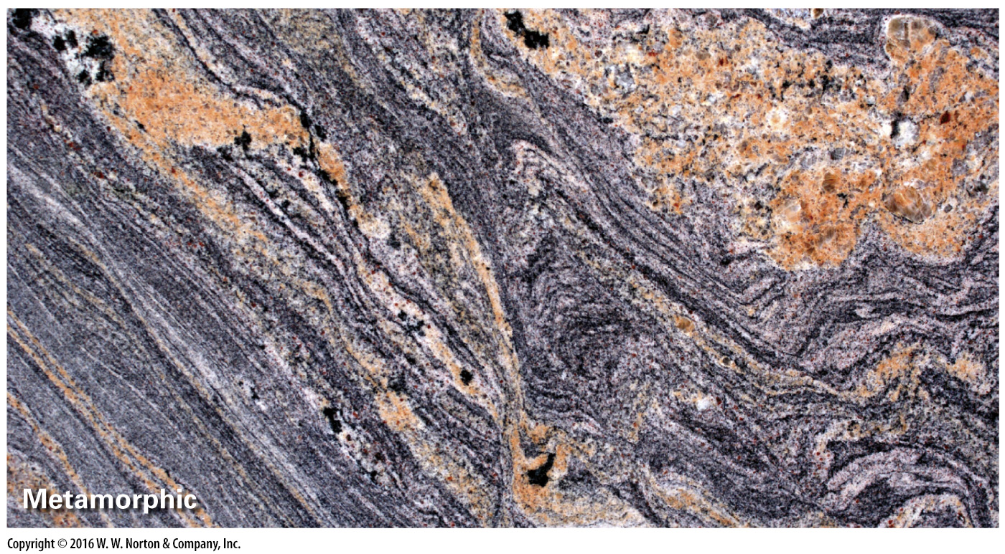
Notes:
FIGURE A.3c Examples of the three major classes of rocks.
(c) Metamorphic rock forms when pre-existing rocks endure changes in temperature and pressure and/or are subjected to shearing, stretching, or shortening. New minerals and textures form.

Slide 15
Notes:
FIGURE A.4 A cross section illustrating various geologic settings in which rocks form.

Slide 16
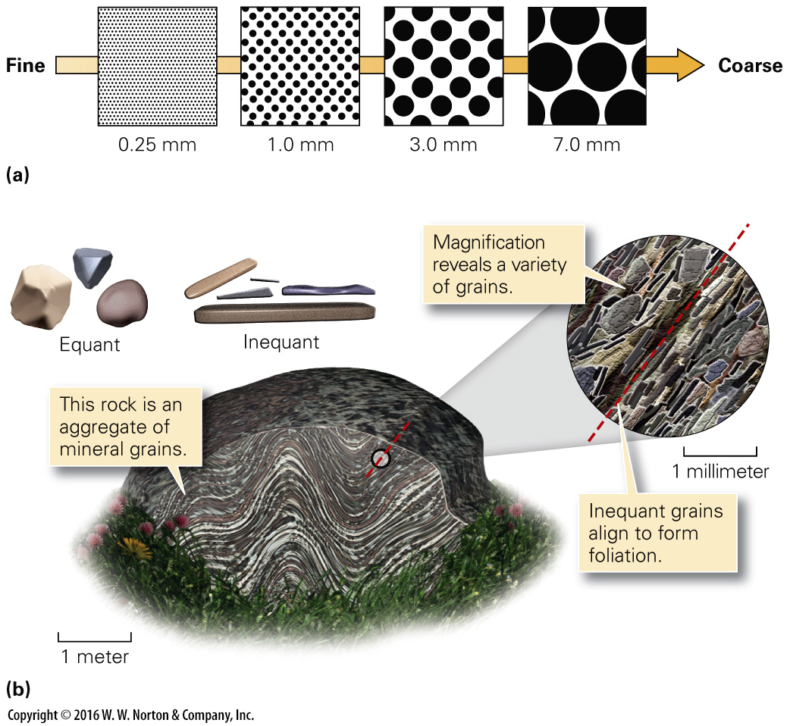
Notes:
FIGURE A.5 Describing grains in rock.
(a) Geologists define grain size by using this comparison chart. (b) Grains in rock come in a variety of shapes. Some are equant, whereas some are inequant. In this example of metamorphic rock, inequant grains align to define a foliation.

Slide 17
Notes:
FIGURE A.5a Describing grains in rock.
(a) Geologists define grain size by using this comparison chart.

Slide 18
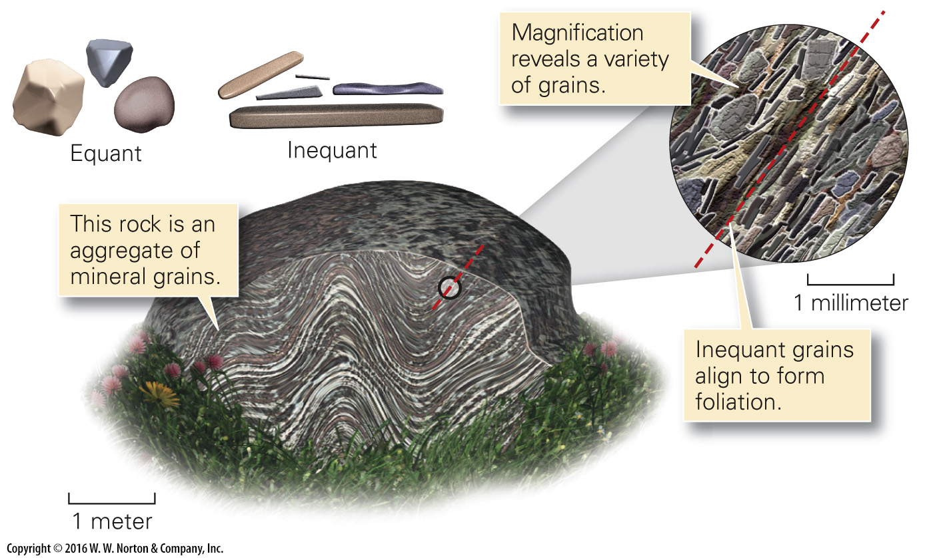
Notes:
FIGURE A.5b Describing grains in rock.
(b) Grains in rock come in a variety of shapes. Some are equant, whereas some are inequant. In this example of metamorphic rock, inequant grains align to define a foliation.

Slide 19
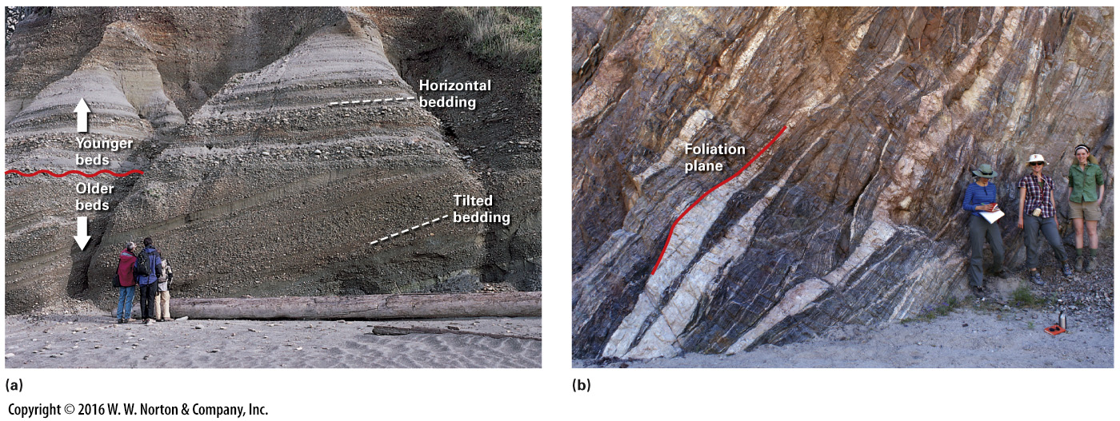
Notes:
FIGURE A.6 Layering in rock.
(a) Bedding in a sedimentary rock, here defined by alternating layers of coarser and finer grains, as exposed on a cliff along an Oregon beach. Older beds were tilted before younger ones were deposited. (b) Foliation in this outcrop of metamorphic rock near Mecca, California, is defined by alternating light and dark layers. The color of the layers depends on the minerals comprising the layers.

Slide 20
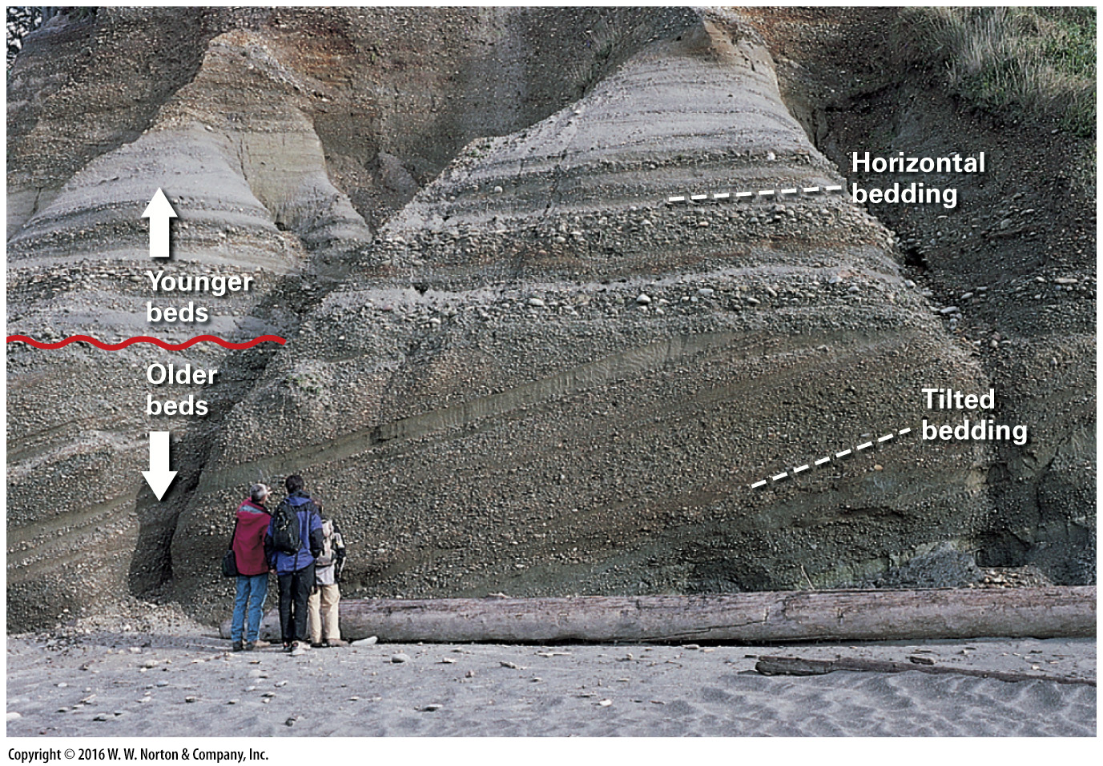
Notes:
FIGURE A.6a Layering in rock.
(a) Bedding in a sedimentary rock, here defined by alternating layers of coarser and finer grains, as exposed on a cliff along an Oregon beach. Older beds were tilted before younger ones were deposited.

Slide 21
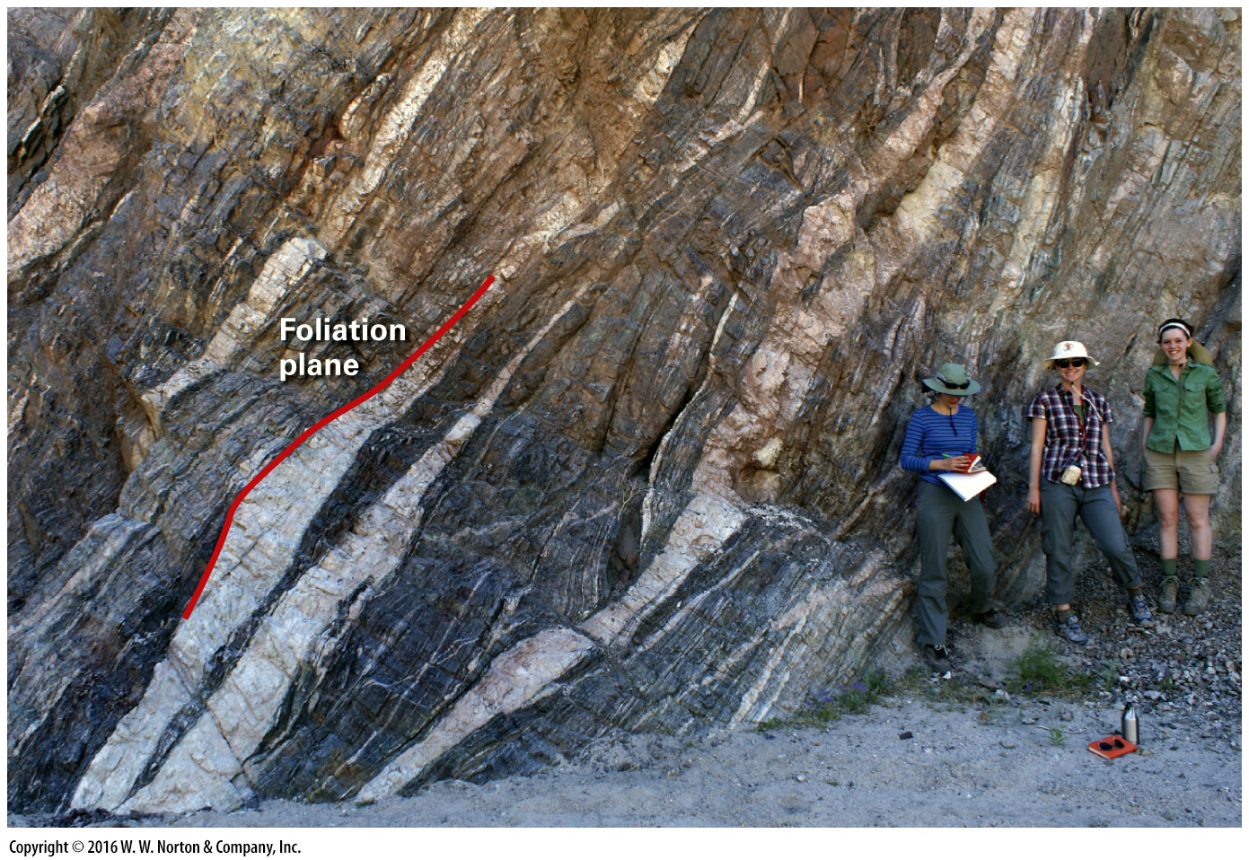
Notes:
FIGURE A.6b Layering in rock.
(b) Foliation in this outcrop of metamorphic rock near Mecca, California, is defined by alternating light and dark layers. The color of the layers depends on the minerals comprising the layers.

Slide 22
Notes:
FIGURE A.7 Two basic tools used for studying rocks in the field.

Slide 23
Notes:
FIGURE A.7 Two basic tools used for studying rocks in the field.

Slide 24
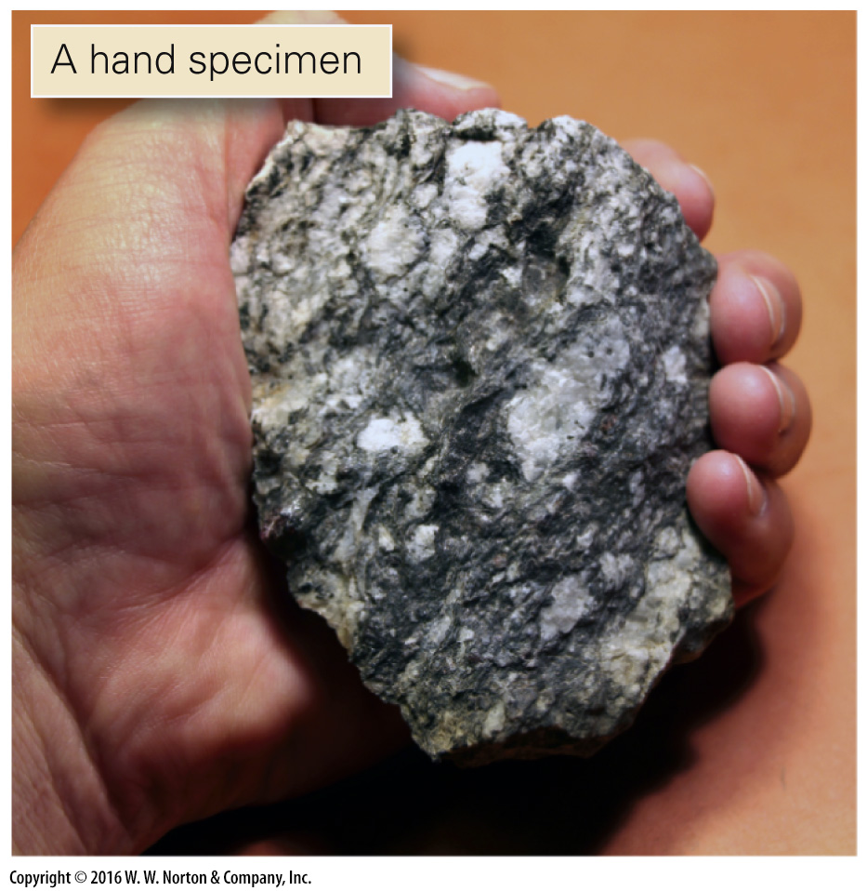
Notes:
FIGURE A.7 Two basic tools used for studying rocks in the field.

Slide 25
Notes:
FIGURE A.7 Two basic tools used for studying rocks in the field.

Slide 26
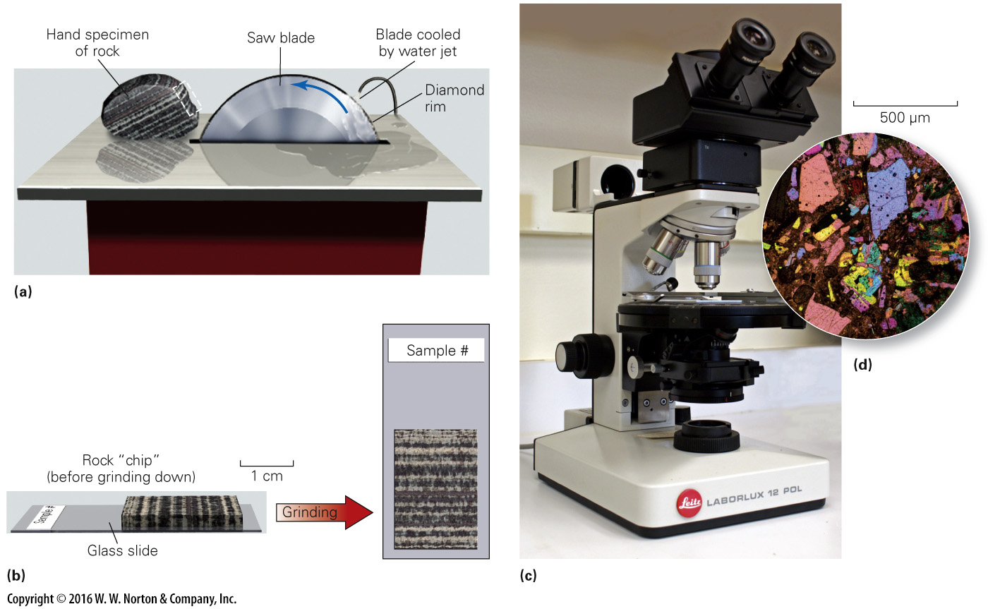
Notes:
FIGURE A.8 Studying rocks in thin section.
(a) Using a special saw, a geologist cuts a thin chip of a rock specimen. (b) The geologist glues the chip to a glass slide and grinds it down until it is so thin that light can pass through it. (c) With a petrographic microscope, it’s possible to view thin sections with light that shines through the sample from below. (d) If the light is polarized, different minerals display different colors when viewed through the microscope.

Slide 27
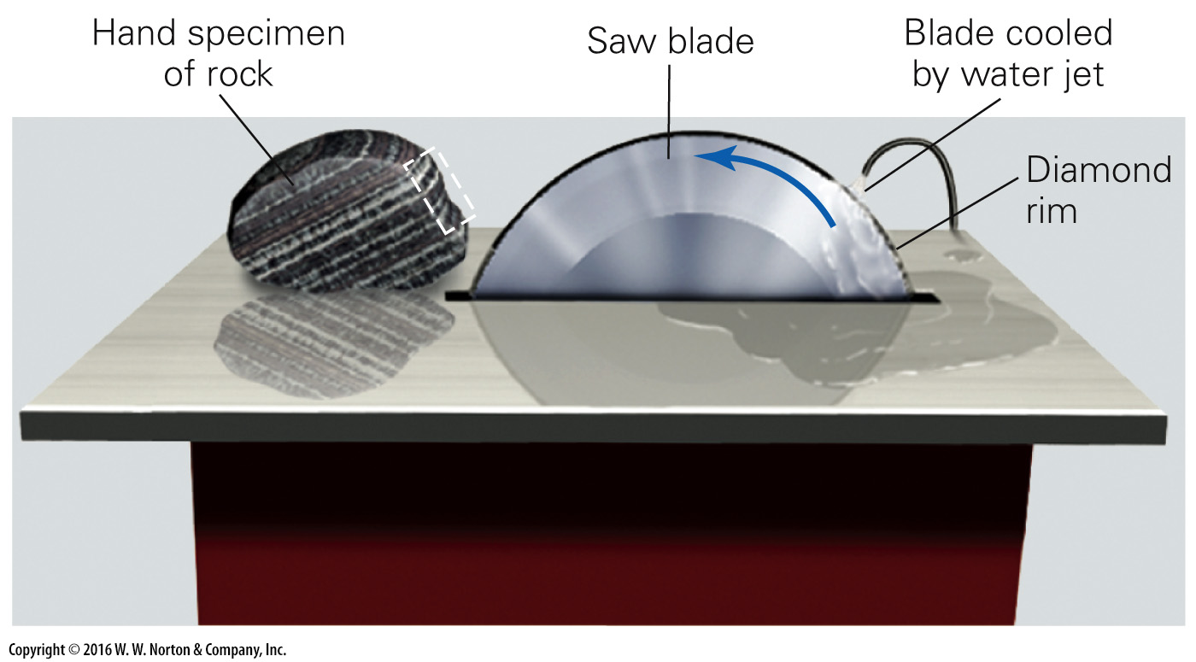
Notes:
FIGURE A.8a Studying rocks in thin section.
(a) Using a special saw, a geologist cuts a thin chip of a rock specimen.

Slide 28
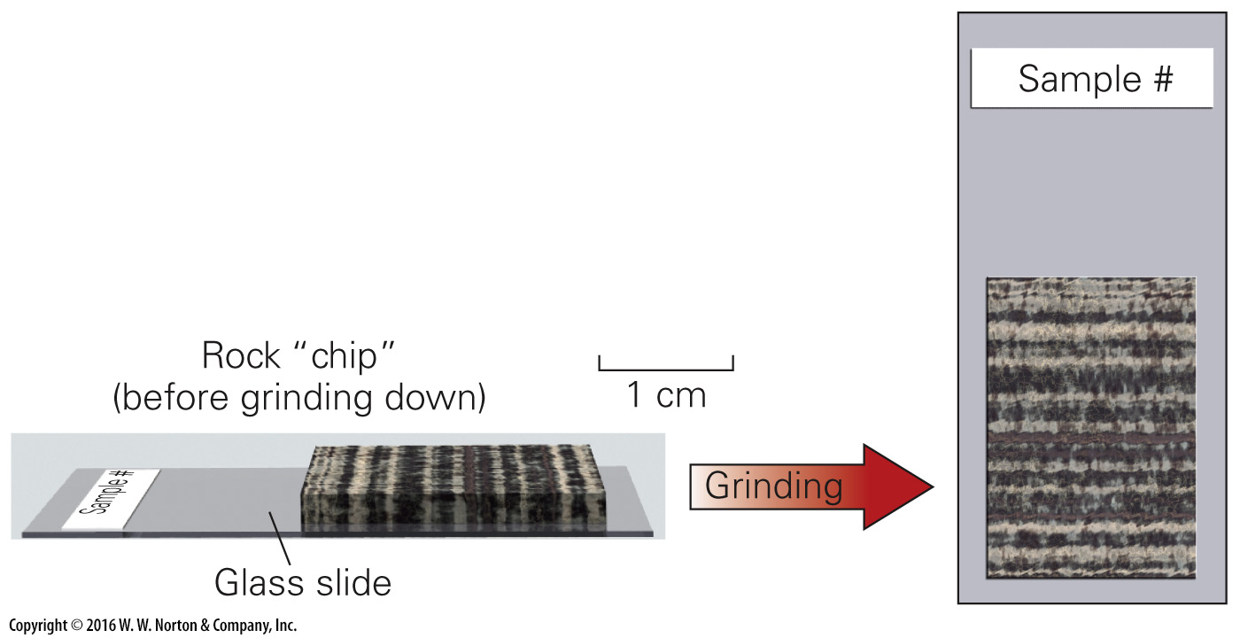
Notes:
FIGURE A.8b Studying rocks in thin section.
(b) The geologist glues the chip to a glass slide and grinds it down until it is so thin that light can pass through it.

Slide 29
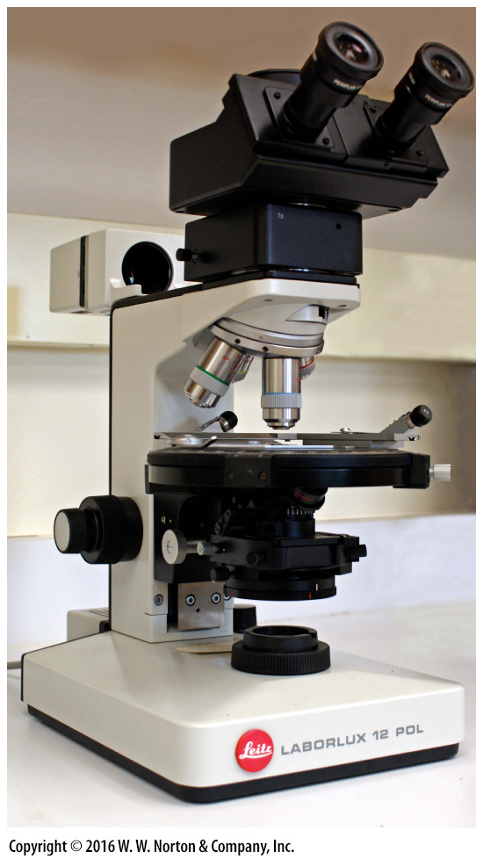
Notes:
FIGURE A.8c Studying rocks in thin section.
(c) With a petrographic microscope, it’s possible to view thin sections with light that shines through the sample from below.

Slide 30
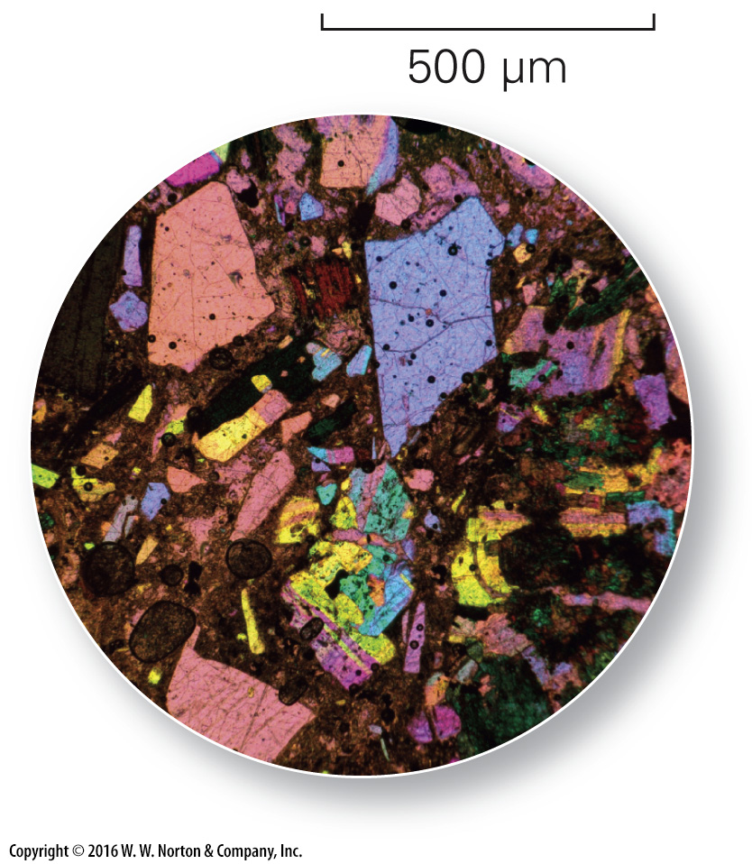
Notes:
FIGURE A.8d Studying rocks in thin section.
(d) If the light is polarized, different minerals display different colors when viewed through the microscope.

Slide 31
Notes:
FIGURE A.9 An electron microprobe uses a beam of electrons to analyze the chemical composition of minerals.

Slide 32
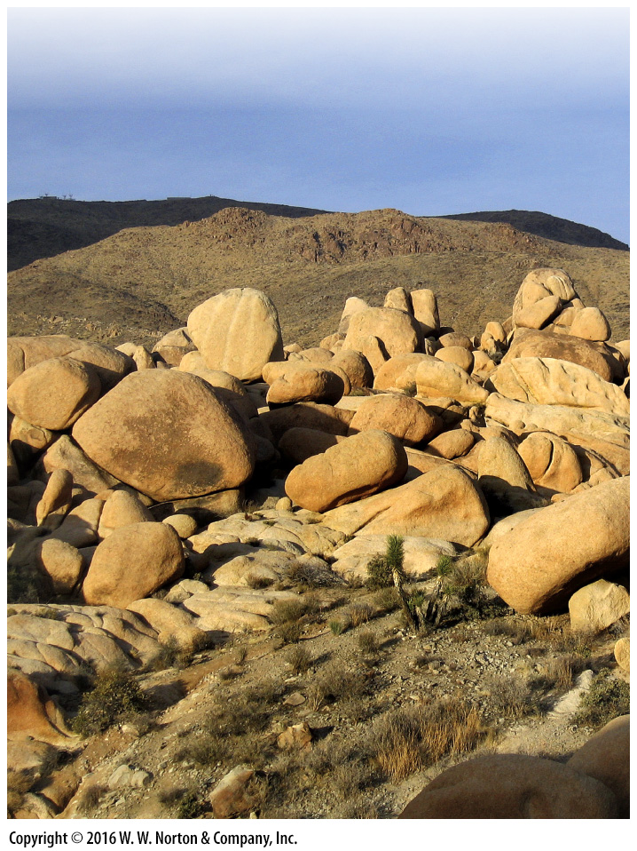
Notes:
Another View Rocks can be beautiful! Here, we see an outcrop of granite in Joshua Tree National Monument, in the Mojave Desert, California. These rocks formed deep underground, about 85 million years ago. Subsequent erosion removed the rocks that once lay above, and exposed the granite. Weathering of the granite has formed rounded blocks, which resemble shapes in modern sculpture.

