Slide 1
Stephen Marshak
ESSENTIALS OF
Geology
FIFTH EDITION
Interlude B
A Surface Veneer:
Sediments and Soils
©2016 W. W. Norton & Company, Inc.

Slide 2
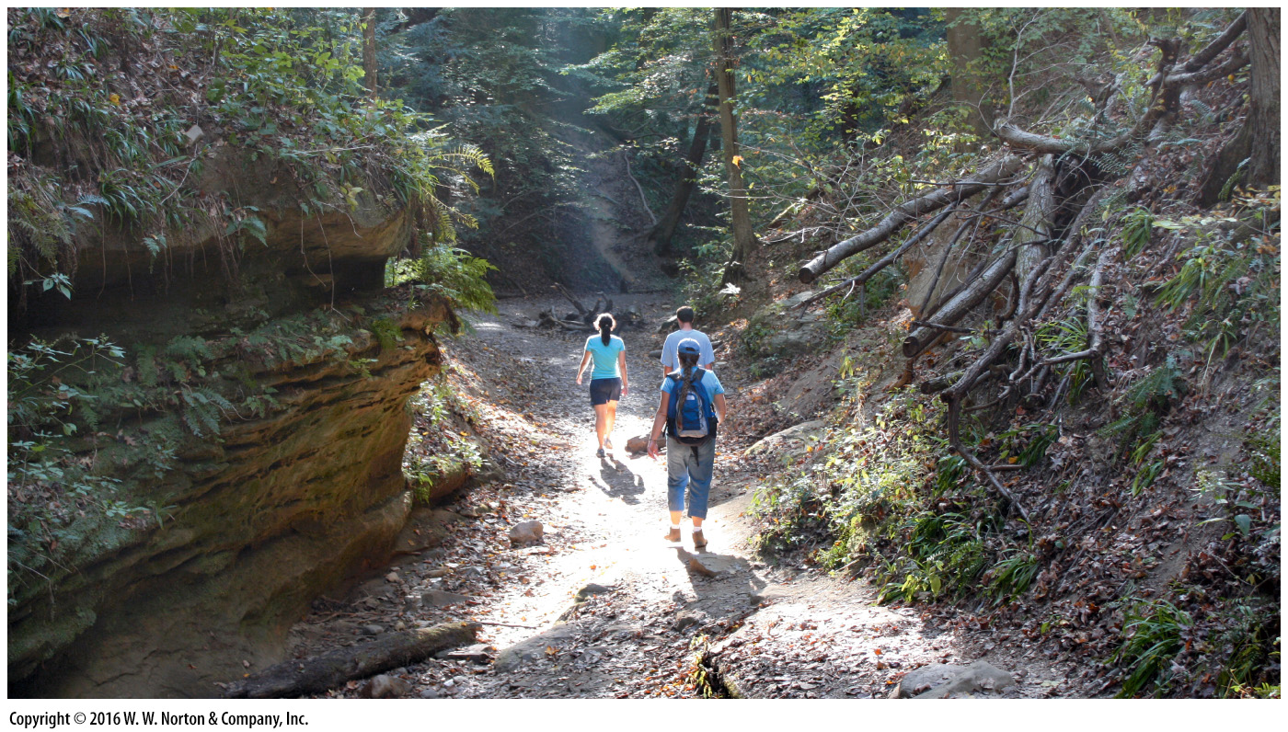
Notes:
Here at the Earth’s surface, in a small canyon in Indiana, a layer of sediment and soil covers bedrock. In stream cuts, bedrock peeks out from under this layer.

Slide 3
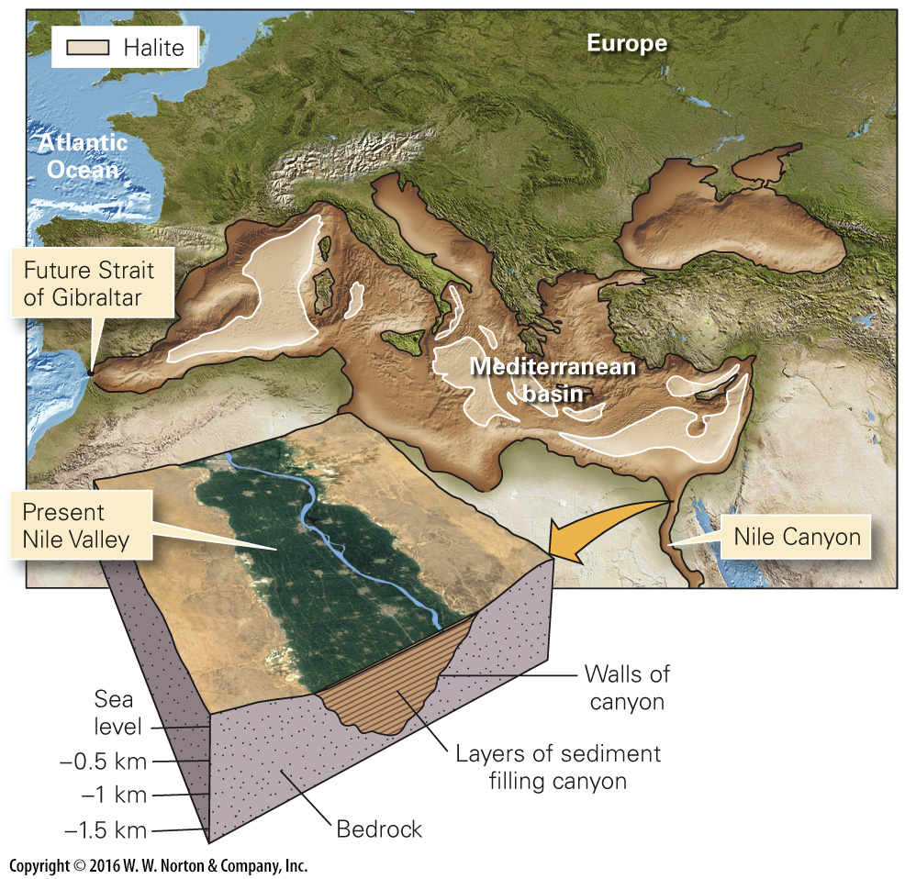
Notes:
FIGURE B.1 The present Nile River flows on sediment that filled a deep canyon. This canyon was formed when the Mediterranean Basin was dry.

Slide 4
Notes:
FIGURE B.2 A layer of unconsolidated sediment (sand, clay, and cobbles), topped by dark soil, overlies bedrock in this outcrop along the coast of western Ireland.

Slide 5
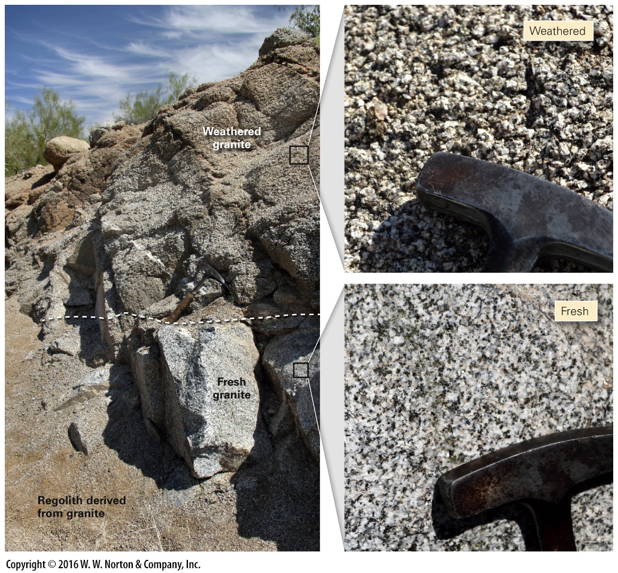
Notes:
FIGURE B.3 The contrast between fresh and weathered granite in an Arizona road cut. Weathered granite can break apart. Grains fall off and collect as detritus at the base of the outcrop. The inset photos show how weathering visibly changes the rock.

Slide 6
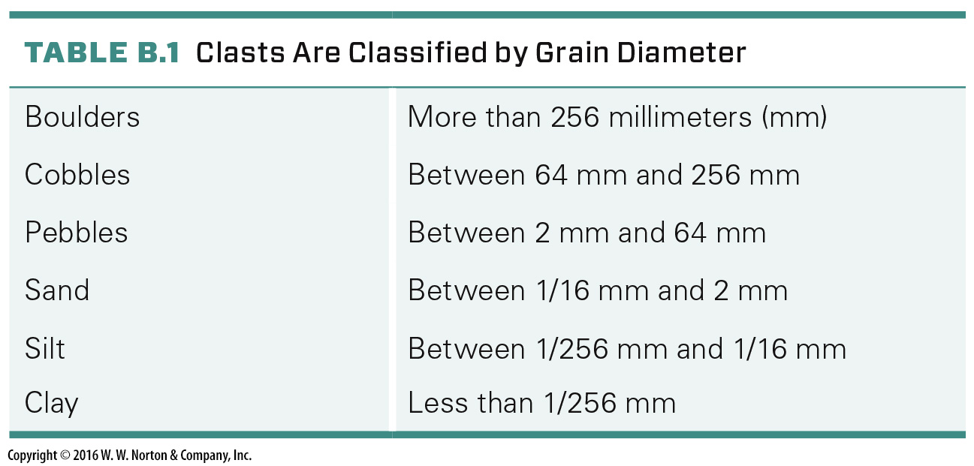
Notes:
TABLE B.1 Clasts Are Classified by Grain Diameter

Slide 7
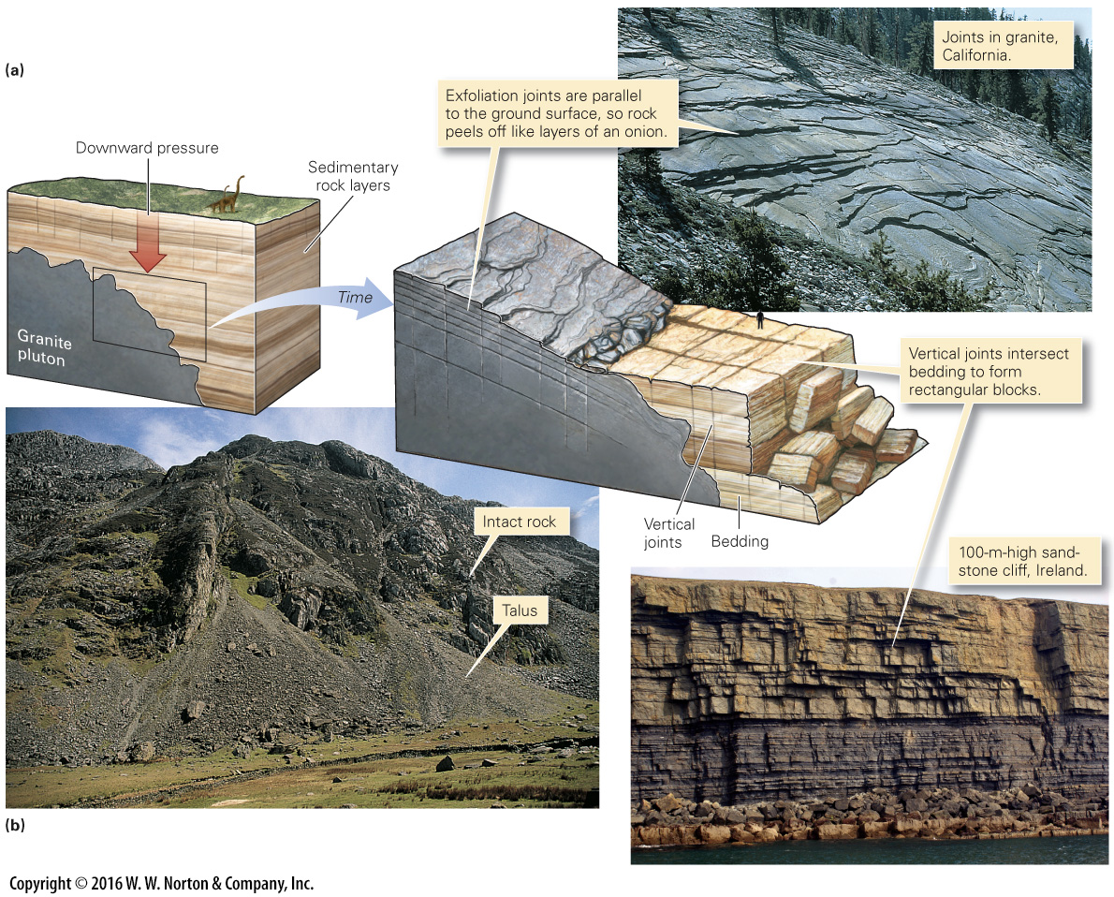
Notes:
FIGURE B.4 Joints (natural cracks) break bedrock into blocks and sheets, which can tumble down a slope.
(a) When buried deeply, rocks are subjected to a large downward pressure. Later, after erosion removes overburden, rocks expand and crack. (b) Joint-bounded blocks tumble from a cliff and accumulate in talus aprons near Mt. Snowdon in Wales.

Slide 8
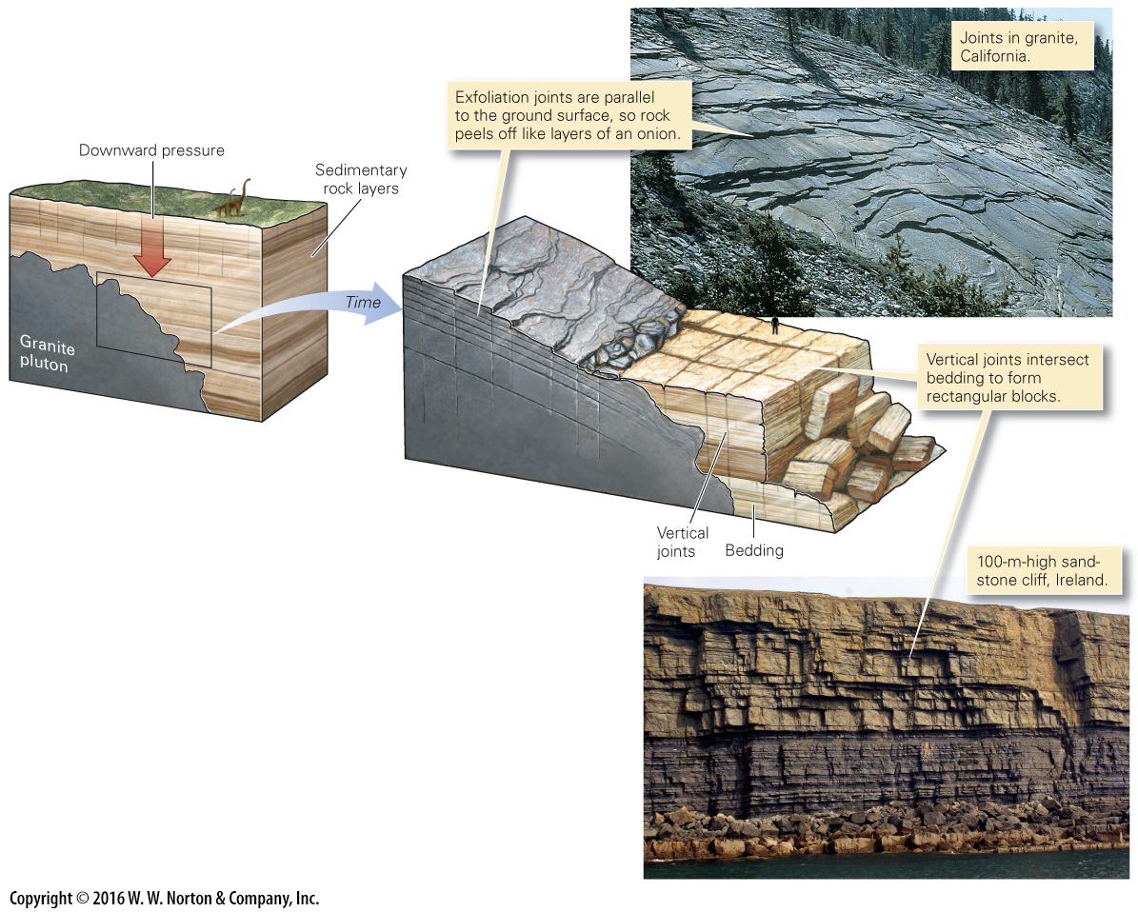
Notes:
FIGURE B.4a Joints (natural cracks) break bedrock into blocks and sheets, which can tumble down a slope.
(a) When buried deeply, rocks are subjected to a large downward pressure. Later, after erosion removes overburden, rocks expand and crack.

Slide 9
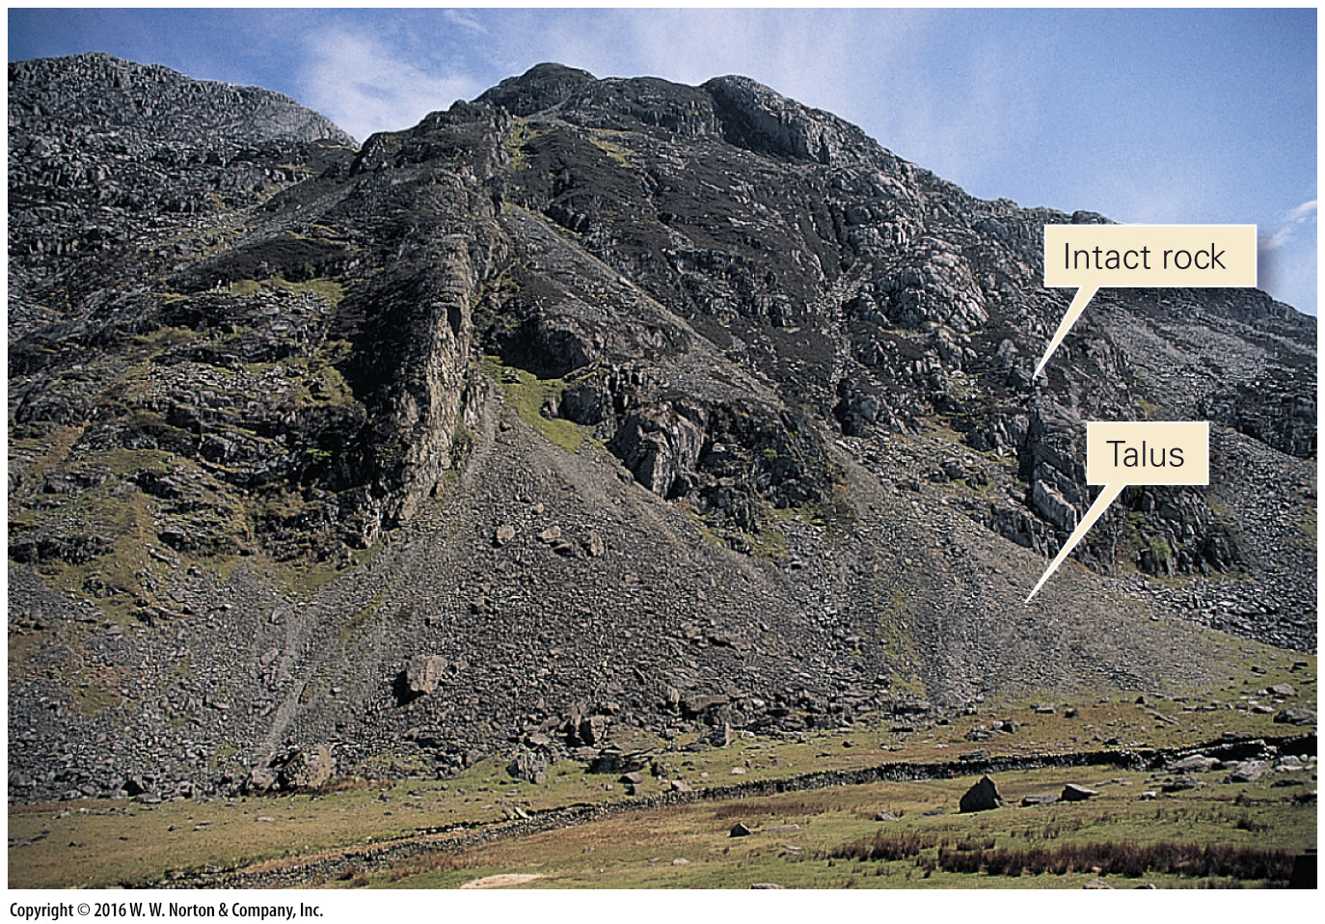
Notes:
FIGURE B.4b Joints (natural cracks) break bedrock into blocks and sheets, which can tumble down a slope.
(b) Joint-bounded blocks tumble from a cliff and accumulate in talus aprons near Mt. Snowdon in Wales.

Slide 10
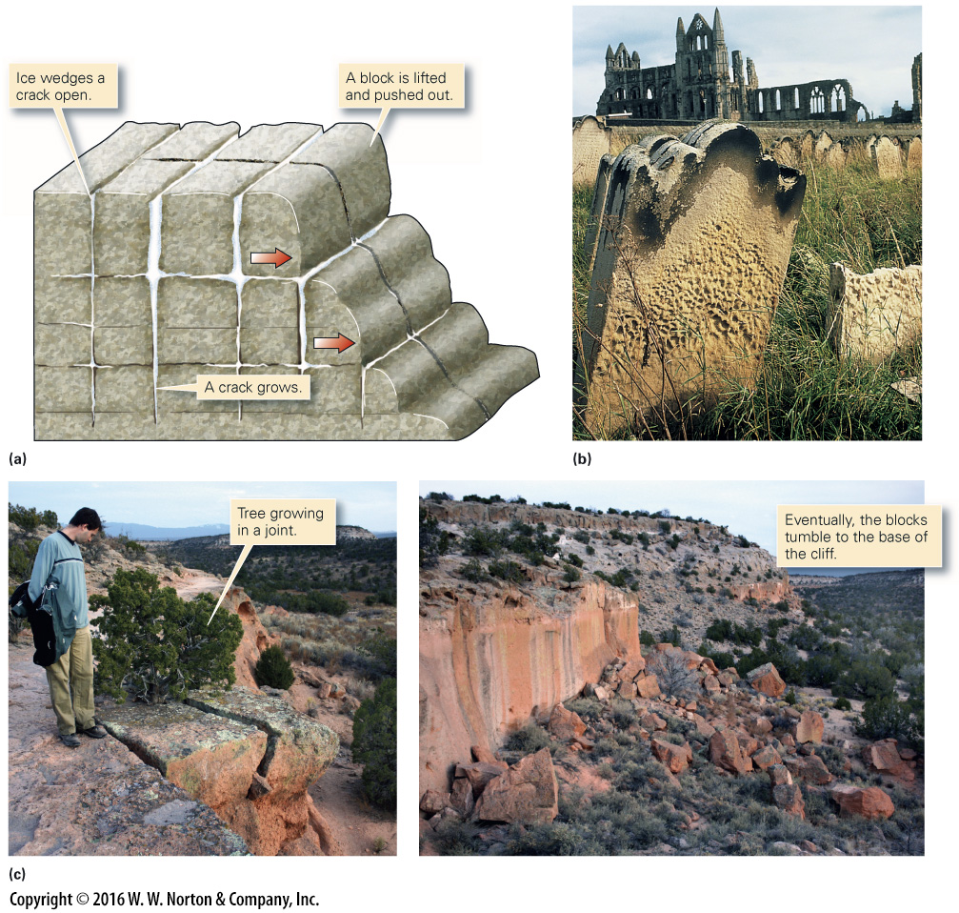
Notes:
FIGURE B.5 Wedging is one type of physical (mechanical) weathering.
(a) When the water that fills cracks freezes, it expands and wedges the cracks open. (b) Salt wedging led to disintegration of gravestones in Whitby, England. (c) Root wedging pushes open a joint, slowly separating a block from the cliff.

Slide 11
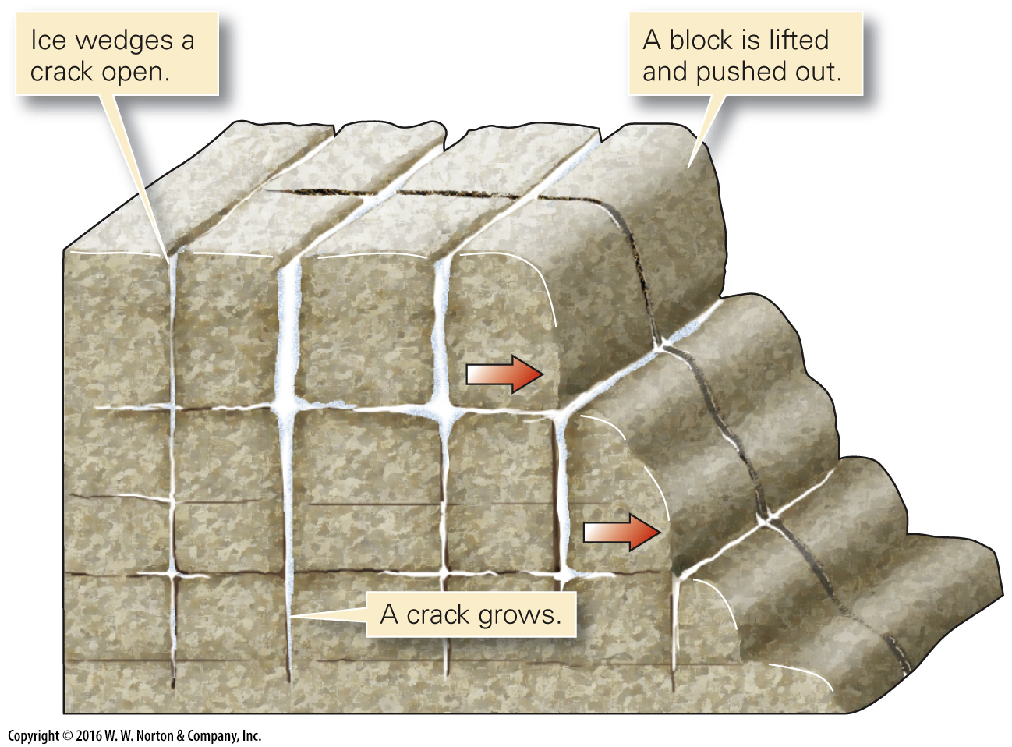
Notes:
FIGURE B.5a Wedging is one type of physical (mechanical) weathering.
(a) When the water that fills cracks freezes, it expands and wedges the cracks open.

Slide 12
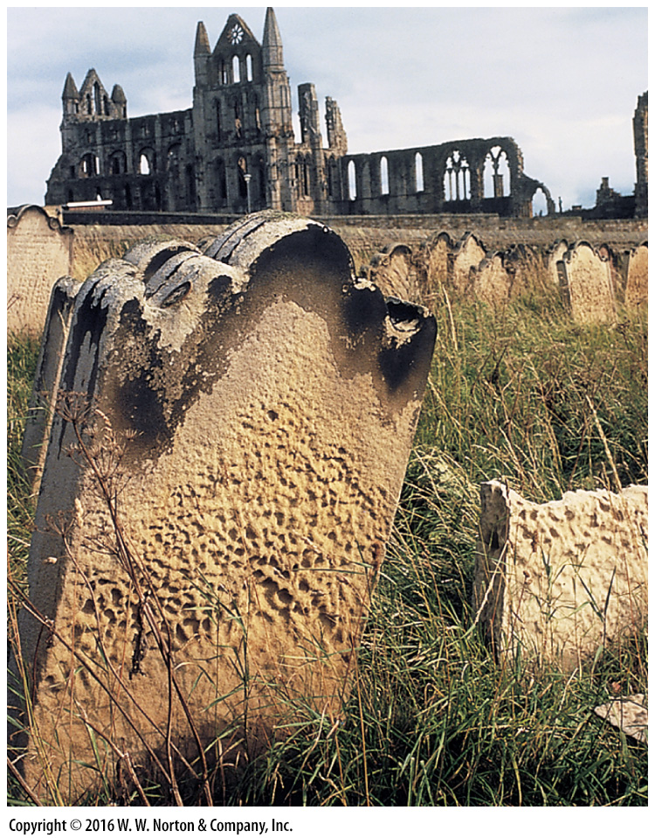
Notes:
FIGURE B.5b Wedging is one type of physical (mechanical) weathering.
(b) Salt wedging led to disintegration of gravestones in Whitby, England.

Slide 13
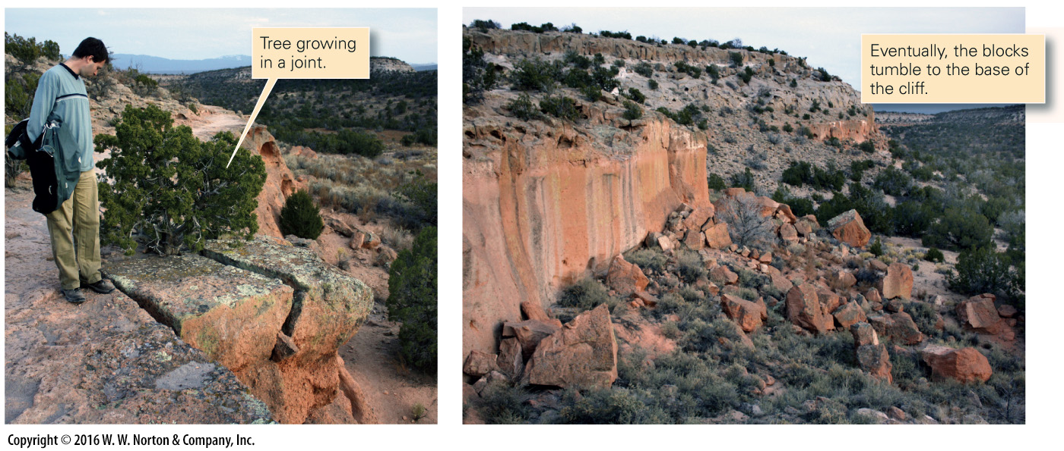
Notes:
FIGURE B.5c Wedging is one type of physical (mechanical) weathering.
(c) Root wedging pushes open a joint, slowly separating a block from the cliff.

Slide 14
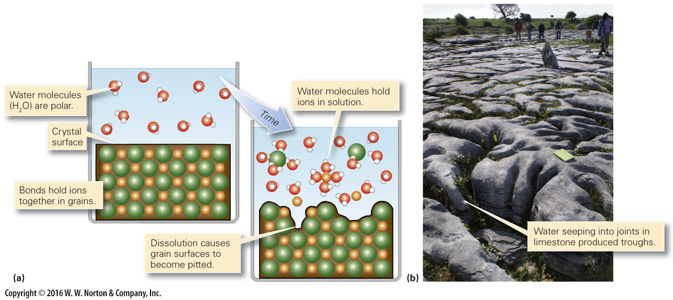
Notes:
FIGURE B.6 Dissolution is one type of chemical weathering.
(a) Dissolution occurs when water molecules pluck ions off of grain surfaces. (b) Dissolution of limestone on an outcrop surface in Ireland.

Slide 15
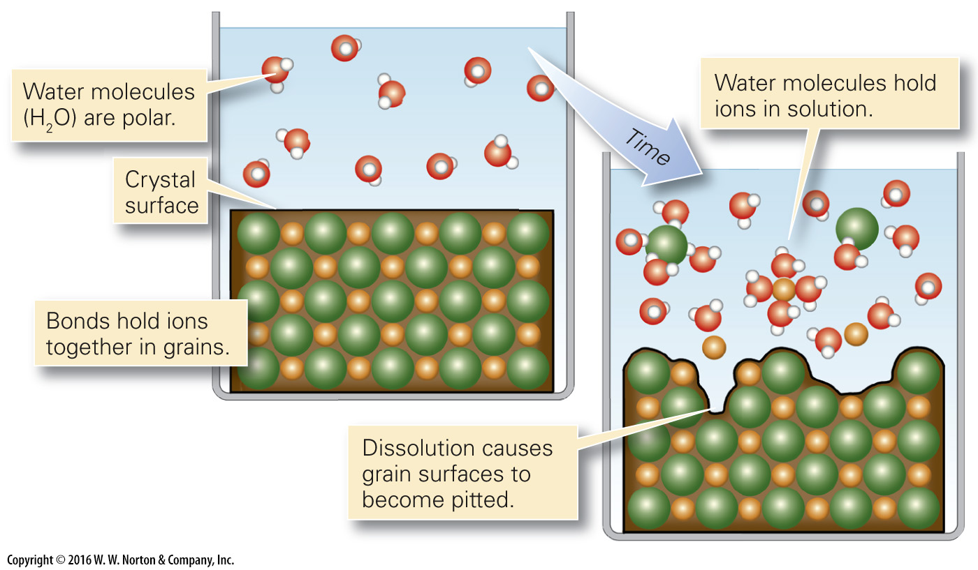
Notes:
FIGURE B.6a Dissolution is one type of chemical weathering.
(a) Dissolution occurs when water molecules pluck ions off of grain surfaces.

Slide 16
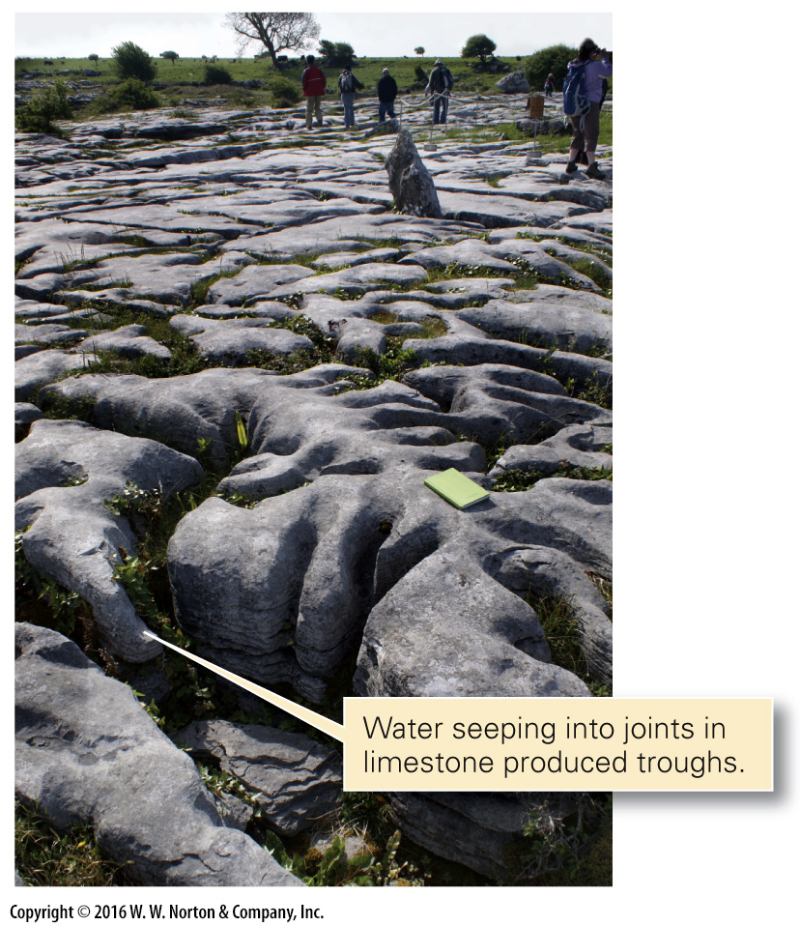
Notes:
FIGURE B.6b Dissolution is one type of chemical weathering.
(b) Dissolution of limestone on an outcrop surface in Ireland.

Slide 17
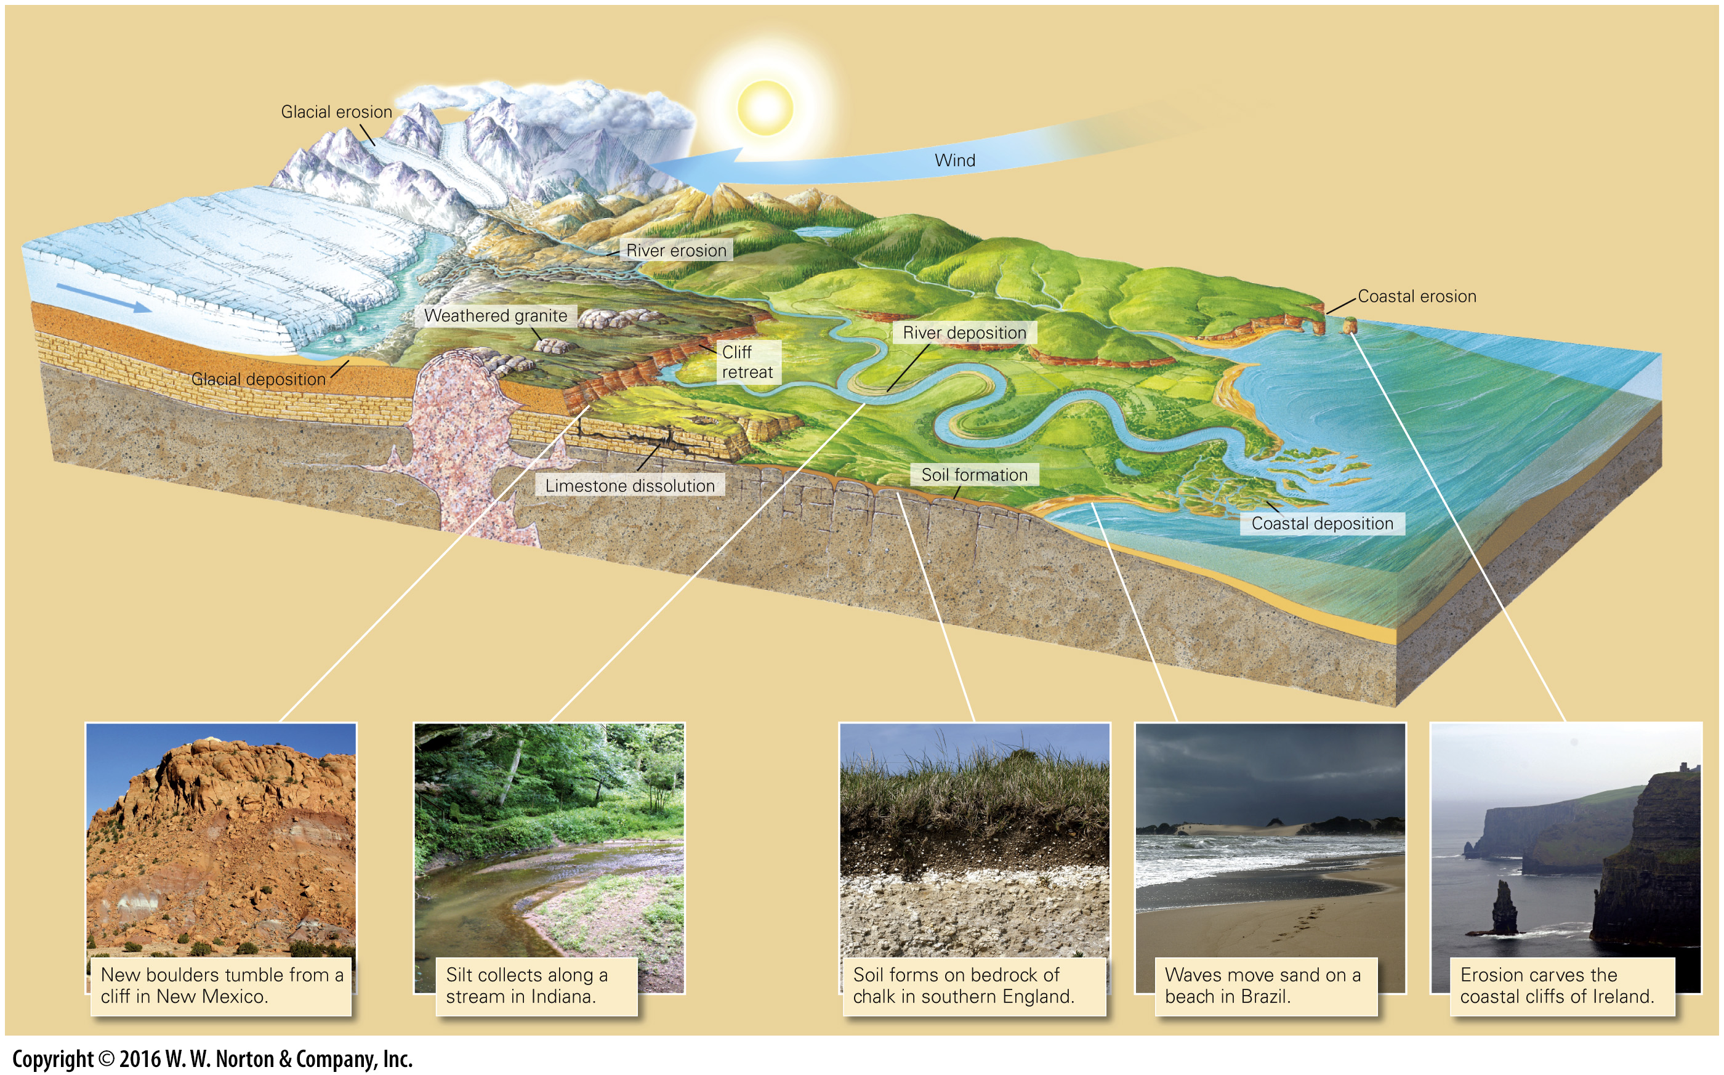
Notes:
GEOLOGY AT A GLANCE
Weathering, Sediment, and Soil Production

Slide 18
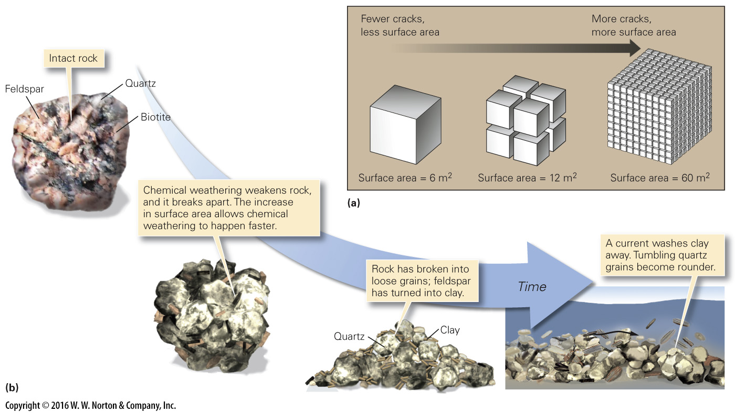
Notes:
FIGURE B.7 Physical and chemical processes work together during the weathering process.
(a) As rock breaks apart due to physical weathering, the surface area increases relative to volume. (b) Chemical weathering weakens rock, so it breaks apart. As this happens, the surface area increases, so chemical weathering happens still faster. Eventually, the rock completely disaggregates to form sediment. Weathering of granite produces quartz sand and clay.

Slide 19
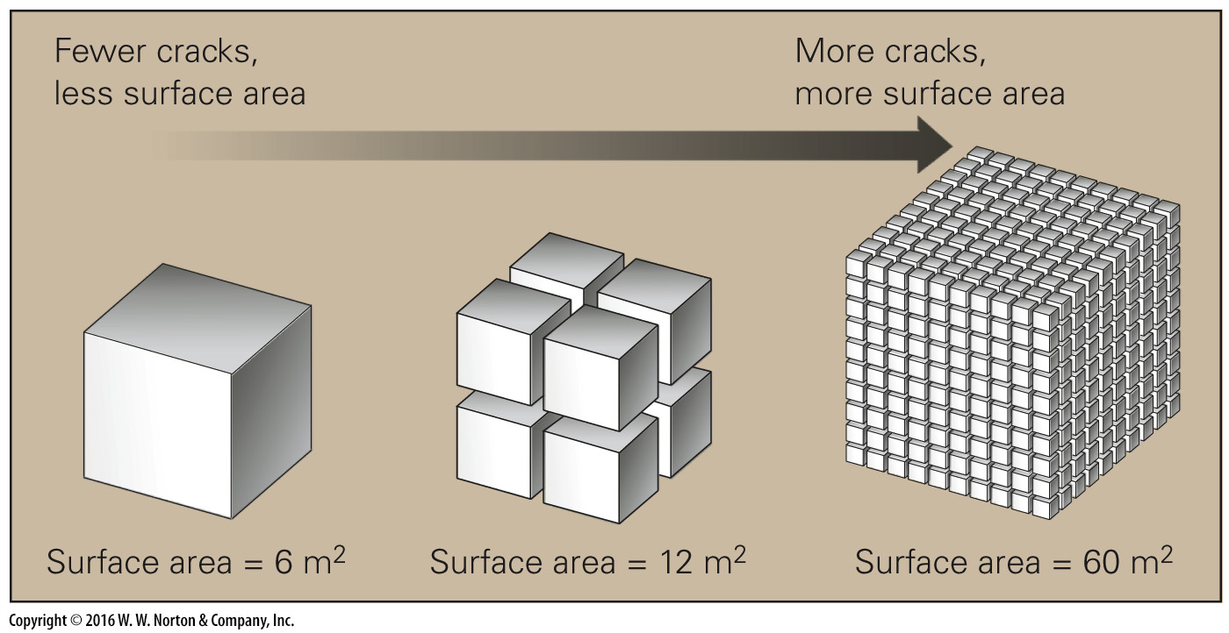
Notes:
FIGURE B.7a Physical and chemical processes work together during the weathering process.
(a) As rock breaks apart due to physical weathering, the surface area increases relative to volume.

Slide 20
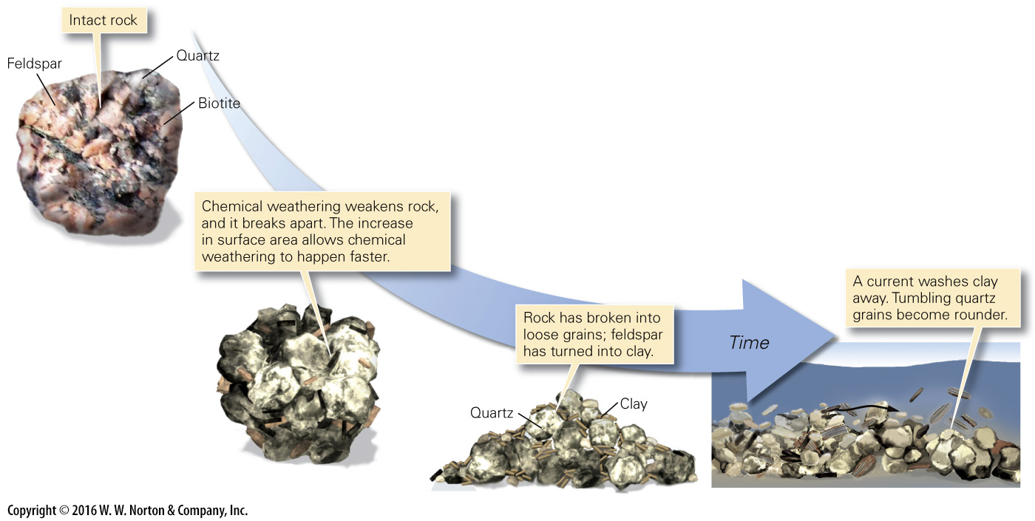
Notes:
FIGURE B.7b Physical and chemical processes work together during the weathering process.
(b) Chemical weathering weakens rock, so it breaks apart. As this happens, the surface area increases, so chemical weathering happens still faster. Eventually, the rock completely disaggregates to form sediment. Weathering of granite produces quartz sand and clay.

Slide 21
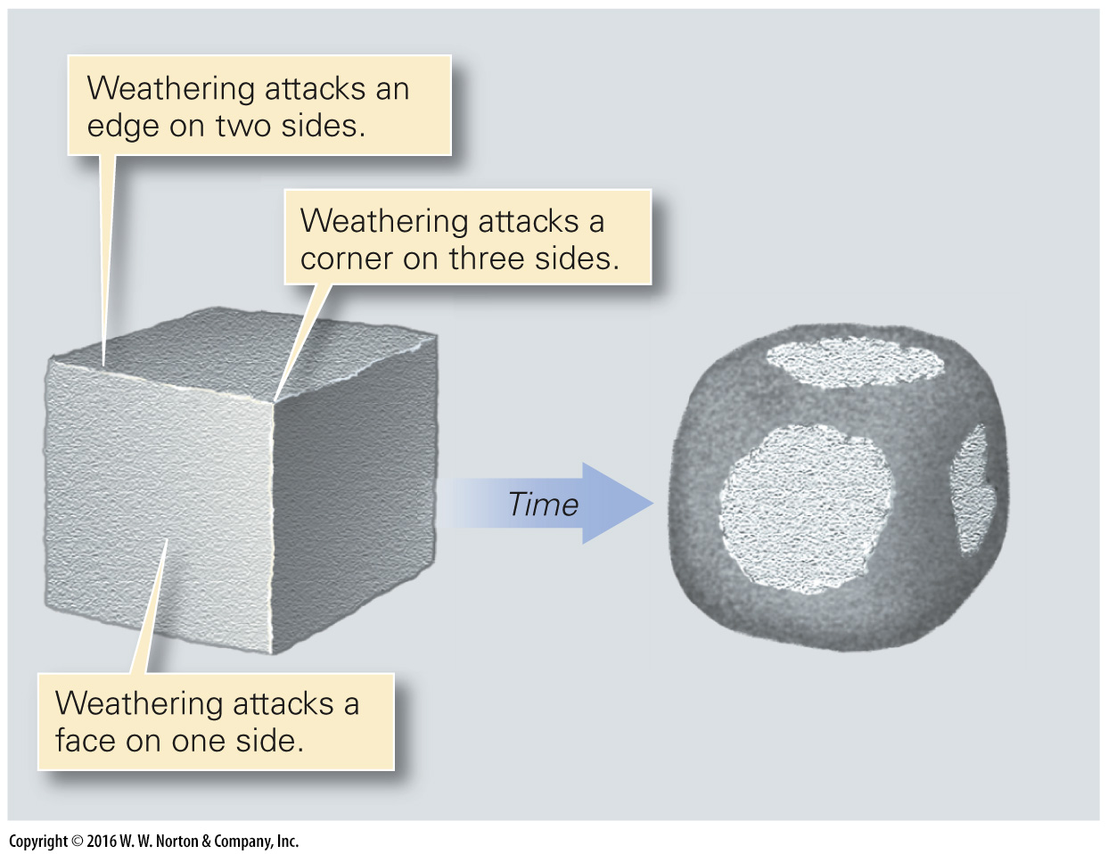
Notes:
FIGURE B.8a Spheroidal weathering and differential weathering.
(a) Weathering attacks more vigorously at the edges of a block and most vigorously at the corners. Thus, homogeneous rocks tend to weather into rounded blocks.

Slide 22
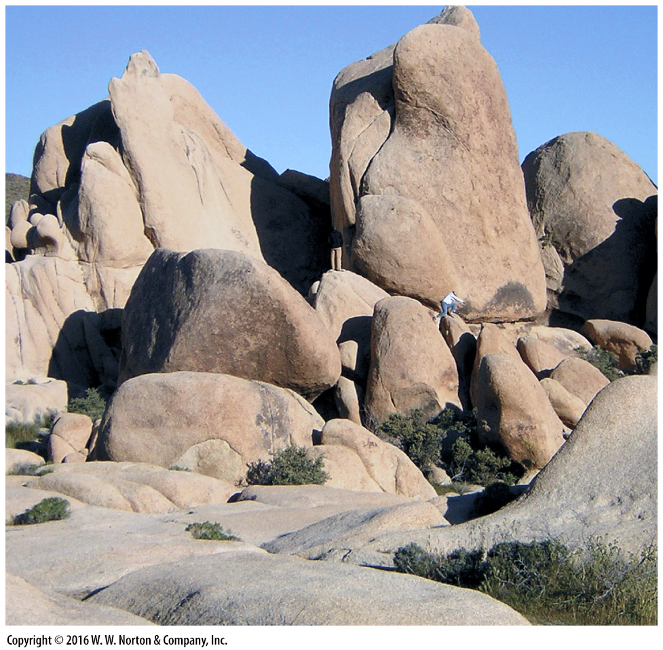
Notes:
FIGURE B.8b Spheroidal weathering and differential weathering.
(b) Weathering along cracks in granite of the Mojave Desert led to the formation of rounded blocks. This style is called spheroidal weathering.

Slide 23
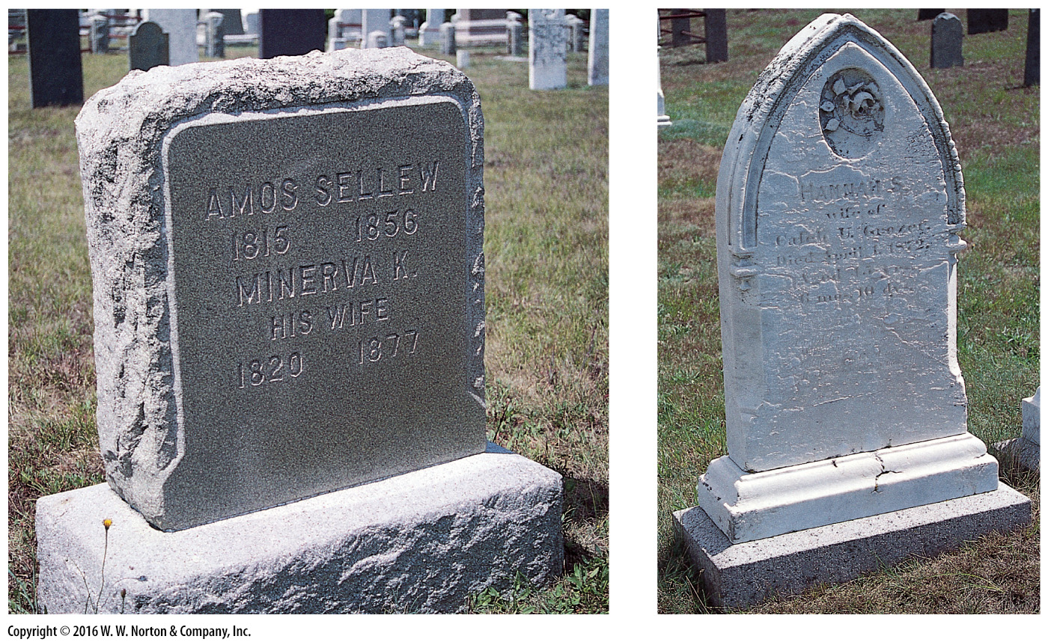
Notes:
FIGURE B.8c Spheroidal weathering and differential weathering.
(c) Inscriptions on a granite headstone (left) last for centuries, but those on a marble headstone (right) may weather away in decades. These gravestones are in the same cemetery and are about the same age.

Slide 24
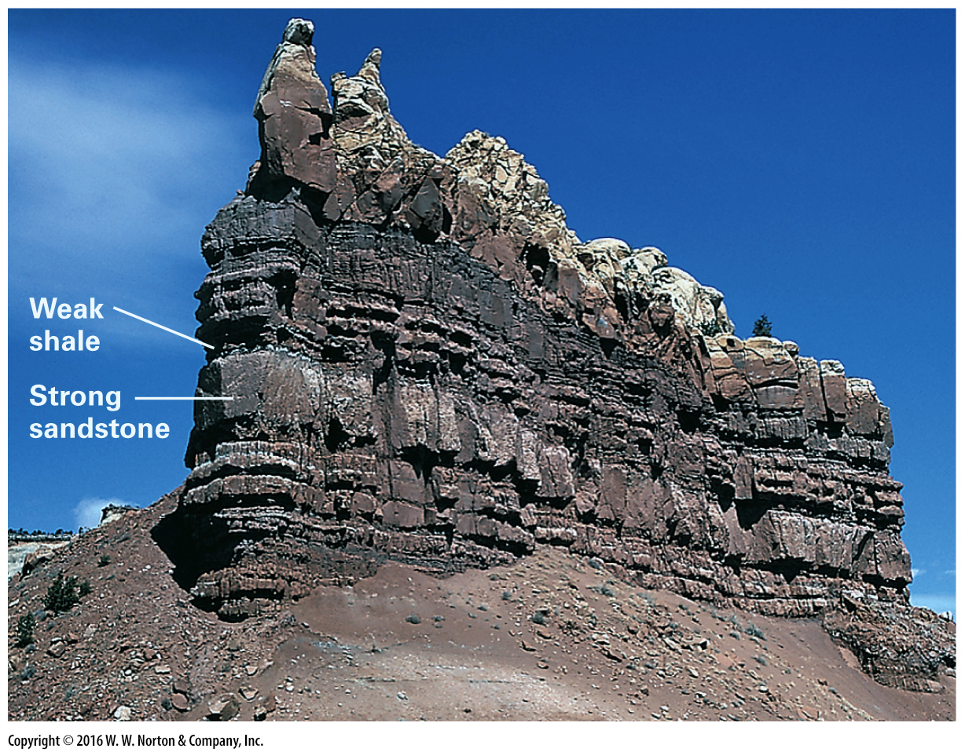
Notes:
FIGURE B.8d Spheroidal weathering and differential weathering.
(d) Sawtooth weathering profiles develop in sequences of alternating strong and weak layers on this exposure in New Mexico. Weak layers are indented, whereas strong (resistant) layers protrude.

Slide 25
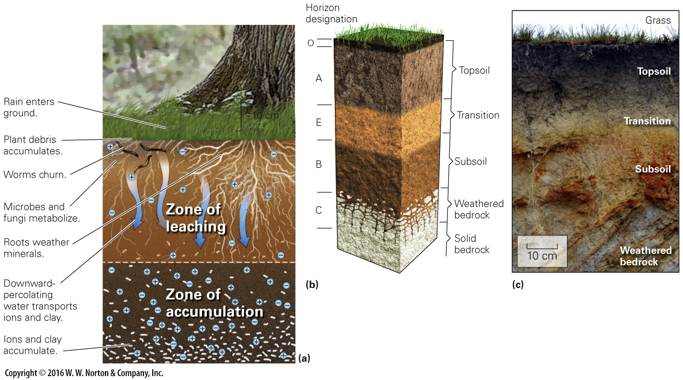
Notes:
FIGURE B.9 Formation of soil horizons.
(a) Soil horizons form as water percolates downward, carrying ions and clay with it, and as organisms interact with the soil. (b) Distinct soil horizons develop, each with a characteristic composition and texture. (c) Soil horizons exposed on the wall of a gully in eastern Brazil.

Slide 26
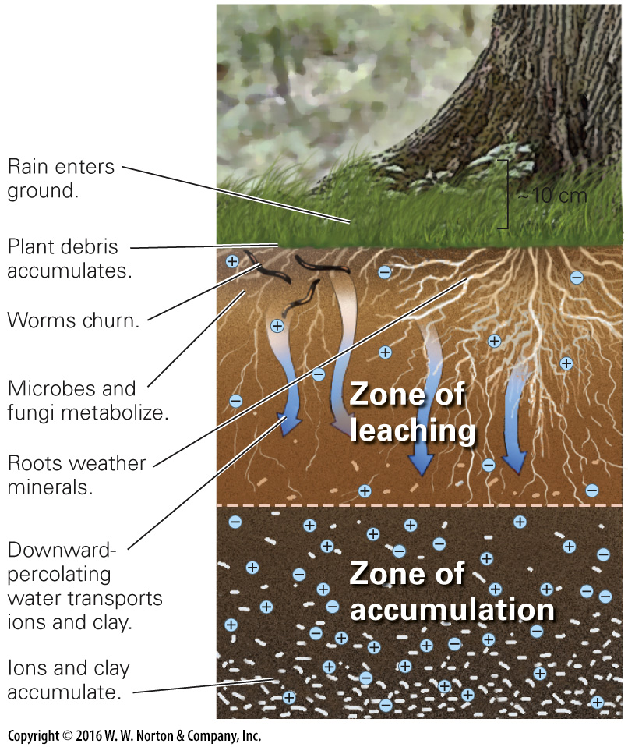
Notes:
FIGURE B.9a Formation of soil horizons.
(a) Soil horizons form as water percolates downward, carrying ions and clay with it, and as organisms interact with the soil.

Slide 27
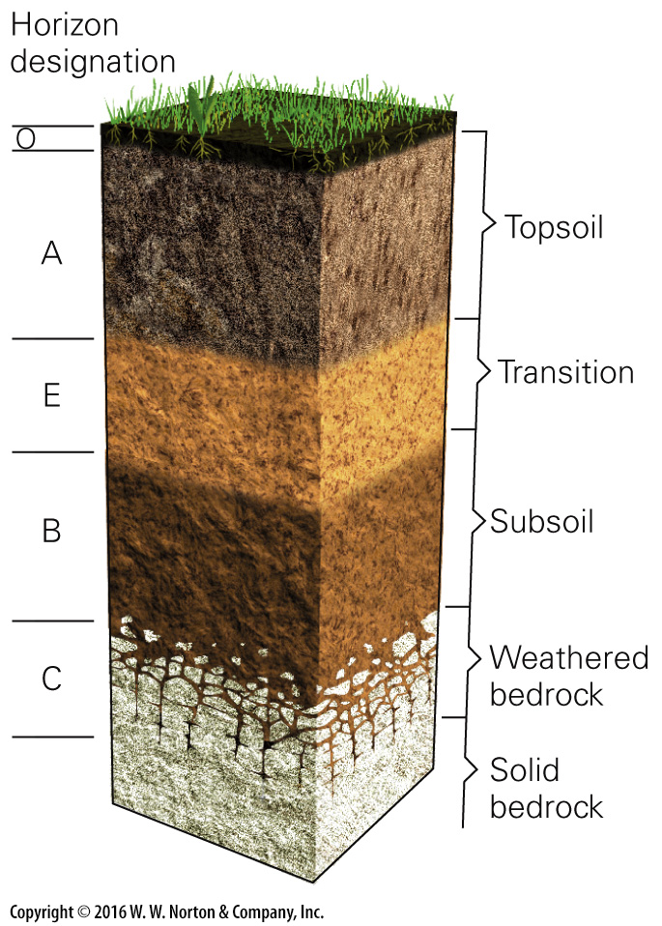
Notes:
FIGURE B.9b Formation of soil horizons.
(b) Distinct soil horizons develop, each with a characteristic composition and texture.

Slide 28
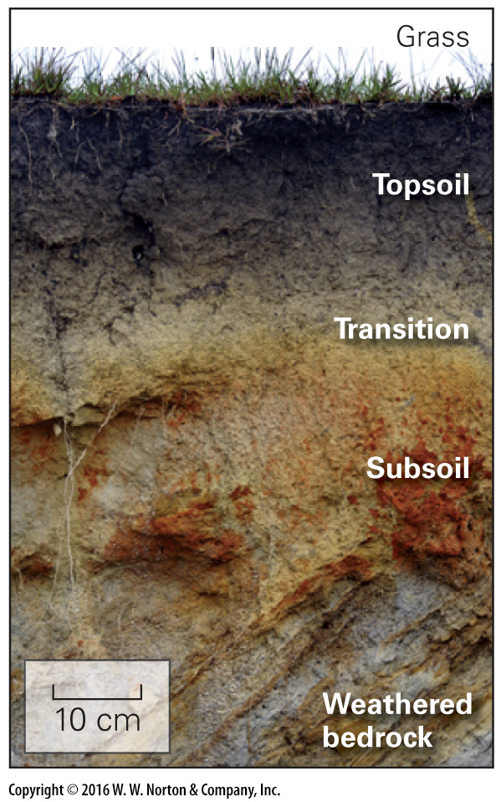
Notes:
FIGURE B.9c Formation of soil horizons.
(c) Soil horizons exposed on the wall of a gully in eastern Brazil.

Slide 29
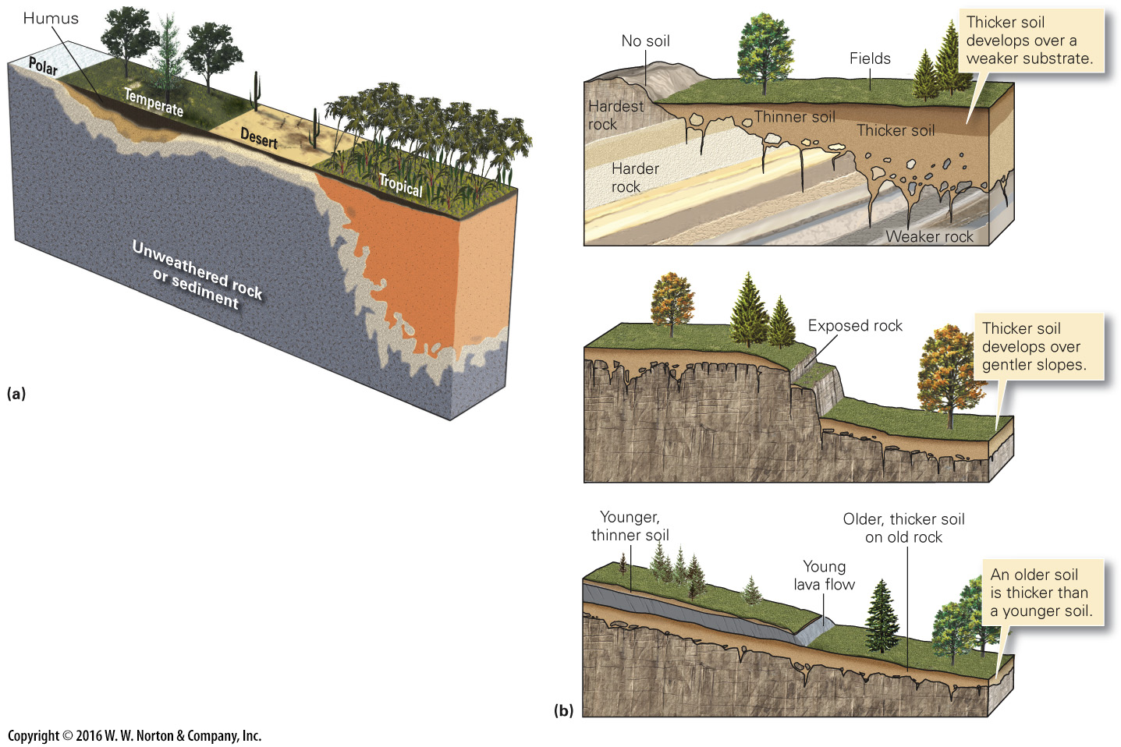
Notes:
FIGURE B.10 Factors that control the character of soil.
(a) Soil character depends on climate, for climate affects rainfall and vegetation. (b) Soil character also depends on the strength of the substrate, the steepness of the slope, and the length of time soil has been forming.

Slide 30
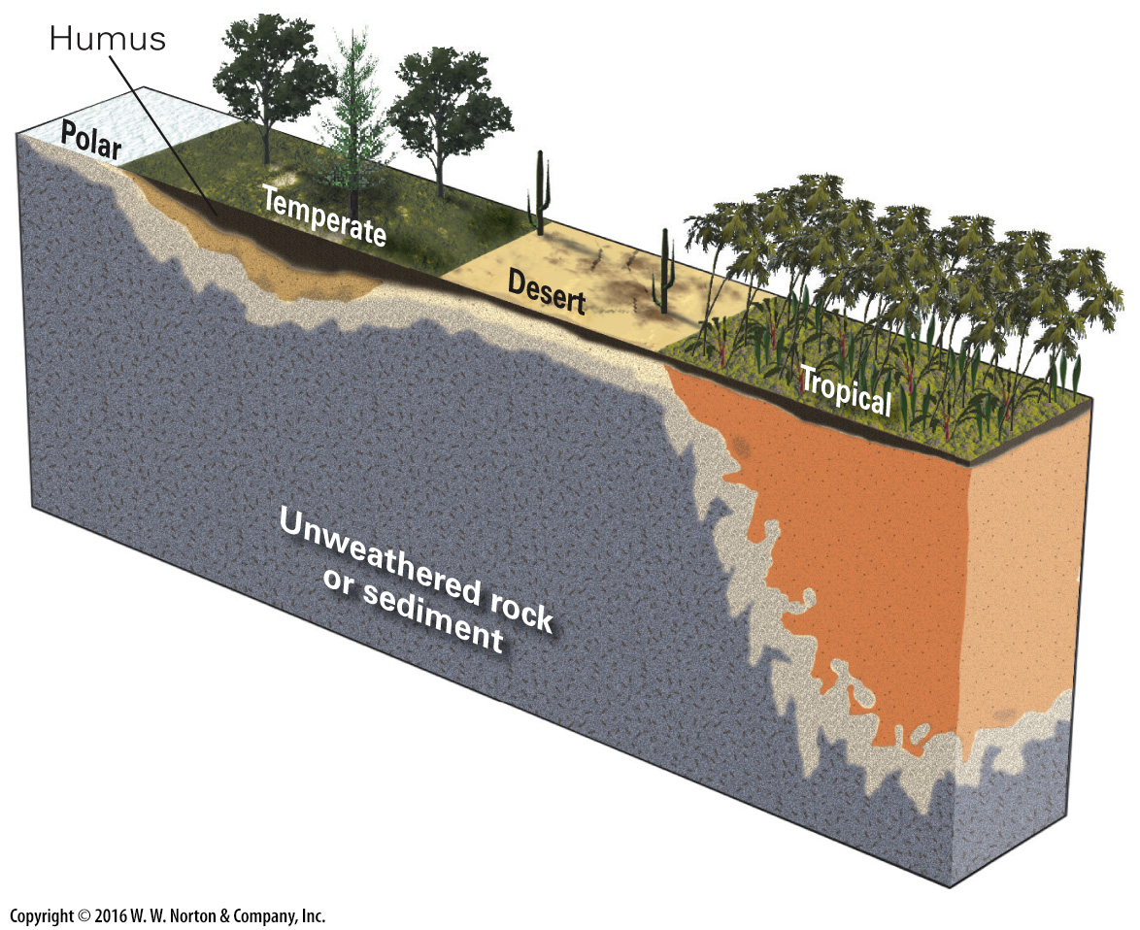
Notes:
FIGURE B.10a Factors that control the character of soil.
(a) Soil character depends on climate, for climate affects rainfall and vegetation.

Slide 31
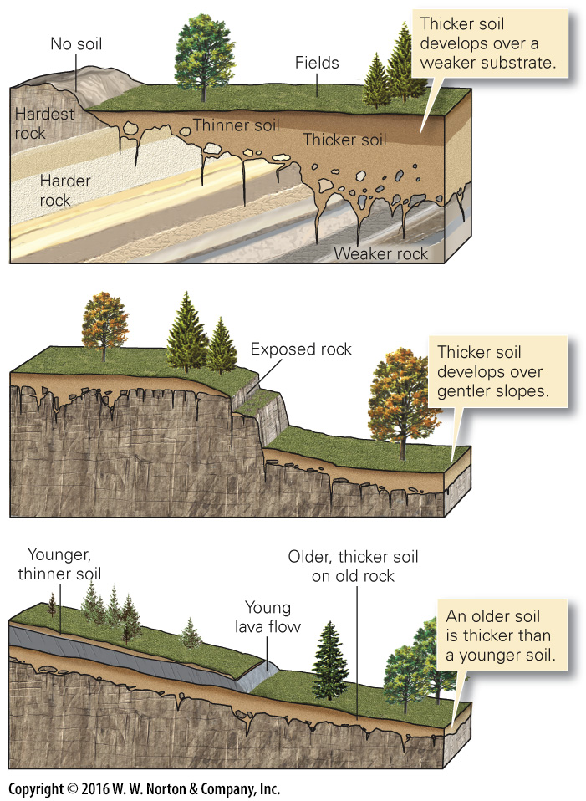
Notes:
FIGURE B.10b Factors that control the character of soil.
(b) Soil character also depends on the strength of the substrate, the steepness of the slope, and the length of time soil has been forming.

Slide 32
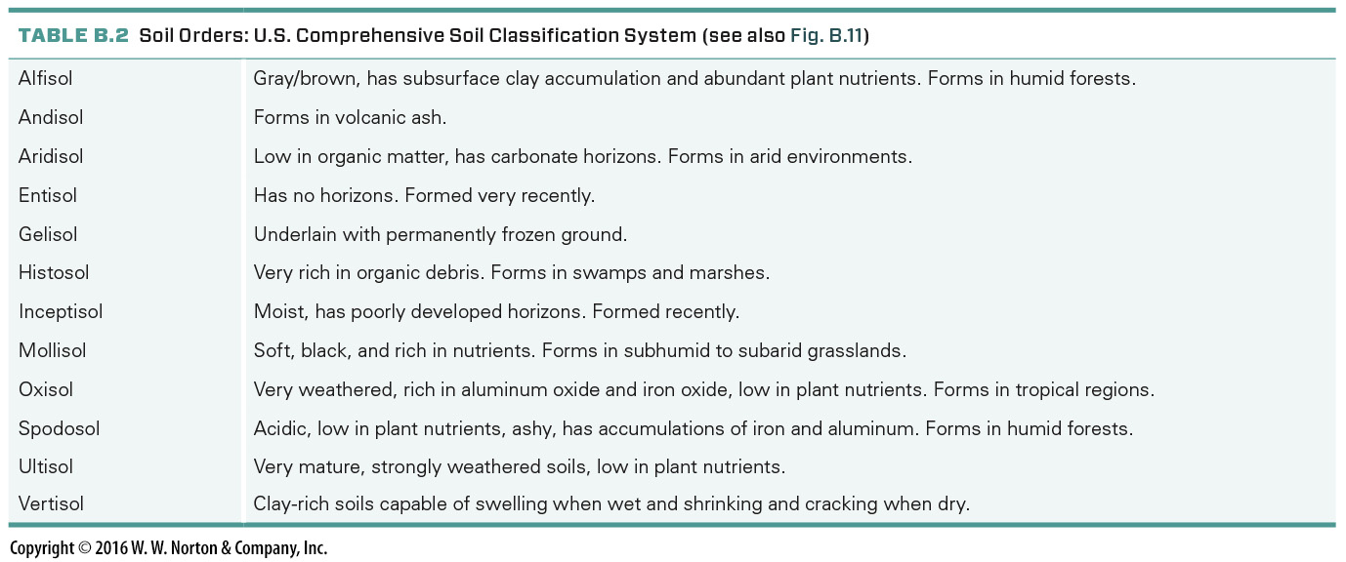
Notes:
TABLE B.2 Soil Orders: U.S. Comprehensive Soil Classification System (see also Fig. B.11)

Slide 33
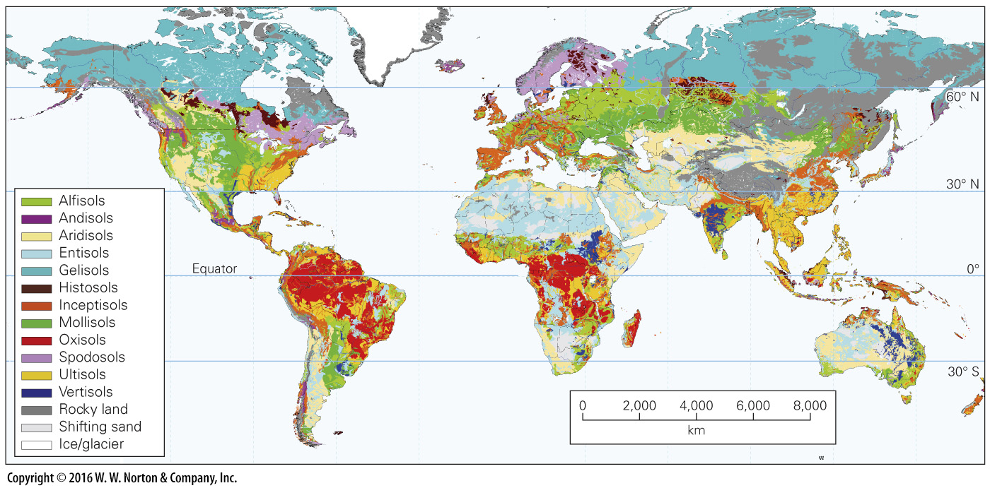
Notes:
FIGURE B.11 U.S. Department of Agriculture map of soil types around the world.

Slide 34
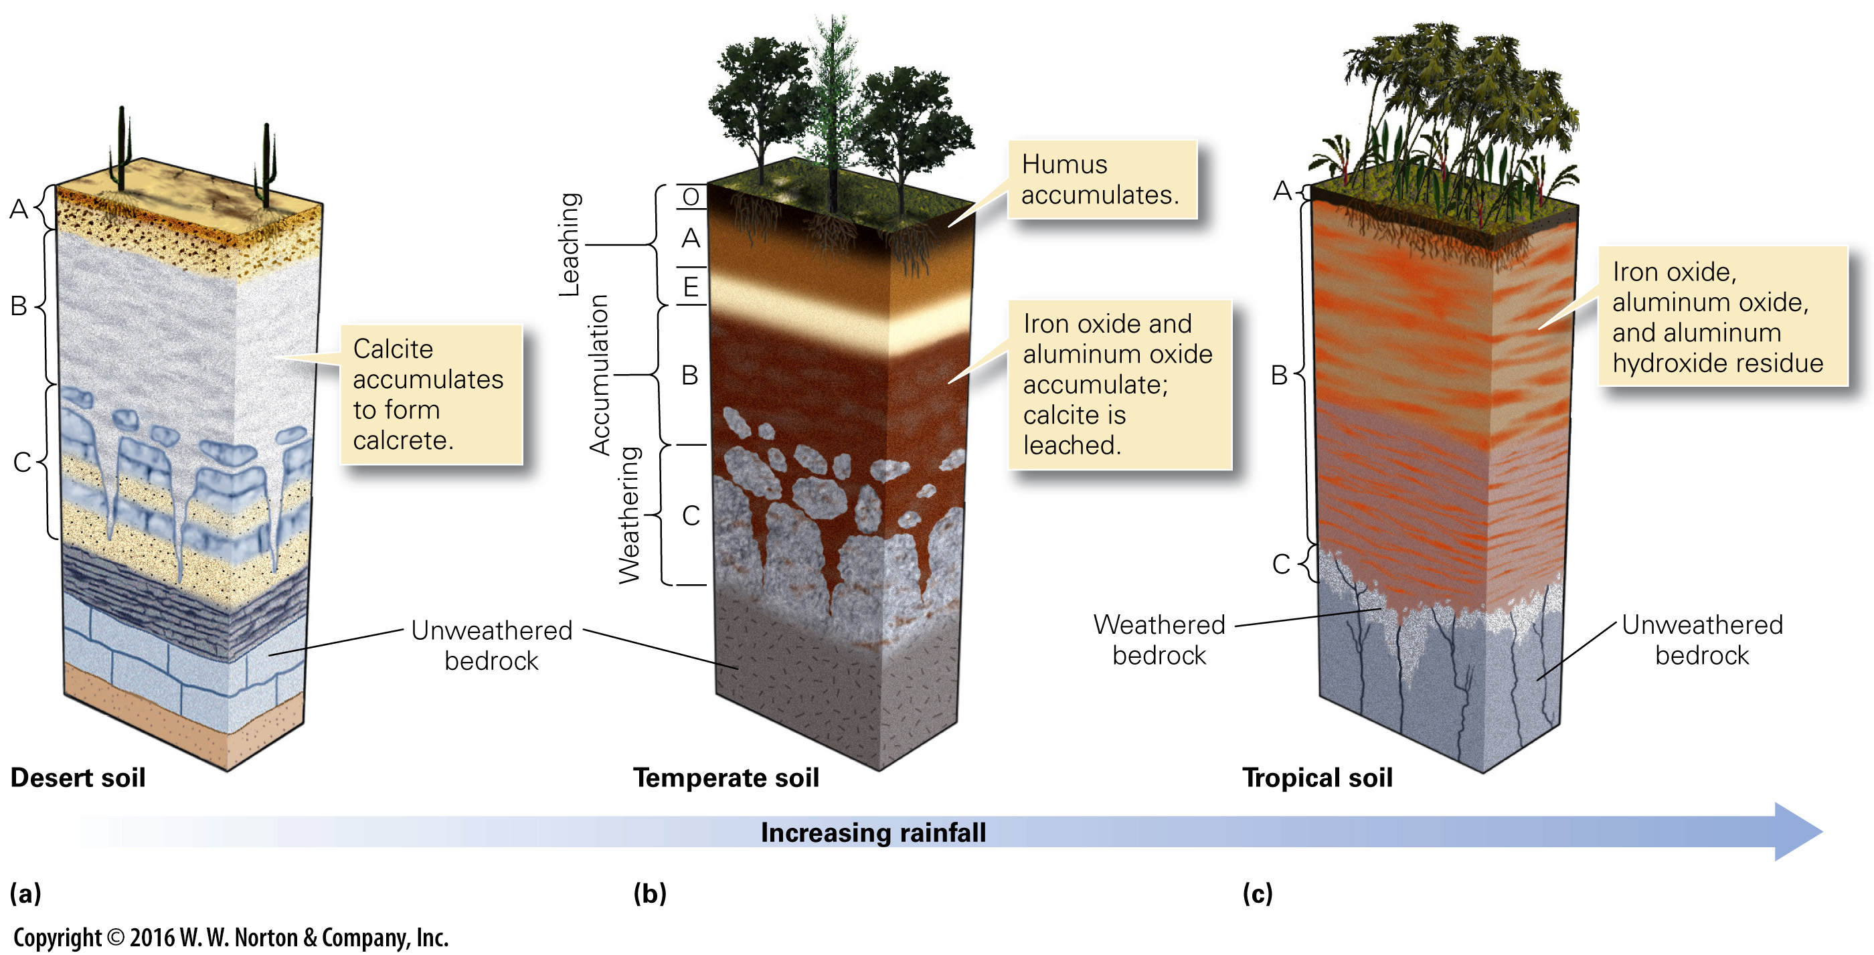
Notes:
FIGURE B.12 Examples of soil classification.
(a) Aridisol forms in deserts. Rainfall is so low that no O-horizon forms, and soluble minerals accumulate in the B-horizon. (b) Alfisol forms in temperate climates. An O-horizon forms, and less-soluble materials accumulate in the B-horizon. (c) Oxisol forms in tropical climates where percolating rainwater leaches all soluble minerals, leaving only iron- and aluminum-rich residues.

Slide 35
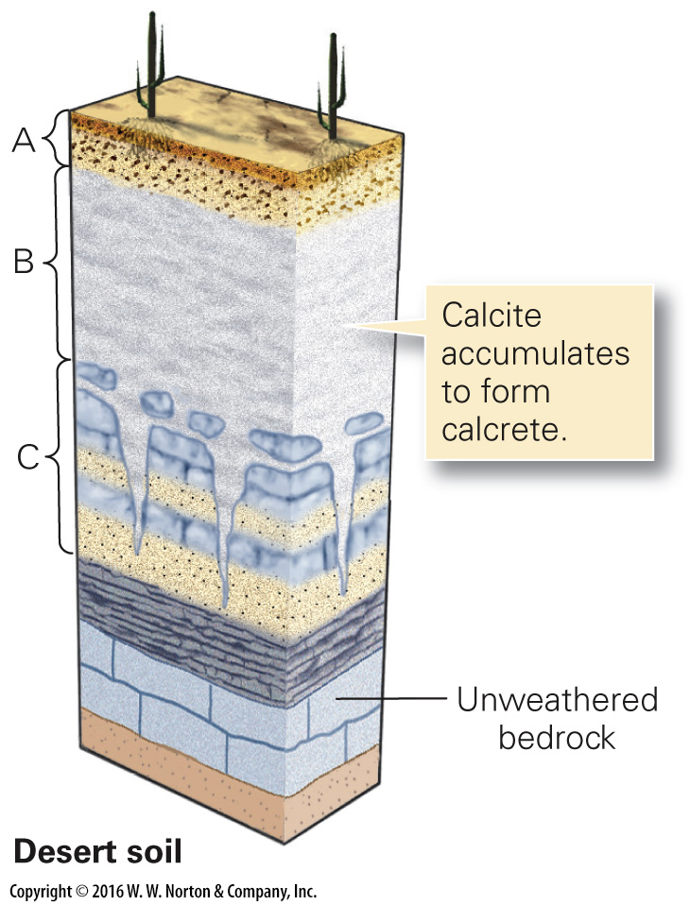
Notes:
FIGURE B.12a Examples of soil classification.
(a) Aridisol forms in deserts. Rainfall is so low that no O-horizon forms, and soluble minerals accumulate in the B-horizon.

Slide 36
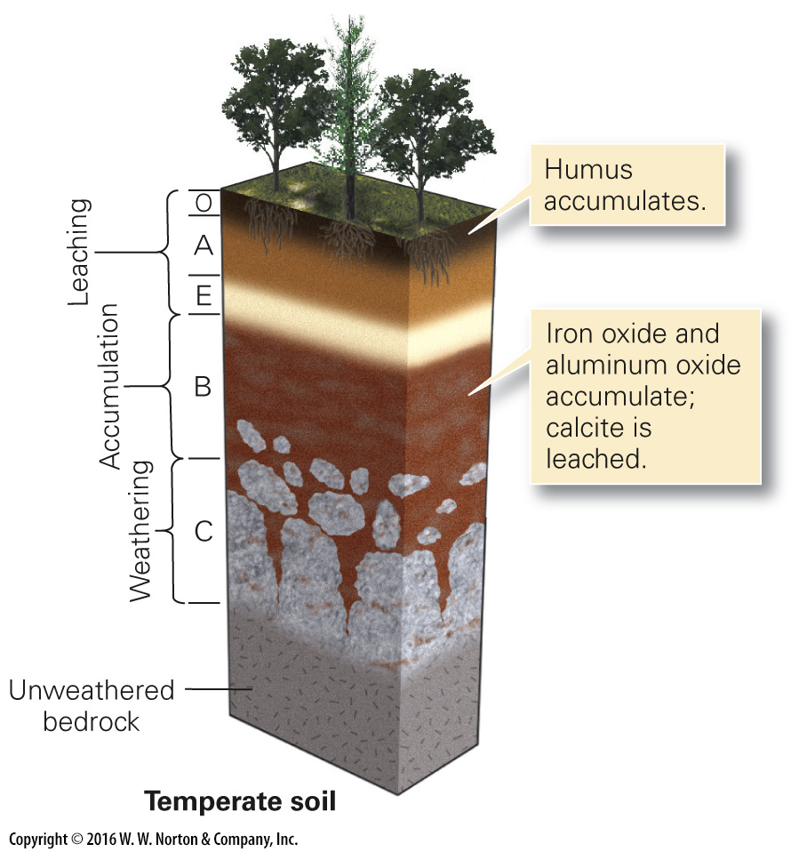
Notes:
FIGURE B.12b Examples of soil classification.
(b) Alfisol forms in temperate climates. An O-horizon forms, and less-soluble materials accumulate in the B-horizon.

Slide 37
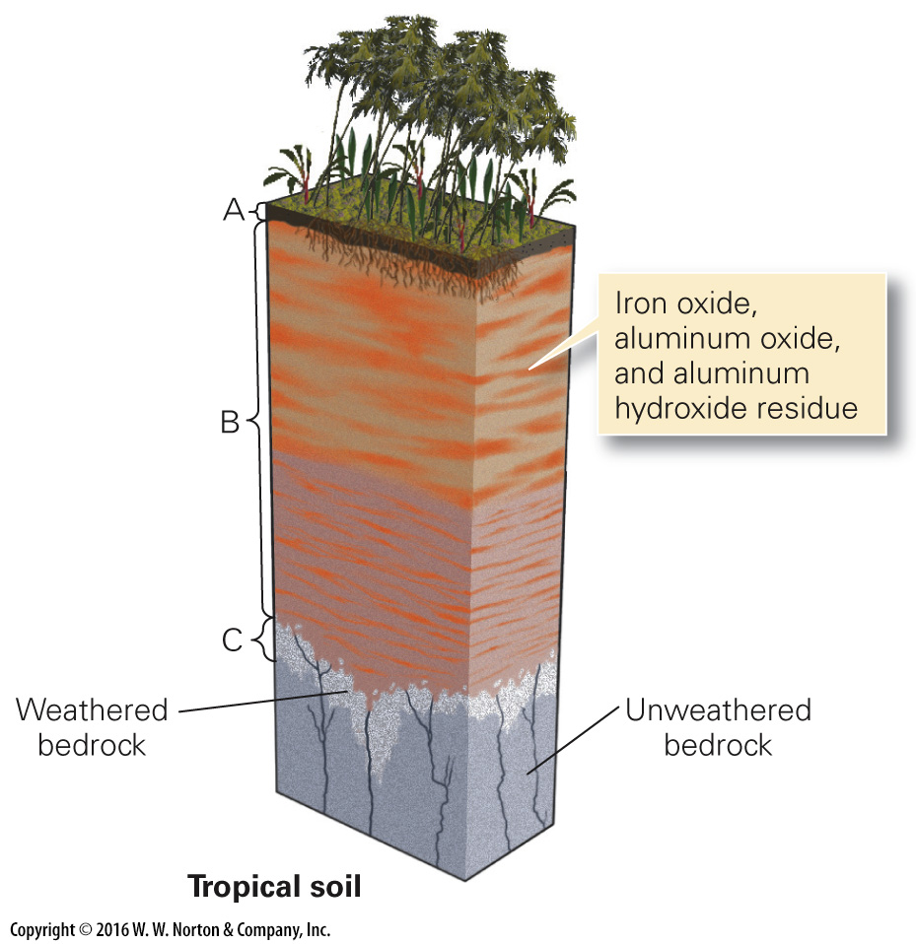
Notes:
FIGURE B.12c Examples of soil classification.
(c) Oxisol forms in tropical climates where percolating rainwater leaches all soluble minerals, leaving only iron- and aluminum-rich residues.

Slide 38
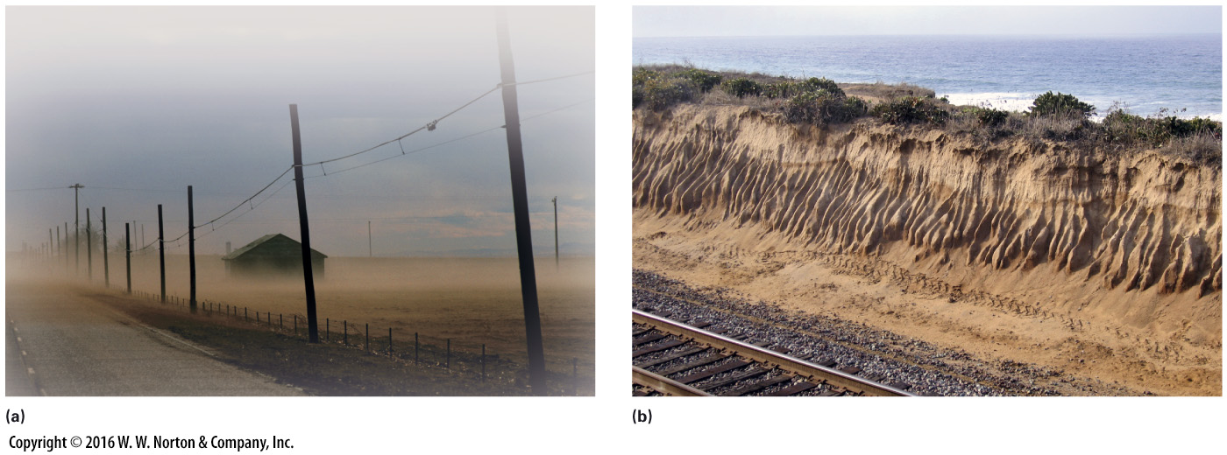
Notes:
FIGURE B.13 Examples of soil erosion.
(a) When crops aren’t growing, the soil of farm fields can be blown away in strong winds. (b) When vegetation doesn’t protect soil, water erosion can carve a badlands of closely spaced gullies.

Slide 39
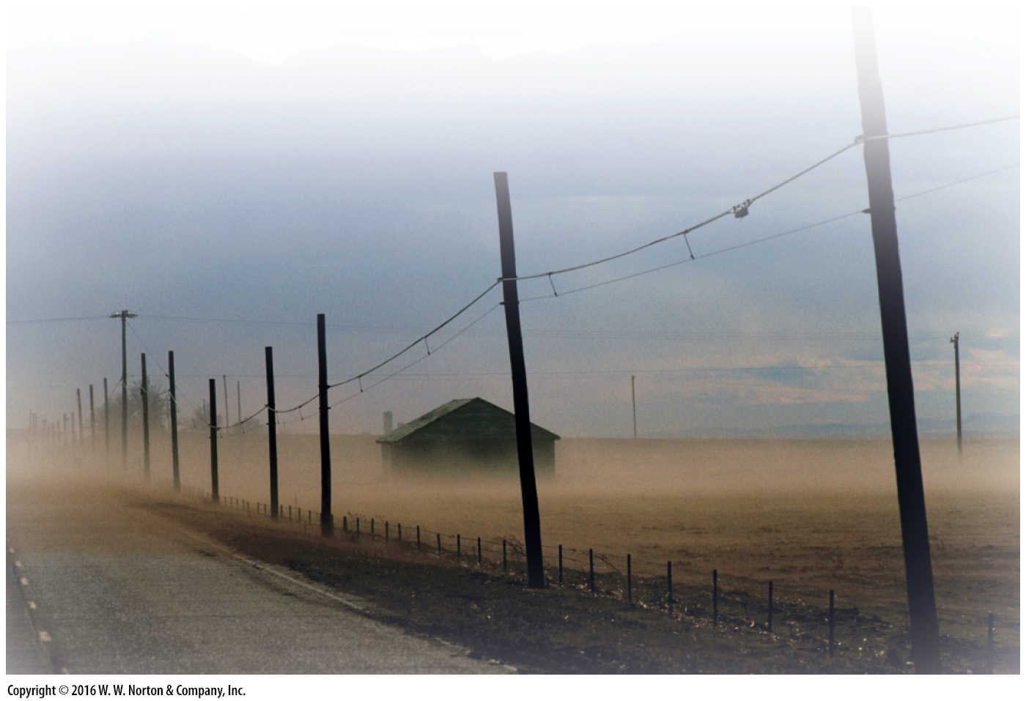
Notes:
FIGURE B.13a Examples of soil erosion.
(a) When crops aren’t growing, the soil of farm fields can be blown away in strong winds.

Slide 40
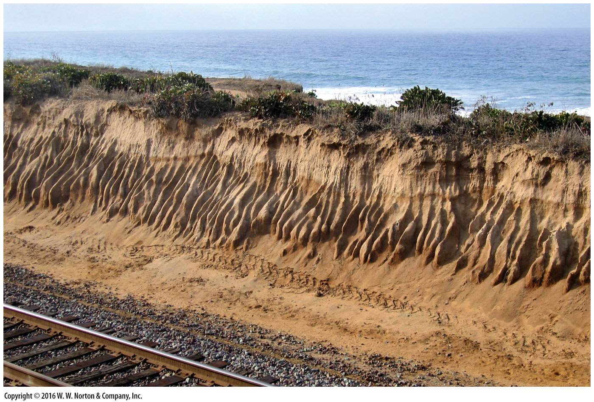
Notes:
FIGURE B.13b Examples of soil erosion.
(b) When vegetation doesn’t protect soil, water erosion can carve a badlands of closely spaced gullies.

Slide 41
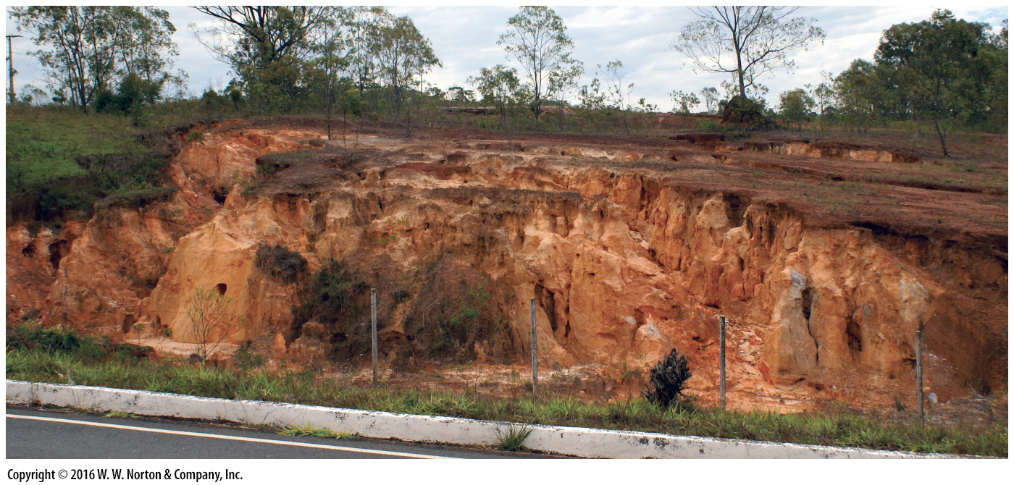
Notes:
Another View Bright red laterite, a soil rich in iron and aluminum oxides and hydroxides, exposed in a Brazilian roadcut.

