Slide 1
Stephen Marshak
ESSENTIALS OF
Geology
FIFTH EDITION
Interlude C
The Rock Cycle
©2016 W. W. Norton & Company, Inc.

Slide 2
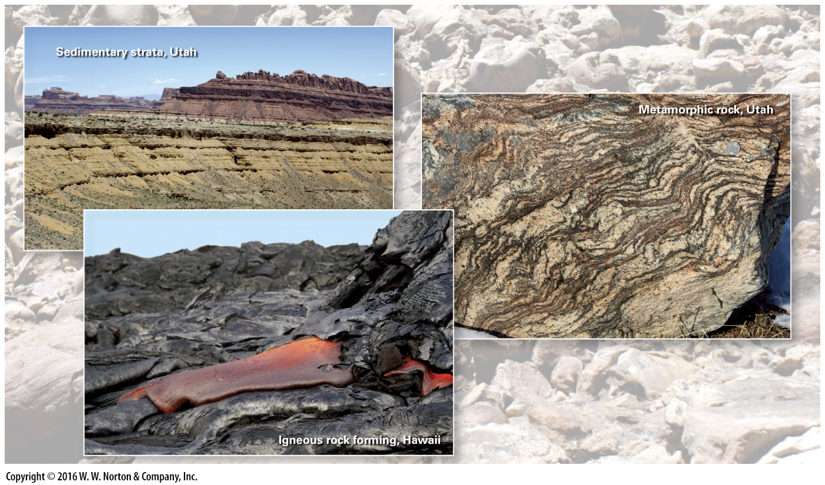
Notes:
On our dynamic planet, the atoms in a rock of one class may, over time, be incorporated in rock of another class, and then another. Such transformations comprise the rock cycle.

Slide 3
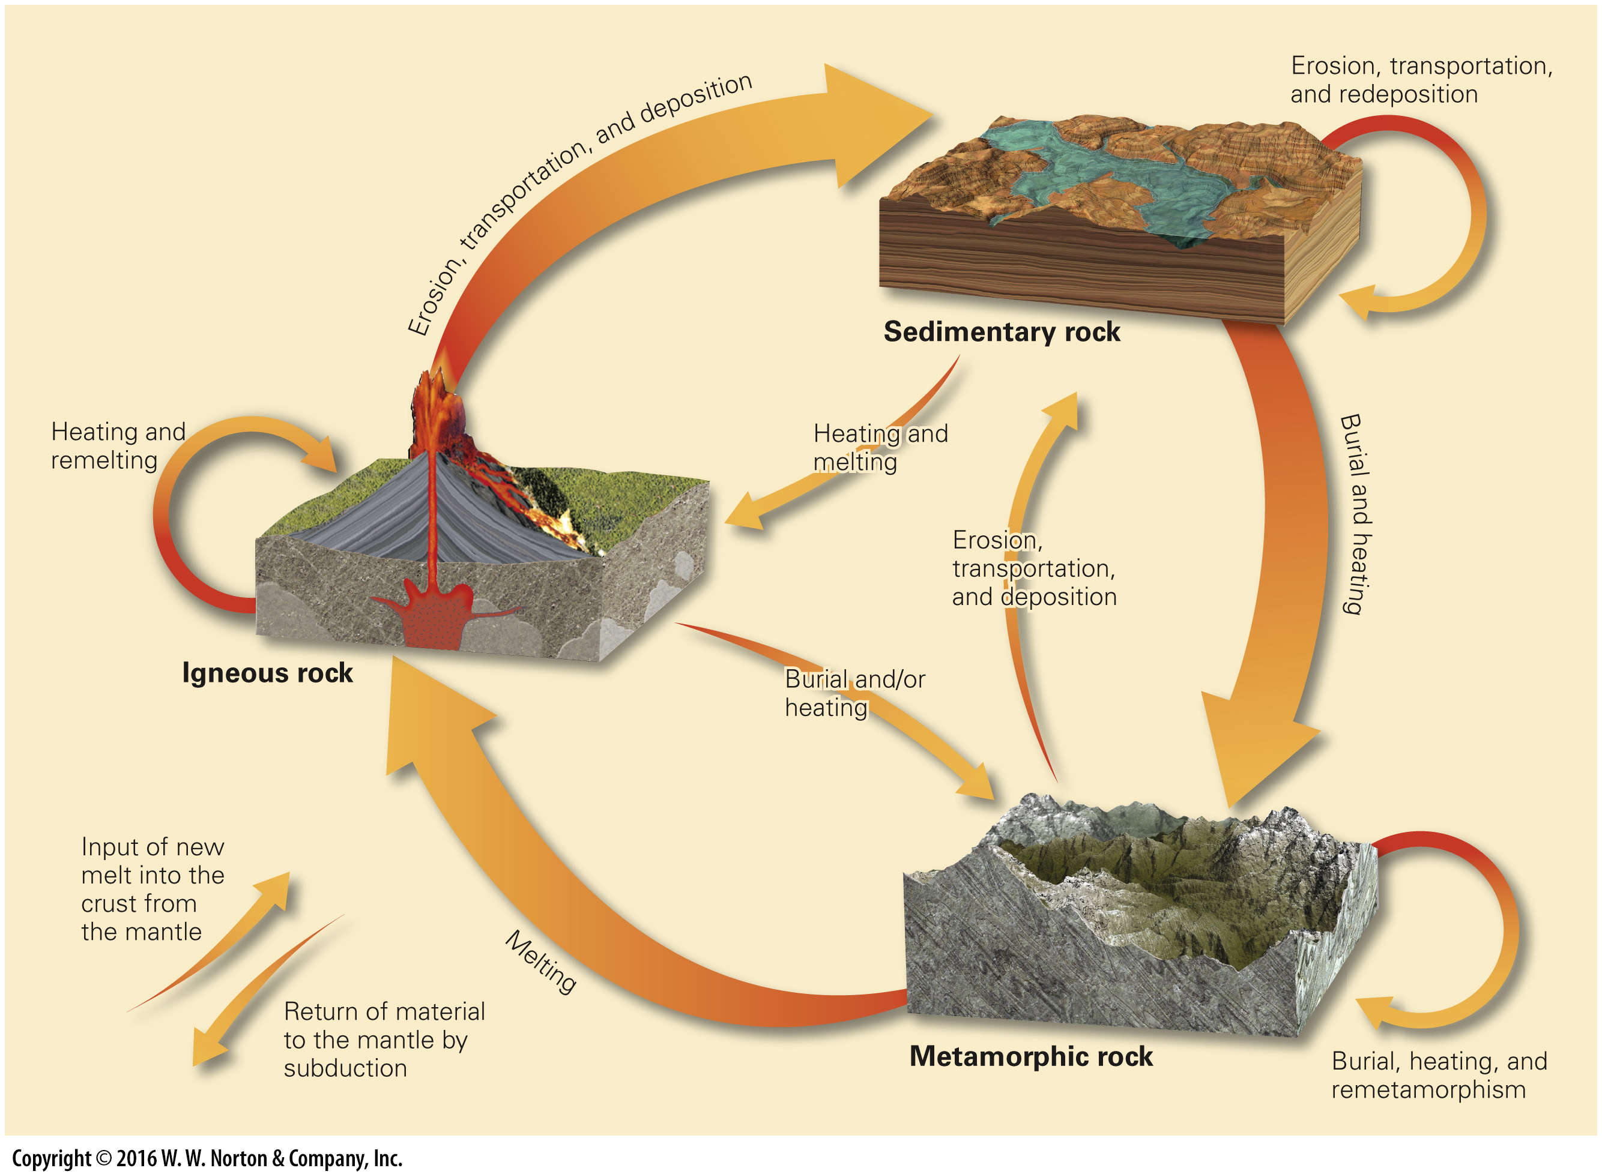
Notes:
FIGURE C.1 The stages of the rock cycle showing various alternative pathways.

Slide 4
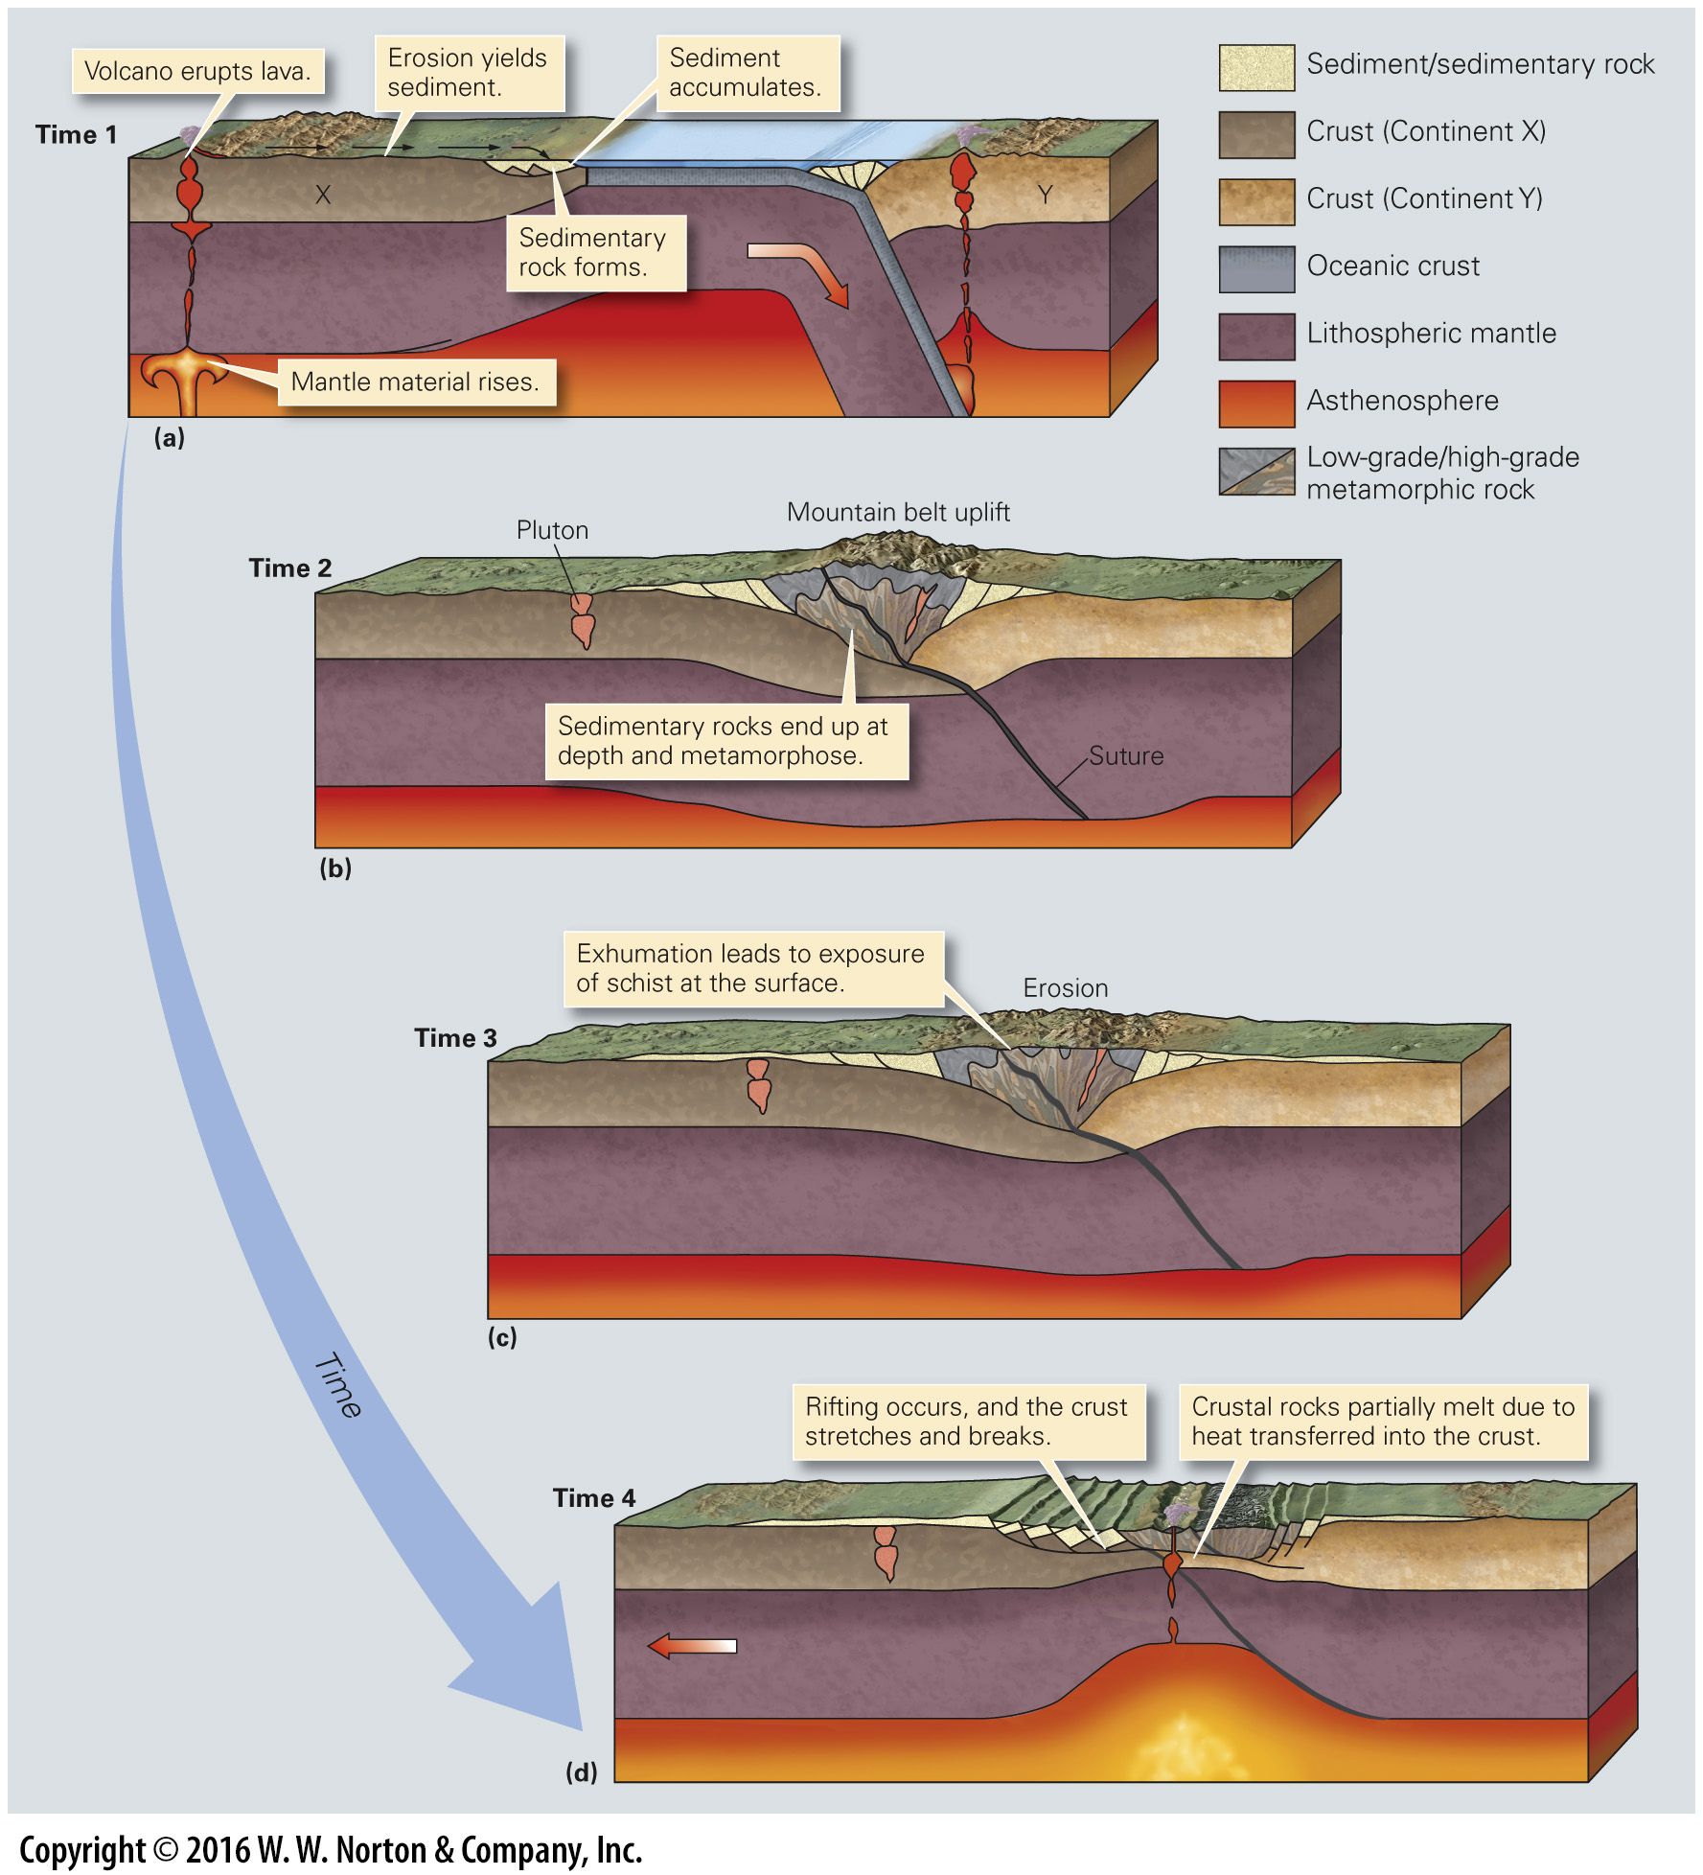
Notes:
FIGURE C.2 An example of the rock cycle in the context of plate tectonics.

Slide 5
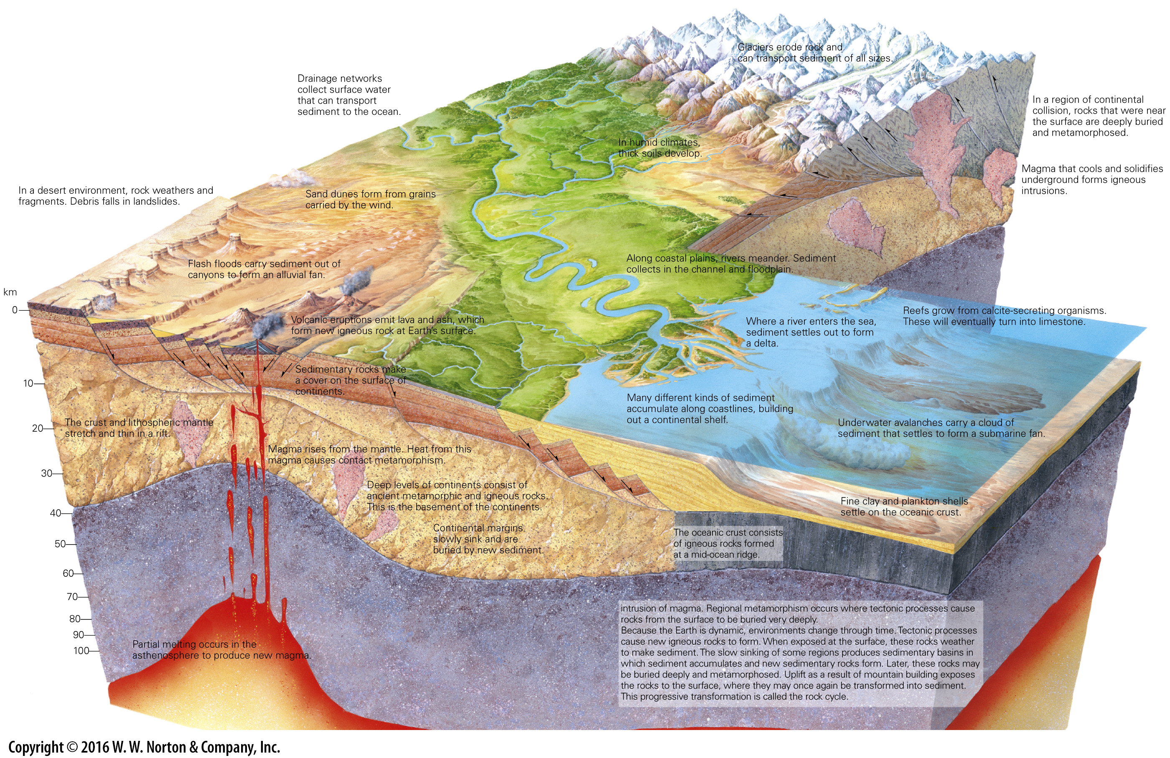
Notes:
GEOLOGY AT A GLANCE
Rock-Forming Environments and the Rock Cycle

Slide 6
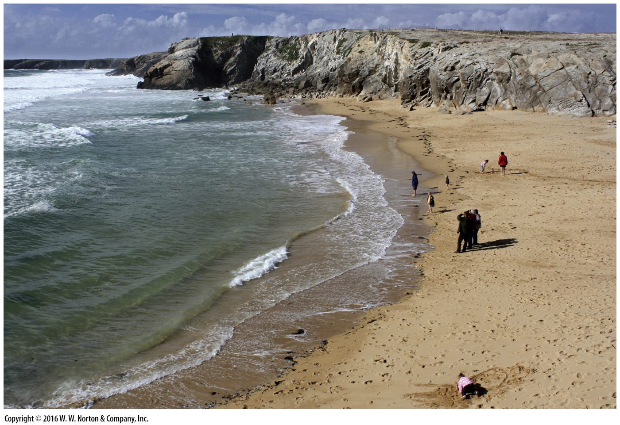
Notes:
Another View We can see stages of the rock cycle in action along the rocky shore of Brittany, France. Weathering breaks igneous rocks into blocks which eventually break down to sand. If the sand were to be buried and lithified, it would become a new sedimentary rock.

