Slide 1
Stephen Marshak
ESSENTIALS OF
Geology
FIFTH EDITION
Interlude D
The Earth's Interior Revisited: Insights from Geophysics
©2016 W. W. Norton & Company, Inc.

Slide 2
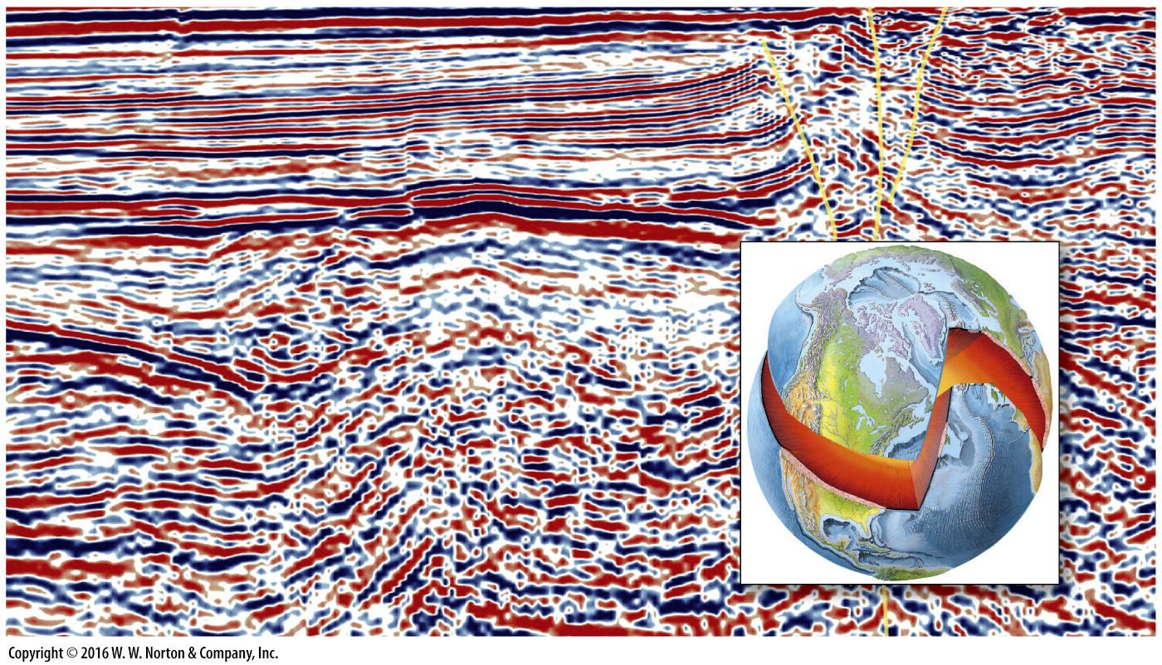
Notes:
Using geophysical techniques, researchers obtain images of the Earth’s interior. Here we see a seismic-reflection profile of sedimentary strata in the upper crust.

Slide 3
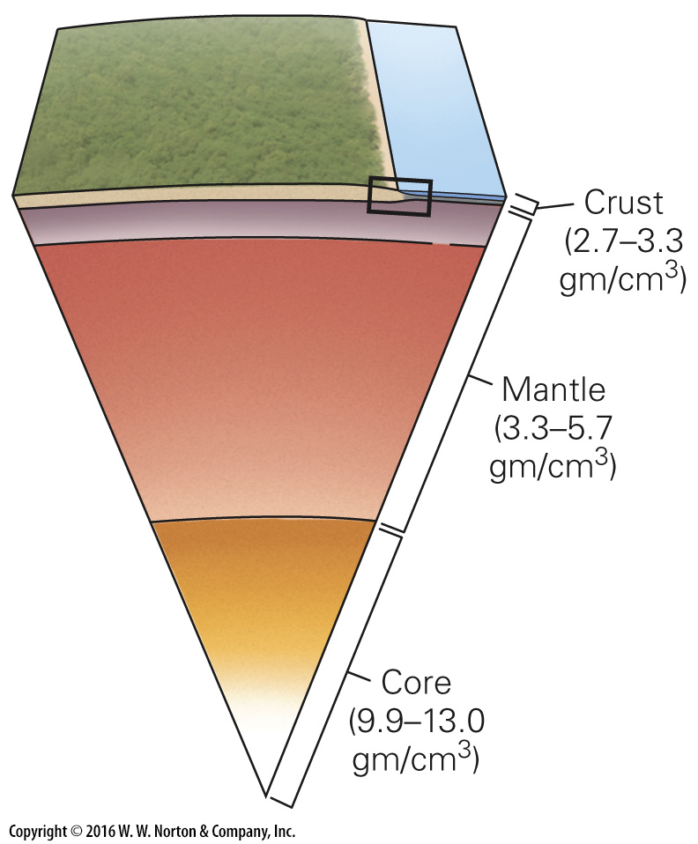
Notes:
FIGURE D.1 Simplified 19th-century image of the Earth’s interior. Geologists realized there were three layers, but they didn’t know the depths of the three layers.

Slide 4
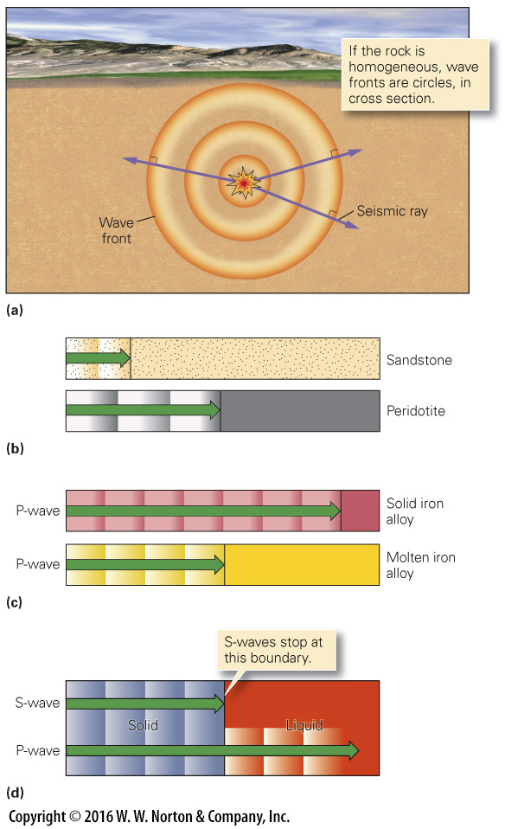
Notes:
FIGURE D.2 The propagation of earthquake waves.
(a) An earthquake sends out waves in all directions. Seismic rays are perpendicular to wave fronts. (b) Seismic waves travel at different velocities in different rock types. After a given time, the wave will have traveled farther in peridotite than in sandstone. (c) P-waves travel faster in solid iron alloy than in liquid, such as molten iron alloy. (d) Both P-waves and S-waves can travel through a solid, but only P-waves can travel through a liquid.

Slide 5
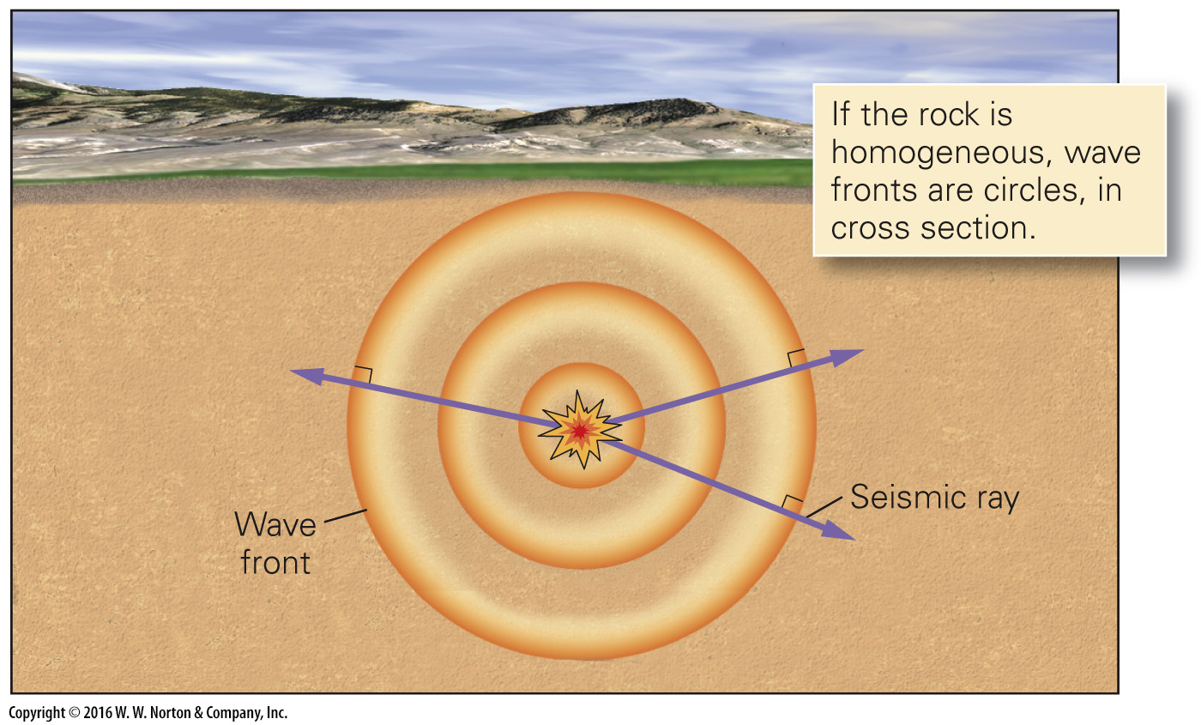
Notes:
FIGURE D.2a The propagation of earthquake waves.
(a) An earthquake sends out waves in all directions. Seismic rays are perpendicular to wave fronts.

Slide 6
Notes:
FIGURE D.2b The propagation of earthquake waves.
(b) Seismic waves travel at different velocities in different rock types. After a given time, the wave will have traveled farther in peridotite than in sandstone.

Slide 7
Notes:
FIGURE D.2c The propagation of earthquake waves.
(c) P-waves travel faster in solid iron alloy than in liquid, such as molten iron alloy.

Slide 8
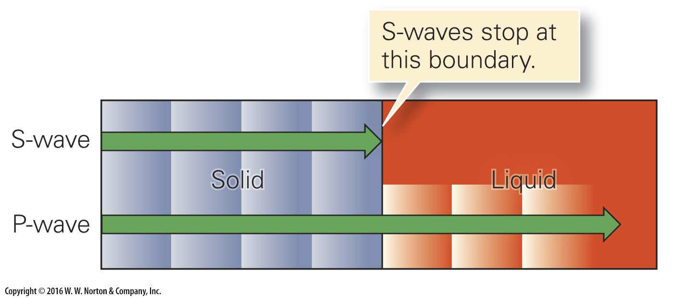
Notes:
FIGURE D.2d The propagation of earthquake waves.
(d) Both P-waves and S-waves can travel through a solid, but only P-waves can travel through a liquid.

Slide 9
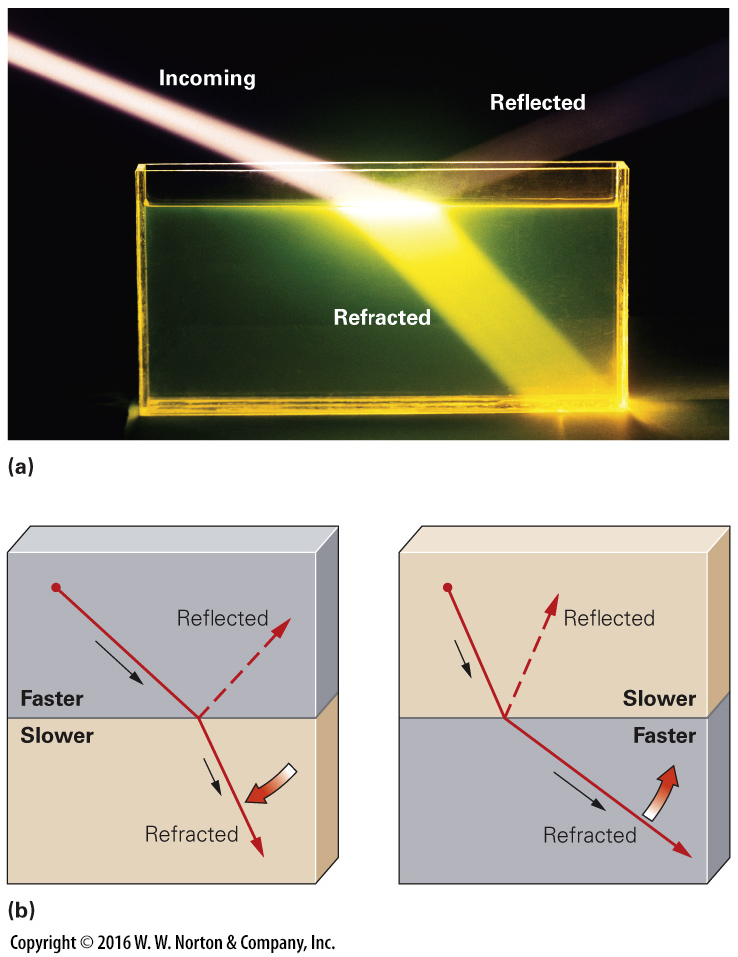
Notes:
FIGURE D.3 Refraction and reflection of waves.
(a) A lab experiment showing how a ray of light reflects and partly refracts when it crosses the boundary between two different materials. (b) A ray that enters a material through which it travels more slowly bends away from the boundary. A ray that enters a faster medium bends toward the boundary.

Slide 10
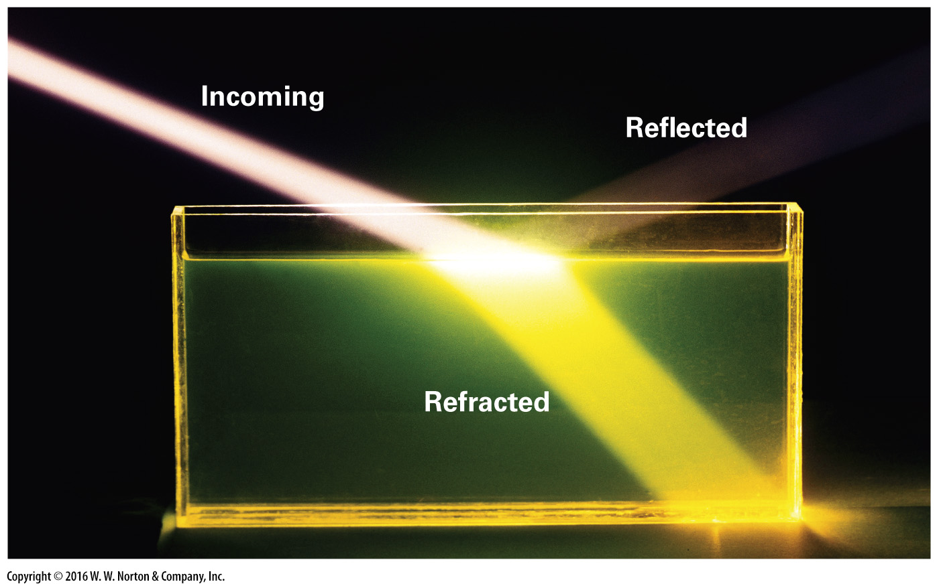
Notes:
FIGURE D.3a Refraction and reflection of waves.
(a) A lab experiment showing how a ray of light reflects and partly refracts when it crosses the boundary between two different materials.

Slide 11
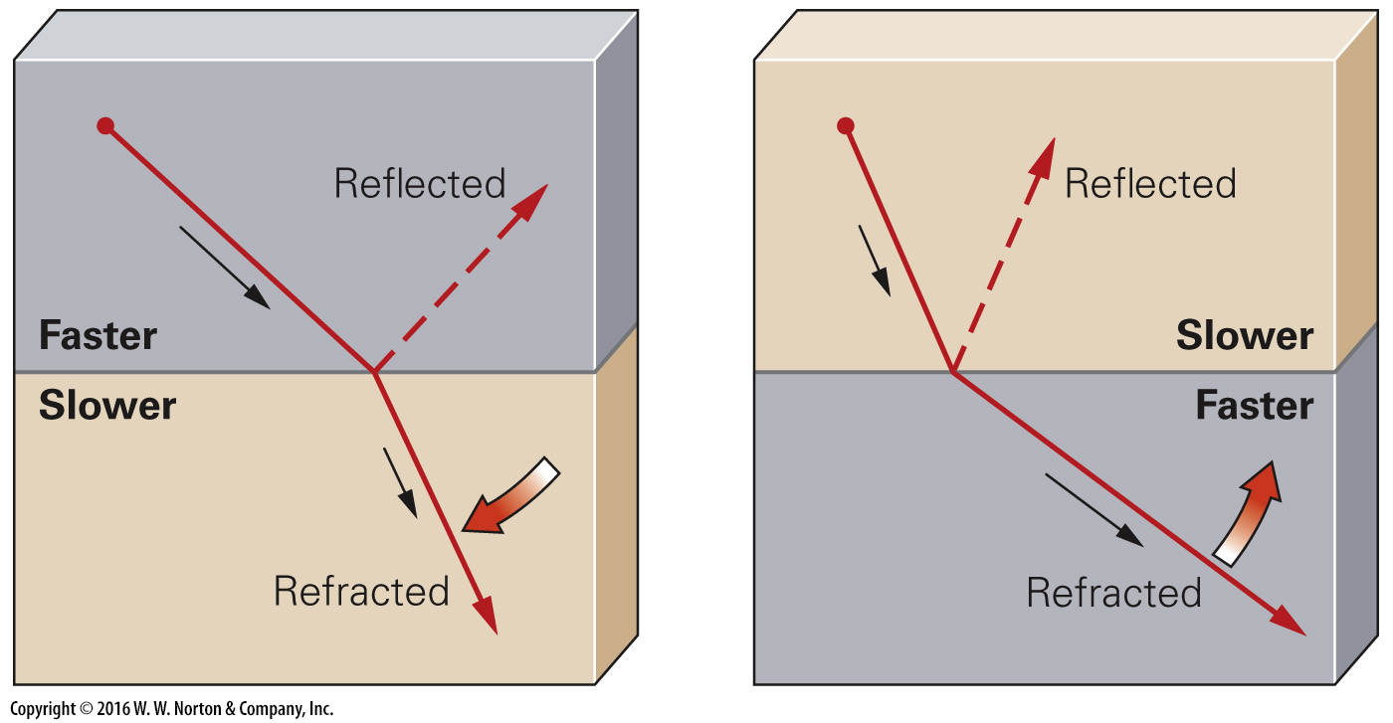
Notes:
FIGURE D.3b Refraction and reflection of waves.
(b) A ray that enters a material through which it travels more slowly bends away from the boundary. A ray that enters a faster medium bends toward the boundary.

Slide 12
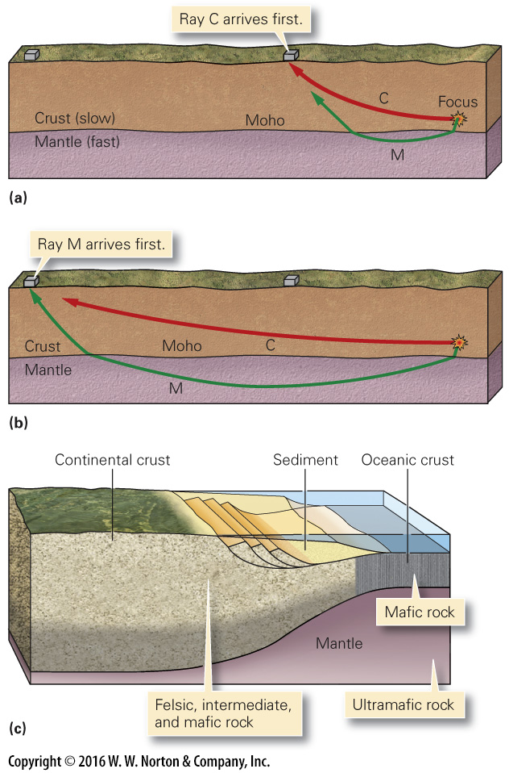
Notes:
FIGURE D.4 Discovery of the Moho.
(a) Seismic waves traveling only in the crust reach a nearby seismometer first. (b) Seismic waves traveling for most of their path in the mantle reach a distant seismometer first. (c) Oceanic crust is thinner than continental crust and has a different composition. The lower part of the continental crust tends to be more mafic than the upper.

Slide 13
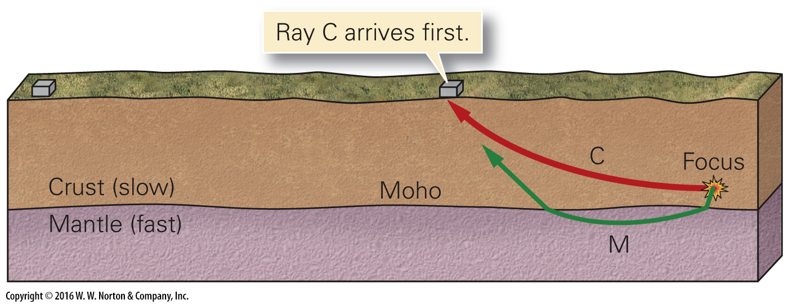
Notes:
FIGURE D.4a Discovery of the Moho.
(a) Seismic waves traveling only in the crust reach a nearby seismometer first.

Slide 14
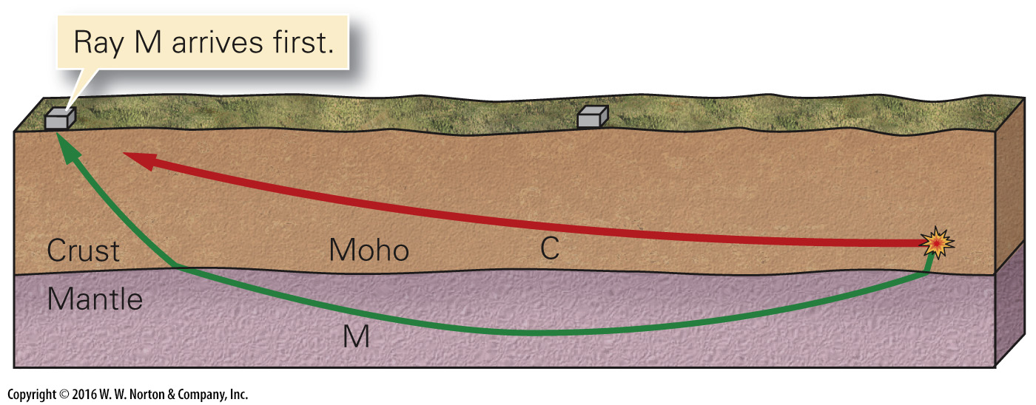
Notes:
FIGURE D.4b Discovery of the Moho.
(b) Seismic waves traveling for most of their path in the mantle reach a distant seismometer first.

Slide 15
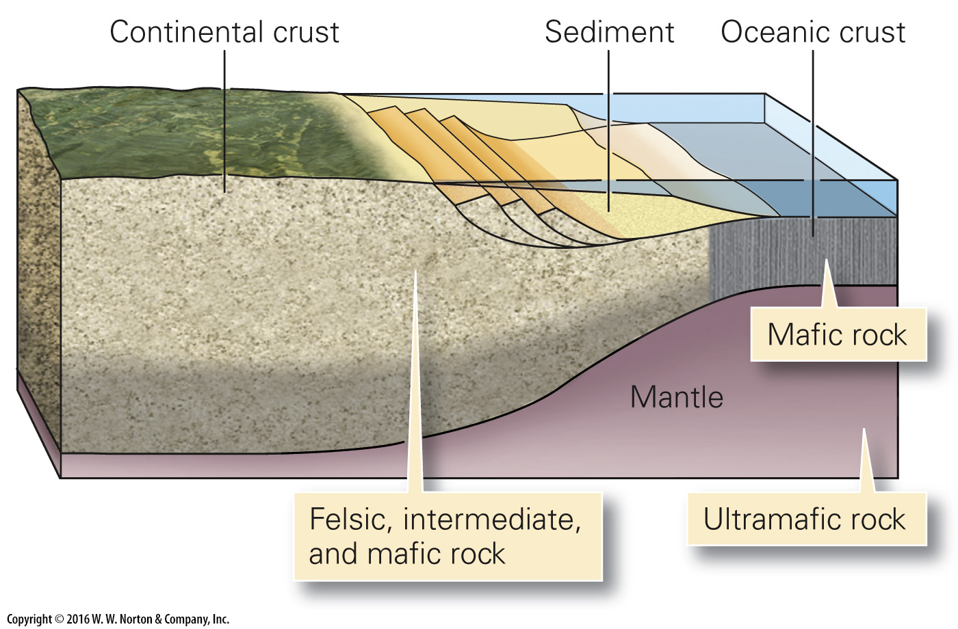
Notes:
FIGURE D.4c Discovery of the Moho.
(c) Oceanic crust is thinner than continental crust and has a different composition. The lower part of the continental crust tends to be more mafic than the upper.

Slide 16
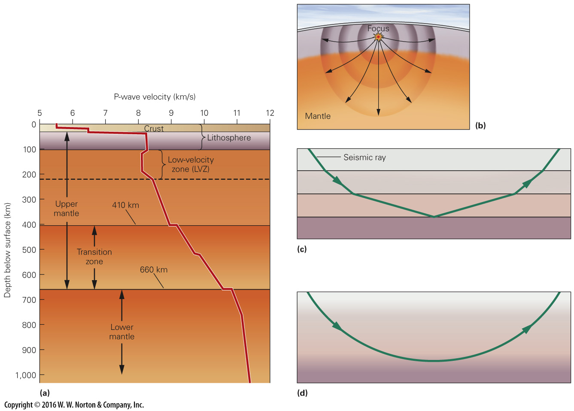
Notes:
FIGURE D.5 The velocity of P-waves in the mantle changes because the physical properties of the mantle change with depth.
(a) The velocity of P-waves changes with depth in the mantle. (b) The velocity of seismic waves increases with depth in the mantle, so rays curve and wave fronts are oblong. (c) In a stack of discrete layers, rays bend at each boundary. If the velocity is progressively faster in each lower layer, the ray eventually bends back and returns to the surface. (d) In a material in which the velocity increases gradually with depth, rays curve smoothly and eventually return to the surface.

Slide 17
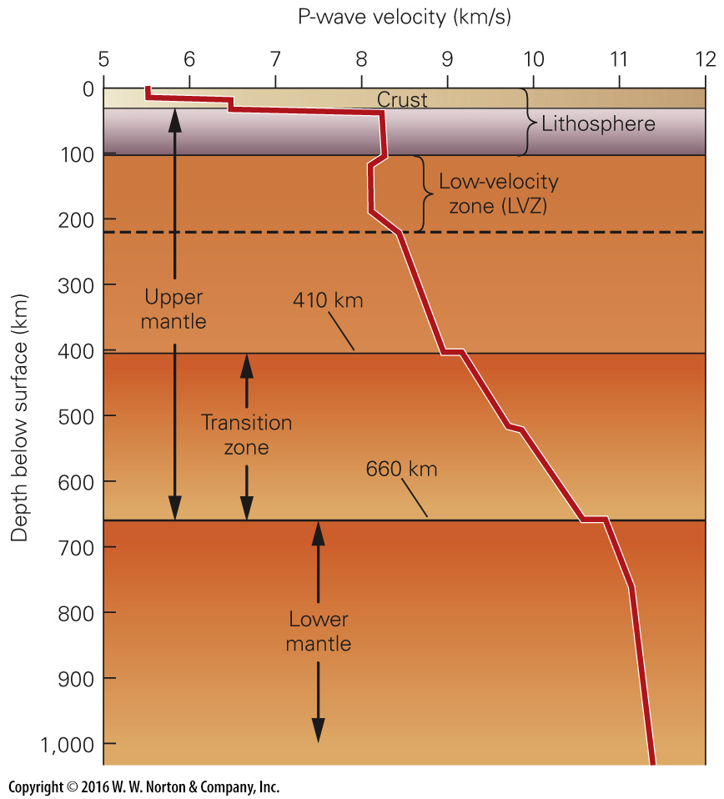
Notes:
FIGURE D.5a The velocity of P-waves in the mantle changes because the physical properties of the mantle change with depth.
(a) The velocity of P-waves changes with depth in the mantle.

Slide 18
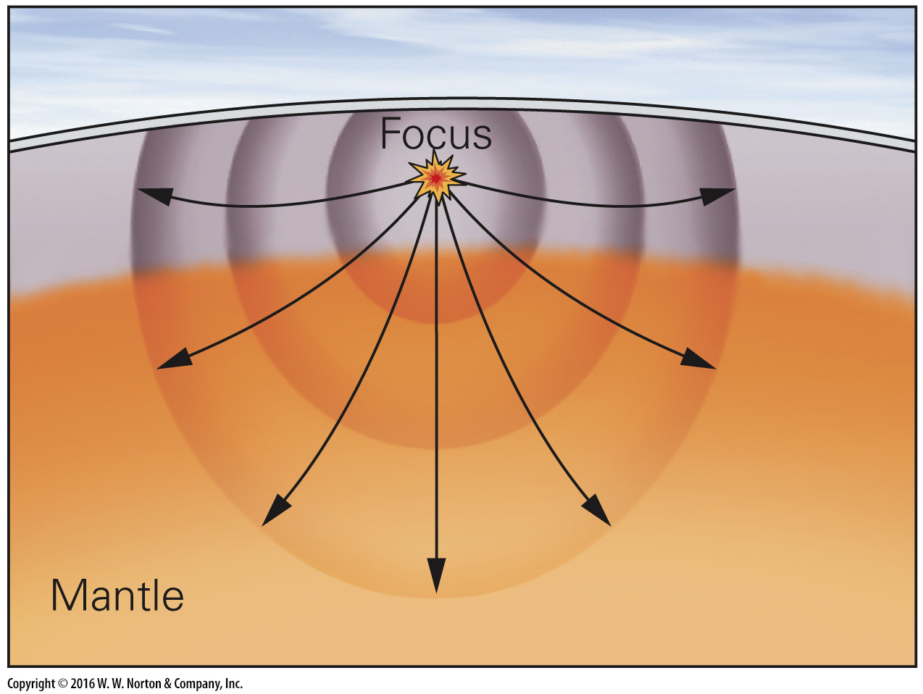
Notes:
FIGURE D.5b The velocity of P-waves in the mantle changes because the physical properties of the mantle change with depth.
(b) The velocity of seismic waves increases with depth in the mantle, so rays curve and wave fronts are oblong.

Slide 19
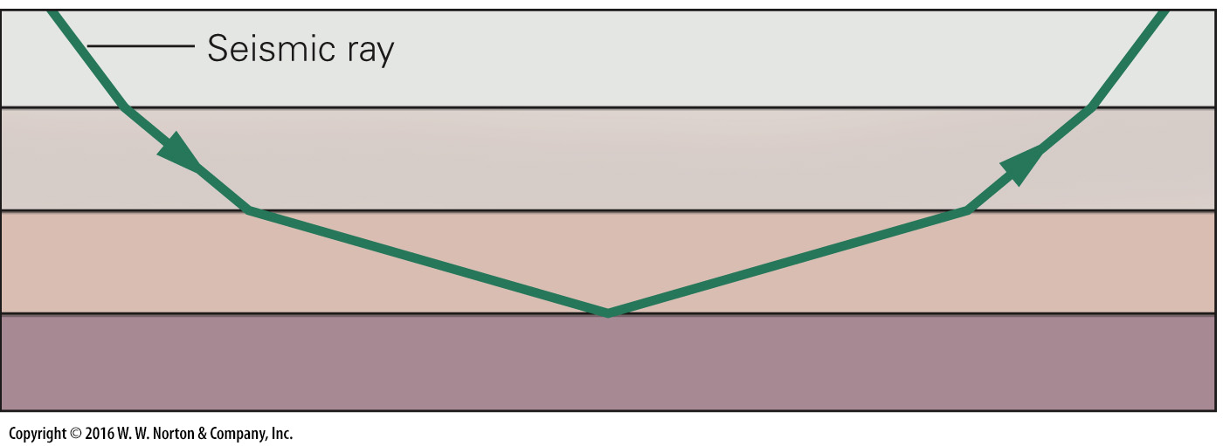
Notes:
FIGURE D.5c The velocity of P-waves in the mantle changes because the physical properties of the mantle change with depth.
(c) In a stack of discrete layers, rays bend at each boundary. If the velocity is progressively faster in each lower layer, the ray eventually bends back and returns to the surface.

Slide 20
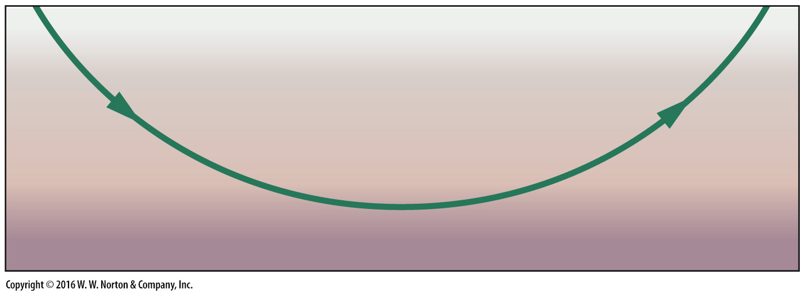
Notes:
FIGURE D.5d The velocity of P-waves in the mantle changes because the physical properties of the mantle change with depth.
(d) In a material in which the velocity increases gradually with depth, rays curve smoothly and eventually return to the surface.

Slide 21
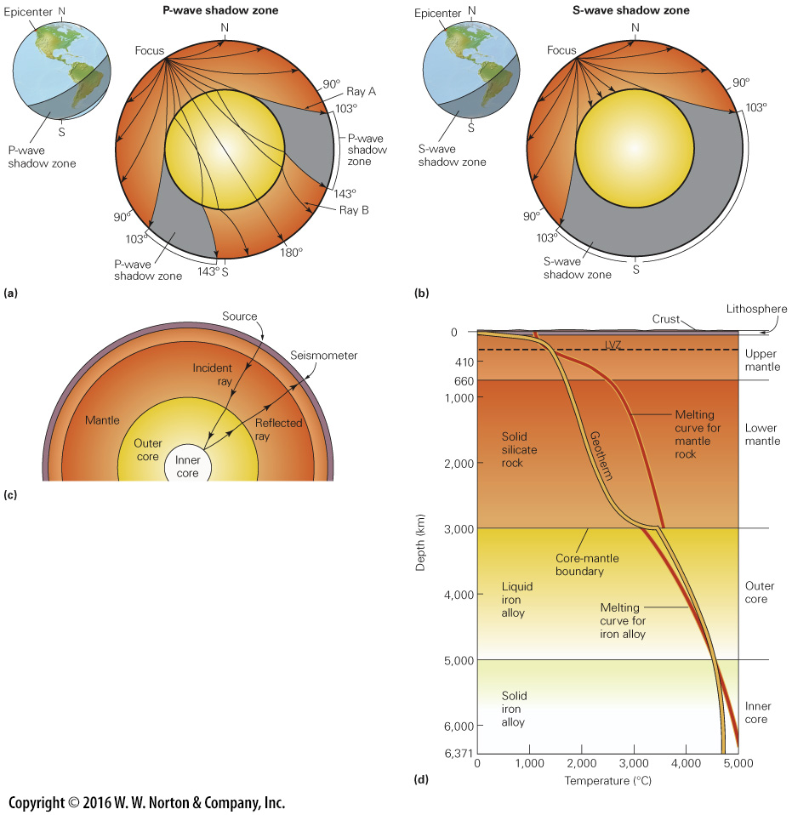
Notes:
FIGURE D.6 Shadow zones and the discovery of the Earth’s core. (Note that the circumference of a circle is 360°, so it is 180° from a given point to a locality on the other side of the planet.)
(a) P-waves do not arrive in the P-wave shadow zone because they refract at the core-mantle boundary. (b) S-waves do not arrive in the S-wave shadow zone because they cannot pass through the liquid outer core. (c) Seismic waves reflect off the inner core–outer core boundary. (d) A graph of the geotherm and melting curve for the Earth. Note that the melting temperature is less than the Earth’s temperature in the outer core, so the outer core is molten.

Slide 22
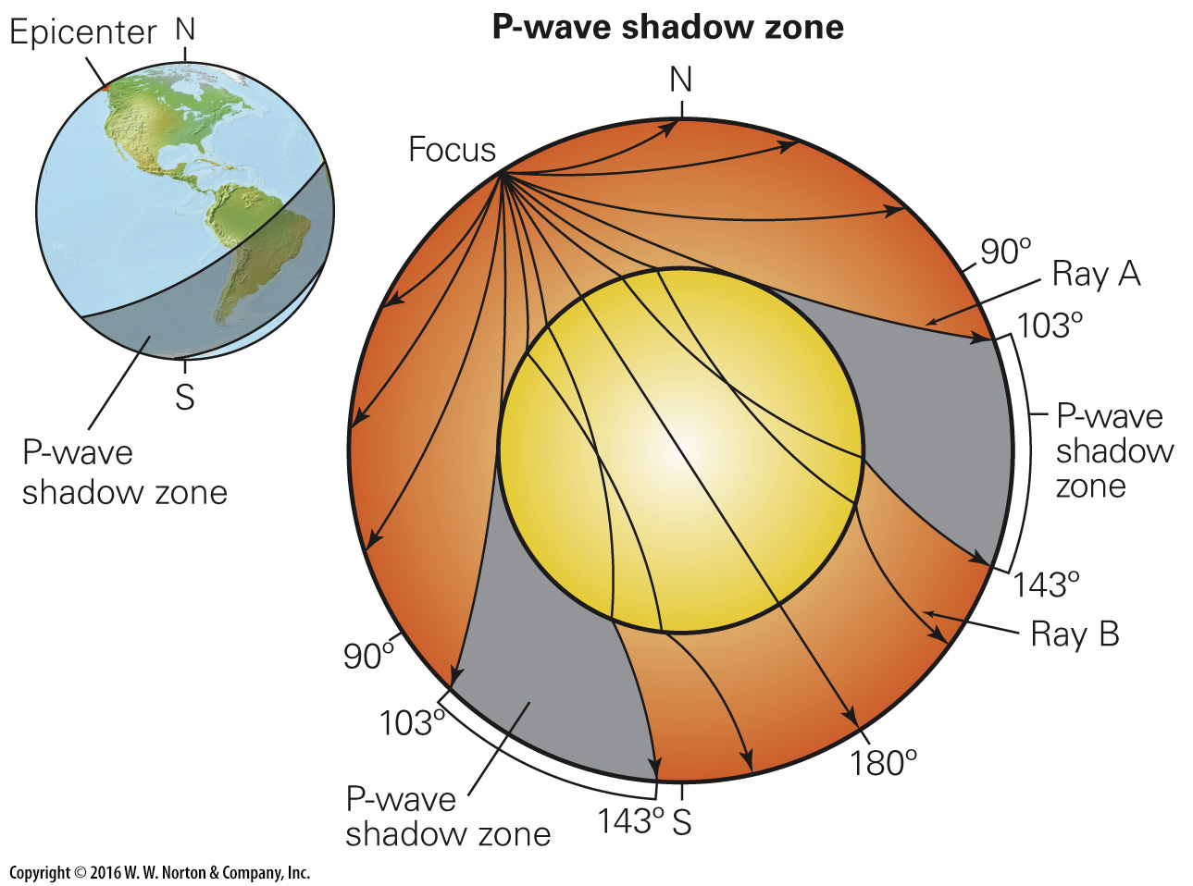
Notes:
FIGURE D.6a Shadow zones and the discovery of the Earth’s core. (Note that the circumference of a circle is 360°, so it is 180° from a given point to a locality on the other side of the planet.)
(a) P-waves do not arrive in the P-wave shadow zone because they refract at the core-mantle boundary.

Slide 23
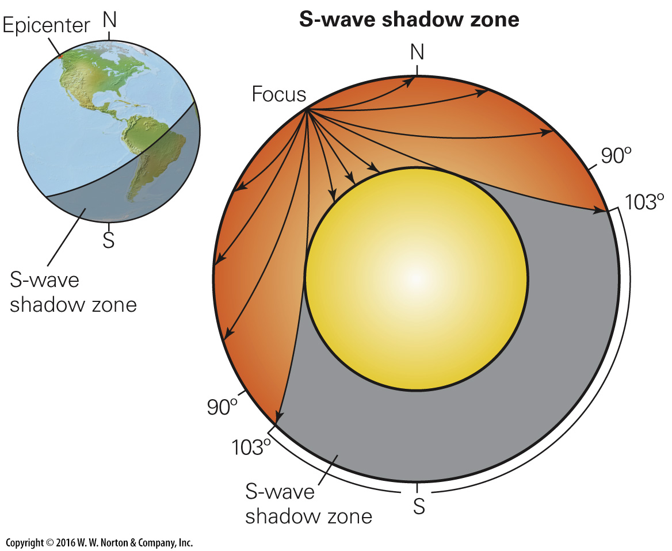
Notes:
FIGURE D.6b Shadow zones and the discovery of the Earth’s core. (Note that the circumference of a circle is 360°, so it is 180° from a given point to a locality on the other side of the planet.)
(b) S-waves do not arrive in the S-wave shadow zone because they cannot pass through the liquid outer core.

Slide 24
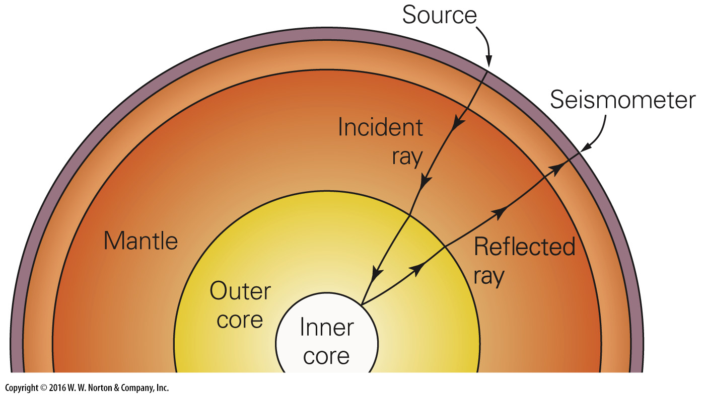
Notes:
FIGURE D.6c Shadow zones and the discovery of the Earth’s core. (Note that the circumference of a circle is 360°, so it is 180° from a given point to a locality on the other side of the planet.)
(c) Seismic waves reflect off the inner core–outer core boundary.

Slide 25
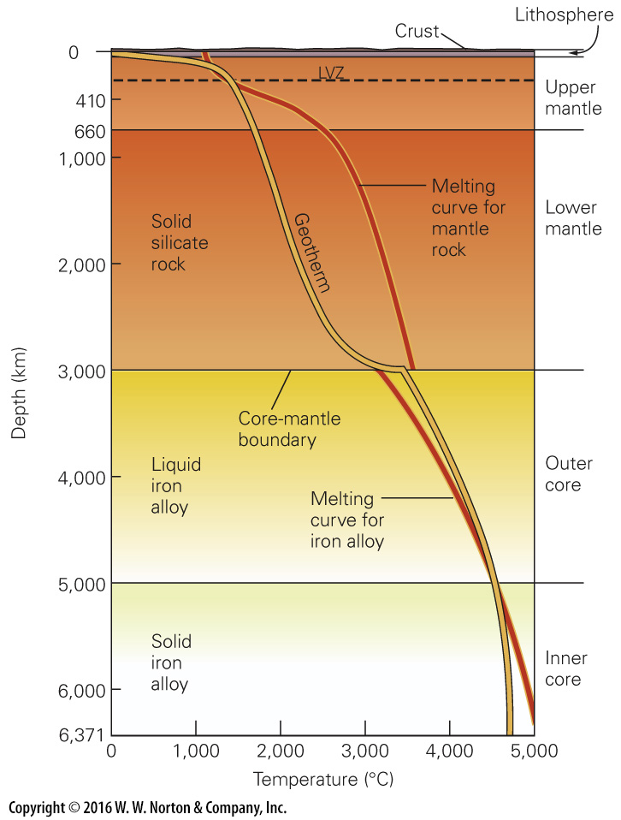
Notes:
FIGURE D.6d Shadow zones and the discovery of the Earth’s core. (Note that the circumference of a circle is 360°, so it is 180° from a given point to a locality on the other side of the planet.)
(d) A graph of the geotherm and melting curve for the Earth. Note that the melting temperature is less than the Earth’s temperature in the outer core, so the outer core is molten.

Slide 26
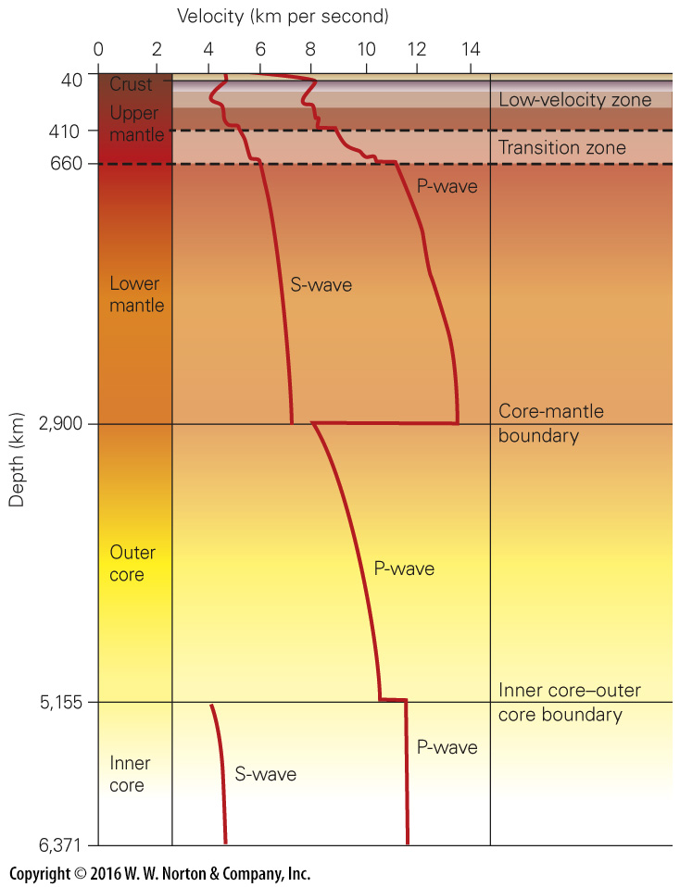
Notes:
FIGURE D.7 The velocity-versus-depth profile of the whole Earth.

Slide 27
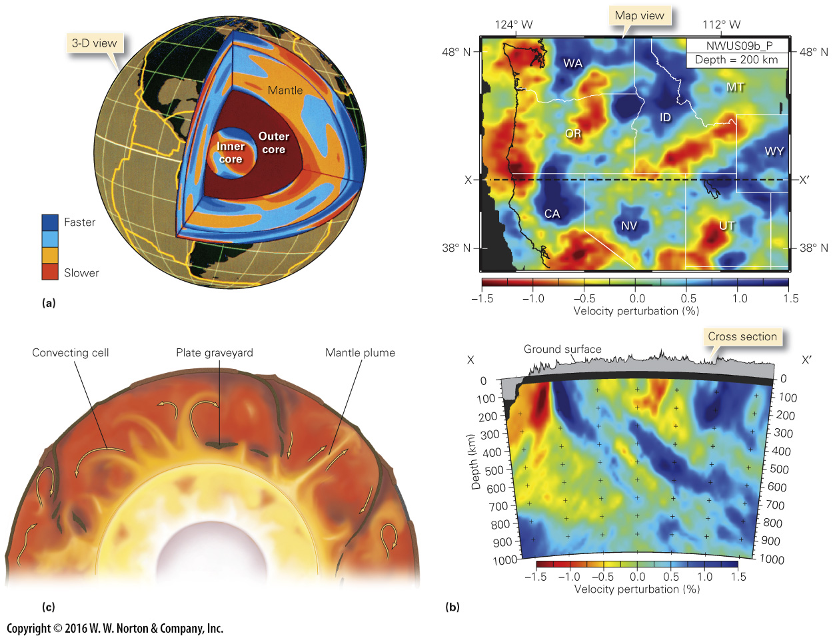
Notes:
FIGURE D.8 Tomographic images of the Earth’s interior and their interpretation.
(a) Tomographic image of the Earth. Slower areas may be relatively warmer than their surroundings, and faster areas may be relatively cooler. (b) A map (of a surface at a depth of 200 km) and cross section of the Earth beneath the western United States, constructed using tomographic data from the EarthScope array. Red areas have slower-than-expected velocities and probably are warmer, whereas blue areas are cooler. (c) An artist’s rendition of a modern view of the complex and dynamic Earth interior. Note the convecting cells, the mantle plumes, and the graveyards of subducted plates.

Slide 28
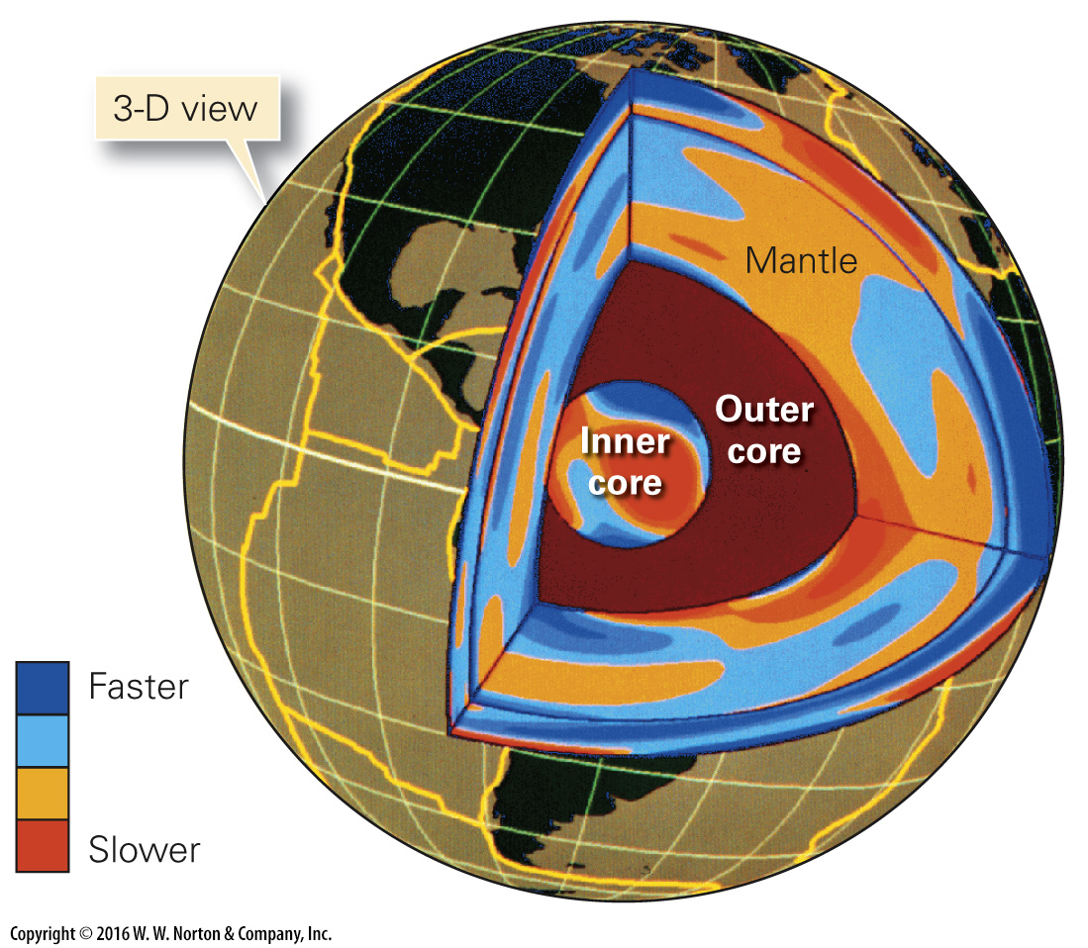
Notes:
FIGURE D.8a Tomographic images of the Earth’s interior and their interpretation.
(a) Tomographic image of the Earth. Slower areas may be relatively warmer than their surroundings, and faster areas may be relatively cooler.

Slide 29
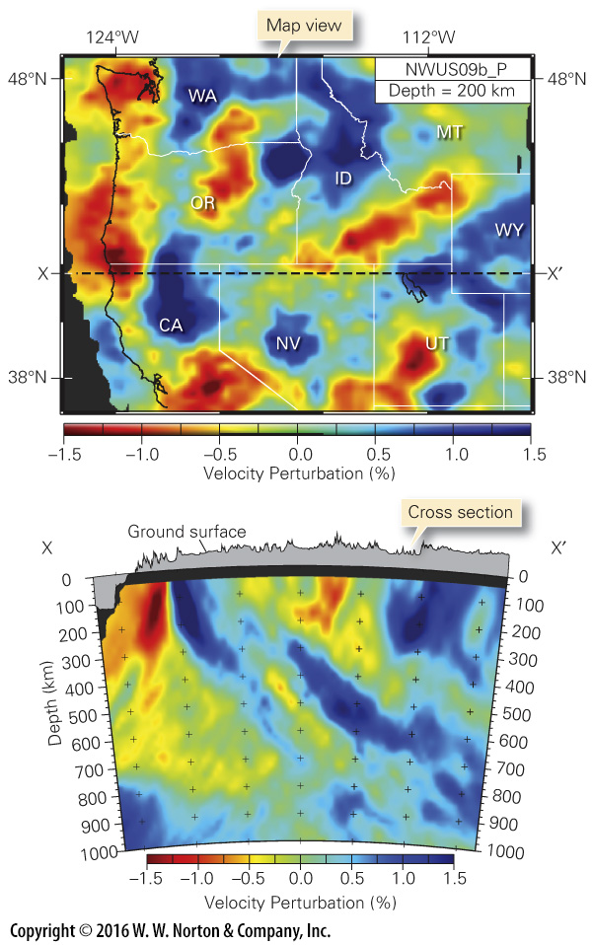
Notes:
FIGURE D.8b Tomographic images of the Earth’s interior and their interpretation.
(b) A map (of a surface at a depth of 200 km) and cross section of the Earth beneath the western United States, constructed using tomographic data from the EarthScope array. Red areas have slower-than-expected velocities and probably are warmer, whereas blue areas are cooler.

Slide 30
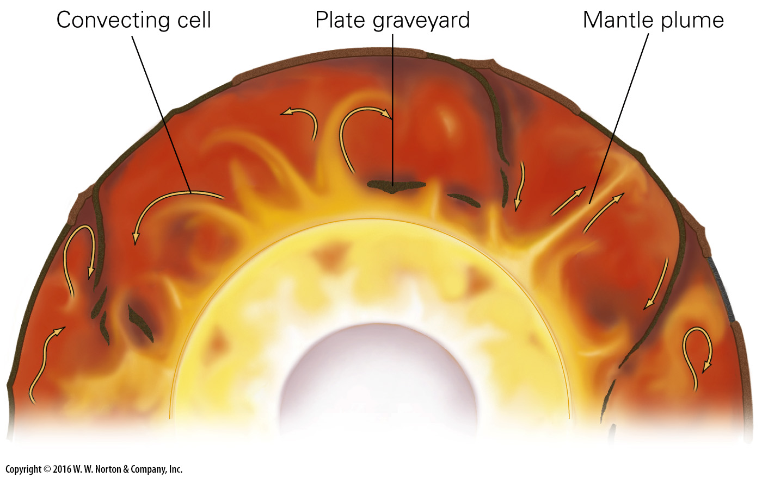
Notes:
FIGURE D.8c Tomographic images of the Earth’s interior and their interpretation.
(c) An artist’s rendition of a modern view of the complex and dynamic Earth interior. Note the convecting cells, the mantle plumes, and the graveyards of subducted plates.

Slide 31
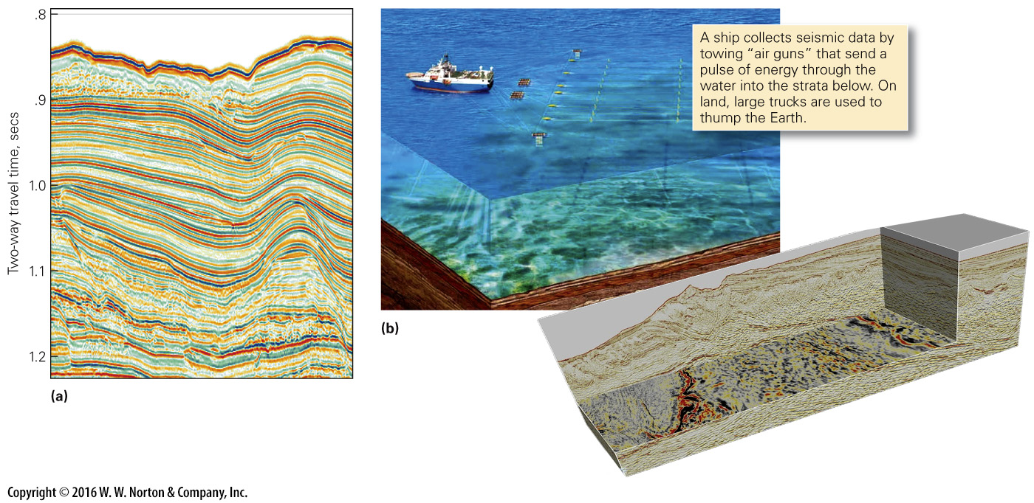
Notes:
FIGURE D.9 Seismic-reflection profiling. The method allows geologists to see layers underground.
(a) After computer analysis, the data yield a seismic-reflection profile. Color bands represent horizons in the stratigraphic sequence. (b) Data can be used to produce a three-dimensional image of the subsurface. Geologists can study both map surfaces and cross sections through the block.

Slide 32
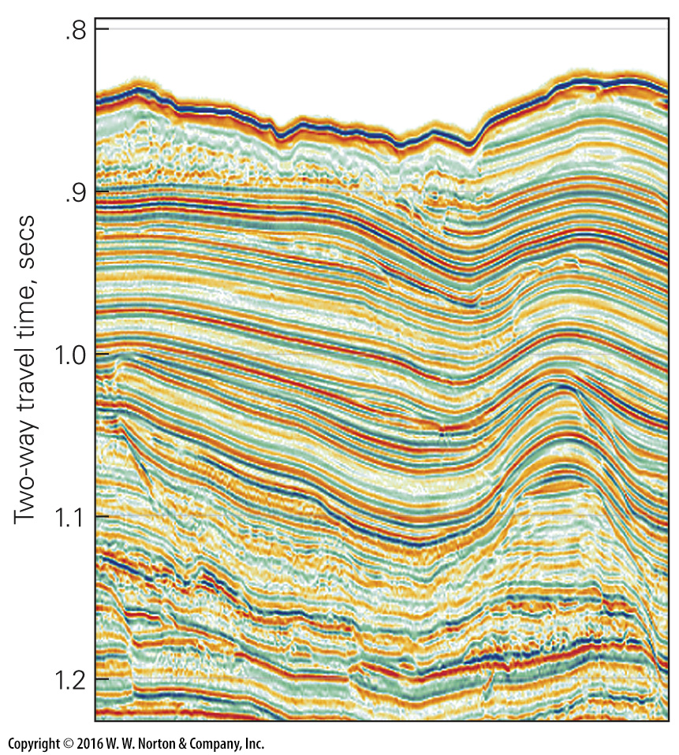
Notes:
FIGURE D.9a Seismic-reflection profiling. The method allows geologists to see layers underground.
(a) After computer analysis, the data yield a seismic-reflection profile. Color bands represent horizons in the stratigraphic sequence.

Slide 33
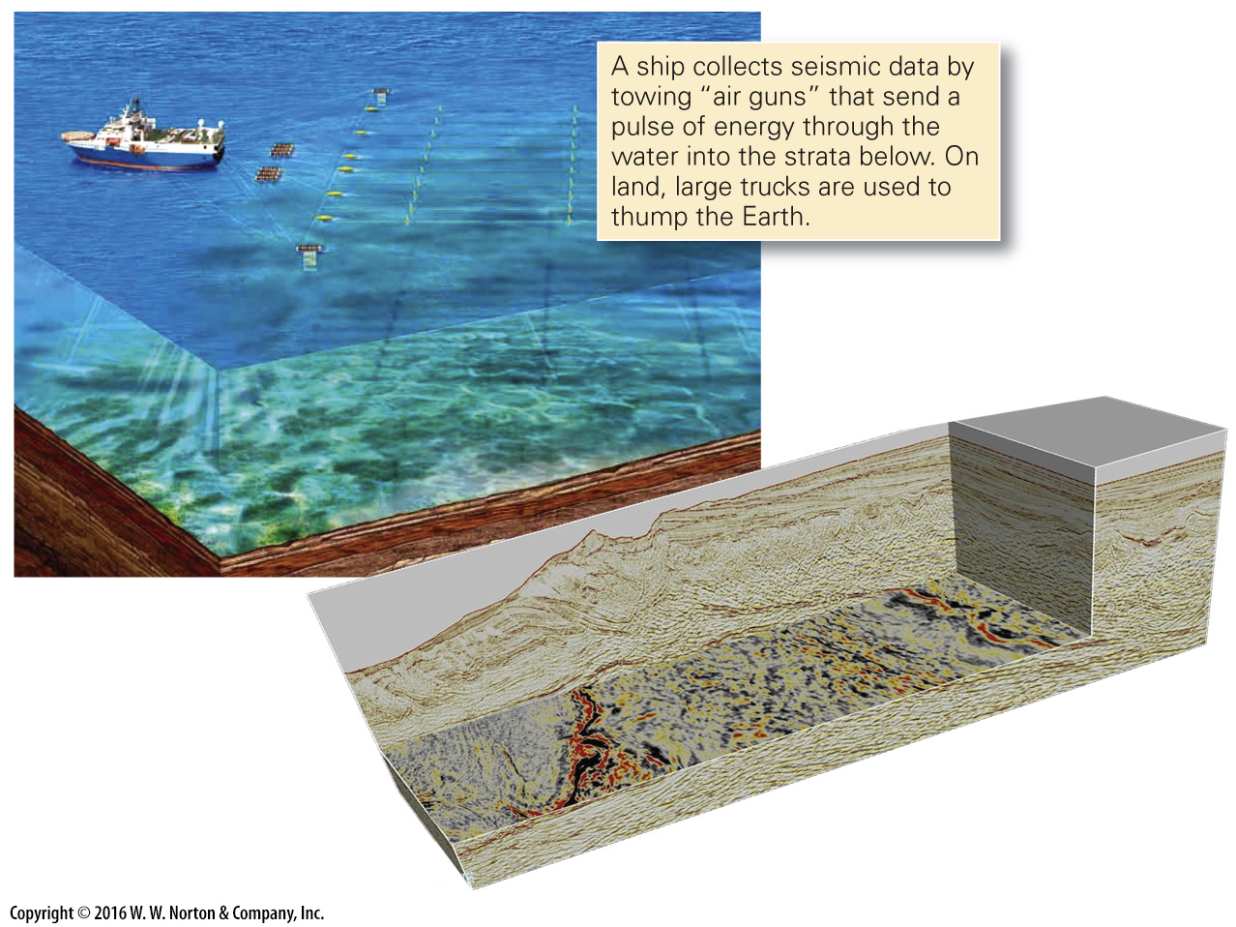
Notes:
FIGURE D.9b Seismic-reflection profiling. The method allows geologists to see layers underground.
(b) Data can be used to produce a three-dimensional image of the subsurface. Geologists can study both map surfaces and cross sections through the block.

Slide 34
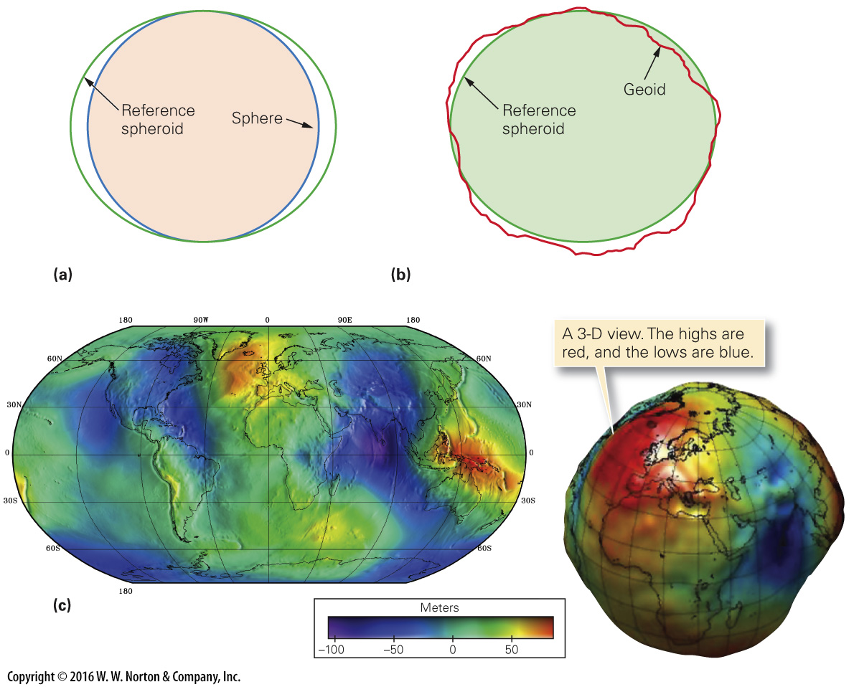
Notes:
FIGURE D.10 Representations of the geoid, the shape of an equipotential surface representing Earth’s gravity. Colors represent elevations of the geoid relative to the reference spheroid.
(a) Earth’s spin makes it slightly elliptical. The elliptical profile it would have (exaggerated here), if other factors didn’t affect gravity, is the reference spheroid. (b) Because the Earth is not homogeneous, there are deviations from the reference spheroid. The actual equipotential surface of the Earth is the geoid; its profile is greatly exaggerated here. (c) The geoid can also be represented in map view, and in 3-D. Note the geoid low in the Indian Ocean.

Slide 35
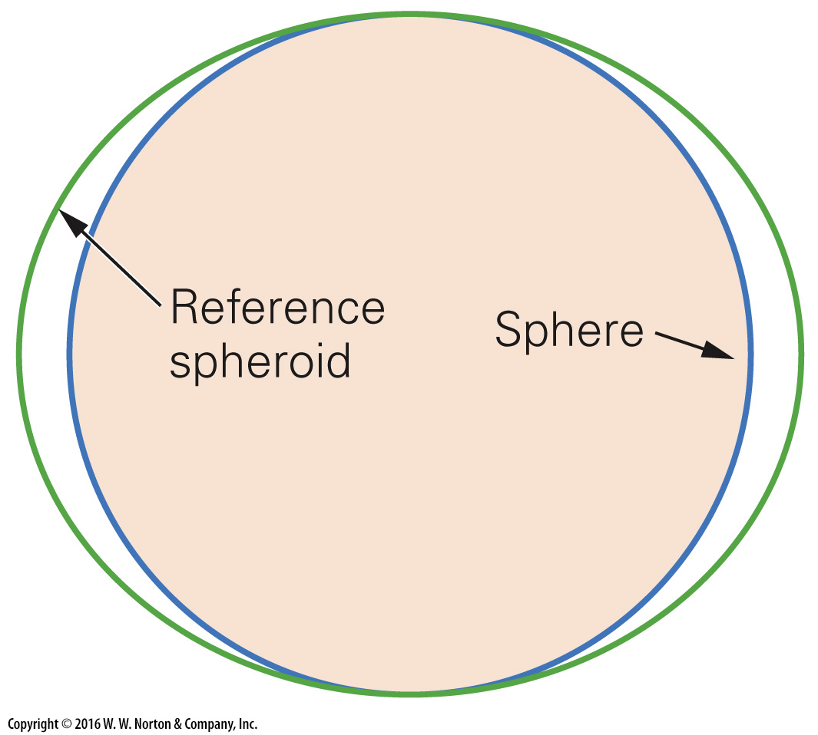
Notes:
FIGURE D.10a Representations of the geoid, the shape of an equipotential surface representing Earth’s gravity. Colors represent elevations of the geoid relative to the reference spheroid.
(a) Earth’s spin makes it slightly elliptical. The elliptical profile it would have (exaggerated here), if other factors didn’t affect gravity, is the reference spheroid.

Slide 36
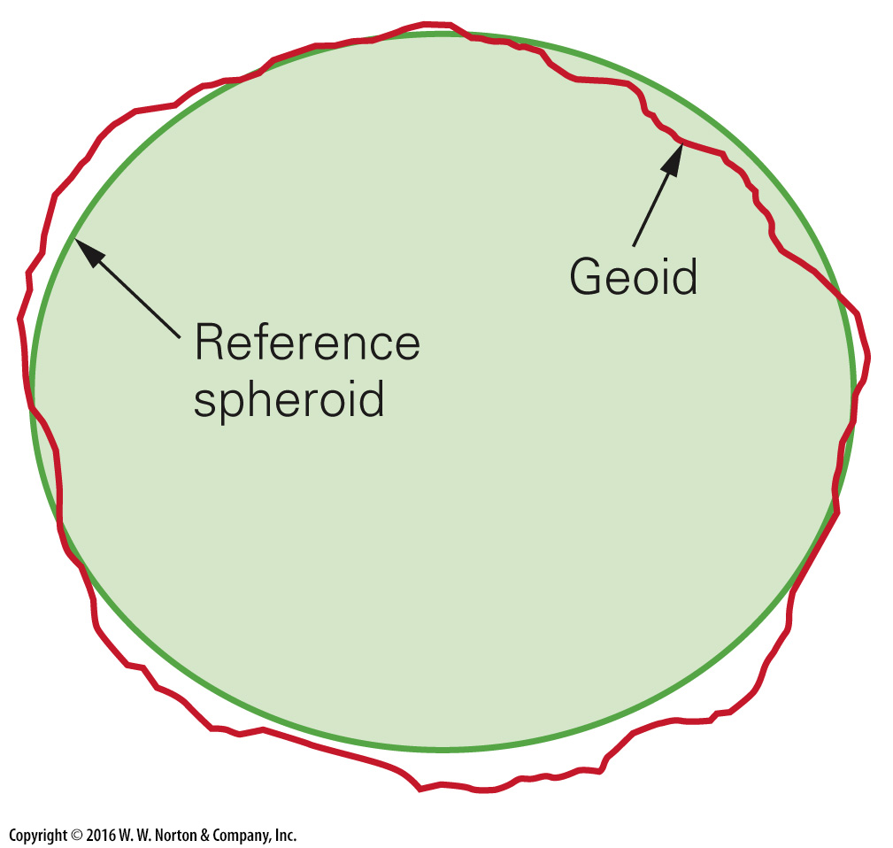
Notes:
FIGURE D.10b Representations of the geoid, the shape of an equipotential surface representing Earth’s gravity. Colors represent elevations of the geoid relative to the reference spheroid.
(b) Because the Earth is not homogeneous, there are deviations from the reference spheroid. The actual equipotential surface of the Earth is the geoid; its profile is greatly exaggerated here.

Slide 37
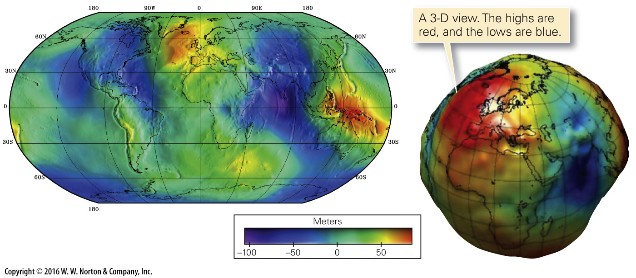
Notes:
FIGURE D.10c Representations of the geoid, the shape of an equipotential surface representing Earth’s gravity. Colors represent elevations of the geoid relative to the reference spheroid.
(c) The geoid can also be represented in map view, and in 3-D. Note the geoid low in the Indian Ocean.

Slide 38
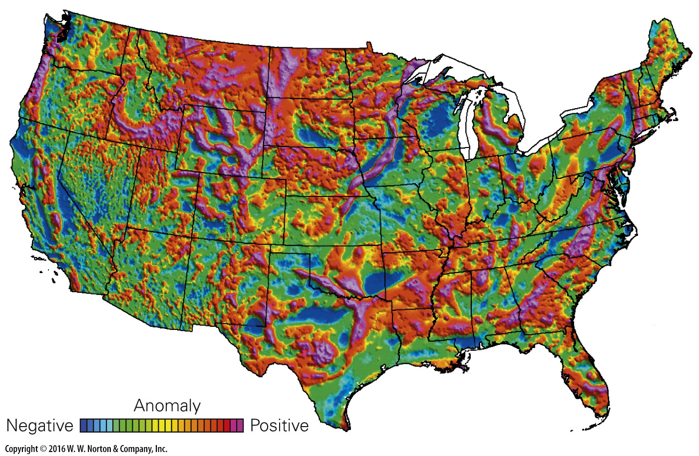
Notes:
FIGURE D.11 A gravity anomaly map of the United States. On this map, colors represent variations in the magnitude of gravitational pull. Red is stronger, blue is weaker.

Slide 39
Notes:
FIGURE D.12 A ship analog for the concept of isostasy. At isostatic equilibrium, the freeboard reflects Archimedes’ principle, so the freeboard decreases as the mass of the ship increases. Water flows out of the way as the ship moves down (right image).

Slide 40
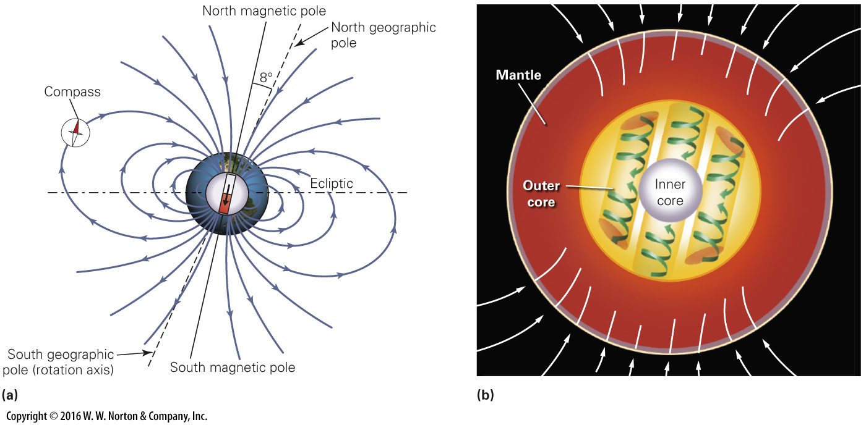
Notes:
FIGURE D.13 Earth’s magnetic field may be due to spiral-like convection cells in the outer core.
(a) The geometry of Earth’s dipole field. (b) An artist’s image of spiral convection cells in the outer core.

Slide 41
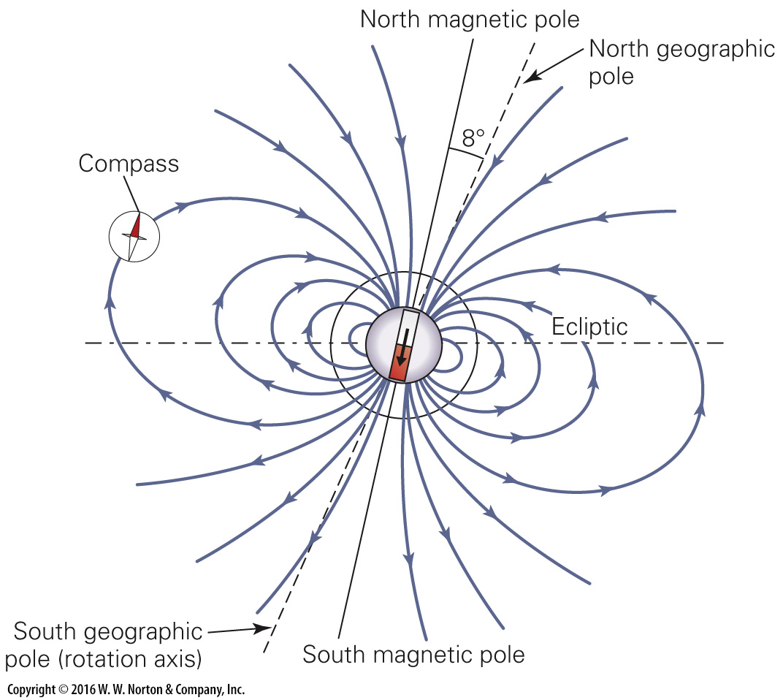
Notes:
FIGURE D.13a Earth’s magnetic field may be due to spiral-like convection cells in the outer core.
(a) The geometry of Earth’s dipole field.

Slide 42
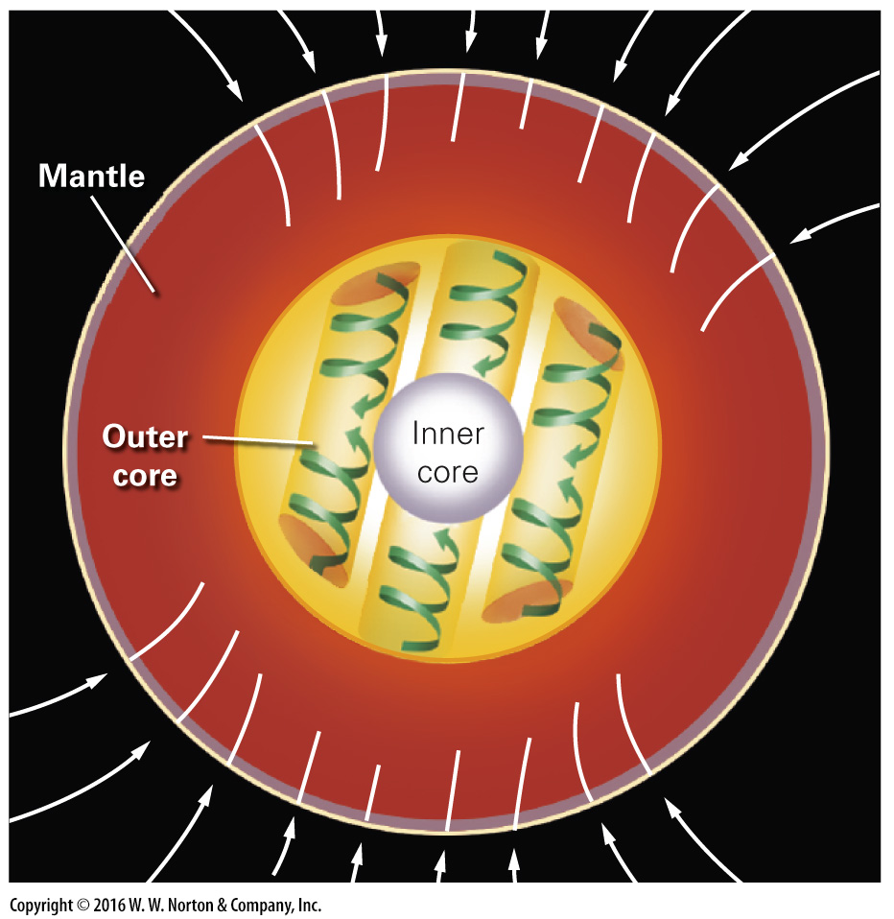
Notes:
FIGURE D.13b Earth’s magnetic field may be due to spiral-like convection cells in the outer core.
(b) An artist’s image of spiral convection cells in the outer core.

Slide 43
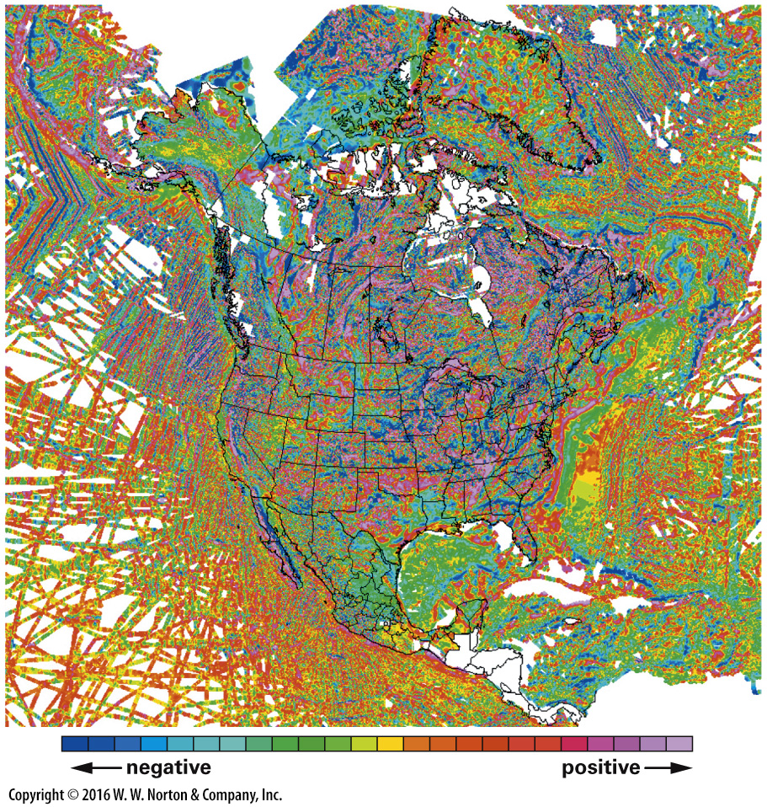
Notes:
FIGURE D.14 A magnetic anomaly map of North America, and adjacent seafloor. Note how there is a regular striped pattern on the seafloor, but not within the continent. The white areas are regions where data have not yet been obtained.

