Slide 1
Stephen Marshak
ESSENTIALS OF
Geology
FIFTH EDITION
Interlude E
Memories of Past Life:
Fossils and Evolution
©2016 W. W. Norton & Company, Inc.

Slide 2
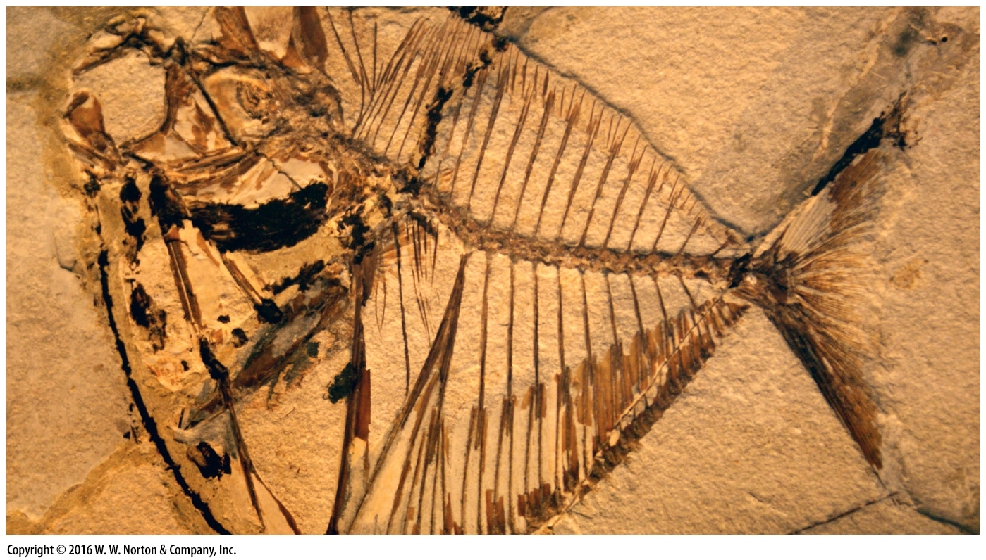
Notes:
This fossil of a fish was carefully exposed by removing the overlying layer of rock. Fine details of the fish’s bones and fins have been preserved for millions of years, allowing us to see a species that no longer exists.

Slide 3
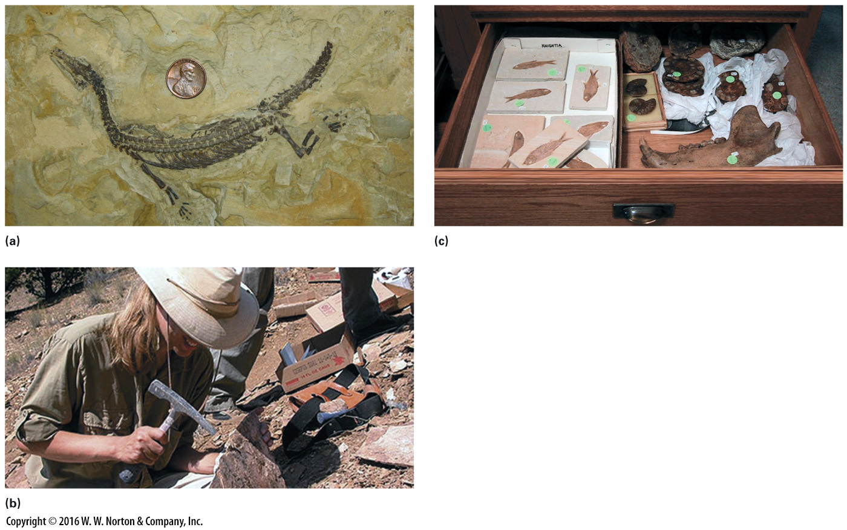
Notes:
FIGURE E.1 Fossils, and their collection.
(a) Fossil skeleton in 200-Ma sandstone. (b) A paleontologist collecting specimens. (c) A drawer of fossil specimens in a museum.

Slide 4
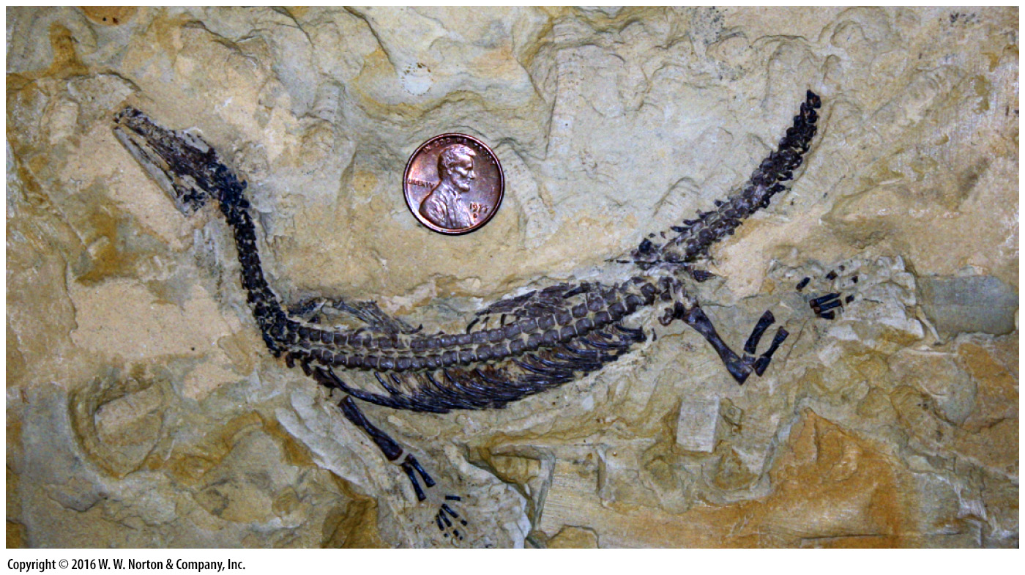
Notes:
FIGURE E.1a Fossils, and their collection.
(a) Fossil skeleton in 200-Ma sandstone.

Slide 5
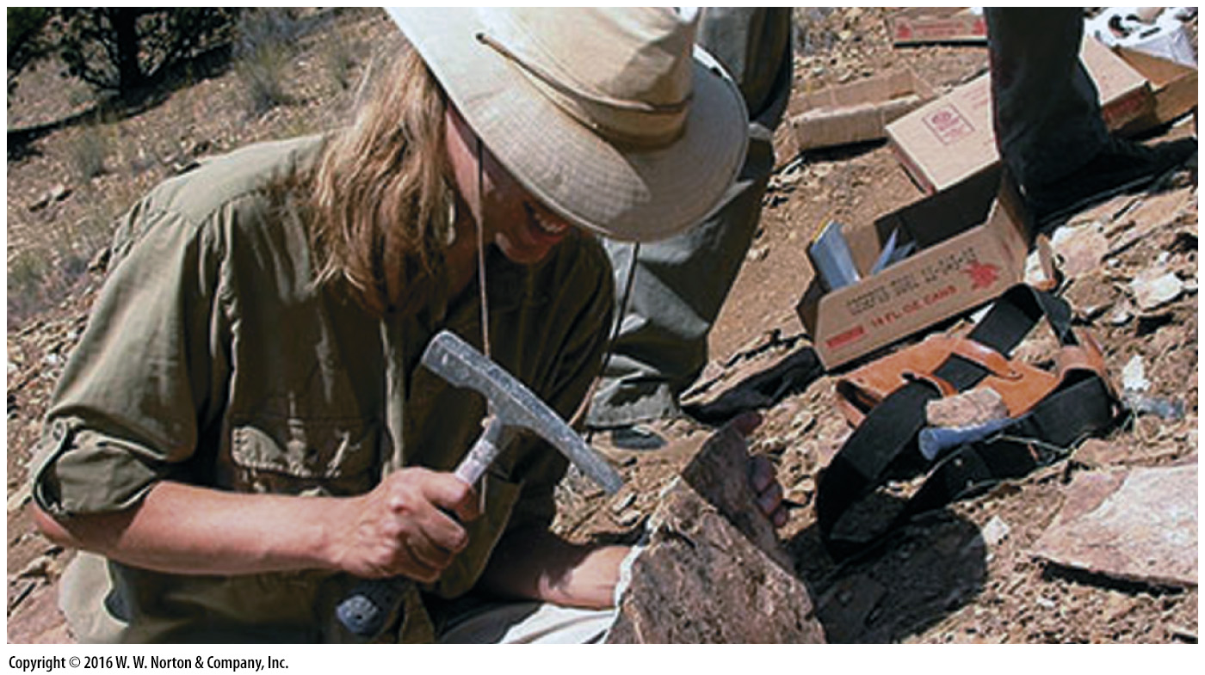
Notes:
FIGURE E.1b Fossils, and their collection.
(b) A paleontologist collecting specimens.

Slide 6
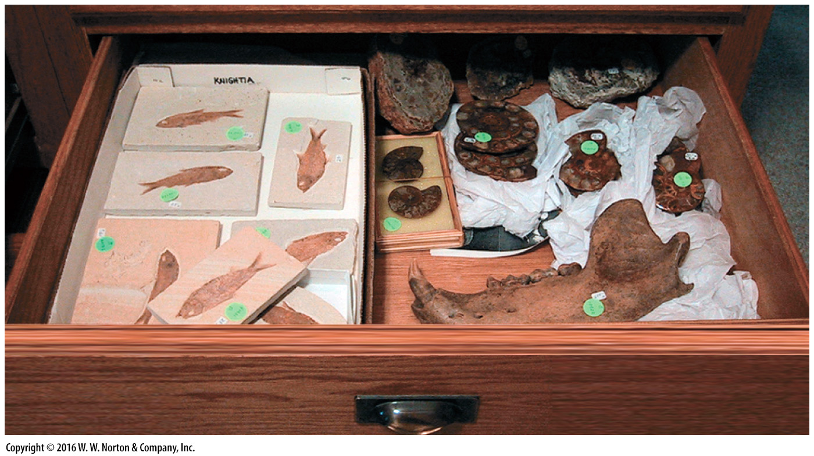
Notes:
FIGURE E.1c Fossils, and their collection.
(c) A drawer of fossil specimens in a museum.

Slide 7
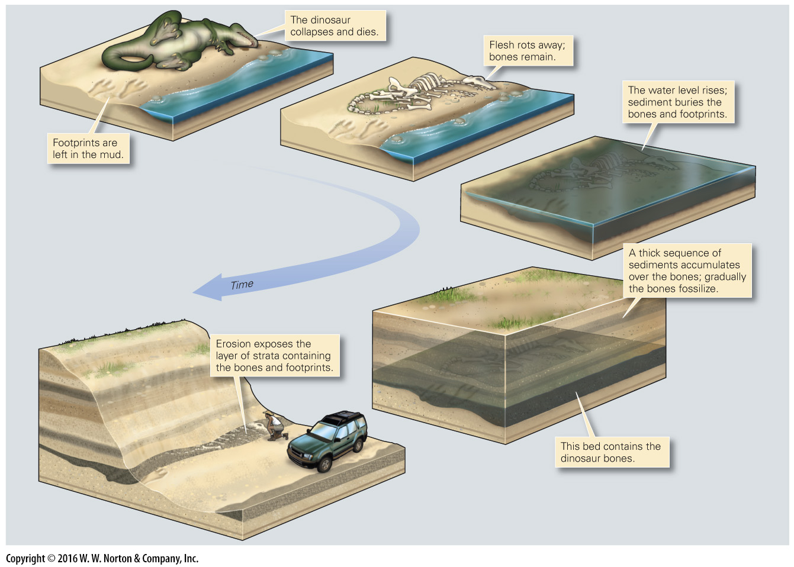
Notes:
FIGURE E.2 The stages in the fossilization of a dinosaur.

Slide 8
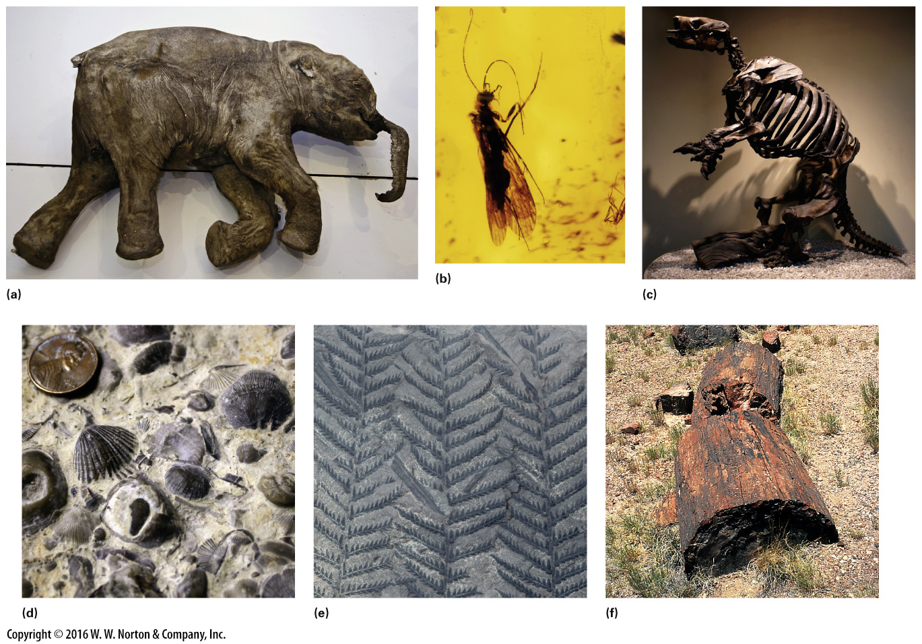
Notes:
FIGURE E.3 Examples of different kinds of fossils.
(a) This 1-m long baby mammoth, found in Siberia, died 37,000 years ago. (b) This insect became embedded in amber about 200 million years ago. (c) A fossil skeleton of a 2-m-high giant ground sloth from the La Brea Tar Pits in California. (d) Fossil shells, the “hard parts” of invertebrates. (e) The carbonized impressions of fern fronds in a shale. (f) Petrified wood from Arizona. It is so hard that it remains after the rock that surrounded it has eroded away.

Slide 9
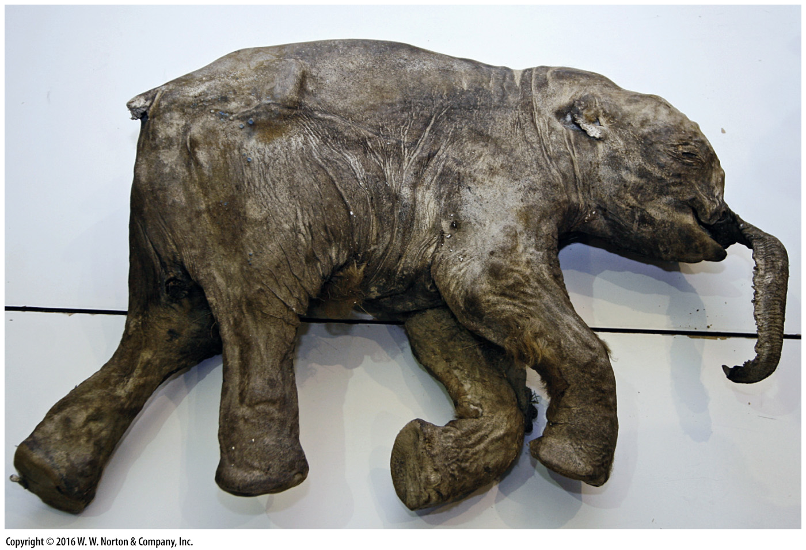
Notes:
FIGURE E.3a Examples of different kinds of fossils.
(a) This 1-m long baby mammoth, found in Siberia, died 37,000 years ago.

Slide 10
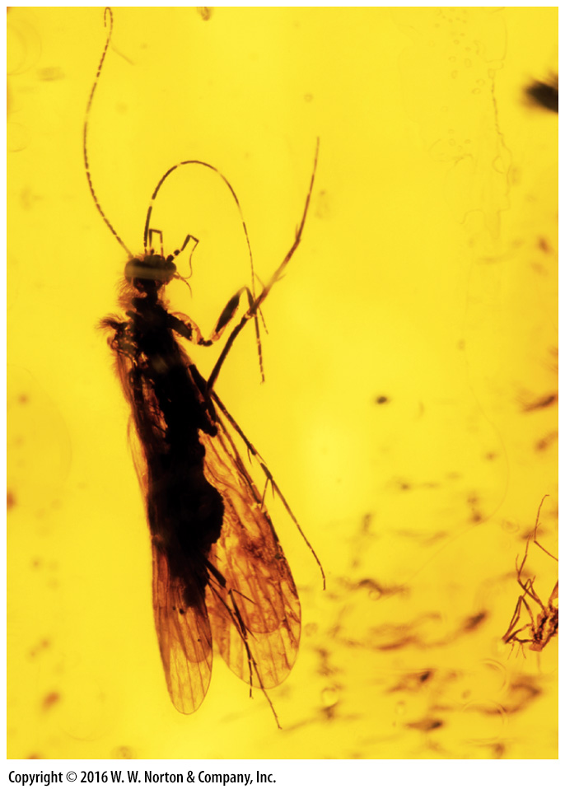
Notes:
FIGURE E.3b Examples of different kinds of fossils.
(b) This insect became embedded in amber about 200 million years ago.

Slide 11
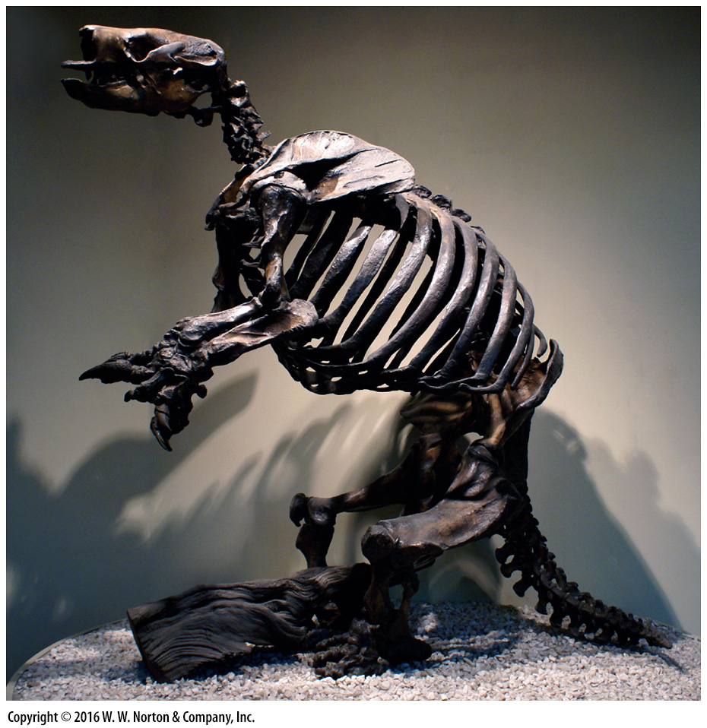
Notes:
FIGURE E.3c Examples of different kinds of fossils.
(c) A fossil skeleton of a 2-m-high giant ground sloth from the La Brea Tar Pits in California.

Slide 12
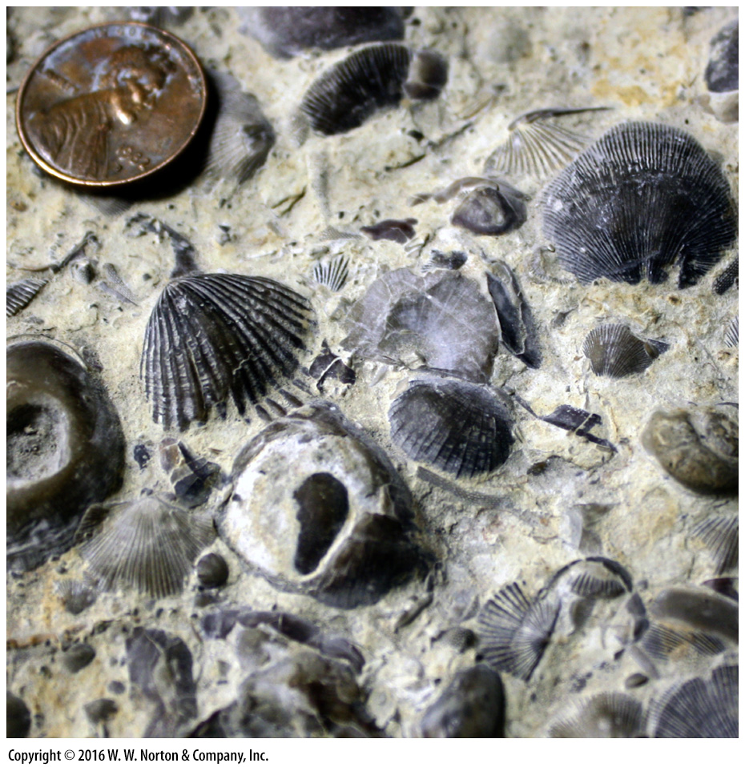
Notes:
FIGURE E.3d Examples of different kinds of fossils.
(d) Fossil shells, the “hard parts” of invertebrates.

Slide 13
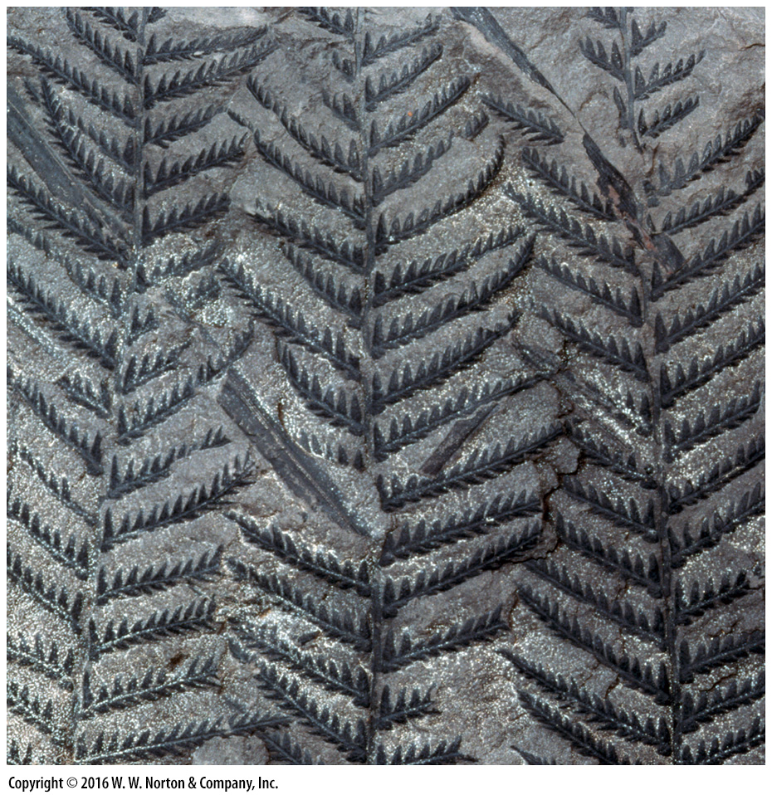
Notes:
FIGURE E.3e Examples of different kinds of fossils.
(e) The carbonized impressions of fern fronds in a shale.

Slide 14
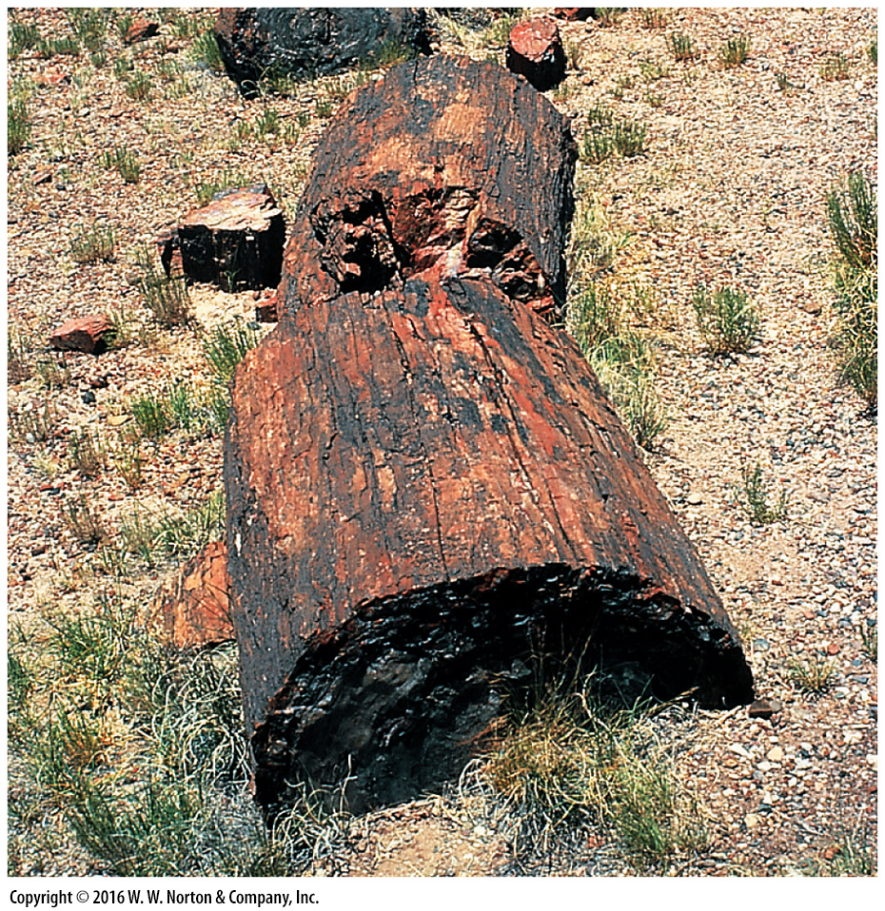
Notes:
FIGURE E.3f Examples of different kinds of fossils.
(f) Petrified wood from Arizona. It is so hard that it remains after the rock that surrounded it has eroded away.

Slide 15
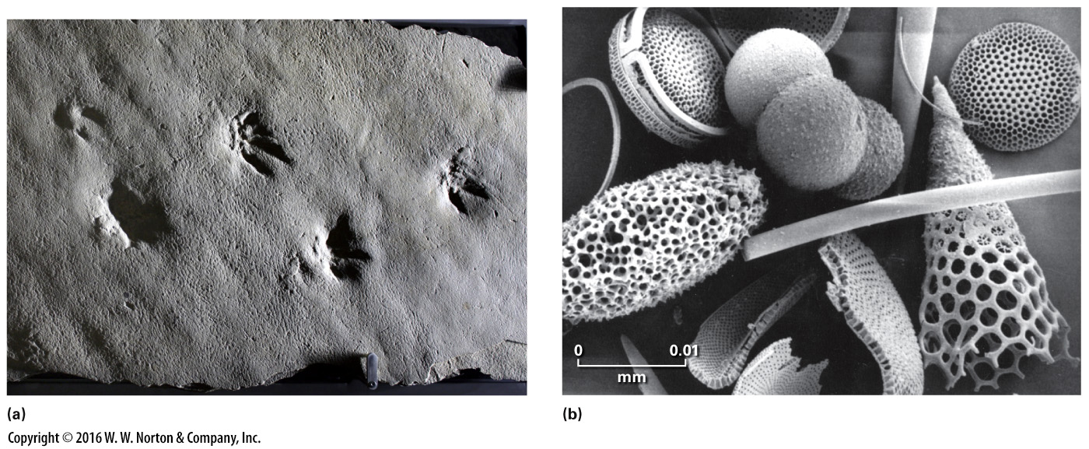
Notes:
FIGURE E.4 Examples of trace fossils and microfossils.
(a) Molds of dinosaur footprints. These push down into the top of a bed. (b) Examples of fossil plankton shells. Because of their size, geologists refer to these as microfossils.

Slide 16
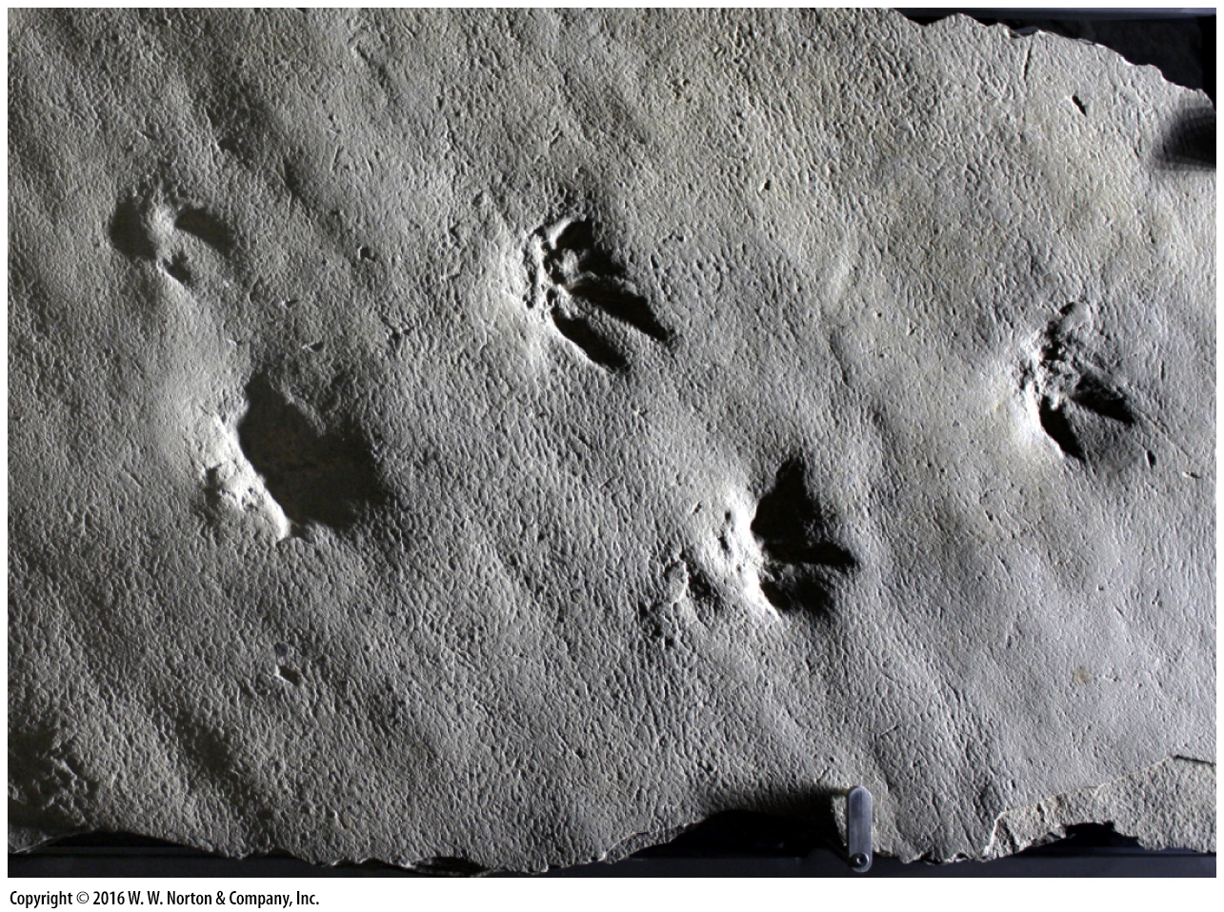
Notes:
FIGURE E.4a Examples of trace fossils and microfossils.
(a) Molds of dinosaur footprints. These push down into the top of a bed.

Slide 17
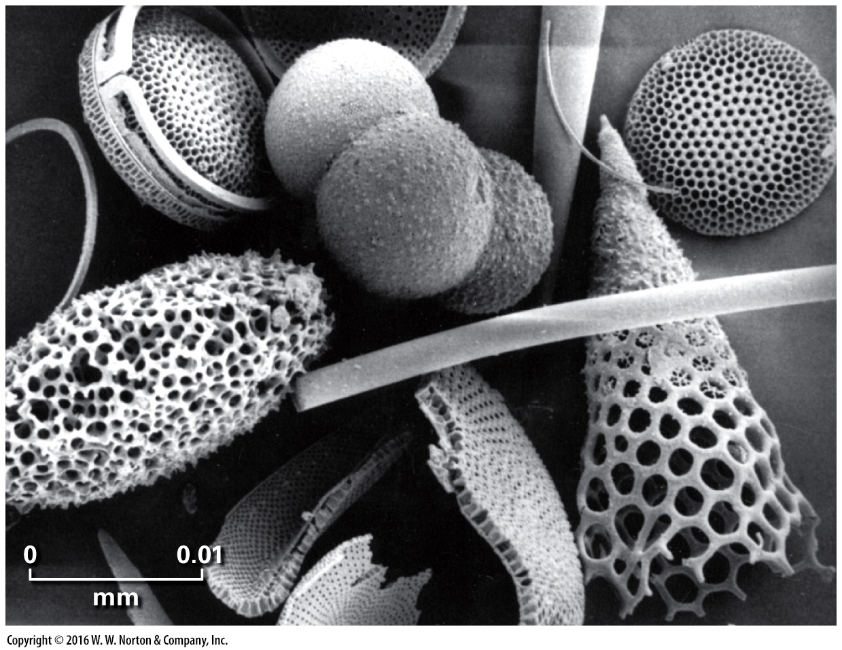
Notes:
FIGURE E.4b Examples of trace fossils and microfossils.
(b) Examples of fossil plankton shells. Because of their size, geologists refer to these as microfossils.

Slide 18
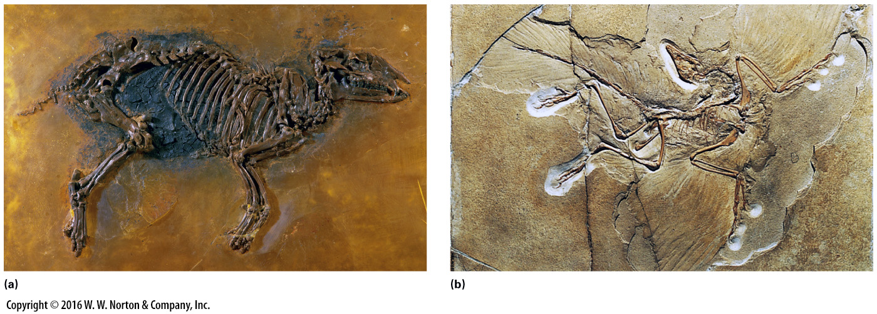
Notes:
FIGURE E.5 Extraordinary fossils. These fossils are particularly well preserved.
(a) A 50-million-year-old mammal fossil was chiseled from oil shale near Messel, Germany. It still contains the remains of skin. (b) Archaeopteryx from the 150-million-year-old Solnhofen Limestone of Germany. The imprints of feathers are clearly visible.

Slide 19
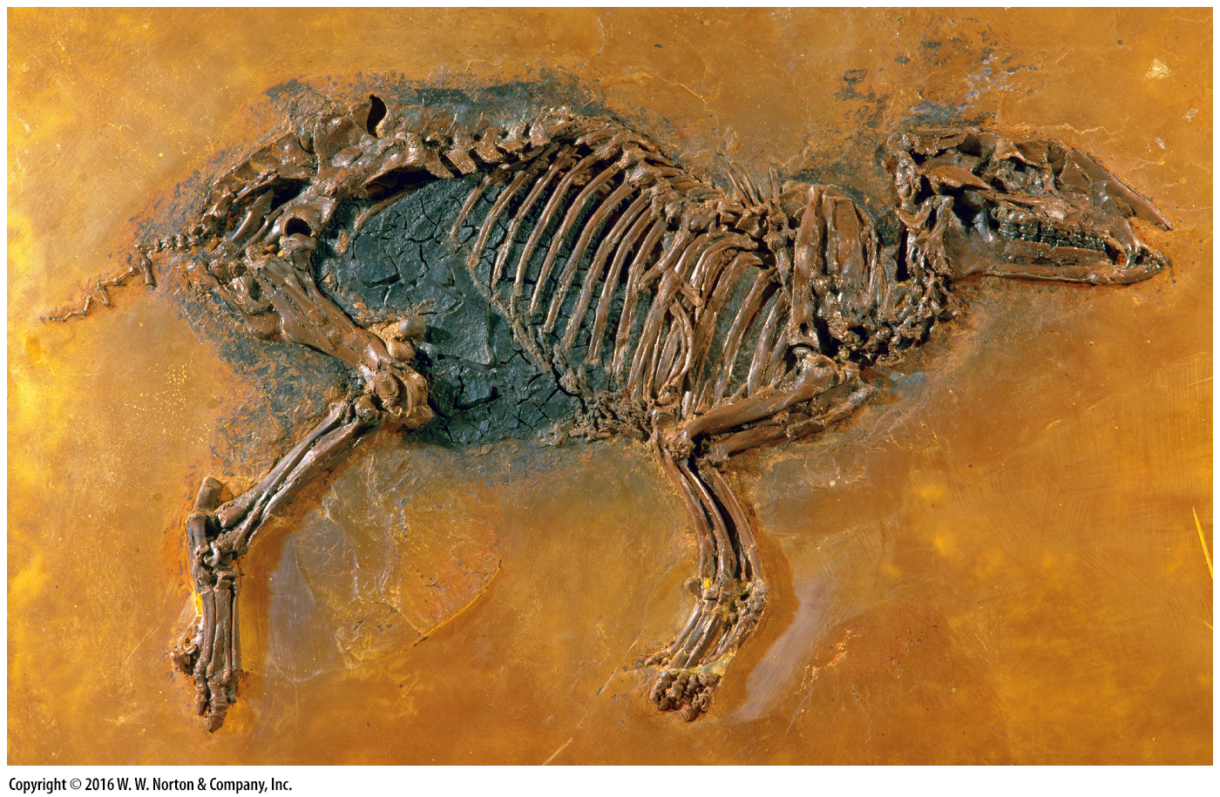
Notes:
FIGURE E.5a Extraordinary fossils. These fossils are particularly well preserved.
(a) A 50-million-year-old mammal fossil was chiseled from oil shale near Messel, Germany. It still contains the remains of skin.

Slide 20
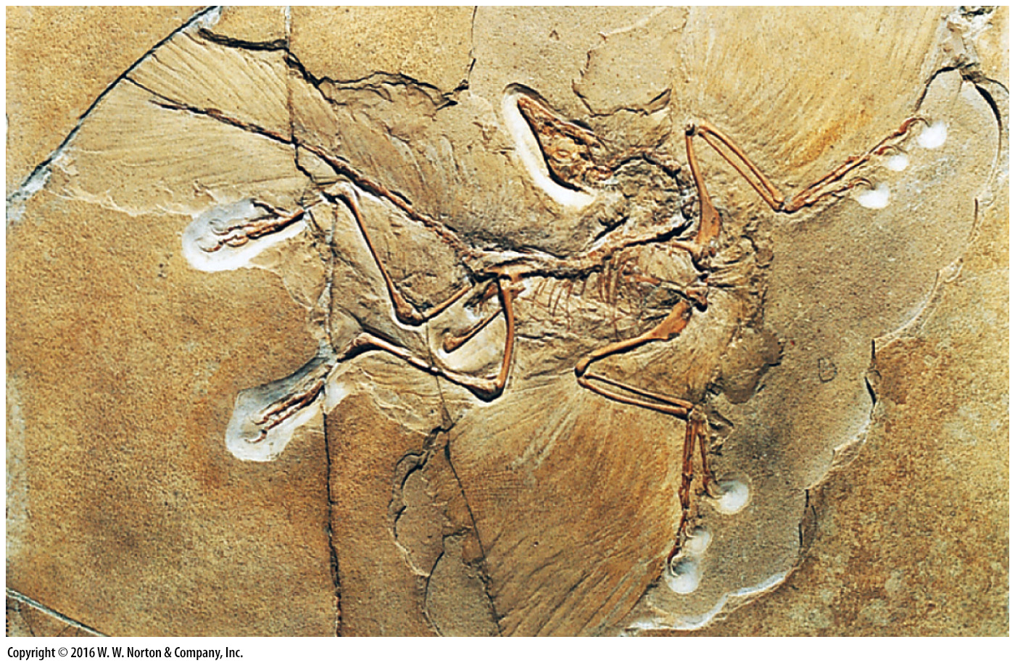
Notes:
FIGURE E.5b Extraordinary fossils. These fossils are particularly well preserved.
(b) Archaeopteryx from the 150-million-year-old Solnhofen Limestone of Germany. The imprints of feathers are clearly visible.

Slide 21
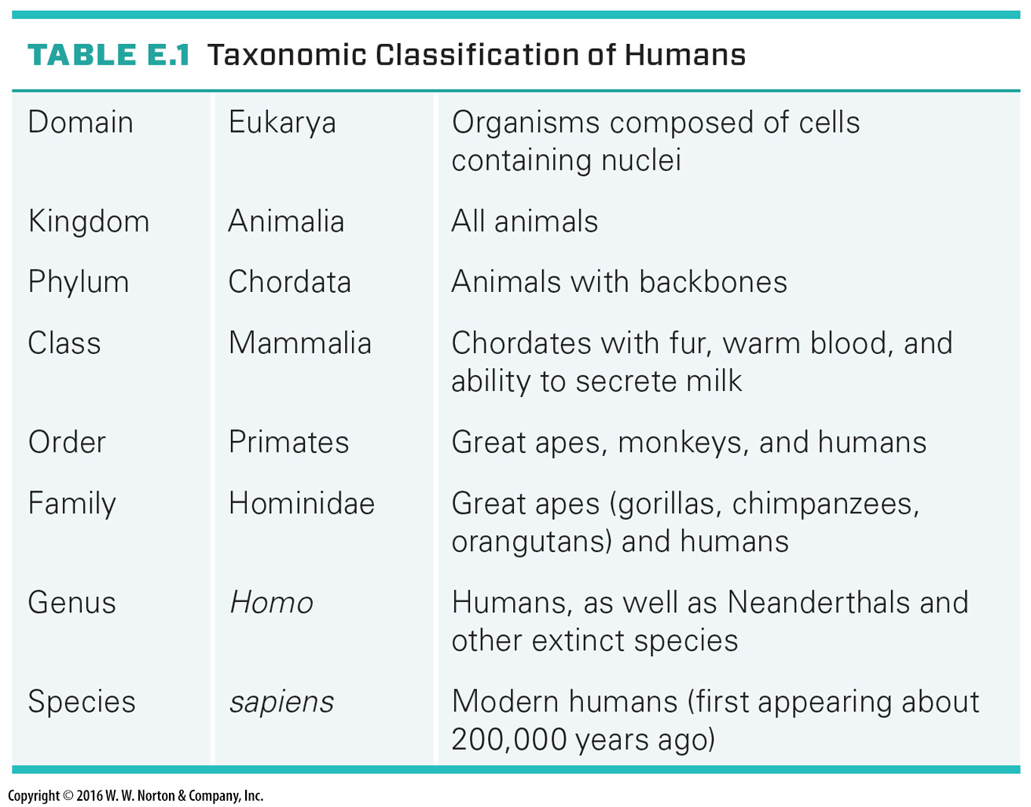
Notes:
TABLE E.1 Taxonomic Classification of Humans

Slide 22
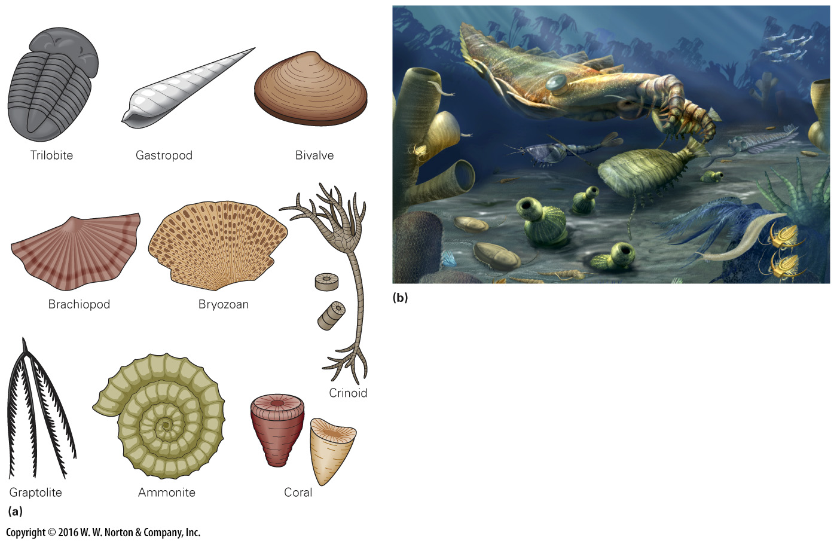
Notes:
FIGURE E.6 Common types of invertebrate fossils.
(a) Sketches of representative fossils. (b) An artist’s reconstruction of a Cambrian ecosystem. The painting is based on Burgess Shale fossils.

Slide 23
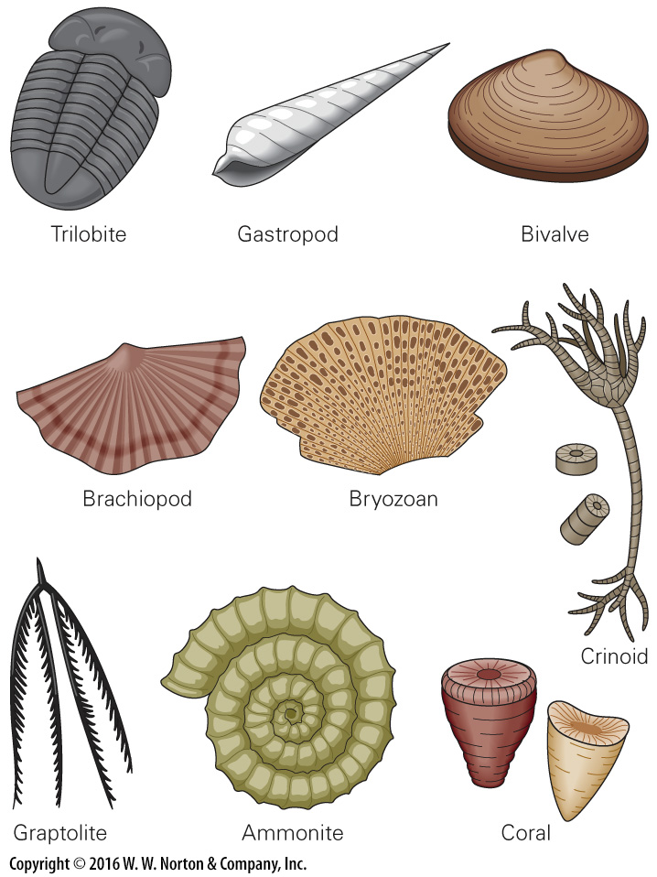
Notes:
FIGURE E.6a Common types of invertebrate fossils.
(a) Sketches of representative fossils.

Slide 24
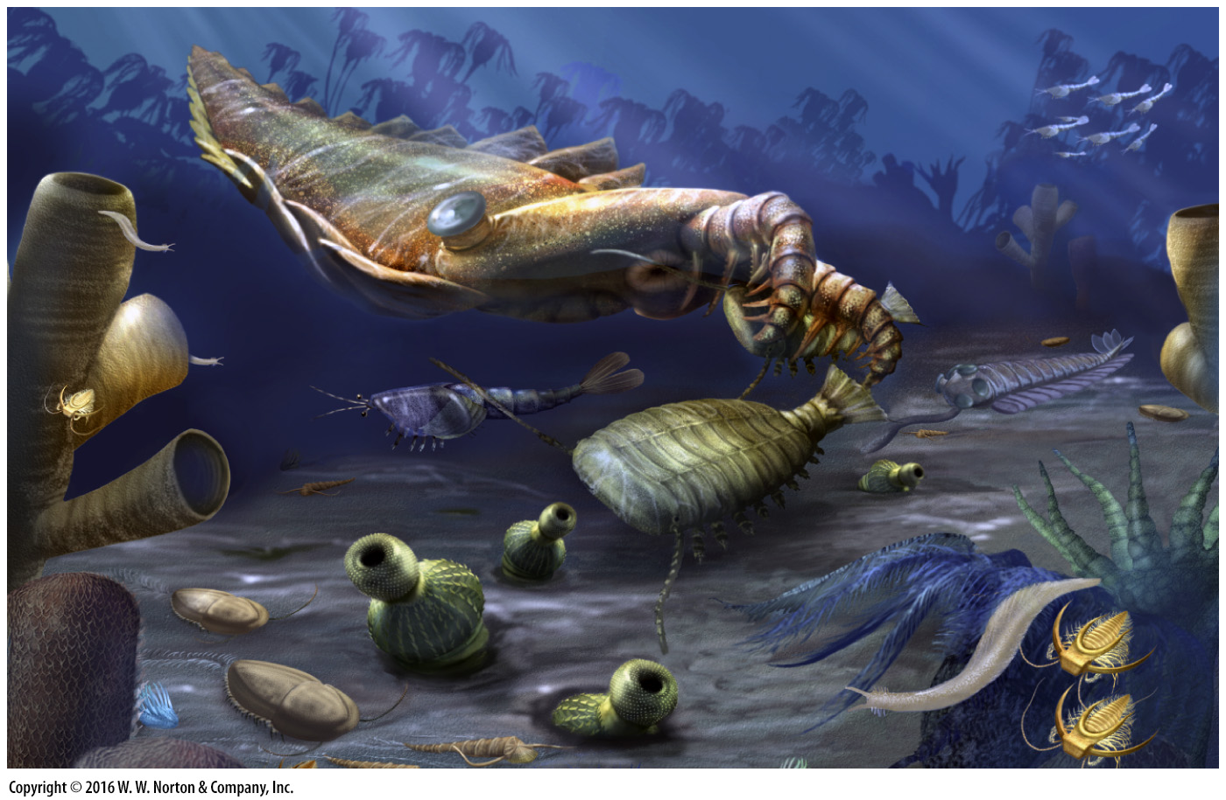
Notes:
FIGURE E.6b Common types of invertebrate fossils.
(b) An artist’s reconstruction of a Cambrian ecosystem. The painting is based on Burgess Shale fossils.

Slide 25
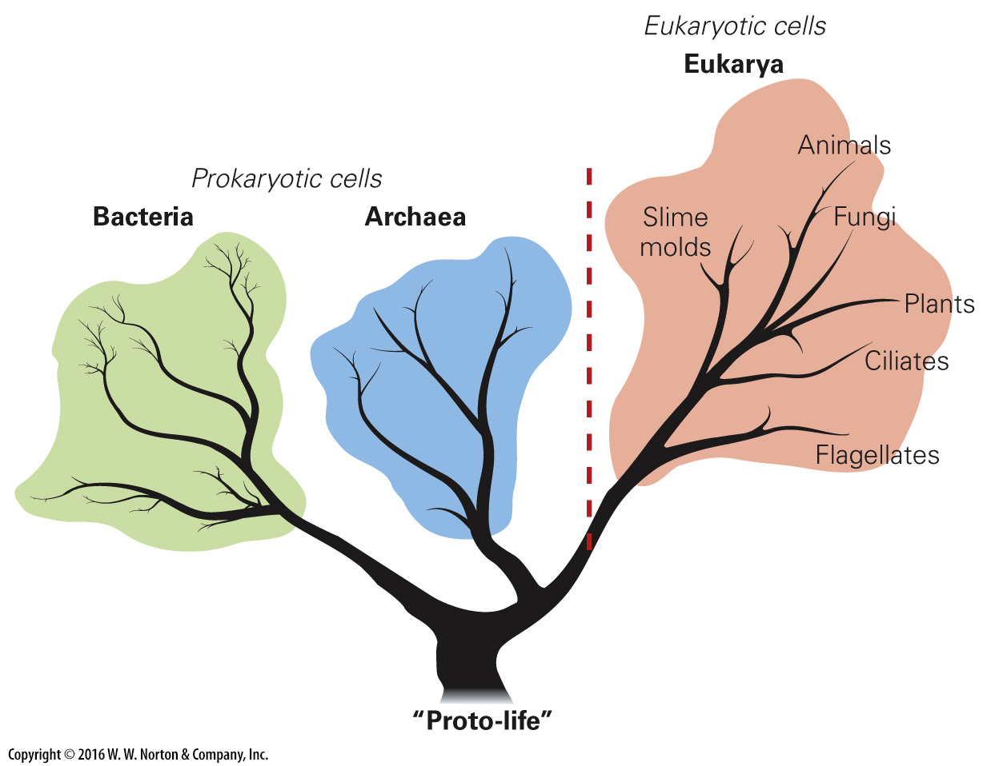
Notes:
FIGURE E.7 A phylogenetic tree. The tree of life symbolically illustrates relations among different domains of organisms. Archaea and bacteria are both prokaryotes and don’t have nuclei. All other life forms are eukaryotes because they have cells with a nucleus.

Slide 26
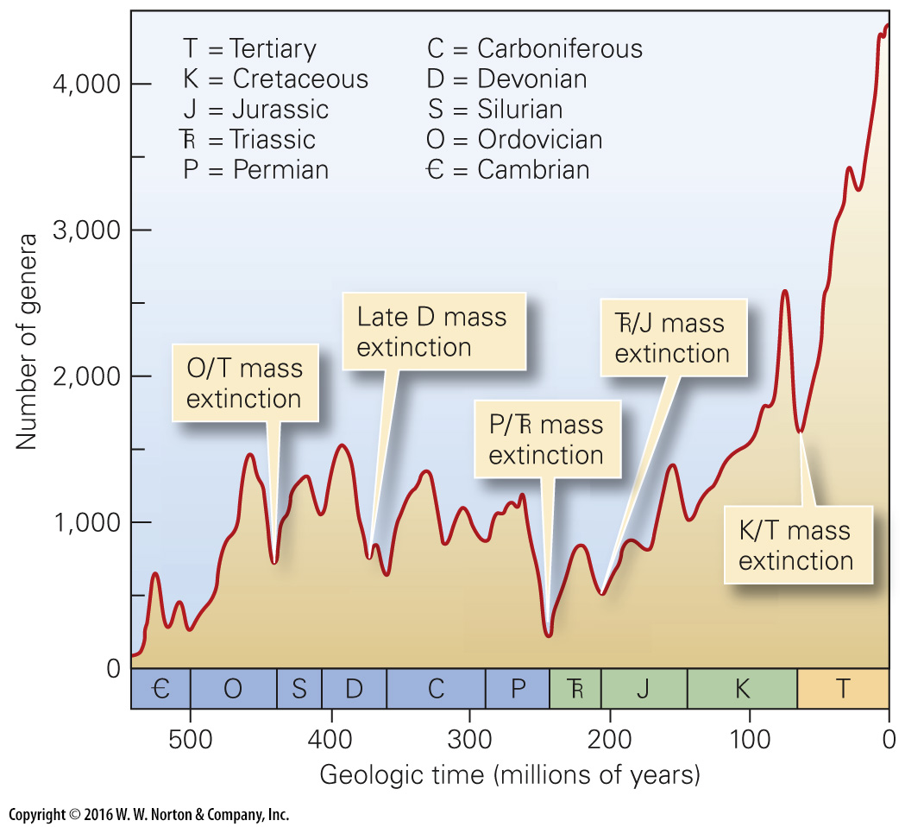
Notes:
FIGURE E.8 This graph shows how the diversity of life has changed with time. Sudden drops indicate periods when mass extinctions occurred.

