Slide 1
Stephen Marshak
ESSENTIALS OF
Geology
FIFTH EDITION
Prelude
And Just What Is Geology?
©2016 W. W. Norton & Company, Inc.

Slide 2
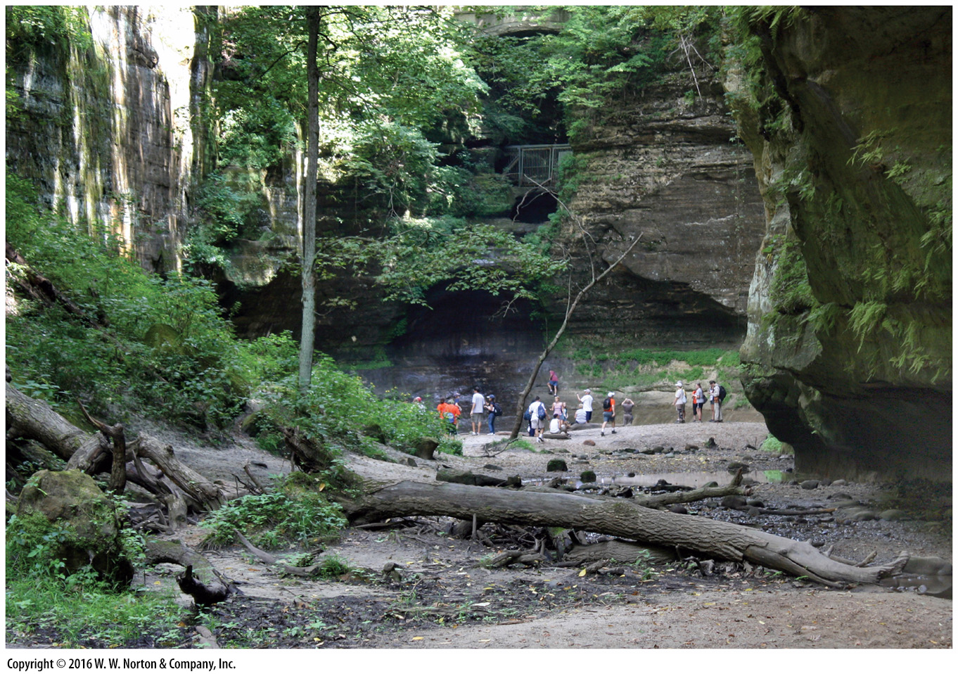
Notes:
Students exploring a small canyon in Illinois. Geology is everywhere!

Slide 3
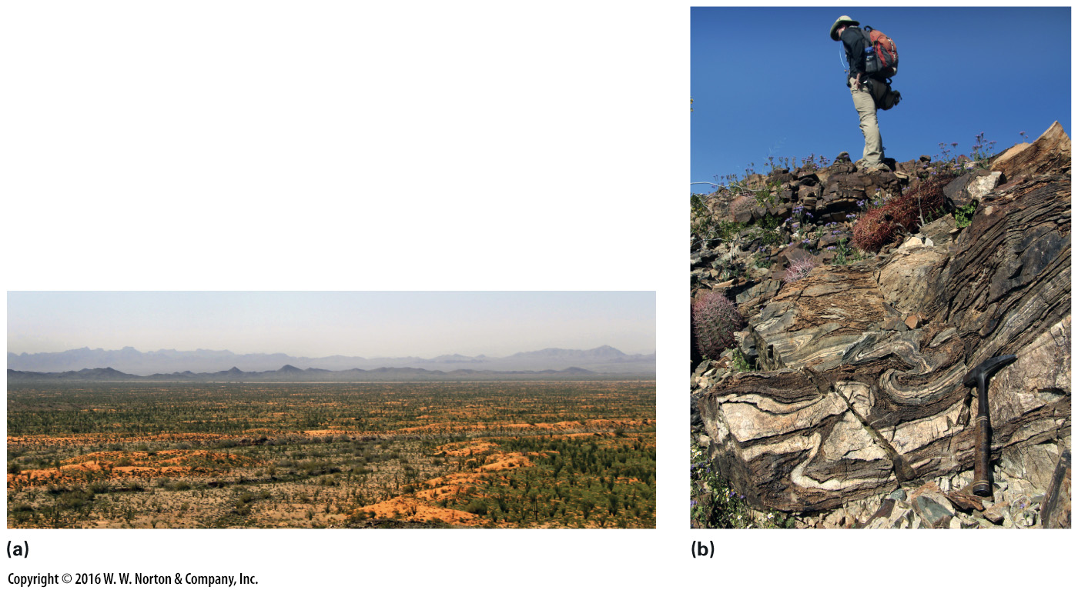
Notes:
FIGURE P.1 Geologic exploration provides beautiful views, and mysteries to solve.
(a) A view of the western Arizona desert is not just beautiful—it holds clues to the Earth’s past and to the changes taking place today. (b) The contortions of the rock layers speak of a time when the rock flowed, like soft plastic.

Slide 4
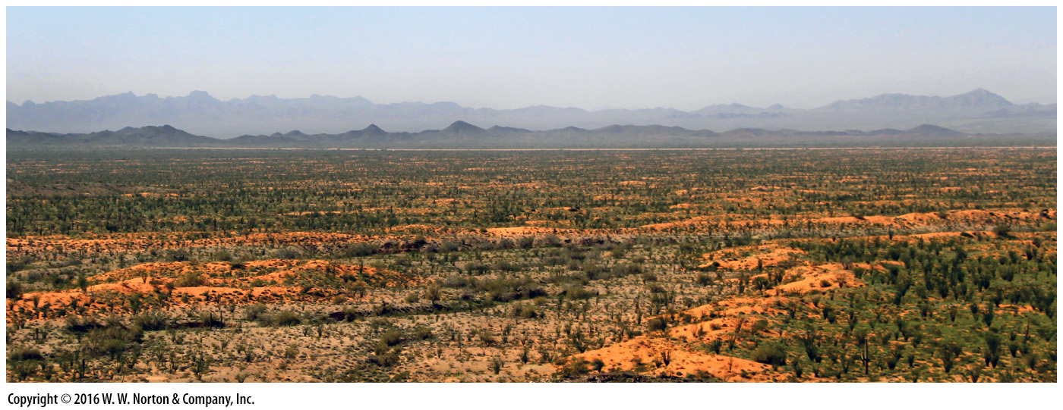
Notes:
FIGURE P.1a Geologic exploration provides beautiful views, and mysteries to solve.
(a) A view of the western Arizona desert is not just beautiful—it holds clues to the Earth’s past and to the changes taking place today.

Slide 5
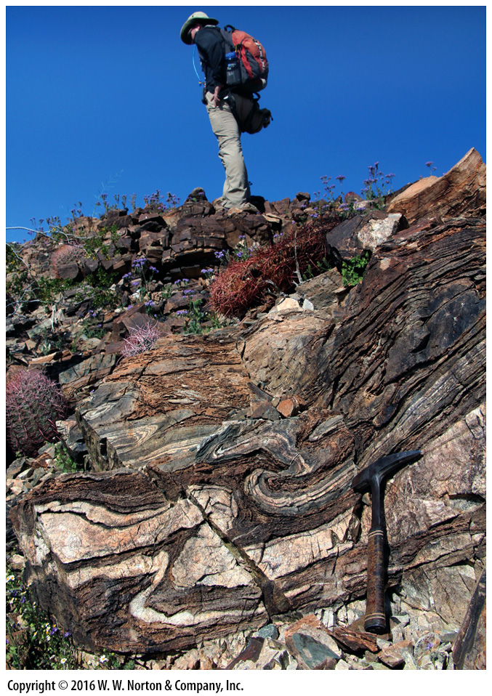
Notes:
FIGURE P.1b Geologic exploration provides beautiful views, and mysteries to solve.
(b) The contortions of the rock layers speak of a time when the rock flowed, like soft plastic.

Slide 6
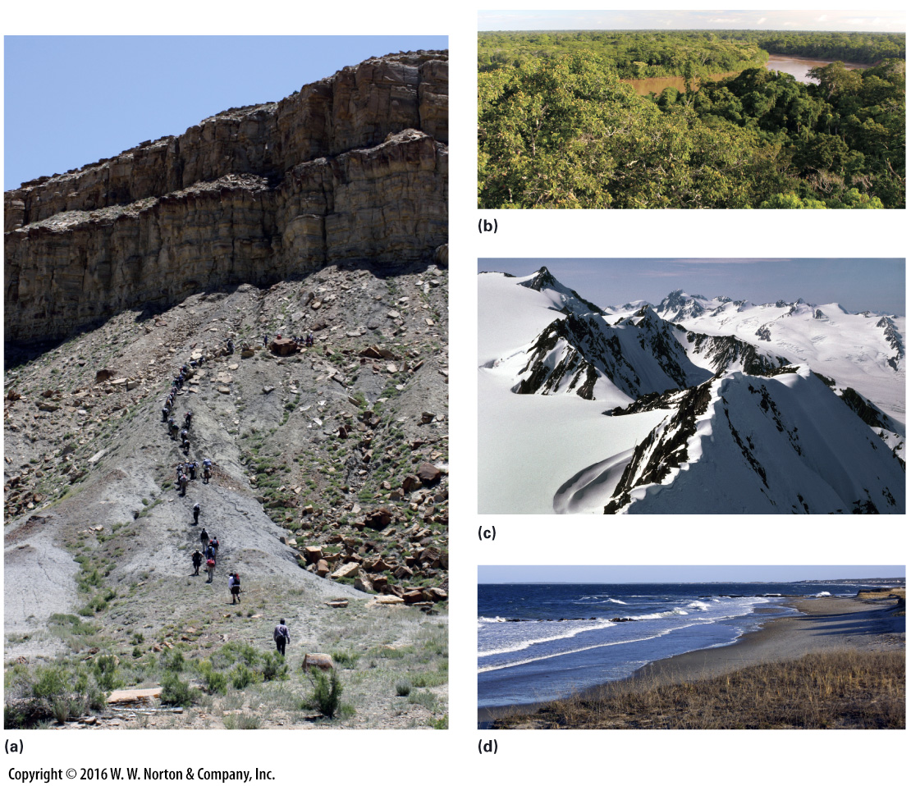
Notes:
FIGURE P.2 Field study in many environments.
(a) A desert cliff in Utah. (b) A rainforest in Peru. (c) Mountains in Alaska. (d) The shore in Massachusetts.

Slide 7
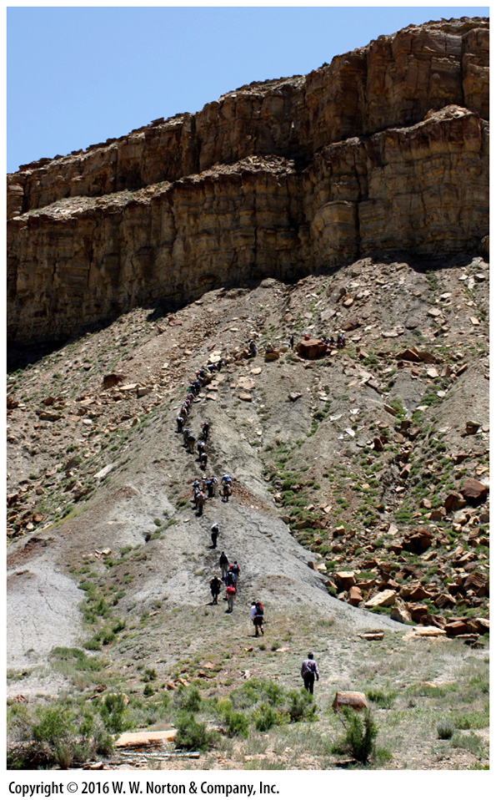
Notes:
FIGURE P.2a Field study in many environments.
(a) A desert cliff in Utah.

Slide 8
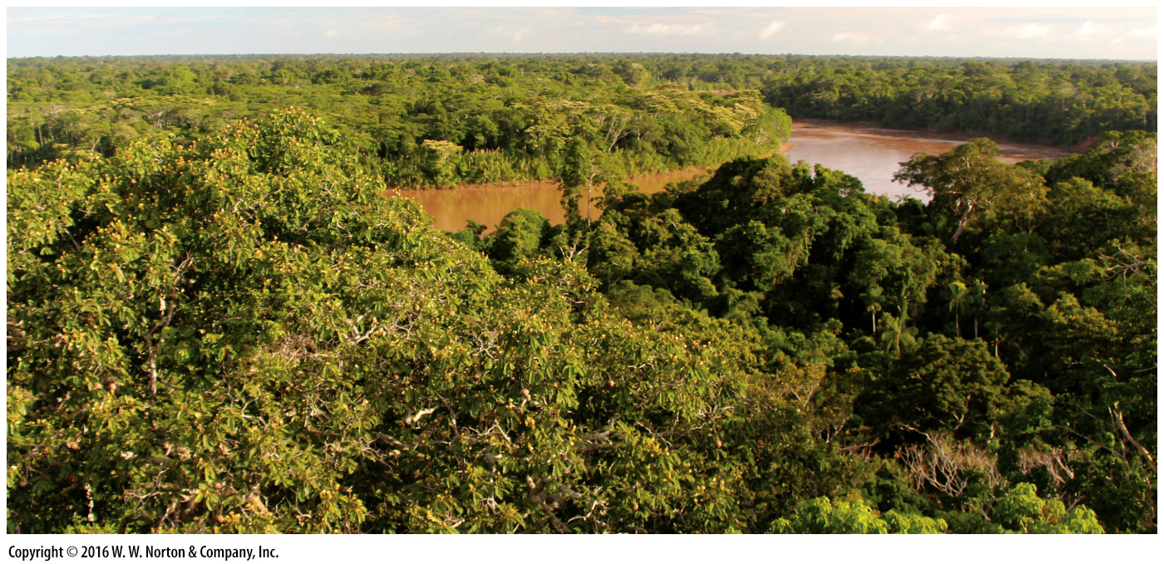
Notes:
FIGURE P.2b Field study in many environments.
(b) A rainforest in Peru.

Slide 9
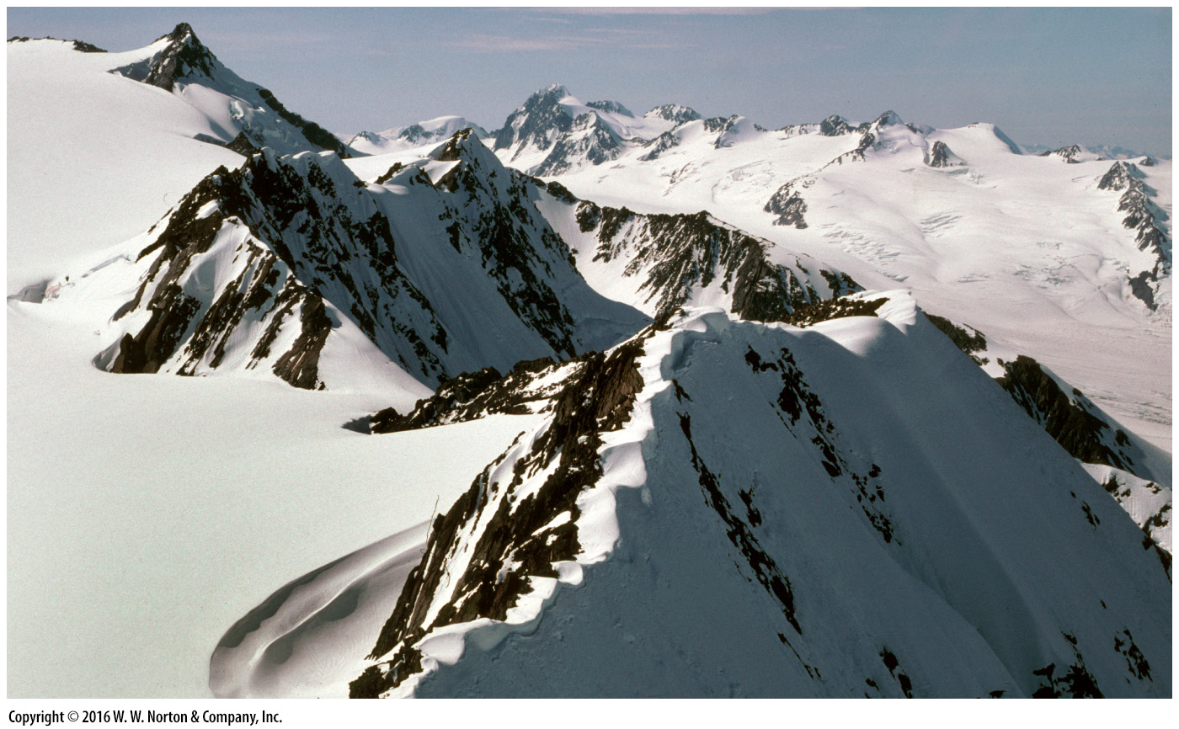
Notes:
FIGURE P.2c Field study in many environments.
(c) Mountains in Alaska.

Slide 10
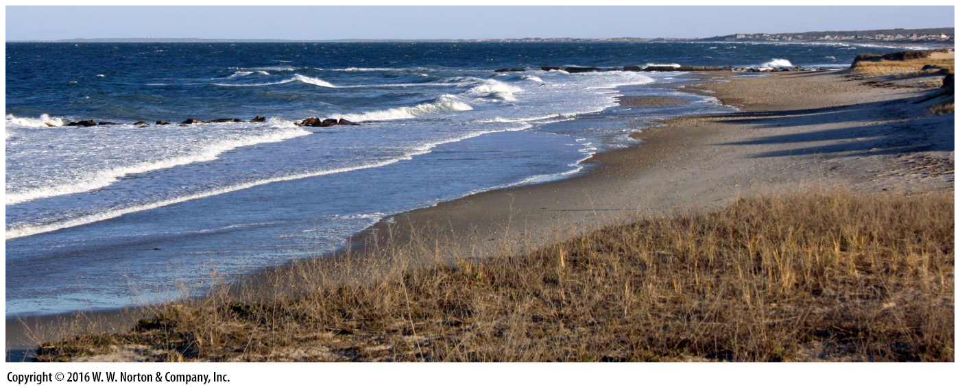
Notes:
FIGURE P.2d Field study in many environments.
(d) The shore in Massachusetts.

Slide 11
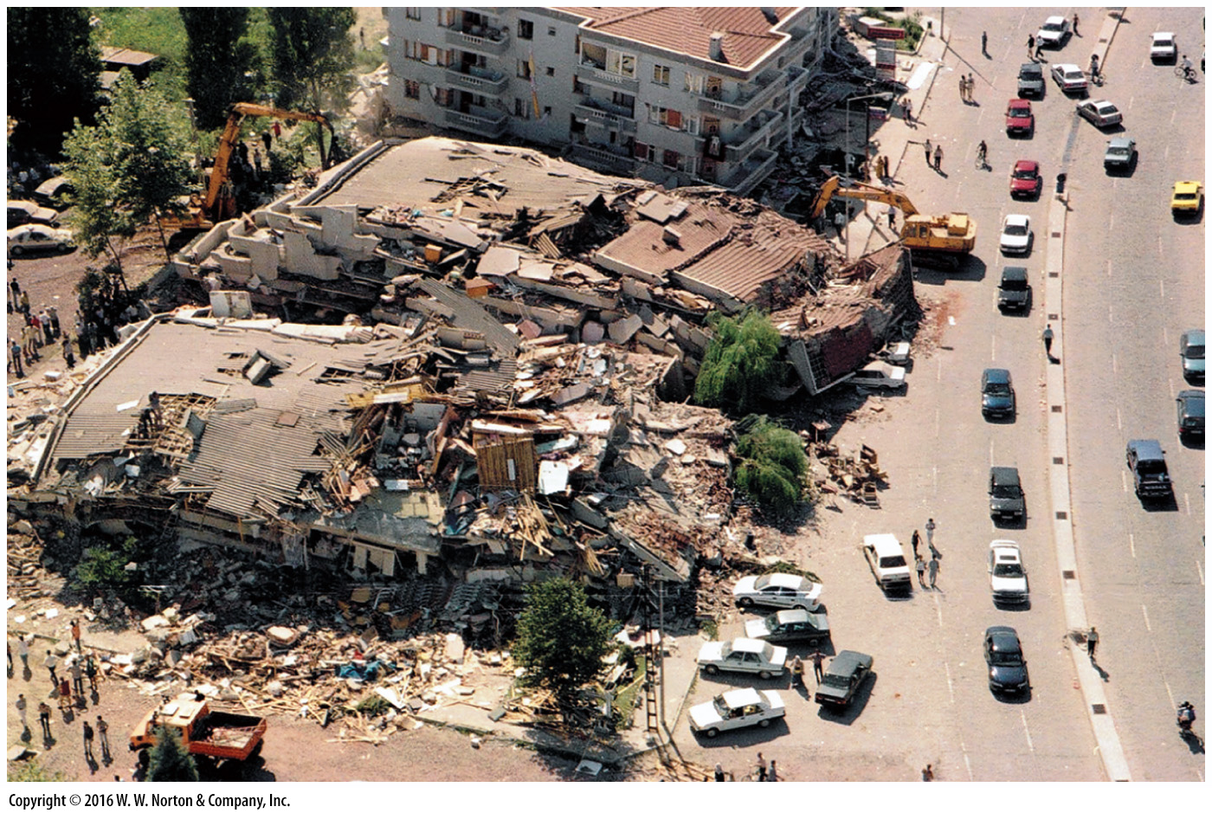
Notes:
FIGURE P.3 Human-made cities cannot withstand the vibrations of a large eathquake. These apartment buildings collapsed during an earthquake in Turkey.

Slide 12
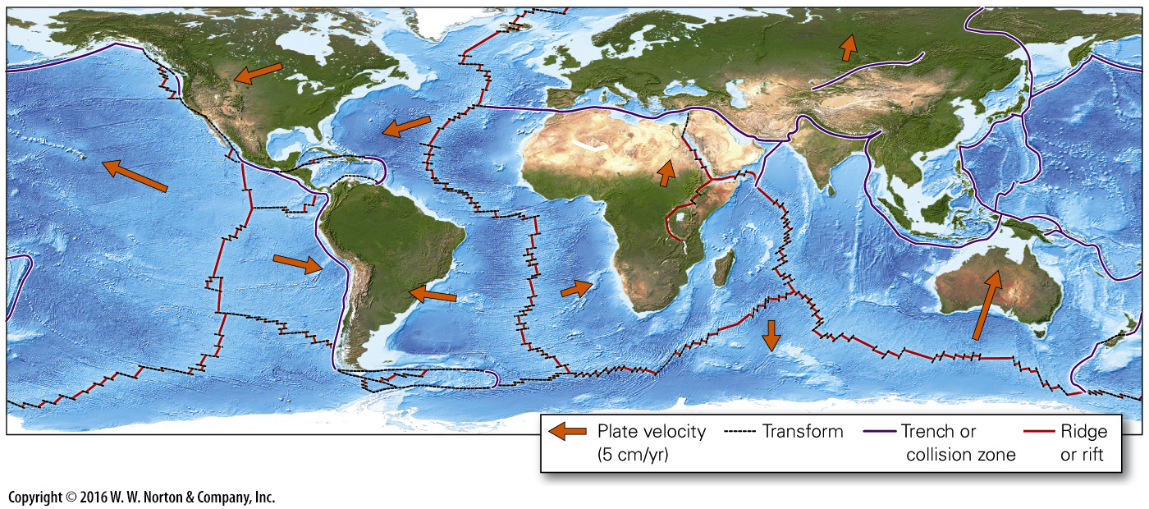
Notes:
FIGURE P.4 A simplified map of the Earth‘s plates. The arrows indicate the direction each plate is moving, and the length of the arrow indicates plate velocity (the longer the arrow, the faster the motion).

Slide 13
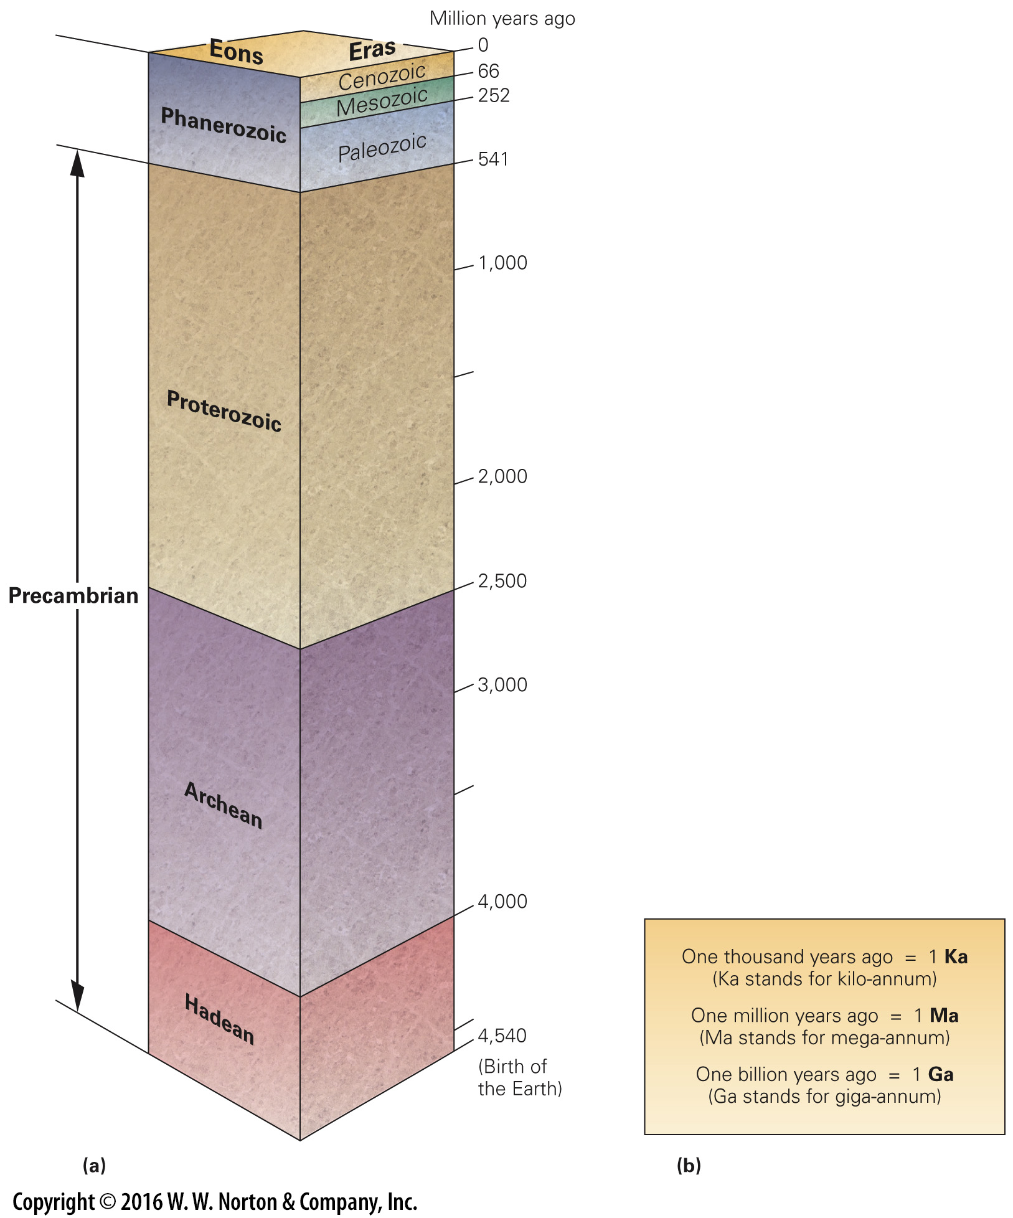
Notes:
FIGURE P.5 The geologic time scale.
(a) The scale has been divided into eons and eras. (b) Abbreviations for time units.

Slide 14
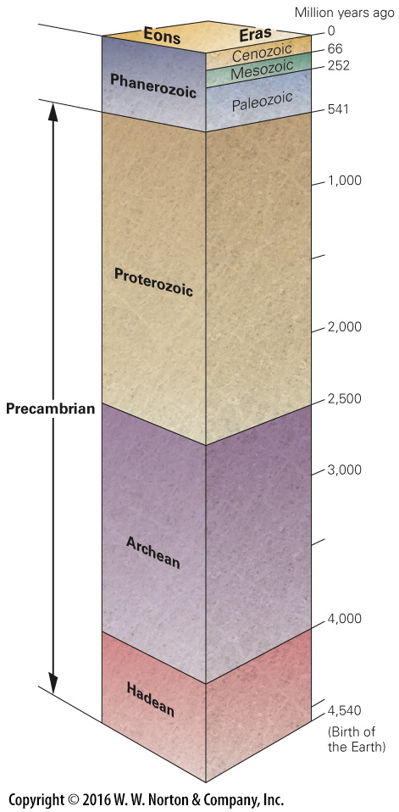
Notes:
FIGURE P.5a The geologic time scale.
(a) The scale has been divided into eons and eras.

Slide 15
Notes:
FIGURE P.5b The geologic time scale.
(b) Abbreviations for time units.

Slide 16
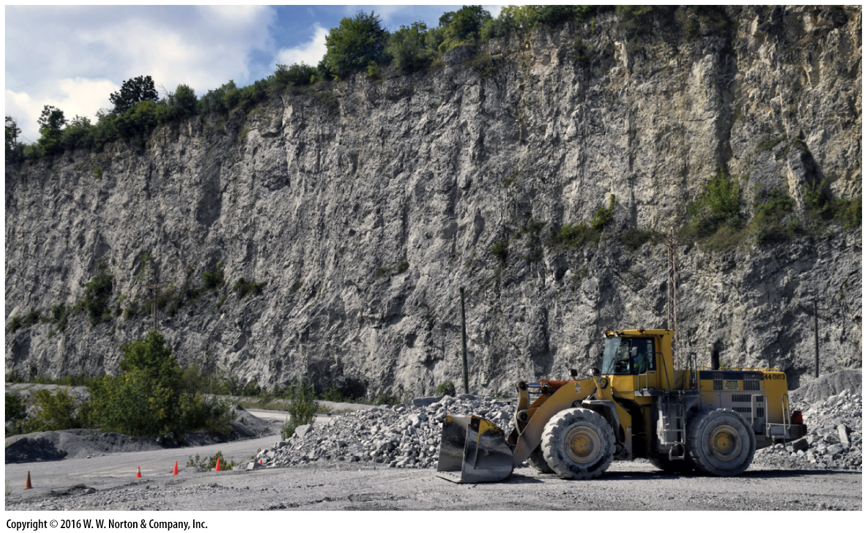
Notes:
FIGURE P.6 Workers excavate limestone in a quarry near Chicago. This rock commonly consists of shells and shell fragments, and can be used in the production of concrete.

Slide 17
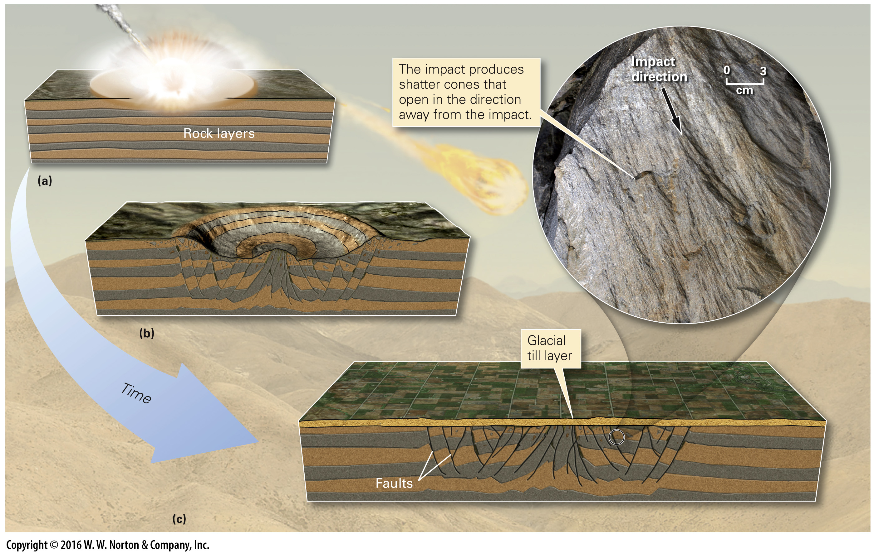
Notes:
FIGURE BxP.1 An ancient meteorite impact excavates a crater and permanently changes rock beneath the surface.

